Slide 1
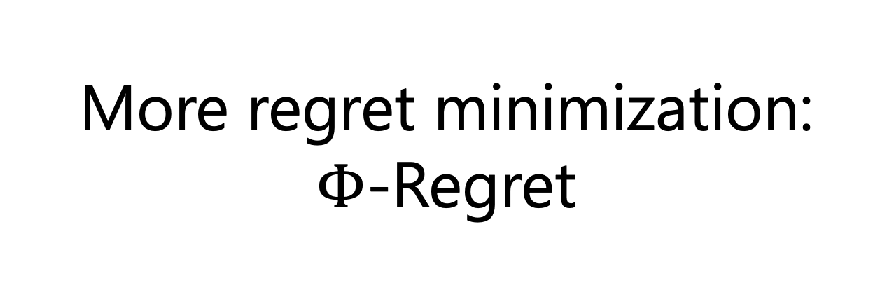
More regret minimization:
$Φ$-Regret

Slide 2












What does it mean to learn?
$$t=1$$
$$t=2$$
$$t=3$$
$$t=4$$
Strategy $x_{1}$
$$\text{Strategy} x_{2}$$
$$\text{Strategy} x_{3}$$
$$\text{Strategy} x_{4}$$
Reward $u_{1}(x_{1})$
$$\text{Reward} u_{2}(x_{2})$$
$$\text{Reward} u_{3}(x_{3})$$
$$\text{Reward} u_{4}(x_{4})$$
💡Idea: we have learnt when we do not strongly wish we had played differently (aka low regret)

Slide 3
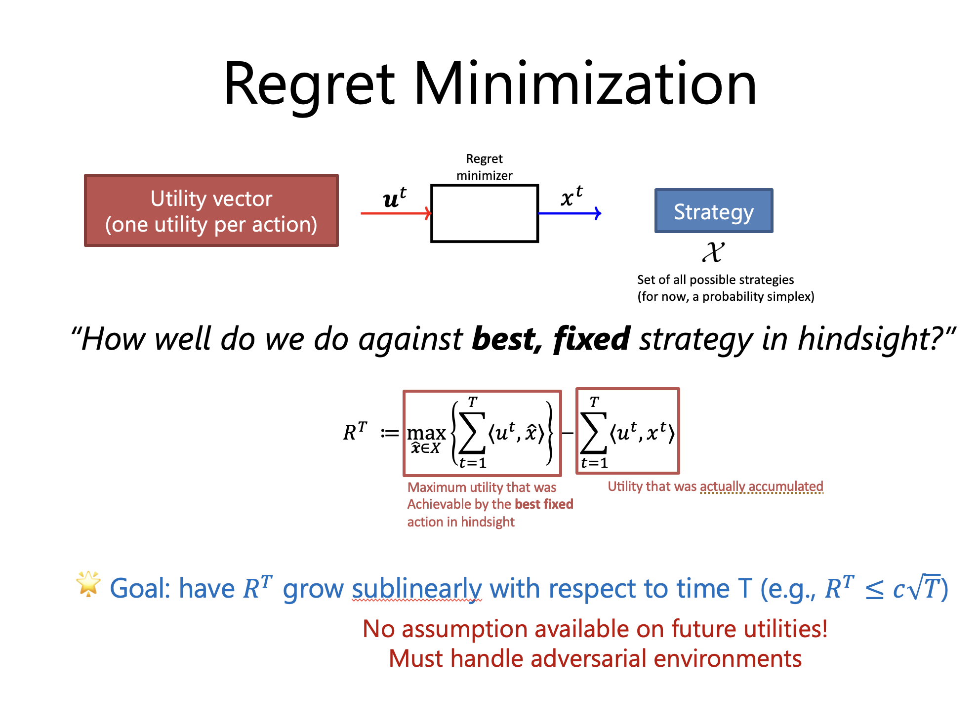
💡In the past lecture, we always equated
“Playing differently in hindsight”
with
“Going back and using one, fixed strategy"
🤔🤔
Isn’t that a weak notion of hindsight rationality?

Slide 4
A no-regret agent as defined for now can consistently observe that its average utility would have increased had it chosen action a’ every time that it actually played a…
…And yet never switch to playing action a’ in these situations.

Slide 5


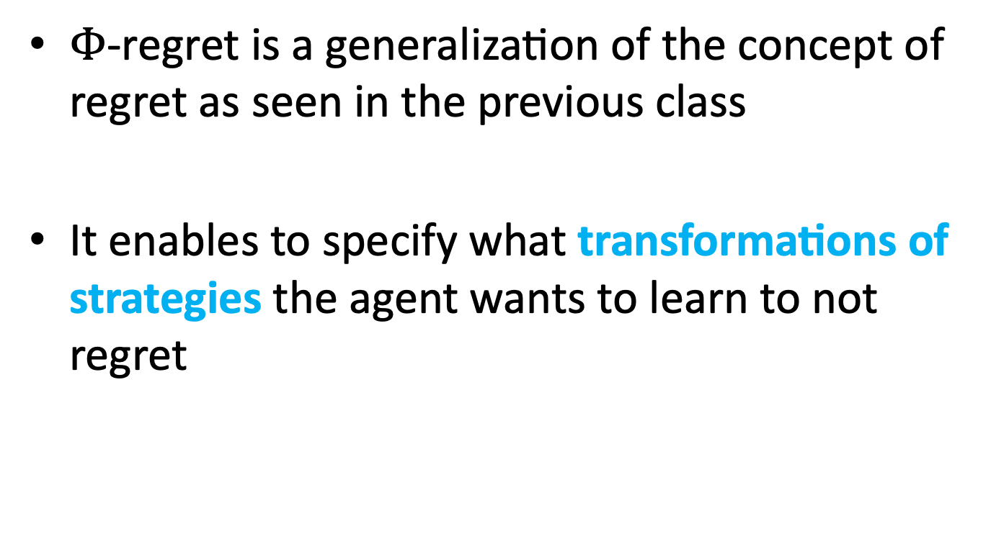
$Φ$-Regret
$Φ$-regret is a generalization of the concept of regret as seen in the previous class
It enables to specify what transformations of strategies the agent wants to learn to not regret
💡 Function $φ$ from the strategy set to itself
Notes:
Phi -> Greek letter

Slide 6








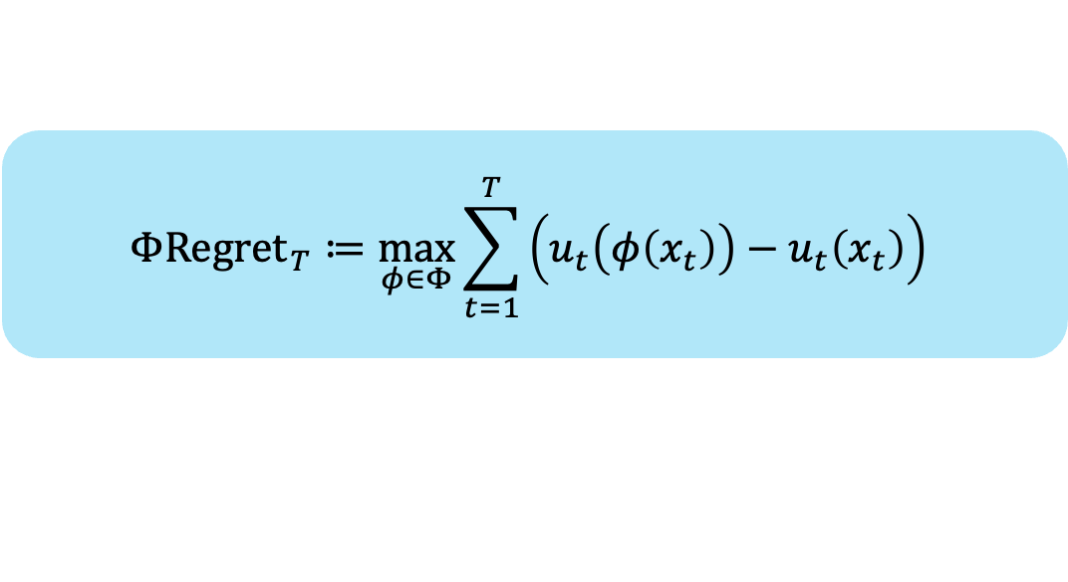


What does it mean to learn?
$$t=1$$
$$t=2$$
$$t=3$$
$$t=4$$
Strategy $x_{1}$
$$\text{Strategy} x_{2}$$
$$\text{Strategy} x_{3}$$
$$\text{Strategy} x_{4}$$
Reward $ℓ_{1}(x_{1})$
$$\text{Reward} ℓ_{2}(x_{2})$$
$$\text{Reward} ℓ_{3}(x_{3})$$
$$\text{Reward} ℓ_{4}(x_{4})$$
Strategy ${φ(x}_{1})$
Strategy ${φ(x}_{2})$
Strategy ${φ(x}_{3})$
Strategy ${φ(x}_{4})$
$$Φ{Regret}_{T}≔\max_{φ∈Φ}{\sum_{t=1}^{T}{\left(u_{t}\left(φ\left(x_{t}\right)\right)−u_{t}\left(x_{t}\right)\right)}}$$

Slide 7


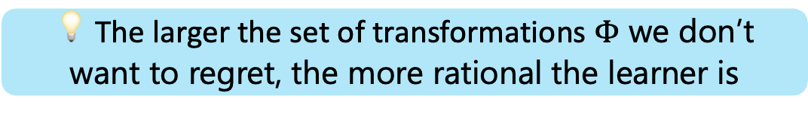
What does it mean to learn?
$$Φ{Regret}_{T}≔\max_{φ∈Φ}{\sum_{t=1}^{T}{\left(u_{t}\left(φ\left(x_{t}\right)\right)−u_{t}\left(x_{t}\right)\right)}}$$
💡 The larger the set of transformations $Φ$ we don’t want to regret, the more rational the learner is
🛠️What sets $Φ$ make the most sense?
🛠️ Is there a connection with game-theoretic notions of rationality and equilibria?

Slide 8
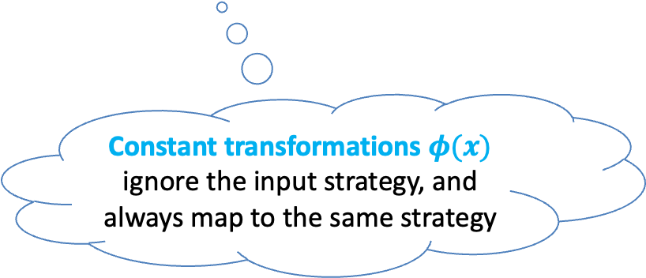
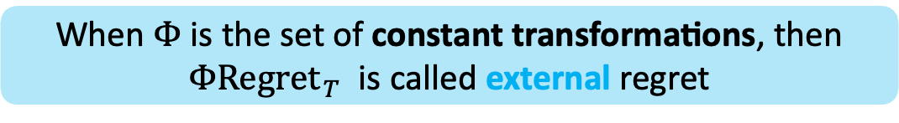
Let’s start from the notion we have already seen last time
When $Φ$ is the set of constant transformations, then
$Φ{Regret}_{T}$ is called external regret
Constant transformations $φ(x)$ ignore the input strategy, and always map to the same strategy
This notion applies to agents acting on either an extensive-form or a normal-form strategy space

Slide 9
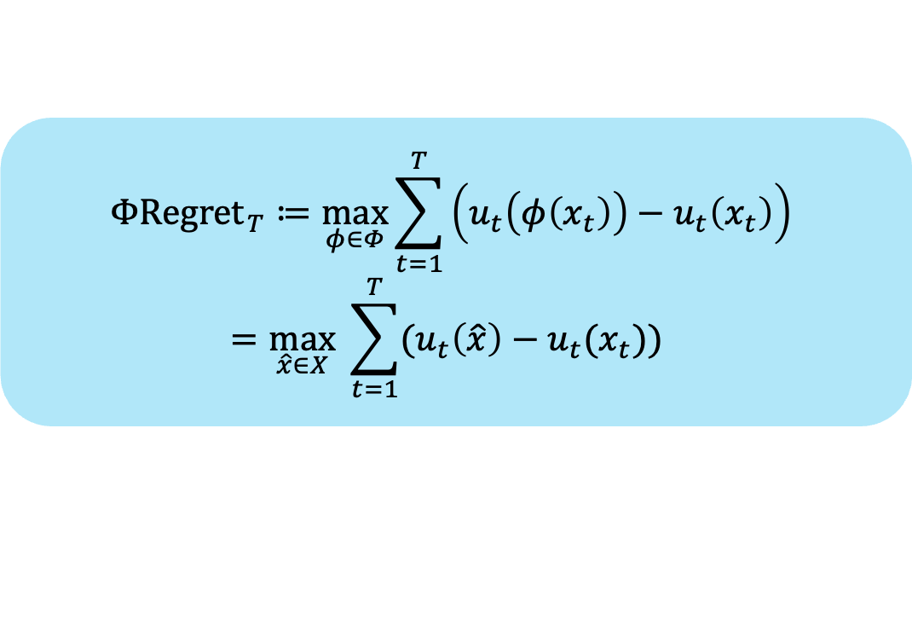
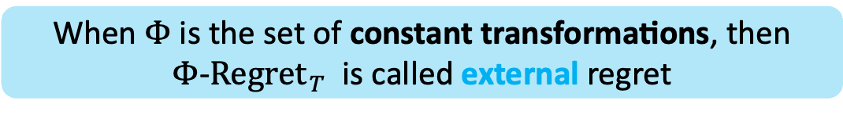
External regret minimization
When $Φ$ is the set of constant transformations, then
$Φ$-${Regret}_{T}$ is called external regret
$$Φ{Regret}_{T}≔\max_{φ∈Φ}{\sum_{t=1}^{T}{\left(u_{t}\left(φ\left(x_{t}\right)\right)−u_{t}\left(x_{t}\right)\right)}}$$
$$=\max_{\hat{x}∈X} \sum_{t=1}^{T}{(u_{t}\left(\hat{x}\right)−u_{t}(x_{t})})$$
This was the formula we used in the previous lecture!

Slide 10
Guarantees of external-regret minimization
Folklore result: if all players play in a way that guarantees sublinear external regret over time, then:
1. Empirical frequency of play is a coarse correlated equilibrium (multiplayer games)
One of the standard notions of rationality in multiplayer games
2. In two-player zero-sum games (e.g., heads-up poker), the average strategy of each player is a Nash equilibrium
“Optimal” game-theoretic play, before exploiting specific weaknesses of the opponent. In poker, this is already superhuman

Slide 11
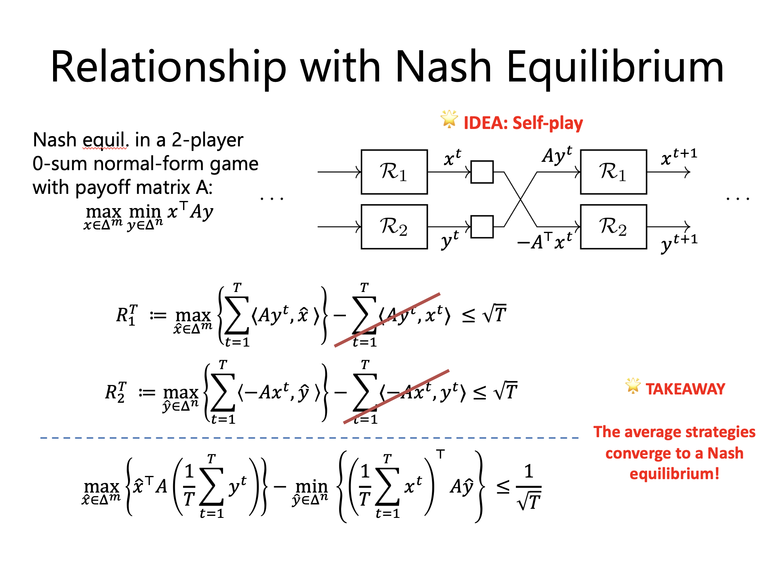
First answer
Folklore result: if all players play in a way that guarantees sublinear external regret over time, then:
1. Empirical frequency of play is a coarse correlated equilibrium (multiplayer games)
One of the standard notions of rationality in multiplayer games
2. In two-player zero-sum games (e.g., poker), the average strategy of each player is a Nash equilibrium
“Optimal” game-theoretic play, before exploiting specific weaknesses of the opponent. In poker, this is already superhuman

Slide 12




Internal regret minimization
Normal-form strategy spaces only
Internal regret minimization: be robust to “probability mass transferring” transformations
P_{R}
0
$$φ_{R→P}$$
P_{P}
P_{R}+P_{P}
“Every time I played rock I should have played paper”
P_{S}
P_{S}

Slide 13
Trigger regret
Generalization of internal regret to extensive-form games
Trigger regret: considers conditional strategy transformations:
“If action A is played at decision point D, transform the strategy from D onwards by setting it equal to S”
(for all possible A, D, and S)
Many other notions of hindsight rationality exist for extensive form games
[Morrill, D’Orazio, Lanctot, Wright, Bowling, Greenwald; Efficient Deviation Types and Learning for Hindsight Rationality in Extensive-Form Games, ICML 2021]
[Celli, Marchesi, Farina, Gatti; No-Regret Learning Dynamics for Extensive-Form Correlated Equilibrium, NeurIPS 2020]
[Farina, Celli, Marchesi, Gatti; Simple Uncoupled No-Regret Learning Dynamics for Extensive-Form Correlated Equilibrium, J.ACM 2022]

Slide 14
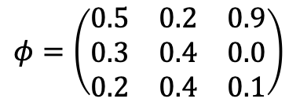
Swap regret minimization
Normal-form strategy spaces only
Swap regret minimization: be robust to any linear transformation from probabilities to probabilities
P_{R}
$$φ=\left(\begin{matrix}0.5 & 0.2 & 0.9 \\ 0.3 & 0.4 & 0.0 \\ 0.2 & 0.4 & 0.1\end{matrix}\right)$$
0.5P_{R}+0.2P_{P} +0.9P_{S}
P_{P}
0.3P_{R}+0.4P_{P} +0.0P_{S}
P_{S}
0.2P_{R}+0.4P_{P} +0.1P_{S}

Slide 15
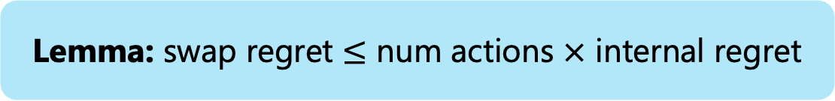
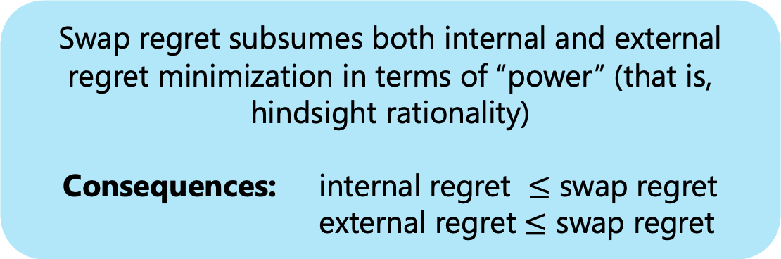
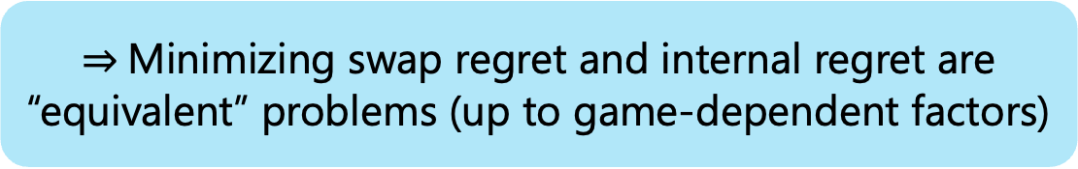
Swap regret minimization
Swap regret subsumes both internal and external regret minimization in terms of “power” (that is, hindsight rationality)
Consequences: internal regret $≤$ swap regret
external regret $≤$ swap regret
Lemma: swap regret $≤$ num actions $×$ internal regret
$⇒$Minimizing swap regret and internal regret are “equivalent” problems (up to game-dependent factors)

Slide 16
Cool fact: we have learning algorithms that guarantee sublinear swap regret
(In fact, we will see how one can construct one later)

Slide 17
What do internal and swap regret achieve?
Recall: Internal regret cares about transformations of the form “every time I did X I should have done Y instead”
So, the following might not be surprising:
No-internal and no-swap regret agents in self play converge to correlated equilibria
in general-sum multi-player normal-form games
In extensive-form games, trigger regret leads to extensive-form correlated equilibrium

Slide 18
Zooming out
One can try to make a pretty strong case that no-external-regret as notion of rationality is very weak and does not deserve so much attention…
Instead, as it turns out, external regret minimization is so important that most people refer to it as just “regret minimization”
Why is that?

Slide 19

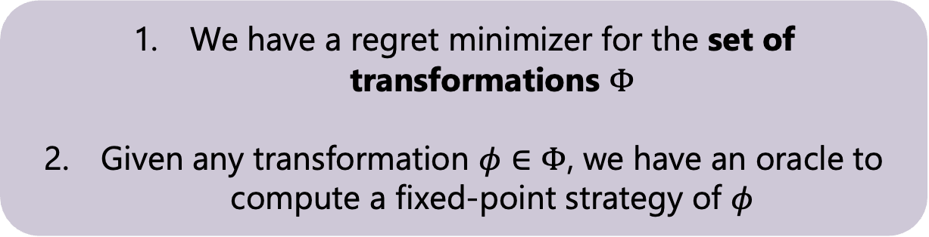
First answer: it leads to Nash equilibrium in two-player zero-sum games. So, perhaps it is less weak than it appears
Second answer: it is easy to define for any strategy set, and we know of very powerful algorithms that minimize external regret for any convex set
Third answer: In general, it is possible to reduce general $Φ$ regret to external regret minimization, provided the set of transformations considered satisfies certain general properties
We have a regret minimizer for the set of transformations $Φ$
Given any transformation $φ∈Φ$, we have an oracle to compute a fixed-point strategy of $φ$

Slide 20


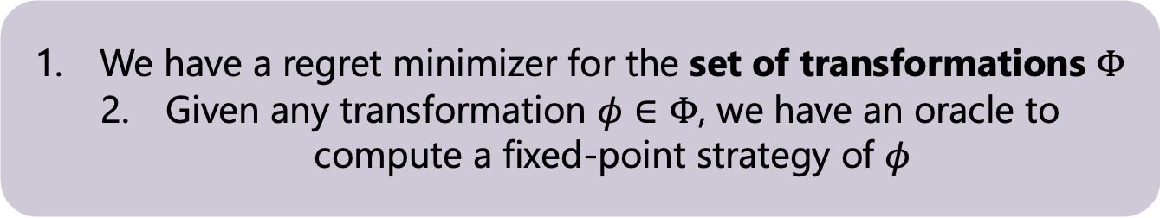





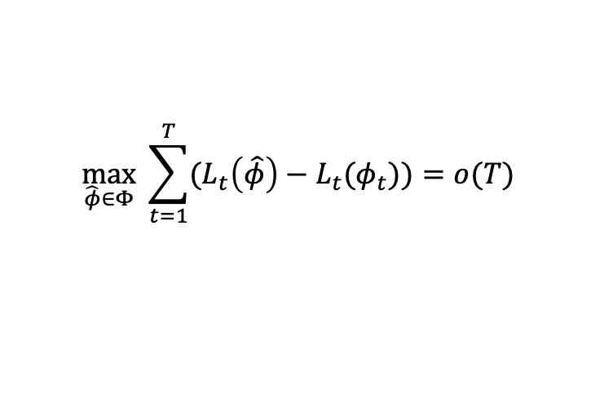
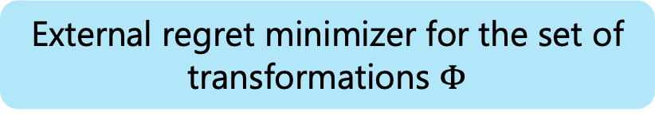

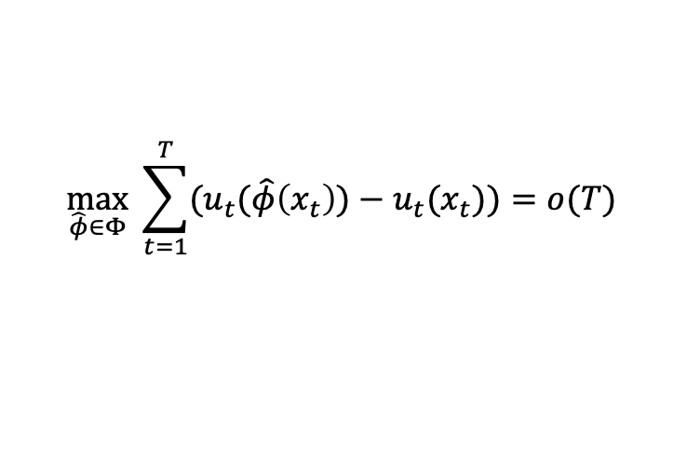
We have a regret minimizer for the set of transformations $Φ$
Given any transformation $φ∈Φ$, we have an oracle to compute a fixed-point strategy of $φ$
We want:
$$u_{t}$$
𝓟
$$x_{t}∈X$$
$Φ$-regret minimizer for strategy set $X$
$$\max_{\hat{φ}∈Φ} \sum_{t=1}^{T}{(u_{t}(\hat{φ}\left(x_{t}\right))−u_{t}(x_{t})})=o(T)$$
We have:
$$L_{t}$$
ℜ_{Φ}
$$φ_{t}∈Φ$$
External regret minimizer for the set of transformations $Φ$
$$\max_{\hat{φ}∈Φ} \sum_{t=1}^{T}{(L_{t}\left(\hat{φ}\right)−L_{t}(φ_{t})})=o(T)$$
$$φ$$
FixedPoint
$$x∈X$$
Fixed-point oracle
$$φ\left(x\right)=x∈X$$
Notes:
Fix transitions
Make labels more verbose

Slide 21
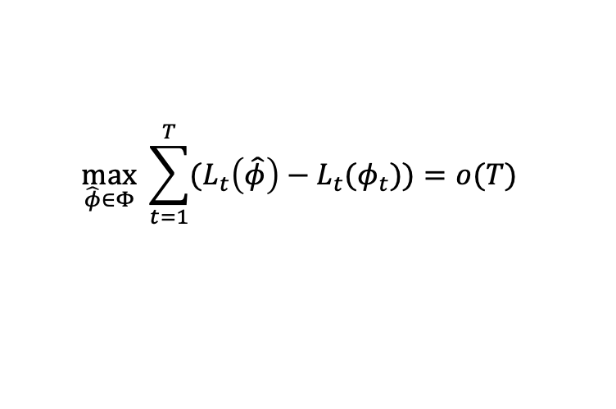

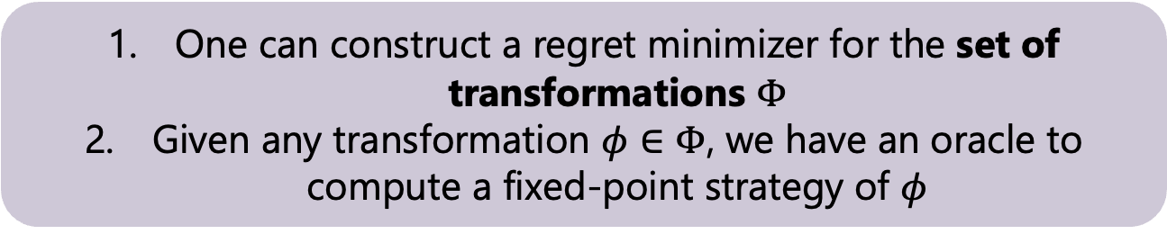

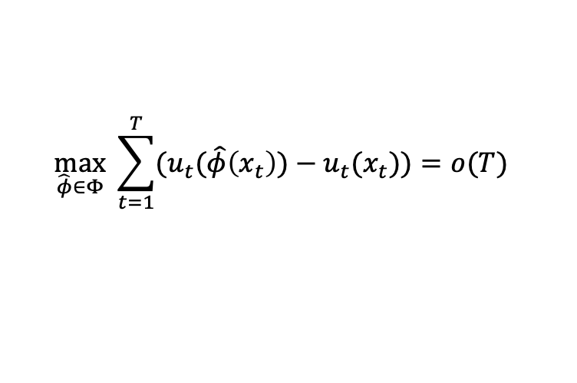

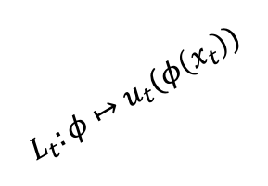


One can construct a regret minimizer for the set of transformations $Φ$
Given any transformation $φ∈Φ$, we have an oracle to compute a fixed-point strategy of $φ$
We want:
𝓟
$$u_{t}$$
𝓟
$$x_{t}∈X$$
$$\max_{\hat{φ}∈Φ} \sum_{t=1}^{T}{(u_{t}(\hat{φ}\left(x_{t}\right))−u_{t}(x_{t})})=o(T)$$
ℜ_{Φ}
$$L_{t}:φ↦u_{t}(φ\left(x_{t}\right))$$
We have:
$$u_{t}$$
$$φ_{t}$$
$$x_{t}∈X$$
$$L_{t}$$
ℜ_{Φ}
$$φ_{t}∈Φ$$
$$\max_{\hat{φ}∈Φ} \sum_{t=1}^{T}{(L_{t}\left(\hat{φ}\right)−L_{t}(φ_{t})})=o(T)$$
FixedPoint
$$φ$$
FixedPoint
$$x∈X$$
Notes:
Fix transitions
Make labels more verbose

Slide 22
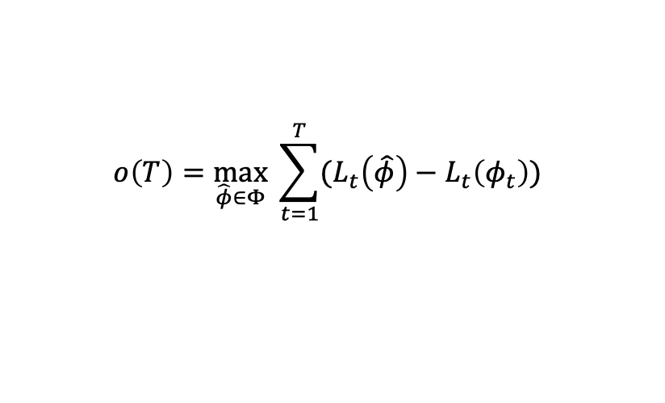
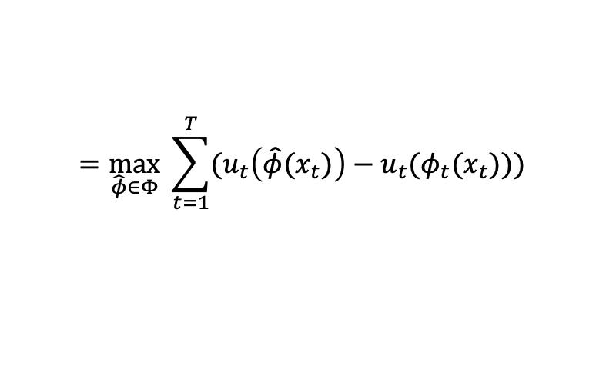
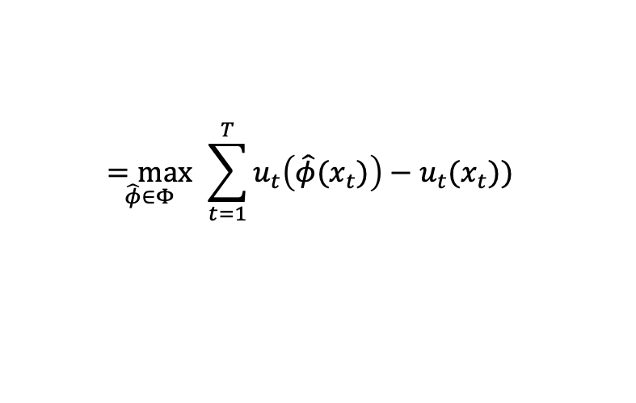
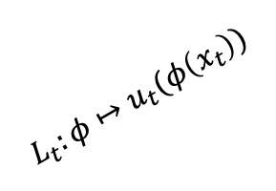
We want:
𝓟
$$u_{t}$$
𝓟
$$x_{t}∈X$$
$$\max_{\hat{φ}∈Φ} \sum_{t=1}^{T}{(u_{t}(\hat{φ}\left(x_{t}\right))−u_{t}(x_{t})})=o(T)$$
ℜ_{Φ}
$$L_{t}:φ↦u_{t}(φ\left(x_{t}\right))$$
We have:
$$u_{t}$$
$$φ_{t}$$
$$x_{t}∈X$$
$$L_{t}$$
ℜ_{Φ}
$$φ_{t}∈Φ$$
$$\max_{\hat{φ}∈Φ} \sum_{t=1}^{T}{(L_{t}\left(\hat{φ}\right)−L_{t}(φ_{t})})=o(T)$$
FixedPoint
$$φ$$
FixedPoint
$$x∈X$$
$$o\left(T\right)=\max_{\hat{φ}∈Φ} \sum_{t=1}^{T}{(L_{t}\left(\hat{φ}\right)−L_{t}\left(φ_{t}\right))}$$
$$=\max_{\hat{φ}∈Φ} \sum_{t=1}^{T}{(u_{t}\left(\hat{φ}(x_{t})\right)−u_{t}(φ_{t}(x_{t}))})$$
Proof:
$$\underset{\hat{φ}∈Φ}{=max} \sum_{t=1}^{T}{u_{t}\left(\hat{φ}(x_{t})\right)−u_{t}(x_{t})})$$
Notes:
Fix transitions
Make labels more verbose

Slide 23
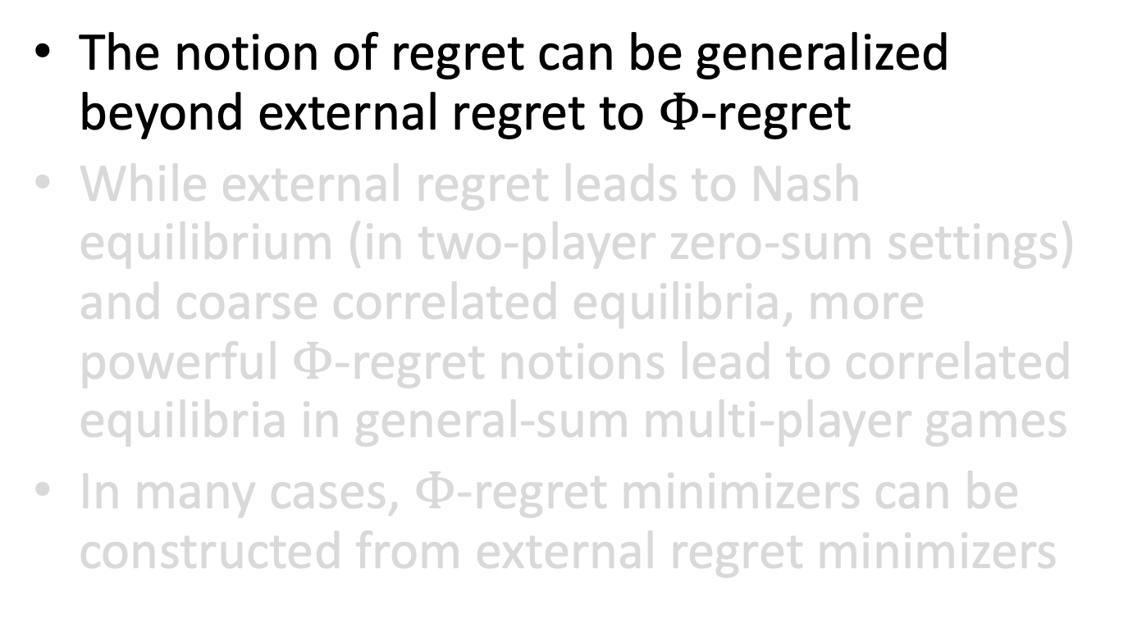
Summary of this lecture
The notion of regret can be generalized beyond external regret to $Φ$-regret
While external regret leads to Nash equilibrium (in two-player zero-sum settings) and coarse correlated equilibria, more powerful $Φ$-regret notions lead to correlated equilibria in general-sum multi-player games
In many cases, $Φ$-regret minimizers can be constructed from external regret minimizers

Slide 24
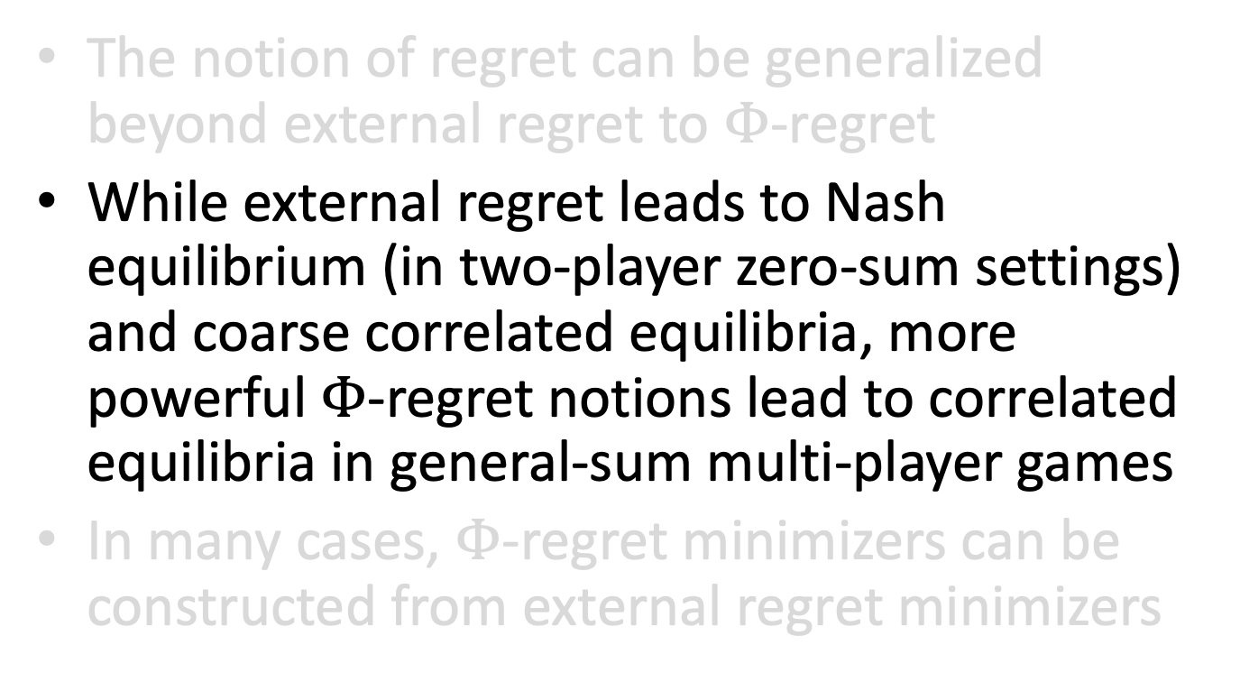
Summary of this lecture
The notion of regret can be generalized beyond external regret to $Φ$-regret
While external regret leads to Nash equilibrium (in two-player zero-sum settings) and coarse correlated equilibria, more powerful $Φ$-regret notions lead to correlated equilibria in general-sum multi-player games
In many cases, $Φ$-regret minimizers can be constructed from external regret minimizers

Slide 25
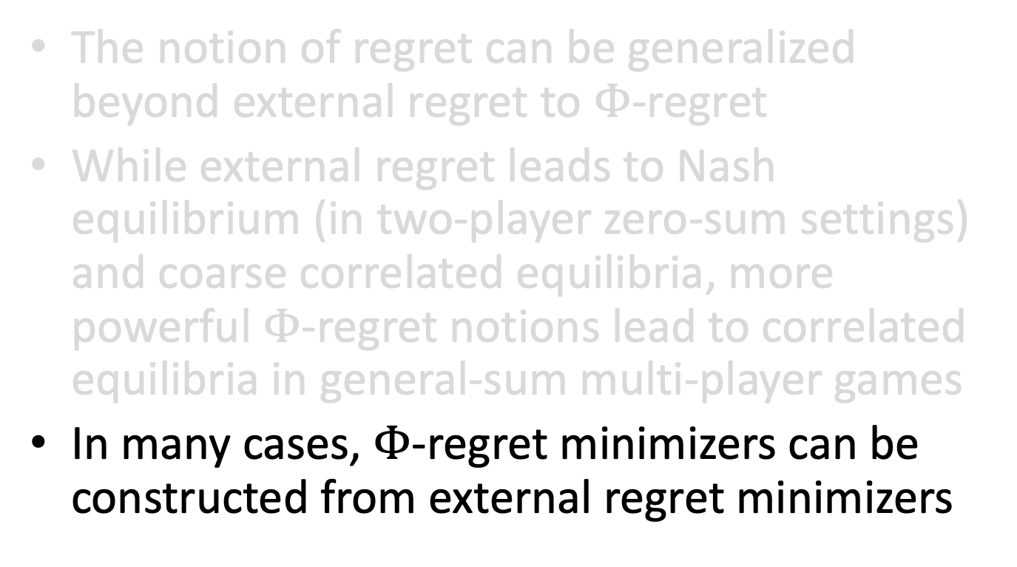
Summary of this lecture
The notion of regret can be generalized beyond external regret to $Φ$-regret
While external regret leads to Nash equilibrium (in two-player zero-sum settings) and coarse correlated equilibria, more powerful $Φ$-regret notions lead to correlated equilibria in general-sum multi-player games
In many cases, $Φ$-regret minimizers can be constructed from external regret minimizers

Slide 27
External regret in normal-form vs extensive-form games
What is known about external regret minimization algorithms for extensive-form decision problems?

Slide 28
Our understanding of regret minimization in extensive-form games lags severely behind normal-form games

Slide 29
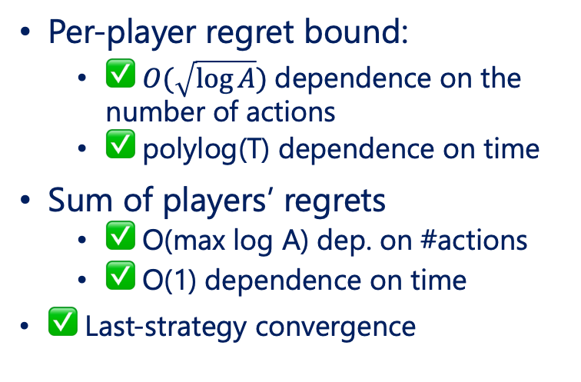
Normal-Form Games
Extensive-Form Games
⭐ OMWU algorithm has all these properties:
Per-player regret bound:
  ✅ $O(\sqrt{\log{A}})$dependence on the number of actions
  ✅ polylog(T) dependence on time
Sum of players’ regrets
  ✅ O(max log A) dep. on #actions
  ✅ O(1) dependence on time
✅ Last-strategy convergence
❌ Not known
❌ Not known
❌ Not known
❌ Not known
🟨 Less is known
Can we somehow bridge the gap?

Slide 30
Folklore result: extensive-form problems can be converted into normal-form problems, but doing so incurs an exponential blowup of the strategy space
Idea: one-shot problem where each action corresponds to a whole tree-form strategy in the original extensive-form problem
Common wisdom: because of the exponential blowup, the above approach is a dead end
The common wisdom is wrong

Slide 31
Kernelization and theoretical state of the art
Recent result: It is possible to simulate OMWU on the normal-form equivalent of an extensive-form decision problem in linear time per iteration in the tree size, via a kernel trick
  We call our algorithm Kernelized OMWU (KOMWU)
[Farina, Lee, Luo, Kroer. Kernelized Multiplicative Weights for 0/1-Polyhedral Games: Bridging the Gap Between Learning in Extensive-Form and Normal-Form Games. Under review at ICML’22]
Notes:
by exploiting the particular combinatorial structure of extensive-form strategy spaces,

Slide 32
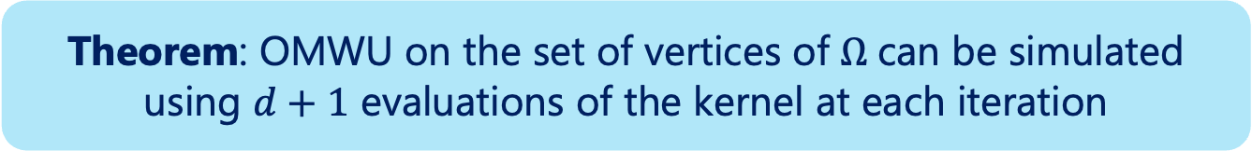
Kernelization and theoretical state of the art
In fact, kernelized OMWU applies to any polyhedral domain with
0/1-coordinate vertices $Ω⊆ℝ^{d}$
Theorem: OMWU on the set of vertices of $Ω$can be simulated using $d+1$ evaluations of the kernel at each iteration
  So, if each kernel evaluation can be performed in poly(d) time, OMWU can be simulated in poly(d) time
[Farina, Lee, Luo, Kroer. Kernelized Multiplicative Weights for 0/1-Polyhedral Games: Bridging the Gap Between Learning in Extensive-Form and Normal-Form Games. Under review at ICML’22]

Slide 33
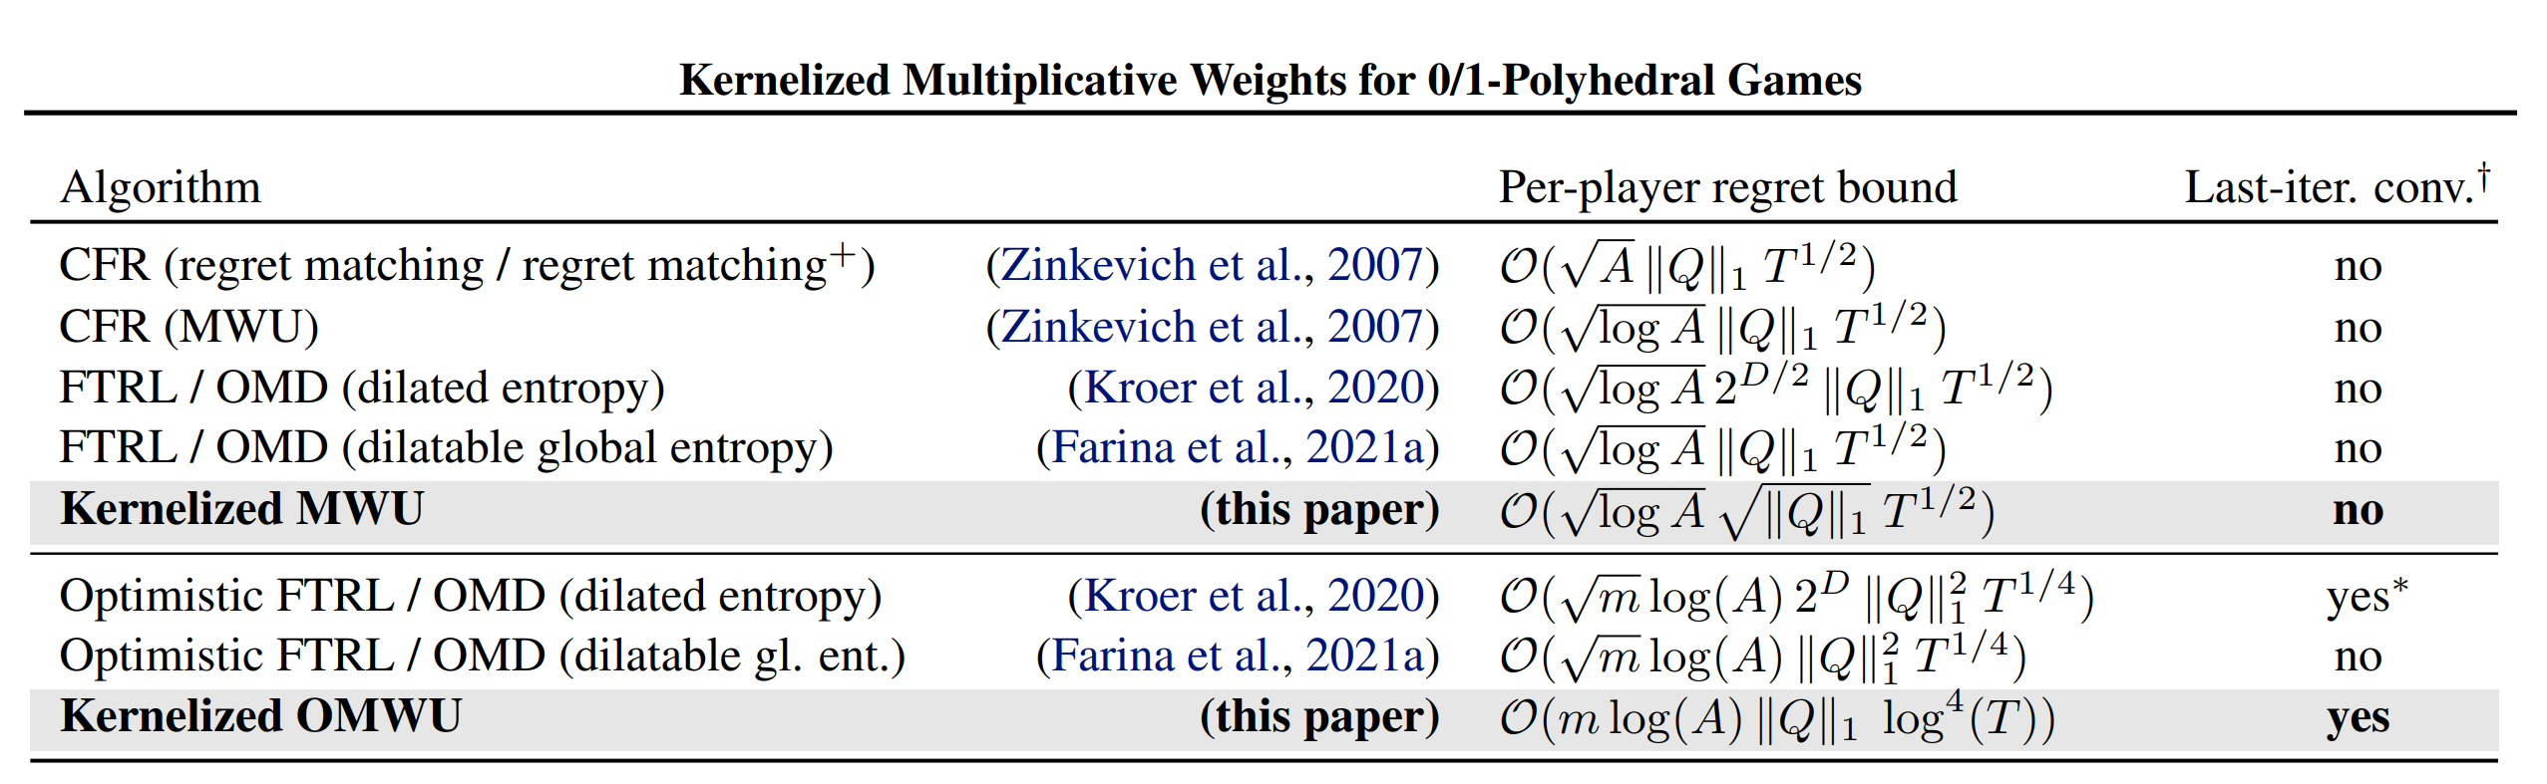
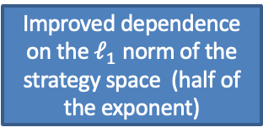
Kernelization and theoretical state of the art
KOMWU closes the gap between normal-form and extensive-form games
It achieves all the properties mentioned earlier (including polylog regret)
…as well as any future regret bounds that might get proven for OMWU
As an unexpected byproduct, KOMWU obtains new state-of-the-art regret bounds among all online learning algorithms for extensive-form problems
Near-optimal O(polylog T) regret bound
Improved dependence on the $ℓ_{1}$ norm of the strategy space (half of the exponent)

