Slide 1
Linear programming
Aditi Raghunathan
15-780 Spring 2023

Slide 2
Recap
Started with search with states as a black-box(e.g. depth-first search)
States could have some structure (e.g. constraint satisfaction problems)
Find best state according to some objective?

Slide 3
Optimization
We have an objective function
We have a set of constraints
Goal: find a solution that satisfies the constraints and achieves the optimal value according to the objective function
Generally, every search problem can be thought of as an optimization problem and vice-versa…

Slide 4
Discrete vs continuous optimization
 | Discrete search | (Convex) Continuous optimization
Variables | Discrete | Continuous
# Solutions | Finite | Infinite
Solution complexity

Slide 5
Discrete vs continuous optimization
 | Discrete search | (Convex) Continuous optimization
Variables | Discrete | Continuous
# Solutions | Finite | Infinite
Solution complexity | Exponential | Polynomial
In the melting pot of techniques that constitute “AI”, a very significant one is convex optimization

Slide 6
In this class: linear programming
Formulation
Key properties (that allow for efficient solving)
Simplex algorithm (teaser)
Duality

Slide 7
In this class: linear programming
Formulation
Key properties (that allow for efficient solving)
Simplex algorithm (teaser)
Duality

Slide 8
Linear programming formulation
Variables:
Objective:
Constraints:

Slide 9
Example
A large factory makes tables and chairs.
Each table returns a profit of $2 and each chair a profit of $1.
Each table takes 1 unit of metal and 3 units of wood
Each chair takes 2 units of metal and 1 unit of wood.
The factory has 6 units of metal and 9 units of wood.
How many tables and chairs should the factory make to maximize profit

Slide 10
Example
A large factory makes tables and chairs Variables
Each table returns a profit of $2 and each chair a profit of $1 Objective
Each table takes 1 unit of metal and 3 units of wood
Each chair takes 2 units of metal and 1 unit of wood. Constraints
The factory has 6 units of metal and 9 units of wood.
How many tables and chairs should the factory make to maximize profit

Slide 11
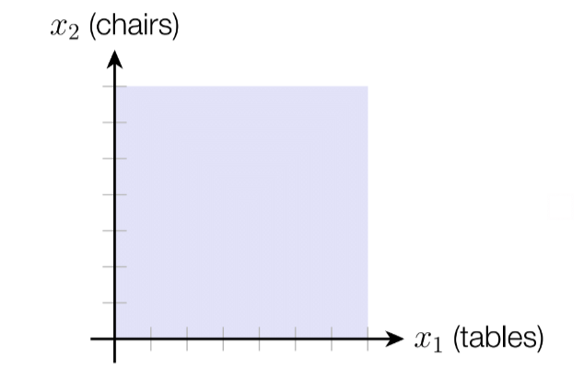
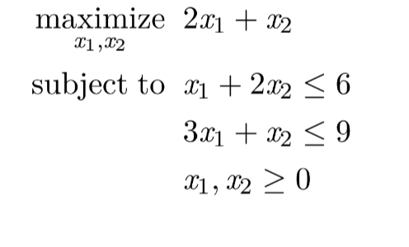
Example LP

Slide 12
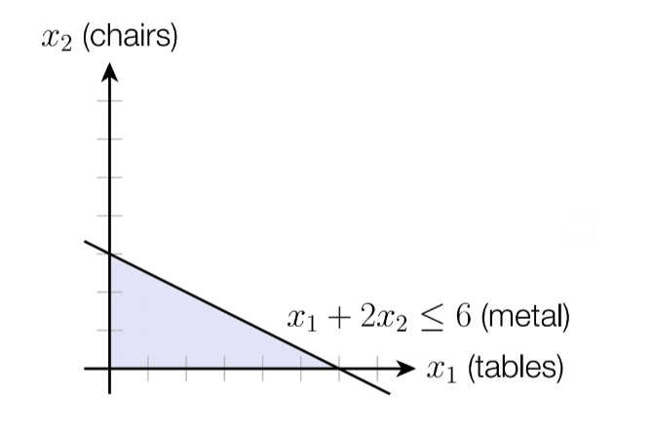
Example LP

Slide 13
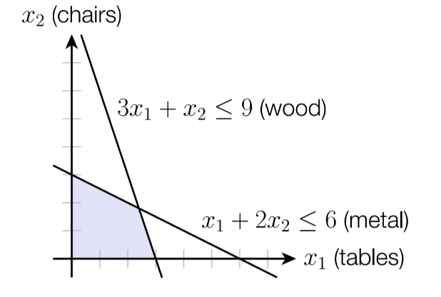
Example LP

Slide 14
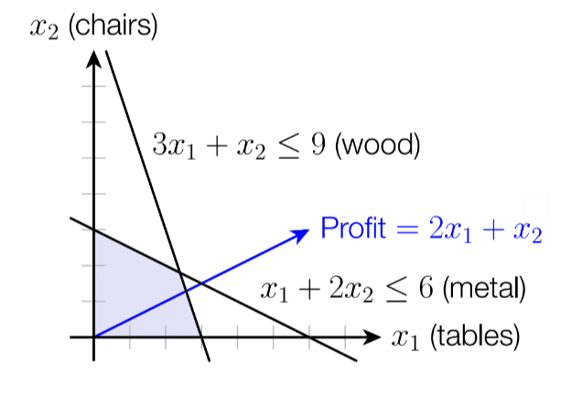
Example LP

Slide 15
Example LP

Slide 16
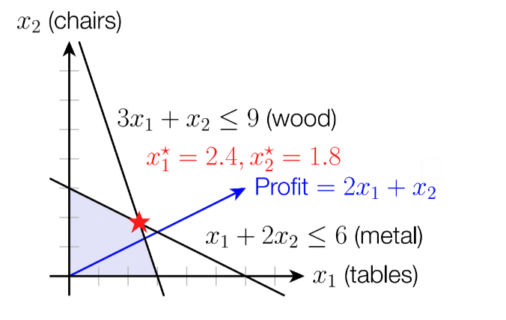
Example LP

Slide 17
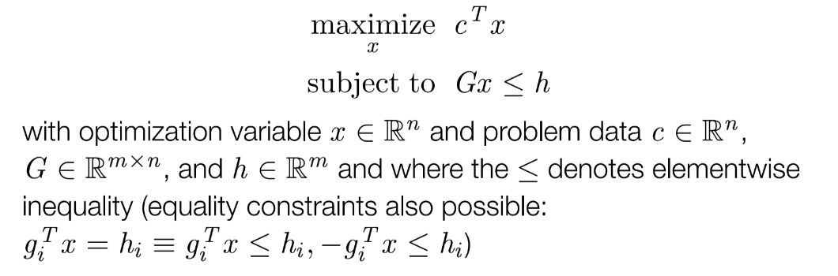
LP formulation

Slide 18
In this class: linear programming
Formulation
Key properties (that allow for efficient solving)
Simplex algorithm (teaser)
Duality

Slide 19
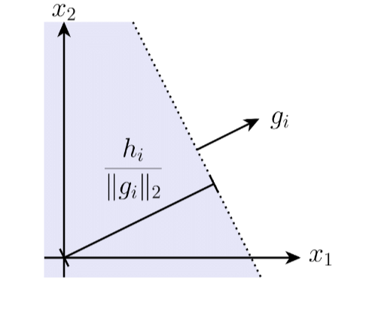
Geometry of LP
Each linear constraint represents a half-space

Slide 20
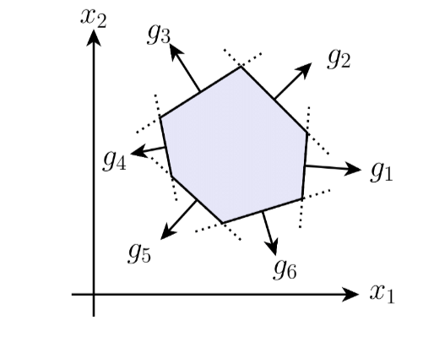
Geometry of LP
Intersection of finite number of linear constraints: polytope

Slide 21
Geometry of LP
Vertex of a polytope:
Not in the interior (no ball around the point that’s entirely feasible)
linearly independent constraints that are tight
Not a vertex

Slide 22
Geometry of LP
Vertex of a polytope:
Not in the interior (no ball around the point that’s entirely feasible)
linearly independent constraints that are tight
Vertex

Slide 23
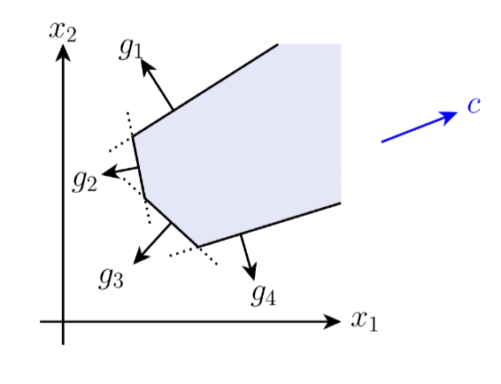
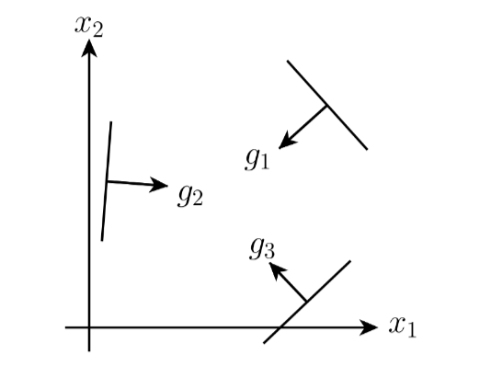
LPs could be unbounded or infeasible
Unbounded
Infeasible

Slide 24
Solutions to a linear program
Either the LP is unbounded or the optimal value occurs at a vertex
Objective increased

Slide 25

How to solve a linear program?
Circle across all the vertices and compute the objective
If you have $O(n)$ constraints, you have $O(c^{n})$ vertices
Seems doable
But slow…?

Slide 26
In this class: linear programming
Formulation
Key properties (that allow for efficient solving)
Simplex algorithm (teaser)
Duality

Slide 27
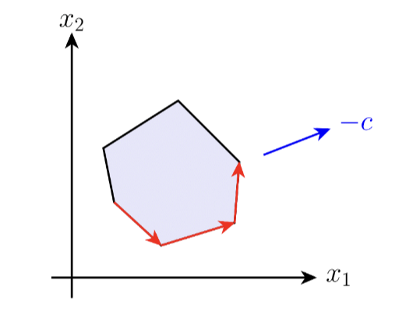
Simplex algorithm: key idea
Goal: search across all vertices (or corners)
Move along edges of polytope from corner to corner, in directions of decreasing cost
Devised by Dantzig in 1947

Slide 28
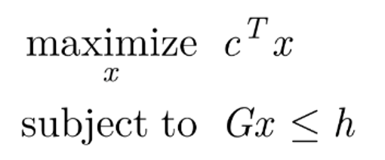
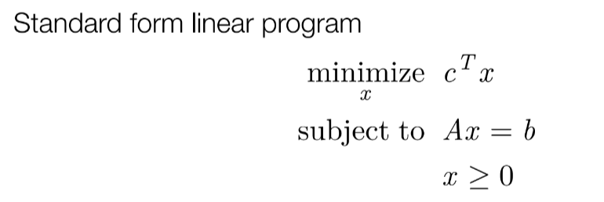
Standard form of a LP
Slack variables

Slide 29
Basic feasible solution
Split indices into and
Choose such that is invertible
Basic solution
Basic feasible solution
If
Always exists if A has independent rows (no redundant constraints)

Slide 30
Basic feasible solution: a vertex
Since cannot be negative, and is invertible, every Basic Feasible Solution is a vertex

Slide 31

Simplex: one BFS to another
Suppose we want to move $j$ to $ℬ$ by increasing $x_{j}$ from 0
Increase $x_{j}$ by $α$ but also have to adjust $x_{ℬ}$

Slide 32


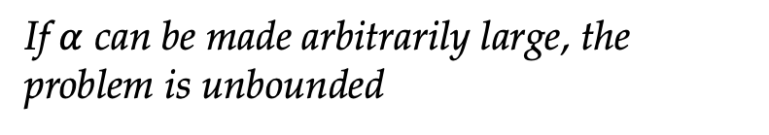
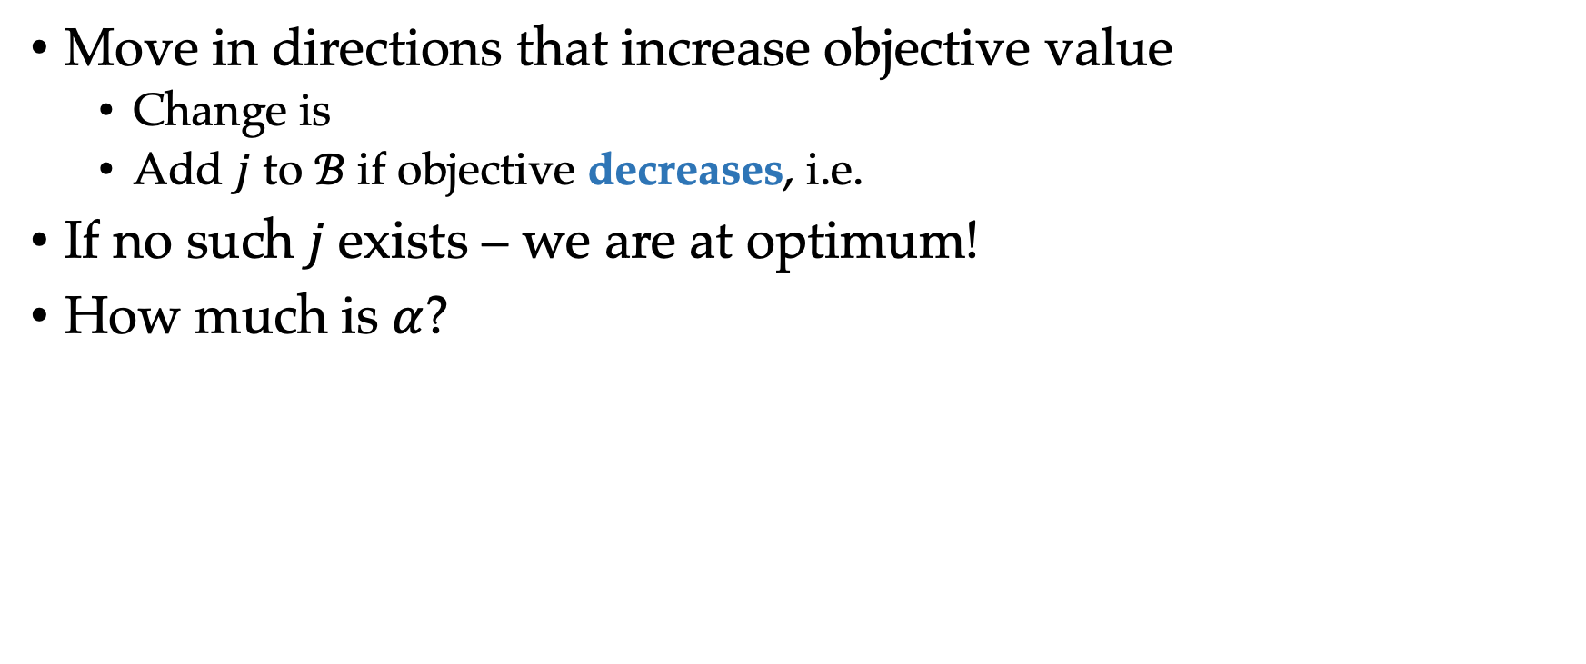
Simplex: one BFS to another
Move in directions that increase objective value
Change is
Add $j$ to $ℬ$ if objective decreases, i.e.
If no such$j$exists – we are at optimum!
How much is $α$?
We need to satisfy
If $α$ can be made arbitrarily large, the problem is unbounded
Some index can move out of $ℬ$

Slide 33
Simplex: summary
Start with Basic Feasible Solution
Move a variable into the ”basic” set by increasing it’s value if it decreases the objective
Some variables might end up moving out of the basic set
This is how we move from corner to corner
How to start with a Basic Feasible Solution?
Solve another auxiliary LP

Slide 34
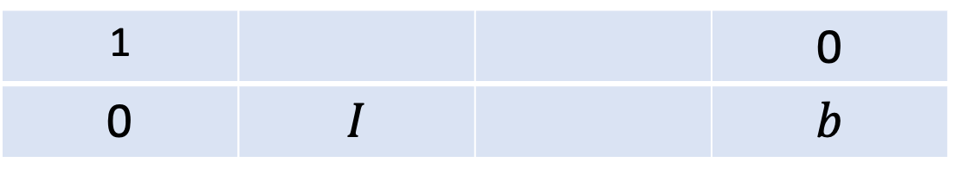
Simplex additional tricks
Fast matrix inversion via incremental updates
Simplex tableau: convenient way to keep track of all relevant quantities
1 |  |  | 0
0 | $$I$$ |  | $$b$$
Row transformations: multiply rows by some scalar and add them
Create new ”identity matrices” using different columns to get new bases

Slide 35
In this class: linear programming
Formulation
Key properties (that allow for efficient solving)
Simplex algorithm (teaser)
Duality

Slide 36
Our example problem
How do we get these multipliers?
Find a linear combination of constraints that matches the objective
Dual LP
Certificate of optimality

Slide 37
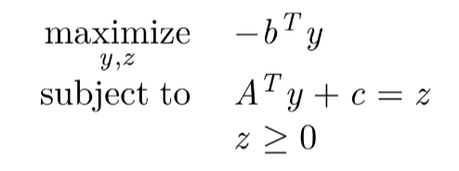
Dual LP
Primal
Dual

Slide 38
Why the dual LP
Any feasible value of the dual is a lower bound
Simplex algorithm needed a basic feasible solution to start
Simplex on the dual makes this convenient when incrementally adding constraints

Slide 39
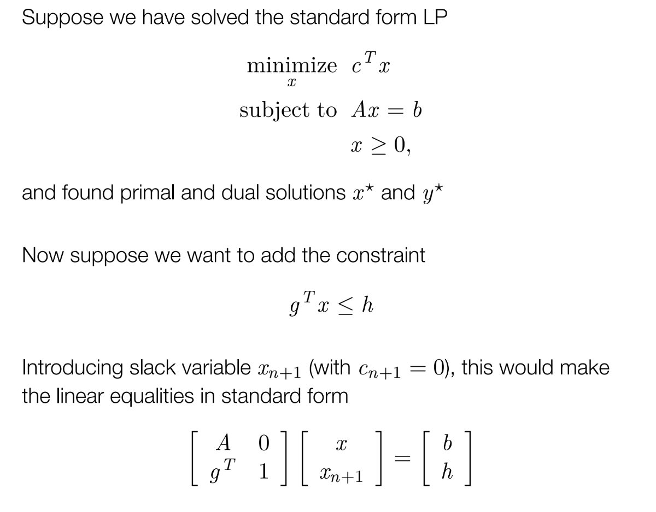
Why the dual LP

Slide 40
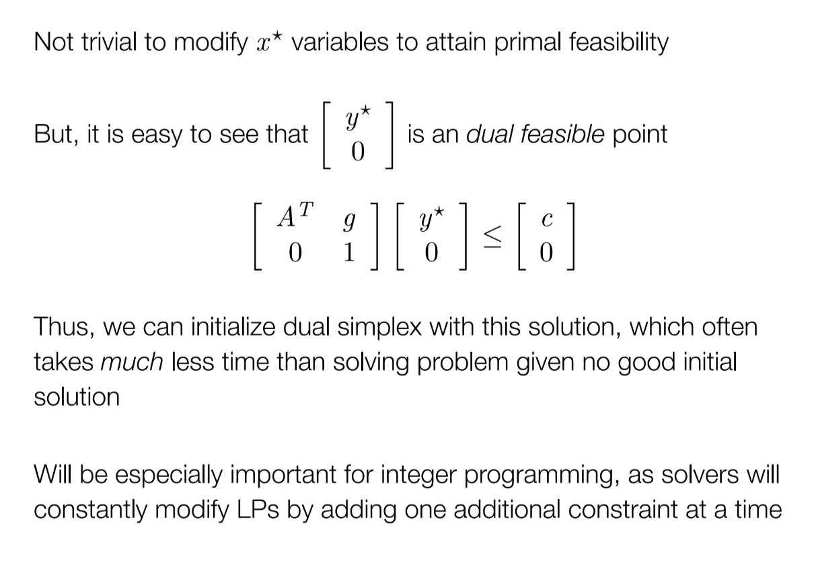
Why the dual LP

