Slide 1
Endgame solving, and Libratus, the state of the art for 2-player no-limit Texas hold’em
Tuomas Sandholm

Slide 2
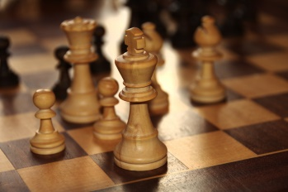
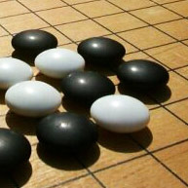

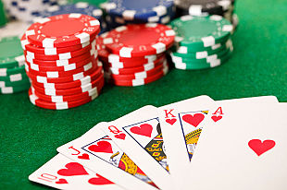
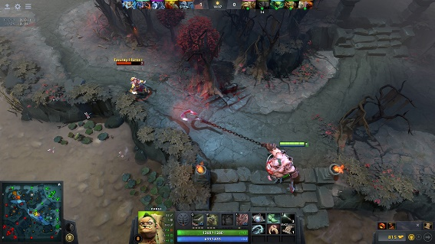

Imperfect-information games

Slide 3
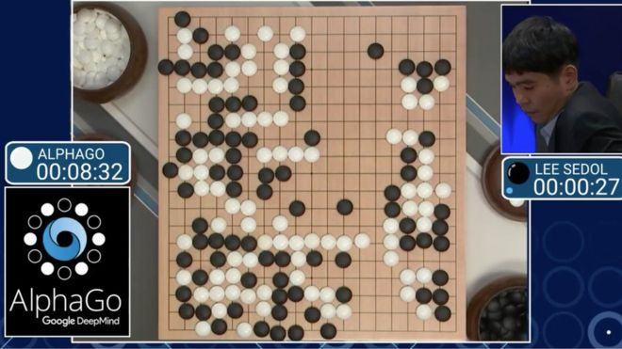
AlphaGo
In principle, AlphaGo techniques extend to other perfect-information games

Slide 4
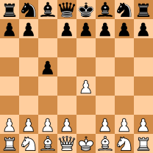
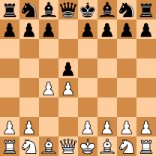
Perfect-information games
Sicilian Defense
Queen’s Gambit
Subgames can be solved with information from the subgame only
This is not true in imperfect-information games

Slide 5
Imperfect-information games Example game: “Coin toss”
Player 1’s information set
Player 1’s information set
C
P = 0.5
P = 0.5
Heads
Tails
P1
P1
Player 2’s information set
Sell
Sell
Play
Play
P2
P2
Heads
Tails
Heads
Tails
Forfeit
Forfeit
-1
1
1
1
1
-1

Slide 6
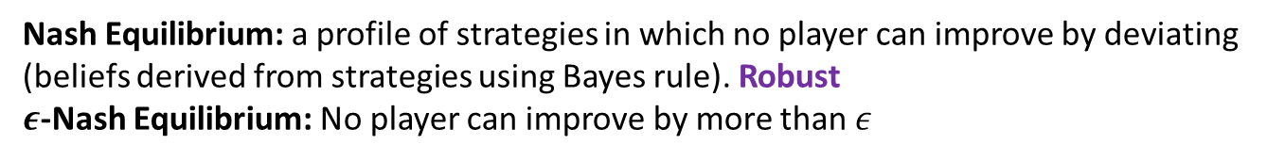
What is rational play?
Nash Equilibrium: a profile of strategies in which no player can improve by deviating (beliefs derived from strategies using Bayes rule). Robust
$ε$-Nash Equilibrium: No player can improve by more than $ε$
C
P = 0.5
P = 0.5
Heads
Tails
P1
P1
P = 0.5
P = 0.5
Sell
Sell
P = 0.5
Play
Play
P = 0.5
0
0
P2
P2
P = 0.5
P = 0.5
P = 0.5
P = 0.5
Heads
Tails
Heads
Tails
Forfeit
Forfeit
-1
1
1
1
1
-1

Slide 7
C
P = 0.5
P = 0.5
Heads
Tails
Subgame
P1
P1
Sell
Sell
Play
Play
P2
P2
Heads
Tails
Heads
Tails
Forfeit
Forfeit
-1
1
1
1
1
-1

Slide 8
C
P = 0.5
P = 0.5
Heads
Tails
Subgame
P1
P1
Sell
Sell
Play
Play
2
-2
P2
P2
Heads
Tails
Heads
Tails
Forfeit
Forfeit
-1
1
1
1
1
-1
Notes:
What is the optimal strategy for P2, looking only at the subgame? Clearly if we know the exact state then we can search just like in Chess. But we only know the information set.
We can see that P1 would have sold the coin if it landed Heads, so P2 should always guess Tails.

Slide 9
C
P = 0.5
P = 0.5
Heads
Tails
Subgame
P1
P1
Sell
Sell
Play
Play
-2
2
P2
P2
Heads
Tails
Heads
Tails
Forfeit
Forfeit
-1
1
1
1
1
-1
Notes:
But if the Sell payoffs are switched, then the optimal strategy in the subgame changes. So the optimal strategy in the subgame depends on outcomes and strategies for situations that are not in the subgame, unlike perfect-information games. Two completely different parts of the game tree can affect the strategies of each other.

Slide 10
Tackling imperfect-info games
Application-independent techniques that algorithmically create the strategy
Techniques for perfect-info games don’t apply
Challenges
Uncertainty about what others and chance will do
Hidden state => need to interpret signals => use game theory
Notes:
(Speculation, counter-speculation, … ad infinitum -> Nash)

Slide 11
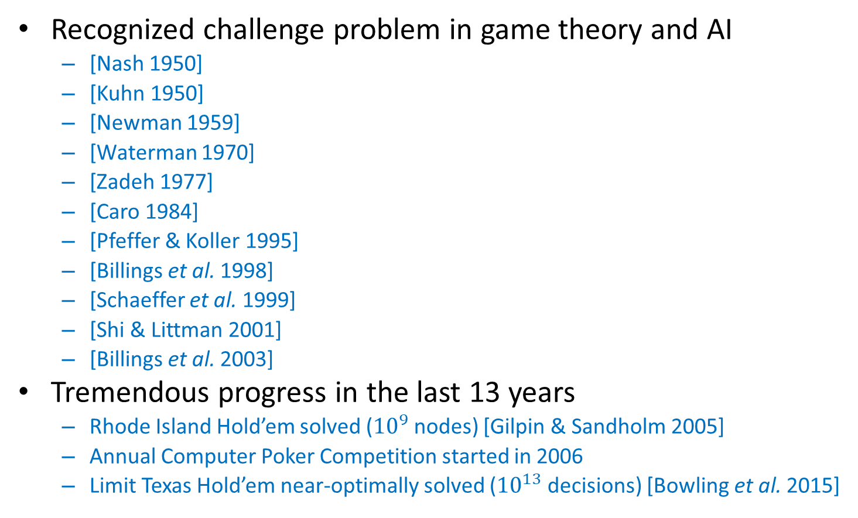
Poker
Recognized challenge problem in game theory and AI
[Nash 1950]
[Kuhn 1950]
[Newman 1959]
[Waterman 1970]
[Zadeh 1977]
[Caro 1984]
[Pfeffer & Koller 1995]
[Billings et al. 1998]
[Schaeffer et al. 1999]
[Shi & Littman 2001]
[Billings et al. 2003]
Tremendous progress in the last 13 years
Rhode Island Hold’em solved (${10}^{9}$ nodes) [Gilpin & Sandholm 2005]
Annual Computer Poker Competition started in 2006
Limit Texas Hold’em near-optimally solved (${10}^{13}$ decisions) [Bowling et al. 2015]
Notes:
ACPC

Slide 12
Heads-up no-limit Texas hold’em
Has become the main benchmark and challenge problem in AI for imperfect-information games
10¹⁶¹ situations
Mostly played on the Internet
Also in World Series of Poker, NBC Heads-Up Championship, etc.
Featured in Casino Royale and Rounders
“Purest form of poker”
No prior AI has beaten top humans

Slide 13
Texas hold’em
Chance deals 2 cards to each player
Round of betting
Chance deals 3 shared cards
Round of betting
Chance deals 1 shared card
Round of betting
Chance deals 1 shared card
Round of betting
Notes:
Most popular poker variant.

Slide 14
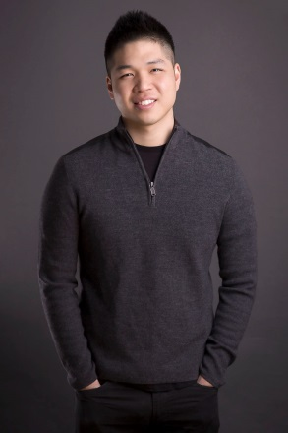
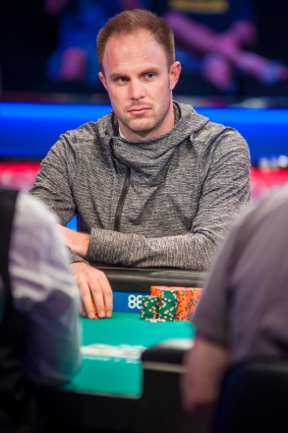
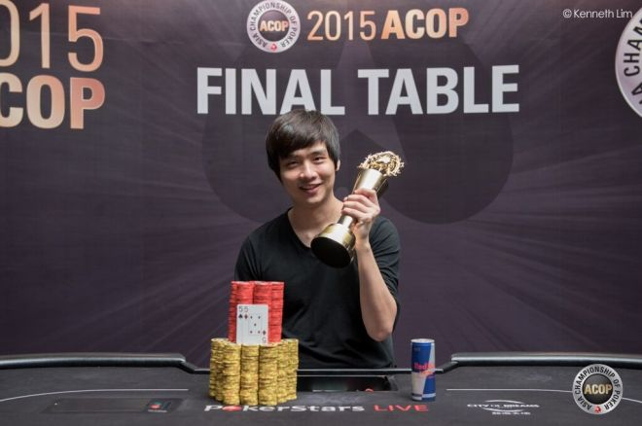

Brains vs AI Rematch
Libratus (= our AI) against four of the best heads-up no-limit Texas Hold’em specialist pros
120,000 hands over 20 days in January 2017
$200,000 divided among the pros based on performance
Conservative experiment design
Notes:
“Libratus” = “balanced” and “forceful”
(Stacks of 200 big blinds at the start of every hand, as in ACPC)

Slide 15
Conservative experiment design to favor humans
Large number of hands
Humans got to choose:
#days, break days, times of day, breaks between sessions—even dynamically
Two tabling
4-color deck
Hot keys, adjustable dynamically
Specific hi-res monitors, their own mice
Twitch chat on vs off
Play in public vs private within each pair
200 big blinds deep
No use of timing tells
Action history displayed
Hand histories given to both sides every evening, including hands opponent folded
Humans allowed to:
Use computers and any programs to analyze
Collaborate and coordinate actions (except within each hand)
Get outside help (e.g., Doug Polk)
Humans allowed to think as long as they want
Mis-click hands canceled
Ginseng ☺

Slide 16


Slide 17


Slide 18
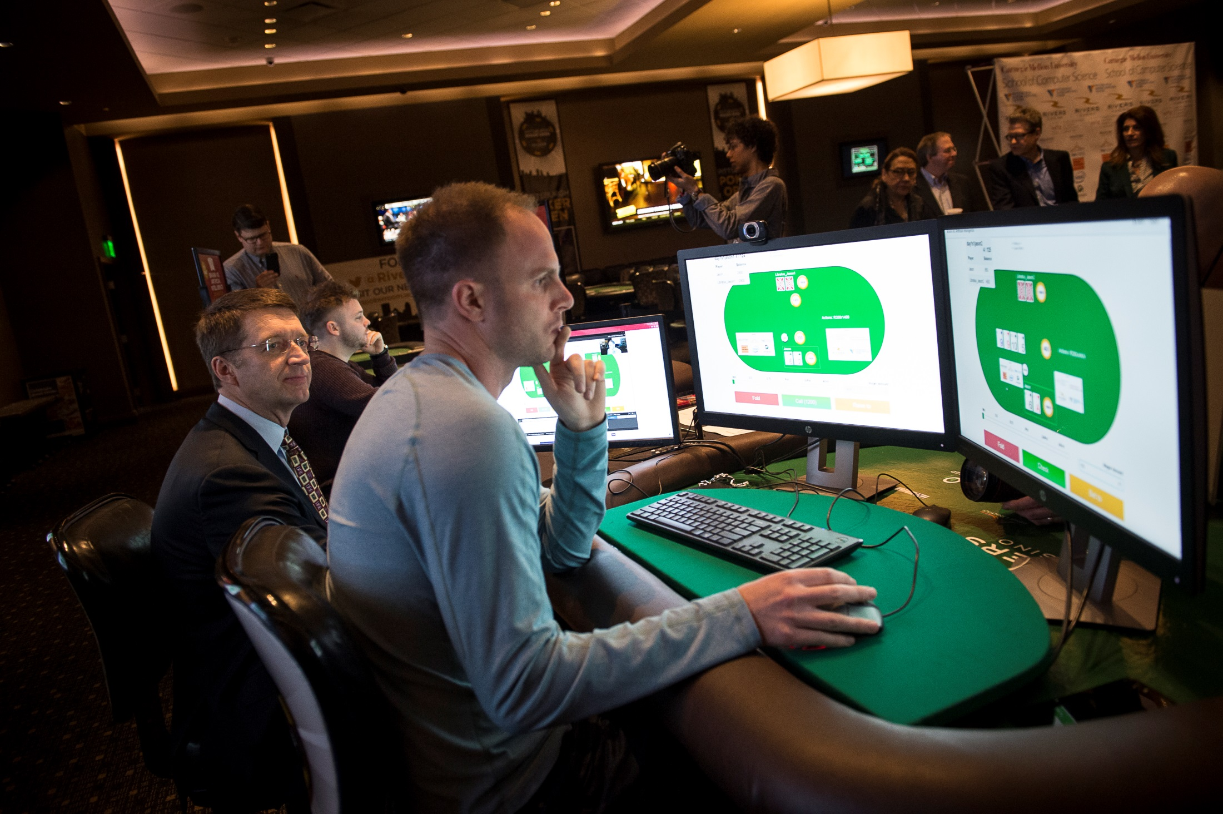

Slide 19
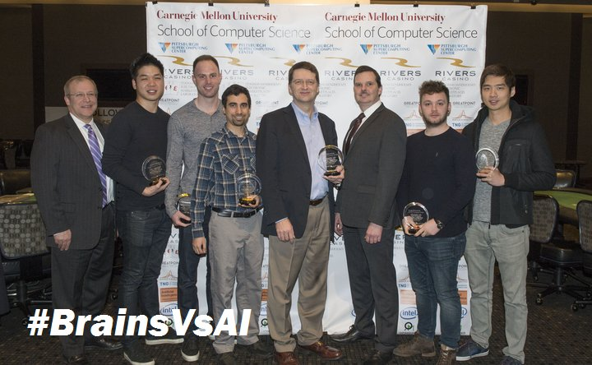
Final result
Libratus beat the top humans in this game by a lot
147 mbb/hand
Statistical significance 99.98%, i.e., 0.0002
Each human lost to Libratus

Slide 20
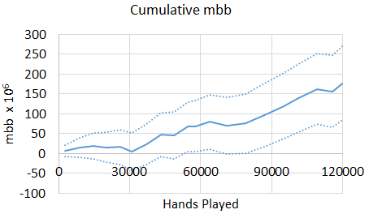
Libratus’s lead

Slide 21

Why is game-theoretic AI better than machine learning for these problems?
Requires no data
Doesn’t assume opponent will continue to behave the same way as in the past
Not exploitable (even if opponent knows our strategy)
36,000 hands against 6 Chinese poker players
WSOP bracelet winner
Expertise in computer science & ML
They studied Libratus’s hand histories in advance
AI won by 220 mbb/hand
Won each of the 9 sessions
Also beat each human individually
Demonstrated that this approach is not frail
Minmax theorem proves this for exact Nash equilibrium. Our experiments showed it for computational approximations
Unlike what has been found with ML approaches (e.g., for Go, DOTA2, and Starcraft II)
Notes:
GT is important. Works even if opponents know the strategy. Unlike DOTA2.
4.5 days: April 6-10, 2017

Slide 22
How does Libratus work? [Brown & Sandholm, Science 2018]

Slide 23
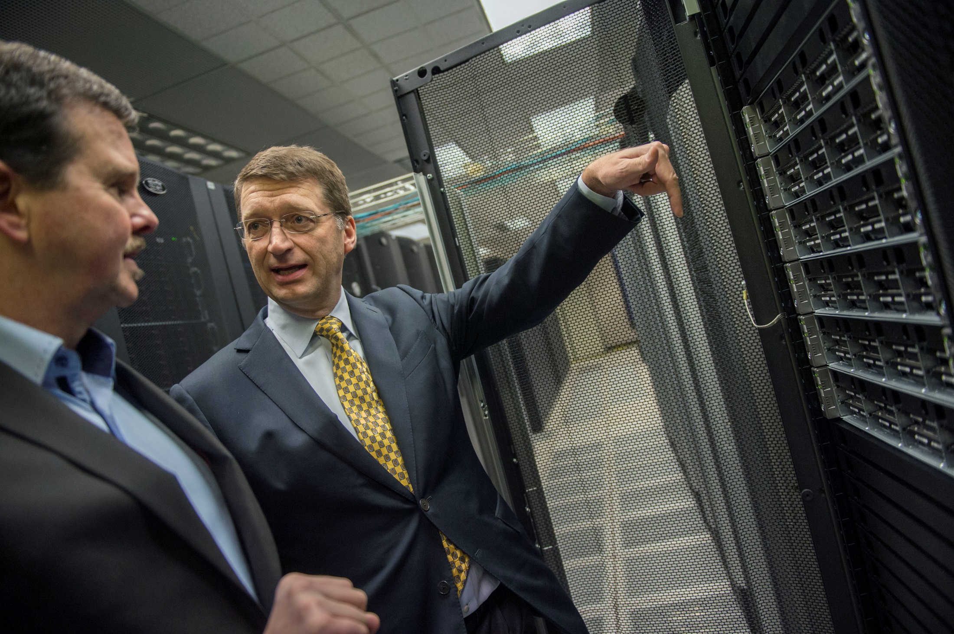
Bridges supercomputer

Slide 24
Libratus
Rules of the game
Abstraction
Equilibrium finding
Subgame solver
Self-improver
Blueprint strategy
New action abstraction for part of game

Slide 25
Libratus
Rules of the game
Abstraction
Equilibrium finding
Subgame solver
Self-improver
Blueprint strategy
New action abstraction for part of game

Slide 26
Abstraction [Gilpin & Sandholm EC-06, J. of the ACM 2007…]
Original game
Abstracted game
Rules
New abstraction algorithm
10¹⁶¹
New
equilibrium-finding
algorithm
“blueprint strategy”
ε-equilibrium
Foreshadowed by Shi & Littman 01, Billings et al. IJCAI-03

Slide 27
Abstraction in Libratus
Abstracting chance’s actions (cards in poker)
Same algorithm that we used in Tartanian8 [Brown, Ganzfried & Sandholm AAMAS-15]
Like the state-of-the-art state-abstraction algorithm for centralized equilibrium finding presented in class, except distributed based on the public flop cards so that any one sample stays within one compute node (blade)
But much finer abstraction
1st and 2nd betting round: no abstraction
3rd betting round: 55M card histories -> 2.5M buckets
4th betting round: 2.4B card histories -> 1.25M buckets
Abstracting player’s actions (bet sizes in poker)
Largely based on what top humans and AIs do
Added radical bet sizes
Optimized some of the bet sizes in the early parts of the tree [Brown & Sandholm AAAI-14]
Notes:
Imperfect recall, earthmover distance

Slide 28
Our equilibrium-finding algorithm
Improvement on Monte-Carlo Counterfactual Regret Minimization [Lanctot et al. NIPS-09]
Starts visiting less often paths where our own actions don’t look promising (similar to Brown & Sandholm NIPS-15 paper and AAAI-17 workshop paper) => Speedup => can solve larger abstractions
Also, the imperfect-recall abstraction, in effect, becomes finer grained => Better solution quality
Distributed across 1 + 195 compute nodes
Distribution along game tree, not “embarrassingly parallel”
Notes:
(actions with very negative regret)
during equilibrium finding because the in-degree of buckets decreases

Slide 29

Systems structuring & our usage
Bridges supercomputer
~$17 million (including running it for its lifetime)
Architected by Hewlett Packard Enterprise (HPE) & Pittsburgh Supercomputing Center
Heterogeneous architecture
We used the part that has 800 HPE Apollo 2000 servers, each with 28 cores and 128GB RAM
We officially used ~24 million core hours for Libratus (Jan 2016-Jan 2017)
But we used only 14 of the 28 cores on each node because that was fastest
We were the biggest user of Bridges in that timeframe (used about half)
Blueprint runs typically used 1 + 195 nodes
Typically ~1-8 weeks per run
Each endgame solver used 50 nodes
Typically 30-60 seconds per run
Each self-improver run used 196-600 nodes
Typically for 8-30 hours per run
C++, Open-MP for parallelism within each server, MPI for distributed computing
2.6 PB disk storage
Multiple strategies
Snapshots (balance in snapshotting)
Connections by Intel Omni-Path
Intel Lustre file system
During the competition, we had three locations connected by Internet:
Front end running on a browser at Rivers casino
Poker server running on a Dell rack server at CMU
AI running on Bridges at Pittsburgh Supercomputing Center (in an industrial basement in Monroeville)

Slide 30
Libratus
Rules of the game
Abstraction
Equilibrium finding
Subgame solver
Self-improver
Blueprint strategy
New action abstraction for part of game

Slide 31
Libratus
Rules of the game
Abstraction
Equilibrium finding
Subgame solver
Self-improver
Strategy computed in a finer-grained abstraction
Blueprint strategy
New action abstraction for part of game
Notes:
Blueprint gives us values of the long-range interactions in the game tree.
(Subgame solving is typically done is a finer abstraction than the abstraction for which the blueprint strategy was computed.)

Slide 32
New ideas in subgame solver
NIPS-17 best paper award
Provably safe subgame solving taking into account opponent’s mistakes in the hand so far
Nested subgame solving
Subgame solving starts much earlier
No card abstraction in the subgame
Changed our action abstraction between hands

Slide 33
New ideas in subgame solver
NIPS-17 best paper award
Provably safe subgame solving taking into account opponent’s mistakes in the hand so far
Nested subgame solving
Subgame solving starts much earlier
No card abstraction in the subgame
Changed our action abstraction between hands

Slide 34
Safe subgame solving taking into account opponent’s mistakes in the hand so far

Slide 35
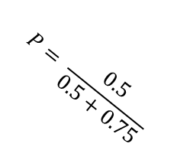
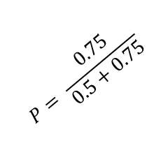
Unsafe subgame solving [Gilpin & Sandholm AAAI-06; Ganzfried & Sandholm AAAMAS 2015]
Blueprint Strategy
(not an exact equilibrium)
No theoretical guarantees
Does well in practice for some domains
C
P = 0.5
P = 0.5
Heads
Tails
Gadget Game
P1
P1
P = 0.25
P = 0.5
Sell
P = 0.75
Sell
P = 0.5
C
Play
Play
Libratus is P2
0.5
-0.5
$$P= \frac{0.75}{0.5+0.75}$$
$$P= \frac{0.5}{0.5+0.75}$$
P2
P2
P2
P2
P = 0.5
P = 0.25
P = 0.5
P = 0.25
P = 1.0
P = 0.0
P = 1.0
P = 0.0
Heads
Tails
Heads
Tails
Heads
Tails
Heads
Tails
Forfeit
Forfeit
Forfeit
Forfeit
P = 0.25
P = 0.25
P = 0.0
P = 0.0
-1
1
1
1
1
-1
-1
1
1
1
1
-1
Notes:
“Now let me walk you through the history of subgame solving techniques for imperfect-information games as a path to our most advanced technique.”

Slide 36
Re-solve refinement [Burch et al. AAAI 2014]
P1 can choose between entering the subgame or taking the EV (according to the blueprint) of the subgame
Makes sure opponent’s EV for entering the subgame is no higher than in the blueprint strategy => Strategy provably no worse than blueprint strategy
But may miss obvious opportunities for improvement (e.g., not forfeiting)
Blueprint Strategy
Gadget Game
C
C
P = 0.5
P = 0.5
P = 0.5
P = 0.5
Heads
Tails
Heads
Tails
P1
P1
Libratus
is P2
P1
P1
Sell
EV = 0
Sell
EV = 0.5
Alt
Alt
Play
Play
Enter
Enter
0.5
-0.5
0
0.5
P2
P2
P2
P2
P = 0.5
P = 0.25
P = 0.5
P = 0.25
P = 0.5
P = 0.25
P = 0.5
P = 0.25
Heads
Tails
Heads
Tails
Heads
Tails
Heads
Tails
Forfeit
Forfeit
Forfeit
Forfeit
P = 0.25
P = 0.25
P = 0.25
P = 0.25
-1
1
1
1
1
-1
-1
1
1
1
1
-1

Slide 37
Interlude: Alternative Payoff Distributions

Slide 38
Alternative payoff distributions
Which is better?
(A)
(B)
Answer: It depends on the assumptions. If the blueprint strategy is not perfect, (B) is probably better
Idea: Assume the alternative payoffs were sampled from a random variable
The narrower the distribution sampled from, the more we maximize the minimum margin
The wider the distribution, the more we maximize the sum of all margins

Slide 39
Alternative payoff distributions
C
P = 0.5
Heads
P = 0.5
C
C
Heads
P1
Alt
P1
…
P1
…
P1
Enter
Alt
Alt
Alt
0
Enter
Enter
-0.1
Enter
0
0.1
P2
P2
This imperfect-recall abstraction is solvable by CFR
If Hedge is used, there is no need to discretize the distribution

Slide 40
Alternative payoff distributions
Complication: How do we decide on a distribution?
Heuristics – constant fraction of the pot
Principled – difference between blueprint EV and full-game best response
Ultimately depends on how blueprint strategy was generated
If distributions are correct, this approach produces an optimal subgame strategy
Improves performance of safe subgame solving dramatically in practice

Slide 41
End of interlude

Slide 42
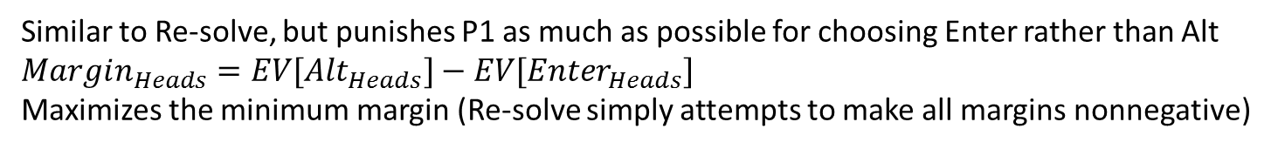
Maxmargin refinement [Moravcik et al. AAAI 2016]
Similar to Re-solve, but punishes P1 as much as possible for choosing Enter rather than Alt $$Margin_{Heads}=EV[Alt_{Heads}]−EV[Enter_{Heads}]$$
Maximizes the minimum margin (Re-solve simply attempts to make all margins nonnegative)
Blueprint Strategy
Gadget Game
C
C
P = 0.5
P = 0.5
P = 0.5
P = 0.5
Heads
Tails
Heads
Tails
P1
P1
P1
P1
Sell
EV = 0
Sell
EV = 0.5
Alt
EV = -0.25
Alt
EV = 0.25
Play
Play
Enter
Enter
0.5
-0.5
0
0.5
P2
P2
P2
P2
P = 0.5
P = 0.25
P = 0.5
P = 0.25
P = 5/8
P = 3/8
P = 5/8
P = 3/8
Heads
Tails
Heads
Tails
Heads
Tails
Heads
Tails
Forfeit
Forfeit
Forfeit
Forfeit
P = 0.25
P = 0.25
P = 0.0
P = 0.0
-1
1
1
-1
1
1
-1
1
1
1
1
-1
Problem: While we focus on reducing P1’s EV for Heads in the subgame to -0.25,
P1 can just Sell for 0.5 in Heads

Slide 43
Reach-maxmargin refinement: (solving a single subgame on this slide) [Brown & Sandholm AAAI-17 workshop, NIPS-17, Science-17; related to Jackson AAAI-15 workshop]
Blueprint Strategy
If P1 chooses Play following Heads, P1 is gifting us 0.5
So, in Gadget Game we can increase the alternative payoff following Heads by 0.5, because choosing Play would still be a mistake for P1 there
Thus the Gadget Game solver focuses on reducing P1’s EV for other types she may have
C
P = 0.5
P = 0.5
Heads
Tails
P1
P1
Sell
EV = 0
Sell
EV = 0.5
Play
Play
0.5
-0.5
P2
P2
P = 0.5
P = 0.25
P = 0.5
P = 0.25
Heads
Tails
Heads
Tails
Forfeit
Forfeit
P = 0.25
P = 0.25
-1
1
1
-1
1
1

Slide 44
Reach-maxmargin refinement: multiple subgames [Brown & Sandholm AAAI-17 workshop, NIPS-17, Science-17]
C
If multiple subgames are refined, off-path EVs might not remain constant
Solution: split gifts among subgames by probability subgame is reached
P = 0.5
P = 0.5
Heads
Tails
EV = 0.5
P1
Sell
EV = 0
Play
0.5
C
P = 0.5
P = 0.5
P1
P1
EV = 0
EV = 0
Enter Subgame A
Enter Subgame B

Slide 45
Reach-maxmargin refinement: multiple subgames [Brown & Sandholm AAAI-17 workshop, NIPS-17, Science-18]
C
If multiple subgames are refined, off-path EVs might not remain constant
Solution: split gifts among subgames by probability subgame is reached
P = 0.5
P = 0.5
Heads
Tails
EV = 0.5
P1
Sell
EV = 0.5
Play
0.5
C
P = 0.5
P = 0.5
P1
P1
EV = 1.0
EV = 0
Enter Subgame A
Enter Subgame B

Slide 46
Reach-maxmargin refinement: multiple subgames [Brown & Sandholm AAAI-17 workshop , NIPS-17, Science-18]
C
If multiple subgames are refined, off-path EVs might not remain constant
Solution: split gifts among subgames by probability subgame is reached
P = 0.5
P = 0.5
Heads
Tails
EV = 0.5
P1
Sell
EV = 0.5
Play
0.5
C
P = 0.5
P = 0.5
P1
P1
EV = 0
EV = 1.0
Enter Subgame A
Enter Subgame B

Slide 47
Reach-maxmargin refinement: multiple subgames [Brown & Sandholm AAAI-17 workshop , NIPS-17, Science-18]
C
If multiple subgames are refined, off-path EVs might not remain constant
Solution: split gifts among subgames by probability subgame is reached
P = 0.5
P = 0.5
Heads
Tails
EV = 0.5
P1
Sell
EV = 1.0
Play
0.5
C
P = 0.5
P = 0.5
P1
P1
EV = 1.0
EV = 1.0
Enter Subgame A
Enter Subgame B

Slide 48
Reach-maxmargin refinement: multiple subgames [Brown & Sandholm AAAI-17 workshop, NIPS-17, Science-18]
C
If multiple subgames are refined, off-path EVs might not remain constant
Solution: split gifts among subgames by probability subgame is reached
P = 0.5
P = 0.5
Heads
Tails
EV = 0.5
P1
Sell
EV = 0.5
Play
0.5
C
P = 0.5
P = 0.5
P1
P1
EV = 0.5
EV = 0.5
Enter Subgame A
Enter Subgame B

Slide 49
Reach-maxmargin refinement: multiple subgames [Brown & Sandholm AAAI-17 workshop, NIPS-17, Science-18]
C
Gifts might not be as large as we thought, because the subgames they come from will be improved
Solution: substitute a lower bound on the gift
In practice, this can be an estimate
P = 0.5
P = 0.5
Heads
Tails
EV = 0.5
P1
Sell
EV = 0.5
Play
0.5
C
P = 0.5
P = 0.5
P1
P1
EV = 0.5
EV = 0.5
Enter Subgame A
Enter Subgame B

Slide 50
Reach-maxmargin refinement: multiple subgames [Brown & Sandholm AAAI-17 workshop, NIPS-17, Science-18]
C
Gifts might not be as large as we thought, because the subgames they come from will be improved
Solution: substitute a lower bound on the gift
In practice, this can be an estimate
P = 0.5
P = 0.5
Heads
Tails
EV = 0.25
P1
Sell
EV = 0.5
Play
0.25
C
P = 0.5
P = 0.5
P1
P1
EV = 0.5
EV = 0.5
Enter Subgame A
Enter Subgame B

Slide 51
Reach-maxmargin refinement: multiple subgames [Brown & Sandholm AAAI-17 workshop, NIPS-17, Science-18]
C
Gifts might not be as large as we thought, because the subgames they come from will be improved
Solution: substitute a lower bound on the gift
In practice, this can be an estimate
P = 0.5
P = 0.5
Heads
Tails
EV = 0.25
P1
Sell
EV = 0.25
Play
0.25
C
P = 0.5
P = 0.5
P1
P1
EV = 0.25
EV = 0.25
Enter Subgame A
Enter Subgame B

Slide 52
Medium-scale experiments on subgame solving within action abstraction
 | Small Game Exploitability | Large Game Exploitability
Blueprint Strategy | 91.3 mbb / hand | 41.4 mbb / hand
Unsafe Subgame Solving | 5.51 mbb / hand | 397 mbb / hand
Re-solve Refinement | 81.2 mbb / hand | 36.3 mbb / hand
Maxmargin Refinement | 9.36 mbb / hand | 6.12 mbb / hand
Reach-Maxmargin Refinement | 8.26 mbb / hand | 5.50 mbb / hand
Notes:
Tested on two Flop Texas Hold’em poker variants
The blueprint was computed with 30,000 card history buckets on the flop
The small game has 57 non-terminal betting sequences
The large game has 202 non-terminal betting sequences

Slide 53
New ideas in subgame solver
Provably safe subgame solving taking into account opponent’s mistakes in the hand so far
Nested subgame solving
Subgame solving starts much earlier
No card abstraction in the subgame
Changed our action abstraction between hands

Slide 54
Action abstraction
P1
P2
. . .
. . .
P2
. . .
. . .
P2

Slide 55
Action abstraction
P1
P2
P2
P2
[Gilpin et al. AAMAS-08], [Hawkin et al. AAAI-11, AAAI-12], [Brown & Sandholm AAAI-14]

Slide 56
Action translation
P1
P2
P2
P2
[Gilpin et al. AAMAS-08], [Schnizlein et al. IJCAI-09], [Ganzfried & Sandholm IJCAI-13]

Slide 57

Nested subgame solving [Brown & Sandholm AAAI-17 workshop, arXiv, NIPS-17]
Idea: Solve a subgame in real time for the off-tree action taken
Theorem. If the blueprint is a Nash equilibrium of the abstraction and EV[Enter] $≤$ EV[Alt], then the strategies form a Nash equilibrium to the new abstraction that includes the new action
Can be repeated for every subsequent off-tree action
P1
P1
EV = z
Alt
Enter
EV = x
EV = y
P2
P2
P2
P2
max(x,y,z)

Slide 58
Medium-scale experiments on nested subgame solving
 | Exploitability
Randomized Pseudo-Harmonic Mapping [Ganzfried & Sandholm IJCAI-13] | 1465 mbb / hand
Nested Re-solve Refinement | 150.2 mbb / hand
Nested Unsafe Refinement | 148.3 mbb / hand
Nested Maxmargin Refinement | 122.0 mbb / hand
Nested Reach-Maxmargin Refinement | 119.1 mbb / hand
Notes:
Tested on a No-Limit Flop Texas Hold’em variant with no card abstraction
P1’s blueprint considered bet sizes of 0.5x pot, 0.75x pot, and 1x pot
P2’s blueprint only considered bet sizes of 0.5x pot and 1x pot
P2 responds to 0.75x pot with nested subgame solving

Slide 59
New ideas in subgame solver
Provably safe subgame solving taking into account opponent’s mistakes in the hand so far
Nested subgame solving
Subgame solving starts much earlier
No card abstraction in the subgame
Changed our action abstraction between hands

Slide 60
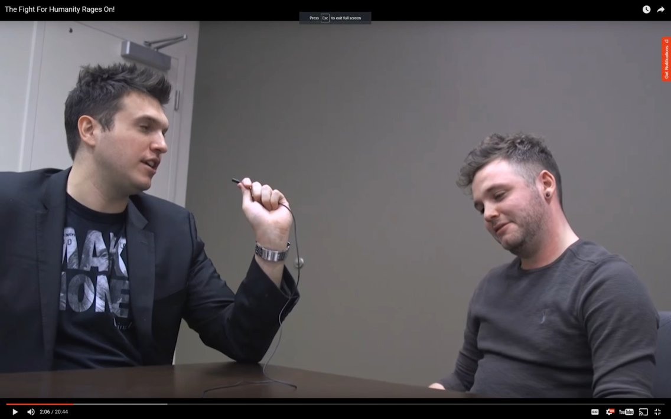
Libratus’s “balance” and use of “blockers”

Slide 61
Libratus
Rules of the game
Abstraction
Equilibrium finding
Subgame solver
Self-improver
Blueprint strategy
New action abstraction for part of game

Slide 62
Libratus
Rules of the game
Abstraction
Equilibrium finding
Subgame solver
Self-improver
Blueprint strategy
New action abstraction for part of game

Slide 63
Filling holes in the action tree
Freeze this part of strategy
Compute an ε–equilibrium for this part
Coarser card abstraction
Opponent
Libratus
Coarser card abstraction
and action abstraction
We do this for top k holes
Notes:
Two variants depending on opponent’s consistency
What are the typical actions that are kept?

Slide 64
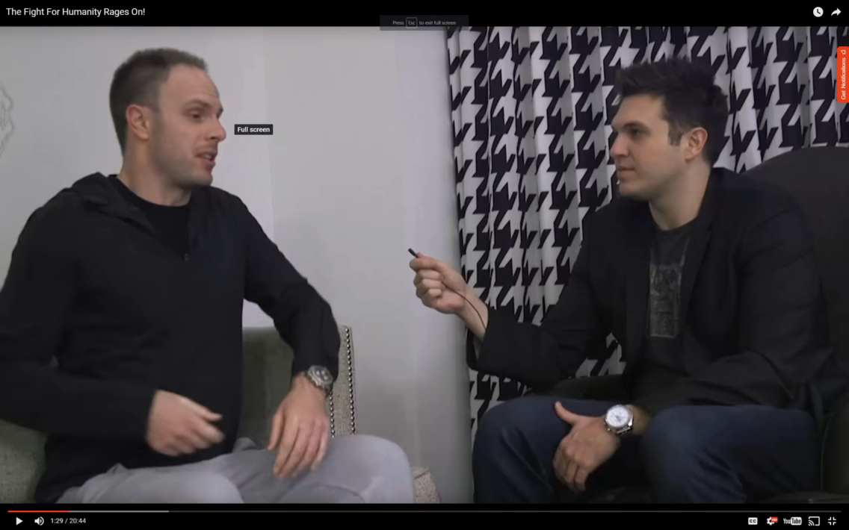
Libratus fixing its own weaknesses

Slide 65
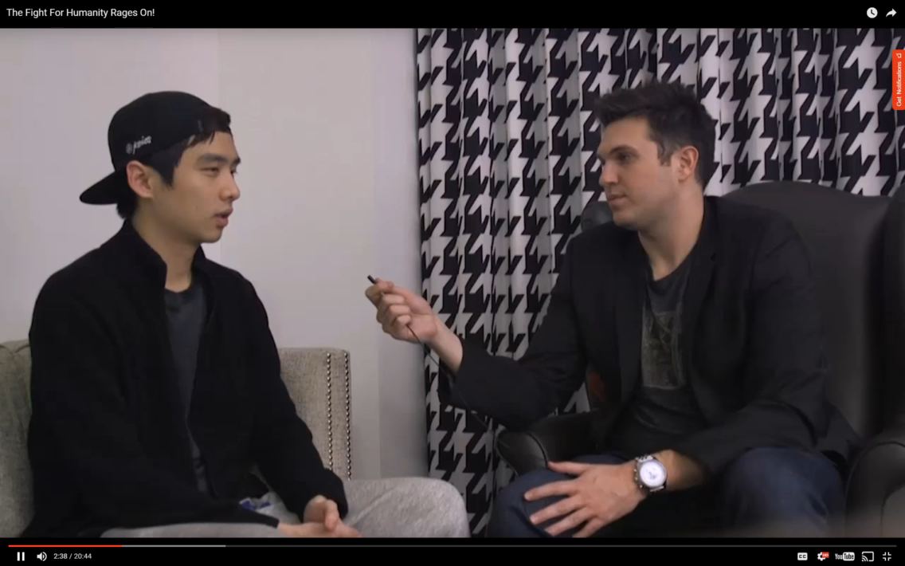
Libratus fixing its own weaknesses…

Slide 66
Head-to-head strength of top AIs
Ours
Others’
Stronger
Libratus (1/2017)
Tartanian8 (12/2015)
Baby Tartanian8 (12/2015)
ACPC 2016 winner
Claudico (4/2015)
Tartanian7 (5/2014)
ACPC 2014 winner
63 mbb / hand
DeepStack (12/2016)
Slumbot (12/2015)
Supremus [2020]
Modicum [NeurIPS-18]
25 mbb / hand
12 mbb / hand

Slide 67
Observations about Libratus’s play
Strengths:
Small bets & huge bets & huge all-ins
Multiple bet sizes in any one situation
“Limping”, “donk betting”
“Perfect balance”
Mixed strategy
Probability distributions over players’ hands; not just “range-based”
Near-perfect subgame play; great use of “blockers”
Different bet sizings used in subgames
Weaknesses?
No opponent exploitation

Slide 68
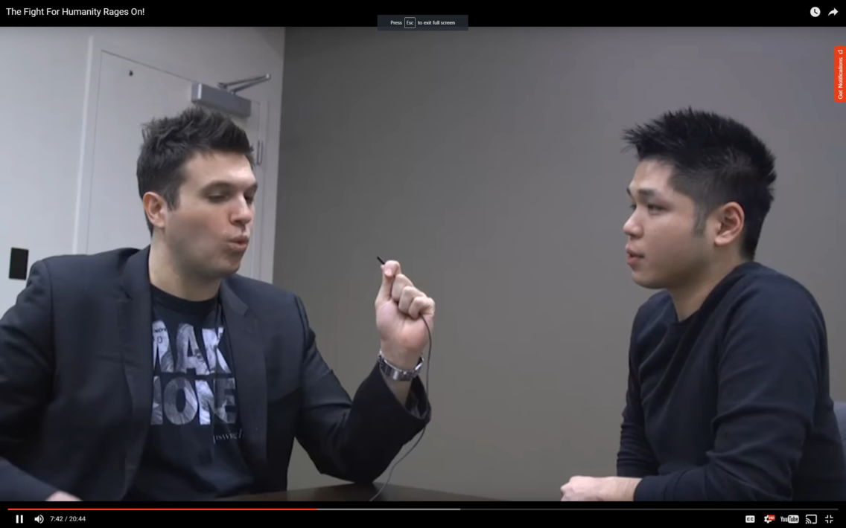
Is safe (equilibrium) play timid/boring?

