Slide 1
GAME THEORY LECTURE 1: Game representations, solution concepts, and Refinements of NASH Equilibrium Tuomas Sandholm

Slide 2
The heart of the problem
In a 1-agent setting, agent’s expected utility maximizing strategy is well-defined
But in a multiagent system, the outcome may depend on others’ strategies also => the agent’s best strategy may depend on what strategies the other agent(s) choose, and vice versa

Slide 3
Terminology
Agent = player
Action = move = choice that agent can make at a point in the game
Strategy s_{i} = mapping from history (to the extent that the agent i can distinguish) to actions
Strategy set S_{i} = strategies available to the agent
Strategy profile (s₁, s₂, ..., s_{|A|}) = one strategy for each agent
Agent’s utility is determined after each agent (including nature that is used to model uncertainty) has chosen its strategy, and game has been played: u_{i} = u_{i}(s₁, s₂, ..., s_{|A|})

Slide 4
Game representations
Normal form
aka strategic form
aka matrix form / bimatrix form
Extensive form
(aka tree form)
player 2’s strategy
Left
1, 2
Left,
Left
Left,
Right
Right,
Left
Right,
Right
Up
player 2
Right
3, 4
Up
1, 2
1, 2
3, 4
3, 4
player 1’s
strategy
player 1
Left
5, 6
Down
5, 6
7, 8
5, 6
7, 8
Down
player 2
Right
7, 8
Potential combinatorial explosion

Slide 5
Dominant strategy “equilibrium”
Best response s_{i}*: for all s_{i}’, u_{i}(s_{i}*,s_{-i}) ≥ u_{i}(s_{i}’,s_{-i})
Dominant strategy s_{i}*: s_{i}* is a best response for all s_{-i}
Does not always exist
Inferior strategies are called “dominated”
Dominant strategy equilibrium is a strategy profile where each agent has picked its dominant strategy
Does not always exist
Requires no counterspeculation
E.g., Prisoners’ Dilemma:
cooperate
defect
Pareto optimal?
cooperate
3, 3
0, 5
Social welfare
maximizing?
defect
5, 0
1, 1

Slide 6
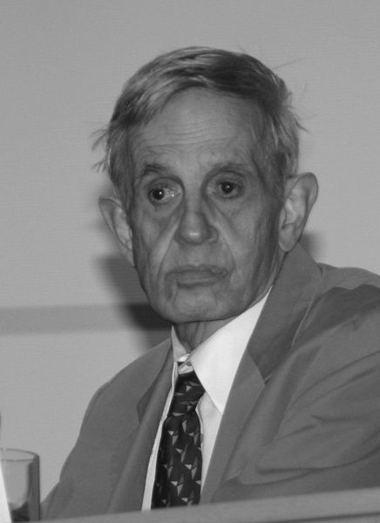
Nash equilibrium [Nash50]
Sometimes an agent’s best response depends on others’ strategies: a dominant strategy does not exist
A strategy profile is a Nash equilibrium if no player has incentive to deviate from his strategy given that others do not deviate: for every agent i, u_{i}(s_{i}*,s_{-i}) ≥ u_{i}(s_{i}’,s_{-i}) for all s_{i}’
Dominant strategy equilibria are Nash equilibria but not vice versa
Defect-defect is the only Nash eq. in Prisoner’s Dilemma
Battle of the Sexes game
Has no dominant strategy equilibria

Slide 7
Criticisms of Nash equilibrium
Not unique in all games, e.g. Battle of the Sexes
Approaches for addressing this problem
Refinements (=strengthenings) of the equilibrium concept
Eliminate weakly dominated strategies first
Choose the Nash equilibrium with highest welfare
Subgame perfection …
Focal points
Mediation
Communication
Convention
Learning
Does not exist in all games

Slide 8
Rock-scissors-paper game
Sequential moves

Slide 9
Rock-scissors-paper game
Simultaneous moves

Slide 10
Imperfect-information extensive-form games
Mixed strategy = agent’s chosen probability distribution over pure strategies from its strategy set
move of
rock
0, 0
(Bayes-)Nash equilibrium: Each agent uses a
best-response strategy
and has consistent beliefs
agent 2
scissors
1, -1
paper
rock
-1, 1
Rock-paper-scissors game has a symmetric mixed-strategy Nash equilibrium where each player plays each pure strategy with probability 1/3
rock
-1, 1
move of
scissors
scissors
0, 0
agent 1
paper
paper
Information set
(the mover does not know which node of the set she is in)
1, -1
rock
1, -1
Fact: In mixed-strategy equilibrium, each strategy that occurs in the mix of agent i has equal expected utility to i
scissors
-1, 1
Chance can also be a player (stochastic, not strategic )
paper
0, 0

Slide 11
Behavioral strategy
Agent has a probability distribution over her actions at each of her information sets
Kuhn’s theorem: If an agent has perfect recall, for every mixed strategy there is a behavioral strategy that has an equivalent payoff (i.e., the strategies are equivalent)
Applies also to infinite games

Slide 12
Existence of pure-strategy Nash equilibria
Thrm.
Any finite game,
where each action node is alone in its information set
(i.e., at every point in the game, the agent whose turn it is to move knows what moves have been played so far)
is dominance solvable by backward induction (at least as long as ties are ruled out)
Constructive proof: Multi-player minimax search
Lots of interesting work has been done on computer chess and Go to tackle the computational complexity
See Prof. Sandholm’s lecture in an earlier course (pptx, video)
We won’t cover that work in this course because most real-world games are imperfect-information games

Slide 13
Existence & complexity of mixed-strategy Nash equilibria
Every finite player, finite strategy game has at least one Nash equilibrium if we admit mixed-strategy equilibria as well as pure [Nash 50]
(Proof is based on Kakutani’s fix point theorem)
May be hard to compute
Complexity of finding a Nash equilibrium in a normal form game:
2-player 0-sum games can be solved in polytime with LP
2-player games are
PPAD-complete (even with 0/1 payoffs) [Chen, Deng & Teng JACM-09; Abbott, Kane & Valiant FOCS-05; Daskalakis, Goldberg & Papadimitriou STOC-06],
NP-complete to find an even approximately good Nash equilibrium [Conitzer & Sandholm GEB-08]
3-player games are FIXP-complete [Etessami & Yannakakis FOCS-07]

Slide 14
Refinements of NASH Equilibrium

Slide 15
Ultimatum game
(for distributional bargaining)

Slide 16
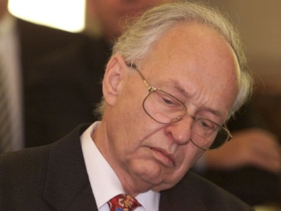
Subgame perfect equilibrium [Selten 72] & credible threats
Proper subgame = subtree (of the game tree) whose root is alone in its information set
Subgame perfect equilibrium = strategy profile that is in Nash equilibrium in every proper subgame (including the root), whether or not that subgame is reached along the equilibrium path of play
E.g. Cuban missile crisis
Pure strategy Nash equilibria: (Arm,Fold), (Retract,Nuke)
Pure strategy subgame perfect equilibria: (Arm,Fold)
Conclusion: Kennedy’s Nuke threat was not credible
- 100, - 100
Nuke
Kennedy
Arm
Fold
10, -10
Khrushchev
Retract
-1, 1

Slide 17
Ultimatum game, again

Slide 18
Thoughts on credible threats
Could use software as a commitment device
If one can credibly convince others that one cannot change one’s software agent, then revealing the agent’s code acts as a credible commitment to one’s strategy
E.g. nuke in the missile crisis
E.g. accept no less than 60% as the second mover in the ultimatum game
Restricting one’s strategy set can increase one’s utility
This cannot occur in single-agent settings
Social welfare can increase or decrease

Slide 19
Solution concepts
Strength
Strong Nash eq [Auman 1959]
against
collusion
Coalition-Proof Nash eq [Bernheim, Peleg & Whinston 1987]
Nash eq
Subgame perfect
equilibrium
Perfect Bayesian
equilibrium
Sequential
equilibrium
Dominant
Bayes-Nash eq
strategy eq
Strength
Ex post equilibrium = Nash equilibrium for all priors
There are other equilibrium refinements too (see, e.g., following slides & wikipedia)
Notes:
Tools for building robust, nonmanipulable systems for self-interested agents
Different solution concepts
For existence, use strongest equilibrium concept
For uniqueness, use weakest equilibrium concept

Slide 20
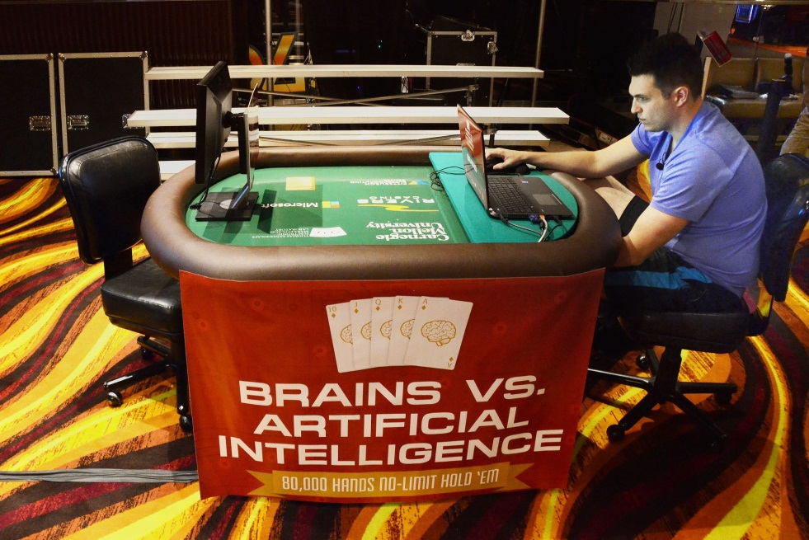
Example from the Brains vs AI Heads’Up No-Limit Texas Hold’em poker competition that I organized in April-May 2015
Claudico made a bad move (not in the beginning of a hand)
“How can that mistake be part of a GTO strategy?”

Slide 21
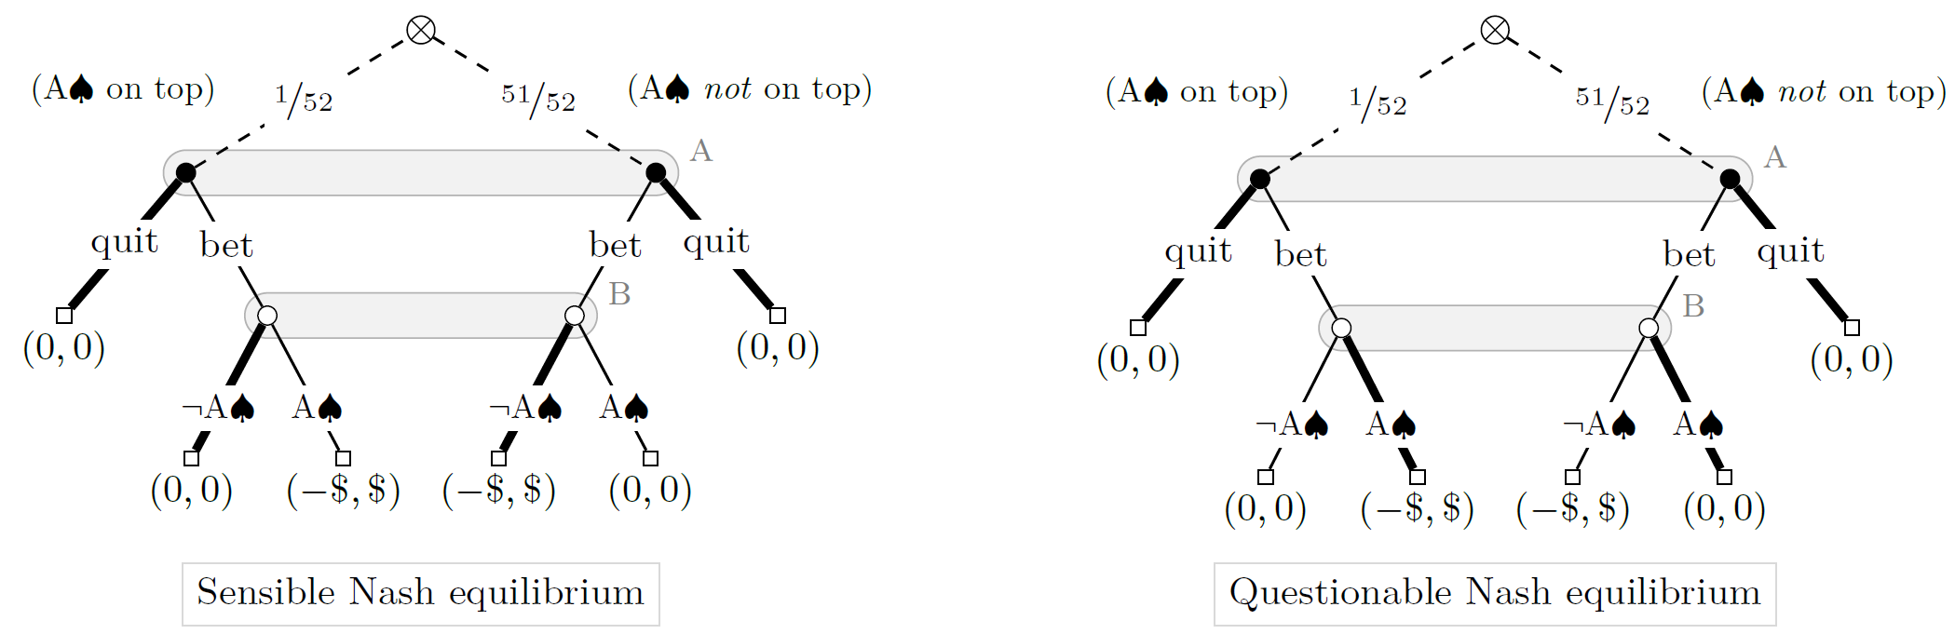
Guess-the-Ace game [Miltersen & Sørensen, 2006]

Slide 22
Solution concepts for extensive-form imperfect-information games (slide 1 of 3)
A player’s beliefs consist of probability distributions over nodes occurring in her information sets
A (Bayesian) Nash equilibrium is a strategy profile where each player maximizes her expected utility given the strategies played by the other players
Perfect Bayesian equilibrium (PBE)
A belief system is consistent for a given strategy profile if the probability assigned by the system to every node is computed as the probability of that node being reached given the strategy profile, i.e., by Bayes’ rule
A strategy profile is sequentially rational at a particular information set for a particular belief system if the expected utility of the player whose information set it is is maximal given the strategies played by the other players
A strategy profile is sequentially rational for a particular belief system if it satisfies the above for every information set
A PBE is a strategy profile and a belief system such that the strategies are sequentially rational given the belief system and the belief system is consistent, wherever possible, given the strategy profile
‘wherever possible’ clause is necessary: some information sets might be reached with zero probability given the strategy profile; hence Bayes’ rule cannot be employed to calculate the probability of nodes in those sets. Such information sets are said to be off the equilibrium path and any beliefs can be assigned to them
In Guess-the-Ace, the questionable Nash equilibrium is also a PBE, so PBE does not solve the issue
Sequential equilibrium [Kreps and Wilson 82]. Refinement of PBE that specifies constraints on beliefs in such zero-probability information sets. Strategies and beliefs must be a limit point of a sequence of totally mixed strategy profiles and associated sensible (in PBE sense) beliefs.
In Guess-the-Ace, the questionable Nash equilibrium is not a sequential equilibrium, so that issue is solved
More refined

Slide 23
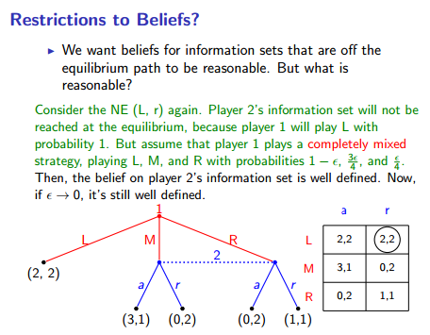
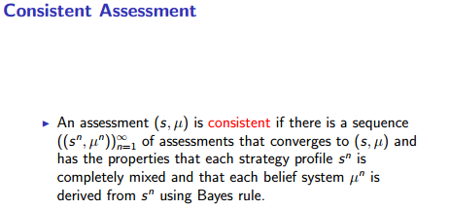
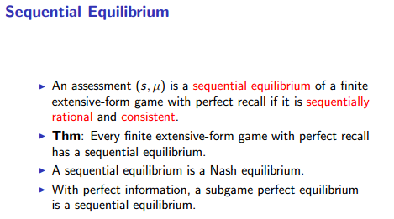
More detail about sequential equilibrium (slide content from Yiling Chen’s course)
The Nash equilibrium is also a sequential equilibrium in this case.

Slide 24
Solution concepts for extensive-form imperfect-information games (slide 2 of 3)
A player’s beliefs consist of probability distributions over nodes occurring in her information sets
A (Bayesian) Nash equilibrium is a strategy profile where each player maximizes her expected utility given the strategies played by the other players
Perfect Bayesian equilibrium (PBE)
A belief system is consistent for a given strategy profile if the probability assigned by the system to every node is computed as the probability of that node being reached given the strategy profile, i.e., by Bayes’ rule
A strategy profile is sequentially rational at a particular information set for a particular belief system if the expected utility of the player whose information set it is is maximal given the strategies played by the other players
A strategy profile is sequentially rational for a particular belief system if it satisfies the above for every information set
A PBE is a strategy profile and a belief system such that the strategies are sequentially rational given the belief system and the belief system is consistent, wherever possible, given the strategy profile
‘wherever possible’ clause is necessary: some information sets might be reached with zero probability given the strategy profile; hence Bayes’ rule cannot be employed to calculate the probability of nodes in those sets. Such information sets are said to be off the equilibrium path and any beliefs can be assigned to them
In Guess-the-Ace, the questionable Nash equilibrium is also a PBE, so PBE does not solve the issue
Sequential equilibrium [Kreps and Wilson 82]. Refinement of PBE that specifies constraints on beliefs in such zero-probability information sets. Strategies and beliefs must be a limit point of a sequence of totally mixed strategy profiles and associated sensible (in PBE sense) beliefs.
In Guess-the-Ace, the questionable Nash equilibrium is not a sequential equilibrium, so that issue is solved
Extensive-form trembling hand perfect equilibrium (EFPE) [Selten 75]. Require every move at every information set to be taken with non-zero probability. Take limit as tremble probability →0
Extensive-form proper equilibrium [Myerson 78]. Idea: Costly trembles much less likely. At any information set, for any two actions A and B, if the mover’s utility from B is less than from A, then prob(B) ≤ ε prob(A). Take limit as ε→0
More refined

Slide 25
Solution concepts for extensive-form imperfect-information games (slide 3 of 3)
Extensive-form perfect/proper equilibrium can involve playing weakly dominated strategies => argument for other solution concepts:
Normal-form perfect equilibrium
Defined analogously to extensive-form trembling hand perfect equilibrium, but now for normal-form games
Normal- and extensive-form perfect equilibria are incomparable
A normal-form perfect equilibrium of an extensive-form game may or may not be sequential (and might not even be subgame perfect)
Quasi-perfect equilibrium (QPE) [van Damme 84]
Original definition, informally: “A player takes observed as well as potential future mistakes of his opponents into account but assumes that he himself will not make a mistake in the future, even if he observes that he has done so in the past.”
Can be defined like EFPE, but the trembling constraints state that each sequence must have probability ≥ ɛ^{length(sequence)} [Miltersen & Sørensen 2010; Gatti et al. 2020]
Incomparable to extensive-form perfect/proper
Admissible, unlike EFPE
Normal-form proper equilibrium
Defined analogously to extensive-form proper equilibrium, but now for normal-form games
Always sequential
For 0-sum games, provides a strategy that maximizes the conditional utility (among minmax strategies), conditioned on the opponent making a mistake
Here a mistake is defined as a pure strategy that doesn’t achieve the value of the game against all minmax strategies
More refined
Notes:
The voting game suggested by Mertens may be described as follows: Two players must elect one of them to perform an effortless task. The task may be performed either correctly or incorrectly. If it is performed correctly, both players receive a payoff of 1, otherwise both players receive a payoff of 0. The election is by a secret vote. If both players vote for the same player, that player gets to perform the task. If each player votes for himself, the player to perform the task is chosen at random but is not told that he was elected this way. Finally, if each player votes for the other, the task is performed by somebody else, with no possibility of it being performed incorrectly.
In the unique quasi-perfect equilibrium for the game, each player votes for himself. This is also the unique admissible behavior (i.e., one that does not play weakly dominated strategies). But in any extensive-form trembling hand perfect equilibrium, at least one of the players believes that he is at least as likely as the other player to perform the task incorrectly and hence votes for the other player.
The example illustrates that being a limit of equilibria of perturbed games, an extensive-form trembling hand perfect equilibrium implicitly assumes an agreement between the players about the relative magnitudes of future trembles. It also illustrates that such an assumption may be unwarranted and undesirable.

Slide 26
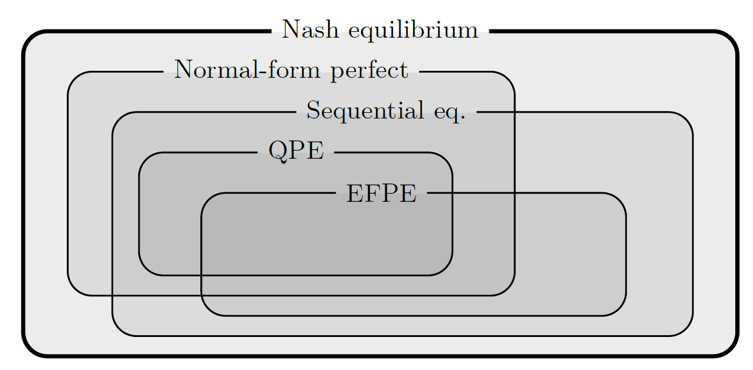

Slide 27
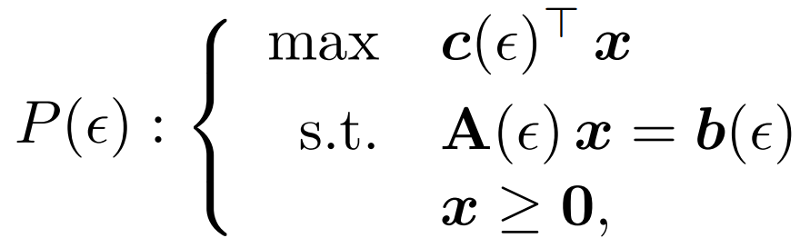
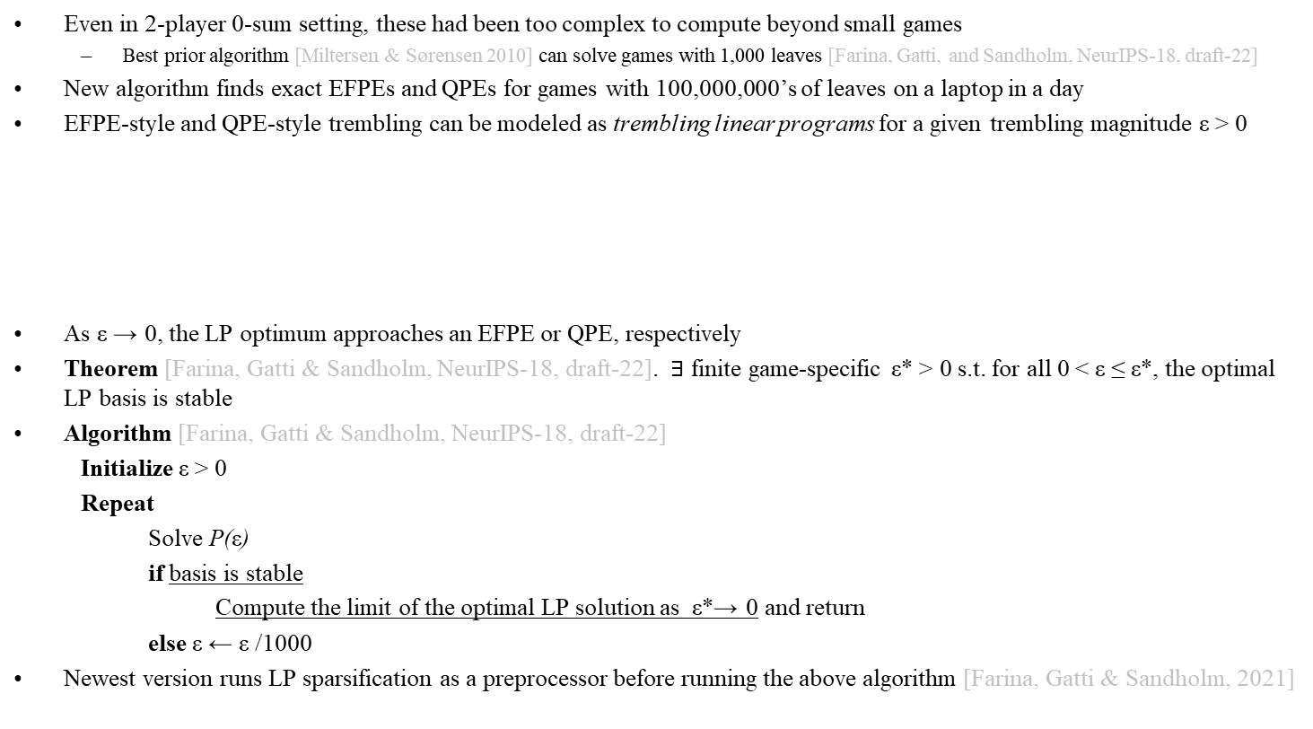
Algorithms for equilibrium refinements in 2-player 0-sum extensive-form imperfect-information games
Extensive-form trembling hand perfect equilibrium (EFPE) [Selten, 1975]
Sequential equilibrium
[Kreps and Wilson, 1982]
Quasi-perfect equilibrium (QPE) [van Damme, 1984]
Even in 2-player 0-sum setting, these had been too complex to compute beyond small games
Best prior algorithm [Miltersen & Sørensen 2010] can solve games with 1,000 leaves [Farina, Gatti, and Sandholm, NeurIPS-18, draft-22]
New algorithm finds exact EFPEs and QPEs for games with 100,000,000’s of leaves on a laptop in a day
EFPE-style and QPE-style trembling can be modeled as trembling linear programs for a given trembling magnitude ε > 0
As ε → 0, the LP optimum approaches an EFPE or QPE, respectively
Theorem [Farina, Gatti & Sandholm, NeurIPS-18, draft-22]. $∃$ finite game-specific ε* > 0 s.t. for all 0 < ε ≤ ε*, the optimal LP basis is stable
Algorithm [Farina, Gatti & Sandholm, NeurIPS-18, draft-22]
Initialize ε > 0
Repeat
Solve P(ε)
if basis is stable
Compute the limit of the optimal LP solution as ε*→ 0 and return
else ε ← ε /1000
Newest version runs LP sparsification as a preprocessor before running the above algorithm [Farina, Gatti & Sandholm, 2021]

