Slide 1
Advanced informed search
Tuomas Sandholm
Computer Science Department
Carnegie Mellon University
Read: Optimal Winner Determination Algorithms.
Sandholm, T. 2006.
Chapter 14 of the book Combinatorial Auctions,
Cramton, Shoham, and Steinberg, editors, MIT Press.

Slide 2
Example application:
Winner determination in multi-item auctions
Auctioning multiple distinguishable items when bidders have preferences over combinations of items: complementarity & substitutability
Example applications
  Allocation of transportation tasks
  Allocation of bandwidth
    Dynamically in computer networks
    Statically e.g. by FCC
  Sourcing
  Electricity markets
  Securities markets
  Liquidation
  Reinsurance markets
  Retail ecommerce: collectibles, flights-hotels-event tickets
  Resource & task allocation in operating systems & mobile agent platforms

Slide 3
Auction design for multi-item settings
Sequential auctions
  How should rational agents bid (in equilibrium)?
    Full vs. partial vs. no lookahead
    Would need normative deliberation control methods
  Inefficiencies can result from future uncertainties
Parallel auctions
  Inefficiencies can still result from future uncertainties
  Postponing & minimum participation requirements
    Unclear what equilibrium strategies would be
Methods to tackle the inefficiencies
  Backtracking via reauctioning (e.g. FCC [McAfee&McMillan96])
  Backtracking via leveled commitment contracts [Sandholm&Lesser95,AAAI-96, GEB-01] [Sandholm96] [Andersson&Sandholm98a,b]
    Breach before allocation
    Breach after allocation

Slide 4
Auction design for multi-item settings…
Combinatorial auctions [Rassenti,Smith&Bulfin82]...
  Bids can be submitted on combinations (bundles) of items
  Bidder’s perspective
    Avoids the need for lookahead
    (Potentially 2^{#items} valuation calculations)
  Auctioneer’s perspective:
    Automated optimal bundling of items
    Winner determination problem:
      Label bids as winning or losing so as to maximize sum of bid prices (= revenue ≈ social welfare)
      Each item can be allocated to at most one bid
    Exhaustive enumeration is 2^{#bids}

Slide 5
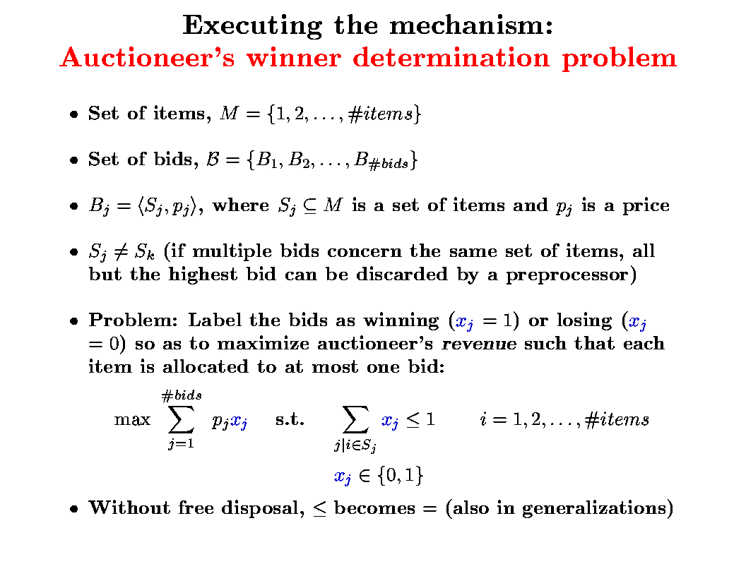

Slide 6
Space of allocations
Level
{1}{2}{3}{4}
(4)
{1},{2},{3,4}
{3},{4},{1,2}
{1},{3},{2,4}
{2},{4},{1,3}
{1},{4},{2,3}
{2},{3},{1,4}
(3)
{1},{2,3,4}
{1,2},{3,4}
{2},{1,3,4}
{1,3},{2,4}
{3},{1,2,4}
{1,4},{2,3}
{4},{1,2,3}
(2)
{1,2,3,4}
(1)
#partitions is ω(#items^{#items/2}), O(#items^{#items}) [Sandholm et al. AAAI-98, AIJ-99, Sandholm AIJ-02]
Another issue: auctioneer could keep items

Slide 7
Dynamic programming for winner determination
1
1,2
[Rothkopf et al. Mgmt Sci 98]
2
1,3
1,2,3
3
2,3
Uses Ω(2^{#items}), O(3^{#items}) operations independent of #bids
  (Can trivially exclude items that are not in any bid)
  Does not scale beyond 20-30 items

Slide 8
NP-completeness
NP-complete [Rothkopf et al Mgmt Sci 98]
  Weighted set packing [Karp 72]
[For an overview of worst-case complexity results of the winner determination problem, see review article by Lehmann, Mueller, and Sandholm in the textbook Combinatorial Auctions, MIT Press 2006
  available at www.cs.cmu.edu/~sandholm]

Slide 9
Polynomial time approximation algorithms with worst case guarantees
value of optimal allocation
k =
value of best allocation found
General case
Cannot be approximated to k = #bids^{1- ε} (unless probabilistic polytime = NP)
  Proven in [Sandholm IJCAI-99, AIJ-02]
  Reduction from MAXCLIQUE, which is inapproximable [Håstad96]
Best known approximation gives
k ∈ O(#bids / (log #bids)² ) [Haldorsson98]

Slide 10
Polynomial time approximation algorithms with worst case guarantees
Special cases
Let κ be the max #items in a bid: k= 2κ / 3 [Haldorsson SODA-98]
Bid can overlap with at most Δ other bids: k= min( ⎡(Δ+1) / 3⎤ , (Δ+2) / 3, Δ / 2 ) [Haldorsson&Lau97;Hochbaum83]
k= sqrt(#items) [Haldorsson99]
k= chromatic number / 2 [Hochbaum83]
  k=[1 + max_{H∈G} min_{v∈H} degree(v) ] / 2 [Hochbaum83]
  Planar: k=2 [Hochbaum83]
So far from optimum that irrelevant for auctions
Probabilistic algorithms?
New special cases, e.g. based on prices [Lehmann et al. 01, …]

Slide 11
Restricting the allowable combinations that can be bid on to get polytime winner determination [Rothkopf et al. Mgmt Sci 98]
1
2
6
3
5
|set| ≤ 2
or |set| > #items / c
4
1 2 3 4 5 6 7
O(n
c-1
#items
)
O(#items
)
3
2
large
or
NP-complete already
O(#items
)
3
if 3 items per bid are
allowed
Gives rise to the same economic inefficiencies that prevail in noncombinatorial auctions

Slide 12
Solving the winner determination problem when all combinations can be bid on:
Search algorithms for optimal anytime winner determination
Capitalize on sparsely populated space of bids
Generate only populated parts of space of allocations
Highly optimized
1st generation algorithm: branch-on-items formulation [Sandholm ICE-98, IJCAI-99, AIJ-02; Fujishima, Leyton-Brown & Shoham IJCAI-99]
2nd generation algorithm: branch-on-bids formulation [Sandholm&Suri AAAI-00, AIJ-03, Sandholm et al. IJCAI-01, MgmtSci-05]
New ideas, e.g., multivariate branching [Gilpin & Sandholm IJCAI-07, …]

Slide 13
First generation search algorithms: branch-on-items formulation
[Sandholm ICE-98, IJCAI-99, AIJ-02]
Bids:
1
2
1,2
1,3,5
1,4
1
3
4
5
3,5
3
2
2,5
2
2,5
2
1,2
1,3,5
1,4
4
4
4
3
3,5
3
3
3,5
3
2,5
3,5
5
5
4
4
4
Prop. Need only consider children that include item with smallest index among items not on the path
Insert dummy bid for price 0 for each single item that has no bids
=> allows bid combinations that do not cover all items (seller can keep some items)
Generates each allocation of positive value once, others not generated
Complexity
  Prop. #leaves ≤ (#bids/#items)^{#items}
  Proof. Let n_{i} be the number of bids that include item i but no items with smaller index. #leaves ≤ max n₁ ∙ n₂ ∙ … ∙ n_{m} s.t. n₁ + n₂ + …+ n_{m} = #bids. Max achieved at n_{i} = n/m. Depth at most m. QED
  #nodes ≤ #items #leaves
  IDA* is 2 orders of magnitude faster than depth first search
  Anytime algorithm
5

Slide 14
2nd generation algorithm: Combinatorial Auction, Branch On Bids
[Sandholm&Suri AAAI-00, AIJ-03]
Bids of this example
A={1,2}
B={2,3}
C={3}
D={1,3}
A
B
A
D
Bid graph
C
IN
OUT
C
B
B
C
D
C
IN
OUT
IN
OUT
C
D
C
Finds an optimal solution
Naïve analysis: 2^{#bids} leaves
Thrm. At most leaves
  where k is the minimum #items per bid
  provably polynomial in bids even in worst case!
IN
OUT
D
D
IN
OUT

Slide 15
Use of h-values (=upper bounds) to prune winner determination search
f* = value of best solution found so far
g = sum of prices of bids that are IN on path
h = value of LP relaxation of remaining problem
Upper bounding: Prune the path when g+h ≤ f*

Slide 16
Linear programming for computing h-values

Slide 17
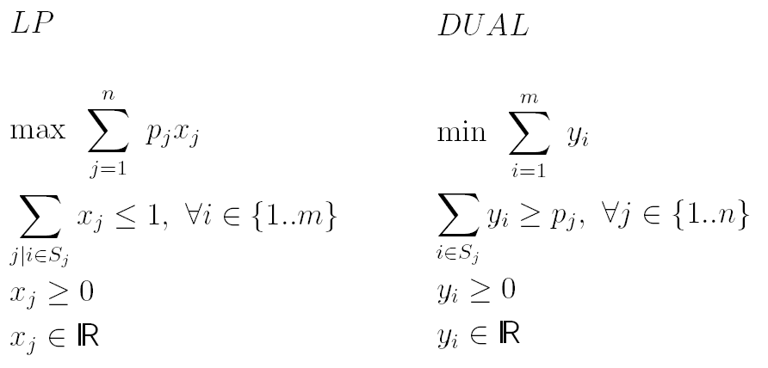
Linear program of the winner determination problem
aka shadow price

Slide 18
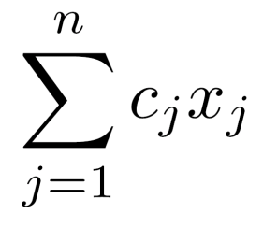
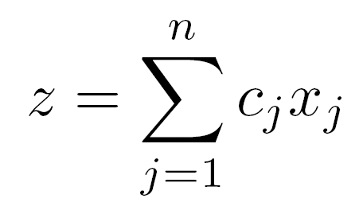
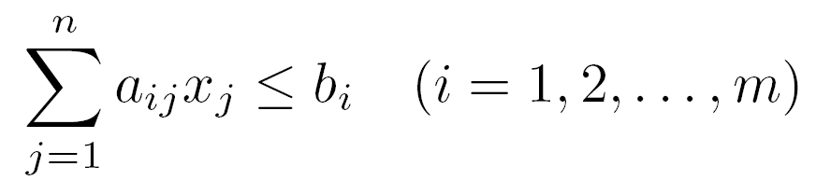
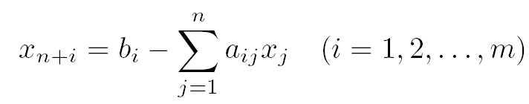
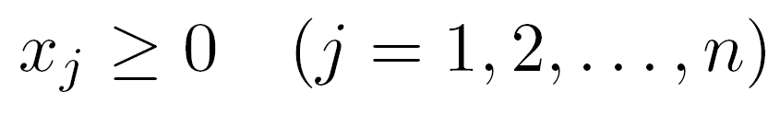
Linear programming
Original problem
maximize
such that
Initial tableau
Slack variables
Assume, for simplicity, that origin is feasible (otherwise have to run a different LP to find first feasible and run the main LP in a revised space)
Simplex method “pivots” variables in and out of the tableau
Basic variables are on the left hand side

Slide 19
Graphical interpretation of simplex algorithm for linear programming
Entering
variable x1
x₂
Departing
variable
Departing
variable is
slack variable
of the constraint
Constraints
c
Feasible region
Each pivot results
in a new tableau
Entering
variable x₂
x₁
If you haven’t seen the simplex algorithm, you can review the details, e.g., on wikipedia
Interior point methods are another family of algorithms for linear programming
  Polynomial worst-case time, unlike simplex algorithm
  Parallelizable
  Together with crossover, can be a good way to solve the root LP, but never used for other search tree nodes

Slide 20
Speeding up the use of linear programs in search
If LP returns a solution where all integer variables have integer values, then that is the solution to that node and no further search is needed below that node
Instead of simplex in the LP, use simplex in the DUAL because after branching, the previous DUAL solution is still feasible and a good starting point for simplex at the new node (see next slide)
  Thrm. LP optimum value = DUAL optimum value
aka shadow price

Slide 21
Interlude: primal LP and dual LP in general
Primal: Maximize c^{T}x subject to Ax ≤ b, x ≥ 0
Dual: Minimize b^{T}y subject to A^{T}y ≥ c, y ≥ 0
Facts:
  Dual of the dual is the primal
  At an optimum, the objective values of the primal and dual are the same
Back to the winner determination example…

Slide 22
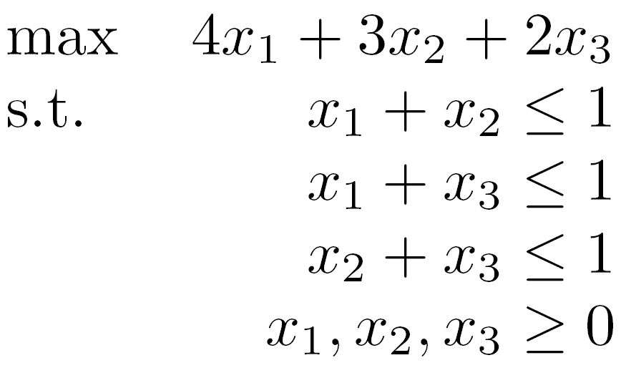
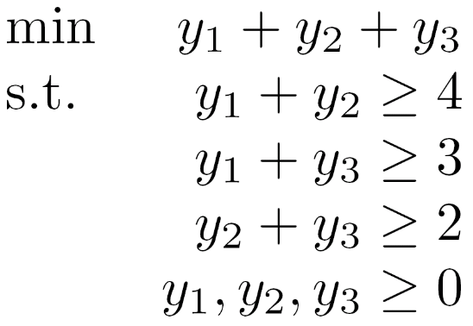
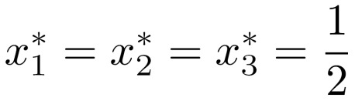
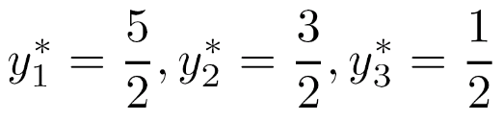


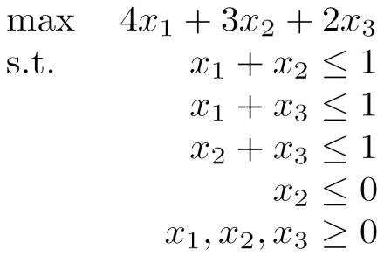
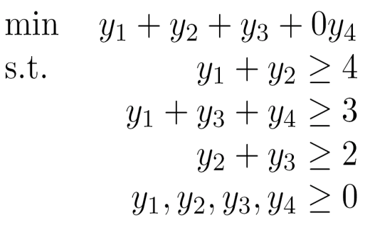
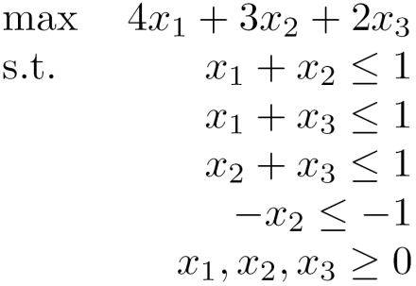
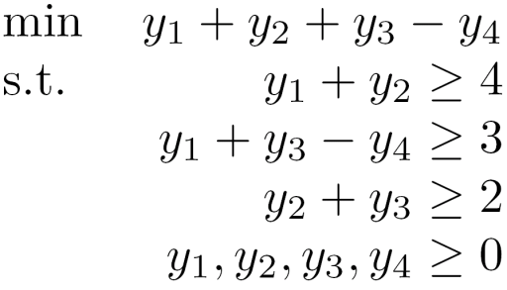
Example showing DUAL is feasible at children
Goods: {1,2,3}, Bids: <{1,2},$4>, <{1,3},$3>, <{2,3},$2>
LP
DUAL
LP
DUAL
LP
DUAL
Root solution is
no longer feasible
(x₂ > 0)
Root solution is
still feasible
(for any y₄)
Root solution is
no longer feasible
(x₂ < 1)
Root solution is
still feasible
(for y₄ = 0)

Slide 23
Branch-and-cut framework

Slide 24
Cutting planes (aka cuts)
Extra linear constraints can be added to the LP to reduce the LP polytope and thus give tighter bounds (less optimistic h-values) if the constraints are guaranteed to not exclude any integer solutions
Applications-specific vs. general-purpose cuts
Branch-and-cut algorithm = branch-and-bound algorithm that uses cuts
  A global cut is valid throughout the search tree
  A local cut is guaranteed to be valid only in the subtree below the node at which it was generated (and thus needs to be removed from consideration when not in that subtree)

Slide 25
Example of a cut that is valid for winner determination:
Odd hole inequality
E.g., 5-hole
x₈
x₃
x₂
No chord
x₁
x₆
Edge means that bids share items, so both bids cannot be accepted
x₁ + x₂ + x₃ + x₆ + x₈ ≤ 2
Notes:
If there is a chord, this cut is still valid, but it does not cut the LP polytope at all.

Slide 26
Separation using cuts
LP optimum
Valid cut that separates
Valid cut that does not separate
Invalid cut

Slide 27
How to find cuts that separate?
For some cut families (and/or some problems), there are polynomial-time algorithms for finding a separating cut
Otherwise, use:
  Generate a cut
    Generation preferably biased towards cuts that are likely to separate
  Test whether it separates

Slide 28
Gomory mixed integer cut
Most powerful general-purpose cut for many problems
Applicable to all problems, where
  constraints and objective are linear,
  the problem has integer variables and potentially also real variables
Cut is generated using the LP optimum so that the cut separates

Slide 29
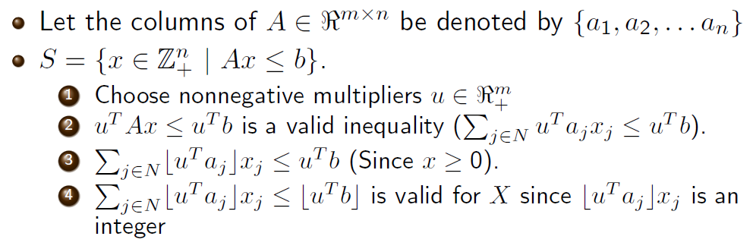
First, a simple version for problems with no real-valued variables
[The above presentation is from Jeff Linderoth’s slides]
Amazing tidbit (which we will not use)… Gomory’s cutting plane algorithm:
Integer program (not MIP) can be solved with no search by an algorithm that generates a finite number of these cuts. How many?
  A: Potentially exponentially many
In each iteration:
  Generate a cut (LP tableau guides which cut is generated)
  Include a new slack variable corresponding to that cut
  Optimize the new LP (e.g., using dual simplex algorithm)
Rules against cycling in LP solving are needed to guarantee optimality in a finite number of steps
  E.g., http://www.math.unl.edu/~shartke2/teaching/2008f432/Handout_Gomory.pdf
While this algorithm has been viewed as a mere curiosity, it has very recently shown promise on some practical problems (the choice of anti-cycling rule is key for speed in practice).

Slide 30
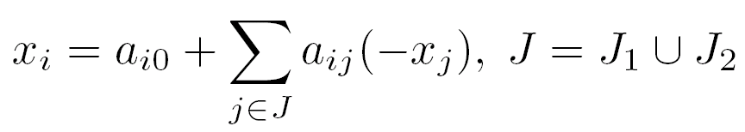

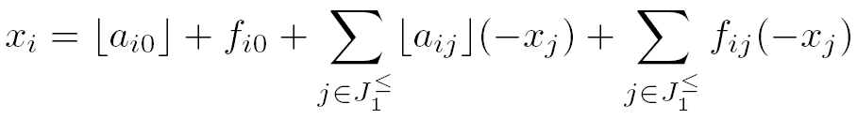
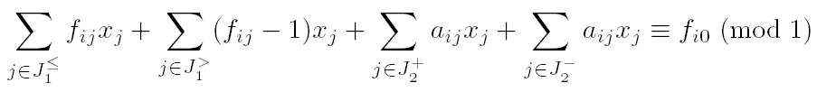
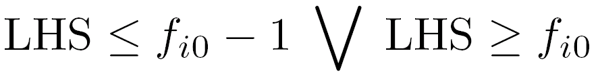
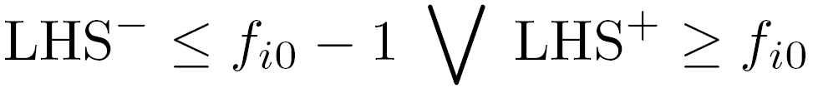
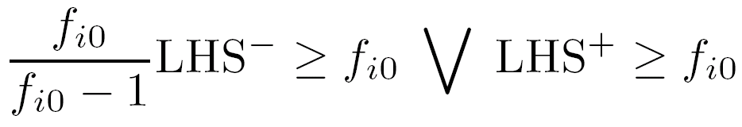
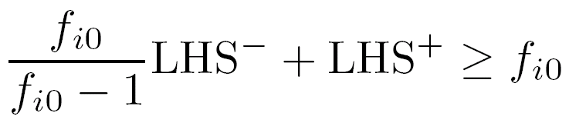

Derivation of Gomory mixed integer cut
Input: one row from optimal LP tableau:
Fractional, basic, not a slack, integer variable
Non-basic. Integer. Continuous.
Define:
Rewrite tableau row:
Idea: RHS above has to be integral.
All integer terms add up to integers, so:
LHS and RHS differ by an integer
Notes:
LHS is the left-hand side of the congruence, LHS- is the negative terms of LHS (going into each summation and separating positive and negative terms), and LHS+ is the positive terms of LHS.

Slide 31
Back to search for winner determination…

Slide 32
Formulation comparison
A branching decision
  in the branch-on-bids formulation locks in only one bid (and on the IN branch also its neighbors)
  in the branch-on-items formulation locks in all bids that include that item
The former follows the principle of least commitment
    More flexibility for further decision ordering (choice of which decision to branch on in light of the newest information)

Slide 33
Structural improvements to search algorithms for winner determination
Optimum reached faster & better anytime performance
Always branch on a bid j that maximizes e.g. p_{j} / |S_{j}|^{α} (presort)
Lower bounding: If g+L>f*, then f*←g+L
Identify decomposition of bid graph in O(|E|+|V|) time & exploit
  Pruning across subproblems (upper & lower bounding) by using f* values of solved subproblems and h values of yet unsolved ones
Forcing decomposition by branching on an articulation bid
  All articulation bids can be identified in O(|E|+|V|) time
  Could try to identify combinations of bids that articulate (cutsets)

Slide 34
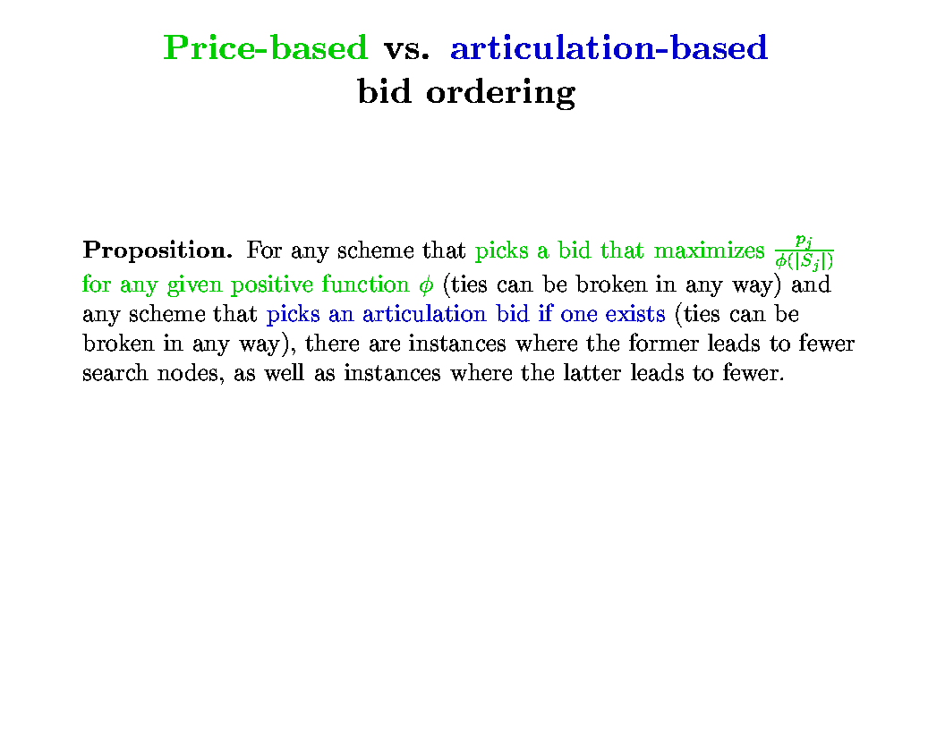

Slide 35
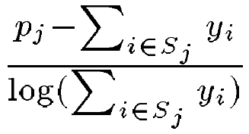
Question ordering heuristics
In depth-first branch-and-bound, it is sometimes best to branch on a question for which the algorithm knows a good answer with high likelihood
  Best (to date) heuristics for branching on bids [Sandholm et al. IJCAI-01, MgmtSci-05]:
    A: Branch on bid whose LP value is closest to 1
    B: Branch on bid with highest normalized shadow surplus:
  Choosing the heuristic dynamically based on remaining subproblem
    E.g. use A when LP table density > 0.25 and B otherwise
In A* search, it is usually best to branch on a question whose right answer the algorithm is very uncertain about
  Traditionally in OR, variable whose LP value is most fractional
  More general idea [Gilpin&Sandholm 03, IJCAI-07, Discrete Optimization 2010]: branch on a question that reduces the entropy of the LP solution the most
    Determine this e.g. based on lookahead
    Or, branch on an indicator variable that controls a set of variables with most LP entropy
    Applies to multivariate branching too

Slide 36
Branching on more general questions than individual variables
[Gilpin&Sandholm 03, IJCAI-07, Discrete Optimization 2010]
Branching question: “Of these k bids, are more than x winners?”
Never use a set of bids whose LP values sum to an integer
  And never include bids whose LP values are integers
Prop. Only one sensible cutoff of x
Prop. The search space size is the same regardless of which bids (and how many) are selected for branching
Usually yields smaller search trees than branching on individual bids only
More generally in MIP, one branch one can branch on hyperplanes: one branch is ∑_{iϵS} α _{i} x _{i} ≤ c₁ and the other branch is ∑_{iϵS} α _{i} x _{i} > c₂ for some S
  But how to decide on which hyperplane to branch?
  For more on this approach, see, e.g.,
  [Improved Strategies for Branching on General Disjunctions
  by Gerard Cornuejols, Leo Liberti and Giacomo Nannicini, 2008]

Slide 37
Other good branching rules
(for integer programs)
Strong branching (= 1-step lookahead)
  At a node, for each variable (from a set of promising candidate variable) in turn, pretend that you branch on that variable and solve the node’s childrens’ LPs
    Sometimes child LPs are not solved to optimality (cap on # of dual pivots) to save time
  Pick the variable to branch on that leads to tightest child LP bounds
    Sometimes better and worse child are weighted differently
      One can learn a good weighting [Balcan, Dick, Sandholm & Vitercik ICML-18]
Reliability branching
  Like strong branching, but once lookahead for a certain variable has been conducted at a large enough number of nodes, stop doing lookahead for that variable, and use average reduction in bound in past lookaheads for that variable as that variable’s goodness measure
These could be used when branching on hyperplanes too

Slide 38
Identifying & solving tractable cases at search nodes
(so that no search is needed below such nodes)
[Sandholm & Suri AAAI-00, AIJ-03; see also Sandholm et al. Management Science 2005]

Slide 39
Example 1: “Short” bids
[Sandholm & Suri AAAI-00, AIJ-03]
Never branch on short bids with 1 or 2 items
  At each search node, we solve short bids from bid graph separately
    O(#short bids ³) time at the node using maximal weighted matching
      [Edmonds 65; Rothkopf et al 98]
    NP-complete even if only 3 items per bid allowed
  Dynamically delete items included in only one bid
  as we go down a search path
Can also do both short and long bids in polytime
  So, the NP-hardness is driven by medium-sized bids

Slide 40
Example 2: Interval bids
At each search node, use a polynomial algorithm if remaining bid graph only contains interval bids
  Ordered list of items: 1..#items
  Each bid is for some interval [q, r] of these items
  [Rothkopf et al. 98] presented O(#items²) DP algorithm
  [Sandholm&Suri AAAI-00, AIJ-03] DP algorithm is O(#items + #bids)
    Bucket sort bids in ascending order of r
    opt(i) is the optimal solution using items 1..i
    opt(i) = max _{b in bids whose last item is i} {p_{b} + opt(q_{b}-1), opt(i-1)}
Identifying linear ordering
  Can be identified in O(|E|+|V|) time [Korte & Mohring SIAM-89]
Interval bids with wraparound can be identified in O(#bids²) time [Spinrad SODA-93] and solved in O(#items (#items + #bids)) time using our DP while DP of Rothkopf et al. is O(#items³)

Slide 41
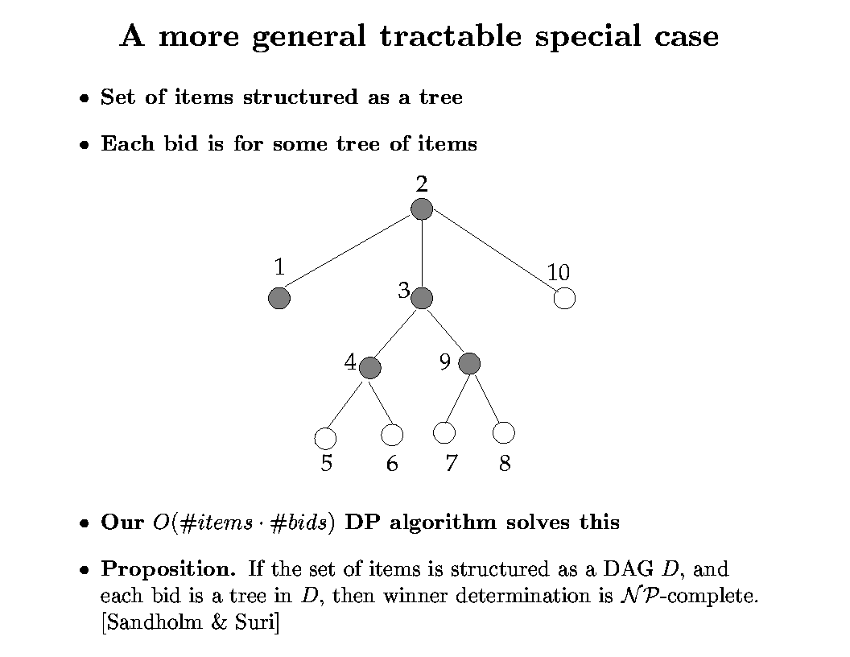
Example 3:
[Sandholm & Suri AAAI-00, AIJ-03]

Slide 42
Example 3...
Thrm. [Conitzer, Derryberry & Sandholm AAAI-04] An item tree that matches the remaining bids (if one exists) can be constructed in time O(|Bids| |#items that any one bid contains|² + |Items|²)
Algorithm:
  Make a graph with the items as vertices
  Each edge (i, j) gets weight #(bids with both i and j)
  Construct maximum spanning tree of this graph: O(|Items|²) time
  Thrm. The resulting tree will have the maximum possible weight #(occurrences of items in bids) - |Bids| iff it is a valid item tree
Complexity of constructing an item graph of treewidth 2 is unknown but it is NP-hard already for treewidth 3 [Gottlob & Greco EC-07] (but complexity of solving any such case given the item graph is “polynomial-time” - exponential only in the treewidth)

Slide 43
Example 4: Even more generality: Item graphs
[Conitzer, Derryberry, Sandholm AAAI-04]
Item graph = graph with the items as vertices where every bid is on a connected set of items
Example:
Caltrain ticket
Ticket to Alcatraz, San Francisco
Ticket to Children’s Museum, San Jose
Rental car
Bus ticket
Does not make sense to bid on items in SF and SJ without transportation
Does not make sense to bid on two forms of transportation

Slide 44
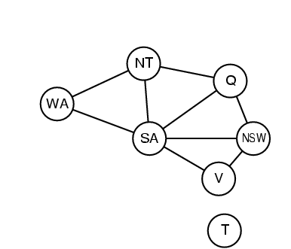
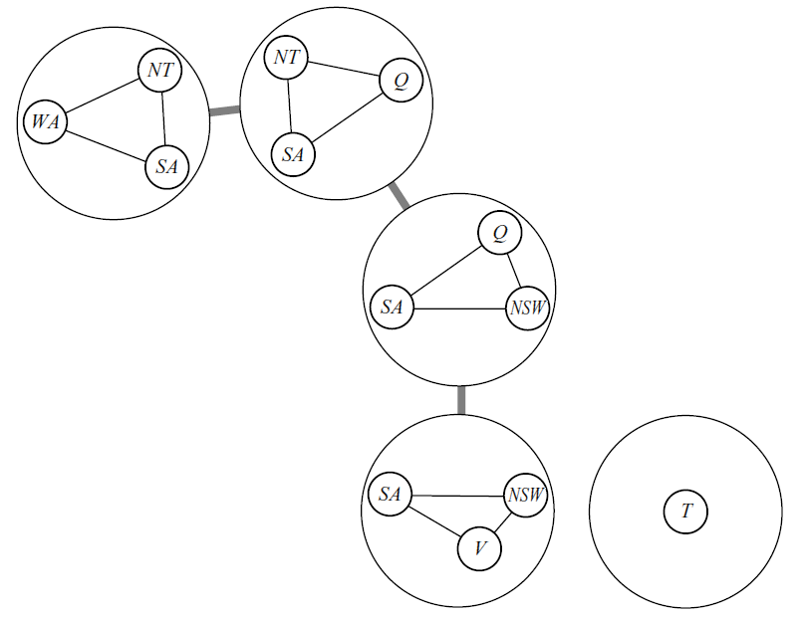
Clearing with item graphs: our old friend Tree Decomposition!
Tree decomposition of a graph G = a tree T with
  Subsets of G’s vertices as T’s vertices; for every G-vertex, set of T-vertices containing it must be a nonempty connected set in T
  Every neighboring pair of vertices in G occurs in some single vertex of T
Width of T = (max #G-vertices in single T-vertex)-1
Thrm. Given an item graph with tree decomposition T (width w), can clear optimally in time O(|T|² (|Bids|+1)^{w+1})
  Sketch: for every partial assignment of a T-vertex’s items to bids, compute maximum possible value below that vertex (using DP)

Slide 45
Application: combinatorial renting
There are multiple resources for rent
“item” = use of a resource for a particular time slot
t₁
t₂
t₃
t₄
resource 1
…
resource 2
invalid bid
resource 3
valid bid
Assume every bid demands items in a connected interval of time periods
Green edges give valid item graph
  width O(#resources)
  can also allow small time gaps in bids by drawing edges that skip small numbers of periods

Slide 46
Application: conditional awarding of items
Can also sell a type of security: you will receive the resource iff state s_{i} of the world materializes
  s_{i} are disjoint so that we never award resource twice
s₁
s₂
s₃
s₄
resource 1
…
resource 2
resource 3
States potentially have a linear order
  e.g. s₁ = “price of oil < $40,” s₂ = “$40 < price of oil < $50,” s₃ = “$50 < price of oil < $60,” …
If each bid demands items in connected set of states, then technically same as renting setting

Slide 47
Hardness of related questions
Constructing the item graph with the fewest edges is NP-complete
  Even when each bid is on at most 5 items, and an item graph of treewidth at most 2 is known to exist; regardless of whether we require the constructed tree to have treewidth 2.
What if a bid can include a few (say, k) connected sets rather than just one?
  Clearing is NP-complete even when the graph is a line and k = 2
  Deciding whether a line graph exists with k = 5 is NP-complete

Slide 48
Preprocessors [Sandholm IJCAI-99, AIJ-02]
Only keep highest bid for each combination that has received bids
Superset pruning
  E.g. ⟨{1,2,3,4}, $10⟩ is pruned by ⟨{1,3}, $7⟩ and ⟨{2,4}, $6⟩
  For each bid (prunee), use same search algorithm as main search, except restrict to bids that are subsets of prunee
  Terminate the search and prune the prunee if f* ≥ prunee’s price
  Only consider bids with ≤ 30 items as potential prunees
Tuple pruning
  E.g. ⟨{1,2}, $8⟩ and ⟨{3,4}, $3⟩ are not competitive together given ⟨{1,3}, $7⟩ and ⟨{2,4}, $6⟩
  Construct virtual prunee from pair of bids with disjoint item sets
  Use same pruning algorithm as superset pruning
  If pruned, insert an edge into bid graph between the bids
  O(#bids² cap #items)
  O(#bids³ cap #items) for pruning triples, etc.
    More complex checking required in main search

Slide 49
Generalization: substitutability
[Sandholm IJCAI-99, AIJ-02]
What if agent 1 bids
  $7 for {1,2}
  $4 for {1}
  $5 for {2} ?
Bids joined with XOR
  Allows bidders to express general preferences
  Groves-Clarke pricing mechanism can be applied to make truthful bidding a dominant strategy
  Worst case: Need to bid on all 2^{#items}-1 combinations
OR-of-XORs bids maintain full expressiveness & are more concise
  E.g. (B₂ XOR B₃) OR (B₁ XOR B₃ XOR B₄) OR ...
  Our algorithms apply (simply more edges in bid graph)
  Can also be encoded using “dummy items”
  Structure required for polytime special cases less frequent here
See also more natural and compact bidding languages
[Sandholm, T. 2013. Very-Large-Scale Generalized Combinatorial Multi-Attribute Auctions: Lessons from Conducting $60 Billion of Sourcing. Ch.16 in The Handbook of Market Design]

Slide 50
Incremental generation of the search problem as needed
Branch-and-price
  Column generation in the LP
Constraint generation

