Slide 1


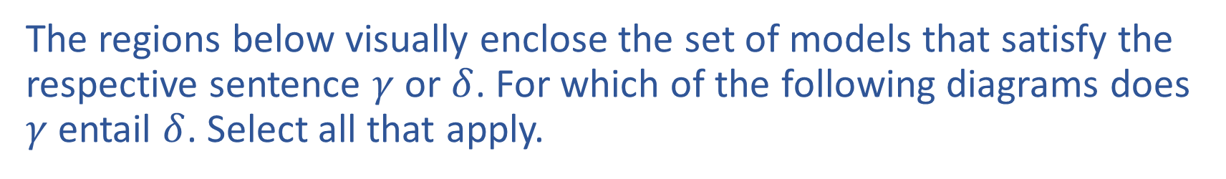









Warm-up:
The regions below visually enclose the set of models that satisfy the respective sentence $γ$ or $δ$. For which of the following diagrams does $γ$ entail $δ$. Select all that apply.
A)
B)
C)
$$γ$$
$$δ$$
$$γ$$
$$δ$$
$$γ$$
$$δ$$
D)
E)
$$γ$$
$$δ$$
$$δ$$
$$γ$$
Notes:
0=7, R=4, W=6, U=2, T=8, F=1; 867 + 867 = 1734

Slide 2
Announcements
Midterm 1 Exam
Grading should be finished tomorrow night
Then we’ll let you know as soon as Canvas reflects your current grade
Assignments:
P2: Optimization
    Due Thu 2/21, 10 pm
HW5
    Out later tonight

Slide 3

Announcements
Index card feedback
Thanks!
Piazza with some responses tonight
Alita Class Field Trip!
Saturday, 2/23, afternoon
Details will be posted on Piazza

Slide 4

AI: Representation and Problem Solving
Logical Agents
Instructors: Pat Virtue & Stephanie Rosenthal
Slide credits: CMU AI, http://ai.berkeley.edu

Slide 5
Piazza Poll 1
The regions below visually enclose the set of models that satisfy the respective sentence $γ$ or $δ$. For which of the following diagrams does $γ$ entail $δ$. Select all that apply.
A)
B)
C)
$$γ$$
$$δ$$
$$γ$$
$$δ$$
$$γ$$
$$δ$$
D)
E)
$$γ$$
$$δ$$
$$δ$$
$$γ$$
Notes:
0=7, R=4, W=6, U=2, T=8, F=1; 867 + 867 = 1734

Slide 6


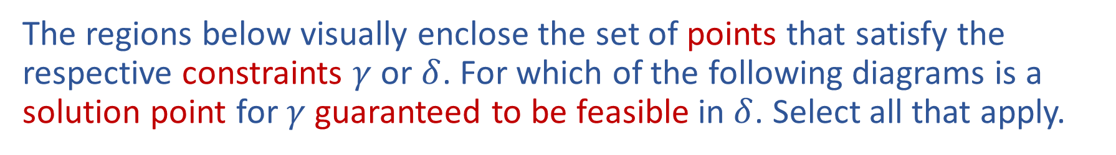









What about intersection feasible regions?
The regions below visually enclose the set of points that satisfy the respective constraints $γ$ or $δ$. For which of the following diagrams is a solution point for $γ$ guaranteed to be feasible in $δ$. Select all that apply.
A)
B)
C)
$$γ$$
$$γ$$
$$γ$$
$$δ$$
$$δ$$
$$δ$$
D)
E)
$$γ$$
$$δ$$
$$γ$$
$$δ$$
Notes:
0=7, R=4, W=6, U=2, T=8, F=1; 867 + 867 = 1734

Slide 7

Piazza Poll 1
The regions below visually enclose the set of models that satisfy the respective sentence $γ$ or $δ$. For which of the following diagrams does $γ$ entail $δ$. Select all that apply.
A)
B)
C)
$$γ$$
$$δ$$
$$γ$$
$$δ$$
$$γ$$
$$δ$$
D)
E)
$$γ$$
$$δ$$
$$δ$$
$$γ$$
Notes:
0=7, R=4, W=6, U=2, T=8, F=1; 867 + 867 = 1734

Slide 8
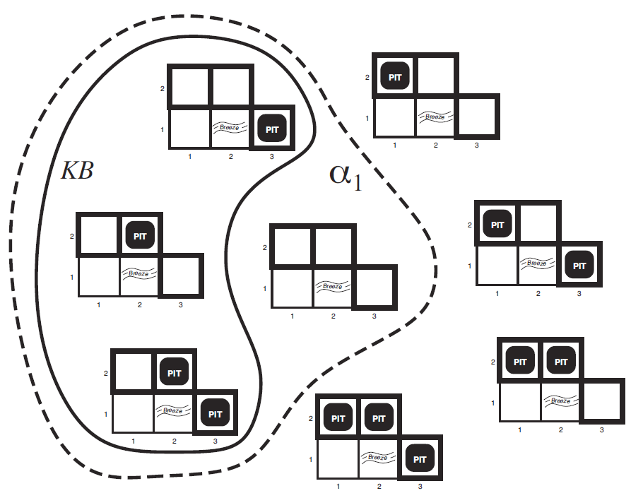
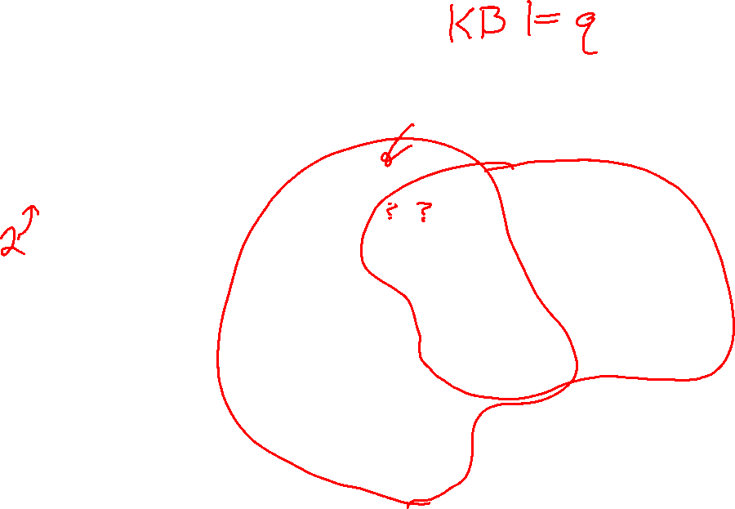
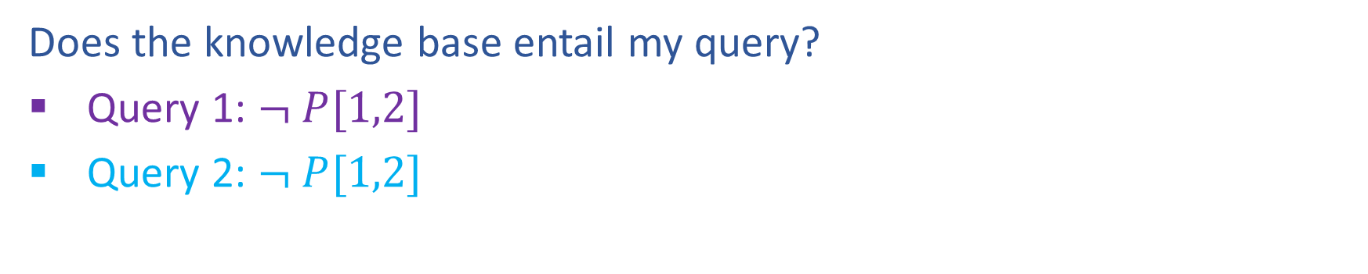

Entailment
Does the knowledge base entail my query?
Query 1: $¬ P[1,2]$
Query 2: $¬ P[1,2]$

Slide 9
Logical Agent Vocab
Model
  Complete assignment of symbols to True/False
Sentence
  Logical statement
  Composition of logic symbols and operators
KB
  Collection of sentences representing facts and rules we know about the world
Query
  Sentence we want to know if it is provably True, provably False, or unsure.

Slide 10

Logical Agent Vocab
Entailment
  Input: sentence1, sentence2
  Each model that satisfies sentence1 must also satisfy sentence2
  "If I know 1 holds, then I know 2 holds"
  (ASK), TT-ENTAILS, FC-ENTAILS
Satisfy
  Input: model, sentence
  Is this sentence true in this model?
  Does this model satisfy this sentence
  "Does this particular state of the world work?’
  PL-TRUE

Slide 11
Logical Agent Vocab
Satisfiable
  Input: sentence
  Can find at least one model that satisfies this sentence
      (We often want to know what that model is)
  "Is it possible to make this sentence true?"
  DPLL
Valid
  Input: sentence
  sentence is true in all possible models

Slide 12
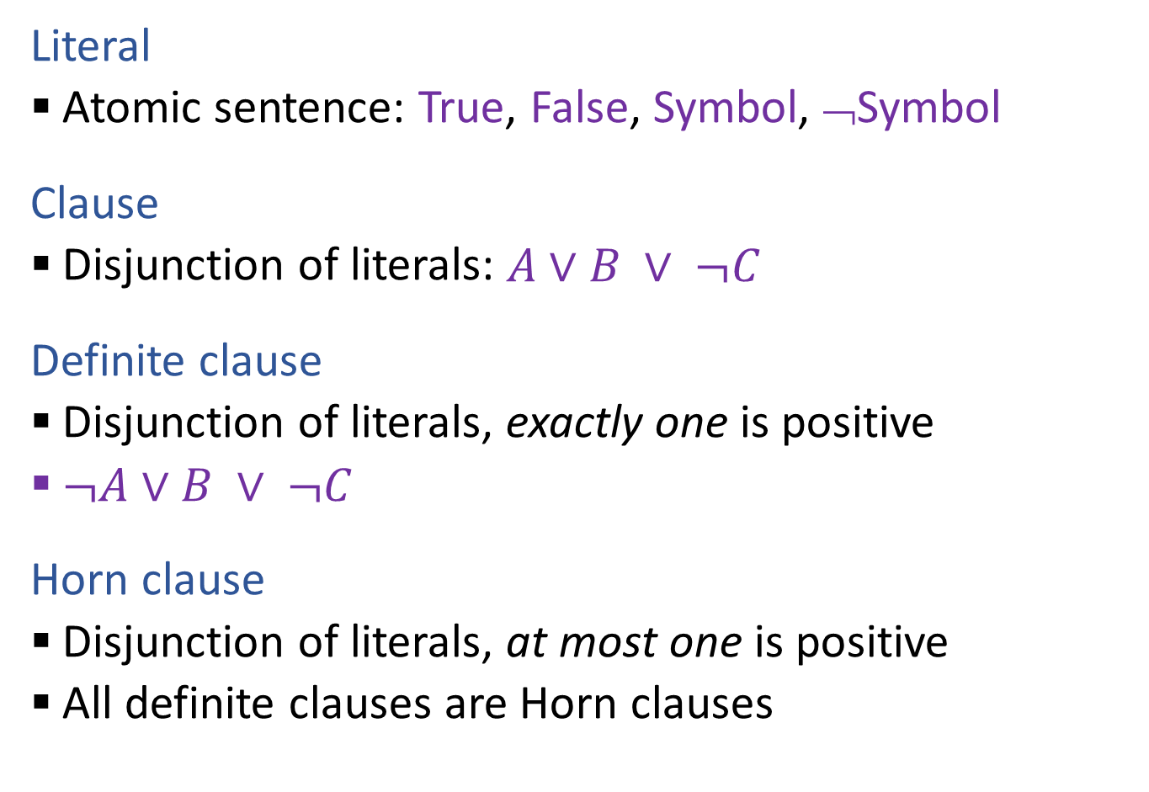

Propositional Logical Vocab
Literal
  Atomic sentence: True, False, Symbol, ¬Symbol
Clause
  Disjunction of literals: $A∨B ∨ ¬C$
Definite clause
  Disjunction of literals, exactly one is positive
  $¬A∨B ∨ ¬C$
Horn clause
  Disjunction of literals, at most one is positive
  All definite clauses are Horn clauses

Slide 13
Propositional Logic
Check if sentence is true in given model
In other words, does the model satisfy the sentence?
function PL-TRUE?(α,model) returns true or false
if α is a symbol then return Lookup(α, model)
if Op(α) = ¬ then return not(PL-TRUE?(Arg1(α),model))
if Op(α) = ∧ then return and(PL-TRUE?(Arg1(α),model),
PL-TRUE?(Arg2(α),model))
etc.
(Sometimes called “recursion over syntax”)

Slide 14
Simple Model Checking
function TT-ENTAILS?(KB, α) returns true or false

Slide 15
Simple Model Checking, contd.
Same recursion as backtracking
O(2^{n}) time, linear space
We can do much better!
P₁=true
P₁=false
P₂=true
P₂=false
P_{n}=true
P_{n}=false
KB?
α?
11111…1
0000…0

Slide 16
Piazza Poll 2
Which would you choose?
DFS
BFS
P₁=true
P₁=false
P₂=true
P₂=false
P_{n}=true
P_{n}=false
KB?
α?
11111…1
0000…0

Slide 17
Simple Model Checking
function TT-ENTAILS?(KB, α) returns true or false
return TT-CHECK-ALL(KB, α, symbols(KB) U symbols(α),{})
function TT-CHECK-ALL(KB, α, symbols,model) returns true or false
if empty?(symbols) then
if PL-TRUE?(KB, model) then return PL-TRUE?(α, model)
else return true
else
P ← first(symbols)
rest ← rest(symbols)
return and (TT-CHECK-ALL(KB, α, rest, model ∪ {P = true})
TT-CHECK-ALL(KB, α, rest, model ∪ {P = false }))

Slide 18
Inference: Proofs
A proof is a demonstration of entailment between α and β
Method 1: model-checking
  For every possible world, if α is true make sure that is β true too
  OK for propositional logic (finitely many worlds); not easy for first-order logic
Method 2: theorem-proving
  Search for a sequence of proof steps (applications of inference rules) leading from α to β
  E.g., from P ∧ (P ⇒ Q), infer Q by Modus Ponens
Properties
Sound algorithm: everything it claims to prove is in fact entailed
Complete algorithm: every sentence that is entailed can be proved

Slide 19
Simple Theorem Proving: Forward Chaining
Forward chaining applies Modus Ponens to generate new facts:
  Given X₁ ∧ X₂ ∧ … X_{n} ⇒ Y and X₁, X₂, …, X_{n}
  Infer Y
Forward chaining keeps applying this rule, adding new facts, until nothing more can be added
Requires KB to contain only definite clauses:
  (Conjunction of symbols) ⇒ symbol; or
  A single symbol (note that X is equivalent to True ⇒ X)

Slide 20

Forward Chaining Algorithm
function PL-FC-ENTAILS?(KB, q) returns true or false
count ← a table, where count[c] is the number of symbols in c’s premise
inferred ← a table, where inferred[s] is initially false for all s
agenda ← a queue of symbols, initially symbols known to be true in KB
Clauses
Count
Inferred
Agenda
P ⇒ Q
L ∧ M ⇒ P
B ∧ L ⇒ M
A ∧ P ⇒ L
A ∧ B ⇒ L
A
B
1
2
2
2
2
0
0
A false
B false
L false
M false
P false
Q false

Slide 21

Forward Chaining Example: Proving Q
Clauses
Count
Inferred
1
2
2
2
2
0
0
A false
B false
L false
M false
P false
Q false
P ⇒ Q
L ∧ M ⇒ P
B ∧ L ⇒ M
A ∧ P ⇒ L
A ∧ B ⇒ L
A
B
// 0
xxxx true
// 1
xxxx true
// 0
// 0
xxxx true
// 1
// 0
xxxx true
// 1
xxxx true
// 0
// 1
xxxx true
Agenda
x
x
Q
x
L
x
x
x
M
P
A B
x
L

Slide 22

Forward Chaining Algorithm
function PL-FC-ENTAILS?(KB, q) returns true or false
count ← a table, where count[c] is the number of symbols in c’s premise
inferred ← a table, where inferred[s] is initially false for all s
agenda ← a queue of symbols, initially symbols known to be true in KB
while agenda is not empty do
p ← Pop(agenda)
if p = q then return true
if inferred[p] = false then
inferred[p]←true
for each clause c in KB where p is in c.premise do
decrement count[c]
if count[c] = 0 then add c.conclusion to agenda
return false

Slide 23
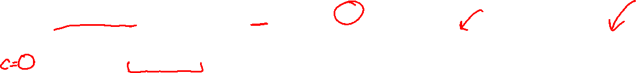
Properties of forward chaining
Theorem: FC is sound and complete for definite-clause KBs
Soundness: follows from soundness of Modus Ponens (easy to check)
Completeness proof:
1. FC reaches a fixed point where no new atomic sentences are derived
2. Consider the final inferred table as a model m, assigning true/false to symbols
3. Every clause in the original KB is true in m
Proof: Suppose a clause a₁∧... ∧a_{k} ⇒ b is false in m
Then a₁∧... ∧a_{k} is true in m and b is false in m
Therefore the algorithm has not reached a fixed point!
4. Hence m is a model of KB
5. If KB |= q, q is true in every model of KB, including m
A false
B false
L false
M false
P false
Q false
xxxx true
xxxx true
xxxx true
xxxx true
xxxx true
xxxx true

Slide 24
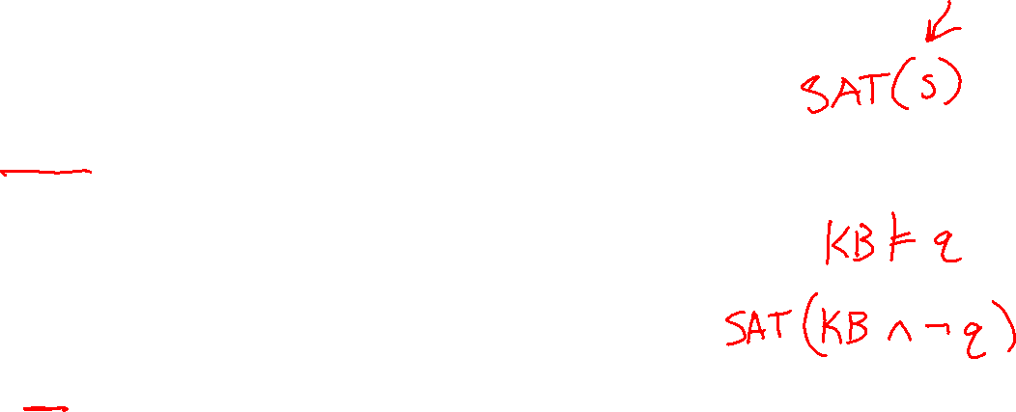
Satisfiability and Entailment
A sentence is satisfiable if it is true in at least one world (CSPs!)
Suppose we have a hyper-efficient SAT solver; how can we use it to test entailment?
  Suppose α |= β
  Then α ⇒ β is true in all worlds
  Hence ¬(α ⇒ β) is false in all worlds
  Hence α ∧ ¬β is false in all worlds, i.e., unsatisfiable
So, add the negated conclusion to what you know, test for (un)satisfiability; also known as reductio ad absurdum
Efficient SAT solvers operate on conjunctive normal form

Slide 25

Conjunctive Normal Form (CNF)
Replace biconditional by two implications
Every sentence can be expressed as a conjunction of clauses
Each clause is a disjunction of literals
Each literal is a symbol or a negated symbol
Conversion to CNF by a sequence of standard transformations:
  At_1,1_0 ⇒ (Wall_0,1 ⇔ Blocked_W_0)
  At_1,1_0 ⇒ ((Wall_0,1 ⇒ Blocked_W_0) ∧ (Blocked_W_0 ⇒Wall_0,1))
  ¬At_1,1_0 v ((¬Wall_0,1 v Blocked_W_0) ∧ (¬Blocked_W_0 v Wall_0,1))
  (¬At_1,1_0 v ¬Wall_0,1 v Blocked_W_0) ∧ (¬At_1,1_0 v ¬Blocked_W_0 v Wall_0,1)
Replace α ⇒ β by ¬α v β
Distribute v over ∧

Slide 26
Efficient SAT solvers
DPLL (Davis-Putnam-Logemann-Loveland) is the core of modern solvers
Essentially a backtracking search over models with some extras:
  Early termination: stop if
    all clauses are satisfied; e.g., (A ∨ B) ∧ (A ∨ ¬C) is satisfied by {A=true}
    any clause is falsified; e.g., (A ∨ B) ∧ (A ∨ ¬C) is satisfied by {A=false, B=false}
  Pure literals: if all occurrences of a symbol in as-yet-unsatisfied clauses have the same sign, then give the symbol that value
    E.g., A is pure and positive in (A ∨ B) ∧ (A ∨ ¬C) ∧ (C ∨ ¬B) so set it to true
  Unit clauses: if a clause is left with a single literal, set symbol to satisfy clause
    E.g., if A=false, (A ∨ B) ∧ (A ∨ ¬C) becomes (false ∨ B) ∧ (false ∨ ¬C), i.e. (B) ∧ (¬C)
    Satisfying the unit clauses often leads to further propagation, new unit clauses, etc.

Slide 27

DPLL algorithm
function DPLL(clauses, symbols, model) returns true or false
if every clause in clauses is true in model then return true
if some clause in clauses is false in model then return false
P, value ←FIND-PURE-SYMBOL(symbols, clauses, model)
if P is non-null then return DPLL(clauses, symbols–P, model∪{P=value})
P, value ←FIND-UNIT-CLAUSE(clauses, model)
if P is non-null then return DPLL(clauses, symbols–P, model∪{P=value})
P ← First(symbols)
rest ← Rest(symbols)
return or(DPLL(clauses, rest, model∪{P=true}),
DPLL(clauses, rest, model∪{P=false}))

Slide 28
Planning as Satisfiability
Given a hyper-efficient SAT solver, can we use it to make plans?
Yes, for fully observable, deterministic case: planning problem is solvable iff there is some satisfying assignment for actions etc.

Slide 29
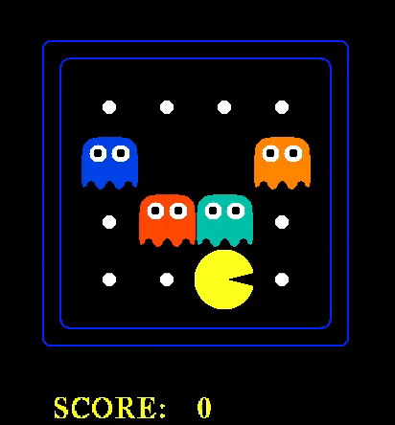

Slide 30
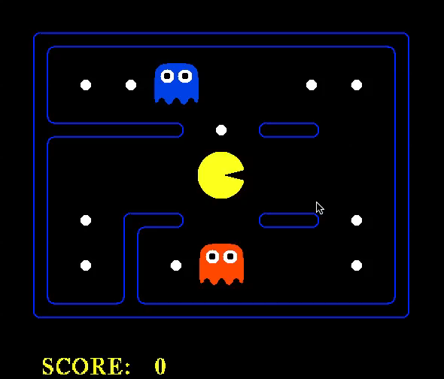

Slide 31
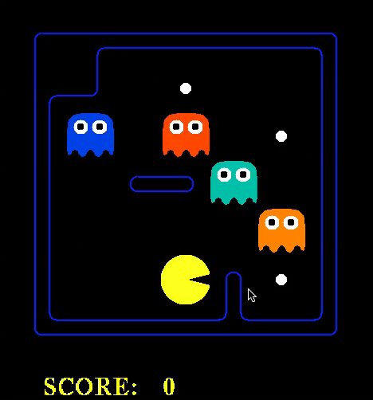

Slide 32
Planning as Satisfiability
Given a hyper-efficient SAT solver, can we use it to make plans?
Yes, for fully observable, deterministic case: planning problem is solvable iff there is some satisfying assignment for actions etc.
For T = 1 to infinity, set up the KB as follows and run SAT solver:
  Initial state, domain constraints
  Transition model sentences up to time T
  Goal is true at time T
  Precondition axioms: At_1,1_0 ∧ N_0 ⇒ ¬Wall_1,2 etc.
  Action exclusion axioms: ¬(N_0 ∧ W_0) ∧ ¬(N_0 ∧ S_0) ∧ .. etc.

Slide 33
Initial State
The agent may know its initial location:
  At_1,1_0
Or, it may not:
  At_1,1_0 v At_1,2_0 v At_1,3_0 v … v At_3,3_0
We also need a domain constraint – cannot be in two places at once!
  ¬(At_1,1_0 ∧ At_1,2_0) ∧ ¬(At_1,1_0 ∧ At_1,3_0) ∧ …
  ¬(At_1,1_1 ∧ At_1,2_1) ∧ ¬(At_1,1_1 ∧ At_1,3_1) ∧ …
  …

Slide 34

Transition Model
How does each state variable or fluent at each time gets its value?
State variables for PL Pacman are At_x,y_t , e.g., At_3,3_17
A state variable gets its value according to a successor-state axiom
  X_{t} ⇔ [X_{t-1} ∧ ¬(some action_{t-1} made it false)] v
  [¬X_{t-1} ∧ (some action_{t-1} made it true)]
For Pacman location:
  At_3,3_17 ⇔ [At_3,3_16 ∧ ¬((¬Wall_3,4 ∧ N_16) v (¬Wall_4,3 ∧ E_16) v …)]
  v [¬At_3,3_16 ∧ ((At_3,2_16 ∧ ¬Wall_3,3 ∧ N_16) v
  (At_2,3_16 ∧ ¬Wall_3,3 ∧ N_16) v …)]

