Slide 1
Announcements
Assignments
P5
    Due Thur, 5/2
Final Exam
Thur, May 9, 1-4 pm, GHC 4401
See Piazza for details
Recitation → Review session, Fri, 3-4:20 pm, GHC 4401
Practice exam out Fri after review session
Office hours

Slide 2

AI: Representation and Problem Solving
Human-Compatible AI
Instructors: Pat Virtue & Stephanie Rosenthal
Slide credits: CMU AI and http://ai.berkeley.edu

Slide 3
Intelligent Agents
From first lecture
  Candy Grab
  11 pieces on the table
  Take turns taking either 1 or 2 pieces
  Person that takes the last piece wins!
class Agent
function getAction(state)
return action

Slide 4
Three “Intelligent” Agents
Piazza Poll 1
Which agent code is the most “intelligent”?

Slide 5

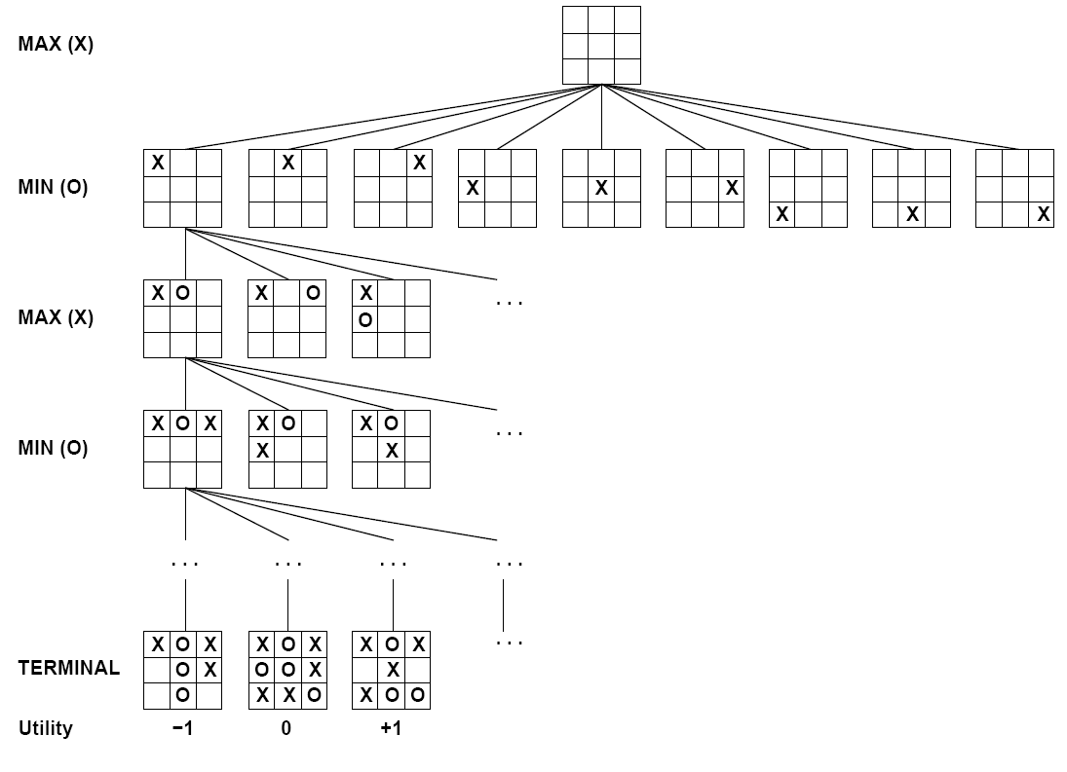

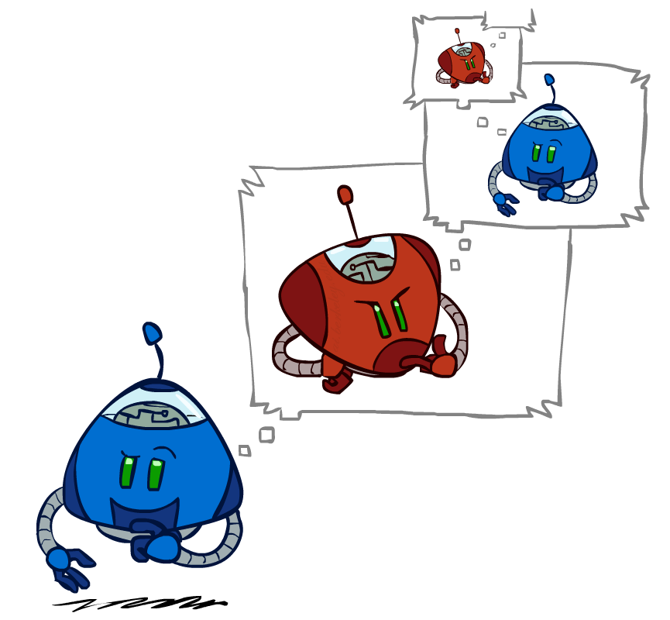
Games – Three “Intelligent” Agents
A: Search

Slide 6
Games – Three “Intelligent” Agents
B: Encode the pattern
10's value:Win
9's value:Lose
8's value:Win
7's value:Win
6's value:Lose
5's value:Win
4's value:Win
3's value:Lose
2's value:Win
1's value:Win
0's value:Lose
function getAction( numPiecesAvailable )
if numPiecesAvailable % 3 == 2
return 2
else
return 1

Slide 7
Games – Three “Intelligent” Agents
C: Record statistics of winning positions
Pieces Available | Take 1 | Take 2
2
3
4
5
6
7
Pieces Available | Take 1 | Take 2
2 |  | 100%
3
4 | 100%
5
6
7 |  | 100%
Pieces Available | Take 1 | Take 2
2 |  | 100%
3 | 0%
4 | 100%
5
6
7 |  | 50%
Pieces Available | Take 1 | Take 2
2 | 0% | 100%
3 | 2% | 0%
4 | 75% | 2%
5 | 4% | 68%
6 | 5% | 6%
7 | 60% | 5%

Slide 8
Piazza Poll 1
Three “Intelligent” Agents
Which agent code is the most “intelligent”?
Search
Encode multiple of 3 pattern
Keep stats on winning positions

Slide 9
Piazza Poll 2
Which 381 technique is the most intelligent?
Search
Logical inference
Numeric optimization
Q-learning
Approximate Q-learning
Exact inference Bayes nets
Approximate inference Bayes nets

Slide 10
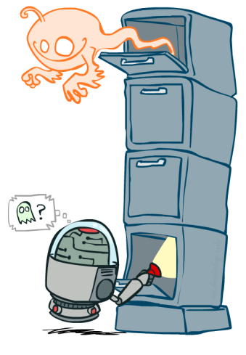

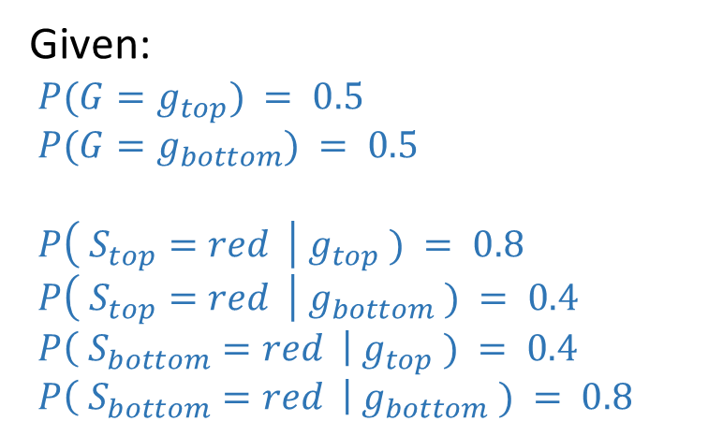
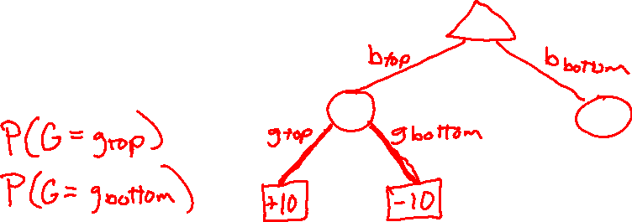
Value of Information
0.50
Ghostbusters
Given:
$P(G=g_{top}) = 0.5$
$P(G=g_{bottom}) = 0.5$
$P\left( S_{top}=red \right| g_{top} ) = 0.8$
$P\left( S_{top}=red \right| g_{bottom} ) = 0.4$
$P\left( S_{bottom}=red \right| g_{top} ) = 0.4$
$P\left( S_{bottom}=red \right| g_{bottom} ) = 0.8$
0.50

Slide 11
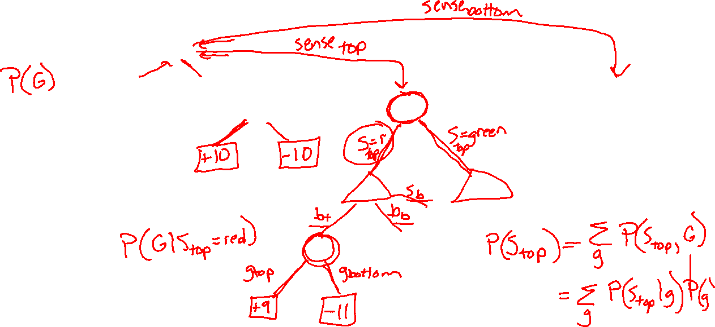
Value of Information

Slide 12

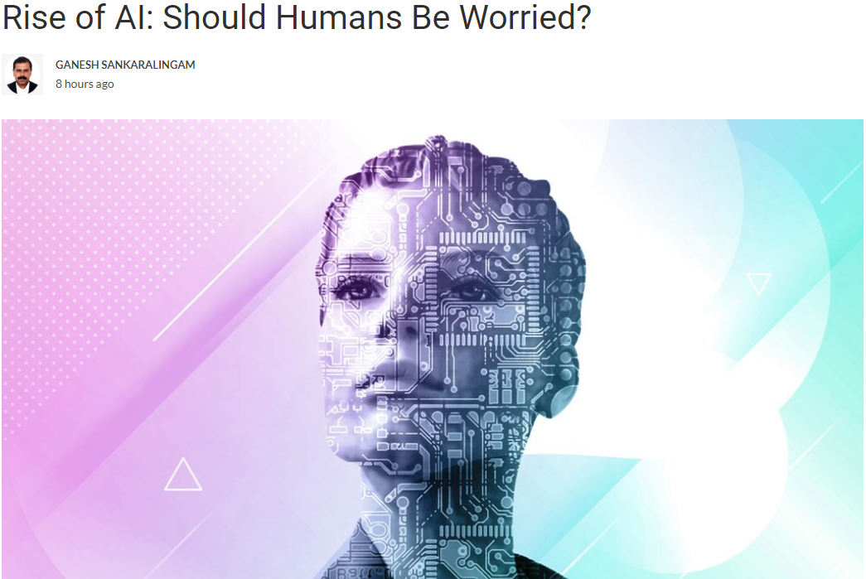
AI in the News
https://martechseries.com/mts-insights/guest-authors/rise-ai-humans-worried/

Slide 13
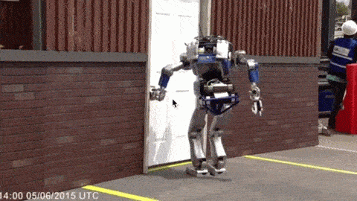
Should We Worry about Today’s A.I.?

Slide 14
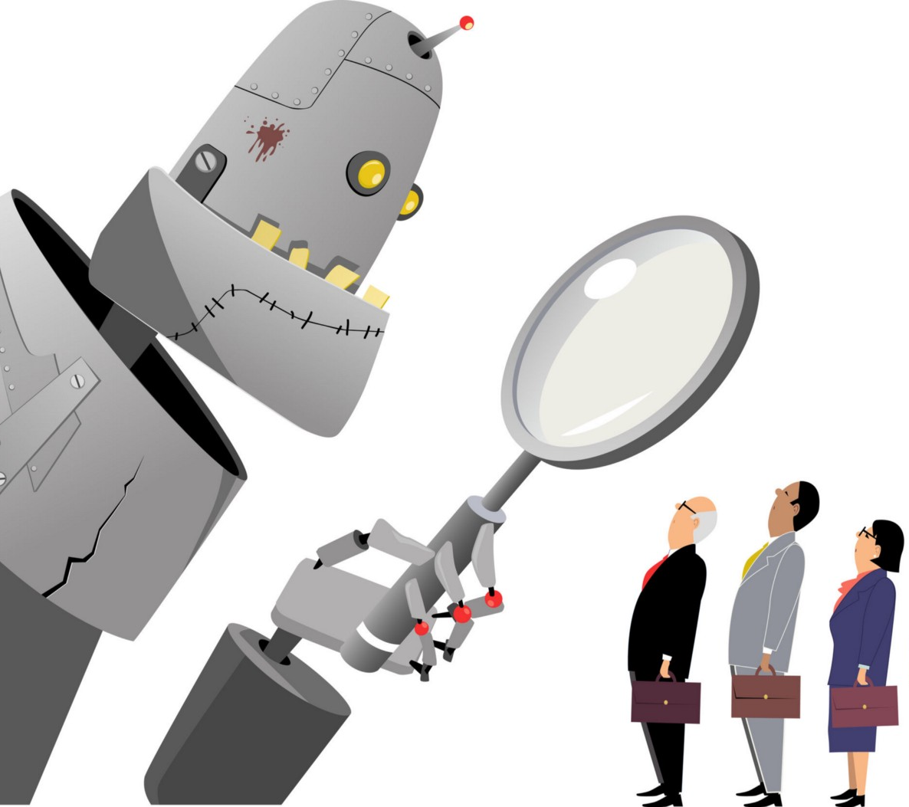
Should We Worry about Today’s A.I.?
Bias
Images:
https://medium.com/@turalt/ai-isnt-biased-we-are-b74ec94d1698

Slide 15

AI Bias
Alexandra Chouldechova
CMU, Statistics and Public Policy
http://www.contrib.andrew.cmu.edu/~achoulde/
https://fatconference.org/

Slide 16
Should We Worry about Today’s A.I.?
Bias
Weapons
Images:
https://medium.com/@turalt/ai-isnt-biased-we-are-b74ec94d1698
http://futureoflife.org/2016/09/20/podcast-what-is-nuclear-risk/

Slide 17
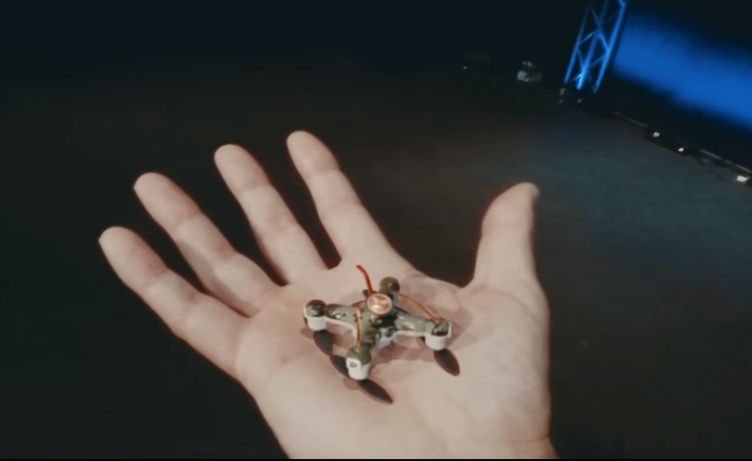
AI Weapons
https://fatconference.org/

Slide 18
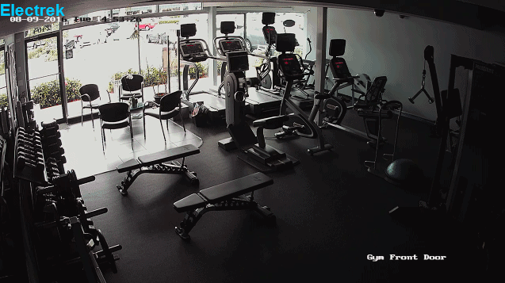
Should We Worry about Today’s A.I.?
Bias
Weapons
Liability
Images:
https://medium.com/@turalt/ai-isnt-biased-we-are-b74ec94d1698
http://futureoflife.org/2016/09/20/podcast-what-is-nuclear-risk/
https://electrek.co/2016/09/25/tesla-model-s-crashes-into-gym-driver-claims-autonomous-acceleration-tesla-says-drivers-fault/
http://ot.to/

Slide 19
Piazza Poll 3
AI Explainability
Which of the following techniques have explainable results?
(SELECT ALL THAT APPLY)
Search
Logical inference
Numeric optimization
Q-learning
Approximate Q-learning
Exact inference Bayes nets
Approximate inference Bayes nets
Deep learning

Slide 20
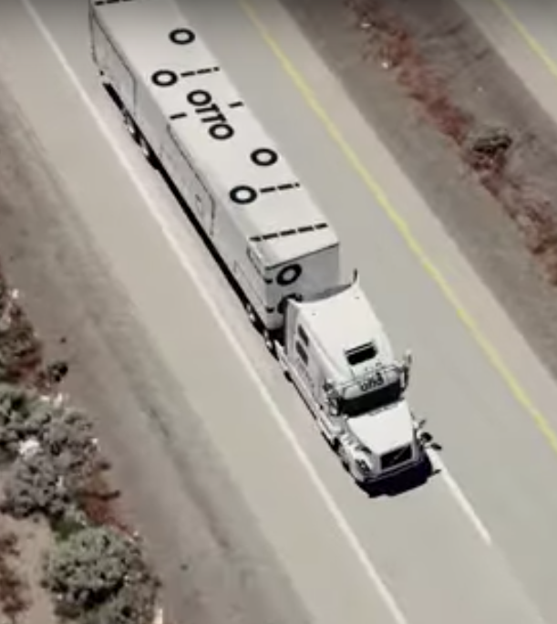
Should We Worry about Today’s A.I.?
Bias
Weapons
Liability
Jobs
Images:
https://medium.com/@turalt/ai-isnt-biased-we-are-b74ec94d1698
http://futureoflife.org/2016/09/20/podcast-what-is-nuclear-risk/
https://electrek.co/2016/09/25/tesla-model-s-crashes-into-gym-driver-claims-autonomous-acceleration-tesla-says-drivers-fault/
http://ot.to/

Slide 21
Piazza Poll 4
Is it ok if autonomous vehicles completely replace human drivers?

Slide 22
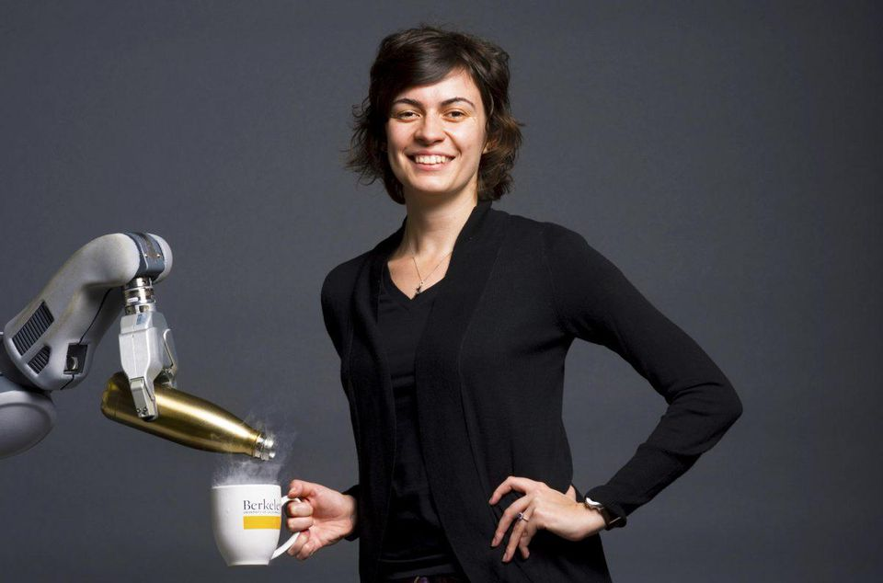
AI Challenge: Humans
Handing humans a drink
Anca Dragan
UC Berkeley, EECS
CMU PhD

Slide 23
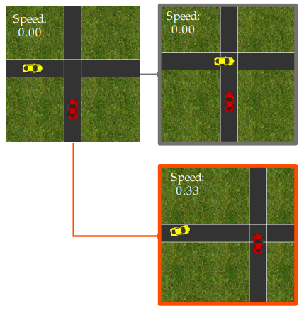
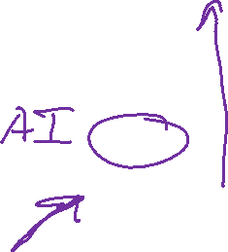
AI Challenge: Humans
Driving with humans
Dorsa Sadigh
Stanford, CS
https://stanford-iliad.github.io/pdfs/publications/sadigh2016planning.pdf

Slide 24
Piazza Poll 5
Once autonomous vehicles are readily available, should it be illegal for humans to drive?

Slide 25
Narrow A.I.
Images:
https://medium.com/@turalt/ai-isnt-biased-we-are-b74ec94d1698
http://futureoflife.org/2016/09/20/podcast-what-is-nuclear-risk/
https://electrek.co/2016/09/25/tesla-model-s-crashes-into-gym-driver-claims-autonomous-acceleration-tesla-says-drivers-fault/
http://ot.to/

Slide 26


AI in the News
Nov. 5, 2017
https://mobile.nytimes.com/2017/11/05/technology/machine-learning-artificial-intelligence-ai.html

Slide 27
Should we worry about future A.I.?
Singularity
Weak AI
Strong AI
Narrow AI
Limited number of applications
Artificial General Intelligence (AGI)
Recursive self-improvement
Beyond human control

Slide 28

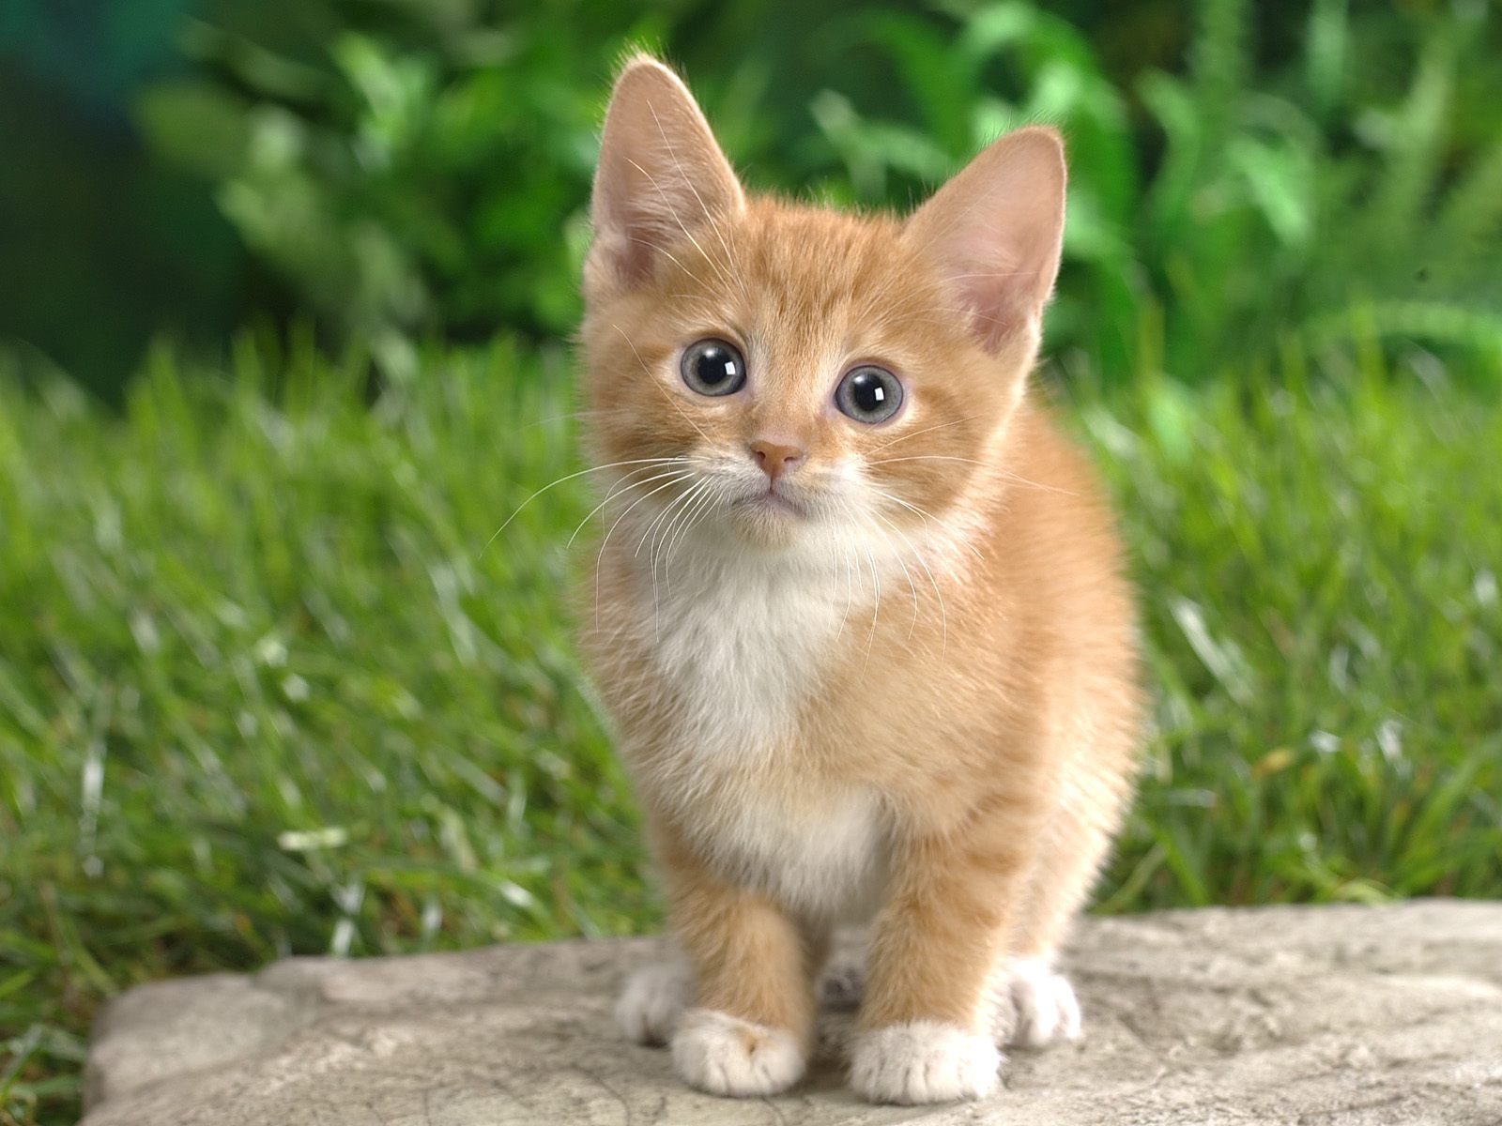
Should we worry about future A.I.?
What motivates agents?
Candy grab
  Ana: “taking 2 makes it 8”
  Bob: “taking 1 makes it 7”
  Ana: “taking 2 makes it 5”
  Bob: “taking 2 makes it 3”
  Ana: “taking 1 makes it 2”
  Bob: “taking 2 makes it 0”
    I WIN!
CAT

Slide 29
Should we worry about future A.I.?
Question: What is the specific motivation behind these techniques?
Search
Logical inference
Linear programming
RL
Inference Bayes nets

Slide 30
Should we worry about future A.I.?
Question: What motivation could cause problems?

Slide 31
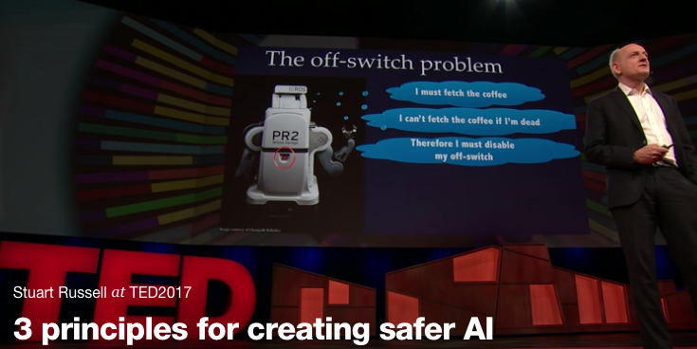
Should we worry about future A.I.?
Stuart Russell, UC Berkeley Center for Human-Compatible AI
https://www.ted.com/talks/stuart_russell_how_ai_might_make_us_better_people

Slide 32
Three simple ideas
1. The robot’s only objective is to maximize the realization of human values
2. The robot is initially uncertain about what those values are
3. The best source of information about human values is human behavior
Slides: Stuart Russell, IJCAI 2017

Slide 33
AIMA 1,2,3: objective given to machine
Human objective
Human behaviour
Machine behaviour
Slides: Stuart Russell, IJCAI 2017

Slide 34
AIMA 4: objective is a latent variable
Human objective
Human behaviour
Machine behaviour
Slides: Stuart Russell, IJCAI 2017

Slide 35
The off-switch problem
A robot, given an objective, has an incentive to disable its own off-switch
  (You can’t fetch the coffee if you’re dead)
How can we prevent this?
Answer: robot must allow for uncertainty about the true human objective
  The human will only switch off the robot if that leads to better outcomes for the true human objective
  Theorem: it’s in the robot’s interest to allow it
  Theorem: Such a robot is provably beneficial
Slides: Stuart Russell, IJCAI 2017

Slide 36
Off-switch model
R
a
s
w(a)
U = U_{a}
H
U = 0
¬ s
s
R
U = 0
a
U = U_{a}
w(a) preferred to a or s
Slides: Stuart Russell, IJCAI 2017

Slide 37
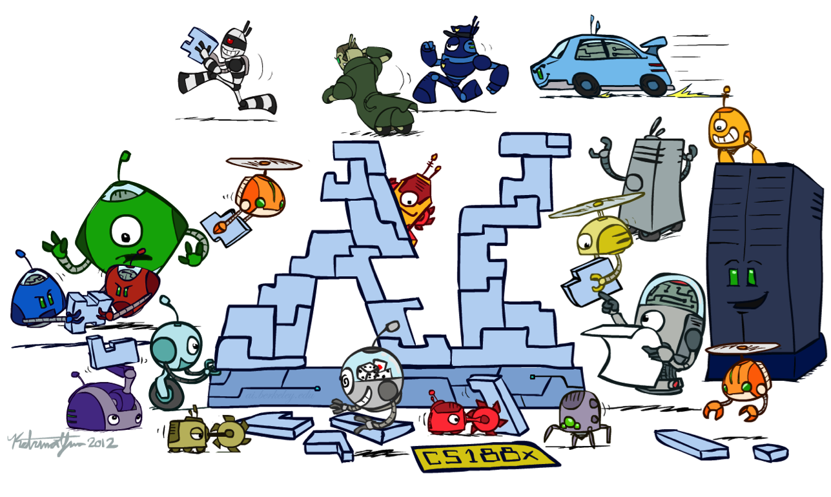
Conclusion

Slide 38




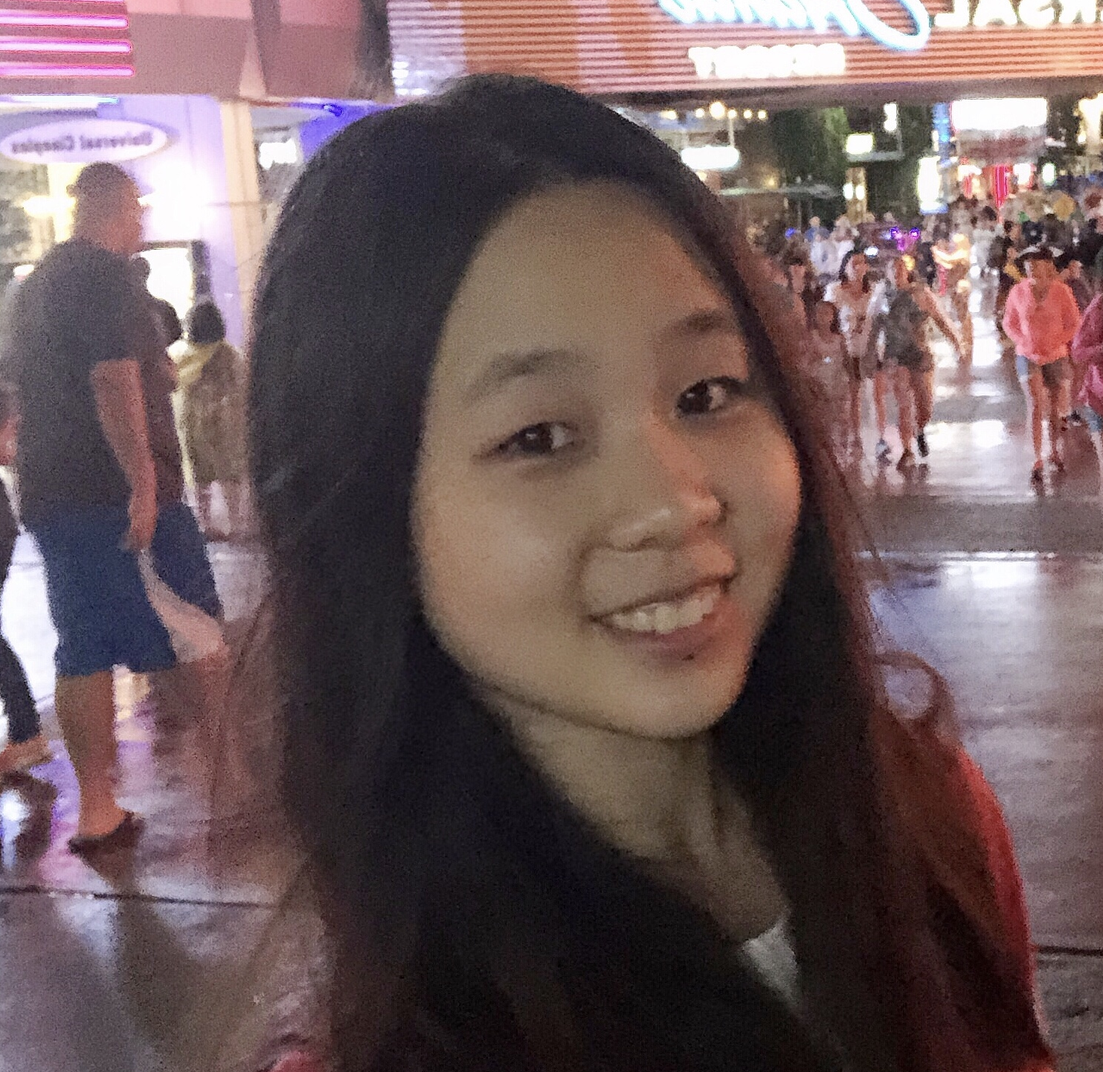



Thanks to Our Course Staff!!
Teaching Assistants
Ajay Kumar
Claire Wang
Ethan Gruman
Lubhaan Kumar
Michelle Ma
Pallavi Koppol
Sean Pereira
Tina Wu

