Slide 1
Candy Grab Game
As you walk in:
Grab a pack of game pieces (candy)
Form groups of 2 (or 3 with an observer)
Play the game!
  11 pieces on the table
  Take turns taking either 1 or 2 pieces
  Person that takes the last piece wins!
Think about how you might implement an Agent to play this in code:
class Agent
function getAction(state)
return action

Slide 2
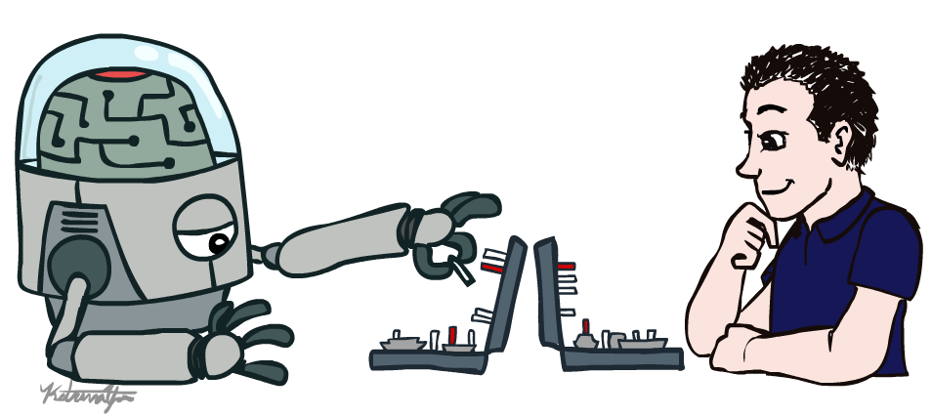
AI: Representation and Problem Solving
Introduction
Instructors: Pat Virtue & Stephanie Rosenthal
Slide credits: Pat Virtue, http://ai.berkeley.edu

Slide 3






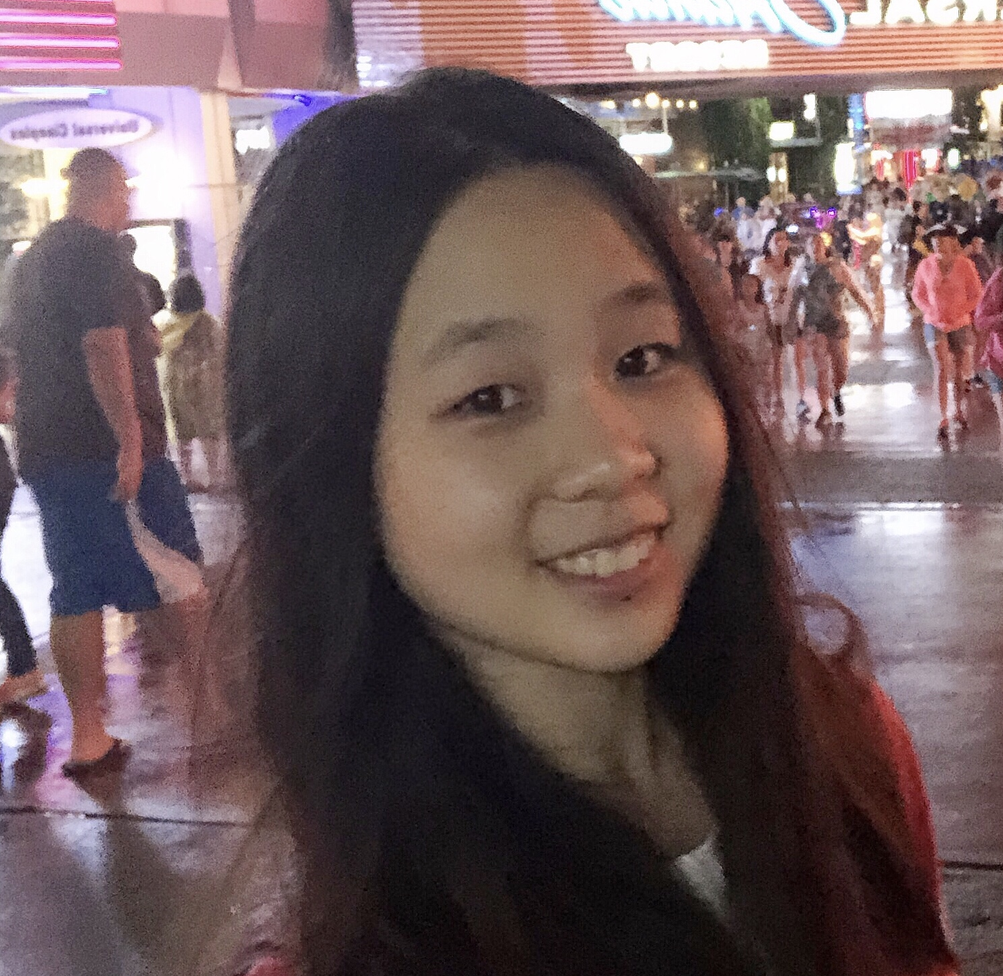



Course Staff
Instructors
Teaching Assistants
Pat Virtue
Ajay Kumar
Claire Wang
Ethan Gruman
Lubhaan Kumar
Stephanie Rosenthal
Michelle Ma
Pallavi Koppol
Sean Pereira
Tina Wu

Slide 4



Course Information
Website: https://www.cs.cmu.edu/~15381
Canvas: canvas.cmu.edu
Gradescope: gradescope.com
Communication: piazza.com
E-mail: pvirtue@cmu.edu
Prerequisites/Corequisites
Course Scope

Slide 5
Announcements
Recitation starting this Fri 3pm, GHC 4401 (recommended)
No class next Mon 1/21, MLK Holiday
Assignments:
HW1 (online)
    Released tomorrow
    Due Tue 1/22, 10 pm
P0: Python & Autograder Tutorial
    Required, but worth zero points
    Due Thu 1/24, 10 pm

Slide 6
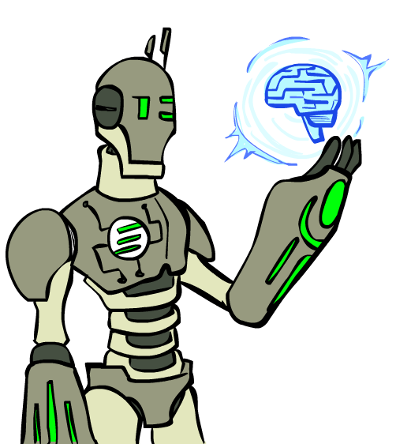
Today
What is artificial intelligence?
A brief history of AI
AI applications and techniques

Slide 7
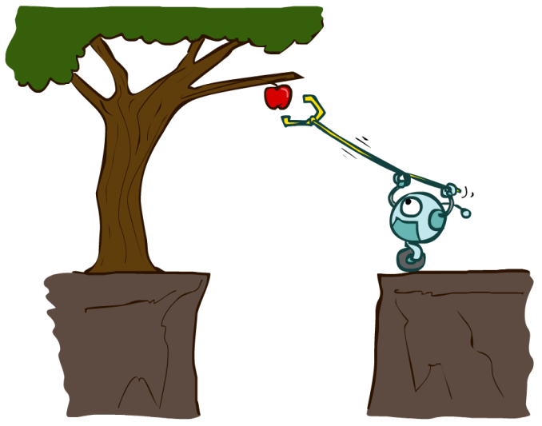
Designing Rational Agents
An agent is an entity that perceives and acts.
A rational agent selects actions that maximize its (expected) utility.
Characteristics of the percepts, environment, and action space dictate techniques for selecting rational actions
This course is about:
  General AI techniques for a variety of problem types
  Learning to recognize when and how a new problem can be solved with an existing technique
Sensors
Agent
Percepts
Environment
?
Actuators
Actions

Slide 8
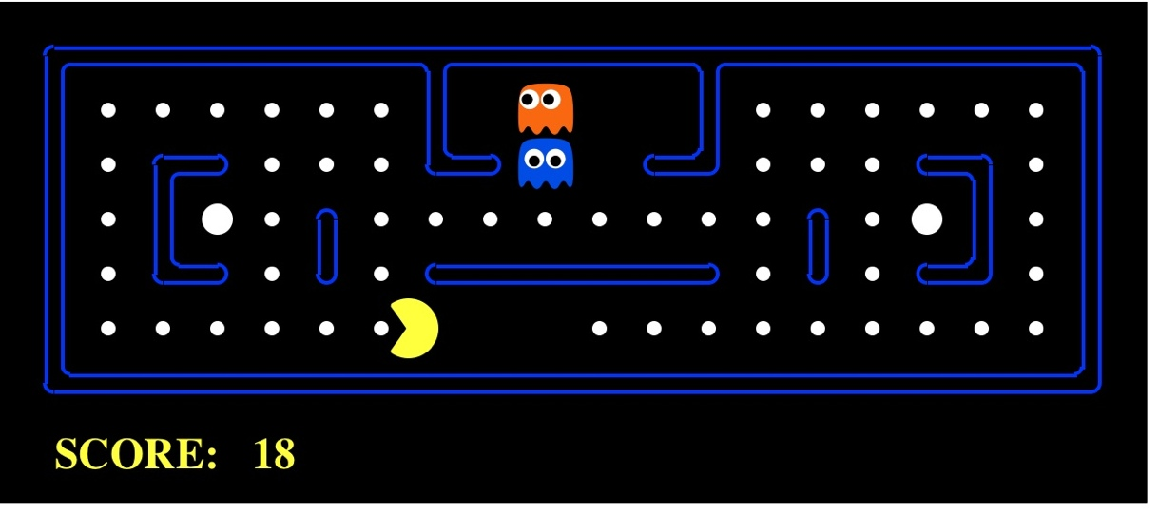
Pac-Man as an Agent
Agent
Environment
Sensors
Percepts
?
Actuators
Actions
Pac-Man is a registered trademark of Namco-Bandai Games, used here for educational purposes

Slide 9
Pac-Man as an Agent

Slide 10
Candy Grab Agent
class Agent
function getAction(state)
return action

Slide 11
Candy Grab Agent
Agent 001 – Always choose 1
function getAction( numPiecesAvailable )
return 1

Slide 12
Candy Grab Agent
Agent 002 – Always choose 2
function getAction( numPiecesAvailable )
return 2

Slide 13
Candy Grab Agent
Agent 004 – Choose the opposite of opponent
function getAction( numPiecesAvailable )
return ?

Slide 14
Candy Grab Agent
Agent 007 – Whatever you think is best
function getAction( numPiecesAvailable )
return ?

Slide 15
Candy Grab Agent
Agent 007 – Whatever you think is best
function getAction( numPiecesAvailable )
if numPiecesAvailable % 3 == 2
return 2
else
return 1

Slide 16
Games – Three “Intelligent” Agents
Piazza Poll question
Which agent code is the most “intelligent”?

Slide 17

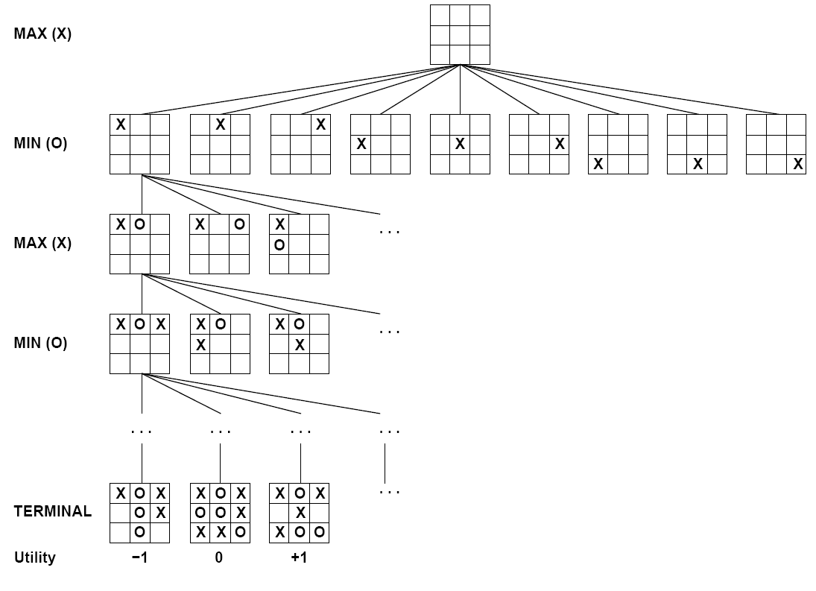

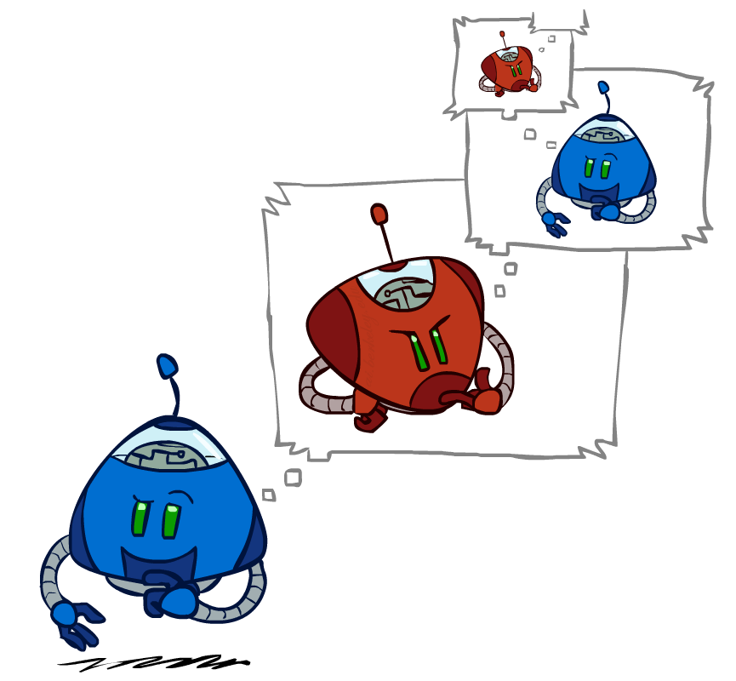
Games – Three “Intelligent” Agents
A: Search / Recursion

Slide 18
Games – Three “Intelligent” Agents
B: Encode the pattern
10's value:Win
9's value:Lose
8's value:Win
7's value:Win
6's value:Lose
5's value:Win
4's value:Win
3's value:Lose
2's value:Win
1's value:Win
0's value:Lose
function getAction( numPiecesAvailable )
if numPiecesAvailable % 3 == 2
return 2
else
return 1

Slide 19
Games – Three “Intelligent” Agents
C: Record statistics of winning positions
Pieces Available | Take 1 | Take 2
2
3
4
5
6
7
Pieces Available | Take 1 | Take 2
2 |  | 100%
3
4 | 100%
5
6
7 |  | 100%
Pieces Available | Take 1 | Take 2
2 |  | 100%
3 | 0%
4 | 100%
5
6
7 |  | 50%
Pieces Available | Take 1 | Take 2
2 | 0% | 100%
3 | 2% | 0%
4 | 75% | 2%
5 | 4% | 68%
6 | 5% | 6%
7 | 60% | 5%

Slide 20
Piazza Poll question
Games – Three “Intelligent” Agents
Which agent code is the most “intelligent”?
Search / Recursion
Encode multiple of 3 pattern
Keep stats on winning positions
Which agent code is the most “intelligent”?

Slide 21
Games – Three “Intelligent” Agents
C: Record statistics of winning positions
Pieces Available | Take 1 | Take 2
2
3
4
5
6
7
Pieces Available | Take 1 | Take 2
2 |  | 100%
3
4 | 100%
5
6
7 |  | 100%
Pieces Available | Take 1 | Take 2
2 |  | 100%
3 | 0%
4 | 100%
5
6
7 |  | 50%
Pieces Available | Take 1 | Take 2
2 | 0% | 100%
3 | 2% | 0%
4 | 75% | 2%
5 | 4% | 68%
6 | 5% | 6%
7 | 60% | 5%

Slide 22
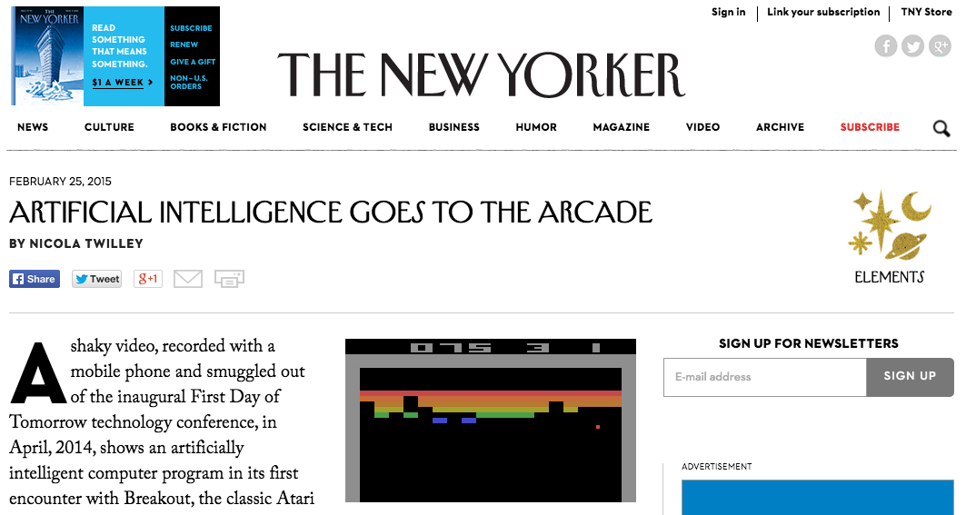
AI in the News
https://www.youtube.com/watch?v=EfGD2qveGdQ

Slide 23
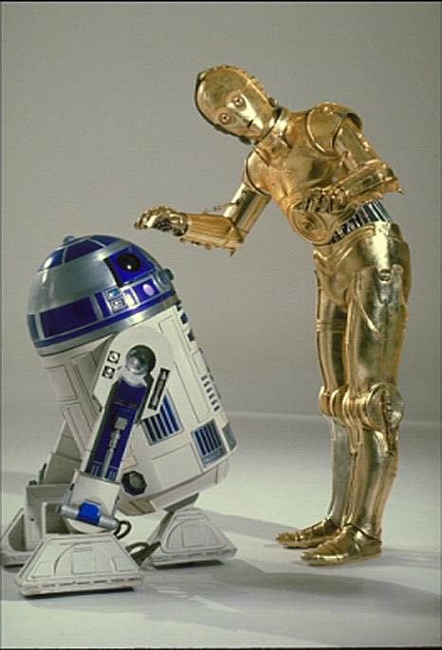
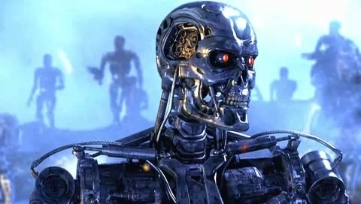
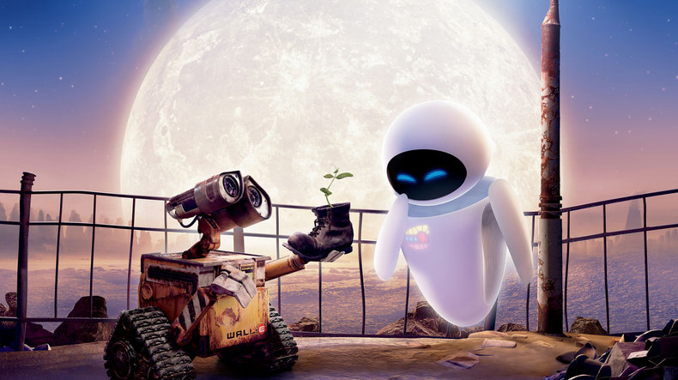
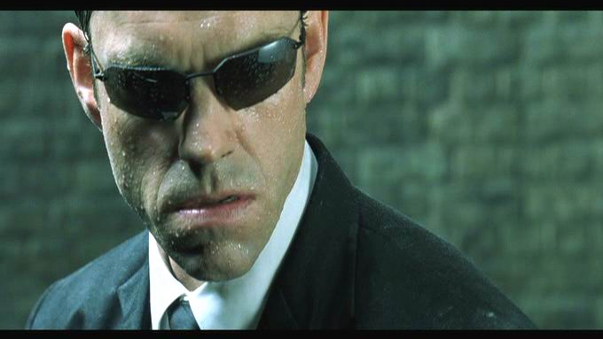
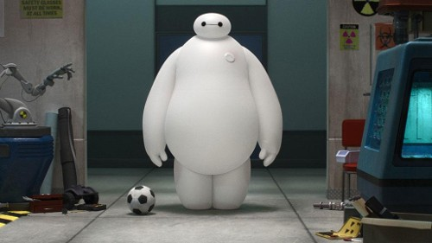
Sci-Fi AI?
Notes:
Who are these? C3PO, what does he do? Essentially google translate, (but with anxiety!)
Little guy? R2D2 – what does he do, yeah, not so sure
Things got darker: machines come back from the future – to kill us!
90’s : software is scary
Basic fear about what technology might do ?
What if we can’t even tell technology apart from ourselves?
OR maybe it’ll look really different and snarky
Some exceptions like wall-E, positive view of technology (but maybe not of us humans!)
But mostly a worry
[not very worried myself, at least at present]

Slide 24
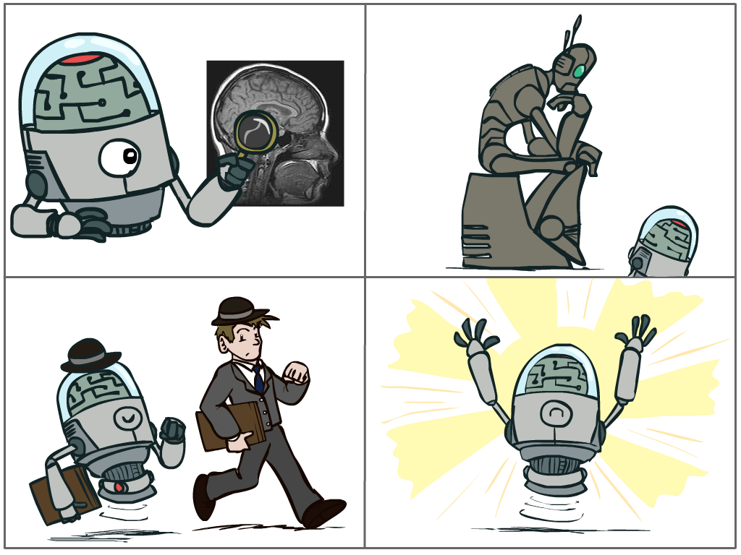
What is AI?
The science of making machines that:
Think like people
Think rationally
Act like people
Act rationally
Notes:
Top left: Think like people --- cognitive science, neuroscience
Bottom left: act like people --- actually very early definition, dating back to Alan Turing --- Turing test; problem to do really well you start focusing on things like don’t answer too quickly what the square root of 1412 is, don’t spell too well, and make sure you have a favorite movie etc. So it wasn’t really leading us to build intelligence
Think rationally – long tradition dating back to Aristotle --- but not a winner, because difficult to encode how to think, and in the end it’s not about how you think, it’s about how you end up acting

Slide 25
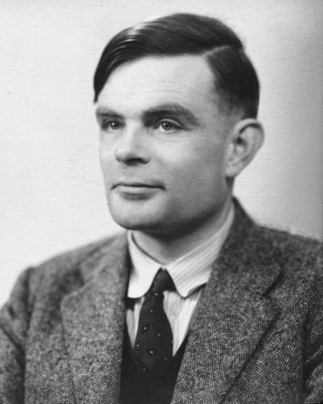
Turing Test
In 1950, Turing defined a test of whether a machine could “think”
“A human judge engages in a natural language conversation with one human and one machine, each of which tries to appear human. If judge can’t tell, machine passes the Turing test”
en.wikipedia.org/wiki/Turing_test
Notes:
Top left: Think like people --- cognitive science, neuroscience
Bottom left: act like people --- actually very early definition, dating back to Alan Turing --- Turing test; problem to do really well you start focusing on things like don’t answer too quickly what the square root of 1412 is, don’t spell too well, and make sure you have a favorite movie etc. So it wasn’t really leading us to build intelligence
Think rationally – long tradition dating back to Aristotle --- but not a winner, because difficult to encode how to think, and in the end it’s not about how you think, it’s about how you end up acting

Slide 26
What is AI?
The science of making machines that:
Think like people
Think rationally
Act like people
Act rationally
Notes:
Top left: Think like people --- cognitive science, neuroscience
Bottom left: act like people --- actually very early definition, dating back to Alan Turing --- Turing test; problem to do really well you start focusing on things like don’t answer too quickly what the square root of 1412 is, don’t spell too well, and make sure you have a favorite movie etc. So it wasn’t really leading us to build intelligence
Think rationally – long tradition dating back to Aristotle --- but not a winner, because difficult to encode how to think, and in the end it’s not about how you think, it’s about how you end up acting

Slide 27
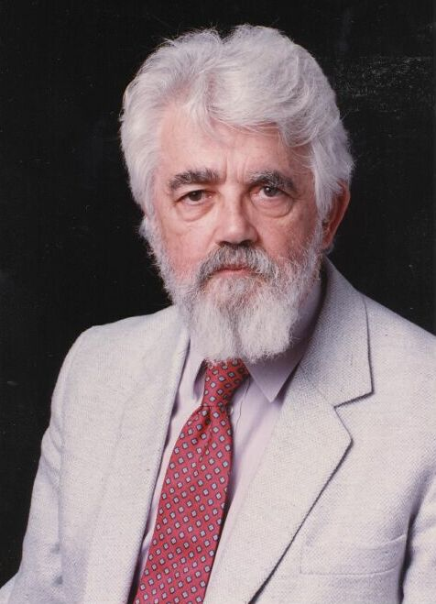
AI Definition by John McCarthy
What is artificial intelligence
  It is the science and engineering of making intelligent machines, especially intelligent computer programs
What is intelligence
  Intelligence is the computational part of the ability to achieve goals in the world
http://www-formal.stanford.edu/jmc/whatisai/whatisai.html
Notes:
Top left: Think like people --- cognitive science, neuroscience
Bottom left: act like people --- actually very early definition, dating back to Alan Turing --- Turing test; problem to do really well you start focusing on things like don’t answer too quickly what the square root of 1412 is, don’t spell too well, and make sure you have a favorite movie etc. So it wasn’t really leading us to build intelligence
Think rationally – long tradition dating back to Aristotle --- but not a winner, because difficult to encode how to think, and in the end it’s not about how you think, it’s about how you end up acting

Slide 28
Rational Decisions
We’ll use the term rational in a very specific, technical way:
  Rational: maximally achieving pre-defined goals
  Rationality only concerns what decisions are made
  (not the thought process behind them)
  Goals are expressed in terms of the utility of outcomes
  Being rational means maximizing your expected utility
A better title for this course would be:
Computational Rationality
Notes:
Example of utilities. 10 for A, 1 for each Friday with friends

Slide 29
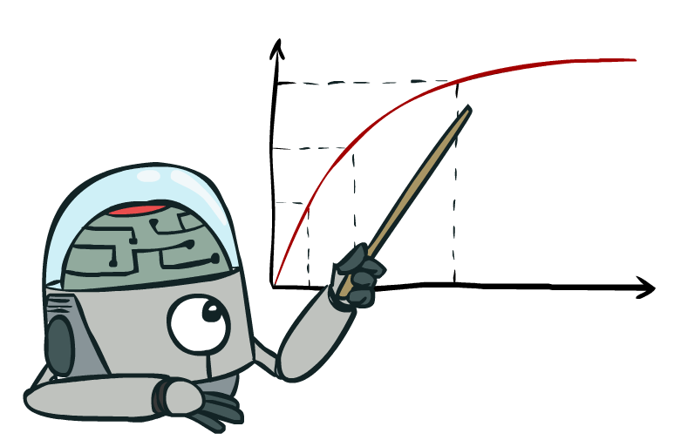
Maximize Your
Expected Utility

Slide 30
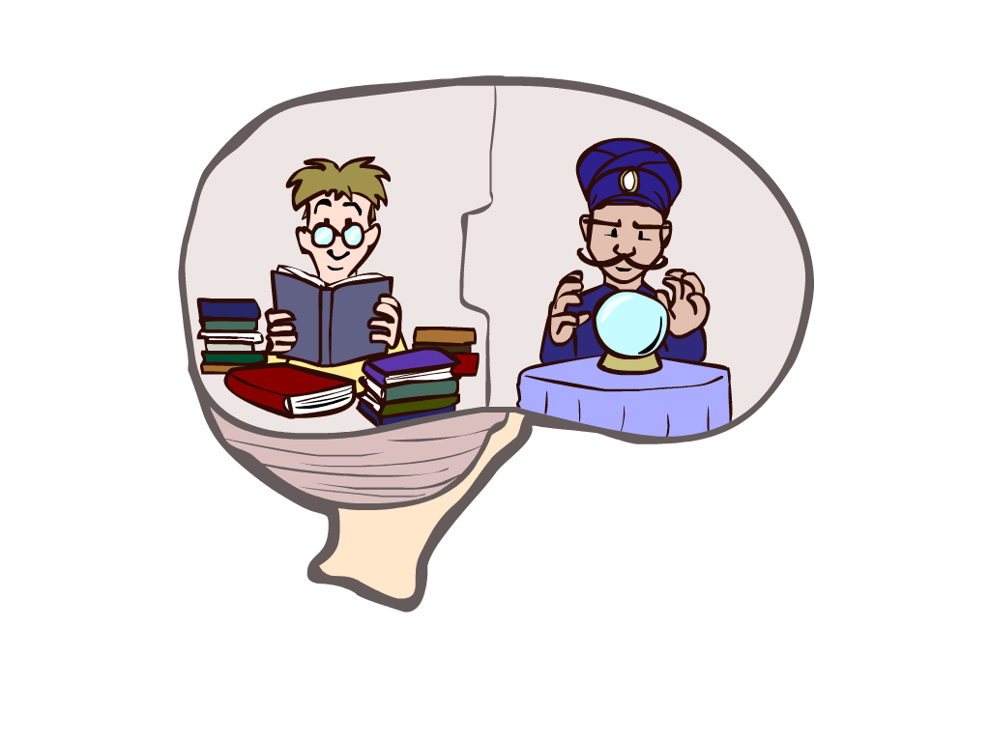
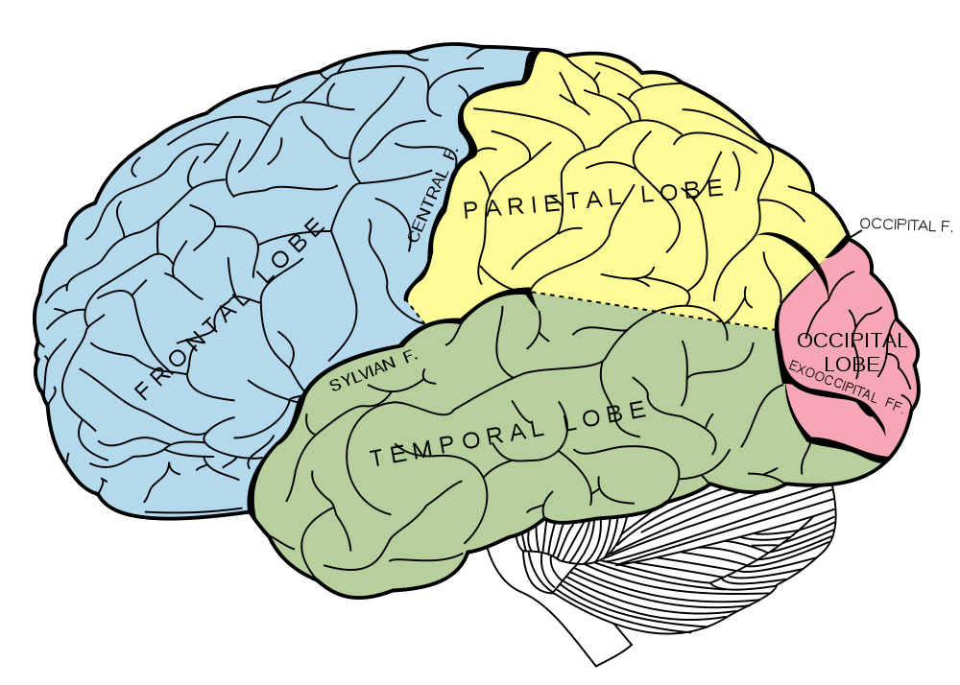
What About the Brain?
Brains (human minds) are very good at making rational decisions, but not perfect
Brains aren’t as modular as software, so hard to reverse engineer!
“Brains are to intelligence as wings are to flight”
Lessons learned from the brain: memory and simulation are key to decision making

Slide 31
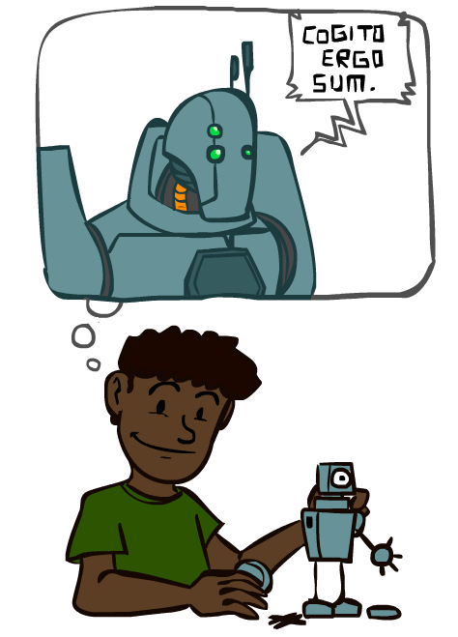
A Brief History of AI

Slide 32
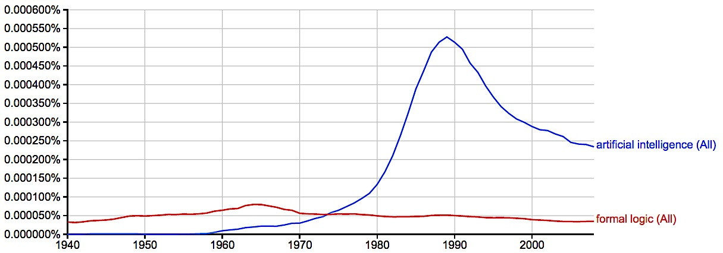
A Brief History of AI
Knowledge Based
Systems
1970-1990
AI
Excitement!
1950-1970
artificial intelligence
formal logic
https://books.google.com/ngrams

Slide 33
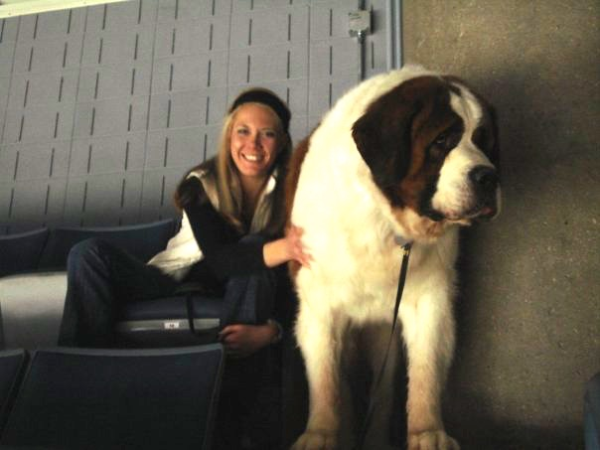
What went wrong?
Dog
  Barks
  Has Fur
  Has four legs
Buster

Slide 34
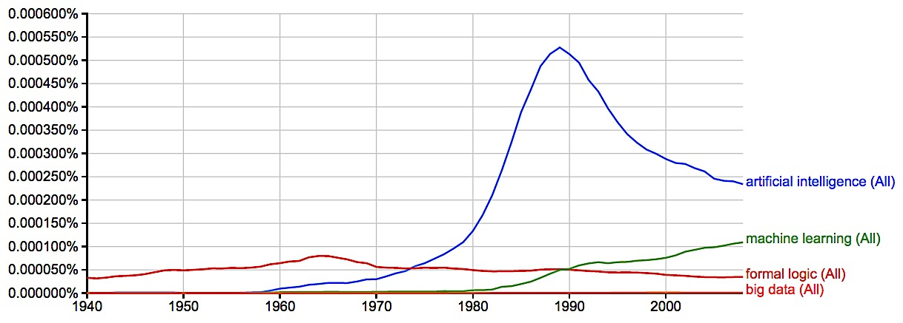
A Brief History of AI
Knowledge Based
Systems
1970-1990
AI
Excitement!
1950-1970
Statistical Approaches
1990--
artificial intelligence
machine learning
formal logic
big data
2008
https://books.google.com/ngrams

Slide 35
A Brief History of AI
1940-1950: Early days
  1943: McCulloch & Pitts: Boolean circuit model of brain
  1950: Turing's “Computing Machinery and Intelligence”
1950—70: Excitement: Look, Ma, no hands!
  1950s: Early AI programs, including Samuel's checkers program, Newell & Simon's Logic Theorist, Gelernter's Geometry Engine
  1956: Dartmouth meeting: “Artificial Intelligence” adopted
  1965: Robinson's complete algorithm for logical reasoning
1970—90: Knowledge-based approaches
  1969—79: Early development of knowledge-based systems
  1980—88: Expert systems industry booms
  1988—93: Expert systems industry busts: “AI Winter”
1990—: Statistical approaches
  Resurgence of probability, focus on uncertainty
  General increase in technical depth
  Agents and learning systems… “AI Spring”?
2012—: Where are we now?
Notes:
Million dollar computer with less computation than your phone
MT was

Slide 36
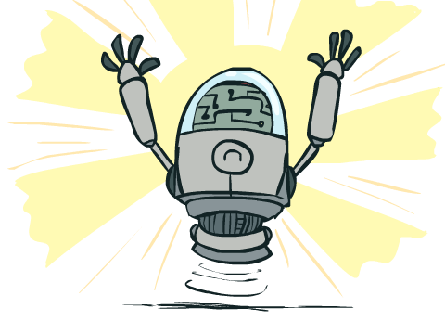
What Can AI Do?
Quiz: Which of the following can be done at present?
Play a decent game of table tennis?
Play a decent game of Jeopardy?
Drive safely along a curving mountain road?
Drive safely across Pittsburgh?
Buy a week's worth of groceries on the web?
Buy a week's worth of groceries at Giant Eagle?
Discover and prove a new mathematical theorem?
Converse successfully with another person for an hour?
Perform a surgical operation?
Put away the dishes and fold the laundry?
Translate spoken Chinese into spoken English in real time?
Write an intentionally funny story?

