Slide 1



Walk-in warm-up: Omega Pizzeria
Three questions: What is the probability of getting a slice with:
  No mushrooms
  Spinach and no mushrooms
  Spinach, when asking for slice with no mushrooms
  Write down your answers.
  We’ll get to them in a few minutes.
Icons: CC, https://openclipart.org/detail/296791/pizza-slice

Slide 2
Announcements
Assignments:
P4
    Due Thu 3/28, 10 pm
HW9 (written)
    Out tonight, due Tue 4/2
Optional Probability (online)
Course Feedback:
See Piazza post for mid-semester survey
Note the separate TA posts

Slide 3
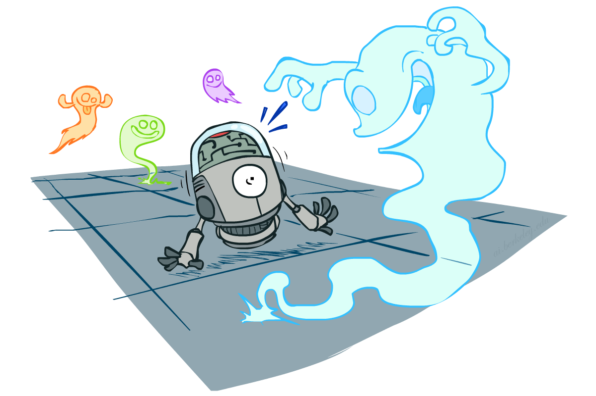
AI: Representation and Problem Solving
Probability
Instructors: Pat Virtue & Stephanie Rosenthal
Slide credits: CMU AI and http://ai.berkeley.edu

Slide 4

Previous Exposure to Probability
Previous topics
  Some version of notation
  Sample spaces, outcomes, sets, events
  Three axioms
  Theorem of total probability
  Partitions
      $$\sum_{i=1}^{n}{P\left(a_{i}\right)=1}$$

Slide 5
Outline
Conditional probability
  Pizza
  Notation
  Definition
Another partition proof
Product rule & Bayes’ theorem
  Algebra
  Why Bayes’ theorem
Our probability toolbox
  Algebra
  Three axioms of probability
  Theorem of total probability
  Definition of conditional probability
  Product rule
  Bayes’ theorem

Slide 6
Piazza Poll 1
Three questions: What is the probability of getting a slice with:
  No mushrooms
  Spinach and no mushrooms
  Spinach, when asking for slice with no mushrooms
  How comfortable are you with this?
  A: I’m good
  B: So-so
  C: A little freaked out
Icons: CC, https://openclipart.org/detail/296791/pizza-slice

Slide 7
Omega Pizzeria
Three questions: What is the probability of getting a slice with:
  No mushrooms
  Spinach and no mushrooms
  Spinach, when asking for slice with no mushrooms
  New information (condition)
  Adjust sample space
Icons: CC, https://openclipart.org/detail/296791/pizza-slice

Slide 8
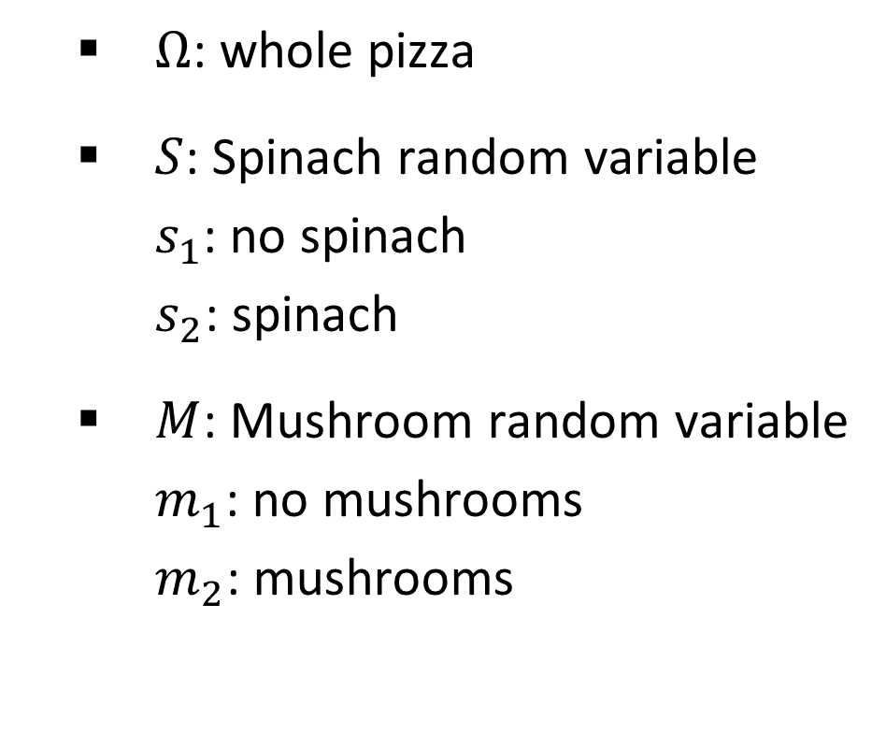
Omega Pizzeria
Formalize this a bit
  $Ω$: whole pizza
  $S$: Spinach random variable
  $s_{1}$: no spinach
  $s_{2}$: spinach
  $M$: Mushroom random variable
  $m_{1}$: no mushrooms
  $m_{2}$: mushrooms
Icons: CC, https://openclipart.org/detail/296791/pizza-slice

Slide 9
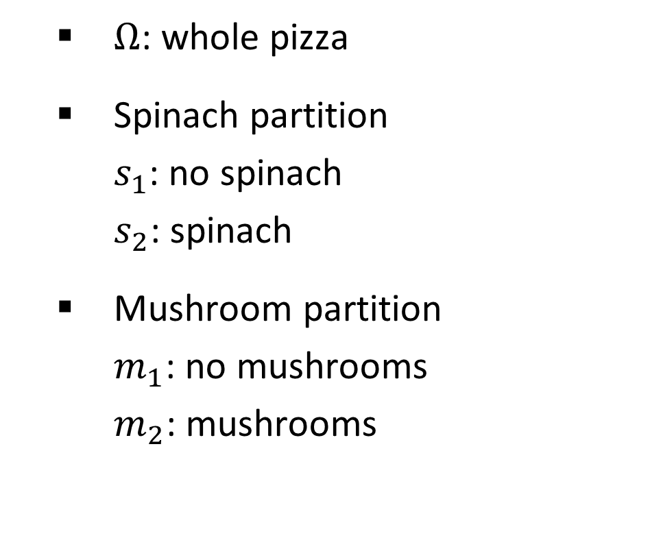
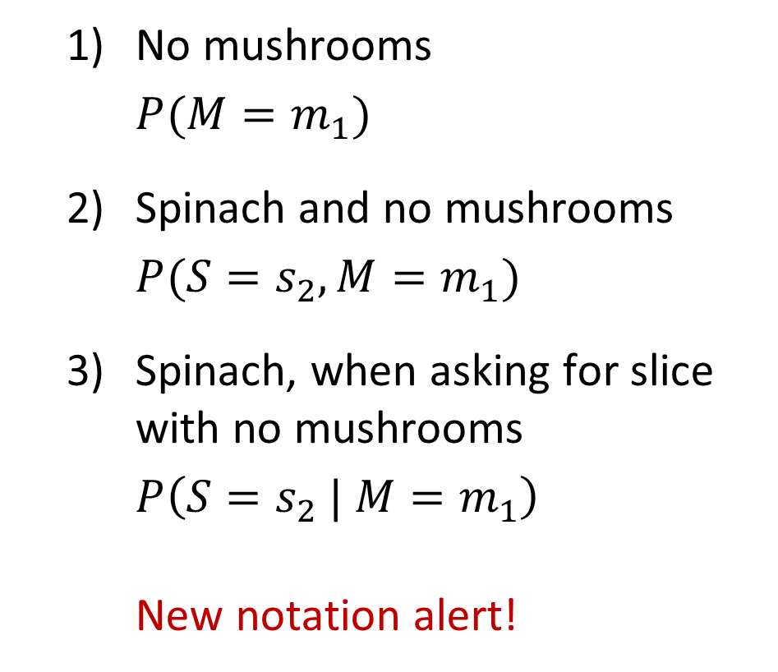
Omega Pizzeria
Formalize this a bit
  $Ω$: whole pizza
  Spinach partition
  $s_{1}$: no spinach
  $s_{2}$: spinach
  Mushroom partition
  $m_{1}$: no mushrooms
  $m_{2}$: mushrooms
  No mushrooms
  $P(M=m_{1})$
  Spinach and no mushrooms
  $P(S=s_{2}, {M=m}_{1})$
  Spinach, when asking for slice with no mushrooms
  $P\left({S=s}_{2} |{ M=m}_{1}\right)$
  New notation alert!
Questions?

Slide 10
Omega Pizzeria
More questions: What is the probability of getting a slice with:
  No mushrooms
  Spinach and no mushrooms
  Spinach, when asking for slice with no mushrooms
  Mushrooms
  Spinach
  No spinach
  No spinach and mushrooms
  No spinach when asking for no mushrooms
  No spinach when asking for mushrooms
  Spinach when asking for mushrooms
  No mushrooms and no spinach
Icons: CC, https://openclipart.org/detail/296791/pizza-slice

Slide 11


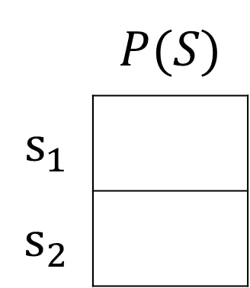
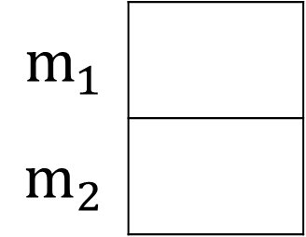

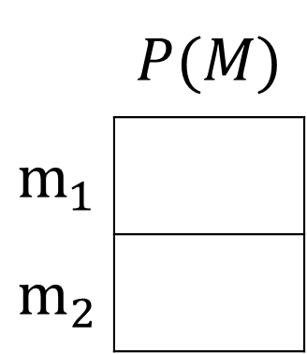


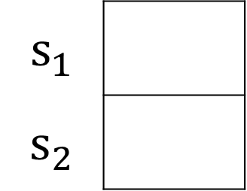
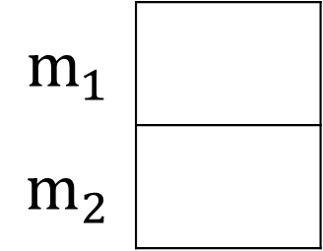


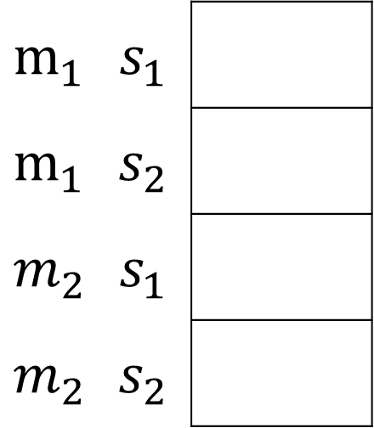
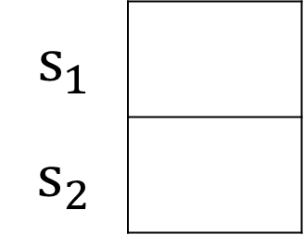

Omega Pizzeria
You can answer all of these questions:
$P(M|s_{1})$
$P(M|s_{2})$
 | $$P(M)$$
$$m_{1}$$
$$m_{2}$$
$P(M,S)$
$$m_{1}$$
$$m_{2}$$
$$m_{1}$$
$$m_{2}$$
$$12/20$$
$$m_{1}$$ | $$s_{1}$$
$$m_{1}$$ | $$s_{2}$$
$$m_{2}$$ | $$s_{1}$$
$$m_{2}$$ | $$s_{2}$$
$$6/20$$
$P(S|m_{1})$
$P(S|m_{2})$
 | $$P(S)$$
$$s_{1}$$
$$s_{2}$$
$$s_{1}$$
$$s_{2}$$
$$s_{1}$$
$$s_{2}$$
$$6/12$$

Slide 12


Sensor Probability
Images CC: https://openclipart.org/detail/275131/car, https://openclipart.org/detail/216619/car

Slide 13
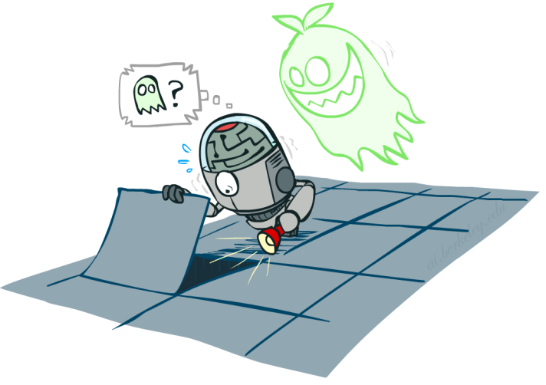
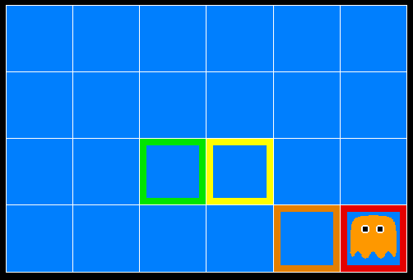
Sensor Probability
Ghostbusters project
[ai.berkeley.edu demo: Ghostbuster – no probability (L12D1) ]

Slide 14


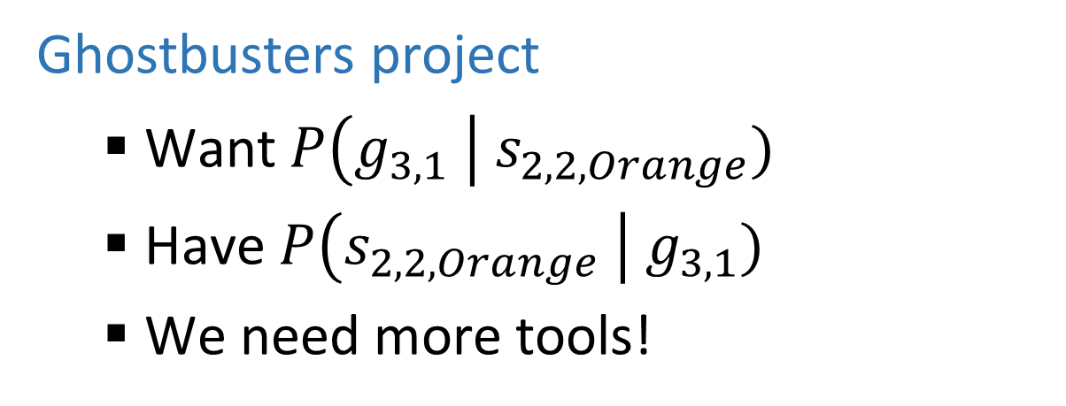
Sensor Probability
?
Ghostbusters project
  Want $P\left(g_{3,1} \right| s_{2,2,Orange})$
  Have $P\left(s_{2,2,Orange} \right| g_{3,1})$
  We need more tools!

Slide 15
Inference in Ghostbusters
A ghost is in the grid somewhere
Sensor readings tell how close a square is to the ghost
  On the ghost: red
  1 or 2 away: orange
  3 or 4 away: yellow
  5+ away: green
Sensors are noisy, but we know P(Color(x,y) | DistanceFromGhost(x,y))
P(red | 3) | P(orange | 3) | P(yellow | 3) | P(green | 3)
0.05 | 0.15 | 0.5 | 0.3

Slide 16
Ghostbusters Demo
[Demo: Ghostbuster – no probability (L12D1) ]

Slide 17

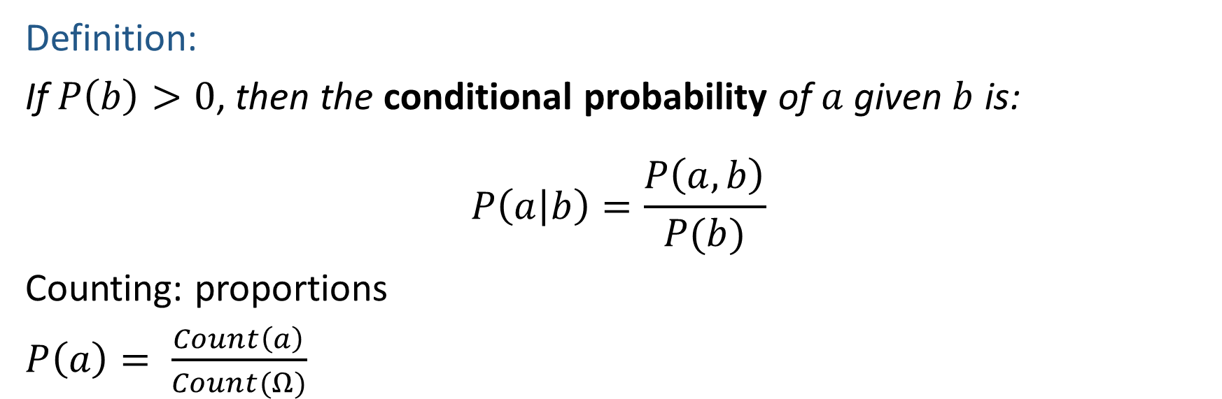


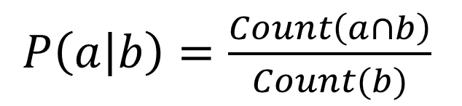
Definition of Conditional Probability
Definition:
If $P\left(b\right)>0$, then the conditional probability of $a$ given $b$ is:
$$P\left(a | b\right)=\frac{P\left(a, b\right)}{P(b)}$$
Counting: proportions
$P\left(a\right)= \frac{Count\left(a\right)}{Count(Ω)}$
$P\left(a | b\right)=\frac{Count\left(a∩b\right)}{Count(b)}$
$$a$$
$$b$$
$$a∩b$$

Slide 18



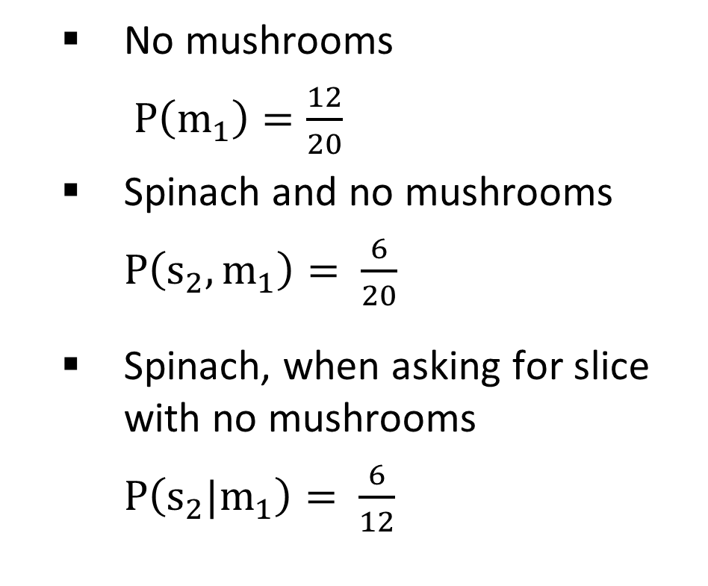
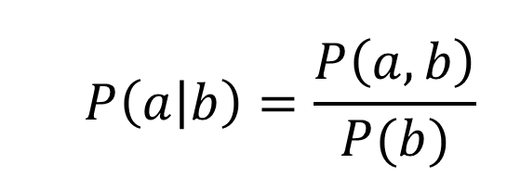
Omega Pizzeria
Apply definition of conditional probability
  No mushrooms
  $P\left(m_{1}\right)=\frac{12}{20}$
  Spinach and no mushrooms
  $P\left(s_{2}, m_{1}\right)= \frac{6}{20}$
  Spinach, when asking for slice with no mushrooms
  $P\left(s_{2}|m_{1}\right)= \frac{6}{12}$
  $$P\left(a | b\right)=\frac{P\left(a, b\right)}{P(b)}$$
Conditional
Probability:

Slide 19
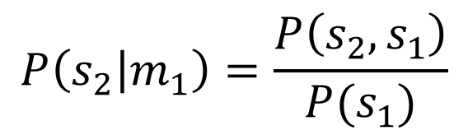
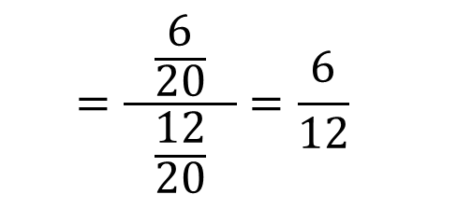
Omega Pizzeria
Apply definition of conditional probability
  No mushrooms
  $P\left(m_{1}\right)=\frac{12}{20}$
  Spinach and no mushrooms
  $P\left(s_{2}, m_{1}\right)= \frac{6}{20}$
  Spinach, when asking for slice with no mushrooms
  $P\left(s_{2}|m_{1}\right)= \frac{6}{12}$
  $$P\left(a | b\right)=\frac{P\left(a, b\right)}{P(b)}$$
Conditional
Probability:
$$P\left(s_{2} | m_{1}\right)=\frac{P\left(s_{2}, s_{1}\right)}{P(s_{1})}$$
  $$=\frac{\frac{6}{20}}{ \frac{12}{20} }=\frac{6}{12}$$

Slide 20

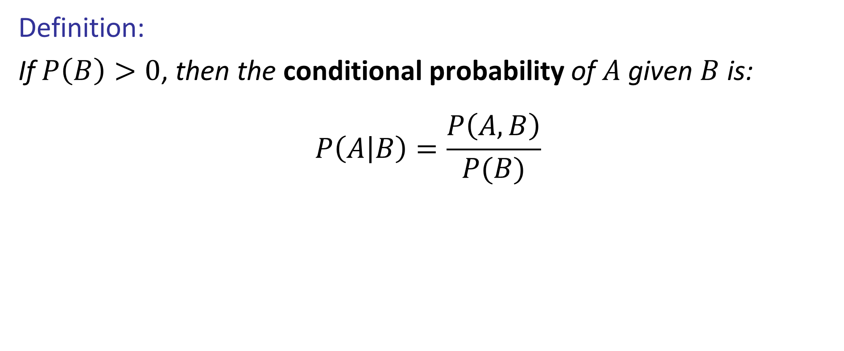
Definition of Conditional Probability
Definition:
If $P\left(B\right)>0$, then the conditional probability of $A$ given $B$ is:
$$P\left(A | B\right)=\frac{P\left(A, B\right)}{P(B)}$$
http://achievementgen.com/360/

Slide 21

Quiz: Normalization Trick
P(X | Y=-y) ?
  SELECT the joint probabilities matching the evidence
  NORMALIZE the selection
  (make it sum to one)
X | Y | P
+x | +y | 0.2
+x | -y | 0.3
-x | +y | 0.4
-x | -y | 0.1

Slide 22
To Normalize
(Dictionary) To bring or restore to a normal condition
Procedure:
  Step 1: Compute Z = sum over all entries
  Step 2: Divide every entry by Z
Example 1
All entries sum to ONE
Example 2
W | P
sun | 0.2
rain | 0.3
Normalize
W | P
sun | 0.4
rain | 0.6
T | W | P
hot | sun | 20
hot | rain | 5
cold | sun | 10
cold | rain | 15
T | W | P
hot | sun | 0.4
hot | rain | 0.1
cold | sun | 0.2
cold | rain | 0.3
Normalize
Z = 0.5
Z = 50

Slide 23
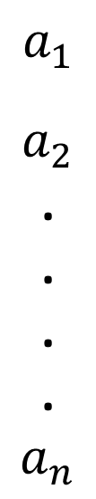
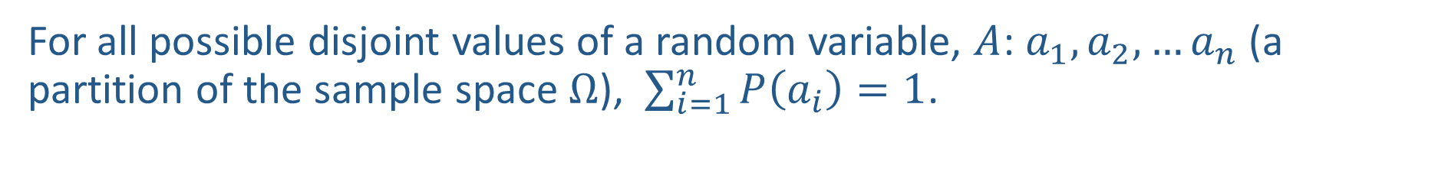



Sum over all values of a random variable
For all possible disjoint values of a random variable, $A$: $a_{1},a_{2},…a_{n}$ (a partition of the sample space $Ω$), $\sum_{i=1}^{n}{P\left(a_{i}\right)}=1$.
$$a_{1}$$
$$a_{2}$$
.
.
.
.
$$a_{n}$$
$$P\left(a_{1}\right)$$
$$P\left(a_{2}\right)$$
$$P\left(a_{n}\right)$$

Slide 24
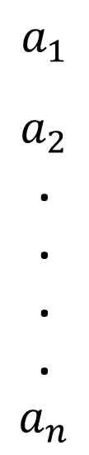

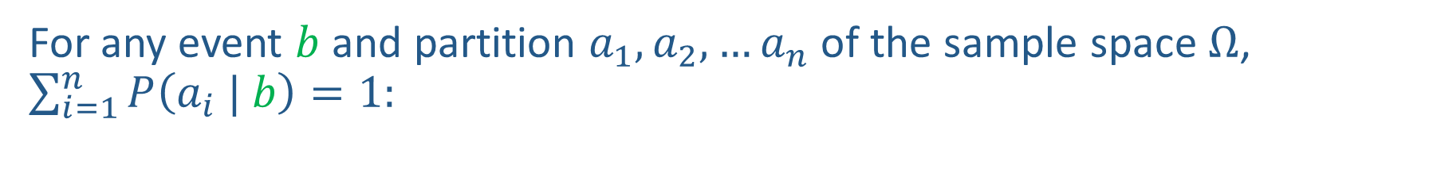



Partition given Event, Still Sums to One
For any event $b$ and partition $a_{1},a_{2},…a_{n}$ of the sample space $Ω$, $\sum_{i=1}^{n}{P\left(a_{i} | b\right)}=1:$
$$P\left(a_{1}\right|b)$$
$$a_{1}$$
$$a_{2}$$
.
.
.
.
$$a_{n}$$
$$b$$
$$P\left(a_{2} | b\right)$$
$$P\left(a_{n} | b\right)$$

Slide 25
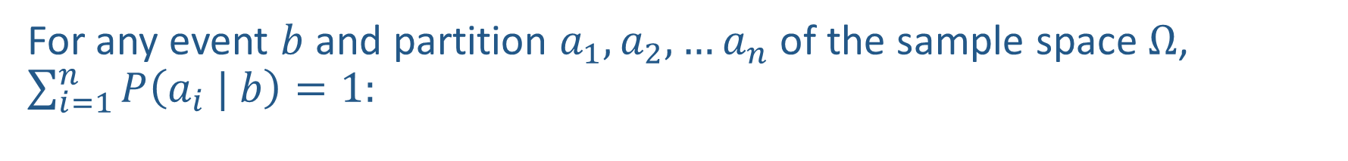




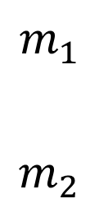
Partition given Event, Still Sums to One
For any event $b$ and partition $a_{1},a_{2},…a_{n}$ of the sample space $Ω$, $\sum_{i=1}^{n}{P\left(a_{i} | b\right)}=1:$
$$P\left(m_{1}\right|s_{2})$$
$$m_{1}$$
$$m_{2}$$
$$s_{2}$$
$$P\left(m_{2} | s_{2}\right)$$
$$P\left(m_{1} | s_{2}\right)+P\left(m_{2} | s_{2}\right)$$
Icons: CC, https://openclipart.org/detail/296791/pizza-slice

Slide 26
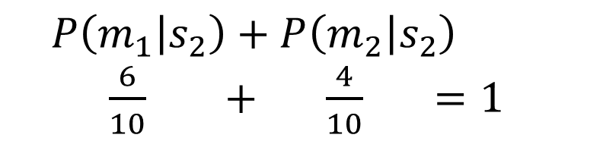
Partition given Event, Still Sums to One
For any event $b$ and partition $a_{1},a_{2},…a_{n}$ of the sample space $Ω$, $\sum_{i=1}^{n}{P\left(a_{i} | b\right)}=1:$
$$P\left(m_{1}\right|s_{2})$$
$$m_{1}$$
$$m_{2}$$
$$s_{2}$$
$$P\left(m_{2} | s_{2}\right)$$
$$P\left(m_{1} | s_{2}\right)+P\left(m_{2} | s_{2}\right)$$
$\frac{6}{10} + \frac{4}{10} =1$
Icons: CC, https://openclipart.org/detail/296791/pizza-slice

Slide 27
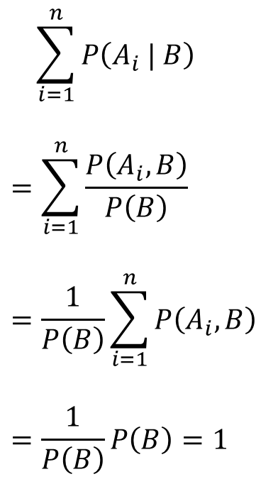
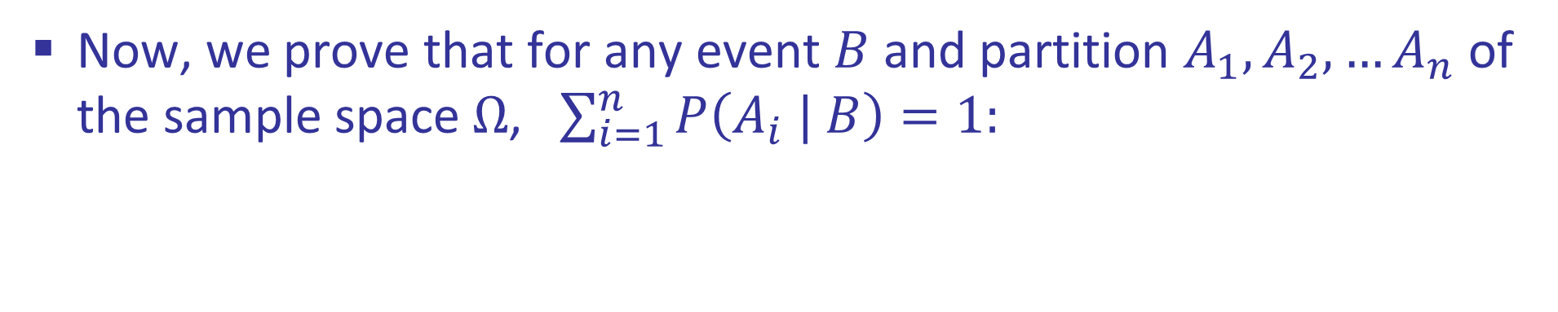
Proof: Partition given Event
Now, we prove that for any event $B$ and partition $A_{1},A_{2},…A_{n}$ of the sample space $Ω$, $\sum_{i=1}^{n}{P\left(A_{i} | B\right)}=1:$
$$\sum_{i=1}^{n}{P\left(A_{i} | B\right)}$$
$$=\sum_{i=1}^{n}{\frac{P\left(A_{i}, B\right)}{P\left(B\right)}}$$
$$=\frac{1}{P\left(B\right)}\sum_{i=1}^{n}{P\left(A_{i}, B\right)}$$
$$=\frac{1}{P\left(B\right)}P\left(B\right)=1$$
Definition of conditional probability
Distribution property of mult. over add.
▪
Theorem of total probability

Slide 28



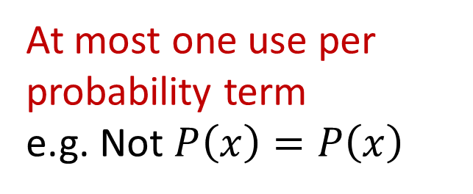
Piazza Poll 2
How many valid equations can we compose using:
$P\left(x\right)$, $P\left(y\right)$, $P\left(x,y\right)$, $P\left(x | y\right)$, $P\left(y | x\right)$ and $=, ×, ÷$
First one: $P\left(x | y\right)=P(x,y)/P\left(y\right)$
A) 2
B) 4
C) 7
D) Other
At most one use per probability term
e.g. Not $P\left(x\right)=P\left(x\right)$
Must be different
e.g. Cannot also use
$$P(x,y)/P(y) =P(x|y)$$

Slide 29
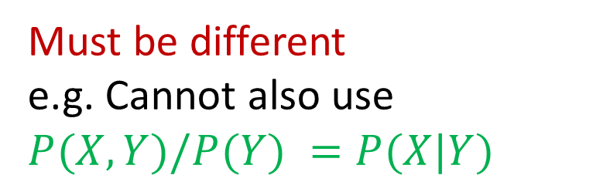
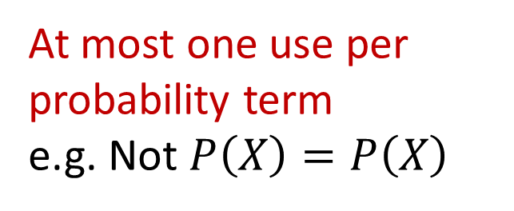
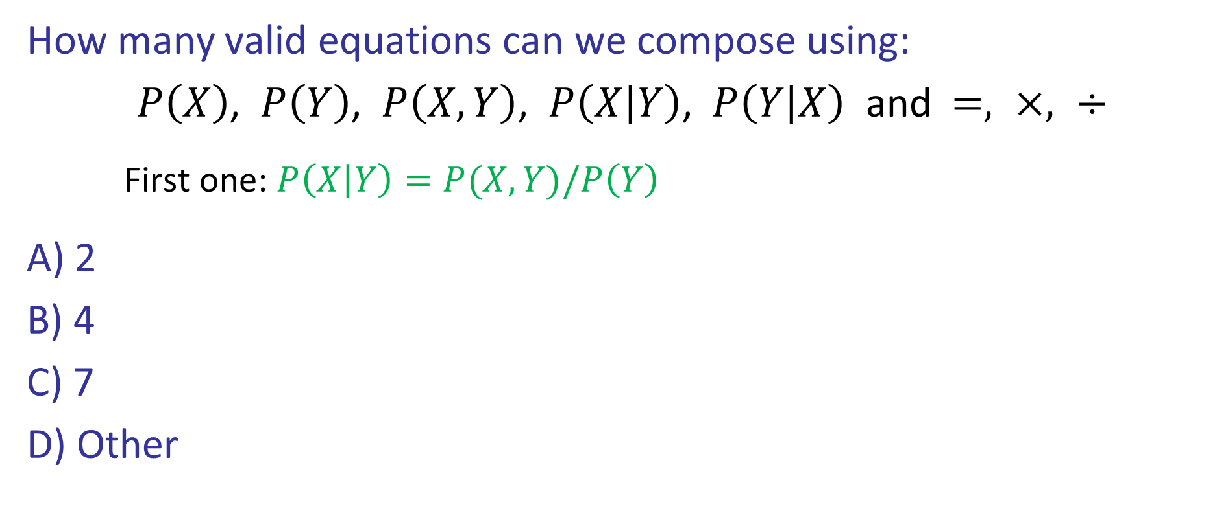

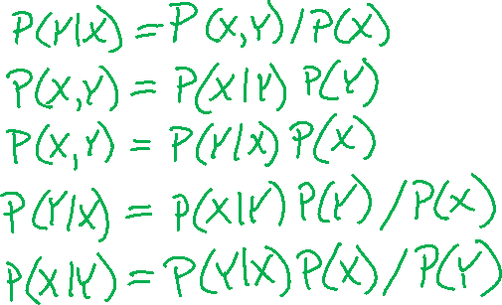
Quiz
How many valid equations can we compose using:
$P\left(X\right)$, $P\left(Y\right)$, $P\left(X,Y\right)$, $P\left(X | Y\right)$, $P\left(Y | X\right)$ and $=, ×, ÷$
First one: $P\left(X | Y\right)=P(X,Y)/P\left(Y\right)$
A) 2
B) 4
C) 7
D) Other
At most one use per probability term
e.g. Not $P\left(X\right)=P\left(X\right)$
Must be different
e.g. Cannot also use
$$P(X,Y)/P(Y) =P(X|Y)$$

Slide 30


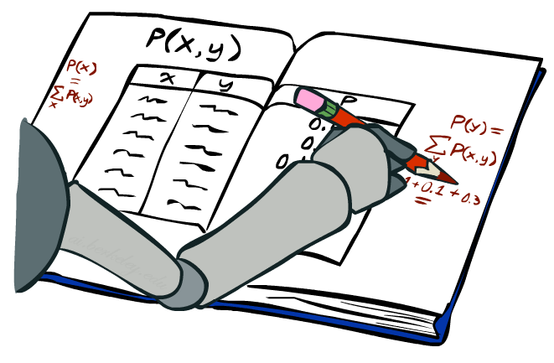
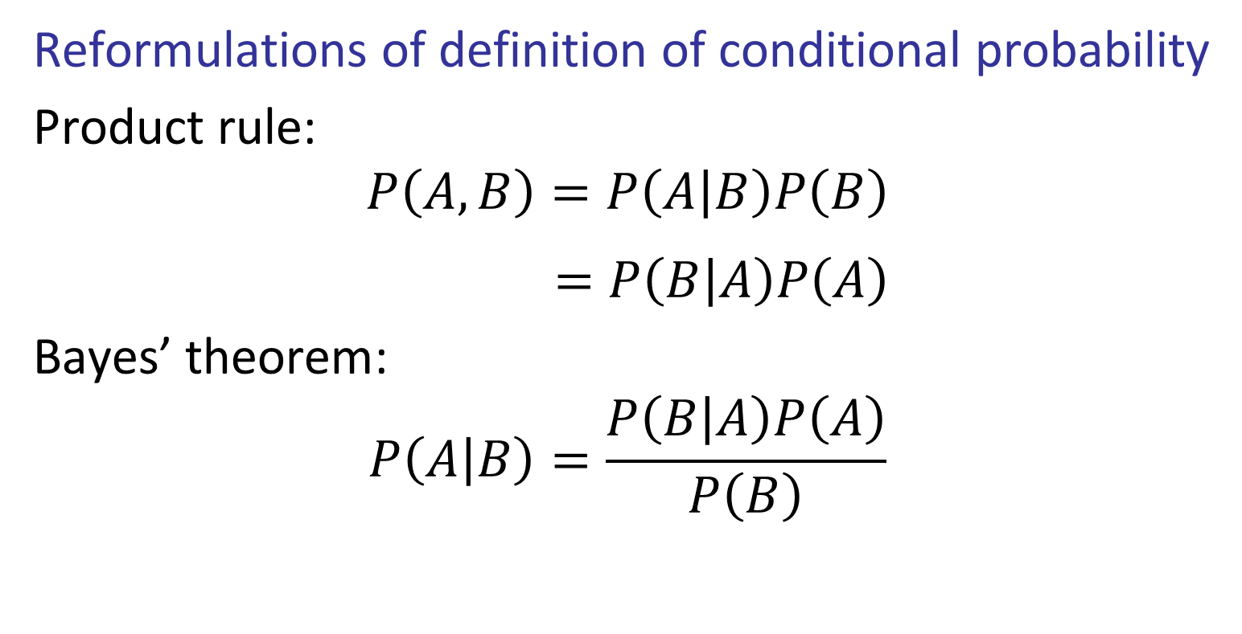
Product Rule and Bayes’ Theorem
Reformulations of definition of conditional probability
Product rule:
$$P\left(A,B\right)=P\left(A | B\right)P\left(B\right)$$
$$=P\left(B | A\right)P\left(A\right)$$
Bayes’ theorem:
$$P\left(A | B\right)=\frac{P\left(B | A\right)P\left(A\right)}{P\left(B\right)}$$
http://achievementgen.com/360/

Slide 31





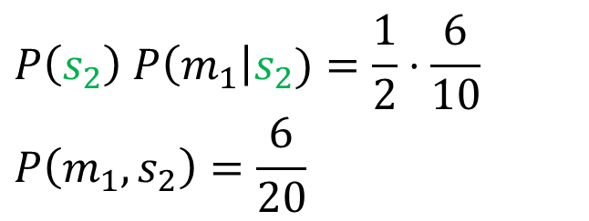



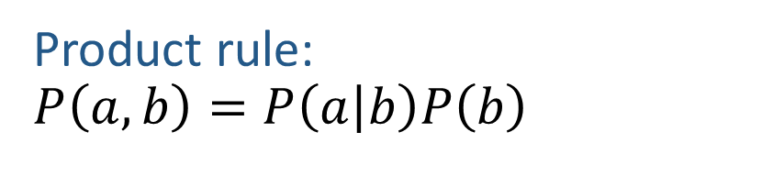


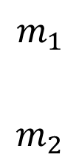




Product Rule: Tree
Product rule:
$$P\left(a,b\right)=P\left(a | b\right)P\left(b\right)$$
$$P\left(m_{1}\right|s_{1})$$
$$m_{1}$$
$$m_{2}$$
$$P(s_{1})$$
$$s_{1}$$
$$P\left(m_{2} | s_{1}\right)$$
$$Ω$$
$$P\left(s_{2}\right) P\left(m_{1}\right|s_{2})=\frac{1}{2}⋅\frac{6}{10}$$
$$P\left(m_{1},s_{2}\right)=\frac{6}{20}$$
$$P\left(m_{1}\right|s_{2})$$
$$m_{1}$$
$$P(s_{2})$$
$$s_{2}$$
$$m_{2}$$
$$P\left(m_{2} | s_{2}\right)$$
Icons: CC, https://openclipart.org/detail/296791/pizza-slice

Slide 32
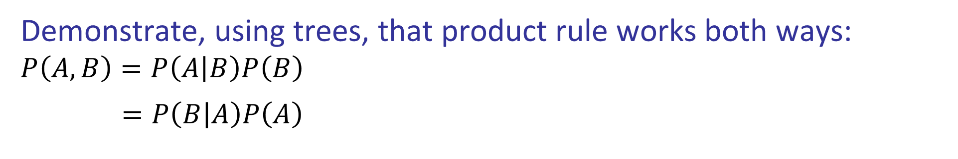
Exercise: Product Rule: Tree
Demonstrate, using trees, that product rule works both ways:
$$P\left(A,B\right)=P\left(A | B\right)P\left(B\right)$$
$=P\left(B | A\right)P\left(A\right)$
Icons: CC, https://openclipart.org/detail/296791/pizza-slice

Slide 33
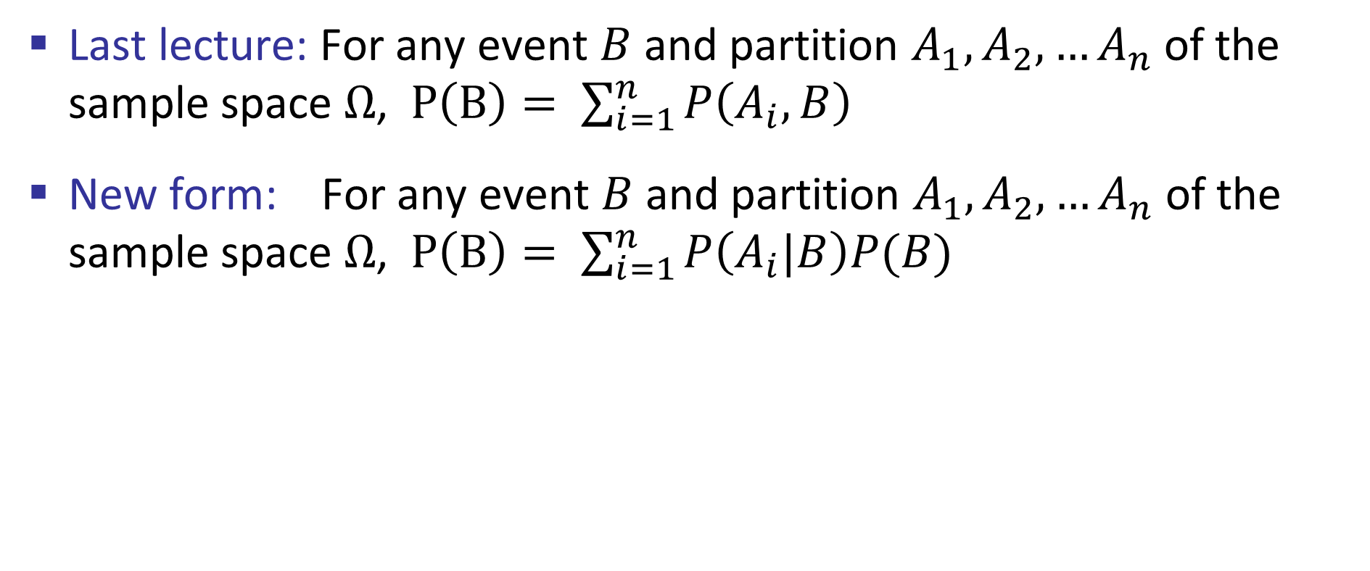
Theorem of Total Probability (again)
Last lecture: For any event $B$ and partition $A_{1},A_{2},…A_{n}$ of the sample space $Ω$, $P\left(B\right)= \sum_{i=1}^{n}{P\left(A_{i}, B\right)}$
New form: For any event $B$ and partition $A_{1},A_{2},…A_{n}$ of the sample space $Ω$, $P\left(B\right)= \sum_{i=1}^{n}{P\left(A_{i}|B\right)P(B)}$

Slide 34
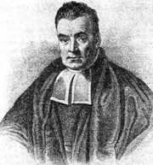
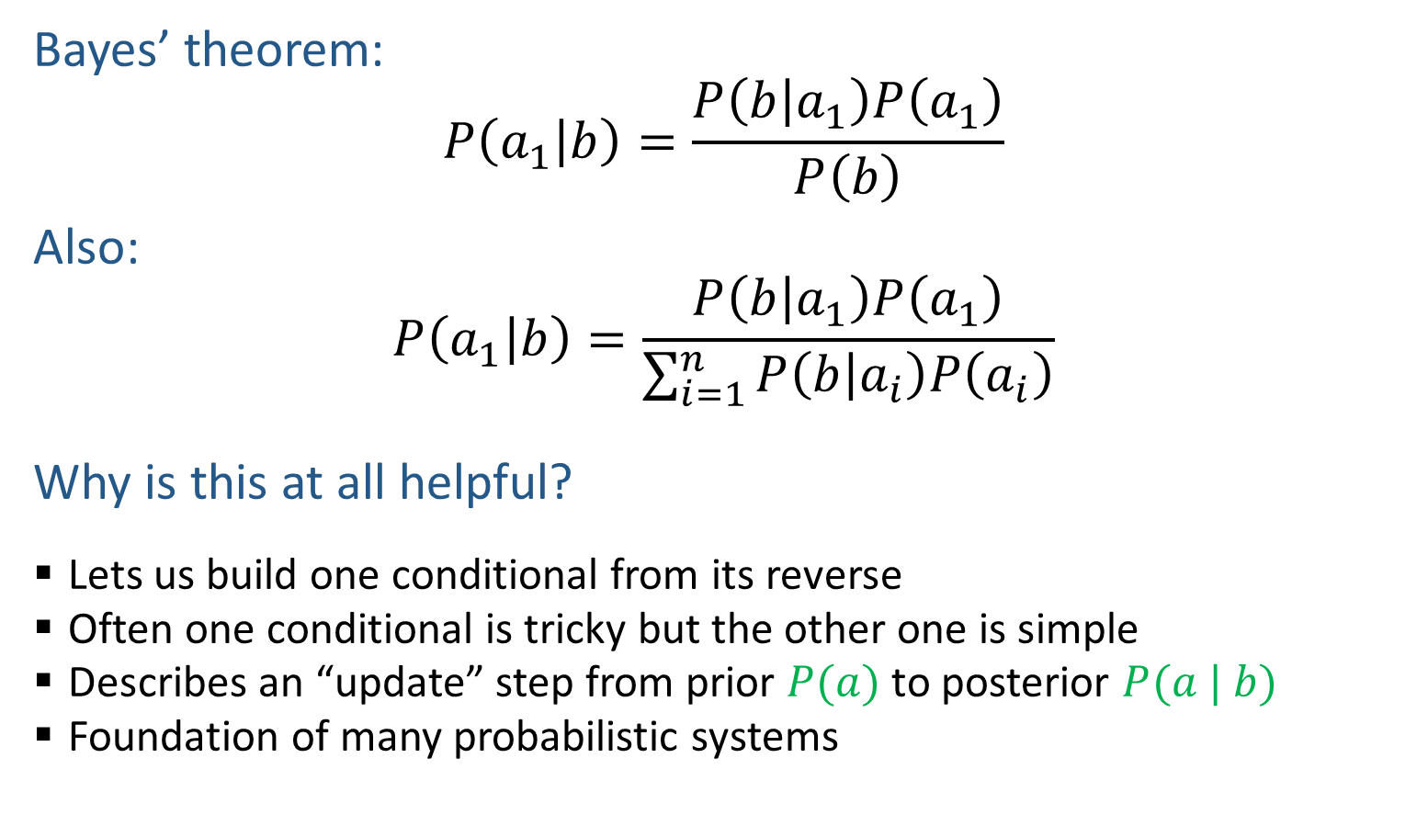
Bayes’ Theorem
Bayes’ theorem:
$$P\left(a_{1} | b\right)=\frac{P\left(b | a_{1}\right)P\left(a_{1}\right)}{P\left(b\right)}$$
Also:
$$P\left(a_{1} | b\right)=\frac{P\left(b | a_{1}\right)P\left(a_{1}\right)}{\sum_{i=1}^{n}{P\left(b | a_{i}\right)P\left(a_{i}\right)}}$$
Why is this at all helpful?
  Lets us build one conditional from its reverse
  Often one conditional is tricky but the other one is simple
  Describes an “update” step from prior $P(a)$ to posterior $P(a | b)$
  Foundation of many probabilistic systems
That’s my rule!

Slide 35
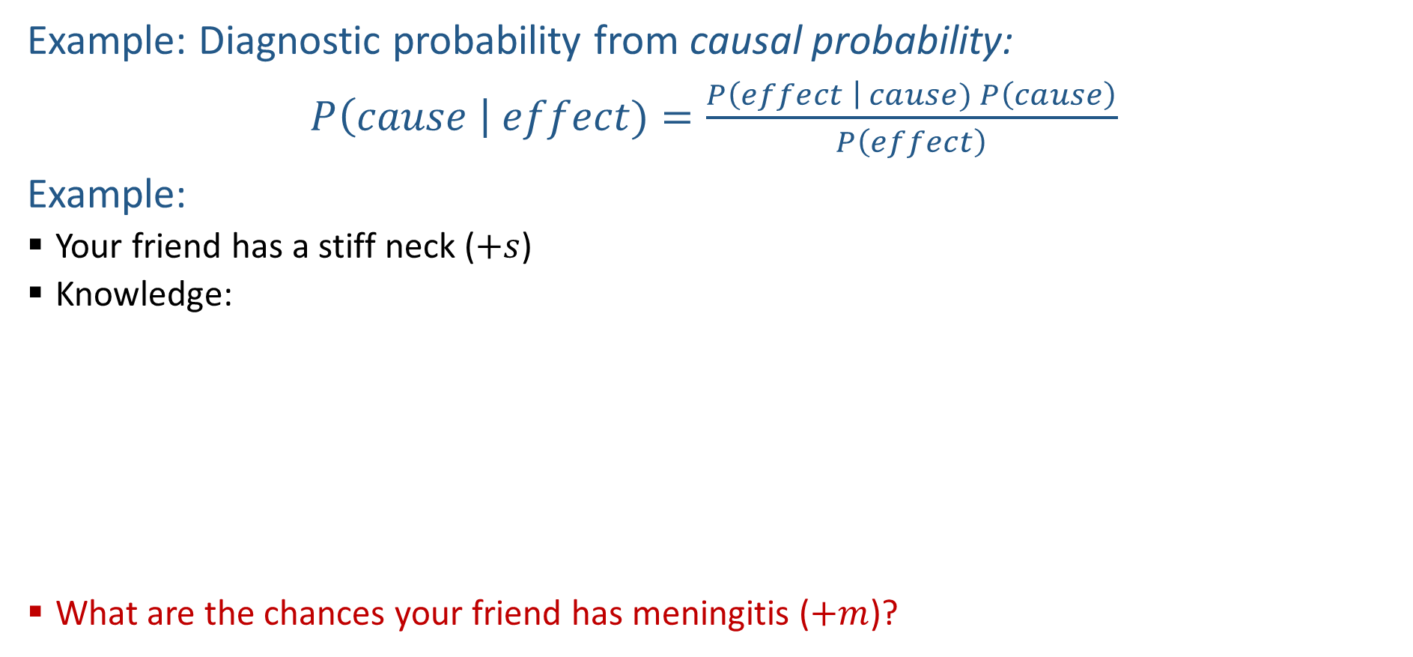
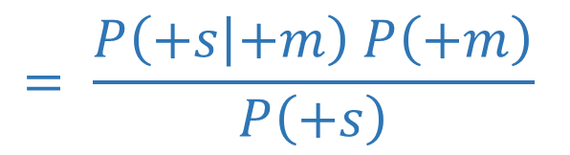
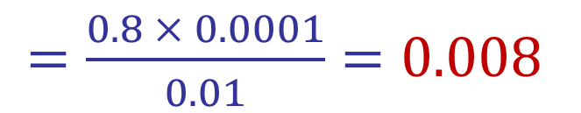


Inference with Bayes’ Theorem
Example: Diagnostic probability from causal probability:
$P\left(cause \right| effect)=\frac{P\left(effect \right| cause) P\left(cause\right)}{P\left(effect\right)}$
Example:
  Your friend has a stiff neck ($+s$)
  Knowledge:
  What are the chances your friend has meningitis ($+m$)?
$$= \frac{P\left(+s | +m\right) P\left(+m\right)}{P\left(+s\right)}$$
$$P(+m |+s)$$
$$P\left(+s\right)= 0.01$$
$$P\left(+m\right)= 0.0001$$
$$P(+s |+m) = 0.8$$
$=\frac{0.8 × 0.0001}{0.01}=0.008$

Slide 36

Probabilistic Inference
Probabilistic inference: compute a desired probability from other known probabilities (e.g. conditional from joint)
We generally compute conditional probabilities
  P(on time | no reported accidents) = 0.90
  These represent the agent’s beliefs given the evidence
Probabilities change with new evidence:
  P(on time | no accidents, 5 a.m.) = 0.95
  P(on time | no accidents, 5 a.m., raining) = 0.80
  Observing new evidence causes beliefs to be updated

Slide 37
Inference by Enumeration
P(W)?
P(W | winter)?
P(W | winter, hot)?
S | T | W | P
summer | hot | sun | 0.30
summer | hot | rain | 0.05
summer | cold | sun | 0.10
summer | cold | rain | 0.05
winter | hot | sun | 0.10
winter | hot | rain | 0.05
winter | cold | sun | 0.15
winter | cold | rain | 0.20

Slide 38











Inference by Enumeration
* Works fine with multiple query variables, too
General case:
  Evidence variables:
  Query* variable:
  Hidden variables:
We want:
All variables
Step 1: Select the entries consistent with the evidence
Step 2: Sum out H to get joint of Query and evidence
Step 3: Normalize

Slide 39
Inference by Enumeration
Obvious problems:
  Worst-case time complexity O(d^{n})
  Space complexity O(d^{n}) to store the joint distribution

Slide 40



Tools Summary
Adding to our toolbox
Definition of conditional probability
Product Rule
Bayes’ theorem
Chain Rule…
$$P\left(A | B\right)=\frac{P\left(A, B\right)}{P(B)}$$
$$P(A,B)=P\left(A | B\right)P(B)$$
$$P\left(B | A\right)=\frac{P\left(A|B\right)P(B)}{P(A)}$$

Slide 41



The Product Rule
Sometimes have conditional distributions but want the joint

Slide 42



The Product Rule
Example:
D | W | P
wet | sun | 0.1
dry | sun | 0.9
wet | rain | 0.7
dry | rain | 0.3
D | W | P
wet | sun | 0.08
dry | sun | 0.72
wet | rain | 0.14
dry | rain | 0.06
R | P
sun | 0.8
rain | 0.2

Slide 43

The Chain Rule
More generally, can always write any joint distribution as an incremental product of conditional distributions

Slide 44



Ghostbusters, Revisited
Let’s say we have two distributions:
  Prior distribution over ghost location: P(G)
    Let’s say this is uniform
  Sensor reading model: P(R | G)
    Given: we know what our sensors do
    R = reading color measured at (1,1)
    E.g. P(R = yellow | G=(1,1)) = 0.1
We can calculate the posterior distribution P(G|r) over ghost locations given a reading using Bayes’ rule:
[Demo: Ghostbuster – with probability (L12D2) ]

Slide 45
Demo Ghostbusters with Probability

