Slide 1
Safe and Nested Subgame Solving for Imperfect-Information Games NIPS 2017 Best Paper Award
Noam Brown and Tuomas Sandholm
Computer Science Department
Carnegie Mellon University

Slide 2
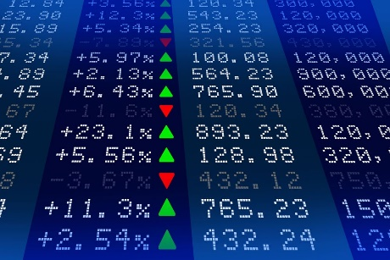
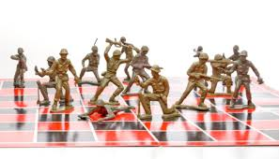
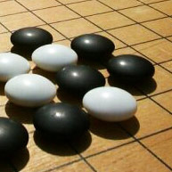
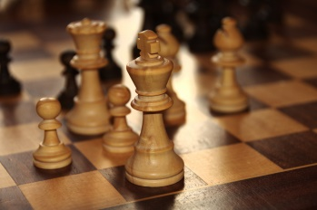
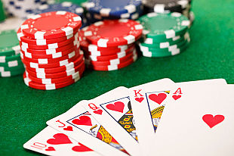


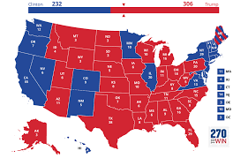
Imperfect-Information Games
Military
(spending, allocation)
Financial markets
Go
Chess
Poker
Negotiation
Security (Physical and Cyber)
Political campaigns

Slide 3
Why is Poker hard?
Notes:
Provably correct techniques

Slide 4
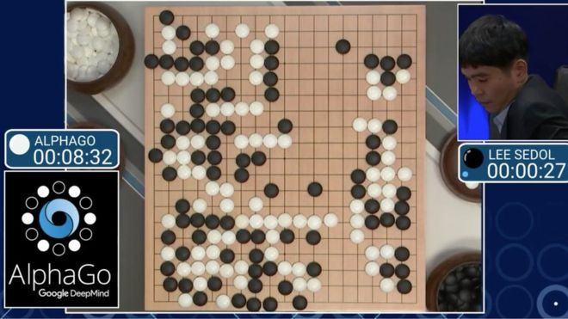
AlphaGo
AlphaGo techniques extend to all perfect-information games

Slide 5
Perfect-Information Games

Slide 6
Perfect-Information Games

Slide 7
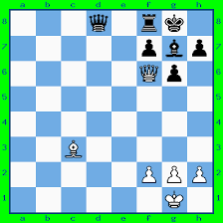
Perfect-Information Games

Slide 8
Imperfect-Information Games

Slide 9
Imperfect-Information Games
Notes:
Add a linked chain. Replace dotted lines.

Slide 10
Example Game: Coin Toss
P1 Information Set
P1 Information Set
C
P = 0.5
P = 0.5
Heads
Tails
P1
P1
EV = 0.5
EV = -0.5
P2 Information Set
Sell
Sell
Play
Play
P2
P2
Heads
Tails
Heads
Tails
-1
1
1
-1
Notes:
If it lands Heads the coin is considered lucky and P1 can sell it. If it lands Tails the coin is unlucky and P1 can pay someone to take it. Or, P1 can play, and P2 can try to guess how the coin landed.

Slide 11
Nash Equilibrium
Nash Equilibrium: a profile of strategies in which no player can improve by deviating
In two-player zero-sum games, playing a Nash equilibrium ensures the opponent can at best tie in expectation.

Slide 12
Imperfect-Information Games: Coin Toss
C
P = 0.5
P = 0.5
Heads
Tails
P1
P1
Imperfect-Information
Subgame
EV = 0.5
EV = -0.5
Sell
Sell
Play
Play
P2
P2
Heads
Tails
Heads
Tails
-1
1
1
-1

Slide 13
Imperfect-Information Games: Coin Toss
C
P = 0.5
P = 0.5
Heads
Tails
P1
P1
EV = 0.5
EV = -0.5
EV = 1.0
Sell
EV = -1.0
Sell
Play
Play
P2
P2
P = 1.0
P = 0.0
P = 1.0
P = 0.0
Heads
Tails
Heads
Tails
-1
1
1
-1
Notes:
What is the optimal strategy for P2, looking only at the subgame? Clearly if we know the exact state then we can search just like in Chess. But we only know the information set.
We can see that P1 would have sold the coin if it landed Heads, so P2 should always guess Tails.

Slide 14
Imperfect-Information Games: Coin Toss
Heads EV = 0.5
Tails EV = 1.0
Average = 0.75
C
P = 0.5
P = 0.5
Heads
Tails
P1
P1
EV = 0.5
EV = -0.5
EV = 1.0
Sell
EV = -1.0
Sell
Play
Play
P2
P2
P = 1.0
P = 0.0
P = 1.0
P = 0.0
Heads
Tails
Heads
Tails
-1
1
1
-1
Notes:
What is the optimal strategy for P2, looking only at the subgame? Clearly if we know the exact state then we can search just like in Chess. But we only know the information set.
We can see that P1 would have sold the coin if it landed Heads, so P2 should always guess Tails.

Slide 15
Imperfect-Information Games: Coin Toss
C
P = 0.5
P = 0.5
Heads
Tails
P1
P1
EV = 0.5
EV = -0.5
EV = -1.0
Sell
EV = 1.0
Sell
Play
Play
P2
P2
P = 0.0
P = 1.0
P = 0.0
P = 1.0
Heads
Tails
Heads
Tails
-1
1
1
-1
Notes:
What is the optimal strategy for P2, looking only at the subgame? Clearly if we know the exact state then we can search just like in Chess. But we only know the information set.
We can see that P1 would have sold the coin if it landed Heads, so P2 should always guess Tails.

Slide 16
Imperfect-Information Games: Coin Toss
Heads EV = 1.0
Tails EV = -0.5
Average = 0.25
C
P = 0.5
P = 0.5
Heads
Tails
P1
P1
EV = 0.5
EV = -0.5
EV = -1.0
Sell
EV = 1.0
Sell
Play
Play
P2
P2
P = 0.0
P = 1.0
P = 0.0
P = 1.0
Heads
Tails
Heads
Tails
-1
1
1
-1
Notes:
What is the optimal strategy for P2, looking only at the subgame? Clearly if we know the exact state then we can search just like in Chess. But we only know the information set.
We can see that P1 would have sold the coin if it landed Heads, so P2 should always guess Tails.

Slide 17
Imperfect-Information Games: Coin Toss
C
P = 0.5
P = 0.5
Heads
Tails
P1
P1
EV = 0.5
EV = -0.5
EV = -0.5
Sell
EV = 0.5
Sell
Play
Play
P2
P2
P = 0.25
P = 0.75
P = 0.25
P = 0.75
Heads
Tails
Heads
Tails
-1
1
1
-1
Notes:
What is the optimal strategy for P2, looking only at the subgame? Clearly if we know the exact state then we can search just like in Chess. But we only know the information set.
We can see that P1 would have sold the coin if it landed Heads, so P2 should always guess Tails.

Slide 18
Imperfect-Information Games: Coin Toss
Heads EV = 0.5
Tails EV = -0.5
Average = 0.0
C
P = 0.5
P = 0.5
Heads
Tails
P1
P1
EV = 0.5
EV = -0.5
EV = -0.5
Sell
EV = 0.5
Sell
Play
Play
P2
P2
P = 0.25
P = 0.75
P = 0.25
P = 0.75
Heads
Tails
Heads
Tails
-1
1
1
-1
Notes:
What is the optimal strategy for P2, looking only at the subgame? Clearly if we know the exact state then we can search just like in Chess. But we only know the information set.
We can see that P1 would have sold the coin if it landed Heads, so P2 should always guess Tails.

Slide 19
Imperfect-Information Games: Coin Toss
C
P = 0.5
P = 0.5
Heads
Tails
P1
P1
EV = 0.5
EV = -0.5
Sell
Sell
Play
Play
P2
P2
P = 0.25
P = 0.75
P = 0.25
P = 0.75
Heads
Tails
Heads
Tails
-1
1
1
-1
Notes:
What is the optimal strategy for P2, looking only at the subgame? Clearly if we know the exact state then we can search just like in Chess. But we only know the information set.
We can see that P1 would have sold the coin if it landed Heads, so P2 should always guess Tails.

Slide 20
Imperfect-Information Games: Coin Toss
C
P = 0.5
P = 0.5
Heads
Tails
P1
P1
EV = -0.5
EV = 0.5
Sell
Sell
Play
Play
P2
P2
P = 0.25
P = 0.75
P = 0.25
P = 0.75
Heads
Tails
Heads
Tails
-1
1
1
-1
Notes:
What is the optimal strategy for P2, looking only at the subgame? Clearly if we know the exact state then we can search just like in Chess. But we only know the information set.
We can see that P1 would have sold the coin if it landed Heads, so P2 should always guess Tails.

Slide 21
Imperfect-Information Games: Coin Toss
C
P = 0.5
P = 0.5
Heads
Tails
P1
P1
EV = -0.5
EV = 0.5
Sell
Sell
Play
Play
P2
P2
P = 0.75
P = 0.25
P = 0.75
P = 0.25
Heads
Tails
Heads
Tails
-1
1
1
-1
Notes:
What is the optimal strategy for P2, looking only at the subgame? Clearly if we know the exact state then we can search just like in Chess. But we only know the information set.
We can see that P1 would have sold the coin if it landed Heads, so P2 should always guess Tails.

Slide 22
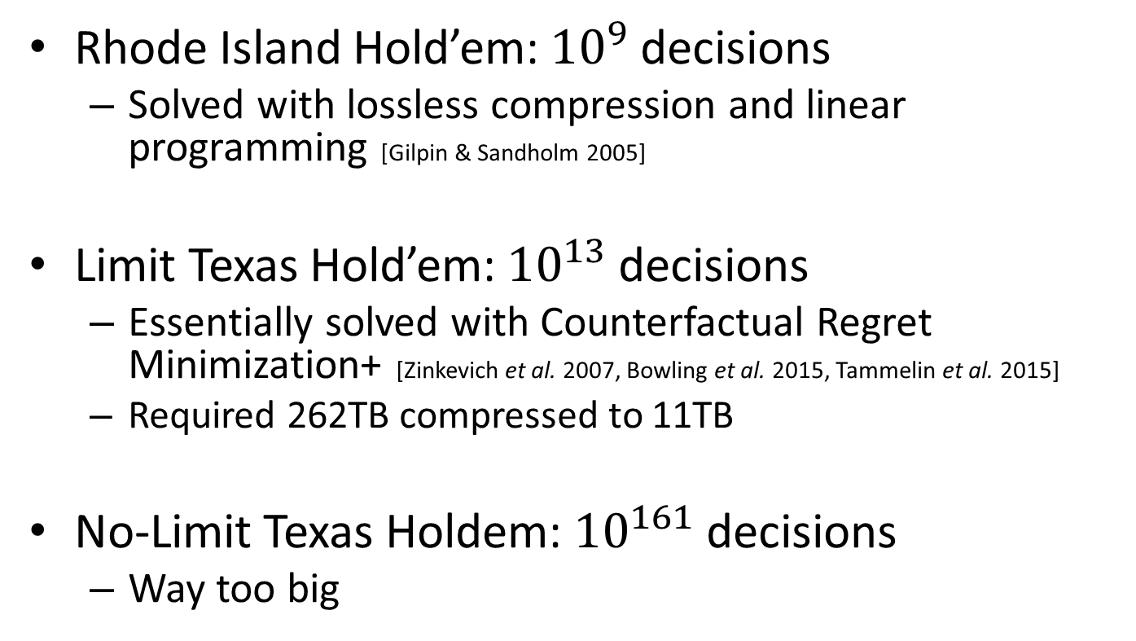
Solving the Whole Game
Rhode Island Hold’em: ${10}^{9}$ decisions
Solved with lossless compression and linear programming [Gilpin & Sandholm 2005]
Limit Texas Hold’em: ${10}^{13}$ decisions
Essentially solved with Counterfactual Regret Minimization+ [Zinkevich et al. 2007, Bowling et al. 2015, Tammelin et al. 2015]
Required 262TB compressed to 11TB
No-Limit Texas Holdem: ${10}^{161}$ decisions
Way too big

Slide 23
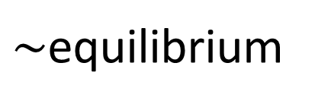
Abstraction [Gilpin & Sandholm EC-06, J. of the ACM 2007…]
Original game
Abstracted game
Automated abstraction
10¹⁶¹
Custom
equilibrium-finding
algorithm
$\sim$equilibrium
Reverse mapping
ε equilibrium
Foreshadowed by Shi & Littman 01, Billings et al. IJCAI-03
Notes:
Key idea: Have a really good abstraction (ideally, no abstraction) for the first two rounds (which is a tiny fraction of the whole game). We only play according to the abstract strategy for those two rounds.

Slide 24
Action Abstraction
P1
P2
. . .
. . .
P2
. . .
. . .
P2

Slide 25
Action Abstraction
P1
P2
. . .
. . .
P2
. . .
. . .
P2
[Gilpin et al. AAMAS-08]
[Hawkin et al. AAAI-11 AAAI-12]
[Brown & Sandholm AAAI-14]

Slide 26
Action Translation
P1
P2
. . .
. . .
P2
. . .
. . .
P2
[Gilpin et al. AAMAS-08]
[Schnizlein et al. IJCAI-09]
[Ganzfried & Sandholm IJCAI-13]

Slide 27
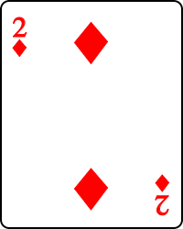
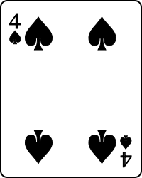
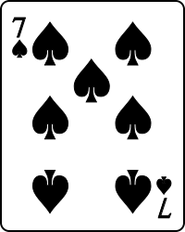
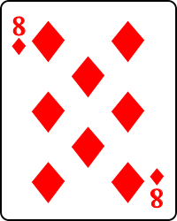
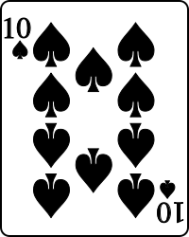
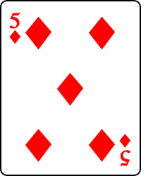
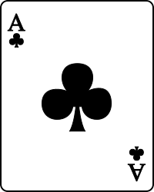
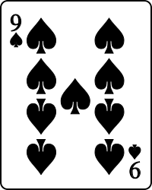
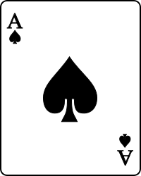
Card Abstraction [Johanson et al. AAMAS-13, Ganzfried & Sandholm AAAI-14]
Best Hand:
Grouped together

Slide 28
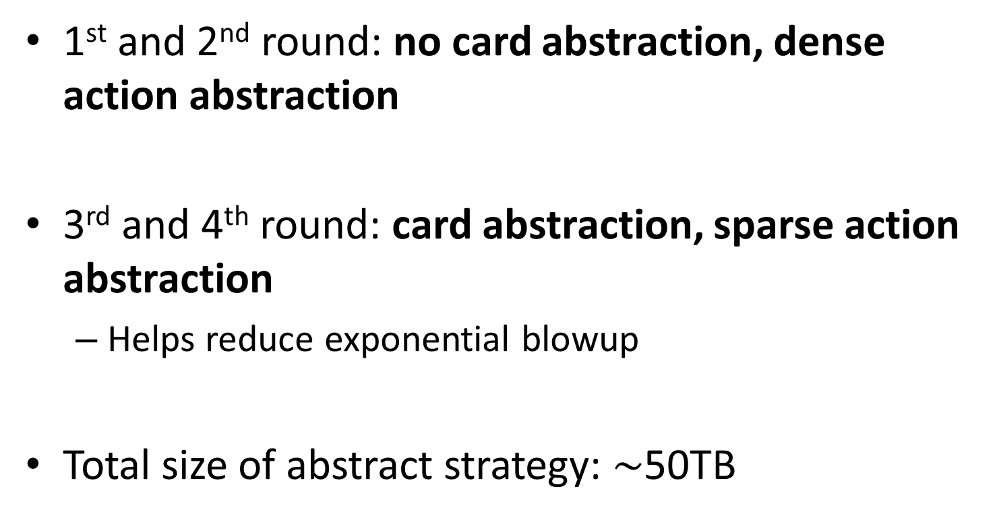
Libratus Abstraction
1st and 2nd round: no card abstraction, dense action abstraction
3rd and 4th round: card abstraction, sparse action abstraction
Helps reduce exponential blowup
Total size of abstract strategy: $\sim$50TB
Notes:
Potential aware, imperfect recall, earthmover distance

Slide 29
Subgame Solving [Burch et al. AAAI-14, Moravcik et al. AAAI-16, Brown & Sandholm NIPS-17]
Notes:
Add Sam’s AAMAS paper

Slide 30
Subgame Solving [Burch et al. AAAI-14, Moravcik et al. AAAI-16, Brown & Sandholm NIPS-17]

Slide 31
Subgame Solving [Burch et al. AAAI-14, Moravcik et al. AAAI-16, Brown & Sandholm NIPS-17]

Slide 32
Coin Toss
C
P = 0.5
P = 0.5
Heads
Tails
P1
P1
Sell
Sell
Play
Play
EV = 0.5
EV = -0.5
P2
P2
Heads
Tails
Heads
Tails
-1
1
1
-1
Notes:
What is the optimal strategy for P2, looking only at the subgame? Clearly if we know the exact state then we can search just like in Chess. But we only know the information set.
We can see that P1 would have sold the coin if it landed Heads, so P2 should always guess Tails.

Slide 33
Blueprint Strategy
C
P = 0.5
P = 0.5
Heads
Tails
P1
P = 0.7
P1
P = 0.2
P = 0.3
Sell
P = 0.8
Sell
Play
Play
EV = 0.5
EV = -0.5
EV = -0.5
EV = 0.5
P2
P2
P = 0.75
P = 0.25
P = 0.75
P = 0.25
Heads
Tails
Heads
Tails
-1
1
1
-1
Notes:
What is the optimal strategy for P2, looking only at the subgame? Clearly if we know the exact state then we can search just like in Chess. But we only know the information set.
We can see that P1 would have sold the coin if it landed Heads, so P2 should always guess Tails.

Slide 34
Unsafe Subgame Solving [Ganzfried & Sandholm AAMAS 2015]
Assume the opponent plays according to the trunk strategy
This gives a belief distribution over states
Update beliefs via Bayes Rule
50% Probability
C
50% Probability
P = 0.5
P = 0.5
Heads
Tails
P1
P = 0.7
P1
P = 0.2
P = 0.3
Sell
P = 0.8
Sell
Play
Play
EV = 0.5
EV = -0.5
EV = -0.5
EV = 0.5
P2
P2
P = 0.75
P = 0.25
P = 0.75
P = 0.25
Heads
Tails
Heads
Tails
-1
1
1
-1
Notes:
What is the optimal strategy for P2, looking only at the subgame? Clearly if we know the exact state then we can search just like in Chess. But we only know the information set.
We can see that P1 would have sold the coin if it landed Heads, so P2 should always guess Tails.

Slide 35
Unsafe Subgame Solving [Ganzfried & Sandholm AAMAS 2015]
Assume the opponent plays according to the trunk strategy
This gives a belief distribution over states
Update beliefs via Bayes Rule
C
P = 0.5
P = 0.5
Heads
Tails
P1
P = 0.7
P1
P = 0.2
P = 0.3
Sell
P = 0.8
Sell
Play
Play
EV = 0.5
EV = -0.5
EV = -0.5
EV = 0.5
73% Probability
27% Probability
P2
P2
P = 0.75
P = 0.25
P = 0.75
P = 0.25
Heads
Tails
Heads
Tails
-1
1
1
-1
Notes:
What is the optimal strategy for P2, looking only at the subgame? Clearly if we know the exact state then we can search just like in Chess. But we only know the information set.
We can see that P1 would have sold the coin if it landed Heads, so P2 should always guess Tails.

Slide 36
Unsafe Subgame Solving [Ganzfried & Sandholm AAMAS 2015]
Assume the opponent plays according to the trunk strategy
This gives a belief distribution over states
Update beliefs via Bayes Rule
C
P = 0.5
P = 0.5
Heads
Tails
P1
P = 0.7
P1
P = 0.2
P = 0.3
Sell
P = 0.8
Sell
Play
Play
EV = 0.5
EV = -0.5
EV = -1.0
EV = 1.0
73% Probability
27% Probability
P2
P2
P = 1.0
P = 0.0
P = 1.0
P = 0.0
Heads
Tails
Heads
Tails
-1
1
1
-1
Notes:
What is the optimal strategy for P2, looking only at the subgame? Clearly if we know the exact state then we can search just like in Chess. But we only know the information set.
We can see that P1 would have sold the coin if it landed Heads, so P2 should always guess Tails.

Slide 37
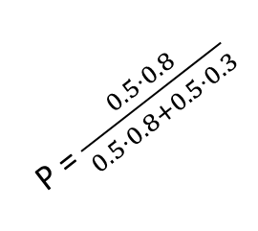
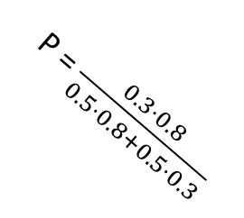
Unsafe Subgame Solving [Ganzfried & Sandholm AAMAS 2015]
Create an augmented subgame that contains the subgame and a few additional nodes
In the augmented subgame, chance reaches one of the subgame roots with probability proportional to both players playing the blueprint strategy
Blueprint Strategy
Augmented Subgame
C
P = 0.5
P = 0.5
Heads
Tails
P = 0.2
P1
P = 0.8
P = 0.7
P1
P = 0.3
C
Sell
EV = -0.5
Sell
EV = 0.5
Play
Play
P = $\frac{0.5⋅0.8}{0.5⋅0.8+0.5⋅0.3}$
P = $\frac{0.3⋅0.8}{0.5⋅0.8+0.5⋅0.3}$
EV = 0.5
EV = -0.5
P2
P2
P2
P2
P = 0.75
P = 0.25
P = 0.75
P = 0.25
P = 0.0
P = 0.0
Heads
Tails
Heads
Tails
P = 1.0
Tails
P = 1.0
Tails
Heads
Heads
-1
1
1
-1
-1
1
1
-1

Slide 38
Subgame Resolving [Burch et al. AAAI 2014]
In the augmented subgame, chance reaches one of the subgame roots with probability proportional to P1 attempting to reach the subgame, and P2 playing the blueprint. P1 then chooses between actions:
Enter: Enter the subgame, proceed normally thereafter
Alt: Take the EV (at this P1 infoset) of playing optimally against P2’s blueprint subgame strategy
Blueprint Strategy
C
P = 0.5
P = 0.5
Heads
Tails
P1
P1
Sell
EV = -0.5
Sell
EV = 0.5
Play
Play
EV = 0.5
EV = -0.5
P2
P2
P = 0.75
P = 0.25
P = 0.75
P = 0.25
Heads
Tails
Heads
Tails
-1
1
1
-1
Notes:
Make the triangles not go out of frame

Slide 39
Subgame Resolving [Burch et al. AAAI 2014]
In the augmented subgame, chance reaches one of the subgame roots with probability proportional to P1 attempting to reach the subgame, and P2 playing the blueprint. P1 then chooses between actions:
Enter: Enter the subgame, proceed normally thereafter
Alt: Take the EV (at this P1 infoset) of playing optimally against P2’s blueprint subgame strategy
Blueprint Strategy
Augmented Subgame
C
C
P = 0.5
P = 0.5
Heads
Tails
P = 0.5
P = 0.5
P1
P1
P1
P1
Sell
EV = -0.5
Sell
EV = 0.5
Alt
Alt
Play
Play
Enter
Enter
EV = 0.5
EV = -0.5
-0.5
0.5
P2
P2
P2
P2
P = 0.75
P = 0.25
P = 0.75
P = 0.25
Heads
Tails
Heads
Tails
Heads
Tails
Heads
Tails
-1
1
1
-1
-1
1
1
-1

Slide 40
Subgame Resolving [Burch et al. AAAI 2014]
In the augmented subgame, chance reaches one of the subgame roots with probability proportional to P1 attempting to reach the subgame, and P2 playing the blueprint. P1 then chooses between actions:
Enter: Enter the subgame, proceed normally thereafter
Alt: Take the EV (at this P1 infoset) of playing optimally against P2’s blueprint subgame strategy
Blueprint Strategy
Augmented Subgame
C
C
P = 0.5
P = 0.5
Heads
Tails
P = 0.5
P = 0.5
P1
P1
P1
P1
Sell
EV = -0.5
Sell
EV = 0.5
Alt
Alt
Play
Play
Enter
Enter
EV = 0.5
EV = -0.5
-0.5
0.5
EV = -1.0
EV = 1.0
P2
P2
P2
P2
P = 0.75
P = 0.25
P = 0.75
P = 0.25
P = 1.00
P = 0.00
P = 1.00
P = 0.00
Heads
Tails
Heads
Tails
Heads
Tails
Heads
Tails
-1
1
1
-1
-1
1
1
-1

Slide 41
Subgame Resolving [Burch et al. AAAI 2014]
In the augmented subgame, chance reaches one of the subgame roots with probability proportional to P1 attempting to reach the subgame, and P2 playing the blueprint. P1 then chooses between actions:
Enter: Enter the subgame, proceed normally thereafter
Alt: Take the EV (at this P1 infoset) of playing optimally against P2’s blueprint subgame strategy
Blueprint Strategy
Augmented Subgame
C
C
P = 0.5
P = 0.5
Heads
Tails
P = 0.5
P = 0.5
P1
P1
P1
P1
Sell
EV = -0.5
Sell
EV = 0.5
Alt
Alt
Play
Play
Enter
Enter
EV = 0.5
EV = -0.5
-0.5
0.5
EV = -0.5
EV = 0.5
P2
P2
P2
P2
P = 0.75
P = 0.25
P = 0.75
P = 0.25
P = 0.75
P = 0.25
P = 0.75
P = 0.25
Heads
Tails
Heads
Tails
Heads
Tails
Heads
Tails
-1
1
1
-1
-1
1
1
-1

Slide 42
Subgame Resolving [Burch et al. AAAI 2014]
Theorem: Resolving will produce a strategy with exploitability no higher than the blueprint
Why not just use the blueprint then?
Don’t need to store the entire subgame strategy. Just store the root EVs and reconstruct the strategy in real time
Guaranteed to do no worse, but may do better!

Slide 43
Subgame Resolving [Burch et al. AAAI 2014]
Question: Why set the value of “Alt” according to the “Play” subgame? Why not to the “Sell” subgame?
Answer: If P1 chose the “Sell” action, we would have applied subgame solving to the “Sell” subgame, so the P1 EV for “Sell” would not be what the blueprint says. Resolving guarantees the EVs of a subgame will never increase.
Blueprint Strategy
Augmented Subgame
C
C
P = 0.5
P = 0.5
Heads
Tails
P = 0.5
P = 0.5
P1
P1
P1
P1
Sell
EV = -0.5
Sell
EV = 0.5
Alt
Alt
Play
Play
Enter
Enter
EV = 0.5
EV = -0.5
-0.5
0.5
EV = -0.5
EV = 0.5
P2
P2
P2
P2
P = 0.75
P = 0.25
P = 0.75
P = 0.25
P = 0.75
P = 0.25
P = 0.75
P = 0.25
Heads
Tails
Heads
Tails
Heads
Tails
Heads
Tails
-1
1
1
-1
-1
1
1
-1

Slide 44
Reach Subgame Solving [Brown & Sandholm NIPS 2017]
Blueprint Strategy
P = 0.5
C
P = 0.5
Heads
Tails
P1
EV = 0.0
P1
EV = 0.0
Sell
Play
Sell
Play
EV = 0.5
C
EV = -0.5
C
P = 0.5
P = 0.5
P = 0.5
P = 0.5
P2
P2
P2
P2
P = 0.5
Tails
P = 0.5
P = 0.5
P = 0.5
P = 0.5
Tails
Tails
Heads
Heads
P = 0.5
Heads
Tails
Heads
P = 0.5
P = 0.5
-1
1
1
-1
-1
1
1
-1

Slide 45
Reach Subgame Solving [Brown & Sandholm NIPS 2017]
Blueprint Strategy
P = 0.5
C
P = 0.5
Heads
Tails
P1
EV = 0.0
P1
EV = 0.0
Sell
Play
Sell
Play
EV = 0.5
C
EV = -0.5
C
P = 0.5
P = 0.5
P = 0.5
P = 0.5
P2
P2
P2
P2
P = 0.0
Tails
P = 0.0
P = 0.5
P = 0.5
P = 1.0
Tails
Tails
Heads
Heads
P = 1.0
Heads
Tails
Heads
P = 0.5
P = 0.5
-1
1
1
-1
-1
1
1
-1

Slide 46
Reach Subgame Solving [Brown & Sandholm NIPS 2017]
Blueprint Strategy
P = 0.5
C
P = 0.5
Heads
Tails
P1
EV = 0.5
P1
EV = -0.5
Sell
Play
Sell
Play
EV = 0.5
C
EV = -0.5
C
P = 0.5
P = 0.5
P = 0.5
P = 0.5
P2
P2
P2
P2
P = 0.0
Tails
P = 0.0
P = 0.5
P = 0.5
P = 1.0
Tails
Tails
Heads
Heads
P = 1.0
Heads
Tails
Heads
P = 0.5
P = 0.5
-1
1
1
-1
-1
1
1
-1

Slide 47
Reach Subgame Solving [Brown & Sandholm NIPS 2017]
Blueprint Strategy
P = 0.5
C
P = 0.5
Heads
Tails
P1
EV = 0.0
P1
EV = 0.0
Sell
Play
Sell
Play
EV = 0.5
C
EV = -0.5
C
P = 0.5
P = 0.5
P = 0.5
P = 0.5
P2
P2
P2
P2
P = 0.5
Tails
P = 0.5
P = 0.5
P = 0.5
P = 0.5
Tails
Tails
Heads
Heads
P = 0.5
Heads
Tails
Heads
P = 0.5
P = 0.5
-1
1
1
-1
-1
1
1
-1

Slide 48
Reach Subgame Solving [Brown & Sandholm NIPS 2017]
Blueprint Strategy
P = 0.5
C
P = 0.5
Heads
Tails
P1
EV = 0.0
P1
EV = 0.0
Sell
Play
Sell
Play
EV = 0.5
C
EV = -0.5
C
P = 0.5
P = 0.5
P = 0.5
P = 0.5
P2
P2
P2
P2
P = 0.5
Tails
P = 0.5
P = 0.0
P = 0.0
P = 0.5
Tails
Tails
Heads
Heads
P = 0.5
Heads
Tails
Heads
P = 1.0
P = 1.0
-1
1
1
-1
-1
1
1
-1

Slide 49
Reach Subgame Solving [Brown & Sandholm NIPS 2017]
Blueprint Strategy
P = 0.5
C
P = 0.5
Heads
Tails
P1
EV = 0.5
P1
EV = -0.5
Sell
Play
Sell
Play
EV = 0.5
C
EV = -0.5
C
P = 0.5
P = 0.5
P = 0.5
P = 0.5
P2
P2
P2
P2
P = 0.5
Tails
P = 0.5
P = 0.0
P = 0.0
P = 0.5
Tails
Tails
Heads
Heads
P = 0.5
Heads
Tails
Heads
P = 1.0
P = 1.0
-1
1
1
-1
-1
1
1
-1

Slide 50
Reach Subgame Solving [Brown & Sandholm NIPS 2017]
Blueprint Strategy
P = 0.5
C
P = 0.5
Heads
Tails
P1
EV = 1.0
P1
EV = -1.0
Sell
Play
Sell
Play
EV = 0.5
C
EV = -0.5
C
P = 0.5
P = 0.5
P = 0.5
P = 0.5
P2
P2
P2
P2
P = 0.0
Tails
P = 0.0
P = 0.0
P = 0.0
P = 1.0
Tails
Tails
Heads
Heads
P = 1.0
Heads
Tails
Heads
P = 1.0
P = 1.0
-1
1
1
-1
-1
1
1
-1

Slide 51
Reach Subgame Solving [Brown & Sandholm NIPS 2017]
P = 0.5
C
P = 0.5
Heads
Tails
Blueprint Strategy
P1
EV = 0.0
P1
EV = 0.0
Difference is a gift
Increase alt by this
Sell
Play
Sell
Play
EV = 0.5
C
EV = -0.5
C
P = 0.5
P = 0.5
P = 0.5
P = 0.5
P2
P2
P2
P2
P = 0.5
Tails
P = 0.5
P = 0.5
P = 0.5
P = 0.5
Tails
Tails
Heads
Heads
P = 0.5
Heads
Tails
Heads
P = 0.5
P = 0.5
-1
1
1
-1
-1
1
1
-1
C
P = 0.5
P = 0.5
P1
EV = 0.0
P1
EV = 0.0
Resolving
Augmented Subgame
Alt
Enter
Alt
Enter
EV = 0.0
EV = 0.0
P2
P2
P = 0.5
Tails
P = 0.5
P = 0.5
Tails
Heads
Heads
P = 0.5
-1
1
1
-1

Slide 52
Reach Subgame Solving [Brown & Sandholm NIPS 2017]
P = 0.5
C
P = 0.5
Heads
Tails
Blueprint Strategy
P1
EV = 0.0
P1
EV = 0.0
Difference is a gift
Increase alt by this
Sell
Play
Sell
Play
EV = 0.5
C
EV = -0.5
C
P = 0.5
P = 0.5
P = 0.5
P = 0.5
P2
P2
P2
P2
P = 0.5
Tails
P = 0.5
P = 0.5
P = 0.5
P = 0.5
Tails
Tails
Heads
Heads
P = 0.5
Heads
Tails
Heads
P = 0.5
P = 0.5
-1
1
1
-1
-1
1
1
-1
C
P = 0.5
P = 0.5
P1
EV = 0.5
P1
EV = -0.5
Reach
Augmented Subgame
Alt
Enter
Alt
Enter
EV = 0.5
EV = 0.0
P2
P2
P = 0.25
Tails
P = 0.25
P = 0.75
Tails
Heads
Heads
P = 0.75
-1
1
1
-1

Slide 53
Reach Subgame Solving [Brown & Sandholm NIPS 2017]
P = 0.5
C
P = 0.5
Heads
Tails
Blueprint Strategy
P1
EV = 0.0
P1
EV = 0.0
Sell
Play
Sell
Play
Actual EV might be less,
so use a lower bound
EV = 0.5
C
EV = -0.5
C
P = 0.5
P = 0.5
P = 0.5
P = 0.5
P2
P2
P2
P2
P = 0.5
Tails
P = 0.5
P = 0.5
P = 0.5
P = 0.5
Tails
Tails
Heads
Heads
P = 0.5
Heads
Tails
Heads
P = 0.5
P = 0.5
-1
1
1
-1
-1
1
1
-1
C
P = 0.5
P = 0.5
P1
EV = 0.5
P1
EV = -0.5
Reach
Augmented Subgame
Alt
Enter
Alt
Enter
EV = 0.5
EV = 0.0
P2
P2
P = 0.25
Tails
P = 0.25
P = 0.75
Tails
Heads
Heads
P = 0.75
-1
1
1
-1

Slide 54
Reach Subgame Solving [Brown & Sandholm NIPS 2017]
P = 0.5
C
P = 0.5
Heads
Tails
Blueprint Strategy
P1
EV = 0.0
P1
EV = 0.0
Sell
Play
Sell
Play
Actual EV might be less,
so use a lower bound
EV = 0.25
C
EV = -0.5
C
P = 0.5
P = 0.5
P = 0.5
P = 0.5
P2
P2
P2
P2
P = 0.5
Tails
P = 0.5
P = 0.5
P = 0.5
P = 0.5
Tails
Tails
Heads
Heads
P = 0.5
Heads
Tails
Heads
P = 0.5
P = 0.5
-1
1
1
-1
-1
1
1
-1
C
P = 0.5
P = 0.5
P1
EV = 0.25
P1
EV = -0.25
Reach
Augmented Subgame
Alt
Enter
Alt
Enter
EV = 0.25
EV = 0.0
P2
P2
P = 0.125
Tails
P = 0.125
Tails
Heads
P = 0.875
Heads
P = 0.875
-1
1
1
-1

Slide 55
Reach Subgame Solving [Brown & Sandholm NIPS 2017]
Theorem: Reach Subgame Solving will never do worse than Resolving, and in certain cases will do better!

Slide 56
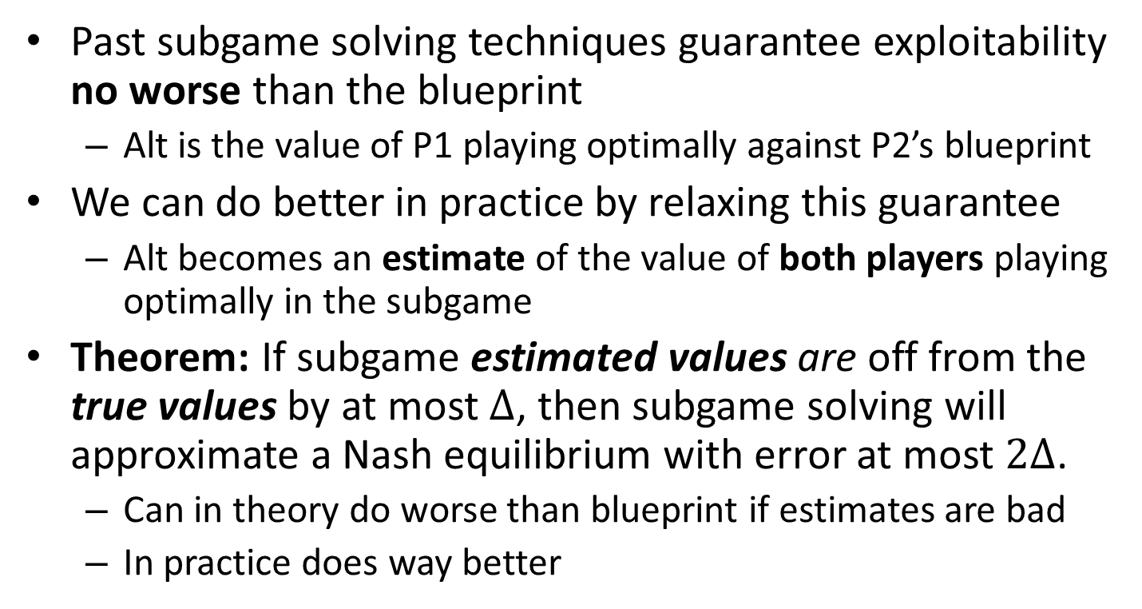
Estimates vs Upper Bounds [Brown & Sandholm NIPS 2017]
Past subgame solving techniques guarantee exploitability no worse than the blueprint
Alt is the value of P1 playing optimally against P2’s blueprint
We can do better in practice by relaxing this guarantee
Alt becomes an estimate of the value of both players playing optimally in the subgame
Theorem: If subgame estimated values are off from the true values by at most $Δ$, then subgame solving will approximate a Nash equilibrium with error at most $2Δ$.
Can in theory do worse than blueprint if estimates are bad
In practice does way better
Notes:
Make it clear this is not a separate technique, but applies to all techniques (same with reach subgame solving)

Slide 57



How good are our estimates?
Test game of Flop Texas Hold’em using an abstraction that is $0.02\%$ of the full game size:
-21 mbb/h
35 mbb/h
38 mbb/h
112 mbb/h
$P_{1}$ value when $P_{2}$
plays a perfect response
Estimated game value
according to abstraction
True Nash equilibrium
game value
$P_{1}$ value when $P_{1}$
plays a perfect response

Slide 58
Medium-scale experiments on subgame solving within action abstraction
 | Small Game Exploitability | Large Game Exploitability
Blueprint Strategy | 91.3 mbb / hand | 41.4 mbb / hand
Unsafe Subgame Solving | 5.51 mbb / hand | 397 mbb / hand
Re-solving | 54.1 mbb / hand | 23.1 mbb / hand
Maxmargin | 43.4 mbb / hand | 19.5 mbb / hand
Reach-Maxmargin | 25.9 mbb / hand | 16.4 mbb / hand
Estimate | 24.2 mbb / hand | 30.1 mbb / hand
Reach-Estimate (Dist.) | 17.3 mbb / hand | 8.8 mbb / hand
Notes:
Add a row for Reach-Estimate, and another for just Distributional (or leave Distributional out for some slidedecks)

Slide 59
Action Abstraction
P1
P2
. . .
. . .
P2
. . .
. . .
P2

Slide 60
Action Abstraction
P1
P2
. . .
. . .
P2
. . .
. . .
P2
[Gilpin et al. AAMAS-08]
[Hawkin et al. AAAI-11 AAAI-12]
[Brown & Sandholm AAAI-14]

Slide 61
Action Translation
P1
P2
. . .
. . .
P2
. . .
. . .
P2
[Gilpin et al. AAMAS-08]
[Schnizlein et al. IJCAI-09]
[Ganzfried & Sandholm IJCAI-13]

Slide 62
Nested Subgame Solving [Brown & Sandholm NIPS 2017]
Idea: Solve a subgame in real time for the off-tree action taken
But we don’t have an estimate of the value for this subgame!
P1
P1
EV = z
Alt
Enter
EV = x
EV = y
P2
P2
P2
?
P2

Slide 63
Nested Subgame Solving [Brown & Sandholm NIPS 2017]
Idea: Solve a subgame in real time for the off-tree action taken
Use the best in-abstraction action as the alternative payoff
If subgame value is lower, the difference is a gift anyway
Can be repeated for every subsequent off-tree action
Theorem. If the subgame values are no higher than an in-abstraction action’s value, then game with the added action is still a Nash equilibrium
P1
P1
EV = z
Alt
Enter
EV = x
EV = y
P2
P2
P2
P2
max(x,y,z)

Slide 64
Medium-scale experiments on nested subgame solving
 | Exploitability
Randomized Pseudo-Harmonic Translation | 146.5 mbb / hand
Nested Unsafe Subgame Solving | 14.83 mbb / hand
Nested Safe Subgame Solving | 11.91 mbb / hand
Notes:
Add all the rows (also update numbers)

Slide 65
Head-to-head strength of recent AIs
Stronger
Ours
Others’
Libratus (1/2017)
Baby Tartanian8 (12/2015)
ACPC 2016 winner
Claudico (4/2015)
Tartanian7 (5/2014)
ACPC 2014 winner
63 mbb / hand
DeepStack (11/2016)
Slumbot (12/2015)
-12 mbb / hand
-25 mbb / hand

Slide 66
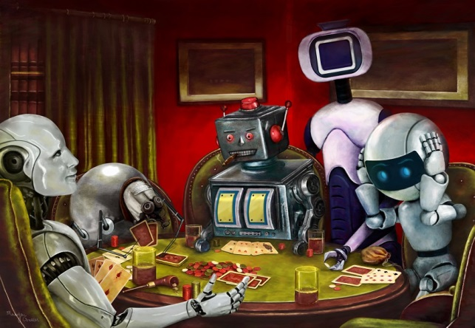
Questions?

Slide 67
What about 3+ players?
Theoretically problematic
With 3+ players, it is still possible to lose in expectation when playing Nash
Calculating Nash becomes PPAD-complete
Unclear if other solution concepts (e.g., Extensive-Form Correlated Equilibrium) are appropriate
How do we evaluate against humans?
In pratice, same techniques do well in poker anyway
3+ players poses an interesting challenge, but there are better domains for evaluation than poker
Not much player interaction in poker

Slide 68
Conservative experiment design to favor humans
Large number of hands
Humans got to choose:
#days, break days, times of day, breaks between sessions—even dynamically
Two tabling
4-color deck
Hot keys, adjustable dynamically
Specific hi-res monitors, their own mice
Twitch chat on vs off
Play in public vs private within each pair
200 big blinds deep
Hand histories given to both sides every evening, including hands opponent folded
Humans allowed to:
Use computers and any programs to analyze
Collaborate and coordinate actions (except within each hand)
Get outside help (e.g., Doug Polk)
Humans allowed to think as long as they want
Mis-click hands canceled
Ginseng ☺

