Slide 1
Deep networks in the brain
(AI and the Brain III)
Tai Sing Lee
15-381/681 AI Lecture 24
Reading:
Yamins and DiCarlo (2016) Using goal-driven deep learning models to understand sensory cortex. Nature Neuroscience.
George D et al. (2017) A generative vision model that trains with high data efficiency and breaks text-based CCAPTCHAs. Science.
Goodfellow, … Courville, Aaron; Bengio, Joshua (2014). "Generative Adversarial Networks". arXiv:1406.2661
Distill: Using AI to augment human intelligence.

Slide 2
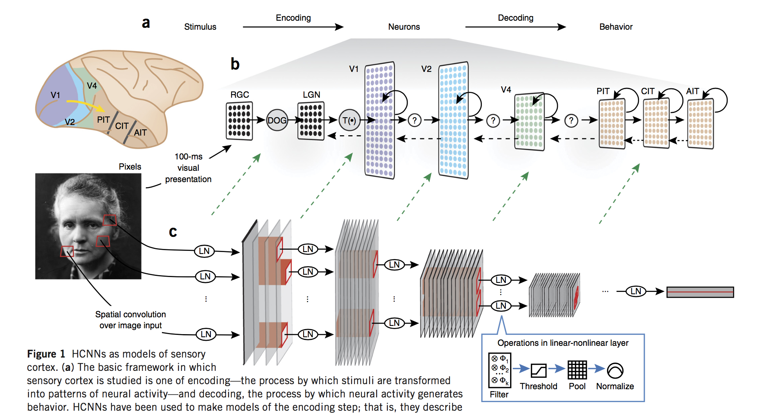
Hierarchical CNN as models of sensory cortex
Yamins and DiCarlo (2016) Using goal-driven deep learning models to understand sensory cortex. Nature Neuroscience.

Slide 3
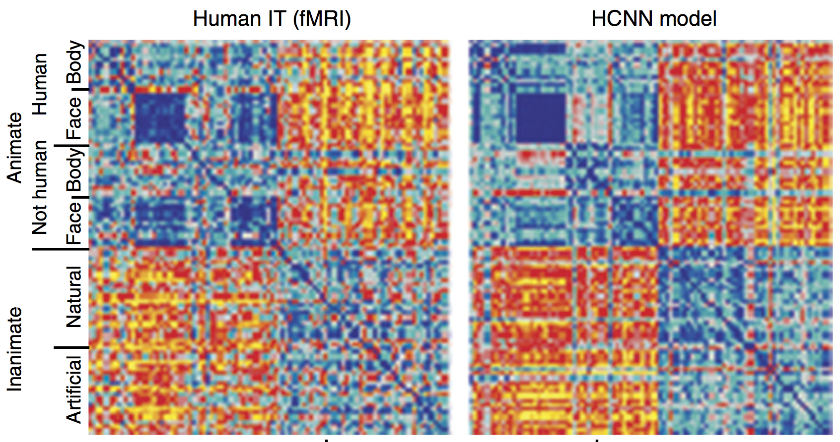
Hierarchical CNN as models of sensory cortex
Neural representation of stimuli are similar to HCNN at the population level.

Slide 4
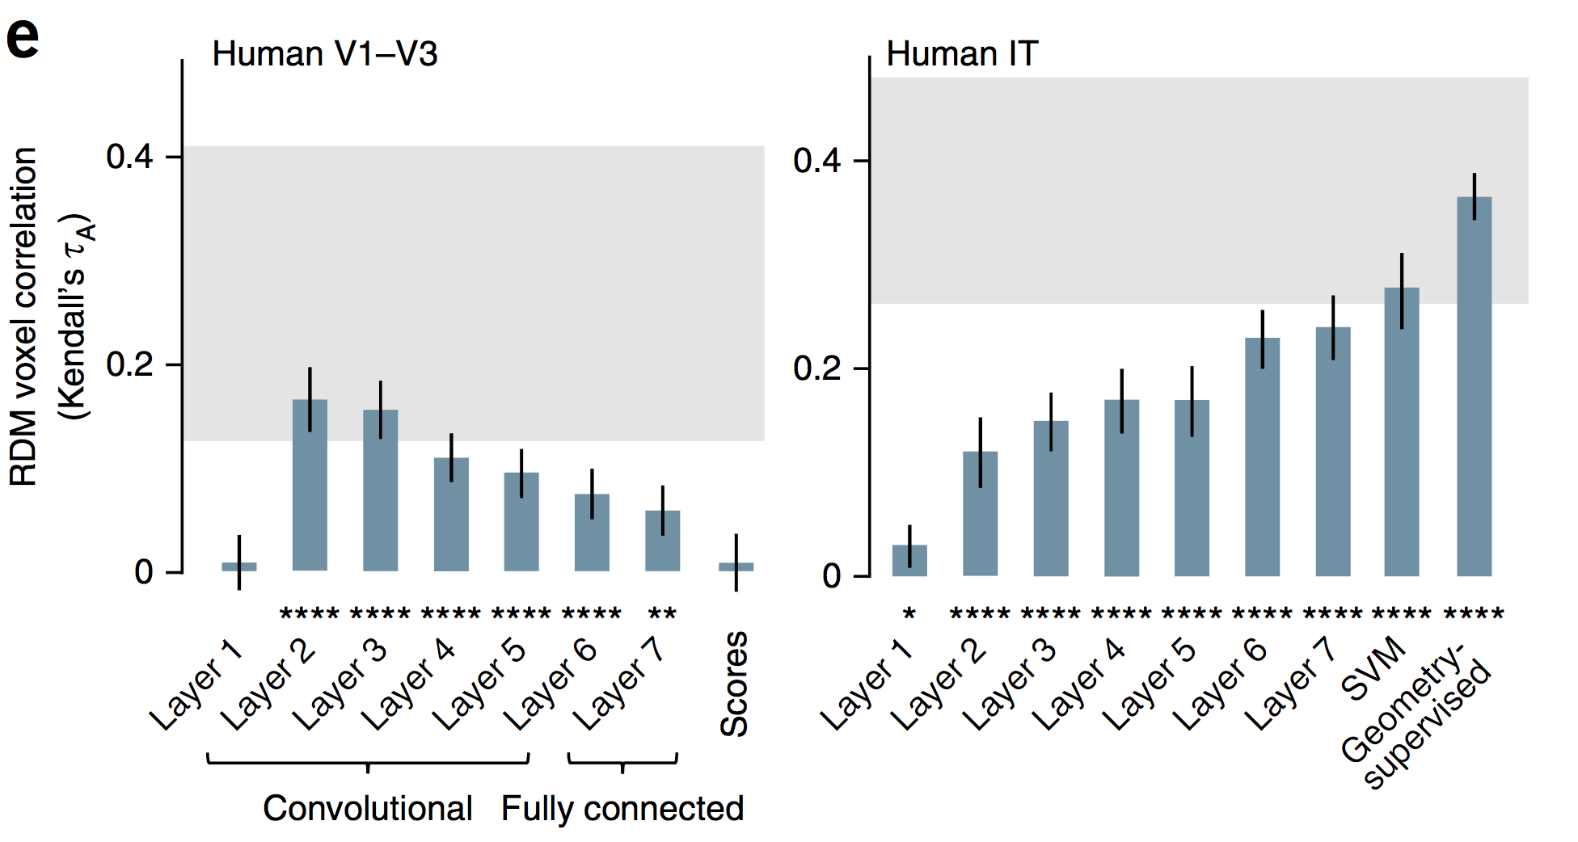
Hierarchical CNN as models of sensory cortex
Neural representation of stimuli are similar to HCNN at the population level.

Slide 5
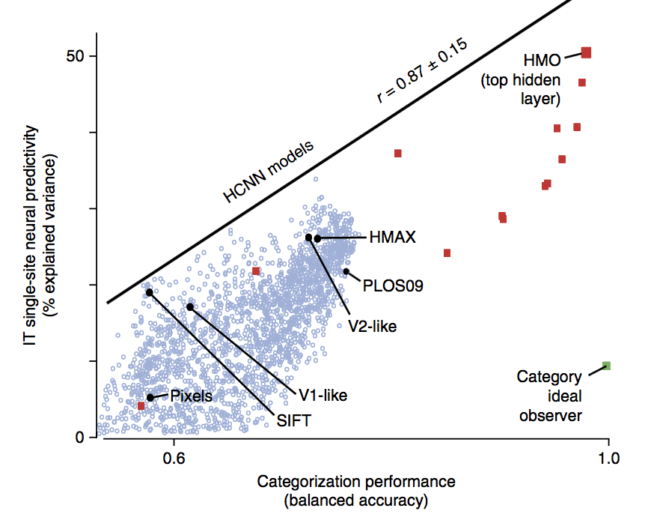
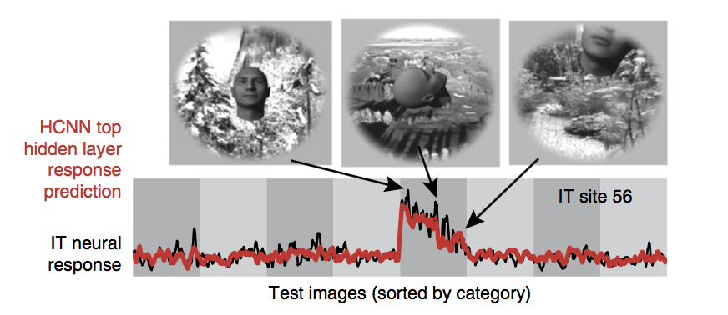
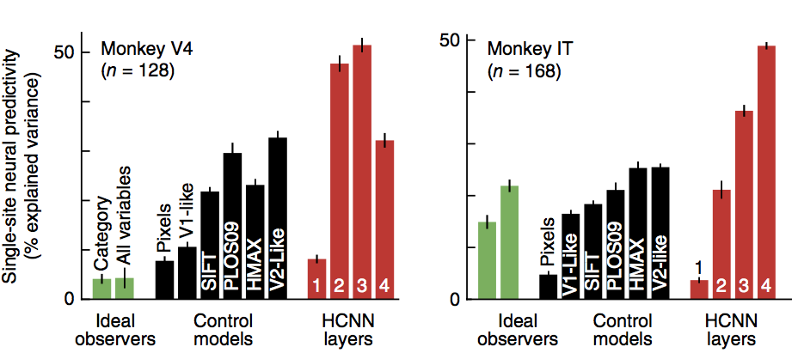
Hierarchical CNN as models of sensory cortex
HCNN model better for solving object categorization produces hidden layer representation that are able to predict IT neural responses better.

Slide 6
Hierarchical CNN as models of sensory cortex
HCNN model better for solving object categorization produces hidden layer representation that are able to predict IT neural responses better.

Slide 7
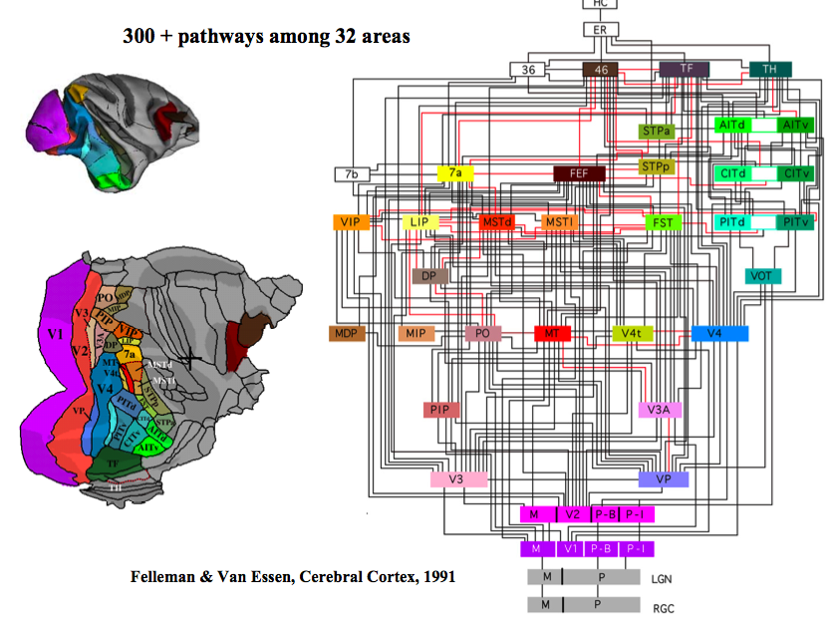
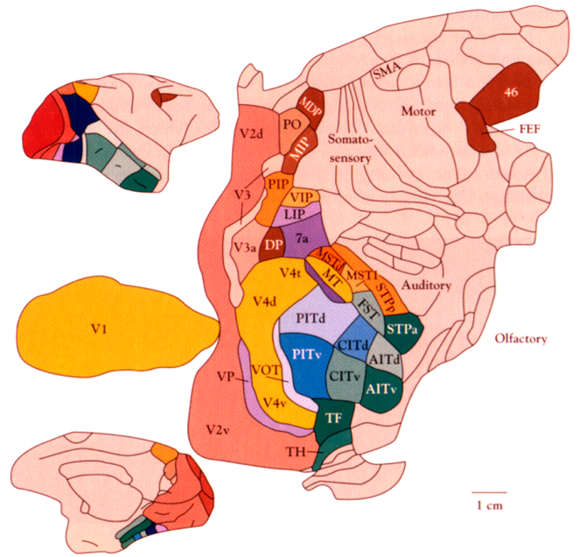
Hierarchical organization of Visual Areas
Notes:
Hierarchical visual system, hierarchcail internal models, natural scenes are complex, so we need flexible composition and recomposition of all the parts to model this complexity.

Slide 8
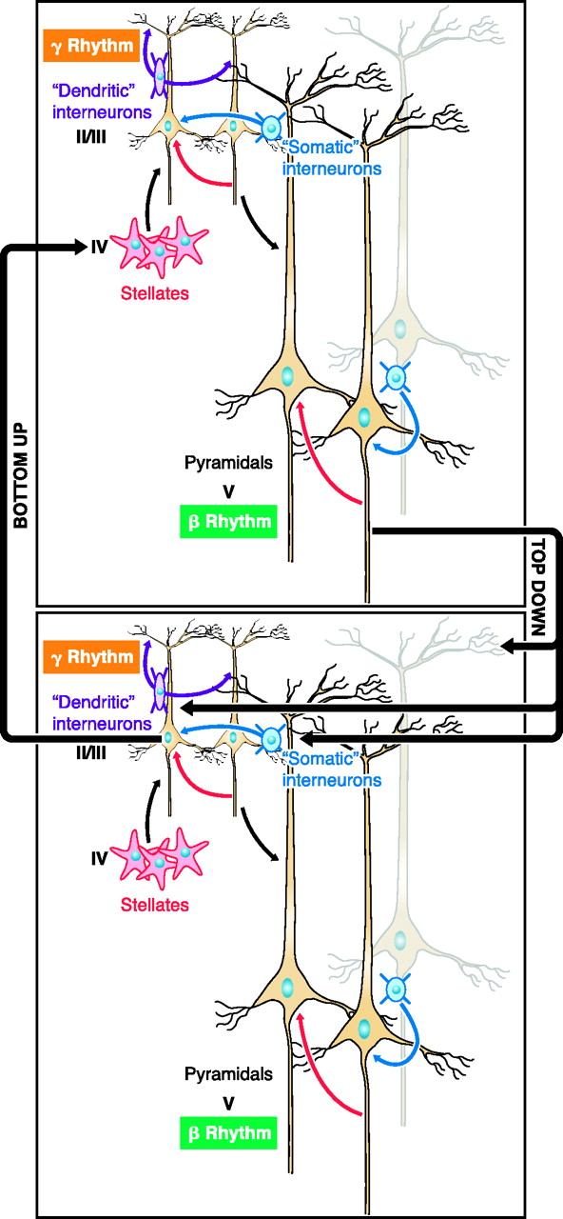
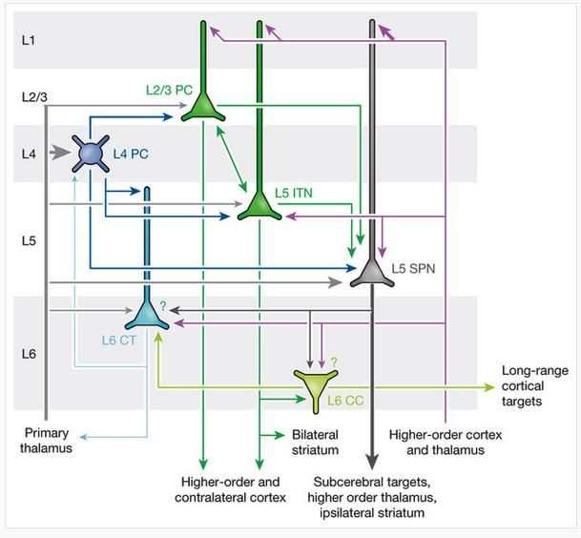
Synthesis
Analysis
Synthesis
Feedforward “input” from bottom module
Feedback input from higher modules.
Feedforward output to higher and same-level modules.
Analysis
Feedback output to lower modules.
Connections within module
Connections across modules

Slide 9
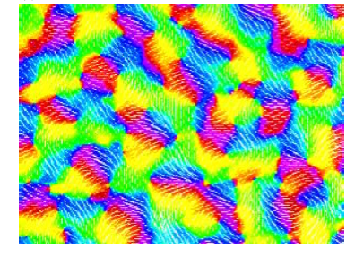
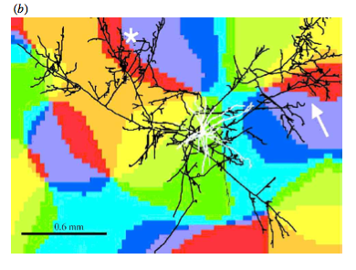
Abundant dense local and sparse long-range connections within each visual area

Slide 10
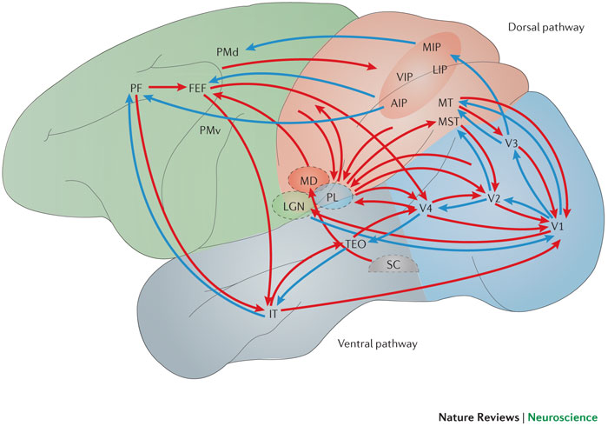
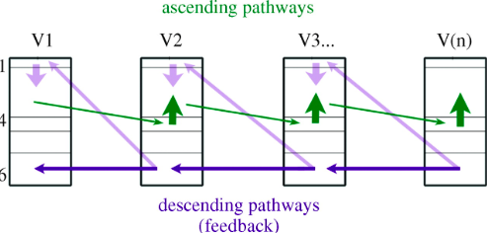

Slide 11
What are these feedback and horizontal connections for?
Notes:
Backpropagation algorithms.
Attention mechanisms.
Synthesis (reconstruction, auto-encoder).
Linking parts and objects in a parse tree, composition and routing.

Slide 12
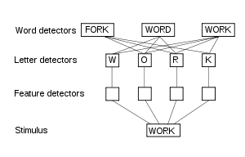
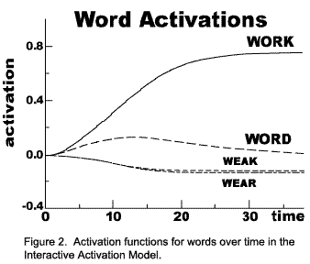

Interactive Activation Model
Catteel 1886, McClelland and Rumelhart 1981’s model
Notes:
word superiority effect (WSE) refers to the phenomenon that people have better recognition of letters presented within words as compared to isolated letters and to letters presented within nonword (orthographically illegal, unpronounceable letter array) strings.^{[1]} Studies have also found a WSE when letter identification within words is compared to letter identification within pseudowords^{[2]} (e.g. "WOSK") and pseudohomophones^{[3]} (e.g. "WERK").

Slide 13
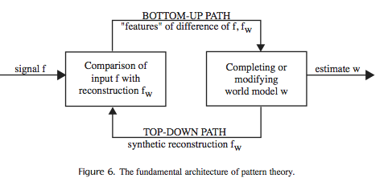
Analysis by Synthesis framework of Vision
David Mumford 1992: On the Computational Architecture of the Neocortex, II: The role of cortico-cortical loops, Biological Cybernetics, 66, pp. 241-251. Lee and Mumford, 2002 Hierarchical Bayesian inference in the visual cortex, JOSA .
Notes:
No compositions, just frequent conjunctions. No deformable templates, coarse vector quantization.

Slide 14
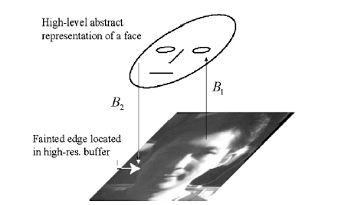
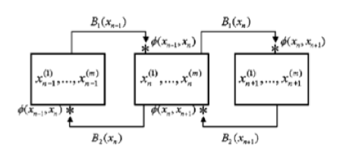
Bayes Net in the brain?
Evidence that Inference is not simply a feed-forward process but involves both bottom-up, horizontal and top-down constraints.
V1 V2 V4 ….
Lee et al. (1998) Higher order computation in the primary visual cortex.
Lee and Mumford 2003 Hierarchical Bayes inference in the visual cortex.
Notes:
Belief propagations. Probability of the different beliefs. The interaction of messages from top and messages from bottom are resolved principally in each area, and within each area, there is also intense computation which is shielded from the other computations.

Slide 15
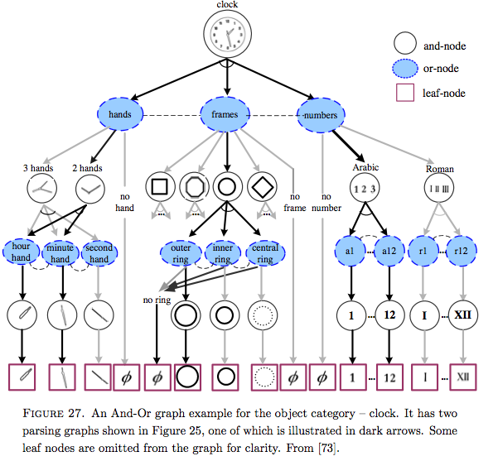
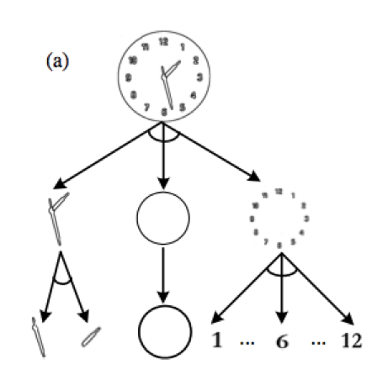
Zhu and Mumford’s Stochastic Grammar of Images (2006)
Notes:
Each node represents a “visual concept”, which defines a distribution of examples (different manifestation of a concept, e.g. a clock).
Each concept is a AND of multiple sub-concepts (hands, frames, and numbers).
Each concept can have different manifestations (number can be Arabic or Roman, governed by a OR relationship).
This whole graph can be in IT. The leaves in this graph in turn can be decomposed into a hierarchy of components.

Slide 16
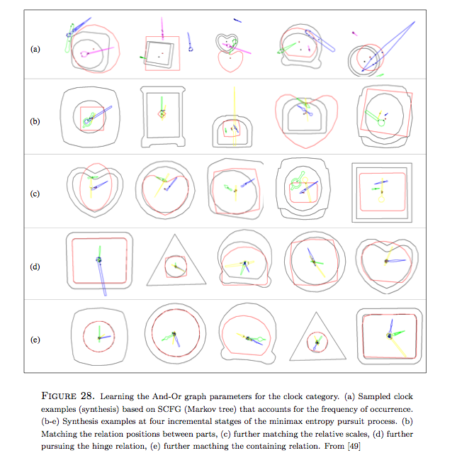
Sampling from the clock graph

Slide 17
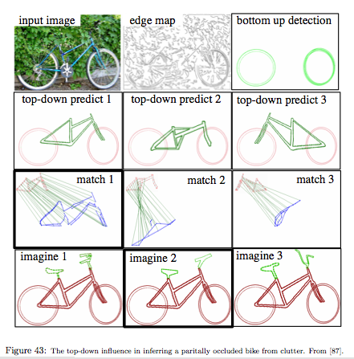
Analysis by Synthesis
Zhu and Mumford (2006)

Slide 18
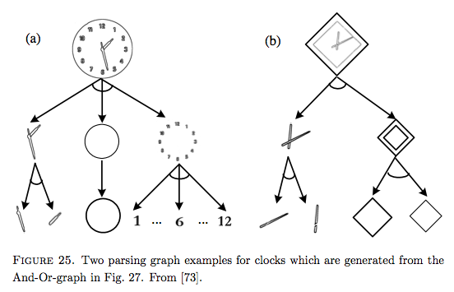
Parsing: Co-activation of whole and components
Competition between competing parts at the OR level lead to selection of a particular parsing tree.

Slide 19
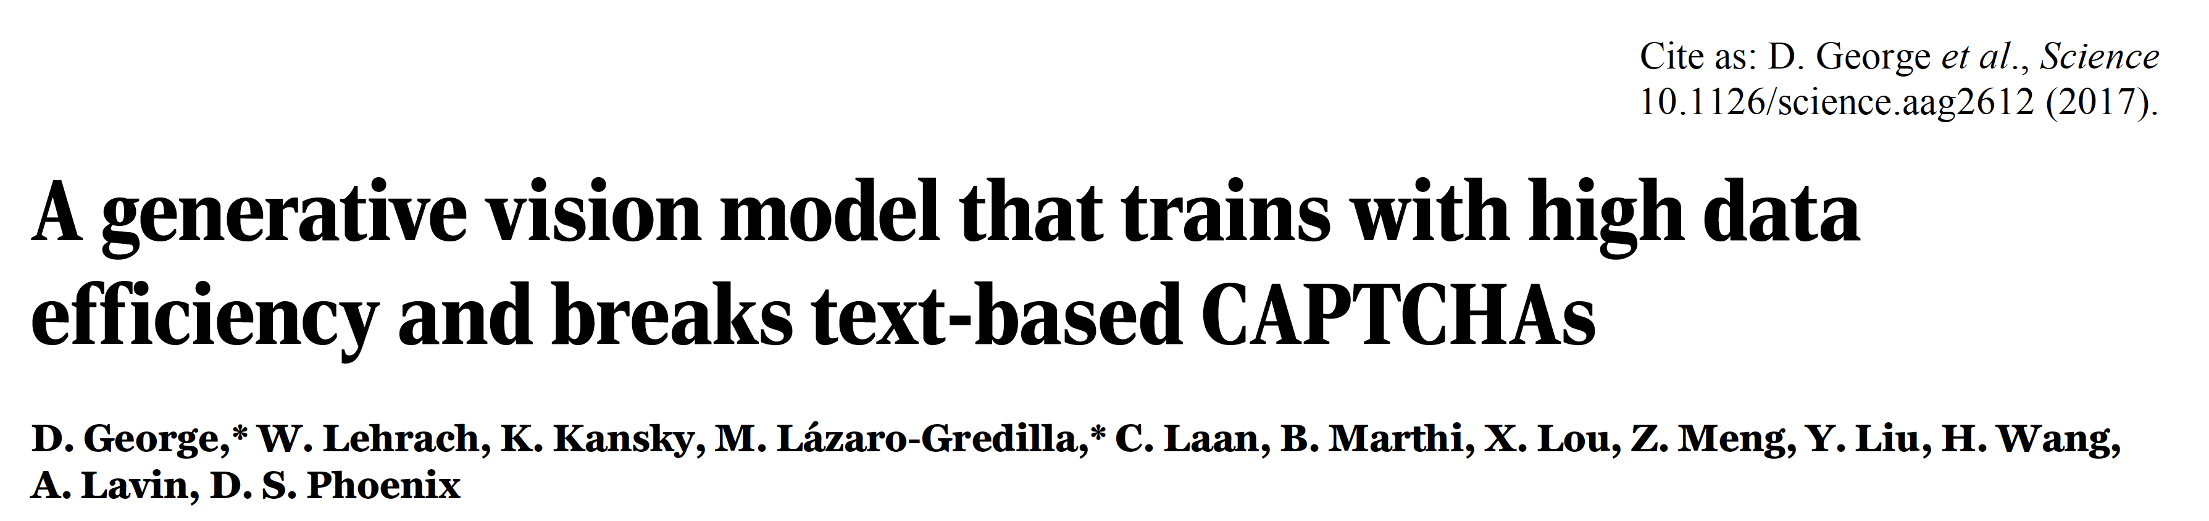
More data efficient for training than CNN – structured probabilistic graphical model, trained with 3D object data rendered in contours. Focused on surfaces and contours.
Notes:
Flexibility of letterform perception in humans. (A) Humans are good at parsing unfamiliar CAPTCHAs. (B) The same character shape can be rendered in a wide variety of appearances, and people can detect the “A” in these images regardless. (C) Common sense and context affect letterform perception: (i) m vs u and n. (ii) the same line segments are interpreted as N or S depending on occluder positions. (iii) perception of the shapes aids the recognition of “b,i,s,o,n” and “b,i,k,e”.

Slide 20
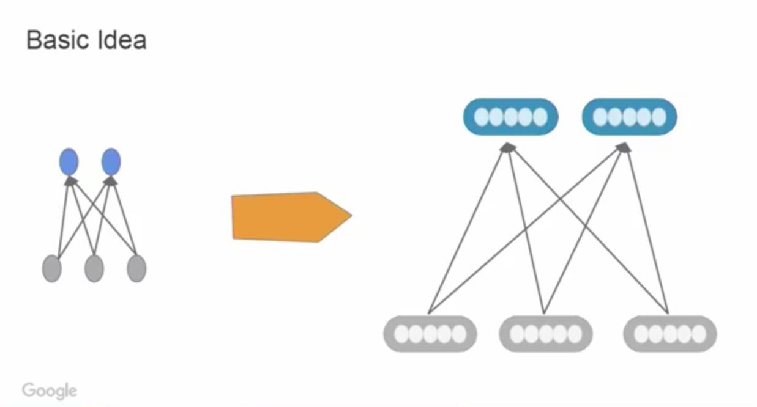
Capsule Network (2017)

Slide 21
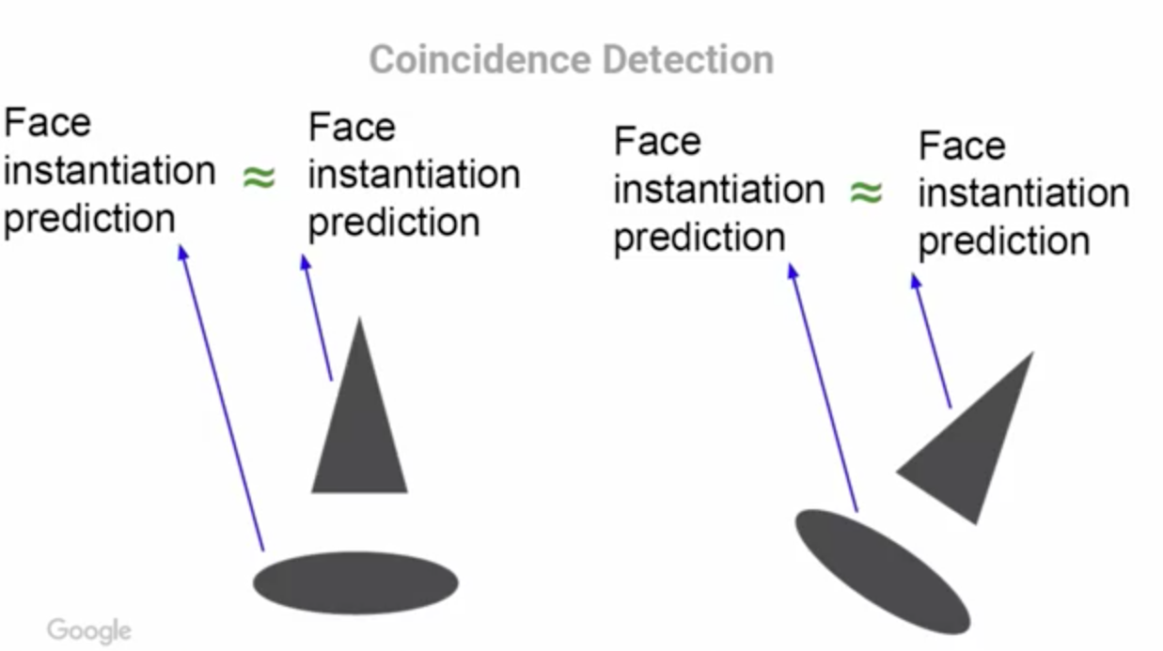
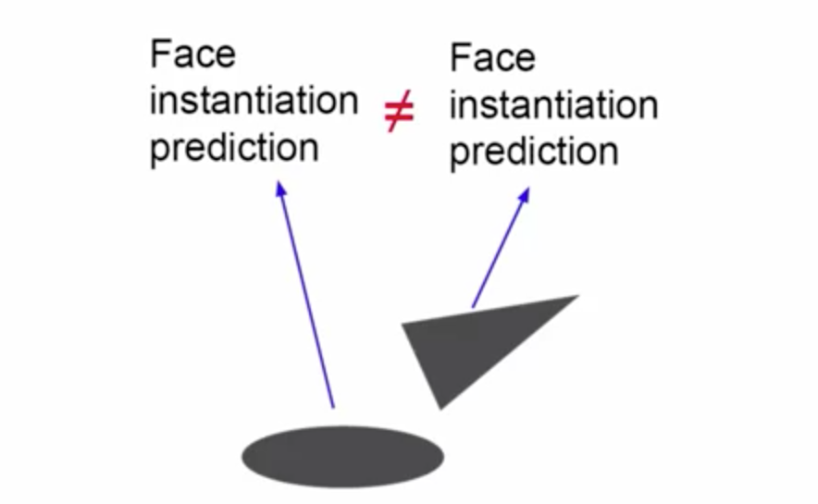
Capsule Network (2017)

Slide 22
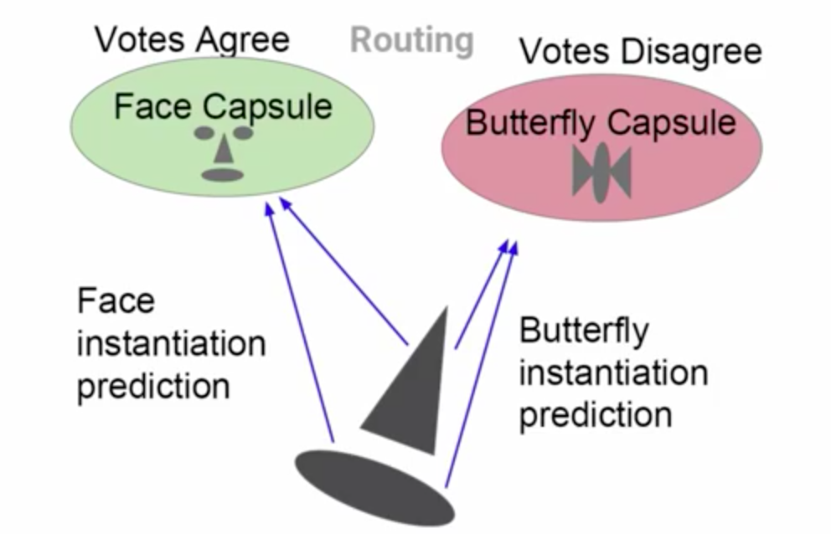
Capsule Network (2017)

Slide 23
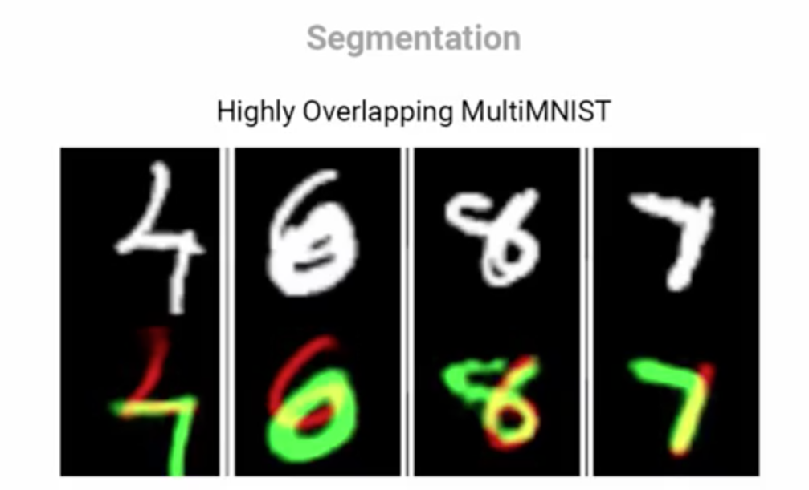
Capsule Network (2017)

Slide 24
What are these feedback and horizontal connections for?
Backpropagation algorithms.
Attention selection mechanisms.
Dynamic routing
Synthesis (reconstruction, auto-encoder).
Linking parts and objects in a parse tree, composition and routing.
Notes:
Backpropagation algorithms.
Attention mechanisms.
Synthesis (reconstruction, auto-encoder).
Linking parts and objects in a parse tree, composition and routing.

Slide 25
Generative Adversary network
Two neural networks contesting in a zero-sum game.
Pitt Generative model against discriminative model.
A powerful way to learn generative model.
Notes:
the generative network learns to map from a latent space to a particular data distribution of interest, while the discriminative network discriminates between instances from the true data distribution and candidates produced by the generator. The generative network's training objective is to increase the error rate of the discriminative network (i.e., "fool" the discriminator network by producing novel synthesized instances that appear to have come from the true data distribution).

Slide 26
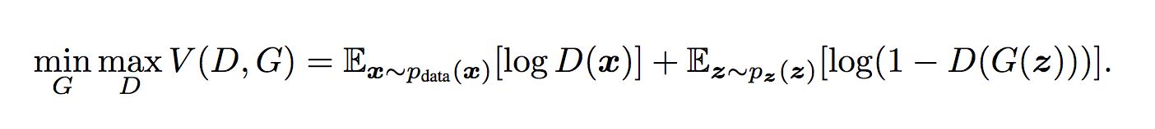
Generative Adversary network
The two networks play a two-player mini-max game with value function V(G,D).
First train D to maximize V(D,G) freeze G
Then train G to minimize log(1-D(G(z)), freeze D
Iterate.
Notes:
D is the probability of x came from the data rather than p_g.
Learn generator’s distribution over p_g over data x, prior on input noise variable pz(z), the represnts a mapping to data spae as G(Z, theta), where G is a neural network (differnetialbe funtioN) with parametrs theta_g.
A second perceptron D(x, theta_d) that outputs a single sclar.
Train D to maximize its correctness and minimizes its mistakes of the discriminator, to put correct label.
Then simultaneously train G to minimize log (1-D(G(Z)).
They play a two-player mini-max game with value function V(G,D).

Slide 27
Generative Adversary network
The two networks play a two-player mini-max game with value function V(G,D).
First train D to maximize V(D,G) freeze G
Then train G to minimize log(1-D(G(z)), freeze D
Iterate.
Notes:
D is the probability of x came from the data rather than p_g.
Learn generator’s distribution over p_g over data x, prior on input noise variable pz(z), the represnts a mapping to data spae as G(Z, theta), where G is a neural network (differnetialbe funtioN) with parametrs theta_g.
A second perceptron D(x, theta_d) that outputs a single sclar.
Train D to maximize its correctness and minimizes its mistakes of the discriminator, to put correct label.
Then simultaneously train G to minimize log (1-D(G(Z)).
They play a two-player mini-max game with value function V(G,D).

Slide 28
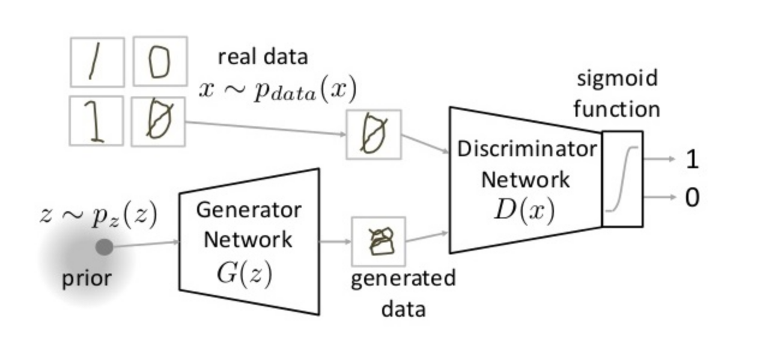
Generative Adversary network
https://www.analyticsvidhya.com
Notes:
D is the probability of x came from the data rather than p_g.
Learn generator’s distribution over p_g over data x, prior on input noise variable pz(z), the represnts a mapping to data spae as G(Z, theta), where G is a neural network (differnetialbe funtioN) with parametrs theta_g.
A second perceptron D(x, theta_d) that outputs a single sclar.
Train D to maximize its correctness and minimizes its mistakes of the discriminator, to put correct label.
Then simultaneously train G to minimize log (1-D(G(Z)).
They play a two-player mini-max game with value function V(G,D).

Slide 29
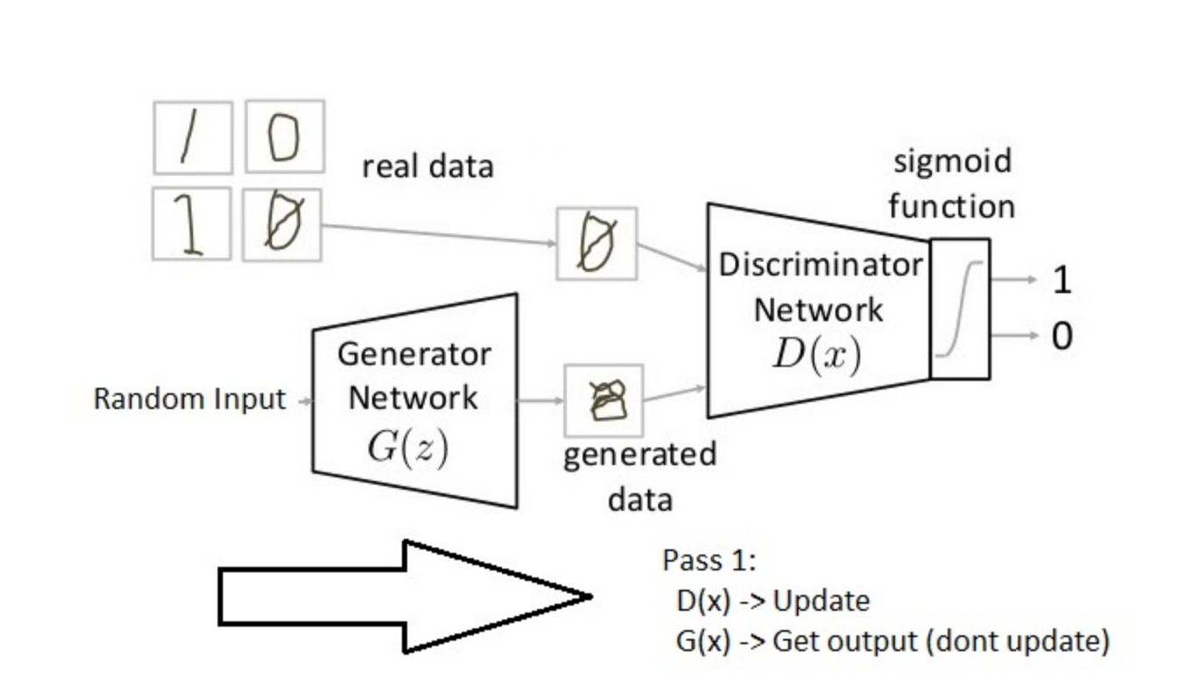
Generative Adversary network
https://www.analyticsvidhya.com
Notes:
D is the probability of x came from the data rather than p_g.
Learn generator’s distribution over p_g over data x, prior on input noise variable pz(z), the represnts a mapping to data spae as G(Z, theta), where G is a neural network (differnetialbe funtioN) with parametrs theta_g.
A second perceptron D(x, theta_d) that outputs a single sclar.
Train D to maximize its correctness and minimizes its mistakes of the discriminator, to put correct label.
Then simultaneously train G to minimize log (1-D(G(Z)).
They play a two-player mini-max game with value function V(G,D).

Slide 30
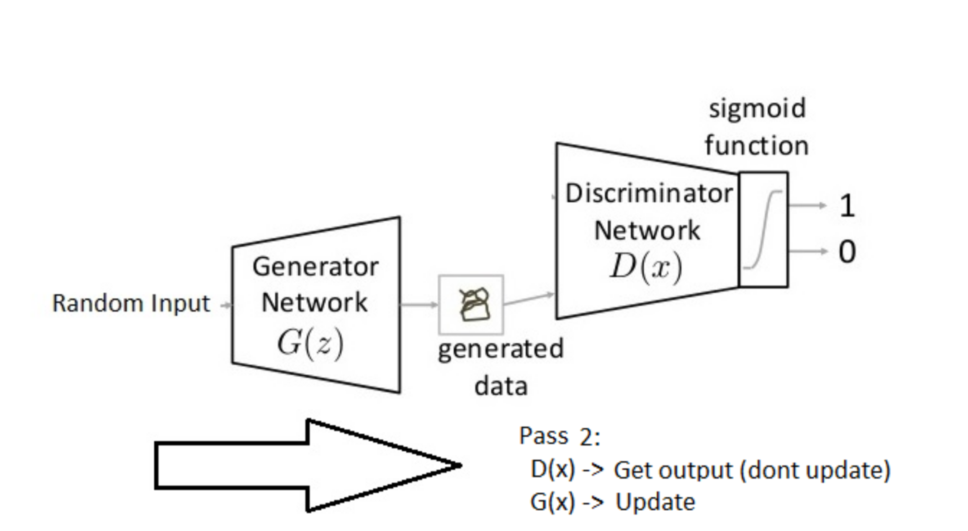
Generative Adversary network
https://www.analyticsvidhya.com
Notes:
Road block: Stability – not easy to train. Simple beautiful idea.
What happen if discirninator is too hard or too lenient, what will happen?

Slide 31
Pool 1
What would happen to the Generator if the Discriminator is really powerful?
1. The generator learns to be really good.
2. The generator fails to learn.
3. Doesn’t really matter.
4. Not sure.
Notes:
the generative network learns to map from a latent space to a particular data distribution of interest, while the discriminative network discriminates between instances from the true data distribution and candidates produced by the generator. The generative network's training objective is to increase the error rate of the discriminative network (i.e., "fool" the discriminator network by producing novel synthesized instances that appear to have come from the true data distribution).

Slide 32
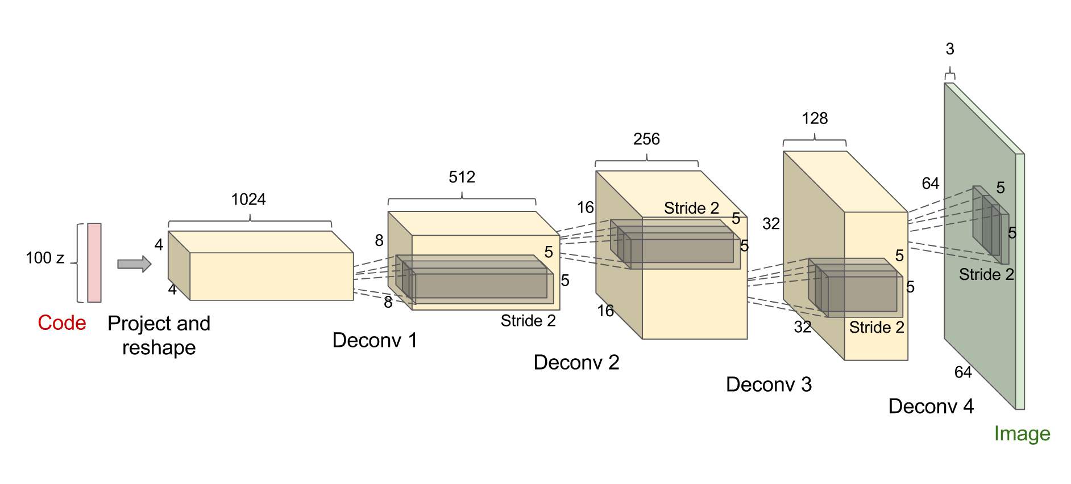
Deconvolutional network
Tutorial: http://www.iangoodfellow.com/slides/2016-12-04-NIPS.pdf
Notes:
The counterfeiter is known as the generative network, and is a special kind of convolutional network that uses transpose convolutions, sometimes known as a deconvolutional network. This generative network takes in some 100 parameters of noise (sometimes known as the code) , and outputs an image accordingly.
As the code is changed incrementally, the generated images do too — this shows the model has learned features to describe how the world looks, rather than just memorizing some examples.
we want the model distribution to match the true data distribution in the space of images.

Slide 33
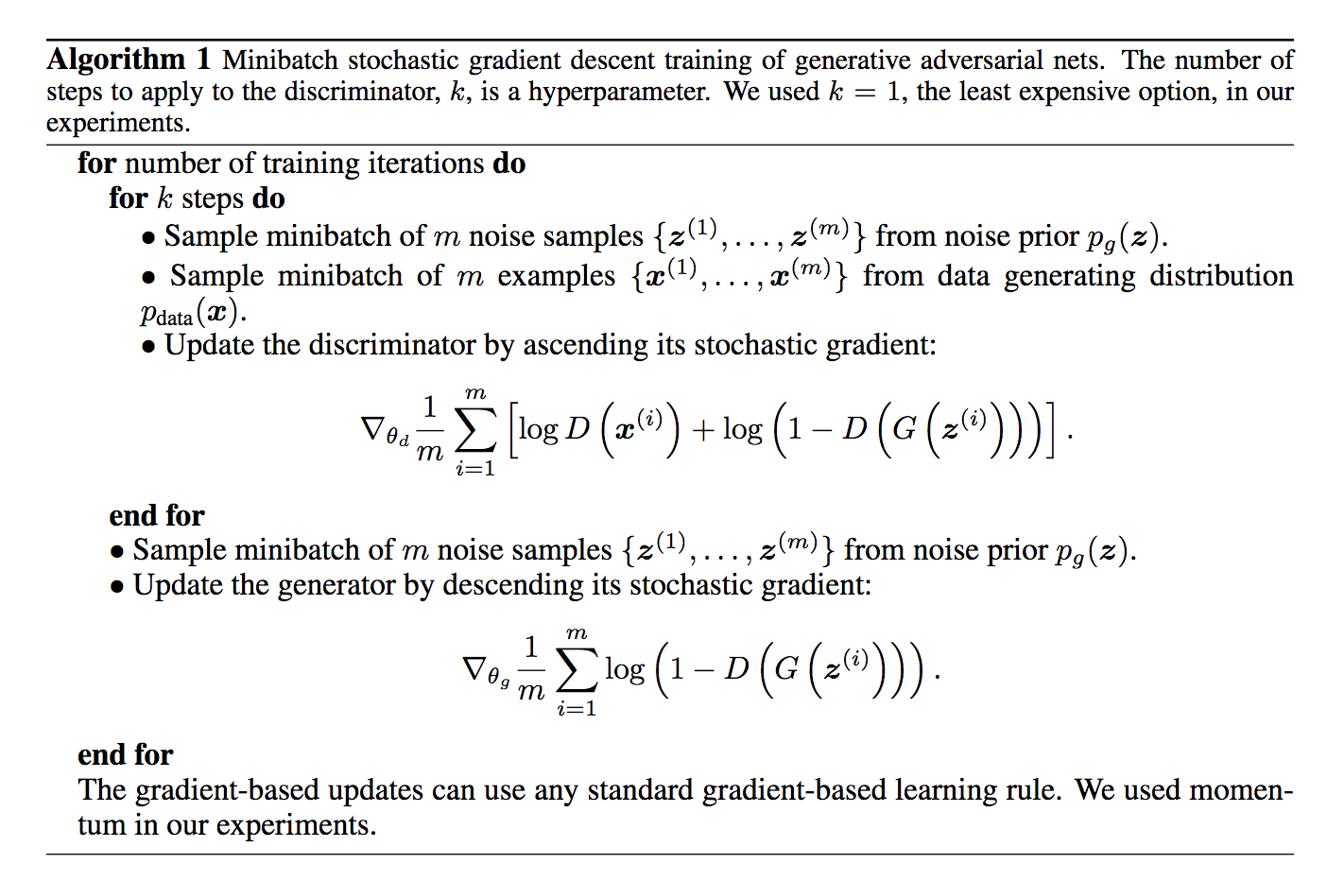
Generative Adversary network
Notes:
Model
MNIST
TFD
DBN [3]
138
±
2
1909
±
66
Stacked CAE [3]
121
±
1
.
6
2110
±
50
Deep GSN [6]
214
±
1
.
1
1890
±
29
Adversarial nets
225
±
2
2057
±
26
Table 1:
Parzen window-based log-likelihood estimates. The reported numbers on MNIST are the mean log-
likelihood of samples on test set, with the standard error of the mean computed across examples. On TFD, we
computed the standard error across folds of the dataset, with a different
σ
chosen using the validation set of
each fold. On TFD,
σ
was cross validated on each fold and mean log-likelihood on each fold were computed.
For MNIST we compare against other models of the real-valued (rather than binary) version of dataset.
of the Gaussians was obtained by cross validation on the validation set. This procedure was intro-
duced in Breuleux
et al.
[8] and used for various generative models for which the exact likelihood
is not tractable [25, 3, 5]. Results are reported in Table 1. This method of estimating the likelihood
has somewhat high variance and does not perform well in high dimensional spaces but it is the best
method available to our knowledge. Advances in generative models that can sample but not estimate
likelihood directly motivate further research into how to evaluate such models.
In Figures 2 and 3 we show samples drawn from the generator net after training. While we make no
claim that these samples are better than samples generated by existing methods, we believe that these
samples are at least competitive with the better generative models in the literature and highlight the
potential of the adversarial framework.
a)
b)
c)
d)
Figure 2:

Slide 34
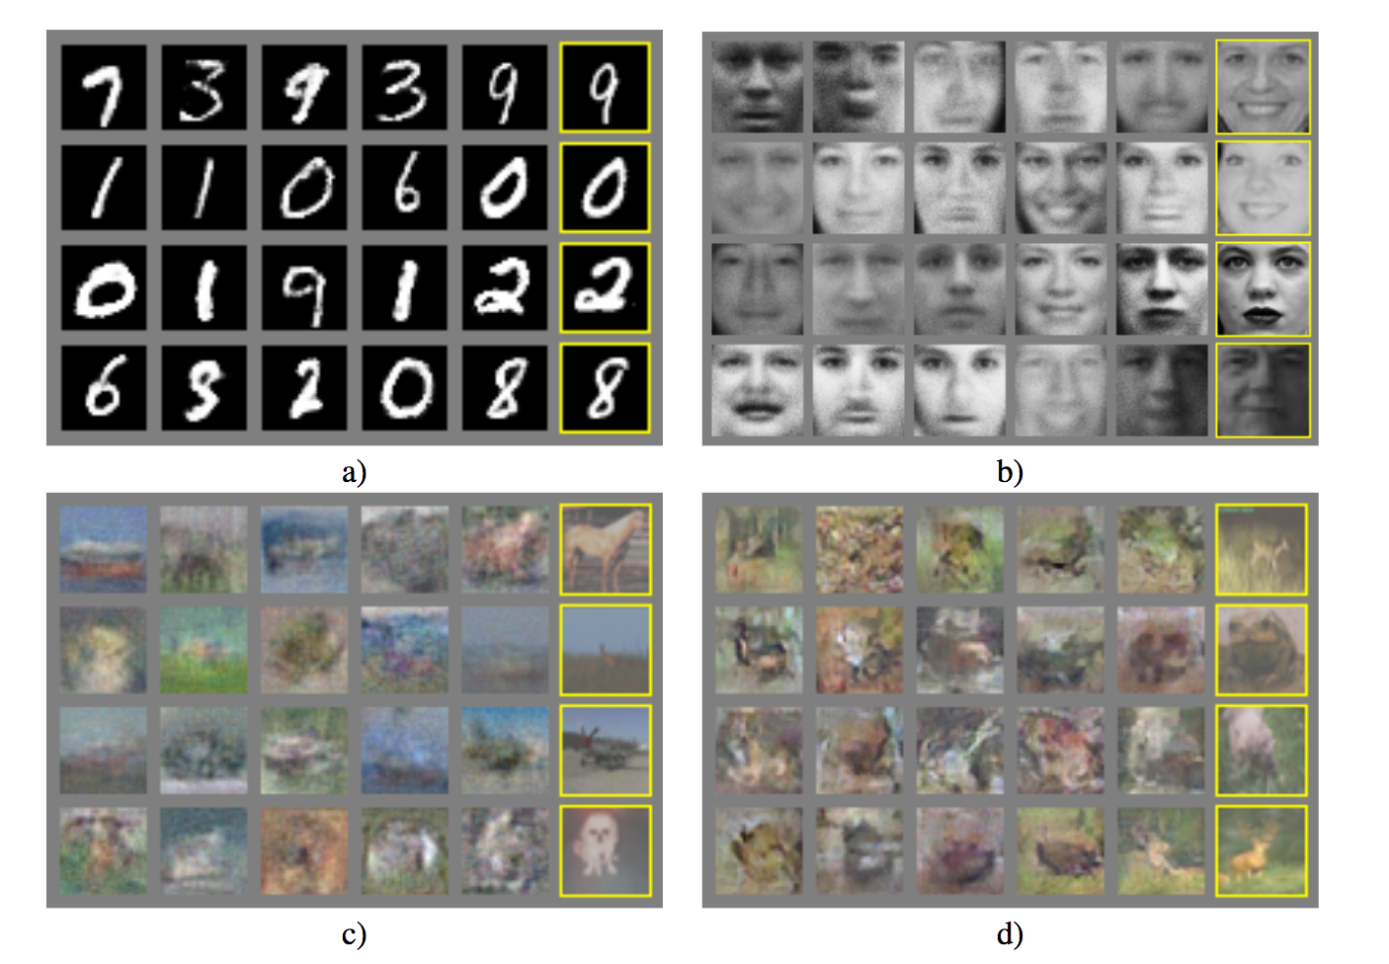
Generative Adversary network
Tutorial: http://www.iangoodfellow.com/slides/2016-12-04-NIPS.pdf
Notes:
Model
MNIST
TFD
DBN [3]
138
±
2
1909
±
66
Stacked CAE [3]
121
±
1
.
6
2110
±
50
Deep GSN [6]
214
±
1
.
1
1890
±
29
Adversarial nets
225
±
2
2057
±
26
Table 1:
Parzen window-based log-likelihood estimates. The reported numbers on MNIST are the mean log-
likelihood of samples on test set, with the standard error of the mean computed across examples. On TFD, we
computed the standard error across folds of the dataset, with a different
σ
chosen using the validation set of
each fold. On TFD,
σ
was cross validated on each fold and mean log-likelihood on each fold were computed.
For MNIST we compare against other models of the real-valued (rather than binary) version of dataset.
of the Gaussians was obtained by cross validation on the validation set. This procedure was intro-
duced in Breuleux
et al.
[8] and used for various generative models for which the exact likelihood
is not tractable [25, 3, 5]. Results are reported in Table 1. This method of estimating the likelihood
has somewhat high variance and does not perform well in high dimensional spaces but it is the best
method available to our knowledge. Advances in generative models that can sample but not estimate
likelihood directly motivate further research into how to evaluate such models.
In Figures 2 and 3 we show samples drawn from the generator net after training. While we make no
claim that these samples are better than samples generated by existing methods, we believe that these
samples are at least competitive with the better generative models in the literature and highlight the
potential of the adversarial framework.
a)
b)
c)
d)
Figure 2:

Slide 35
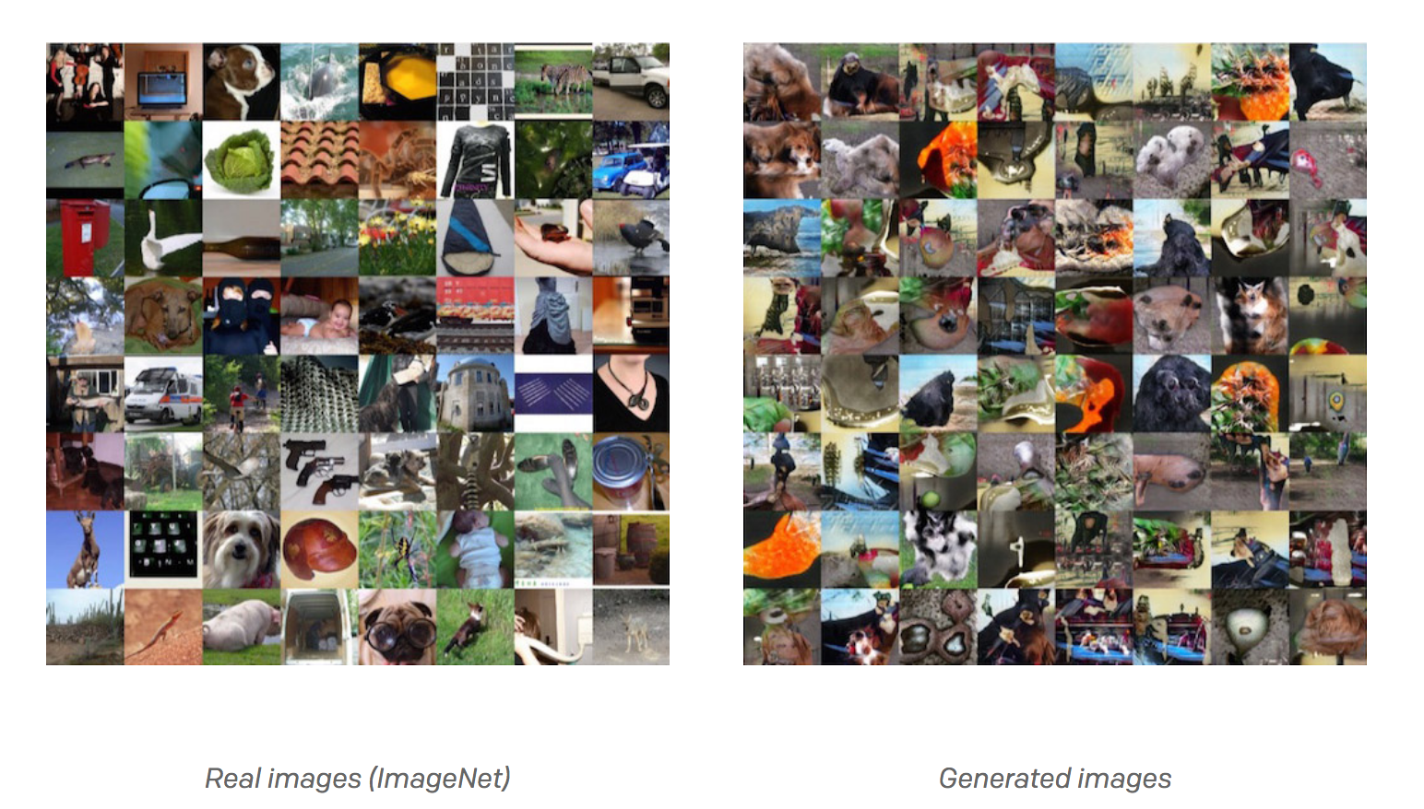
Generative Adversary network
https://blog.openai.com/generative-models/
Notes:
we can also backpropagate through both the discriminator and the generator to find how we should change the generator’s parameters to make its 200 samples slightly more confusing for the discriminator. These two networks are therefore locked in a battle: the discriminator is trying to distinguish real images from fake images and the generator is trying to create images that make the discriminator think they are real. In the end, the generator network is outputting images that are indistinguishable from real images for the discriminator.

Slide 36
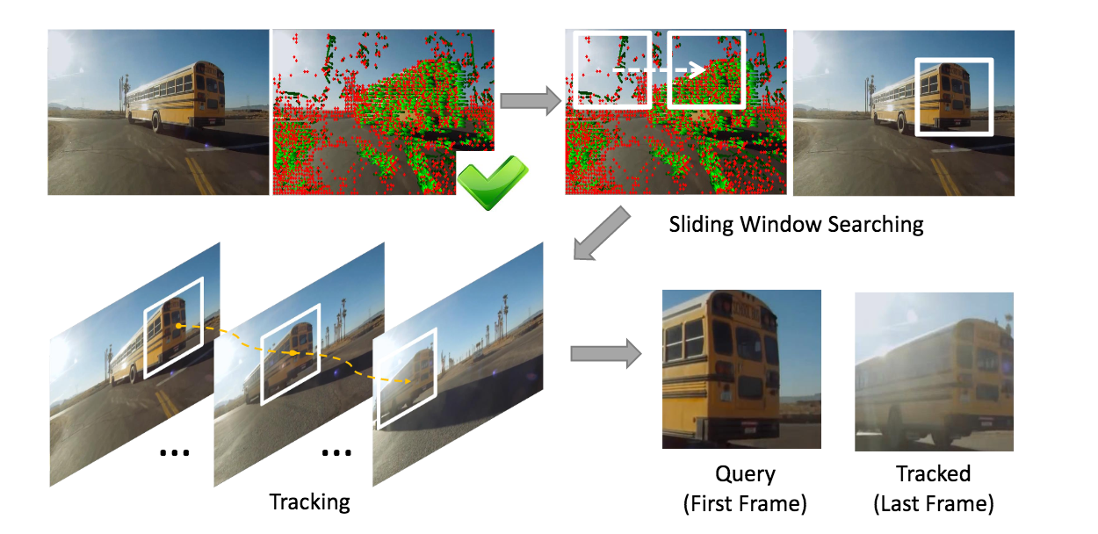
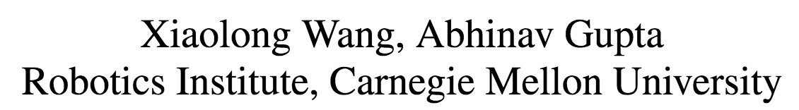
Siamese network

Slide 37
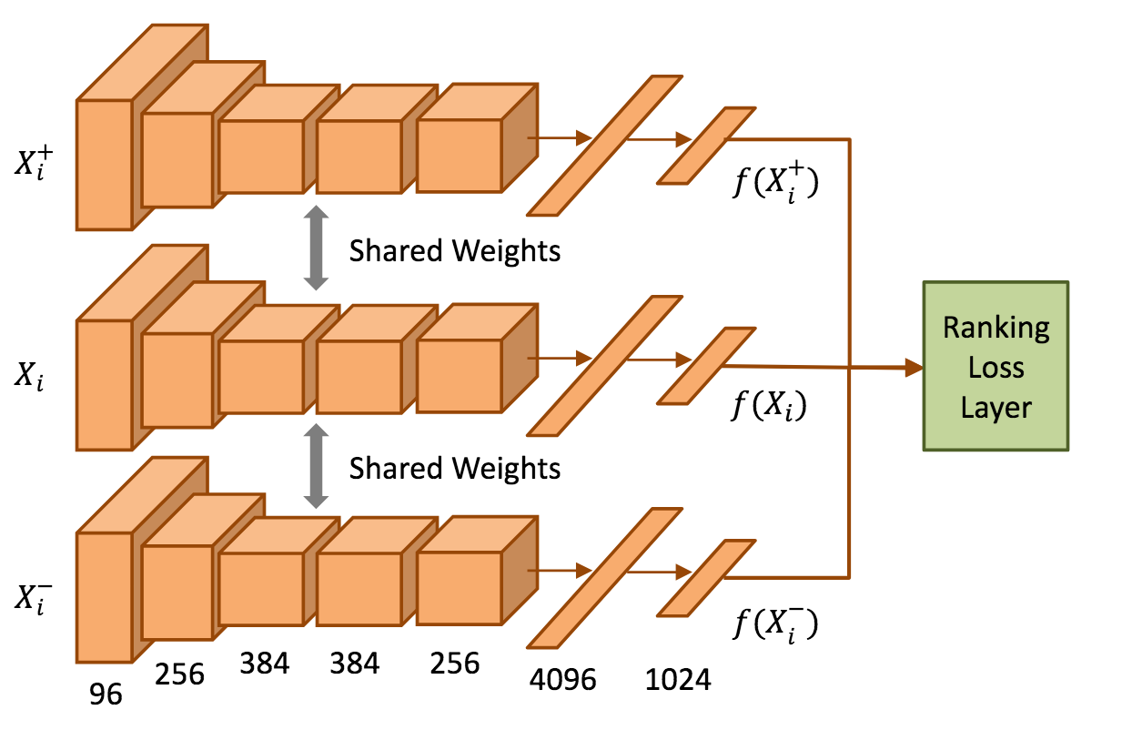
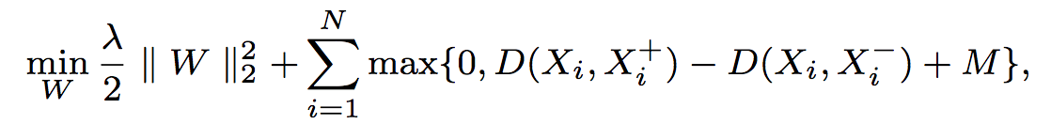
Siamese network

Slide 38
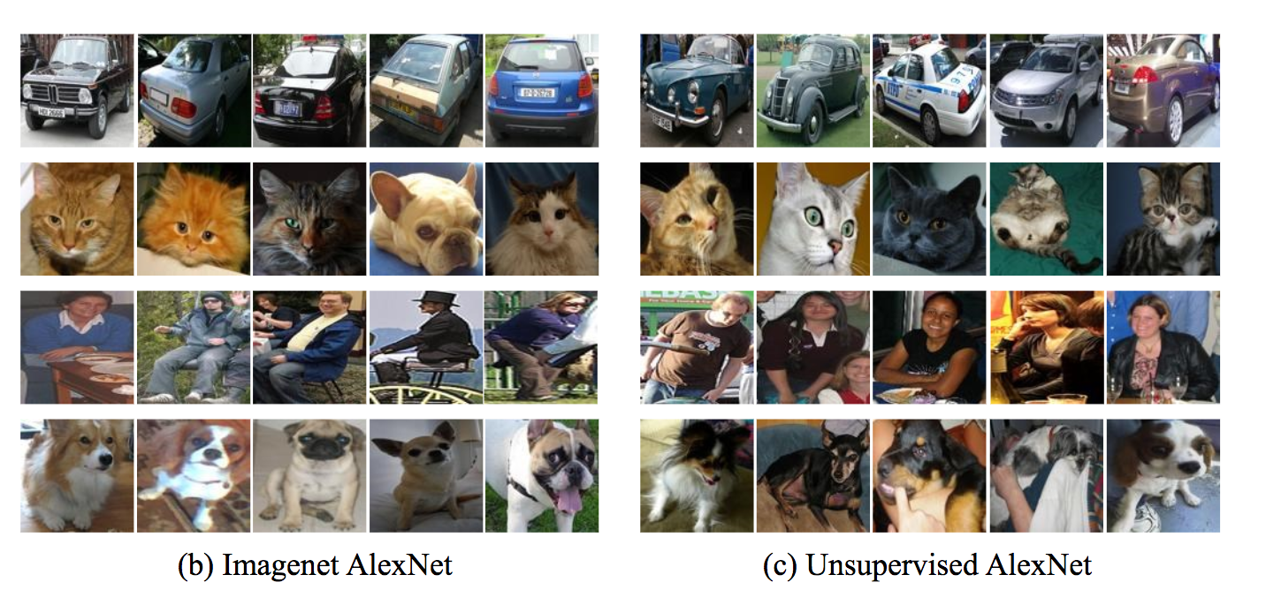
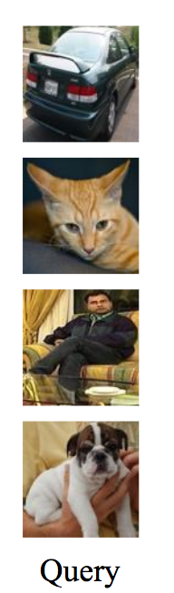
Siamese network

Slide 39
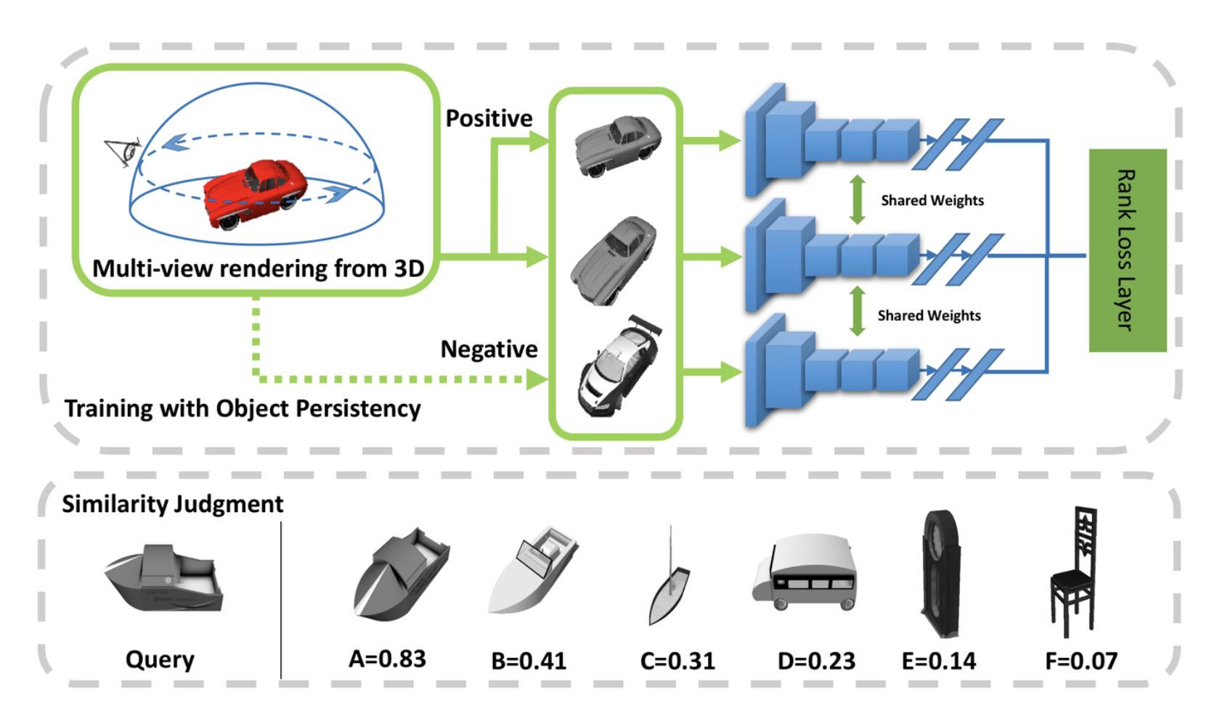
Transfer learning

Slide 40
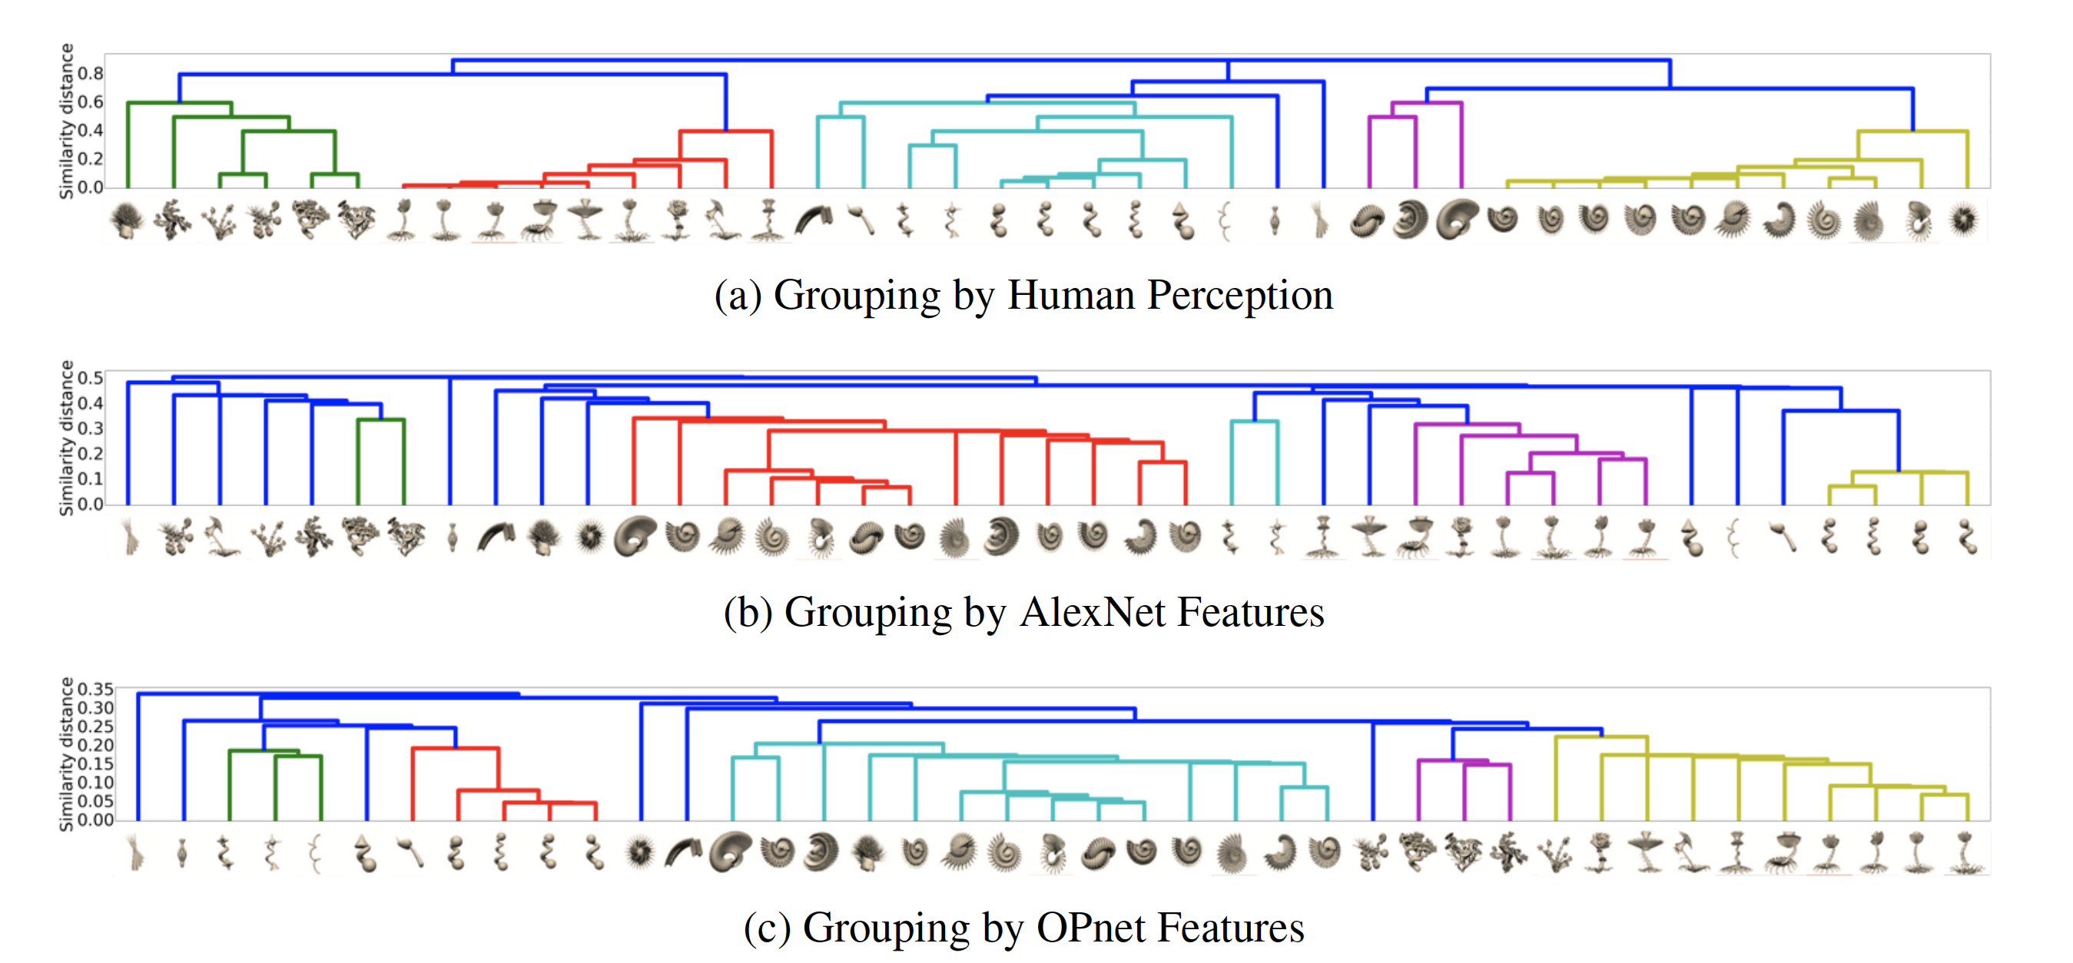
Siamese network
Lin et al. (2017) Transfer of view-manifold learning to similarity perception of novel objects. (ICLR)
Notes:
F(x) feature vector.
X+ positive example,
X- negative example
Minize weight vector.

Slide 41
Emerging new connections
Neural Turing machine
Attention network
Long-short term memory
Compositional machine
Dynamic Routing
Deep Generative models
Siamese Network
Generative Adversary Network
Capsule Network
Transfer learning
One-shot learning
Notes:
No compositions, just frequent conjunctions. No deformable templates, coarse vector quantization.

