Slide 1
Understanding deep networks (AI and the Brain II)
Tai Sing Lee
15-381/681 AI Lecture 24
Reading:
Yann LeCun, Yoshua Bengio and Geoff Hinton, (2015). Deep learning. Nature. 521: 436-444.
Matt Zeiler and Rob Fergus, visualizing and understanding convolutional networks, (2013).
Distill machine learning.

Slide 2
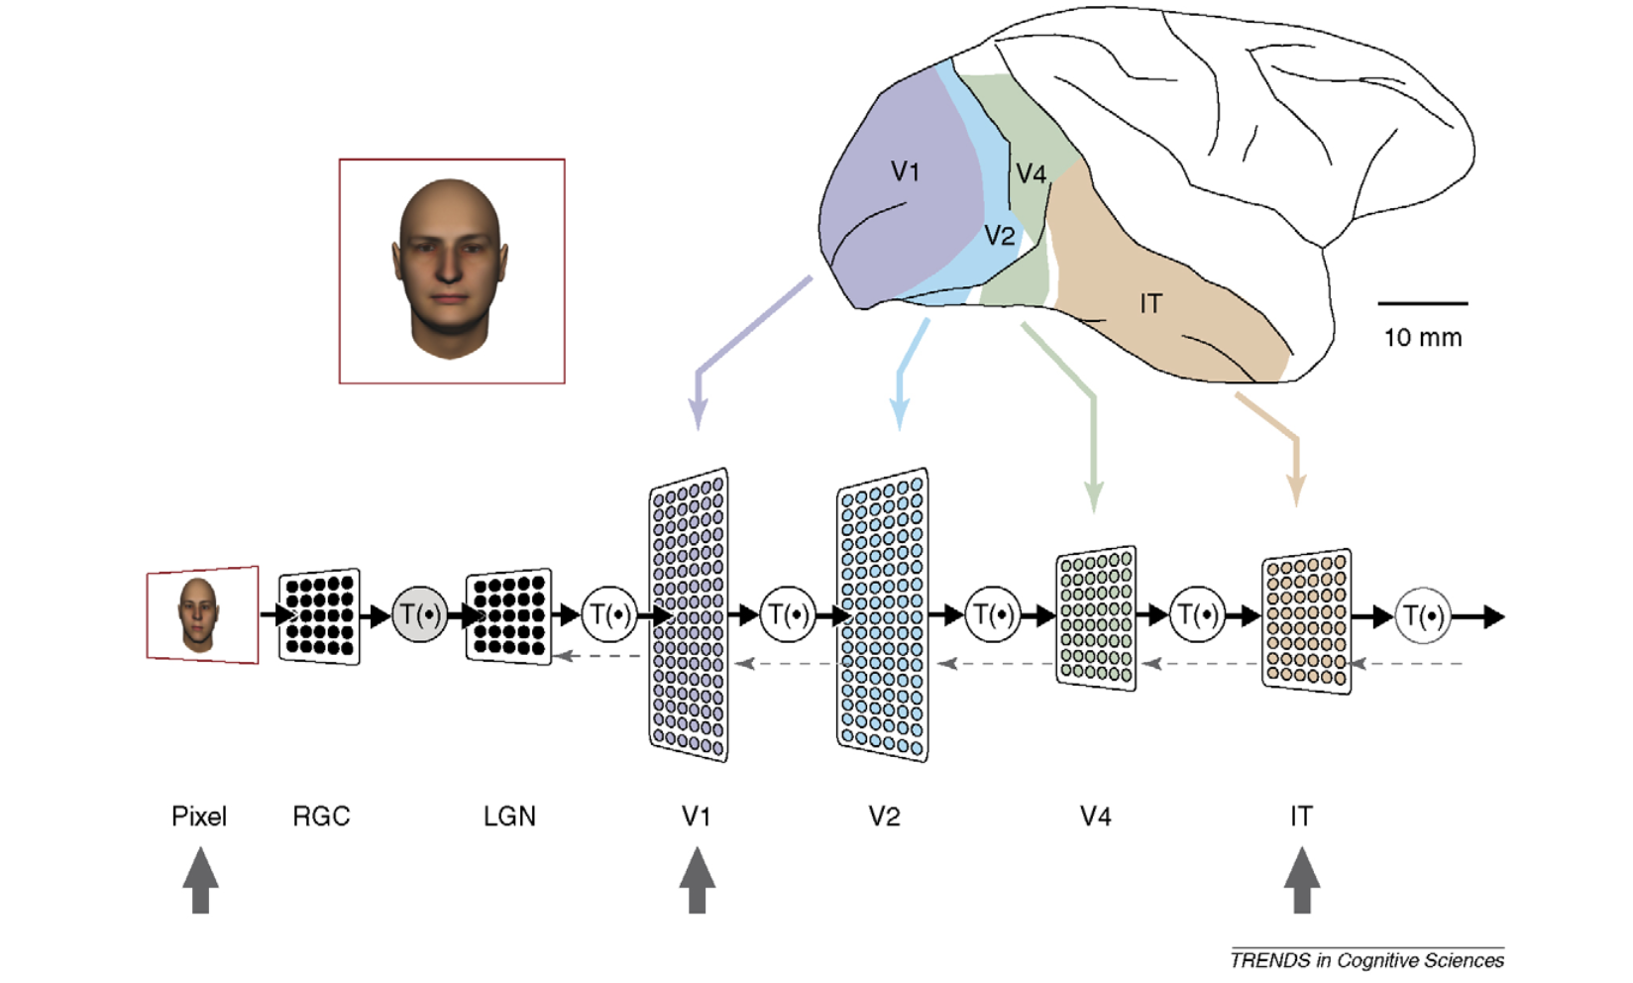
What is vision?
What is Vision?
DiCarlo and Cox 2007

Slide 3
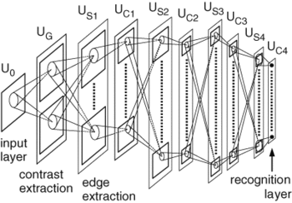
Convolutional Neural Network: Fukushima’s Neocognitron (1970s)
Alternating S and C layers:
S - feature detectors (e.g. simple cells) convolution - specificity,
C – pooling spatial or feature invariance (e.g. complex cells)
Notes:
Simple cells take conjunction of inputs. Complex cells introduce variance and tolerance.

Slide 4
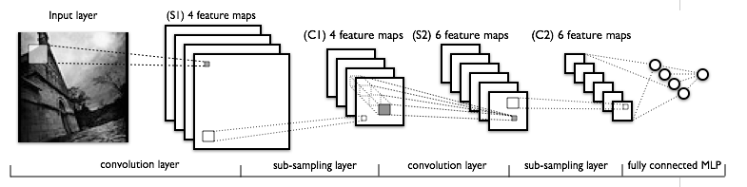
LeCun’s convolution net (90s)
Shared weight network
Backpropagation learning
http://yann.lecun.com/exdb/lenet/multiples.html
Notes:
Time-delay neural networks. (TDNN). Lang and Hinton, Waibel. Bottou.
Build a multi-layer neural net (with hierarchical features in resolution) to do pattern classification.
What kinds of dictionaries or features the neurons at different levels of the hierarchy extract?
Achieve some shift and distortion invariance while maintaining topology using local RF, weight sharing and spatial or temporal subsampling.
Again follow the same pattern of Simple-”Complex” cell alternating structures to build feature detectors (simple) and then provide translation invariance by subsampling(complex -- not straightly complex cells).

Slide 5
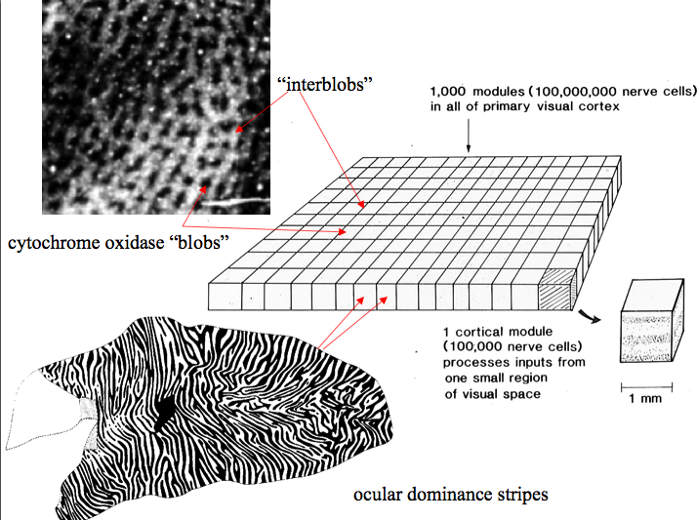
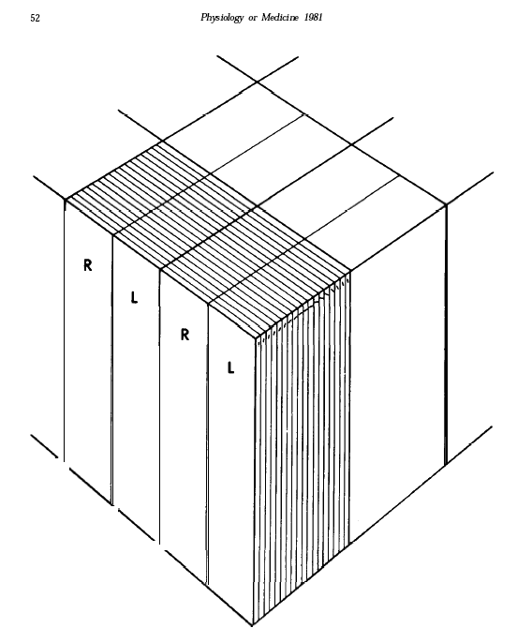
Retinotopic Maps and Hypercolumns:
Feature detectors same across map (why?)
© Stephen E. Palmer, 2002

Slide 6
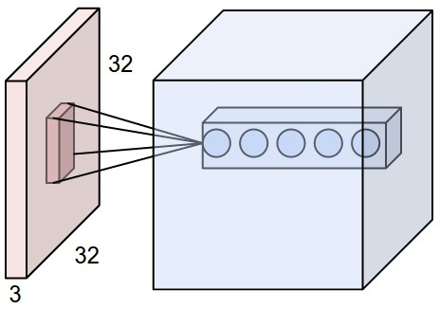
Volumes and Depths
Each node here has the same input but different weight vectors (e.g. computing different features of same input)
A feature detector – filter.

Slide 7
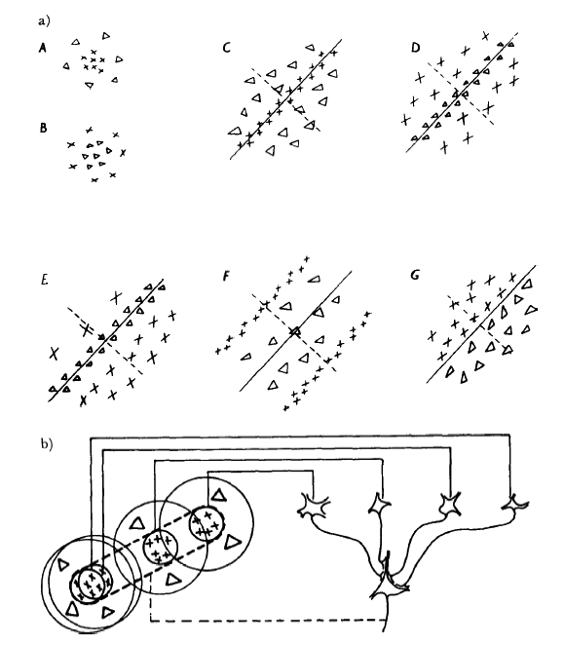
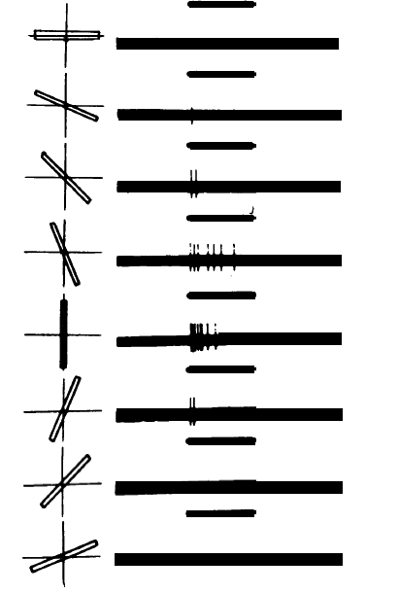
Simple cell: convolution layer
Hubel and Wiesel
Notes:
7

Slide 8

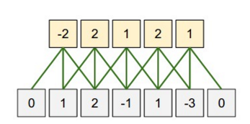
Filtering Pool
Ouptut
Input

Slide 9
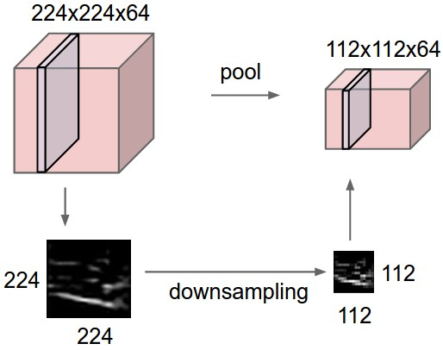
Pooling

Slide 10
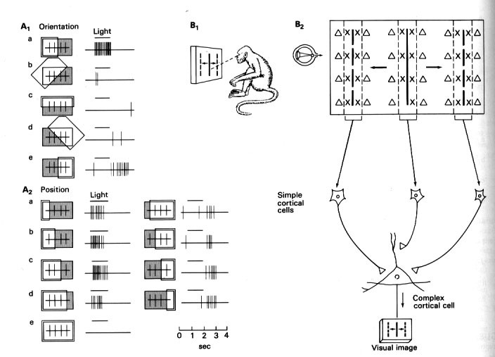
Complex cells: pooling layer
Hubel and Wiesel
Notes:
Bipolar have antagonistic center-surround receptive fields and are either on-center and off-center. Cones directly connected to a bipolar cell. On-center cell depolarize to light, off-center hyperpolarize with light. Horizontal cells connected to cones, have gap junctions to connect to each other, signals flow from the surround. Cone release neurotransmitter, glutamate, opposite actions on the 2 classes of cells.

Slide 11
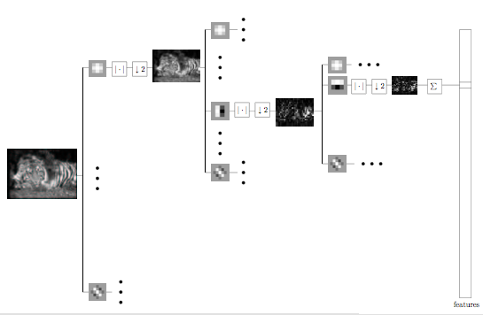
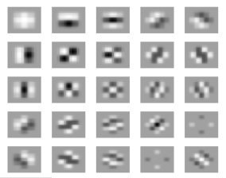
What does a cascade of filter operation with nonlinearity do?
25 linear filters
Successive filtering, rectified and downsampled 3 times to create 46875 feature maps (3 color bands).
-- Viola and Tieu: Boosting image retrieval (97)
Notes:
Each feature map is summed to a number.

Slide 12
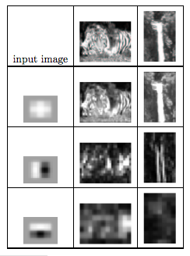
Combining features and detecting organization of features
Each level of feature processing discovers arrangement of feature responses from the previous level.
The final feature map has a strong peak at the `tiger strips’, which is absent in the waterfall.
Notes:
Each feature map is summed to a number.

Slide 13
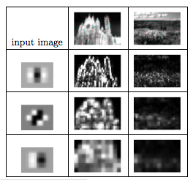
Cascade provides highly selective features
The final feature map of this sequence has a strong response to the cathedral but not the field.
These sequences provide highly selective features.
Notes:
Each feature map is summed to a number.

Slide 14
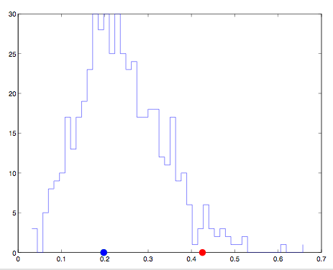
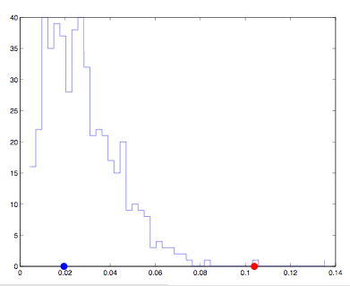
We can use distinct features to retrieve images
Same feature map to 500 images. Red dot: tiger, blue dot: waterfall.
Another feature map to 500 images. Red dot: church, blue dot: field.
Notes:
Each feature map is summed to a number.

Slide 15
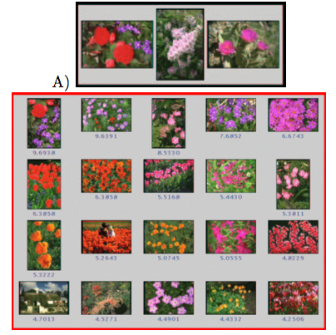
examples
retrieval
Notes:
Each feature map is summed to a number.

Slide 16
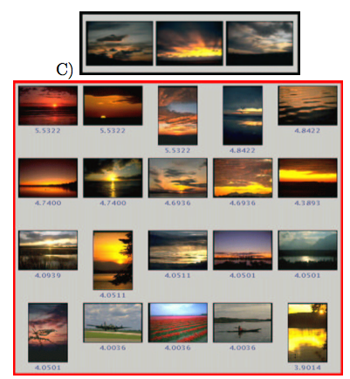
Notes:
Each feature map is summed to a number.

Slide 17
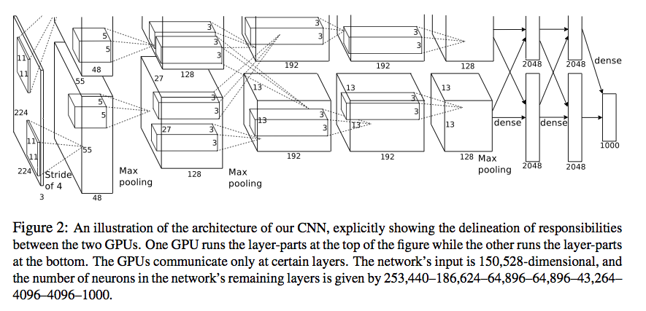
AlexNet: deep convolution neural networks
Alex Krizhevsky, Ilya Sutskever, and Geoff Hinton (2012)
http://yann.lecun.com/exdb/lenet/multiples.html
Notes:
Time-delay neural networks. (TDNN). Lang and Hinton, Waibel. Bottou.
Build a multi-layer neural net (with hierarchical features in resolution) to do pattern classification.
What kinds of dictionaries or features the neurons at different levels of the hierarchy extract?
Achieve some shift and distortion invariance while maintaining topology using local RF, weight sharing and spatial or temporal subsampling.
Again follow the same pattern of Simple-”Complex” cell alternating structures to build feature detectors (simple) and then provide translation invariance by subsampling(complex -- not straightly complex cells).

Slide 18
Pool 1:
What is NOT the “new” features in AlexNet that contribute to its success?
Rectifier Linear units
Skip connections
Local normalization
Drop-out
Data Augmentation
Notes:
Time-delay neural networks. (TDNN). Lang and Hinton, Waibel. Bottou.
Build a multi-layer neural net (with hierarchical features in resolution) to do pattern classification.
What kinds of dictionaries or features the neurons at different levels of the hierarchy extract?
Achieve some shift and distortion invariance while maintaining topology using local RF, weight sharing and spatial or temporal subsampling.
Again follow the same pattern of Simple-”Complex” cell alternating structures to build feature detectors (simple) and then provide translation invariance by subsampling(complex -- not straightly complex cells).

Slide 19
Pool 2:
Which is not true for describing the use of dropout in AlexNet?
Avoid overfitting during learning
Encourage discovery of multiple paths to solve a problem
Save metabolic energy during inference – sparser responses
Used only during learning
Notes:
Time-delay neural networks. (TDNN). Lang and Hinton, Waibel. Bottou.
Build a multi-layer neural net (with hierarchical features in resolution) to do pattern classification.
What kinds of dictionaries or features the neurons at different levels of the hierarchy extract?
Achieve some shift and distortion invariance while maintaining topology using local RF, weight sharing and spatial or temporal subsampling.
Again follow the same pattern of Simple-”Complex” cell alternating structures to build feature detectors (simple) and then provide translation invariance by subsampling(complex -- not straightly complex cells).

Slide 20
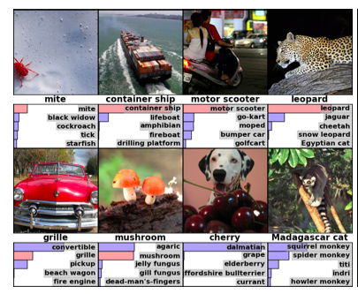
Interesting finding ….
Eight ILSVRC-2010 test images and the five labels considered most probable by our model. The correct label is written under each image, and the probability assigned to the correct label is also shown with a red bar (if it happens to be in the top 5).
Notes:
Time-delay neural networks. (TDNN). Lang and Hinton, Waibel. Bottou.
Build a multi-layer neural net (with hierarchical features in resolution) to do pattern classification.
What kinds of dictionaries or features the neurons at different levels of the hierarchy extract?
Achieve some shift and distortion invariance while maintaining topology using local RF, weight sharing and spatial or temporal subsampling.
Again follow the same pattern of Simple-”Complex” cell alternating structures to build feature detectors (simple) and then provide translation invariance by subsampling(complex -- not straightly complex cells).

Slide 21
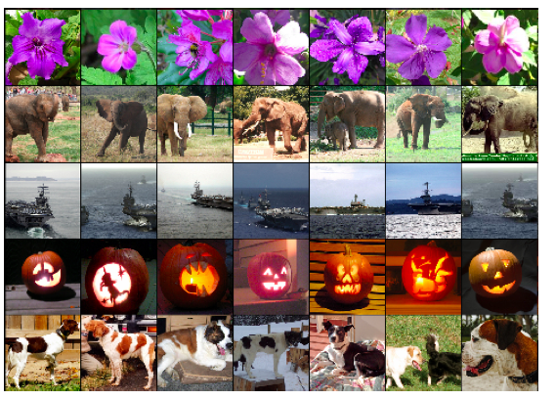
Interesting finding ….
Five ILSVRC-2010 test images in the first column. The remaining columns show the six training images that produce feature vectors in the last hidden layer with the smallest Euclidean distance from the feature vector for the test image.
Notes:
Time-delay neural networks. (TDNN). Lang and Hinton, Waibel. Bottou.
Build a multi-layer neural net (with hierarchical features in resolution) to do pattern classification.
What kinds of dictionaries or features the neurons at different levels of the hierarchy extract?
Achieve some shift and distortion invariance while maintaining topology using local RF, weight sharing and spatial or temporal subsampling.
Again follow the same pattern of Simple-”Complex” cell alternating structures to build feature detectors (simple) and then provide translation invariance by subsampling(complex -- not straightly complex cells).

Slide 22
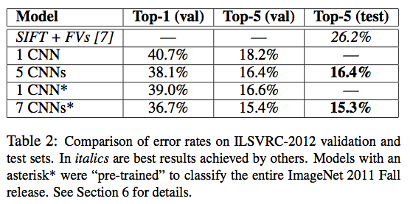
AlexNet: deep convolution neural networks
Alex Krizhevsky, Ilya Sutskever, and Geoff Hinton
ImageNet classification with deep convolutional neural networks (NIPS 2012)
Notes:
Time-delay neural networks. (TDNN). Lang and Hinton, Waibel. Bottou.
Build a multi-layer neural net (with hierarchical features in resolution) to do pattern classification.
What kinds of dictionaries or features the neurons at different levels of the hierarchy extract?
Achieve some shift and distortion invariance while maintaining topology using local RF, weight sharing and spatial or temporal subsampling.
Again follow the same pattern of Simple-”Complex” cell alternating structures to build feature detectors (simple) and then provide translation invariance by subsampling(complex -- not straightly complex cells).

Slide 23
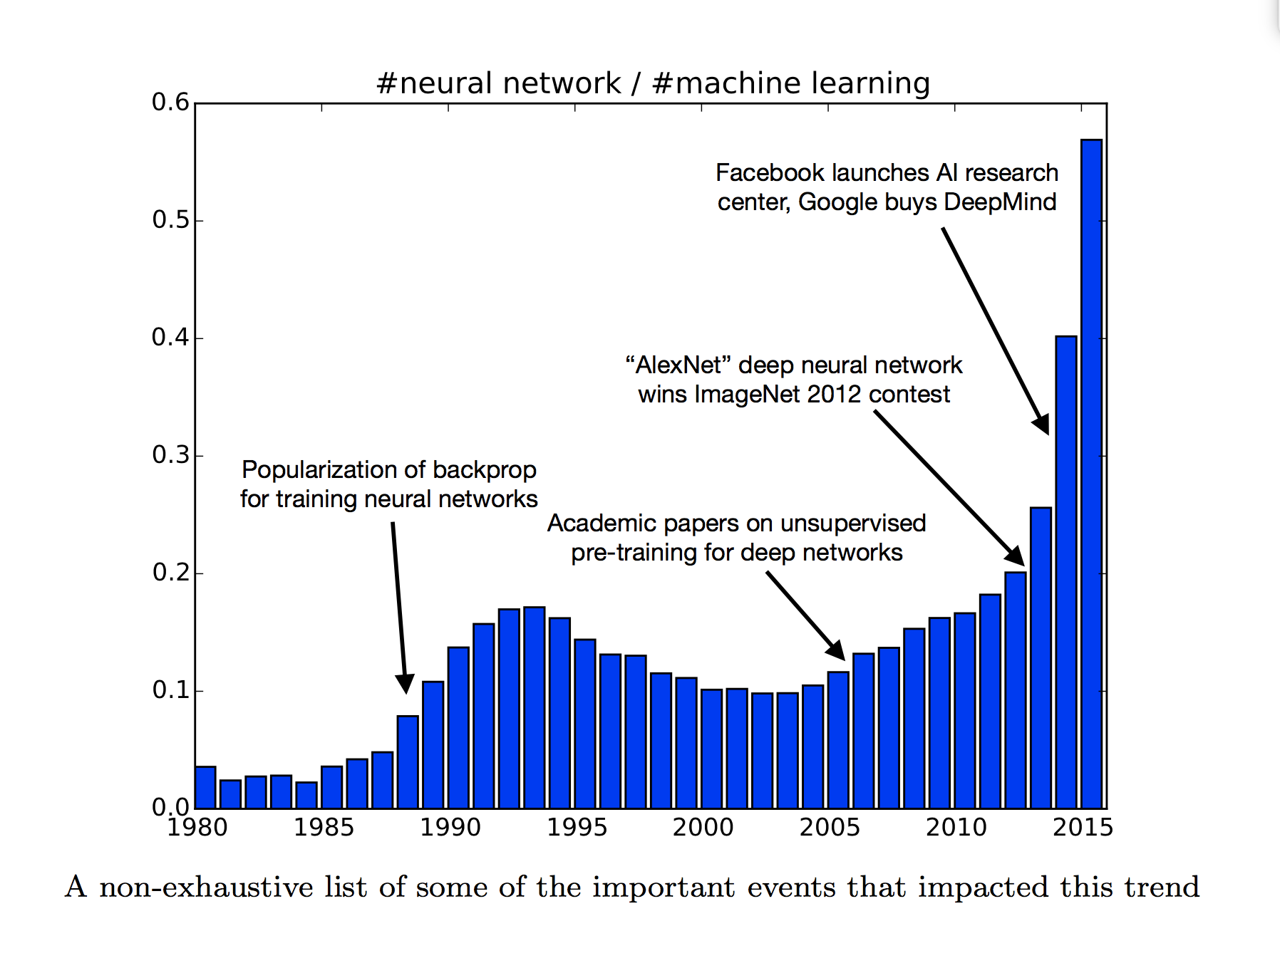

Slide 24
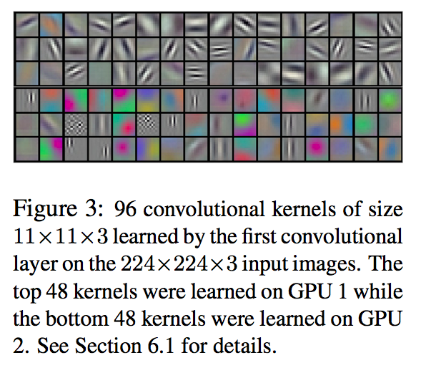
Interesting finding ….
Notes:
Time-delay neural networks. (TDNN). Lang and Hinton, Waibel. Bottou.
Build a multi-layer neural net (with hierarchical features in resolution) to do pattern classification.
What kinds of dictionaries or features the neurons at different levels of the hierarchy extract?
Achieve some shift and distortion invariance while maintaining topology using local RF, weight sharing and spatial or temporal subsampling.
Again follow the same pattern of Simple-”Complex” cell alternating structures to build feature detectors (simple) and then provide translation invariance by subsampling(complex -- not straightly complex cells).

Slide 25
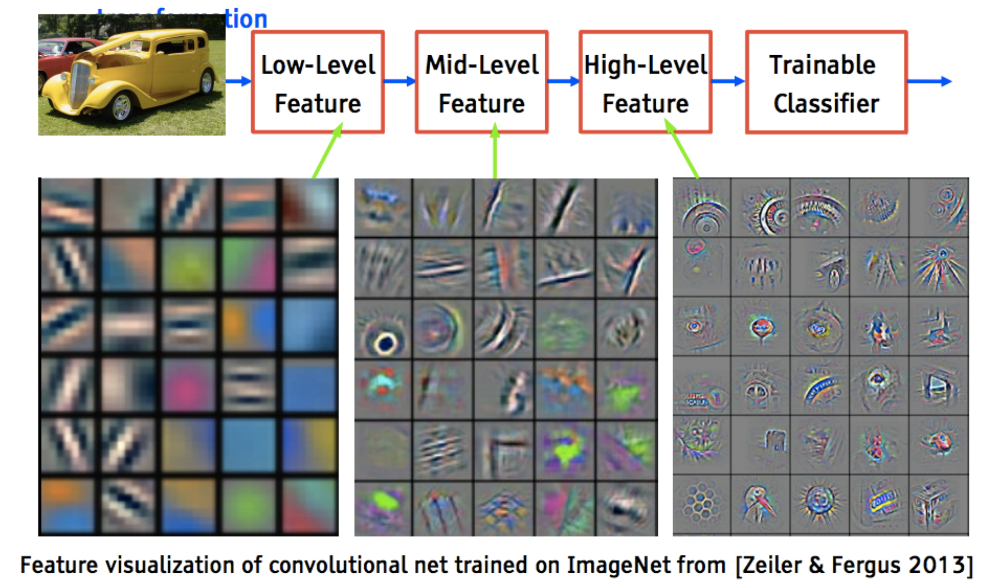
Hierarchical feature representation

Slide 26
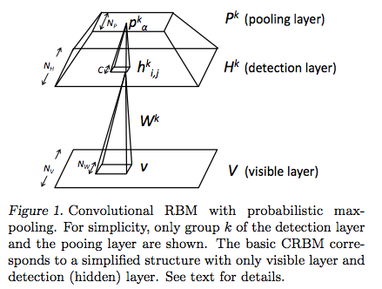
Convolutional Deep Belief net
Honglak Lee, Roger Grosse, Rajesh Ranganath and Andrew Y. Ng. In Proceedings of the Twenty-Sixth International Conference on Machine Learning, 2009.
Notes:
Convolution DBN (Andrew Ng and Honglak Lee) –sharing the weights
Dropout (Toronto group, Geoff Hinton): Dropout is meant to reduce overfitting by randomly omitting half of the feature detectors on each training case.
Sparsity: A small fraction of neurons is allowed to respond at a time.

Slide 27
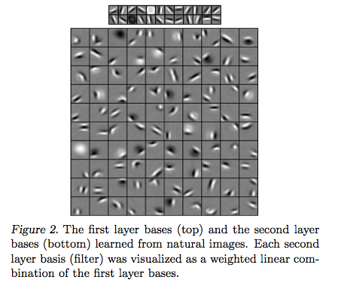

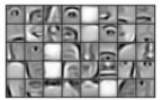
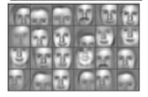
Convolutional Deep Belief net
Notes:
The idea of Deep Belief Net

Slide 28
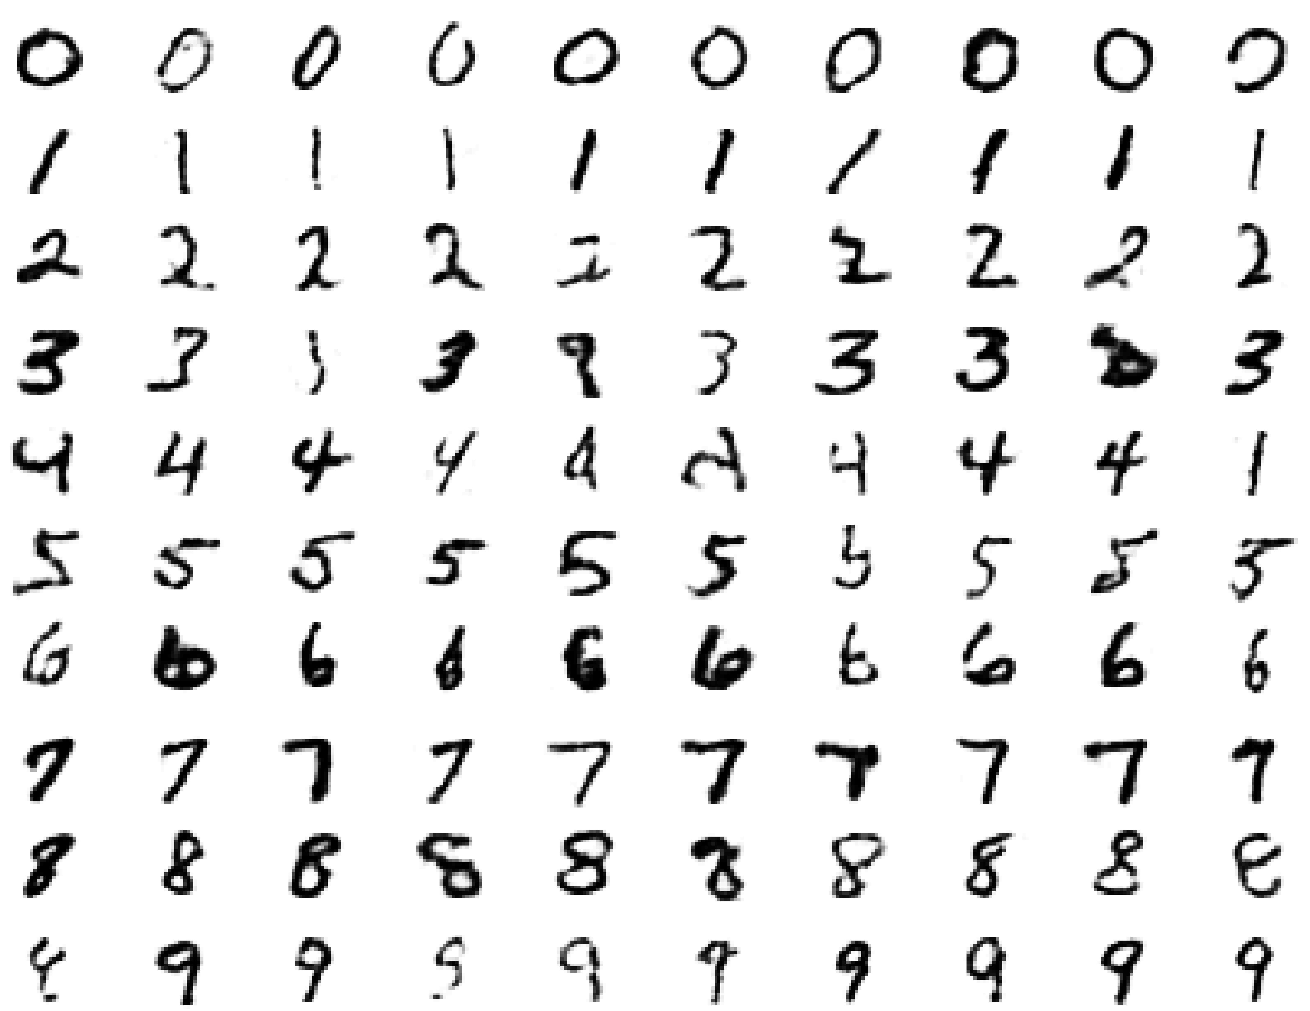
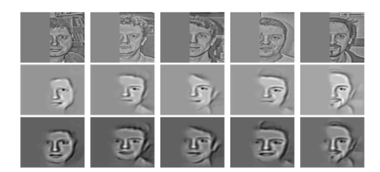
Visualizing higher layer of neurons
Deep Belief Net can do it.
Pool 3: What is the main reason for visualizing higher layer units in AlexNet?
1. Drop-out
2. Convolution layer
Max-Pooling
Rectified linear unit
Notes:
Time-delay neural networks. (TDNN). Lang and Hinton, Waibel. Bottou.
Build a multi-layer neural net (with hierarchical features in resolution) to do pattern classification.
What kinds of dictionaries or features the neurons at different levels of the hierarchy extract?
Achieve some shift and distortion invariance while maintaining topology using local RF, weight sharing and spatial or temporal subsampling.
Again follow the same pattern of Simple-”Complex” cell alternating structures to build feature detectors (simple) and then provide translation invariance by subsampling(complex -- not straightly complex cells).

Slide 29

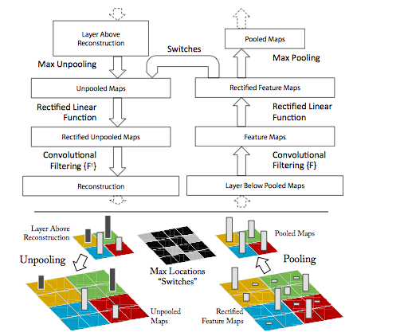
Notes:
Top: A deconvnet layer (left) attached to a convnet layer (right). The deconvnet will reconstruct an approximate version of the convnet features from the layer beneath. Bottom: An illustration of the unpooling operation in the deconvnet, using switches which record the location of the local max in each pooling region (colored zones) during pooling in the convnet. The black/white bars are negative/positive activations within the feature map.
introduce a visualization technique that reveals the in-
put stimuli that excite individual feature maps at any
layer in the model. It also allows us to observe the
evolution of features during training and to diagnose
potential problems with the model. The visualization
technique we propose uses a multi-layered Deconvo-
lutional Network (deconvnet), as proposed by (Zeiler
et al., 2011), to project the feature activations back to
the input pixel space.

Slide 30
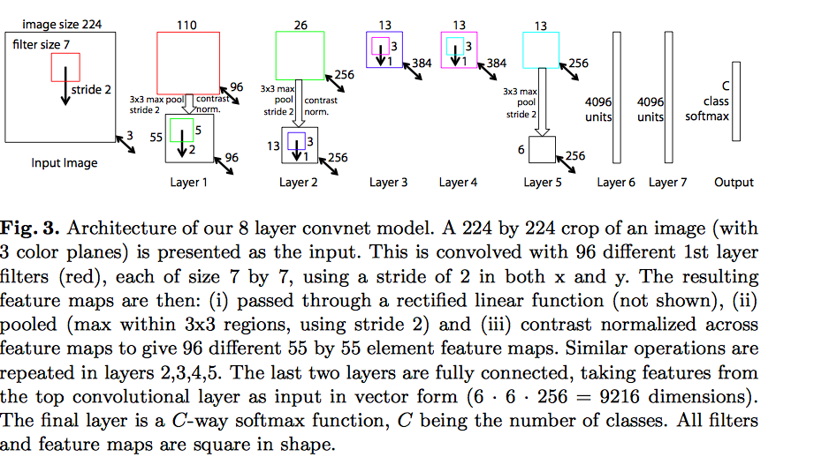
Notes:
Visualization of features in a fully trained model. For layers 2-5 we show the top 9 activations in a random subset of feature maps across the validation data, projected down to pixel space using our deconvolutional network approach. Our reconstructions are not samples from the model: they are reconstructed patterns from the validation set that cause high activations in a given feature map. For each feature map we also show the corresponding image patches. Note: (i) the the strong grouping within each feature map, (ii) greater invariance at higher layers and (iii) exaggeration of discriminative parts of the image, e.g. eyes and noses of dogs (layer 4, row 1, cols 1). Best viewed in electronic form. The compression artifacts are a consequence of the 30Mb submission limit, not the reconstruction algorithm itself.

Slide 31
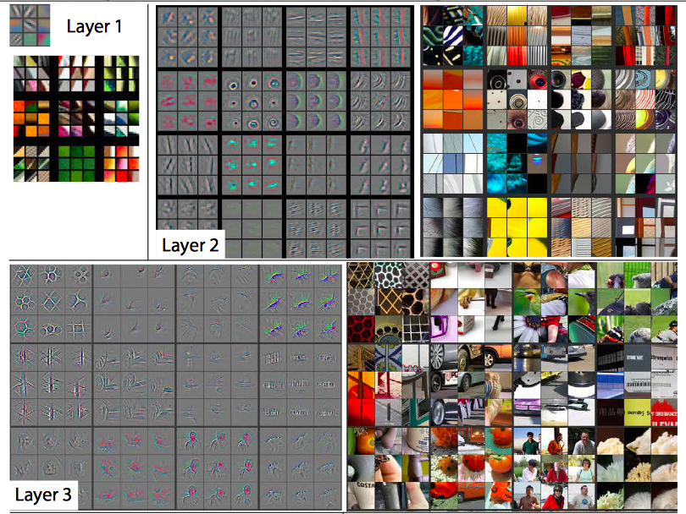

Slide 32
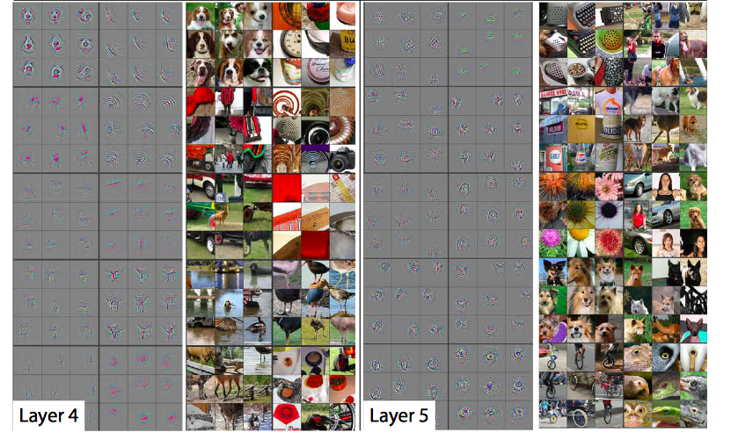
Notes:
Visualization of features in a fully trained model. For layers 2-5 we show the top 9 activations in a random subset of feature maps across the validation data, projected down to pixel space using our deconvolutional network approach. Our reconstructions are not samples from the model: they are reconstructed patterns from the validation set that cause high activations in a given feature map. For each feature map we also show the corresponding image patches. Note: (i) the the strong grouping within each feature map, (ii) greater invariance at higher layers and (iii) exaggeration of discriminative parts of the image, e.g. eyes and noses of dogs (layer 4, row 1, cols 1). Best viewed in electronic form. The compression artifacts are a consequence of the 30Mb submission limit, not the reconstruction algorithm itself.

Slide 33
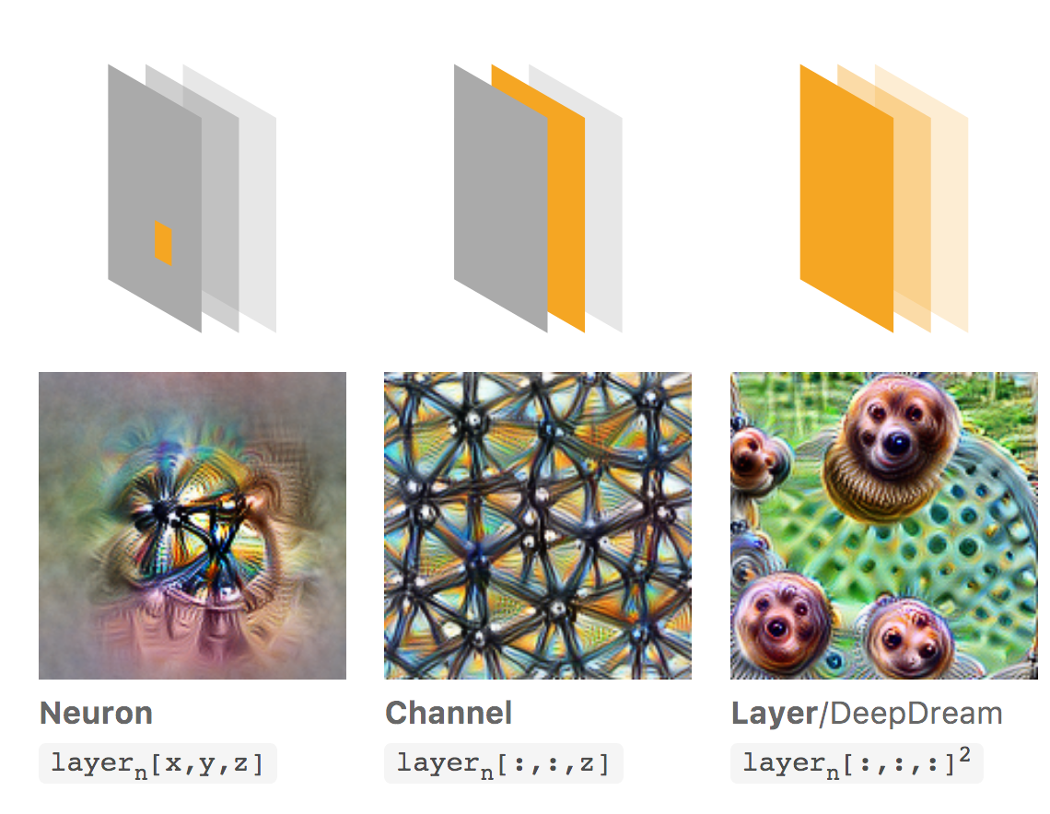
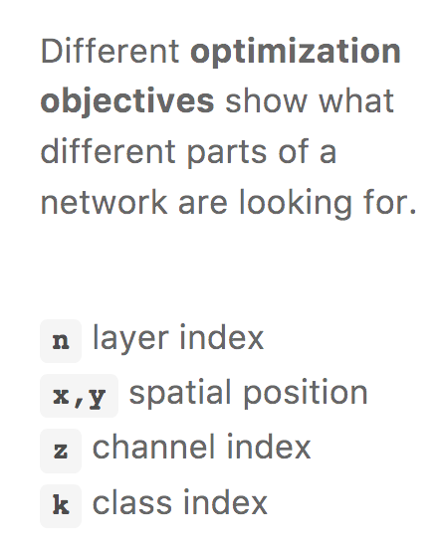
Visualization
Neural network interpretability
Optimize images to maximize a neuron’s response at a particular position or for an entire channel.
https://distill.pub/
Notes:
DeepDream objective, searching for images the layer ﬁnds “interesting.”

Slide 34
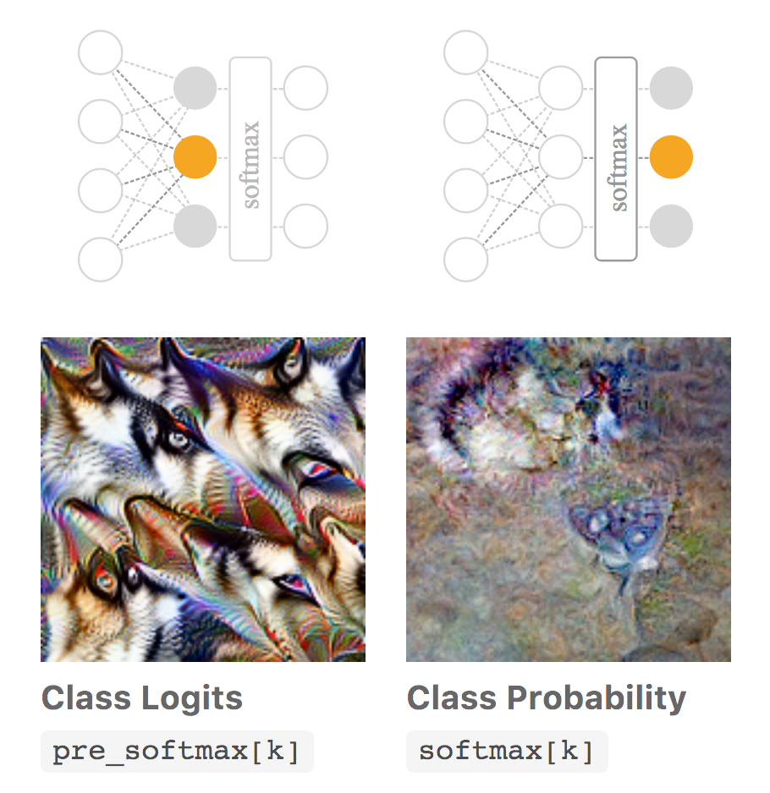
Visualization
Notes:
If we want to create examples of output classes from a classiﬁer, we have two options — optimizing class logits before the softmax or optimizing class probabilities after the softmax. One can see the logits as the evidence for each class, and the probabilities as the likelihood of each class given the evidence. Unfortunately, the easiest way to increase the probability softmax gives to a class is often to make the alternatives unlikely rather than to make the class of interest likely [5]
. From our experience, optimizing pre-softmax logits produces images of better visual quality

Slide 35
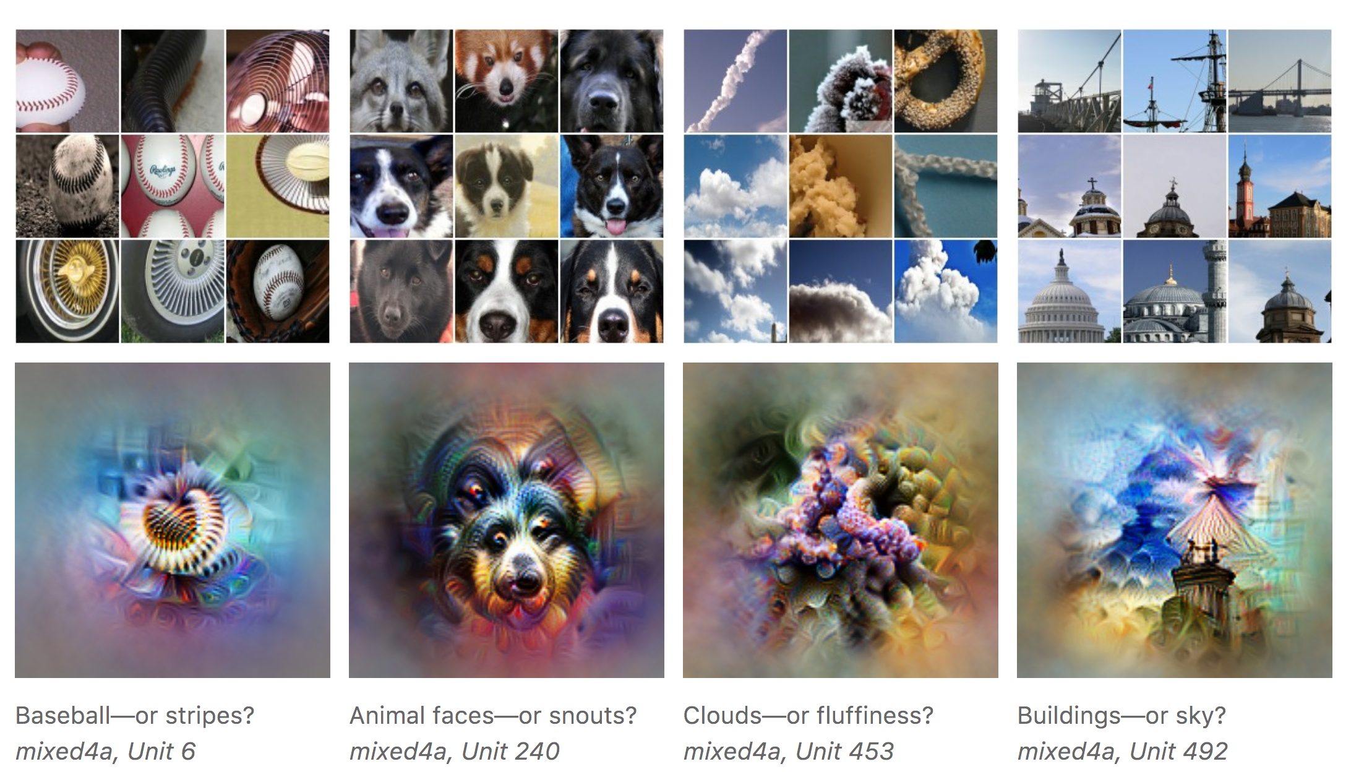
Visualization
What is the neuron really coding?
Notes:
Optimization approach can be a powerful way to understand what a model is really looking for, because it separates the things causing behavior from things that merely correlate with the causes.

Slide 36
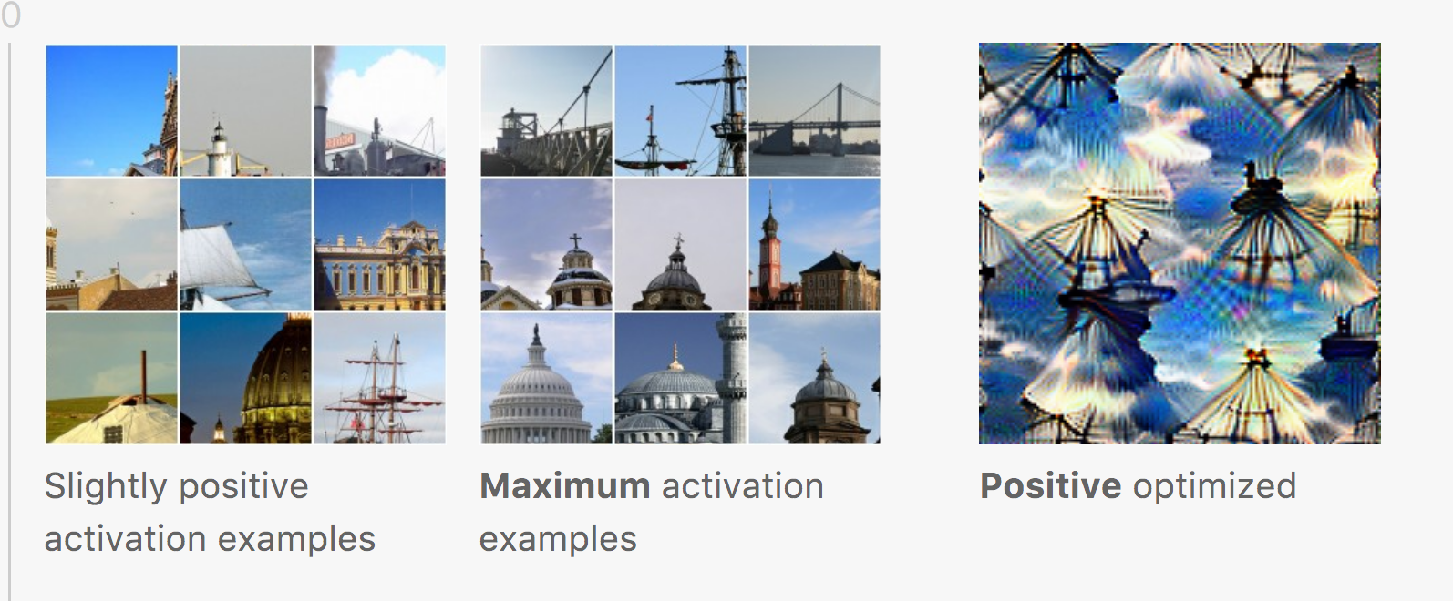
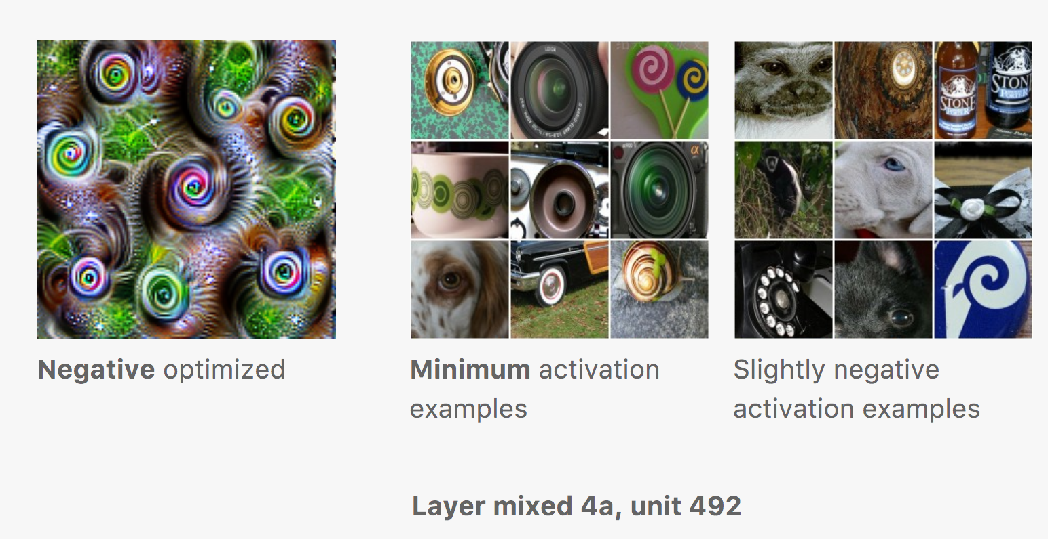
Visualization
Positive optimized and negative optimzied
Notes:
Optimization approach can be a powerful way to understand what a model is really looking for, because it separates the things causing behavior from things that merely correlate with the causes.

Slide 37
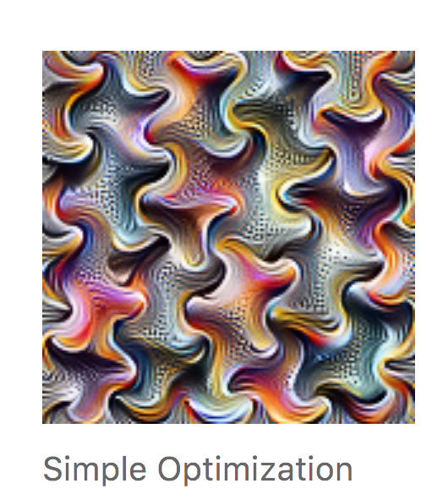
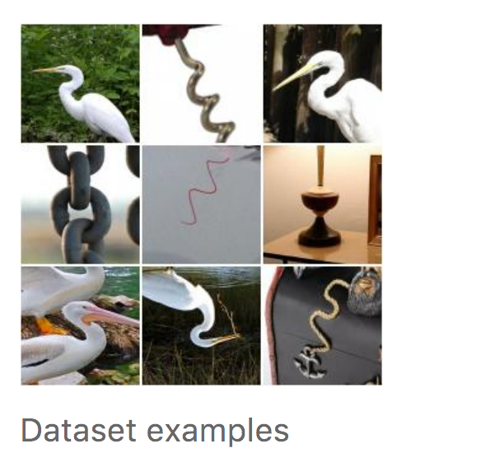
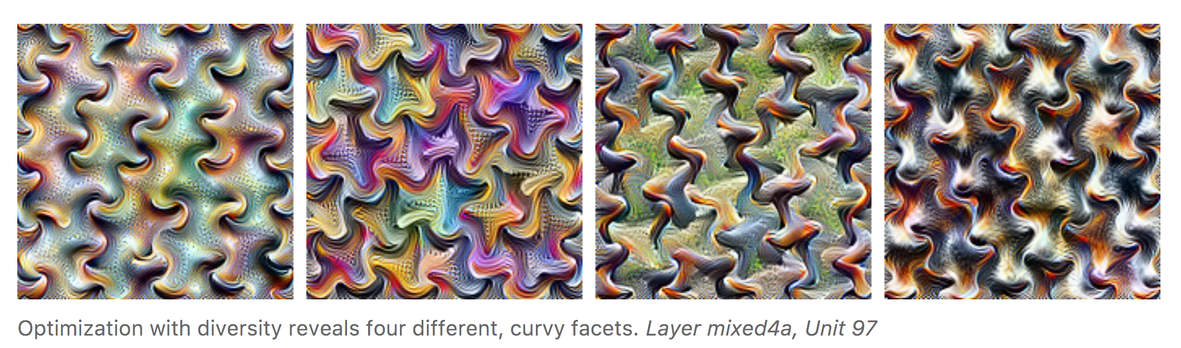
Diversity
Notes:
Optimization approach can be a powerful way to understand what a model is really looking for, because it separates the things causing behavior from things that merely correlate with the causes.

Slide 38
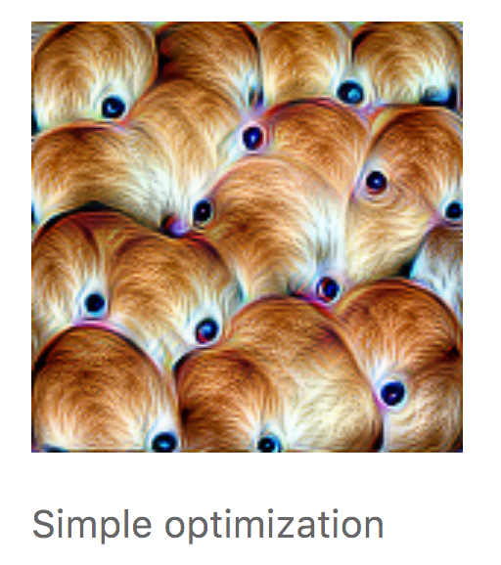
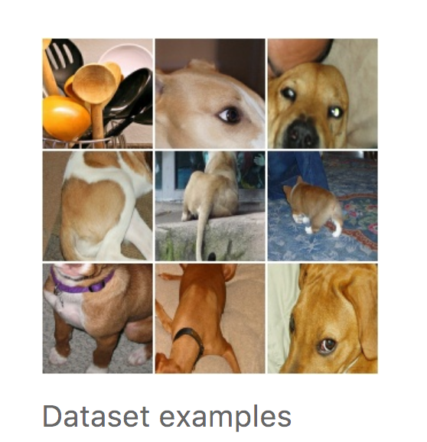
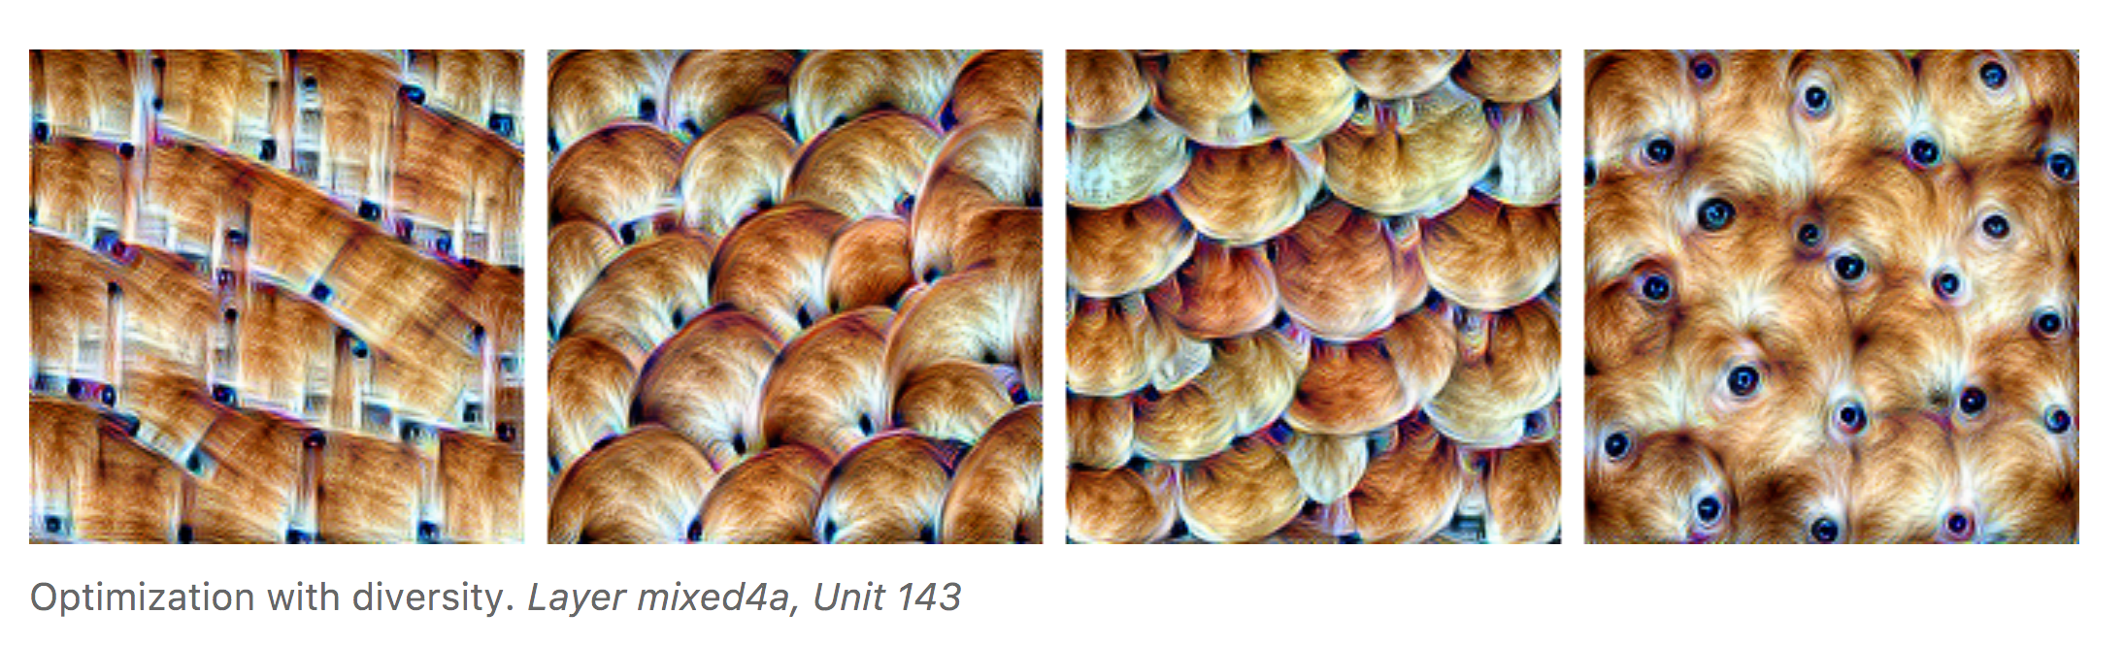
Diversity
Notes:
Optimization approach can be a powerful way to understand what a model is really looking for, because it separates the things causing behavior from things that merely correlate with the causes.

Slide 39
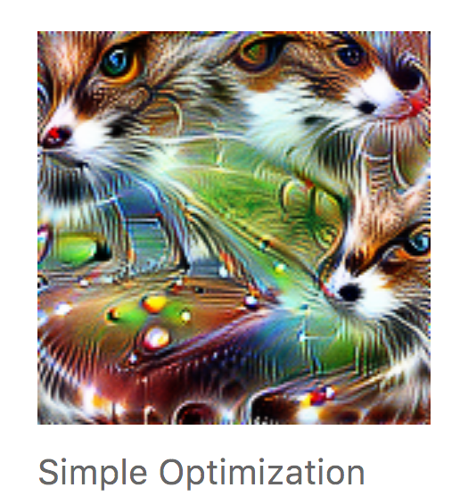
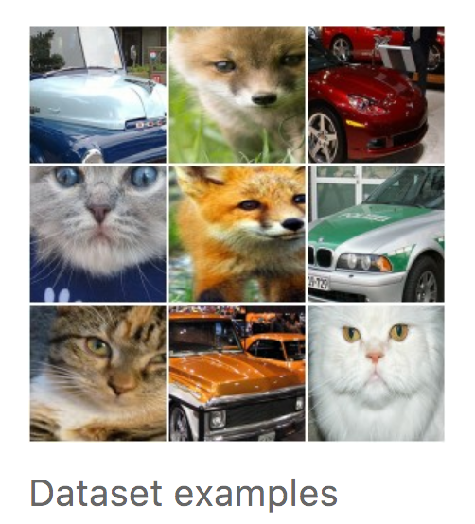

Diversity
Notes:
Optimization approach can be a powerful way to understand what a model is really looking for, because it separates the things causing behavior from things that merely correlate with the causes.

Slide 40

Interaction of neurons
Notes:
Optimization approach can be a powerful way to understand what a model is really looking for, because it separates the things causing behavior from things that merely correlate with the causes.

Slide 41

Interpolation of neurons
Notes:
Optimization approach can be a powerful way to understand what a model is really looking for, because it separates the things causing behavior from things that merely correlate with the causes.

Slide 42

Visualization
Deep dream
Optimize the image to excite a banana neuron, with natural image priors – correlation in pixels across space.
Notes:
we actually understand surprisingly little of why certain models work and others don’t. So let’s take a look at some simple techniques for peeking inside these networks.

Slide 43

Visualization
Notes:
Why is this important? Well, we train networks by simply showing them many examples of what we want them to learn, hoping they extract the essence of the matter at hand (e.g., a fork needs a handle and 2-4 tines), and learn to ignore what doesn’t matter (a fork can be any shape, size, color or orientation). But how do you check that the network has correctly learned the right features? It can help to visualize the network’s representation of a fork.

Slide 44

Visualization
What are these? What is strange about it?
Visualization helps us understand what the neurons are actually learning, and can help us correct these kinds of training mishaps.
Notes:
Why is this important? Well, we train networks by simply showing them many examples of what we want them to learn, hoping they extract the essence of the matter at hand (e.g., a fork needs a handle and 2-4 tines), and learn to ignore what doesn’t matter (a fork can be any shape, size, color or orientation). But how do you check that the network has correctly learned the right features? It can help to visualize the network’s representation of a fork.

