Slide 1
Deep learning and vision (AI and the Brain I)
Tai Sing Lee
15-381/681 AI Lecture 22
Reading: : Yann LeCun, Yoshua Bengio and Geoff Hinton, (2015). Deep learning. Nature. 521: 436-444.
Slide credit: Lee, Ranzato, Hoim, Brunskill, Zico.

Slide 2
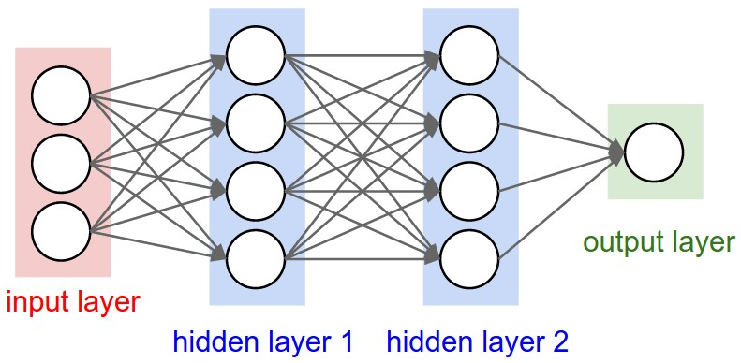
Standard Neural Network
Each internal node is connected to all nodes in prior layer
Each node in the same layer independent (separate set of weights)

Slide 3
Backpropagation
Compute all the necessary gradient using one “forward pass” (just computing all the values at layers) and one ”backward pass” (computing gradients backwards in the network).

Slide 4
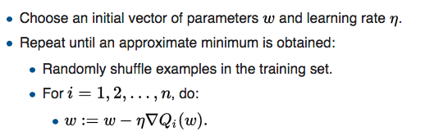
Stochastic gradient descent (SGD)
On-line gradient descent
True gradient Q(w) is approximated by gradient of a single example.
Update per sample, several pass over training set.
Data shuffled in each pass.
Mini-batch to get better estimate.

Slide 5
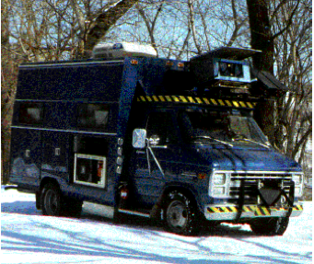
Can you use neural network to recognize images?
CMU’s ALVINN
Early 90s, 95% hand-free across America.

Slide 6
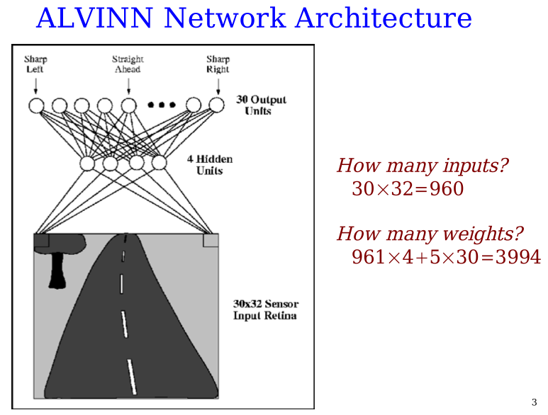

Slide 7
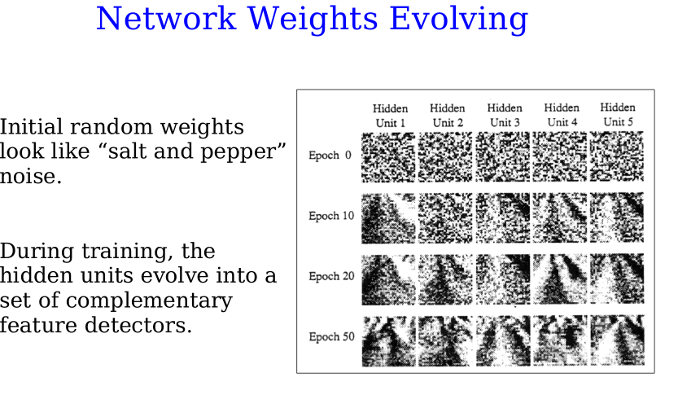
Pomerleau and Touretzky

Slide 8
What is vision?
What is Vision?

Slide 9
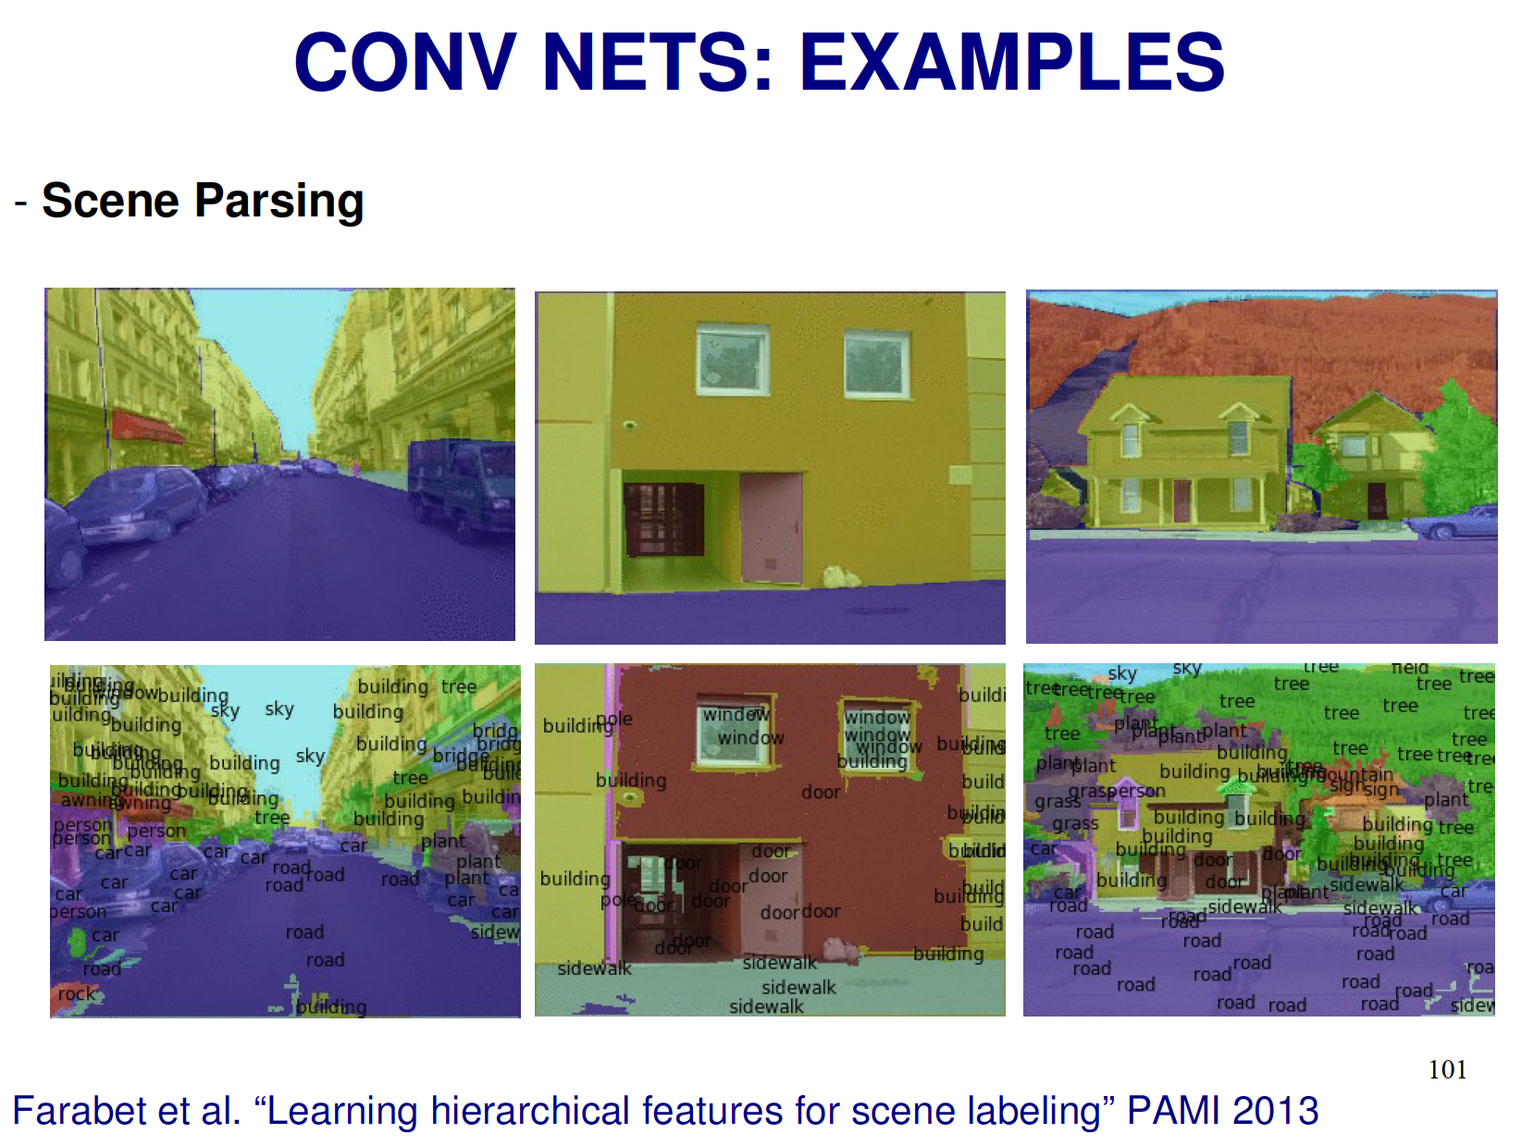
What is vision?
What is Vision?

Slide 10
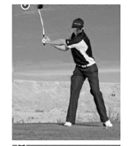
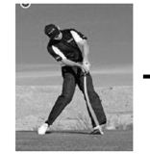
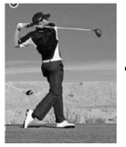
What is vision?
What is Vision?

Slide 11
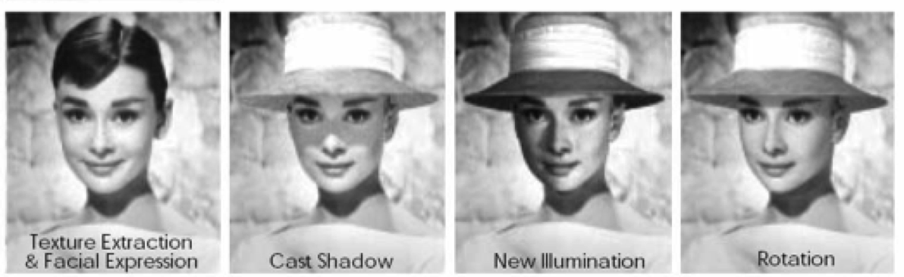
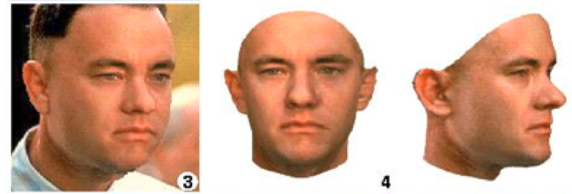
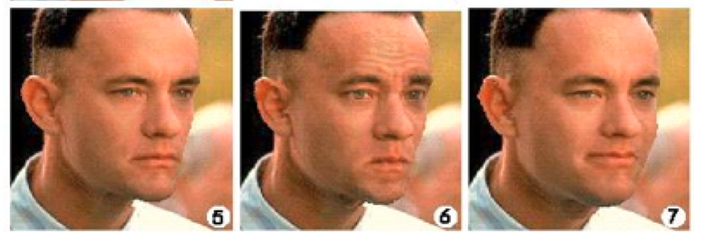
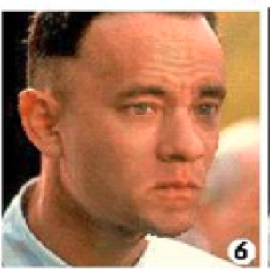

Specificity versus invariance problem.
What is Vision?

Slide 12
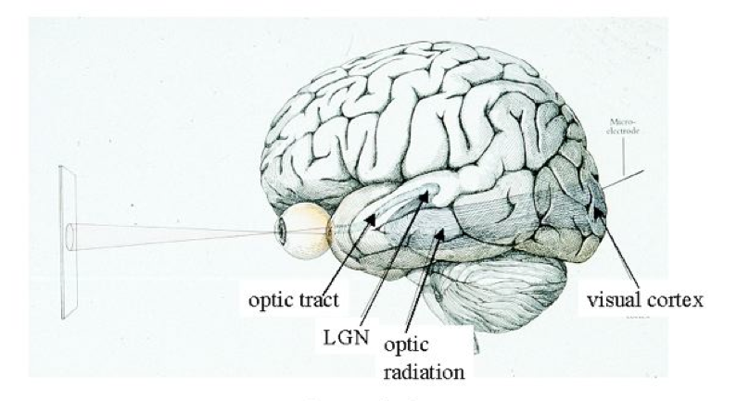
Primate Visual System
Notes:
Let us look at what we know about the visual system at the time, … sadly, we are flushing out some of the details, but there are little major surprises or advances in the last thirty years…

Slide 13
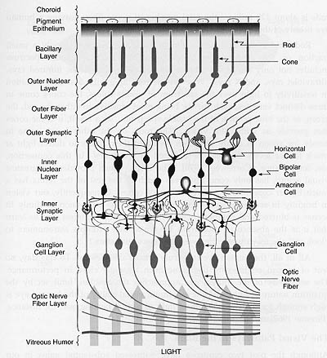
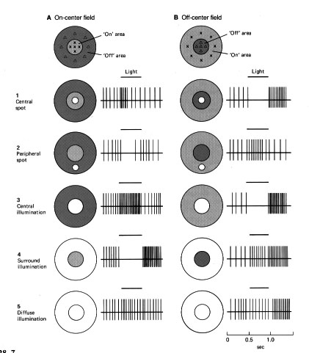
Input: Photoreceptors: rods and cones
Output: retinal ganglian cells (1M cells per eye).
Notes:
13
Shiny layer: cows and cats noctornal animals. Collect and redirect and reflect the light.

Slide 14

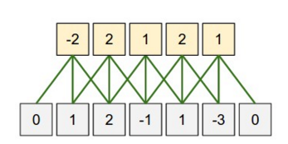
Filtering
Ouptut
Input

Slide 15
Filtering
Ouptut
Input

Slide 16





Filtering
*
*
Notes:
Image features such as edges and bars appear enhanced in the Laplacian pyramid. Enhanced features are segregated by size: fine details are prominent in bottom; coarser features are prominent in the higher level images.
Non-causal prediction, based on symmetric neighborhood centered at each pixel, should yield more accurate prediction and hence, greater data-compression. Involve image transforms. Rather than pixel by pixel, encode them all at once. Predictive is simple , but transform involves greater compression, but require greater computation. Laplacian pyramid combines features from both the predictive and transform methods. A non-causal technique with simple and local computations.

Slide 17
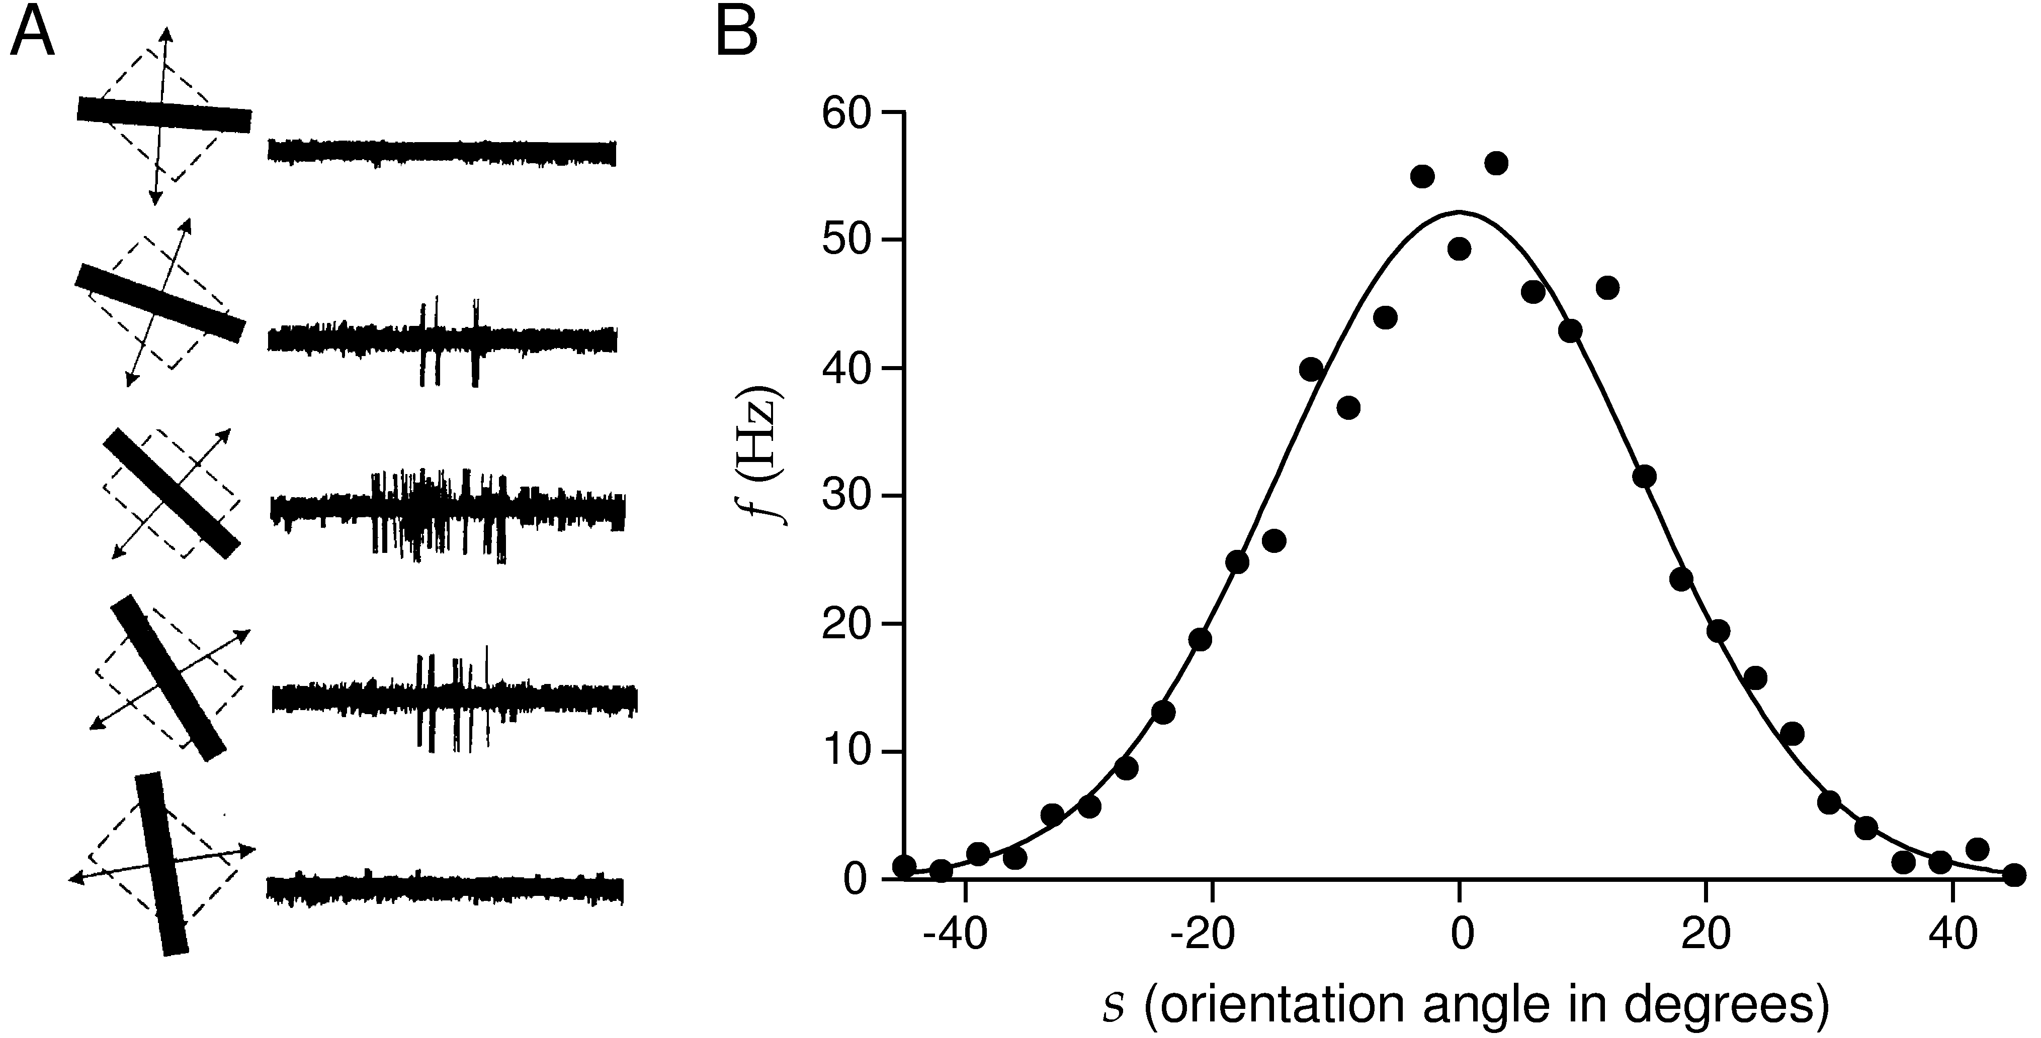
Orientation tuning of striate (V1) neurons
Notes:
17

Slide 18
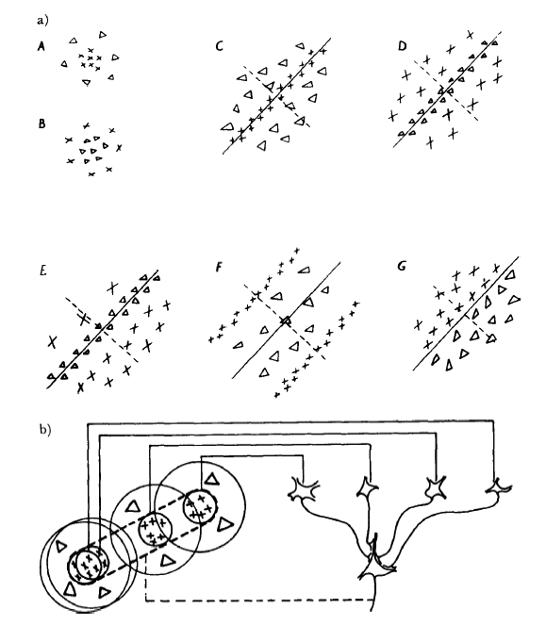
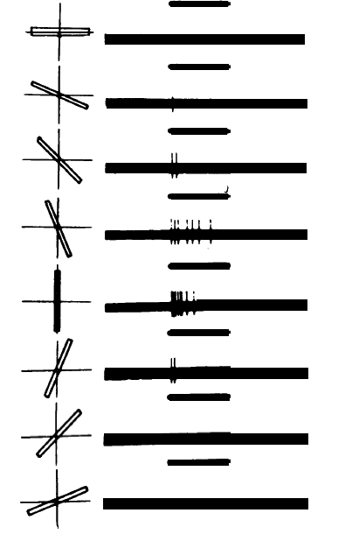
Simple cell: what for?
Hubel and Wiesel
Notes:
18

Slide 19
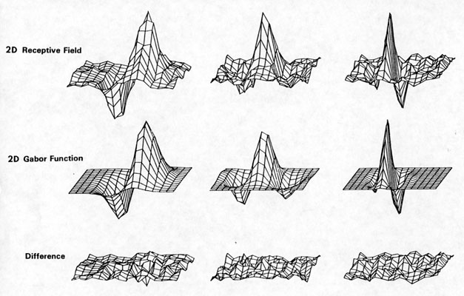
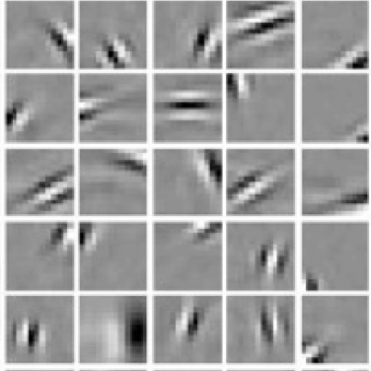
Gabor filters / wavelets
Daugman 1985
Jones and Palmer (1988) showed that the Gabor filter (1940) model can fit the receptive fields of simple cells.
Notes:
19
Red and green can be mixed so that all traces of the original redness or greenness are lost and a pure yellow is seen; yellow and blue lights are mixed to produce white wihtout any trace of the original blue or yellow. Why? Ewald Hering: each channel respond excitatory to red but inhibitory to green or vice versa. When properly balanced with precise mixture of red and green, this channel produces no output.

Slide 20
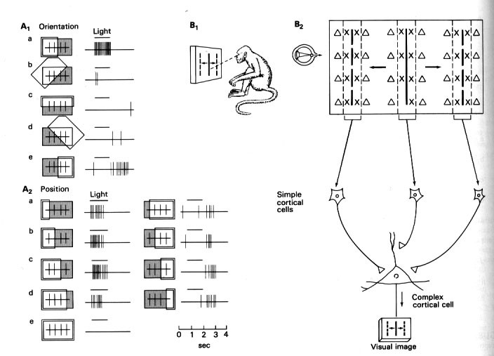
Complex cells: why?
Hubel and Wiesel
Notes:
Bipolar have antagonistic center-surround receptive fields and are either on-center and off-center. Cones directly connected to a bipolar cell. On-center cell depolarize to light, off-center hyperpolarize with light. Horizontal cells connected to cones, have gap junctions to connect to each other, signals flow from the surround. Cone release neurotransmitter, glutamate, opposite actions on the 2 classes of cells.

Slide 21
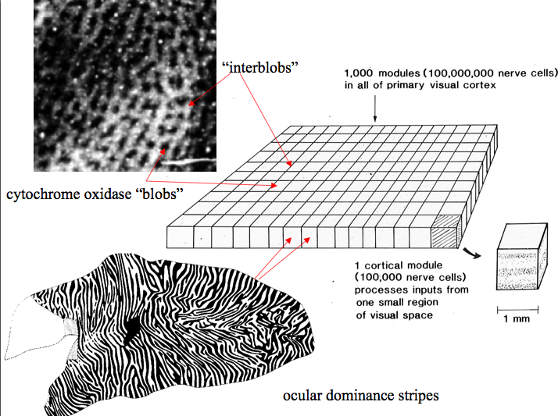
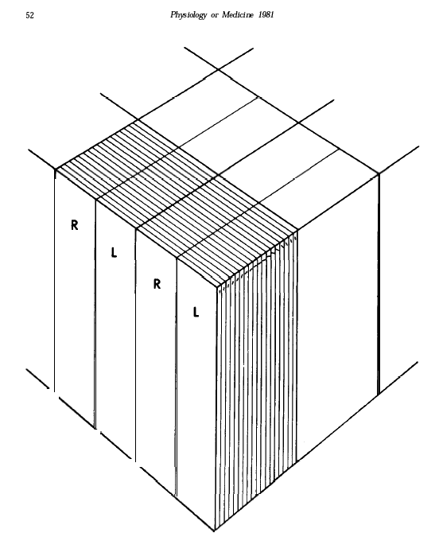
Retinotopic Maps and Hypercolumns:
Feature detectors same across map (why?)
© Stephen E. Palmer, 2002

Slide 22
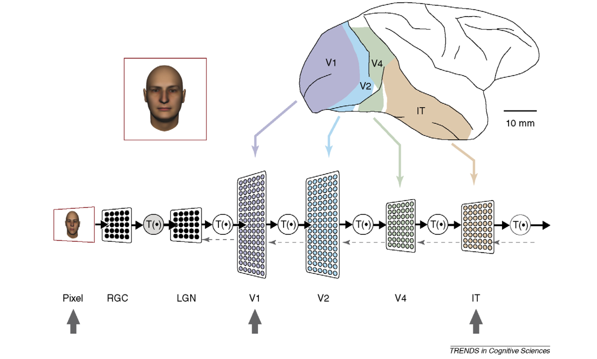
What is vision?
What is Vision?
DiCarlo and Cox 2007

Slide 23
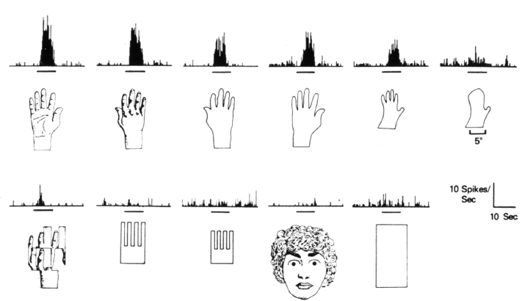
Hand recognition IT neurons
Charles Gross

Slide 24
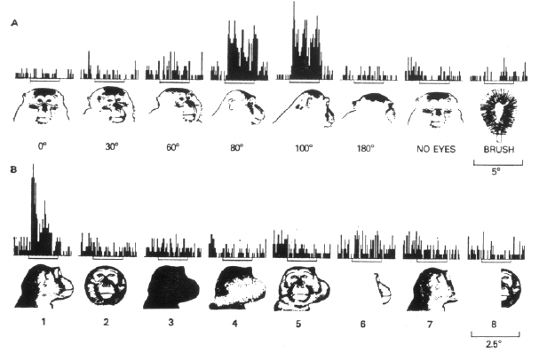
Object recognition neurons
Charles Gross

Slide 25
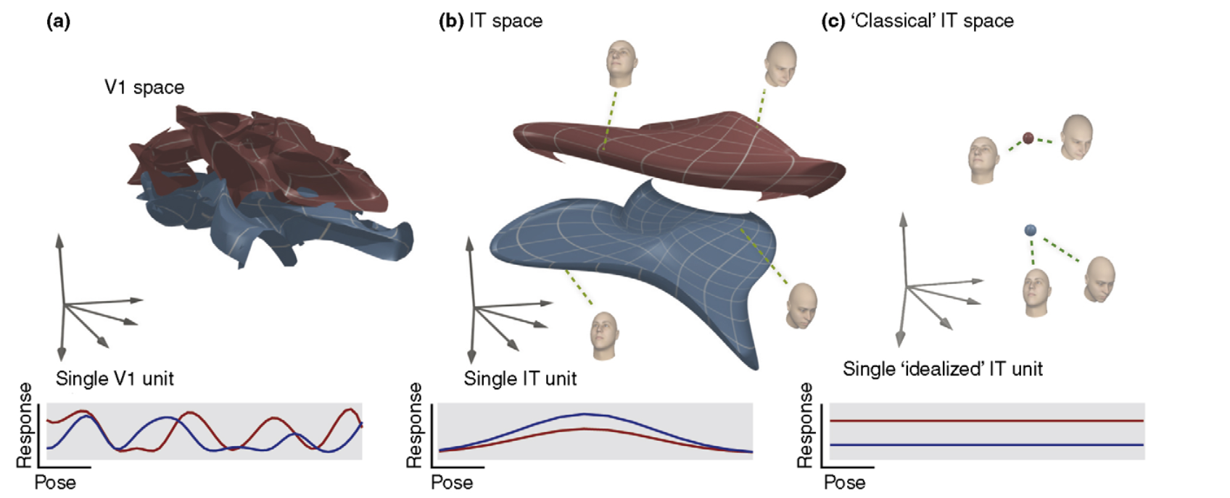
Untangling the manifolds
Each face is represented by 500 V1 neurons, and 500 IT neurons, each being a vector in the 500-D space. The distance between the vectors of the neural representations of two persons’ faces at different poses are shown.

Slide 26
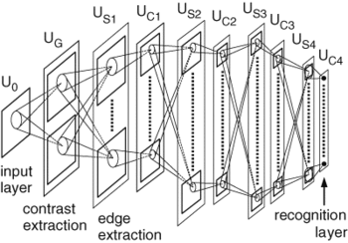
Convolutional Neural Network: Fukushima’s Neocognitron (1970s)
Alternating S and C layers:
S - feature detectors (e.g. simple cells) convolution - specificity,
C – pooling spatial or feature invariance (e.g. complex cells)
Notes:
Simple cells take conjunction of inputs. Complex cells introduce variance and tolerance.

Slide 27
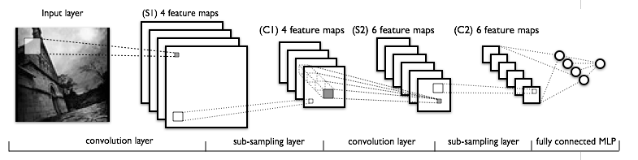
LeCun’s convolution net (90s)
Shared weight network
Backpropagation learning
http://yann.lecun.com/exdb/lenet/multiples.html
Notes:
Time-delay neural networks. (TDNN). Lang and Hinton, Waibel. Bottou.
Build a multi-layer neural net (with hierarchical features in resolution) to do pattern classification.
What kinds of dictionaries or features the neurons at different levels of the hierarchy extract?
Achieve some shift and distortion invariance while maintaining topology using local RF, weight sharing and spatial or temporal subsampling.
Again follow the same pattern of Simple-”Complex” cell alternating structures to build feature detectors (simple) and then provide translation invariance by subsampling(complex -- not straightly complex cells).

Slide 28
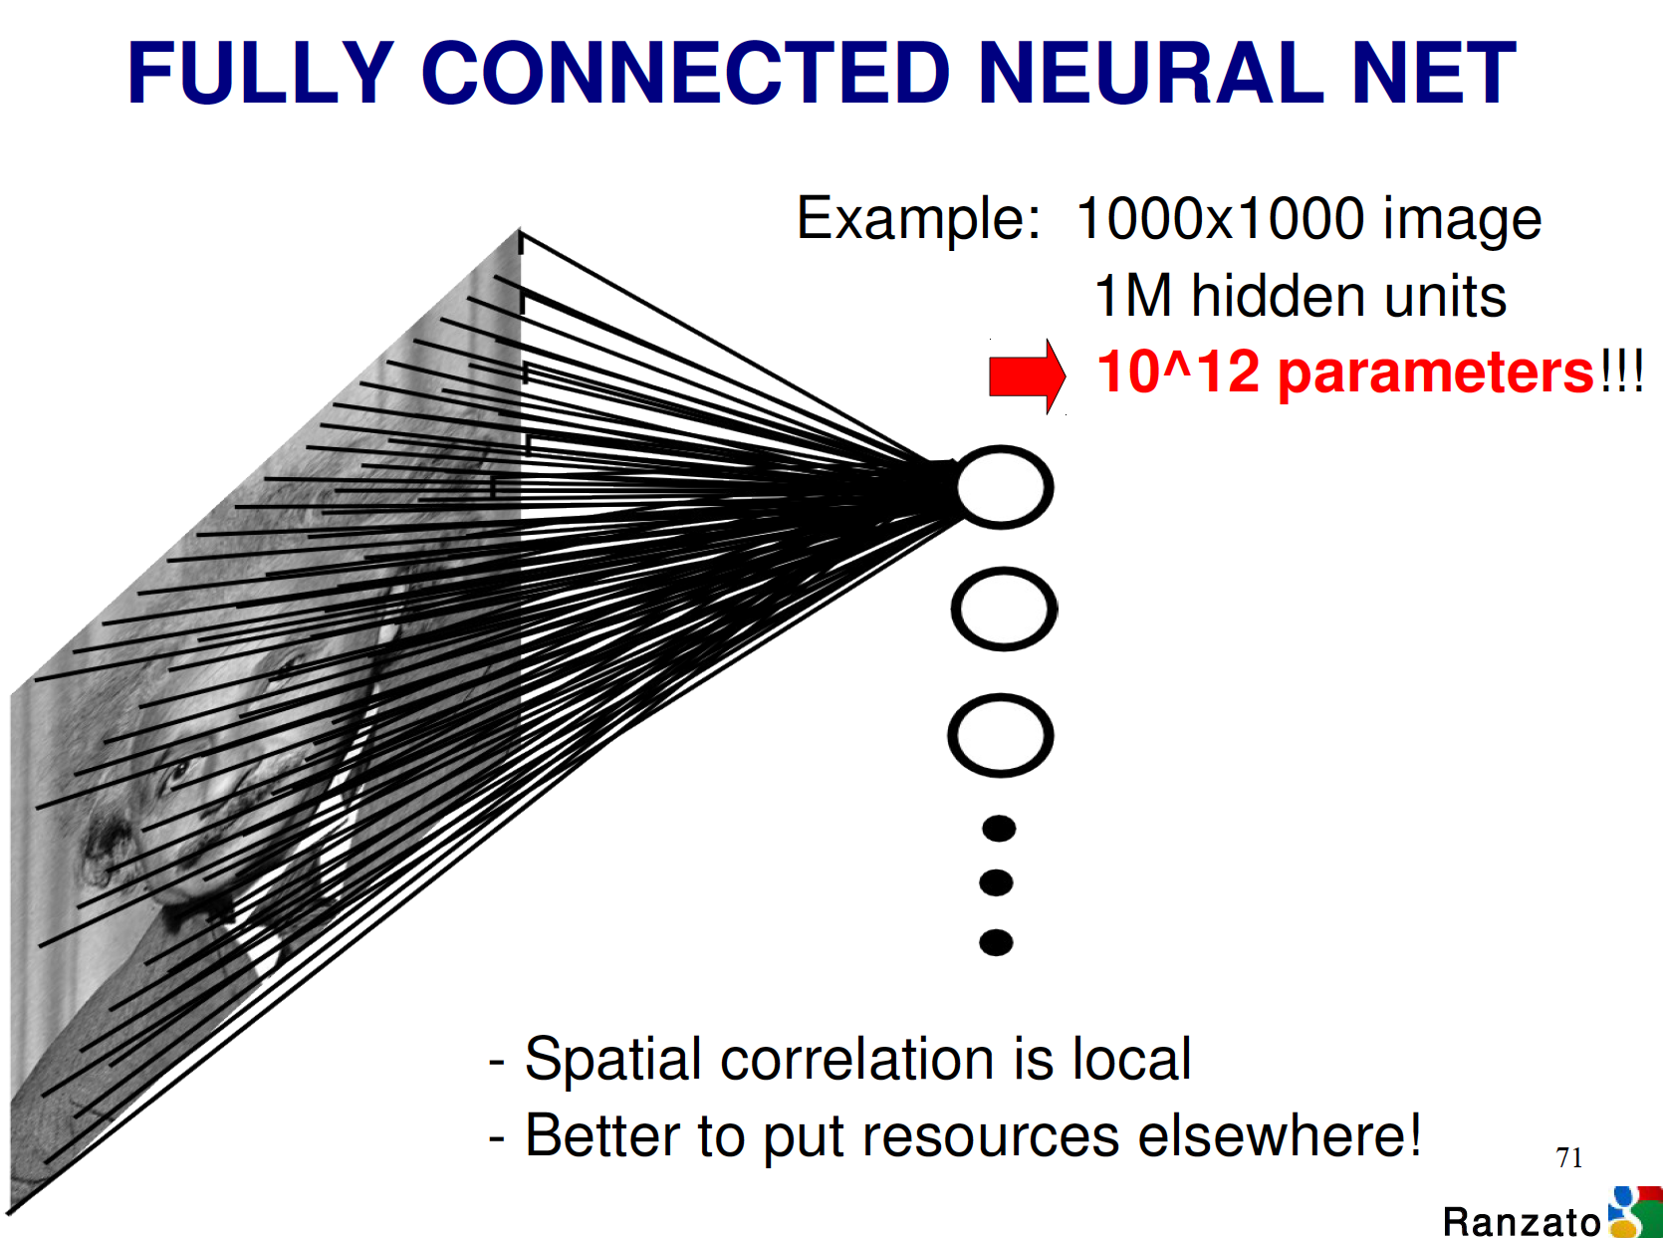
How many weight parameters for a single node which is a linear combination of input?

Slide 29
How many weight parameters for a single node which is a linear combination of input?

Slide 30
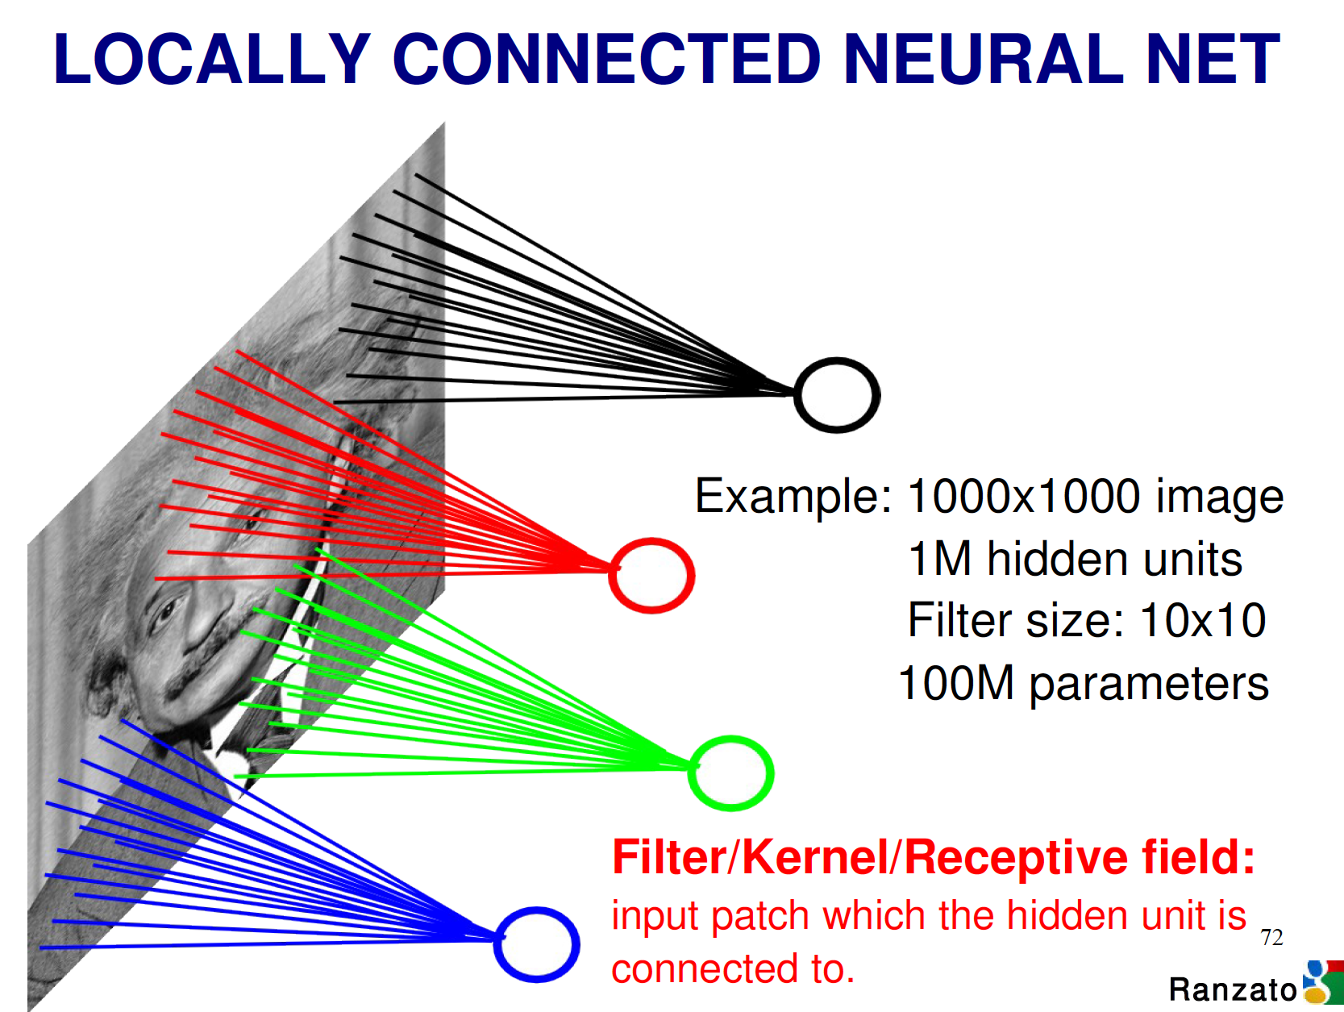

Slide 31
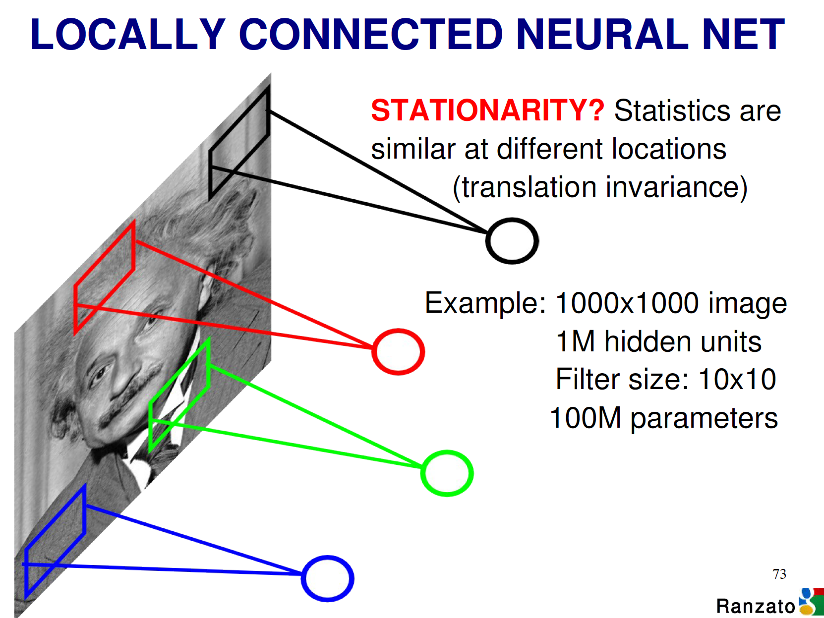

Slide 32
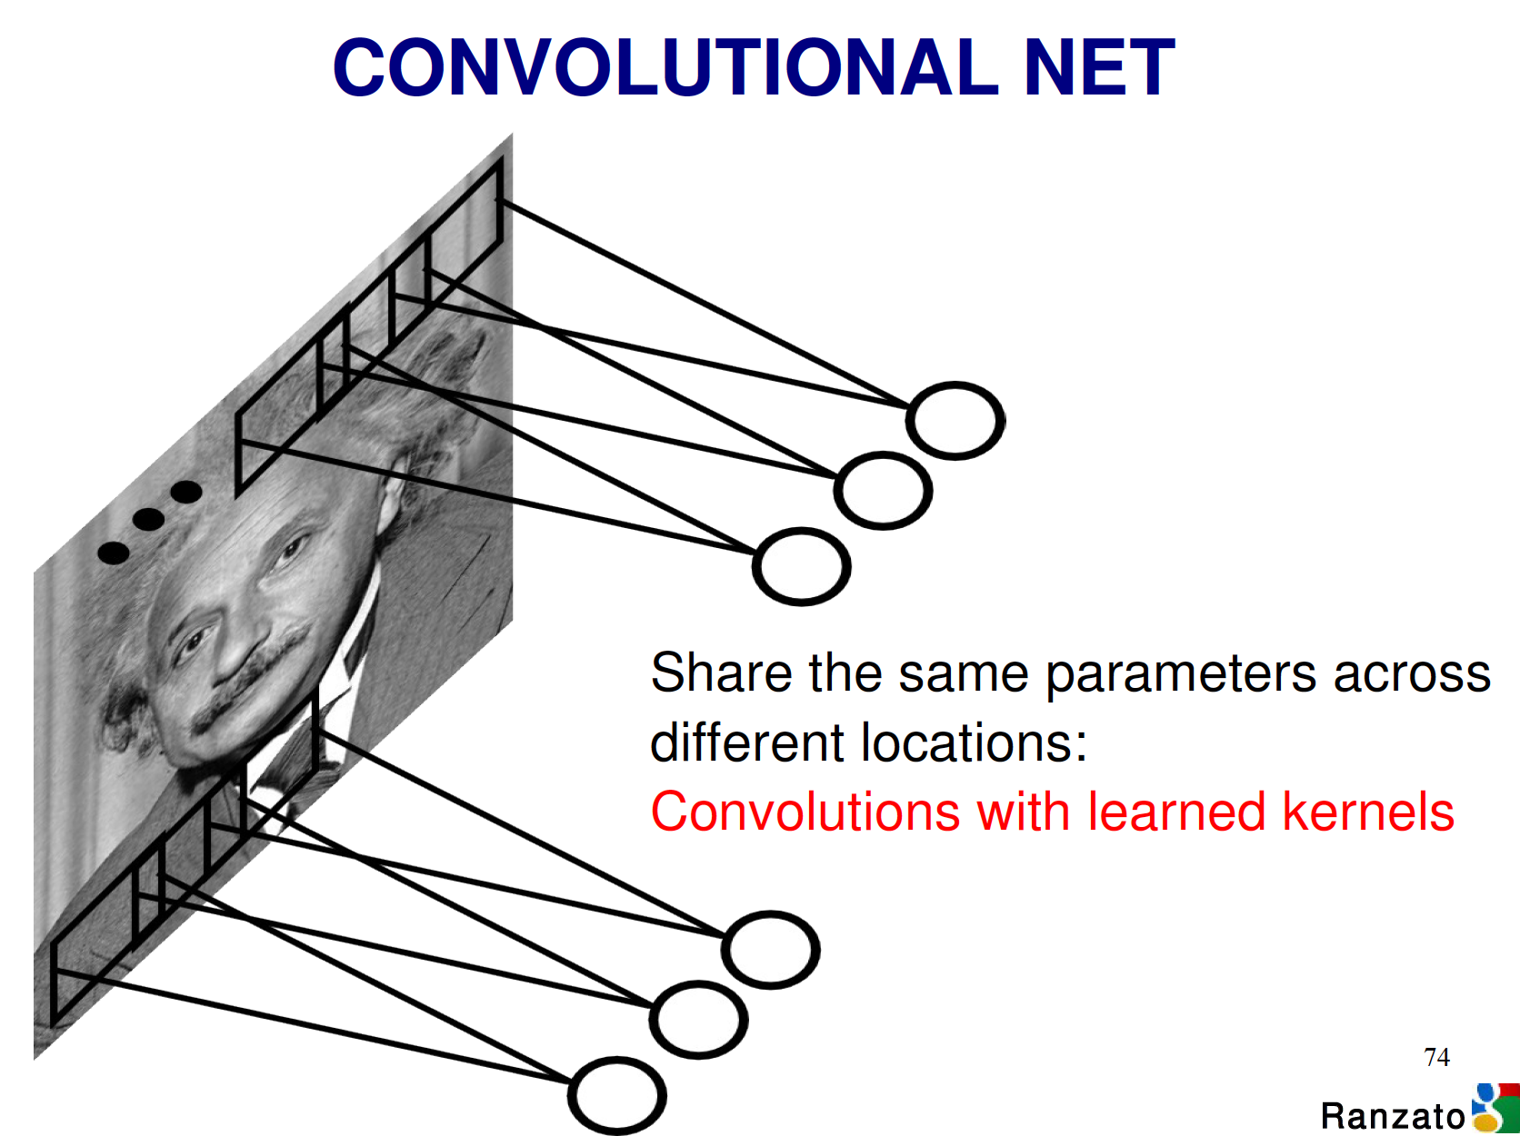
Notes:
How much does this reduce set of parameters?

Slide 33
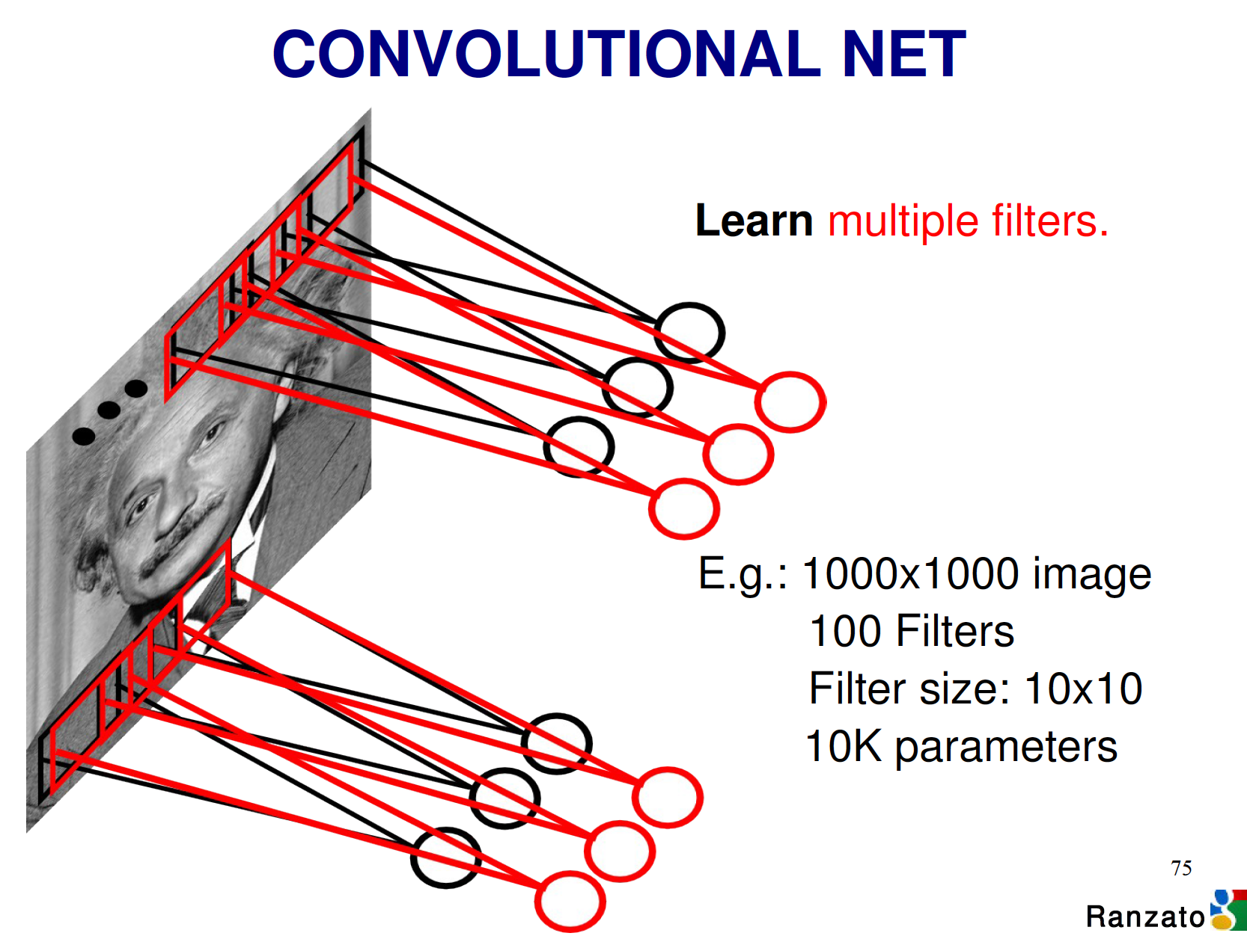

Slide 34
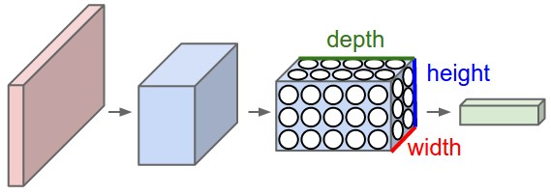
Convolutional neural networks - uses volumes
E.g. height and width are the size of the image
Depth = number of features (filters)
Pooling: position and other invariance
Depth ~= # of classes/features

Slide 35
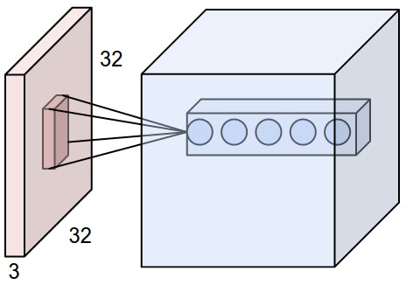
Volumes and Depths
Each node here has the same input but different weight vectors (e.g. computing different features of same input)
A feature detector – filter.

Slide 36
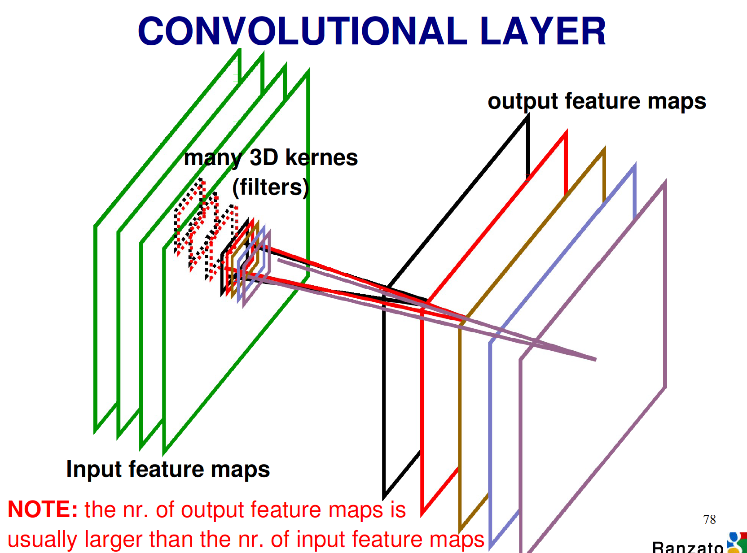

Slide 37
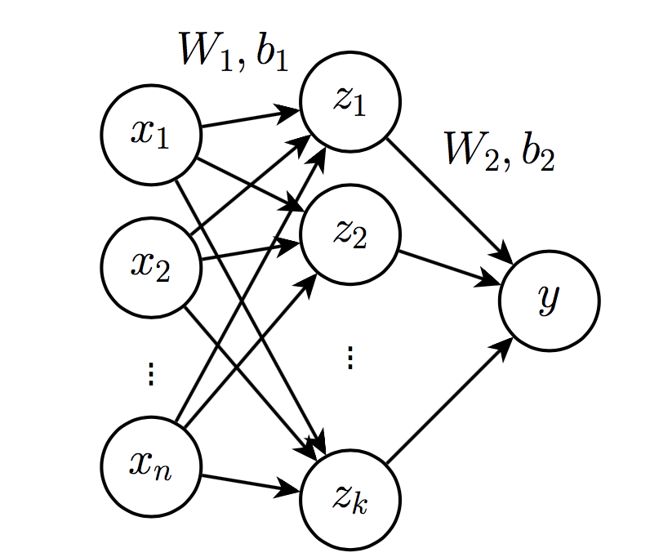
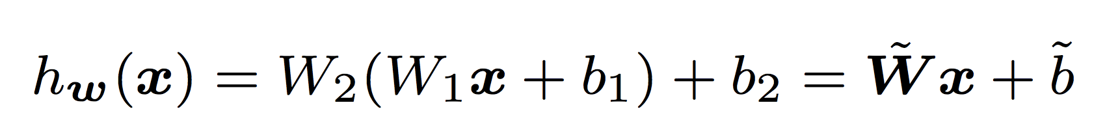
Two layers of linear filters
!

Slide 38
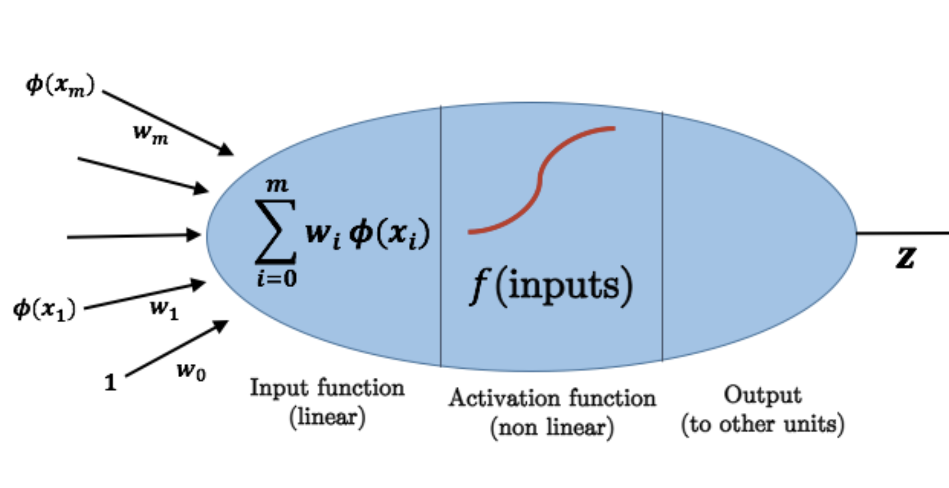
Cascade of nonlinear transform
!

Slide 39
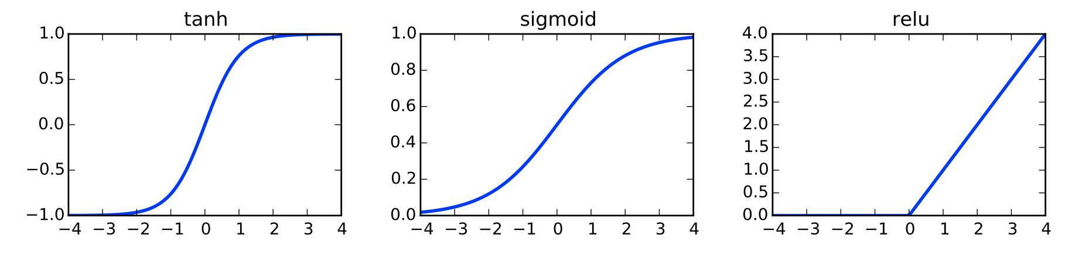
NonLinear Transformation
Increases expressive power
Universal function approximator with 1 hidden layer
When chaining nonlinear transformations, makes optimization harder
Not convex
Potentially lots of local optima

Slide 40
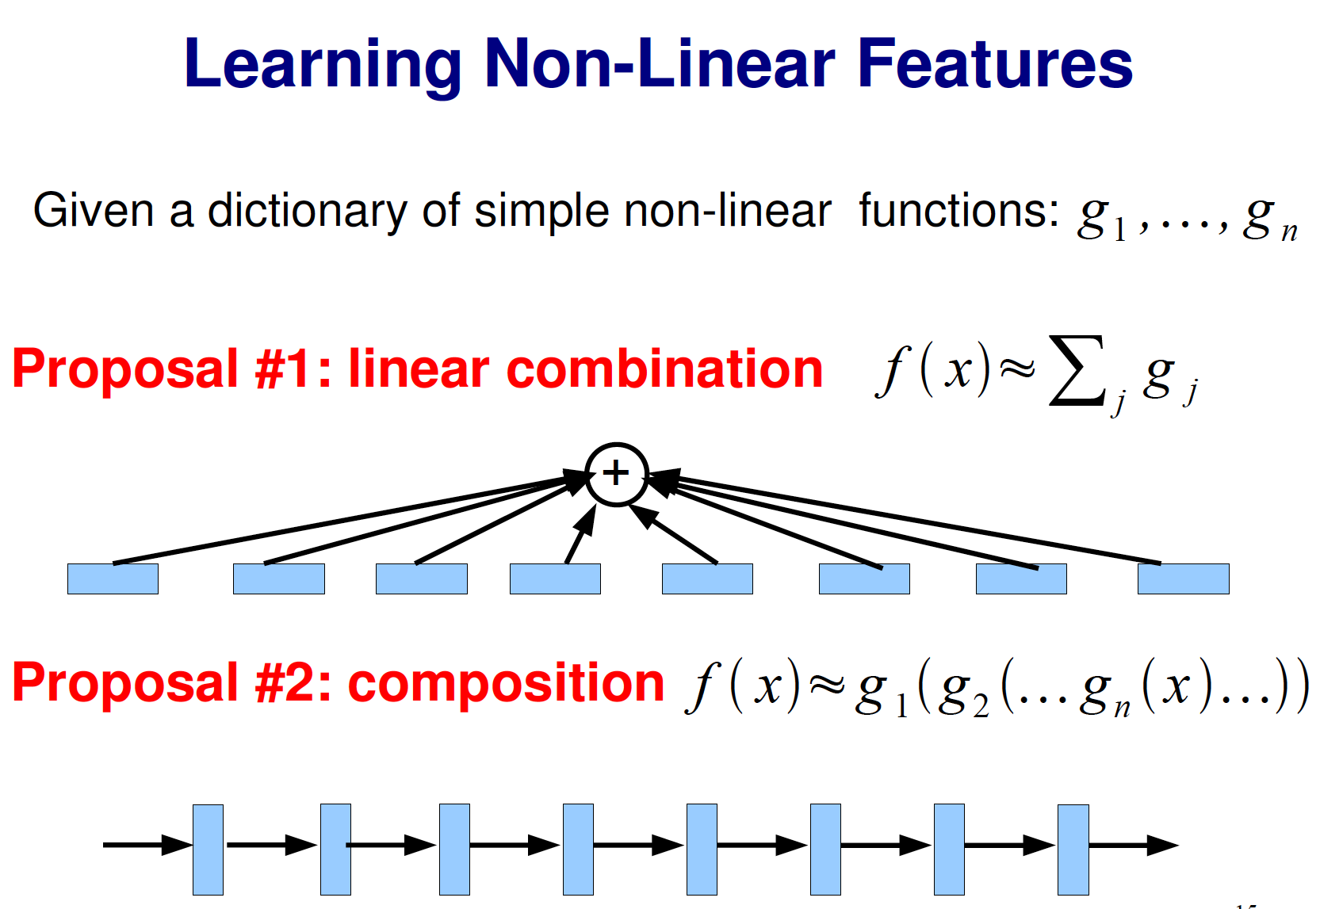

Slide 41
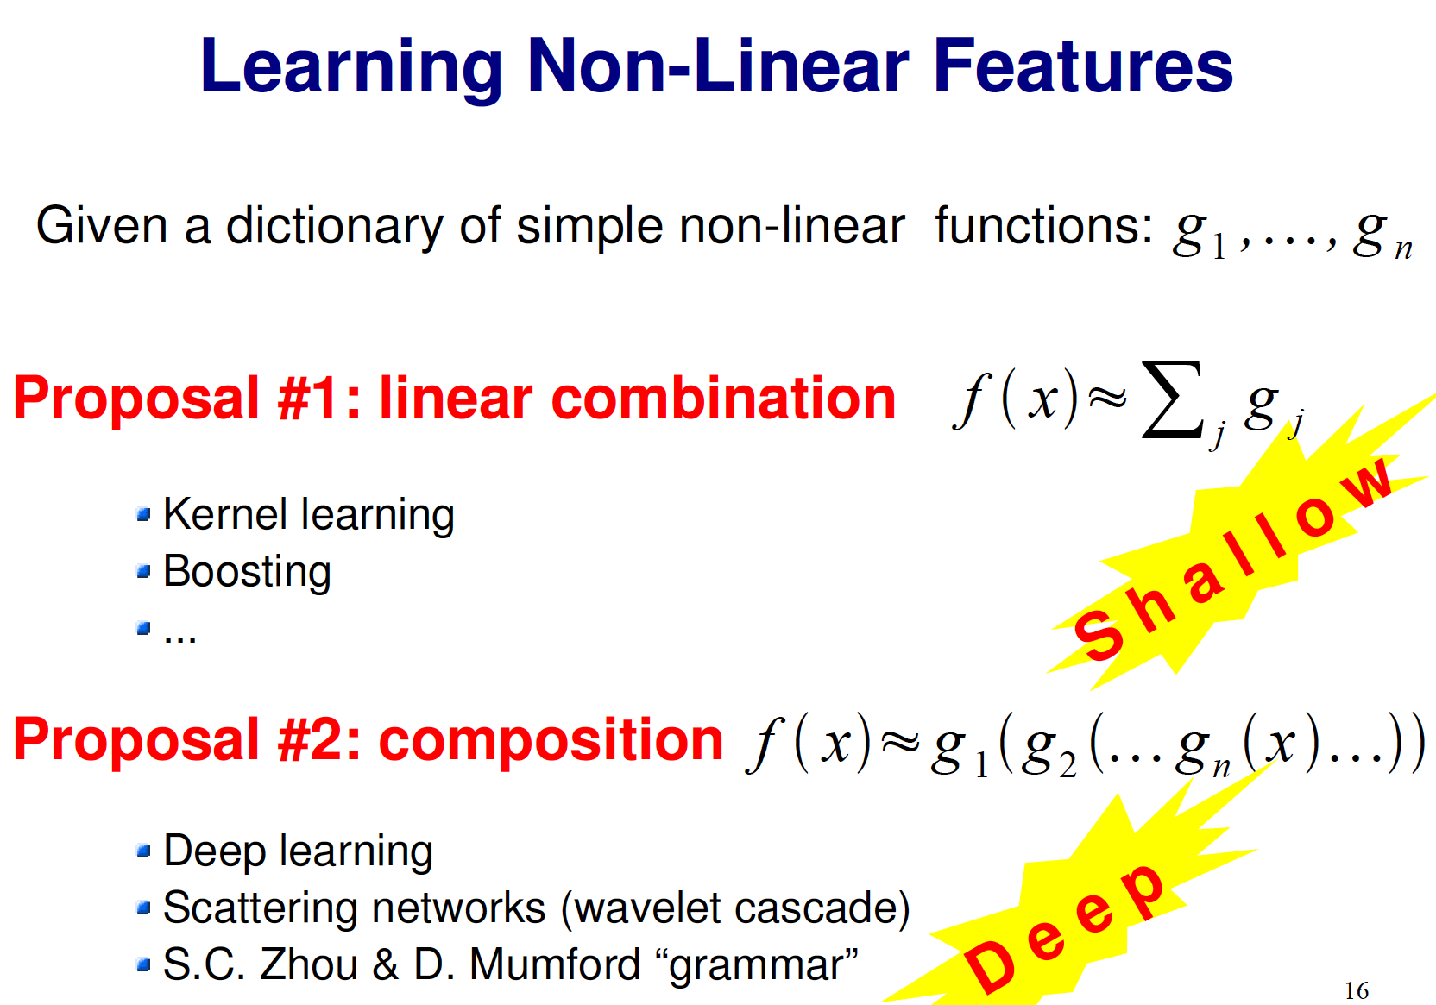

Slide 42
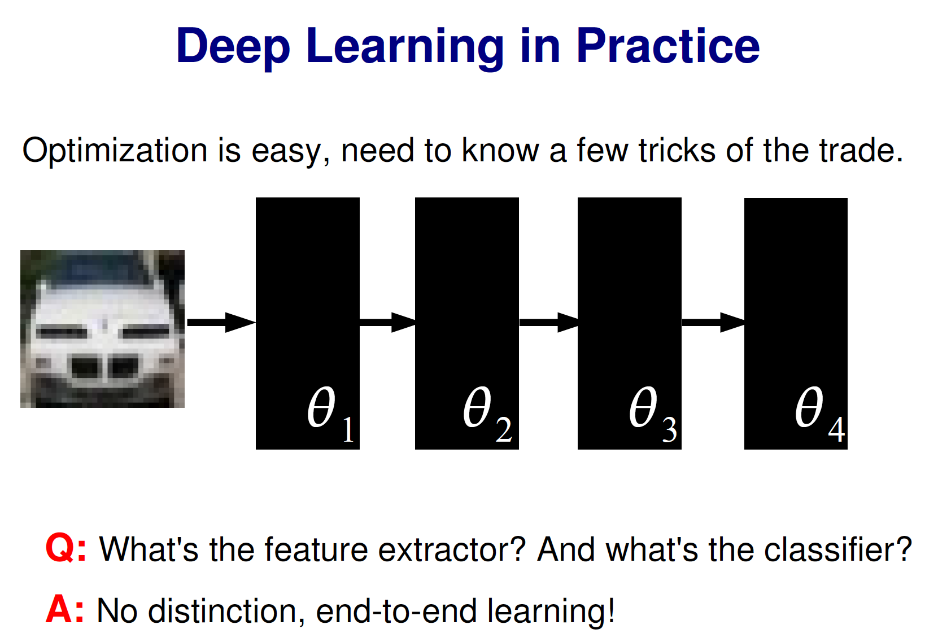

Slide 43
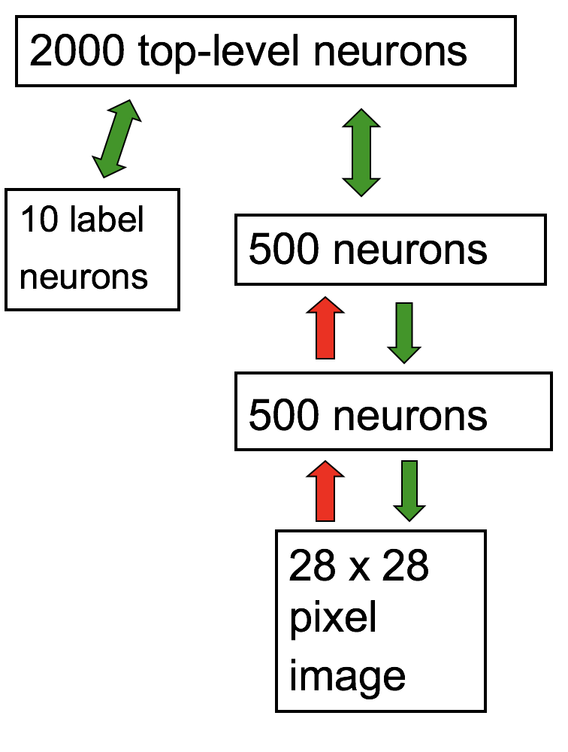
Deep belief nets
Unsupervised learning First.
Infinite data.
Learn hierarchical generative models.
Can hallucinate.
Stack up restricted Boltzmann machine.
Fine tune using Backpropgation.

Slide 44
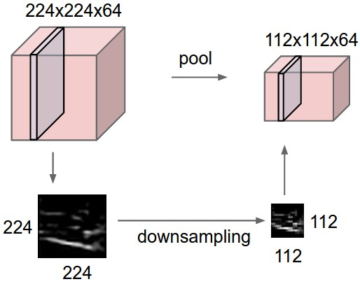
Pooling

Slide 45
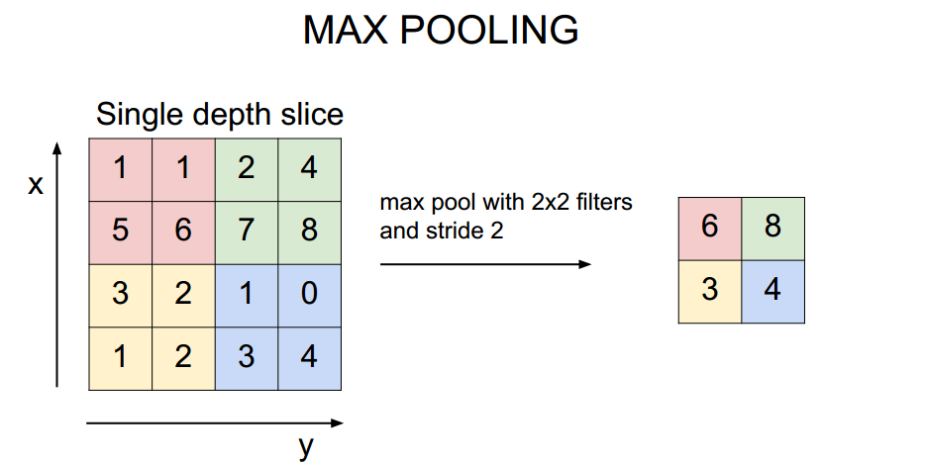
Max-Pooling
Why do pooling or max-pooling?

Slide 46
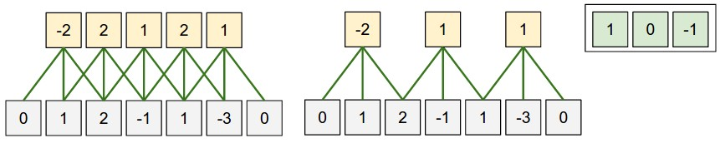
Stride and zero-padding
Stride: how far (spatially) move over filter
Zero padding: how many 0s to add to either side of input layer

Slide 47

Convolutional Deep Belief net
Honglak Lee, Roger Grosse, Rajesh Ranganath and Andrew Y. Ng. In Proceedings of the Twenty-Sixth International Conference on Machine Learning, 2009.
Notes:
Image 100 x 100, RF 10 x 10, S map 91 x 91, Pooling 45 x 45 (pooling 2 x 2 grid)
Use the sparsity.
Convolution DBN (Andrew Ng and Honglak Lee)
Dropout (Toronto group, Geoff Hinton): Dropout is meant to reduce overfitting by randomly omitting half of the feature detectors on each training case.
Sparsity: A small fraction of neurons is allowed to respond at a time.

Slide 48




Convolutional Deep Belief net
Notes:
Forms interesting separable states with DBN.

Slide 49
Overfitting: Dropout
Inspiration: neurons communication with each other are noisy and lossy. signals do not get across to the other neurons 50% of the time.
Dropout: Individual nodes randomly drop out of the net during each training stage, reinsert nodes with original weights in next stage, effectively training many networks.
DropConnect: Connection, rather than nodes are dropped with certain probability.
Notes:
One of the newest and most effective ways to resolve the vanishing gradient problem is with residual neural networks (ResNets^{[10]} - not to be confused with recurrent neural networks^{[11]}). It was noted prior to ResNets that a deeper network would actually have higher training error than the shallow network. This intuitively can be understood as data disappearing through too many layers of the network, meaning output from a shallow layer was diminished through the greater number of layers in the deeper network, yielding a worse result. Going with this intuitive hypothesis, Microsoft research found that splitting a deep network into e.g., three layer chunks and passing the input into each chunk straight through to the next chunk (along with the residual—output of the chunk minus the input to the chunk that is reintroduced) helped eliminate much of this disappearing signal problem. No extra parameters or changes to the learning algorithm were needed. ResNets^{[12]} yielded lower training error (and test error) than their shallower counterparts simply by reintroducing outputs from shallower layers in the network to compensate for the vanishing data.^{[13]}
Other ideas: Stochastic pooling, augmented data.

Slide 50

AlexNet: deep convolution neural networks
Alex Krizhevsky, Ilya Sutskever, and Geoff Hinton (2012)
http://yann.lecun.com/exdb/lenet/multiples.html
Notes:
Time-delay neural networks. (TDNN). Lang and Hinton, Waibel. Bottou.
Build a multi-layer neural net (with hierarchical features in resolution) to do pattern classification.
What kinds of dictionaries or features the neurons at different levels of the hierarchy extract?
Achieve some shift and distortion invariance while maintaining topology using local RF, weight sharing and spatial or temporal subsampling.
Again follow the same pattern of Simple-”Complex” cell alternating structures to build feature detectors (simple) and then provide translation invariance by subsampling(complex -- not straightly complex cells).

Slide 51

AlexNet: deep convolution neural networks
Alex Krizhevsky, Ilya Sutskever, and Geoff Hinton
ImageNet classification with deep convolutional neural networks (NIPS 2012)
Notes:
Time-delay neural networks. (TDNN). Lang and Hinton, Waibel. Bottou.
Build a multi-layer neural net (with hierarchical features in resolution) to do pattern classification.
What kinds of dictionaries or features the neurons at different levels of the hierarchy extract?
Achieve some shift and distortion invariance while maintaining topology using local RF, weight sharing and spatial or temporal subsampling.
Again follow the same pattern of Simple-”Complex” cell alternating structures to build feature detectors (simple) and then provide translation invariance by subsampling(complex -- not straightly complex cells).

Slide 52

Earlier Computer Vision approach: Design Features
Engineered features: SFIT and HOG based statistics of on retinal and V1 filters.
Freeze first N-1 layers (engineer the features)
Essentially turns it into shallow learning

Slide 53

Interesting finding ….
Eight ILSVRC-2010 test images and the five labels considered most probable by our model. The correct label is written under each image, and the probability assigned to the correct label is also shown with a red bar (if it happens to be in the top 5).
Notes:
Time-delay neural networks. (TDNN). Lang and Hinton, Waibel. Bottou.
Build a multi-layer neural net (with hierarchical features in resolution) to do pattern classification.
What kinds of dictionaries or features the neurons at different levels of the hierarchy extract?
Achieve some shift and distortion invariance while maintaining topology using local RF, weight sharing and spatial or temporal subsampling.
Again follow the same pattern of Simple-”Complex” cell alternating structures to build feature detectors (simple) and then provide translation invariance by subsampling(complex -- not straightly complex cells).

Slide 54

Interesting finding ….
Five ILSVRC-2010 test images in the first column. The remaining columns show the six training images that produce feature vectors in the last hidden layer with the smallest Euclidean distance from the feature vector for the test image.
Notes:
Time-delay neural networks. (TDNN). Lang and Hinton, Waibel. Bottou.
Build a multi-layer neural net (with hierarchical features in resolution) to do pattern classification.
What kinds of dictionaries or features the neurons at different levels of the hierarchy extract?
Achieve some shift and distortion invariance while maintaining topology using local RF, weight sharing and spatial or temporal subsampling.
Again follow the same pattern of Simple-”Complex” cell alternating structures to build feature detectors (simple) and then provide translation invariance by subsampling(complex -- not straightly complex cells).

Slide 55

Hierarchical feature representation

Slide 56


Slide 57


Slide 58


Slide 59


Slide 60


