Slide 1
Extensive-form games and how to solve them: Part 2
CMU 15-381 and 15-681
Fall 2017
Teachers:
Noam Brown
Tuomas Sandholm

Slide 2
Removing Dominated Actions
If an action is never better than some linear combination of other actions, then it is dominated
Strictly dominated: The action is always worse than some other (mixed) strategy
Weakly dominated: The action is never better than some other (mixed) strategy
Two-player zero-sum games can be simplified by iteratively removing all dominated actions (in general-sum, can only remove strictly dominated)
Player 2
 | Left | Center | Right
Up | -5 | -4 | 1
Middle | -4 | 0 | 0
Down | 3 | 4 | -1
Player 1

Slide 3
Removing Dominated Actions
50% Up, 50% Down: [-1, 0, 0]
Middle: [-4, 0, 0]
Thus, Middle is a weakly dominated action
Player 2
 | Left | Center | Right
Up | -5 | -4 | 1
Middle | -4 | 0 | 0
Down | 3 | 4 | -1
Player 1

Slide 4
Removing Dominated Actions
50% Up, 50% Down: [-1, 0, 0]
Middle: [-4, 0, 0]
Thus, Middle is a weakly dominated action
Player 2
 | Left | Center | Right
Up | -5 | -4 | 1
Middle | -4 | 0 | 0
Down | 3 | 4 | -1
Player 1

Slide 5
Nash equilibrium
Standard Nash equilibrium:
Each player has no incentive to deviate
In other words: No agent can gain utility by switching to another strategy
In any Nash equilibrium, if a player has positive probability on two different actions, then they must result in the same expected value
If they didn’t, it wouldn’t be a Nash equilibrium! (Player could improve by switching to the higher-EV action)
ε-Nash equilibrium:
Each player has only ε incentive to deviate
In other words: No agent can gain more than ε utility by switching to another strategy

Slide 6

Nash equilibrium
$V\left[UP\right]=0.2\left(−5\right)+0.8\left(1\right)=−1+0.8=−0.2$
$V\left[DOWN\right]=0.2\left(3\right)+0.8\left(−1\right)=0.6−0.8=−0.2$
$V\left[LEFT\right]=0.4\left(−5\right)+0.6\left(3\right)=−2+1.8=−0.2$
$V\left[CENTER\right]=0.4\left(−4\right)+0.6\left(−4\right)=0$
$V\left[RIGHT\right]=0.4\left(1\right)+0.6\left(−1\right)=−0.2$
Player 2
.2
.8
 | Left | Center | Right
Up | -5 | -4 | 1
Down | 3 | 4 | -1
.4
Player 1
.6

Slide 7
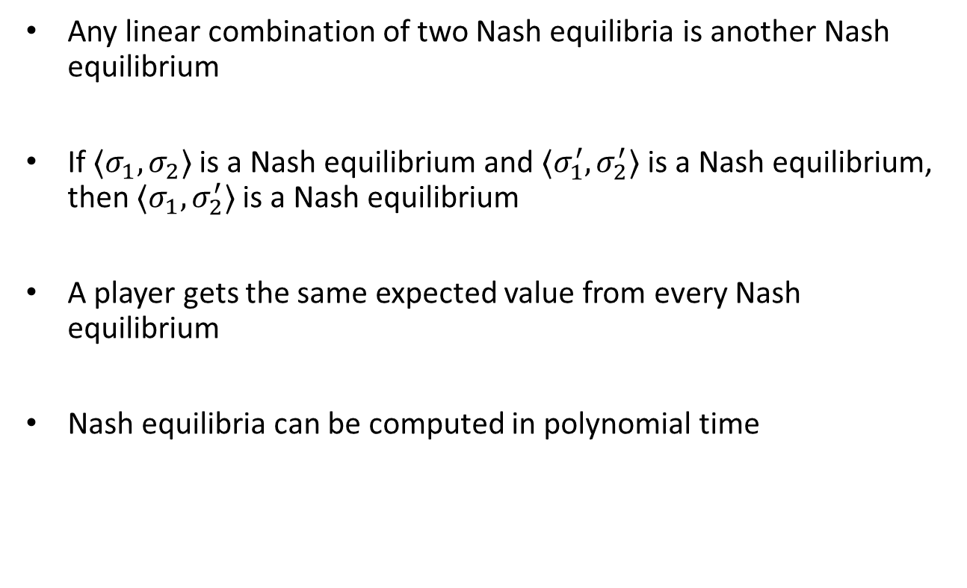
Nash equilibria for two-player zero-sum games
Any linear combination of two Nash equilibria is another Nash equilibrium
If $⟨σ_{1},σ_{2}⟩$ is a Nash equilibrium and $⟨σ_{1}^{′},σ_{2}^{′}⟩$ is a Nash equilibrium, then $⟨σ_{1},σ_{2}^{′}⟩$ is a Nash equilibrium
A player gets the same expected value from every Nash equilibrium
Nash equilibria can be computed in polynomial time

Slide 8
Solving two-player zero-sum extensive-form games

Slide 9
Plan for next part of the presentation
We will introduce counterfactual regret minimization (CFR)-based equilibrium finding in two-player zero-sum games
Most common algorithm
Relatively easy to understand and implement
We start from first principles and proceed step by step to the most advanced algorithms in this family
Used to be best in practice, but now there is a gradient-based algorithm that is better in practice also [Kroer et al. EC-17]
But that is much more difficult to understand

Slide 10

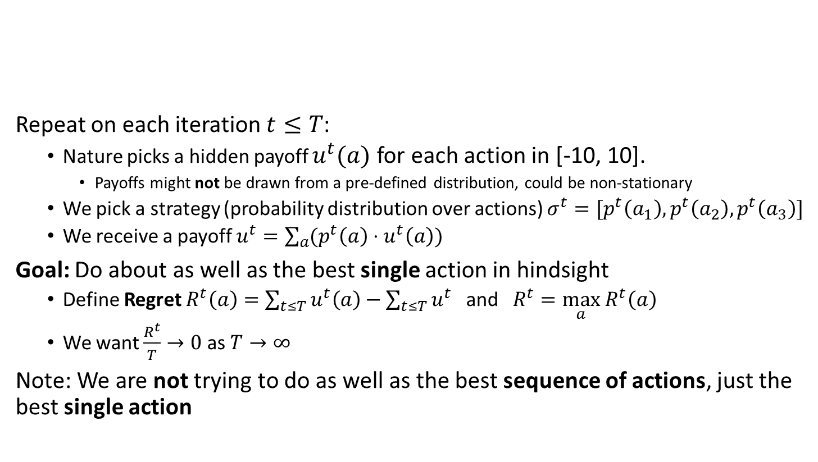
Regret Minimization
Repeat on each iteration $t≤T$:
Nature picks a hidden payoff $u^{t}(a)$ for each action in [-10, 10].
Payoffs might not be drawn from a pre-defined distribution, could be non-stationary
We pick a strategy (probability distribution over actions) $σ^{t}=[p^{t}\left(a_{1}\right),p^{t}\left(a_{2}\right),p^{t}\left(a_{3}\right)]$
We receive a payoff $u^{t}=\sum_{a}{(p^{t}\left(a\right)⋅u^{t}\left(a\right))}$
Goal: Do about as well as the best single action in hindsight
Define Regret $R^{t}\left(a\right)=\sum_{t≤T}{u^{t}\left(a\right)}−\sum_{t≤T}{u^{t}}$ and $R^{t}=\max_{a} R^{t}\left(a\right)$
We want $\frac{R^{t}}{T}→0$ as $T→∞$
Note: We are not trying to do as well as the best sequence of actions, just the best single action

Slide 11
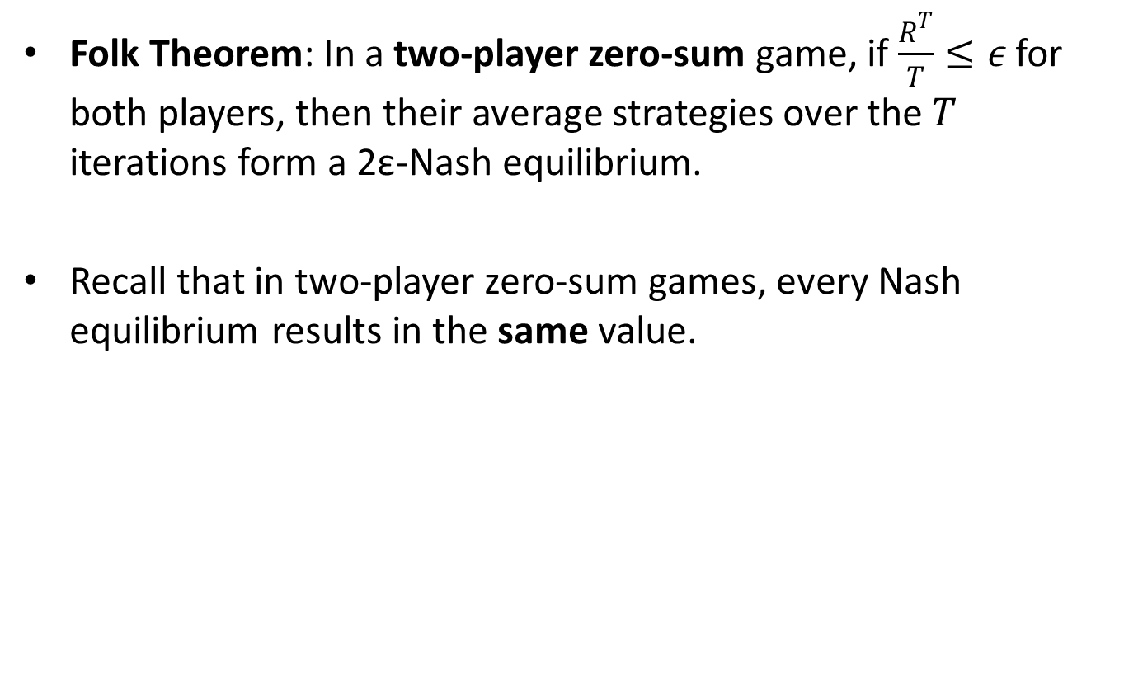
Convergence to Nash Equilibrium
Folk Theorem: In a two-player zero-sum game, if $\frac{R^{T}}{T}≤ε$ for both players, then their average strategies over the $T$ iterations form a 2ε-Nash equilibrium.
Recall that in two-player zero-sum games, every Nash equilibrium results in the same value.

Slide 12
Regret Minimization: Example
Iteration 1
Payoff: 10
Payoff: 0
Payoff: 10
Action A
Action B
Action C
Total Payoff: 0
Total Payoff: 0
Total Payoff: 0
Our Total Payoff: 0
Difference between our
payoff and the best lever
Maximum Regret: 0

Slide 13
Regret Minimization: Example
Iteration 1
Payoff: 10
Payoff: 0
Payoff: 10
Action A
Action B
Action C
Total Payoff: 10
Total Payoff: 0
Total Payoff: 10
Our Total Payoff: 0
Maximum Regret: 10

Slide 14
Regret Minimization: Example
Iteration 2
1/3
1/3
1/3
Payoff: 10
Payoff: -10
Payoff: -10
Action A
Action B
Action C
Total Payoff: 10
Total Payoff: 0
Total Payoff: 10
Our Total Payoff: 0
Maximum Regret: 10

Slide 15


Regret Minimization: Example
Iteration 2
1/3
1/3
1/3
Payoff: 10
Payoff: -10
Payoff: -10
Action A
Action B
Action C
Total Payoff: 20
Total Payoff: -10
Total Payoff: 0
Our Total Payoff: $−3\frac{1}{3}$
Maximum Regret: $23\frac{1}{3}$

Slide 16
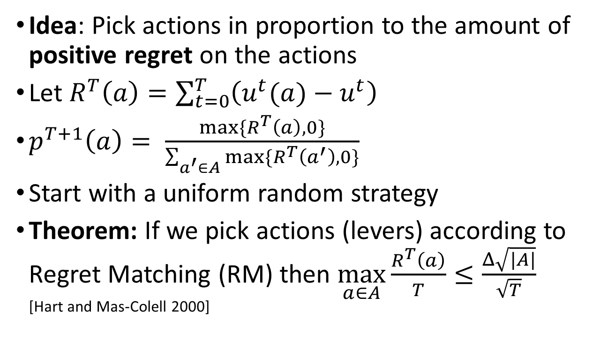
Regret Matching
Idea: Pick actions in proportion to the amount of positive regret on the actions
Let $R^{T}\left(a\right)=\sum_{t=0}^{T}{\left(u^{t}(a)−u^{t}\right)}$
$p^{T+1}\left(a\right)= \frac{max⁡\{R^{T}\left(a\right),0\}}{\sum_{a^{′}∈A}{max⁡\{R^{T}\left(a^{′}\right),0\}}}$
Start with a uniform random strategy
Theorem: If we pick actions (levers) according to Regret Matching (RM) then $\max_{a∈A}{\frac{R^{T}\left(a\right)}{T}≤\frac{Δ\sqrt{|A|}}{\sqrt{T}}}$ [Hart and Mas-Colell 2000]
Range of payoffs
(20 in our example)
Number of actions

Slide 17
Regret Matching
Step 1: Set current strategy based on regrets
Iteration 0
Strategy Sum: | 0.0 | 0.0
Regret Sum: | 0.0 | 0.0
Strategy Sum: | Regret Sum:
0.0 | 0.0
0.0 | 0.0
 | Left 50% | Right 50%
Up 50% | 1 | 0
Down 50% | 0 | 2

Slide 18
Regret Matching
Step 2: Update average strategy tracker
Iteration 0
Strategy Sum: | 0.5 | 0.5
Regret Sum: | 0.0 | 0.0
Strategy Sum: | Regret Sum:
0.5 | 0.0
0.5 | 0.0
 | Left 50% | Right 50%
Up 50% | 1 | 0
Down 50% | 0 | 2

Slide 19
Regret Matching
Step 3: Calculate total EV
Iteration 0
Strategy Sum: | 0.5 | 0.5
Regret Sum: | 0.0 | 0.0
Strategy Sum: | Regret Sum:
0.5 | 0.0
0.5 | 0.0
 | Left 50% | Right 50%
Up 50% | 1 | 0
Down 50% | 0 | 2
Expected Value: 0.75

Slide 20
Regret Matching
Step 4: Calculate EV for each action
Iteration 0
Strategy Sum: | 0.5 | 0.5
Regret Sum: | 0.0 | 0.0
Strategy Sum: | Regret Sum:
0.5 | 0.0
0.5 | 0.0
 | Left 50% | Right 50%
Up 50% | 1 | 0
Down 50% | 0 | 2
Expected Value: 0.75
Up: 0.5
Added Regret: 0.5 – 0.75 = -0.25
Down: 1
Added Regret: 1.0 – 0.75 = 0.25

Slide 21
Regret Matching
Step 5: Update regret for each action
Iteration 0
Strategy Sum: | 0.5 | 0.5
Regret Sum: | 0.25 | -0.25
Strategy Sum: | Regret Sum:
0.5 | -0.25
0.5 | 0.25
 | Left 50% | Right 50%
Up 50% | 1 | 0
Down 50% | 0 | 2
Expected Value: 0.75
Up: 0.5
Added Regret: 0.5 – 0.75 = -0.25
Down: 1
Added Regret: 1.0 – 0.75 = 0.25

Slide 22
Regret Matching
Step 1: Set current strategy based on regrets
Iteration 1
Strategy Sum: | 0.5 | 0.5
Regret Sum: | 0.25 | -0.25
Strategy Sum: | Regret Sum:
0.5 | -0.25
0.5 | 0.25
 | Left 100% | Right 0%
Up 0% | 1 | 0
Down 100% | 0 | 2

Slide 23
Regret Matching
Step 2: Update average strategy tracker
Iteration 1
Strategy Sum: | 1.5 | 0.5
Regret Sum: | 0.25 | -0.25
Strategy Sum: | Regret Sum:
0.5 | -0.25
1.5 | 0.25
 | Left 100% | Right 0%
Up 0% | 1 | 0
Down 100% | 0 | 2

Slide 24
Regret Matching
Step 3: Calculate total EV
Iteration 1
Strategy Sum: | 1.5 | 0.5
Regret Sum: | 0.25 | -0.25
Strategy Sum: | Regret Sum:
0.5 | -0.25
1.5 | 0.25
 | Left 100% | Right 0%
Up 0% | 1 | 0
Down 100% | 0 | 2
Expected Value: 0.0

Slide 25
Regret Matching
Step 4: Calculate EV for each action
Iteration 1
Strategy Sum: | 1.5 | 0.5
Regret Sum: | 0.25 | -0.25
Strategy Sum: | Regret Sum:
0.5 | -0.25
1.5 | 0.25
 | Left 100% | Right 0%
Up 0% | 1 | 0
Down 100% | 0 | 2
Expected Value: 0.0
Up: 1.0
Added Regret: 1.0 – 0.0 = 1
Down: 0.0
Added Regret: 0.0 – 0.0 = 0.0

Slide 26
Regret Matching
Step 5: Update regret for each action
Iteration 1
Strategy Sum: | 1.5 | 0.5
Regret Sum: | 0.25 | 1.75
Strategy Sum: | Regret Sum:
0.5 | 0.75
1.5 | 0.25
 | Left 100% | Right 0%
Up 0% | 1 | 0
Down 100% | 0 | 2
Expected Value: 0.0
Up: 1.0
Added Regret: 1.0 – 0.0 = 1
Down: 0.0
Added Regret: 0.0 – 0.0 = 0.0

Slide 27
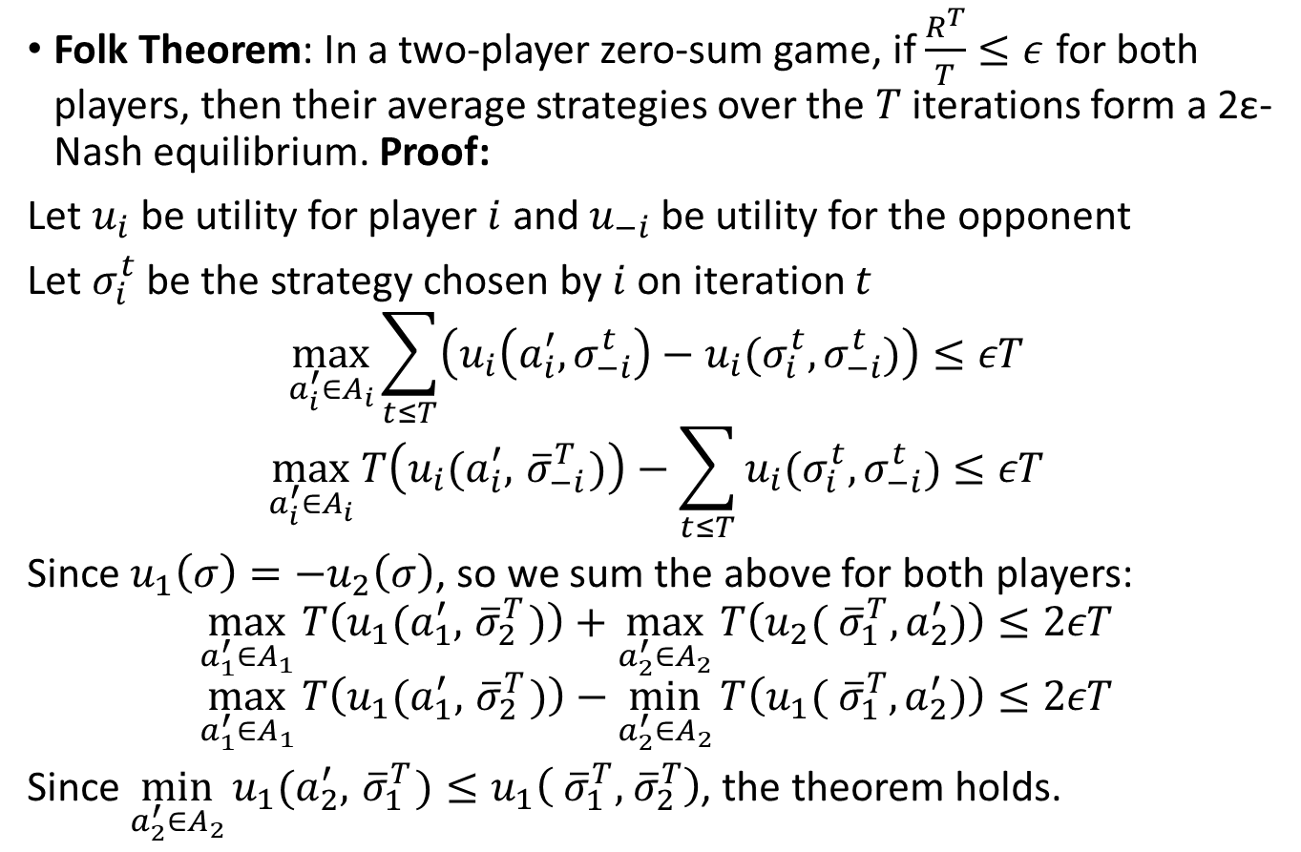
Proof of Convergence
Folk Theorem: In a two-player zero-sum game, if $\frac{R^{T}}{T}≤ε$ for both players, then their average strategies over the $T$ iterations form a 2ε-Nash equilibrium. Proof:
Let $u_{i}$ be utility for player $i$ and $u_{−i}$ be utility for the opponent
Let $σ_{i}^{t}$ be the strategy chosen by $i$ on iteration $t$
$$\max_{a_{i}^{′}∈A_{i}}{\sum_{t≤T}{\left(u_{i}\left(a_{i}^{′},σ_{−i}^{t}\right)−u_{i}(σ_{i}^{t},σ_{−i}^{t})\right)}}≤εT$$
$$\max_{a_{i}^{′}∈A_{i}}{T\left(u_{i}(a_{i}^{′},{ \overline{σ}}_{−i}^{T})\right)−\sum_{t≤T}{u_{i}(σ_{i}^{t},σ_{−i}^{t})}}≤εT$$
Since $u_{1}\left(σ\right)=−u_{2}\left(σ\right)$, so we sum the above for both players:
$$\max_{a_{1}^{′}∈A_{1}}{T\left(u_{1}(a_{1}^{′},{ \overline{σ}}_{2}^{T})\right)}+\max_{a_{2}^{′}∈A_{2}}{T\left(u_{2}({ \overline{σ}}_{1}^{T},a_{2}^{′})\right)}≤2εT$$
$$\max_{a_{1}^{′}∈A_{1}}{T\left(u_{1}(a_{1}^{′},{ \overline{σ}}_{2}^{T})\right)}−\min_{a_{2}^{′}∈A_{2}}{T\left(u_{1}({ \overline{σ}}_{1}^{T},a_{2}^{′})\right)}≤2εT$$
Since $\min_{a_{2}^{′}∈A_{2}}{u_{1}(a_{2}^{′},{ \overline{σ}}_{1}^{T})}≤u_{1}\left({ \overline{σ}}_{1}^{T},{ \overline{σ}}_{2}^{T}\right)$, the theorem holds.
Regret
{
}
Average
strategy
By symmetry
this holds for
player 2 too.

Slide 28

Counterfactual Regret Minimization (CFR) [Zinkevich et al. NIPS-2007]
Applies regret matching to minimize regret independently in each information set (infoset) of an extensive-form game.
In CFR, an infoset belonging to player $i$ weighs each iteration in proportion to the probability the infoset was reached if player $i$ had tried to reach the infoset.

Slide 29
Counterfactual Regret Minimization (CFR) [Zinkevich et al. NIPS-2007]
P1
P2
P2
P1
P1
P1
P1
-1
1
1
-1
-1
1
1
-1

Slide 30

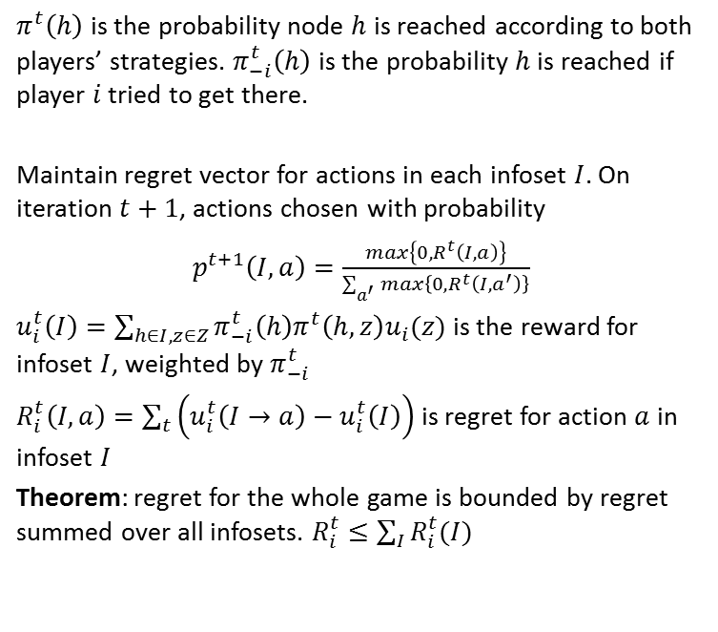
Counterfactual Regret Minimization (CFR) [Zinkevich et al. NIPS-2007]
$π_{−i}^{t}\left(h\right)$ for this history is $0.1$
P1
0.5
0.5
P2
$π_{}^{t}\left(h\right)$ is the probability node $h$ is reached according to both players’ strategies. $π_{−i}^{t}\left(h\right)$ is the probability $h$ is reached if player $i$ tried to get there.
Maintain regret vector for actions in each infoset $I$. On iteration $t+1$, actions chosen with probability
$p^{t+1}\left(I,a\right)=\frac{max\left\{0, R^{t}\left(I,a\right)\right\}}{\sum_{a^{′}}{max\left\{0, R^{t}\left({I,a}^{′}\right)\right\}}}$
$u_{i}^{t}\left(I\right)=\sum_{h∈I,z∈Z}{π_{−i}^{t}\left(h\right)π^{t}\left(h,z\right)u_{i}(z)}$ is the reward for infoset $I$, weighted by $π_{−i}^{t}$
$R_{i}^{t}\left(I,a\right)=\sum_{t}{\left(u_{i}^{t}\left(I→a\right)−u_{i}^{t}\left(I\right)\right)}$ is regret for action $a$ in infoset $I$
Theorem: regret for the whole game is bounded by regret summed over all infosets. $R_{i}^{t}≤\sum_{I}{R_{i}^{t}(I)}$
0.1
0.9
P1
P1
-1
1
1
-1

Slide 31

Counterfactual Regret Minimization (CFR) [Zinkevich et al. NIPS-2007]
P1
0.5
0.5
P2
0.1
0.9
Iteration 1: Regret is $〈0,0〉$, so pick uniform random probability. That is, $p^{1}\left(I\right)=〈0.5, 0.5〉$
P1
P1
0.5
0.5
0.5
0.5
-1
1
1
-1

Slide 32

Counterfactual Regret Minimization (CFR) [Zinkevich et al. NIPS-2007]
P1
0.5
0.5
P2
0.1
0.9
Iteration 1: Regret is $〈0,0〉$, so pick uniform random probability. That is, $p^{1}\left(I\right)=〈0.5, 0.5〉$
$$u_{i}^{1}\left(I\right)=\left(0.1\right)\left(0.5⋅(−1)+0.5⋅1\right)+$$
P1
P1
0.5
0.5
0.5
0.5
-1
1
1
-1

Slide 33

Counterfactual Regret Minimization (CFR) [Zinkevich et al. NIPS-2007]
P1
0.5
0.5
P2
0.1
0.9
Iteration 1: Regret is $〈0,0〉$, so pick uniform random probability. That is, $p^{1}\left(I\right)=〈0.5, 0.5〉$
$$u_{i}^{1}\left(I\right)=\left(0.1\right)\left(0.5⋅(−1)+0.5⋅1\right)+$$
$\left(0.9\right)\left(0.5⋅1+0.5⋅\left(−1\right)\right)=0$
P1
P1
0.5
0.5
0.5
0.5
-1
1
1
-1

Slide 34
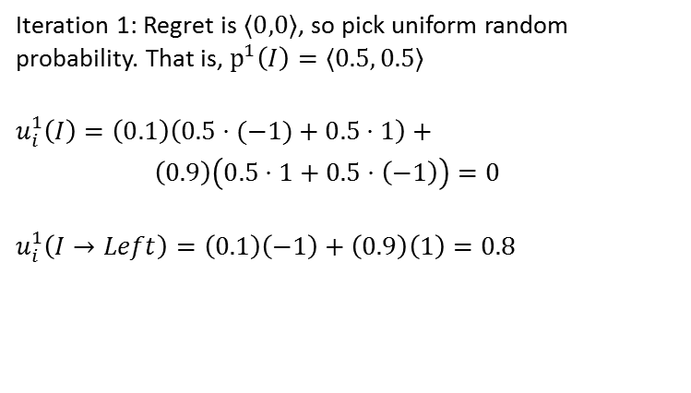
Counterfactual Regret Minimization (CFR) [Zinkevich et al. NIPS-2007]
P1
0.5
0.5
P2
0.1
0.9
Iteration 1: Regret is $〈0,0〉$, so pick uniform random probability. That is, $p^{1}\left(I\right)=〈0.5, 0.5〉$
$$u_{i}^{1}\left(I\right)=\left(0.1\right)\left(0.5⋅(−1)+0.5⋅1\right)+$$
$\left(0.9\right)\left(0.5⋅1+0.5⋅\left(−1\right)\right)=0$
$$u_{i}^{1}\left(I→Left\right)=\left(0.1\right)\left(−1\right)+\left(0.9\right)\left(1\right)=0.8$$
P1
P1
0.5
0.5
0.5
0.5
-1
1
1
-1

Slide 35
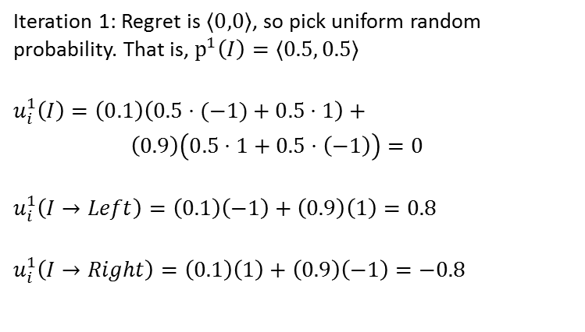
Counterfactual Regret Minimization (CFR) [Zinkevich et al. NIPS-2007]
P1
0.5
0.5
P2
0.1
0.9
Iteration 1: Regret is $〈0,0〉$, so pick uniform random probability. That is, $p^{1}\left(I\right)=〈0.5, 0.5〉$
$$u_{i}^{1}\left(I\right)=\left(0.1\right)\left(0.5⋅(−1)+0.5⋅1\right)+$$
$\left(0.9\right)\left(0.5⋅1+0.5⋅\left(−1\right)\right)=0$
$$u_{i}^{1}\left(I→Left\right)=\left(0.1\right)\left(−1\right)+\left(0.9\right)\left(1\right)=0.8$$
$$u_{i}^{1}\left(I→Right\right)=\left(0.1\right)\left(1\right)+\left(0.9\right)\left(−1\right)=−0.8$$
P1
P1
0.5
0.5
0.5
0.5
-1
1
1
-1

Slide 36
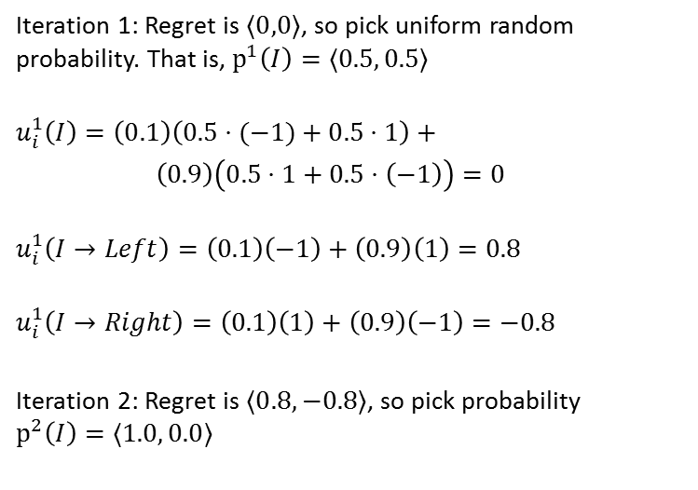
Counterfactual Regret Minimization (CFR) [Zinkevich et al. NIPS-2007]
P1
0.5
0.5
P2
0.1
0.9
Iteration 1: Regret is $〈0,0〉$, so pick uniform random probability. That is, $p^{1}\left(I\right)=〈0.5, 0.5〉$
$$u_{i}^{1}\left(I\right)=\left(0.1\right)\left(0.5⋅(−1)+0.5⋅1\right)+$$
$\left(0.9\right)\left(0.5⋅1+0.5⋅\left(−1\right)\right)=0$
$$u_{i}^{1}\left(I→Left\right)=\left(0.1\right)\left(−1\right)+\left(0.9\right)\left(1\right)=0.8$$
$$u_{i}^{1}\left(I→Right\right)=\left(0.1\right)\left(1\right)+\left(0.9\right)\left(−1\right)=−0.8$$
Iteration 2: Regret is $〈0.8,−0.8〉$, so pick probability $p^{2}\left(I\right)=〈1.0, 0.0〉$
P1
P1
0.5
0.5
0.5
0.5
-1
1
1
-1

Slide 37
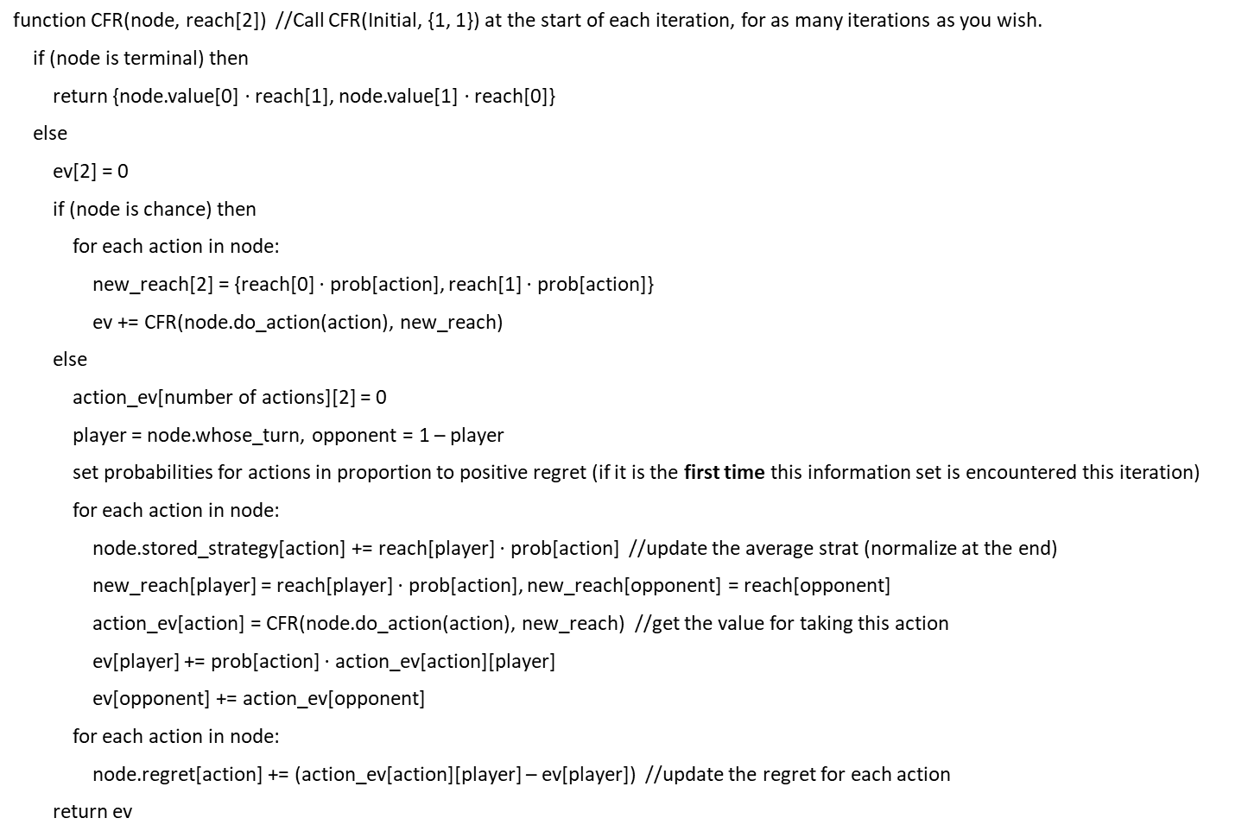
CFR Pseudocode
function CFR(node, reach[2]) //Call CFR(Initial, {1, 1}) at the start of each iteration, for as many iterations as you wish.
if (node is terminal) then
return {node.value[0] $⋅$ reach[1], node.value[1] $⋅$ reach[0]}
else
ev[2] = 0
if (node is chance) then
for each action in node:
new_reach[2] = {reach[0] $⋅$ prob[action], reach[1] $⋅$ prob[action]}
ev += CFR(node.do_action(action), new_reach)
else
action_ev[number of actions][2] = 0
player = node.whose_turn, opponent = 1 – player
set probabilities for actions in proportion to positive regret (if it is the first time this information set is encountered this iteration)
for each action in node:
node.stored_strategy[action] += reach[player] $⋅$ prob[action] //update the average strat (normalize at the end)
new_reach[player] = reach[player] $⋅$ prob[action], new_reach[opponent] = reach[opponent]
action_ev[action] = CFR(node.do_action(action), new_reach) //get the value for taking this action
ev[player] += prob[action] $⋅$ action_ev[action][player]
ev[opponent] += action_ev[opponent]
for each action in node:
node.regret[action] += (action_ev[action][player] – ev[player]) //update the regret for each action
return ev

Slide 38
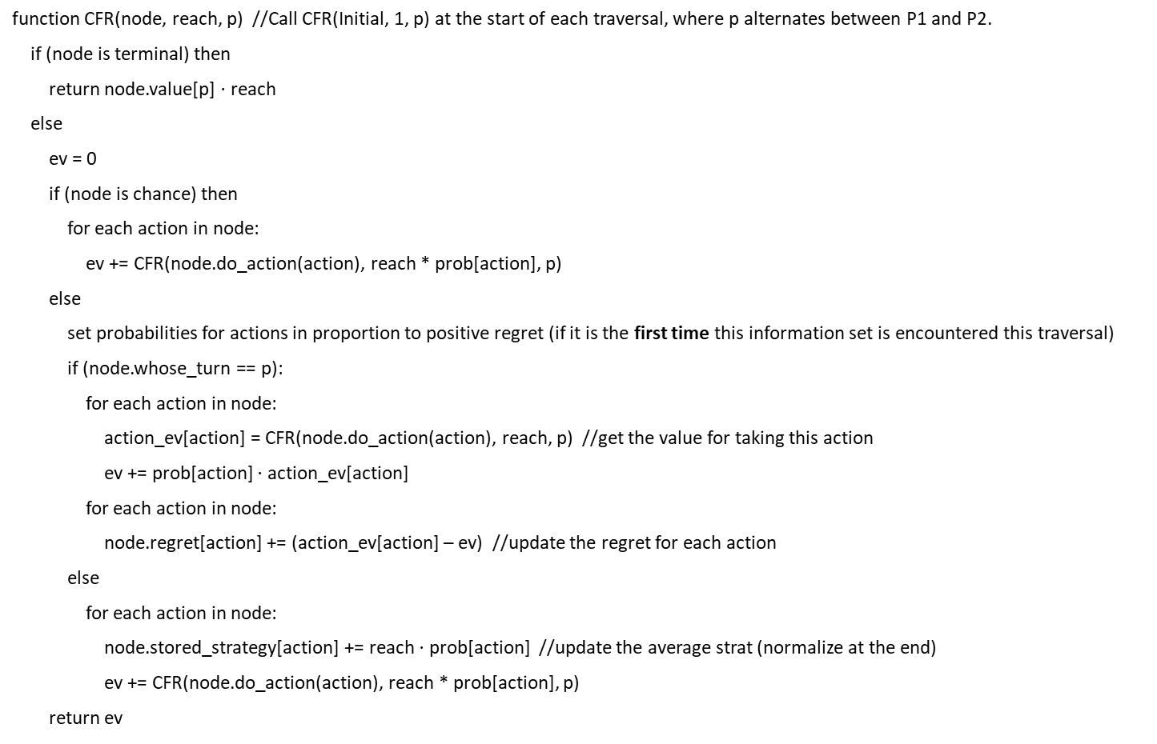
Alternating-Updates CFR Pseudocode
function CFR(node, reach, p) //Call CFR(Initial, 1, p) at the start of each traversal, where p alternates between P1 and P2.
if (node is terminal) then
return node.value[p] $⋅$ reach
else
ev = 0
if (node is chance) then
for each action in node:
ev += CFR(node.do_action(action), reach * prob[action], p)
else
set probabilities for actions in proportion to positive regret (if it is the first time this information set is encountered this traversal)
if (node.whose_turn == p):
for each action in node:
action_ev[action] = CFR(node.do_action(action), reach, p) //get the value for taking this action
ev += prob[action] $⋅$ action_ev[action]
for each action in node:
node.regret[action] += (action_ev[action] – ev) //update the regret for each action
else
for each action in node:
node.stored_strategy[action] += reach $⋅$ prob[action] //update the average strat (normalize at the end)
ev += CFR(node.do_action(action), reach * prob[action], p)
return ev

Slide 39
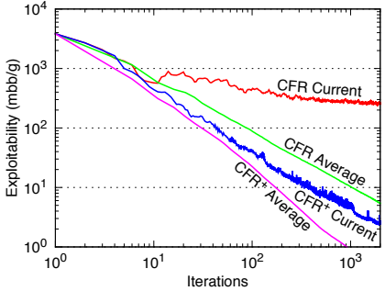

CFR+ [Tammelin 2014]
Simple modification of CFR:
After each iteration, any regrets below zero are set to zero
Weigh strategy on iteration $t$ by weight $t$. That is, ${\overline{σ}}_{i}=\sum_{t}{(t⋅σ_{i}^{t}})/\sum_{t}{t}$
Tends to do better when using Alternating Updates
Same theoretical convergence rate, but way better in practice

Slide 40
PureCFR
Regrets = [0,0]
P1
Strategy Sum = [0,1,0]
Strategy Sum = [0,0,0]
P2
Regrets = [0,0,0]
P1

Slide 41

PureCFR
Regrets = [0,0]
P1
Reward = $50
P2
Regrets = [0,0,0]
Regrets = [0,$−$50,50]
P1
Hypothetical
Reward = $100
Reward = $50
Hypothetical
Reward = $0

Slide 42
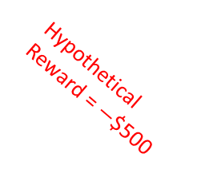


PureCFR
Regrets = [0,0]
P1
Regrets = [0,$−$550]
Regrets = [0, 600]
Regrets = [0, 0]
Reward = $50
Hypothetical
Reward = $−$$500
P2
P1
Hypothetical
Reward = $100
Reward = -$500
Regrets = [0,$−$50,50]
P1
Hypothetical
Reward = $100
Reward = $50
Hypothetical
Reward = $0

Slide 43
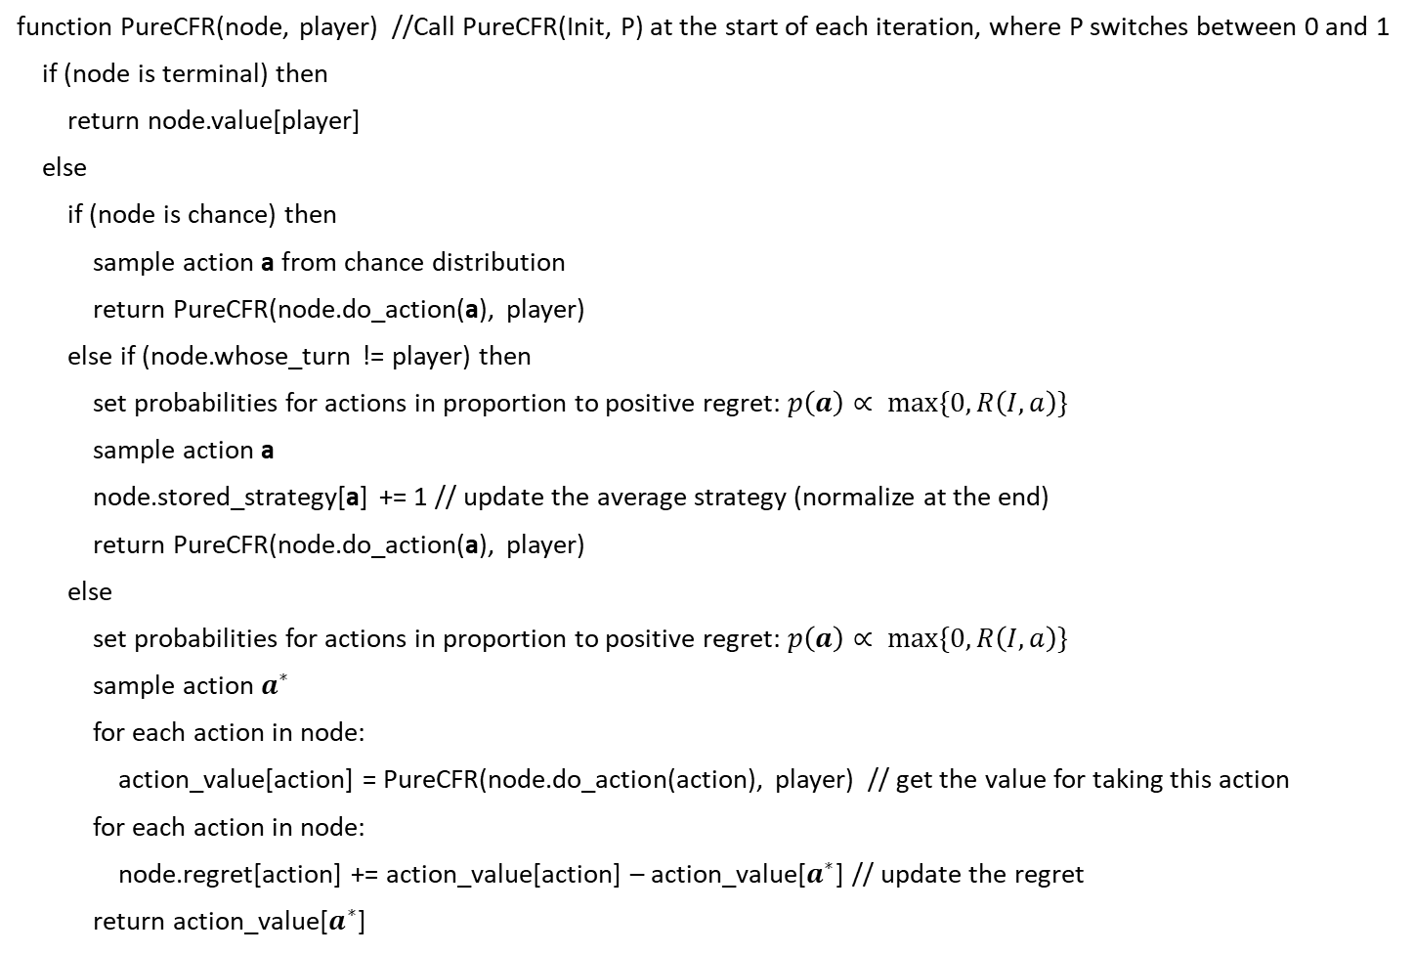
PureCFR Pseudocode
function PureCFR(node, player) //Call PureCFR(Init, P) at the start of each iteration, where P switches between 0 and 1
if (node is terminal) then
return node.value[player]
else
if (node is chance) then
sample action a from chance distribution
return PureCFR(node.do_action(a), player)
else if (node.whose_turn != player) then
set probabilities for actions in proportion to positive regret: $p\left(a\right)∝ max\{0, R\left(I,a\right)\}$
sample action a
node.stored_strategy[a] += 1 // update the average strategy (normalize at the end)
return PureCFR(node.do_action(a), player)
else
set probabilities for actions in proportion to positive regret: $p\left(a\right)∝ max\{0, R\left(I,a\right)\}$
sample action $a^{∗}$
for each action in node:
action_value[action] = PureCFR(node.do_action(action), player) // get the value for taking this action
for each action in node:
node.regret[action] += action_value[action] – action_value[$a^{∗}$] // update the regret
return action_value[$a^{∗}$]

Slide 44
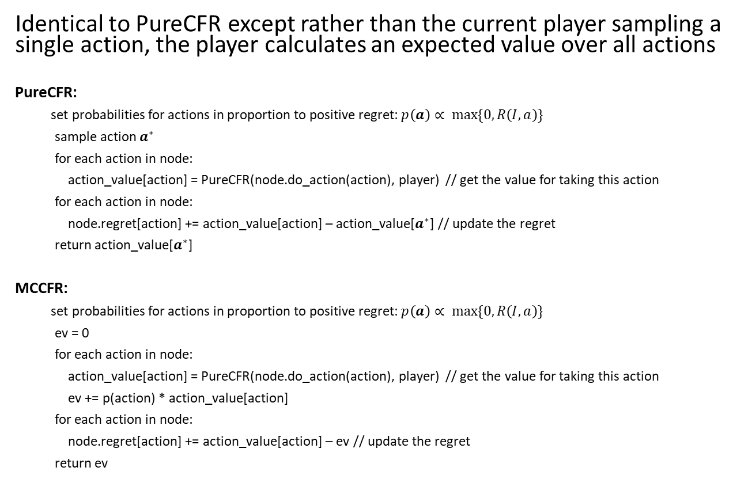
Monte Carlo CFR (MCCFR) [Lanctot et al. NIPS-2009]
Identical to PureCFR except rather than the current player sampling a single action, the player calculates an expected value over all actions
PureCFR:
set probabilities for actions in proportion to positive regret: $p\left(a\right)∝ max\{0, R\left(I,a\right)\}$
sample action $a^{∗}$
for each action in node:
action_value[action] = PureCFR(node.do_action(action), player) // get the value for taking this action
for each action in node:
node.regret[action] += action_value[action] – action_value[$a^{∗}$] // update the regret
return action_value[$a^{∗}$]
MCCFR:
set probabilities for actions in proportion to positive regret: $p\left(a\right)∝ max\{0, R\left(I,a\right)\}$
ev = 0
for each action in node:
action_value[action] = PureCFR(node.do_action(action), player) // get the value for taking this action
ev += p(action) * action_value[action]
for each action in node:
node.regret[action] += action_value[action] – ev // update the regret
return ev

Slide 45
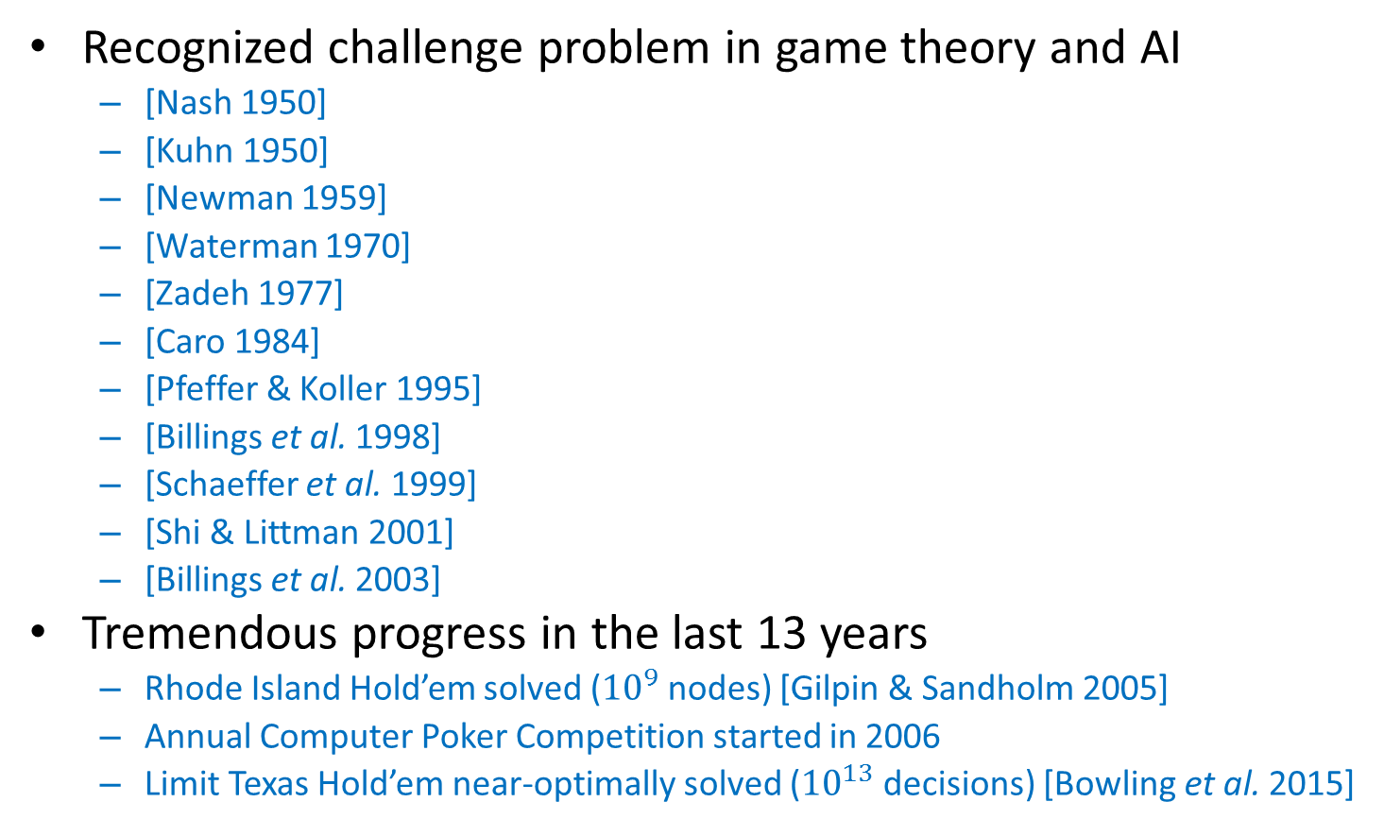
Poker
Recognized challenge problem in game theory and AI
[Nash 1950]
[Kuhn 1950]
[Newman 1959]
[Waterman 1970]
[Zadeh 1977]
[Caro 1984]
[Pfeffer & Koller 1995]
[Billings et al. 1998]
[Schaeffer et al. 1999]
[Shi & Littman 2001]
[Billings et al. 2003]
Tremendous progress in the last 13 years
Rhode Island Hold’em solved (${10}^{9}$ nodes) [Gilpin & Sandholm 2005]
Annual Computer Poker Competition started in 2006
Limit Texas Hold’em near-optimally solved (${10}^{13}$ decisions) [Bowling et al. 2015]
Notes:
ACPC

Slide 46
Heads-up no-limit Texas hold’em
Has become the main benchmark and challenge problem in AI for imperfect-information games
10¹⁶¹ situations
Mostly played on the Internet
Also in World Series of Poker, NBC Heads-Up Championship, etc.
Featured in Casino Royale and Rounders
“Purest form of poker”
No prior AI has beat top humans
Notes:
2-player is highly complex & difficult to play well.
Mano a mano
No others to muddle up the game.
(Luck plays a smaller role.)
(Picture is a Heads-Up competition televised by NBC.)

Slide 47

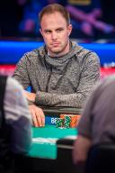
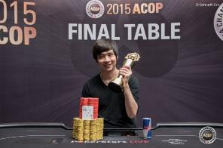
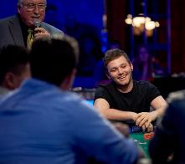
Brains vs AI Rematch
Libratus (= our AI) against four of the best heads-up no-limit Texas Hold’em specialist pros
120,000 hands over 20 days in January 2017
$200,000 divided among the pros based on performance
Conservative experiment design
Notes:
“Libratus” = “balanced” and “forceful
(Stacks of 200 big blinds at the start of every hand, as in ACPC)

Slide 48
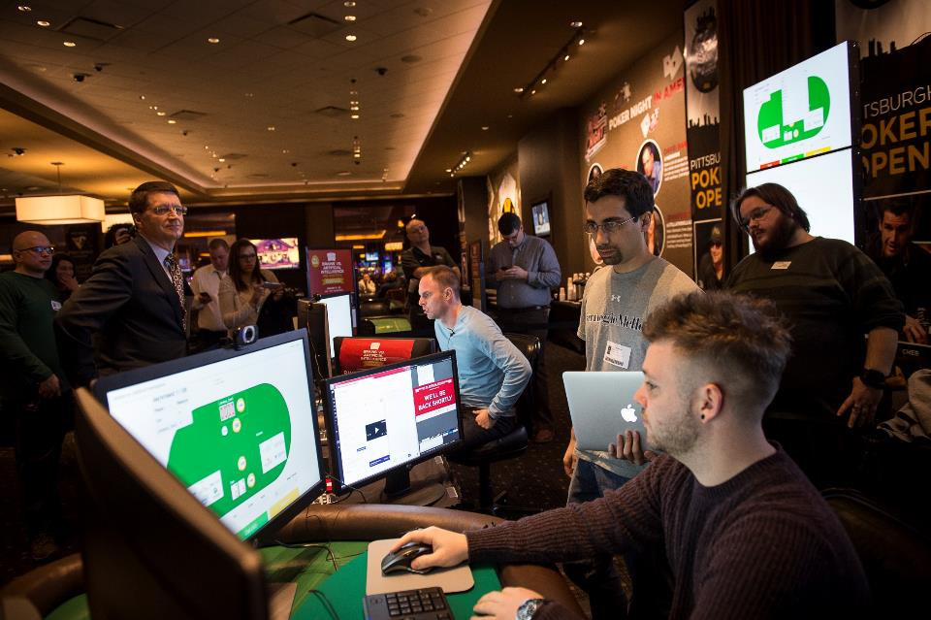

Slide 49
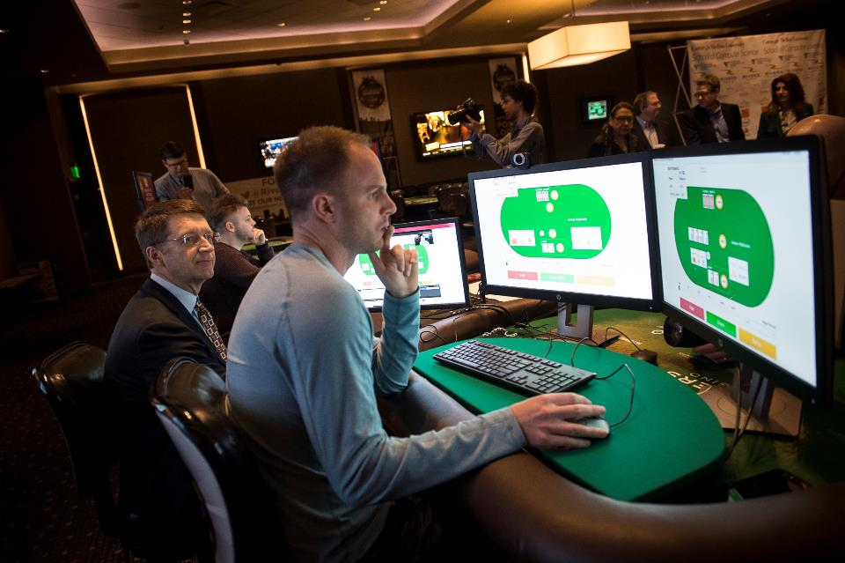

Slide 50

Final result
Libratus beat the top humans in this game by a lot
147 mbb/hand
Statistical significance 99.98%, i.e., 0.0002
Each human lost to Libratus

Slide 51
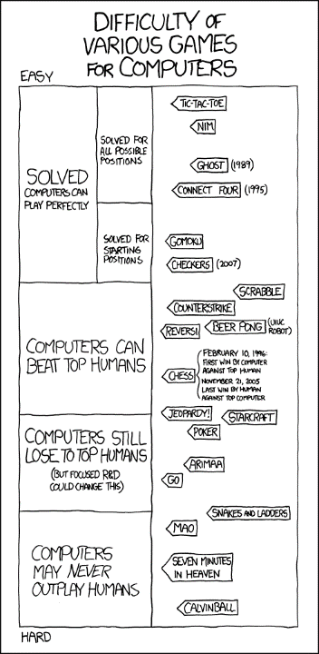
2012
2017

Slide 52
Libratus [Brown & Sandholm AAAI-17]

Slide 53
Libratus [Brown & Sandholm AAAI-17]

Slide 54
Libratus [Brown & Sandholm AAAI-17]

Slide 55
Libratus [Brown & Sandholm AAAI-17]

Slide 56
Libratus
Rules of the game
Abstraction
Equilibrium finding
Subgame solver
Self-improver
Belief distributions f and g
New action abstraction for part of game

Slide 57
Libratus
Rules of the game
Abstraction
Equilibrium finding
Subgame solver
Self-improver
Belief distributions f and g
New action abstraction for part of game

Slide 58
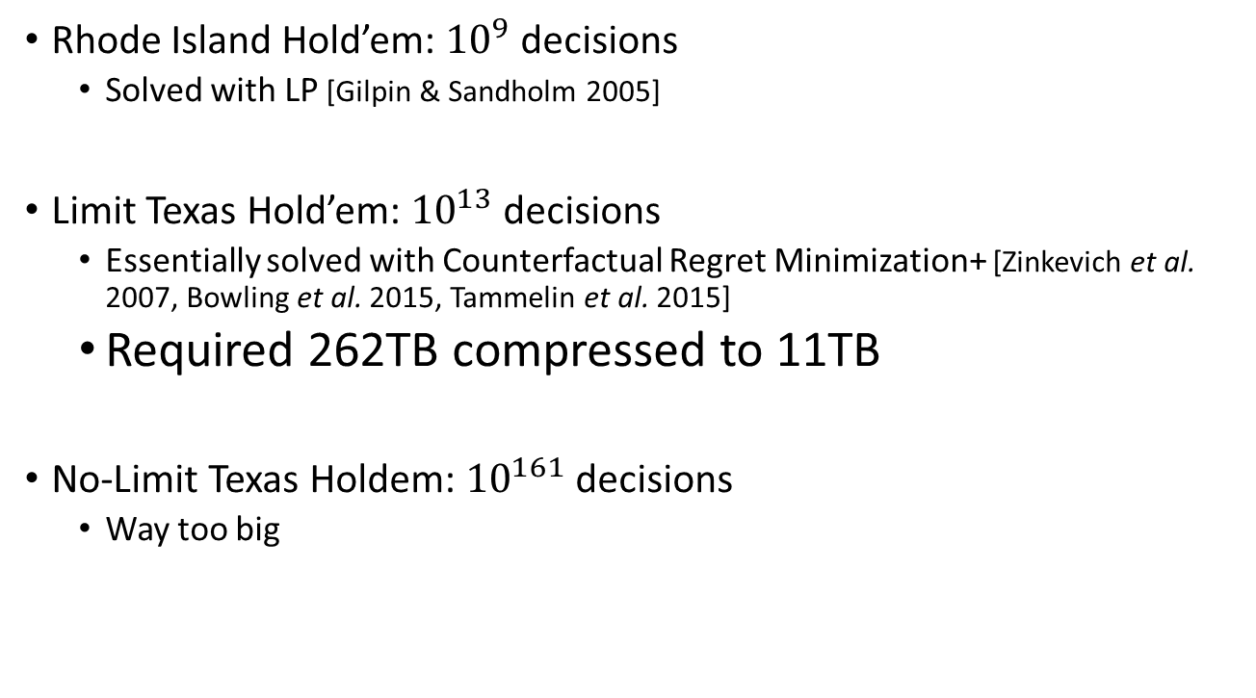
Solving the Whole Game
Rhode Island Hold’em: ${10}^{9}$ decisions
Solved with LP [Gilpin & Sandholm 2005]
Limit Texas Hold’em: ${10}^{13}$ decisions
Essentially solved with Counterfactual Regret Minimization+ [Zinkevich et al. 2007, Bowling et al. 2015, Tammelin et al. 2015]
Required 262TB compressed to 11TB
No-Limit Texas Holdem: ${10}^{161}$ decisions
Way too big

Slide 59
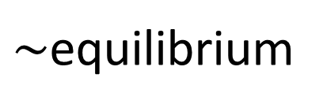
Abstraction [Gilpin & Sandholm EC-06, J. of the ACM 2007…]
Original game
Abstracted game
Automated abstraction
10¹⁶¹
Custom
equilibrium-finding
algorithm
$\sim$equilibrium
Reverse mapping
ε equilibrium
Foreshadowed by Shi & Littman 01, Billings et al. IJCAI-03
Notes:
Key idea: Have a really good abstraction (ideally, no abstraction) for the first two rounds (which is a tiny fraction of the whole game). We only play according to the abstract strategy for those two rounds.

Slide 60
Action Abstraction
P1
P2
. . .
. . .
P2
. . .
. . .
P2

Slide 61
Action Abstraction
P1
P2
. . .
. . .
P2
. . .
. . .
P2
[Gilpin et al. AAMAS-08]
[Hawkin et al. AAAI-11 AAAI-12]
[Brown & Sandholm AAAI-14]

Slide 62
Action Translation
P1
P2
. . .
. . .
P2
. . .
. . .
P2
[Gilpin et al. AAMAS-08]
[Schnizlein et al. IJCAI-09]
[Ganzfried & Sandholm IJCAI-13]

Slide 63
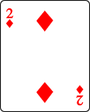
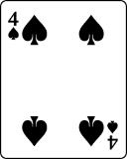
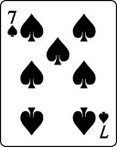
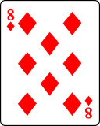
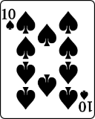
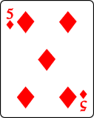
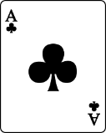
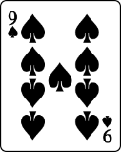
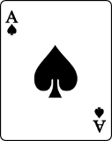
Card Abstraction [Johanson et al. AAMAS-13, Ganzfried & Sandholm AAAI-14]
Best Hand:
Grouped together

Slide 64
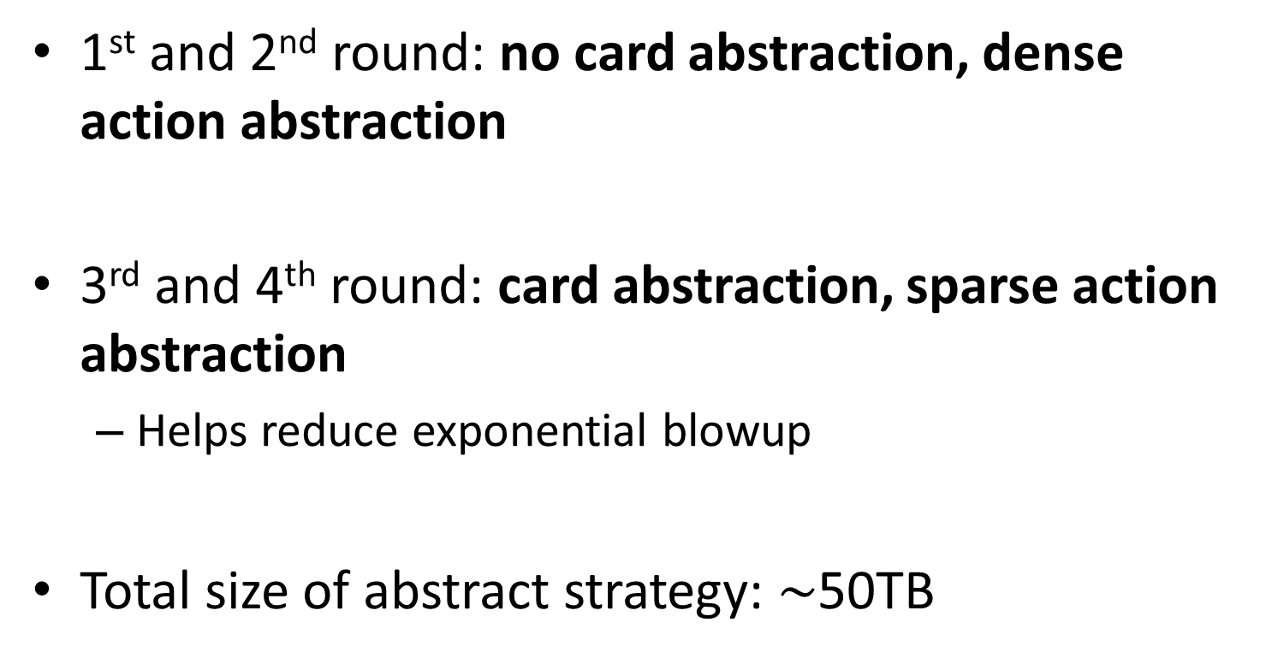
Libratus Abstraction
1st and 2nd round: no card abstraction, dense action abstraction
3rd and 4th round: card abstraction, sparse action abstraction
Helps reduce exponential blowup
Total size of abstract strategy: $\sim$50TB
Notes:
Potential aware, imperfect recall, earthmover distance

Slide 65
Libratus
Rules of the game
Abstraction
Equilibrium finding
Subgame solver
Self-improver
Belief distributions f and g
New action abstraction for part of game

Slide 66
Libratus
Rules of the game
Abstraction
Equilibrium finding
Subgame solver
Self-improver
Belief distributions f and g
New action abstraction for part of game

Slide 67
Subgame Solving [Burch et al. AAAI-14, Moravcik et al. AAAI-16, Brown & Sandholm AAAI-17]

Slide 68
Trunk Strategy
C
P = 0.5
P = 0.5
Heads
Tails
P1
P = 0.3
P1
P = 0.8
P = 0.7
Sell
P = 0.2
Sell
Play
Play
EV = 0.5
EV = -0.5
EV = -0.5
EV = 0.5
P2
P2
P = 0.75
P = 0.25
P = 0.75
P = 0.25
Heads
Tails
Heads
Tails
-1
1
1
-1
Notes:
What is the optimal strategy for P2, looking only at the subgame? Clearly if we know the exact state then we can search just like in Chess. But we only know the information set.
We can see that P1 would have sold the coin if it landed Heads, so P2 should always guess Tails.

Slide 69
Unsafe Subgame Solving [Ganzfried & Sandholm AAAMAS 2015]
Assume the opponent plays according to the trunk strategy
This gives a belief distribution over states
Update beliefs via Bayes Rule
50% Probability
C
50% Probability
P = 0.5
P = 0.5
Heads
Tails
P1
P = 0.3
P1
P = 0.8
P = 0.7
Sell
P = 0.2
Sell
Play
Play
EV = 0.5
EV = -0.5
EV = -0.5
EV = 0.5
P2
P2
P = 0.75
P = 0.25
P = 0.75
P = 0.25
Heads
Tails
Heads
Tails
-1
1
1
-1
Notes:
What is the optimal strategy for P2, looking only at the subgame? Clearly if we know the exact state then we can search just like in Chess. But we only know the information set.
We can see that P1 would have sold the coin if it landed Heads, so P2 should always guess Tails.

Slide 70
Unsafe Subgame Solving [Ganzfried & Sandholm AAAMAS 2015]
Assume the opponent plays according to the trunk strategy
This gives a belief distribution over states
Update beliefs via Bayes Rule
C
P = 0.5
P = 0.5
Heads
Tails
P1
P = 0.3
P1
P = 0.8
P = 0.7
Sell
P = 0.2
Sell
Play
Play
EV = 0.5
EV = -0.5
EV = -0.5
EV = 0.5
22% Probability
78% Probability
P2
P2
P = 0.75
P = 0.25
P = 0.75
P = 0.25
Heads
Tails
Heads
Tails
-1
1
1
-1
Notes:
What is the optimal strategy for P2, looking only at the subgame? Clearly if we know the exact state then we can search just like in Chess. But we only know the information set.
We can see that P1 would have sold the coin if it landed Heads, so P2 should always guess Tails.

Slide 71
Unsafe Subgame Solving [Ganzfried & Sandholm AAAMAS 2015]
Assume the opponent plays according to the trunk strategy
This gives a belief distribution over states
Update beliefs via Bayes Rule
C
P = 0.5
P = 0.5
Heads
Tails
P1
P = 0.3
P1
P = 0.8
P = 0.7
Sell
P = 0.2
Sell
Play
Play
EV = 0.5
EV = -0.5
EV = 1.0
EV = -1.0
22% Probability
78% Probability
P2
P2
P = 0.0
P = 1.0
P = 0.0
P = 1.0
Heads
Tails
Heads
Tails
-1
1
1
-1
Notes:
What is the optimal strategy for P2, looking only at the subgame? Clearly if we know the exact state then we can search just like in Chess. But we only know the information set.
We can see that P1 would have sold the coin if it landed Heads, so P2 should always guess Tails.

Slide 72

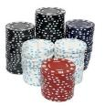

Unsafe Subgame Solving [Ganzfried & Sandholm AAAMAS 2015]

Slide 73






Safe Subgame Solving [Burch et al AAAI-14, Moravcik et al AAAI-16, Brown & Sandholm NIPS-17]
Fold
Shove All-in
Call
Shove All-in
Raise Small
Shove All-in
-$50
$25
$1000
-$60
$10
$950

Slide 74
Safe Subgame Solving [Brown & Sandholm NIPS-17]
Theorem: If subgame estimated values are close to the true values, then subgame solving plays close to a Nash equilibrium strategy.

Slide 75
Action Abstraction
P1
P2
. . .
. . .
P2
. . .
. . .
P2

Slide 76
Action Abstraction
P1
P2
. . .
. . .
P2
. . .
. . .
P2
[Gilpin et al. AAMAS-08]
[Hawkin et al. AAAI-11 AAAI-12]
[Brown & Sandholm AAAI-14]

Slide 77
Action Translation
P1
P2
. . .
. . .
P2
. . .
. . .
P2
[Gilpin et al. AAMAS-08]
[Schnizlein et al. IJCAI-09]
[Ganzfried & Sandholm IJCAI-13]

Slide 78

Nested Subgame Solving [Brown & S.]
Idea: Solve a subgame in real time for the off-tree action taken
Can be repeated for every subsequent off-tree action
Theorem. If the blueprint was a Nash equilibrium and EV[Enter] $≤$ EV[Alt], then the game with the added action is still a Nash equilibrium
P1
P1
EV = z
Alt
Enter
EV = x
EV = y
P2
P2
P2
P2
max(x,y,z)

Slide 79
Head-to-head strength of recent AIs
Stronger
Ours
Others’
Libratus (1/2017)
Baby Tartanian8 (12/2015)
ACPC 2016 winner
Claudico (4/2015)
Tartanian7 (5/2014)
ACPC 2014 winner
63 mbb / hand
DeepStack (11/2016)
Slumbot (12/2015)
-12 mbb / hand
-25 mbb / hand

Slide 80
Libratus
Rules of the game
Abstraction
Equilibrium finding
Subgame solver
Self-improver
Belief distributions f and g
New action abstraction for part of game

Slide 81
Libratus
Rules of the game
Abstraction
Equilibrium finding
Subgame solver
Self-improver
Belief distributions f and g
New action abstraction for part of game

Slide 82
Filling Holes in the Betting Tree
Abstraction
Opponent
Libratus
We do this for top k holes
Notes:
What are the typical actions that are kept?

Slide 83
Observations About Libratus’s Play
Strengths:
Many different bet sizes
“Donk betting”
Huge overbets
Near-perfect balance
Weaknesses:
“No” opponent exploitation

