Slide 1
Extensive-form games and how to solve them
CMU 15-381 and 15-681
Fall 2017
Teachers:
Noam Brown
Tuomas Sandholm

Slide 2


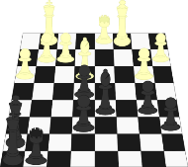
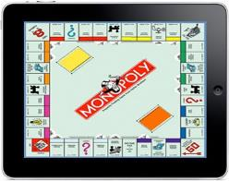
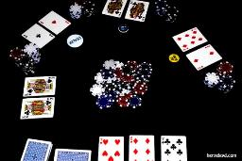
What are Games?
Requirements for a game:
At least 2 players
Actions available for each player
Payoffs to each player for those actions
Examples?

Slide 3
What is Game Theory?
Assumptions in Game Theory:
1) All players want to maximize their utility
2) All players are rational
3) It is common knowledge that all players are rational

Slide 4
Two-Player Zero-Sum Games
For now, we will focus on two-player zero-sum games
Only two players
Whatever one player wins, the other player loses
Common in recreational games (rock-paper-scissors, chess, Go, poker)
Player 2
 | Rock | Paper | Scissors
Rock | 0, 0 | -1, 1 | 1, -1
Paper | 1, -1 | 0, 0 | -1, 1
Scissors | -1, 1 | 1, -1 | 0, 0
Player 1

Slide 5
Extensive-Form Games
P1
Moves are done sequentially
Although “information sets”, discussed later, enable modeling simultaneous moves too
There can be an extra player called chance (aka. nature) that plays stochastically, not strategically
Game forms a tree
Rewards are shown for P1, then P2
P2
P2
-4,4
-3,3
-2,2
P1
1,-1
0,0

Slide 6
Backward Induction
P1
Start at the bottom of the tree and solve assuming we reached that point
Replace the decision point with the value of the decision
Move up, and repeat
P2
P2
-4,4
-3,3
-2,2
P1
1,-1
0,0

Slide 7
Backward Induction
P1
Start at the bottom of the tree and solve assuming we reached that point
Replace the decision point with the value of the decision
Move up, and repeat
P2
P2
-4,4
-3,3
-2,2
P1
1,-1
0,0

Slide 8
Backward Induction
P1
Start at the bottom of the tree and solve assuming we reached that point
Replace the decision point with the value of the decision
Move up, and repeat
P2
P2
2,4
5,3
-2,2
1,-1

Slide 9
Backward Induction
P1
Start at the bottom of the tree and solve assuming we reached that point
Replace the decision point with the value of the decision
Move up, and repeat
P2
P2
2,4
5,3
-2,2
1,-1

Slide 10
Backward Induction
P1
Start at the bottom of the tree and solve assuming we reached that point
Replace the decision point with the value of the decision
Move up, and repeat
P2
-2,2
-4,4
-3,3

Slide 11
Backward Induction
P1
Start at the bottom of the tree and solve assuming we reached that point
Replace the decision point with the value of the decision
Move up, and repeat
-4,4
-2,2

Slide 12
Backward Induction
P1
Start at the bottom of the tree and solve assuming we reached that point
Replace the decision point with the value of the decision
Move up, and repeat
P2
P2
-4,4
-3,3
-2,2
P1
1,-1
0,0

Slide 13


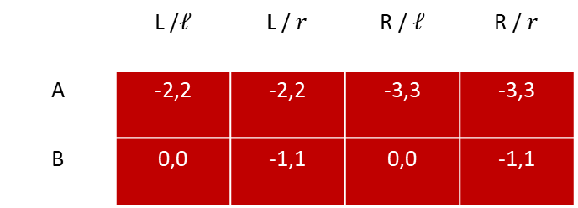
Converting to Normal Form
P1
Every extensive-form game can be converted to a normal-form game
Must define strategy for every situation
Problem: Exponential in the size of the game
A
B
P2
P2
L
R
$$ℓ$$
$$r$$
-2,2
-3,3
0,0
-1,1
 | L /$ℓ$ | L / $r$ | R / $ℓ$ | R / $r$
A | -2,2 | -2,2 | -3,3 | -3,3
B | 0,0 | -1,1 | 0,0 | -1,1

Slide 14
Solving Perfect-Information Games
Checkers solved – can always draw [Schaeffer et al. "Checkers is solved." Science (2007)]
At about 10²⁰ states, checkers is the largest game ever solved. Chess has about 10⁴⁰. Go has about 10¹⁷⁰.

Slide 15
Imperfect-information Games
C
What about games like poker?
Backward induction doesn’t work in imperfect-information games!
An information set is the set of all possible states (nodes in the game tree) that the player may be in, given the information available to him.
A strategy must be identical for all nodes in an information set.
Heads
Tails
P1
P1
Play
Sell
Play
Sell
0.5
-0.5
P2
P2
Heads
Tails
Heads
Tails
-1
1
1
-1

Slide 16



Half-Street Kuhn Poker
3 cards: K, Q, and J. Highest card wins
Two players are dealt one of the cards
Both players ante 1 chip
P1 may bet or check
If P1 checks, the higher card wins 1 chip
If P1 bets, P2 may call or fold
- If P2 folds, P1 wins 1 chip
- If P2 calls, the higher card wins 2 chips
Poll: What should P1 do with a Queen?
1. Always bet
2. Sometimes bet, sometimes check
3. Always check
4. No idea
P1
Check
Bet
$$±1$$
P2
Fold
Call
$$1$$
$$±2$$

Slide 17
Imperfect-information Games
C
P1: K, P2: Q
P1: K, P2: J
P1: Q, P2: J
P1: Q, P2: K
P1: J, P2: K
P1: J, P2: Q
P1
P1
P1
P1
P1
P1
Check
Bet
Check
Bet
Check
Bet
Check
Bet
Check
Bet
Check
Bet
1
1
1
-1
-1
-1
P2
P2
P2
P2
P2
P2
Fold
Call
Fold
Call
Fold
Call
Fold
Call
Fold
Call
Fold
Call
1
2
1
2
1
2
1
-2
1
-2
1
-2
Try iterative removal of dominated strategies!

Slide 18
Imperfect-information Games
C
P1: K, P2: Q
P1: K, P2: J
P1: Q, P2: J
P1: Q, P2: K
P1: J, P2: K
P1: J, P2: Q
P1
P1
P1
P1
P1
P1
Bet
Bet
Check
Bet
Check
Bet
Check
Bet
Check
Bet
1
-1
-1
-1
P2
P2
P2
P2
P2
P2
Fold
Call
Fold
Fold
Call
Call
Fold
Call
1
2
1
1
-2
-2
1
-2

Slide 19
Imperfect-information Games
C
P1: K, P2: Q
P1: K, P2: J
P1: Q, P2: J
P1: Q, P2: K
P1: J, P2: K
P1: J, P2: Q
P1
P1
P1
P1
P1
P1
Bet
Bet
Check
Check
Check
Bet
Check
Bet
1
-1
-1
-1
P2
P2
P2
P2
Fold
Call
Fold
Call
Fold
Call
1
2
1
-2
1
-2

Slide 20
Imperfect-information Games
Two questions remain:
How often should P1 bet with a Jack (bluff)?
How often should P2 call with a Queen when P1 bets?
 | Call with Q | Fold with Q
Bet with J
Check with J

Slide 21
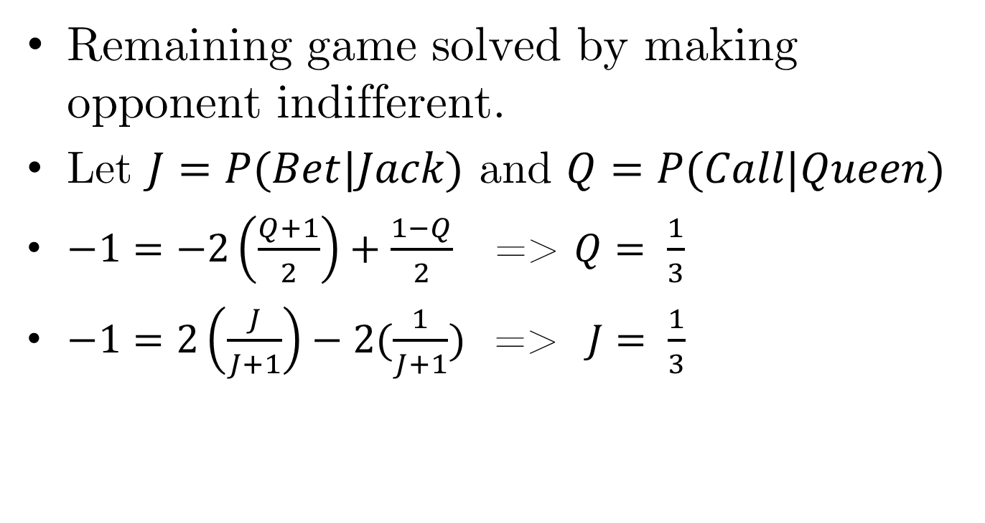
Imperfect-information Games
Remaining game solved by making opponent indifferent.
Let $J=P(Bet|Jack)$ and $Q=P(Call|Queen)$
$−1=−2\left(\frac{Q+1}{2}\right)+\frac{1−Q}{2}$ => $Q= \frac{1}{3}$
$−1=2\left(\frac{J}{J+1}\right)−2(\frac{1}{J+1})$ => $J= \frac{1}{3}$

Slide 22
Solving two-player zero-sum extensive-form games

Slide 23
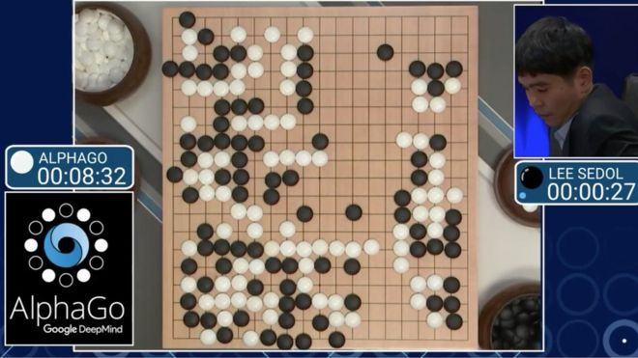
AlphaGo
AlphaGo techniques extend, in principle, to other perfect-information games

Slide 24
Perfect-Information Games

Slide 25
Perfect-Information Games

Slide 26
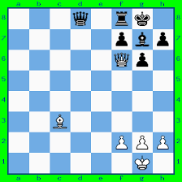
Perfect-Information Games

Slide 27
Imperfect-Information Games

Slide 28
Imperfect-Information Games

Slide 29
Example Game: Coin Toss
P1 Information Set
P1 Information Set
C
P = 0.5
P = 0.5
Heads
Tails
P1
P1
EV = 0.5
EV = -0.5
P2 Information Set
Sell
Sell
Play
Play
P2
P2
Heads
Tails
Heads
Tails
-1
1
1
-1
Notes:
If it lands Heads the coin is considered lucky and P1 can sell it. If it lands Tails the coin is unlucky and P1 can pay someone to take it. Or, P1 can play, and P2 can try to guess how the coin landed.

Slide 30
Imperfect-Information Games: Coin Toss
C
P = 0.5
P = 0.5
Heads
Tails
P1
P1
Imperfect-Information
Subgame
EV = 0.5
EV = -0.5
Sell
Sell
Play
Play
P2
P2
Heads
Tails
Heads
Tails
-1
1
1
-1

Slide 31
Imperfect-Information Games: Coin Toss
C
P = 0.5
P = 0.5
Heads
Tails
P1
P1
EV = 0.5
EV = -0.5
EV = 1.0
Sell
EV = -1.0
Sell
Play
Play
P2
P2
P = 1.0
P = 0.0
P = 1.0
P = 0.0
Heads
Tails
Heads
Tails
-1
1
1
-1
Notes:
What is the optimal strategy for P2, looking only at the subgame? Clearly if we know the exact state then we can search just like in Chess. But we only know the information set.
We can see that P1 would have sold the coin if it landed Heads, so P2 should always guess Tails.

Slide 32
Imperfect-Information Games: Coin Toss
Heads EV = 0.5
Tails EV = 1.0
Average = 0.75
C
P = 0.5
P = 0.5
Heads
Tails
P1
P1
EV = 0.5
EV = -0.5
EV = 1.0
Sell
EV = -1.0
Sell
Play
Play
P2
P2
P = 1.0
P = 0.0
P = 1.0
P = 0.0
Heads
Tails
Heads
Tails
-1
1
1
-1
Notes:
What is the optimal strategy for P2, looking only at the subgame? Clearly if we know the exact state then we can search just like in Chess. But we only know the information set.
We can see that P1 would have sold the coin if it landed Heads, so P2 should always guess Tails.

Slide 33
Imperfect-Information Games: Coin Toss
C
P = 0.5
P = 0.5
Heads
Tails
P1
P1
EV = 0.5
EV = -0.5
EV = -1.0
Sell
EV = 1.0
Sell
Play
Play
P2
P2
P = 0.0
P = 1.0
P = 0.0
P = 1.0
Heads
Tails
Heads
Tails
-1
1
1
-1
Notes:
What is the optimal strategy for P2, looking only at the subgame? Clearly if we know the exact state then we can search just like in Chess. But we only know the information set.
We can see that P1 would have sold the coin if it landed Heads, so P2 should always guess Tails.

Slide 34
Imperfect-Information Games: Coin Toss
Heads EV = 1.0
Tails EV = -0.5
Average = 0.25
C
P = 0.5
P = 0.5
Heads
Tails
P1
P1
EV = 0.5
EV = -0.5
EV = -1.0
Sell
EV = 1.0
Sell
Play
Play
P2
P2
P = 0.0
P = 1.0
P = 0.0
P = 1.0
Heads
Tails
Heads
Tails
-1
1
1
-1
Notes:
What is the optimal strategy for P2, looking only at the subgame? Clearly if we know the exact state then we can search just like in Chess. But we only know the information set.
We can see that P1 would have sold the coin if it landed Heads, so P2 should always guess Tails.

Slide 35
Imperfect-Information Games: Coin Toss
C
P = 0.5
P = 0.5
Heads
Tails
P1
P1
EV = 0.5
EV = -0.5
EV = -0.5
Sell
EV = 0.5
Sell
Play
Play
P2
P2
P = 0.25
P = 0.75
P = 0.25
P = 0.75
Heads
Tails
Heads
Tails
-1
1
1
-1
Notes:
What is the optimal strategy for P2, looking only at the subgame? Clearly if we know the exact state then we can search just like in Chess. But we only know the information set.
We can see that P1 would have sold the coin if it landed Heads, so P2 should always guess Tails.

Slide 36
Imperfect-Information Games: Coin Toss
Heads EV = 0.5
Tails EV = -0.5
Average = 0.0
C
P = 0.5
P = 0.5
Heads
Tails
P1
P1
EV = 0.5
EV = -0.5
EV = -0.5
Sell
EV = 0.5
Sell
Play
Play
P2
P2
P = 0.25
P = 0.75
P = 0.25
P = 0.75
Heads
Tails
Heads
Tails
-1
1
1
-1
Notes:
What is the optimal strategy for P2, looking only at the subgame? Clearly if we know the exact state then we can search just like in Chess. But we only know the information set.
We can see that P1 would have sold the coin if it landed Heads, so P2 should always guess Tails.

Slide 37
Imperfect-Information Games: Coin Toss
C
P = 0.5
P = 0.5
Heads
Tails
P1
P1
EV = 0.5
EV = -0.5
Sell
Sell
Play
Play
P2
P2
P = 0.25
P = 0.75
P = 0.25
P = 0.75
Heads
Tails
Heads
Tails
-1
1
1
-1
Notes:
What is the optimal strategy for P2, looking only at the subgame? Clearly if we know the exact state then we can search just like in Chess. But we only know the information set.
We can see that P1 would have sold the coin if it landed Heads, so P2 should always guess Tails.

Slide 38
Imperfect-Information Games: Coin Toss
C
P = 0.5
P = 0.5
Heads
Tails
P1
P1
EV = -0.5
EV = 0.5
Sell
Sell
Play
Play
P2
P2
P = 0.25
P = 0.75
P = 0.25
P = 0.75
Heads
Tails
Heads
Tails
-1
1
1
-1
Notes:
What is the optimal strategy for P2, looking only at the subgame? Clearly if we know the exact state then we can search just like in Chess. But we only know the information set.
We can see that P1 would have sold the coin if it landed Heads, so P2 should always guess Tails.

Slide 39
Imperfect-Information Games: Coin Toss
C
P = 0.5
P = 0.5
Heads
Tails
P1
P1
EV = -0.5
EV = 0.5
Sell
Sell
Play
Play
P2
P2
P = 0.75
P = 0.25
P = 0.75
P = 0.25
Heads
Tails
Heads
Tails
-1
1
1
-1
Notes:
What is the optimal strategy for P2, looking only at the subgame? Clearly if we know the exact state then we can search just like in Chess. But we only know the information set.
We can see that P1 would have sold the coin if it landed Heads, so P2 should always guess Tails.

Slide 40
Increasing scalability: Abstraction
Idea: Create smaller game that is similar to big game
Run equilibrium-finding algorithm on smaller game
Map computed equilibrium to a strategy profile in big game

Slide 41
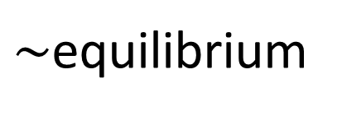
Abstraction [Gilpin & Sandholm EC-06, J. of the ACM 2007…]
Original game
Abstracted game
Compact representation
Automated abstraction
10¹⁶¹
Equilibrium-finding
algorithm
$\sim$equilibrium
Reverse mapping
ε-equilibrium
Foreshadowed by Shi & Littman 01, Billings et al. IJCAI-03
Notes:
Key idea: Have a really good abstraction (ideally, no abstraction) for the first two rounds (which is a tiny fraction of the whole game). We only play according to the abstract strategy for those two rounds.

Slide 42
Lossless abstraction
C
C
0.5
0.5
1
P1
P1
P1
P2
P2
P2
P2
P2
P2
10
0
0
10
10
0
0
10
10
0
0
10

Slide 43
Lossy abstraction
C
C
0.5
0.5
1
P1
P1
P1
P2
P2
P2
P2
P2
P2
8
0
0
10
10
0
0
10
9
0
0
10

Slide 44
ε-Nash equilibrium
Standard Nash equilibrium:
Each player has no incentive to deviate
In other words: No agent can gain utility by switching to another strategy
ε-Nash equilibrium:
Each player has only ε incentive to deviate
In other words: No agent can gain more than ε utility by switching to another strategy

Slide 45
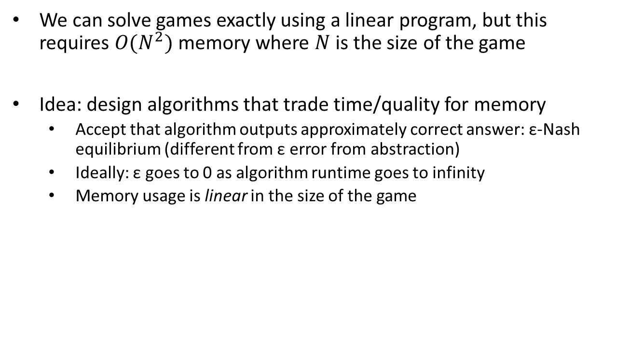
Increasing scalability: Sparse algorithms
We can solve games exactly using a linear program, but this requires $O(N^{2})$ memory where $N$ is the size of the game
Idea: design algorithms that trade time/quality for memory
Accept that algorithm outputs approximately correct answer: ε-Nash equilibrium (different from ε error from abstraction)
Ideally: ε goes to 0 as algorithm runtime goes to infinity
Memory usage is linear in the size of the game

Slide 46
Plan for next part of the presentation
We will introduce counterfactual regret minimization (CFR)-based equilibrium finding in two-player zero-sum games
Most common algorithm
Relatively easy to understand and implement
We start from first principles and proceed step by step to the most advanced algorithms in this family
Used to be best in practice, but now there is a gradient-based algorithm that is better in practice also [Kroer et al. EC-17]
But that is much more difficult to understand

