Slide 1
Neural Networks
Tai Sing Lee
15-381/681 AI Lecture 17
Read Chapter 18.6and 18.7 of Russell & Norvig
With thanks to Bruno Olshausen, Terry Sejnowski, Dave Touretzky for some slides on neural networks

Slide 2
Alternative way to learn Q
Can learn Q(s,a) table explicitly using this approach.
But there is a scaling-up problem (many S, and A).
Use Neural Network to learn a mapping to Q – functional approximation.
To flap or not to flap – that is the question.

Slide 3
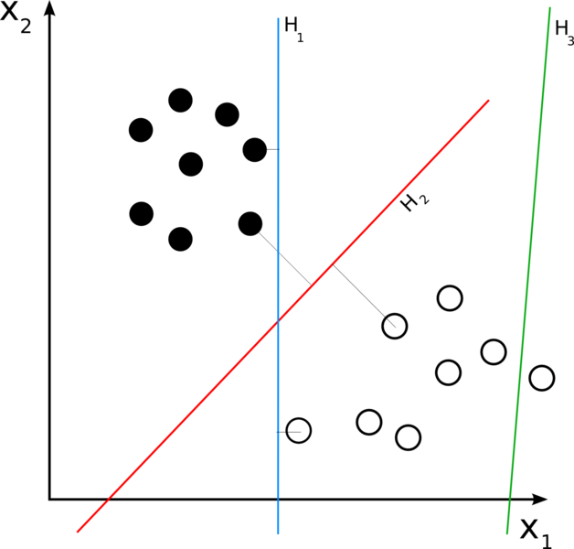
Linear Classifier:
-
The operation of a ‘neuron’, as a linear classifier, linear combination of features to discover a way to split the objects/actions into two classes depending on those features.
Notes:
A linear classifier achieves this by making a classification decision based on the value of a linear combination of the characteristics. An object's characteristics are also known as feature values and are typically presented to the machine in a vector called a feature vector.

Slide 4
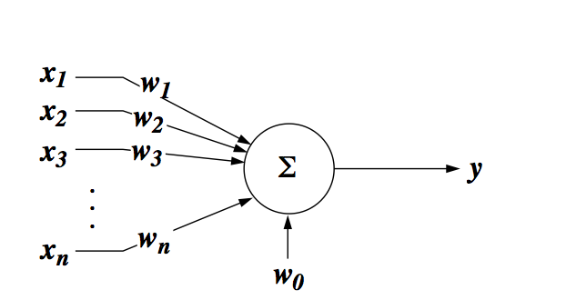

Neural Network: McCulloch-Pitts neuron
Notes:
What kind of input does this neuron like the best?
What does this neuron do?
What kinds of input this neuron will like the best?
When x matches w, but i.e. what will maximize w.x + w_0?
Keeping |x| a constant, or normalized.
W^tX = |W||x| cos theta.

Slide 5
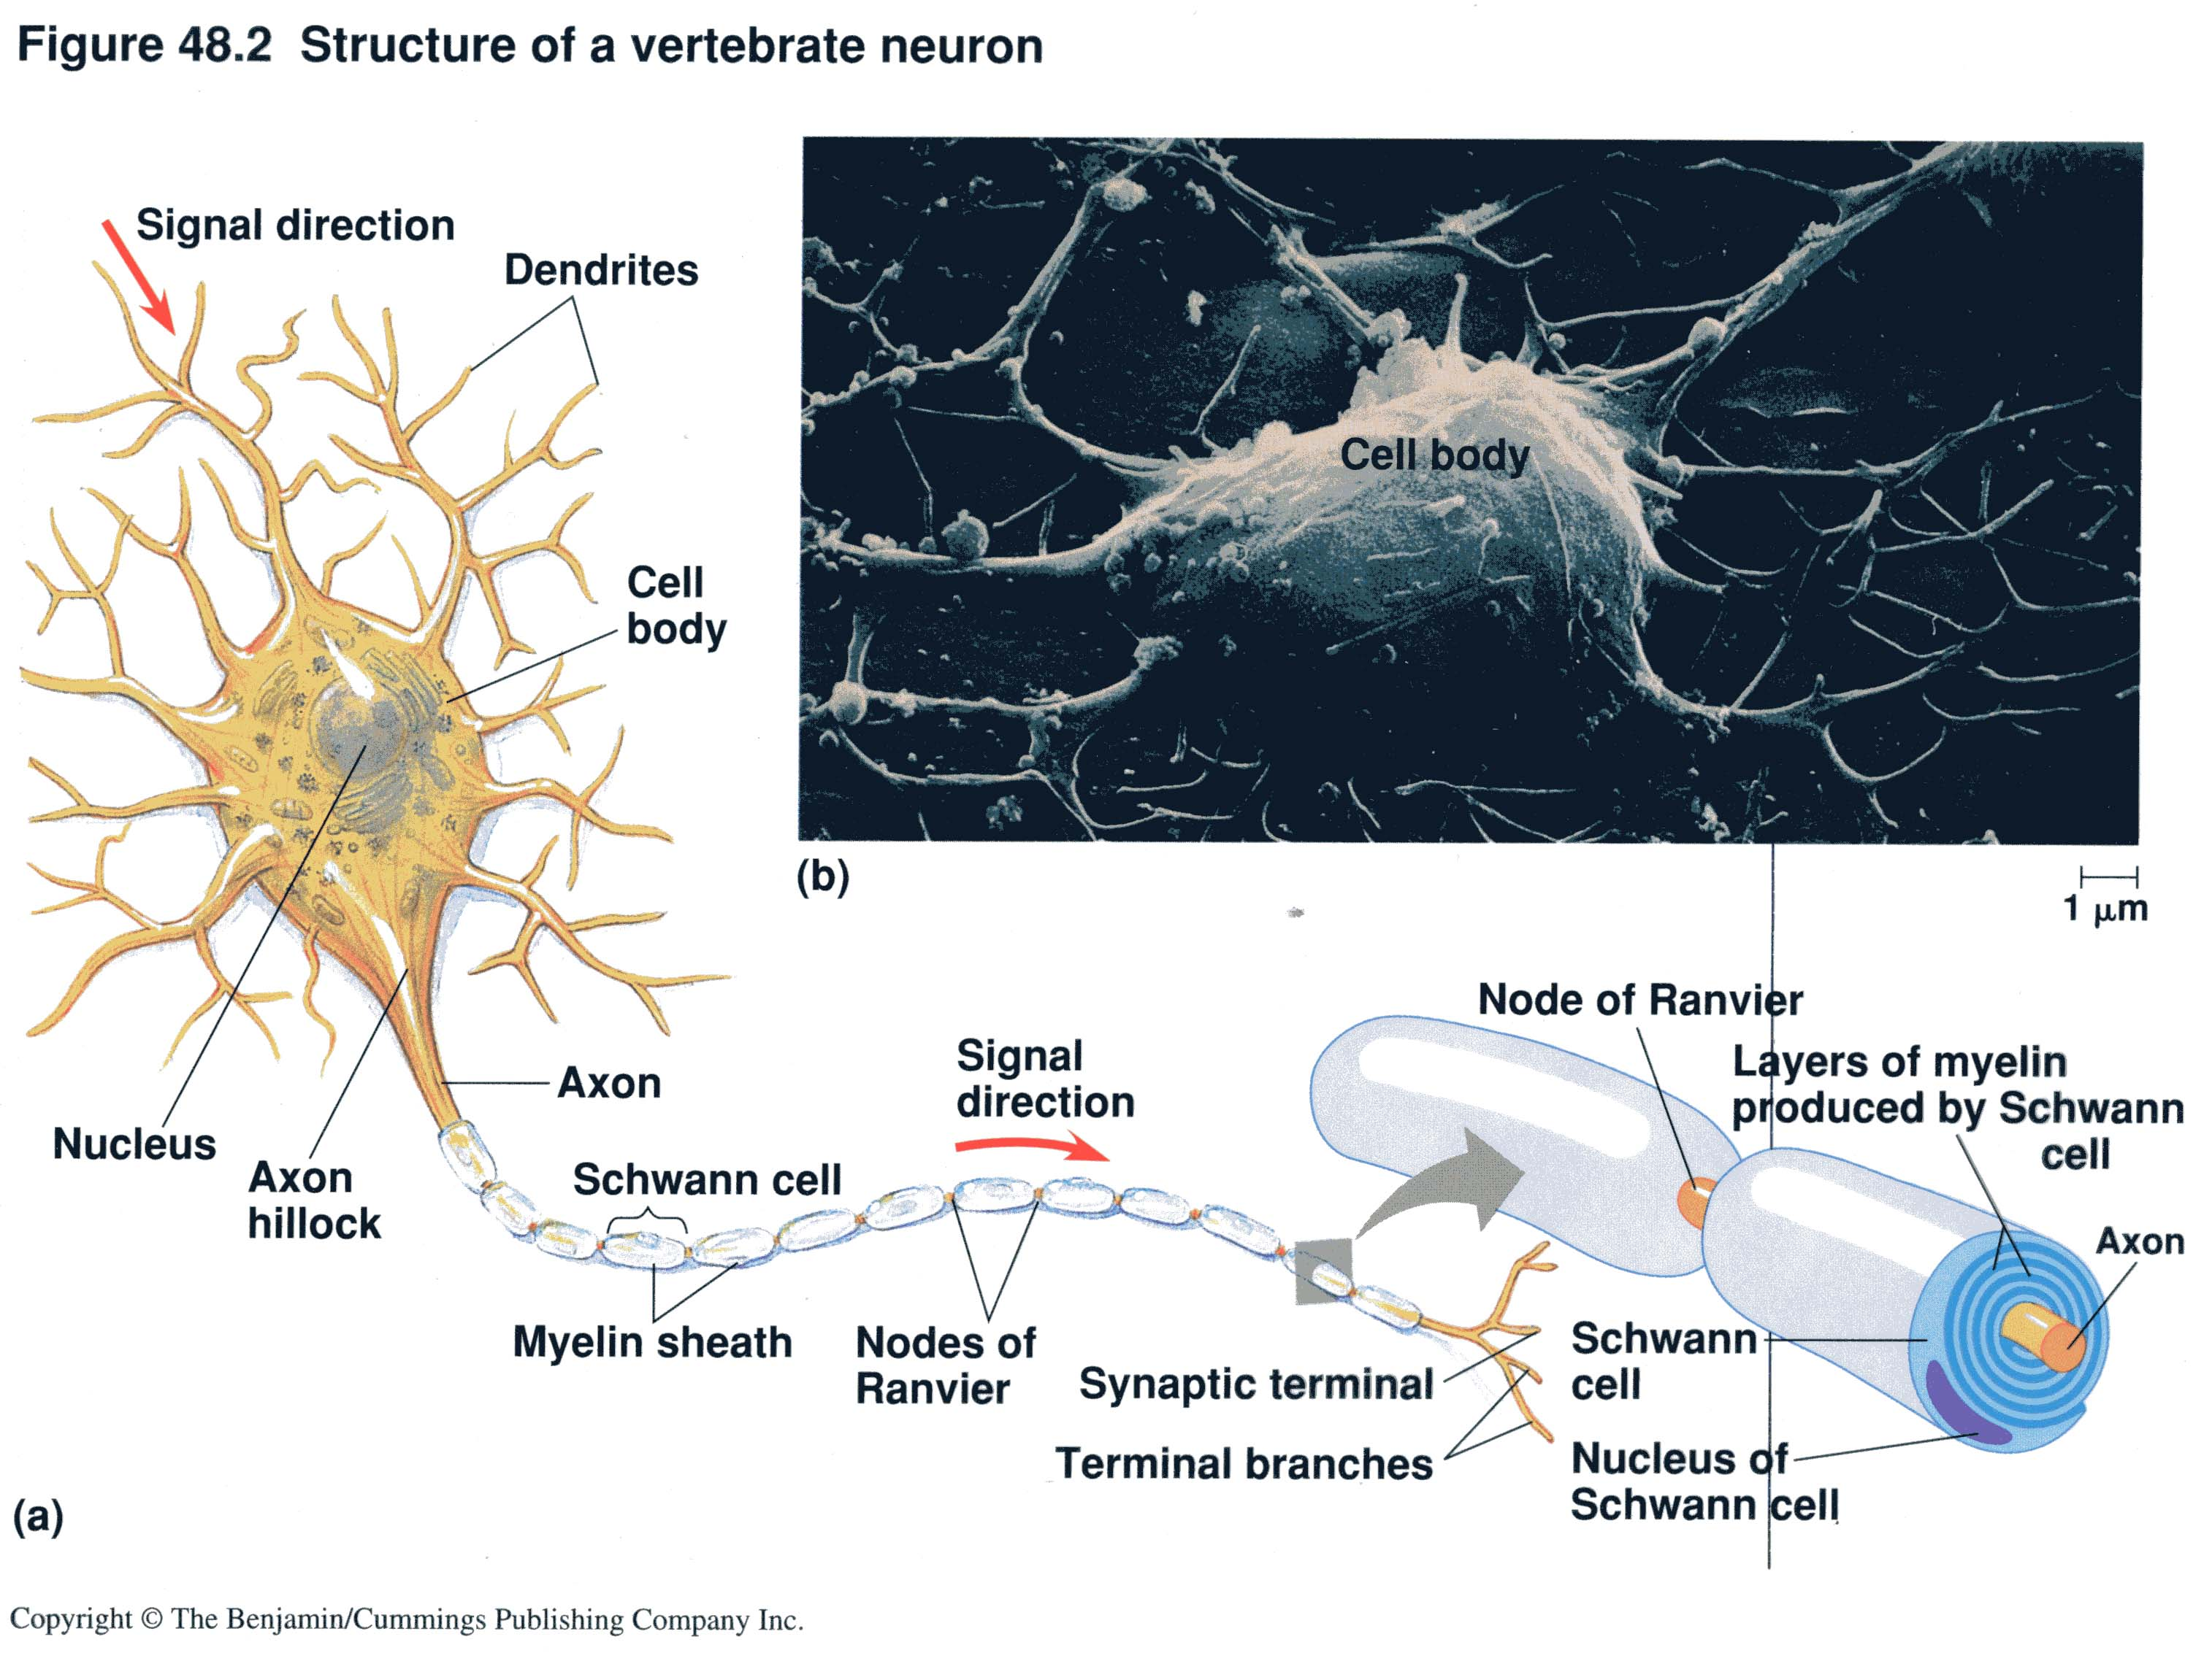
Basic structure of a neuron
Notes:
Information flows in one drection through a neron, from dendrites, to cel body to the axon, while the popular theory of the day is the reticular, because Cajal’s is isolated from the scientific community,, and people also don’t pay attention to him. Cajal found no evidence of a recticulum, noting instead that each neuron is an absolutely autonomous unit.
Reticulum is a lage network of tissues formed by fused proceses of neve cells. The other group argued that they ar dstinct elements.

Slide 6
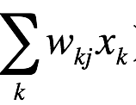
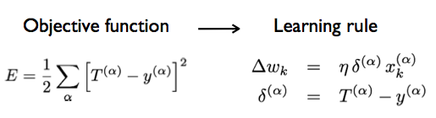
How to find the weights?
Linear
=

Slide 7
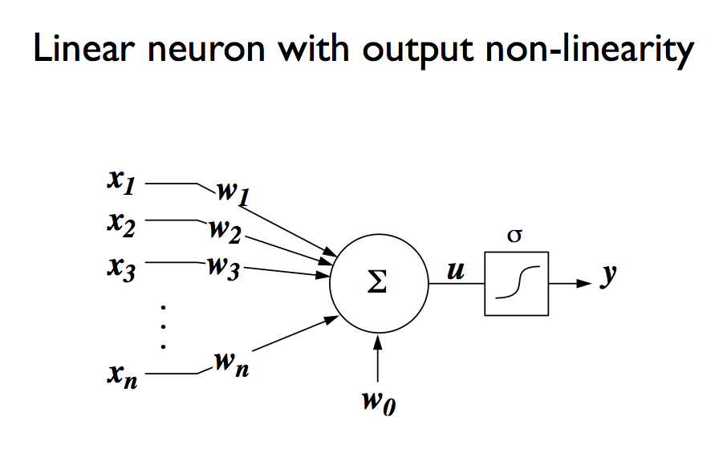
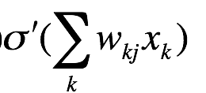
Output nonlinearity – making decision
=

Slide 8
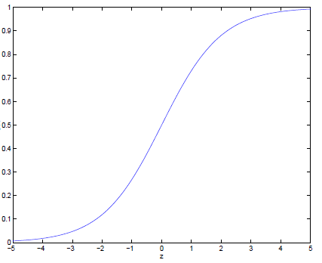

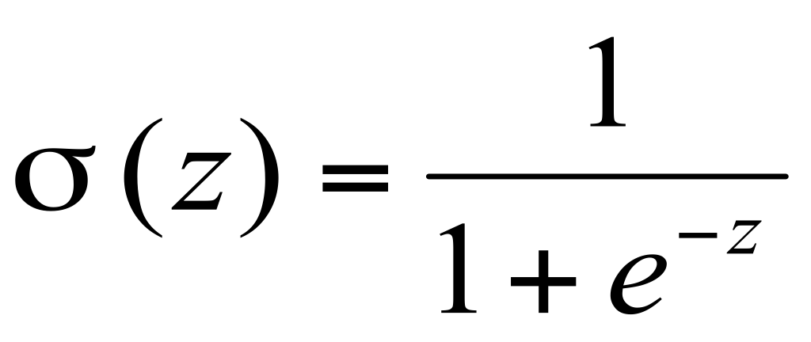

Threshold: Sigmoid function
Notice σ(x) is always bounded between [0,1] (a nice property)
and as z increases σ(z) approaches 1, as z decreases σ(z) approaches 0

Slide 9
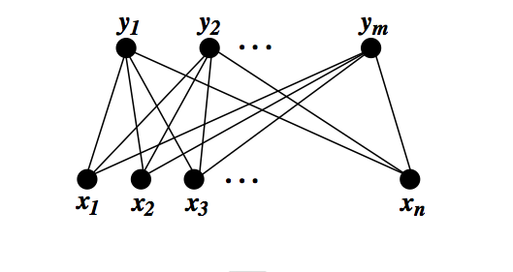
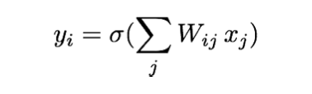
Single layer perceptron (1950s)
sigmoid neuron learning rule:

Slide 10
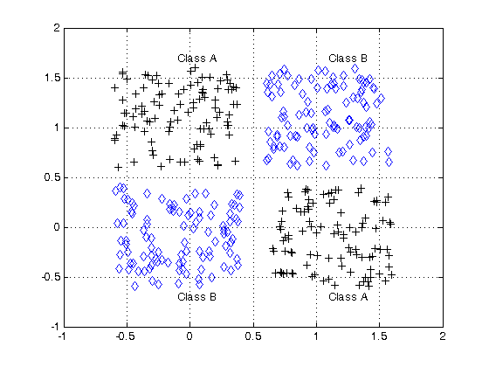
Single layer perceptron (1950s)
X-OR
sigmoid neuron learning rule:

Slide 11
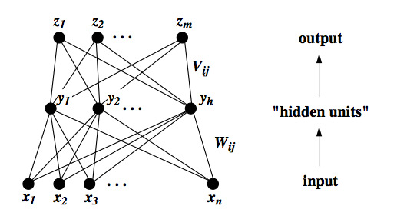
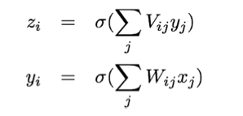
Two-layer (multi-layer) perceptron (80s)
Notes:
Bottom-neck, squeeze representations. Why do you need hidden layers?
A Multi-layer perceptron using a linear transfer function has an equivalent single-layer network; a non-linear function is therefore necessary to gain the advantages of a multi-layer network.

Slide 12
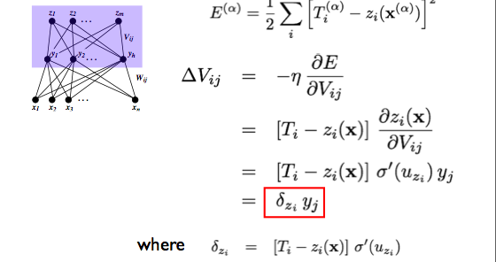

Learning rule for output layer

Slide 13
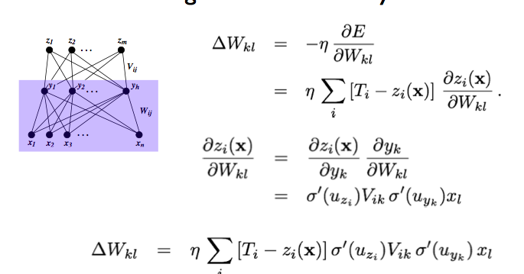

Backpropagation (1980s) Learning rule for hidden layer
Notes:
Statistical learning theory is a framework for machine learning drawing from the fields of statistics and functional analysis.^{[1][2]} Statistical learning theory deals with the problem of finding a predictive function based on data. Statistical learning theory has led to successful applications in fields such as computer vision, speech recognition, bioinformatics and baseball.^{[3]}

Slide 14
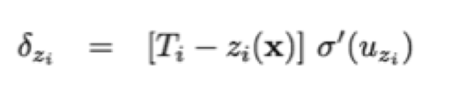
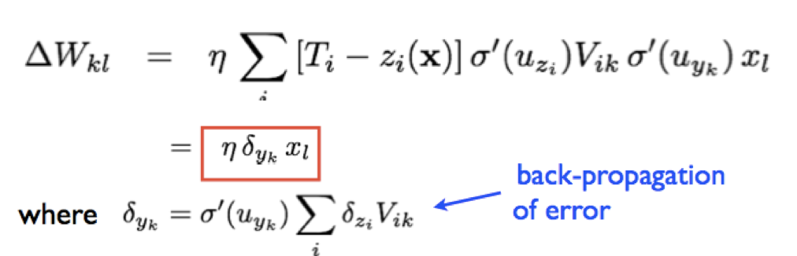
Still have a problem with many layers
Notes:
One of the newest and most effective ways to resolve the vanishing gradient problem is with residual neural networks (ResNets^{[10]} - not to be confused with recurrent neural networks^{[11]}). It was noted prior to ResNets that a deeper network would actually have higher training error than the shallow network. This intuitively can be understood as data disappearing through too many layers of the network, meaning output from a shallow layer was diminished through the greater number of layers in the deeper network, yielding a worse result. Going with this intuitive hypothesis, Microsoft research found that splitting a deep network into e.g., three layer chunks and passing the input into each chunk straight through to the next chunk (along with the residual—output of the chunk minus the input to the chunk that is reintroduced) helped eliminate much of this disappearing signal problem. No extra parameters or changes to the learning algorithm were needed. ResNets^{[12]} yielded lower training error (and test error) than their shallower counterparts simply by reintroducing outputs from shallower layers in the network to compensate for the vanishing data.^{[13]}

Slide 15
There is a problem with many layers
What is the problem?
Solutions ?
Notes:
One of the newest and most effective ways to resolve the vanishing gradient problem is with residual neural networks (ResNets^{[10]} - not to be confused with recurrent neural networks^{[11]}). It was noted prior to ResNets that a deeper network would actually have higher training error than the shallow network. This intuitively can be understood as data disappearing through too many layers of the network, meaning output from a shallow layer was diminished through the greater number of layers in the deeper network, yielding a worse result. Going with this intuitive hypothesis, Microsoft research found that splitting a deep network into e.g., three layer chunks and passing the input into each chunk straight through to the next chunk (along with the residual—output of the chunk minus the input to the chunk that is reintroduced) helped eliminate much of this disappearing signal problem. No extra parameters or changes to the learning algorithm were needed. ResNets^{[12]} yielded lower training error (and test error) than their shallower counterparts simply by reintroducing outputs from shallower layers in the network to compensate for the vanishing data.^{[13]}

Slide 16
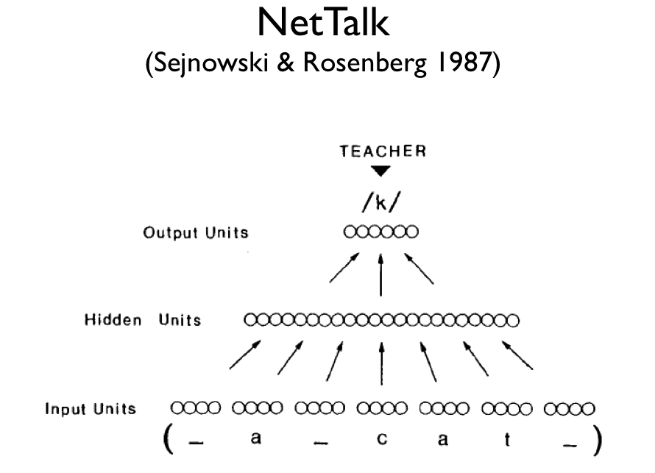

Neural networks
How to learn to read aloud?
26
80
203
18629 connection weights

Slide 17
Network design
Input: 7 groups of 29 units: each group represents a letter. 7 letters at one time in the time window. Pay attention only to the central letter, the surround serves as context.
The 29 units are used to indicate the 26 letters in the alphabet plus 3 units to encode punctuation and word boundaries.
The input text can move continuously letter by letter through the window.
Output: The desired output is the phoneme associated with the center letter.
21 of the 26 output units represent articulatory features such as point of articulation, voicing, vowel height and so on.
5 of the output units encode stress and syllable boundaries.
Notes:
Phoneme: any of the perceptually distinct units of sound in a specified language that distinguish one word from another, for example p, b, d, and t in the English words pad, pat, bad, and bat.

Slide 18
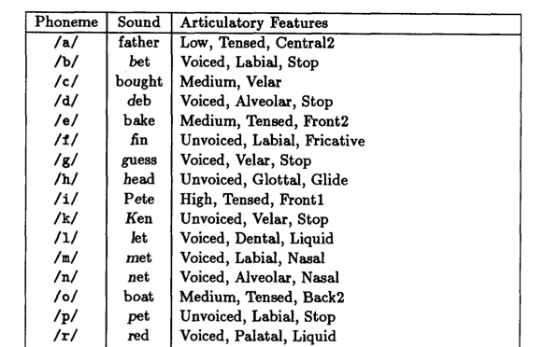

Slide 19
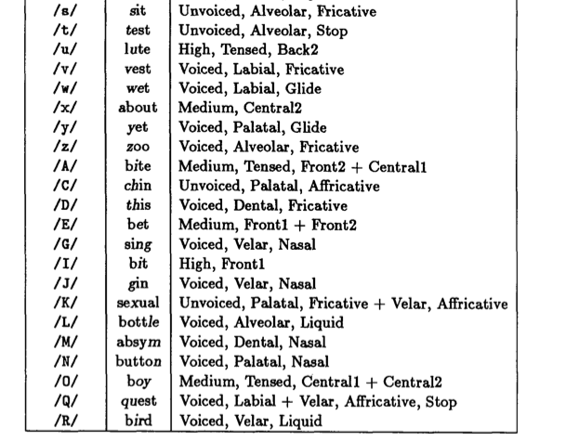

Slide 20
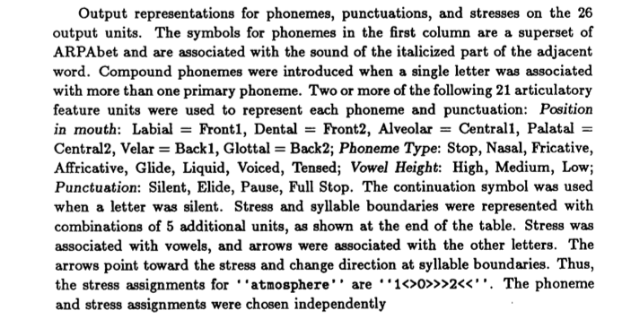

Slide 21
Network design
Hidden layer: map letters to phonemes.
Goal of the learning: search effectively the space of all possible weights for a network that performs such a mapping.
Training set:
Continuous speech of a first grade (1024 words)
Reach 95% correct after 50 passes Learn distinction between vowels and consonants: babbling.
Then learn word boundaries: resemble pseudo-words
10 passes: become intelligible.
Notes:
300 neurons, 18K synapses. In a day, learn 1000 words, in a week, learn 20K words.
Once the system has evolved, it learned the rules, implicitly coded in the network of connections, but you odn’t know where it is.
Vowels are represented differently from consonants. Things sound similar are clustered toether. P and near b, and while a and e each have regions.
10 randomly chosen neurons could be used as a seed to reproduce the entire coding scheeme. Like a hologram. A small part can actually cause activation of the whole patterns, though become fuzzier. Also deleting neurons, would determiate performance but still robust.

Slide 22
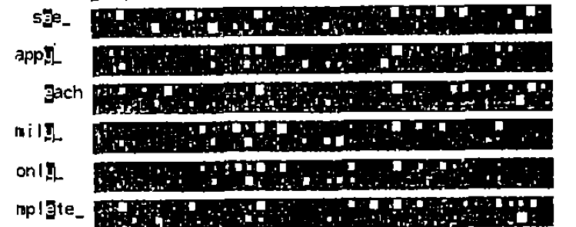
Parallel and distributed Representations
Network robust against damage.
Relearning is faster than first-time learning.
Distributed or spaced practice more effective for long-term retention than massed practice.
Notes:
Any mental state can be described as an (N)-dimensional vector of numeric activation values over neural units in a network.
Memory is created by modifying the strength of the connections between neural units. The connection strengths, or "weights", are generally represented as an (N×N)-dimensional matrix
Development of the Connectionist School (Connectionisms) in the late 80s
Debate between connectionisms (neural nets, associations, parallel distributed processing and representation) and computationalism: mind operates by performing purely formal operations on symbols, like a Turing machine, and there is a language of thoughts.

Slide 23
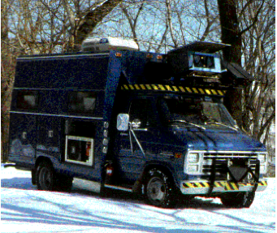
ALVINN Autonomous land vehicle in a neural network
Dean Pomerleau, Chuck Thorpe, Martial Hebert and others
The Nav lab, the first generation of self-driving car
Early 90s, 95% hand-free across America.

Slide 24
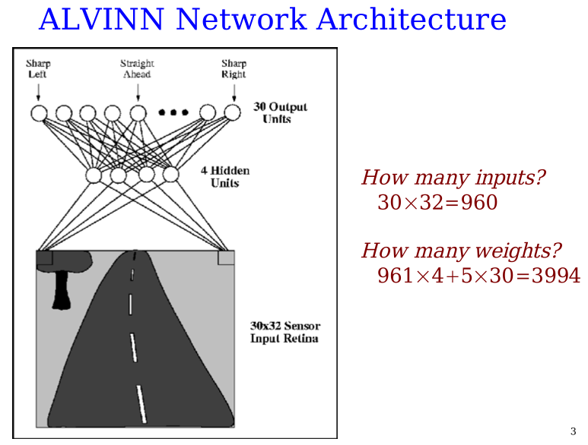

Slide 25
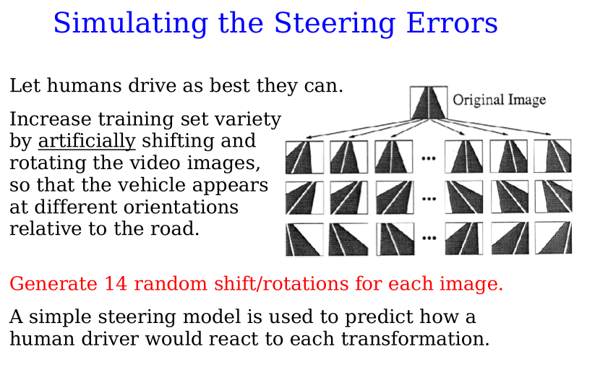

Slide 26
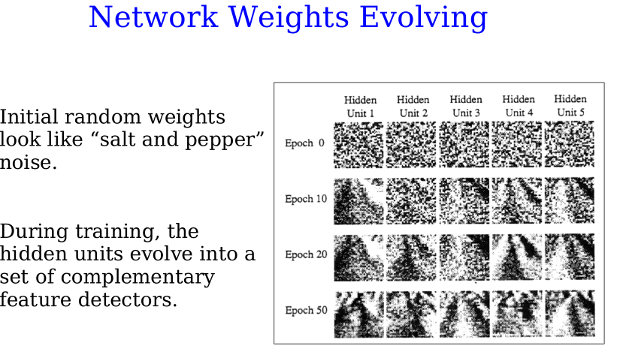
Pomerleau and Touretzky

Slide 27
Flappy bird
Use Neural Network to learn a mapping to Q – functional approximation.
Q(To flap,s)
Q(Not to flap, s)

Slide 28



Putting things together in Flappy Bird
At each time step, given state s, select action a.
Observe new state s’ and reward and look up expected utility.
Q learning approximates maximum expected return for performing action a at state s based on Q state-action value function.
Q action value function at state s is:
How to get Q* ? From the same neural network
Notes:
The intuition behind reinforcement learning is to continually update the action-value function based on observations using the Bellman equation. It has been shown by Sutton et al 1998 [2] that such update algorithms will converge on the optimal action-value function as time approaches infinity. Based on this, we can define Q as the output of a neural network, which has weights θ, and train this network by minimizing the following loss function at each iteration i:

Slide 29



Neural network learns to associate every state with a Q(s,a) function. The flappy bird network has two Q nodes, “to flap” or “not to flap” – the stronger one will dictate the decision on action a.
The network (with parameters θ) is trained by minimizing the following cost function:
where y_{i} is the target function to approach during each iteration (time step).
Terminal state: Hit the pipe r = -1000
Notes:
The intuition behind reinforcement learning is to continually update the action-value function based on observations using the Bellman equation. It has been shown by Sutton et al 1998 [2] that such update algorithms will converge on the optimal action-value function as time approaches infinity. Based on this, we can define Q as the output of a neural network, which has weights θ, and train this network by minimizing the following loss function at each iteration i:

Slide 30
Do we need a model of our action? Eric’s question.
Actually, we don’t, because once the bird makes a decision, the action will be executed (deterministically), and it will experience s’ and reward, and it can calculate y = R + max(Q) based on its actual experience.
In fact, the bird will be learning in mini-batch mode. That is, it will execute a series of actions, and get a set of observations (experiences), and then it updates the neural network by experience replay, drawing random samples from these (s, a, s’ Q(s,a), r, max(Q(s’,a’)) that it has experienced in the last 1000 ms for example.
Notes:
The intuition behind reinforcement learning is to continually update the action-value function based on observations using the Bellman equation. It has been shown by Sutton et al 1998 [2] that such update algorithms will converge on the optimal action-value function as time approaches infinity. Based on this, we can define Q as the output of a neural network, which has weights θ, and train this network by minimizing the following loss function at each iteration i:

Slide 31
Experience replayed
Training is done with mini-batch
Gather the (s, a) in the last 1000 steps, randomly sample 200 steps to train.
Why?
Inspiration? Hippocampus experience replay in rodents.
Notes:
The intuition behind reinforcement learning is to continually update the action-value function based on observations using the Bellman equation. It has been shown by Sutton et al 1998 [2] that such update algorithms will converge on the optimal action-value function as time approaches infinity. Based on this, we can define Q as the output of a neural network, which has weights θ, and train this network by minimizing the following loss function at each iteration i:

Slide 32
What reward “r” to choose?
When the bird moves to state s’, it observes the immediate reward you designed (r = positive if alive, r = somewhat negative if alive but in a bad region , r = very negative if crash into pipes), and finds max(Q(s’, a’) based on the current network learned.
It will use y = R + max(Q(s’,a’) as teaching signal to train the network by clamping y to the output node corresponding to the chosen.
Notes:
The intuition behind reinforcement learning is to continually update the action-value function based on observations using the Bellman equation. It has been shown by Sutton et al 1998 [2] that such update algorithms will converge on the optimal action-value function as time approaches infinity. Based on this, we can define Q as the output of a neural network, which has weights θ, and train this network by minimizing the following loss function at each iteration i:

