Slide 1
Reinforcement Learning with Neural Networks
Tai Sing Lee
15-381/681 AI Lecture 17
Read Chapter 21 and 18.7 of Russell & Norvig
With thanks to Dan Klein, Pieter Abbeel (Berkeley), and Past 15-381 Instructors for slide contents, particularly Ariel Procaccia, Emma Brunskill and Gianni Di Caro. and Russell and Norvig, Olshausen for some slides on neural networks

Slide 2
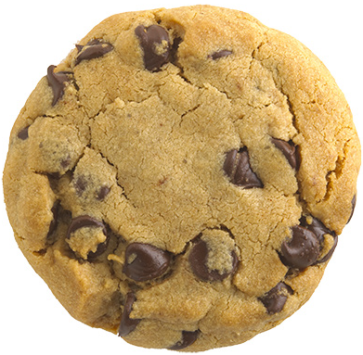
Passive Reinforcement Learning
Transition
Model?
Two Approaches
Build a model
Model-free: directly estimate V^{π}
V^{π}(s₁)=1.8,
V^{π}(s₂)=2.5,…
State
Action
Reward model?
Agent
Remember, we know S and A, just not T and R.

Slide 3
Passive Reinforcement Learning
Assume MDP framework:
Model-based RL: Follow policy π, estimate T and R model.
Use estimated MDP to do policy evaluation of π.
Model-free RL: learn V^{𝝅} (s) table directly
Direct utility evaluation
Observe whole sequences and count and average V^{𝝅} (s)
Temporal difference learning
Sample of V(s):
Update to V(s):
Notes:
Policy is kept the same. Still doing evaluation.
For example, if V(1,3) = 0.84, and V(2,3) = 0.92, V(1,3) = -0.04 + V(2,3) if this happens all the time – not necessarily true. But if it does, then V(1,3) should be 0.88. So the current value of 0.84 is a bit low and should be increased.
V(s) <- V(s) + alpha (R + gamma(V(s’)) - V(s)).
Current sample - current belief on the expected value. If there is a difference, update, with certain learning rate, which should decrease over time.
Even though it should be over probability of transition states, (the actual equilibirum) rather than just the next state, it will converge because rare things do happen rarely. The average value of V will converge to the correct value. Also, alpha also needs to decrease over time. Does TD learning does not need a transition model to perform its update. Just observe what happen, and keep track of things.
Move Vs a bit toward the sample. Weighted average.

Slide 4
Active RL: Exploration issues
Consider acting randomly in the world
Can such experience allow the agent to learn the optimal values and policy?

Slide 5
Model-Based active RL w/Random Actions
Choose actions randomly
Estimate MDP model parameters given observed transitions and rewards
If finite set of states and actions, can just count and average counts
Use estimated MDP to compute estimate of optimal values and policy
Will the computed values and policy converge to the true optimal values and policy in the limit of infinite data?
Notes:
Infnite data of all the states, as long as all states can be reached.
Are their scenario not all states can be reached? Crashing.

Slide 6

Reachability
When acting randomly forever, still need to be able to visit each state and take each action many times
Want all states to be reachable from any other state
Quite mild assumption but doesn’t always hold
Notes:
If al the states are reachable from all the other states, in a finite number of steps, then your MDP will converge to the true models and get the optimal
But in real domain, a lot of actions can be get into absorbing states, then you can’t do much.

Slide 7
Model-Free Learning with Random Actions?
Model-free temporal-difference learning for policy evaluation:
As act in the world, go through (s,a,r,s’,a’,r’,…)
Update V^{π} estimates at each step
Over time updates mimic Bellman updates
Sample of V^{π}(s):
Update to V^{π}(s):
Slide adapted from Klein and Abbeel

Slide 8
Q-Learning
Running estimate of state-action Q values (instead of V in TD learning).
Observe R and s’
Update Q(s,a) every time experience (s,a,s’,r(s,a,s’))
Consider old estimate Q(s,a)
Create new sample estimate
Update estimate of Q(s,a)
Notes:
Similar to TD learning but change policy over time. But you can change the policy over time. Sample Q a’ might not be
Use that to optimize your Q(s,a). Not just your values based on policy but can change your acton.
Update to estiamte Q(s,a).
a’ what would be the best thing you would o if you are in that state, not necessarily what is in the policy.

Slide 9
Q-Learning
Update Q(s,a) every time experience (s,a,s’,r(s,a,s’))
Intuition: using samples to approximate
Future rewards
Expected reward over next states -- don’t know T.
Notes:
We are using to approximate the future reward and expectation over the next states. Sampling repeatedly will yield a expectation.
Empirically driven way to do that.
Be careful how you set alpha. Set alpha = 0, won’t learn anymore. Q won’t change.
Sufficient to set alpha = 1/n.

Slide 10
Q-Learning: TD state-action learning
Any
exploration
policy
Update Q estimate with the sample data but according to a greedy policy for action selection (take the max) ≠ from behavior policy
or keep acting forever, or termination criterion
Notes:
Is this on or off policy learning?

Slide 11
Q-Learning Example
a₁₂
a₂₃
S1 | S2 | S3
S4 | S5 | S6: END
a₁₄
a₂₁
a₂₅
a₃₂
a₃₆
a₄₁
a₅₂
a₄₅
a₅₆
a₅₄
6 states, S1,..S6
12 actions a_{ij} for state transitions, deterministic
R=100 in S6 (terminal state), R=0 otherwise
𝛾=0.5, 𝛼 = 1
Random behavior policy

Slide 12
Initial state
a₁₂
a₂₃
S1 | S2 | S3
S4 | S5 | S6: END
a₁₄
a₂₁
a₂₅
a₃₂
a₃₆
a₄₁
a₅₂
a₄₅
a₅₆
a₅₄

Slide 13
New state, Update
a₁₂
a₂₃
S1 | S2 | S3
S4 | S5 | S6: END
a₁₄
a₂₁
a₂₅
a₃₂
a₃₆
a₄₁
a₅₂
a₄₅
a₅₆
a₅₄

Slide 14
New Action
a₁₂
a₂₃
S1 | S2 | S3
S4 | S5 | S6: END
a₁₄
a₂₁
a₂₅
a₃₂
a₃₆
a₄₁
a₅₂
a₄₅
a₅₆
a₅₄

Slide 15
New State, Update
a₁₂
a₂₃
S1 | S2 | S3
S4 | S5 | S6: END
a₁₄
a₂₁
a₂₅
a₃₂
a₃₆
a₄₁
a₅₂
a₄₅
a₅₆
a₅₄

Slide 16
New Action
a₁₂
a₂₃
S1 | S2 | S3
S4 | S5 | S6: END
a₁₄
a₂₁
a₂₅
a₃₂
a₃₆
a₄₁
a₅₂
a₄₅
a₅₆
a₅₄

Slide 17
New State, Update
a₁₂
a₂₃
S1 | S2 | S3
S4 | S5 | S6: END
a₁₄
a₂₁
a₂₅
a₃₂
a₃₆
a₄₁
a₅₂
a₄₅
a₅₆
a₅₄

Slide 18
New Episode
a₁₂
a₂₃
S1 | S2 | S3
S4 | S5 | S6: END
a₁₄
a₂₁
a₂₅
a₃₂
a₃₆
a₄₁
a₅₂
a₄₅
a₅₆
a₅₄

Slide 19
New State, Update
a₁₂
a₂₃
S1 | S2 | S3
S4 | S5 | S6: END
a₁₄
a₂₁
a₂₅
a₃₂
a₃₆
a₄₁
a₅₂
a₄₅
a₅₆
a₅₄

Slide 20
After many episodes …
The optimal Q-values for the discount factor 𝛾=0.5
a₁₂
a₂₃
S1 | S2 | S3
S4 | S5 | S6: END
a₁₄
a₂₁
a₂₅
a₃₂
a₃₆
a₄₁
a₅₂
a₄₅
a₅₆
a₅₄

Slide 21
Q-Learning Properties
If acting randomly, Q-learning converges to optimal state—action values, and also therefore finds optimal policy
Off-policy learning
Can act in one way
But learning values of another policy (the optimal one!)
Acting randomly is sufficient, but not necessary, to learn the optimal values and policy
Notes:
Need to try actions in every state.

Slide 22
On-Policy / Off-policy RL learning
An Active RL agent can have two (different) policies:
Behavior policy → Used to generate actions (⟷ Interact with environment to gather sample data)
Learning policy → Target action policy to learn (the “good”/optimal policy the agent eventually aims to discover through interaction)
If Behavior policy = Learning policy → On-policy learning
If Behavior policy ≠ Learning policy → Off-policy learning

Slide 23
Leveraging Learned Values
Initialize s to a starting state
Initialize Q(s,a) values
For t=1,2,…
Choose a = argmax Q(s,a)
Observe s’,r(s,a,s’)
Update/Compute Q values (using model-based or Q-learning approach)
Always follow the current optimal policy.
Notes:
This is good because using knowledge to try to gain reward. But will this always work?

Slide 24
Is this Approach Guaranteed to Learn Optimal Policy?
Initialize s to a starting state
Initialize Q(s,a) values
For t=1,2,…
Choose a = argmax Q(s,a)
Observe s’,r(s,a,s’)
Update/Compute Q values (using model-based or Q-learning approach)
1. Yes 2. No 3. Not sure

Slide 25
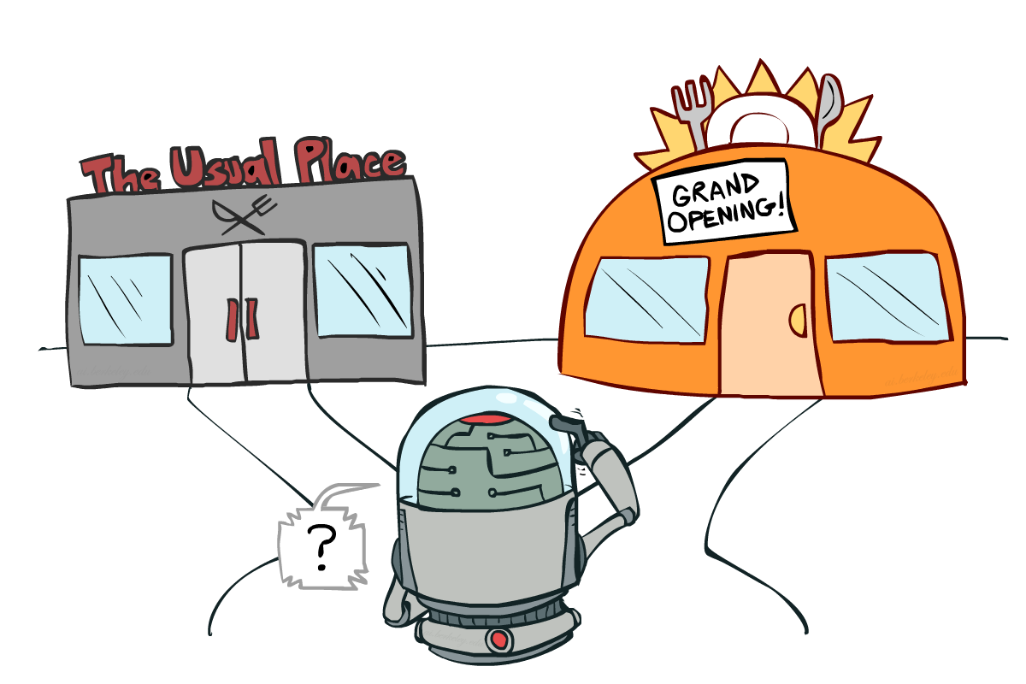
To Explore or Exploit?
Slide adapted from Klein and Abbeel

Slide 26
Simple Approach: E-greedy
With probability 1-e
Choose argmax_{a} Q(s,a)
With probability e
Select random action
Guaranteed to compute optimal policy
Does this make sense? How you would like to modify it?
Notes:
Good idea? Limitations?
But even after millions of steps still won’t always be following policy compute (the argmax Q(s,a))

Slide 27
Greedy in Limit of Infinite Exploration (GLIE)
E-Greedy approach
But decay epsilon over time
Eventually will be following optimal policy almost all the time

Slide 28
Alternative way to learn Q
You can learn Q(s,a) table explicitly using this approach.
But there is a scaling-up problem (many S, and A).
You can also use Neural Network to learn a mapping to Q – functional approximation.

Slide 29
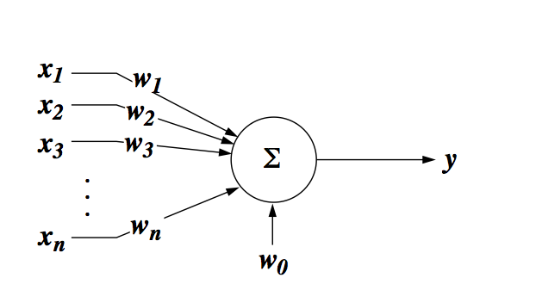

Neural Network: McCulloch-Pitts neuron
Notes:
What kind of input does this neuron like the best?
What does this neuron do?
What kinds of input this neuron will like the best?
When x matches w, but i.e. what will maximize w.x + w_0?
Keeping |x| a constant, or normalized.
W^tX = |W||x| cos theta.

Slide 30

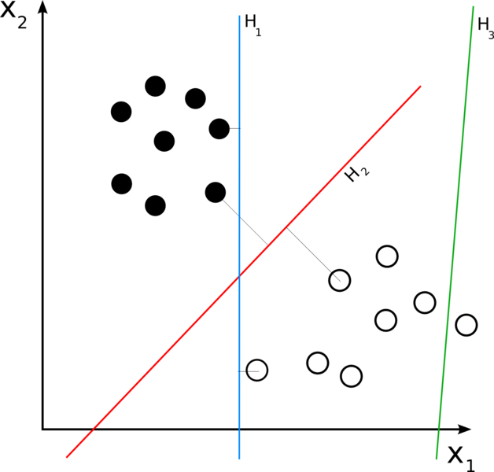
Binary (Linear) Classifier:
-
The operation of a ‘neuron’, as a linear classifier, is to split a high-D input space (|x| high) with a hyperplane (2D a line, 3D a plane etc) into two halves . All points on one side of the hyperplane will be classified as 1, the other side classified as 0.
Notes:
It is a type of linear classifier, i.e. a classification algorithm that makes its predictions based on a linear predictor functioncombining a set of weights with the feature vector. The algorithm allows for online learning, in that it processes elements in the training set one at a time.

Slide 31
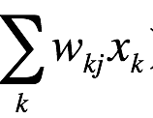
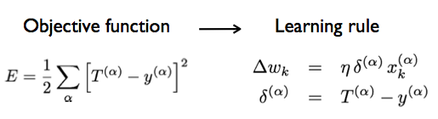
Delta rule: supervised learning
Linear
=

Slide 32
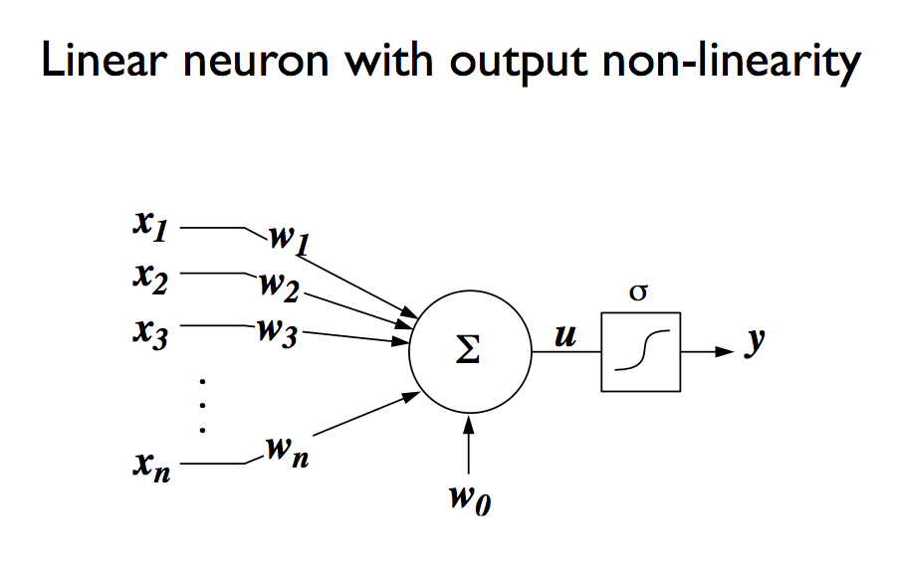
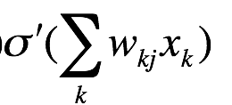
Linear neuron with output nonlinearity – for making decision decision
=

Slide 33
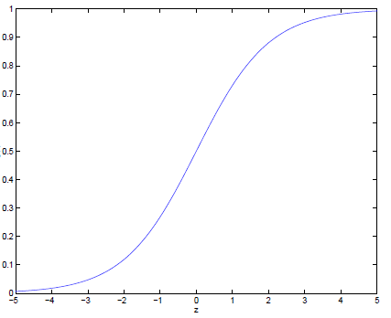

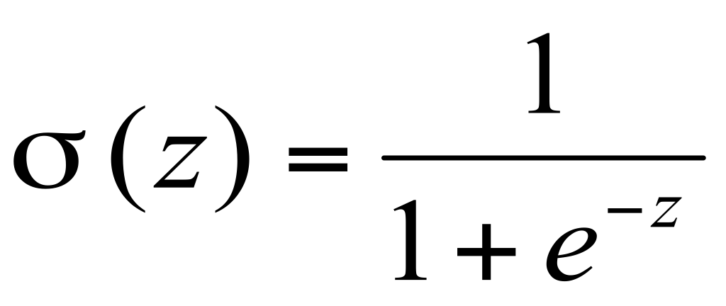

Threshold: Sigmoid function
Notice σ(x) is always bounded between [0,1] (a nice property)
and as z increases σ(z) approaches 1, as z decreases σ(z) approaches 0

Slide 34
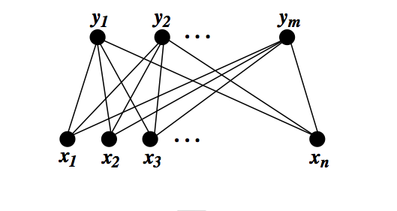
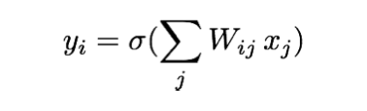
Single layer perceptron
sigmoid neuron learning rule:

Slide 35
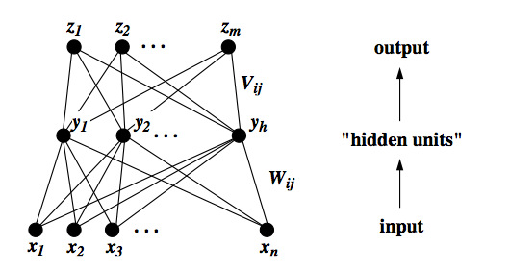
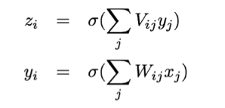
Two-layer (multi-layer) perceptron
Notes:
Bottom-neck, squeeze representations. Why do you need hidden layers?
A Multi-layer perceptron using a linear transfer function has an equivalent single-layer network; a non-linear function is therefore necessary to gain the advantages of a multi-layer network.

Slide 36
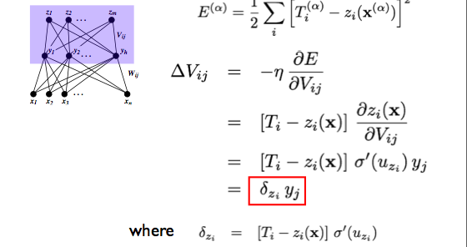

Learning rule for output layer

Slide 37
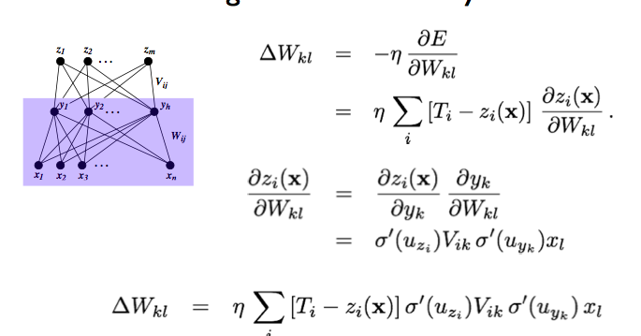
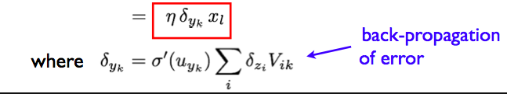
Backpropagation Learning rule for hidden layer
Notes:
Statistical learning theory is a framework for machine learning drawing from the fields of statistics and functional analysis.^{[1][2]} Statistical learning theory deals with the problem of finding a predictive function based on data. Statistical learning theory has led to successful applications in fields such as computer vision, speech recognition, bioinformatics and baseball.^{[3]}

Slide 38



Putting things together in Flappy Bird
At each time step, given state s, select action a.
Observe new state s’ and reward.
Q learning approximates maximum expected return for performing a at state s based on Q state-action value function.
Q action value function at state s is:
Based on current knowledge of Q (embedded in NN)
Notes:
The intuition behind reinforcement learning is to continually update the action-value function based on observations using the Bellman equation. It has been shown by Sutton et al 1998 [2] that such update algorithms will converge on the optimal action-value function as time approaches infinity. Based on this, we can define Q as the output of a neural network, which has weights θ, and train this network by minimizing the following loss function at each iteration i:

Slide 39



Neural network learns to associate every state with a Q(s,a) function. The flappy bird network has two Q nodes, one for a (press button), and one for a’ (not pressing). They are the values of the two actions at state s.
The network (with parameters θ) is trained by minimizing the following cost function:
where y_{i} is the target function we want to approach during each iteration (time step).
Hit the pipe r = -1000
Notes:
The intuition behind reinforcement learning is to continually update the action-value function based on observations using the Bellman equation. It has been shown by Sutton et al 1998 [2] that such update algorithms will converge on the optimal action-value function as time approaches infinity. Based on this, we can define Q as the output of a neural network, which has weights θ, and train this network by minimizing the following loss function at each iteration i:

Slide 40
At each step, compute using NN to Q associated with the two actions.
The bird moves to state s’, it observes the immediate reward (r = 1 if alive, r = 10 if alive and stay between the gap of two pipes ahead), and calculates max(Q(s’, a’) based on the current network to compute Q* or y,
Use y = R + max(Q) as teaching signal to train the network by clamping y to the output node corresponding to the action we took.
Notes:
The intuition behind reinforcement learning is to continually update the action-value function based on observations using the Bellman equation. It has been shown by Sutton et al 1998 [2] that such update algorithms will converge on the optimal action-value function as time approaches infinity. Based on this, we can define Q as the output of a neural network, which has weights θ, and train this network by minimizing the following loss function at each iteration i:

