Slide 1
Markov Decision Processes
Tai Sing Lee
15-381/681 AI Lecture 14
Read Chapter 17.1-3 of Russell & Norvig
With thanks to Dan Klein, Pieter Abbeel (Berkeley), and Past 15-381 Instructors for slide contents, particularly Ariel Procaccia, Emma Brunskill and Gianni Di Caro.
Notes:
Syntax = the grammatical arrangement of words in sentences
a systematic orderly arrangement
Semantics: the meaning of a word, phrase, sentence, or text

Slide 2
Decision-Making, so far …
Known environment
Full observability
Deterministic world
Plan: Sequence of actions with deterministic consequences, each next state is known with certainty
Stochastic
Sensors
Percepts
Agent
Environment
Actuators
Actions

Slide 3
Markov Decision Processes
Sequential decision problem for a fully observable, stochastic environment
Markov transition model and additive reward
Consists of
A set S of world states (s, with initial state s₀)
A set A of feasible actions (a)
A Transition model P(s’|s,a)
A reward or penalty function R(s)
Start and terminal states.
Want optimal Policy: what to do at each state
Choose policy depends on expected utility of being in each state.
Notes:
Reflex agent – deterministic decision (stochastic outcome)

Slide 4
Markov Property
Assume that only the current state and action matters for taking a decision
-- Markov property (memoryless):

Slide 5
Actions’ outcomes are usually uncertain in the real world!
Action effect is stochastic: probability distribution over next states
Need a sequence of actions (decisions):
Outcome can depend on all history of actions:
MDP Goal: find decision sequences that maximize a given function of the rewards

Slide 6
Stochastic decision - Expected Utility
Money state(t+1)
Money state(t)
Example adapted from M. Hauskrecht

Slide 7
Expected utility (values)
How a rational agent makes a choice,
given that its preference is to make money?

Slide 8
Expected values
X = random variable representing the monetary outcome for taking an action, with values in 𝛺_{X} (e.g., 𝛺_{X} = {110, 90} for action Stock 1)
Expected value of X is:
Expected value summarizes all stochastic outcomes into a single quantity

Slide 9
Expected values

Slide 10
Optimal decision
The optimal decision
is the action that maximizes the expected
outcome

Slide 11
Where do probabilities values come from?
Models
Data
For now assume we are given the probabilities for any chance node
max
chance

Slide 12
Markov Decision Processes (MPD)
Goal: define decision sequences that
maximize a given function of the rewards
Notes:
Markov decision process (MDP)
Markov reward process MDP ∖ {Actions}
Markov chain: MDP ∖ {Actions} ∖ {Rewards}
All share the state set and the transition matrix, that defines the internal stochastic dynamics of the system

Slide 13
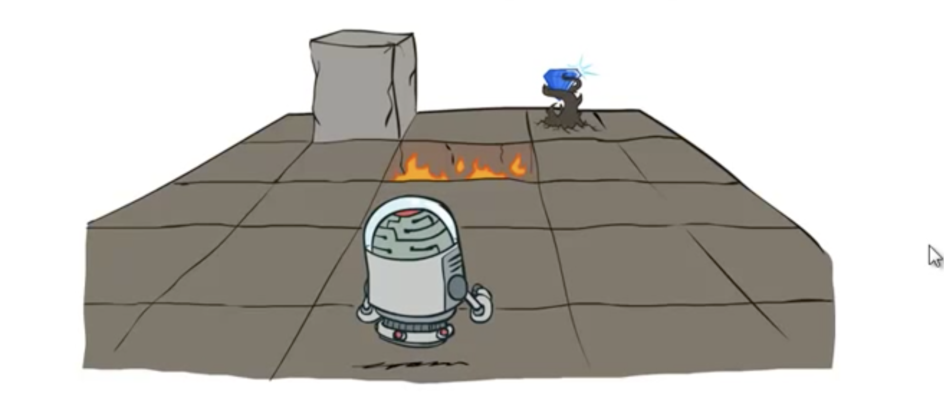
Slide adapted from Klein and Abbeel

Slide 14
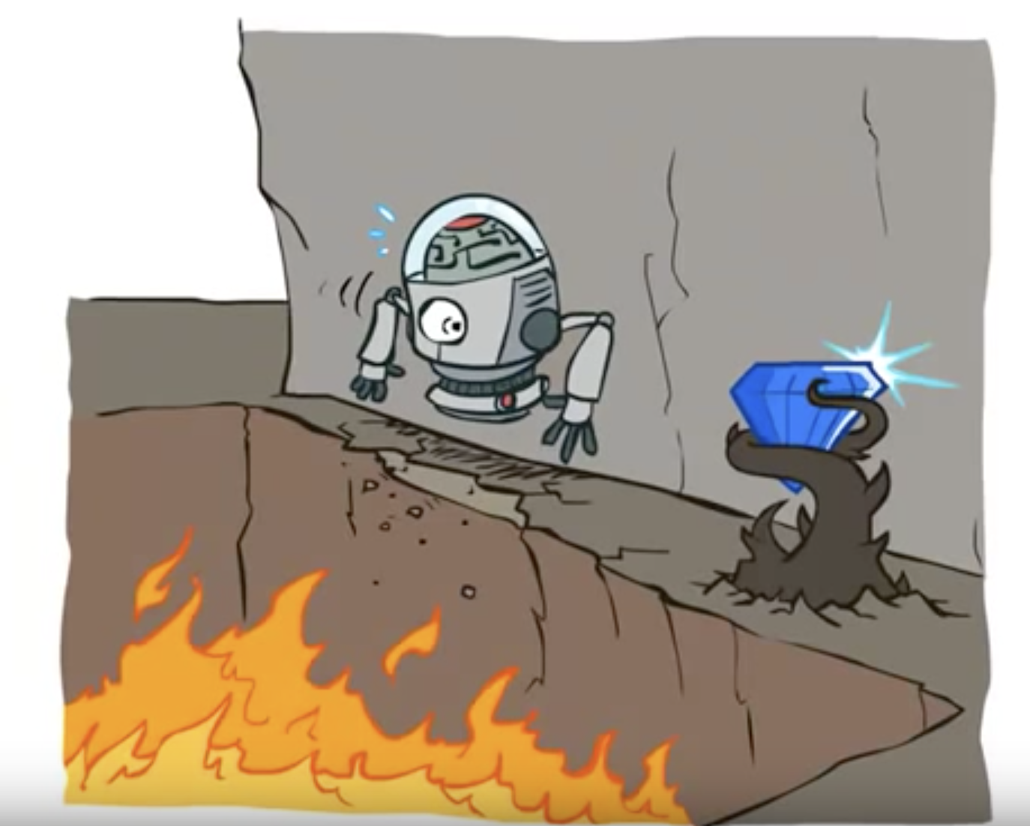
Slide adapted from Klein and Abbeel

Slide 15
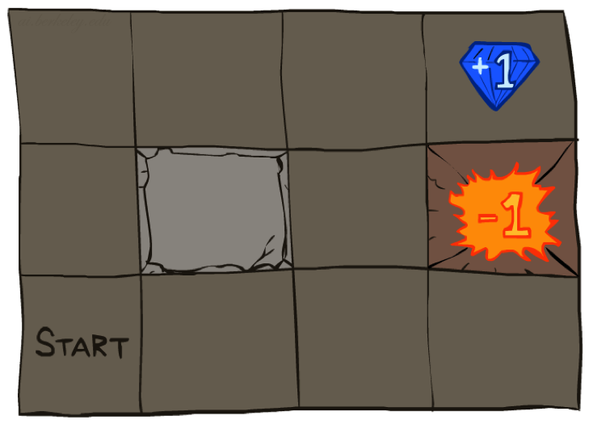




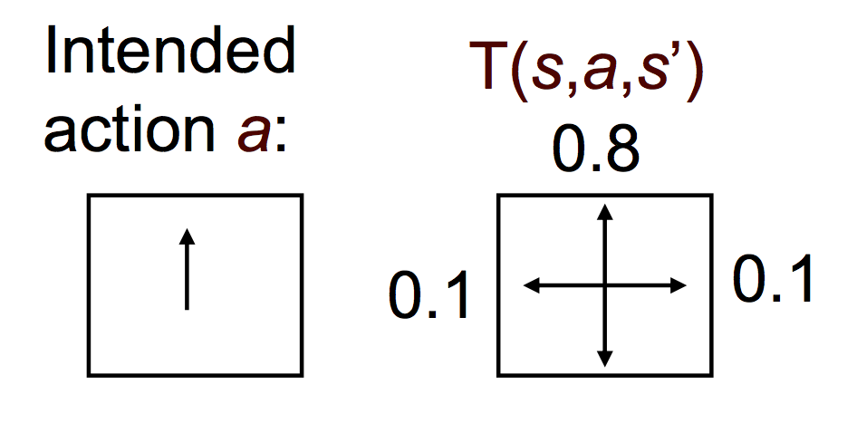
Example: Grid World
A maze-like problem
The agent lives in a grid
Walls block the agent’s path
The agent receives rewards each time step
Small “living” reward (+) or cost (-) each step
Big rewards come at the end (good or bad)
Goal: maximize sum of rewards
Noisy movement: actions do not always go as planned
80% of the time, the action takes the agent in the desired direction (if there is no wall there)
10% of the time, the action takes the agent to the direction perpendicular to the right; 10% perpendicular to the left.
If there is a wall in the direction the agent would have gone, agent stays put
Slide adapted from Klein and Abbeel

Slide 16
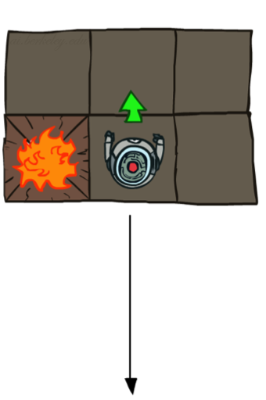
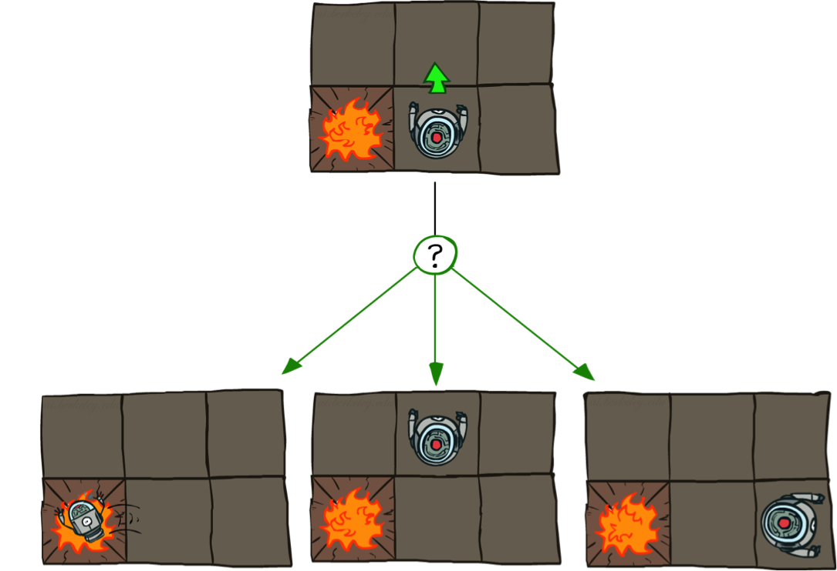
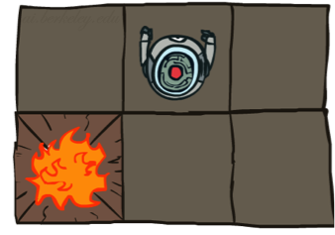
Grid World Actions
Deterministic Grid World
Stochastic Grid World
0.1 0.8 0.1
Slide adapted from Klein and Abbel

Slide 17
Policies
In deterministic single-agent search problems, we wanted an optimal plan, or sequence of actions, from start to a goal
In MDPs instead of plans, we have a policies
A policy π*: S → A
Specifies what action to take in each state
Slide adapted from Klein and Abbeel
Notes:
An optimal policy is one that maximizes expected utility if followed
An explicit policy defines a reflex agent
Expectimax didn’t compute entire policies
It computed the action for a single state only
In deterministic single-agent search problems, we wanted an optimal plan, or sequence of actions, from start to a goal
In MDPs, we have a policy, a mapping from states to actions: π: S → A
π(s) specifies what action to take in each state → deterministic policy
An explicit policy defines a reflex agent
A policy can also be stochastic, π(s,a) specifies the probability of taking action a in state s (in MDPs, if R is deterministic, the optimal policy is deterministic)

Slide 18
How Many Policies?
How many non-terminal states?
How many actions?
How many deterministic policies over non-terminal states?
Notes:
9, 4, 4⁹

Slide 19
Utility of a Policy
Starting from s_{0,} applying the policy π, generates a sequence of states s₀, s₁, … s_{t}, and of rewards r₀, r₁, … r_{t}
Each sequence has an utility
“Utility is an additive combination of the rewards”
The utility, or value of a policy π starting in state s₀ is the expected utility over all the state sequences generated by applying π

Slide 20
Optimal Policies
An optimal policy π* yields the maximal utility
The maximal expected sum of rewards from following a policy starting from the initial state
Principle of maximum expected utility: a rational agent should choose the action that maximizes its expected utility

Slide 21
Optimal Policies depend on Reward and Action Consequences
Uniform living cost (negative reward) R(s) = -0.01
That is the cost of being any given state.
What should the robot do in each state? There are 4 choices.
Notes:
R(s) = the “living reward”
Or living cost to be in each slot’s state. The more negative number, the more anxious he wants to move toward exit.
When R(s) > 0, perceptual student analogy.

Slide 22
Optimal Policies
R(s) = -0.01
R(s) = -0.04
✦
R(s) is assumed to be uniform living cost (condition)
Why are they difference?
Notes:
R(s) = the “living reward”
Or living cost to be in each slot’s state. The more negative number, the more anxious he wants to move toward exit.
When R(s) > 0, perceptual student analogy.
Balance between risk and reward changes depending on the value of R(s)

Slide 23
Optimal Policies
Pool 1:
Which of the following are the optimal policies for R(s) < -2 and R(s) > 2?
R(s) = ?
R(s) = ?
R(s) =?
A B C
R(s) < -2 is for A R(s)> 2 is for B
R(s) < -2 is for B R(s)> 2 is for C
R(s) < -2 is for C R(s)> 2 is for B
R(s) < -2 is for B R(s)> 2 is for A
Notes:
R(s) = the “living reward”
Or living cost to be in each slot’s state. The more negative number, the more anxious he wants to move toward exit.
When R(s) > 0, perceptual student analogy.

Slide 24
Optimal Policies
R(s) = -0.01
R(s) = -0.04
✦
Balance between risk and reward changes depending on the value of R(s)
R(s) = -0.4
R(s) = -2.0
R(s) > 0
Notes:
R(s) = the “living reward”
Or living cost to be in each slot’s state. The more negative number, the more anxious he wants to move toward exit.
When R(s) > 0, perceptual student analogy.

Slide 25
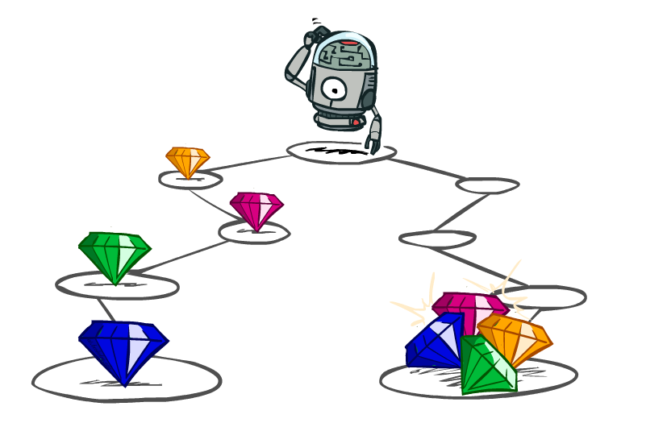
Utilities of Sequences
What preferences should an agent have over reward sequences?
More or less?
Now or later?
[1, 2, 2]
or
[2, 3, 4]
[0, 0, 1]
or
[1, 0, 0]
Slide adapted from Klein and Abbeel

Slide 26
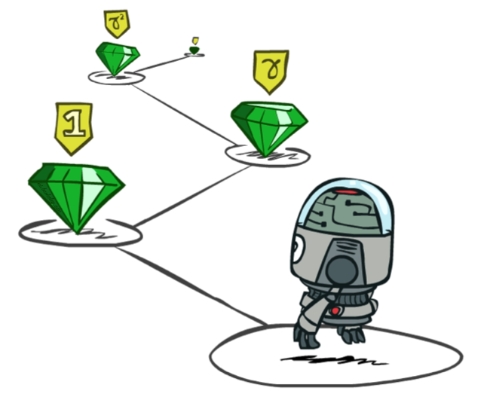
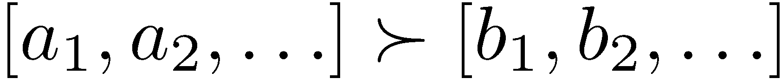
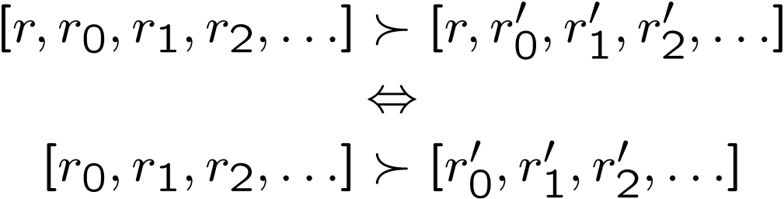
Stationary Preferences
Theorem: if we assume stationary preferences between sequences:
Two ways to define utilities over sequences of rewards
Additive utility:
Discounted utility:
Klein and Abbeel

Slide 27

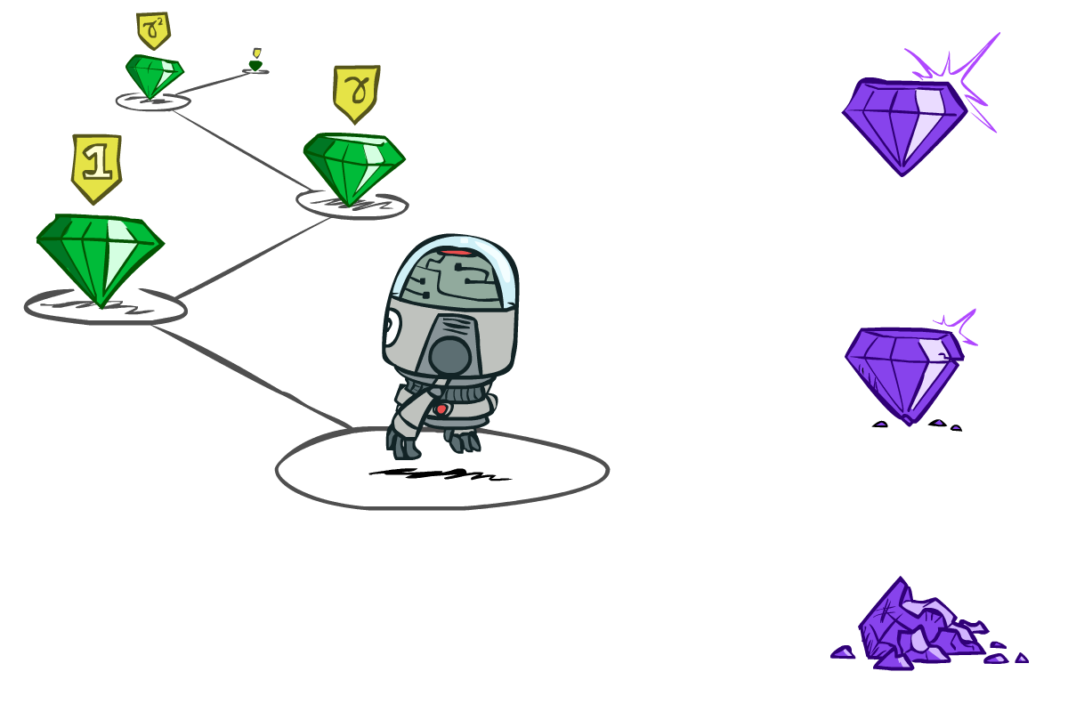

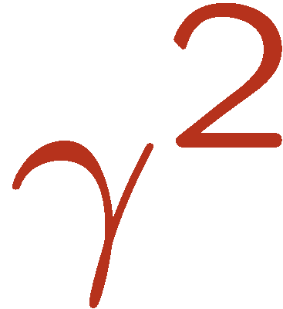

What are Discounts?
It’s reasonable to prefer rewards now to rewards later
Decay rewards exponentially
Worth Now
Worth Next Step
Worth In Two Steps
Klein and Abbeel

Slide 28

Discounting
Given:
Actions: East, West
Terminal states: a and e (end when reach one or the other)
Transitions: deterministic
Reward for reaching a is 10
reward for reaching e is 1, and the reward for reaching all other states is 0
For γ = 1, what is the optimal policy?

Slide 29
Discounting
Given:
Actions: East, West
Terminal states: a and e (end when reach one or the other)
Transitions: deterministic
Reward for reaching a is 10
reward for reaching e is 1, and the reward for reaching all other states is 0
For γ = 1, what is the optimal policy?

Slide 30
Discounting
Given:
Pool 2: For γ = 0.1, what is the optimal policy for states b, c and d?
Optimal Policy (move toward E (east), W (west)?) .
b c d
E E W
E E E
E W E
W W E
W W W
Notes:
B C D
E E W
E E E
E W E
W W E
W W W

Slide 31
Discounting
Given:
Actions: East, West
Terminal states: a and e (end when reach one or the other)
Transitions: deterministic
Reward for reaching a is 10
reward for reaching e is 1, and the reward for reaching all other states is 0
Pool 1: For γ = 0.1, what is the optimal policy for states b, c and d?
Notes:
B C D
E E W
E E E
E W E
W W E
W W W

Slide 32
Discounting
Given:
Actions: East, West
Terminal states: a and e (end when reach one or the other)
Transitions: deterministic
Reward for reaching a is 10
reward for reaching e is 1, and the reward for reaching all other states is 0
Quiz : For which γ are West and East equally good when in state d?

Slide 33
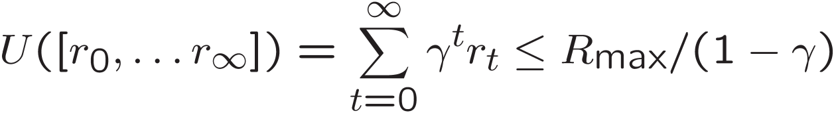
Infinite Utilities?!
Problem: What if the process lasts forever? Do we get infinite rewards?
Solutions:
Finite horizon: (similar to depth-limited search)
Terminate episodes after a fixed T steps (e.g. life)
Gives nonstationary policies (π depends on time left)
Discounting: use 0 < γ < 1
Smaller γ means smaller “horizon” – shorter term focus
Absorbing state: guarantee that for every policy, a terminal state will eventually be reached (like “overheated” for racing)
Slide adapted from Klein and Abbeel

Slide 34
Recap: Defining MDPs
Markov decision processes:
Set of states S
Start state s₀
Set of actions A
Transitions P(s’|s,a) (or T(s,a,s’))
Rewards R(s,a,s’) (and discount γ)
MDP quantities so far:
Policy π = Choice of action for each state
Utility/Value = sum of (discounted) rewards
Optimal policy π* = Best choice, that max Utility

Slide 35
What is the value of a policy?
The expected utility - value V^{π}(s) of a state s under the policy π is the expected value of its return, the utility of all state sequences starting in s and applying π
State
Value-function
Notes:
The rational agent tries to select actions so that the sum of the discounted rewards it receives over the future is maximized (i.e., its utility is maximized)
Expected immediate reward for taking action prescribed by policy
And expected future reward get after taking policy from that state and following π

Slide 36
Expected Utility: Value function

Slide 37
Bellman equation for Value function
Expected immediate reward (short-term) for taking action π(s) prescribed by π for state s + Expected future reward (long-term) get after taking that action from that state and following π

Slide 38
Bellman equation for Value function
How do we find V values for all states?
|S| linear equations in |S| unknowns

Slide 39
Optimal Value V* and π*
Optimal value: V* Highest possible expected utility for each s
Satisfies the Bellman Equation
Optimal policy
Want to find these optimal values!

Slide 40
Assume we know the utility (values) for the grid world states
V*
Given
𝛾=1, R(s)=-00.4
π
(π is also optimal)

Slide 41
Optimal V* for the grid world
For our grid world, here assume all R = 0,
V*(1,1) = R + 𝛾 max{u,l,d,r} [
{0.8V*(1,2) + 0.1V*(2,1) + 0.1V*(1,1)}, up
{0.9V*(1,1) + 0.1V*(1,2)}, left
{0.9V*(1,1) + 0.1V*(2,1)}, down
{0.8V*(2,1) + 0.1V*(1,2) + 0.1V*(1,1)} right
]
Plugging in V, we found up the best move,
Notes:
If we know V*, we know the best policy in each state.

Slide 42
Value Iteration
Bellman equation inspires an update rule
Also called Bellman Backup:
Notes:
So the Bellman Equation says that the first equation must hold for V* e g optimal value

Slide 43
Value Iteration Algorithm
Initialize V₀(s_{i})=0 for all states s_{i,} Set K=1
While k < desired horizon or (if infinite horizon) values have converged
For all s,
Extract Policy

Slide 44
Value Iteration on Grid World
R(s)=0
everywhere except at the terminal states
1 2 3
V_{k}(s) =0 at k=0
1 2 3 4
Example figures from P. Abbeel
Notes:
After the first step. N

Slide 46
Value Iteration on Grid World
Example figures from P. Abbeel

Slide 47
Value Iteration on Grid World
Example figures from P. Abbeel

Slide 48
Value Iteration on Grid World
Example figures from P. Abbeel

