Slide 1
CS 15-281:
AI: Representation and Problem Solving
Tuomas Sandholm
Jan 12th, 2026

Slide 2
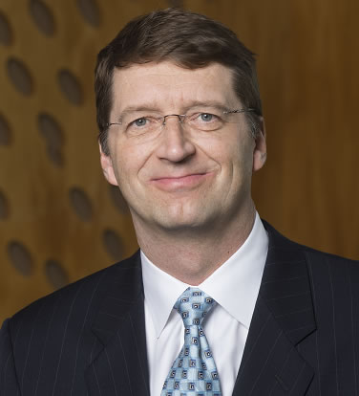


Course team
Professor
TAs
Tuomas Sandholm
Pranav
Sunny

Slide 3
Outline for today
Course logistics
What is AI?
History of AI
Current applications of AI
What is an agent?

Slide 4



Course Information
Website: www.cs.cmu.edu/~15281
Canvas: canvas.cmu.edu
Gradescope: gradescope.com
Communication: piazza.com/cmu/spring2026/15281/home
Please check website for: Prerequisites/Corequisites/Course Scope

Slide 5
Course Structure
Course will be taught through pre-recorded lectures from last year's version of this class (links on canvas/course website)
Scheduled class times will be used as office hours for students to ask questions
Ideally mostly about the corresponding lecture/related assignments
Please watch the assigned lecture before this!
Friday recitations (in person!) will be a review of lecture topics

Slide 6
Grading policy
Final scores will be composed of:
  15% Midterm 1
  15% Midterm 2
  30% Final exam
  20% Programming homework
  10% Written homework
  5% Online homework
  5% Recitation attendance
    5% for 10 or more recitations attended (out of 13)
    Linear scale between 0 (0%) and 10 (5%) recitations attended

Slide 7
Late Days
Late Days
Total 6 late days allowed for the semester
  At most 2 late days for any one homework
  There will be no questions asked for use of these late days
No further extensions will be granted unless there are extremely extenuating circumstances

Slide 8
Misc.
In-person office hours!
Email a TA if scheduled office hour times do not work for you
Lectures, handouts, and course notes will all be available on the website
Use the late days appropriately.

Slide 9
Announcements
Recitation starting this Friday
  Materials are fair game for exams
Assignments:
P0: Python & Autograder Tutorial (out tonight)
    Required, but worth zero points
    Due 1/23
HW1 (online) – out tonight
    Due 1/23
  Weekly Office hours (details on course website)
  Homework questions should generally be directed to TAs
  Instructors can offer more help in broader and conceptual questions, so their office hours are better used for that

Slide 10
Outline
Course logistics
What is AI?
History of AI
Current applications of AI
What is an agent?

Slide 11
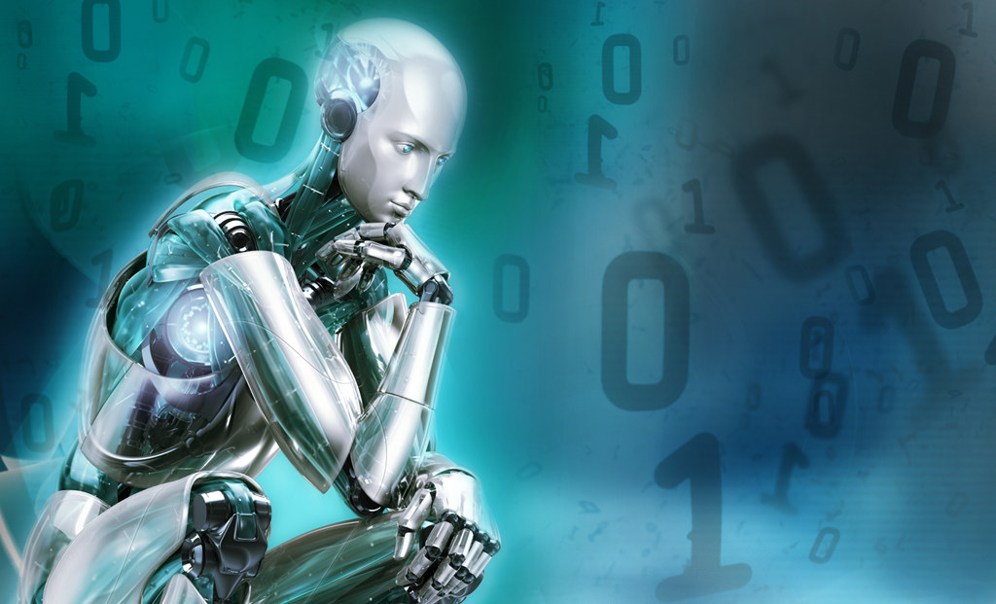
What is AI?

Slide 12
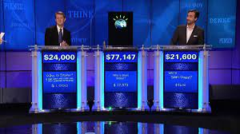
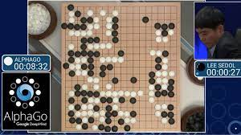

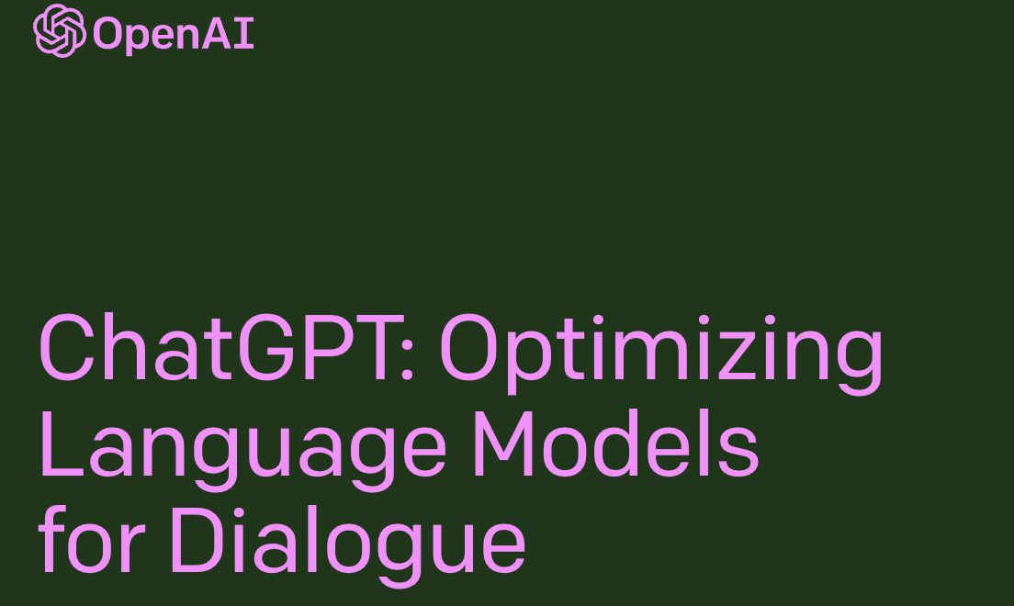
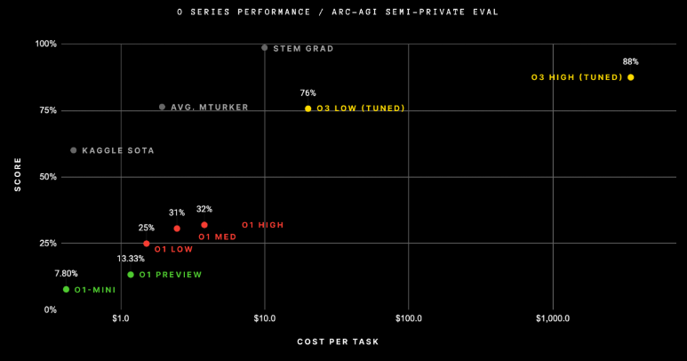
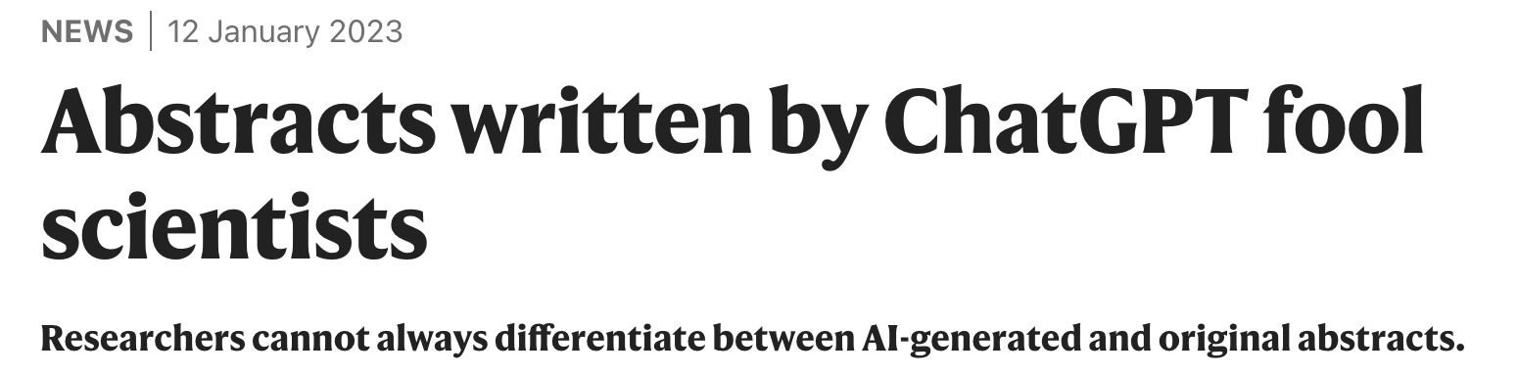
Measurable progress in AI

Slide 13
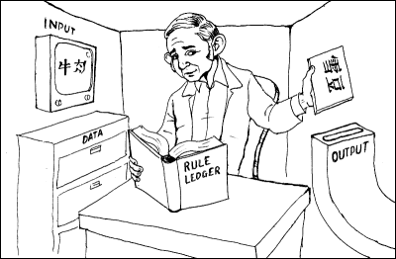
“Chinese room” argument [Searle 1980]
Person who knows English but not Chinese sits in room
Receives notes in Chinese
Has systematic English rule book for how to write new Chinese characters based on input Chinese characters, returns his notes
  Person=CPU, rule book=AI program, really also need lots of paper (storage)
  Has no understanding of what they mean
  But from the outside, the room gives perfectly reasonable answers in Chinese!
Searle’s argument: the room has no intelligence in it!
image from http://www.unc.edu/~prinz/pictures/c-room.gif

Slide 14
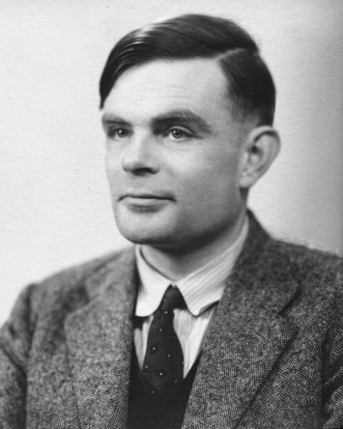
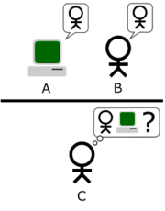
Turing Test
In 1950, Turing defined a test of whether a machine could “think”
“A human judge engages in a natural language conversation with one human and one machine, each of which tries to appear human. If judge can’t tell, machine passes the Turing test”
en.wikipedia.org/wiki/Turing_test
Notes:
Top left: Think like people --- cognitive science, neuroscience
Bottom left: act like people --- actually very early definition, dating back to Alan Turing --- Turing test; problem to do really well you start focusing on things like don’t answer too quickly what the square root of 1412 is, don’t spell too well, and make sure you have a favorite movie etc. So it wasn’t really leading us to build intelligence
Think rationally – long tradition dating back to Aristotle --- but not a winner, because difficult to encode how to think, and in the end it’s not about how you think, it’s about how you end up acting

Slide 15
Some classic definitions
Think like a human Cognitive science / neuroscience Does intelligence require biology? | Think rationally Logic and automated reasoning But, not all problems can be solved just by these techniques
Act like a human Turing test ELISA, Loebner prize “What is 1228 x 5873”? … “I don’t know, I’m just a human | Act rationally Basis for intelligent agents framework Unclear if this captures the current scope of AI research
Notes:
Four quadrant view – First quadrant: has been impactful in terms of forming the core of some our ideas. But we don’t necessarily have to tie ourselves to humans. This was the predominant view that is behind the advances via automated reasoning, logic etc. Seemed limiting to focus just on thinking-–we are agents that act and take actions. Turing test is great because it makes it clear how to check what the goal is. Loebner prize. Rusell and Norvig uses this framework. AI today is really very diverse and broader and has many different ways of connecting computers to intelligence

Slide 16
The pragmatist view
“AI is that which appears in academic conferences on AI”
Alternate definition: “AI is that which marketing departments call AI”

Slide 17
Paper titles in AAAI
1980s

Slide 18
Paper titles in AAAI
1990s

Slide 19
Paper titles in AAAI
2000s

Slide 20
Paper titles in AAAI
2010s

Slide 21
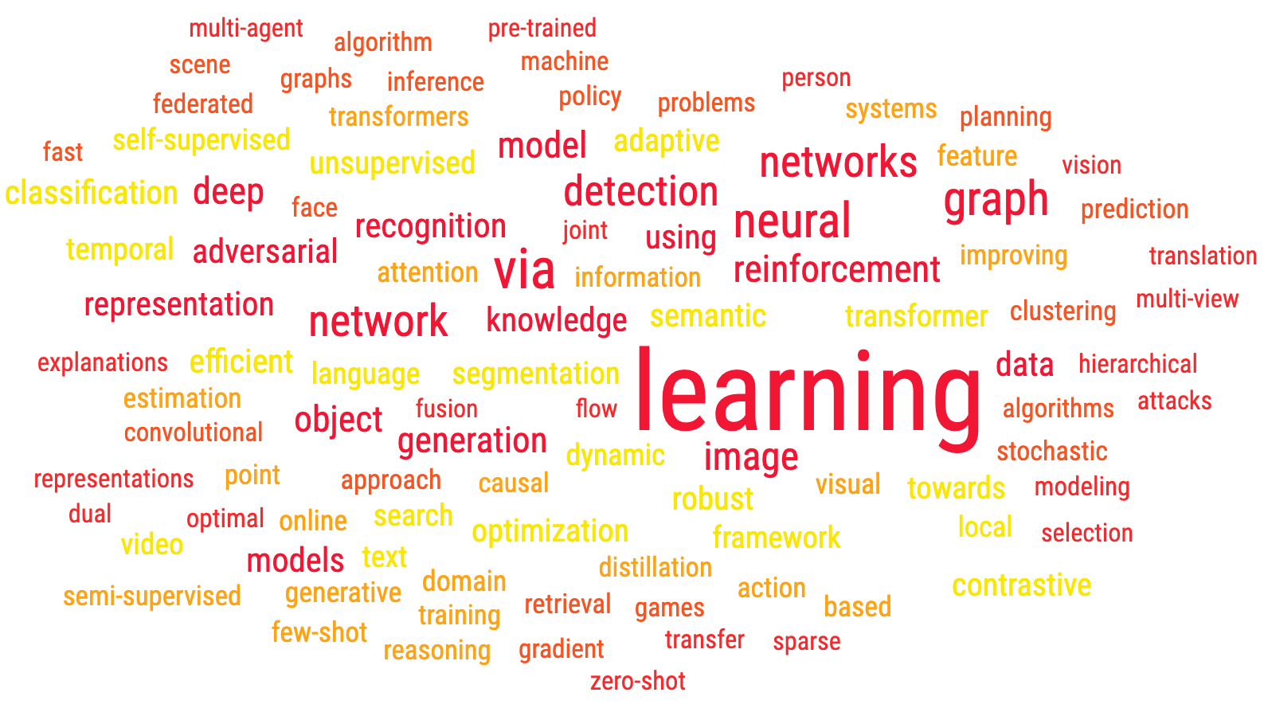
Paper titles in AAAI
2020s

Slide 22
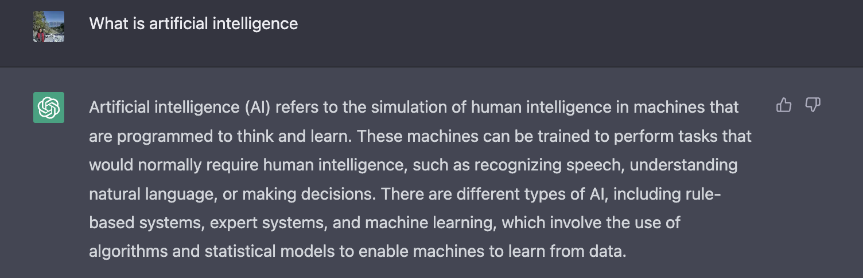
Let us ask chatGPT

Slide 23
A broader (but vague) definition
Artificial intelligence is the development and study of computer systems to address complex real-world problems typically associated with some form of intelligence

Slide 24
Outline
Course logistics
What is AI?
History of AI
Current applications of AI
What is an agent?

Slide 25
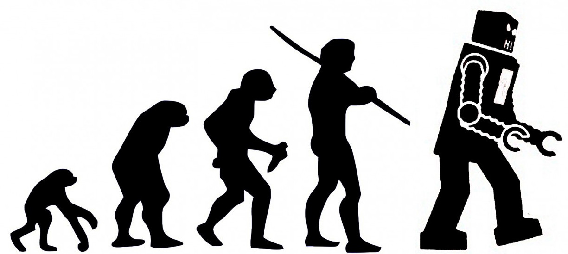
A brief history of AI

Slide 26
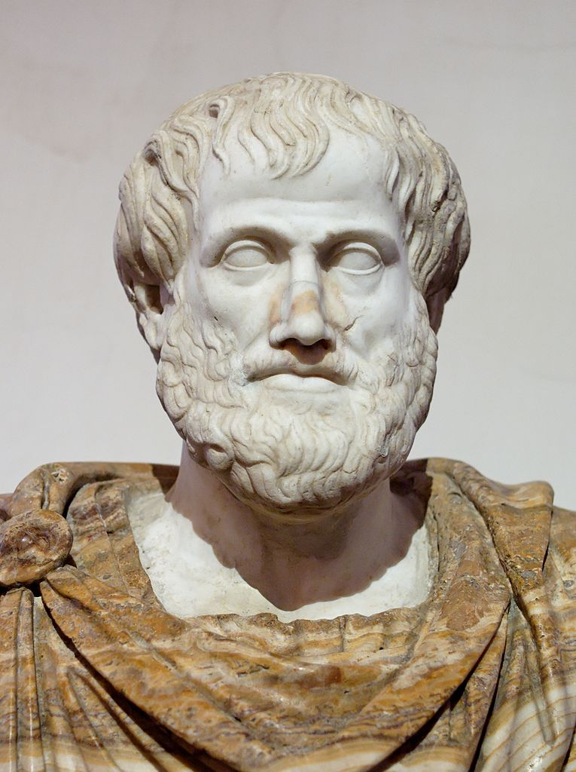
Prehistory (400 B.C -)
Philosophy: mind/body dualism, materialism
Mathematics: logic, probability, decision theory, game theory
Cognitive psychology
Computer engineering
Aristotle

Slide 27
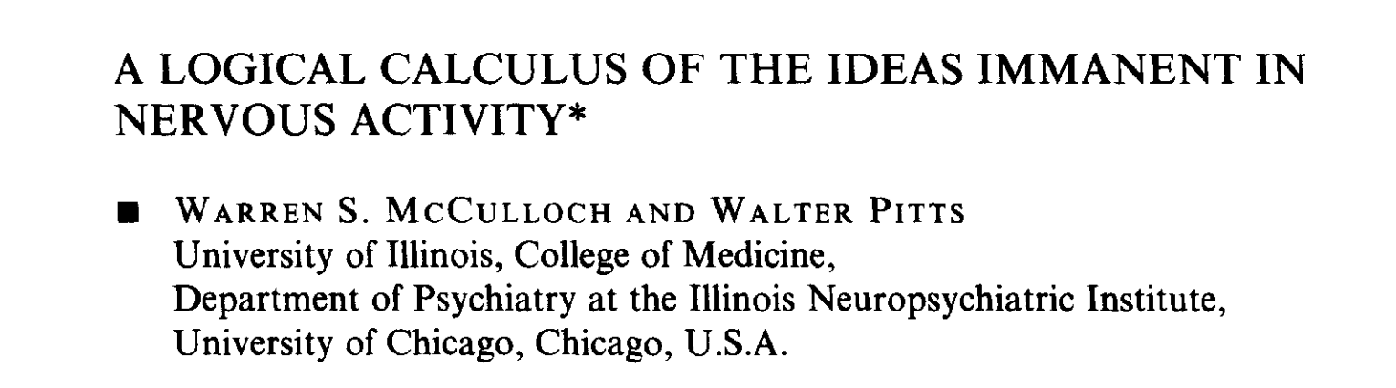
Birth of AI (1943 –1956)
[1943] McCullogh and Pitts: simple neural networks
  A computational model inspired by the brain

Slide 28
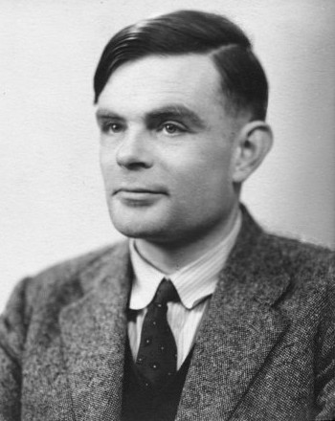
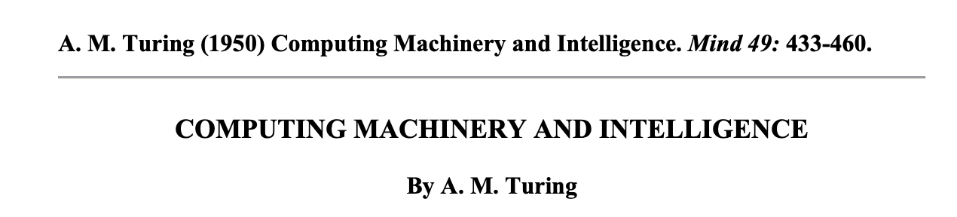
Birth of AI (1943 –1956)
[1943] McCullogh and Pitts: simple neural networks
[1950] Turing test

Slide 29
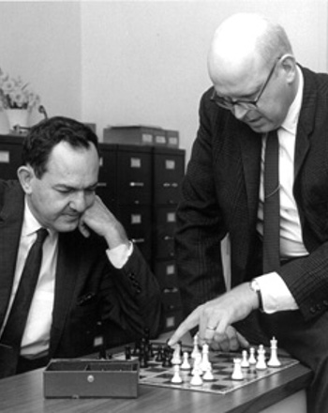
Birth of AI (1943 –1956)
[1943] McCullogh and Pitts: simple neural networks
[1950] Turing test
[1955-56] Newell and Simon: Logic Theorist
First program deliberately engineered to perform automated reasoning; eventually goes onto being called the first artificial intelligence program
Uses search + heuristics

Slide 30
Birth of AI (1943 –1956)
[1943] McCullogh and Pitts: simple neural networks
[1950] Turing test
[1955-56] Newell and Simon: Logic Theorist
[1956] Dartmouth workshop (coined the term artificial intelligence)

Slide 31
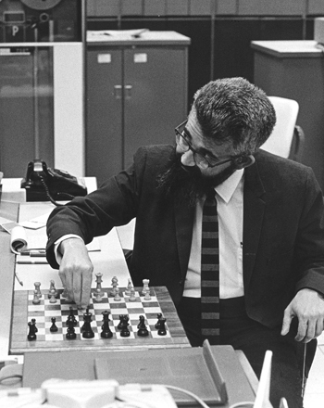
Birth of AI (1956 Dartmouth workshop)
1956: workshop at Dartmouth college; 11 attendees including John McCarthy, Marvin Minsky, Claude Shannon, Allen Newell and Herbert Simon
Aim for general principles: Every aspect of learning or any other feature of intelligence can be so precisely described that a machine can be made to simulate it
We think that a significant advance can be made in one or more of these problems if a carefully selected group of scientists work on it together for a summer
John McCarthy
Notes:
They sought generality, something that could do it all. This was motivated by the early successes which really kickstarted this field

Slide 32
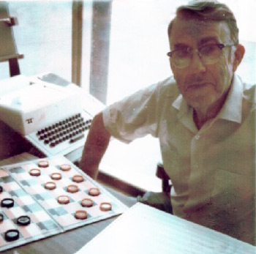
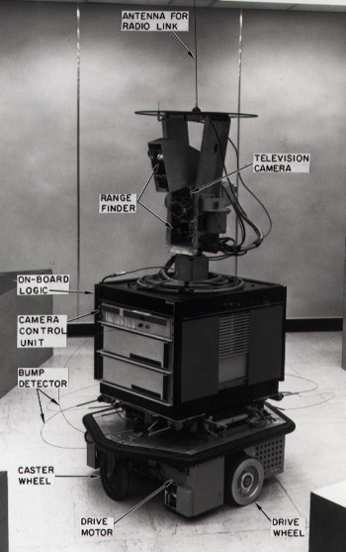
Early successes in AI (1950s – 60s)
[1952] Checkers: Arthur Samuel’s program learned weights via self-play and played at a strong amateur level
[1958] McCarthy LISP, advice taker, time sharing
[1968-72] Shakey the robot
[1971-74] Blocksworld planning and reasoning domain
Notes:
Shakey – robot at Stanford and SRI. Personal assistant robot

Slide 33
Early success in AI (1950s – 60s)
Overwhelming optimism
Machines will be capable of doing any work a man can do – Herbert Simon [1965]
Within a generation, I am convinced, few compartments of intellect will remain outside the machine’s realm—the problems of creating “artificial intelligence” will be substantially solved – Marvin Minsky [1960s]
I visualize a time when we will be to robots what dogs are to humans. And I am rooting for the machines – Claude Shannon

Slide 34
First AI winter (Later 1970s)
AI did not live up to the promise
1966 ALPAC report cut off funding for machine translation
  we will not suddenly or at least quickly attain machine translation
1973 LightHill report
  In no part of the field have the discoveries made so far produced the major impact that was then promised
1970s DARPA cut funding

Slide 35
What went wrong?
Limited compute: search space grows exponentially
Limited information about the complex world
How to address this? The answer at the time was knowledge-based systems or expert systems that encode prior knowledge
  Moved away from the optimism of generality…
Notes:
What went wrong? It turns out that the real world is very complex and most AI problems require a lot of compute and data.
The hardware at the time was simply too limited both compared to the human brain and computers available now. Also, casting problems as general logical reasoning meant that the approaches fell prey to the exponential search space, which no possible amount of compute could really fix.
Even if you had infinite compute, AI would not be solved. There are simply too many words, objects, and concepts in the world, and this information has to be somehow encoded in the AI system.
Though AI was not solved, a few generally useful technologies came out of the effort, such as Lisp (still the world's most advanced programming language in a sense).
One particularly powerful paradigm is the separation between what you want to compute (modeling) and how to compute it (inference).

Slide 36
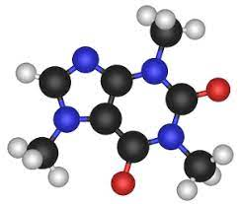
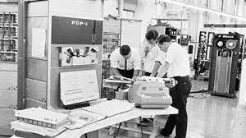
Knowledge based systems (1970s-80s)
[1971-74] Feigenbaum’s DENRAL to infer molecular structure from mass spectrometry
MYCIN: diagnose blood infections, recommend antibiotics
1981–Japan’s “fifth generation” computer project, intelligence computers running Prolog
[1982] XCON or R1 expert system to configure customer orders; deployed at DEC and saved $40 million a year
Notes:
Encode everything you know as logical rules (often written in LISP)
In the seventies and eighties, AI researchers looked to knowledge as a way to combat both the limited computation and information problems. If we could only figure out a way to encode prior knowledge in these systems, then they would have the necessary information and also have to do less compute.

Slide 37
Second AI winter (late 1980s to early 1990s)
Knowledge based systems also failed to deliver at the time
  Required considerable manual effort to develop and maintain
  “Knowledge acquisition bottleneck”
  Deterministic rules could not handle uncertainty
[1987] DARPA cuts AI funding for expert systems
[1991] Japan’s fifth generation project fails to meet goals
Notes:
This was the first time AI had a measurable impact on industry. However, the technology ran into limitations and failed to scale up to more complex problems. Due to plenty of overpromising and underdelivering, the field collapsed again.
Terry Winograd built a famous dialogue system called SHRDLU summed up well by the sentiment in this quote: the complex interactions between all the components made it too hard for mortals to even grasp. After that, he moved to Stanford and became an HCI professor.

Slide 38
Splintering & changing of AI, and cross-fertilization with other fields (mid 1990s-)
Many subfields and ideas: machine learning, computer vision, robotics, language processing, multiagent systems, ...
Ideas from different fields
  Bayes rule from probability
  Cross-fertilization between search in AI and integer programming in operations research
  Game theory from mathematics and economics
  Stochastic gradient descent from statistics
  Value iteration from control theory
  Artificial neural networks from neuroscience
AI becomes more mathematical
Statistical rigor starts to be required in experimental results

Slide 39
Beyond symbolic AI
Symbolic AI: top-down approach with a vision
Neural AI: bottoms-up approach inspired by the human mind
Neural AI had its own story with promise, successes, and winters

Slide 40
Phase one of neural AI
[1943] McCulloch/Pitts model for computation
[1958] Rosenblatt’s perceptron algorithm for binary classification
[1969] Perceptrons book showed that linear networks could not solve XOR <> part of the AI winter that killed neural net research

Slide 41
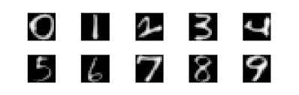
Phase two of neural AI
[1986] Popularization of the backpropagation algorithm (originally invented by Seppo Linnainmaa in 1972) for training multi-layer networks by Rumelhardt, Hinton, Williams
[1989] LeCun applied CNNs (pioneered previously by
CMU's Alex Waibel) for handwriting recognition
Was still hard to train very deep networks successfully---hence successes limited to simple tasks

Slide 42
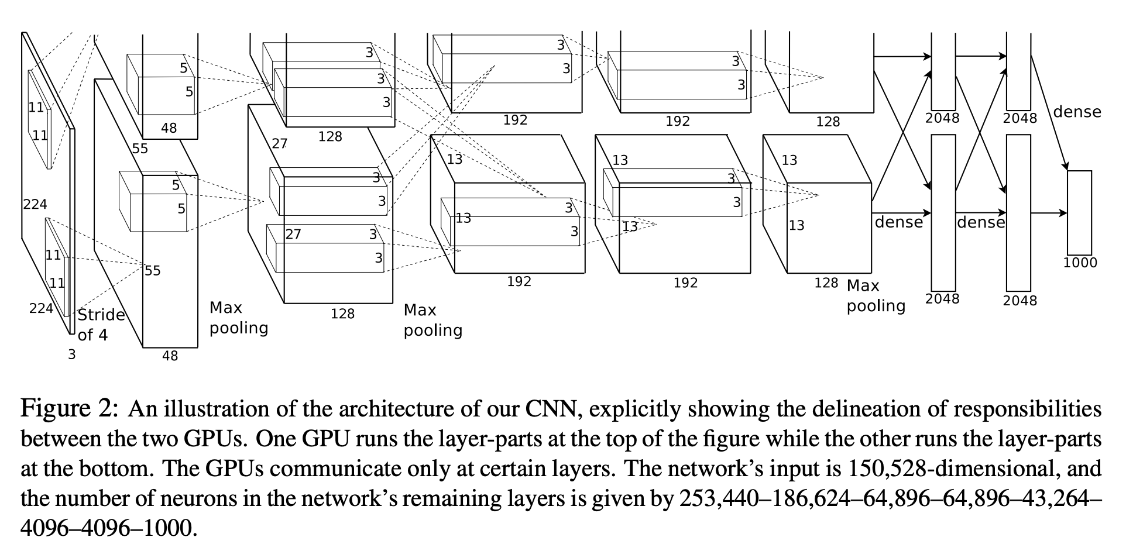
Phase three of neural AI
”AlexNet moment” [2012]: huge gains on a real-world image classification task by successfully training deep networks
  Large scale data (ImageNet) + GPUs + training heuristics
Notes:
Many other success stories in speech recognition and machine translation followed.

Slide 43
Phase three of neural AI
Ever larger amounts of data and compute (both offline and real time)
[2020] GPT-3 with 175B parameters, trained on about 45TB of text data from different datasets
[2024] Llama-3.1 was released on July 23, 2024, with three sizes: 8B, 70B, and 405B parameters

Slide 44
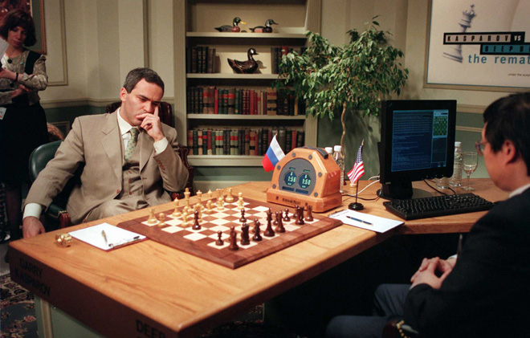
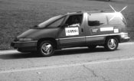
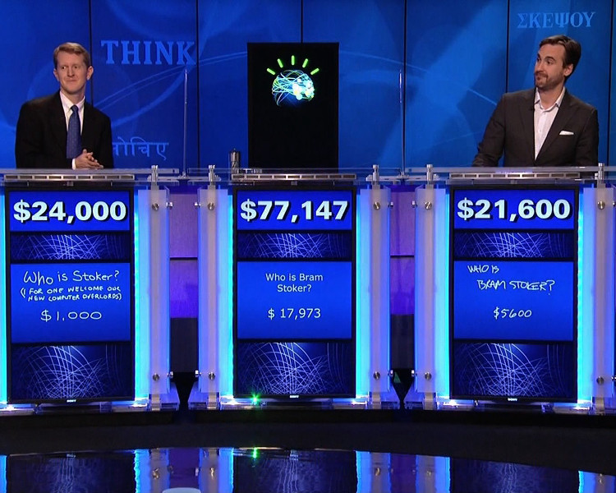
The AI renaissance
[1997] DeepBlue defeats Garry Kasparov
[1995] NavLab5 automobile drives across country 98% autonomously
[2005, 2007] Stanford and CMU win DARPA grand challenges in autonomous driving
[2011] IBM’s Watson defeats human Jeopardy opponents

Slide 45

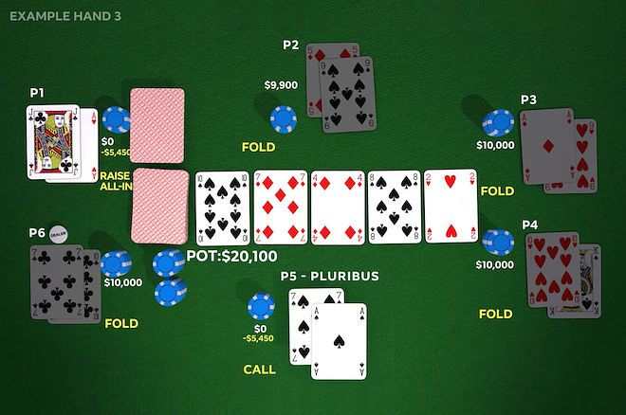
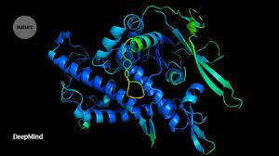
The AI renaissance
[2016] DeepMind’s AlphaGo beats top human player Lee Sodol
[2017] CMU’s Libratus defeats world’s best players at two-player no-limit Texas Hold’em
[2019] CMU’s Pluribus defeats world’s best players at multi-player no-limit Texas Hold’em
[2021] DeepMind’s AlphaFold offers highly accurate protein structure prediction

Slide 46
Outline
Course logistics
What is AI?
History of AI
Current applications of AI
What is an agent?

Slide 47


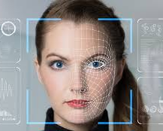
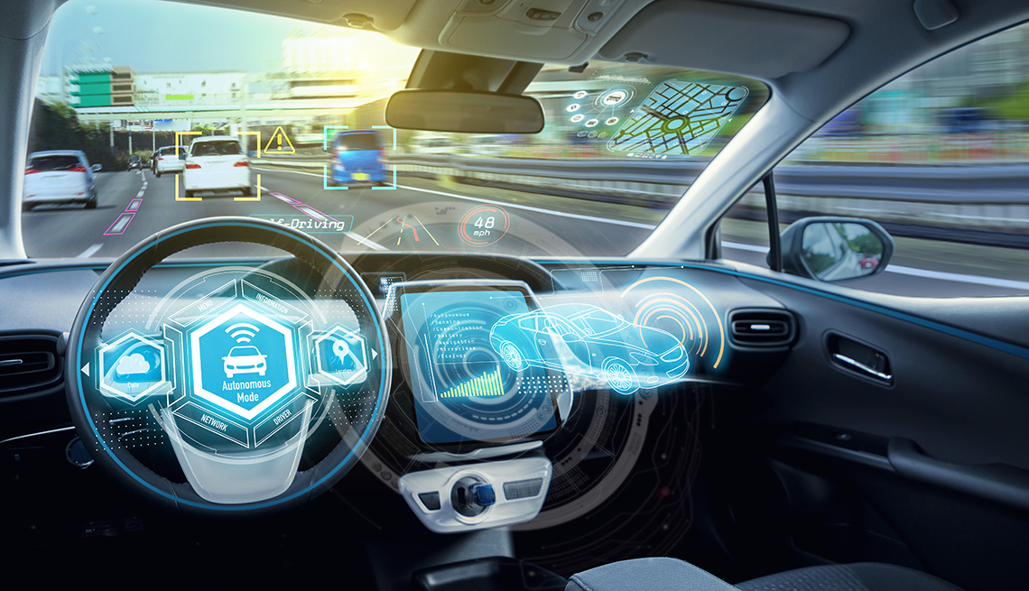


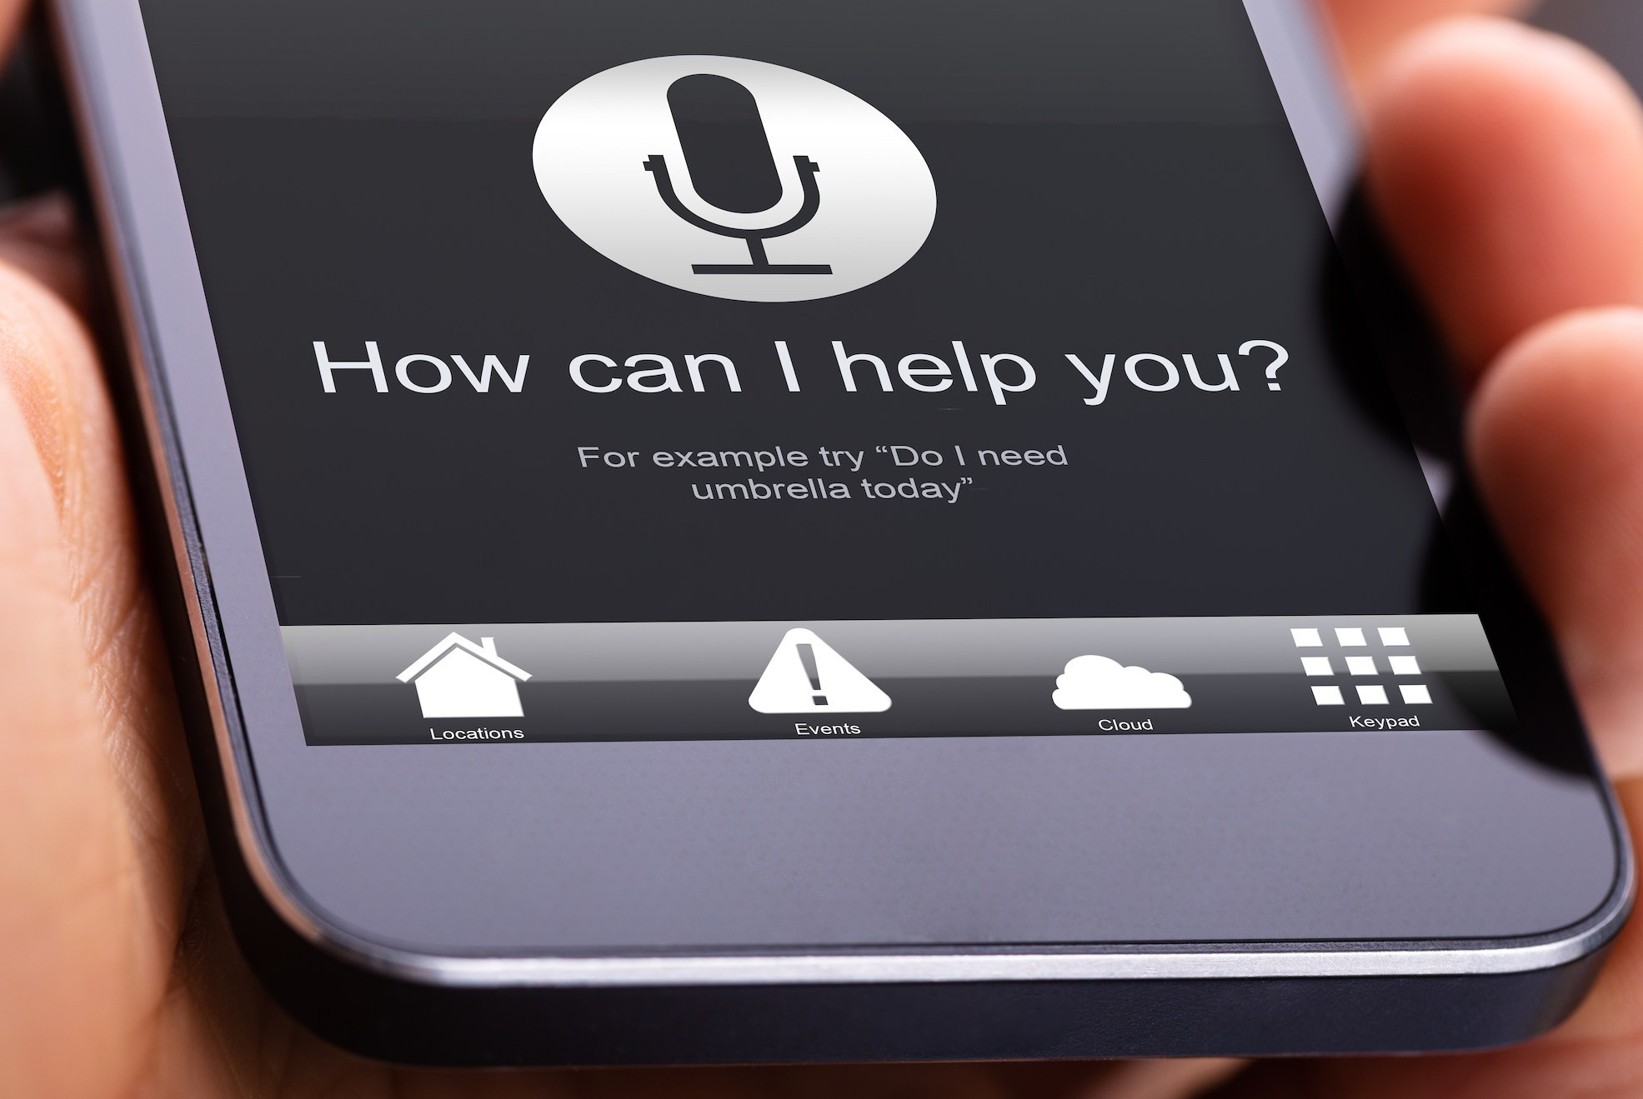
AI in the real world
Translation
Facial recognition
Spam detection
Autonomous driving
Stock market
Hiring systems
Voice assistant

Slide 48
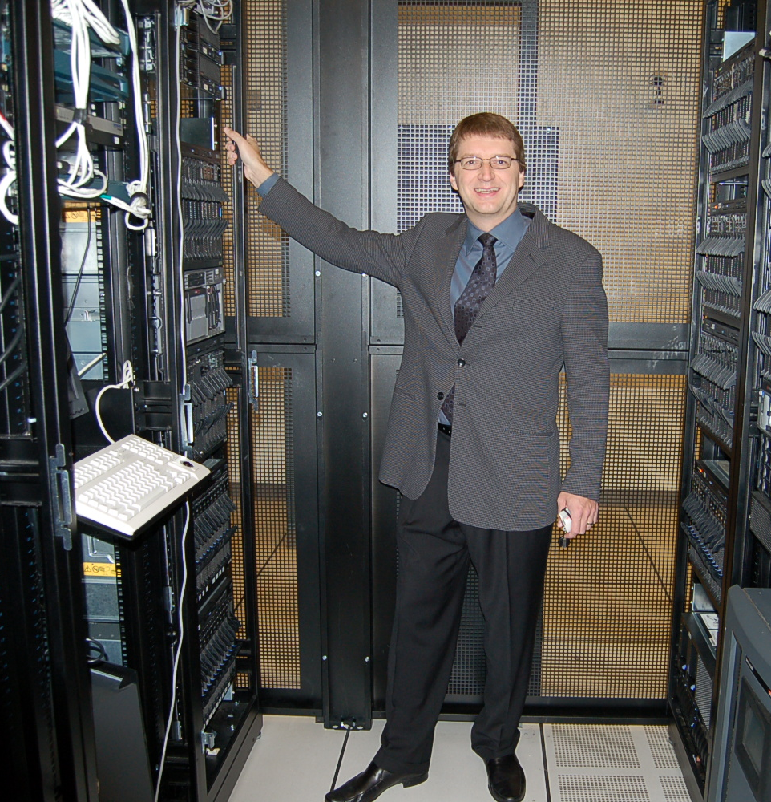
Large-scale combinatorial multi-attribute sourcing auctions 2001-2010
[Sandholm, Handbook of Market Design, Ch. 16, 2013]
One of the first SaaS analytics companies
Over 800 auctions, totaling over $60 Billion
  The most expressive auctions ever conducted
Created 12.6% savings for buy side
Suppliers also benefited
Grew to 130 employees, operations on 4 continents
Acquired in 2010
Key AI technologies:
  Winner determination algorithms
  Bidding languages
  Preference elicitation from multiple agents
  Automated mechanism design

Slide 49
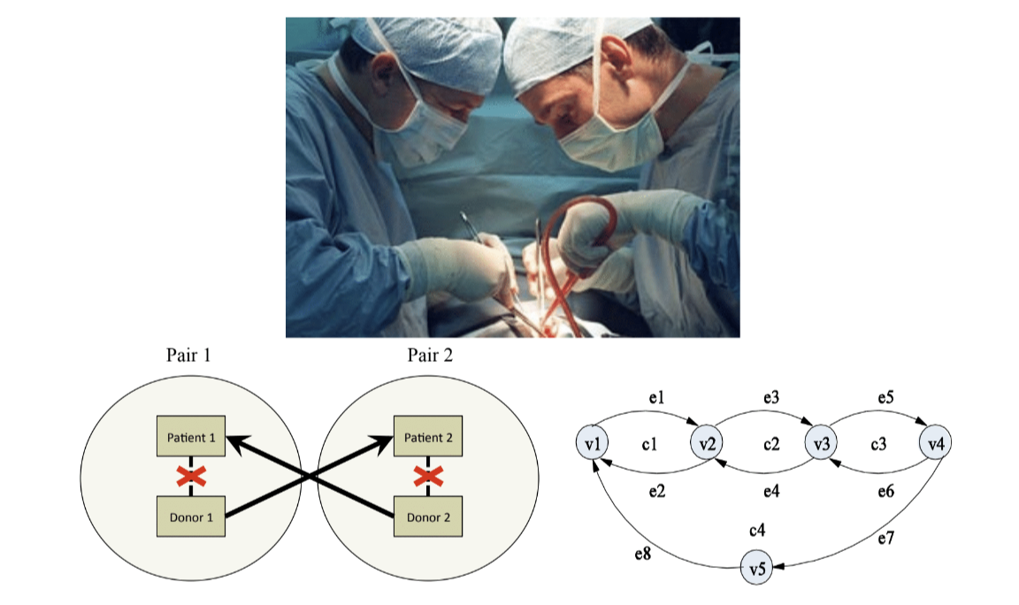
Kidney exchange
AI from Prof. Sandholm’s lab has been running the national kidney exchange for UNOS since 2010.

Slide 50
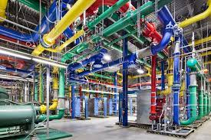
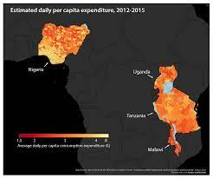
AI and sustainability
Deepmind’s AI reduces Google Data Center’s energy consumption
Combining satellite imagery and machine learning to predict poverty [Jean et al. 2016]

Slide 51
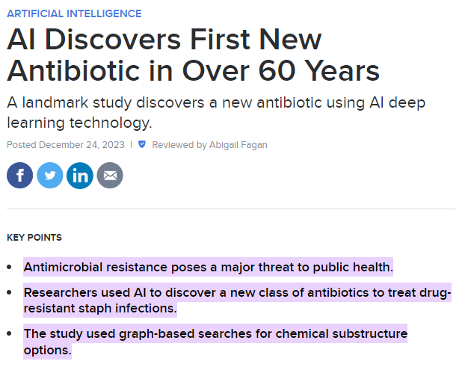

Slide 52

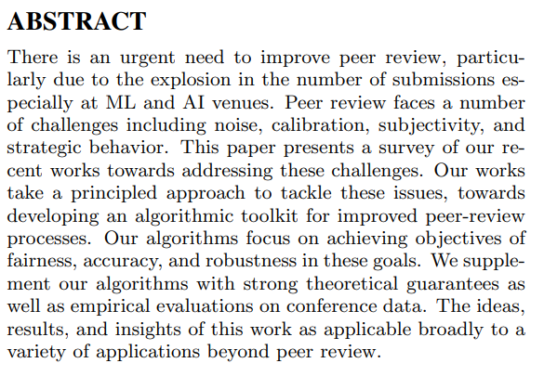

Slide 53
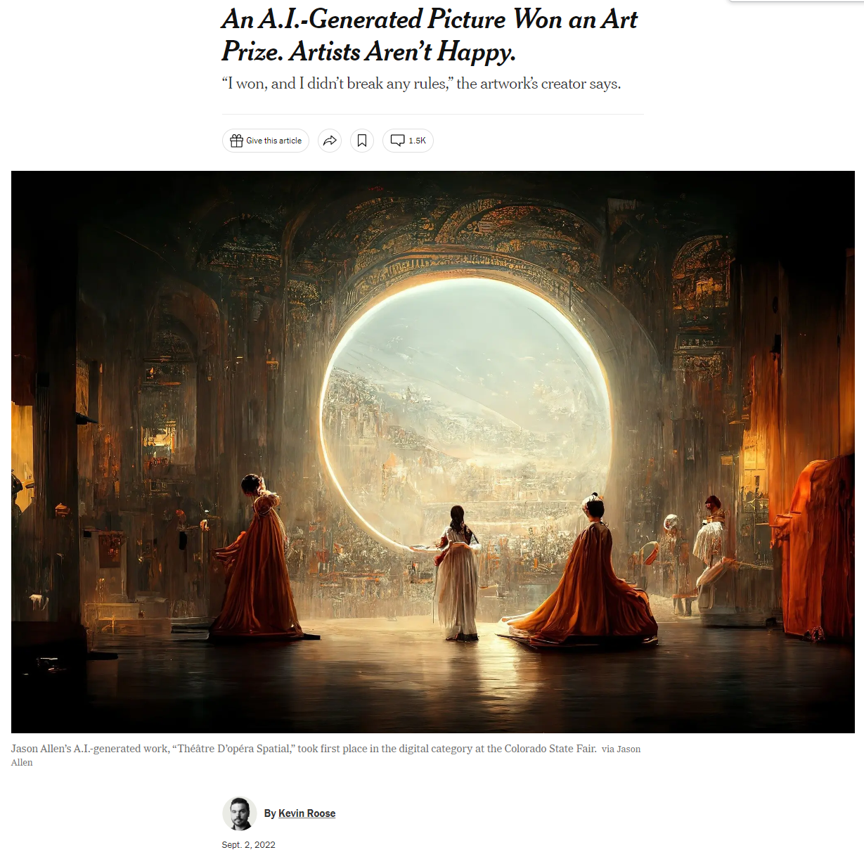
In Prof. Sandholm’s August 2021 IJCAI John McCarthy Award talk,
he predicted there will be human-only categories in future art competitions
New York Times
Notes:
Bach and Mahler -> superhuman art: we won’t be able to distinguish better vs worse art.
Atonal music example => bad for development

Slide 54


Deepfakes of Prof. Sandholm Spring 2023-

Slide 55
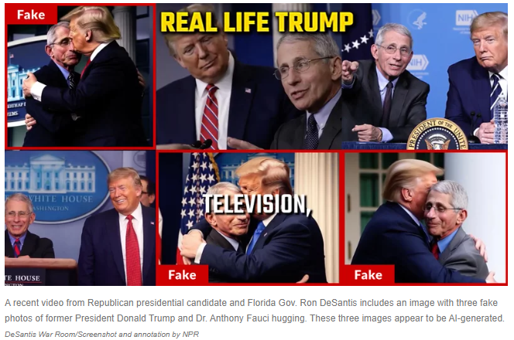
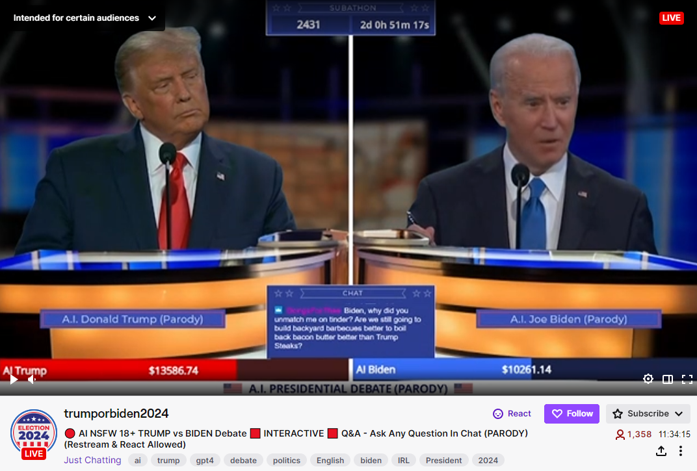

Some harmful applications of deepfakes
https://www.twitch.tv/trumporbiden2024

Slide 56
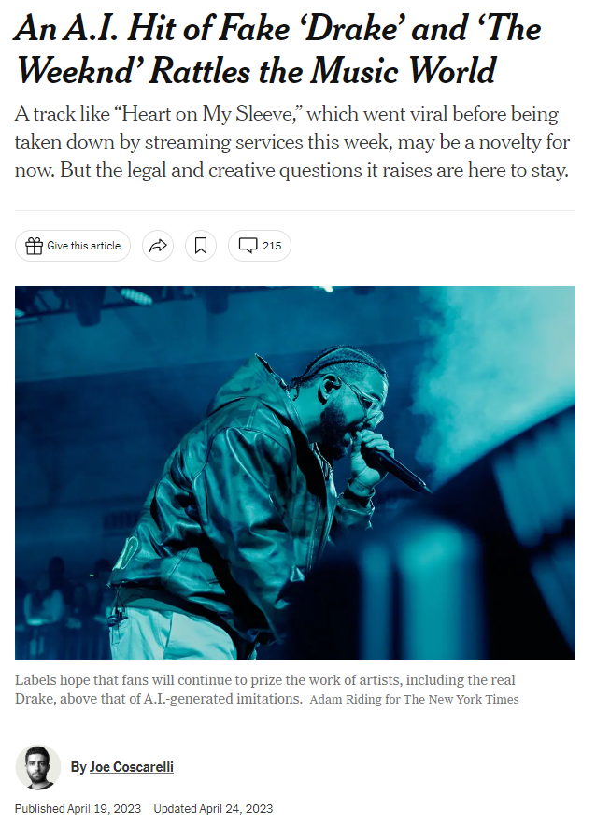

New York Times

Slide 57
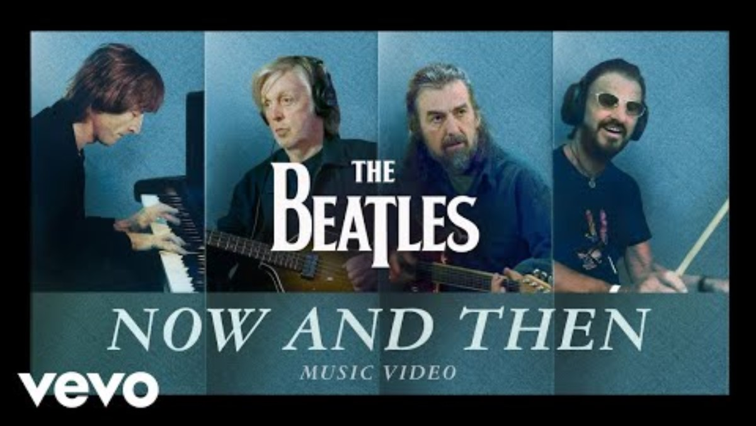
The Beatles: “Now And Then”
https://www.youtube.com/watch?v=Opxhh9Oh3rg

Slide 58
Large language models (LLMs) 2018-
Generation (e.g., story writing, marketing content creation)
  Tim Boucher wrote 97 books in 9 months using ChatGPT from OpenAI and Claude from Anthropic. He used Midjourney to generate images to match the story. Word count 2,000 - 83,000. Price $1.99 - $5.99
  Non-AI-assisted record, by Barbara Cartland, is 191 books per year
Summarization (e.g., web search, legal paraphrasing, meeting notes summarization)
  E.g., Bing co-pilot, Bard
  In the future also question answering from specific corpora
Translation (e.g., between languages, text-to-code, text-to-database)
Classification (e.g., toxicity classification, sentiment analysis)
Chatbot (e.g., open-domain Q+A, virtual assistants)
  E.g., Bing co-pilot, Bard

Slide 59
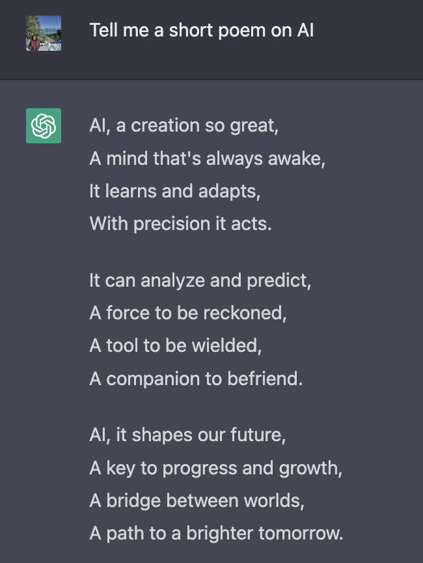

Slide 60
Downsides of LLMs
Hallucination
  May be impossible to fully get rid of
    But code writing & external calls help
  In important applications, getting sensical answers most of the time isn’t good enough (cf. self-driving in 2015)
Limited reasoning. Thus poor at
  strategies against adversaries
    Can’t play tic-tac-toe, much less no-limit Texas hold’em poker
  logic
  collaborative filtering
  …

Slide 61
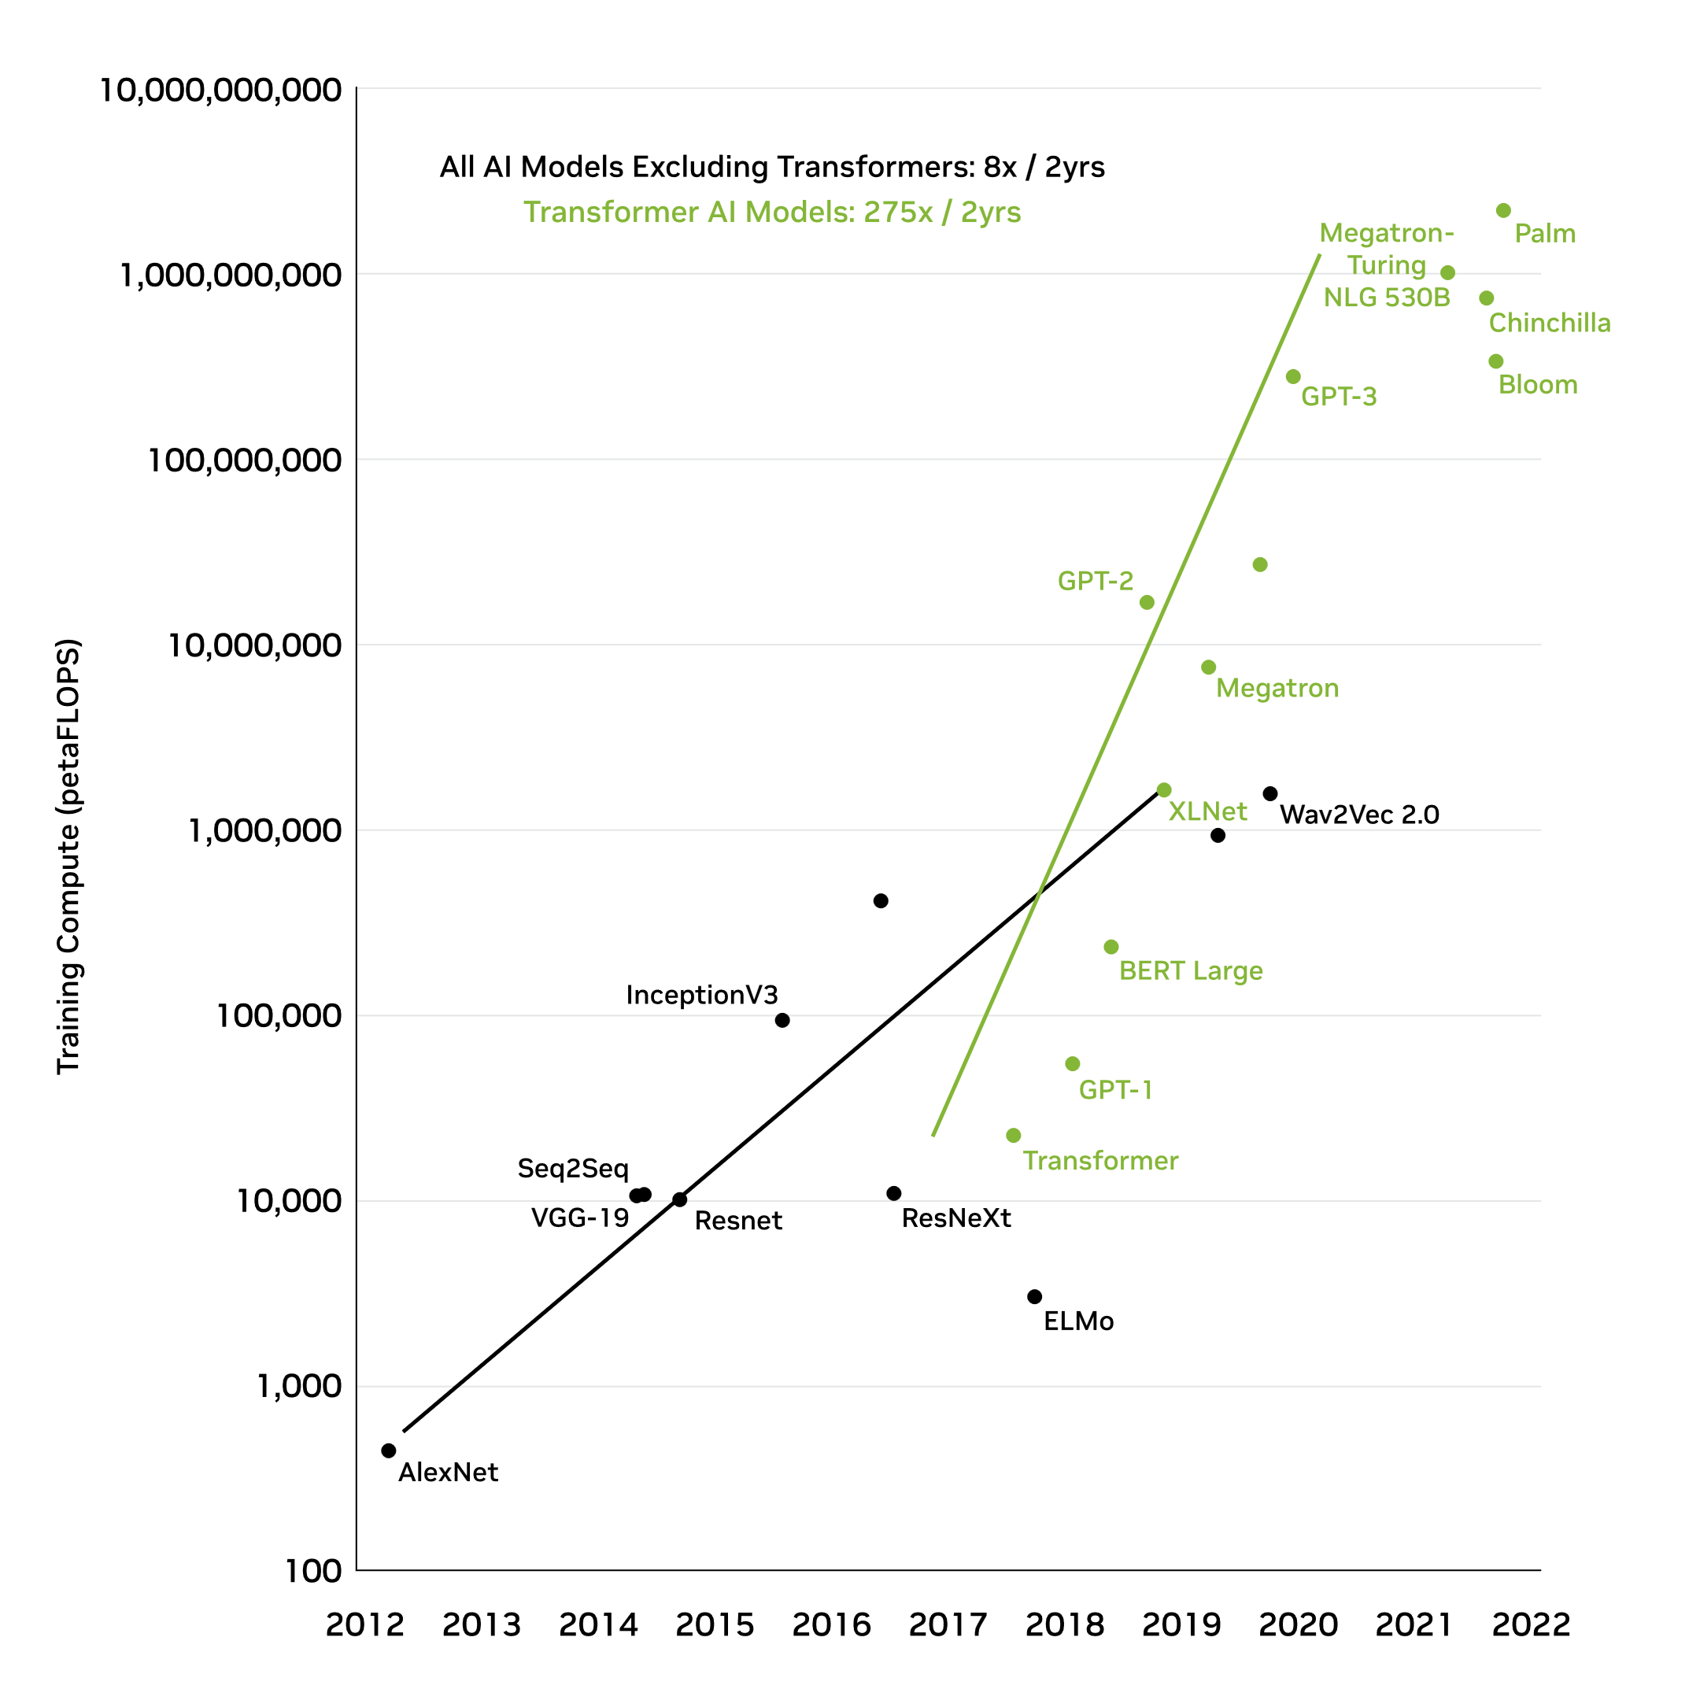
Downsides of LLMs …
Training cost
  Open AI’s GPT-4 took “more than $100M”
  [OpenAI CEO 4/17/2023] (Microsoft invested $1B+$10B in OpenAI)
  “Really good large language models take $ Billions to train” [Amazon CEO 4/13/2023]
[Figure credit: nVIDIA]
Notes:
OpenAI CEO quote and Amazon CEO quote.

Slide 62
Downsides of LLMs …
Proliferation of content
Privacy loss & copyright issues
Biases & inclusivity
Explainability
No “understanding” (?) but LLMs are used as if they understand in consulting, medicine, customer service, etc.
Regulation?

Slide 63
The AI Renaissance
tools and ideas from other fields…
Symbolic AI
Neural AI
Optimization,
algorithms,
probabilistic inference,
statistics,
game theory, etc.

Slide 64
Outline
Course logistics
What is AI?
History of AI
Current applications of AI
What is an agent?

Slide 65
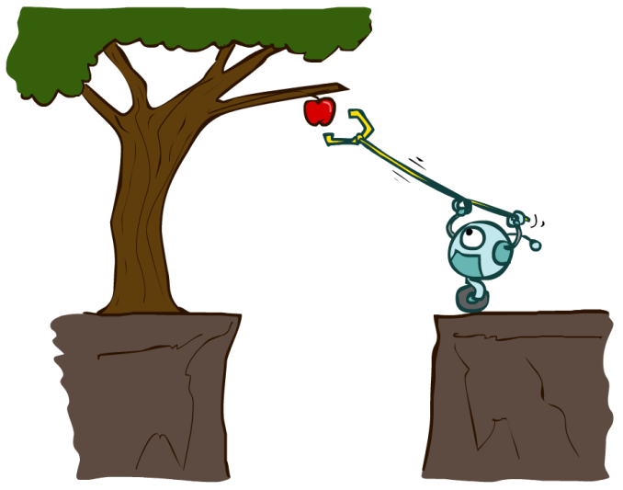
Designing Agents
An agent is an entity that perceives and acts.
Characteristics of the percepts and state, environment, and action space dictate techniques for selecting actions
How can we design an AI agent to solve our problems given their task environments?
Sensors
Agent
Percepts
Environment
?
Actuators
Actions

Slide 66
Rational Decisions
We’ll use the term rational in a very specific, technical way:
  Rational: maximally achieving pre-defined goals
  Rationality only concerns what decisions are made
  (not the thought process behind them)
  Goals are expressed in terms of the utility of outcomes
  Being rational means maximizing your expected utility
Another title for this course could be:
Introduction to Computational Rationality
Notes:
Example of utilities. 10 for A, 1 for each Friday with friends

Slide 67
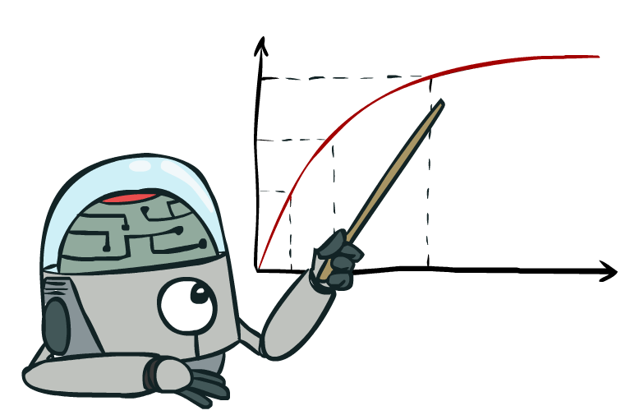
Rationality, contd.
What is rational depends on:
  Performance measure
  Agent’s prior knowledge of environment
  Actions available to agent
  Percept sequence to date
Being rational means maximizing your expected utility

Slide 68
Rational Agents
Are rational agents omniscient?
  No – they are limited by the available percepts and state
Are rational agents clairvoyant?
  No – they may lack knowledge of the environment dynamics
Do rational agents explore and learn?
  Yes – in unknown environments these are essential
So, rational agents are not necessarily successful, but they are autonomous (i.e., make decisions on their own to achieve their goals)
Don’t have to be used as autonomous but rather as recommenders of actions or in some settings as collaborators

Slide 69
Artificial Intelligence (AI) vs Machine Learning (ML)?
Artificial Intelligence
Machine Learning
Deep Learning

