Slide 1
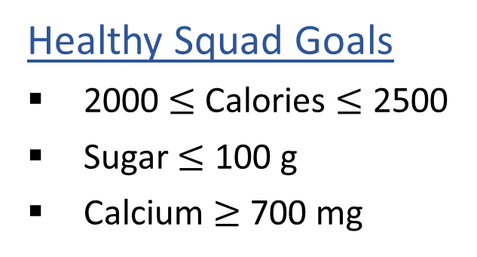
Warm-up: What to eat?
We are trying to stay healthy by finding the optimal amount of food to purchase.
We can choose the amount of stir-fry (ounce) and boba (fluid ounces).
Food | Cost | Calories | Sugar | Calcium
Stir-fry (per oz) | 1 | 100 | 3 | 20
Boba (per fl oz) | 0.5 | 50 | 4 | 70
What is the cheapest way to stay “healthy” with this menu?
How much stir-fry (ounce) and boba (fluid ounces) should we buy?

Slide 2
Reminders
P1 and HW3 Online are both due Feb 6th
P2 and HW4 Written + Online will be released Feb 6th
HW4 due Feb 13th, P2 due Feb 20th (day after the midterm so budget time)
You must attend the recitation you chose to commit to on the recitation selection form for the rest of the semester
Midterm is Feb 19th so we will release practice material/review session details early next week
When asking for programming help on Piazza please format code in codeblock!

Slide 3
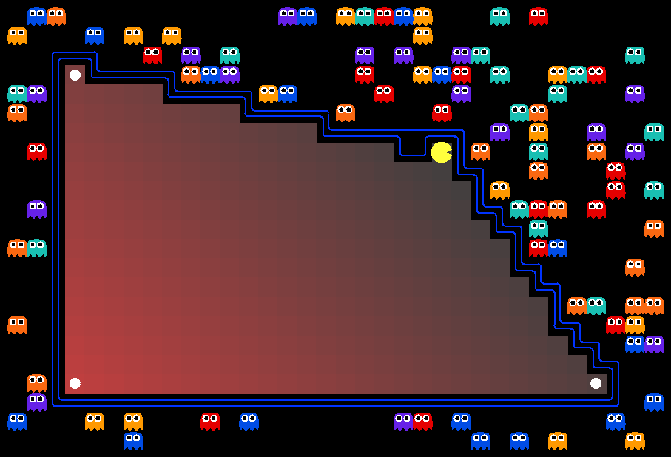
AI: Representation and Problem Solving
Linear Programming
Instructors: Tuomas Sandholm and Vincent Conitzer
Slide credits: CMU AI with drawings from http://ai.berkeley.edu

Slide 4
Warm-up: What to eat?
We are trying to stay healthy by finding the optimal amount of food to purchase.
We can choose the amount of stir-fry (ounce) and boba (fluid ounces).
Food | Cost | Calories | Sugar | Calcium
Stir-fry (per oz) | 1 | 100 | 3 | 20
Boba (per fl oz) | 0.5 | 50 | 4 | 70
What is the cheapest way to stay “healthy” with this menu?
How much stir-fry (ounce) and boba (fluid ounces) should we buy?

Slide 5
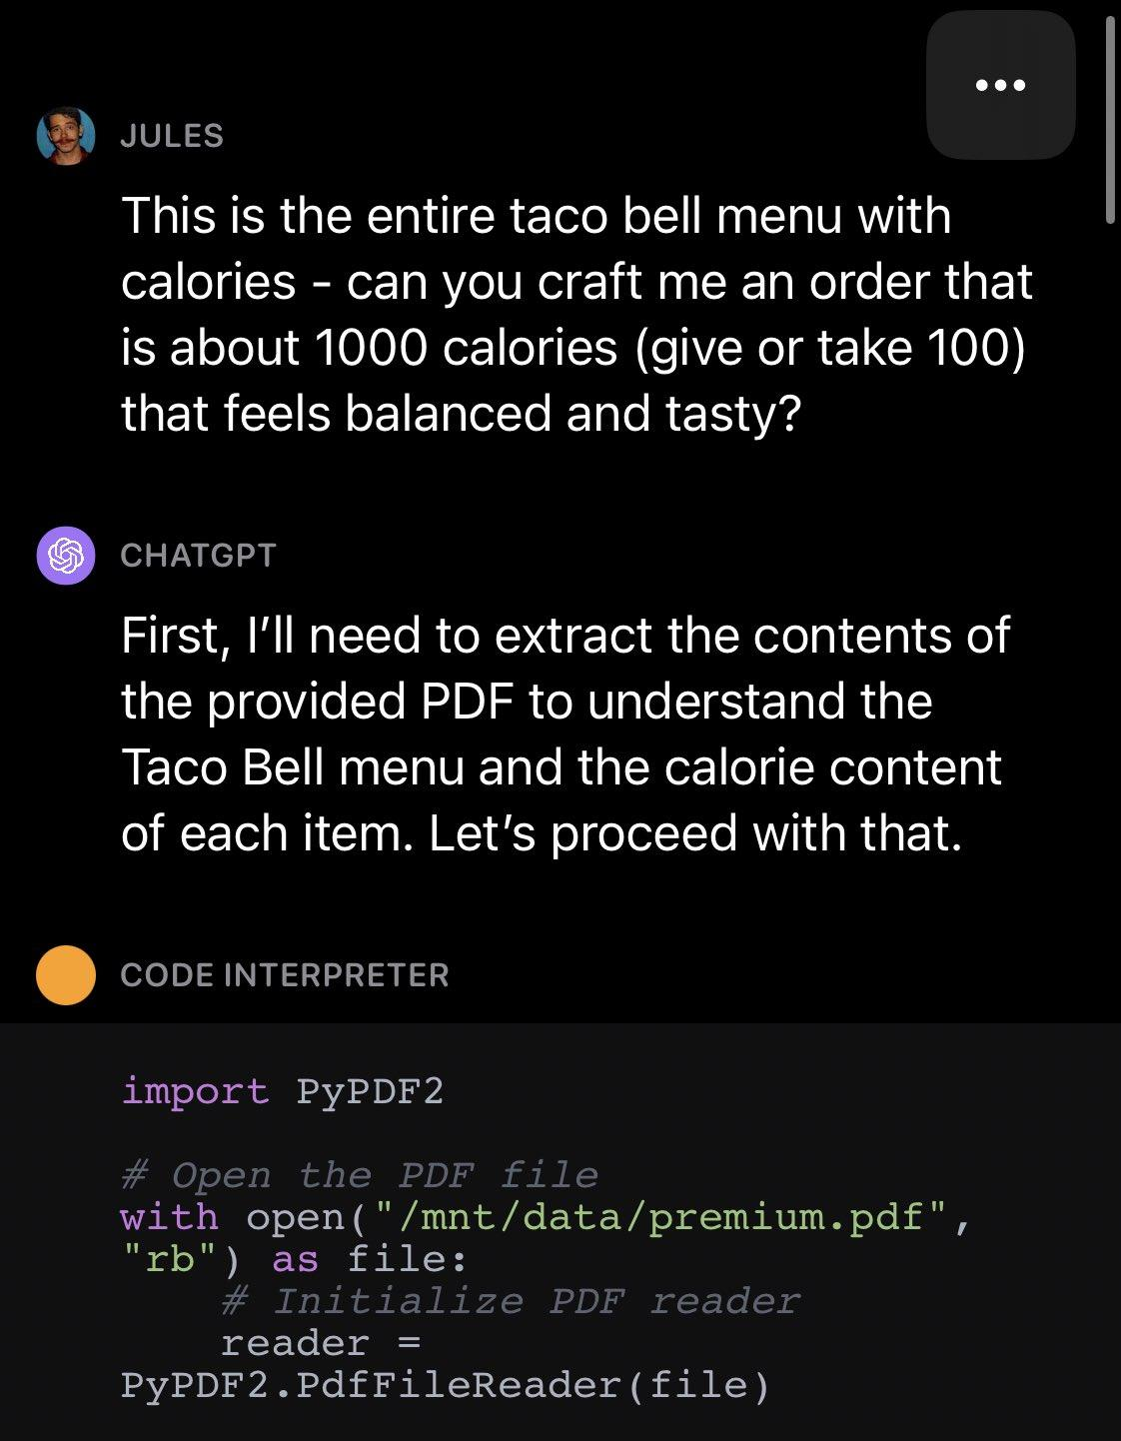
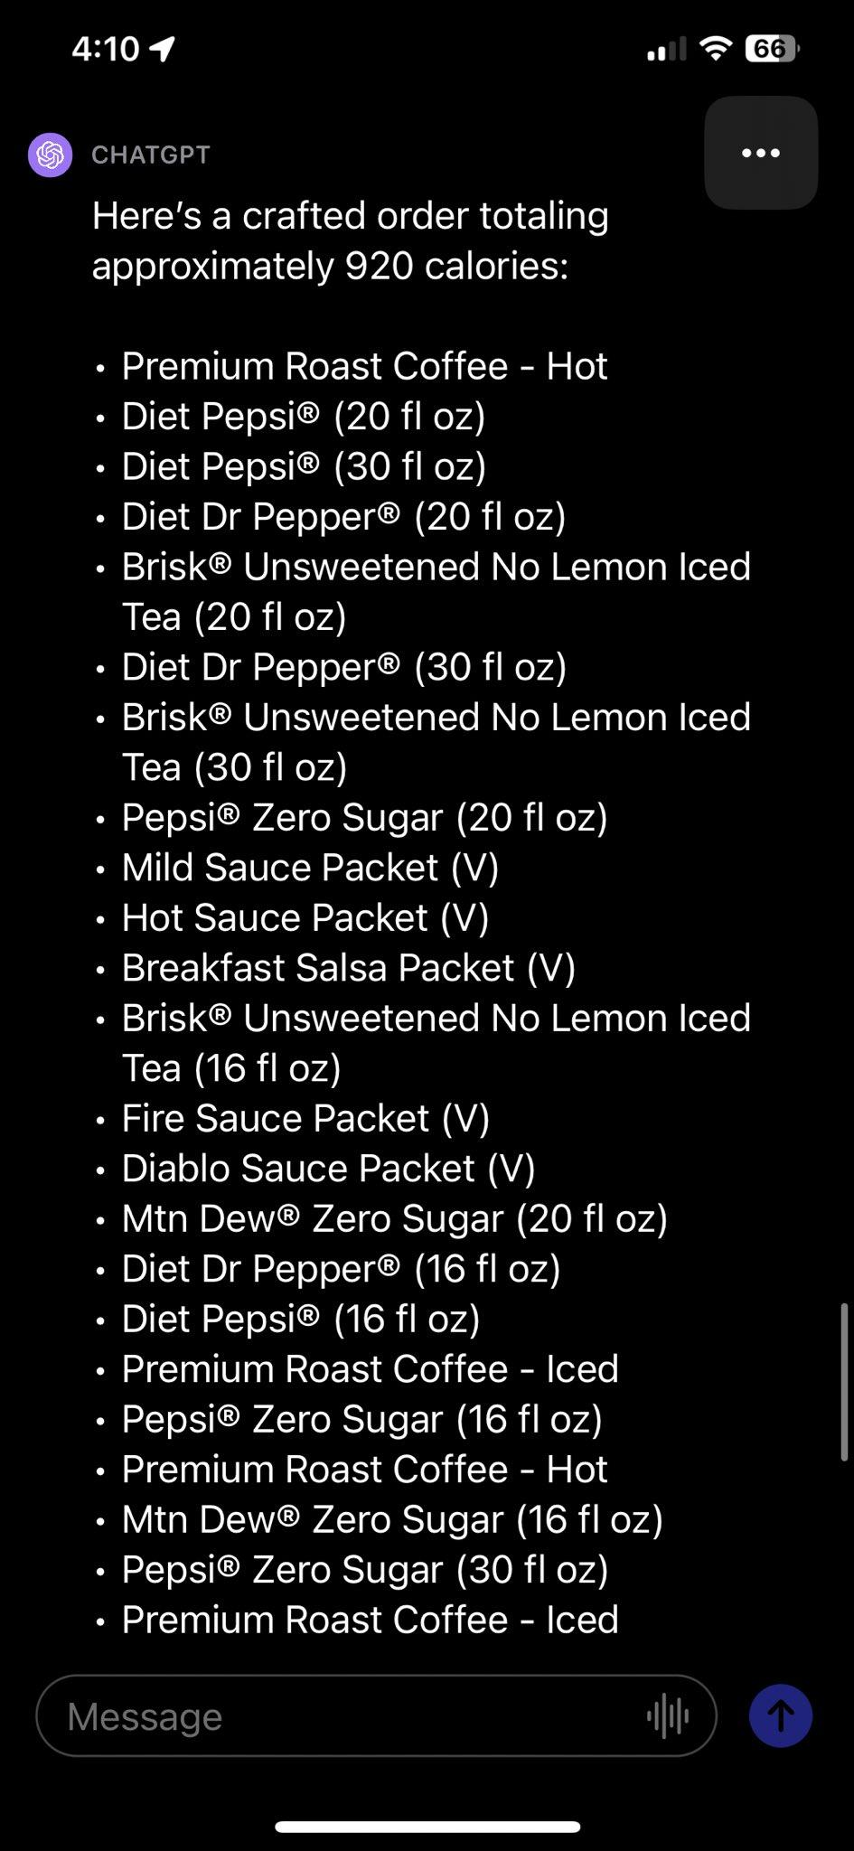
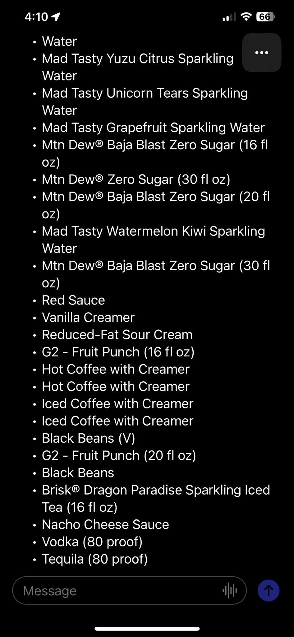

Slide 6
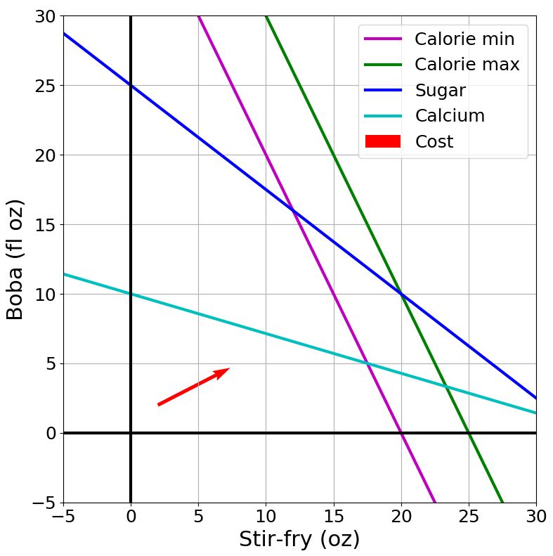
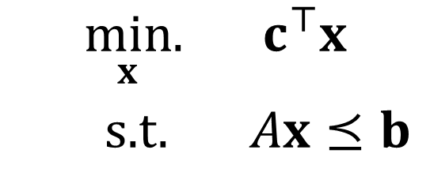
Optimization
Graphical Representation
Problem Description
Optimization Representation

Slide 7
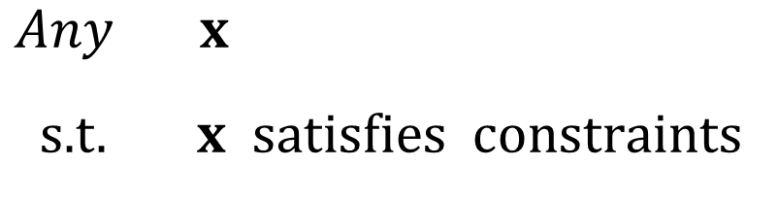
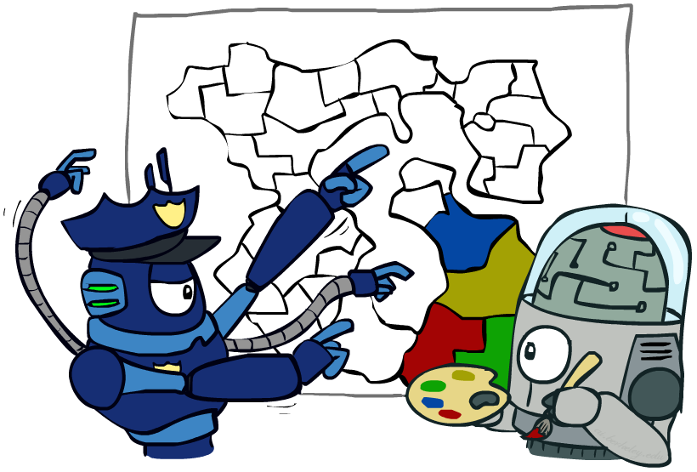
Constraint Satisfaction Problems
Map coloring
"such that"
Assume vectors are column vectors
Notation Alert!

Slide 8

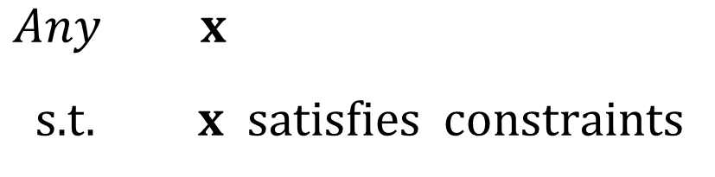
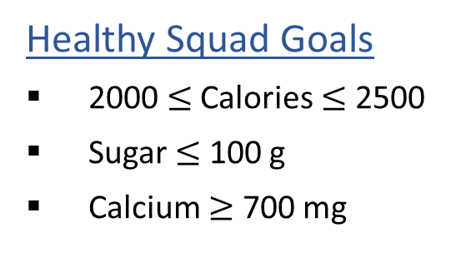
Optimization Formulation
Diet Problem
Food | Cost | Calories | Sugar | Calcium
Stir-fry (per oz) | 1 | 100 | 3 | 20
Boba (per fl oz) | 0.5 | 50 | 4 | 70

Slide 9
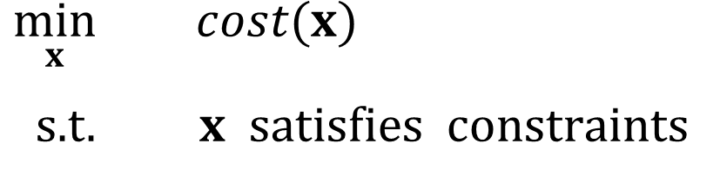

Optimization Formulation
Diet Problem
Objective function
Food | Cost | Calories | Sugar | Calcium
Stir-fry (per oz) | 1 | 100 | 3 | 20
Boba (per fl oz) | 0.5 | 50 | 4 | 70
Notation Alert!

Slide 10
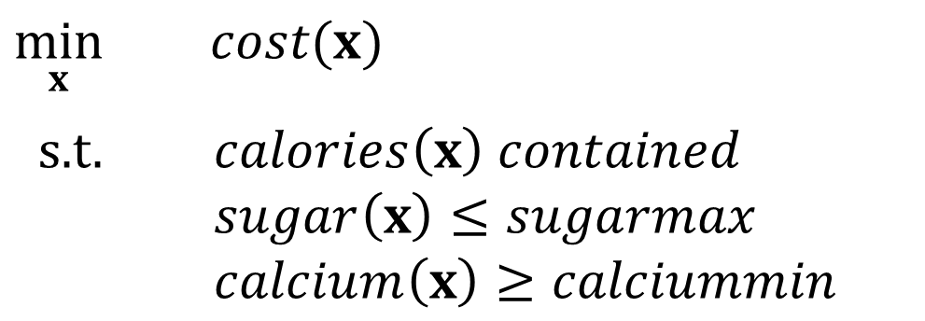
Optimization Formulation
Diet Problem
Food | Cost | Calories | Sugar | Calcium
Stir-fry (per oz) | 1 | 100 | 3 | 20
Boba (per fl oz) | 0.5 | 50 | 4 | 70

Slide 11
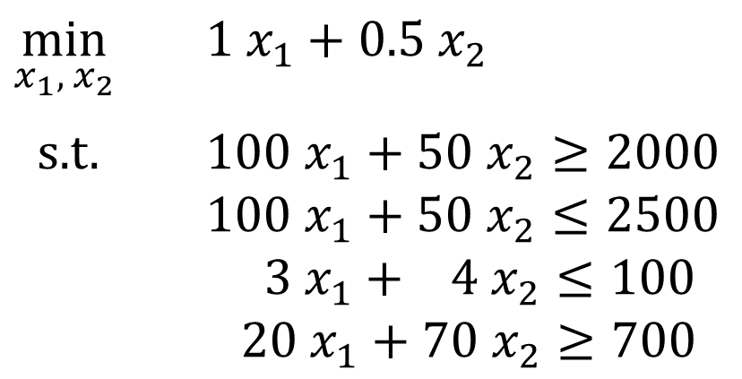
Optimization Formulation
Diet Problem
Food | Cost | Calories | Sugar | Calcium
Stir-fry (per oz) | 1 | 100 | 3 | 20
Boba (per fl oz) | 0.5 | 50 | 4 | 70
Notation Alert!

Slide 12
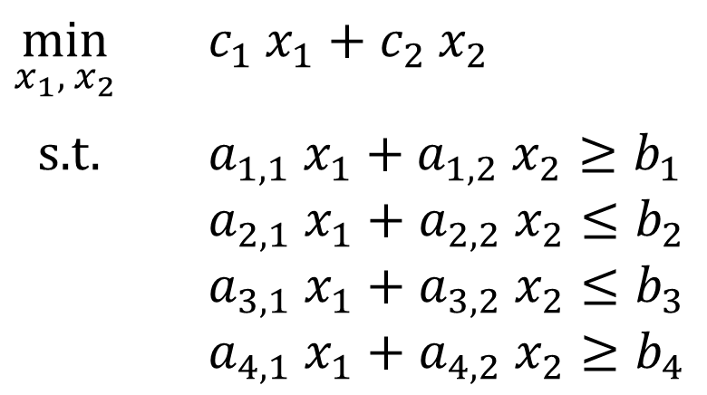
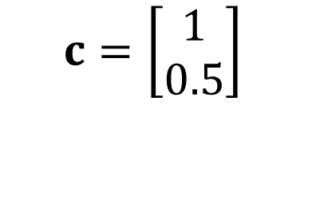
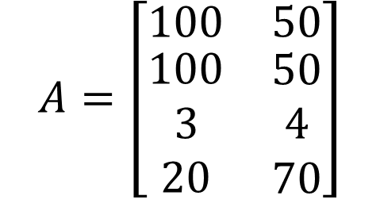
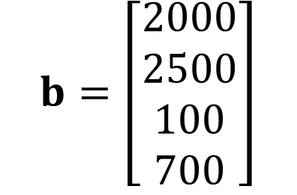
Optimization Formulation
Diet Problem
Cost
Stir-fry
Boba
Limit
Calorie min
Calorie max
Sugar
Notation Alert!
Calcium

Slide 13
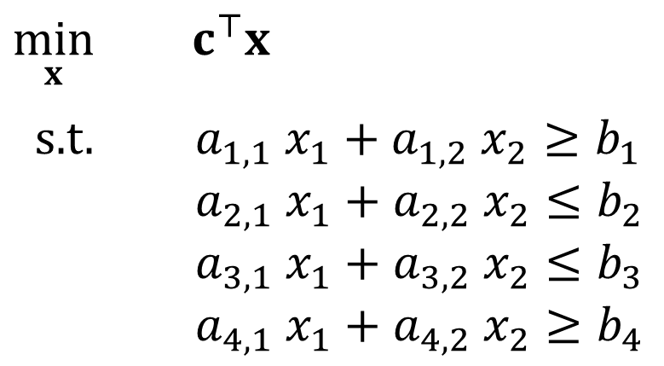
Optimization Formulation
Diet Problem
Cost
Stir-fry
Boba
Limit
Calorie min
Calorie max
Sugar
Notation Alert!
Calcium

Slide 14
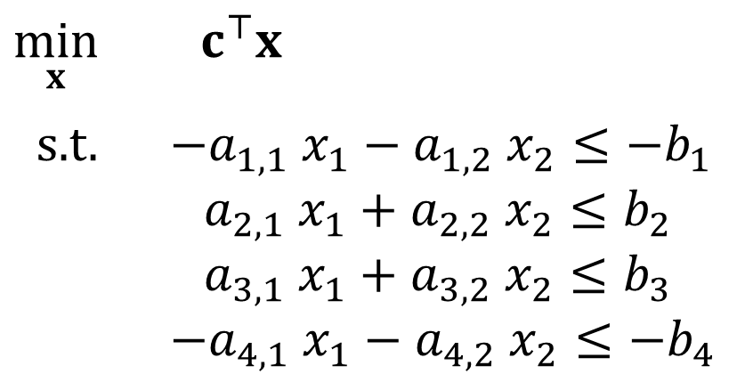
Optimization Formulation
Diet Problem
Cost
Stir-fry
Boba
Limit
Calorie min
Calorie max
Sugar
Calcium

Slide 15
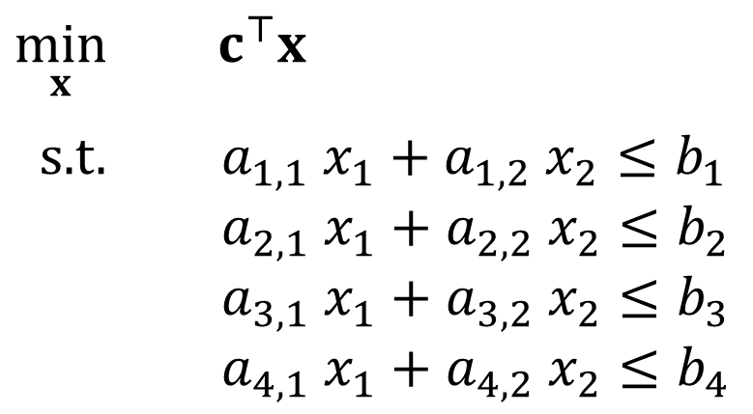
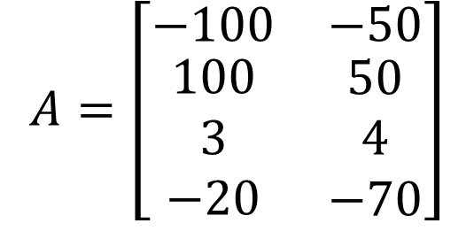
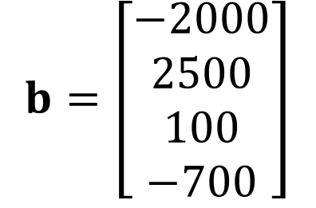
Optimization Formulation
Diet Problem
Cost
Stir-fry
Boba
Limit
Calorie min
Calorie max
Sugar
Calcium

Slide 16
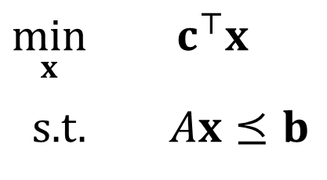
Optimization Formulation
Diet Problem
Cost
Stir-fry
Boba
Limit
Calorie min
Calorie max
Sugar
Notation Alert!
Calcium

Slide 17
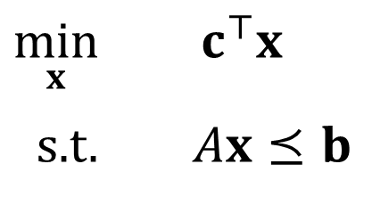
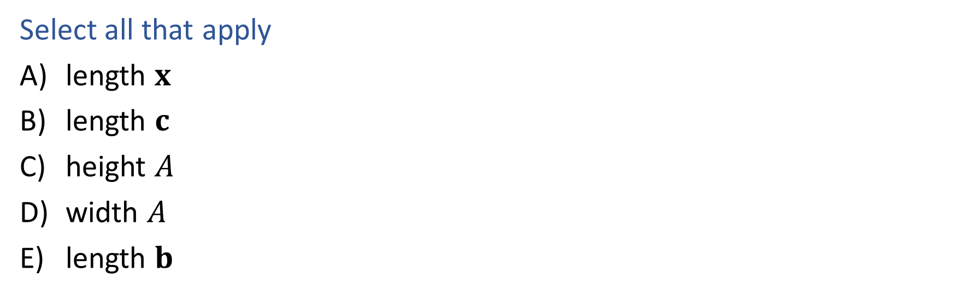
Poll 1
What has to increase to add more nutrition constraints?
Food | Cost | Calories | Sugar | Calcium
Stir-fry (per oz) | 1 | 100 | 3 | 20
Boba (per fl oz) | 0.5 | 50 | 4 | 70

Slide 18
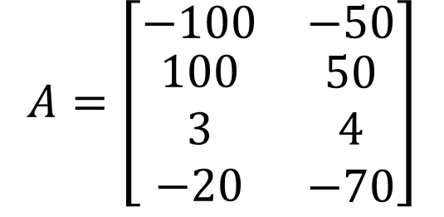
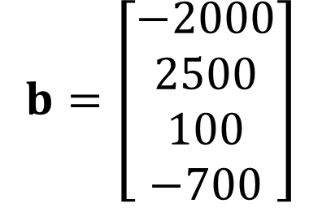
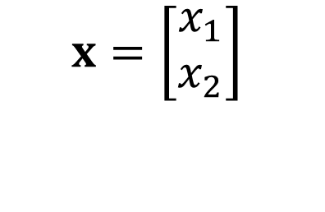
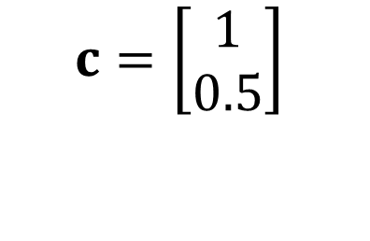
Poll 1
What has to increase to add more nutrition constraints?

Slide 19
Poll 2
What has to increase to add more menu items?
Food | Cost | Calories | Sugar | Calcium
Stir-fry (per oz) | 1 | 100 | 3 | 20
Boba (per fl oz) | 0.5 | 50 | 4 | 70

Slide 20
Poll 2
What has to increase to add more menu items?

Slide 21
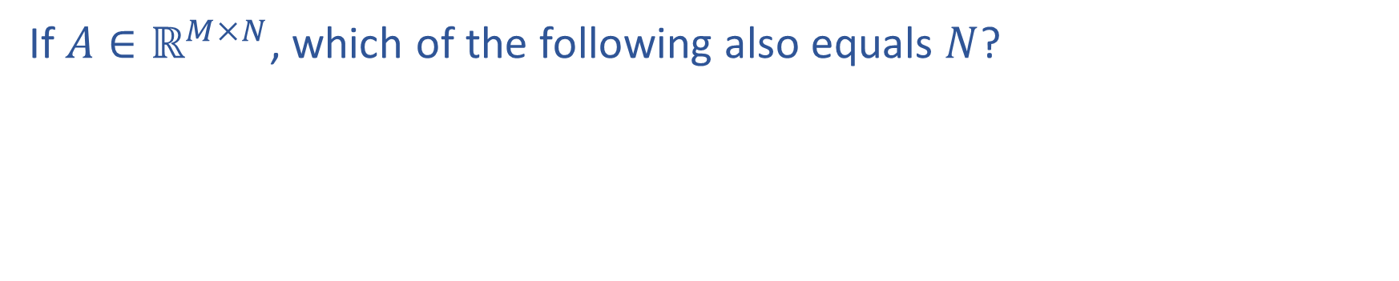
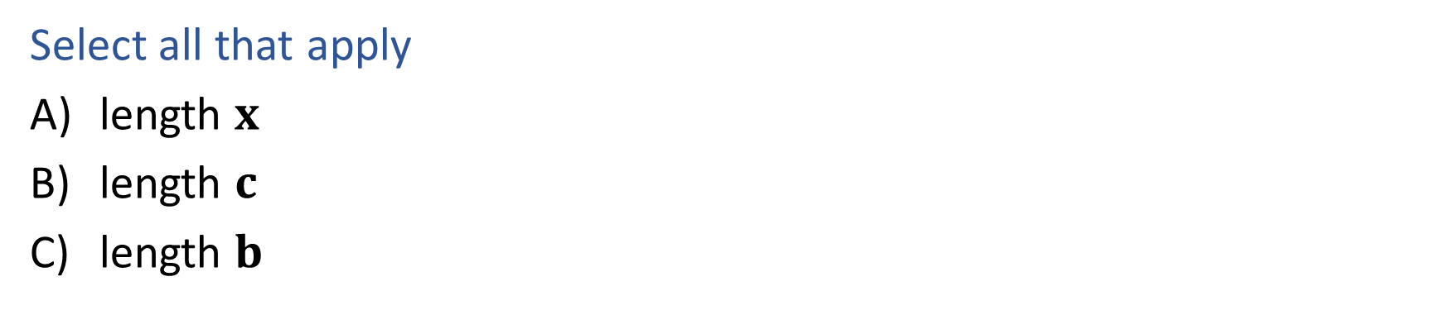
Poll 3
Notation Alert!

Slide 22
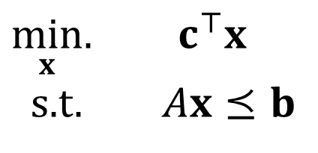
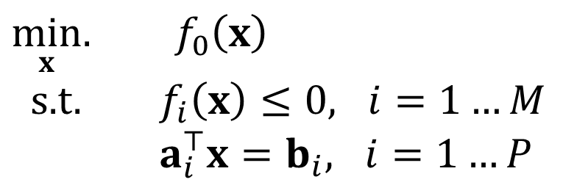
Linear Programming
Linear objective with linear constraints
As opposed to general optimization

Slide 23
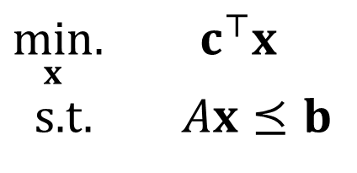
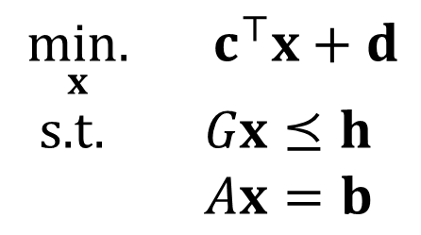
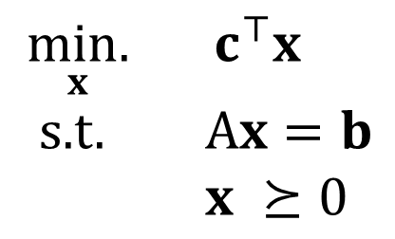
Linear Programming
Different formulations
Inequality form
General form
Standard form
Important to pay attention to form!
Can switch between formulations!

Slide 24
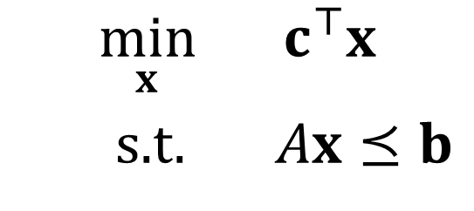
Optimization
Graphical Representation
Problem Description
Optimization Representation

Slide 25
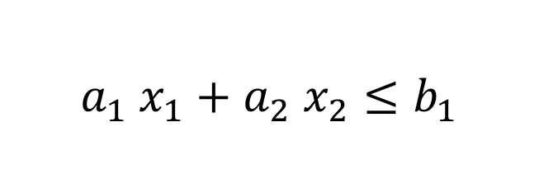
Graphical Representation
Geometry / Algebra I Quiz
What shape does this inequality represent?

Slide 26
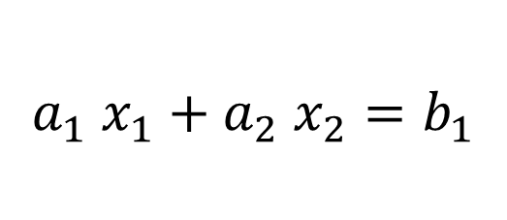
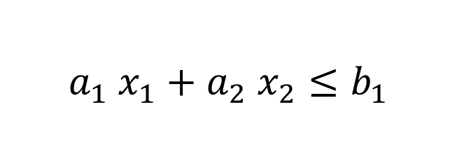
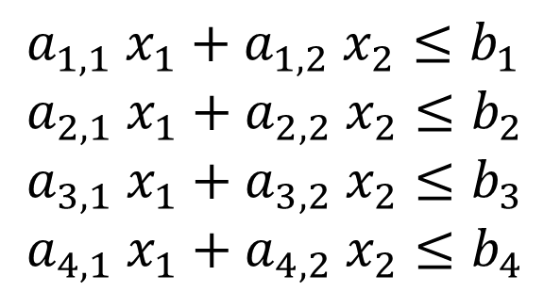
Graphics Representation
Geometry / Algebra I Quiz
What shape do these represent?
Feasible region:
All points x that satisfy the constraints

Slide 27
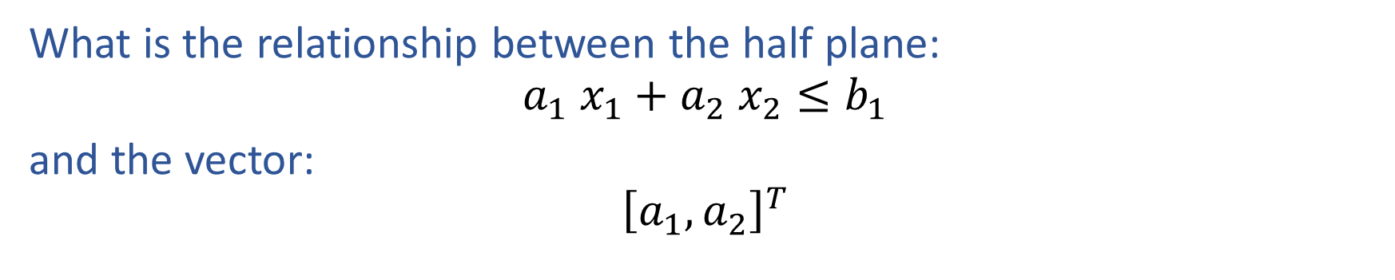


Poll 4
Infeasible
II
Feasible
I
III
IV
Notes:
II is the correct one, pointing into the infeasible region (in the > direction)

Slide 28
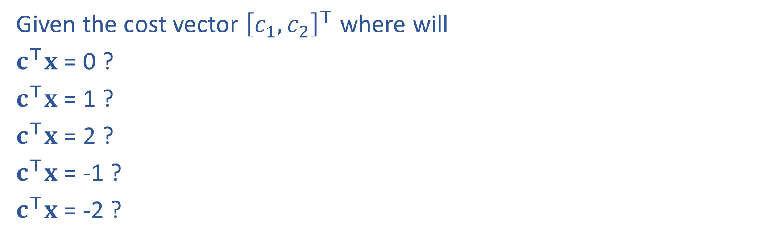



Cost Contours

Slide 29

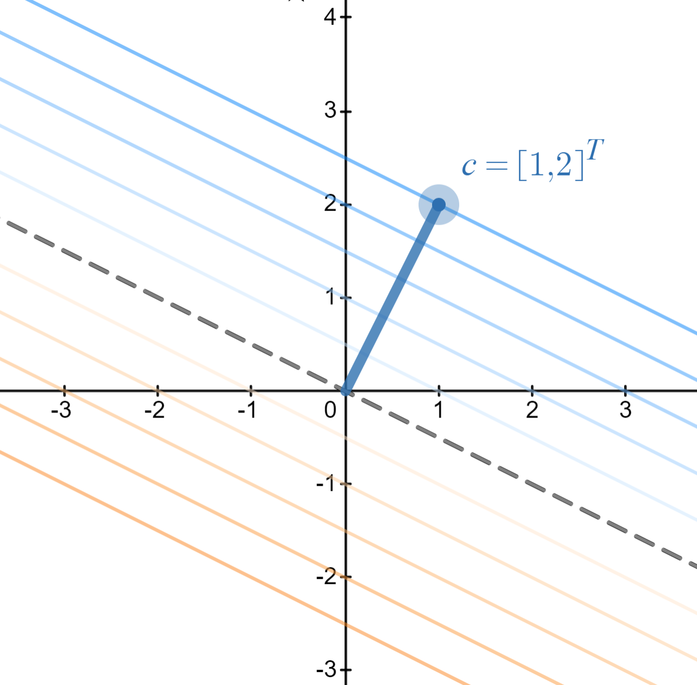
Poll 5
Increases
Decreases
https://www.desmos.com/calculator/8d9kxbdq9u

Slide 30
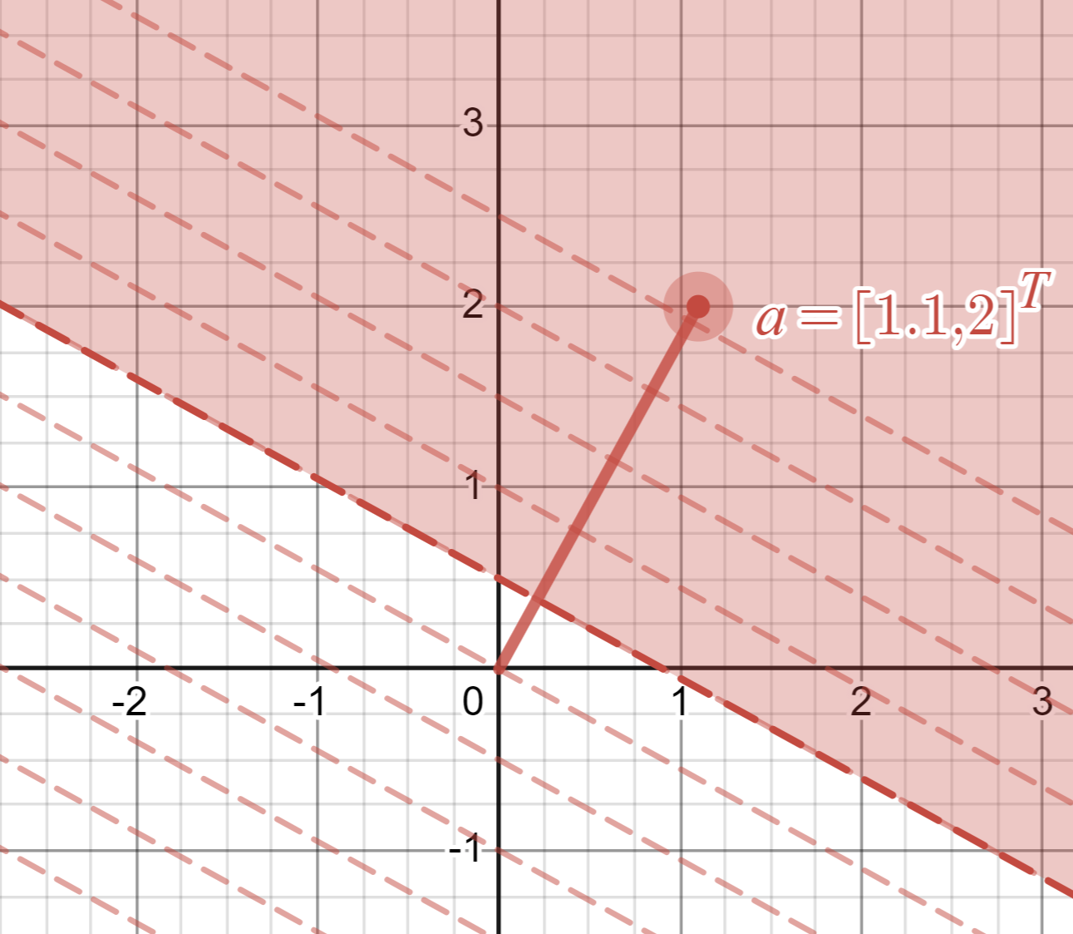
Graphics Representation
Geometry / Algebra I Quiz
What shape do these represent?
https://www.desmos.com/calculator/lp0rqsb1w6

Slide 31
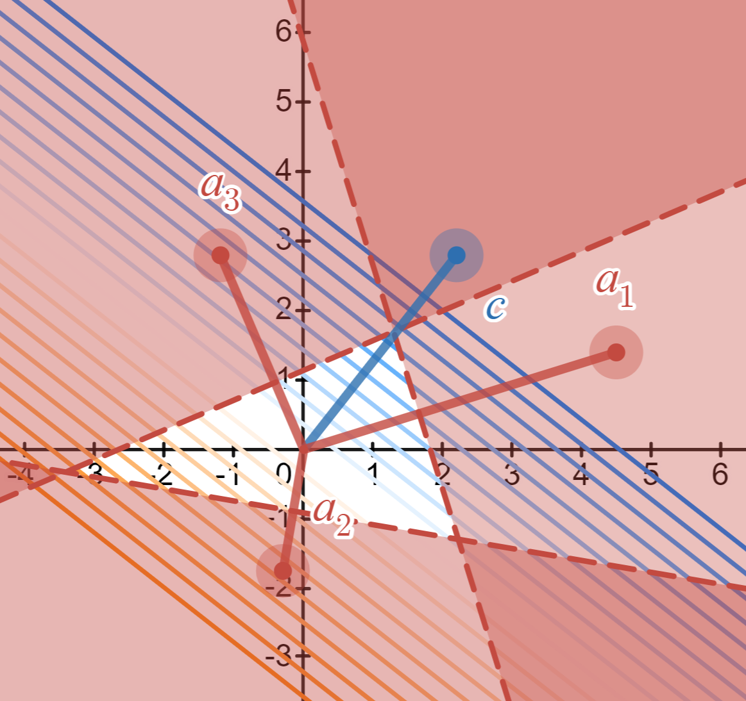
Graphics Representation
Geometry / Algebra I Quiz
What shape do these represent?
https://www.desmos.com/calculator/plp1thgsbh

