Slide 1

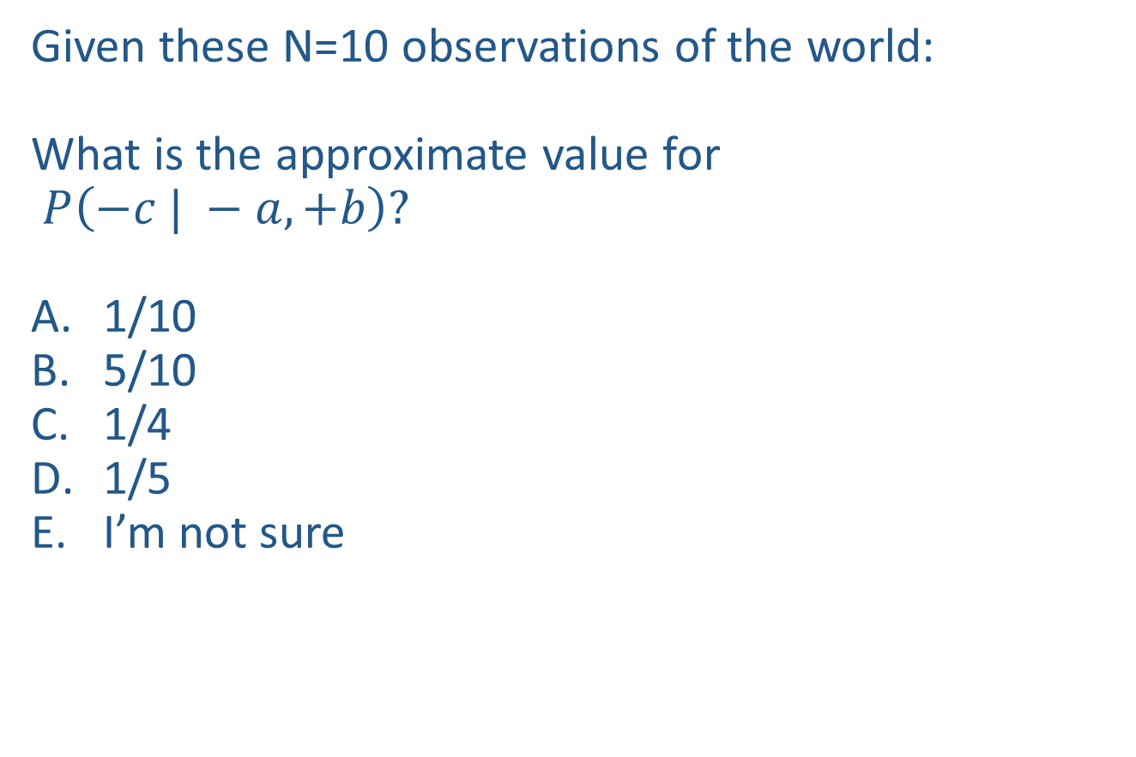
Warm-up as you walk in
Given these N=10 observations of the world:
What is the approximate value for
$P\left(−c | −a, +b\right)?$
1/10
5/10
1/4
1/5
I’m not sure
Counts
$$−a, −b, +c$$
$$+a,−b, +c$$
$$−a, −b,+c$$
$$−a, +b, +c$$
$$+a, −b, +c$$
$$−a, +b, −c$$
$$−a, +b, +c$$
$$−a, +b, +c$$
$$+a, −b, +c$$
$$−a, +b, +c$$
+a | +b | +c | 0
+a | +b | -c | 0
+a | -b | +c | 3
+a | -b | -c | 0
-a | +b | +c | 4
-a | +b | -c | 1
-a | -b | +c | 2
-a | -b | -c | 0

Slide 2
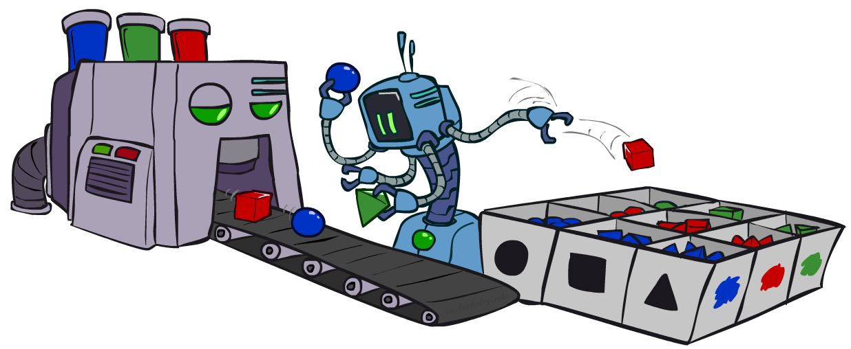
AI: Representation and Problem Solving
Bayes Nets Sampling
Instructors: Tuomas Sandholm and Vincent Conitzer
Slide credits: CMU AI and http://ai.berkeley.edu

Slide 3
Announcements
HW9 due April 11 (Friday)

Slide 4

Bayes Nets
Part I: Representation
Part II: Exact inference
Enumeration (always exponential complexity)
Variable elimination (worst-case exponential complexity, often better)
Inference is NP-hard in general
Part III: Approximate Inference

Slide 5
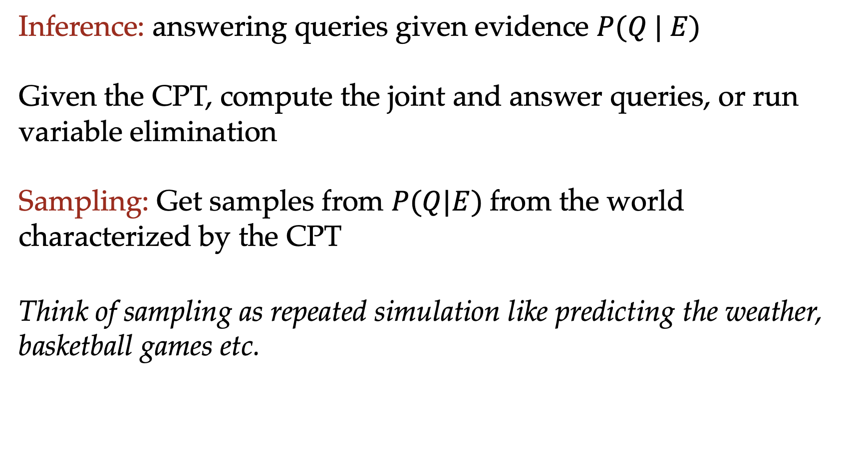
Inference vs Sampling
Inference: answering queries given evidence $P(Q | E)$
Given the CPT, compute the joint and answer queries, or run variable elimination
Sampling: Get samples from $P(Q|E)$from the world characterized by the CPT
Think of sampling as repeated simulation like predicting the weather, basketball games etc.

Slide 6
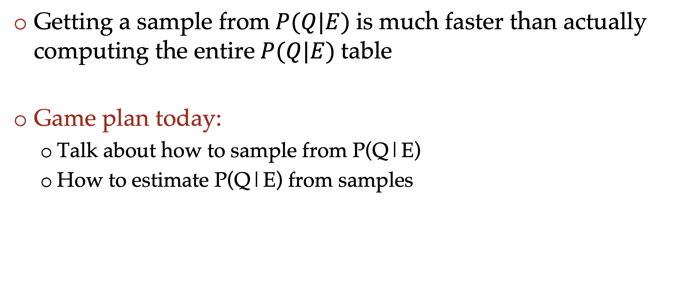
Sampling vs inference
Getting a sample from$P(Q|E)$is much faster than actually computing the entire$P(Q|E)$table
Game plan today:
Talk about how to sample from P(Q|E)
How to estimate P(Q|E) from samples

Slide 7

Approximate Inference: Sampling

Slide 8
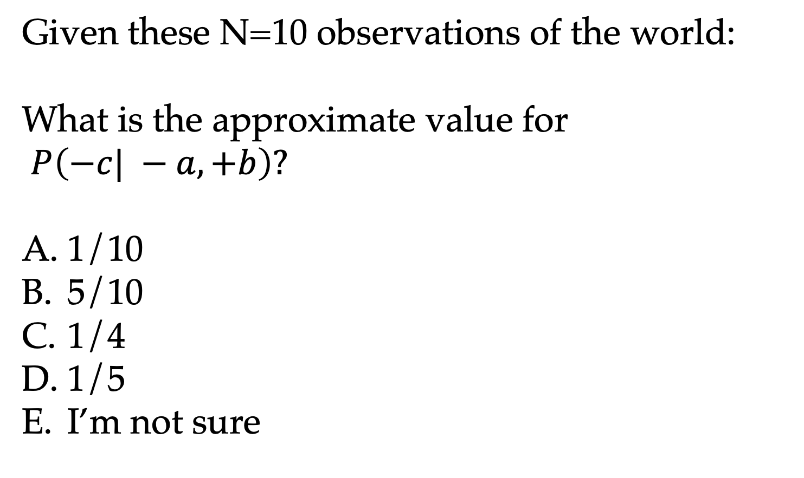
Warm-up
Given these N=10 observations of the world:
What is the approximate value for
$P\left(−c| −a, +b\right)?$
1/10
5/10
1/4
1/5
I’m not sure
Counts
$$−a, −b, +c$$
$$+a,−b, +c$$
$$−a, −b,+c$$
$$−a, +b, +c$$
$$+a, −b, +c$$
$$−a, +b, −c$$
$$−a, +b, +c$$
$$−a, +b, +c$$
$$+a, −b, +c$$
$$−a, +b, +c$$
+a | +b | +c | 0
+a | +b | -c | 0
+a | -b | +c | 3
+a | -b | -c | 0
-a | +b | +c | 4
-a | +b | -c | 1
-a | -b | +c | 2
-a | -b | -c | 0

Slide 9




Sampling
How would you sample from a Bayes net?
+a | 1/2
-a | 1/2
$$P(A)$$
$$A$$
+a | +b | 1/10
 | -b | 9/10
-a | +b | 1/2
 | -b | 1/2
$$P(B|A)$$
$$B$$

Slide 10
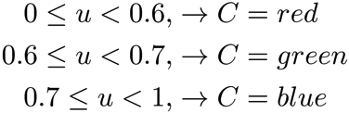

Sampling
Sampling from given distribution
Step 1: Get sample u from uniform distribution over [0, 1)
e.g. random() in python
Step 2: Convert this sample u into an outcome for the given distribution by having each outcome associated with a sub-interval of [0,1) with sub-interval size equal to probability of the outcome
Example
If random() returns u = 0.83, then our sample is C = blue
E.g, after sampling 8 times:
C | P(C)
red | 0.6
green | 0.1
blue | 0.3

Slide 11

Sampling
Sampling is a lot like repeated simulation
Predicting the weather, basketball games, …
Basic idea
Draw N samples from a sampling distribution S
Compute an approximate posterior probability
Show this converges to the true probability P
Why sample?
Learning: get samples from a distribution you don’t know
Inference: getting a sample is faster than computing the right answer (e.g. with variable elimination)

Slide 12
Sampling in Bayes’ Nets
Prior Sampling
Rejection Sampling
Likelihood Weighting
Gibbs Sampling

Slide 13
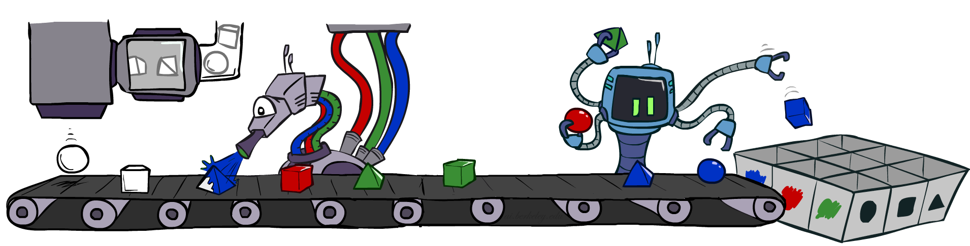
Prior Sampling

Slide 14




Prior Sampling
+c | 0.5
-c | 0.5
Cloudy
Cloudy
+c | +s | 0.1
 | -s | 0.9
-c | +s | 0.5
 | -s | 0.5
+c | +r | 0.8
 | -r | 0.2
-c | +r | 0.2
 | -r | 0.8
Sprinkler
Sprinkler
Rain
Rain
WetGrass
WetGrass
Samples:
+s | +r | +w | 0.99
 |  | -w | 0.01
 | -r | +w | 0.90
 |  | -w | 0.10
-s | +r | +w | 0.90
 |  | -w | 0.10
 | -r | +w | 0.01
 |  | -w | 0.99
+c, -s, +r, +w
-c, +s, -r, +w
…

Slide 15
Prior Sampling
For i=1, 2, …, n
Sample x_{i} from P(X_{i} | Parents(X_{i}))
Return (x₁, x₂, …, x_{n})
One sample

Slide 16
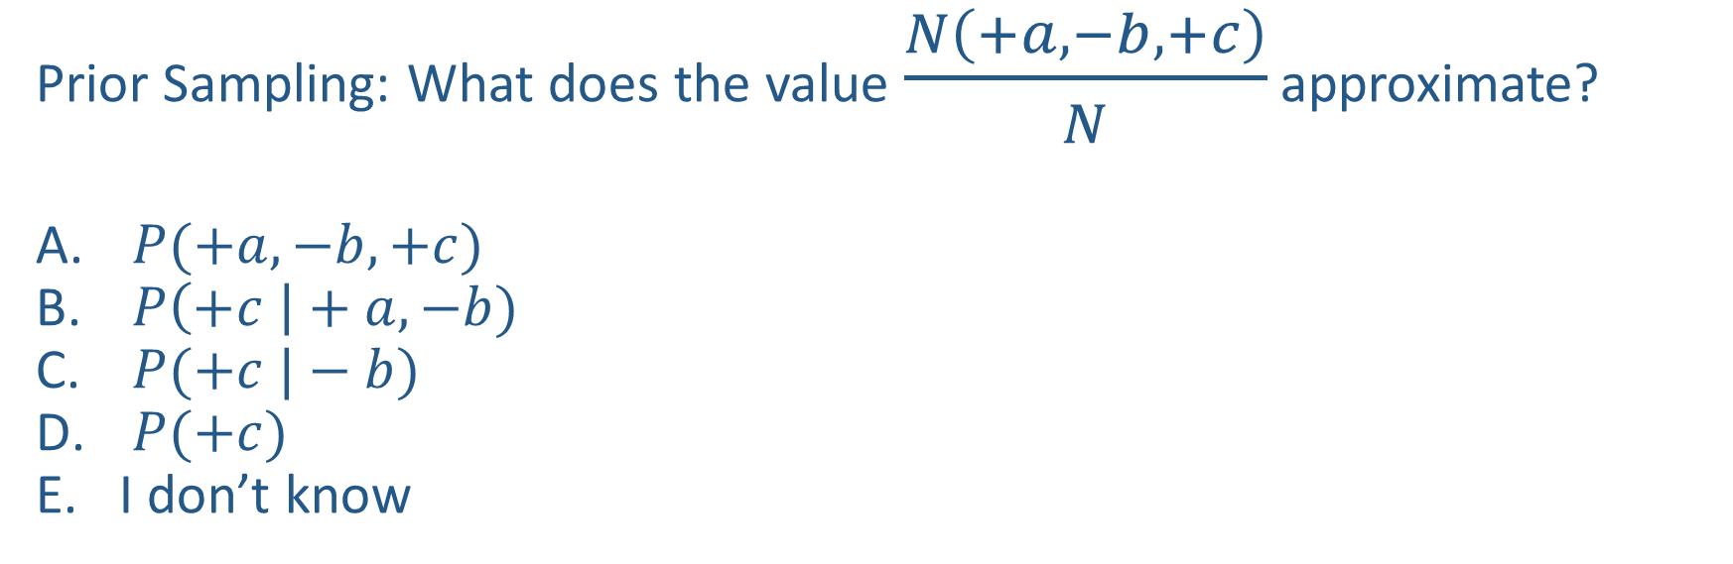

Poll 1
Prior Sampling: What does the value $\frac{N\left(+a, −b, +c\right)}{N}$ approximate?
$P(+a, −b, +c)$
$P\left(+c \right|+a, −b)$
$P(+c |−b)$
$P(+c)$
I don’t know
$$A$$
$$B$$
$$C$$

Slide 17

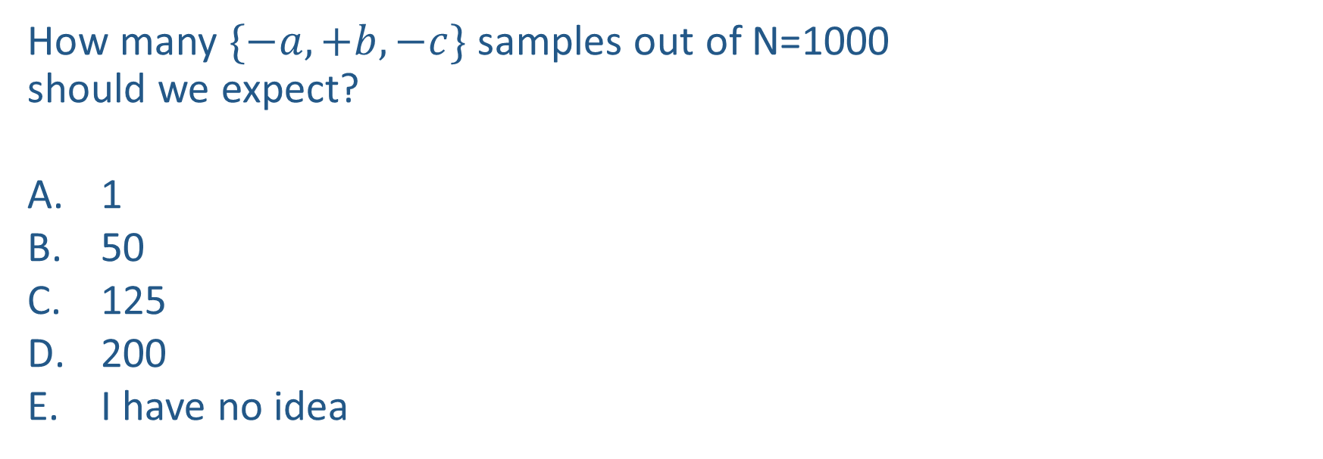
Poll 2
How many $\{−a,+b,−c\}$ samples out of N=1000
should we expect?
1
50
125
200
I have no idea
+a | 1/2
-a | 1/2
$$P(A)$$
$$A$$
+a | +b | 1/10
 | -b | 9/10
-a | +b | 1/2
 | -b | 1/2
$$P(B|A)$$
$$B$$
+b | +c | 4/5
 | -c | 1/5
-b | +c | 1
 | -c | 0
$$C$$
$$P(C|B)$$

Slide 18
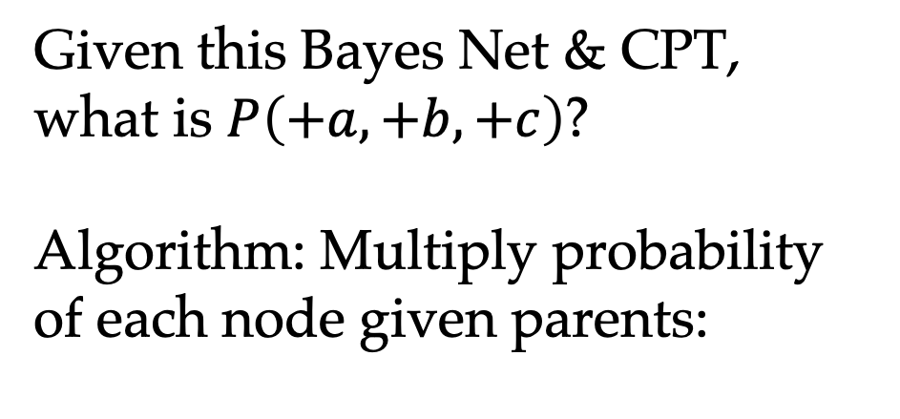
Probability of a sample
Given this Bayes Net & CPT,
what is $P\left(+a,+b,+c\right)$?
Algorithm: Multiply probability of each node given parents:
+a | 1/2
-a | 1/2
$$P(A)$$
$$A$$
+a | +b | 1/10
 | -b | 9/10
-a | +b | 1/2
 | -b | 1/2
$$P(B|A)$$
w = 1.0
for i=1, 2, …, n
Set w = w * P(x_{i} | Parents(X_{i}))
return w
$$B$$
+b | +c | 4/5
 | -c | 1/5
-b | +c | 1
 | -c | 0
$$C$$
$$P(C|B)$$

Slide 19
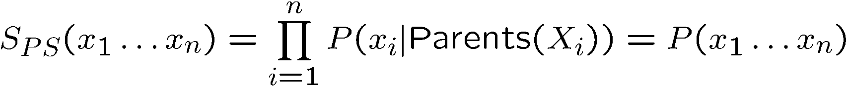

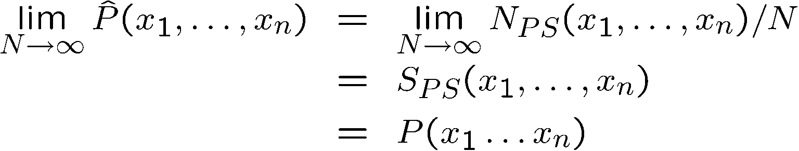
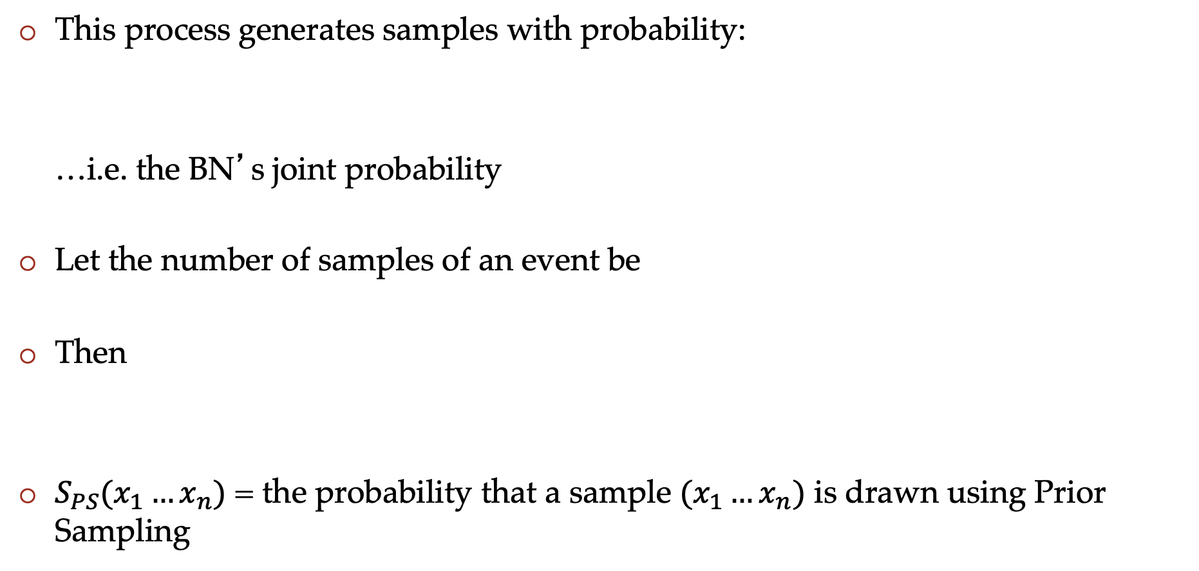
Prior Sampling
This process generates samples with probability:
…i.e. the BN’s joint probability
Let the number of samples of an event be
Then
$S_{PS}(x_{1}…x_{n})$ = the probability that a sample $(x_{1}…x_{n})$ is drawn using Prior Sampling

Slide 20
Example
We’ll get a bunch of samples from the BN:
+c, -s, +r, +w
+c, +s, +r, +w
-c, +s, +r, -w
+c, -s, +r, +w
-c, -s, -r, +w
If we want to know P(W)
We have counts <+w:4, -w:1>
Normalize to get P(W) = <+w:0.8, -w:0.2>
This will get closer to the true distribution with more samples
Can estimate anything else, too
What about P(C| +w)? P(C| +r, +w)? P(C| -r, -w)?
Fast: can use fewer samples if less time (what’s the drawback?)
C
S
R
W

Slide 21
Practice Prior Sampling
Use a random number generator to pick a number between 0 and 100, divide random number by 100 to get a probability
Check the relevant probability distribution to determine what value is selected.
Continue selecting values for each variable until you have a single sample
Record the sample, repeat the process for 9 more samples

Slide 22
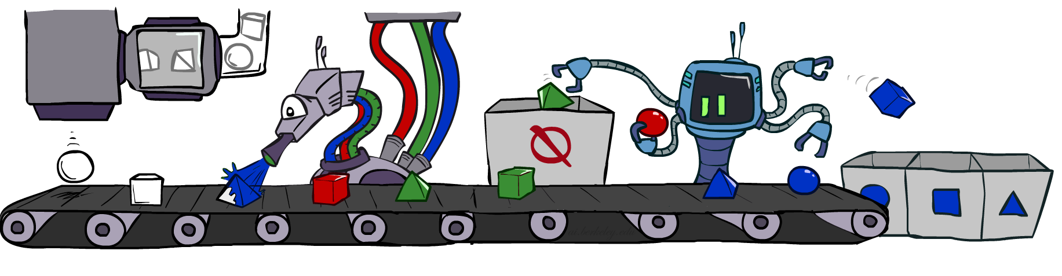
Rejection Sampling

Slide 23
Rejection Sampling
Let’s say we want P(C)
No point keeping all samples around
Just tally counts of C as we go
Let’s say we want P(C| +s)
Same thing: tally C outcomes, but ignore (reject) samples which don’t have S=+s
This is called rejection sampling
It is also consistent for conditional probabilities (i.e., correct in the limit)
C
S
R
W
+c, -s, +r, +w
+c, +s, +r, +w
-c, +s, +r, -w
+c, -s, +r, +w
-c, -s, -r, +w

Slide 24
Rejection Sampling
IN: evidence instantiation
For i=1, 2, …, n
Sample x_{i} from P(X_{i} | Parents(X_{i}))
If x_{i} not consistent with evidence
Reject: Return, and no sample is generated in this cycle
Return (x₁, x₂, …, x_{n})

Slide 25

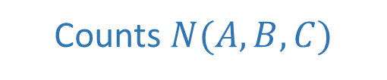
Poll 3
What queries can we (approximately) answer
with rejection sampling samples (evidence: $+c$)?
$P(+a, −b, +c)$
$P(+a, −b |+c)$
Both
Neither
I have no idea
$$A$$
Counts $N(A,B,C)$
+a | +b | +c | 4
+a | +b | -c
+a | -b | +c | 3
+a | -b | -c
-a | +b | +c | 2
-a | +b | -c
-a | -b | +c | 1
-a | -b | -c
$$B$$
$$C$$

Slide 26
Practice Rejection Sampling
Use a random number generator to pick a number between 0 and 100, divide random number by 100 to get a probability
Check the relevant probability distribution to determine what value is selected.
REJECT ENTIRE SAMPLE IF VALUE IS INCONSISTENT WITH EVIDENCE
Continue selecting values for each variable until you have a single sample
Record the sample, repeat the process for 9 more samples

Slide 27
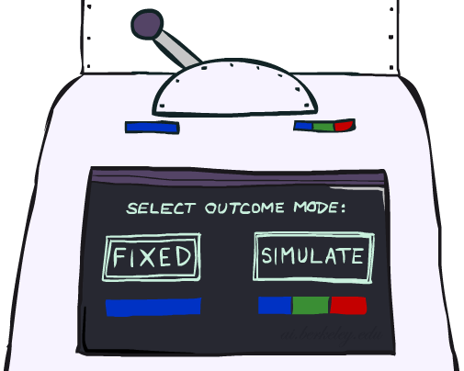
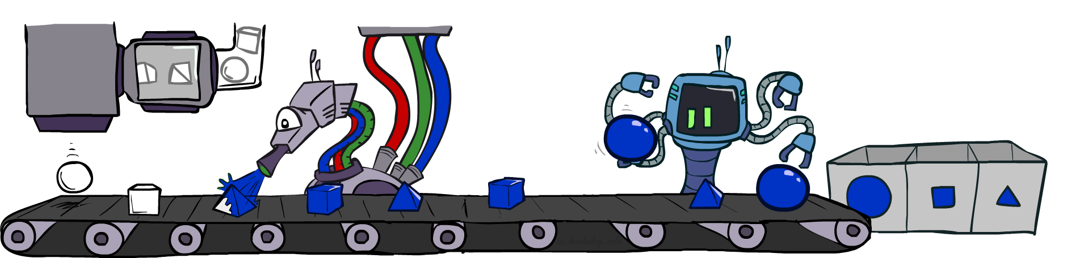
Likelihood Weighting

Slide 28
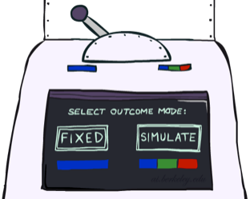


Likelihood Weighting
Problem with rejection sampling:
If evidence is unlikely, rejects lots of samples
Evidence not exploited as you sample
Consider P(Shape|blue)
Idea: fix evidence variables and sample the rest
Problem: sample distribution not consistent!
Solution: weight by probability of evidence given parents
pyramid, green
pyramid, red
sphere, blue
cube, red
sphere, green
pyramid, blue
pyramid, blue
sphere, blue
cube, blue
sphere, blue
Shape
Color
Shape
Color

Slide 29



Likelihood Weighting
+c | 0.5
-c | 0.5
Cloudy
Cloudy
+c | +s | 0.1
 | -s | 0.9
-c | +s | 0.5
 | -s | 0.5
+c | +r | 0.8
 | -r | 0.2
-c | +r | 0.2
 | -r | 0.8
Sprinkler
Sprinkler
Rain
Rain
WetGrass
Samples:
WetGrass
+s | +r | +w | 0.99
 |  | -w | 0.01
 | -r | +w | 0.90
 |  | -w | 0.10
-s | +r | +w | 0.90
 |  | -w | 0.10
 | -r | +w | 0.01
 |  | -w | 0.99
+c, +s, +r, +w
…

Slide 30
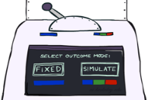
Likelihood Weighting
IN: evidence instantiation
w = 1.0
for i=1, 2, …, n
if X_{i} is an evidence variable
X_{i} = observation x_{i} for X_{i}
Set w = w * P(x_{i} | Parents(X_{i}))
else
Sample x_{i} from P(X_{i} | Parents(X_{i}))
return (x₁, x₂, …, x_{n}), w

Slide 31
Likelihood Weighting
No nodes in evidence:
Prior Sampling
Some nodes in evidence:
Likelihood Weighted Sampling
All nodes in evidence:
Likelihood Weighted
Input: no evidence
for i=1, 2, …, n
Sample x_{i} from P(X_{i} | Parents(X_{i}))
return (x₁, x₂, …, x_{n})
Input: evidence instantiation
w = 1.0
for i=1, 2, …, n
if X_{i} is an evidence variable
X_{i} = observation x_{i} for X_{i}
Set w = w * P(x_{i} | Parents(X_{i}))
else
Sample x_{i} from P(X_{i} | Parents(X_{i}))
return (x₁, x₂, …, x_{n}), w
Input: evidence instantiation
w = 1.0
for i=1, 2, …, n
Set w = w * P(x_{i} | Parents(X_{i}))
return w

Slide 32
Remember Poll 2
How many $\{−a,+b,−c\}$ samples out of N=1000
should we expect?
1
50
125
200
I have no idea
+a | 1/2
-a | 1/2
$$P(A)$$
$$A$$
+a | +b | 1/10
 | -b | 9/10
-a | +b | 1/2
 | -b | 1/2
$$P(B|A)$$
$$B$$
+b | +c | 4/5
 | -c | 1/5
-b | +c | 1
 | -c | 0
$$C$$
$$P(C|B)$$

Slide 33




Likelihood Weighting
How many $\{−a,+b,−c\}$ samples out of N=1000 should we expect?
+a | 1/2
-a | 1/2
$$P(A)$$
$$A$$
+a | +b | 1/10
 | -b | 9/10
-a | +b | 1/2
 | -b | 1/2
$$P(B|A)$$
$$B$$
+b | +c | 4/5
 | -c | 1/5
-b | +c | 1
 | -c | 0
$$C$$
$$P(C|B)$$

Slide 34


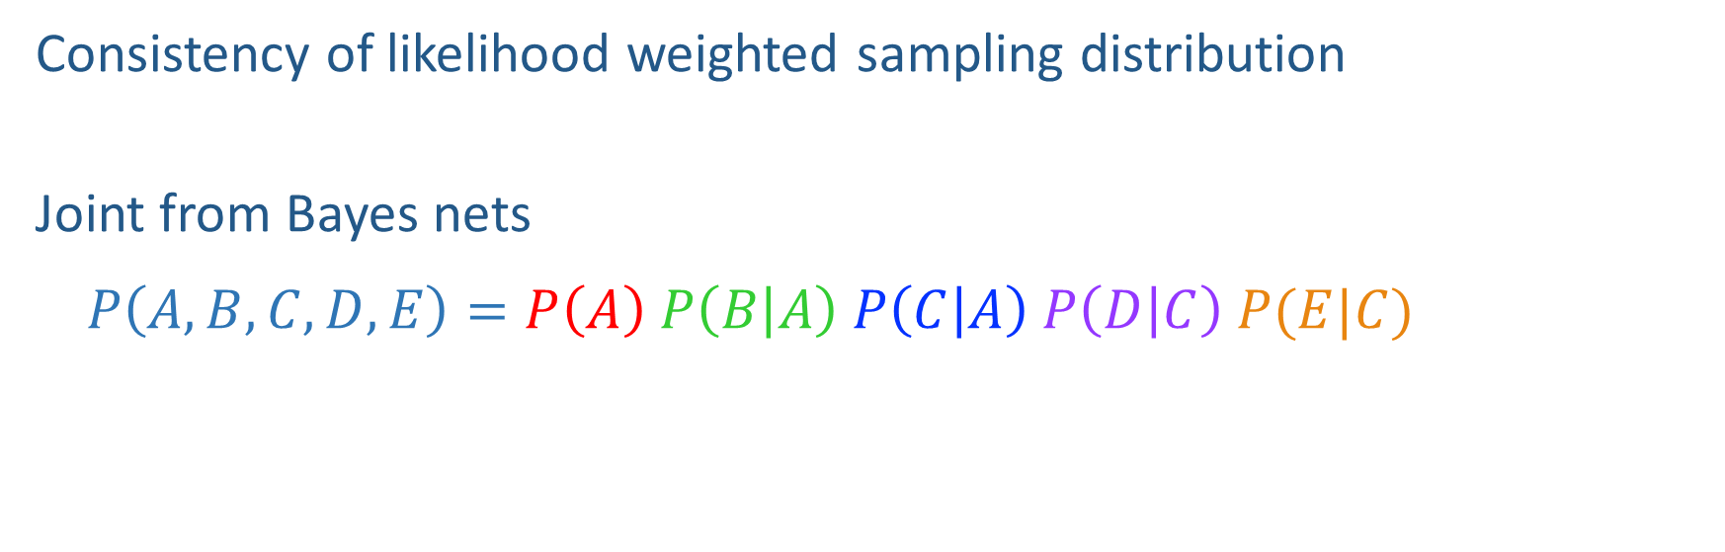



Likelihood Weighting Distribution
Consistency of likelihood weighted sampling distribution
Joint from Bayes nets
$P\left(A,B,C,D,E\right)=P\left(A\right) P\left(B | A\right) P\left(C | A\right) P\left(D | C\right) P(E|C)$
$$A$$
$$B$$
$$C$$
$$D$$
$$E$$

Slide 35
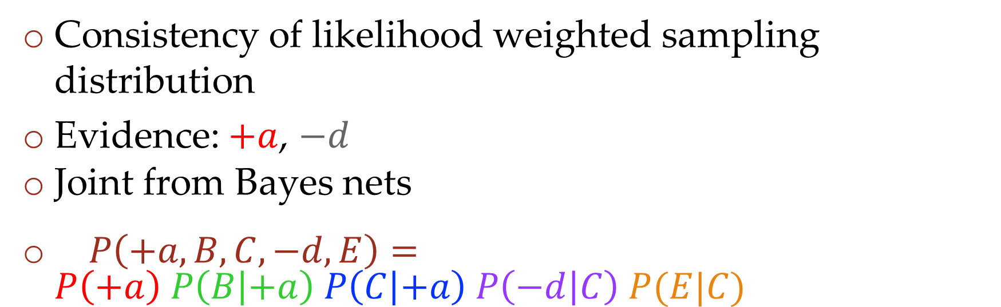

Likelihood Weighting Distribution
Consistency of likelihood weighted sampling distribution
Evidence: $+a$, $−d$
Joint from Bayes nets
$P\left(+a,B,C,−d,E\right)=P\left(+a\right) P\left(B | +a\right) P\left(C | +a\right) P\left(−d | C\right) P(E|C)$
$$A$$
$$B$$
$$C$$
$$D$$
$$E$$

Slide 36
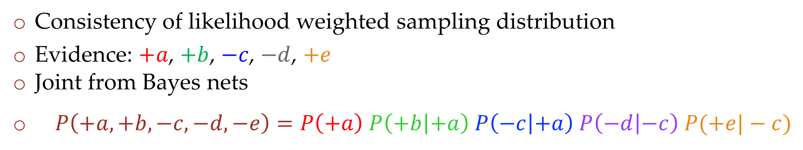
Likelihood Weighting Distribution
Consistency of likelihood weighted sampling distribution
Evidence: $+a$, $+b$, $−c$, $−d$, $+e$
Joint from Bayes nets
$P\left(+a,+b,−c,−d,−e\right)=P\left(+a\right) P\left(+b | +a\right) P\left(−c | +a\right) P\left(−d | −c\right) P(+e|−c)$
$$A$$
$$B$$
$$C$$
$$D$$
$$E$$

Slide 37

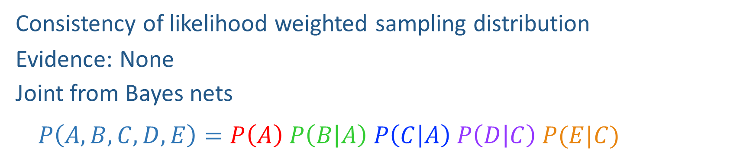
Likelihood Weighting Distribution
Consistency of likelihood weighted sampling distribution
Evidence: None
Joint from Bayes nets
$P\left(A,B,C,D,E\right)=P\left(A\right) P\left(B | A\right) P\left(C | A\right) P\left(D | C\right) P(E|C)$
$$A$$
$$B$$
$$C$$
$$D$$
$$E$$

Slide 38
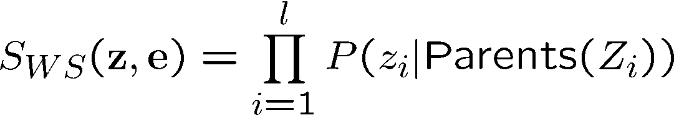
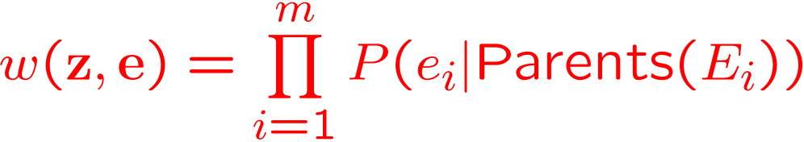
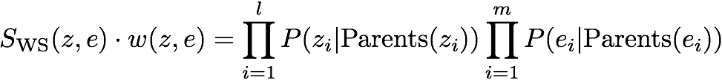

Likelihood Weighting
Sampling distribution if z sampled and e fixed evidence
Now, samples have weights
Together, weighted sampling distribution is consistent
Cloudy
C
S
R
W

Slide 39
Poll 4
Given a fixed query, two identical samples from likelihood weighted sampling will have the same exact weights.
True
False
It depends
I don’t know

Slide 40
Prior sampling vs likelihood sampling

Slide 41
Practice Likelihood Weighted Sampling
For each variable:
If evidence variable: you know the value, and multiply the weight of the sample by P(evidence|parents)
Else: Use a random number generator to pick a number between 0 and 100, divide random number by 100 to get a probability. Check the relevant probability distribution to determine what value is selected.
Continue selecting values for each variable until you have a single sample
Record the sample, repeat the process for 9 more samples
The probability for a given set of variables equals
(COUNT OF SAMPLES * WEIGHT)/(TOTAL COUNT OF SAMPLES)

Slide 42

Likelihood Weighting
Likelihood weighting is good
We have taken evidence into account as we generate the sample
E.g. here, W’s value will get picked based on the evidence values of S, R
More of our samples will reflect the state of the world suggested by the evidence
Likelihood weighting doesn’t solve all our problems
Evidence influences the choice of downstream variables, but not upstream ones (C isn’t more likely to get a value matching the evidence)
We would like to consider evidence when we sample every variable

Slide 43
Likelihood Weighting
Likelihood weighting is good
We have taken evidence into account as we generate the sample
E.g. here, W’s value will get picked based on the evidence values of S, R
More of our samples will reflect the state of the world suggested by the evidence
Likelihood weighting doesn’t solve all our problems
Evidence influences the choice of downstream variables, but not upstream ones (C isn’t more likely to get a value matching the evidence)
We would like to consider evidence when we sample every variable
→ Gibbs sampling

Slide 44
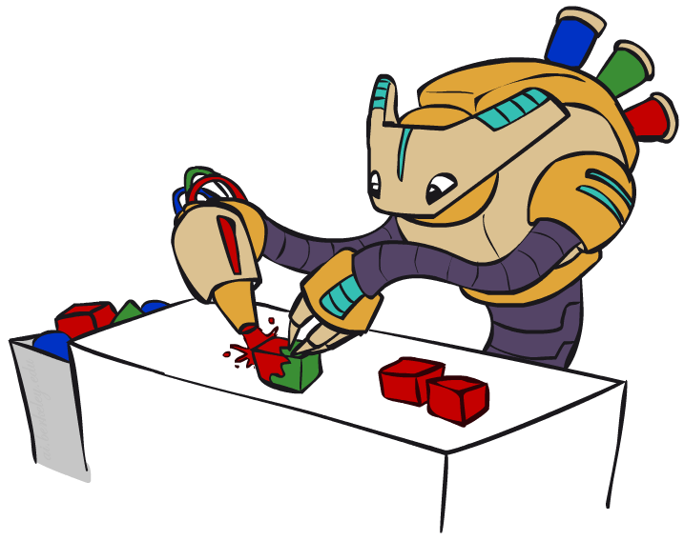
Gibbs Sampling

Slide 45
Gibbs Sampling
Procedure: keep track of a full instantiation x₁, x₂, …, x_{n}.
Start with an arbitrary instantiation consistent with the evidence.
Sample one variable at a time, conditioned on all the rest, but keep evidence fixed.
Keep repeating this for a long time.
When done, keep last values of variables as 1 sample.
Repeat iteration for each sample.

Slide 46
Gibbs Sampling Example: P( S | +r)
Step 1: Fix evidence
R = +r
Steps 3: Repeat
Choose a non-evidence variable X
Resample X from P( X | all other variables)
Step 2: Initialize other variables
Randomly
C
C
S
+r
S
+r
W
W
C
C
C
C
C
C
S
+r
S
+r
S
+r
S
+r
S
+r
S
+r
W
W
W
W
W
W

Slide 47
Gibbs Sampling Example: P( S | +r)
Each iteration here is repeated 5 times.
Keep only the last sample from each iteration:
C
C
C
C
C
S
+r
S
+r
S
+r
S
+r
S
+r
W
W
W
W
W
C
C
C
C
C
S
+r
S
+r
S
+r
S
+r
S
+r
W
W
W
W
W
C
C
C
C
C
S
+r
S
+r
S
+r
S
+r
S
+r
W
W
W
W
W

Slide 48
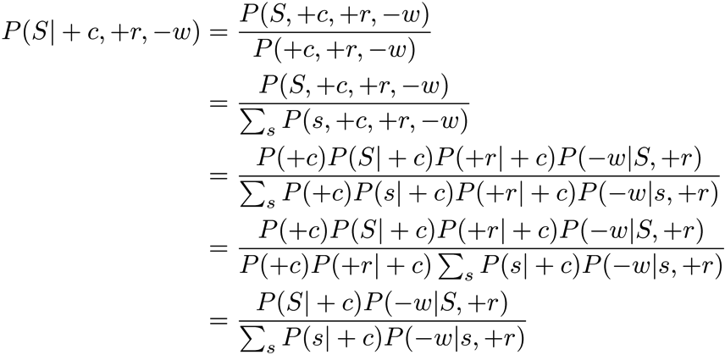
Efficient Resampling of One Variable
C
Sample from P(S | +c, +r, -w)
Many things cancel out – only CPTs with S remain!
More generally: only CPTs that have resampled variable need to be considered, and joined together
S
+r
W

Slide 49
Practice Gibbs Sampling
Procedure: keep track of a full instantiation x₁, x₂, …, x_{n}.
Start with an arbitrary instantiation consistent with the evidence.
Sample one variable at a time, conditioned on all the rest, but keep evidence fixed.
Iterate to repeat this for a long time.
Keep only the last set of variables as ONE sample
Repeat with new sample
Property: in the limit of repeating this infinitely many times the resulting sample is coming from the correct distribution

Slide 50
Gibbs Sampling
Property: in the limit of repeating this infinitely many times the resulting sample is coming from the correct distribution
Rationale: both upstream and downstream variables condition on evidence.
In contrast: likelihood weighting only conditions on upstream evidence, and hence weights obtained in likelihood weighting can sometimes be very small. Sum of weights over all samples is indicative of how many “effective” samples were obtained, so want high weight.

Slide 51
Further Reading on Gibbs Sampling
Gibbs sampling produces sample from the query distribution P( Q | e ) in limit of re-sampling infinitely often
Gibbs sampling is a special case of more general methods called Markov chain Monte Carlo (MCMC) methods
Metropolis-Hastings is one of the more famous MCMC methods (in fact, Gibbs sampling is a special case of Metropolis-Hastings)
You may read about Monte Carlo methods – they’re just sampling

Slide 52
Markov Chain Monte Carlo*
Idea: instead of sampling from scratch, create samples that are each like the last one.
Procedure: resample one variable at a time, conditioned on all the rest, but keep evidence fixed. E.g., for P(b|c):
Properties: Now samples are not independent (in fact they’re nearly identical), but sample averages are still consistent estimators!
What’s the point: both upstream and downstream variables condition on evidence.
+b
+a
+c
-b
+a
+c
-b
-a
+c

Slide 53



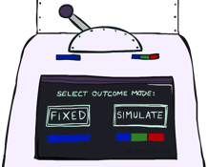

Bayes’ Net Sampling Summary
Prior Sampling P(Q, E)
Likelihood Weighting P( Q , e)
Rejection Sampling P( Q | e )
Gibbs Sampling P( Q | e )

