Slide 1
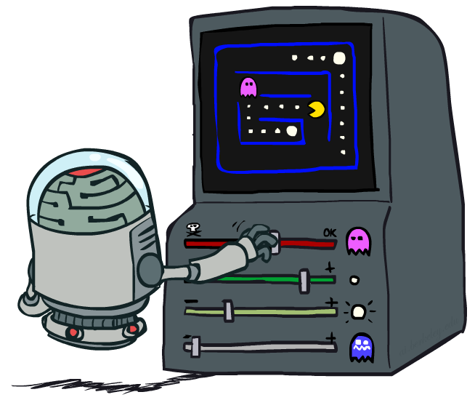
AI: Representation and Problem Solving
Reinforcement Learning II
Instructors: Tuomas Sandholm and Vincent Conitzer
Slide credits: CMU AI and http://ai.berkeley.edu

Slide 2
Overview: MDPs and Reinforcement Learning
Known MDP: Offline Solution
Value Iteration / Policy Iteration
Unknown MDP: Online Learning
Model-Free
Estimate MDP T(s,a,s') and R(s,a,s')
from samples of environment
Passive Reinforcement Learning
Direct Evaluation (simple)
TD Learning
Active Reinforcement Learning
Q-Learning

Slide 3
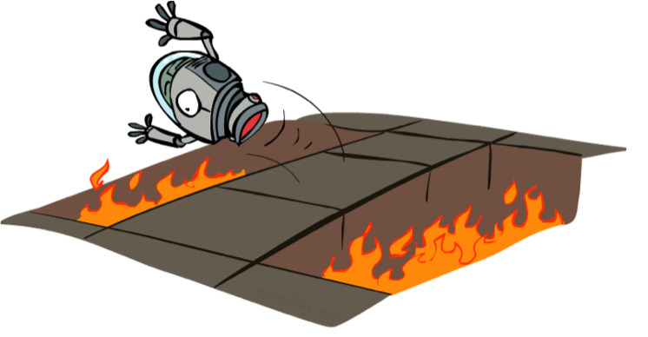
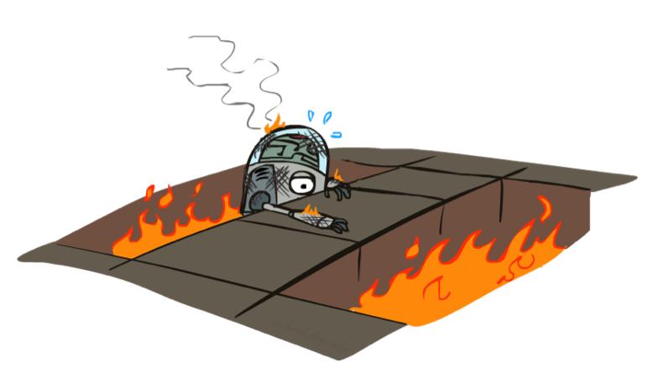
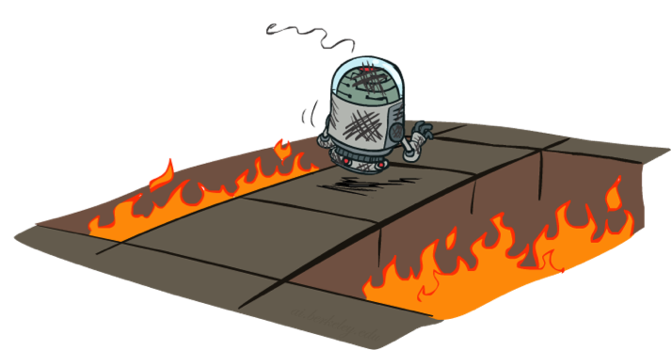
Online Learning Model-free Learning Active Reinforcement Learning Q-learning

Slide 4
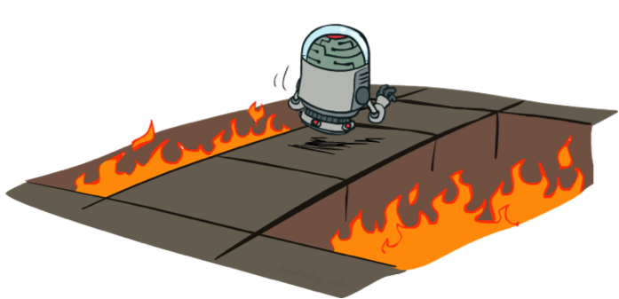
Active Reinforcement Learning
Full reinforcement learning: optimal policies (like value iteration)
You don’t know the transitions T(s,a,s’)
You don’t know the rewards R(s,a,s’)
You choose the actions now
Goal: learn the optimal policy / values
In this case:
Learner makes choices!
Fundamental tradeoff: exploration vs. exploitation
This is NOT offline planning! You actually take actions in the world and find out what happens…

Slide 5
Recall: Q-Value Iteration
Value iteration: find successive (depth-limited) values
Start with V₀(s) = 0, which we know is right
Given V_{k}, calculate the depth k+1 values for all states:
But Q-values are more useful, so compute them instead
Start with Q₀(s,a) = 0, which we know is right
Given Q_{k}, calculate the depth k+1 q-values for all q-states:

Slide 6

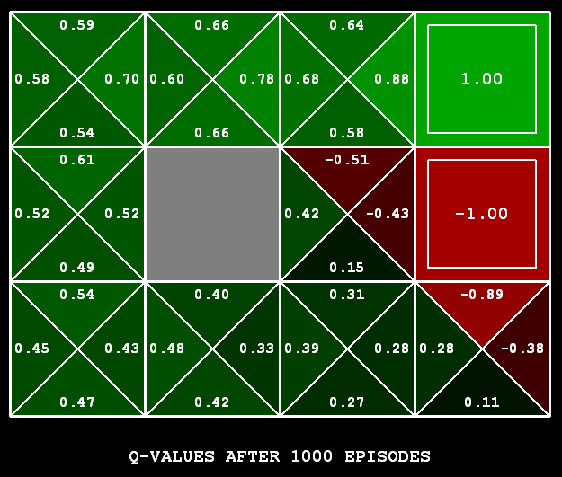
Q-Learning
We’d like to do Q-value updates to each Q-state:
But can’t compute this update without knowing T, R
Instead, learn Q(s,a) values as you go
Receive a sample (s,a,s’,r)
Consider your old estimate:
Consider your new sample estimate:
Incorporate the new estimate into a running average:

Slide 7
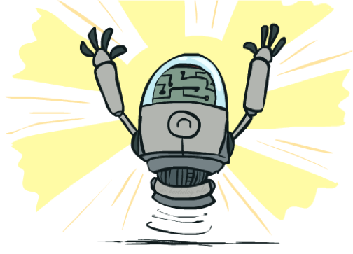
Q-Learning Properties
Amazing result: Q-learning converges to optimal policy -- even if you’re acting suboptimally!
This is called off-policy learning
Caveats:
You have to explore enough
You have to eventually make the learning rate
small enough
… but not decrease it too quickly
Basically, in the limit, it doesn’t matter how you select actions (!)

Slide 8
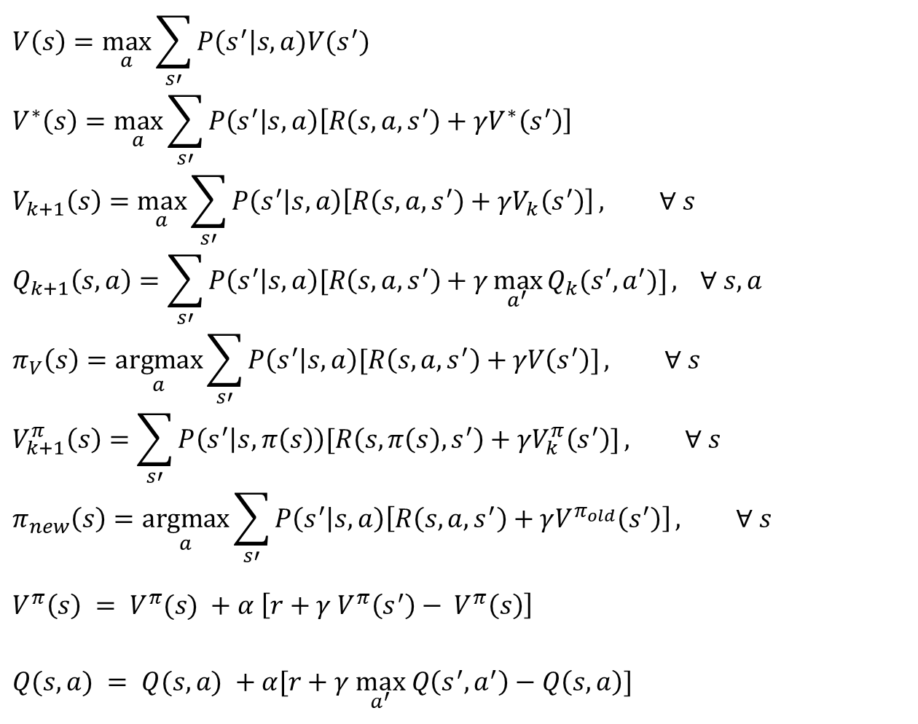
Review: MDP/RL Notation
Standard expectimax:
$$V\left(s\right)=\max_{a}{\sum_{s′}{P\left(s^{′}\right|s,a)V(s^{′})}}$$
$$V^{∗}\left(s\right)=\max_{a}{\sum_{s′}{P\left(s^{′} | s,a\right)\left[R\left(s,a,s^{′}\right)+γV^{∗}\left(s^{′}\right)\right]}}$$
$$V_{k+1}\left(s\right)=\max_{a}{\sum_{s′}{P\left(s^{′} | s,a\right)\left[R\left(s,a,s^{′}\right)+γV_{k}\left(s^{′}\right)\right]}}, ∀ s$$
$$Q_{k+1}\left(s,a\right)=\sum_{s′}{P\left(s^{′} | s,a\right)[R\left(s,a,s^{′}\right)+γ\max_{a^{′}}{Q_{k}(s^{′},a^{′})]}, } ∀ s,a$$
$$π_{V}\left(s\right)=\underset{a}{argmax}{\sum_{s′}{P\left(s^{′} | s,a\right)[R\left(s,a,s^{′}\right)+γV\left(s^{′}\right)]}}, ∀ s$$
$$V_{k+1}^{π}\left(s\right)=\sum_{s′}{P\left(s^{′} | s,π\left(s\right)\right)[R\left(s,π\left(s\right),s^{′}\right)+γV_{k}^{π}\left(s^{′}\right)]}, ∀ s$$
$$π_{new}\left(s\right)=\underset{a}{argmax}{\sum_{s′}{P\left(s^{′} | s,a\right)\left[R\left(s,a,s^{′}\right)+γV^{π_{old}}\left(s^{′}\right)\right]}}, ∀ s$$
$$V^{π}\left(s\right) = V^{π}(s) +α \left[r+γ V^{π}\left(s^{′}\right)− V^{π}\left(s\right)\right]$$
$Q(s,a) = Q(s,a) +α[r+γ \max_{a^{′}} Q\left(s^{′},a^{′}\right)−Q\left(s, a\right)]$
Bellman equations:
Value iteration:
Q-iteration:
Policy extraction:
Policy evaluation:
Policy improvement:
Value (TD) learning:
Q-learning:

Slide 9
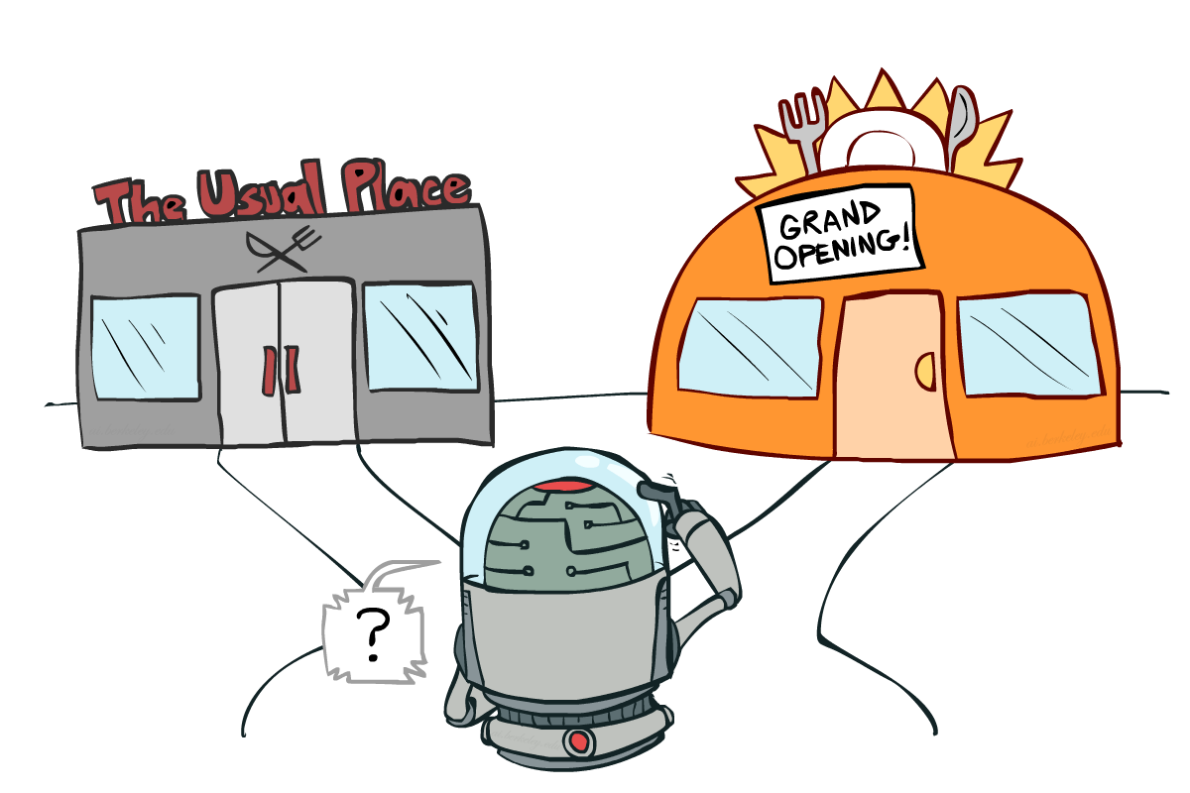
Exploration vs. Exploitation

Slide 10
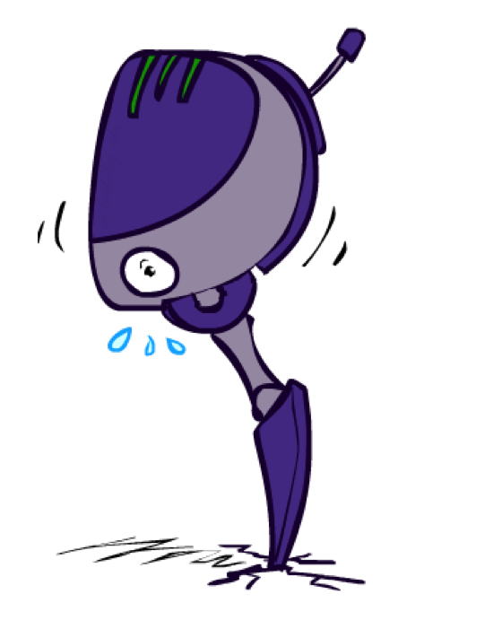
How to Explore?
Several schemes for forcing exploration
Simplest: random actions (ε-greedy)
Every time step, flip a coin
With (small) probability ε, act randomly
With (large) probability 1-ε, act on current policy
Problems with random actions?
You do eventually explore the space, but keep thrashing around once learning is done
One solution: lower ε over time
Another solution: exploration functions

Slide 11
Poll
Exploration should be
Optimistic
Pessimistic

Slide 12
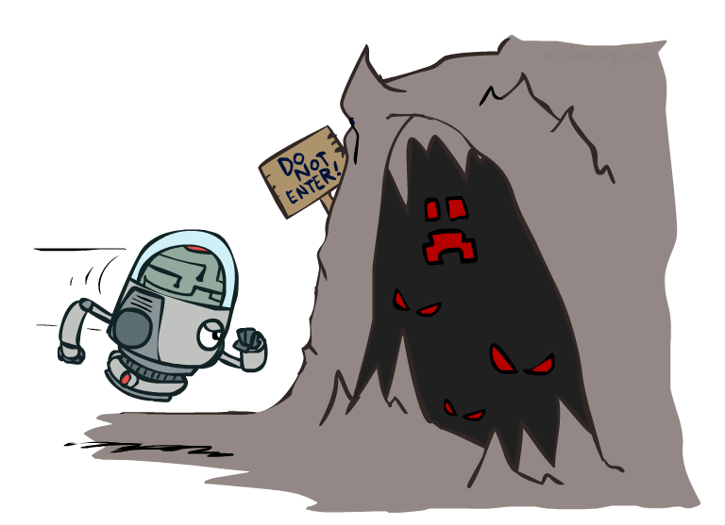

Exploration Functions
When to explore?
Random actions: explore a fixed amount
Better idea: explore areas whose badness is not
(yet) established, eventually stop exploring
Exploration function
Takes a value estimate u and a visit count n, and
returns an optimistic utility, e.g.
Note: this propagates the “bonus” back to states that lead to unknown states as well!
Regular Q-Update:
Modified Q-Update:

Slide 13
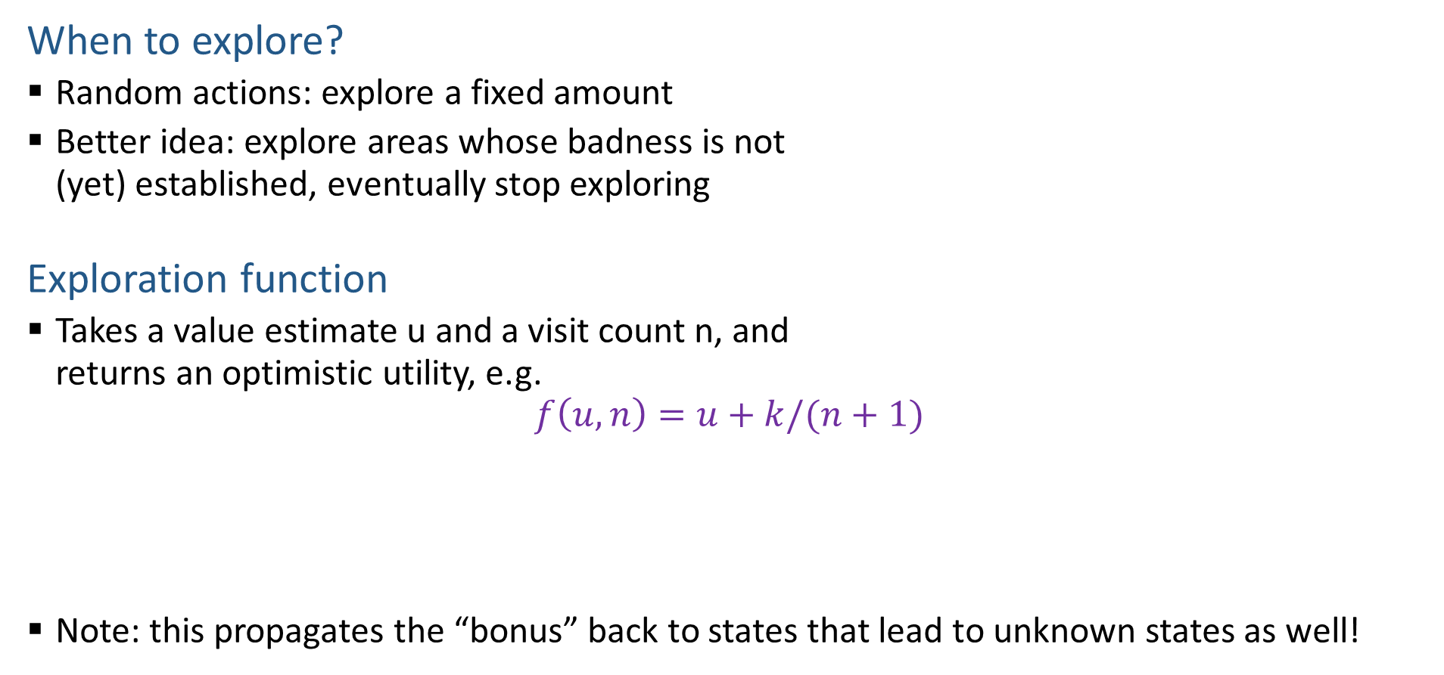
Exploration Functions
When to explore?
Random actions: explore a fixed amount
Better idea: explore areas whose badness is not
(yet) established, eventually stop exploring
Exploration function
Takes a value estimate u and a visit count n, and
returns an optimistic utility, e.g.
$$f\left(u, n\right)=u+k/(n+1)$$
Note: this propagates the “bonus” back to states that lead to unknown states as well!
Regular Q-Update: $Q\left(s, a\right)=Q\left(s,a\right)+α [r+γ\max_{a^{′}} Q\left(s^{′}, a^{′}\right) −Q\left(s, a\right)]$
Modified Q-Update: $Q\left(s, a\right)=Q\left(s,a\right)+α [r+γ\max_{a^{′}} f(Q\left(s^{′}, a^{′}\right), N\left(s^{′}, a^{′}\right)) −Q\left(s, a\right)]$

Slide 14
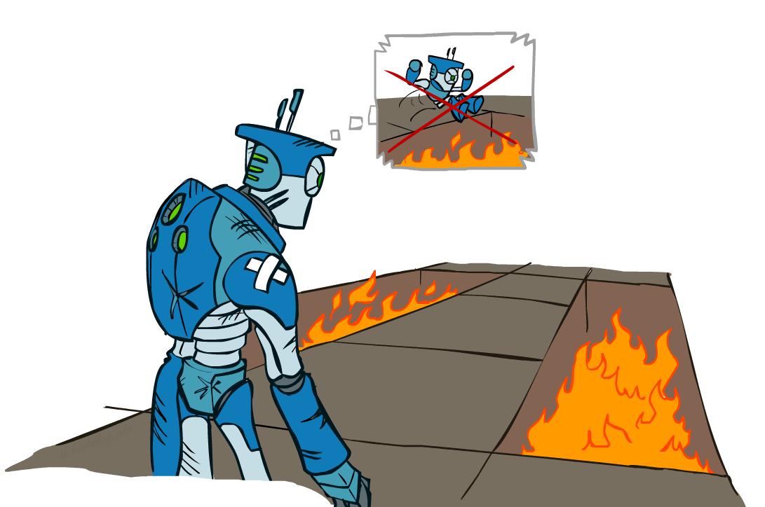
Regret
Even if you learn the optimal policy, you still make mistakes along the way!
Regret is a measure of your total mistake cost: the difference between your (expected) rewards, including youthful suboptimality, and optimal (expected) rewards
Minimizing regret goes beyond learning to be optimal – it requires optimally learning to be optimal
Example: random exploration and exploration functions both end up optimal, but random exploration has higher regret

Slide 15

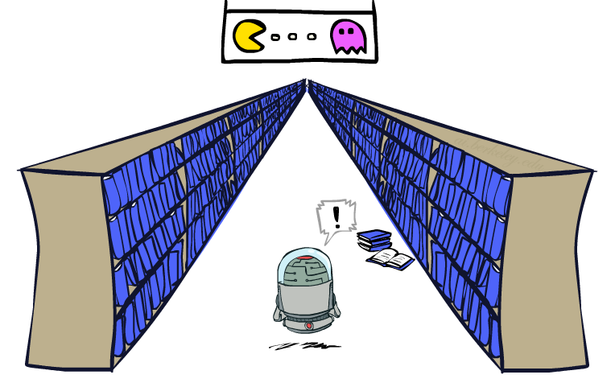
Approximate Q-Learning: Generalizing Across States
Basic Q-Learning keeps a table of all Q-values
In realistic situations, we cannot possibly learn about every single state!
Too many states to visit them all in training
Too many states to hold the Q-tables in memory
Instead, we want to generalize:
Learn about some small number of training states from experience
Generalize that experience to new, similar situations
(This is a fundamental idea in many types of machine learning)

Slide 16
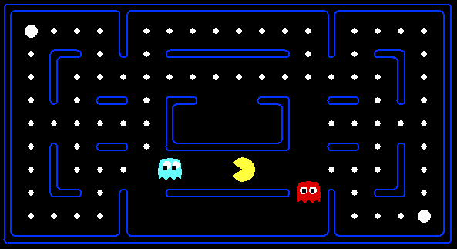



Example: Pacman
Let’s say we discover through experience that this state is bad:
In naïve Q-learning, we know nothing about this state:
Or even this one!

Slide 17
Feature-Based Representations
Solution: describe a state using a vector of features (properties)
Features are functions from states to real numbers (often 0/1) that capture important properties of the state
Example features:
Distance to closest ghost
Distance to closest dot
Number of ghosts
1 / (dist to dot)²
Is Pacman in a tunnel? (0/1)
…… etc.
Is it the exact state on this slide?
Can also describe a Q-state (s, a) with features (e.g., action moves closer to food)

Slide 18
Linear Value Functions
Using a feature representation, we can write a Q function (or value function) for any state using a few weights:
V_{w}(s) = w₁f₁(s) + w₂f₂(s) + … + w_{n}f_{n}(s)
Q_{w}(s,a) = w₁f₁(s,a) + w₂f₂(s,a) + … + w_{n}f_{n}(s,a)
Advantage: our experience is summed up in a few powerful numbers
Disadvantage: states may share features but actually be very different in value!

Slide 19
Updating a linear value function
Original Q learning rule tries to reduce prediction error at s, a:
Q(s,a) ← Q(s,a) + α ⋅ [r + γ max_{a’} Q (s’,a’) - Q(s,a) ]
Instead, we update the weights to try to reduce the error at s, a:
w_{i} ← w_{i} + α ⋅ [r + γ max_{a’} Q (s’,a’) - Q(s,a) ] ∂Q_{w}(s,a)/∂w_{i}
= w_{i} + α ⋅ [r + γ max_{a’} Q (s’,a’) - Q(s,a) ] f_{i}(s,a)

Slide 20

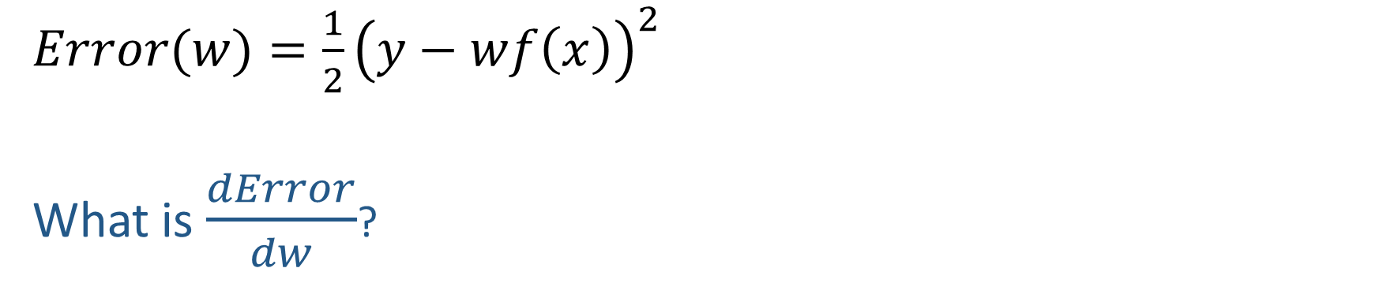
Quick Calculus Quiz
Last time
$$Error\left(x\right)=\frac{1}{2}{\left(y−x\right)}^{2}$$
$$\frac{dError}{dx}=−(y−x)$$
$Error(w)=\frac{1}{2}{\left(y−wf\left(x\right)\right)}^{2}$
What is $\frac{dError}{dw}$?

Slide 21

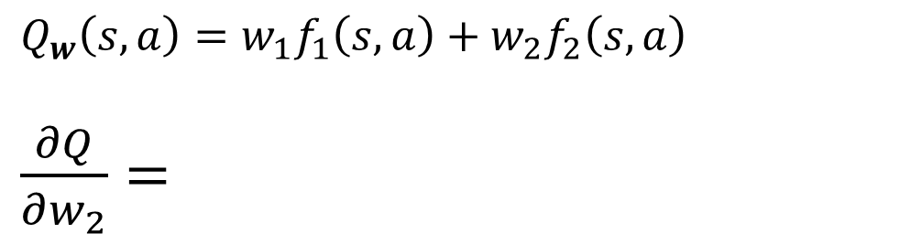
Updating a linear value function
Original Q learning rule tries to reduce prediction error at s, a:
Q(s,a) ← Q(s,a) + α ⋅ [r + γ max_{a’} Q (s’,a’) - Q(s,a) ]
Instead, we update the weights to try to reduce the error at s, a:
w_{i} ← w_{i} + α ⋅ [r + γ max_{a’} Q (s’,a’) - Q(s,a) ] ∂Q_{w}(s,a)/∂w_{i}
= w_{i} + α ⋅ [r + γ max_{a’} Q (s’,a’) - Q(s,a) ] f_{i}(s,a)
$Q_{w}\left(s, a\right)=w_{1}f_{1}\left(s, a\right)+w_{2}f_{2}\left(s, a\right)$
$\frac{∂Q}{∂w_{2}}=$
$$Error\left(w\right)=\frac{1}{2}{\left(y−wf\left(x\right)\right)}^{2}$$
$$\frac{dError}{dw}=−\left(y−wf\left(x\right)\right)f(x)$$

Slide 22
Updating a linear value function
Original Q learning rule tries to reduce prediction error at s, a:
Q(s,a) ← Q(s,a) + α ⋅ [r + γ max_{a’} Q (s’,a’) - Q(s,a) ]
Instead, we update the weights to try to reduce the error at s, a:
w_{i} ← w_{i} + α ⋅ [r + γ max_{a’} Q (s’,a’) - Q(s,a) ] ∂Q_{w}(s,a)/∂w_{i}
= w_{i} + α ⋅ [r + γ max_{a’} Q (s’,a’) - Q(s,a) ] f_{i}(s,a)
Qualitative justification:
Pleasant surprise: increase weights on +ve features, decrease on –ve ones
Unpleasant surprise: decrease weights on +ve features, increase on –ve ones

Slide 23
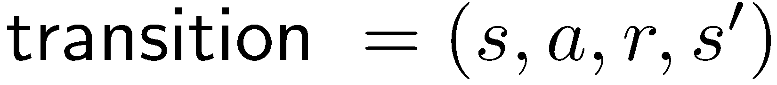
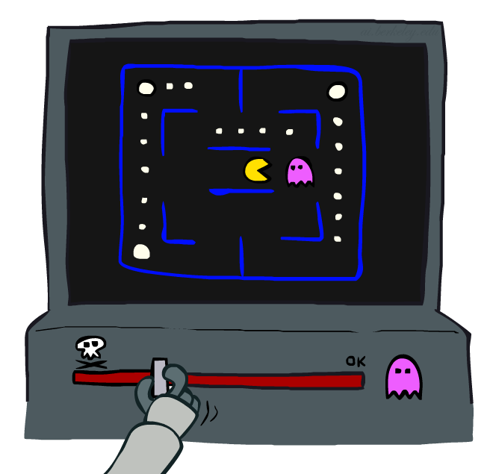
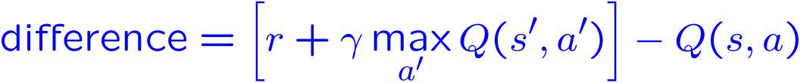
Approximate Q-Learning
Q-learning with linear Q-functions:
Intuitive interpretation:
Adjust weights of active features
E.g., if something unexpectedly bad happens, blame the features that were on: disprefer all states with that state’s features
Formal justification: online least squares
Exact Q’s
Approximate Q’s

Slide 24

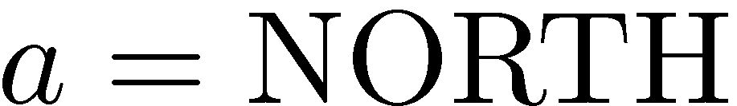
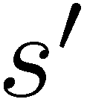
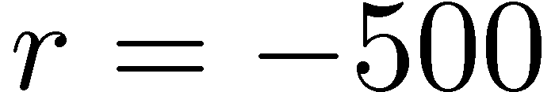


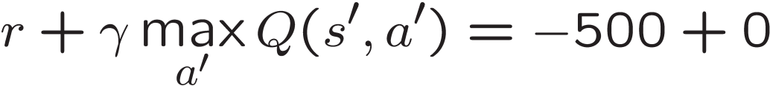
Example: Q-Pacman

Slide 25
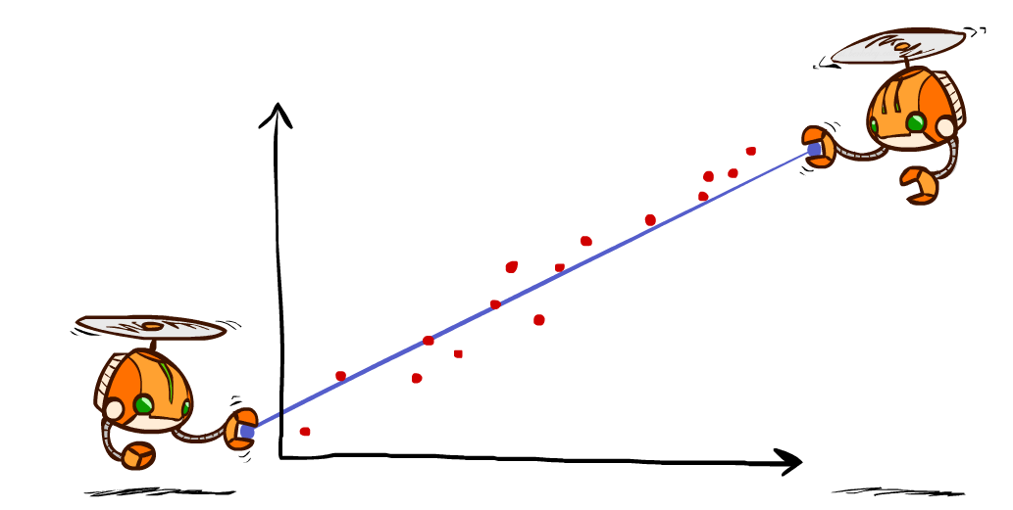
Q-Learning and Least Squares
Notes:
DK :57 in, :17 to go

Slide 26
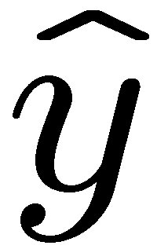
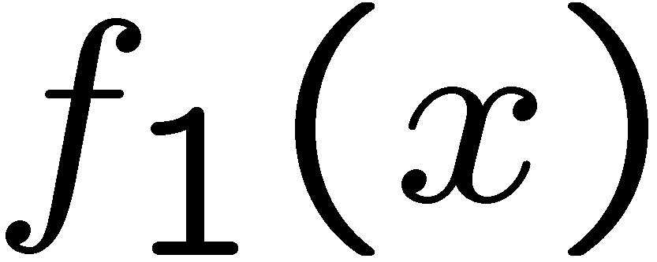
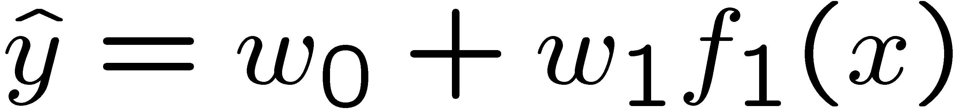
Linear Approximation: Regression
40
26
24
20
22
20
30
20
40
0
0
20
30
10
20
0
10
0
Prediction:
Prediction:
Notes:
Figure 1: scatter(1:20,10+(1:20)+2*randn(1,20),'k','filled'); a=axis; a(3)=0; axis(a);

Slide 27
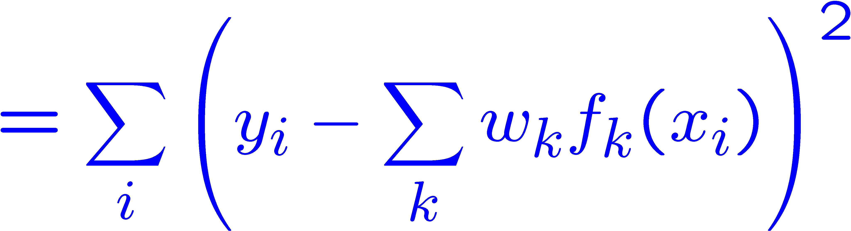
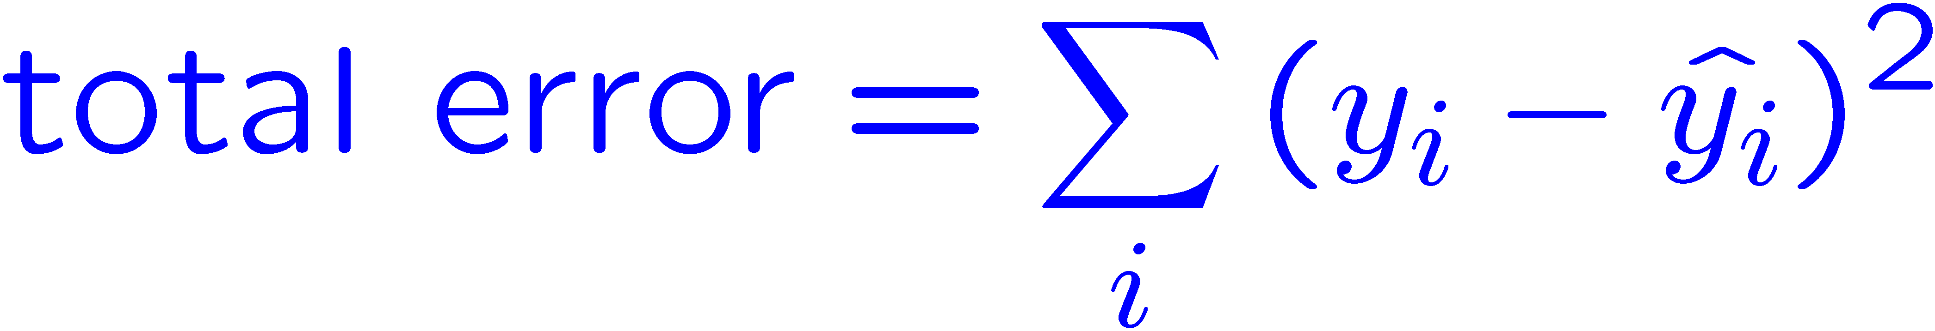
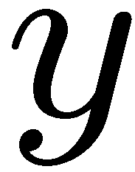
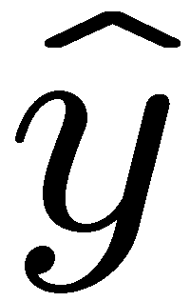

Optimization: Least Squares
Error or “residual”
Observation
Prediction
0
0
20
Notes:
Figure 1: scatter(1:20,10+(1:20)+2*randn(1,20),'k','filled'); a=axis; a(3)=0; axis(a);

Slide 28
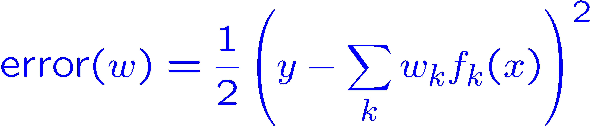
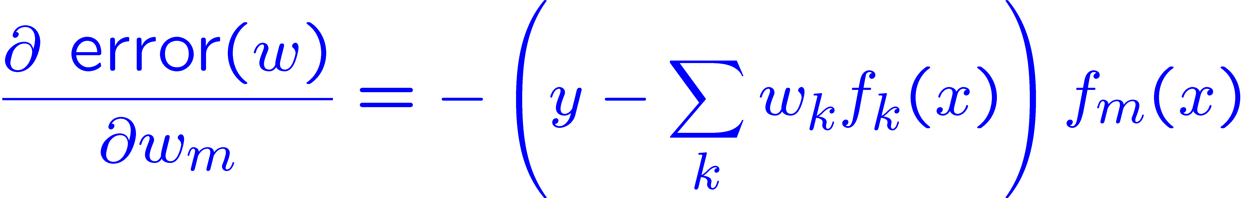
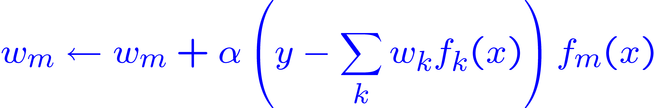
Minimizing Error
Imagine we had only one point x, with features f(x), target value y, and weights w:
Approximate q update explained:
“target”
“prediction”

Slide 29
Recent Reinforcement Learning Milestones

Slide 30
TDGammon
1992 by Gerald Tesauro, IBM
4-ply lookahead using V(s) trained from 1,500,000 games of self-play
3 hidden layers, ~100 units each
Input: contents of each location plus several handcrafted features
Experimental results:
Plays approximately at parity with world champion
Led to radical changes in the way humans play backgammon

Slide 31
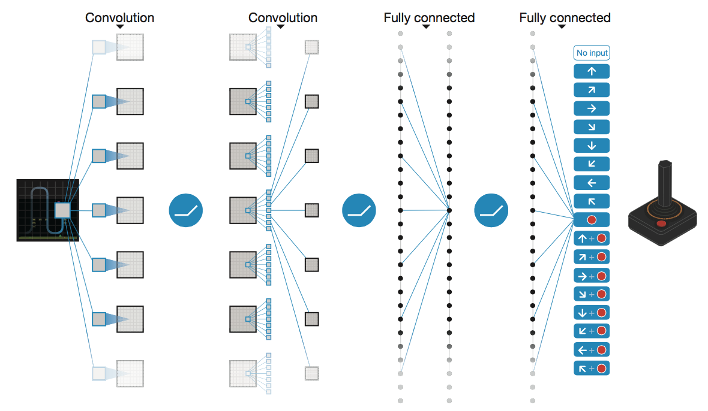
Deep Q-Networks
sample = r + γ max_{a’} Q_{w} (s’,a’)
Q_{w}(s,a): Neural network
Deep Mind, 2015
Used a deep learning network to represent Q:
Input is last 4 images (84x84 pixel values) plus score
49 Atari games, incl. Breakout, Space Invaders, Seaquest, Enduro
Image: Deep Mind

Slide 32
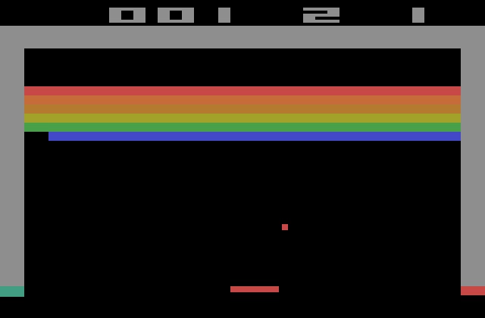
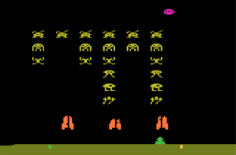
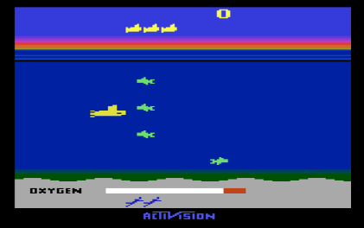
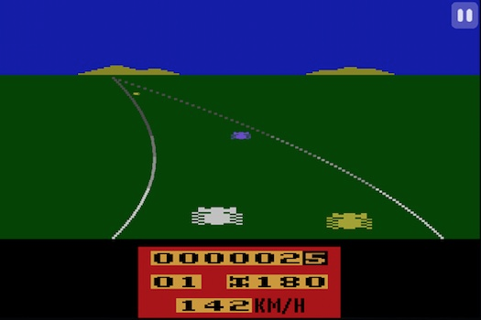
Images: Open AI, Atari

Slide 33
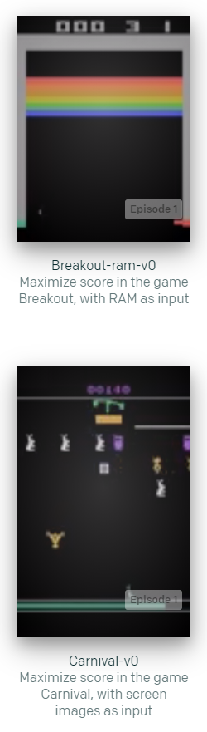
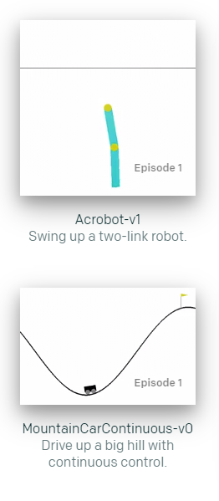
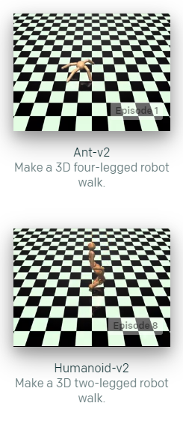
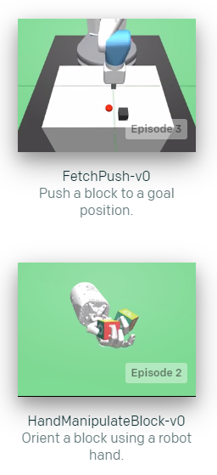
OpenAI Gym
2016+
Benchmark problems for learning agents
https://gym.openai.com/envs
Images: Open AI

Slide 34

AlphaGo, AlphaZero
Deep Mind, 2016+

Slide 35
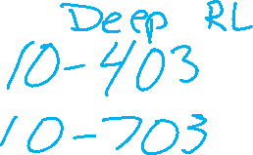
Autonomous Vehicles?

Slide 36
Reinforcement Learning from Human Feedback (RLHF)
Successful applications:
Videogame bots
Simulated robotics
Fine-Tuning Large Language Models (LMMs), e.g., ChatGPT, Gemini, Claude
Text-to-image models

