Slide 1
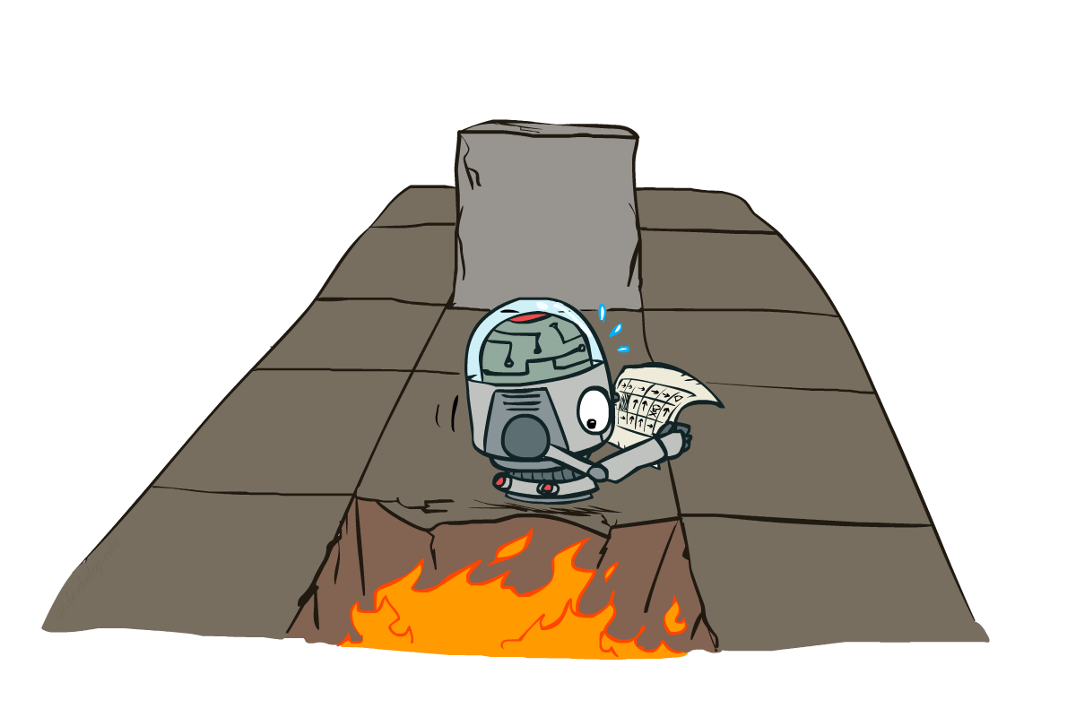
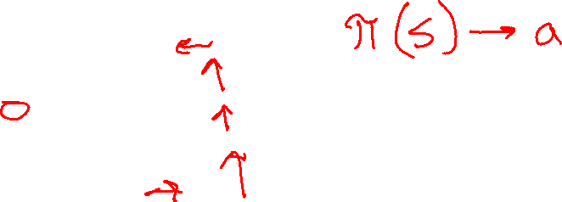
AI: Representation and Problem Solving
Markov Decision Processes II
Instructors: Tuomas Sandholm and Vincent Conitzer
Slide credits: CMU AI and http://ai.berkeley.edu

Slide 2
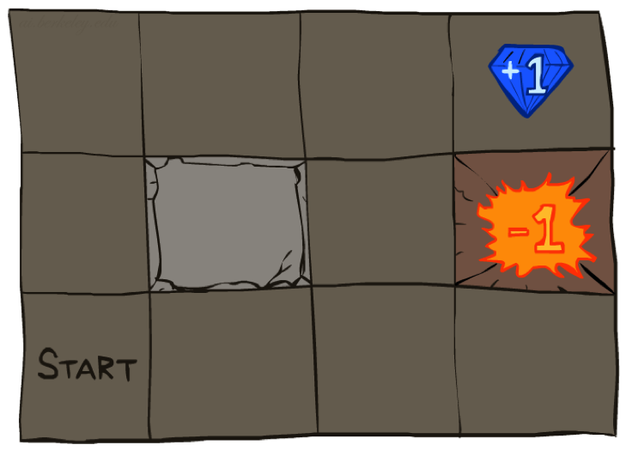




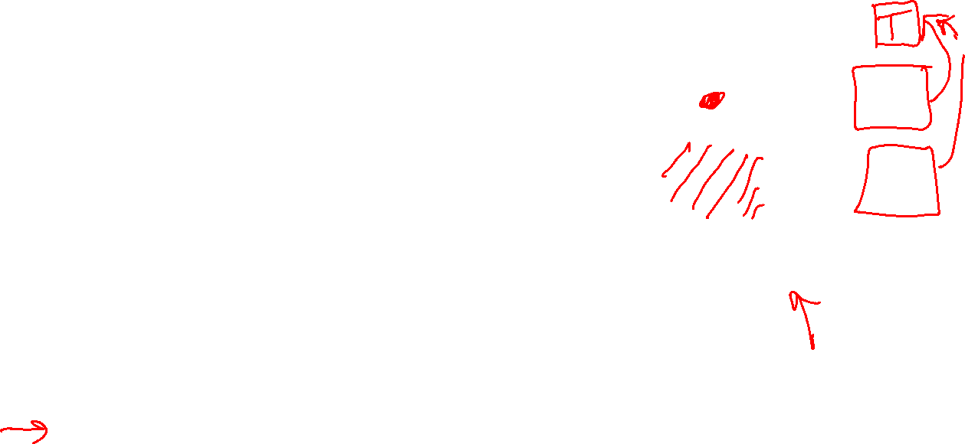
Recap: Grid World
A maze-like problem
The agent lives in a grid
Walls block the agent’s path
Noisy movement: actions do not always go as planned
80% of the time, the action North takes the agent North
10% of the time, North takes the agent West; 10% East
If there is a wall in the direction the agent would have been taken, the agent stays put
The agent receives rewards each time step
Small “living” reward each step (can be negative)
Big rewards come at the end (good or bad)
In the previous lecture we showed an algorithm for solving MDPs: value iteration

Slide 3

The Bellman Equations
How to be optimal:
Step 1: Take correct first action
Step 2: Keep being optimal

Slide 4
The Bellman Equations
s
Definition of “optimal utility” via expectimax recurrence gives a simple one-step lookahead relationship amongst optimal utility values
a
s, a
s,a,s’
s’
Notes:
Let’s start by equations that characterize these quantities through mutual recursions.
Recursive characterization of V* in terms of V*; not necessarily helpful; but it is a characterization.
Note: this is a set of equations that needs to be satisfied; but it could have multiple solutions (it does not, but at this stage of our knowledge it could).

Slide 5

The Bellman Equations
s
Definition of “optimal utility” via expectimax recurrence gives a simple one-step lookahead relationship amongst optimal utility values
a
s, a
s,a,s’
s’
Notes:
Let’s start by equations that characterize these quantities through mutual recursions.
Recursive characterization of V* in terms of V*; not necessarily helpful; but it is a characterization.
Note: this is a set of equations that needs to be satisfied; but it could have multiple solutions (it does not, but at this stage of our knowledge it could).

Slide 6
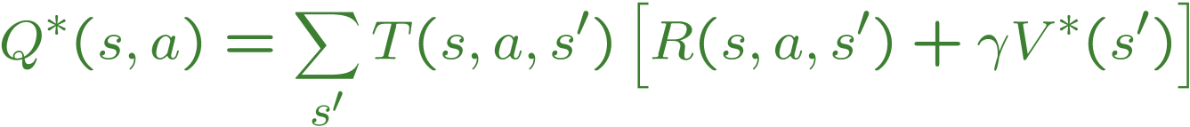
The Bellman Equations
s
Definition of “optimal utility” via expectimax recurrence gives a simple one-step lookahead relationship amongst optimal utility values
a
s, a
s,a,s’
s’
Notes:
Let’s start by equations that characterize these quantities through mutual recursions.
Recursive characterization of V* in terms of V*; not necessarily helpful; but it is a characterization.
Note: this is a set of equations that needs to be satisfied; but it could have multiple solutions (it does not, but at this stage of our knowledge it could).

Slide 7
The Bellman Equations
s
Definition of “optimal utility” via expectimax recurrence gives a simple one-step lookahead relationship amongst optimal utility values
These are the Bellman equations, and they characterize optimal values in a way we’ll use over and over
a
s, a
s,a,s’
s’
Notes:
Let’s start by equations that characterize these quantities through mutual recursions.
Recursive characterization of V* in terms of V*; not necessarily helpful; but it is a characterization.
Note: this is a set of equations that needs to be satisfied; but it could have multiple solutions (it does not, but at this stage of our knowledge it could).

Slide 8
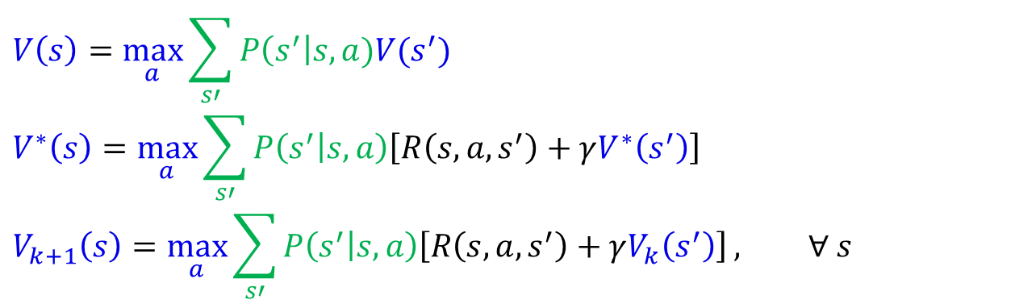
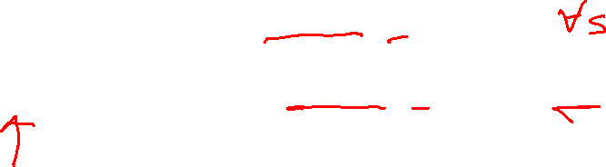
MDP Notation
$$V\left(s\right)=\max_{a}{\sum_{s′}{P\left(s^{′}\right|s,a)V(s^{′})}}$$
$$V^{∗}\left(s\right)=\max_{a}{\sum_{s′}{P\left(s^{′} | s,a\right)\left[R\left(s,a,s^{′}\right)+γV^{∗}\left(s^{′}\right)\right]}}$$
$$V_{k+1}\left(s\right)=\max_{a}{\sum_{s′}{P\left(s^{′} | s,a\right)\left[R\left(s,a,s^{′}\right)+γV_{k}\left(s^{′}\right)\right]}}, ∀ s$$
Standard expectimax:
Bellman equations:
Value iteration:

Slide 9
Value Iteration
s
Bellman equations characterize the optimal values:
Value iteration computes them:
Value iteration is just a fixed point solution method
… though the V_{k} vectors are also interpretable as time-limited values
a
s, a
s,a,s’
Notes:
Computational complexity: S * A * S * number of iterations
Note: updates not in place [if in place, it means something else and not even clear what it means]

Slide 10
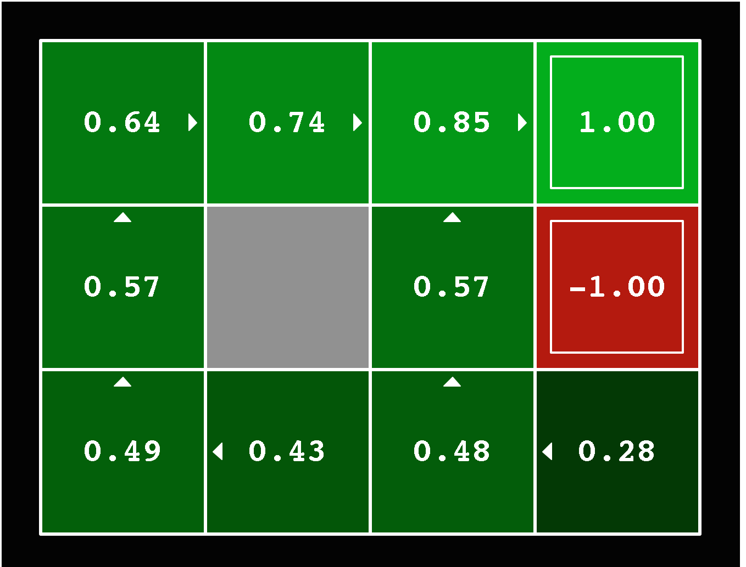
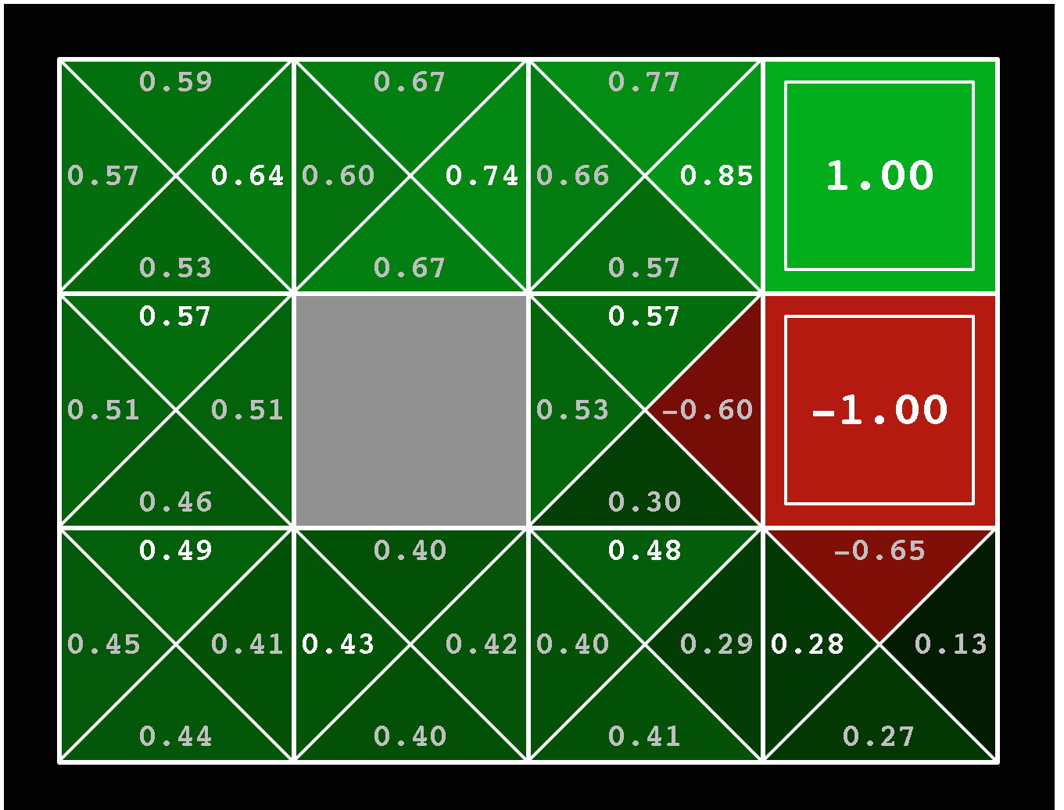



Solved MDP! Now what?
What are we going to do with these values??
$$V^{∗}\left(s\right)$$
$$Q^{∗}\left(s,a\right)$$

Slide 11
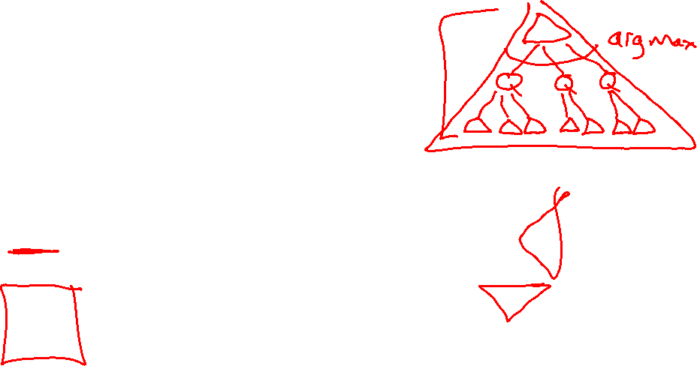
Poll
If you need to extract a policy, would you rather have
A) Values, B) Q-values?

Slide 12
Poll
If you need to extract a policy, would you rather have
A) Values, B) Q-values ?

Slide 13
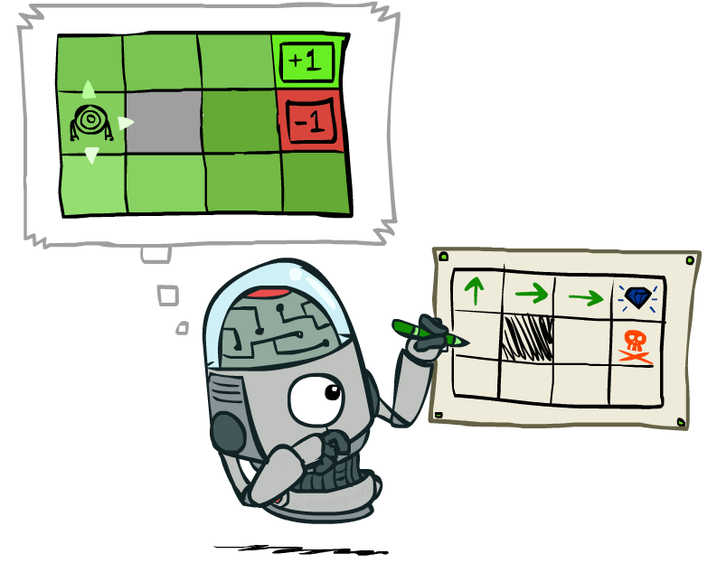
Policy Extraction

Slide 14
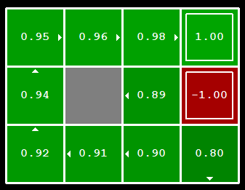

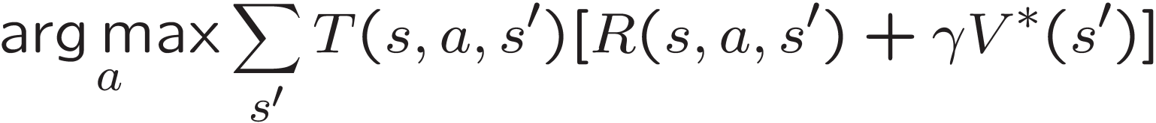
Computing Actions from Values
Let’s imagine we have the optimal values V*(s)
How should we act?
It’s not obvious!
We need to do a mini-expectimax (one step)
This is called policy extraction, since it gets the policy implied by the values

Slide 15
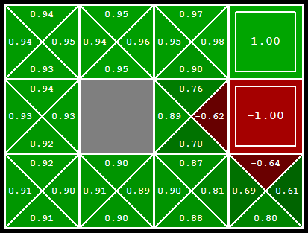
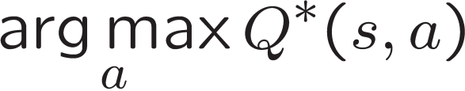
Computing Actions from Q-Values
Let’s imagine we have the optimal Q-values:
How should we act?
Completely trivial to decide!
Important lesson: actions are easier to select from q-values than values!

Slide 16
Value Iteration Notes
Value iteration repeats the Bellman updates:
Things to notice when running value iteration:
It’s slow – O(S²A) per iteration
The “max” at each state rarely changes
The optimal policy appears before the values converge (but we don’t know that the policy is optimal until the values converge)
s
a
s, a
s,a,s’
s’
Notes:
Demo steps through value iteration; snapshots of values shown on next slides.

Slide 17
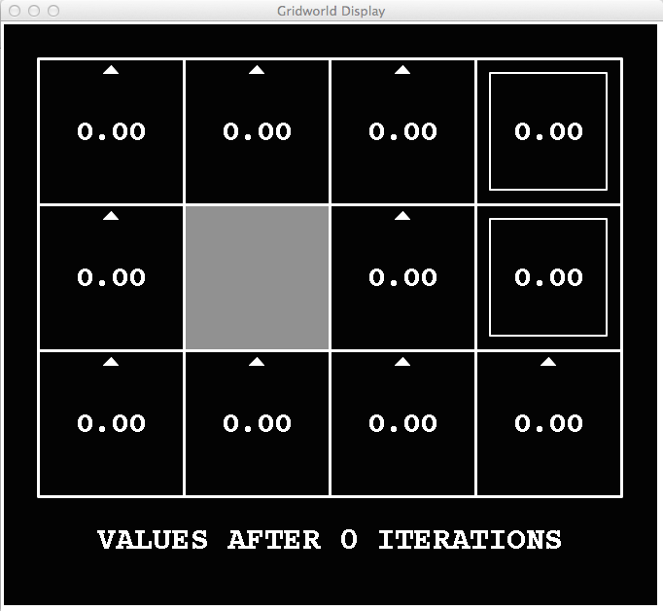
k=0
Noise = 0.2
Discount = 0.9
Living reward = 0
Notes:
Assuming zero living reward

Slide 18
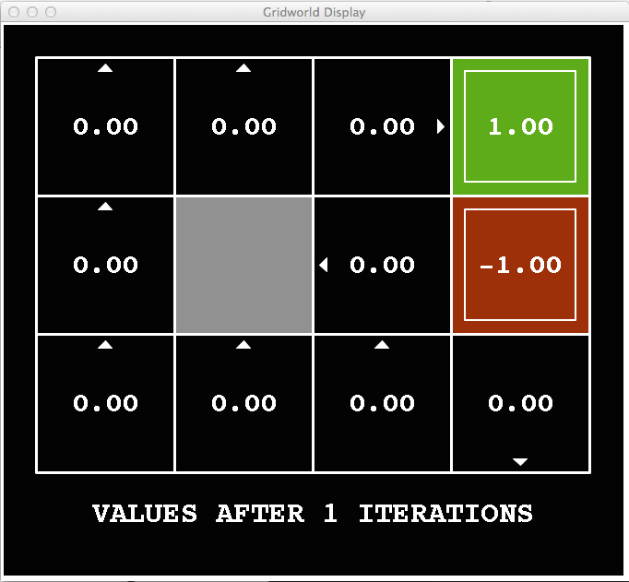
k=1
Noise = 0.2
Discount = 0.9
Living reward = 0
Notes:
Assuming zero living reward

Slide 19
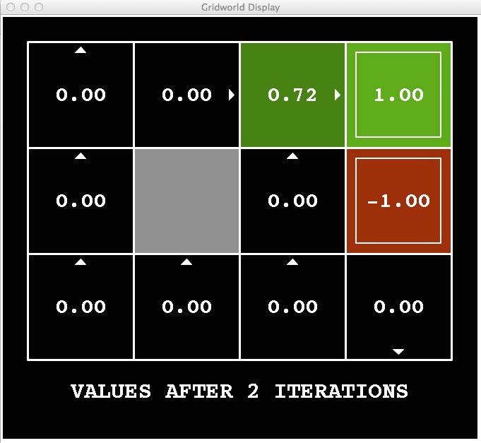
k=2
Noise = 0.2
Discount = 0.9
Living reward = 0
Notes:
Assuming zero living reward

Slide 20
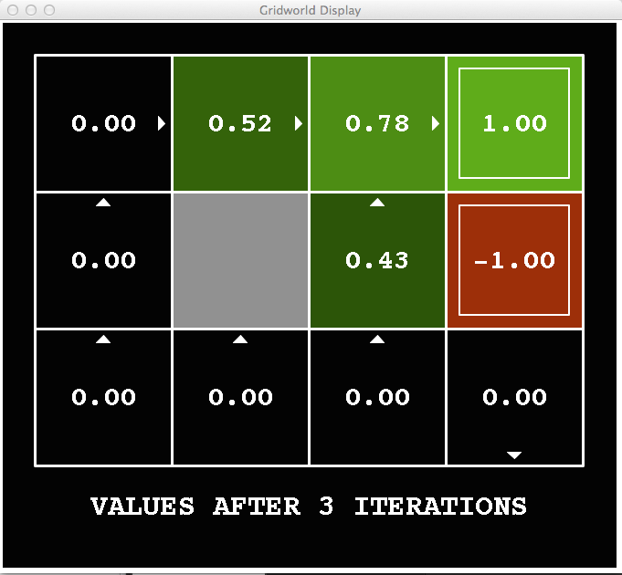
k=3
Noise = 0.2
Discount = 0.9
Living reward = 0
Notes:
Assuming zero living reward

Slide 21
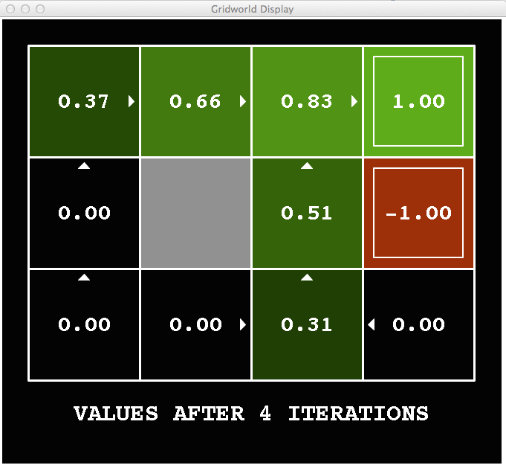
k=4
Noise = 0.2
Discount = 0.9
Living reward = 0
Notes:
Assuming zero living reward

Slide 22
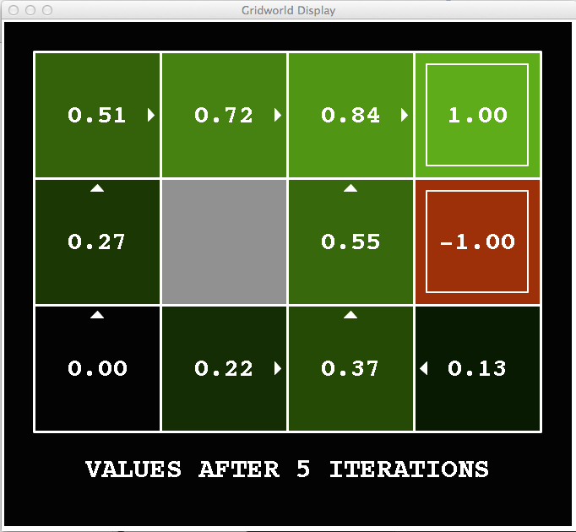
k=5
Noise = 0.2
Discount = 0.9
Living reward = 0
Notes:
Assuming zero living reward

Slide 23
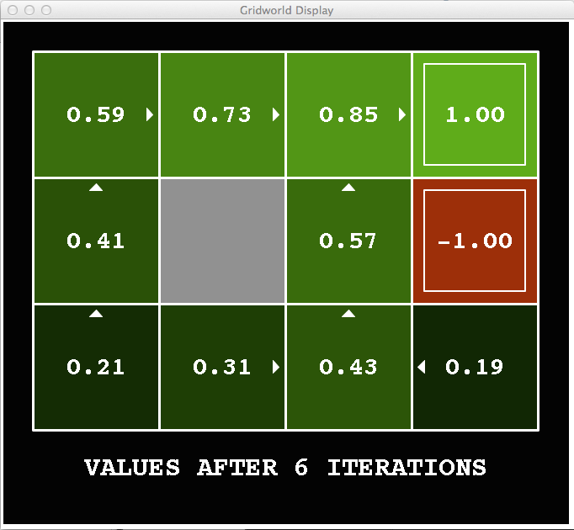
k=6
Noise = 0.2
Discount = 0.9
Living reward = 0
Notes:
Assuming zero living reward

Slide 24
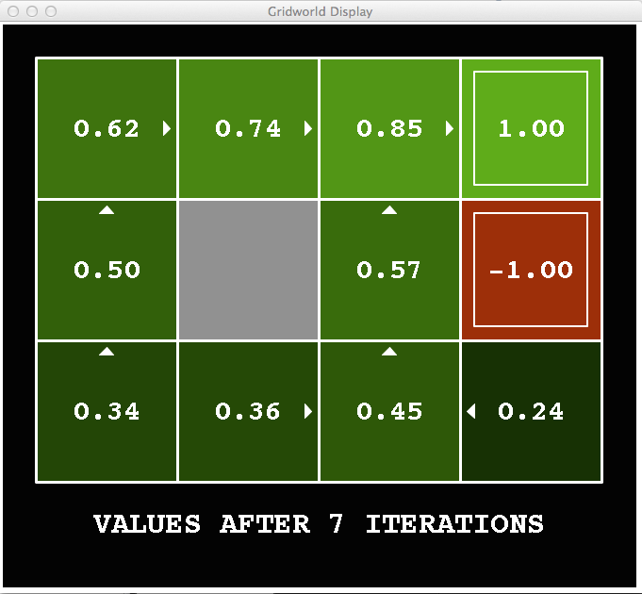
k=7
Noise = 0.2
Discount = 0.9
Living reward = 0
Notes:
Assuming zero living reward

Slide 25
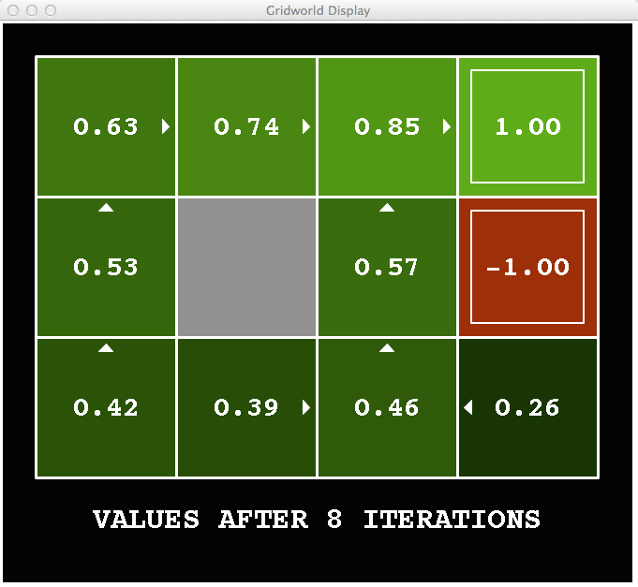
k=8
Noise = 0.2
Discount = 0.9
Living reward = 0
Notes:
Assuming zero living reward

Slide 26
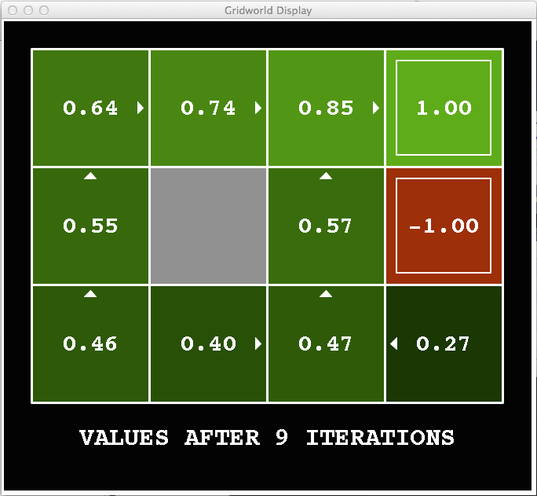

k=9
Noise = 0.2
Discount = 0.9
Living reward = 0
Notes:
Assuming zero living reward

Slide 27


k=10
Noise = 0.2
Discount = 0.9
Living reward = 0
Notes:
Assuming zero living reward

Slide 28

k=11
Noise = 0.2
Discount = 0.9
Living reward = 0
Notes:
Assuming zero living reward

Slide 29
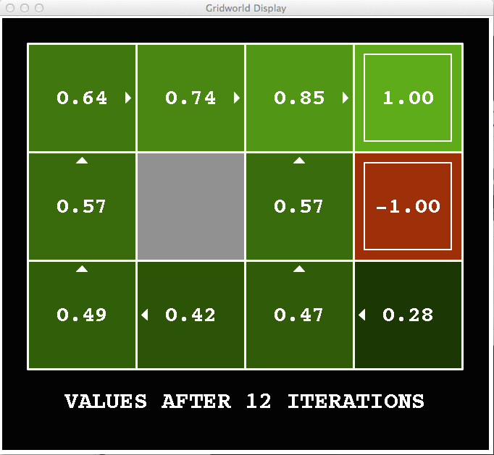

k=12
Noise = 0.2
Discount = 0.9
Living reward = 0
Notes:
Assuming zero living reward

Slide 30

k=100
Noise = 0.2
Discount = 0.9
Living reward = 0
Notes:
Assuming zero living reward

Slide 31

Policy Iteration

Slide 32
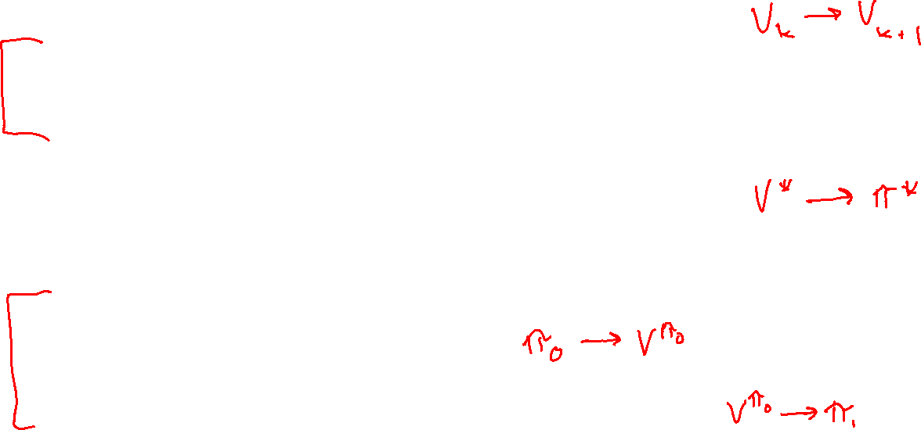
Two Methods for Solving MDPs
Value iteration + policy extraction
Step 1: Value iteration: calculate values for all states by running one ply of the Bellman equations using values from previous iteration until convergence
Step 2: Policy extraction: compute policy by running one ply of the Bellman equations using values from value iteration
Policy iteration
Step 1: Policy evaluation: calculate values for some fixed policy (not optimal values!) until convergence
Step 2: Policy improvement: update policy by running one ply of the Bellman equations using values from policy evaluation
Repeat steps until policy converges

Slide 33
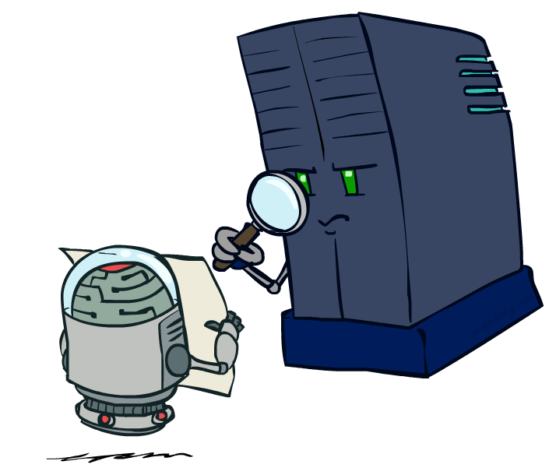
Policy Evaluation

Slide 34

Fixed Policies
Do the optimal action
Do what π says to do
s
s
a
π(s)
s, a
s, π(s)
s,a,s’
s, π(s),s’
s’
s’
Expectimax trees max over all actions to compute the optimal values
If we fixed some policy π(s), then the tree would be simpler – only one action per state
… though the tree’s value would depend on which policy we fixed

Slide 35
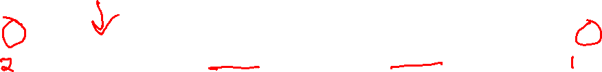
Utilities for a Fixed Policy
Another basic operation: compute the utility of a state s under a fixed (generally non-optimal) policy
Define the utility of a state s, under a fixed policy π:
V^{π}(s) = expected total discounted rewards starting in s and following π
Recursive relation (one-step look-ahead / Bellman equation):
s
π(s)
s, π(s)
s, π(s),s’
s’

Slide 36
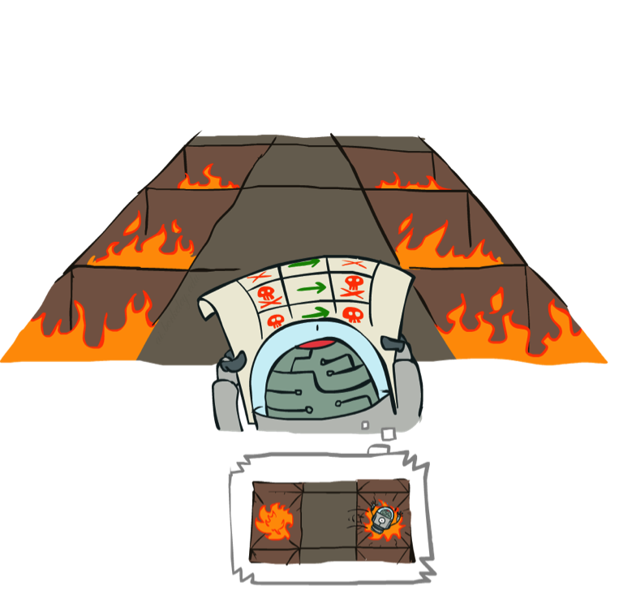
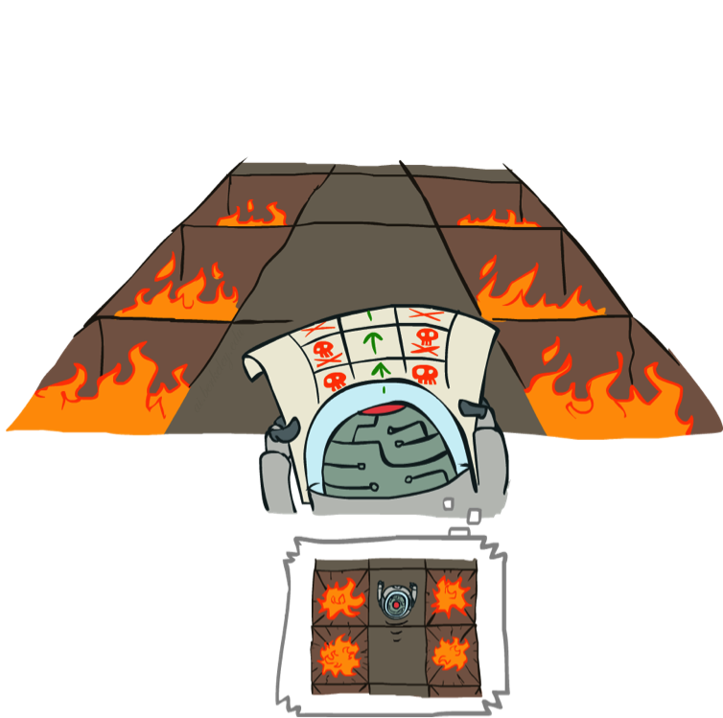

Example: Policy Evaluation
Always Go Right
Always Go Forward

Slide 37
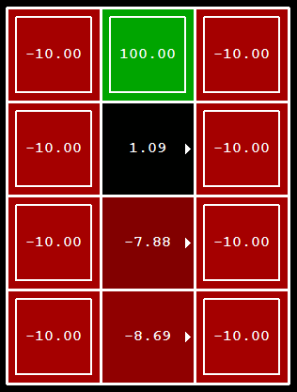
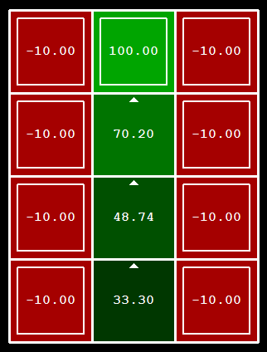
Example: Policy Evaluation
Always Go Right
Always Go Forward

Slide 38

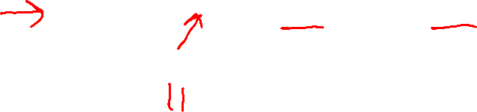
Policy Evaluation
How do we calculate the V’s for a fixed policy π?
Idea 1: Turn recursive Bellman equations into updates
(like value iteration)
Efficiency: O(S²) per iteration
Idea 2: Without the maxes, the Bellman equations are just a linear system
Solve with your favorite linear system solver
s
π(s)
s, π(s)
s, π(s),s’
s’

Slide 39
Policy Iteration

Slide 40
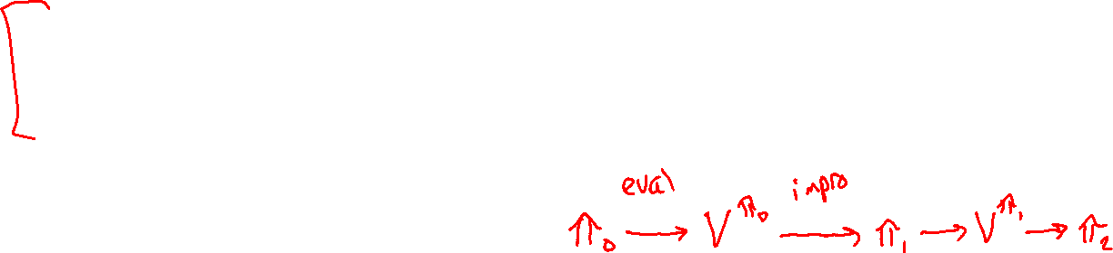
Policy Iteration
Alternative approach for optimal values:
Step 1: Policy evaluation: calculate values for some fixed policy (not optimal values!) until convergence
Step 2: Policy improvement: update policy by running one ply of the Bellman equations using values from policy evaluation
Repeat steps until policy converges
This is policy iteration
It’s still optimal!
Can converge faster under some conditions

Slide 41
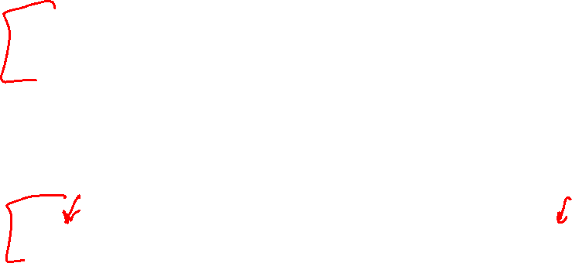
Policy Iteration:
Evaluation: For fixed current policy π, find values with policy evaluation:
Iterate until values converge:
Improvement: For fixed values, get a better policy using policy extraction
One-step look-ahead:

Slide 42
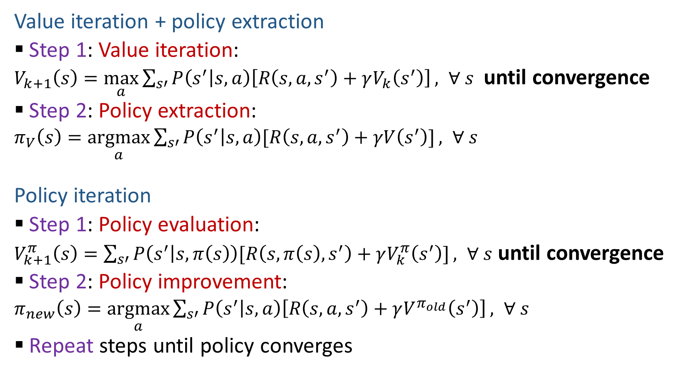
Two Methods for Solving MDPs
Value iteration + policy extraction
Step 1: Value iteration:
$V_{k+1}\left(s\right)=\max_{a}{\sum_{s′}{P\left(s^{′} | s,a\right)\left[R\left(s,a,s^{′}\right)+γV_{k}\left(s^{′}\right)\right]}}, ∀ s$ until convergence
Step 2: Policy extraction:
$π_{V}\left(s\right)=\underset{a}{argmax}{\sum_{s′}{P\left(s^{′} | s,a\right)[R\left(s,a,s^{′}\right)+γV\left(s^{′}\right)]}}, ∀ s$
Policy iteration
Step 1: Policy evaluation:
$V_{k+1}^{π}\left(s\right)=\sum_{s′}{P\left(s^{′} | s,π\left(s\right)\right)[R\left(s,π\left(s\right),s^{′}\right)+γV_{k}^{π}\left(s^{′}\right)]}, ∀ s$ until convergence
Step 2: Policy improvement:
$π_{new}\left(s\right)=\underset{a}{argmax}{\sum_{s′}{P\left(s^{′} | s,a\right)\left[R\left(s,a,s^{′}\right)+γV^{π_{old}}\left(s^{′}\right)\right]}}, ∀ s$
Repeat steps until policy converges

Slide 43
Comparison
Both value iteration and policy iteration compute the same thing (all optimal values)
In value iteration:
Every iteration updates both the values and (implicitly) the policy
We don’t track the policy, but taking the max over actions implicitly recomputes it
In policy iteration:
We do several passes that update values with fixed policy (each pass is fast because we consider only one action, not all of them; however we do many passes)
After the policy is evaluated, a new policy is chosen (slow like a value iteration pass)
The new policy will be better (or we’re done)
(Both are dynamic programs for solving MDPs)

Slide 44
Summary: MDP Algorithms
So you want to….
Compute optimal values: use value iteration or policy iteration
Compute values for a particular policy: use policy evaluation
Turn your values into a policy: use policy extraction (one-step lookahead)
These all look the same!
They basically are – they are all variations of Bellman updates
They all use one-step lookahead expectimax fragments
They differ only in whether we plug in a fixed policy or max over actions

Slide 45
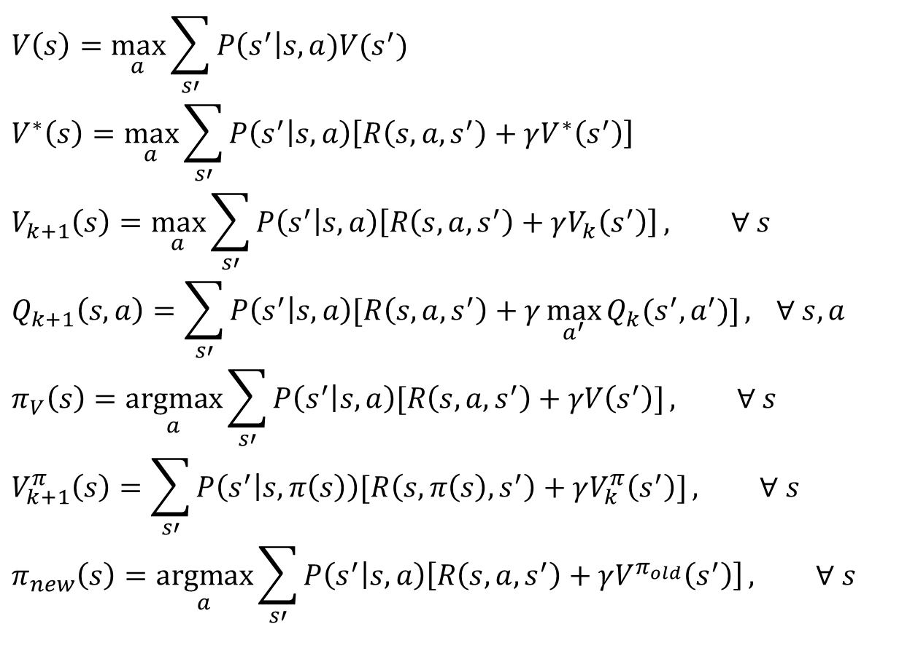
MDP Notation
$$V\left(s\right)=\max_{a}{\sum_{s′}{P\left(s^{′}\right|s,a)V(s^{′})}}$$
$$V^{∗}\left(s\right)=\max_{a}{\sum_{s′}{P\left(s^{′} | s,a\right)\left[R\left(s,a,s^{′}\right)+γV^{∗}\left(s^{′}\right)\right]}}$$
$$V_{k+1}\left(s\right)=\max_{a}{\sum_{s′}{P\left(s^{′} | s,a\right)\left[R\left(s,a,s^{′}\right)+γV_{k}\left(s^{′}\right)\right]}}, ∀ s$$
$$Q_{k+1}\left(s,a\right)=\sum_{s′}{P\left(s^{′} | s,a\right)[R\left(s,a,s^{′}\right)+γ\max_{a^{′}}{Q_{k}(s^{′},a^{′})]}, } ∀ s,a$$
$$π_{V}\left(s\right)=\underset{a}{argmax}{\sum_{s′}{P\left(s^{′} | s,a\right)[R\left(s,a,s^{′}\right)+γV\left(s^{′}\right)]}}, ∀ s$$
$$V_{k+1}^{π}\left(s\right)=\sum_{s′}{P\left(s^{′} | s,π\left(s\right)\right)[R\left(s,π\left(s\right),s^{′}\right)+γV_{k}^{π}\left(s^{′}\right)]}, ∀ s$$
$$π_{new}\left(s\right)=\underset{a}{argmax}{\sum_{s′}{P\left(s^{′} | s,a\right)\left[R\left(s,a,s^{′}\right)+γV^{π_{old}}\left(s^{′}\right)\right]}}, ∀ s$$
Standard expectimax:
Bellman equations:
Value iteration:
Q-iteration:
Policy extraction:
Policy evaluation:
Policy improvement:

Slide 46
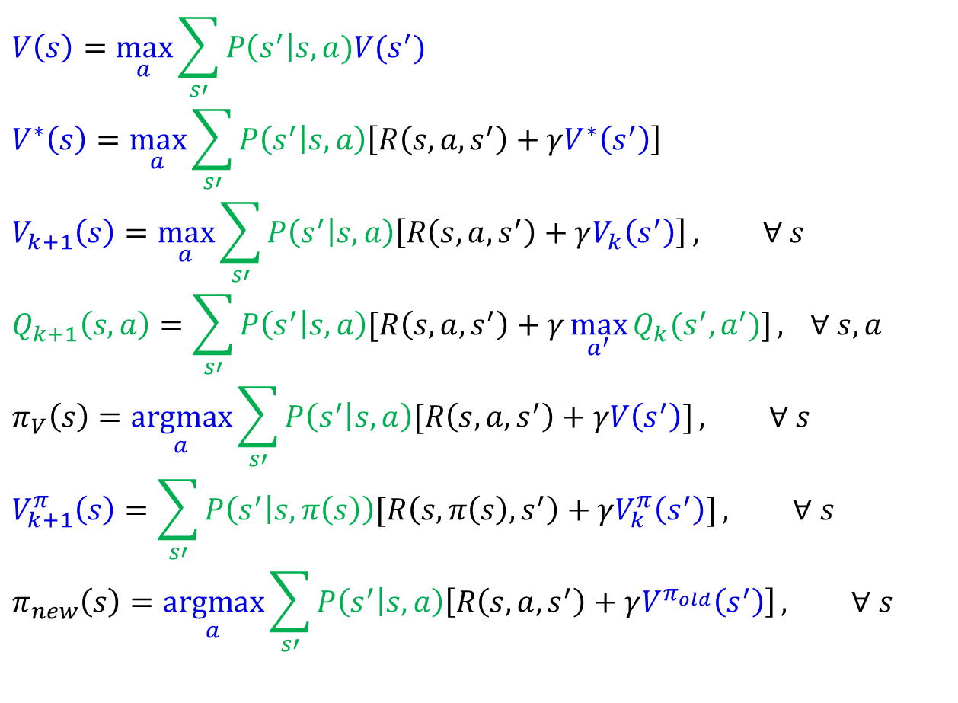
MDP Notation
$$V\left(s\right)=\max_{a}{\sum_{s′}{P\left(s^{′}\right|s,a)V(s^{′})}}$$
$$V^{∗}\left(s\right)=\max_{a}{\sum_{s′}{P\left(s^{′} | s,a\right)\left[R\left(s,a,s^{′}\right)+γV^{∗}\left(s^{′}\right)\right]}}$$
$$V_{k+1}\left(s\right)=\max_{a}{\sum_{s′}{P\left(s^{′} | s,a\right)\left[R\left(s,a,s^{′}\right)+γV_{k}\left(s^{′}\right)\right]}}, ∀ s$$
$$Q_{k+1}\left(s,a\right)=\sum_{s′}{P\left(s^{′} | s,a\right)[R\left(s,a,s^{′}\right)+γ\max_{a^{′}}{Q_{k}(s^{′},a^{′})]}, } ∀ s,a$$
$$π_{V}\left(s\right)=\underset{a}{argmax}{\sum_{s′}{P\left(s^{′} | s,a\right)[R\left(s,a,s^{′}\right)+γV\left(s^{′}\right)]}}, ∀ s$$
$$V_{k+1}^{π}\left(s\right)=\sum_{s′}{P\left(s^{′} | s,π\left(s\right)\right)[R\left(s,π\left(s\right),s^{′}\right)+γV_{k}^{π}\left(s^{′}\right)]}, ∀ s$$
$$π_{new}\left(s\right)=\underset{a}{argmax}{\sum_{s′}{P\left(s^{′} | s,a\right)\left[R\left(s,a,s^{′}\right)+γV^{π_{old}}\left(s^{′}\right)\right]}}, ∀ s$$
Standard expectimax:
Bellman equations:
Value iteration:
Q-iteration:
Policy extraction:
Policy evaluation:
Policy improvement:

Slide 47
MDP Notation
$$V\left(s\right)=\max_{a}{\sum_{s′}{P\left(s^{′}\right|s,a)V(s^{′})}}$$
$$V^{∗}\left(s\right)=\max_{a}{\sum_{s′}{P\left(s^{′} | s,a\right)\left[R\left(s,a,s^{′}\right)+γV^{∗}\left(s^{′}\right)\right]}}$$
$$V_{k+1}\left(s\right)=\max_{a}{\sum_{s′}{P\left(s^{′} | s,a\right)\left[R\left(s,a,s^{′}\right)+γV_{k}\left(s^{′}\right)\right]}}, ∀ s$$
$$Q_{k+1}\left(s,a\right)=\sum_{s′}{P\left(s^{′} | s,a\right)[R\left(s,a,s^{′}\right)+γ\max_{a^{′}}{Q_{k}(s^{′},a^{′})]}, } ∀ s,a$$
$$π_{V}\left(s\right)=\underset{a}{argmax}{\sum_{s′}{P\left(s^{′} | s,a\right)[R\left(s,a,s^{′}\right)+γV\left(s^{′}\right)]}}, ∀ s$$
$$V_{k+1}^{π}\left(s\right)=\sum_{s′}{P\left(s^{′} | s,π\left(s\right)\right)[R\left(s,π\left(s\right),s^{′}\right)+γV_{k}^{π}\left(s^{′}\right)]}, ∀ s$$
$$π_{new}\left(s\right)=\underset{a}{argmax}{\sum_{s′}{P\left(s^{′} | s,a\right)\left[R\left(s,a,s^{′}\right)+γV^{π_{old}}\left(s^{′}\right)\right]}}, ∀ s$$
Standard expectimax:
Bellman equations:
Value iteration:
Q-iteration:
Policy extraction:
Policy evaluation:
Policy improvement:

Slide 48
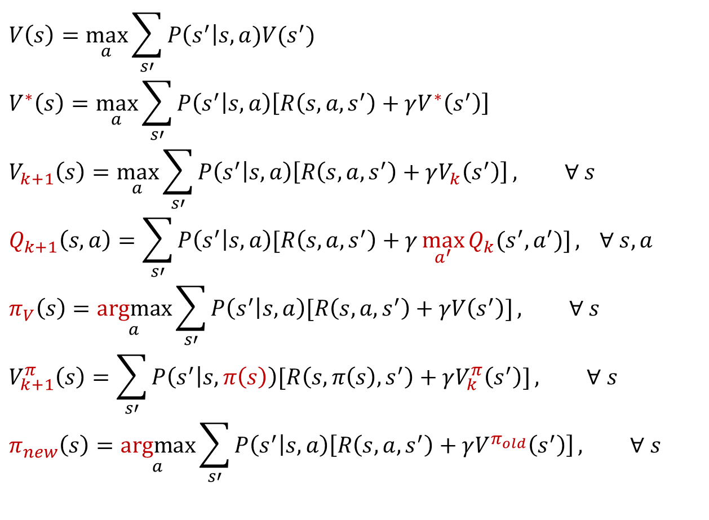
MDP Notation
$$V\left(s\right)=\max_{a}{\sum_{s′}{P\left(s^{′}\right|s,a)V(s^{′})}}$$
$$V^{∗}\left(s\right)=\max_{a}{\sum_{s′}{P\left(s^{′} | s,a\right)\left[R\left(s,a,s^{′}\right)+γV^{∗}\left(s^{′}\right)\right]}}$$
$$V_{k+1}\left(s\right)=\max_{a}{\sum_{s′}{P\left(s^{′} | s,a\right)\left[R\left(s,a,s^{′}\right)+γV_{k}\left(s^{′}\right)\right]}}, ∀ s$$
$$Q_{k+1}\left(s,a\right)=\sum_{s′}{P\left(s^{′} | s,a\right)[R\left(s,a,s^{′}\right)+γ\max_{a^{′}}{Q_{k}(s^{′},a^{′})]}, } ∀ s,a$$
$$π_{V}\left(s\right)=\underset{a}{argmax}{\sum_{s′}{P\left(s^{′} | s,a\right)[R\left(s,a,s^{′}\right)+γV\left(s^{′}\right)]}}, ∀ s$$
$$V_{k+1}^{π}\left(s\right)=\sum_{s′}{P\left(s^{′} | s,π\left(s\right)\right)[R\left(s,π\left(s\right),s^{′}\right)+γV_{k}^{π}\left(s^{′}\right)]}, ∀ s$$
$$π_{new}\left(s\right)=\underset{a}{argmax}{\sum_{s′}{P\left(s^{′} | s,a\right)\left[R\left(s,a,s^{′}\right)+γV^{π_{old}}\left(s^{′}\right)\right]}}, ∀ s$$
Standard expectimax:
Bellman equations:
Value iteration:
Q-iteration:
Policy extraction:
Policy evaluation:
Policy improvement:

Slide 49
Next Time: Reinforcement Learning!

Slide 50

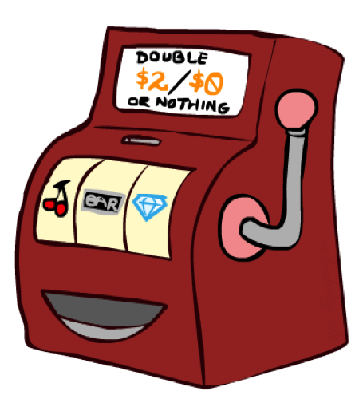

Double Bandits
Slide: ai.berkeley.edu

Slide 51
Double-Bandit MDP
No discount
100 time steps
Both states have the same value
Actions: Blue, Red
States: Win, Lose
0.25 $0
0.75
$2
W
L
0.25
$0
$1
1.0
$1
1.0
0.75 $2
Slide: ai.berkeley.edu

Slide 52
Offline Planning
No discount
100 time steps
Both states have the same value
Solving MDPs is offline planning
You determine all quantities through computation
You need to know the details of the MDP
You do not actually play the game!
0.25 $0
Value
0.75
$2
0.25
$0
Play Red
150
W
L
$1
1.0
$1
1.0
0.75 $2
Play Blue
100
Slide: ai.berkeley.edu

Slide 53
Let’s Play!
$2
$2
$0
$2
$2
$2
$2
$0
$0
$0
Slide: ai.berkeley.edu

Slide 54

Online Planning
Rules changed! Red’s win chance is different.
?? $0
??
$2
W
L
??
$0
$1
1.0
$1
1.0
?? $2
Slide: ai.berkeley.edu

Slide 55
Let’s Play!
$0
$0
$0
$2
$0
$2
$0
$0
$0
$0
Slide: ai.berkeley.edu

Slide 56
What Just Happened?
That wasn’t planning, it was learning!
Specifically, reinforcement learning
There was an MDP, but you couldn’t solve it with just computation
You needed to actually act to figure it out
Important ideas in reinforcement learning that came up
Exploration: you have to try unknown actions to get information
Exploitation: eventually, you have to use what you know
Regret: even if you learn intelligently, you make mistakes
Sampling: because of chance, you have to try things repeatedly
Difficulty: learning can be much harder than solving a known MDP
Slide: ai.berkeley.edu

