Slide 1
Plan
Last Time
Adversarial search
Minimax
Evaluation functions
Pruning
Today
Adversarial search: Expectimax
Constraint Satisfaction Problems

Slide 2
Expectimax
Adversarial search slides

Slide 3

AI: Representation and Problem Solving
Constraint Satisfaction Problems (CSPs)
Instructor: Pat Virtue
Slide credits: CMU AI, http://ai.berkeley.edu

Slide 4
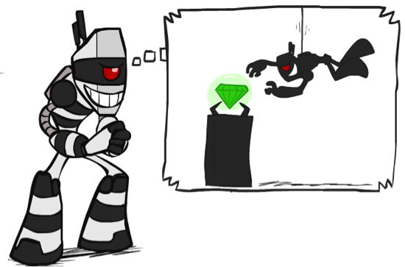


What is Search For?
Planning: sequences of actions
The path to the goal is the important thing
Paths have various costs, depths
Heuristics give problem-specific guidance
Identification: assignments to variables
The goal itself is important, not the path
All paths at the same depth (for some formulations)
Are the warm-up assignments planning or identification problems?

Slide 5
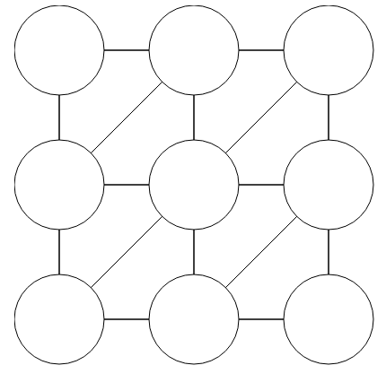

Warm-up as You Walk In
Assign Red, Green, or Blue
Neighbors must be different
Sudoku
1
2
1
3
4
Notes:
Demo:
CS188 javascript demos -> source -> exercises -> csps -> CSPs demos -> CSPs demos.html
Settings:
Graph = Complex
Algorithm = Backtracking
Ordering = MRV
Filtering = Forward Checking
Solves already without any need for backtracking
Note: need a bigger problem to illustrate relevance of backtracking+AC+MRV+MCV

Slide 6



Constraint Satisfaction Problems
CSP is a special class of search problems
Mostly identification problems
Have specialized algorithms for them
Standard search problems:
State is an arbitrary data structure
Goal test can be any function over states
Constraint satisfaction problems (CSPs):
State is defined by variables X_{i} with values from a domain D (sometimes D depends on i)
Goal test is a set of constraints specifying allowable combinations of values for subsets of variables
Notes:
Goal test has structure, it ‘s more like a manual describing a set of constraints that have to hold true

Slide 7
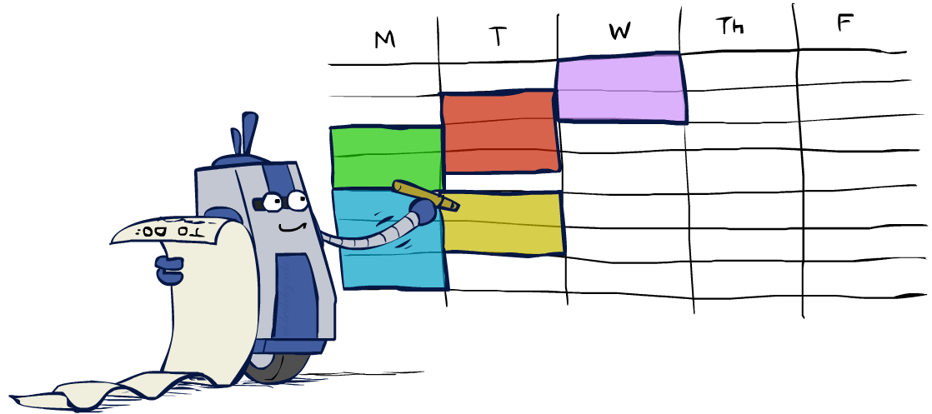



Why study CSPs?
Many real-world problems can be formulated as CSPs
Assignment problems: e.g., who teaches what class
Timetabling problems: e.g., which class is offered when and where?
Hardware configuration
Transportation scheduling
Factory scheduling
Circuit layout
Fault diagnosis
… lots more!
Sometimes involve real-valued variables…

Slide 8
CSP Examples

Slide 9


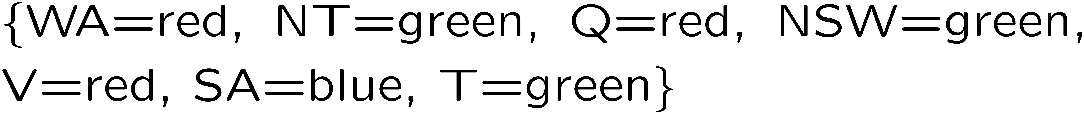
Example: Map Coloring
Variables:
Domains:
Constraints: adjacent regions must have different colors
Solutions are assignments satisfying all constraints, e.g.:
Implicit:
Explicit:

Slide 10
Constraint Graphs

Slide 11

Constraint Graphs
Binary CSP: each constraint relates (at most) two variables
Binary constraint graph: nodes are variables, arcs show constraints
General-purpose CSP algorithms use the graph structure to speed up search. E.g., Tasmania is an independent subproblem!
Notes:
Demo:
Run constraint.jar or constraint.exe, load the 5 queens problem.
Demo is just showing the n-queens applet as illustration of constraint graph, but later in lecture we’ll interact with the applet.
aispace.org will have the latest version

Slide 12

Varieties of CSPs and Constraints

Slide 13
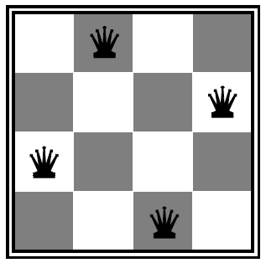

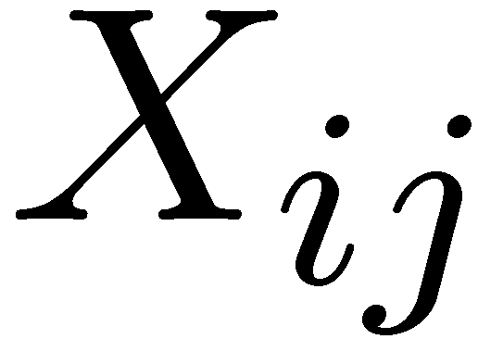

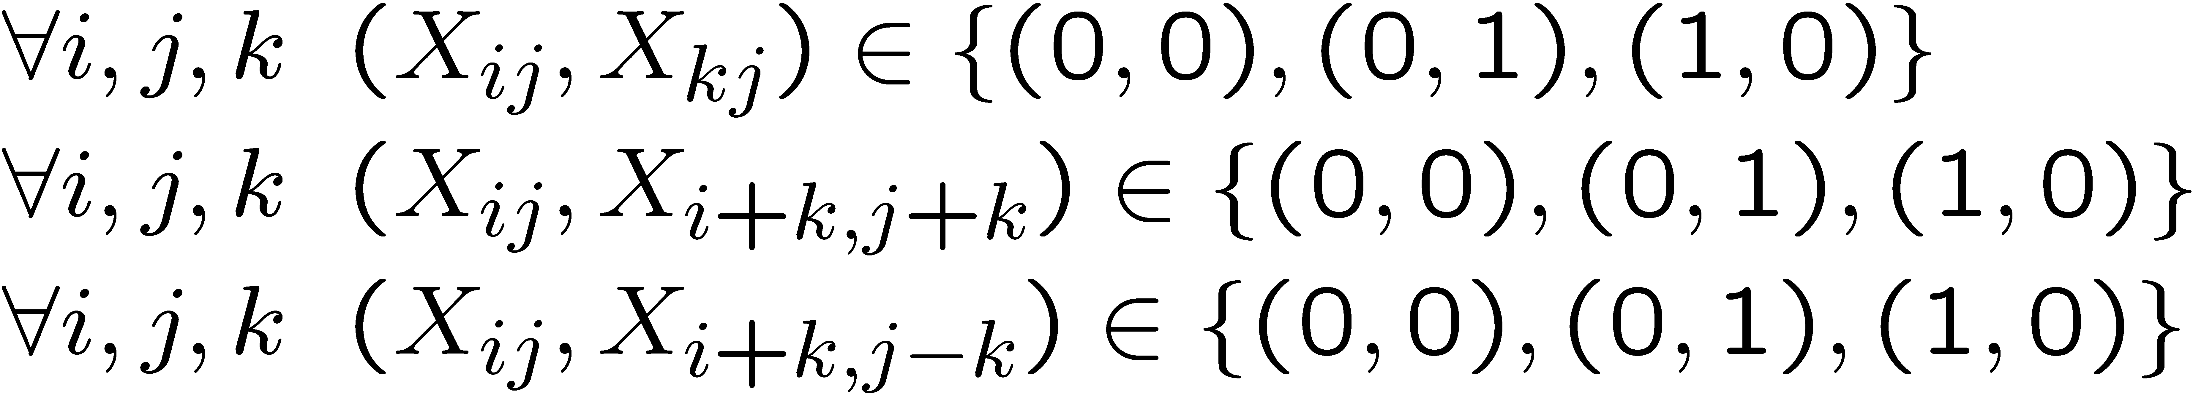
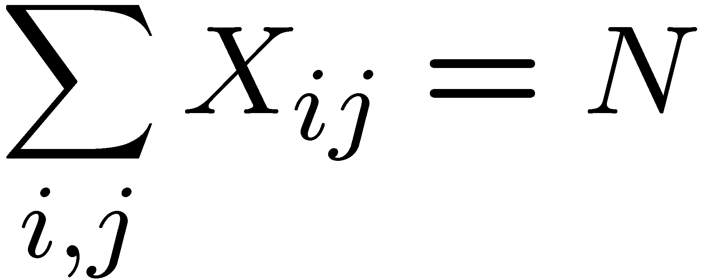
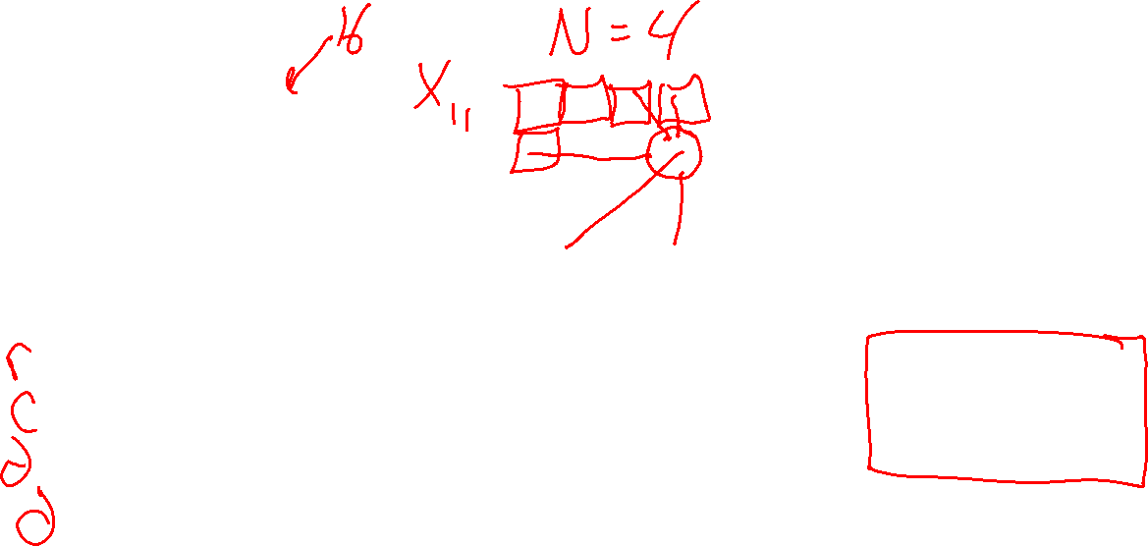
Example: N-Queens
Formulation 1:
Variables:
Domains:
Constraints

Slide 14







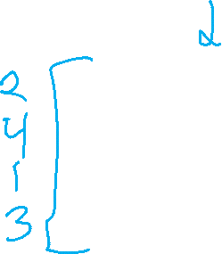
Example: N-Queens
Formulation 2:
Variables:
Domains:
Constraints:
Implicit:
Explicit:

Slide 15
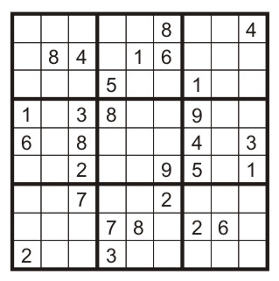
Example: Sudoku
Variables: Each (open) square
Domains: {1,2,…,9}
Constraints:
9-way alldiff for each column
9-way alldiff for each row
9-way alldiff for each region
(or can have a bunch of pairwise inequality constraints)

Slide 16


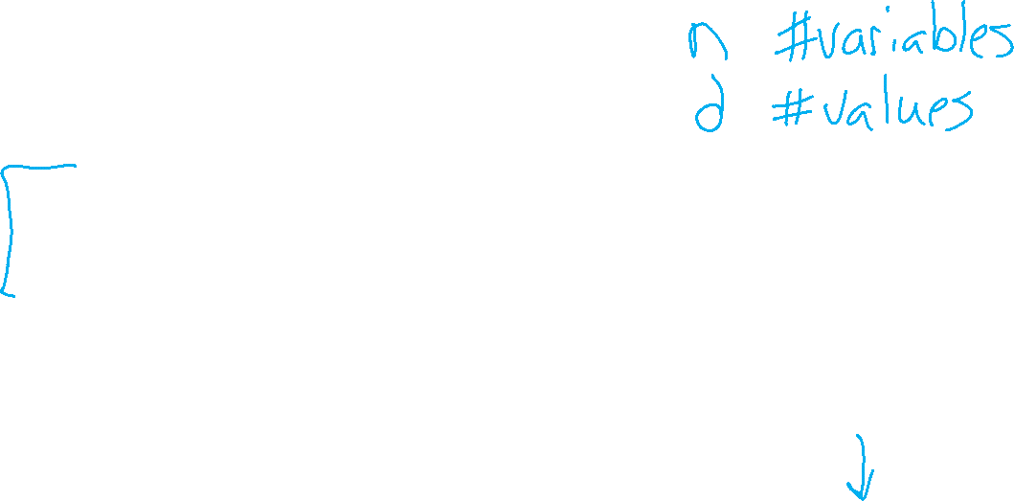
Varieties of CSPs
We will cover today
Discrete Variables
Finite domains
Size d means O(d^{n}) complete assignments
E.g., Boolean CSPs, including Boolean satisfiability (NP-complete)
Infinite domains (integers, strings, etc.)
E.g., job scheduling, variables are start/end times for each job
Linear constraints solvable, nonlinear undecidable
Continuous variables
E.g., start/end times for Hubble Telescope observations
Linear constraints solvable in polynomial time
We will cover in a later lecture (linear programming)

Slide 17



Varieties of Constraints
Varieties of Constraints
Unary constraints involve a single variable (equivalent to reducing domains), e.g.:
Binary constraints involve pairs of variables, e.g.:
Higher-order constraints involve 3 or more variables:
e.g., sudoku constraints
Focus of today
Preferences (soft constraints):
E.g., red is better than green
Often representable by a cost for each variable assignment
Gives constrained optimization problems

Slide 18

Solving CSPs

Slide 19

Standard Search Formulation
Standard search formulation of CSPs
States defined by the values assigned so far (partial assignments)
Initial state: the empty assignment, {}
Successor function: assign a value to an unassigned variable
Goal test: the current assignment is complete and satisfies all constraints
We’ll start with the straightforward, naïve approach, then improve it
$→$Can be any unassigned variable

Slide 20
Poll 1: Search for CSPs
Should we use BFS or DFS?

Slide 21







Depth First Search
At each node, assign a value from the domain to the variable
Check feasibility (constraints) when the assignment is complete

Slide 22
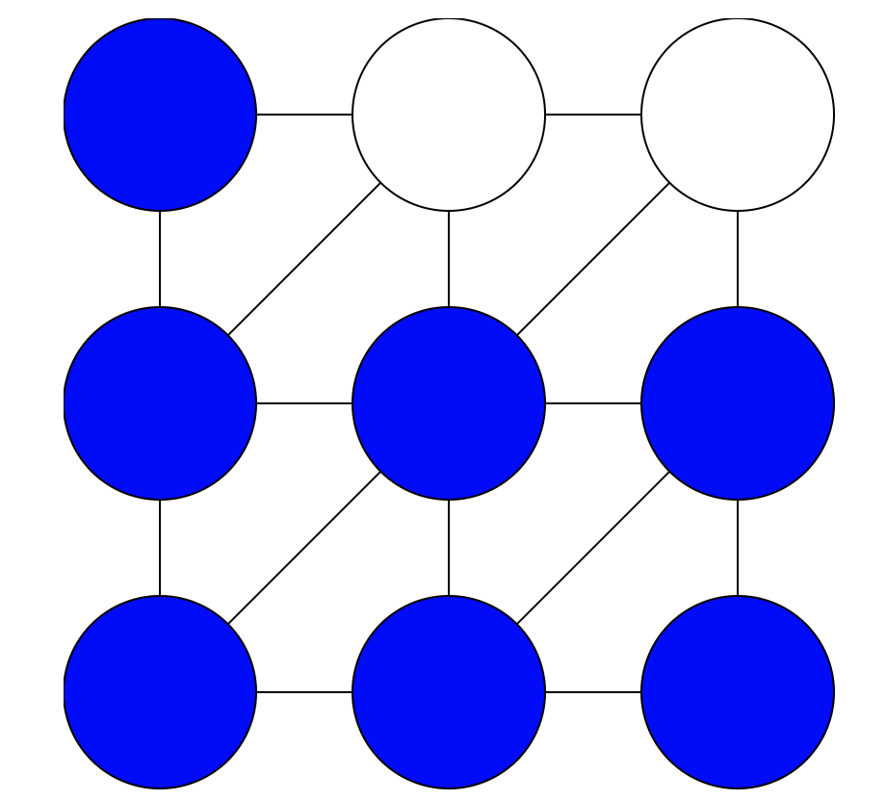
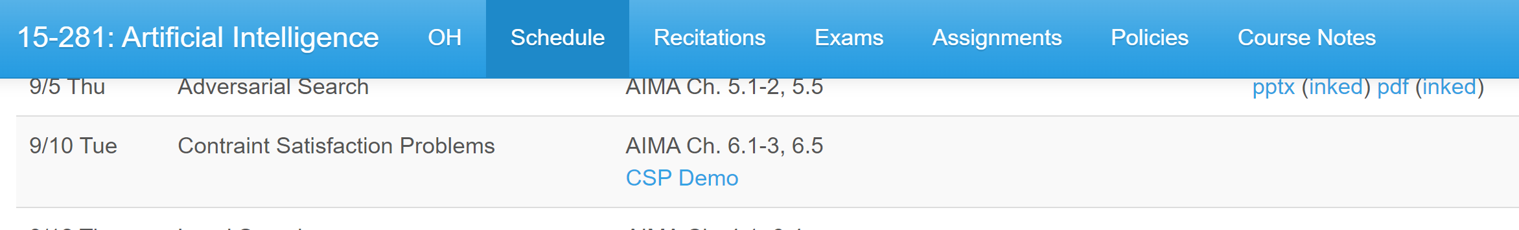

Demo – Naïve Search

Slide 23

Backtracking Search

Slide 24

Backtracking Search
Backtracking search is the basic uninformed algorithm for solving CSPs
Backtracking search = DFS + two improvements
Idea 1: One variable at a time
Variable assignments are commutative
[WA = red then NT = green] same as [NT = green then WA = red]
Only need to consider assign value to a single variable at each step
Idea 2: Check constraints as you go
Consider only values which do not conflict previous assignments
May need some computation to check the constraints
“Incremental goal test”
Can solve n-queens for n ≈ 25

Slide 25

Backtracking Example

Slide 26

Backtracking Search
Notes:
Demo:
CS188 javascript demos -> source -> exercises -> csps -> CSPs demos -> CSPs demos.html
Settings:
Graph = Simple
Algorithm = Backtracking
Ordering = None
Filtering = None

Slide 27
Backtracking Search
Notes:
Demo:
CS188 javascript demos -> source -> exercises -> csps -> CSPs demos -> CSPs demos.html
Settings:
Graph = Simple
Algorithm = Backtracking
Ordering = None
Filtering = None

Slide 28
Backtracking Search
Notes:
Demo:
CS188 javascript demos -> source -> exercises -> csps -> CSPs demos -> CSPs demos.html
Settings:
Graph = Simple
Algorithm = Backtracking
Ordering = None
Filtering = None

Slide 29
Backtracking Search
No need to check constraints for a complete assignment
Notes:
Demo:
CS188 javascript demos -> source -> exercises -> csps -> CSPs demos -> CSPs demos.html
Settings:
Graph = Simple
Algorithm = Backtracking
Ordering = None
Filtering = None

Slide 30
Backtracking Search
Checks consistency at each assignment
Notes:
Demo:
CS188 javascript demos -> source -> exercises -> csps -> CSPs demos -> CSPs demos.html
Settings:
Graph = Simple
Algorithm = Backtracking
Ordering = None
Filtering = None

Slide 31
Backtracking Search
Backtracking = DFS + variable-ordering + fail-on-violation
What are the decision points?
Notes:
Demo:
CS188 javascript demos -> source -> exercises -> csps -> CSPs demos -> CSPs demos.html
Settings:
Graph = Simple
Algorithm = Backtracking
Ordering = None
Filtering = None

Slide 32
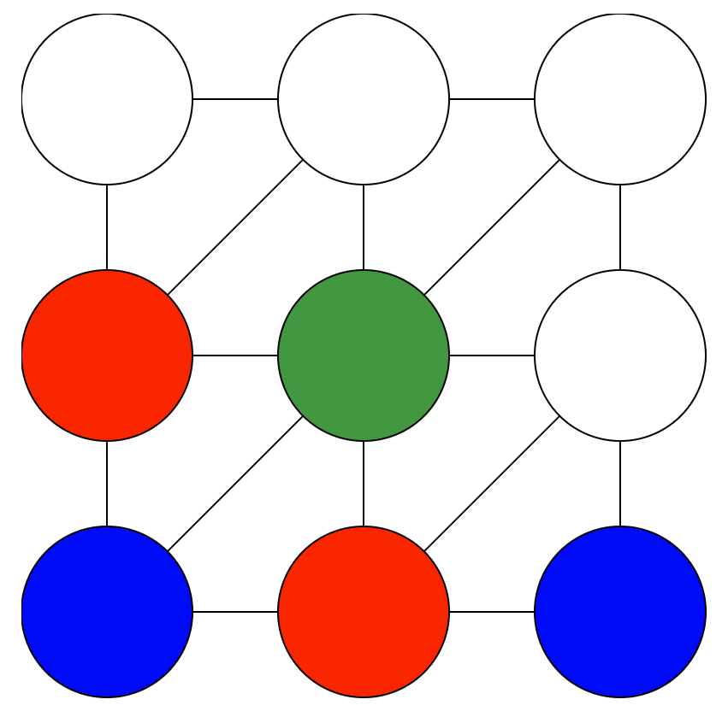
Demo – Backtracking
https://www.cs.cmu.edu/~15281/demos/csp_backtracking

Slide 33

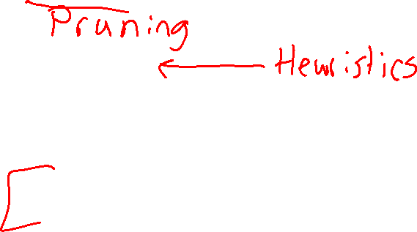
Improving Backtracking
General-purpose ideas give huge gains in speed
Filtering: Can we detect inevitable failure early?
Ordering:
Which variable should be assigned next?
In what order should its values be tried?
Structure: Can we exploit the problem structure?

Slide 34

Filtering

Slide 35
Filtering: Forward Checking
Filtering: Keep track of domains for unassigned variables and cross off bad options
Forward checking: A simple way for filtering
After a variable is assigned a value, check related constraints and cross off values of unassigned variables which violate the constraints
Failure detected if some variables have no values remaining
Notes:
Demo:
CS188 javascript demos -> source -> exercises -> csps -> CSPs demos -> CSPs demos.html
Settings:
Graph = Simple
Algorithm = Backtracking
Ordering = None
Filtering = Forward Checking

Slide 36

Filtering: Forward Checking
Filtering: Keep track of domains for unassigned variables and cross off bad options
Forward checking: A simple way for filtering
After a variable is assigned a value, check related constraints and cross off values of unassigned variables which violate the constraints
Failure detected if some variables have no values remaining
NT
Q
WA
SA
NSW
V
T
Notes:
Demo:
CS188 javascript demos -> source -> exercises -> csps -> CSPs demos -> CSPs demos.html
Settings:
Graph = Simple
Algorithm = Backtracking
Ordering = None
Filtering = Forward Checking

Slide 37
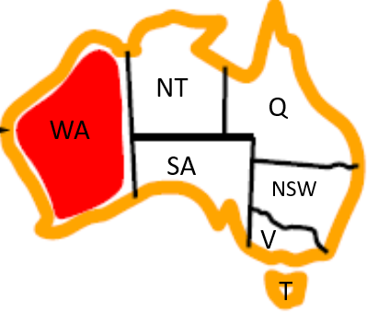

Filtering: Forward Checking
Filtering: Keep track of domains for unassigned variables and cross off bad options
Forward checking: A simple way for filtering
After a variable is assigned a value, check related constraints and cross off values of unassigned variables which violate the constraints
Failure detected if some variables have no values remaining
Recall: Binary constraint graph for a binary CSP (i.e., each constraint has most two variables): nodes are variables, edges show constraints
Notes:
Demo:
CS188 javascript demos -> source -> exercises -> csps -> CSPs demos -> CSPs demos.html
Settings:
Graph = Simple
Algorithm = Backtracking
Ordering = None
Filtering = Forward Checking

Slide 38
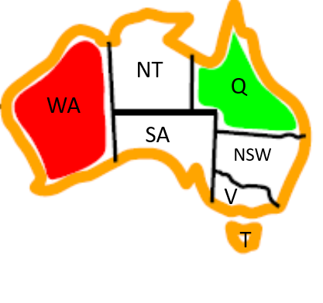
Filtering: Forward Checking
Filtering: Keep track of domains for unassigned variables and cross off bad options
Forward checking: A simple way for filtering
After a variable is assigned a value, check related constraints and cross off values of unassigned variables which violate the constraints
Failure detected if some variables have no values remaining
Notes:
Demo:
CS188 javascript demos -> source -> exercises -> csps -> CSPs demos -> CSPs demos.html
Settings:
Graph = Simple
Algorithm = Backtracking
Ordering = None
Filtering = Forward Checking

Slide 39

Filtering: Forward Checking
Filtering: Keep track of domains for unassigned variables and cross off bad options
Forward checking: A simple way for filtering
After a variable is assigned a value, check related constraints and cross off values of unassigned variables which violate the constraints
Failure detected if some variables have no values remaining
FAIL – variable with no possible values
Notes:
Demo:
CS188 javascript demos -> source -> exercises -> csps -> CSPs demos -> CSPs demos.html
Settings:
Graph = Simple
Algorithm = Backtracking
Ordering = None
Filtering = Forward Checking

Slide 40
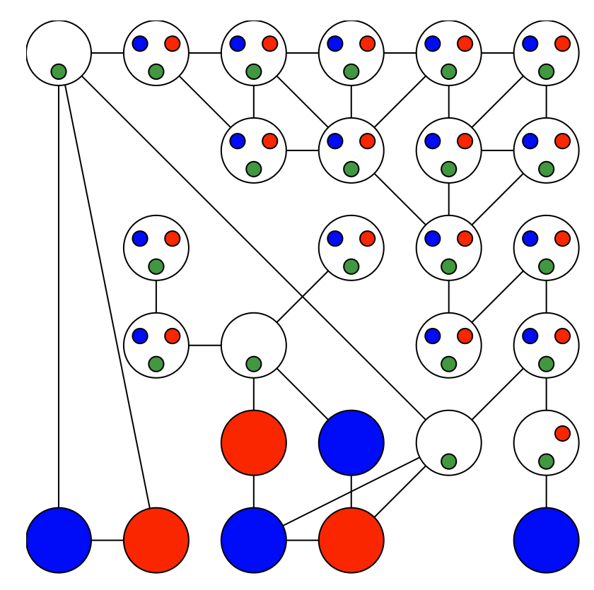
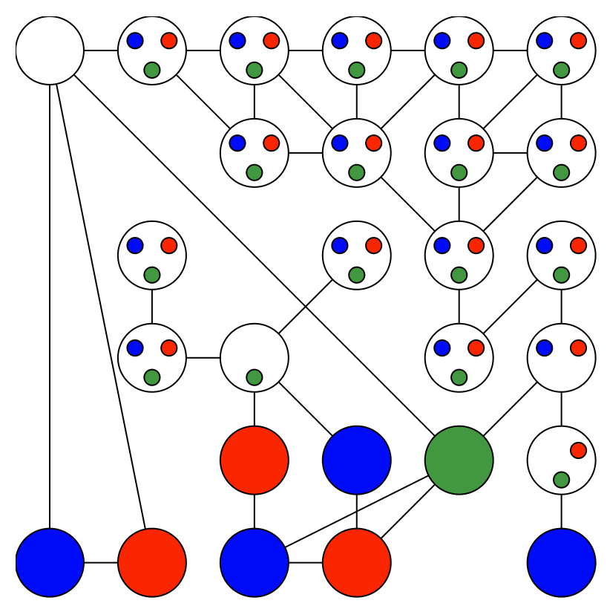
Demo – Backtracking with Forward Checking
https://www.cs.cmu.edu/~15281/demos/csp_backtracking

Slide 41
Filtering: Constraint Propagation
Limitations of simple forward checking: propagates information from assigned to unassigned variables, but doesn't provide early detection for all failures
NT and SA cannot both be blue! Why didn’t we detect this yet?
Constraint propagation: reason from constraint to constraint
Notes:
Demo:
CS188 javascript demos -> source -> exercises -> csps -> CSPs demos -> CSPs demos.html
Settings:
Graph = Simple
Algorithm = Backtracking
Ordering = None
Filtering = Forward Checking

Slide 42

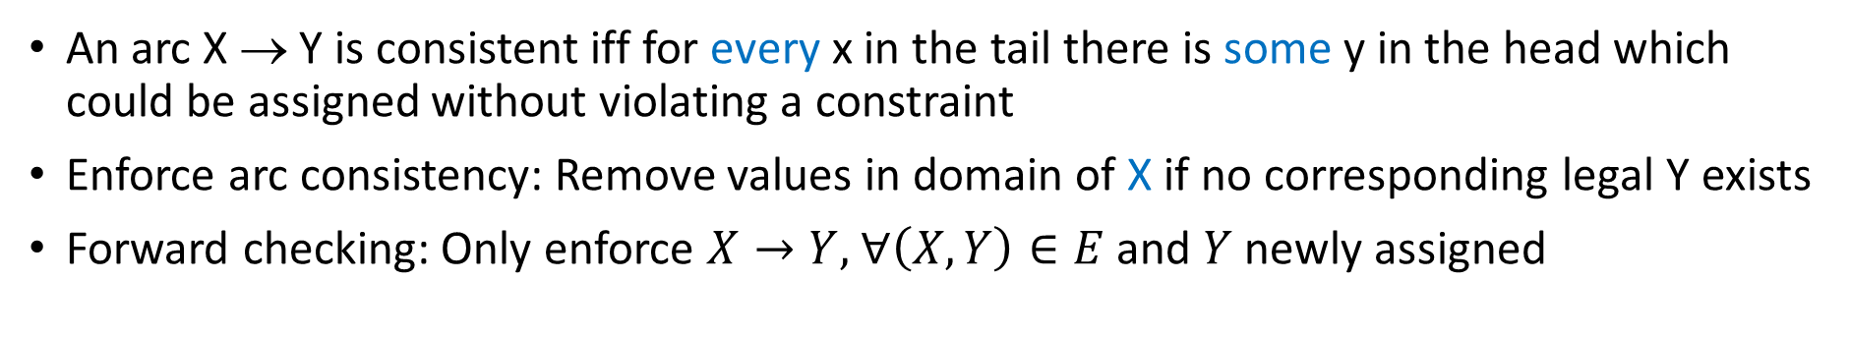
Consistency of A Single Arc
An arc X → Y is consistent iff for every x in the tail there is some y in the head which could be assigned without violating a constraint
Enforce arc consistency: Remove values in domain of X if no corresponding legal Y exists
Forward checking: Only enforce $X→Y,$ $∀\left(X,Y\right)∈E$ and $Y$ newly assigned
(Remove values from the tail!)
Recall: Binary constraint graph for a binary CSP (i.e., each constraint has most two variables): nodes are variables, edges show constraints

Slide 43

Consistency of A Single Arc
An arc X → Y is consistent iff for every x in the tail there is some y in the head which could be assigned without violating a constraint
Enforce arc consistency: Remove values in domain of X if no corresponding legal Y exists
Forward checking: Only enforce $X→Y,$ $∀\left(X,Y\right)∈E$ and $Y$ newly assigned

Slide 44
How to Enforce Arc Consistency of Entire CSP
A simplistic algorithm: Cycle over the pairs of variables, enforcing arc-consistency, repeating the cycle until no domains change for a whole cycle
AC-3 (short for Arc Consistency Algorithm #3): A more efficient algorithm ignoring constraints that have not been modified since they were last analyzed
NT
Q
WA
SA
NSW
V
T

Slide 45
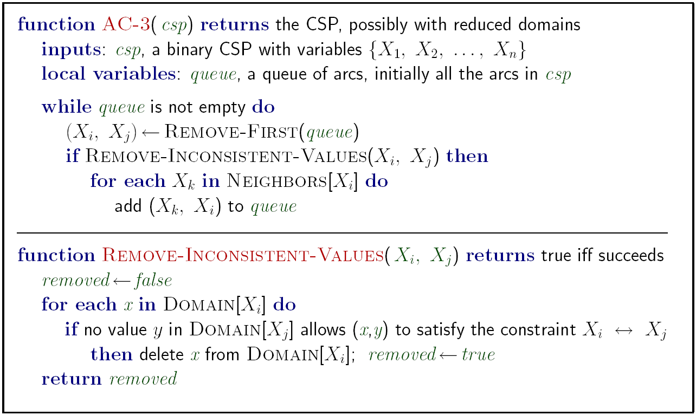
AC-3: Enforce Arc Consistency of Entire CSP
Constraint Propagation!
Notes:
Auto-consistency (note initially nothing gets deleted/pruned since there are consistent options for all constraints for initial variable domains)
Flashes whenever something needs to be re-checked

Slide 46

AC-3: Enforce Arc Consistency of Entire CSP
Queue:
SA->WA
NT->WA
NT
Q
WA
SA
NSW
V
T
Remember: Delete from the tail!

Slide 47

AC-3: Enforce Arc Consistency of Entire CSP
Queue:
NT->WA
WA->SA
NT->SA
Q->SA
NSW->SA
V->SA
NT
Q
WA
SA
NSW
V
T
Remember: Delete from the tail!

Slide 48
AC-3: Enforce Arc Consistency of Entire CSP
Queue:
WA->SA
NT->SA
Q->SA
NSW->SA
V->SA
WA->NT
SA->NT
Q->NT
NT
Q
WA
SA
NSW
V
T
Remember: Delete from the tail!

Slide 49
AC-3: Enforce Arc Consistency of Entire CSP
Queue:
WA->SA
NT->SA
Q->SA
NSW->SA
V->SA
WA->NT
SA->NT
Q->NT
NT
Q
WA
SA
NSW
V
T
Remember: Delete from the tail!

Slide 50
AC-3: Enforce Arc Consistency of Entire CSP
Queue:
NT->SA
Q->SA
NSW->SA
V->SA
WA->NT
SA->NT
Q->NT
NT
Q
WA
SA
NSW
V
T
Remember: Delete from the tail!

Slide 51
AC-3: Enforce Arc Consistency of Entire CSP
Queue:
Q->SA
NSW->SA
V->SA
WA->NT
SA->NT
Q->NT
NT
Q
WA
SA
NSW
V
T
Remember: Delete from the tail!

Slide 52
AC-3: Enforce Arc Consistency of Entire CSP
Queue:
NSW->SA
V->SA
WA->NT
SA->NT
Q->NT
NT
Q
WA
SA
NSW
V
T
Remember: Delete from the tail!

Slide 53
AC-3: Enforce Arc Consistency of Entire CSP
Queue:
NT
Q
WA
SA
NSW
V
T
Remember: Delete from the tail!

Slide 54
Poll 2: After assigning Q to Green, what gets added to the Queue?
Queue:
NT
Q
WA
SA
NSW
V
T
A: NSW->Q, SA->Q, NT->Q
B: Q->NSW, Q->SA, Q->NT

Slide 55
AC-3: Enforce Arc Consistency of Entire CSP
Queue:
NT->Q
SA->Q
NSW->Q
NT
Q
WA
SA
NSW
V
T
Remember: Delete from the tail!

Slide 56
AC-3: Enforce Arc Consistency of Entire CSP
Queue:
SA->Q
NSW->Q
WA->NT
SA->NT
Q->NT
NT
Q
WA
SA
NSW
V
T
Remember: Delete from the tail!

Slide 57
AC-3: Enforce Arc Consistency of Entire CSP
Queue:
NSW->Q
WA->NT
SA->NT
Q->NT
WA->SA
NT->SA
Q->SA
NSW->SA
V->SA
NT
Q
WA
SA
NSW
V
T
Remember: Delete from the tail!

Slide 58
AC-3: Enforce Arc Consistency of Entire CSP
Queue:
WA->NT
SA->NT
Q->NT
WA->SA
NT->SA
Q->SA
NSW->SA
V->SA
V->NSW
Q->NSW
SA->NSW
NT
Q
WA
SA
NSW
V
T
Remember: Delete from the tail!

Slide 59
AC-3: Enforce Arc Consistency of Entire CSP
Queue:
WA->NT
SA->NT
Q->NT
WA->SA
NT->SA
Q->SA
NSW->SA
V->SA
V->NSW
Q->NSW
SA->NSW
NT
Q
WA
SA
NSW
V
T
Remember: Delete from the tail!

Slide 60
AC-3: Enforce Arc Consistency of Entire CSP
Queue:
SA->NT
Q->NT
WA->SA
NT->SA
Q->SA
NSW->SA
V->SA
V->NSW
Q->NSW
SA->NSW
NT
Q
WA
SA
NSW
V
T
!!!
Remember: Delete from the tail!

Slide 61
AC-3: Enforce Arc Consistency of Entire CSP
Queue:
SA->NT
Q->NT
WA->SA
NT->SA
Q->SA
NSW->SA
V->SA
V->NSW
Q->NSW
SA->NSW
Backtrack on the assignment of Q
Arc consistency detects failure earlier than forward checking
Can be run as a preprocessor or after each assignment
What’s the downside of enforcing arc consistency?
NT
Q
WA
SA
NSW
V
T
!!!
Remember: Delete from the tail!

Slide 62

Limitations of Arc Consistency
After enforcing arc consistency:
Can have one solution left
Can have multiple solutions left
Can have no solutions left (and not know it)
Arc consistency only checks local consistency conditions
Arc consistency still runs inside a backtracking search!
What went wrong here?
Notes:
Demo:
CS188 javascript demos -> source -> exercises -> csps -> CSPs demos -> CSPs demos.html
Settings:
Graph = Complex
Algorithm = Backtracking
Ordering = None
Filtering = Forward Checking (first) / Arc Consistency (second)

Slide 63
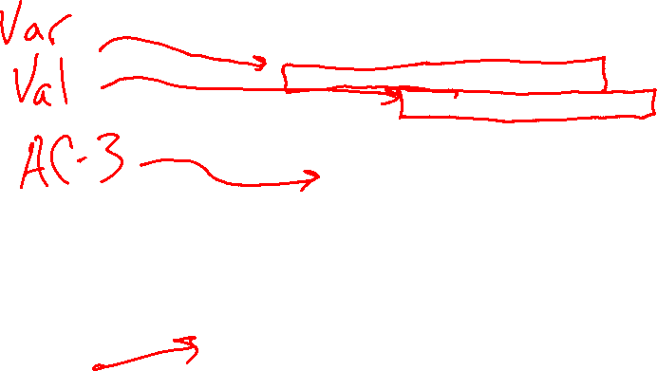

Backtracking Search with AC-3
AC-3($csp$)
Where do you run AC-3?
Notes:
Demo:
CS188 javascript demos -> source -> exercises -> csps -> CSPs demos -> CSPs demos.html
Settings:
Graph = Simple
Algorithm = Backtracking
Ordering = None
Filtering = None

Slide 64
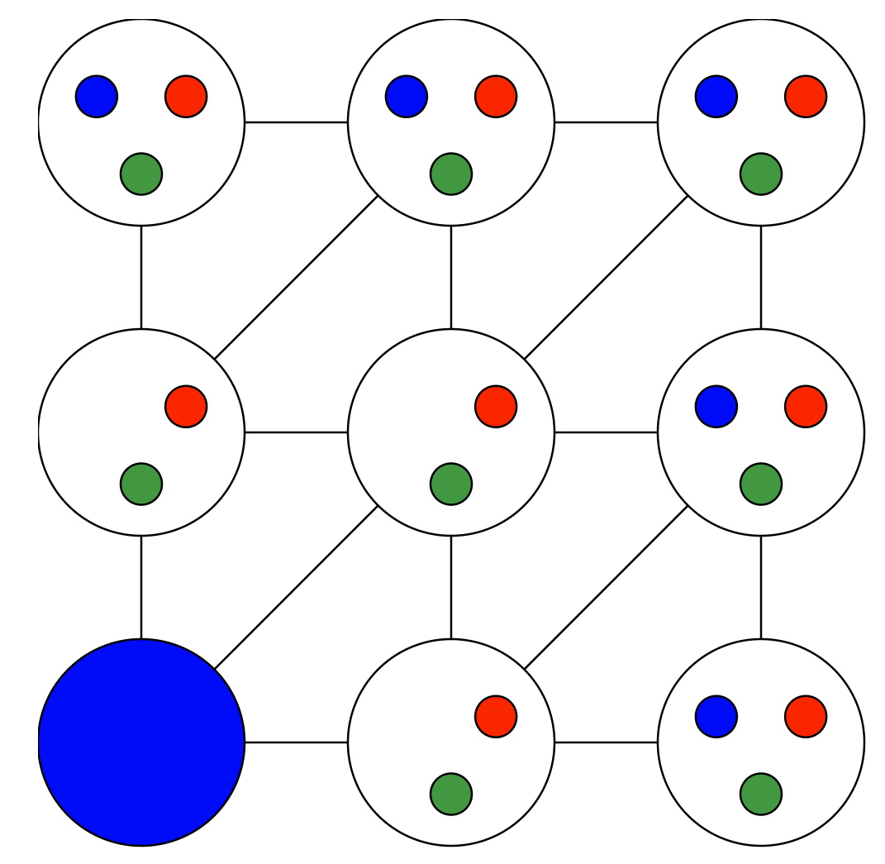

Demo – Backtracking with AC-3
Forward checking only check arcs connecting variables a variable that we just assigned.
With AC-3, we make sure all arcs are consistent
Compare
Backtracking with Forward Checking
Backtracking with AC-3

Slide 65
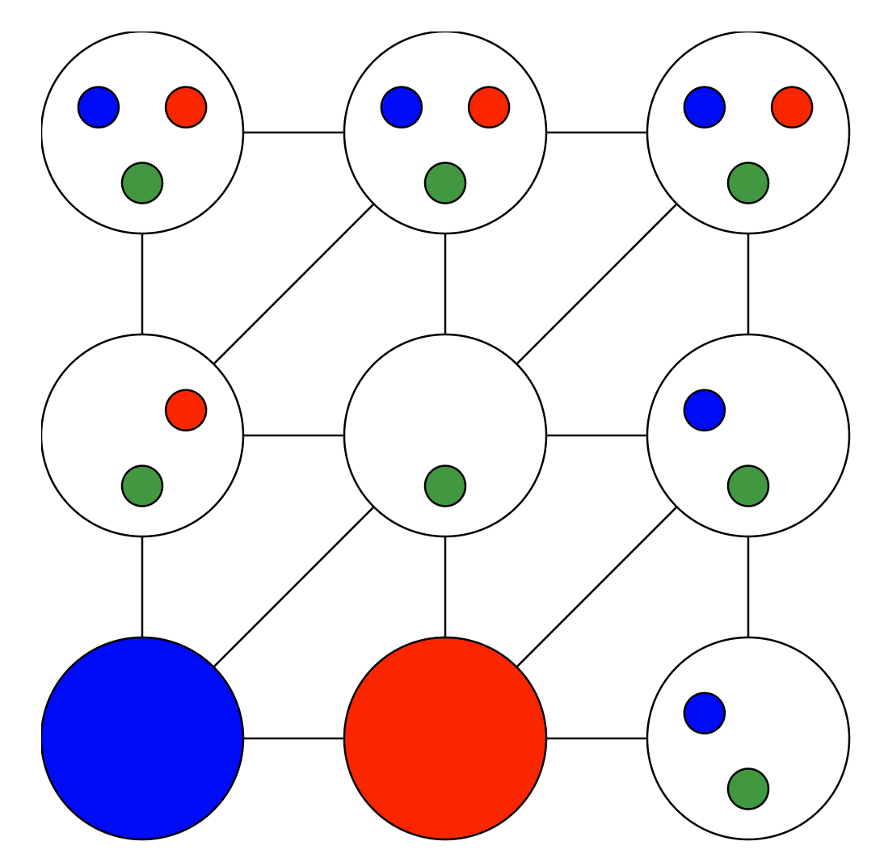
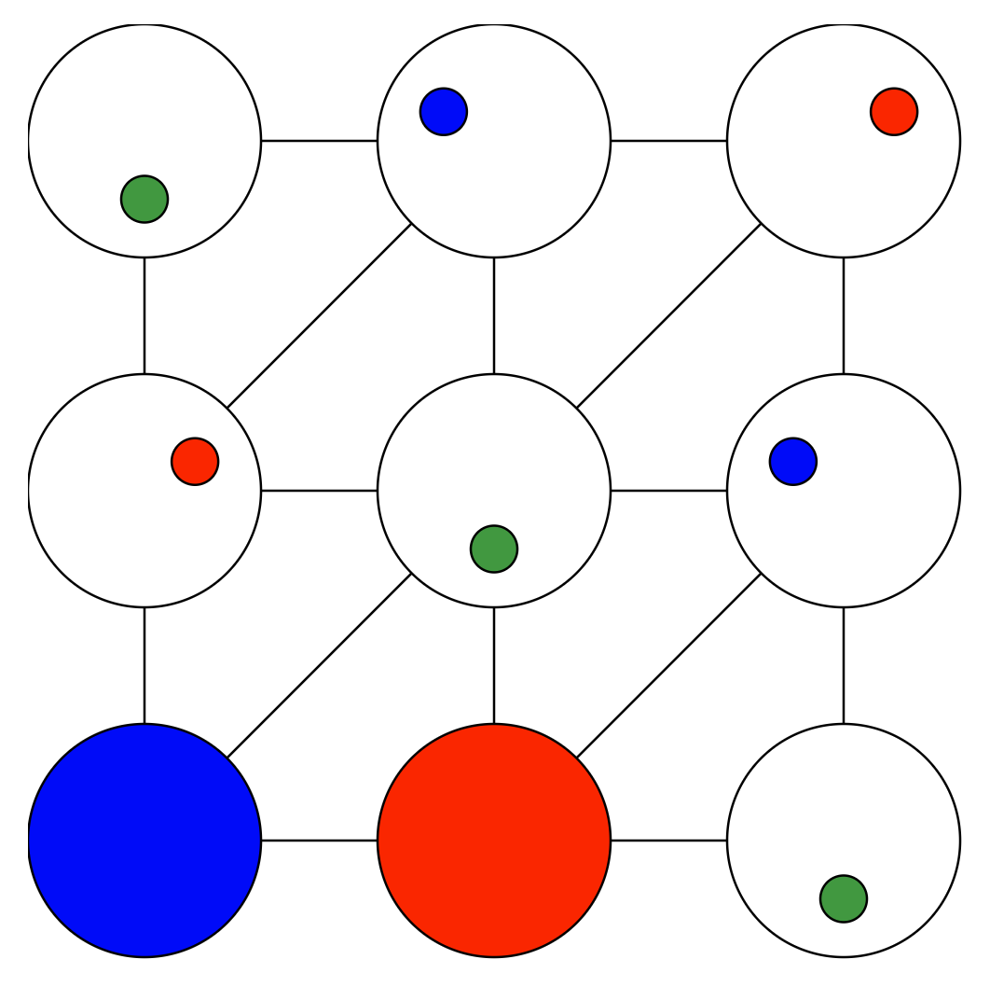


Demo – Backtracking with AC-3
Forward checking only check arcs connecting variables a variable that we just assigned.
With AC-3, we make sure all arcs are consistent
Compare
Backtracking with Forward Checking
Backtracking with AC-3

Slide 66
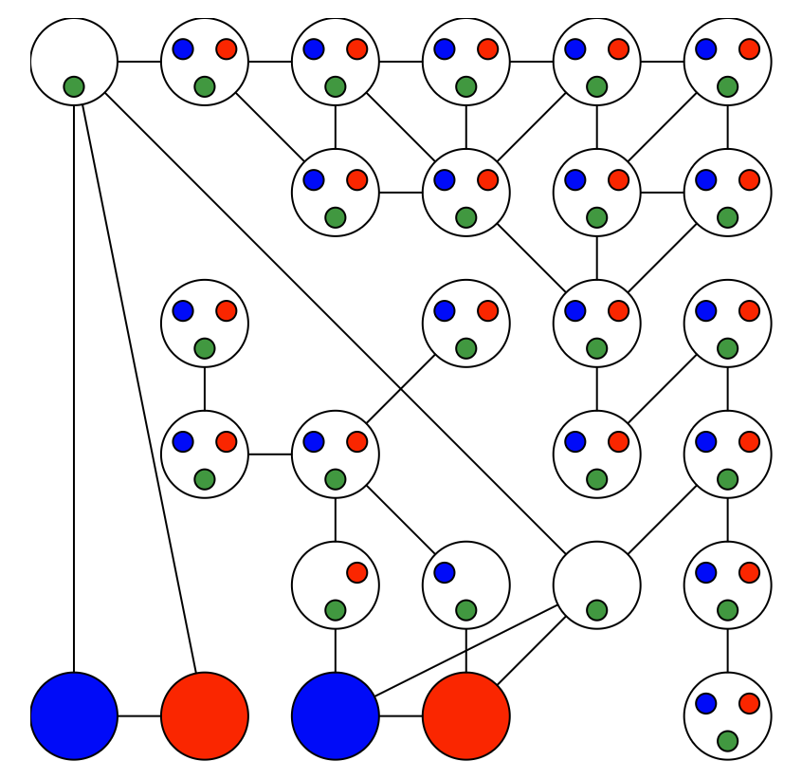
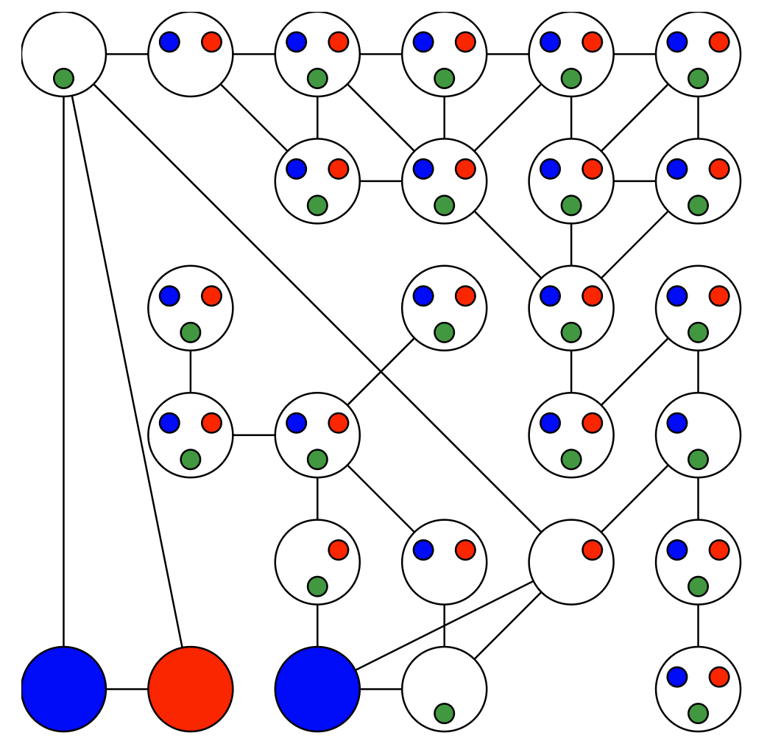
Demo – Backtracking with AC-3
Forward checking only check arcs connecting variables a variable that we just assigned.
With AC-3, we can find existing problems, such as the arc between these two variables with only green left.
Compare
Backtracking with Forward Checking
Backtracking with AC-3

Slide 67

Complexity of a single run of AC-3
Recall that the whole backtracking algorithm with AC-3 will call AC-3 many times
Notes:
Auto-consistency (note initially nothing gets deleted/pruned since there are consistent options for all constraints for initial variable domains)
Flashes whenever something needs to be re-checked

Slide 68
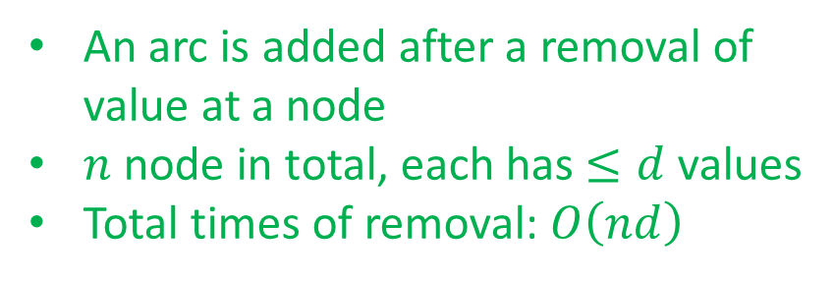
Complexity of a single run of AC-3
An arc is added after a removal of value at a node
$n$ node in total, each has $≤d$ values
Total times of removal: $O\left(nd\right)$
Notes:
Auto-consistency (note initially nothing gets deleted/pruned since there are consistent options for all constraints for initial variable domains)
Flashes whenever something needs to be re-checked

Slide 69
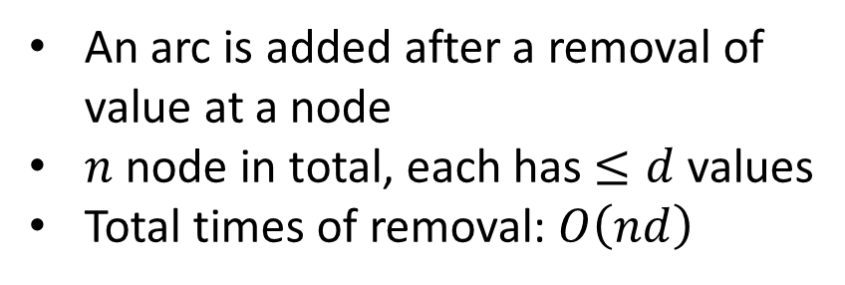
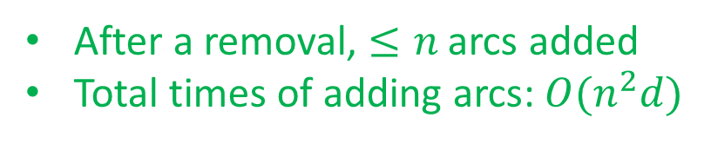
Complexity of a single run of AC-3
An arc is added after a removal of value at a node
$n$ node in total, each has $≤d$ values
Total times of removal: $O\left(nd\right)$
After a removal, $≤n$ arcs added
Total times of adding arcs: $O(n^{2}d)$
Notes:
Auto-consistency (note initially nothing gets deleted/pruned since there are consistent options for all constraints for initial variable domains)
Flashes whenever something needs to be re-checked

Slide 70
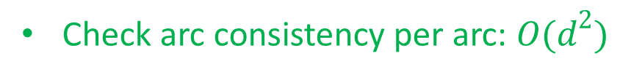
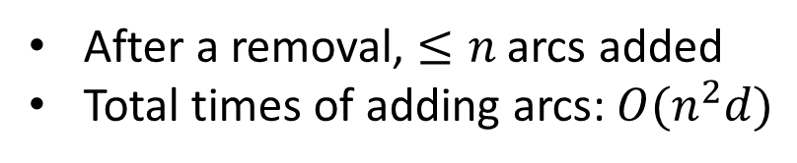
Complexity of a single run of AC-3
An arc is added after a removal of value at a node
$n$ node in total, each has $≤d$ values
Total times of removal: $O\left(nd\right)$
After a removal, $≤n$ arcs added
Total times of adding arcs: $O(n^{2}d)$
Check arc consistency per arc: $O(d^{2})$
Complexity of a single run of AC-3 is at most $O(n^{2}d^{3})$
(Not required) Zhang&Yap (2001) show that its complexity is $O(n^{2}d^{2})$
Notes:
Auto-consistency (note initially nothing gets deleted/pruned since there are consistent options for all constraints for initial variable domains)
Flashes whenever something needs to be re-checked

Slide 71

Ordering

Slide 72
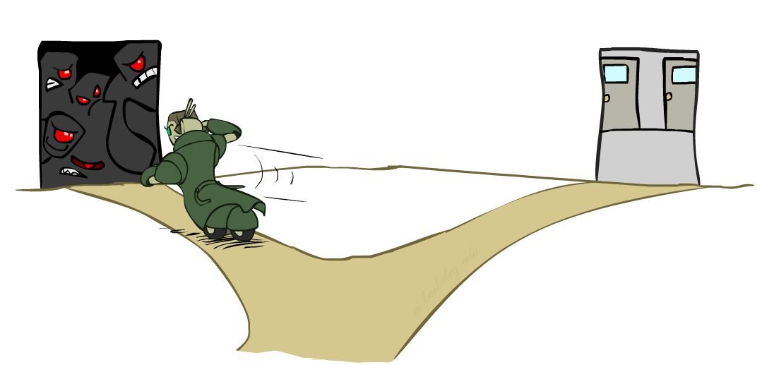

Ordering: Minimum Remaining Values
Variable Ordering: Minimum remaining values (MRV):
Choose the variable with the fewest legal left values in its domain
Why min rather than max?
Also called “most constrained variable”
“Fail-fast” ordering

Slide 73
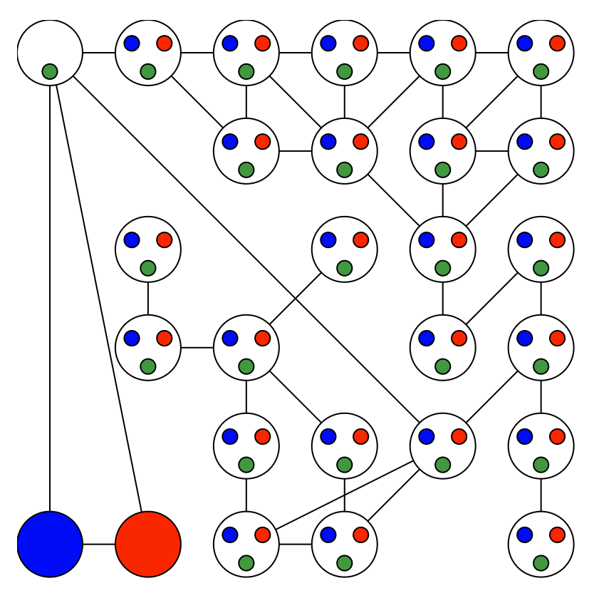
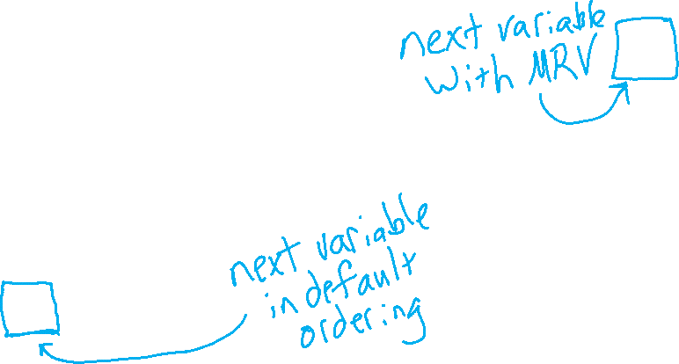
Demo – Coloring with a Complex Graph
Compare
Backtracking with Forward Checking
Backtracking with AC-3
Backtracking + Forward Checking + Minimum Remaining Values (MRV)

Slide 74
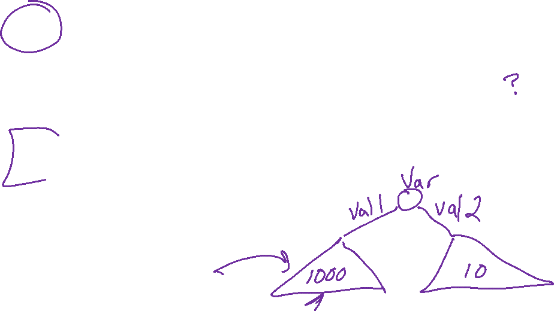
Ordering: Least Constraining Value
Value Ordering: Least Constraining Value
Given a choice of variable, choose the least constraining value
i.e., the one that rules out the fewest values in the remaining variables
Note that it may take some computation to determine this! (E.g., rerunning filtering)

Slide 75
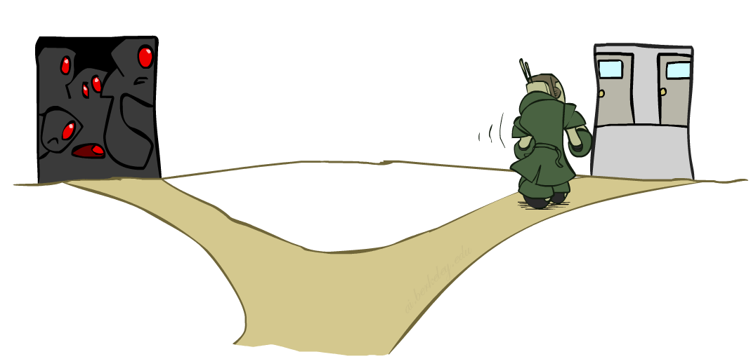

Ordering: Least Constraining Value
Value Ordering: Least Constraining Value
Given a choice of variable, choose the least constraining value
i.e., the one that rules out the fewest values in the remaining variables
Note that it may take some computation to determine this! (E.g., rerunning filtering)
Why least rather than most?
Combining these ordering ideas makes
1000 queens feasible

Slide 76

Demo – Coloring with a Complex Graph
Compare
Backtracking with Forward Checking
Backtracking with AC-3
Backtracking + Forward Checking + Minimum Remaining Values (MRV)
Backtracking + AC-3 + MRV + LCV

Slide 77

Summary: CSPs
CSPs are a special kind of search problem:
States are partial assignments
Goal test defined by constraints
Basic solution: backtracking search
Speed-ups:
Ordering
Filtering
(Structure)

