Slide 1
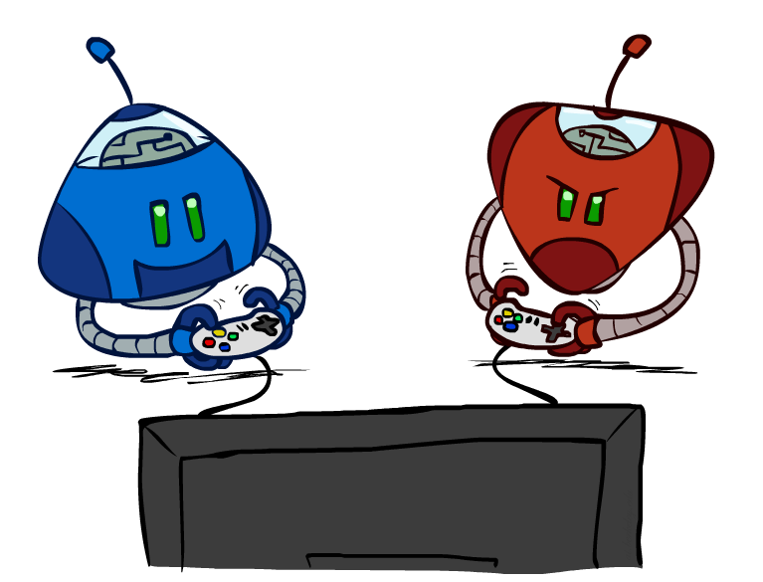
AI: Representation and Problem Solving
Adversarial Search
Instructor: Pat Virtue
Slide credits: CMU AI, http://ai.berkeley.edu

Slide 2
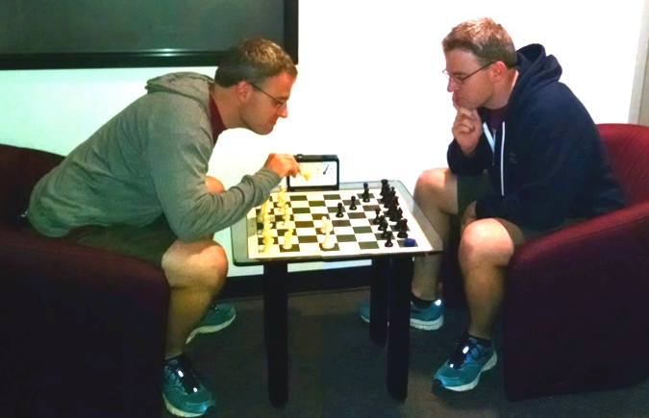
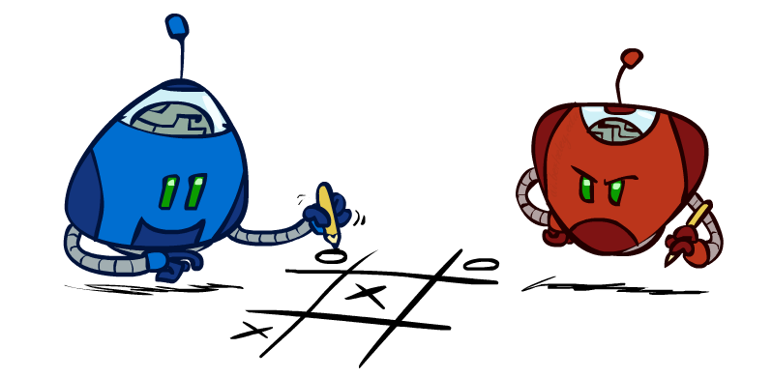
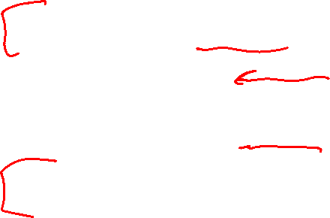
Outline
History / Overview
Zero-Sum Games (Minimax)
Evaluation Functions
Search Efficiency (α-β Pruning)
Games of Chance (Expectimax)

Slide 3
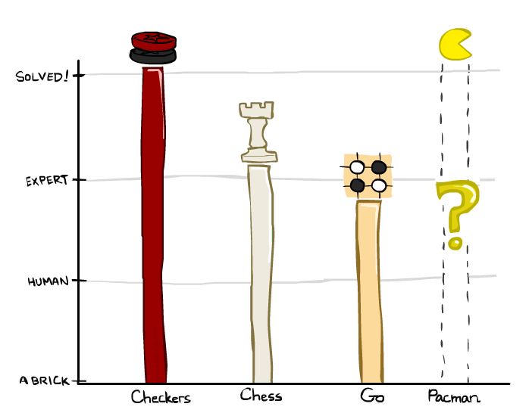
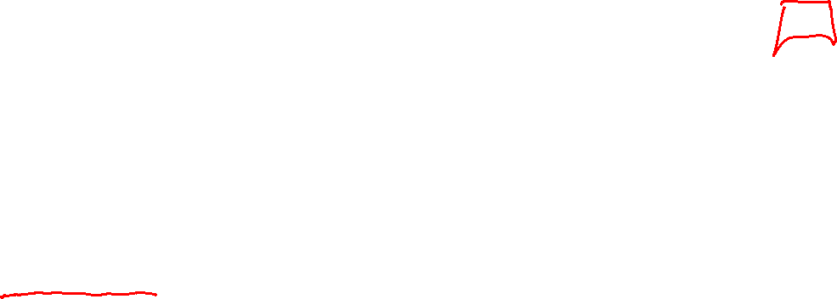
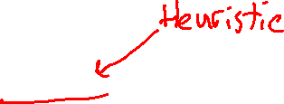
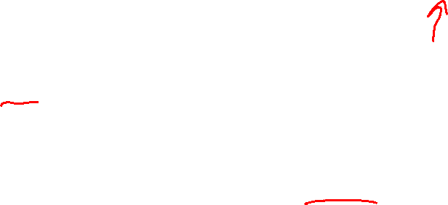
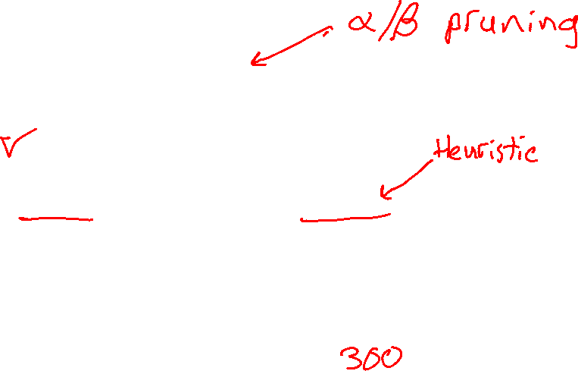

Game Playing State-of-the-Art
Checkers:
  1950: First computer player.
  1959: Samuel’s self-taught program.
  1994: First computer world champion: Chinook ended 40-year-reign of human champion Marion Tinsley using complete 8-piece endgame.
  2007: Checkers solved! Endgame database of 39 trillion states
Chess:
  1945-1960: Zuse, Wiener, Shannon, Turing, Newell & Simon, McCarthy.
  1960s onward: gradual improvement under “standard model”
  1997: special-purpose chess machine Deep Blue defeats human champion Gary Kasparov in a six-game match. Deep Blue examined 200M positions per second and extended some lines of search up to 40 ply. Current programs running on a PC rate > 3200 (vs 2870 for Magnus Carlsen).
Go:
  1968: Zobrist’s program plays legal Go, barely (b>300!)
  2005-2014: Monte Carlo tree search enables rapid advances: current programs beat strong amateurs, and professionals with a 3-4 stone handicap.
Notes:
Tinsley lost only 5 games to humans in 42 years; has been known to solve 60-ply problems

Slide 4
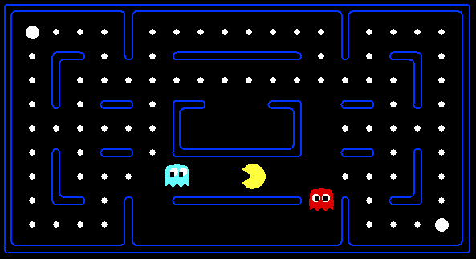
Behavior from Computation
[Demo: mystery pacman (L6D1)]

Slide 5
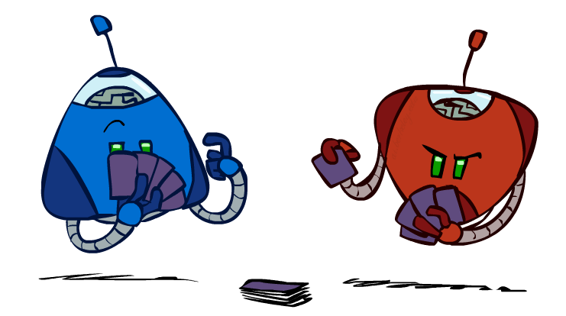

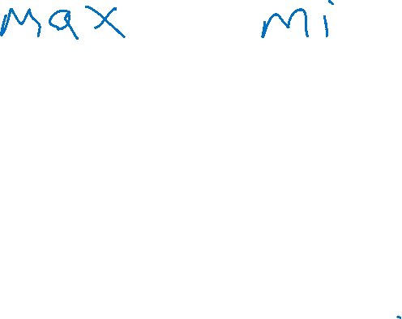
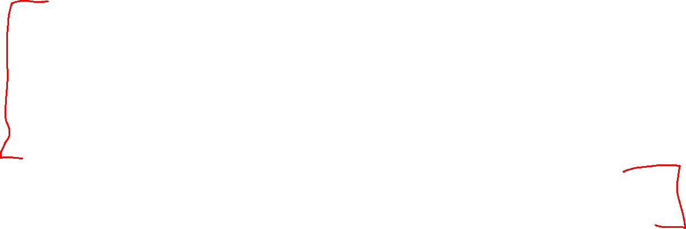
Types of Games
Many different kinds of games!
Axes:
  Deterministic or stochastic?
  Perfect information (fully observable)?
  One, two, or more players?
  Turn-taking or simultaneous?
  Zero sum?
Want algorithms for calculating a contingent plan (a.k.a. strategy or policy) which recommends a move for every possible eventuality

Slide 6
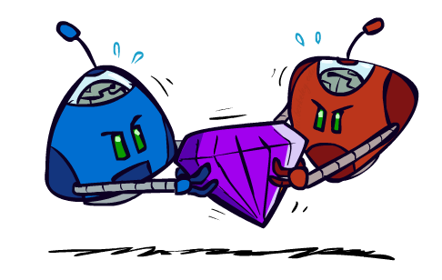
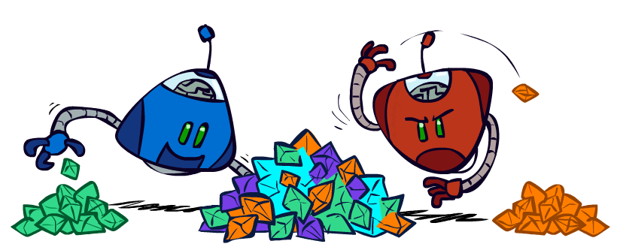
Zero-Sum Games
Zero-Sum Games
  Agents have opposite utilities
  Pure competition:
    One maximizes,
    the other minimizes
General Games
  Agents have independent utilities
  Cooperation, indifference, competition, shifting alliances, and more are all possible

Slide 7
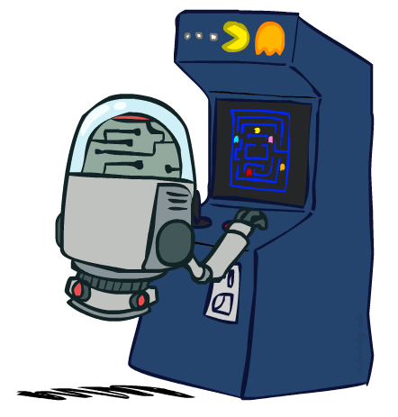
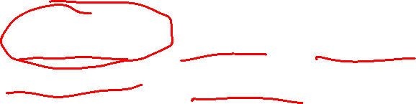
“Standard” Games
Standard games are:
deterministic, observable, two-player,
turn-taking, and zero-sum
Game formulation:
  Initial state: s₀
  Players: Player(s) indicates whose move it is
  Actions: Actions(s) for player on move
  Transition model: Result(s,a)
  Terminal test: Terminal-Test(s)
  Terminal values: Utility(s,p) for player p
    (Or just Utility(s) for player making the decision at root)

Slide 8
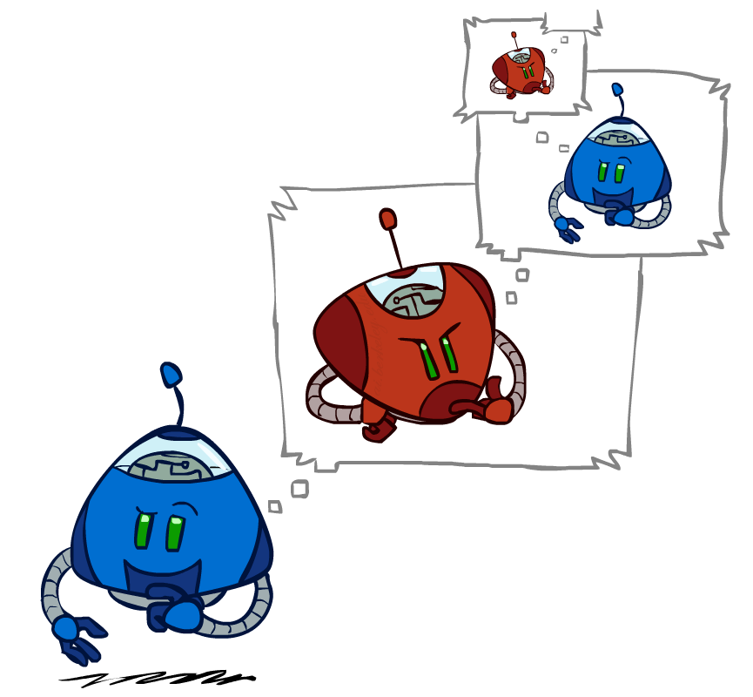
Adversarial Search

Slide 9
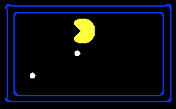
Single-Agent Trees
8
2
0
…
2
6
…
4
6
Notes:
10 points for eating dot; -1 for each time step

Slide 10

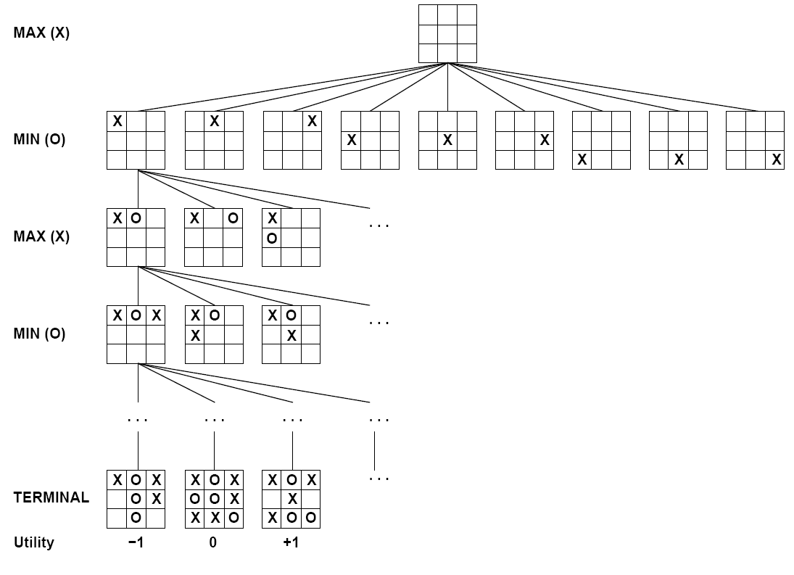

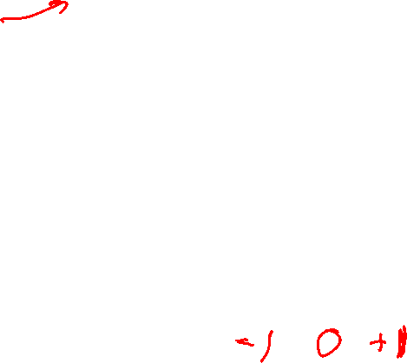
Minimax
States
Actions
Values

Slide 11

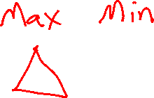

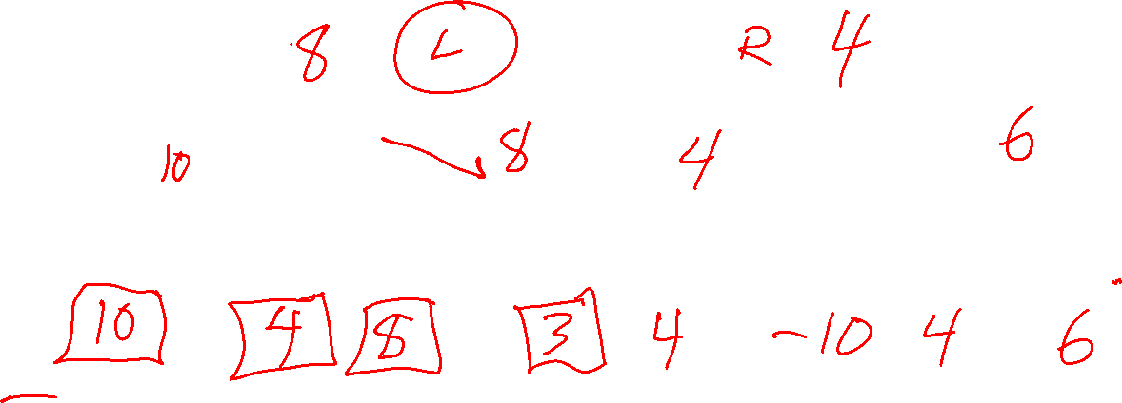
Minimax
States
Actions
Values

Slide 12
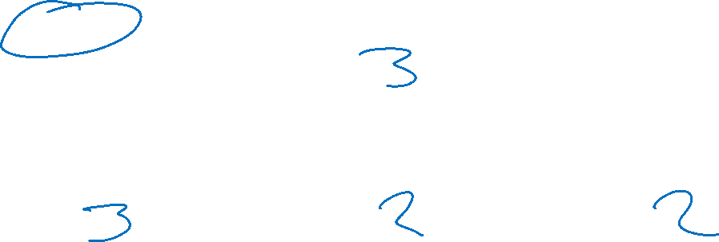
Poll 1
What is the minimax value at the root?
2
3
6
12
14
3
12
8
2
4
6
14
5
2
Notes:
Add values by hand if on tablet, or add by animation steps

Slide 13
Poll 1
What is the minimax value at the root?
2
3
6
12
14
3
3
2
2
3
12
8
2
4
6
14
5
2
Notes:
Add values by hand if on tablet, or add by animation steps

Slide 14
Minimax Code

Slide 15
Max Code
-8
-10
+8

Slide 16
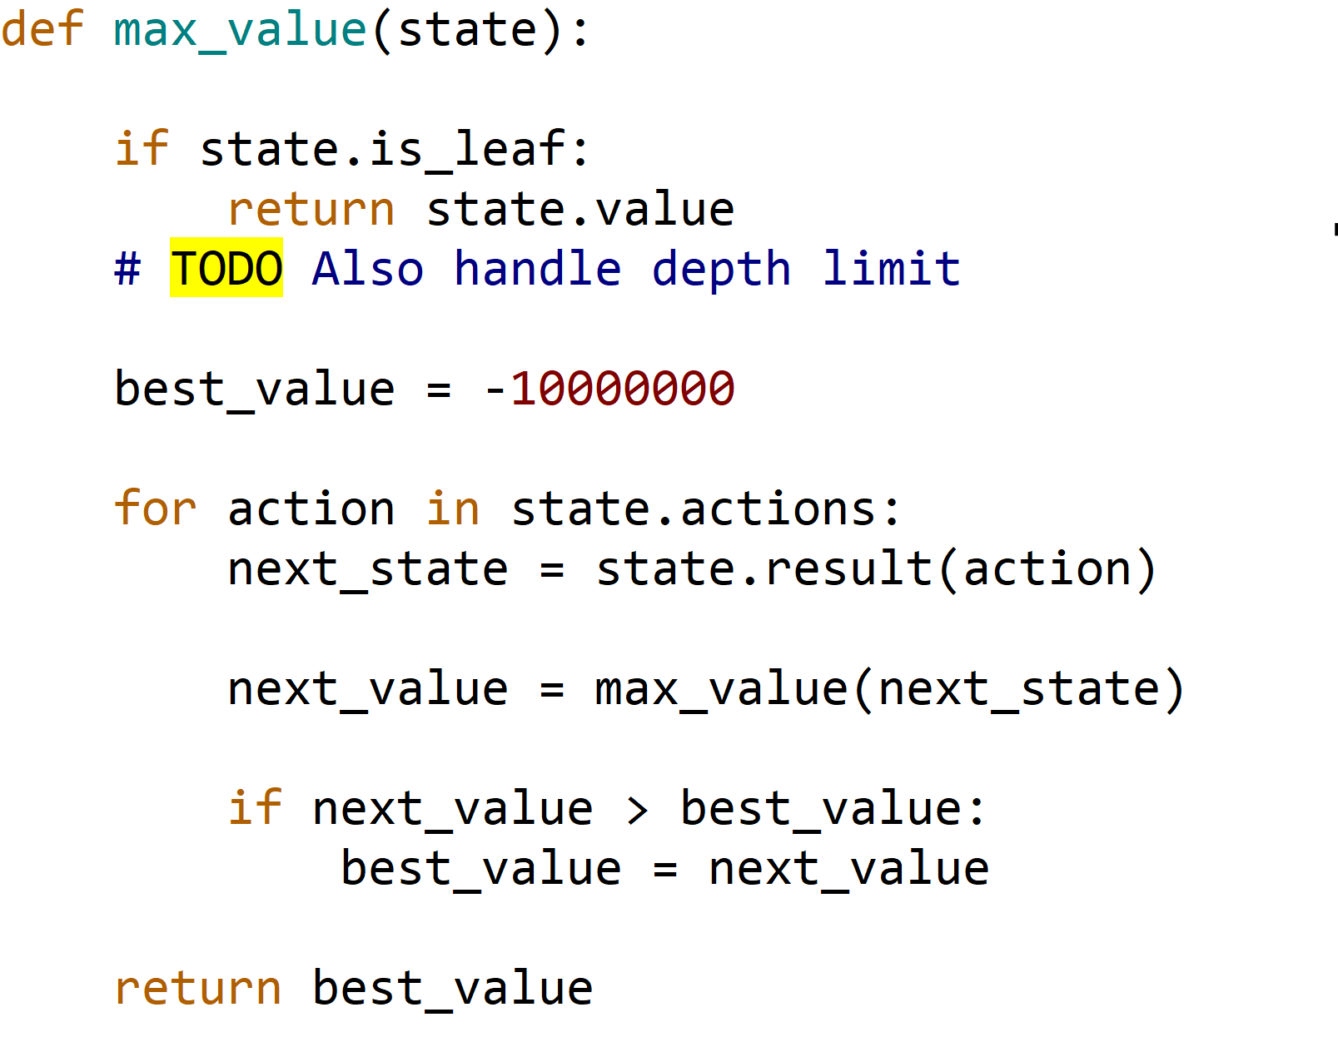
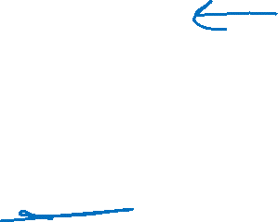
Max Code
-8
-10
+8

Slide 17
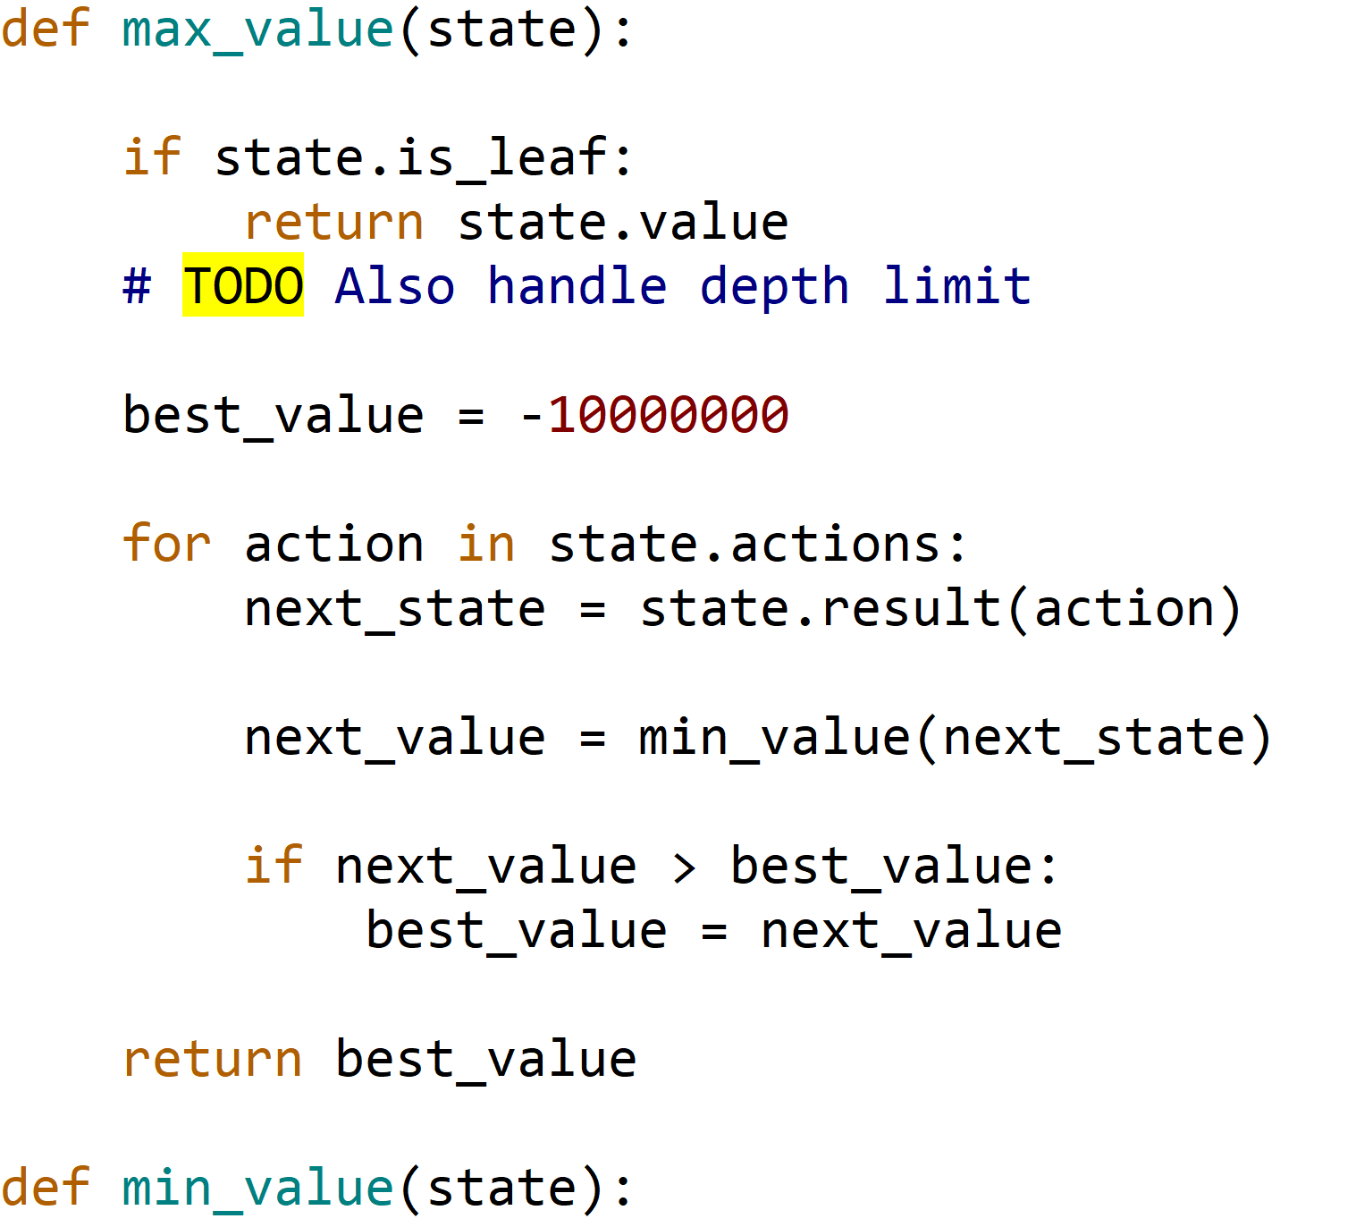

Minimax Code

Slide 18
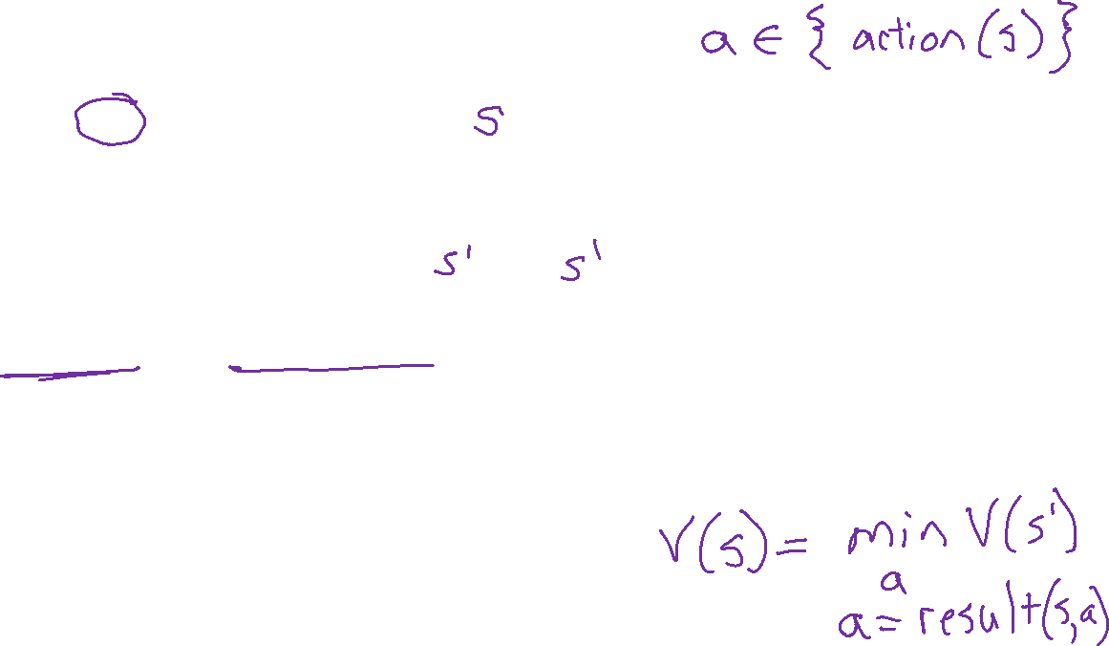
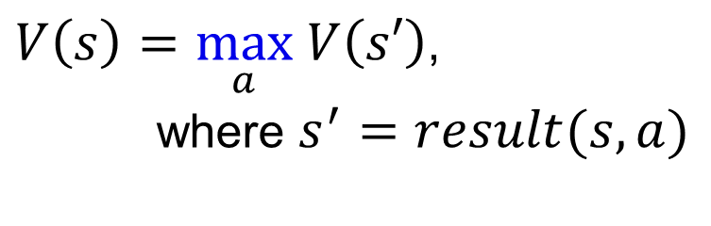
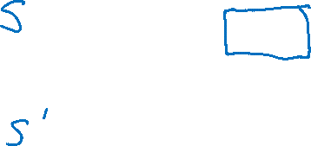
Minimax Notation
$V\left(s\right)=\max_{a} V\left(s′\right)$,
where $s^{′}=result(s, a)$

Slide 19

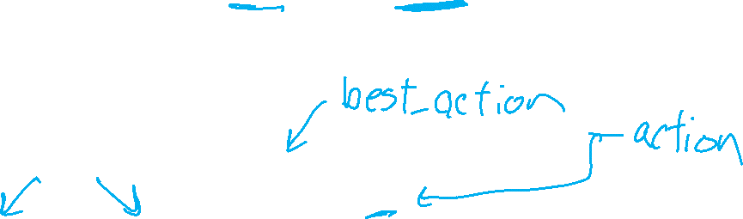
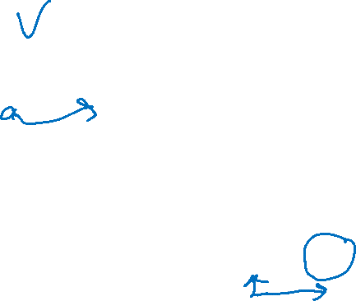


Minimax Notation
$V\left(s\right)=\max_{a} V\left(s′\right)$,
where $s^{′}=result(s, a)$
$a=\underset{a}{argmax} V\left(s′\right)$,
where $s^{′}=result(s, a)$
$\hat{a}=\underset{a}{argmax} V\left(s′\right)$,
where $s^{′}=result(s, a)$

Slide 20
Generic Game Tree Pseudocode
function minimax_decision( state )
return argmax _{a in state.actions} value( state.result(a) )
function value( state )
  if state.is_leaf
  return state.value
  if state.player is MAX
  return max _{a in state.actions} value( state.result(a) )
  if state.player is MIN
  return min _{a in state.actions} value( state.result(a) )

Slide 21
Minimax Efficiency
How efficient is minimax?
  Just like (exhaustive) DFS
  Time: O(b^{m})
  Space: O(bm)
Example: For chess, b ≈ 35, m ≈ 100
  Exact solution is completely infeasible
  Humans can’t do this either, so how do we play chess?
  Bounded rationality – Herbert Simon

Slide 22

Resource Limits

Slide 23

Resource Limits
Problem: In realistic games, cannot search to leaves!
Solution 1: Bounded lookahead
  Search only to a preset depth limit or horizon
  Use an evaluation function for non-terminal positions
Guarantee of optimal play is gone
More plies make a BIG difference
Example:
  Suppose we have 100 seconds, can explore 10K nodes / sec
  So can check 1M nodes per move
  For chess, b=~35 so reaches about depth 4 – not so good
max
4
-2
4
min
-1
-2
4
9
?
?
?
?

Slide 24
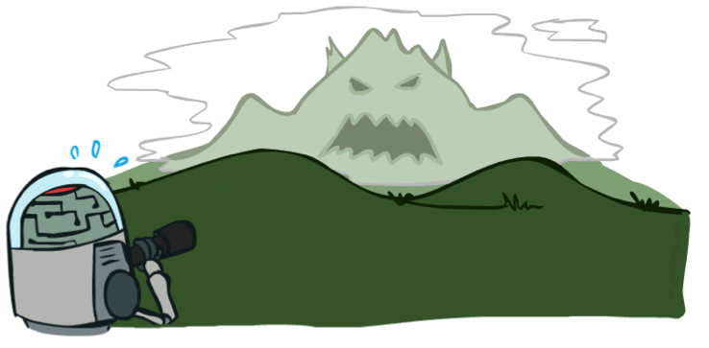

Depth Matters
Evaluation functions are always imperfect
Deeper search => better play (usually)
Or, deeper search gives same quality of play with a less accurate evaluation function
An important example of the tradeoff between complexity of features and complexity of computation
[Demo: depth limited (L6D4, L6D5)]

Slide 25
Demo Limited Depth (2)
Notes:
Depth 2, one dot and two ghosts; dot is about 8 steps away – cannot see actual eating, so need to include distance to dots in eval; but limited depth means it goes into a dead end and cannot escape even a simple ghost strategy;

Slide 26
Demo Limited Depth (10)
Notes:
Perfect lookahead: head towards red ghost!!! Wait for blue to commit to one pursuit direction, go the other way, eat the dot

Slide 27
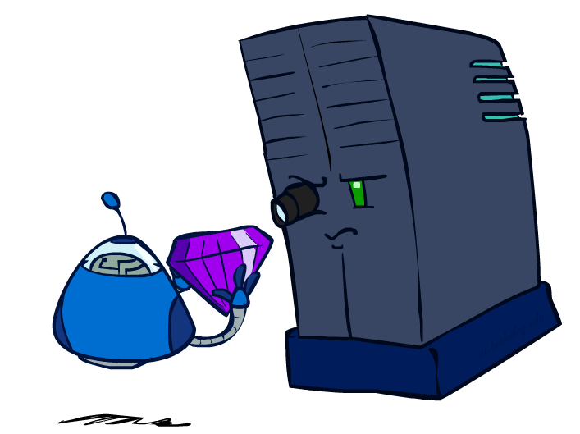
Evaluation Functions

Slide 28
Evaluation Functions
Evaluation functions score non-terminals in depth-limited search
Ideal function: returns the actual minimax value of the position
In practice: typically weighted linear sum of features:
  EVAL(s) = w₁ f₁(s) + w₂ f₂(s) + …. + w_{n} f_{n}(s)
  E.g., w₁ = 9, f₁(s) = (num white queens – num black queens), etc.

Slide 29




Evaluation for Pacman

Slide 30
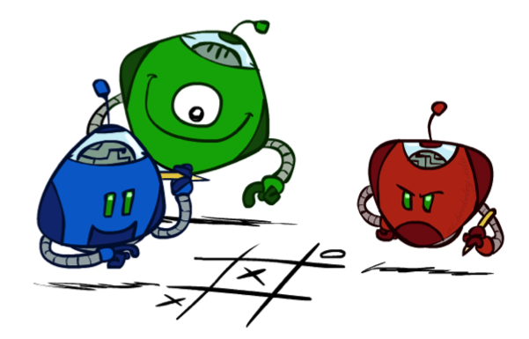
Generalized minimax
What if the game is not zero-sum, or has multiple players?
Generalization of minimax:
  Terminals have utility tuples
  Node values are also utility tuples
  Each player maximizes its own component
  Can give rise to cooperation and
  competition dynamically…
8,8,1
8,8,1
7,7,2
0,0,7
8,8,1
7,7,2
0,0,8
1,1,6
0,0,7
9,9,0
8,8,1
9,9,0
7,7,2
0,0,8
0,0,7
Notes:
If both ghosts go the same way, pacman wins; if they go different ways, pacman loses

Slide 31
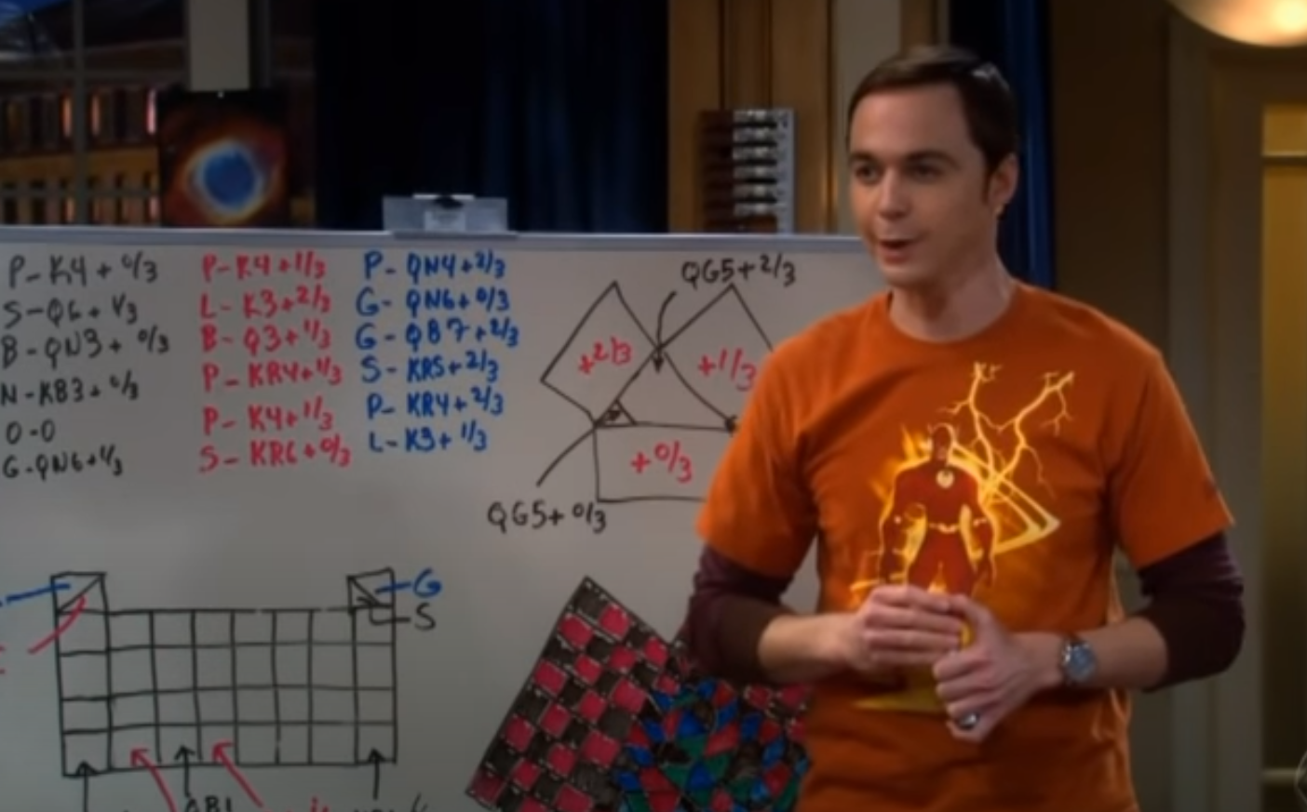
Generalized minimax
Three Person Chess
https://www.youtube.com/watch?v=HHVPutfveVs

Slide 32
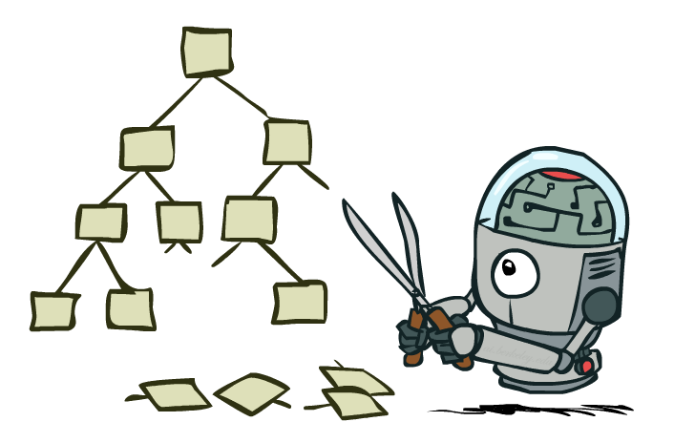
Game Tree Pruning

Slide 33
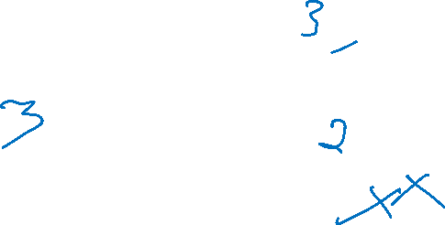
Minimax Example
3
3
2
2
3
12
8
2
4
6
14
5
2
Notes:
Add values by hand if on tablet, or add by animation steps

Slide 34

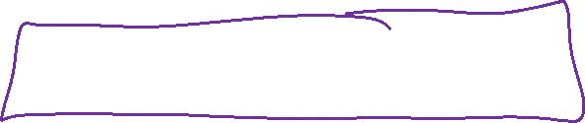
Alpha-Beta Example
α = best option so far from any
MAX node on this path
3
α =3
α =3
3
3
12
8
2
14
5
2
The order of generation matters: more pruning
is possible if good moves come first
Notes:
Add values by hand if on tablet, or add by animation steps

Slide 35
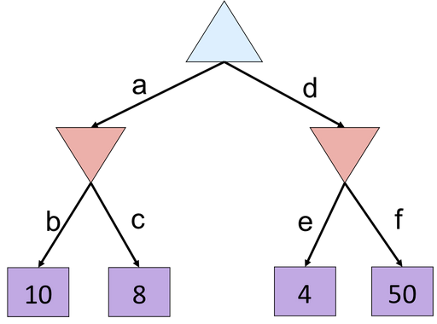
Poll 2
Which branches are pruned?
(Left to right traversal)
(Select all that apply)
Notes:
f is not evaluated

Slide 36
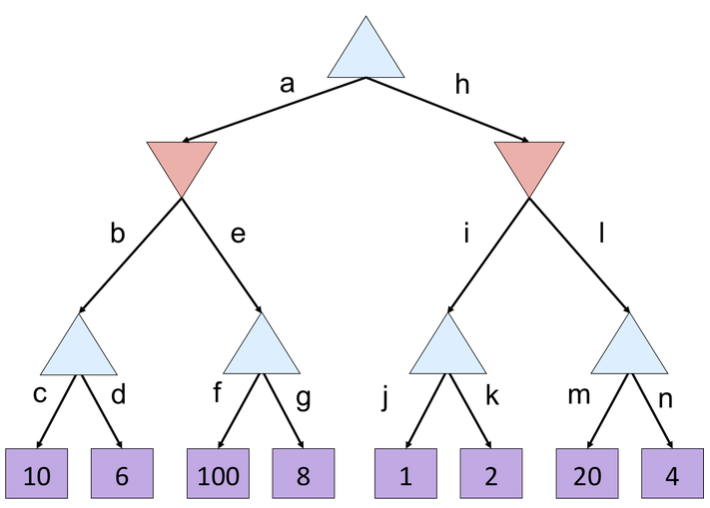
Poll 3
Which branches are pruned?
(Left to right traversal)
A) e, l
B) g, l
C) g, k, l
D) g, n

Slide 37
Poll 3
α =
10
?
β =
10
β =
2
?
?
1
2
α=
α=
10
α=
100
?
?
?

Slide 38
Alpha-Beta Implementation
  α: MAX’s best option on path to root
  β: MIN’s best option on path to root
def max-value(state, α, β):
  initialize v = -∞
  for each successor of state:
    v = max(v, value(successor, α, β))
    if v ≥ β
    return v
    α = max(α, v)
  return v
def min-value(state , α, β):
  initialize v = +∞
  for each successor of state:
    v = min(v, value(successor, α, β))
    if v ≤ α
    return v
    β = min(β, v)
  return v
Notes:
Pick an order for two reasons: sequential processor and pruning

Slide 39

Alpha-Beta Poll 3
  α: MAX’s best option on path to root
  β: MIN’s best option on path to root
def max-value(state, α, β):
  initialize v = -∞
  for each successor of state:
    v = max(v, value(successor, α, β))
    if v ≥ β
    return v
    α = max(α, v)
  return v
β = 10
10
v=100

Slide 40
Alpha-Beta Poll 3
  α: MAX’s best option on path to root
  β: MIN’s best option on path to root
α = 10
def min-value(state , α, β):
  initialize v = +∞
  for each successor of state:
    v = min(v, value(successor, α, β))
    if v ≤ α
    return v
    β = min(β, v)
  return v
10
v = 2
10
100
2

Slide 41
Alpha-Beta Pruning Properties
Theorem: This pruning has no effect on minimax value computed for the root!
Good child ordering improves effectiveness of pruning
  Iterative deepening helps with this
With “perfect ordering”:
  Time complexity drops to O(b^{m/2})
  Doubles solvable depth!
  1M nodes/move => depth=8, respectable
This is a simple example of metareasoning (computing about what to compute)
max
min
10
10
0

Slide 42
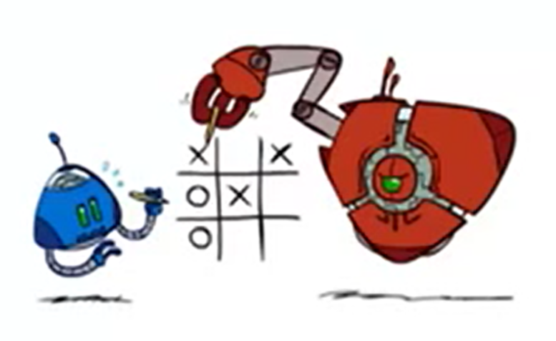
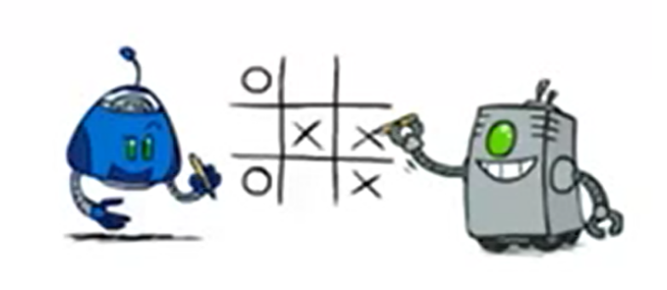
Modeling Assumptions
Know your opponent
10
10
9
100

Slide 43
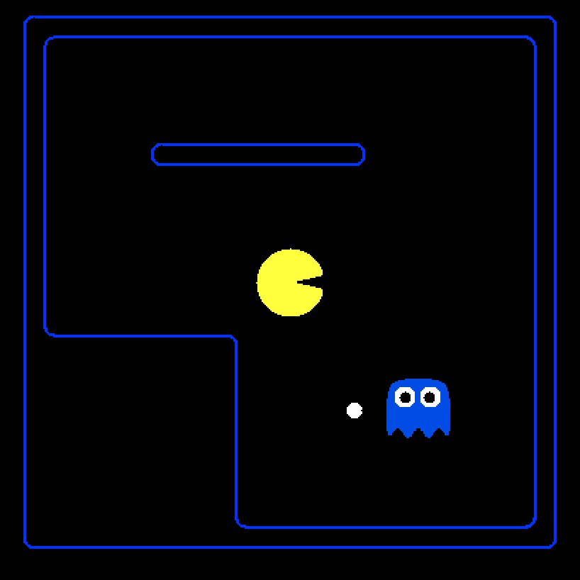
Minimax Demo
Points
+500 win
-500 lose
-1 each move
Fine print
Pacman: uses depth 4 minimax
Ghost: uses depth 2 minimax

Slide 44
Poll 4
How well would a minimax Pacman perform against a
ghost that moves randomly?
  Better than against a minimax ghost
  Worse than against a minimax ghost
  Same as against a minimax ghost
Fine print
Pacman: uses depth 4 minimax as before
Ghost: moves randomly
[Demo: L7D6)]

Slide 45
Demo

Slide 46
Assumptions vs. Reality
 | Minimax Ghost | Random Ghost
Minimax Pacman | Won 5/5 Avg. Score: 493 | Won 5/5 Avg. Score: 464
Expectimax Pacman | Won 1/5 Avg. Score: -303 | Won 5/5 Avg. Score: 503
Results from playing 5 games
[Demo: (L7D6, L7D5)]

Slide 47
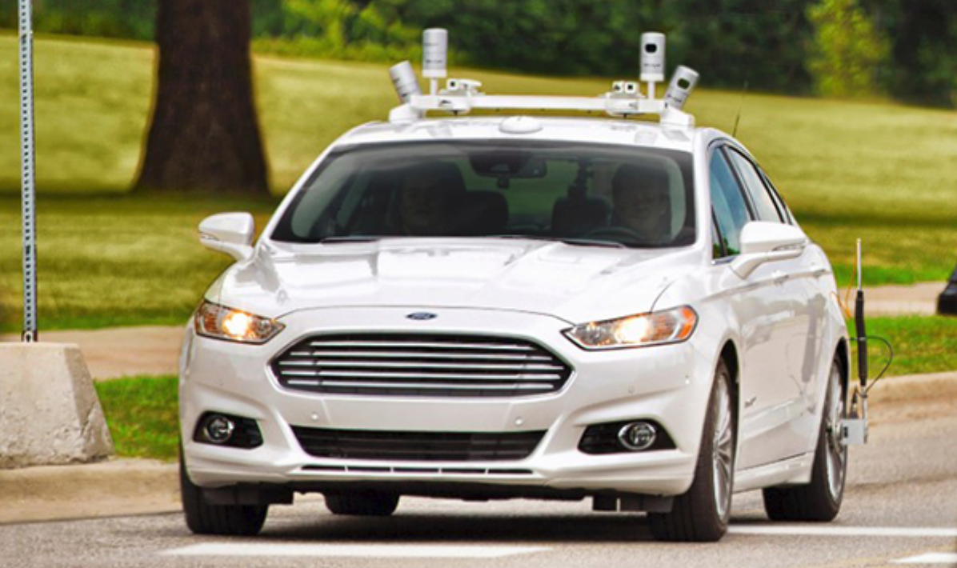
Modeling Assumptions
Minimax autonomous vehicle?
Image: https://corporate.ford.com/innovation/autonomous-2021.html

Slide 48
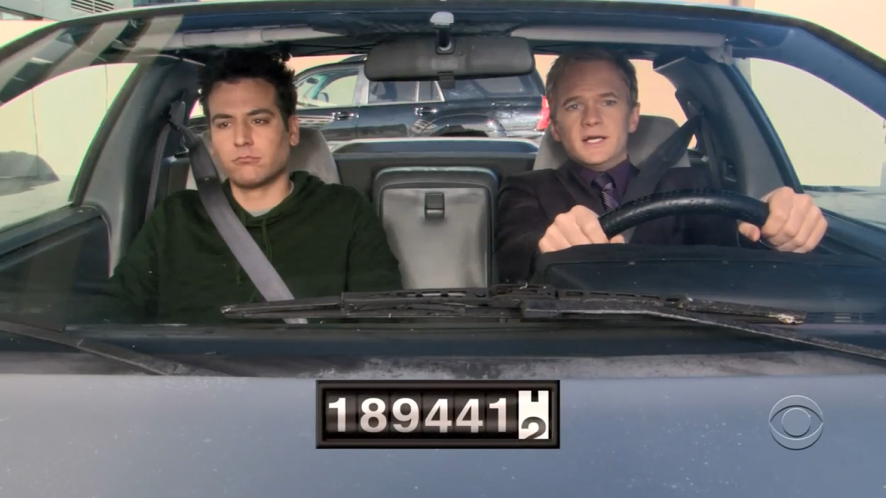
Minimax Driver?
https://youtu.be/5PRrwlkPdNI?t=52
Clip: How I Met Your Mother, CBS

Slide 49
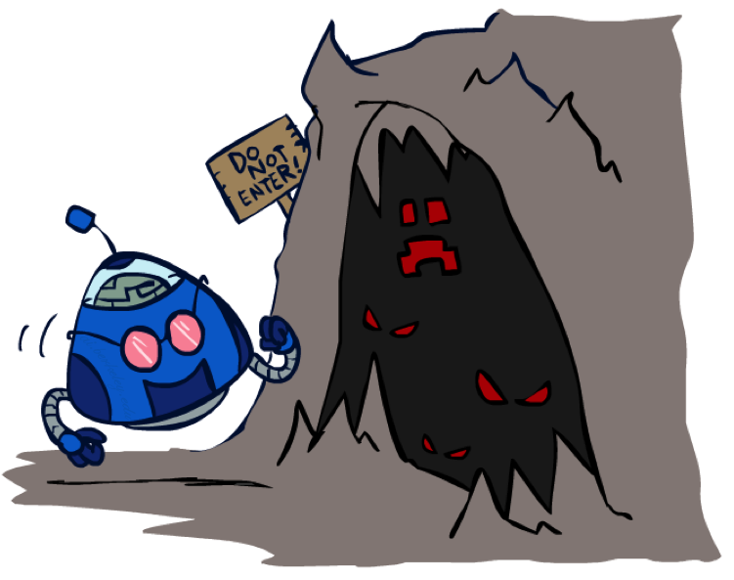
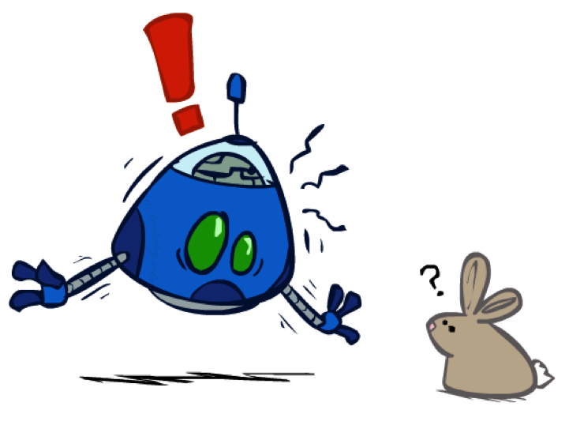
Modeling Assumptions
Dangerous Pessimism
Assuming the worst case when it’s not likely
Dangerous Optimism
Assuming chance when the world is adversarial

Slide 50

Modeling Assumptions
Chance nodes: Expectimax
10
10
9
100

Slide 51
Assumptions vs. Reality
 | Minimax Ghost | Random Ghost
Minimax Pacman | Won 5/5 Avg. Score: 493 | Won 5/5 Avg. Score: 464
Expectimax Pacman | Won 1/5 Avg. Score: -303 | Won 5/5 Avg. Score: 503
Results from playing 5 games

Slide 52

Probabilities

Slide 53



Probabilities
A random variable represents an event whose outcome is unknown
A probability distribution is an assignment of weights to outcomes
Example: Traffic on freeway
  Random variable: T = whether there’s traffic
  Outcomes: T in {none, light, heavy}
  Distribution:
  P(T=none) = 0.25, P(T=light) = 0.50, P(T=heavy) = 0.25
Probabilities over all possible outcomes sum to one
0.25
0.50
0.25

Slide 54
Expected Value
Expected value of a function of a random variable:
  Average the values of each outcome,
  weighted by the probability of that outcome
Example: How long to get to the airport?
Probability:
0.25
0.50
0.25
+
+
35 min
x
x
x
Time:
20 min
30 min
60 min
0.25
0.25
0.5
20
30
60

Slide 55
Poll 5
Expectimax tree search:
Which action do we choose?
A: Left
B: Center
C: Right
D: Eight
Left
Right
Center
1/4
1/2
1/2
1/2
1/3
2/3
1/4
12
8
4
8
6
12
6

Slide 56
Poll 5
Expectimax tree search:
Which action do we choose?
A: Left
B: Center
C: Right
D: Eight
8, Right
Left
Right
Center
3+2+2=7
4+3=7
4+4=8
1/4
1/2
1/2
1/2
1/3
2/3
1/4
12
8
4
8
6
12
6

Slide 57


Chance outcomes in trees
10
10
9
100
10
10
9
100
Tictactoe, chess
Minimax
Tetris, investing
Expectimax
10
9
10
9
10
100
Backgammon, Monopoly
Expectiminimax
Notes:
At least 10, or otherwise just rather dead; or just 100, or otherwise rather dead; that’s yet something different than minimax or expectimax

Slide 58
Expectimax Code
function value( state )
  if state.is_leaf
  return state.value
  if state.player is MAX
  return max _{a in state.actions} value( state.result(a) )
  if state.player is MIN
  return min _{a in state.actions} value( state.result(a) )
  if state.player is CHANCE
  return sum _{s in state.next_states} P( s ) * value( s )

Slide 59


Expectimax Pruning?
3
12
9
2

Slide 60




Expectimax Notation
Time:
20 min
30 min
60 min
+
+
x
x
x
Probability:
0.25
0.50
0.25
0.25
0.25
0.5
20
30
60
Max node notation
Chance node notation
$$\sum_{s′}{P\left(s^{′}\right) V(s′)}$$
$V\left(s\right)=\max_{a} V\left(s′\right)$,
where $s^{′}=result(s, a)$
$$V\left(s\right)=$$

Slide 61


Preview: MDP/Reinforcement Learning Notation
$$V\left(s\right)=\max_{a}{\sum_{s′}{P(s^{′}) V(s^{′})}}$$

Slide 62



Preview: MDP/Reinforcement Learning Notation
$$V\left(s\right)=\max_{a}{\sum_{s′}{P\left(s^{′}\right|s,a)V(s^{′})}}$$
$$V\left(s\right)=\max_{a}{\sum_{s′}{P\left(s^{′} | s,a\right)\left[R\left(s,a,s^{′}\right)+γV\left(s^{′}\right)\right]}}$$
$$V_{k+1}\left(s\right)=\max_{a}{\sum_{s′}{P\left(s^{′} | s,a\right)\left[R\left(s,a,s^{′}\right)+γV_{k}\left(s^{′}\right)\right]}}, ∀ s$$
$$Q_{k+1}\left(s,a\right)=\sum_{s′}{P\left(s^{′} | s,a\right)[R\left(s,a,s^{′}\right)+γ\max_{a^{′}}{Q_{k}(s^{′},a^{′})]}, } ∀ s,a$$
$$π_{V}\left(s\right)=\underset{a}{argmax}{\sum_{s′}{P\left(s^{′} | s,a\right)[R\left(s,a,s^{′}\right)+γV\left(s^{′}\right)]}}, ∀ s$$
$$V_{k+1}^{π}\left(s\right)=\sum_{s′}{P\left(s^{′} | s,π\left(s\right)\right)[R\left(s,π\left(s\right),s^{′}\right)+γV_{k}^{π}\left(s^{′}\right)]}, ∀ s$$
$$π_{new}\left(s\right)=\underset{a}{argmax}{\sum_{s′}{P\left(s^{′} | s,a\right)\left[R\left(s,a,s^{′}\right)+γV^{π_{old}}\left(s^{′}\right)\right]}}, ∀ s$$
Standard expectimax:
Bellman equations:
Value iteration:
Q-iteration:
Policy extraction:
Policy evaluation:
Policy improvement:

Slide 63

Preview: MDP/Reinforcement Learning Notation
$$V\left(s\right)=\max_{a}{\sum_{s′}{P\left(s^{′}\right|s,a)V(s^{′})}}$$
$$V\left(s\right)=\max_{a}{\sum_{s′}{P\left(s^{′} | s,a\right)\left[R\left(s,a,s^{′}\right)+γV\left(s^{′}\right)\right]}}$$
$$V_{k+1}\left(s\right)=\max_{a}{\sum_{s′}{P\left(s^{′} | s,a\right)\left[R\left(s,a,s^{′}\right)+γV_{k}\left(s^{′}\right)\right]}}, ∀ s$$
$$Q_{k+1}\left(s,a\right)=\sum_{s′}{P\left(s^{′} | s,a\right)[R\left(s,a,s^{′}\right)+γ\max_{a^{′}}{Q_{k}(s^{′},a^{′})]}, } ∀ s,a$$
$$π_{V}\left(s\right)=\underset{a}{argmax}{\sum_{s′}{P\left(s^{′} | s,a\right)[R\left(s,a,s^{′}\right)+γV\left(s^{′}\right)]}}, ∀ s$$
$$V_{k+1}^{π}\left(s\right)=\sum_{s′}{P\left(s^{′} | s,π\left(s\right)\right)[R\left(s,π\left(s\right),s^{′}\right)+γV_{k}^{π}\left(s^{′}\right)]}, ∀ s$$
$$π_{new}\left(s\right)=\underset{a}{argmax}{\sum_{s′}{P\left(s^{′} | s,a\right)\left[R\left(s,a,s^{′}\right)+γV^{π_{old}}\left(s^{′}\right)\right]}}, ∀ s$$
Standard expectimax:
Bellman equations:
Value iteration:
Q-iteration:
Policy extraction:
Policy evaluation:
Policy improvement:

Slide 64
Why Expectimax?
Pretty great model for an agent in the world
Choose the action that has the: highest expected value

Slide 65
Bonus Question
Let’s say you know that your opponent is actually running a depth 1 minimax, using the result 80% of the time, and moving randomly otherwise
Question: What tree search should you use?
A: Minimax
B: Expectimax
C: Something completely different

Slide 66
Summary
Games require decisions when optimality is impossible
  Bounded-depth search and approximate evaluation functions
Games force efficient use of computation
  Alpha-beta pruning
Game playing has produced important research ideas
  Reinforcement learning (checkers)
  Iterative deepening (chess)
  Monte Carlo tree search (Go)
  Solution methods for partial-information games in economics (poker)
Video games present much greater challenges – lots to do!
  b = 10⁵⁰⁰, |S| = 10⁴⁰⁰⁰, m = 10,000

