Slide 1

Warm-up as you walk in
Think about:
How humans learn to play
How you might implement an Agent bot to play this in code:
class Agent:
def getAction(state)
return action
Candy Grab game!
Grab a pack of game pieces (candy/pretzels)
Groups of 3
Play the game!
Select 2 players
(third player will observe)
11 pieces on the table
Take turns taking 1 or 2 pieces
Person that takes the last piece wins!
Keep playing the game
(rotate which two students are playing)

Slide 2
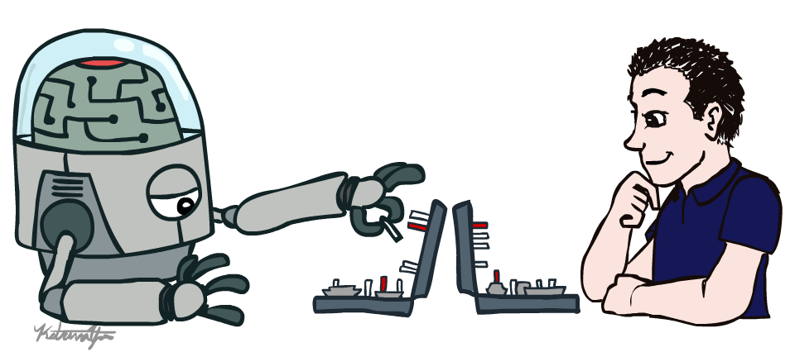
AI: Representation and Problem Solving
Introduction
Instructor: Pat Virtue
Slide credits: CMU AI & http://ai.berkeley.edu

Slide 3

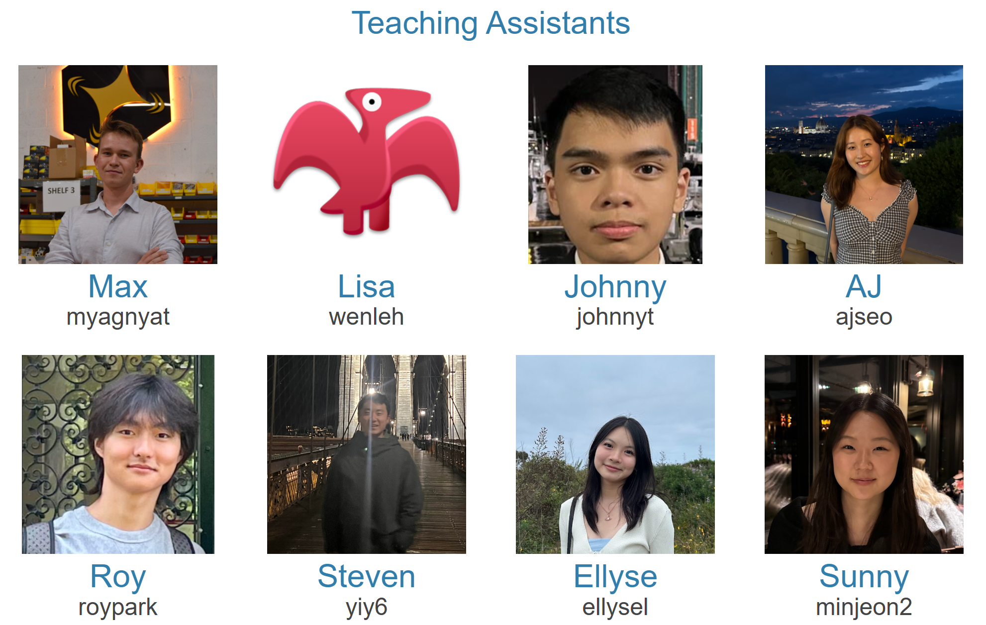
Course Team
Instructor
Teaching Assistants

Slide 4
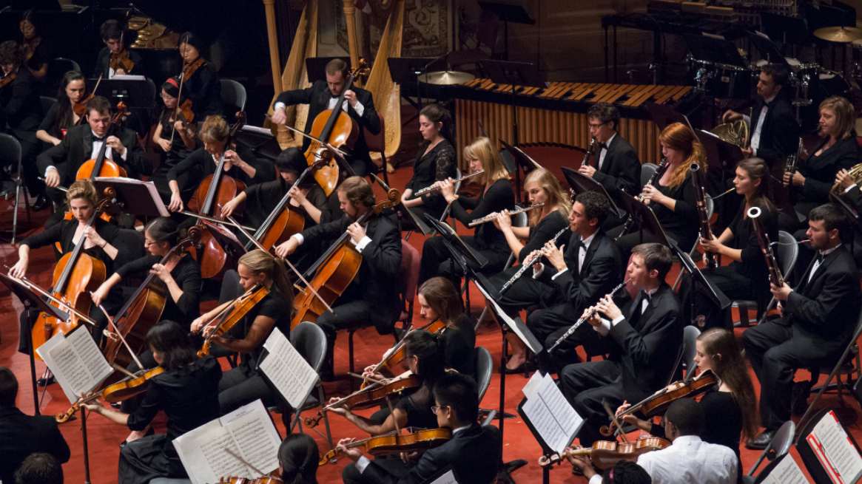
Course Team
Students!!

Slide 5

Course Information
Website: https://www.cs.cmu.edu/~15281
Communication:
https://edstem.org/
Including any messages to Pat
(e-mail Pat if Ed doesn’t work pvirtue@andrew.cmu.edu)
Important posts coming soon!
Office Hours
Recitation (Fri)
P0
HW1

Slide 6
Announcements
Recitation starting this Friday
Recommended. Materials are fair game for exams
Choosing sections
Assignments:
P0: Python & Autograder Tutorial
Not required, worth zero points
Recommended for those with little Python experience
Due Thu 9/4, 10 pm
HW1 (online)
Released Thursday
Due Thu 9/4, 10 pm

Slide 7
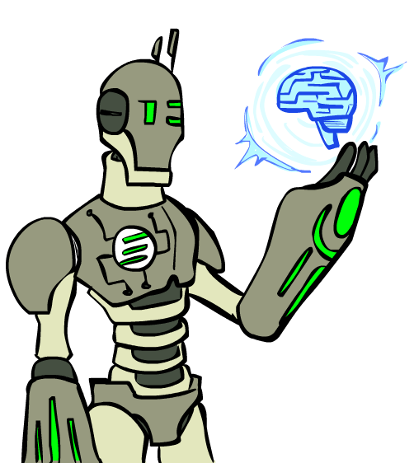
Today
Agents
What is artificial intelligence?
A brief history of AI

Slide 8
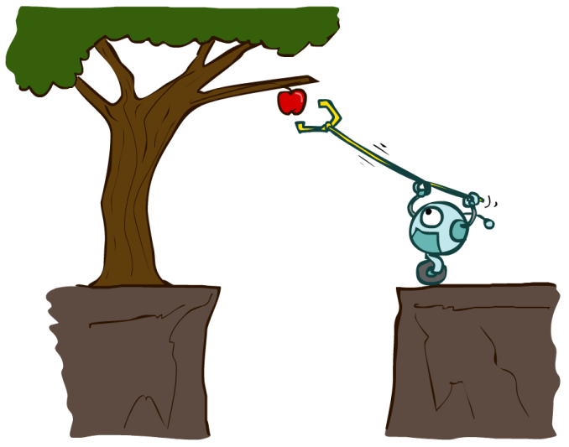

Designing Agents
An agent is an entity that perceives and acts.
Characteristics of the percepts, environment, and action space dictate techniques for selecting actions
This course is about:
General AI techniques for a variety of problem types
Learning to recognize when and how a new problem can be solved with an existing technique
Sensors
Agent
Percepts
Environment
?
Actuators
Actions

Slide 9
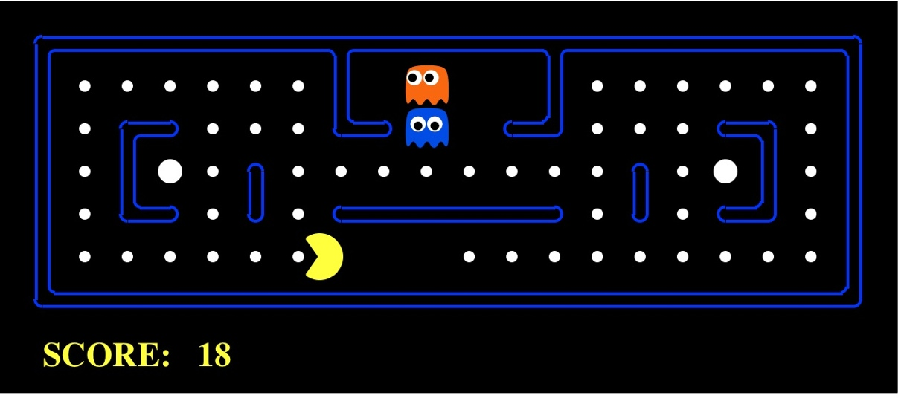

Pac-Man as an Agent
Agent
Environment
Sensors
Percepts
?
Actuators
Actions
Pac-Man is a registered trademark of Namco-Bandai Games, used here for educational purposes

Slide 10

Candy Grab (Nim) Agent
class Agent
function getAction(state)
return action

Slide 11
Nim Agent
Agent 001 – Always choose 1
function getAction( numPiecesAvailable )
return 1

Slide 12
Nim Agent
Agent 002 – Always choose 2
function getAction( numPiecesAvailable )
return 2

Slide 13
Nim Agent
Agent 004 – Choose the opposite of opponent
function getAction( numPiecesAvailable )
return ?

Slide 14
Nim Agent
Agent 007 – Whatever you think is best
function getAction( numPiecesAvailable )
return ?

Slide 15
Nim Agent
Agent 007 – Whatever you think is best
function getAction( numPiecesAvailable )
if numPiecesAvailable % 3 == 2
return 2
else
return 1

Slide 16
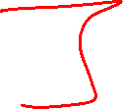
Participation Polls
See Ed for link to Drive
Seat form
More details on participation later

Slide 17
Games – Three “Intelligent” Agents
Poll 1
Which agent code is the most “intelligent”?

Slide 18

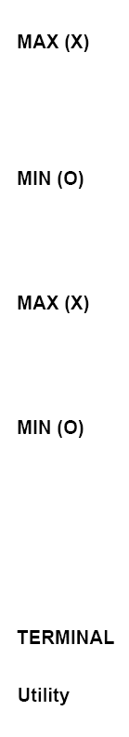

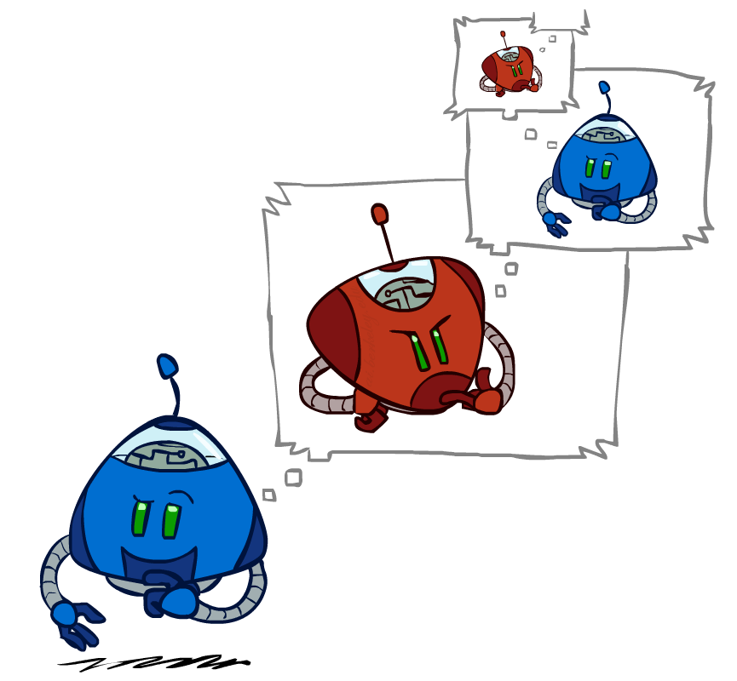
Games – Three “Intelligent” Agents
A: Search / Recursion
11
10
9
9
8
8
7
8
7
…
…
2
1
0
+1
+1
-1

Slide 19
Games – Three “Intelligent” Agents
B: Encode the pattern
10’s value:Win
9’s value:Lose
8’s value:Win
7’s value:Win
6’s value:Lose
5’s value:Win
4’s value:Win
3’s value:Lose
2’s value:Win
1’s value:Win
0’s value:Lose
function getAction( numPiecesAvailable )
if numPiecesAvailable % 3 == 2
return 2
else
return 1

Slide 20


Games – Three “Intelligent” Agents
C: Record statistics of winning positions
Pieces Available | Take 1 | Take 2
2
3
4
5
6
7

Slide 21
Games – Three “Intelligent” Agents
C: Record statistics of winning positions
Pieces Available | Take 1 | Take 2
2 |  | 100%
3
4 | 100%
5
6
7 |  | 100%

Slide 22


Games – Three “Intelligent” Agents
C: Record statistics of winning positions
Pieces Available | Take 1 | Take 2
2
3
4
5
6
7

Slide 23
Games – Three “Intelligent” Agents
C: Record statistics of winning positions
Pieces Available | Take 1 | Take 2
2 |  | 100%
3 | 0%
4 | 100%
5
6
7 |  | 50%

Slide 24

Games – Three “Intelligent” Agents
C: Record statistics of winning positions
Pieces Available | Take 1 | Take 2
2 | 0% | 100%
3 | 2% | 0%
4 | 75% | 2%
5 | 4% | 68%
6 | 5% | 6%
7 | 60% | 5%

Slide 25
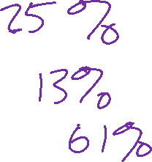
Poll 1
Games – Three “Intelligent” Agents
Which agent code is the most “intelligent”?
Search / Recursion
Encode multiple of 3 pattern
Keep stats on winning positions
Which agent code is the most “intelligent”?

Slide 26
Games – Three “Intelligent” Agents
C: Record statistics of winning positions
Pieces Available | Take 1 | Take 2
2
3
4
5
6
7
Pieces Available | Take 1 | Take 2
2 |  | 100%
3
4 | 100%
5
6
7 |  | 100%
Pieces Available | Take 1 | Take 2
2 |  | 100%
3 | 0%
4 | 100%
5
6
7 |  | 50%
Pieces Available | Take 1 | Take 2
2 | 0% | 100%
3 | 2% | 0%
4 | 75% | 2%
5 | 4% | 68%
6 | 5% | 6%
7 | 60% | 5%

Slide 27
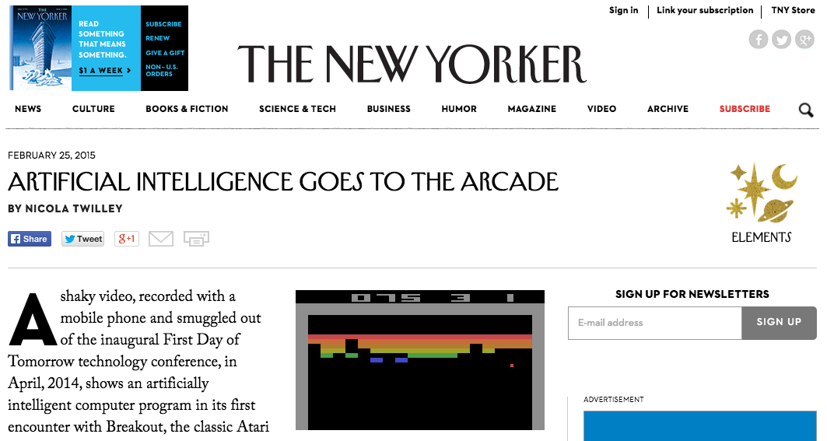
AI Breakthrough!
https://www.youtube.com/watch?v=EfGD2qveGdQ

Slide 28
What is "Aritifical Intelligence"?

Slide 29
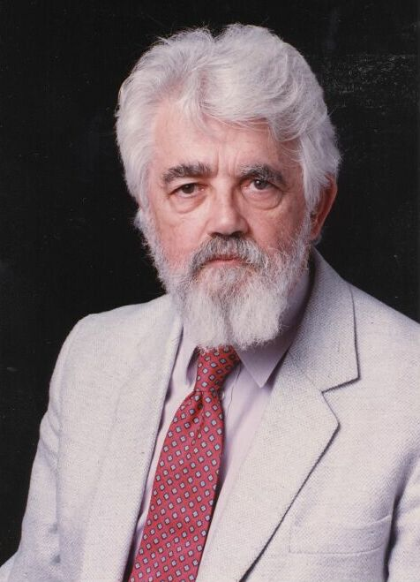
AI Definition by John McCarthy
What is artificial intelligence
It is the science and engineering of making intelligent machines, especially intelligent computer programs
What is intelligence
Intelligence is the computational part of the ability to achieve goals in the world
Source: http://www-formal.stanford.edu/jmc/whatisai/whatisai.html

Slide 30
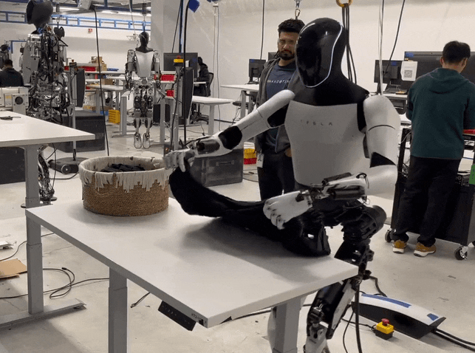
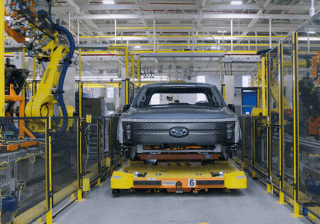
What is artificial Intelligence?
Why is folding clothes a research problem while robots are actively being used to assemble cars in factories?

Slide 31


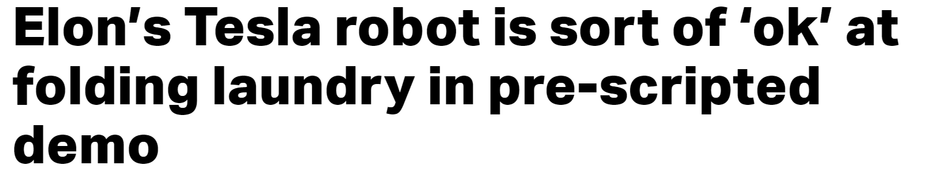
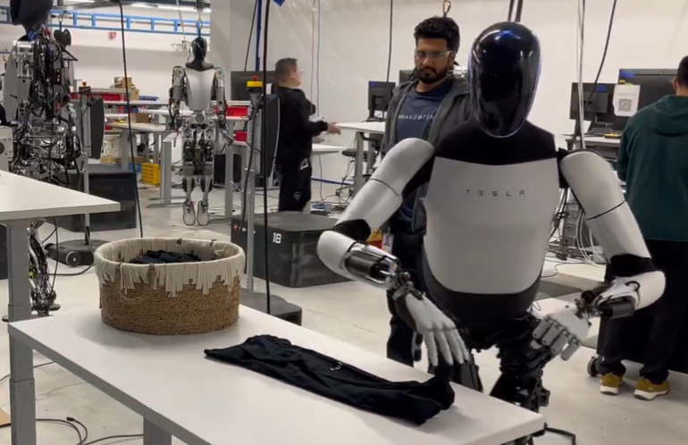
Whoops
Musk said that eventually, it will “certainly be able to do this fully autonomously,” however, and without the highly artificial constraints in place for this demo, including the fixed-height table and single article of clothing in the carefully placed basket.
https://techcrunch.com/2024/01/15/elons-tesla-robot-is-sort-of-ok-at-folding-laundry-in-pre-scripted-demo
https://x.com/elonmusk/status/1746964887949934958

Slide 32
Intelligence and Uncertainty
Another way to think about intelligence is to consider how much uncertainty is involved
Uncertainty comes into play whenever it is not feasible to determine exact information
Uncertainty requires decisions to be made

Slide 33
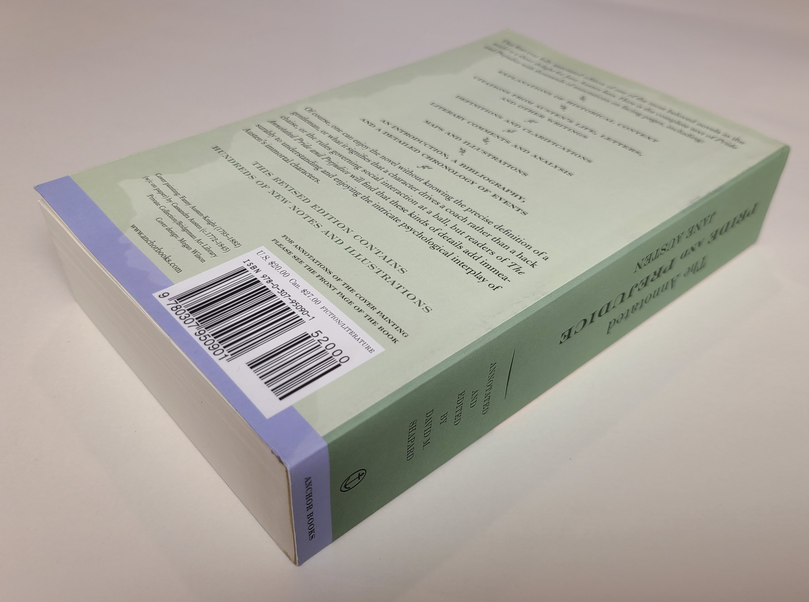
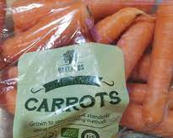
Intelligence and Uncertainty
ISBN 978-0-307-95090-1
Consider the uncertainty present in the following
Typing a product ID number into a website (book ISBN number into amazon.com)
Barcode reader scanning a book in a well-lit library
Barcode reader scanning a bag of carrots in a grocery store

Slide 34

Intelligence and Uncertainty
Uncertainty can have lots of sources, including anything we attribute to random chance
Hidden information
Cards in another player’s hand
Noise
Sensor noise
Way to complicated to model
Leaves blowing in the wind
Infinite number of possible configurations
More possibilities than any computer can compute in a reasonable time
Tic-tac-toe → Checkers → Chess

Slide 35
AI Definition by John McCarthy
What is artificial intelligence
It is the science and engineering of making intelligent machines, especially intelligent computer programs
What is intelligence
Intelligence is the computational part of the ability to achieve goals in the world
Source: http://www-formal.stanford.edu/jmc/whatisai/whatisai.html

Slide 36



AI Definition (Pat's Version)
What is intelligence
Intelligence is the ability to perform well on a task that involves uncertainty
Intelligence is not binary
How well an agent performs and how much uncertainty is involved will determine how intelligent we consider the agent to be

Slide 37
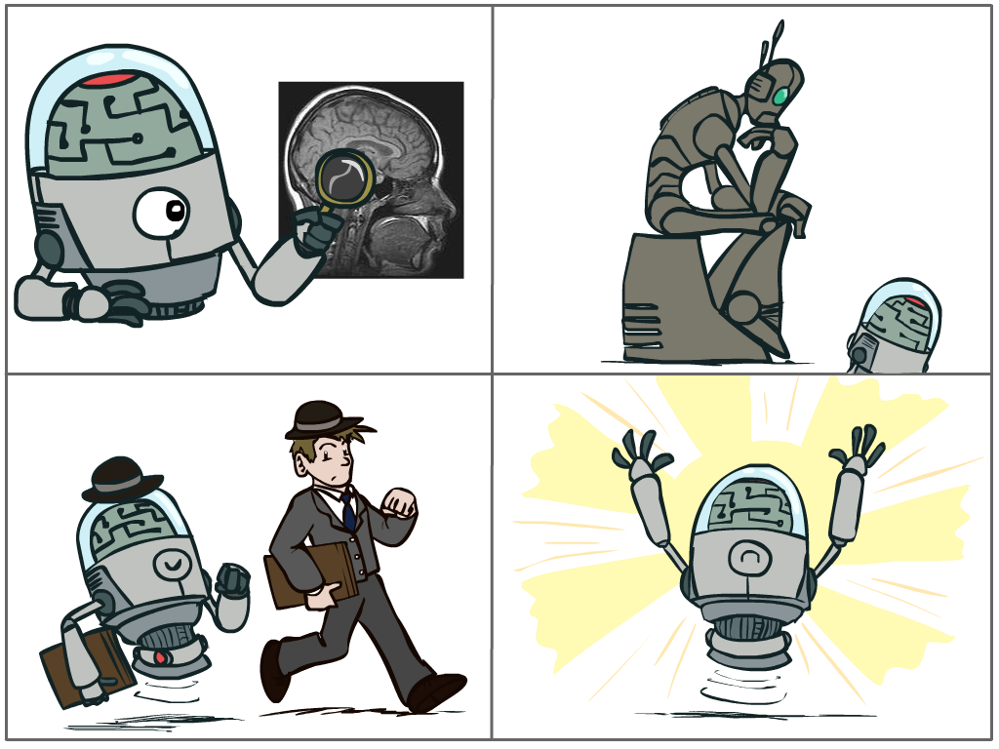
What is AI?
The science of making machines that:
Think like people
Think rationally
Act like people
Act rationally
Notes:
Top left: Think like people --- cognitive science, neuroscience
Bottom left: act like people --- actually very early definition, dating back to Alan Turing --- Turing test; problem to do really well you start focusing on things like don’t answer too quickly what the square root of 1412 is, don’t spell too well, and make sure you have a favorite movie etc. So it wasn’t really leading us to build intelligence
Think rationally – long tradition dating back to Aristotle --- but not a winner, because difficult to encode how to think, and in the end it’s not about how you think, it’s about how you end up acting

Slide 38
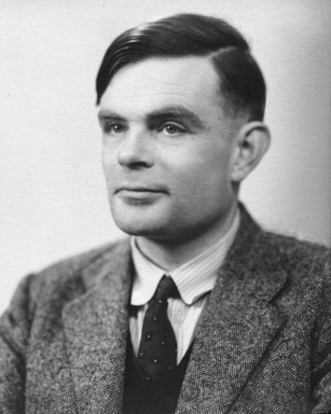
Turing Test
In 1950, Turing defined a test of whether a machine could “think”
“A human judge engages in a natural language conversation with one human and one machine, each of which tries to appear human. If judge can’t tell, machine passes the Turing test”
en.wikipedia.org/wiki/Turing_test
Notes:
Top left: Think like people --- cognitive science, neuroscience
Bottom left: act like people --- actually very early definition, dating back to Alan Turing --- Turing test; problem to do really well you start focusing on things like don’t answer too quickly what the square root of 1412 is, don’t spell too well, and make sure you have a favorite movie etc. So it wasn’t really leading us to build intelligence
Think rationally – long tradition dating back to Aristotle --- but not a winner, because difficult to encode how to think, and in the end it’s not about how you think, it’s about how you end up acting

Slide 39
What is AI?
The science of making machines that:
Think like people
Think rationally
Act like people
Act rationally
Notes:
Top left: Think like people --- cognitive science, neuroscience
Bottom left: act like people --- actually very early definition, dating back to Alan Turing --- Turing test; problem to do really well you start focusing on things like don’t answer too quickly what the square root of 1412 is, don’t spell too well, and make sure you have a favorite movie etc. So it wasn’t really leading us to build intelligence
Think rationally – long tradition dating back to Aristotle --- but not a winner, because difficult to encode how to think, and in the end it’s not about how you think, it’s about how you end up acting

Slide 40

Rational Decisions
We’ll use the term rational in a very specific, technical way:
Rational: maximally achieving pre-defined goals
Only concerned with what decisions are made (not the thought process behind them)
Goals are expressed in terms of the utility of outcomes
Being rational means maximizing your expected utility
Notes:
Example of utilities. 10 for A, 1 for each Friday with friends

Slide 41
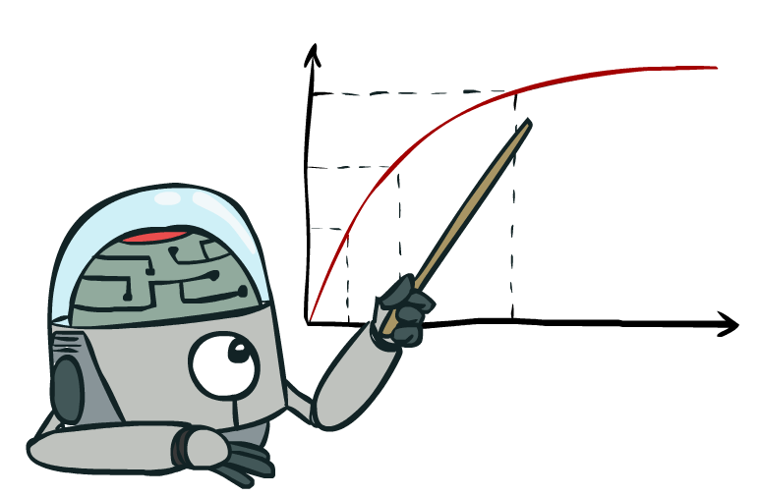
Maximize Your
Expected Utility

Slide 42
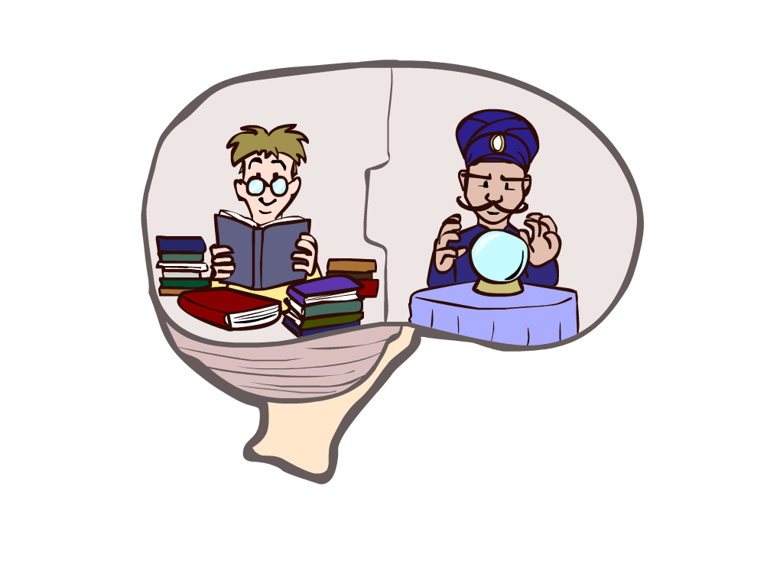
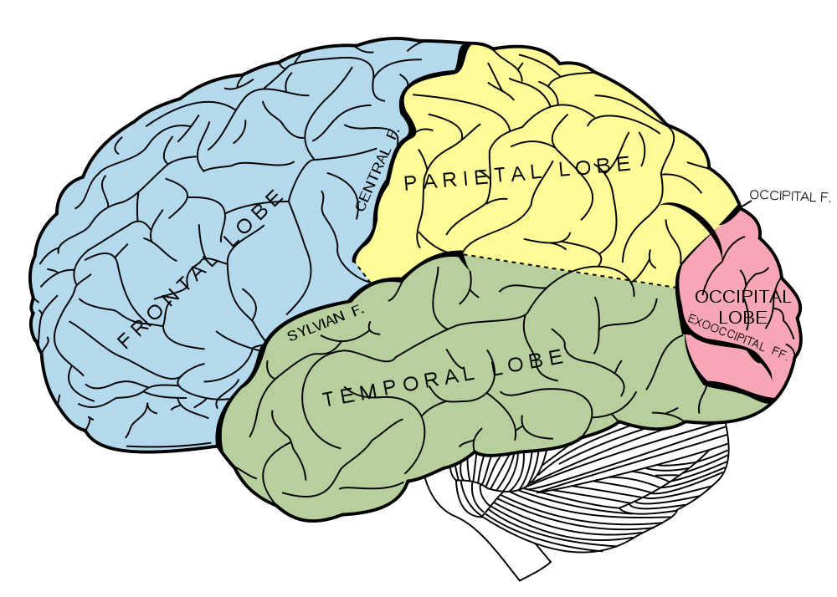
What About the Brain?
Brains (human minds) are very good at making rational decisions, but not perfect
Brains aren’t as modular as software, so hard to reverse engineer!
“Brains are to intelligence as wings are to flight”
Lessons learned from the brain: memory and simulation are key to decision making

Slide 43



Artificial Intelligence vs Machine Learning?
Artificial Intelligence
Machine Learning

Slide 44

Artificial Intelligence vs Machine Learning?
Artificial Intelligence
Search
AI Ethics
Machine Learning
CSPs
Planning
Deep Learning
Logic
Linear/Int. Programming
Probabilistic Graphical Models
Generative
AI
Game Theory
Reinforcement Learning

Slide 45
AI and ML Courses
15-281 and 10-315 (Intro ML)
Designed to go together
Topics divided among two courses for breadth
Two courses allows depth
15-281 has some machine learning topics but, notably, no neural networks (deep learning)
Reinforcement learning (RL)
Probabilisted Graphical Models (Bayes Nets, HMMs)
10-301/10-601 (Intro ML)
Has really good ML breadth (and also decent depth) but not AI breadth

Slide 46
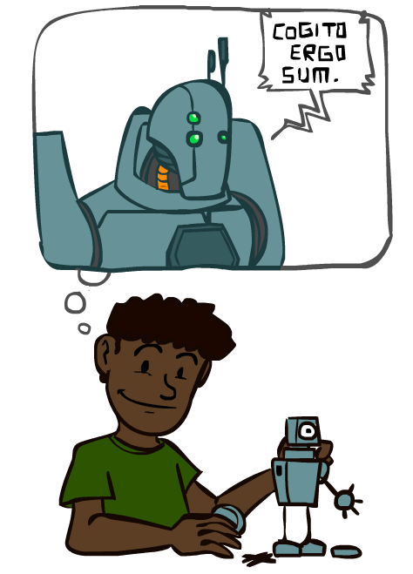
A Brief History of AI

Slide 47
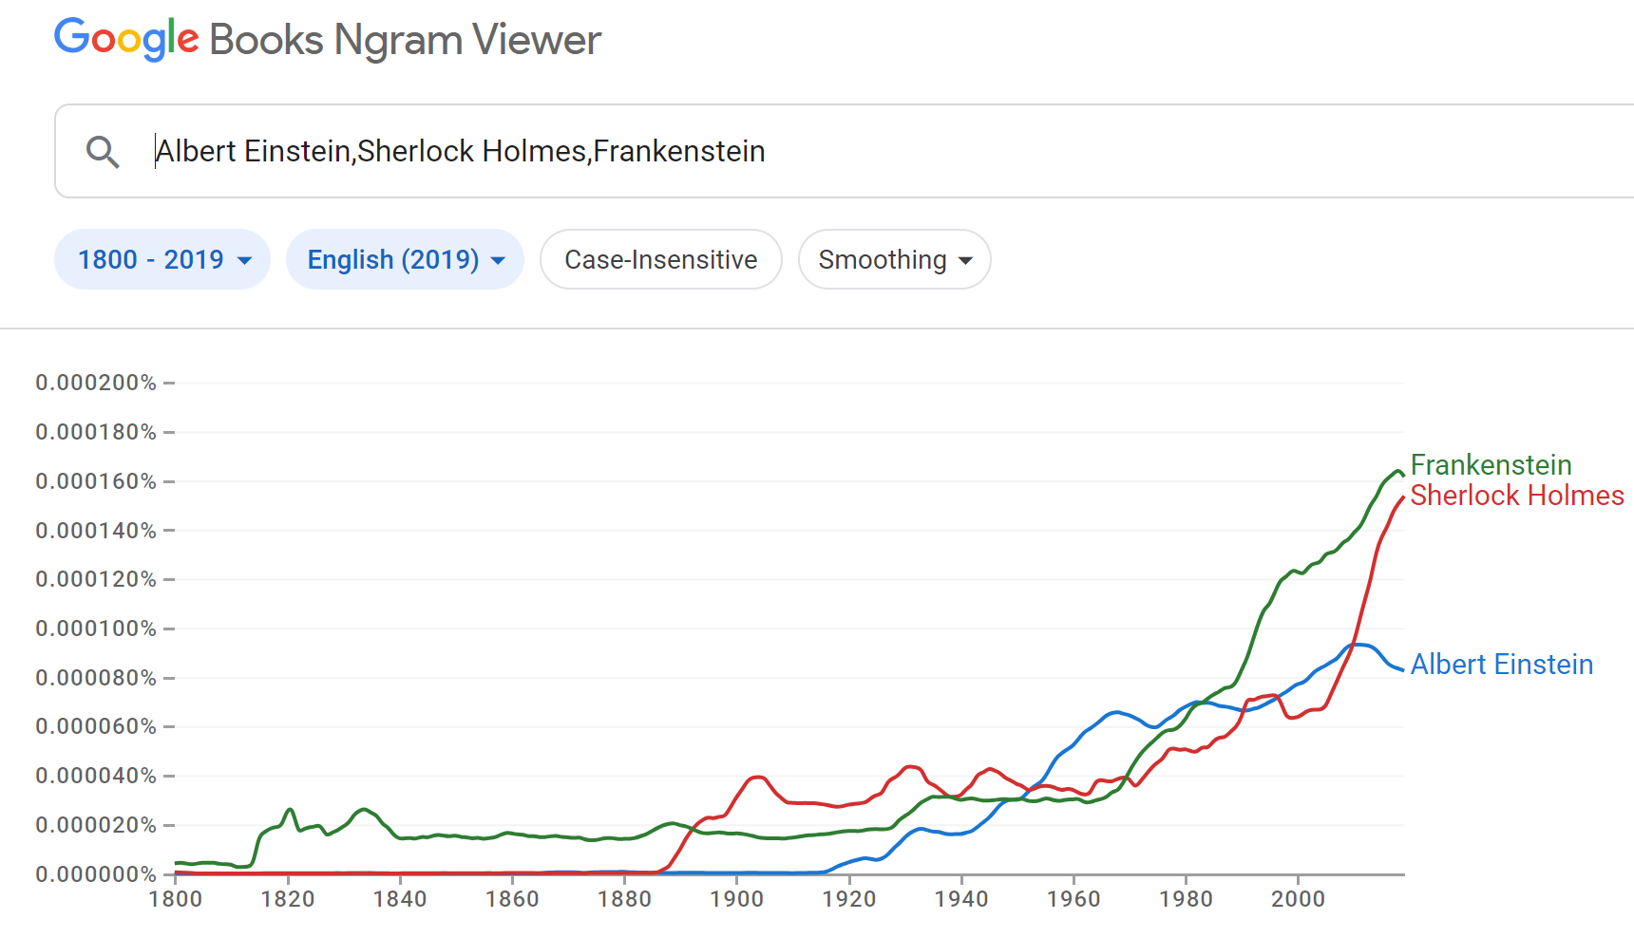
A Brief History of AI: Via Google N-grams Viewer
https://books.google.com/ngrams
https://books.google.com/ngrams

Slide 48
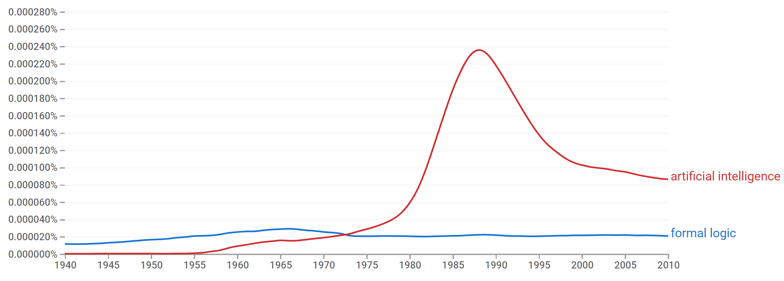
A Brief History of AI
Knowledge Based
Systems
1970-1990
AI
Excitement!
1950-1970
artificial intelligence
formal logic
https://books.google.com/ngrams

Slide 49
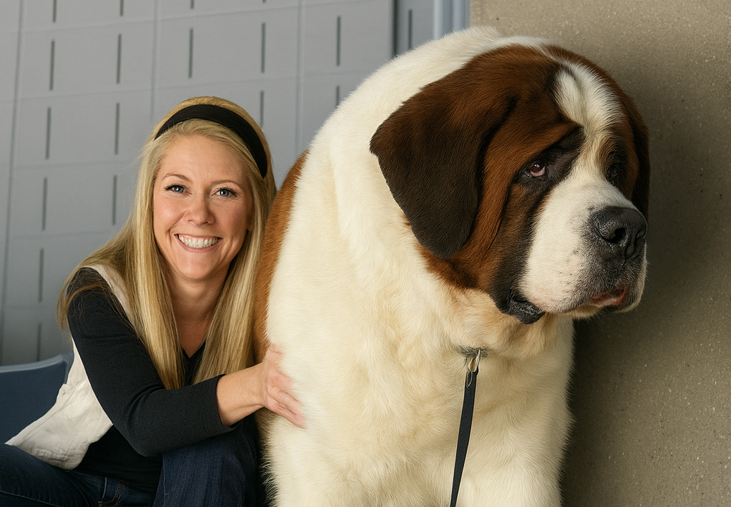
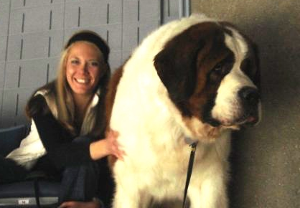
What went wrong?
Dog
Barks
Has Fur
Has four legs
Buster

Slide 50
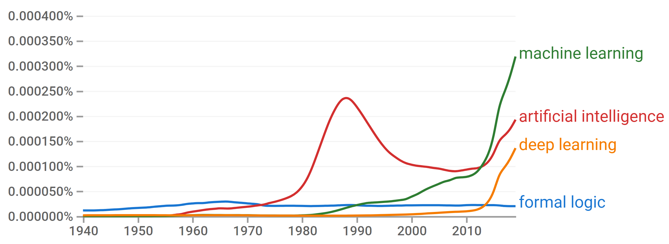
A Brief History of AI
Knowledge Based
Systems
1970-1990
Statistical Approaches
1990-
Deep Learning Era
2012-
Generative AI Era
2023-
AI
Excitement!
1950-1970
https://books.google.com/ngrams

Slide 51
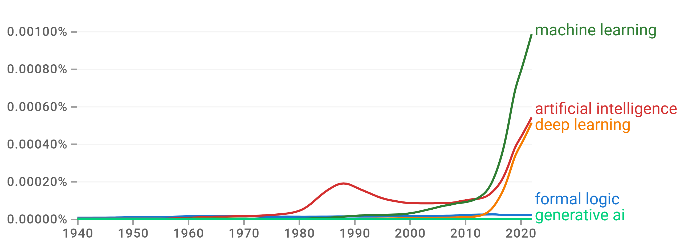
A Brief History of AI
Knowledge Based
Systems
1970-1990
Statistical Approaches
1990-
Deep Learning Era
2012-
Generative AI Era
2023-
AI
Excitement!
1950-1970
https://books.google.com/ngrams

Slide 52
A Brief History of AI
1940-1950: Early days
1943: McCulloch & Pitts: Boolean circuit model of brain
1950: Turing's “Computing Machinery and Intelligence”
1950—70: Excitement: Look, Ma, no hands!
1950s: Early AI programs, including Samuel's checkers program, Newell & Simon's Logic Theorist, Gelernter's Geometry Engine
1956: Dartmouth meeting: “Artificial Intelligence” adopted
1970—90: Knowledge-based approaches
1969—79: Early development of knowledge-based systems
1980—88: Expert systems industry booms
1988—93: Expert systems industry busts: “AI Winter”
1990—: Statistical approaches
Resurgence of probability, focus on uncertainty
General increase in technical depth
Agents and learning systems… “AI Spring”?
2012—: Deep learning
2012: ImageNet & AlexNet
2023—: Generative AI
Nov. 2022: ChatGPT released to public
Images: ai.berkeley.edu
Notes:
Million dollar computer with less computation than your phone
MT was

