Slide 1
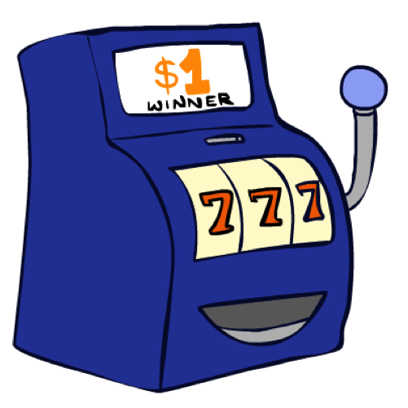
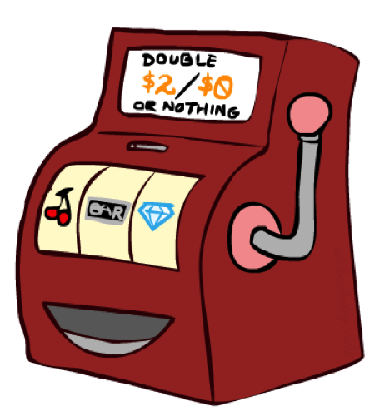

Double Bandits
Slide: ai.berkeley.edu

Slide 2
Double-Bandit MDP
Actions: Blue, Red
States: Win, Lose
0.25 $0
0.75
$2
W
L
0.25
$0
$1
1.0
$1
1.0
0.75 $2
Slide: ai.berkeley.edu

Slide 3
Offline Planning
No discount
100 time steps
Solving MDPs is offline planning
You determine all quantities through computation
You need to know the details of the MDP
You do not actually play the game!
0.25 $0
Value
0.75
$2
0.25
$0
Play Red
150
W
L
$1
1.0
$1
1.0
0.75 $2
Play Blue
100
Slide: ai.berkeley.edu

Slide 4
Let’s Play!
$2
$2
$0
$2
$2
$2
$2
$0
$0
$0
Slide: ai.berkeley.edu

Slide 5
Online Planning
Rules changed! Red’s win chance is different.
?? $0
??
$2
W
L
??
$0
$1
1.0
$1
1.0
?? $2
Slide: ai.berkeley.edu

Slide 6
Let’s Play!
$0
$0
$0
$2
$0
$2
$0
$0
$0
$0
Slide: ai.berkeley.edu

Slide 7
What Just Happened?
That wasn’t planning, it was learning!
Specifically, reinforcement learning
There was an MDP, but you couldn’t solve it with just computation
You needed to actually act to figure it out
Important ideas in reinforcement learning that came up
Exploration: you have to try unknown actions to get information
Exploitation: eventually, you have to use what you know
Regret: even if you learn intelligently, you make mistakes
Sampling: because of chance, you have to try things repeatedly
Difficulty: learning can be much harder than solving a known MDP
Slide: ai.berkeley.edu

Slide 8
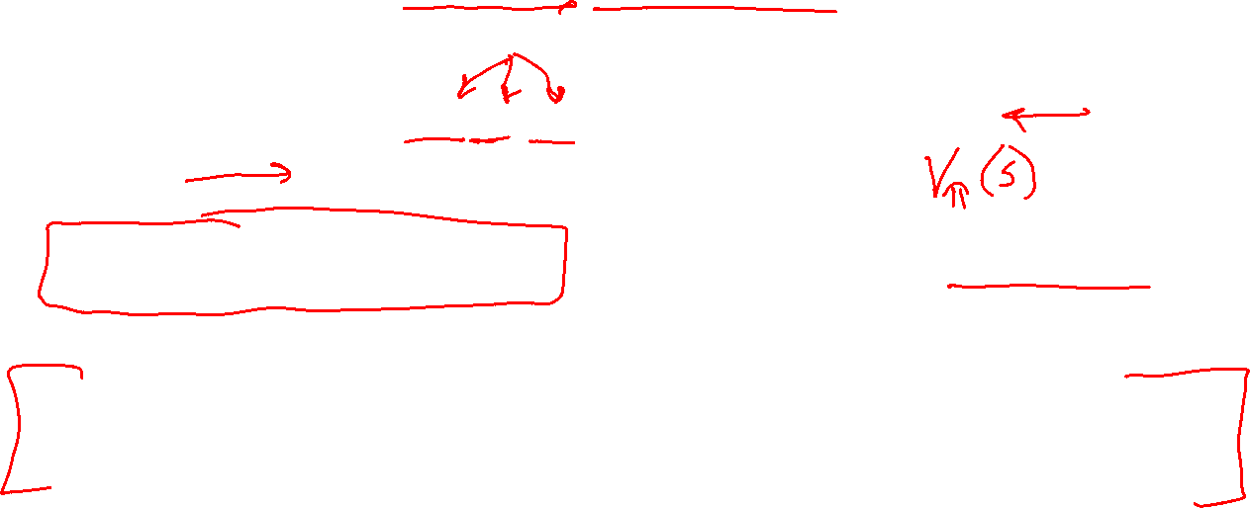
Overview: MDPs and Reinforcement Learning
Known MDP: Offline Solution
Goal Technique
Compute V*, Q*, π* Value / policy iteration
Evaluate a fixed policy π Policy evaluation
Unknown MDP: Model-Based
Unknown MDP: Model-Free
Goal Technique
Compute V*, Q*, π* VI/PI on approx. MDP
Eval fixed policy π PE on approx. MDP
Goal Technique
Compute V*, Q*, π* Q-learning
Eval fixed policy π TD/Value Learning

Slide 9

AI: Representation and Problem Solving
Reinforcement Learning
Instructor: Pat Virtue
Slide credits: CMU AI and http://ai.berkeley.edu

Slide 10
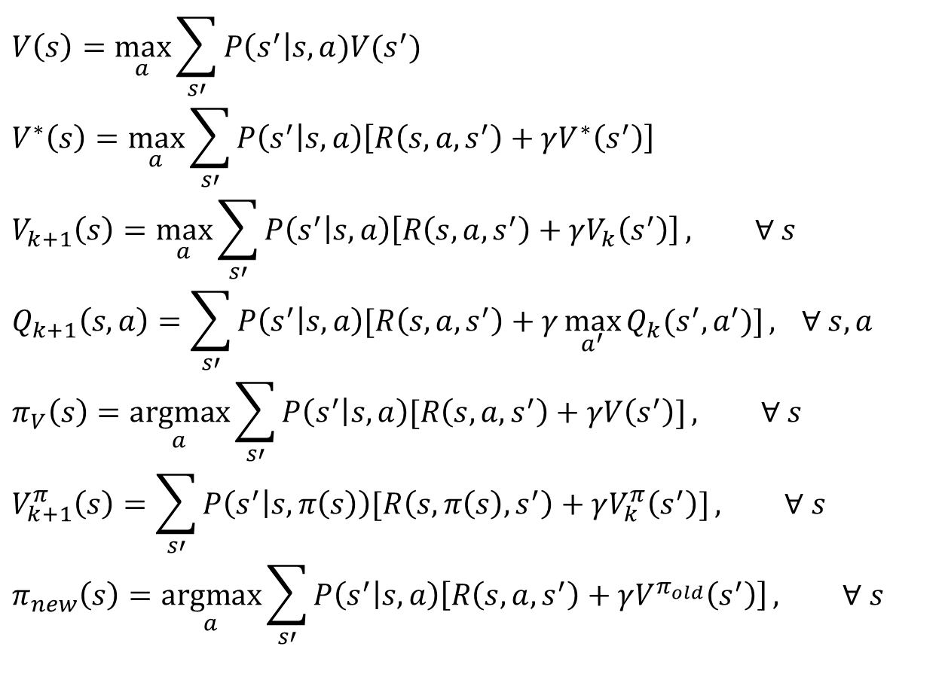
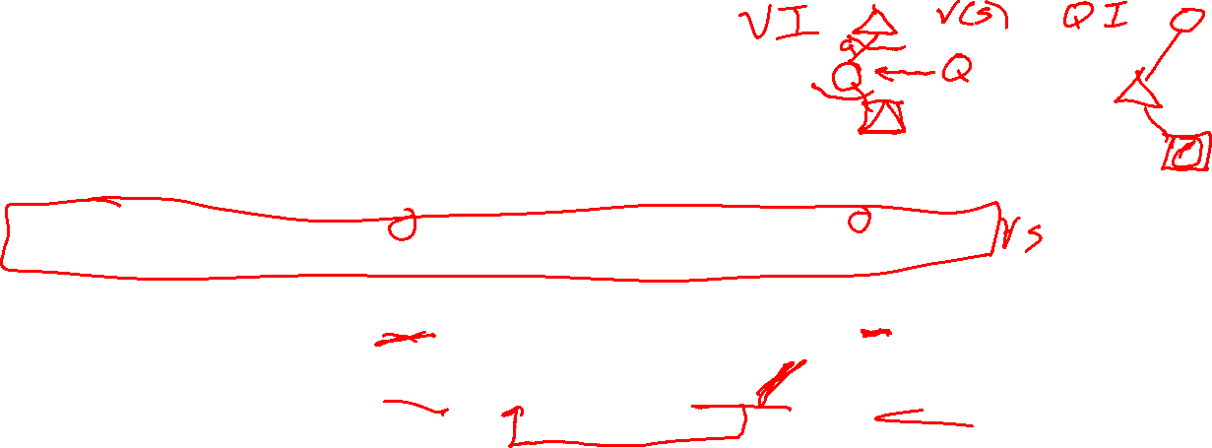
MDP Notation
$$V\left(s\right)=\max_{a}{\sum_{s′}{P\left(s^{′}\right|s,a)V(s^{′})}}$$
$$V^{∗}\left(s\right)=\max_{a}{\sum_{s′}{P\left(s^{′} | s,a\right)\left[R\left(s,a,s^{′}\right)+γV^{∗}\left(s^{′}\right)\right]}}$$
$$V_{k+1}\left(s\right)=\max_{a}{\sum_{s′}{P\left(s^{′} | s,a\right)\left[R\left(s,a,s^{′}\right)+γV_{k}\left(s^{′}\right)\right]}}, ∀ s$$
$$Q_{k+1}\left(s,a\right)=\sum_{s′}{P\left(s^{′} | s,a\right)[R\left(s,a,s^{′}\right)+γ\max_{a^{′}}{Q_{k}(s^{′},a^{′})]}, } ∀ s,a$$
$$π_{V}\left(s\right)=\underset{a}{argmax}{\sum_{s′}{P\left(s^{′} | s,a\right)[R\left(s,a,s^{′}\right)+γV\left(s^{′}\right)]}}, ∀ s$$
$$V_{k+1}^{π}\left(s\right)=\sum_{s′}{P\left(s^{′} | s,π\left(s\right)\right)[R\left(s,π\left(s\right),s^{′}\right)+γV_{k}^{π}\left(s^{′}\right)]}, ∀ s$$
$$π_{new}\left(s\right)=\underset{a}{argmax}{\sum_{s′}{P\left(s^{′} | s,a\right)\left[R\left(s,a,s^{′}\right)+γV^{π_{old}}\left(s^{′}\right)\right]}}, ∀ s$$
Standard expectimax:
Bellman equations:
Value iteration:
Q-iteration:
Policy extraction:
Policy evaluation:
Policy improvement:

Slide 11


Poll 1
Which of the following are used in policy iteration? Select all that apply.
$$V_{k+1}\left(s\right)=\max_{a}{\sum_{s′}{P\left(s^{′} | s,a\right)\left[R\left(s,a,s^{′}\right)+γV_{k}\left(s^{′}\right)\right]}}, ∀ s$$
$$Q_{k+1}\left(s,a\right)=\sum_{s′}{P\left(s^{′} | s,a\right)[R\left(s,a,s^{′}\right)+γ\max_{a^{′}}{Q_{k}(s^{′},a^{′})]}, } ∀ s,a$$
$$π_{V}\left(s\right)=\underset{a}{argmax}{\sum_{s′}{P\left(s^{′} | s,a\right)[R\left(s,a,s^{′}\right)+γV\left(s^{′}\right)]}}, ∀ s$$
$$V_{k+1}^{π}\left(s\right)=\sum_{s′}{P\left(s^{′} | s,π\left(s\right)\right)[R\left(s,π\left(s\right),s^{′}\right)+γV_{k}^{π}\left(s^{′}\right)]}, ∀ s$$
$$π_{new}\left(s\right)=\underset{a}{argmax}{\sum_{s′}{P\left(s^{′} | s,a\right)\left[R\left(s,a,s^{′}\right)+γV^{π_{old}}\left(s^{′}\right)\right]}}, ∀ s$$
A. Value iteration:
B. Q-iteration:
C. Policy extraction:
D. Policy evaluation:
E. Policy improvement:

Slide 12

Poll 1
Which of the following are used in policy iteration? Select all that apply.
$$V_{k+1}\left(s\right)=\max_{a}{\sum_{s′}{P\left(s^{′} | s,a\right)\left[R\left(s,a,s^{′}\right)+γV_{k}\left(s^{′}\right)\right]}}, ∀ s$$
$$Q_{k+1}\left(s,a\right)=\sum_{s′}{P\left(s^{′} | s,a\right)[R\left(s,a,s^{′}\right)+γ\max_{a^{′}}{Q_{k}(s^{′},a^{′})]}, } ∀ s,a$$
$$π_{V}\left(s\right)=\underset{a}{argmax}{\sum_{s′}{P\left(s^{′} | s,a\right)[R\left(s,a,s^{′}\right)+γV\left(s^{′}\right)]}}, ∀ s$$
$$V_{k+1}^{π}\left(s\right)=\sum_{s′}{P\left(s^{′} | s,π\left(s\right)\right)[R\left(s,π\left(s\right),s^{′}\right)+γV_{k}^{π}\left(s^{′}\right)]}, ∀ s$$
$$π_{new}\left(s\right)=\underset{a}{argmax}{\sum_{s′}{P\left(s^{′} | s,a\right)\left[R\left(s,a,s^{′}\right)+γV^{π_{old}}\left(s^{′}\right)\right]}}, ∀ s$$
A. Value iteration:
B. Q-iteration:
C. Policy extraction:
D. Policy evaluation:
E. Policy improvement:

Slide 13
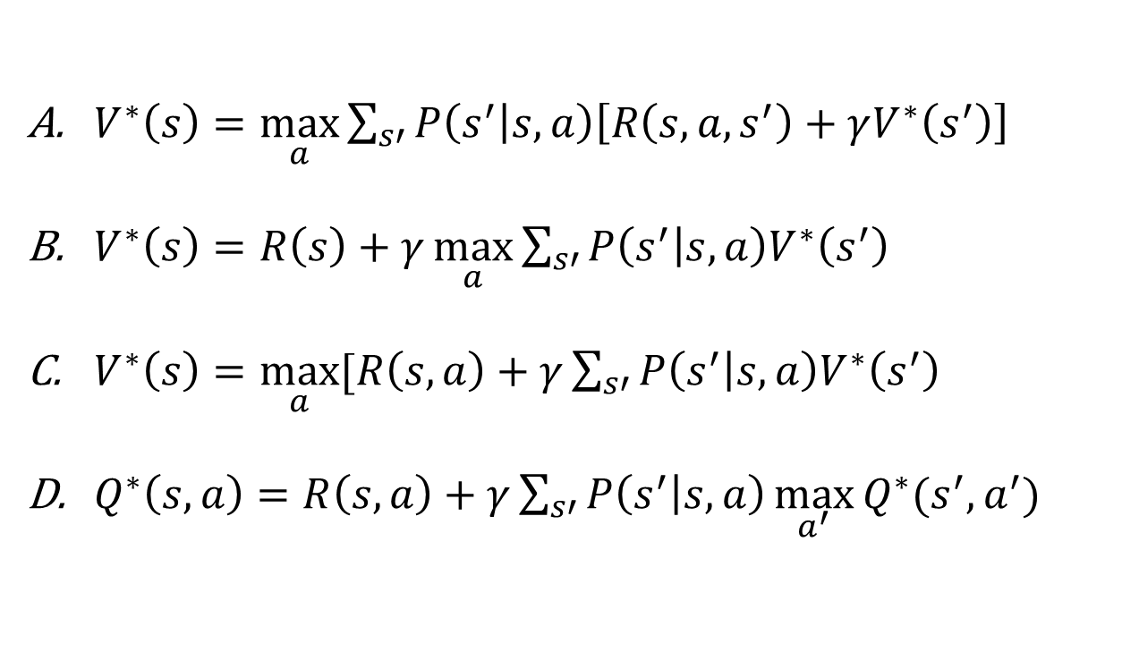
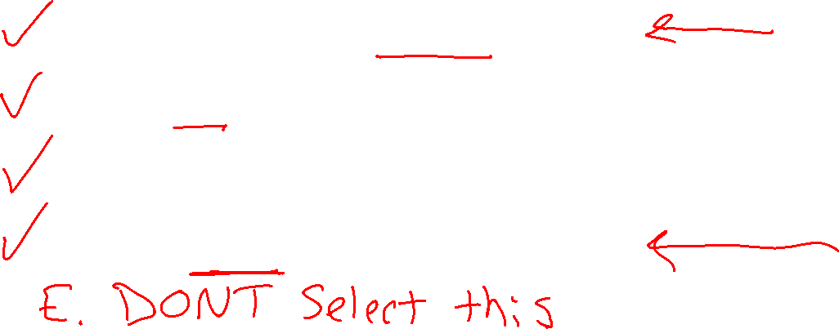
Poll 2
Rewards may depend on any combination of state, action, next state.
Which of the following are valid formulations of the Bellman equations?
Select all that apply.
$V^{∗}\left(s\right)=\max_{a}{\sum_{s′}{P\left(s^{′} | s,a\right)\left[R\left(s,a,s^{′}\right)+γV^{∗}\left(s^{′}\right)\right]}}$
$V^{∗}\left(s\right)=R\left(s\right)+γ\max_{a}{\sum_{s′}{P\left(s^{′} | s,a\right)V^{∗}\left(s^{′}\right)}}$
$V^{∗}\left(s\right)=\max_{a}{[R\left(s, a\right)+γ\sum_{s′}{P\left(s^{′} | s,a\right)V^{∗}\left(s^{′}\right)}}$
$Q^{∗}\left(s,a\right)=R\left(s, a\right)+γ\sum_{s′}{P\left(s^{′} | s,a\right)\max_{a^{′}}{Q^{∗}(s^{′},a^{′})} }$

Slide 14
Poll 2
Rewards may depend on any combination of state, action, next state.
Which of the following are valid formulations of the Bellman equations?
Select all that apply.
$V^{∗}\left(s\right)=\max_{a}{\sum_{s′}{P\left(s^{′} | s,a\right)\left[R\left(s,a,s^{′}\right)+γV^{∗}\left(s^{′}\right)\right]}}$
$V^{∗}\left(s\right)=R\left(s\right)+γ\max_{a}{\sum_{s′}{P\left(s^{′} | s,a\right)V^{∗}\left(s^{′}\right)}}$
$V^{∗}\left(s\right)=\max_{a}{[R\left(s, a\right)+γ\sum_{s′}{P\left(s^{′} | s,a\right)V^{∗}\left(s^{′}\right)}}$
$Q^{∗}\left(s,a\right)=R\left(s, a\right)+γ\sum_{s′}{P\left(s^{′} | s,a\right)\max_{a^{′}}{Q^{∗}(s^{′},a^{′})} }$

Slide 15

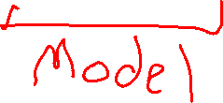
Reinforcement learning
What if we didn’t know $P(s’|s,a)$and $R(s,a,s’)$?
$$V_{k+1}\left(s\right)=\max_{a}{\sum_{s′}{P\left(s^{′} | s,a\right)\left[R\left(s,a,s^{′}\right)+γV_{k}\left(s^{′}\right)\right]}}, ∀ s$$
$$Q_{k+1}\left(s,a\right)=\sum_{s′}{P\left(s^{′} | s,a\right)[R\left(s,a,s^{′}\right)+γ\max_{a^{′}}{Q_{k}(s^{′},a^{′})]}, } ∀ s,a$$
$$π_{V}\left(s\right)=\underset{a}{argmax}{\sum_{s′}{P\left(s^{′} | s,a\right)[R\left(s,a,s^{′}\right)+γV\left(s^{′}\right)]}}, ∀ s$$
$$V_{k+1}^{π}\left(s\right)=\sum_{s′}{P\left(s^{′} | s,π\left(s\right)\right)[R\left(s,π\left(s\right),s^{′}\right)+γV_{k}^{π}\left(s^{′}\right)]}, ∀ s$$
$$π_{new}\left(s\right)=\underset{a}{argmax}{\sum_{s′}{P\left(s^{′} | s,a\right)\left[R\left(s,a,s^{′}\right)+γV^{π_{old}}\left(s^{′}\right)\right]}}, ∀ s$$
Value iteration:
Q-iteration:
Policy extraction:
Policy evaluation:
Policy improvement:

Slide 16

Reinforcement Learning
Agent
State: s
Reward: r
Actions: a
Environment
Basic idea:
All learning is based on observed samples of rewards and next states!
Receive feedback in the form of rewards
Must (learn to) act so as to maximize expected rewards
Notes:
Show robot-soccer learning to walk videos (UT Austin):
? Show snake robot:

Slide 17
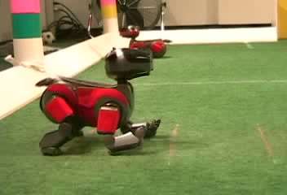
Example: Learning to Walk
Initial
[Kohl and Stone, ICRA 2004]
[Video: AIBO WALK – initial]

Slide 18
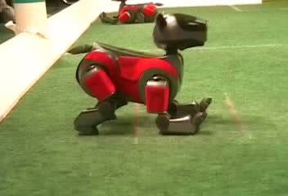
Example: Learning to Walk
Training
[Kohl and Stone, ICRA 2004]
[Video: AIBO WALK – training]

Slide 19
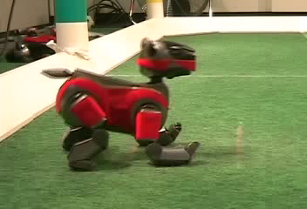
Example: Learning to Walk
Finished
[Kohl and Stone, ICRA 2004]
[Video: AIBO WALK – finished]

Slide 20
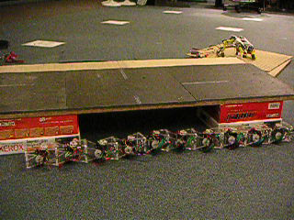
Example: Sidewinding
[Andrew Ng]
[Video: SNAKE – climbStep+sidewinding]

Slide 21

Example: Toddler Robot
[Tedrake, Zhang and Seung, 2005]
[Video: TODDLER – 40s]
Notes:
MIT

Slide 22
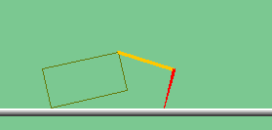
The Crawler!
[Demo: Crawler Bot (L10D1)] [You, in Project 3]
Notes:
At times no reward accumulated at all, just sitting still

Slide 23
Demo Crawler Bot

Slide 24
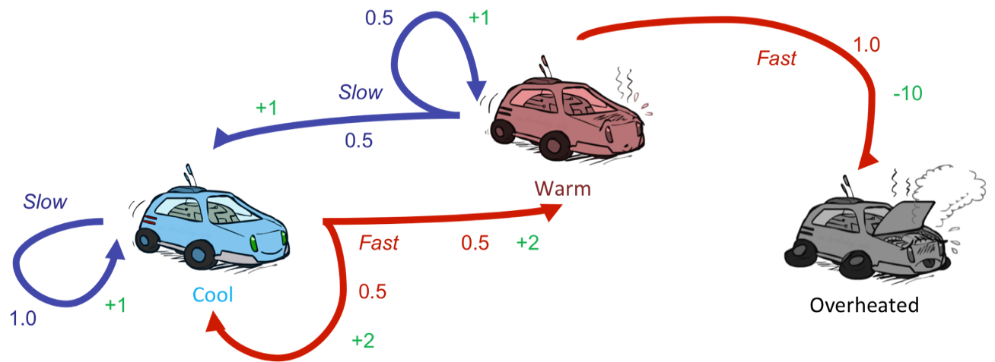
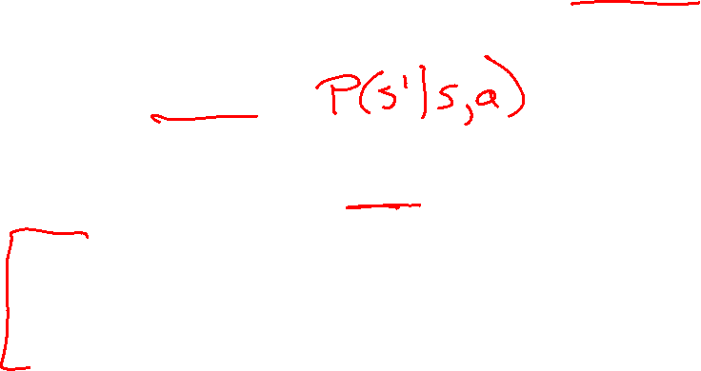
Reinforcement Learning
Still assume a Markov decision process (MDP):
A set of states s ∈ S
A set of actions (per state) A
A model T(s,a,s’)
A reward function R(s,a,s’)
Still looking for a policy π(s)
New twist: don’t know T or R
I.e. we don’t know which states are good or what the actions do
Must actually try actions and states out to learn

Slide 25
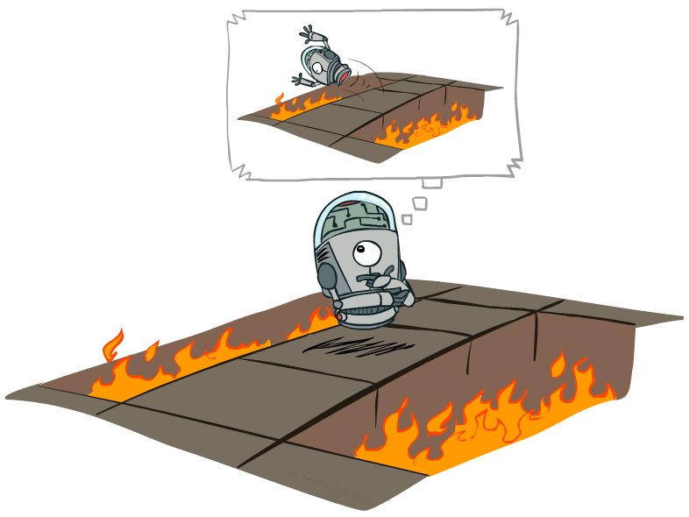
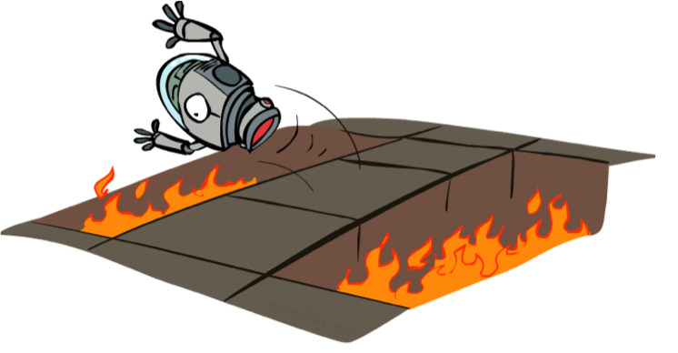
Offline (MDPs) vs. Online (RL)
Offline Solution
(Known MDP)
Online Learning
(Unknown MDP)

Slide 26
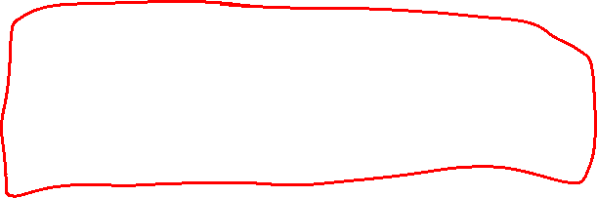
Overview: MDPs and Reinforcement Learning
Known MDP: Offline Solution
Value Iteration / Policy Iteration
Unknown MDP: Online Learning
Model-Based
Model-Free
Estimate MDP T(s,a,s') and R(s,a,s')
from samples of environment
Passive Reinforcement Learning
Direct Evaluation (simple)
TD Learning
Active Reinforcement Learning
Q-Learning

Slide 27

Online Learning Model-based Learning

Slide 28




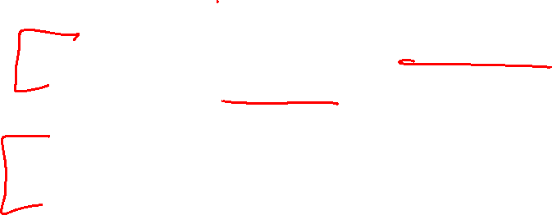
Model-Based Learning
Model-Based Idea:
Learn an approximate model based on experiences
Solve for values as if the learned model were correct
Step 1: Learn empirical MDP model
Count outcomes s’ for each s, a
Normalize to give an estimate of
Discover each when we experience (s, a, s’)
Step 2: Solve the learned MDP
For example, use value iteration, as before

Slide 29
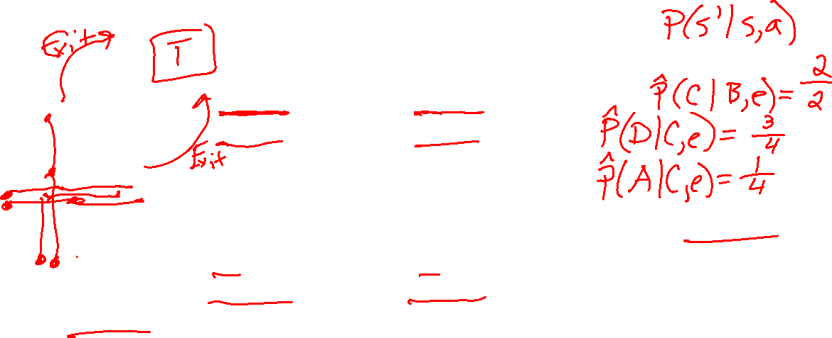
Example: Model-Based Learning
Episode: a sequence of states actions and rewards sampled from the environment
Input Policy π
Observed Episodes (Training)
Learned Model
Episode 1
Episode 2
 | A
B | C | D
 | E
B, east, C, -1
C, east, D, -1
D, exit, x, +10
B, east, C, -1
C, east, D, -1
D, exit, x, +10
Episode 3
Episode 4
E, north, C, -1
C, east, D, -1
D, exit, x, +10
E, north, C, -1
C, east, A, -1
A, exit, x, -10
Assume: γ = 1

Slide 30
Example: Model-Based Learning
Input Policy π
Observed Episodes (Training)
Learned Model
Episode 1
Episode 2
T(s,a,s’).
T(B, east, C) = 1.00
T(C, east, D) = 0.75
T(C, east, A) = 0.25
…
R(s,a,s’).
R(B, east, C) = -1
R(C, east, D) = -1
R(D, exit, x) = +10
…
 | A
B | C | D
 | E
B, east, C, -1
C, east, D, -1
D, exit, x, +10
B, east, C, -1
C, east, D, -1
D, exit, x, +10
Episode 3
Episode 4
E, north, C, -1
C, east, D, -1
D, exit, x, +10
E, north, C, -1
C, east, A, -1
A, exit, x, -10
Assume: γ = 1

Slide 31
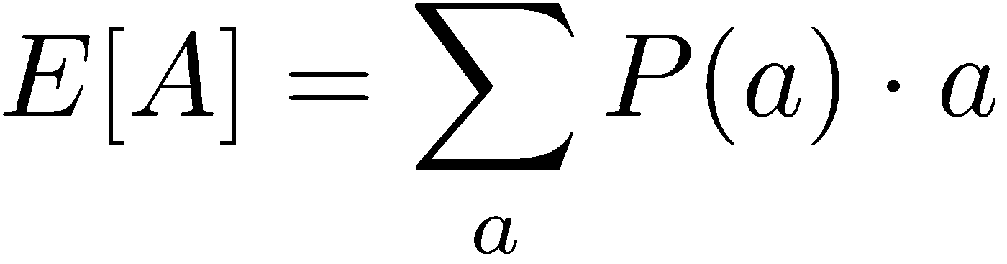
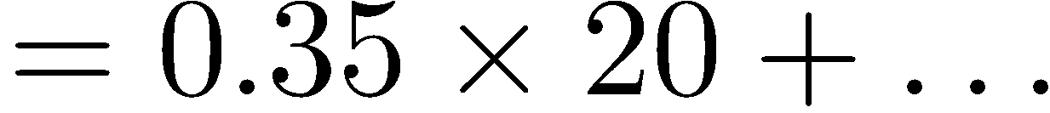
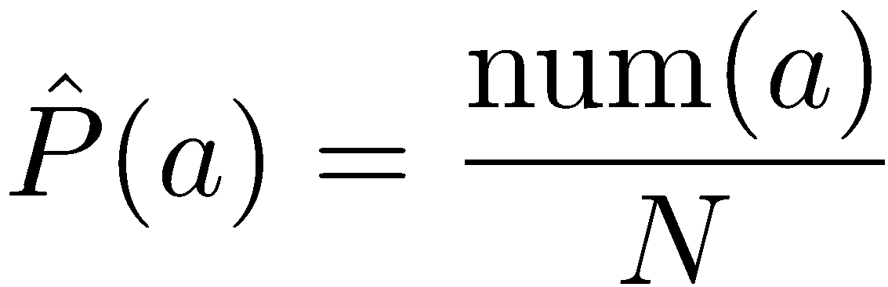
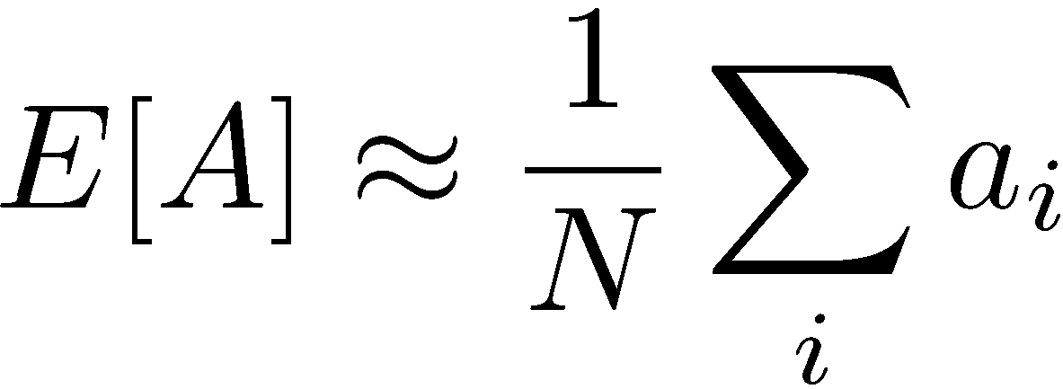
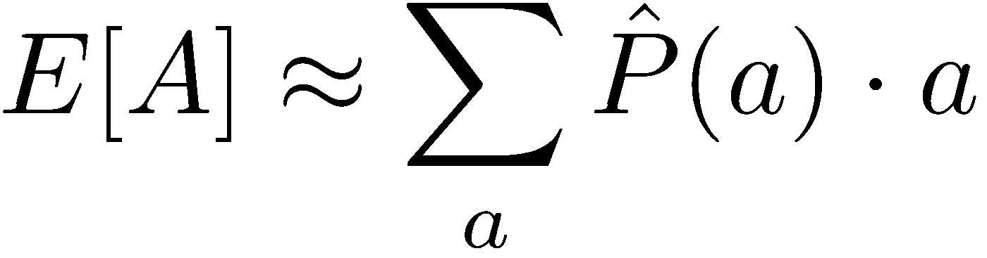
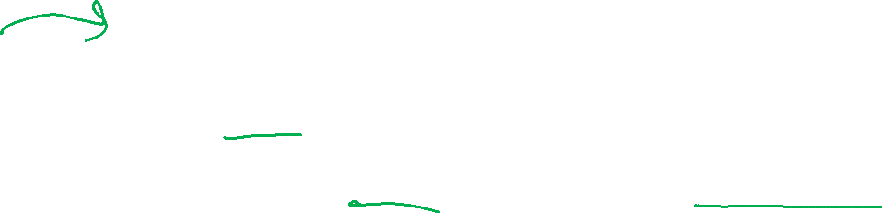
Example: Expected Age
Goal: Compute expected age of 15-281 students
Known P(A)
Without P(A), instead collect samples [a₁, a₂, … a_{N}]
Unknown P(A): “Model Based”
Unknown P(A): “Model Free”
Why does this work? Because samples appear with the right frequencies.

Slide 32
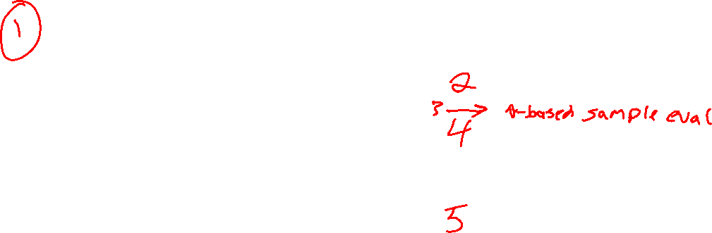
Overview: MDPs and Reinforcement Learning
Known MDP: Offline Solution
Value Iteration / Policy Iteration
Unknown MDP: Online Learning
Model-Based
Model-Free
Estimate MDP T(s,a,s') and R(s,a,s')
from samples of environment
Passive Reinforcement Learning
Direct Evaluation (simple)
TD Learning
Active Reinforcement Learning
Q-Learning

Slide 33
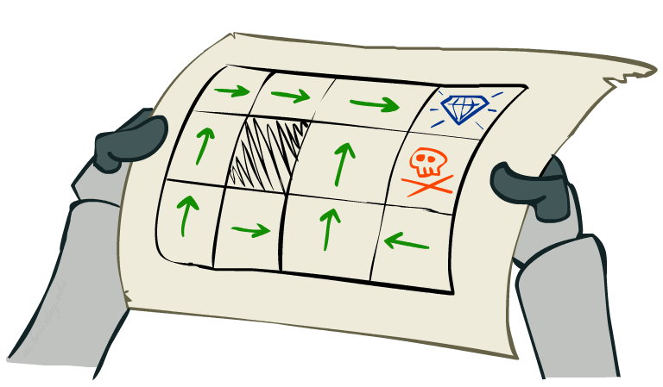
Online Learning Model-free Learning Passive Reinforcement Learning

Slide 34
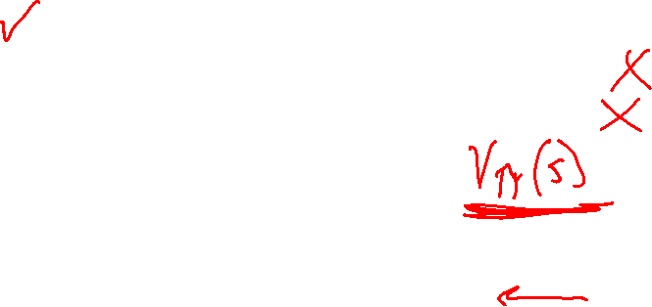
Passive Reinforcement Learning
Simplified task: policy evaluation
Input: a fixed policy π(s)
You don’t know the transitions T(s,a,s’)
You don’t know the rewards R(s,a,s’)
Goal: learn the state values
In this case:
Learner is “along for the ride”
No choice about what actions to take
Just execute the policy and learn from experience
This is NOT offline planning! You actually take actions in the world

Slide 35
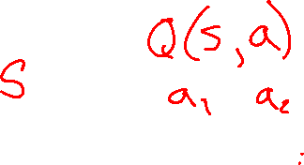
Simple Passive Learning: Direct Evaluation
Goal: Compute values for each state under π
Idea: Average together observed sample values
Act according to π
Every time you visit a state, write down what the sum of discounted rewards turned out to be
Average those samples
This is called direct evaluation
Pieces Available | Take 1 | Take 2
2 | 0 | 100
3 | 2 | 0
4 | 75 | 2
5 | 4 | 68
6 | 5 | 6
7 | 60 | 5

Slide 36
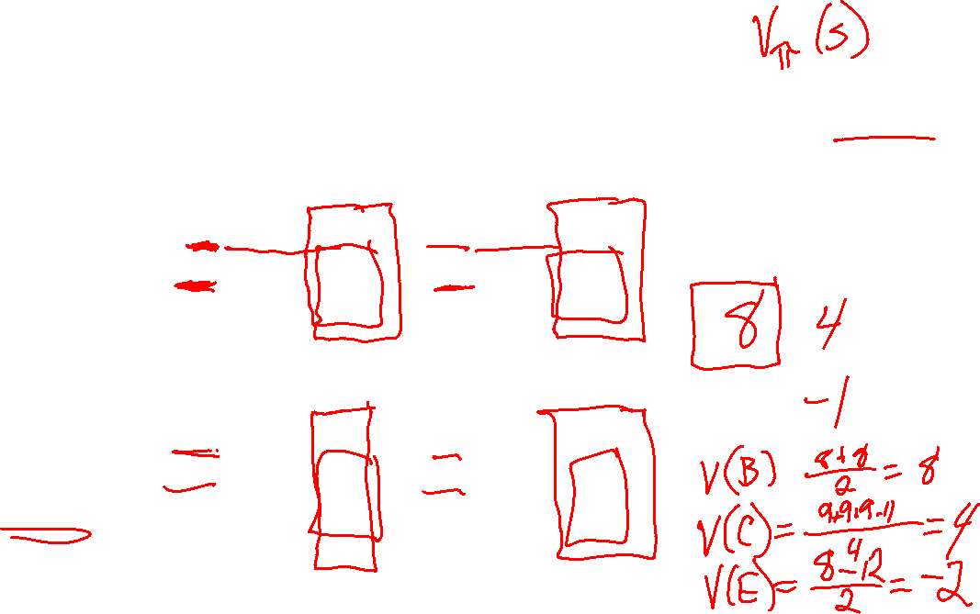
Example: Direct Evaluation
Input Policy π
Observed Episodes (Training)
Output Values
Episode 1
Episode 2
 | A
B | C | D
 | E
 | A
B | C | D
 | E
B, east, C, -1
C, east, D, -1
D, exit, x, +10
B, east, C, -1
C, east, D, -1
D, exit, x, +10
-10
+8
+4
+10
Episode 3
Episode 4
-2
E, north, C, -1
C, east, D, -1
D, exit, x, +10
E, north, C, -1
C, east, A, -1
A, exit, x, -10
Assume: γ = 1

Slide 37
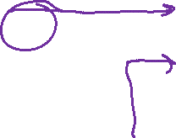
Problems with Direct Evaluation
What’s good about direct evaluation?
It’s easy to understand
It doesn’t require any knowledge of T, R
It eventually computes the correct average values, using just sample transitions
What bad about it?
It wastes information about state connections
Each state must be learned separately
So, it takes a long time to learn
Output Values
 | A
B | C | D
 | E
-10
+8
+4
+10
-2
If B and E both go to C under this policy, how can their values be different?

Slide 38
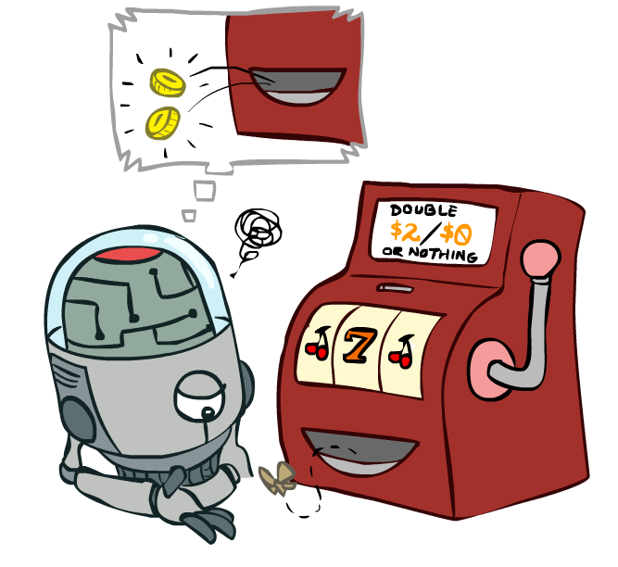
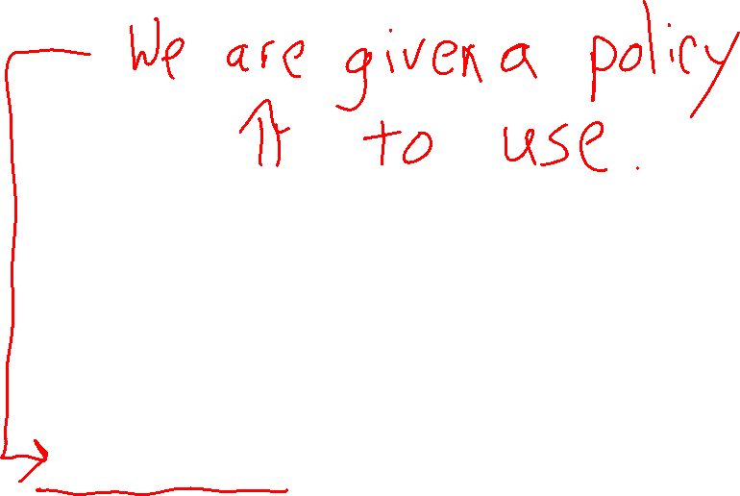

Online Learning Model-free Learning Passive Reinforcement Learning Temporal Difference Learning

Slide 39

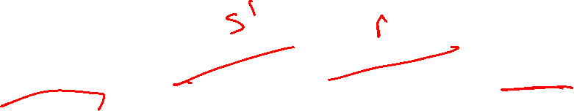
Why Not Use Policy Evaluation?
s
Simplified Bellman updates calculate V for a fixed policy:
Each round, replace V with a one-step-look-ahead layer over V
This approach fully exploited the connections between the states
Unfortunately, we need T and R to do it!
Key question: How can we do this update to V without knowing T and R?
In other words, how to we take a weighted average without knowing the weights?
π(s)
s, π(s)
s, π(s),s’
s’

Slide 40
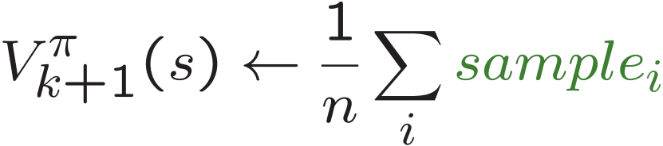
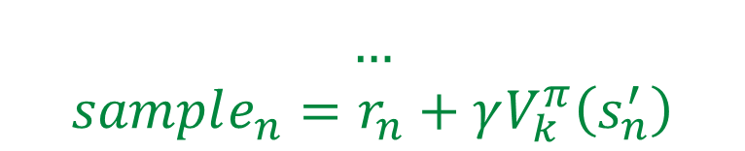

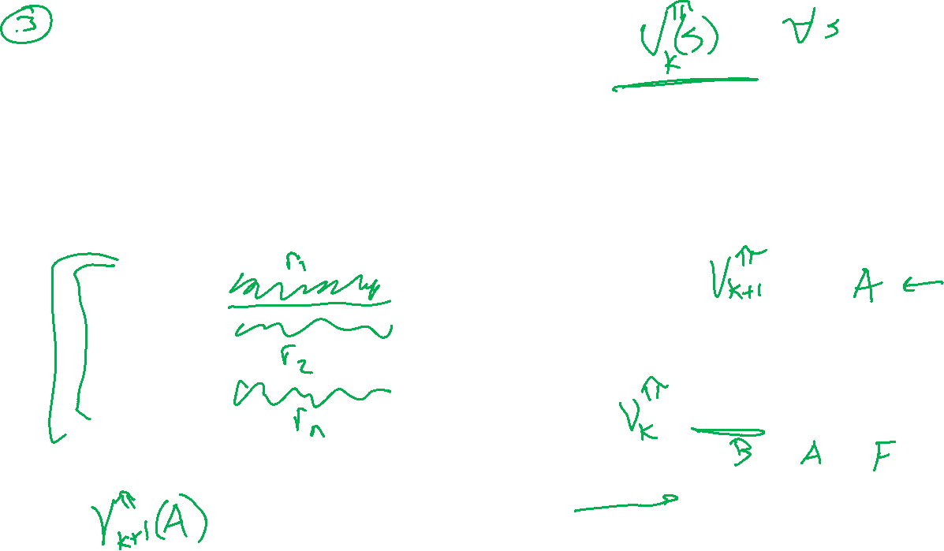

Sample-Based Policy Evaluation?
We want to improve our estimate of V by computing these averages:
Idea: Take samples of outcomes s’ (by doing the action!) and average
$$sample_{1}=r_{1}+γV_{k}^{π}\left(s_{1}^{′}\right)$$
s
$$sample_{2}=r_{2}+γV_{k}^{π}\left(s_{2}^{′}\right)$$
π(s)
$$…$$
$$sample_{n}=r_{n}+γV_{k}^{π}\left(s_{n}^{′}\right)$$
s, π(s)
s, π(s),s’
s₁'
s₂'
s'
s₃'
Almost! But we can’t rewind time to get sample after sample from state s.

Slide 41

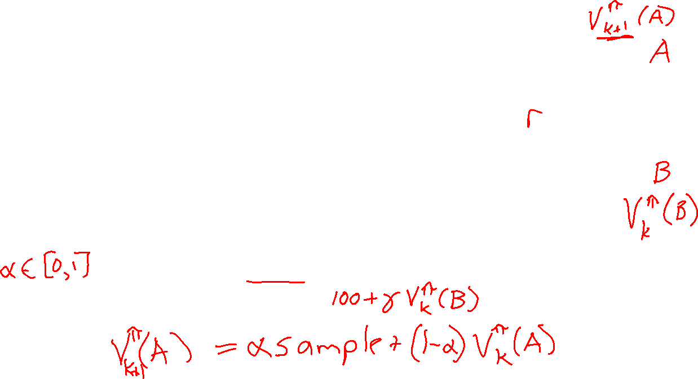
Temporal Difference Learning
s
Big idea: learn from every experience!
Update V(s) each time we experience a transition (s, a, s’, r)
Likely outcomes s’ will contribute updates more often
Temporal difference learning of values
Policy still fixed, still doing evaluation!
Move values toward value of whatever successor occurs: running average
π(s)
s, π(s)
s’
Sample of V(s):
$$sample = r + γ V_{k}^{π}\left(s′\right)$$
Update to V(s):

Slide 42
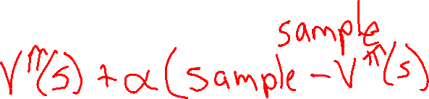
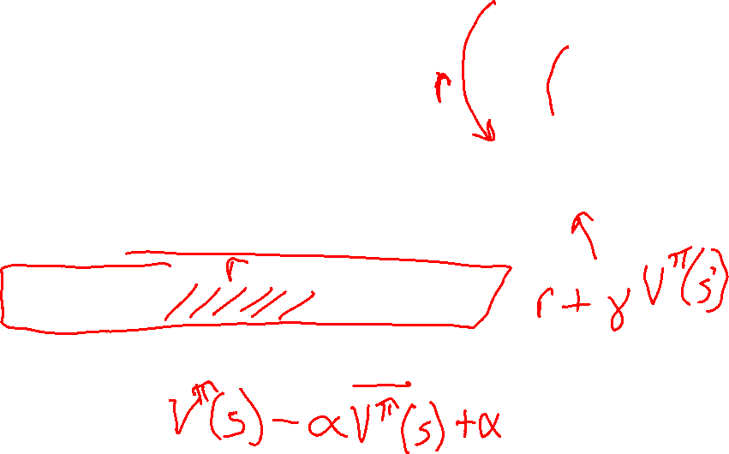
Temporal Difference Learning
s
Big idea: learn from every experience!
Update V(s) each time we experience a transition (s, a, s’, r)
Likely outcomes s’ will contribute updates more often
Temporal difference learning of values
Policy still fixed, still doing evaluation!
Move values toward value of whatever successor occurs: running average
π(s)
s, π(s)
s’
Sample of V(s):
$$sample = r + γ V_{k}^{π}\left(s′\right)$$
Update to V(s):

Slide 43
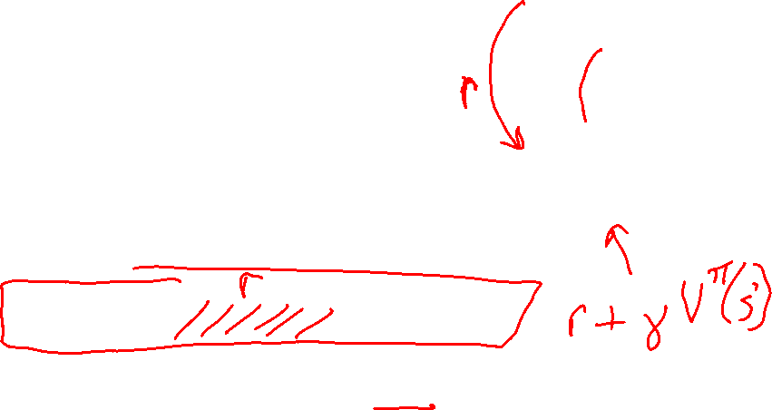

Temporal Difference Learning
s
Big idea: learn from every experience!
Update V(s) each time we experience a transition (s, a, s’, r)
Likely outcomes s’ will contribute updates more often
Temporal difference learning of values
Policy still fixed, still doing evaluation!
Move values toward value of whatever successor occurs: running average
π(s)
s, π(s)
s’
Sample of V(s):
$$sample = r + γ V_{k}^{π}\left(s′\right)$$
Update to V(s):
Same update:

Slide 44

Exponential Moving Average
Exponential moving average
The running interpolation update:
Makes recent samples more important:
Forgets about the past (distant past values were wrong anyway)
Decreasing learning rate (alpha) can give converging averages

