Slide 1
Warm-up as You Walk In
Given
Set actions (persistent/static)
Set states (persistent/static)
Function T(s,a,s_prime)
Write the pseudo code for:
function V(s) return value
that implements:

Slide 2
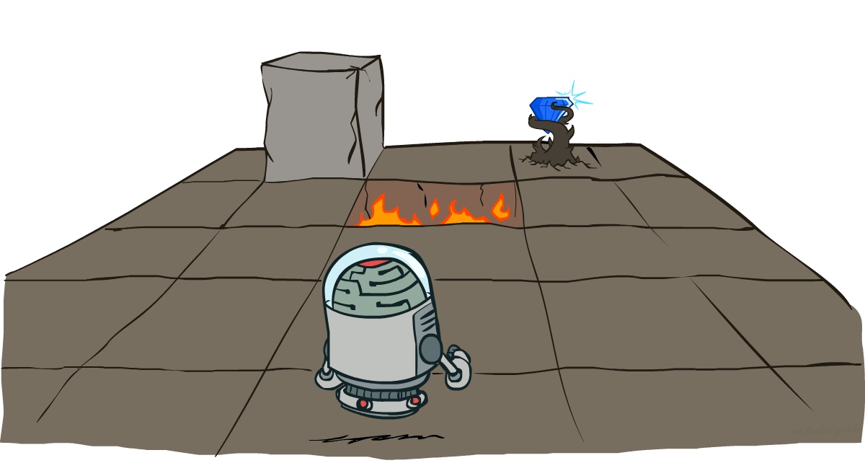
AI: Representation and Problem Solving
Markov Decision Processes
Instructor: Pat Virtue
Slide credits: CMU AI and http://ai.berkeley.edu

Slide 3

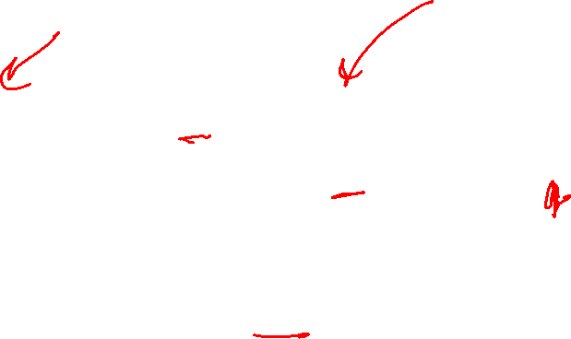
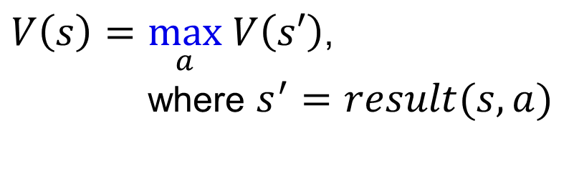

Minimax Notation
$V\left(s\right)=\max_{a} V\left(s′\right)$,
where $s^{′}=result(s, a)$
$a=\underset{a}{argmax} V\left(s′\right)$,
where $s^{′}=result(s, a)$
$\hat{a}=\underset{a}{argmax} V\left(s′\right)$,
where $s^{′}=result(s, a)$

Slide 4
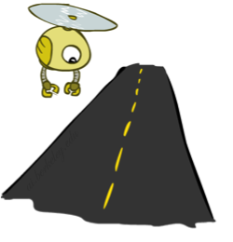
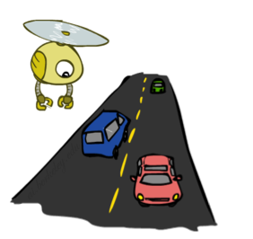
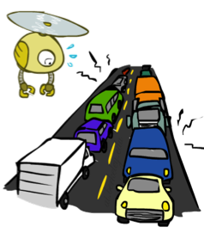
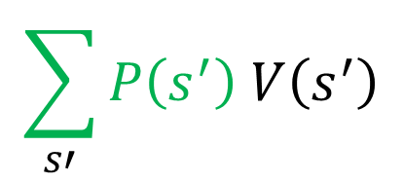

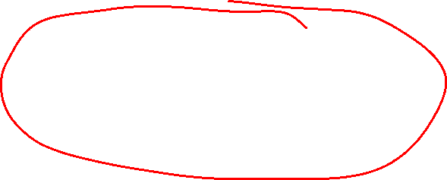
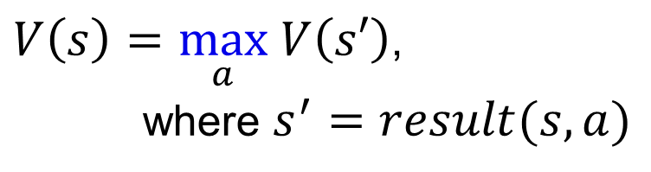
Expectations
Time:
20 min
30 min
60 min
+
+
x
x
x
Probability:
0.25
0.50
0.25
0.25
0.25
0.5
20
30
60
Max node notation
Chance node notation
$$\sum_{s′}{P\left(s^{′}\right) V\left(s^{′}\right)}$$
$V\left(s\right)=\max_{a} V\left(s′\right)$,
where $s^{′}=result(s, a)$
$$V\left(s\right)=$$

Slide 5
Previous Poll
Expectimax tree search:
Which action do we choose?
A) Left
B) Center
C) Right
D) Eight
Left
Right
Center
1/4
1/2
1/2
1/2
1/3
2/3
1/4
12
8
4
8
6
12
6

Slide 6
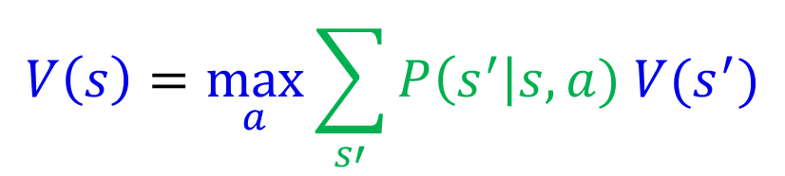
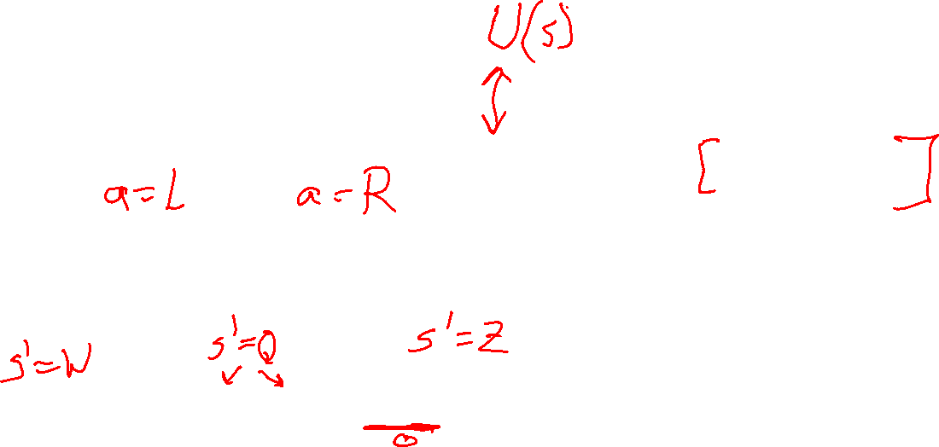
Expectimax Notation
$$V\left(s\right)=\max_{a}{\sum_{s′}{P\left(s^{′}\right|s,a) V(s^{′})}}$$

Slide 7
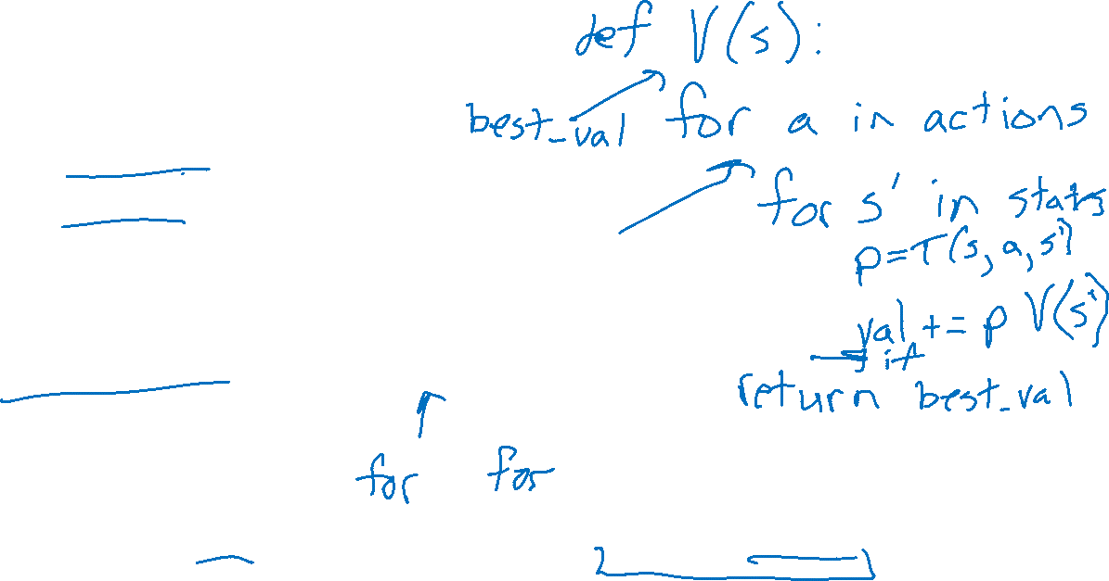
Warm-up as You Log In
Given
Set actions (persistent/static)
Set states (persistent/static)
Function T(s,a,s_prime)
Write the pseudo code for:
function V(s) return value
that implements:

Slide 8
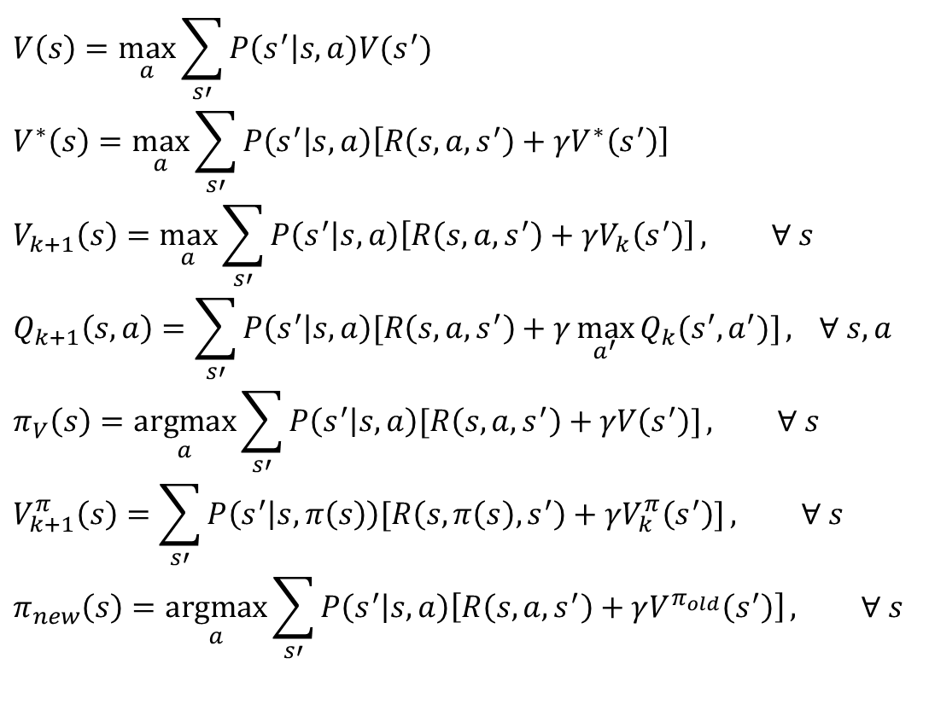

MDP Notation
$$V\left(s\right)=\max_{a}{\sum_{s′}{P\left(s^{′}\right|s,a)V(s^{′})}}$$
$$V^{∗}\left(s\right)=\max_{a}{\sum_{s′}{P\left(s^{′} | s,a\right)\left[R\left(s,a,s^{′}\right)+γV^{∗}\left(s^{′}\right)\right]}}$$
$$V_{k+1}\left(s\right)=\max_{a}{\sum_{s′}{P\left(s^{′} | s,a\right)\left[R\left(s,a,s^{′}\right)+γV_{k}\left(s^{′}\right)\right]}}, ∀ s$$
$$Q_{k+1}\left(s,a\right)=\sum_{s′}{P\left(s^{′} | s,a\right)[R\left(s,a,s^{′}\right)+γ\max_{a^{′}}{Q_{k}(s^{′},a^{′})]}, } ∀ s,a$$
$$π_{V}\left(s\right)=\underset{a}{argmax}{\sum_{s′}{P\left(s^{′} | s,a\right)[R\left(s,a,s^{′}\right)+γV\left(s^{′}\right)]}}, ∀ s$$
$$V_{k+1}^{π}\left(s\right)=\sum_{s′}{P\left(s^{′} | s,π\left(s\right)\right)[R\left(s,π\left(s\right),s^{′}\right)+γV_{k}^{π}\left(s^{′}\right)]}, ∀ s$$
$$π_{new}\left(s\right)=\underset{a}{argmax}{\sum_{s′}{P\left(s^{′} | s,a\right)\left[R\left(s,a,s^{′}\right)+γV^{π_{old}}\left(s^{′}\right)\right]}}, ∀ s$$
Standard expectimax:
Bellman equations:
Value iteration:
Q-iteration:
Policy extraction:
Policy evaluation:
Policy improvement:

Slide 9
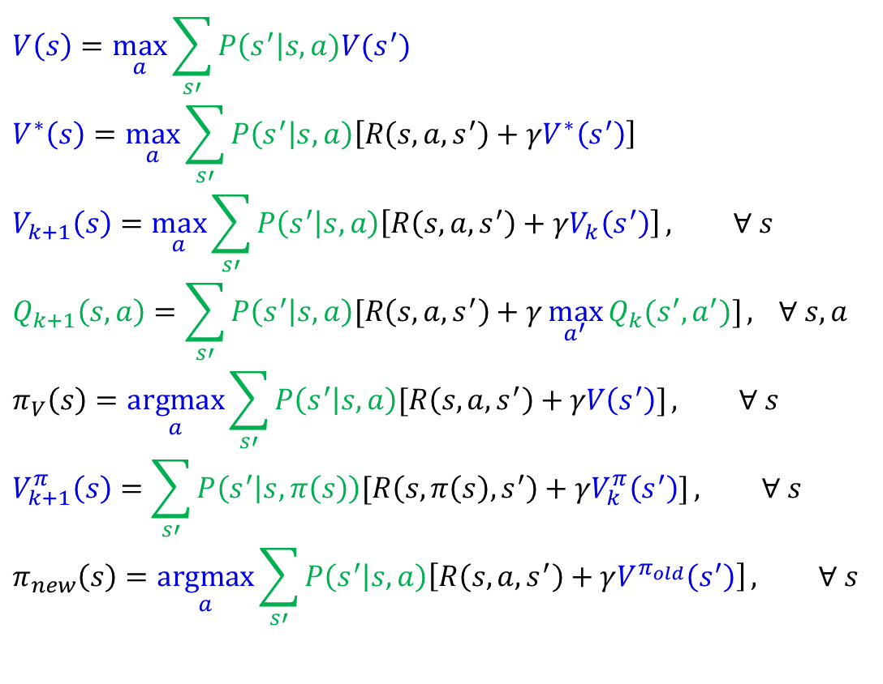
MDP Notation
$$V\left(s\right)=\max_{a}{\sum_{s′}{P\left(s^{′}\right|s,a)V(s^{′})}}$$
$$V^{∗}\left(s\right)=\max_{a}{\sum_{s′}{P\left(s^{′} | s,a\right)\left[R\left(s,a,s^{′}\right)+γV^{∗}\left(s^{′}\right)\right]}}$$
$$V_{k+1}\left(s\right)=\max_{a}{\sum_{s′}{P\left(s^{′} | s,a\right)\left[R\left(s,a,s^{′}\right)+γV_{k}\left(s^{′}\right)\right]}}, ∀ s$$
$$Q_{k+1}\left(s,a\right)=\sum_{s′}{P\left(s^{′} | s,a\right)[R\left(s,a,s^{′}\right)+γ\max_{a^{′}}{Q_{k}(s^{′},a^{′})]}, } ∀ s,a$$
$$π_{V}\left(s\right)=\underset{a}{argmax}{\sum_{s′}{P\left(s^{′} | s,a\right)[R\left(s,a,s^{′}\right)+γV\left(s^{′}\right)]}}, ∀ s$$
$$V_{k+1}^{π}\left(s\right)=\sum_{s′}{P\left(s^{′} | s,π\left(s\right)\right)[R\left(s,π\left(s\right),s^{′}\right)+γV_{k}^{π}\left(s^{′}\right)]}, ∀ s$$
$$π_{new}\left(s\right)=\underset{a}{argmax}{\sum_{s′}{P\left(s^{′} | s,a\right)\left[R\left(s,a,s^{′}\right)+γV^{π_{old}}\left(s^{′}\right)\right]}}, ∀ s$$
Standard expectimax:
Bellman equations:
Value iteration:
Q-iteration:
Policy extraction:
Policy evaluation:
Policy improvement:

Slide 10
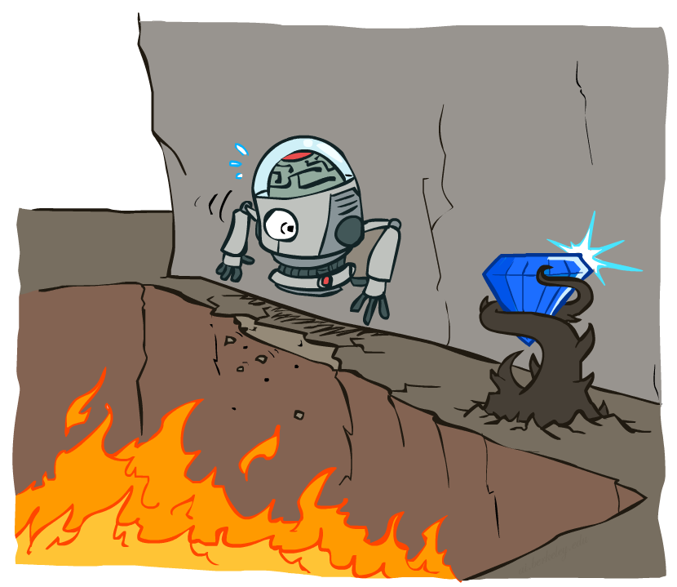
Non-Deterministic Search

Slide 11
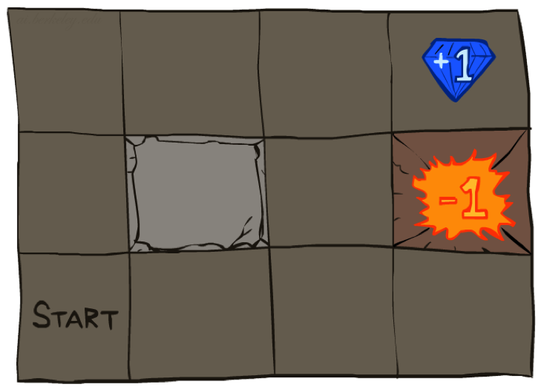




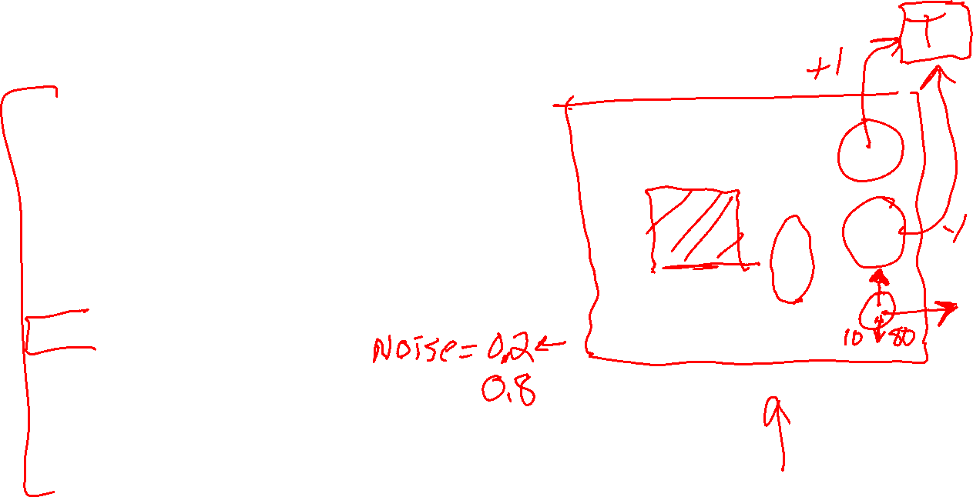
Example: Grid World
A maze-like problem
The agent lives in a grid
Walls block the agent’s path
Noisy movement: actions do not always go as planned
80% of the time, the action North takes the agent North (if there is no wall there)
10% of the time, North takes the agent West; 10% East
If there is a wall in the direction the agent would have been taken, the agent stays put
The agent receives rewards each time step
Small “living” reward each step (can be negative)
Big rewards come at the end (good or bad)
Goal: maximize sum of rewards
Notes:
[cut demo of moving around in grid world program]

Slide 12
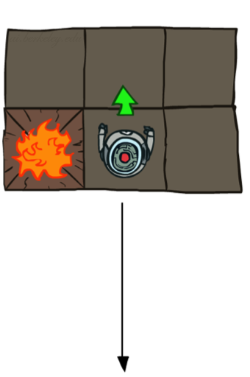
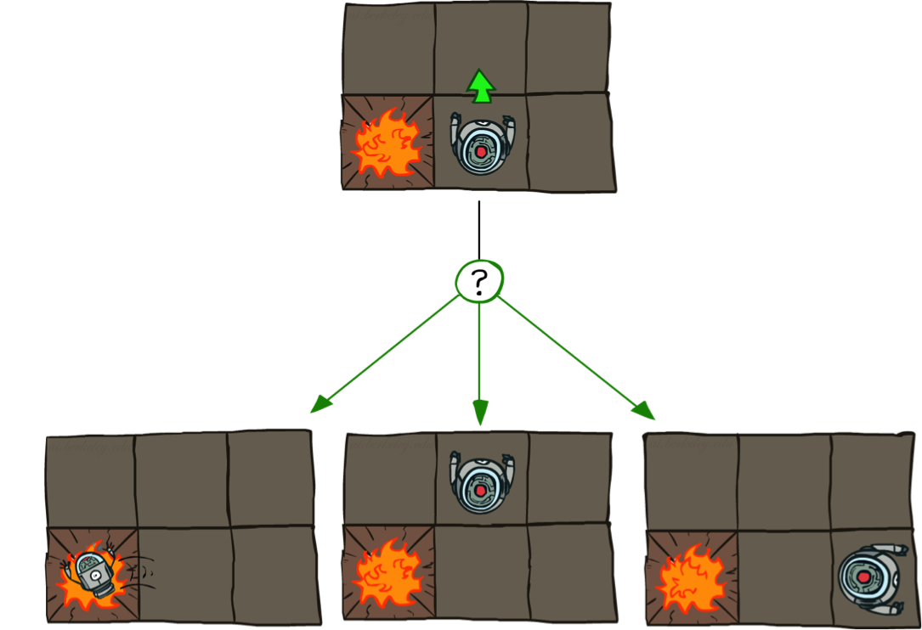
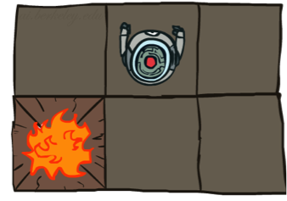
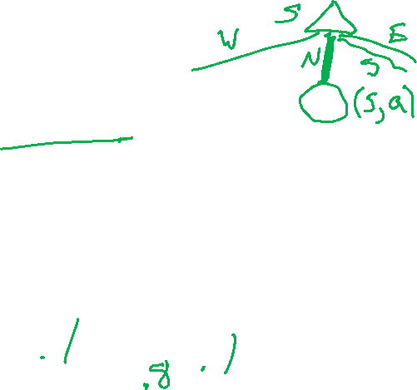
Grid World Actions
Deterministic Grid World
Stochastic Grid World

Slide 13
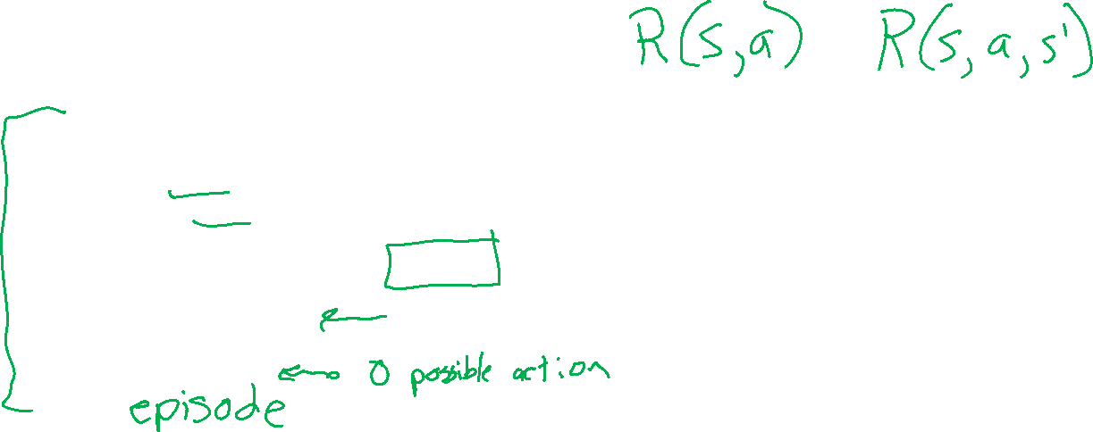
Markov Decision Processes
An MDP is defined by:
A set of states s ∈ S
A set of actions a ∈ A
A transition function T(s, a, s’)
Probability that a from s leads to s’, i.e., P(s’| s, a)
Also called the model or the dynamics
A reward function R(s, a, s’)
Sometimes just R(s) or R(s’)
Maybe a terminal state
MDPs are non-deterministic search problems
One way to solve them is with expectimax search
We’ll have a new tool soon
[Demo – gridworld manual intro (L8D1)]
Notes:
In search problems: did not talk about actions, but about successor functions --- now the information inside the successor function is unpacked into actions, transitions and reward
Write out S, A, example entry in T, entry in R
Reward function different from the book : R(s,a,s’)
In book simpler for equations, but not useful for the projects.
Need to modify expectimax a tiny little bit to account for rewards along the way, but that’s something you should be able to do, and so you can already solve MDP’s (not in most efficient way)

Slide 14
Demo of Gridworld

Slide 15
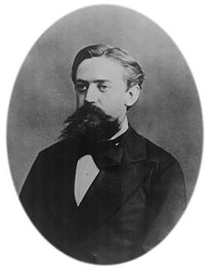

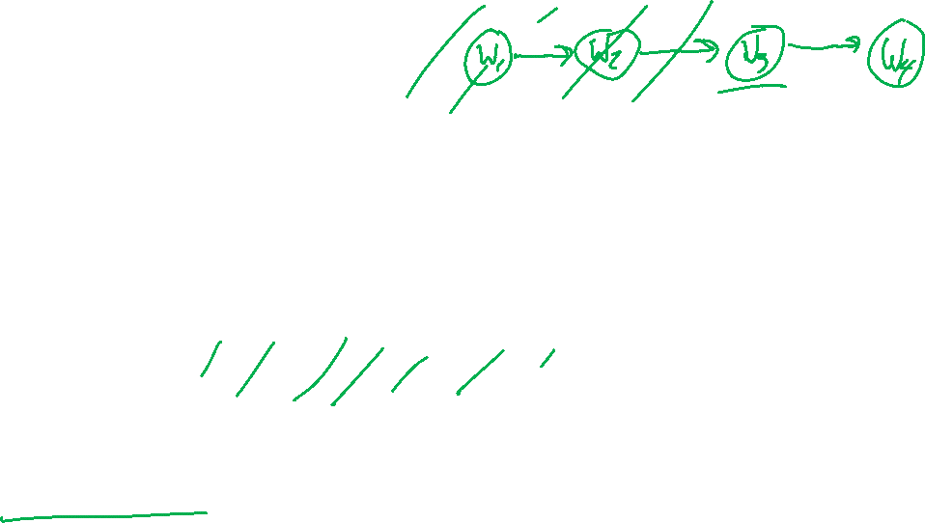
What is Markov about MDPs?
“Markov” generally means that given the present state, the future and the past are independent
For Markov decision processes, “Markov” means action outcomes depend only on the current state
This is just like search, where the successor function could only depend on the current state (not the history)
Andrey Markov (1856-1922)
Notes:
Like search: successor function only depended on current state
Can make this happen by stuffing more into the state;
Very similar to search problems: when solving a maze with food pellets, we stored which food pellets were eaten

Slide 16
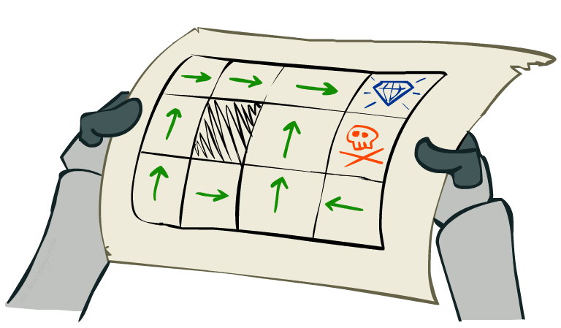
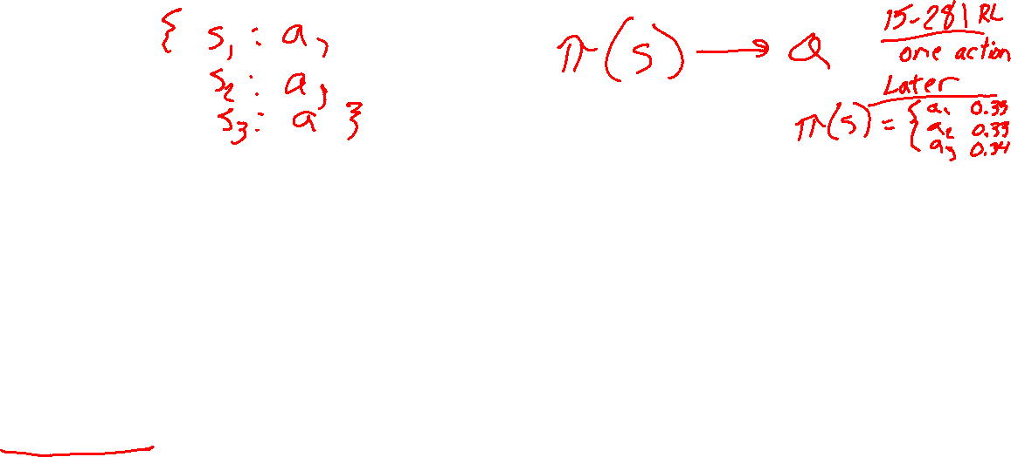
Policies
In deterministic single-agent search problems, we wanted an optimal plan, or sequence of actions, from start to a goal
For MDPs, we want an optimal policy π*: S → A
A policy π gives an action for each state
An optimal policy is one that maximizes expected utility if followed
An explicit policy defines a reflex agent
Expectimax didn’t compute entire policies
It computed the action for a single state only
Optimal policy when R(s, a, s’) = -0.03 for all non-terminals s
Notes:
Dan has a DEMO for this.

Slide 17
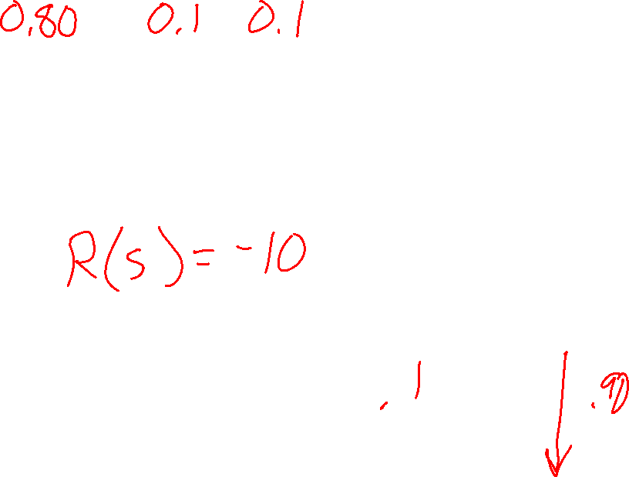
Poll 1
Which is the best move?
A. North
B. East
C. South
D. West
Notes:
R(s) = the “living reward”

Slide 18
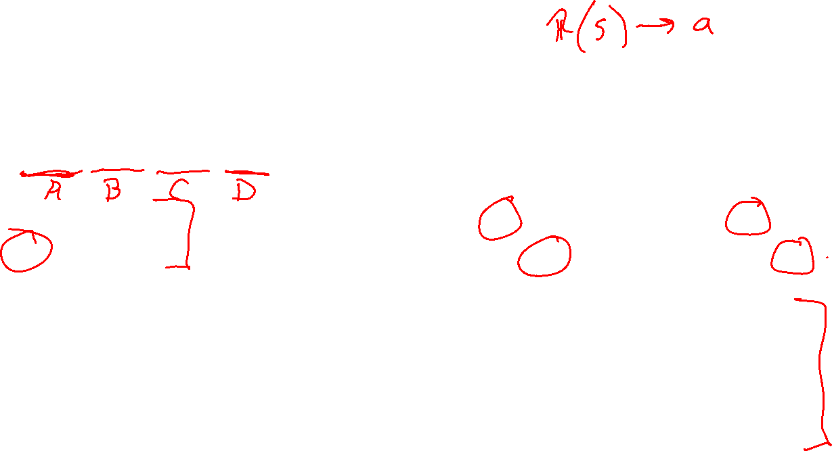
Poll 2
Which sequence of optimal policies matches
the following sequence of living rewards:
{-0.01, -0.03, -0.04, -2.0}
{A, B, C, D}
{B, C, A, D}
{D, C, B, A}
{D, A, C, B}
A)
B)
+1
+1
-1
-1
C)
D)
+1
+1
-1
-1
Notes:
R(s) = the “living reward”

Slide 19
Optimal Policies
R(s) = -0.01
R(s) = -0.03
R(s) = -0.4
R(s) = -2.0
Notes:
R(s) = the “living reward”

Slide 20
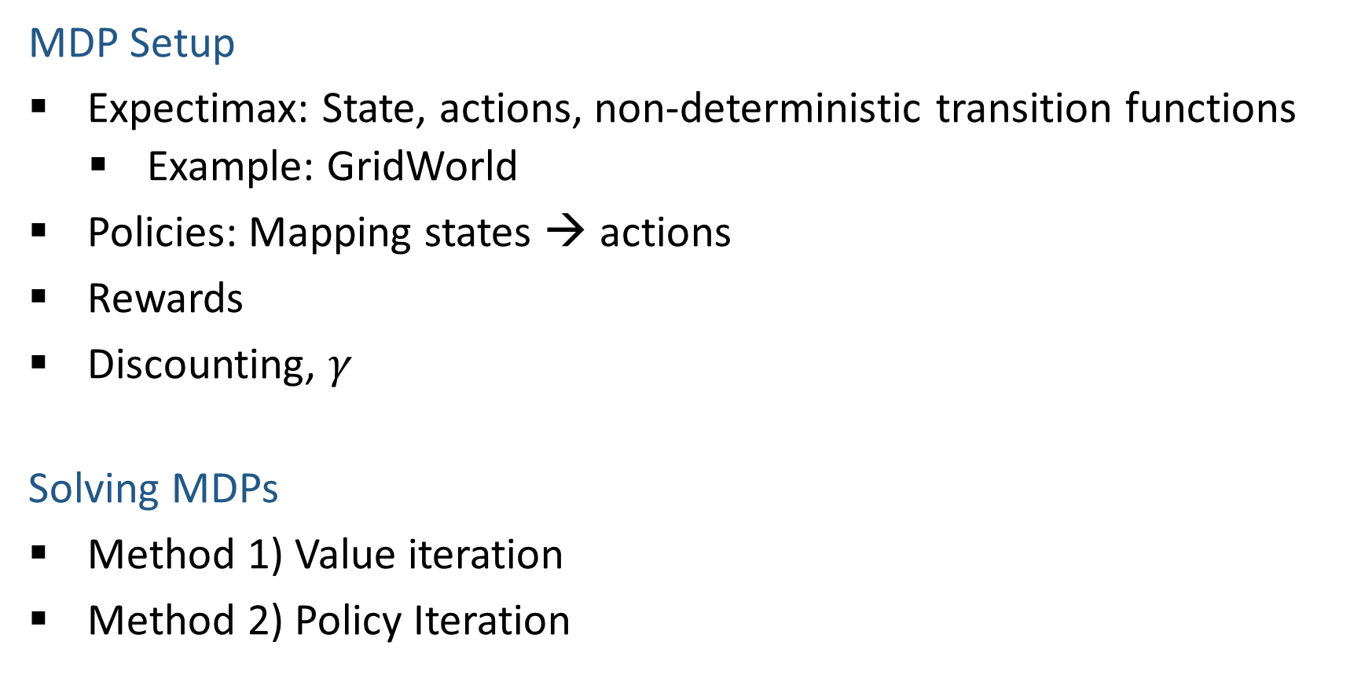
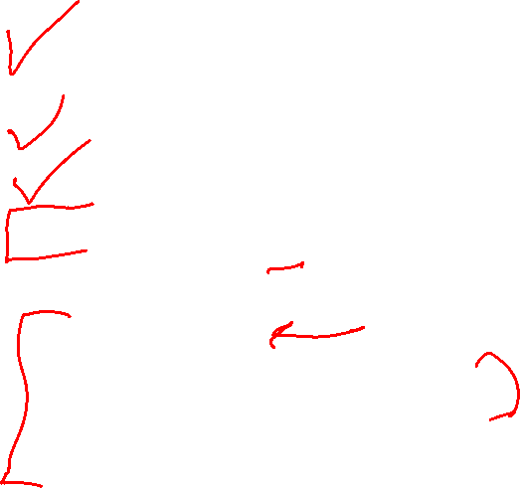
MDP Outline
MDP Setup
Expectimax: State, actions, non-deterministic transition functions
Example: GridWorld
Policies: Mapping states → actions
Rewards
Discounting, $γ$
Solving MDPs
Method 1) Value iteration
Method 2) Policy Iteration

Slide 21
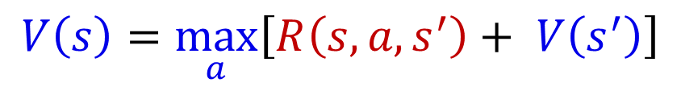
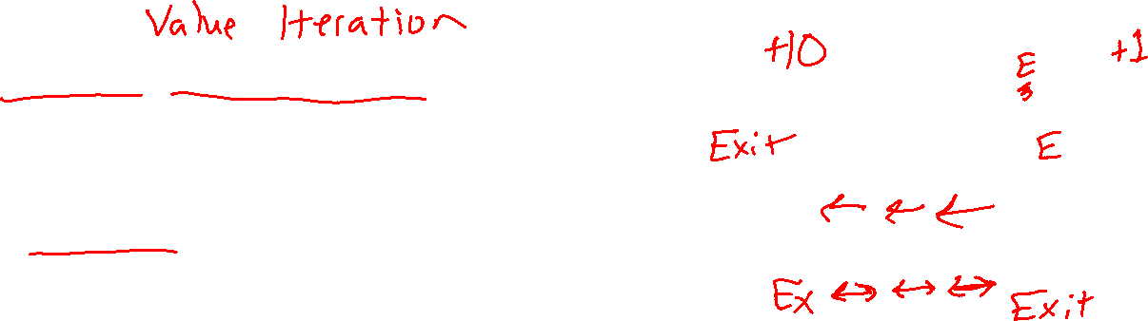
Simple Deterministic Example
T (Terminal)
R(A, Exit, T) = 10
R(A, Exit, T) = 1
Actions: B, C, D: East, West
Actions: A, E: Exit
Transitions: deterministic
Rewards only for transitioning to terminal state
A | B | C | D | E
$$V\left(s\right)=\max_{a}\left[R\left(s, a, s^{′}\right)+ V\left(s^{′}\right)\right]$$

Slide 22
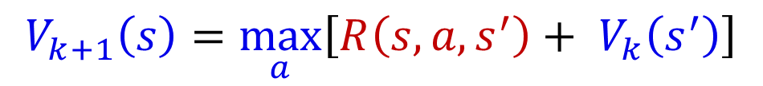
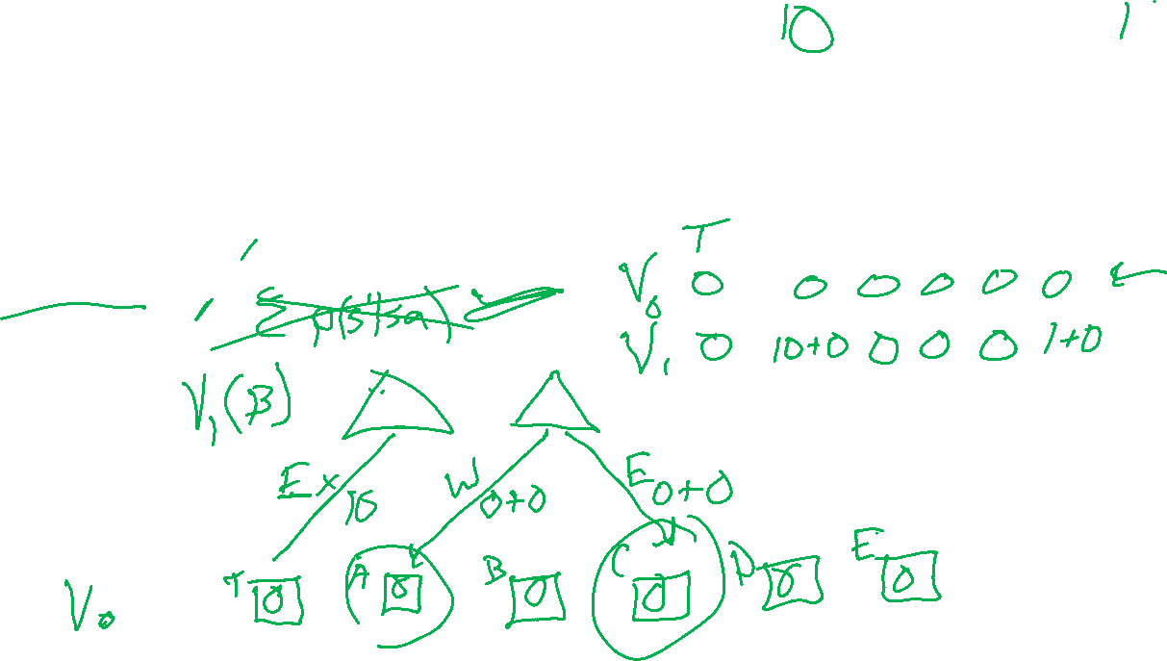
Simple Deterministic Example
T (Terminal)
R(A, Exit, T) = 10
R(E, Exit, T) = 1
Actions: B, C, D: East, West
Actions: A, E: Exit
Transitions: deterministic
Rewards only for transitioning to terminal state
A | B | C | D | E
$$V_{k+1}\left(s\right)=\max_{a}\left[R\left(s, a, s^{′}\right)+ V_{k}\left(s^{′}\right)\right]$$

Slide 23
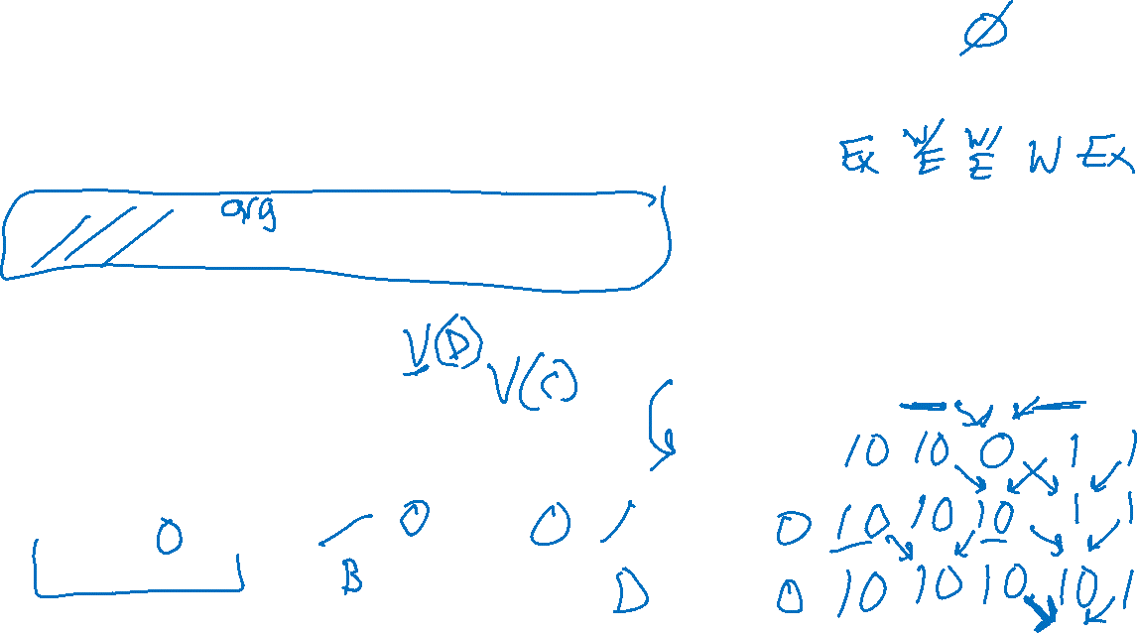
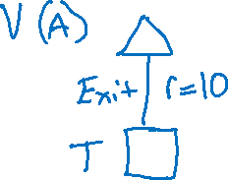
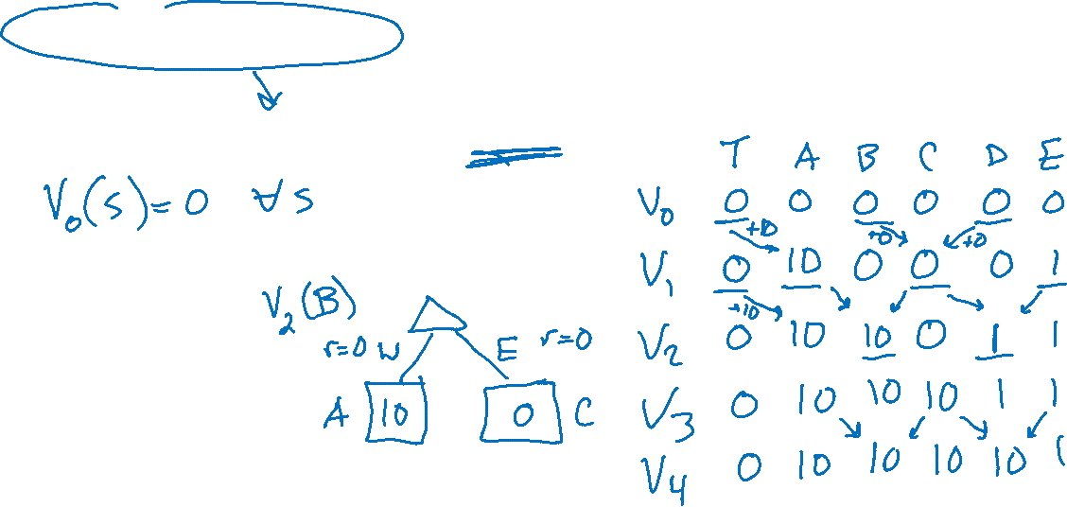
Simple Deterministic Example
T (Terminal)
R(A, Exit, T) = 10
R(E, Exit, T) = 1
Actions: B, C, D: East, West
Actions: A, E: Exit
Transitions: deterministic
Rewards only for transitioning to terminal state
A | B | C | D | E
$$V_{k+1}\left(s\right)=\max_{a}\left[R\left(s, a, s^{′}\right)+ V_{k}\left(s^{′}\right)\right]$$

Slide 24
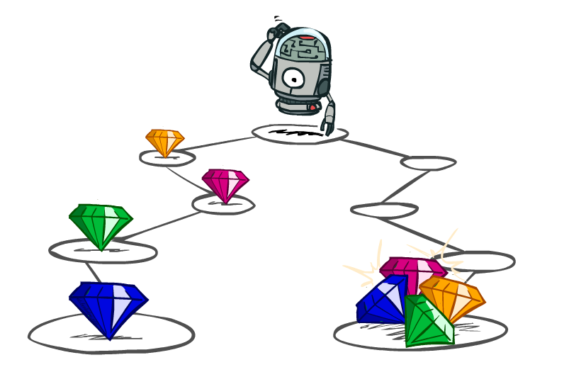
Utilities of Sequences

Slide 25

Utilities of Sequences
What preferences should an agent have over reward sequences?
More or less?
Now or later?
[1, 2, 2]
or
[2, 3, 4]
[0, 0, 1]
or
[1, 0, 0]

Slide 26

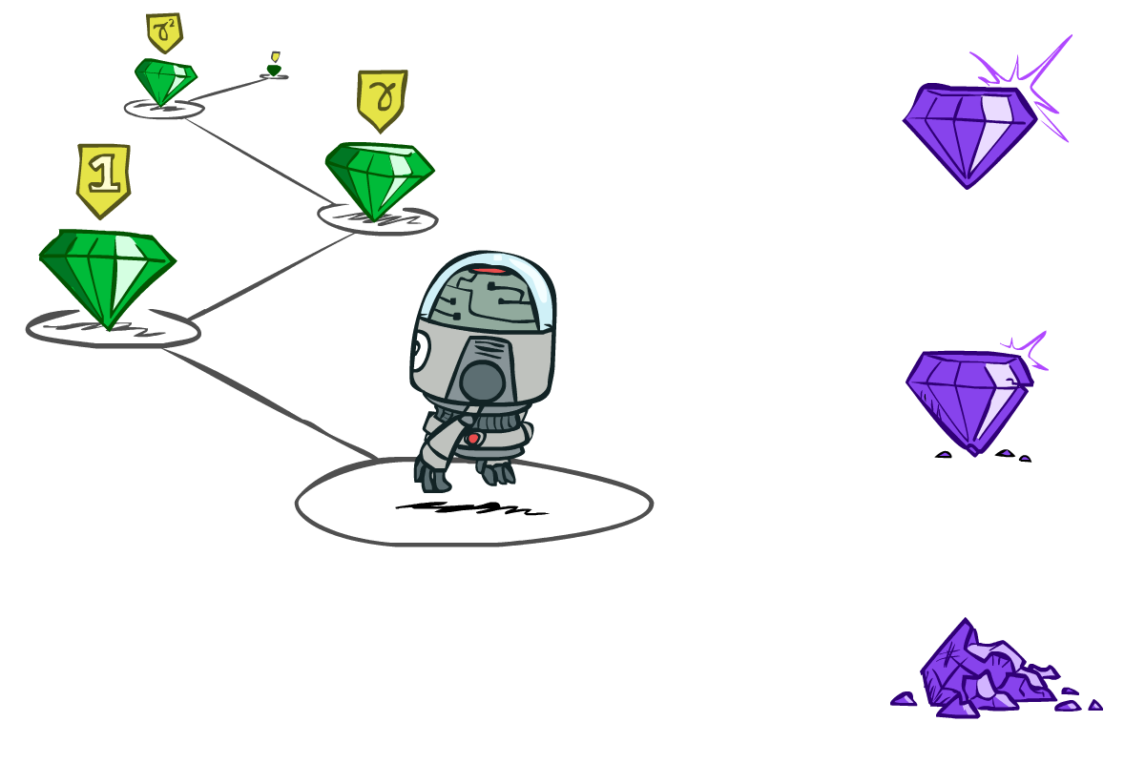

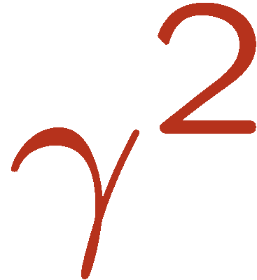

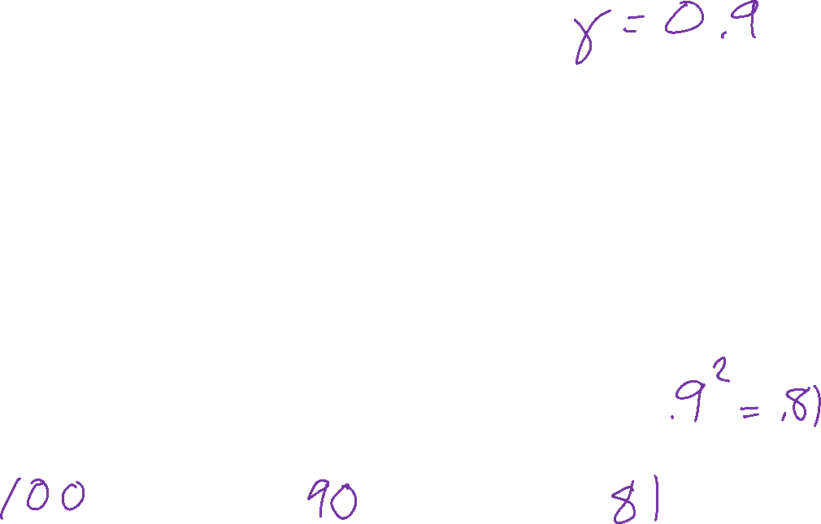
Discounting
It’s reasonable to maximize the sum of rewards
It’s also reasonable to prefer rewards now to rewards later
One solution: values of rewards decay exponentially
Worth Now
Worth Next Step
Worth In Two Steps

Slide 27

Discounting
How to discount?
Each time we descend a level, we multiply in the discount once
Why discount?
Sooner rewards probably do have higher utility than later rewards
Also helps our algorithms converge
Important: use 0 < γ < 1
Notes:
Rewards in the future (deeper in the tree) matter less
Interesting: running expectimax, if having to truncate the search, then not losing much; e.g., less then \gamma^d / (1-\gamma)

Slide 28
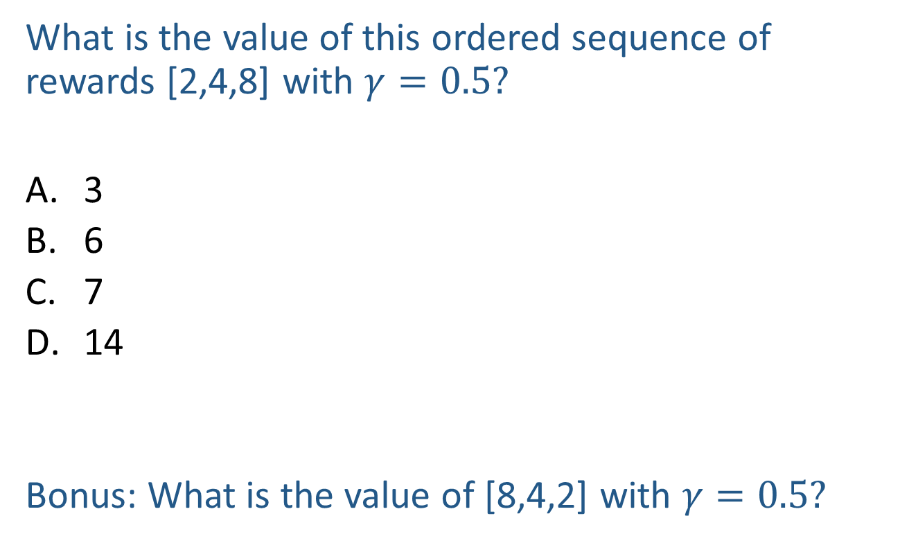
Poll
What is the value of this ordered sequence of rewards [2,4,8] with $γ=0.5?$
3
6
7
14
Bonus: What is the value of [8,4,2] with $γ=0.5?$
Notes:
Rewards in the future (deeper in the tree) matter less
Interesting: running expectimax, if having to truncate the search, then not losing much; e.g., less then \gamma^d / (1-\gamma)

