Slide 1
AI: Representation and Problem Solving
Classical Planning
or Symbolic Planning
Instructor: Pat Virtue
Slide credits: CMU AI

Slide 2
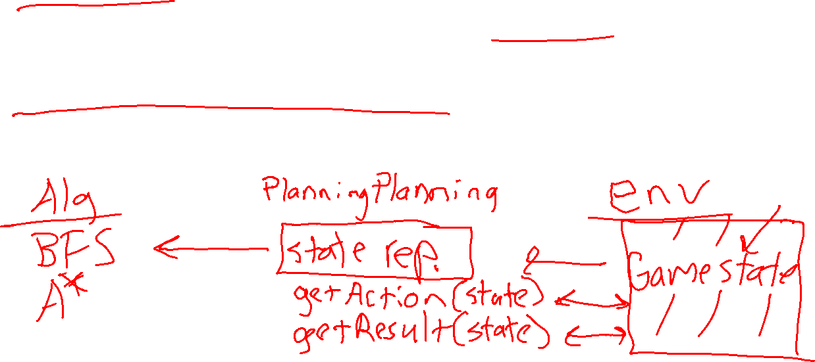
Represent this Blocks World
A robot arm (yellow) can pick up and put down blocks to form stacks.
It cannot pick up a block that has another block on top of it.
It cannot pick up more than one block at a time.
Any number of blocks can sit on the table.
How would solve Blocks World problems with search, e.g., BFS?
Notes:
0=7, R=4, W=6, U=2, T=8, F=1; 867 + 867 = 1734

Slide 3
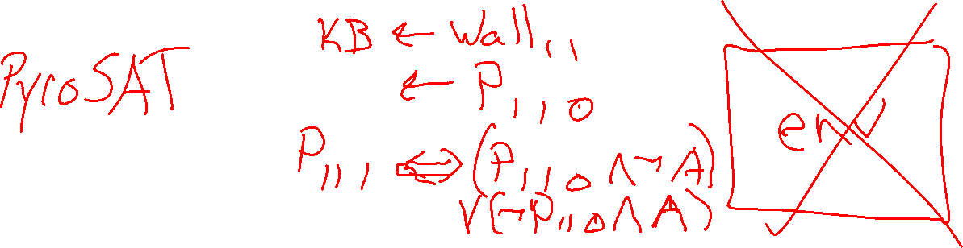
Represent this Blocks World
A robot arm (yellow) can pick up and put down blocks to form stacks.
It cannot pick up a block that has another block on top of it.
It cannot pick up more than one block at a time.
Any number of blocks can sit on the table.
How would solve Blocks World problems with logical planning?
Notes:
0=7, R=4, W=6, U=2, T=8, F=1; 867 + 867 = 1734

Slide 4
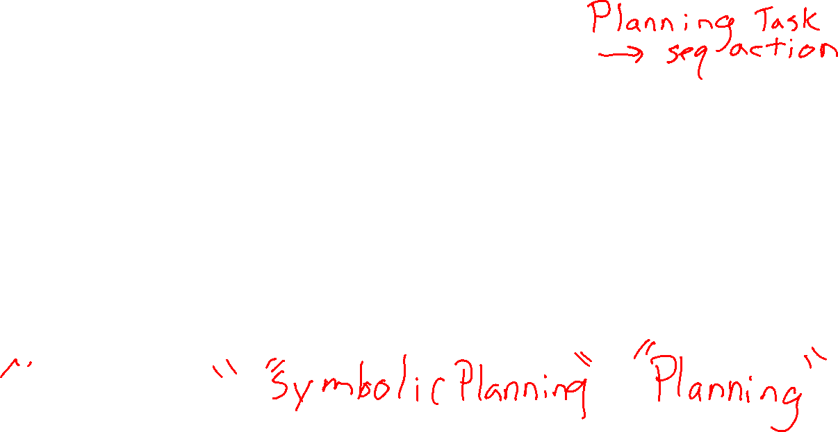
Search, Logic, and Classical Planning
Search Planning
Assumes actions and transitions are provided for you, s’ = result(s, a)
State changes as you take actions
Propositional Logic Planning
Can reason about what actions are possible and their effects
Represent world with only Boolean symbols
Different symbols for different time points
Classical Planning
Can reason about what actions are possible and their effects
State changes as you take actions

Slide 5
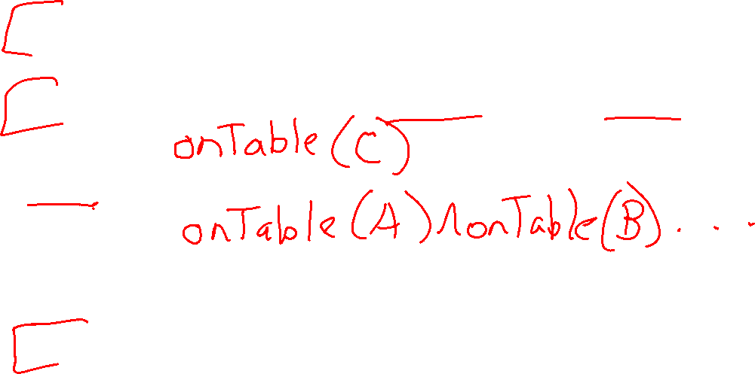
Idea of Classical Planning
Represent objects/values separately from the state (instances)
Define predicates as true/false functions over the objects (propositions)
States are conjunctions of predicates
Goals are conjunctions of predicates
Operators (actions)
Robot Arm
A
B
C

Slide 6

STRIPS Representation
STRIPS = Stanford Research Institute Problem Solver (1970s system)
Actions defined by:
Preconditions
Add effects
Delete effects
Convention: all other facts remain unchanged → avoids frame axioms

Slide 7
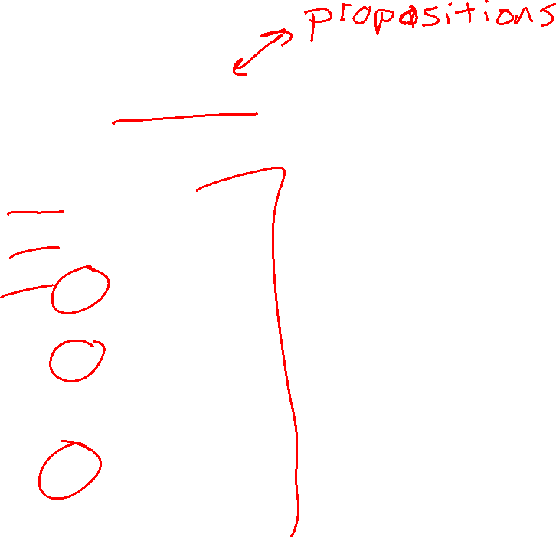
Poll 1
Which predicates apply to this state? (Select all that apply)
Instances: A, B, C
Predicates:
1) In-Hand(A)
2) In-Hand(B)
3) In-Hand(C)
4) On-Table(A)
5) On-Table(B)
6) On-Table(C)
7) On-Block(B,C)
8) On-Block(A,B)
9) HandEmpty()
A
C
B

Slide 8
Poll 1
Which predicates apply to this state? (Select all that apply)
Instances: A, B, C
Predicates:
1) In-Hand(A)
2) In-Hand(B)
3) In-Hand(C)
4) On-Table(A)
5) On-Table(B)
6) On-Table(C)
7) On-Block(B,C)
8) On-Block(A,B)
9) HandEmpty()
A
C
B

Slide 9

Full State Description
Instances: A, B, C
Predicates:
In-Hand(C)
On-Table(B)
On-Block(A,B)
Clear(A)
Clear(C)
Optional: ~HandEmpty(), ~On-Table(C), ~On-Table(A), ~On-Block(B,A), ~On-Block(C,A), ~On-Block(B,C), ~On-Block(C,B), ~On-Block(A,C), ~Clear(B), ~In-Hand(A), ~In-Hand(B)
A
C
B

Slide 10
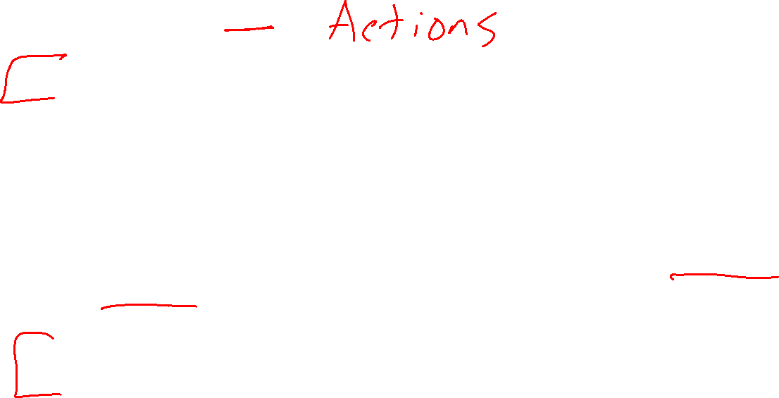
Operators
Operators change the state by adding/deleting predicates
Preconditions:
Actions can be applied only if all precondition predicates are true in the current state
Effects:
New state is a copy of the current predicates with the addition or deletion of specified predicates
Unlike the successor-state axioms, we do not explicitly represent time

Slide 11
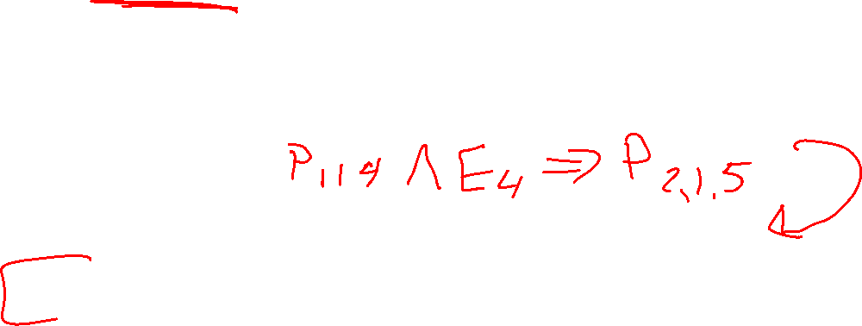
The Frame Problem
Frame problem: how to specify what remains unchanged after actions
Frame axioms (logic): one per unaffected predicate
Successor-State Axiom: combines persistence + change
STRIPS convention: actions only list what changes (preconditions, add, delete)

Slide 12

Rules of Blocks World
Blocks are picked up and put down by the hand
Blocks can be picked up only if they are clear
Hand can pick up a block only if the hand is empty
Hand can pick up and put down blocks on blocks or on the table

Slide 13
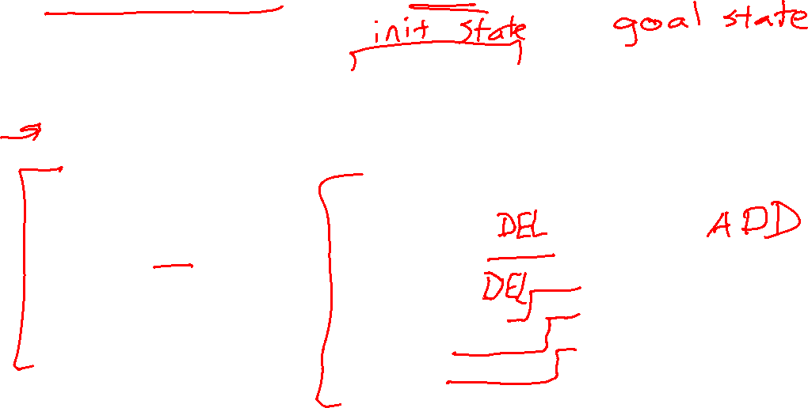
Pickup Block C from Table (State Transition)
Instances:
Blocks A, B, C
Possible Predicates:
HandEmpty()
On-Table(block)
On-Block(b1,b2)
Clear(block)
In-Hand(block)
A
B
C
State:
HandEmpty()
On-Table(B)
On-Table(C)
On-Block(A,B)
Clear(A)
Clear(C)
State:
In-Hand(C)
On-Table(B)
On-Block(A,B)
Clear(A)
Clear(C)

Slide 14
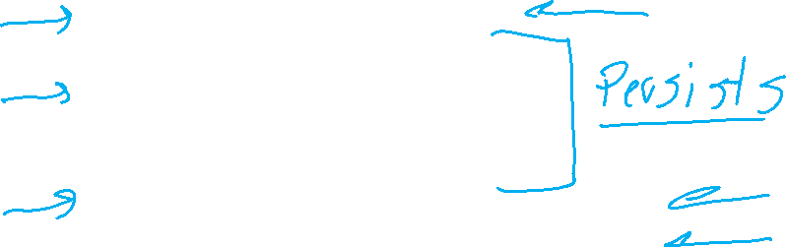
Pickup Block C from Table (Preconditions, Effects)
Instances:
Blocks A, B, C
Possible Predicates:
HandEmpty()
On-Table(block)
On-Block(b1,b2)
Clear(block)
In-Hand(block)
A
B
C
State:
HandEmpty()
On-Table(B)
On-Table(C)
On-Block(A,B)
Clear(A)
Clear(C)
State:
HandEmpty()
On-Table(B)
On-Table(C)
On-Block(A,B)
Clear(A)
Clear(C)
State:
In-Hand(C)
On-Table(B)
On-Block(A,B)
Clear(A)
Clear(C)
State:
In-Hand(C)
On-Table(B)
On-Block(A,B)
Clear(A)
Clear(C)
Delete HandEmpty()
Delete On-Table(C)

Slide 15

Operator: Pickup-Block-C from Table
Preconditions Effects
HandEmpty() Add In-Hand(C)
Clear(C) Delete HandEmpty()
On-Table(C) On-Table(C)
A
B
C

Slide 16

Operator: Pickup-Block from Table
Preconditions Effects
HandEmpty() Add In-Hand(block)
Clear(block) Delete HandEmpty()
On-Table(block) On-Table(block)
Create a variable that takes on the value of a particular instance for all times it appears in an operator.

Slide 17
Operator: PutDown-Block on Table
Preconditions Effects
In-Hand(block) Add HandEmpty()
On-Table(block)
Delete In-Hand(block)
Why don’t we need to check if ~HandEmpty() is true?

Slide 18

Full State Description
Instances: A, B, C
Predicates:
In-Hand(C)
On-Table(B)
On-Block(A,B)
Clear(A)
Clear(C)
Optional: ~HandEmpty(), ~On-Table(C), ~On-Table(A), ~On-Block(B,A), ~On-Block(C,A), ~On-Block(B,C), ~On-Block(C,B), ~On-Block(A,C), ~Clear(B), ~In-Hand(A), ~In-Hand(B)
RULE OF THUMB: If you must match that Predicate is explicitly not true, you must include ~Predicate in the state description.
A
C
B

Slide 19

Operators for Block Stacking
Pickup_Table(b):
Pre: HandEmpty(), Clear(b), On-Table(b)
Add: In-Hand(b)
Delete: HandEmpty(), On-Table(b)
Putdown_Table(b):
Pre: In-Hand(b)
Add: HandEmpty(), On-Table(b)
Delete: In-Hand(b)
Pickup_Block(b,c):
Pre: HandEmpty(), On-Block(b,c), b!=c
Add: In-Hand(b), Clear(c)
Delete: HandEmpty(), On-Block(b,c)
Putdown_Block(b,c):
Pre: In-Hand(b), Clear(c)
Add: HandEmpty(), On-Block(b,c)
Delete: Clear(c), In-Hand(b)
Why do we need separate operators for table vs on a block?

Slide 20
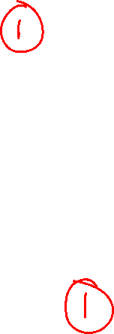
Example Matching Operators
HandEmpty() & On-Table(O) & On-Block(B,O) & Clear(B) & On-Table(G) & Clear(G)

Slide 21
Example Matching Operators
HandEmpty() & On-Table(O) & On-Block(B,O) & Clear(B) & On-Table(G) & Clear(G)
Pickup_Block(b,c):
Pre: HandEmpty(), On-Block(b,c), b!=c
Add: In-Hand(b), Clear(c)
Delete: HandEmpty(), On(b,c)
Pickup_Table(b):
Pre: HandEmpty, Clear(b), On-Table(b)
Add: In-Hand(b)
Delete: HandEmpty(), On-Table(b)

Slide 22
State Space Graph (also called Reachability Graph)
Start
Goal

Slide 23
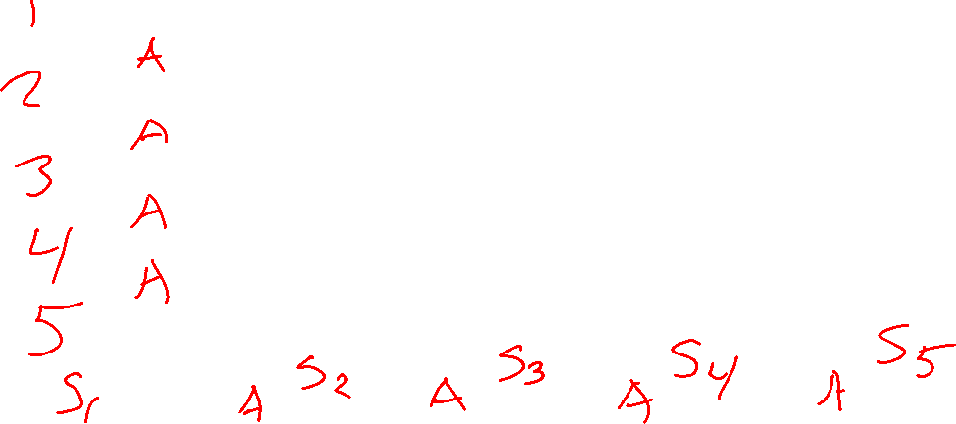
Example Matching Operators
HandEmpty() & On-Table(O) & On-Block(B,O) & Clear(B) & On-Table(G) & Clear(G)
Pickup_Block(B,O)
On-Table(O) & Clear(B) & On-Table(G) & Clear(G) & In-Hand(B) & Clear(O)
Putdown_Table(B)
On-Table(O) & Clear(O) & On-Table(G) & Clear(G) & Clear(B) & On-Table(B) & HandEmpty()
Pickup_Table(G)
On-Table(O) & Clear(B) & Clear(G) & Clear(O) & On-Table(B) & In-Hand(G)
Putdown_Block(G,O)
On-Table(O) & Clear(B) & Clear(G) & On-Table(B) & On-Block(G,O) & HandEmpty()

Slide 24
Search with a State Space Graph
Start
Goal

Slide 25
Finding Plans with Symbolic Representations
Breadth-First Search
Sound?
Complete?
Optimal?
Yes
Yes
Yes
Soundness - all solutions found are legal plans
Completeness - a solution can be found whenever one actually exists
Optimality - the order in which solutions are found is consistent with some measure of plan quality

Slide 26

Size of the Search Tree
A planning tree’s size is exponential in the number of predicates
Even if we use linear or non-linear planning, they use this graph
Can we reduce the size of the planning graph?

Slide 27
GraphPlan

Slide 28
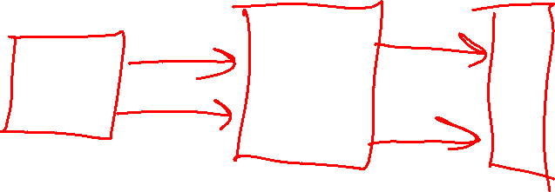
GraphPlan
Allow actions to be simultaneous
Always add predicates (don't delete)
GraphPlan is a relaxation of other classical planning search techniques
The GraphPlan search graph space is linear in the number of predicates
State space search
sockL()
bareR()
putShoeL
putSockL
putSockR
bareL()
bareR()
bareL()
sockR()
putSockL
putSockR
putShoeR

Slide 29

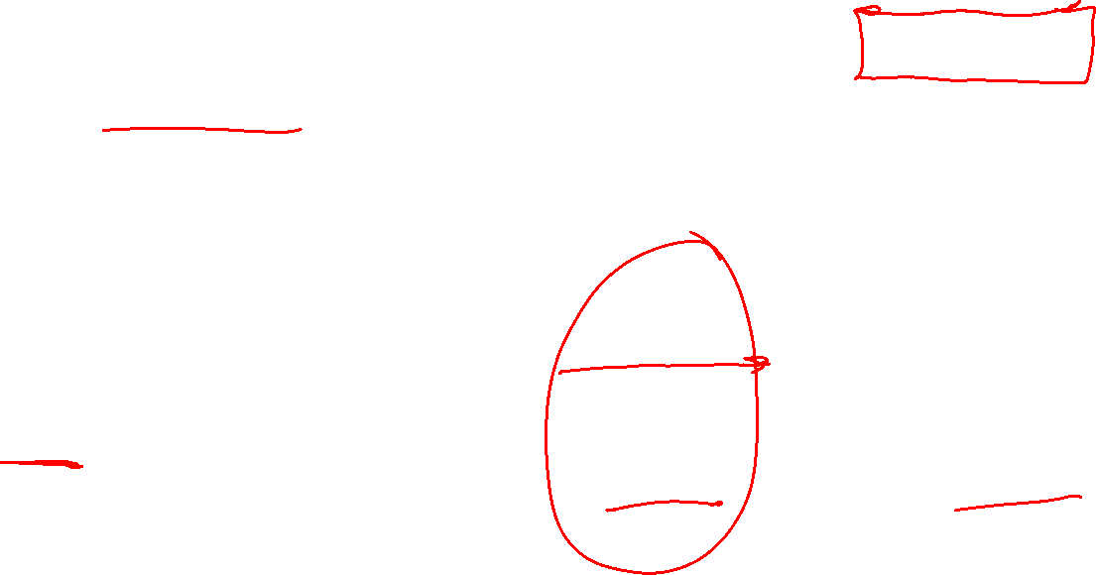



GraphPlan
Allow actions to be simultaneous
Always add predicates (don't delete)
GraphPlan is a relaxation of other classical planning search techniques
The GraphPlan search graph space is linear in the number of predicates
State space search
GraphPlan graph
sockL()
bareR()
putShoeL
bareL()
bareR()
sockL()
bareL()
bareR()
sockR()
putShoeL
putSockL
putSockL
putSockL
putSockR
bareL()
bareR()
bareL()
bareR()
noop
noop
noop
bareL()
sockR()
putSockL
putSockR
putSockR
putSockR
putShoeR
putShoeR
$$S_{0}$$
$$A_{0}$$
$$S_{1}$$
$$A_{1}$$

Slide 30
GraphPlan
Allow actions to be simultaneous
Always add predicates (don't delete)
GraphPlan is a relaxation of other classical planning search techniques
The GraphPlan search graph space is linear in the number of predicates
sockL()
bareR()
putShoeL
bareL()
bareR()
sockL()
bareL()
bareR()
sockR()
putShoeL
putSockL
putSockL
putSockL
putSockR
bareL()
bareR()
bareL()
bareR()
noop
noop
noop
bareL()
sockR()
putSockL
putSockR
putSockR
putSockR
putShoeR
putShoeR
$$S_{0}$$
$$A_{0}$$
$$S_{1}$$
$$A_{1}$$

Slide 31

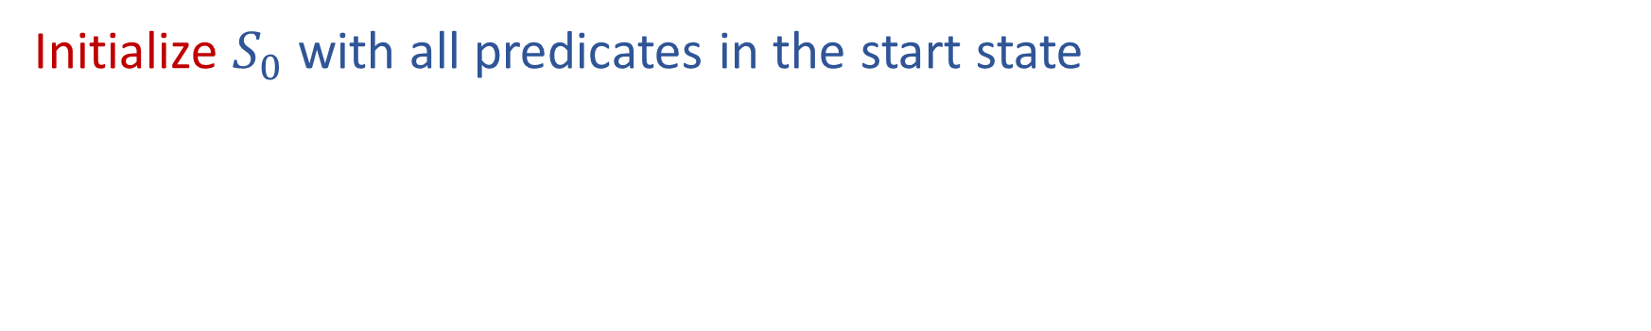


Building a GraphPlan Graph
Initialize $S_{0}$ with all predicates in the start state
bareL()
bareR()
$$S_{0}$$
$$A_{0}$$
$$S_{1}$$

Slide 32
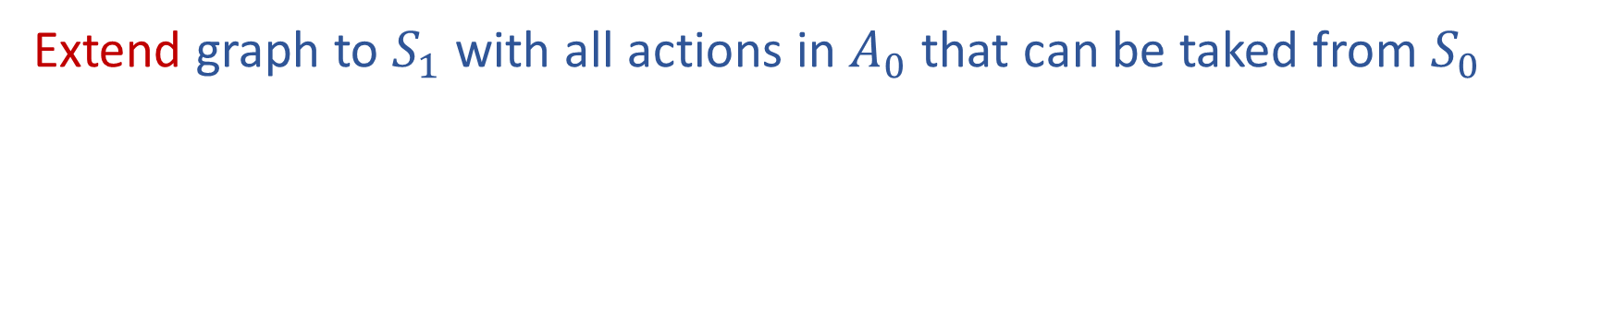
Building a GraphPlan Graph
Extend graph to $S_{1}$ with all actions in $A_{0}$ that can be taked from $S_{0}$
bareL()
bareR()
sockL()
bareL()
bareR()
sockR()
For now, we are just assuming that any actions (including no-ops) can be taken individually in any order to get us to the next state
This certainly isn't always true
E.g., we can't put our socks
on and then take the no-ops that require bare feet
(More on these exclusion checks later)
putSockL
noop
putSockR
$$S_{0}$$
$$A_{0}$$
$$S_{1}$$

Slide 33
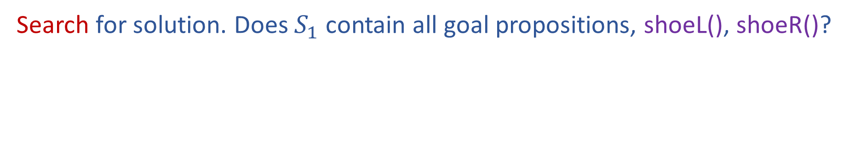
Building a GraphPlan Graph
Search for solution. Does $S_{1}$ contain all goal propositions, shoeL(), shoeR()?
bareL()
bareR()
sockL()
bareL()
bareR()
sockR()
Nope, not yet
putSockL
noop
putSockR
$$S_{0}$$
$$A_{0}$$
$$S_{1}$$

Slide 34

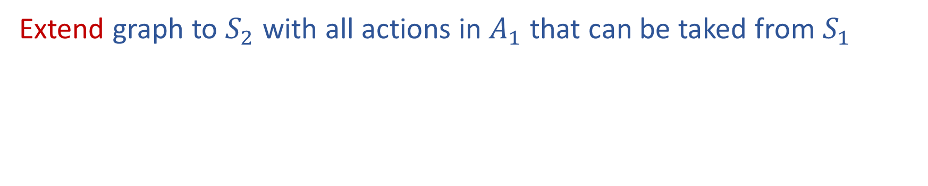

Building a GraphPlan Graph
Extend graph to $S_{2}$ with all actions in $A_{1}$ that can be taked from $S_{1}$
bareL()
bareR()
sockL()
bareL()
bareR()
sockR()
shoeL()
sockL()
bareL()
bareR()
sockR()
shoeR()
putShoeL
putSockL
putSockL
noop
noop
putSockR
putSockR
putShoeR
$$S_{0}$$
$$A_{0}$$
$$S_{1}$$
$$A_{1}$$
$$S_{2}$$

Slide 35
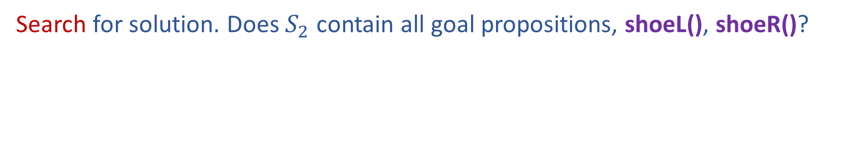
Building a GraphPlan Graph
Search for solution. Does $S_{2}$ contain all goal propositions, shoeL(), shoeR()?
bareL()
bareR()
sockL()
bareL()
bareR()
sockR()
shoeL()
sockL()
bareL()
bareR()
sockR()
shoeR()
Yes, but
....is this ok??
Maybe ☺
We need to check that we can actually take the subset of actions that lead us the goal proposition
putShoeL
putSockL
putSockL
noop
noop
putSockR
putSockR
putShoeR
$$S_{0}$$
$$A_{0}$$
$$S_{1}$$
$$A_{1}$$
$$S_{2}$$

Slide 36

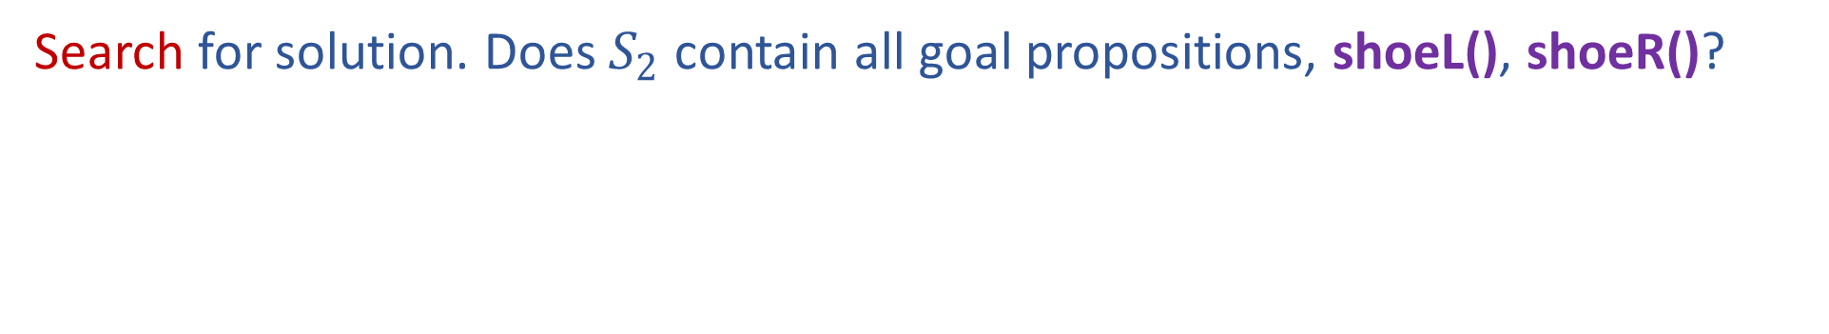




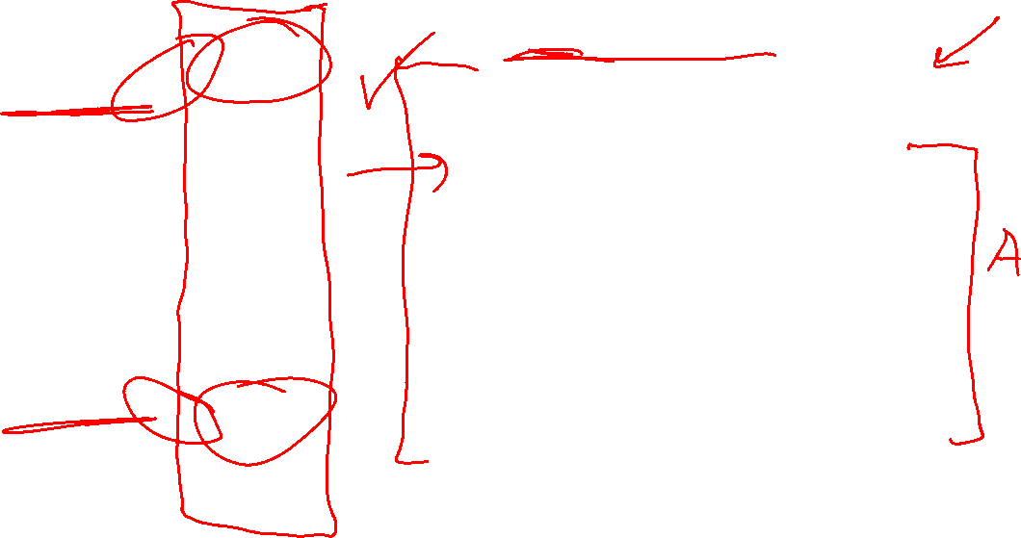
Building a GraphPlan Graph
Search for solution. Does $S_{2}$ contain all goal propositions, shoeL(), shoeR()?
bareL()
bareR()
sockL()
bareL()
bareR()
sockR()
shoeL()
sockL()
bareL()
bareR()
sockR()
shoeR()
Are the goal propositions ok?
Do they directly contradict each other (negation)?
Are the actions that produced them ok (consistent support)?
We'll need to check putShoeL and putShoeR
Can we really do both of these actions in either order?
putShoeL
putSockL
putSockL
noop
noop
putSockR
putSockR
putShoeR
$$S_{0}$$
$$A_{0}$$
$$S_{1}$$
$$A_{1}$$
$$S_{2}$$

Slide 37

Building a GraphPlan Graph
Search for solution. Does $S_{2}$ contain all goal propositions, shoeL(), shoeR()?
bareL()
bareR()
sockL()
bareL()
bareR()
sockR()
shoeL()
sockL()
bareL()
bareR()
sockR()
shoeR()
Are the actions leading to the goals okay (not exclusive)?
putShoeL
putSockL
putSockL
Actions A and B are exclusive (mutex) at action-level i, if:
Interference: one action effect deletes or negates a precondition of the other
Inconsistency: one action effect deletes or negates the effect of the other
Competing Needs: the actions have preconditions that are mutex in prev. proposition-level
noop
noop
putSockR
putSockR
putShoeR
$$S_{0}$$
$$A_{0}$$
$$S_{1}$$
$$A_{1}$$
$$S_{2}$$

Slide 38
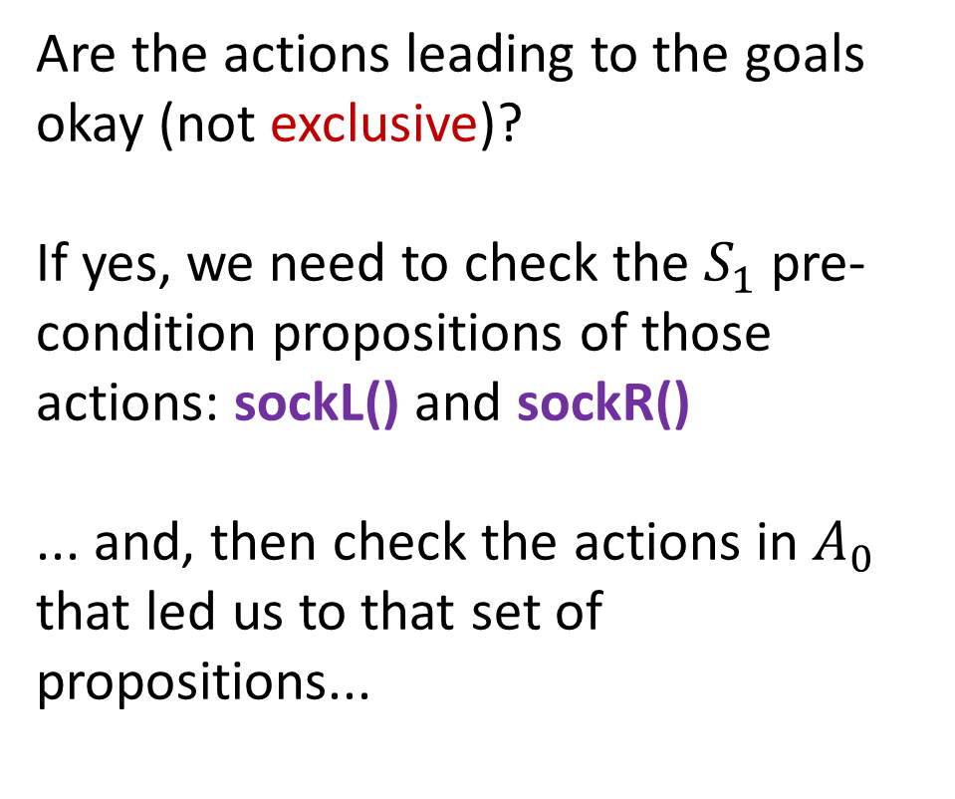





Building a GraphPlan Graph
Search for solution. Does $S_{2}$ contain all goal propositions, shoeL(), shoeR()?
bareL()
bareR()
sockL()
bareL()
bareR()
sockR()
shoeL()
sockL()
bareL()
bareR()
sockR()
shoeR()
Are the actions leading to the goals okay (not exclusive)?
If yes, we need to check the $S_{1}$ pre-condition propositions of those actions: sockL() and sockR()
... and, then check the actions in $A_{0}$ that led us to that set of propositions...
putShoeL
putSockL
putSockL
noop
noop
putSockR
putSockR
putShoeR
$$S_{0}$$
$$A_{0}$$
$$S_{1}$$
$$A_{1}$$
$$S_{2}$$

Slide 39
Building a GraphPlan Graph
Search backwards for solution of non-exclusive propositions and actions
bareL()
bareR()
sockL()
bareL()
bareR()
sockR()
shoeL()
sockL()
bareL()
bareR()
sockR()
shoeR()
Solution found!
We can do putSockL and putSockR
in any order, then
We can do putShoeL and putShoeR
in any order
putShoeL
putSockL
putSockL
noop
noop
putSockR
putSockR
putShoeR
$$S_{0}$$
$$A_{0}$$
$$S_{1}$$
$$A_{1}$$
$$S_{2}$$

Slide 40
GraphPlan High Level Algorithm
Initialize first proposition layer with proposition from initial state
Loop
Extend the GraphPlan graph by adding an action level and
then a proposition level
If graph has leveled off (no new propositions added from previous level):
Return NO SOLUTION
If all propositions in the goal are present in the added proposition level: Search for a possible plan in the planning graph
(see solution algorithm)
If plan found, return with that plan

Slide 41

GraphPlan and GraphPlan Graph Representation
Graphplan graphs contain two types of layers
Proposition layers – all reachable predicates
Action layers – actions that could be taken
Both layers represent one time step
GraphPlan algorithm includes two subtasks
Extend: One time step (two layers) in the graphplan graph
Search: Find a valid plan in the graphplan graph
GraphPlan finds a plan or proves that no plan has fewer time steps
Each time step can contain multiple actions

Slide 42
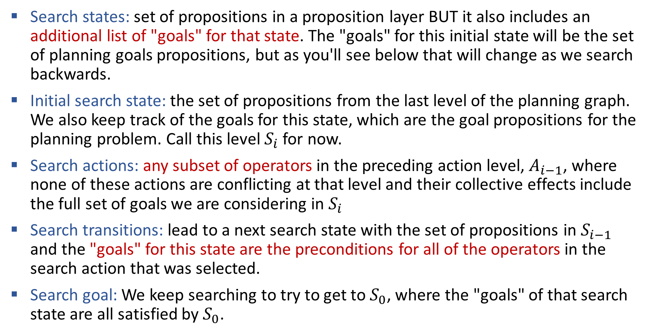
Details: Searching the GraphPlan Graph
Search states: set of propositions in a proposition layer BUT it also includes an additional list of "goals" for that state. The "goals" for this initial state will be the set of planning goals propositions, but as you'll see below that will change as we search backwards.
Initial search state: the set of propositions from the last level of the planning graph. We also keep track of the goals for this state, which are the goal propositions for the planning problem. Call this level $S_{i}$ for now.
Search actions: any subset of operators in the preceding action level, $A_{i−1}$, where none of these actions are conflicting at that level and their collective effects include the full set of goals we are considering in $S_{i}$
Search transitions: lead to a next search state with the set of propositions in $S_{i−1}$ and the "goals" for this state are the preconditions for all of the operators in the search action that was selected.
Search goal: We keep searching to try to get to $S_{0}$, where the "goals" of that search state are all satisfied by $S_{0}$.

Slide 43

Poll
What kind of mutex are actions to each other? (select all that apply)
Pickup-pickup are interference
Pickup-pickup are inconsistent
Pickup-pickup are competing needs
Pickup-put are interference
Pickup-put are inconsistent
Pickup-put are competing needs
HandEmpty
On-Table(O)
On-Table(G)
On(B,O)
Clear(B)
Clear(G)
Clear(O)
In-Hand(B)
In-Hand(G)
HandEmpty
On-Table(O)
On-Table(B)
On-Table(G)
On(G,B)
On(B,O)
On(B,G)
Clear(B)
Clear(G)
Clear(O)
In-Hand(B)
In-Hand(G)
Pickup(B)
Put(B,O)
Put(B,G)
Actions A and B are exclusive (mutex) at action-level i, if:
Interference: one action effect deletes or negates a precondition of the other
Inconsistency: one action effect deletes or negates the effect of the other
Competing Needs: the actions have preconditions that are mutex in previous proposition-level
Put-Table(B)
Pickup(G)
Put-Table(G)
Put(G,B)
Pickup(O)

Slide 44
Poll
What kind of mutex are actions to each other? (select all that apply)
Pickup-pickup are interference
Pickup-pickup are inconsistent
Pickup-pickup are competing needs
Pickup-put are interference
Pickup-put are inconsistent
Pickup-put are competing needs
HandEmpty
On-Table(O)
On-Table(G)
On(B,O)
Clear(B)
Clear(G)
Clear(O)
In-Hand(B)
In-Hand(G)
HandEmpty
On-Table(O)
On-Table(B)
On-Table(G)
On(G,B)
On(B,O)
On(B,G)
Clear(B)
Clear(G)
Clear(O)
In-Hand(B)
In-Hand(G)
Pickup(B)
Put(B,O)
Put(B,G)
Actions A and B are exclusive (mutex) at action-level i, if:
Interference: one action effect deletes or negates a precondition of the other
Inconsistency: one action effect deletes or negates the effect of the other
Competing Needs: the actions have preconditions that are mutex in previous proposition-level
Put-Table(B)
Pickup(G)
Put-Table(G)
Put(G,B)
Pickup(O)

Slide 45

GraphPlan Big Picture
Construct a Graphplan graph as an approximation of the planning graph in polynomial space
The approximation: we do not delete any predicates that were EVER true since the start of the search. The GraphPlan graph computes the possibly reachable states although they aren’t necessarily feasible
-> We can match multiple actions in one timestep if preconditions all match
Finds shorter than optimal plans if actions are sequential
How do we fix this?
-> We have to handle the case that plans that couldn’t be actually executed because one action negates another

Slide 46
We provide the GraphPlan implementation
In the programming assignment, you will create the representation, which will be passed into our GraphPlan implementation
In written assignments, you’ll be asked to build graph plan graphs and assess the graph plan graph for mutexes, goals, leveling off, and solutions.

Slide 47
Implementation

Slide 48
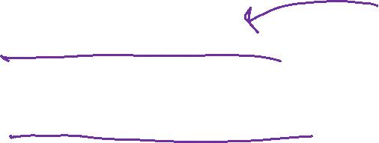
Implementing Symbolic Representations
Literals: Each thing/object in our model
i = Instance(“name”,TYPE)
Variables: Can take on any TYPE thing
v = Variable(“v_name”,TYPE)
Block World Example:
Pickup_from_Table(b):
Pre: HandEmpty(), Clear(b), On-Table(b)
Add: In-Hand(b)
Delete: HandEmpty(), On-Table(b)
Instances: “A”, “B”, “C” of type BLOCK
Variable: “b” of type BLOCK
In this operator, b can take on the value of any block instance

Slide 49
Implementing Symbolic Representations
Literals: Each thing/object in our model
i_a = Instance(“A”,BLOCK), i_b = Instance(“B”,BLOCK)
Variables: Can take on any TYPE thing
v_block = Variable(“b”,BLOCK)
Block World Example:
Pickup_from_Table(b):
Pre: HandEmpty(), Clear(b), On-Table(b)
Add: In-Hand(b)
Delete: HandEmpty(), On-Table(b)
ALERT: no two literals nor variables can have the same string name!!

Slide 50
Implementing Symbolic Representations
Literals: Each thing/object in our model
i_a = Instance(“A”,BLOCK), i_b = Instance(“B”,BLOCK)
Variables: Can take on any TYPE thing
v_block = Variable(“b”,BLOCK)
Propositions: Predicate Relationships
p1 = proposition(“relation”, v_a, i, …)
Block World Example:
HandEmpty(), Clear(b), On-Table(b), On-Block(b1,b2)
Proposition(“handempty”), Proposition(“clear”,v_block), Proposition(“on-table”,v_block), Proposition(“on-block”,v_block, i_a)
NOTE: variables and instances do not have to start with i_ and v_

Slide 51
Initial State and Goal State
Create lists of Propositions as the initial state and goal state
initial = [ Proposition(“handempty”), Proposition(“on-table”, i_c), Proposition(“on-table”, i_b), Proposition(“on-block”, i_a, i_b), Proposition(“clear”, i_a), Proposition(“clear”, i_c)]
Goal = [Proposition(“on-table”,i_b), Proposition(“on-table”,i_c), Proposition(“on-block”,i_a, i_c), Proposition(“clear”,i_a), Proposition(“clear”,”c”)]

Slide 52
Implementing Symbolic Representations
Operators: the actions we take change state
pickup_table = Operator(“pick_table”, #name
[ Proposition(“handempty”,), #preconditions
Proposition(“clear”, v_block),
Proposition(“on-table”, v_block) ],
[ Proposition(“in-hand”, v_block) ], #add effects
[ Proposition(“handempty”), #delete effects
Proposition(“on-table”, v_block ]
)
Lists are conjunctions!
All propositions with a variable must take on the same instance!
Variables that don’t match name don’t have to be the same but can be unless otherwise specified!

Slide 53
We provide the GraphPlan implementation
You will create the representation, which will be passed into our GraphPlan implementation

Slide 54
Another Example - Rocket Ship
Suppose we have a rocket ship that can only be used once.
It has to carry two payloads.

Slide 55
Another Example - Rocket Ship
Suppose we have a rocket ship that can only be used once.
It has to carry two payloads.
Literals?

Slide 56
Another Example - Rocket Ship
Suppose we have a rocket ship that can only be used once.
It has to carry two payloads.
Literals: Rocket, G, O, LocA, LocB

Slide 57
Another Example - Rocket Ship
Suppose we have a rocket ship that can only be used once. It has to carry two payloads.
Literals: Rocket, G, O, LocA, LocB
Start state:
At(Rocket, LocA), Has-Fuel(),
Unloaded(G,LocA), Unloaded(O,LocA)
Goal state:
At(Rocket, LocB), Unloaded(G,LocB), Unloaded(O,LocB)
I create literals and variables as I go through the problem. In order to create the start state and the goal state, I need the literals defined.

Slide 58
Another Example - Rocket Ship
Literals: Rocket, G, O, LocA, LocB
Start state:
At(Rocket, LocA), Has-Fuel(),
Unloaded(G,LocA), Unloaded(O,LocA)
Goal state:
At(Rocket, LocB), Unloaded(G,LocB), Unloaded(O,LocB)
Move: Load: Unload:
As I create my operators, I will add variables.

Slide 59
Another Example - Rocket Ship
Literals: Rocket, G, O, LocA, LocB
Start state:
At(Rocket, LocA), Has-Fuel(),
Unloaded(G,LocA), Unloaded(O,LocA)
Goal state:
At(Rocket, LocB), Unloaded(G,LocB), Unloaded(O,LocB)
Move:
P:
A:
D:

Slide 60
Another Example - Rocket Ship
Literals: Rocket, G, O, LocA, LocB
Start state:
At(Rocket, LocA), Has-Fuel(),
Unloaded(G,LocA), Unloaded(O,LocA)
Goal state:
At(Rocket, LocB), Unloaded(G,LocB), Unloaded(O,LocB)
Variables: L
Move:
P: At(Rocket,L)
A:
D:
The rocket starts at a location, and it could be either location. I need to add a location variable

Slide 61
Another Example - Rocket Ship
Literals: Rocket, G, O, LocA, LocB
Start state:
At(Rocket, LocA), Has-Fuel(),
Unloaded(G,LocA), Unloaded(O,LocA)
Goal state:
At(Rocket, LocB), Unloaded(G,LocB), Unloaded(O,LocB)
Variables: L
Move:
P: At(Rocket,L), Has-Fuel()
A:
D:

Slide 62
Another Example - Rocket Ship
Literals: Rocket, G, O, LocA, LocB
Start state:
At(Rocket, LocA), Has-Fuel(),
Unloaded(G,LocA), Unloaded(O,LocA)
Goal state:
At(Rocket, LocB), Unloaded(G,LocB), Unloaded(O,LocB)
Variables: L, Dest
Move:
P: At(Rocket,L), Has-Fuel(), L!=Dest
A: At(Rocket,Dest)
D:
The rocket needs to go to a destination, which needs to be different from the start location. We need to define a dest variable.

Slide 63
Another Example - Rocket Ship
Literals: Rocket, G, O, LocA, LocB
Start state:
At(Rocket, LocA), Has-Fuel(),
Unloaded(G,LocA), Unloaded(O,LocA)
Goal state:
At(Rocket, LocB), Unloaded(G,LocB), Unloaded(O,LocB)
Variables: L, Dest
Move:
P: At(Rocket,L), Has-Fuel(), L!=Dest
A: At(Rocket,Dest)
D: Has-Fuel(),At(Rocket,L)

Slide 64
Another Example - Rocket Ship
Literals: Rocket, G, O, LocA, LocB
Start state:
At(Rocket, LocA), Has-Fuel(),
Unloaded(G,LocA), Unloaded(O,LocA)
Goal state:
At(Rocket, LocB), Unloaded(G,LocB), Unloaded(O,LocB)
Variables: L, Dest
Load:
P:
A:
D:

Slide 65
Another Example - Rocket Ship
Literals: Rocket, G, O, LocA, LocB
Start state:
At(Rocket, LocA), Has-Fuel(),
Unloaded(G,LocA), Unloaded(O,LocA)
Goal state:
At(Rocket, LocB), Unloaded(G,LocB), Unloaded(O,LocB)
Variables: L, Dest, Pkg
Load:
P: At(Rocket,L), Unloaded(Pkg,L)
A:
D:
The rocket needs to load a specific package G or O. The load action doesn’t care which package it is. We need a variable pkg to use.

Slide 66
Another Example - Rocket Ship
Literals: Rocket, G, O, LocA, LocB
Start state:
At(Rocket, LocA), Has-Fuel(),
Unloaded(G,LocA), Unloaded(O,LocA)
Goal state:
At(Rocket, LocB), Unloaded(G,LocB), Unloaded(O,LocB)
Variables: L, Dest, Pkg
Load:
P: At(Rocket,L), Unloaded(Pkg,L)
A: Loaded(Pkg,Rocket)
D: Unloaded(Pkg,L)

Slide 67
Another Example - Rocket Ship
Literals: Rocket, G, O, LocA, LocB
Start state:
At(Rocket, LocA), Has-Fuel(),
Unloaded(G,LocA), Unloaded(O,LocA)
Goal state:
At(Rocket, LocB), Unloaded(G,LocB), Unloaded(O,LocB)
Variables: L, Dest, Pkg
Unload:
P: At(Rocket,Dest), Loaded(Pkg,Rocket)
A: Unloaded(Pkg,Dest)
D: Loaded(Pkg,Rocket)
No new variables needed for unload.

Slide 68
Rocket Ship GraphPlan Graph
Start state
Action Layer 1
Predicate Layer 1
At(Rocket,LocA)
Has-Fuel()
Unloaded(G,LocA)
Unloaded(O,LocA)
At(Rocket,LocB)
At(Rocket,LocA)
Has-Fuel()
Unloaded(G,LocA)
Unloaded(O,LocA)
Loaded(G,Rocket)
Loaded(O,Rocket)
Move
Load(G)
Load(O)

Slide 69
Rocket Ship GraphPlan Graph
At(Rocket,LocA)
Has-Fuel()
Unloaded(G,LocA)
Unloaded(O,LocA)
At(Rocket,LocB)
At(Rocket,LocA)
Has-Fuel()
Unloaded(G,LocA)
Unloaded(O,LocA)
Loaded(G,Rocket)
Loaded(O,Rocket)
Move
Load(G)
Load(O)
Mutex Actions
Interference:
Move deletes At which is a precondition of Load
Inconsistent:
Move deletes At but noop adds it
Move deletes Has-Fuel but noop adds it
Mutex Propositions:
- At(Rocket,LocB) and
At(Rocket,LocA) because
Move and noop are mutex actions
- What else?
Notes:
Both Loaded conflict with At(B)
Both Loaded conflict with Unloaded

Slide 70
Rocket Ship GraphPlan Graph
Start state
Action Layer 1
Predicate Layer 1
Action Layer 2
Predicate Layer 2
At(Rocket,LocA)
Has-Fuel()
Unloaded(G,LocA)
Unloaded(O,LocA)
At(Rocket,LocB)
At(Rocket,LocA)
Has-Fuel()
Unloaded(G,LocA)
Unloaded(O,LocA)
Loaded(G,Rocket)
Loaded(O,Rocket)
At(Rocket,LocB)
At(Rocket,LocA)
Has-Fuel()
Unloaded(G,LocA)
Unloaded(O,LocA)
Loaded(G,Rocket)
Loaded(O,Rocket)
Move
Move
Load(G)
Load(G)
Load(O)
Load(O)

Slide 71
Rocket Ship GraphPlan Graph
At(Rocket,LocA)
Has-Fuel()
Unloaded(G,LocA)
Unloaded(O,LocA)
At(Rocket,LocB)
At(Rocket,LocA)
Has-Fuel()
Unloaded(G,LocA)
Unloaded(O,LocA)
Loaded(G,Rocket)
Loaded(O,Rocket)
At(Rocket,LocB)
At(Rocket,LocA)
Has-Fuel()
Unloaded(G,LocA)
Unloaded(O,LocA)
Loaded(G,Rocket)
Loaded(O,Rocket)
Move
Move
Load(G)
Load(G)
Load(O)
Load(O)
At time 1: Move can be performed OR both Load actions
At time 2: Possible plans include:
Load(G), Load(O), Move(LocB) ← reachable goal in two steps but feasible in three
Load(G), Move(LocB)
Load(O), Move(LocB)

