Slide 1
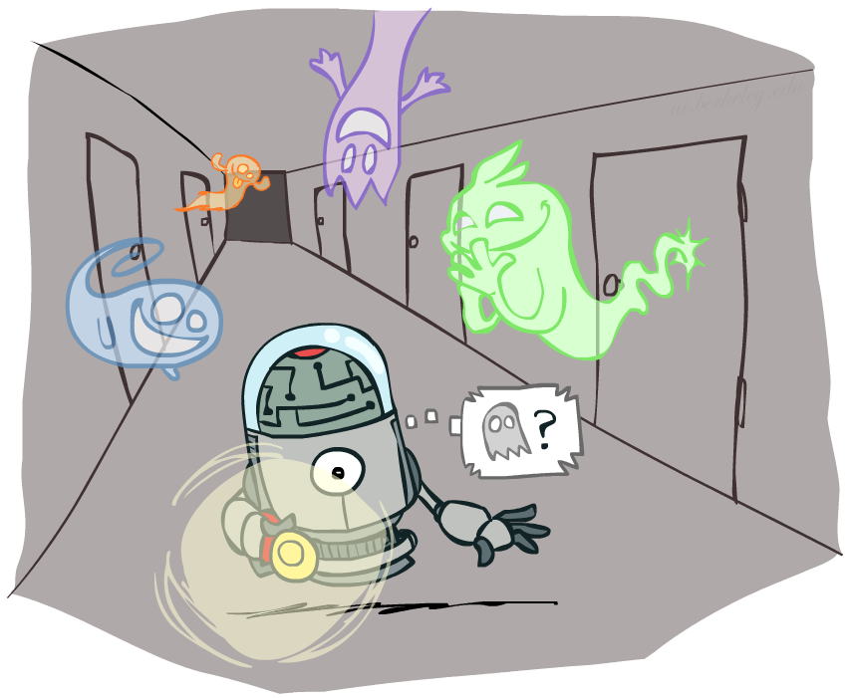
AI: Representation and Problem Solving
Hidden Markov Models
Instructors: Pat Virtue
Slide credits: CMU AI and http://ai.berkeley.edu

Slide 2
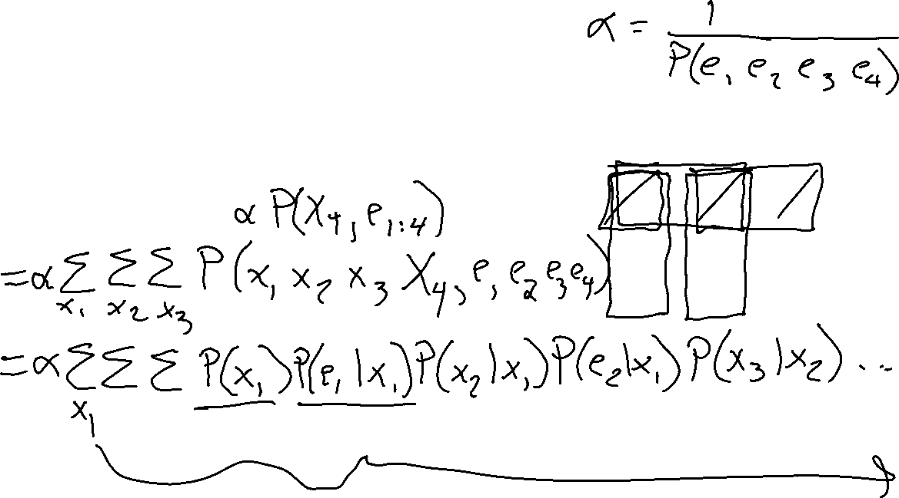
Warm-up
For the following Bayes net, write the query P(X₄ | e_{1:4}) in terms of the conditional probability tables associated with the Bayes net.
P(X₄ | e₁, e₂, e₃, e₄) =
X₁
X₂
X₃
X₄
e₁
e₂
e₃
e₄

Slide 3
Reasoning over Time or Space
Often, we want to reason about a sequence of observations
  Speech recognition
  Robot localization
  User attention
  Medical monitoring
Need to introduce time (or space) into our models

Slide 4

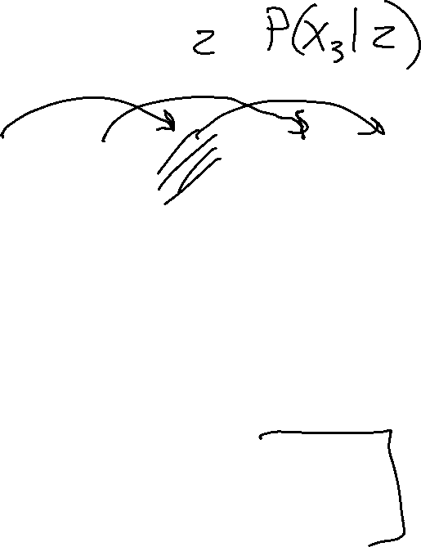
Conditional Independence
Basic conditional independence:
  Past and future independent given the present
  Each time step only depends on the previous
  This is called the (first order) Markov property
Note that the chain is just a (growable) BN
  We can always use generic BN reasoning on it if we truncate the chain at a fixed length

Slide 5



Markov Chain Models
  Value of X at a given time is called the state
  Parameters: called transition probabilities or dynamics, specify how the state evolves over time (also, initial state probabilities)
  Stationarity assumption: transition probabilities the same at all times
  Same as MDP transition model, but no choice of action
X₁
X₂
X₃
X₄
$$P\left(X_{1}\right)$$
$$P\left(X_{t}∣X_{t−1}\right)$$

Slide 6
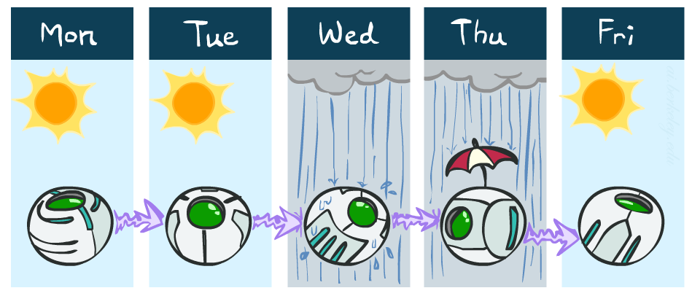
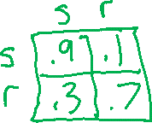
Example: Markov Chain Weather
States: X = {rain, sun}
Initial distribution: 1.0 sun
CPT P(X_{t} | X_{t-1}):
Two new ways of representing the same CPT
X_{t-1} | X_{t} | P(X_{t}|X_{t-1})
sun | sun | 0.9
sun | rain | 0.1
rain | sun | 0.3
rain | rain | 0.7
0.9
0.3
0.9
rain
sun
sun
sun
0.1
0.3
rain
rain
0.7
0.7
0.1

Slide 7
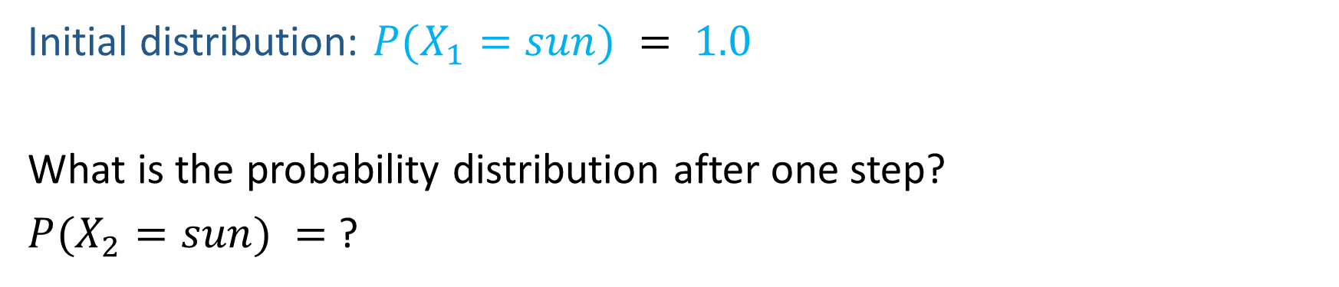

Example: Markov Chain Weather
0.9
0.3
rain
sun
Initial distribution: $P(X_{1}=sun) = 1.0$
What is the probability distribution after one step?
$P(X_{2}=sun) =$ ?
0.7
0.1

Slide 8
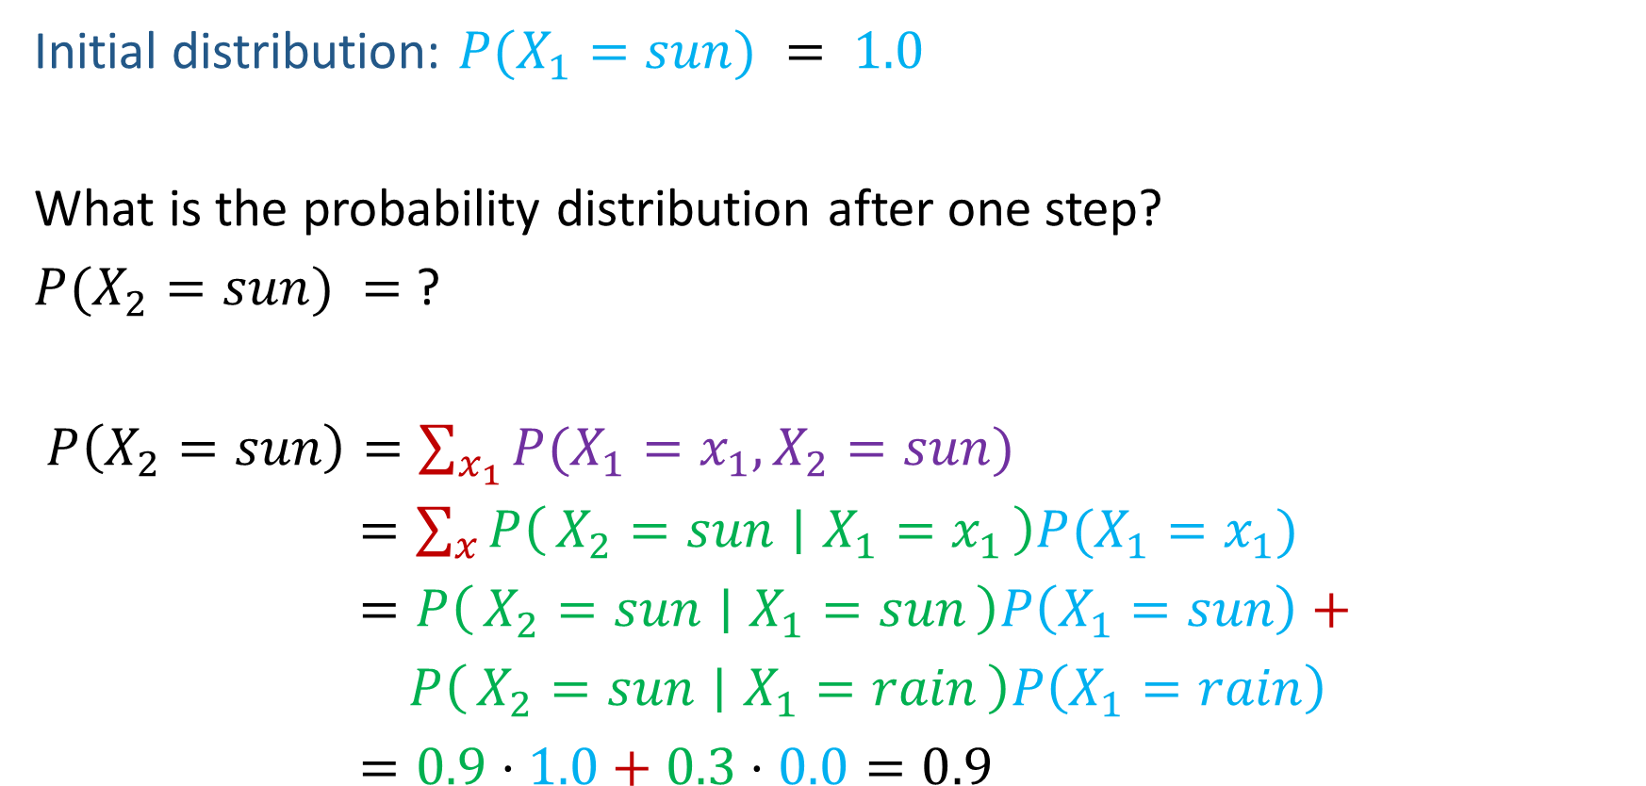

Example: Markov Chain Weather
0.9
0.3
rain
sun
Initial distribution: $P(X_{1}=sun) = 1.0$
What is the probability distribution after one step?
$P(X_{2}=sun) =$ ?
$P\left(X_{2}=sun\right)=\sum_{x_{1}}{P(X_{1}=x_{1}, X_{2}=sun})$
$=\sum_{x}{P\left(X_{2}=sun ∣ X_{1}=x_{1}\right)P(X_{1}=x_{1}})$
$=P\left(X_{2}=sun ∣ X_{1}=sun\right)P\left(X_{1}=sun\right)+$
$P\left(X_{2}=sun ∣ X_{1}=rain\right)P\left(X_{1}=rain\right)$
$=0.9⋅1.0+0.3⋅0.0=0.9$
0.7
0.1

Slide 9
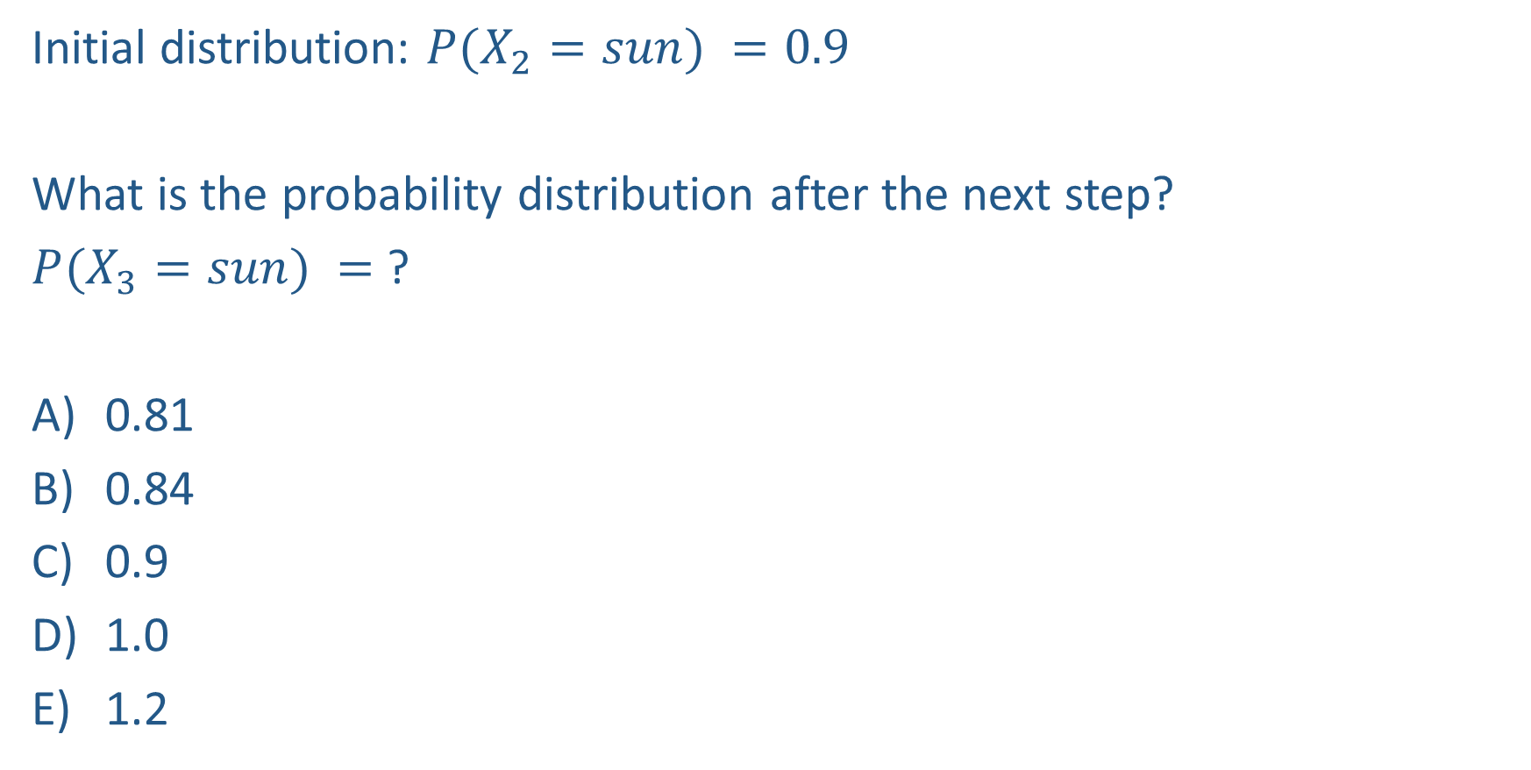
Poll 1
0.9
0.3
rain
sun
Initial distribution: $P(X_{2}=sun) =0.9$
What is the probability distribution after the next step?
$P(X_{3}=sun) =$ ?
0.81
0.84
0.9
1.0
1.2
0.7
0.1

Slide 10
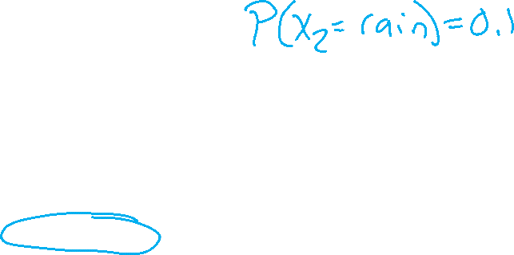
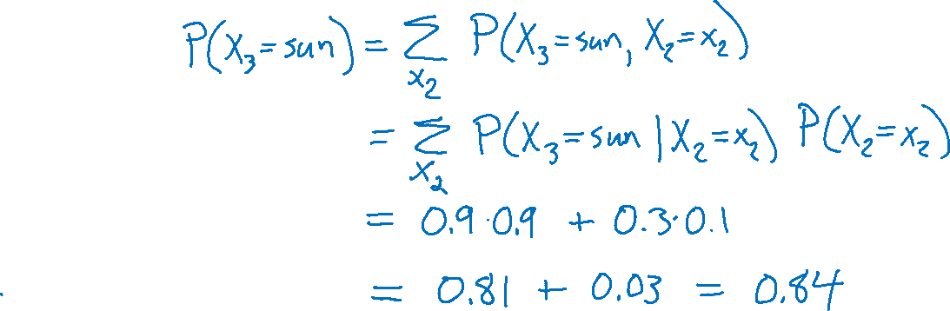
Poll 1
0.9
0.3
rain
sun
Initial distribution: $P(X_{2}=sun) =0.9$
What is the probability distribution after the next step?
$P(X_{3}=sun) =$ ?
0.81
0.84
0.9
1.0
1.2
0.7
0.1

Slide 11

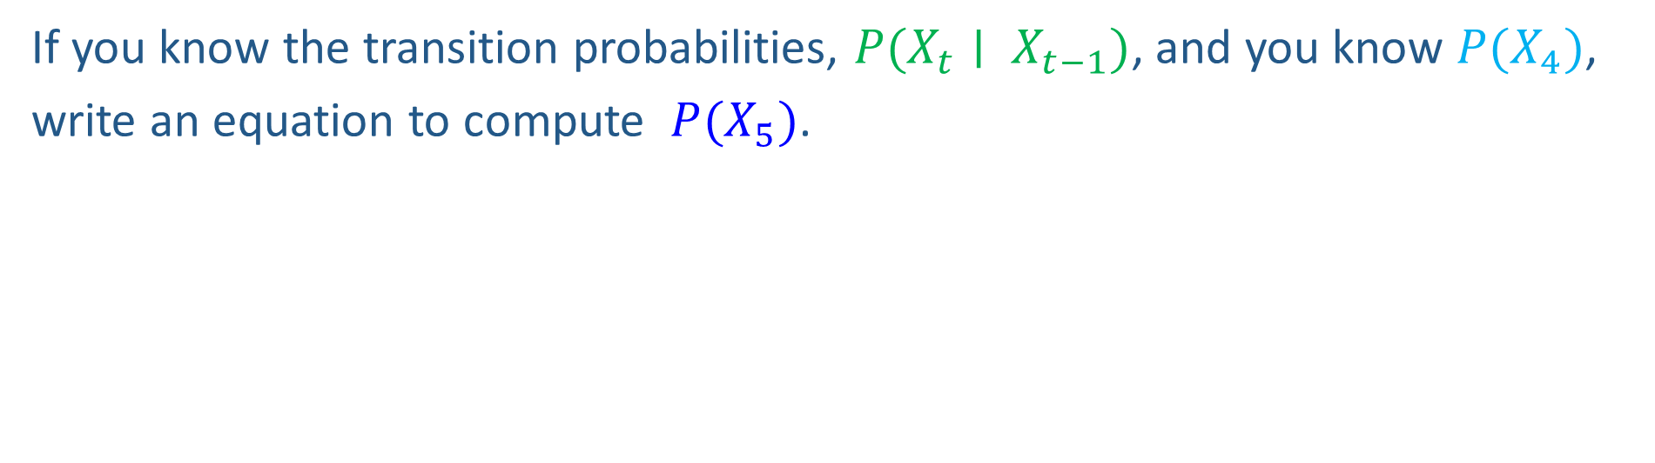

Markov Chain Inference
X₁
X₂
X₃
X₄
If you know the transition probabilities, $P(X_{t}∣ X_{t−1})$, and you know $P(X_{4})$,
write an equation to compute $P(X_{5})$.

Slide 12
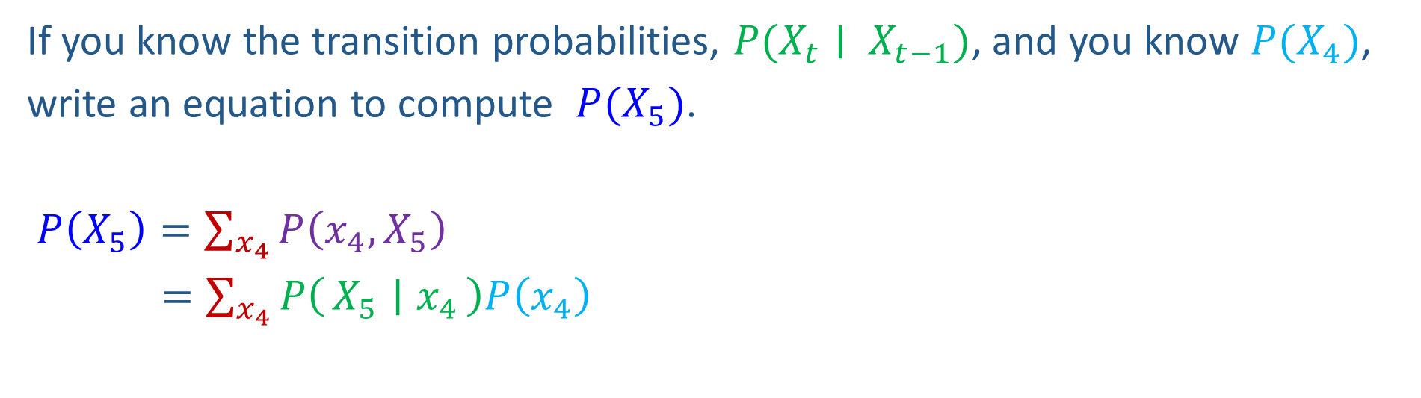
Markov Chain Inference
X₁
X₂
X₃
X₄
If you know the transition probabilities, $P(X_{t}∣ X_{t−1})$, and you know $P(X_{4})$,
write an equation to compute $P(X_{5})$.
$P\left(X_{5}\right)=\sum_{x_{4}}{P\left(x_{4},X_{5}\right)}$
$=\sum_{x_{4}}{P\left(X_{5} ∣ x_{4}\right)P\left(x_{4}\right)}$

Slide 13
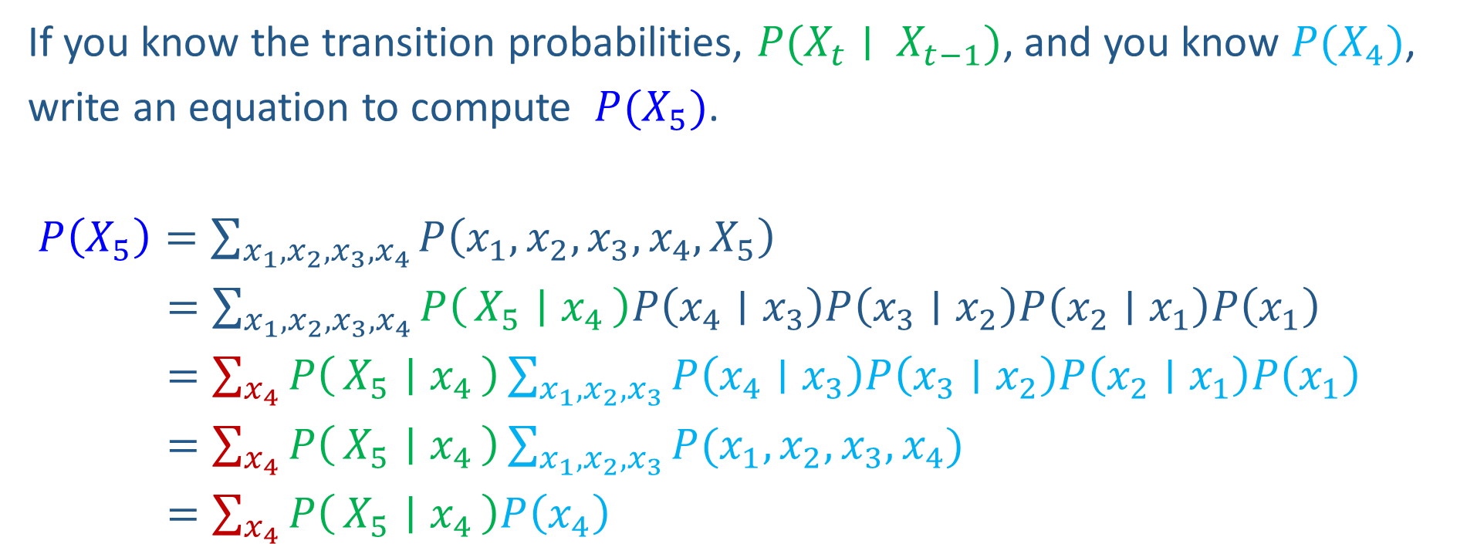
Markov Chain Inference
X₁
X₂
X₃
X₄
If you know the transition probabilities, $P(X_{t}∣ X_{t−1})$, and you know $P(X_{4})$,
write an equation to compute $P(X_{5})$.
$P\left(X_{5}\right)=\sum_{{x_{1},x_{2}, x_{3},x}_{4}}{P\left({x_{1},x_{2},x_{3},x}_{4},X_{5}\right)}$
$=\sum_{{x_{1},x_{2}, x_{3},x}_{4}}{P\left(X_{5} ∣ x_{4}\right)P\left(x_{4}∣x_{3}\right)P\left(x_{3}∣x_{2}\right)P\left(x_{2}∣x_{1}\right)P\left(x_{1}\right)}$
$=\sum_{x_{4}}{P\left(X_{5} ∣ x_{4}\right)}\sum_{x_{1},x_{2}, x_{3}}{P\left(x_{4}∣x_{3}\right)P\left(x_{3}∣x_{2}\right)P\left(x_{2}∣x_{1}\right)P\left(x_{1}\right)}$
$=\sum_{x_{4}}{P\left(X_{5} ∣ x_{4}\right)}\sum_{x_{1},x_{2}, x_{3}}{P(x_{1},x_{2},x_{3},x_{4})}$
$=\sum_{x_{4}}{P\left(X_{5} ∣ x_{4}\right)P\left(x_{4}\right)}$

Slide 14
Weather prediction
States {rain, sun}
Initial distribution P(X₀)
  Transition model P(X_{t} | X_{t-1})
P(X₀)
sun | rain
0.5 | 0.5
Two new ways of representing the same CPT
0.9
0.3
0.9
X_{t-1} | P(X_{t}|X_{t-1})
 | sun | rain
sun | 0.9 | 0.1
rain | 0.3 | 0.7
rain
sun
sun
sun
0.1
0.3
rain
rain
0.7
0.7
0.1

Slide 15
Weather prediction
X_{t-1} | P(X_{t}|X_{t-1})
 | sun | rain
sun | 0.9 | 0.1
rain | 0.3 | 0.7
Time 0: P(X₀) =<0.5,0.5>
What is the weather like at time 1?
  P(X₁) =
∑_{x0} P(X₀=x_{0,} X₁)
  = ∑_{x0} P(X₁| X₀=x₀) P(X₀=x₀)
  = 0.5<0.9,0.1> + 0.5<0.3,0.7>
  = <0.6,0.4>
X₀
X₁

Slide 16
Weather prediction, contd.
X_{t-1} | P(X_{t}|X_{t-1})
 | sun | rain
sun | 0.9 | 0.1
rain | 0.3 | 0.7
Time 1: P(X₁) =<0.6,0.4>
What is the weather like at time 2?
  P(X₂) =
∑_{x1} P(X₁=x₁, X₂)
  = ∑_{x1} P(X₂| X₁=x₁) P(X₁=x₁)
  = 0.6<0.9,0.1> + 0.4<0.3,0.7>
  = <0.66,0.34>
X₀
X₁
X₂

Slide 17
Weather prediction, contd.
X_{t-1} | P(X_{t}|X_{t-1})
 | sun | rain
sun | 0.9 | 0.1
rain | 0.3 | 0.7
Time 2: P(X₂) =<0.66,0.34>
What is the weather like at time 3?
  P(X₃) =
∑_{x2} P(X₂=x₂, X₃)
  = ∑_{x2} P(X₃| X₂=x₂) P(X₂=x₂)
  = 0.66<0.9,0.1> + 0.34<0.3,0.7>
  = <0.696,0.304>
X₁
X₂
X₃

Slide 18
Forward algorithm (simple form)
Probability from previous iteration
What is the state at time t?
  P(X_{t}) = ∑_{xt-1} P(X_{t-1}=x_{t-1}, X_{t})
  = ∑_{xt-1} P(X_{t}| X_{t-1}=x_{t-1}) P(X_{t-1}=x_{t-1})
Iterate this update starting at t=0
Transition model

Slide 19

Hidden Markov Models

Slide 20
Hidden Markov Models
Usually the true state is not observed directly
Hidden Markov models (HMMs)
  Underlying Markov chain over states X
  You observe evidence E at each time step
  X_{t} is a single discrete variable; E_{t} may be continuous and may consist of several variables
X₀
X₁
X₂
X₃
X₅
E₁
E₂
E₃
E₅

Slide 21
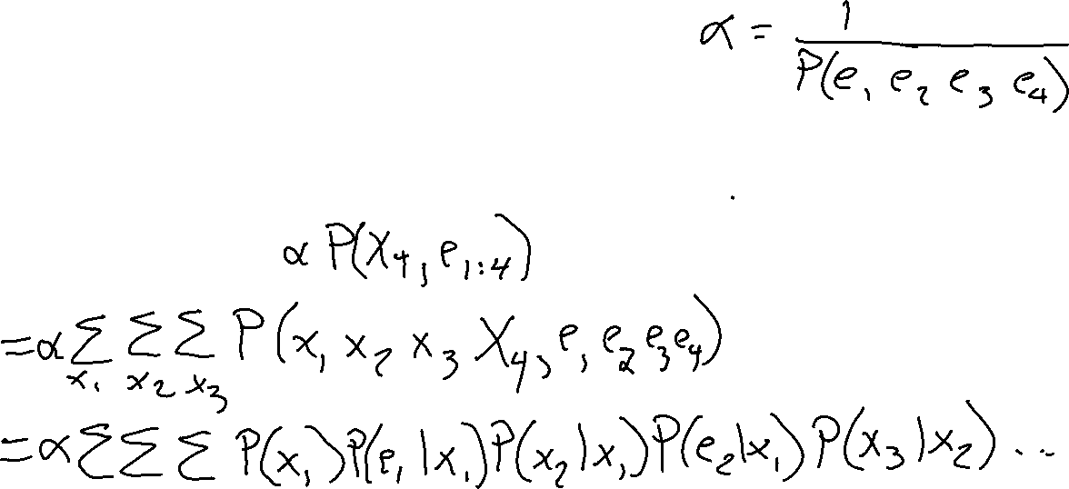
HMM as a Bayes Net Warm-up
For the following Bayes net, write the query P(X₄ | e_{1:4}) in terms of the conditional probability tables associated with the Bayes net.
P(X₄ | e₁, e₂, e₃, e₄) =
X₁
X₂
X₃
X₄
e₁
e₂
e₃
e₄
Useful notation: X_{a:b} = X_{a} , X_{a+1}, …, X_{b}
For example: P(X_{1:2} | e_{1:3}) = P(X₁, X₂, | e₁ , e₂, e₃)

Slide 22


Example: Weather HMM
An HMM is defined by:
  Initial distribution: P(X₀)
  Transition model: P(X_{t} | X_{t-1})
  Sensor model: P(E_{t} | X_{t})
W_{t-1} | P(W_{t}|W_{t-1})
 | sun | rain
sun | 0.9 | 0.1
rain | 0.3 | 0.7
Weather _{t-1}
Weather _{t}
Weather _{t+1}
W_{t} | P(U_{t}|W_{t})
 | true | false
sun | 0.2 | 0.8
rain | 0.9 | 0.1
Umbrella _{t-1}
Umbrella _{t}
Umbrella _{t+1}
Notes:
demo

Slide 23



Example: Ghostbusters HMM
  State: location of moving ghost
  Observations: Color recorded by ghost sensor at clicked squares
  P(X₀) = uniform
  P(X_{t} | X_{t-1}) = usually move clockwise, but sometimes move randomly or stay in place
P(C_{tij} | X_{t}) = same sensor model as before:
red means close, green means far away.
1/6
1/6
1/2
0
1/6
0
0
0
0
1/9
1/9
1/9
1/9
1/9
1/9
P( X₂ | X₁=(2,3) )
1/9
1/9
1/9
P(X₀)
X₀
X₁
X₂
X₃
X₅
C_{1ij}
C_{2ij}
C_{3ij}
[Demo: Ghostbusters – Circular Dynamics – HMM (L14D2)]
Notes:
Dan has some demo for this.

Slide 24
Filtering Algorithm
Query: What is the current state, given all of the current and past evidence?
Marching forward through the HMM network
X₁
X₂
e₁
e₂

Slide 25
Filtering Algorithm
Query: What is the current state, given all of the current and past evidence?
Marching forward through the HMM network
X₁
X₂
X₃
e₁
e₂
e₃

Slide 26
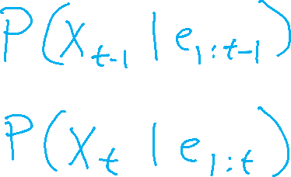
Filtering Algorithm
Query: What is the current state, given all of the current and past evidence?
Marching forward through the HMM network
X₁
X₂
X₃
X₄
e₁
e₂
e₃
e₄

Slide 27

Filtering Algorithm
Query: What is the current state, given all of the current and past evidence?
Marching forward through the HMM network
X₁
X₂
X₃
X₄
e₁
e₂
e₃
e₄

Slide 28
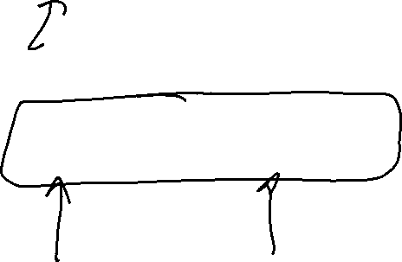

Filtering Algorithm
P(X_{t+1}|e_{1:t+1}) = α P(e_{t+1}|X_{t+1}) ∑_{xt} P(X_{t+1}| x_{t}) P(x_{t} | e_{1:t})
f_{1:t+1} = Forward(f_{1:t} , e_{t+1})
Normalize
Update
Predict

Slide 29
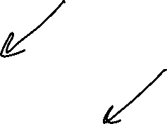
HMM as Probability Model
  Joint distribution for Markov model:
  P(X₀,…, X_{T}) = P(X₀) ∏_{t=1:T} P(X_{t} | X_{t-1})
  Joint distribution for hidden Markov model:
  P(X₀, X₁,E₁, …, X_{T},E_{T}) = P(X₀) ∏_{t=1:T} P(X_{t} | X_{t-1}) P(E_{t} | X_{t})
  Future states are independent of the past given the present
  Current evidence is independent of everything else given the current state
  Are evidence variables independent of each other?
X₀
X₁
X₂
X₃
X₅
Useful notation: X_{a:b} = X_{a} , X_{a+1}, …, X_{b}
For example: P(X_{1:2} | e_{1:3}) = P(X₁, X₂, | e₁ , e₂, e₃)
E₁
E₂
E₃
E₅
Notes:
Add conditional independence consequences here

Slide 30
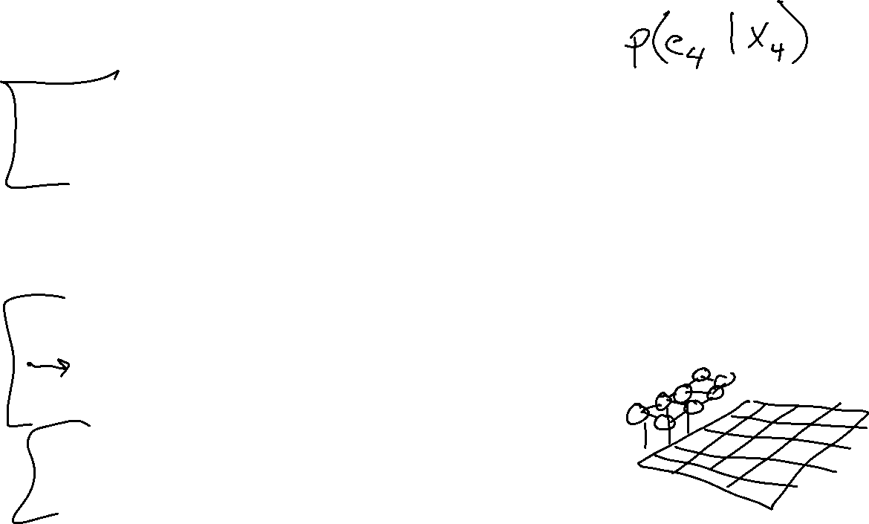
Real HMM Examples
Speech recognition HMMs:
  Observations are acoustic signals (continuous valued)
  States are specific positions in specific words (so, tens of thousands)
Machine translation HMMs:
  Observations are words (tens of thousands)
  States are translation options
Robot tracking:
  Observations are range readings (continuous)
      Or even images
  States are positions on a map (continuous)
Molecular biology:
  Observations are nucleotides ACGT
  States are coding/non-coding/start/stop/splice-site etc.
X₁
X₂
X₃
X₄
e₁
e₂
e₃
e₄

Slide 31
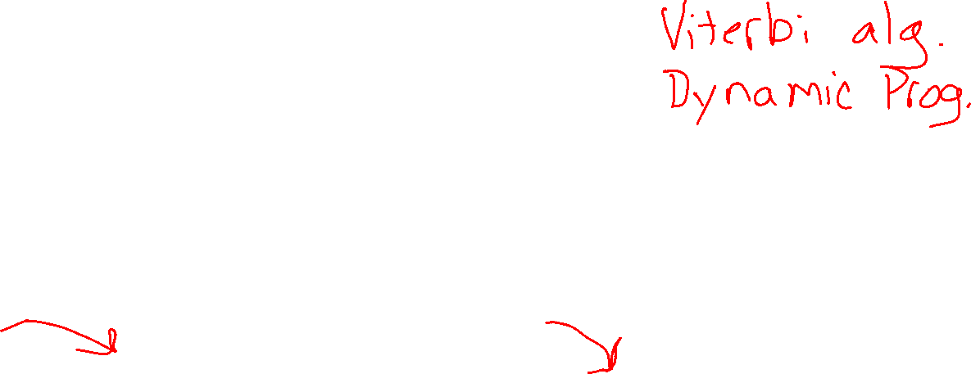
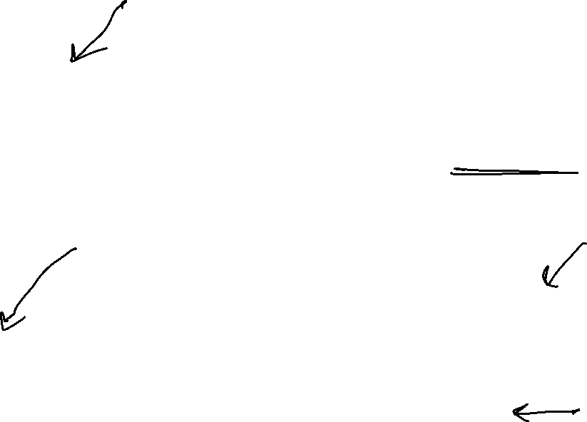
Other HMM Queries
Filtering: P(X_{t}|e_{1:t})
Prediction: P(X_{t+k}|e_{1:t})
X₁
X₂
X₃
X₄
X₁
X₂
X₃
X₄
X₅
e₁
e₂
e₃
e₄
e₁
e₂
e₃
Smoothing: P(X_{k}|e_{1:t}), k<t
Explanation: P(X_{1:t}|e_{1:t})
X₁
X₂
X₃
X₄
X₁
X₂
X₃
X₄
e₁
e₂
e₃
e₄
e₁
e₂
e₃
e₄

Slide 32
Inference Tasks
Filtering: P(X_{t}|e_{1:t})
  belief state—input to the decision process of a rational agent
Prediction: P(X_{t+k}|e_{1:t}) for k > 0
  evaluation of possible action sequences; like filtering without the evidence
Smoothing: P(X_{k}|e_{1:t}) for 0 ≤ k < t
  better estimate of past states, essential for learning
Most likely explanation: argmax_{x1:t} P(x_{1:t} | e_{1:t})
  speech recognition, decoding with a noisy channel

Slide 33

Dynamic Bayes Nets (DBNs)
We want to track multiple variables over time, using multiple sources of evidence
Idea: Repeat a fixed Bayes net structure at each time
Variables from time t can condition on those from t-1
t =1
t =2
t =3
G₁ª
G₂ª
G₃ª
G₁^{b}
G₂^{b}
G₃^{b}
E₁ª
E₁^{b}
E₂ª
E₂^{b}
E₃ª
E₃^{b}

Slide 34
Filtering Algorithm
P(X_{t+1}|e_{1:t+1}) = α P(e_{t+1}|X_{t+1}) ∑_{xt} P(X_{t+1}| x_{t}) P(x_{t} | e_{1:t})
f_{1:t+1} = Forward(f_{1:t} , e_{t+1})
Normalize
Update
Predict

Slide 35

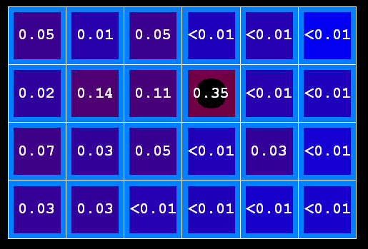
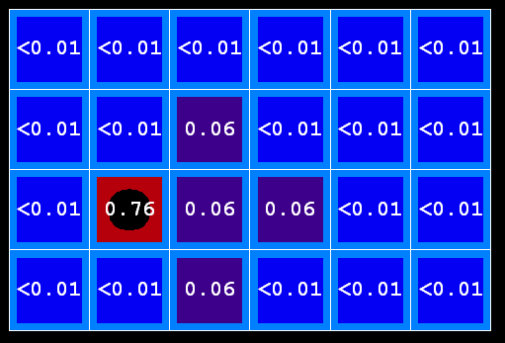

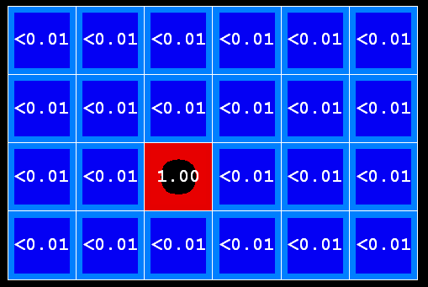
Example: Prediction step
As time passes, uncertainty “accumulates”
(Transition model: ghosts usually go clockwise)
T = 1
T = 2
T = 5

Slide 36


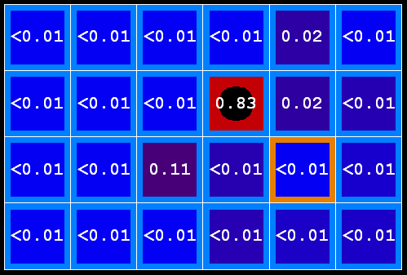
Example: Update step
As we get observations, beliefs get reweighted, uncertainty “decreases”
Before observation
After observation

Slide 37
Demo Ghostbusters – Circular Dynamics -- HMM

Slide 38
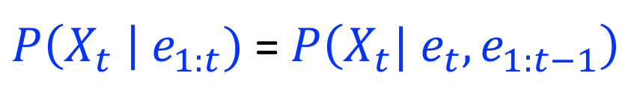
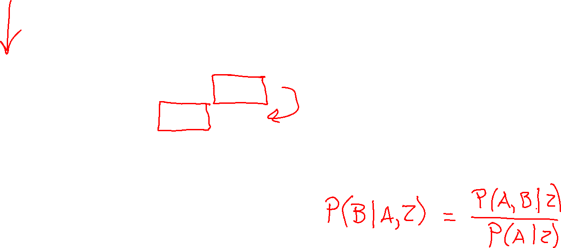


Filtering Algorithm
Query: What is the current state, given all of the current and past evidence?
Matching math with Bayes net
$P\left(X_{t} \right| e_{1:t})$ =$P\left(X_{t}{| e_{t}, e}_{1:t−1}\right)$
X₁
X₂
X₃
X₄
$$=α P\left(X_{t}, {e_{t}| e}_{1:t−1}\right)$$
e₁
e₂
e₃
e₄
Def. of cond. probability with $X_{t}$, $e_{t}$
Notes:
Explain propto

Slide 39
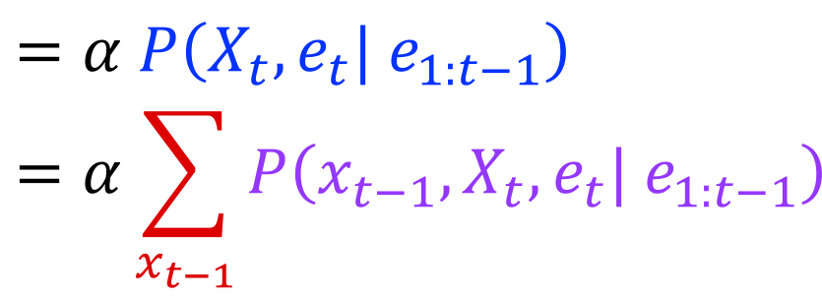

Filtering Algorithm
Query: What is the current state, given all of the current and past evidence?
Matching math with Bayes net
$P\left(X_{t} \right| e_{1:t})$ =$P\left(X_{t}{| e_{t}, e}_{1:t−1}\right)$
X₁
X₂
X₃
X₄
$$=α P\left(X_{t}, {e_{t}| e}_{1:t−1}\right)$$
$$=α\sum_{x_{t−1}}{P\left(x_{t−1},X_{t}, e_{t}| e_{1:t−1}\right)}$$
e₁
e₂
e₃
e₄
Summation over variable $X_{t−1}$

Slide 40
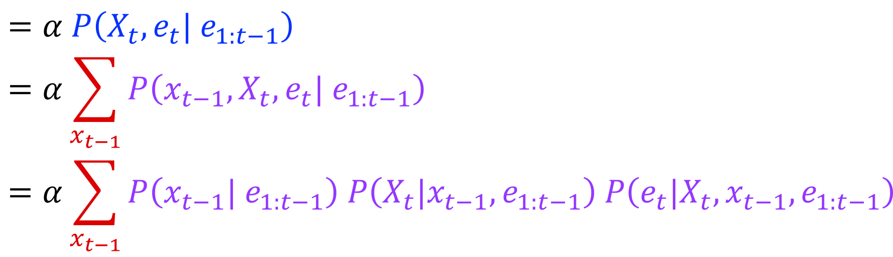

Filtering Algorithm
Query: What is the current state, given all of the current and past evidence?
Matching math with Bayes net
$P\left(X_{t} \right| e_{1:t})$ =$P\left(X_{t}{| e_{t}, e}_{1:t−1}\right)$
X₁
X₂
X₃
X₄
$$=α P\left(X_{t}, {e_{t}| e}_{1:t−1}\right)$$
$$=α\sum_{x_{t−1}}{P\left(x_{t−1},X_{t}, e_{t}| e_{1:t−1}\right)}$$
$$=α\sum_{x_{t−1}}{P\left(x_{t−1}| e_{1:t−1}\right) P\left(X_{t}|x_{t−1},e_{1:t−1}\right) P\left(e_{t}|X_{t},x_{t−1},e_{1:t−1}\right)}$$
e₁
e₂
e₃
e₄
Chain rule with $x_{t−1}$, $X_{t}$, and $e_{t}$

Slide 41
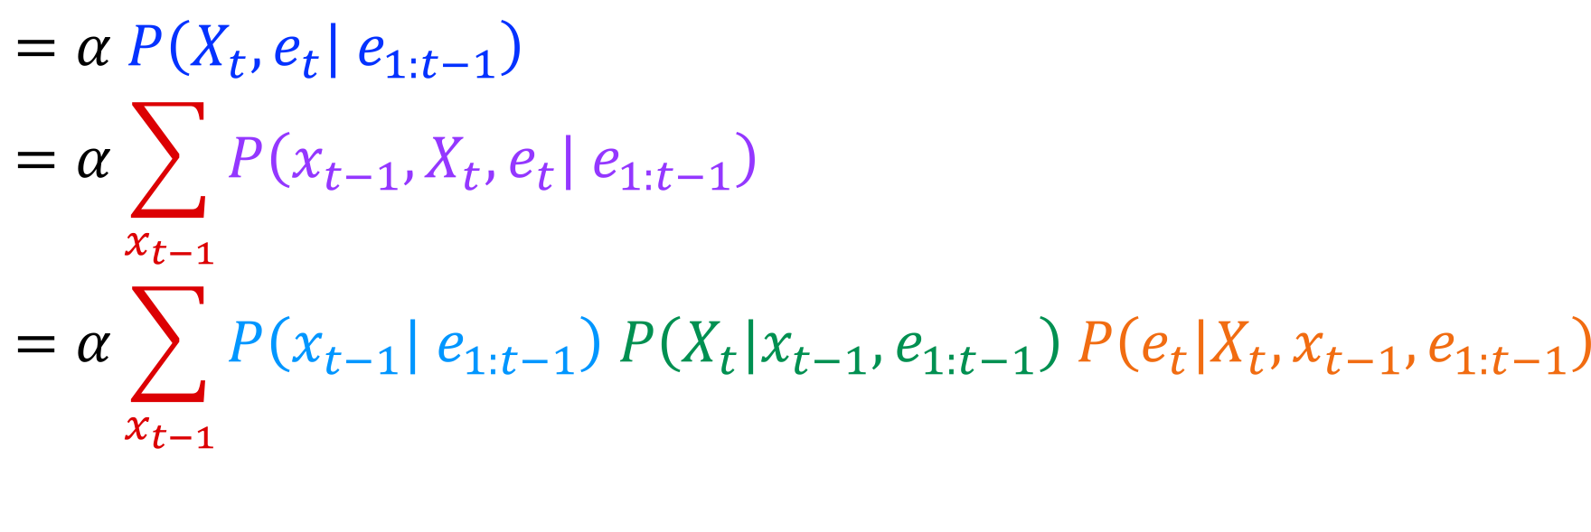
Filtering Algorithm
Query: What is the current state, given all of the current and past evidence?
Matching math with Bayes net
$P\left(X_{t} \right| e_{1:t})$ =$P\left(X_{t}{| e_{t}, e}_{1:t−1}\right)$
X₁
X₂
X₃
X₄
$$=α P\left(X_{t}, {e_{t}| e}_{1:t−1}\right)$$
$$=α\sum_{x_{t−1}}{P\left(x_{t−1},X_{t}, e_{t}| e_{1:t−1}\right)}$$
$$=α\sum_{x_{t−1}}{P\left(x_{t−1}| e_{1:t−1}\right) P\left(X_{t}|x_{t−1},e_{1:t−1}\right) P\left(e_{t}|X_{t},x_{t−1},e_{1:t−1}\right)}$$
e₁
e₂
e₃
e₄
Chain rule with $x_{t−1}$, $X_{t}$, and $e_{t}$

Slide 42
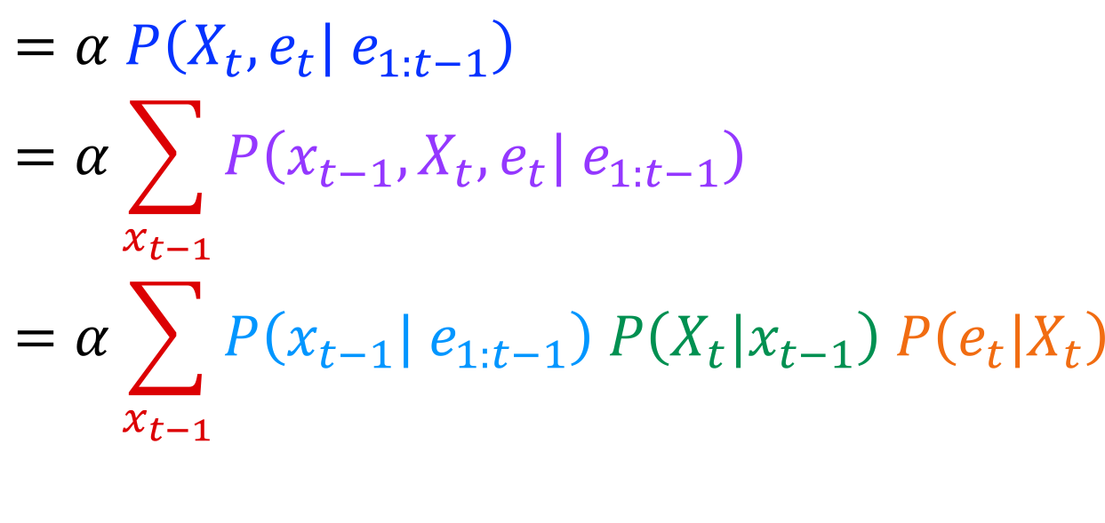
Filtering Algorithm
Query: What is the current state, given all of the current and past evidence?
Matching math with Bayes net
$P\left(X_{t} \right| e_{1:t})$ =$P\left(X_{t}{| e_{t}, e}_{1:t−1}\right)$
X₁
X₂
X₃
X₄
$$=α P\left(X_{t}, {e_{t}| e}_{1:t−1}\right)$$
$$=α\sum_{x_{t−1}}{P\left(x_{t−1},X_{t}, e_{t}| e_{1:t−1}\right)}$$
$$=α\sum_{x_{t−1}}{P\left(x_{t−1}| e_{1:t−1}\right) P\left(X_{t}|x_{t−1}\right) P\left(e_{t}|X_{t}\right)}$$
e₁
e₂
e₃
e₄
Bayes net conditional independence

Slide 43
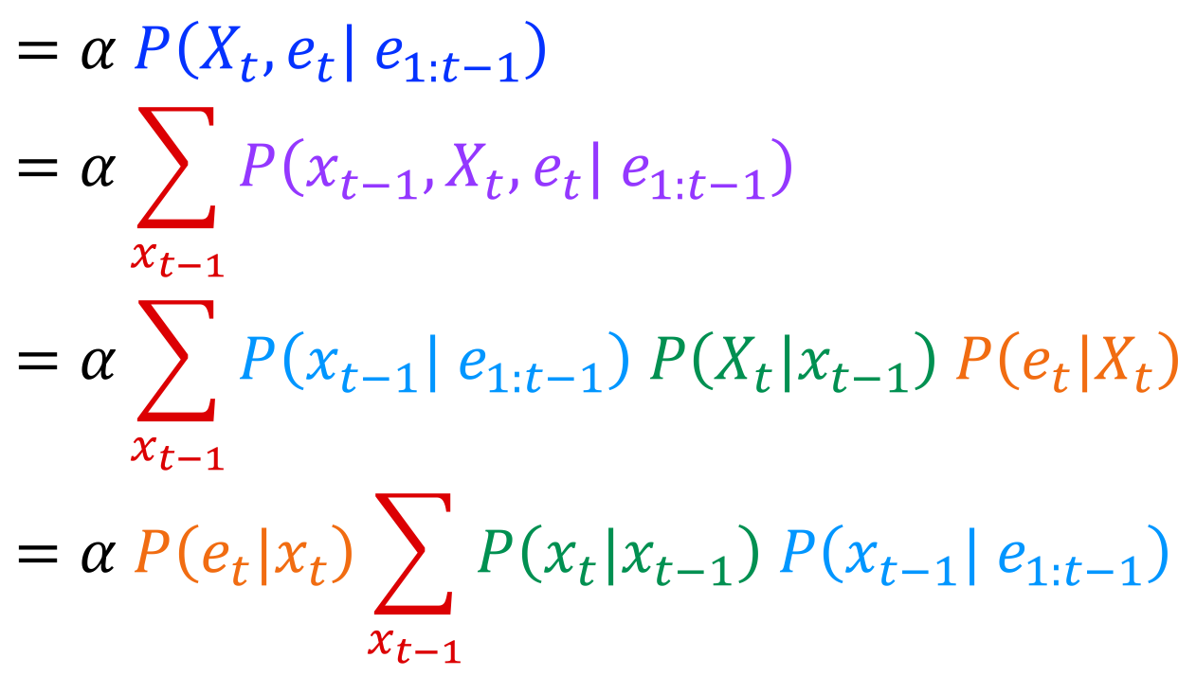

Filtering Algorithm
Query: What is the current state, given all of the current and past evidence?
Matching math with Bayes net
$P\left(X_{t} \right| e_{1:t})$ =$P\left(X_{t}{| e_{t}, e}_{1:t−1}\right)$
X₁
X₂
X₃
X₄
$$=α P\left(X_{t}, {e_{t}| e}_{1:t−1}\right)$$
$$=α\sum_{x_{t−1}}{P\left(x_{t−1},X_{t}, e_{t}| e_{1:t−1}\right)}$$
$$=α\sum_{x_{t−1}}{P\left(x_{t−1}| e_{1:t−1}\right) P\left(X_{t}|x_{t−1}\right) P\left(e_{t}|X_{t}\right)}$$
$$=α P\left(e_{t}|x_{t}\right)\sum_{x_{t−1}}{P\left(x_{t}|x_{t−1}\right) P\left(x_{t−1}| e_{1:t−1}\right) }$$
e₁
e₂
e₃
e₄
Pulling $P\left(e_{t}|X_{t}\right)$ out of the summation

Slide 44
Filtering Algorithm
Query: What is the current state, given all of the current and past evidence?
Matching math with Bayes net
$P\left(X_{t} \right| e_{1:t})$ =$P\left(X_{t}{| e_{t}, e}_{1:t−1}\right)$
X₁
X₂
X₃
X₄
$$=α P\left(X_{t}, {e_{t}| e}_{1:t−1}\right)$$
$$=α\sum_{x_{t−1}}{P\left(x_{t−1},X_{t}, e_{t}| e_{1:t−1}\right)}$$
$$=α\sum_{x_{t−1}}{P\left(x_{t−1}| e_{1:t−1}\right) P\left(X_{t}|x_{t−1}\right) P\left(e_{t}|X_{t}\right)}$$
$$=α P\left(e_{t}|x_{t}\right)\sum_{x_{t−1}}{P\left(x_{t}|x_{t−1}\right) P\left(x_{t−1}| e_{1:t−1}\right) }$$
e₁
e₂
e₃
e₄
Recursion!

Slide 45
Filtering Algorithm
Query: What is the current state, given all of the current and past evidence?
Matching math with Bayes net
$P\left(X_{t} \right| e_{1:t})$ =$P\left(X_{t}{| e_{t}, e}_{1:t−1}\right)$
X₁
X₂
X₃
X₄
$$=α P\left(X_{t}, {e_{t}| e}_{1:t−1}\right)$$
$$=α\sum_{x_{t−1}}{P\left(x_{t−1},X_{t}, e_{t}| e_{1:t−1}\right)}$$
$$=α\sum_{x_{t−1}}{P\left(x_{t−1}| e_{1:t−1}\right) P\left(X_{t}|x_{t−1}\right) P\left(e_{t}|X_{t}\right)}$$
$$=α P\left(e_{t}|x_{t}\right)\sum_{x_{t−1}}{P\left(x_{t}|x_{t−1}\right) P\left(x_{t−1}| e_{1:t−1}\right) }$$
e₁
e₂
e₃
e₄
Recursion!

Slide 46
Other HMM Queries
Filtering: P(X_{t}|e_{1:t})
Prediction: P(X_{t}|e_{1:t-1})
X₁
X₂
X₃
X₄
X₁
X₂
X₃
X₄
e₁
e₂
e₃
e₄
e₁
e₂
e₃
Smoothing: P(X_{t}|e_{1:N}), t<N
Explanation: P(X_{1:N}|e_{1:N})
X₁
X₂
X₃
X₄
X₁
X₂
X₃
X₄
e₁
e₂
e₃
e₄
e₁
e₂
e₃
e₄

Slide 47
Demo: Pacman Ghostbusters
[Demos: ghostbusters (L14D1,3)]

Slide 48
Filtering Algorithm
P(X_{t+1}|e_{1:t+1}) = α P(e_{t+1}|X_{t+1}) ∑_{xt} P(X_{t+1}| x_{t}) P(x_{t} | e_{1:t})
f_{1:t+1} = Forward(f_{1:t} , e_{t+1})
Cost per time step: O(|X|²) where |X| is the number of states
Time and space costs are constant, independent of t
O(|X|²) is infeasible for models with many state variables
We get to invent really cool approximate filtering algorithms
Normalize
Update
Predict

