Slide 1
Warm-up as You Log In
Given
Set actions (persistent/static)
Set states (persistent/static)
Function T(s,a,s_prime)
Write the pseudo code for:
function V(s) return value
that implements:

Slide 2
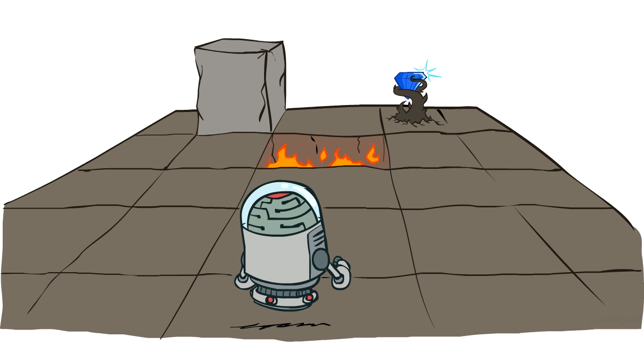
AI: Representation and Problem Solving
Markov Decision Processes (MDPs)
Instructors: Tuomas Sandholm and Vincent Conitzer
Slide credits: CMU AI and http://ai.berkeley.edu

Slide 3
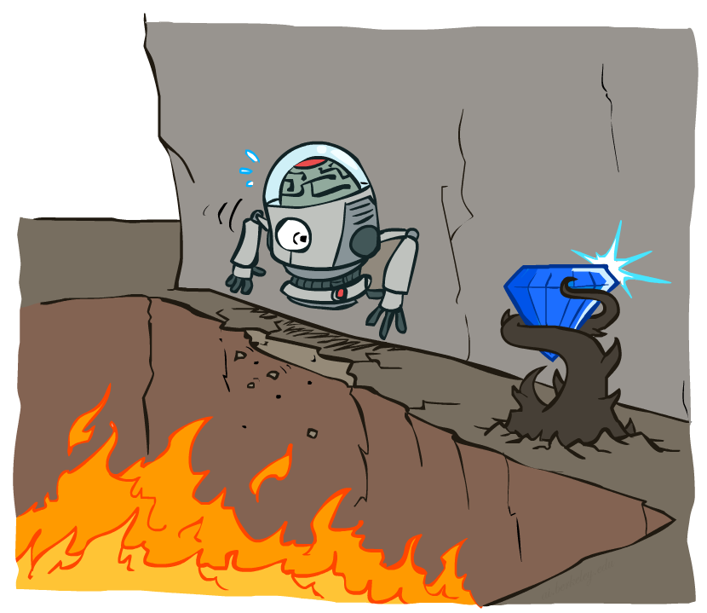
We’ll now study planning problems where actions have stochastic effects

Slide 4

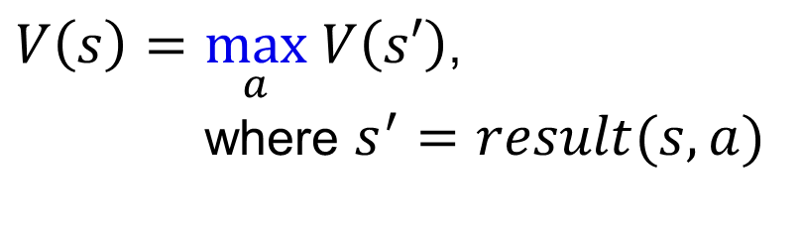

Minimax Notation
$V\left(s\right)=\max_{a} V\left(s′\right)$,
where $s^{′}=result(s, a)$
$a=\underset{a}{argmax} V\left(s′\right)$,
where $s^{′}=result(s, a)$
$\hat{a}=\underset{a}{argmax} V\left(s′\right)$,
where $s^{′}=result(s, a)$

Slide 5

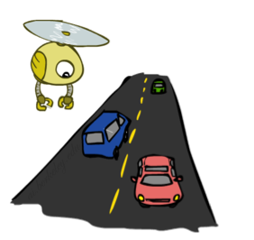
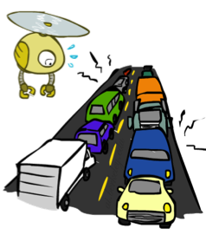
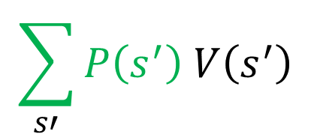


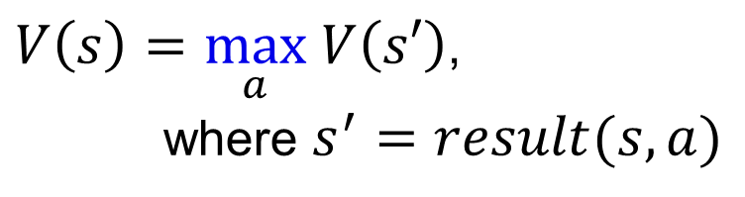
Expectations
Time:
20 min
30 min
60 min
+
+
x
x
x
Probability:
0.25
0.50
0.25
0.25
0.25
0.5
20
30
60
Max node notation
Chance node notation
$$\sum_{s′}{P\left(s^{′}\right) V\left(s^{′}\right)}$$
$V\left(s\right)=\max_{a} V\left(s′\right)$,
where $s^{′}=result(s, a)$
$$V\left(s\right)=$$

Slide 6
Poll 1
Expectimax tree search:
Which action do we choose?
A) Left
B) Center
C) Right
D) Eight
Left
Right
Center
1/4
1/2
1/2
1/2
1/3
2/3
1/4
12
8
4
8
6
12
6
Notes:
C

Slide 7
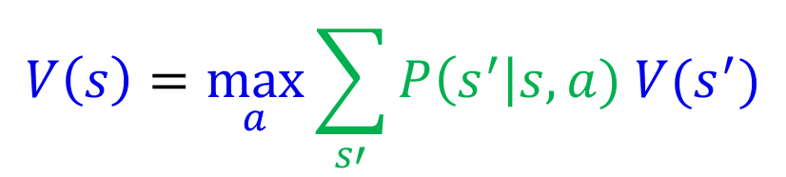
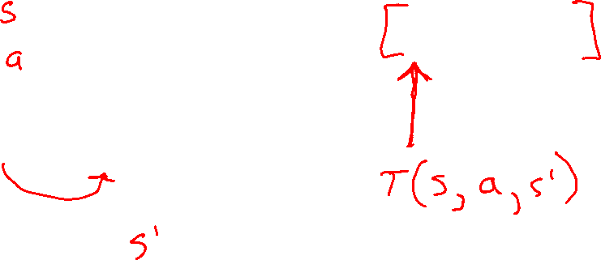
Expectimax Notation
$$V\left(s\right)=\max_{a}{\sum_{s′}{P\left(s^{′}\right|s,a) V(s^{′})}}$$

Slide 8
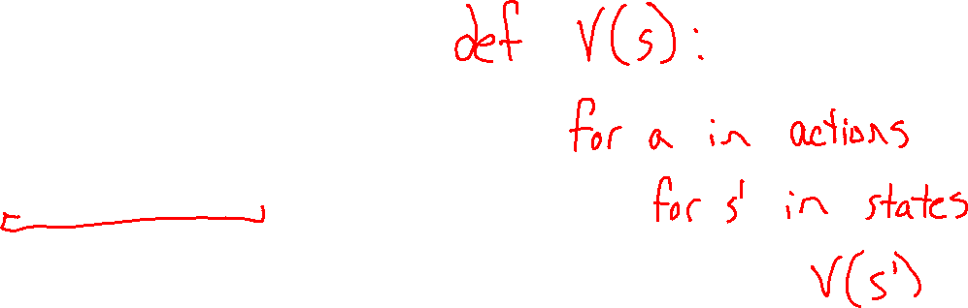
Warm-up as You Log In
Given
Set actions (persistent/static)
Set states (persistent/static)
Function T(s,a,s_prime)
Write the pseudo code for:
function V(s) return value
that implements:

Slide 9
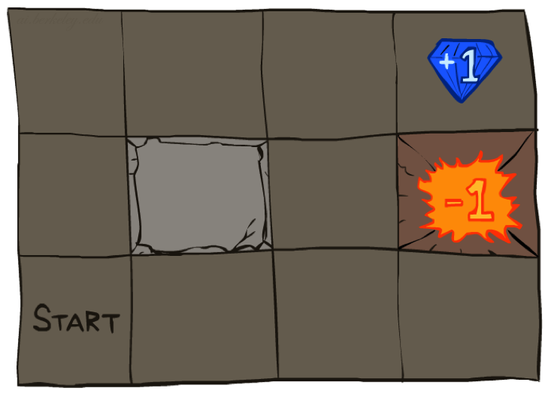




Example: Grid World
Running example grid world
A maze-like problem
The agent lives in a grid
Walls block the agent’s path
Noisy movement: actions do not always go as planned
80% of the time, the action North takes the agent North (if there is no wall there)
10% of the time, North takes the agent West; 10% East
If there is a wall in the direction the agent would have been taken, the agent stays put
The agent receives rewards each time step
Small “living” reward each step (can be negative)
Big rewards come at the end (good or bad)
Goal: maximize sum of rewards

Slide 10
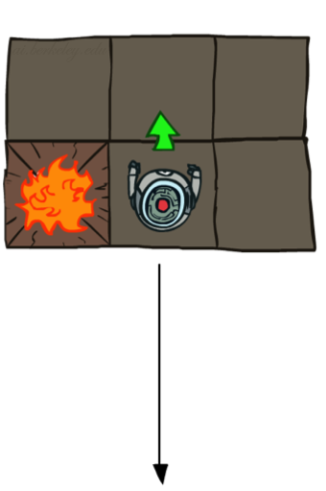
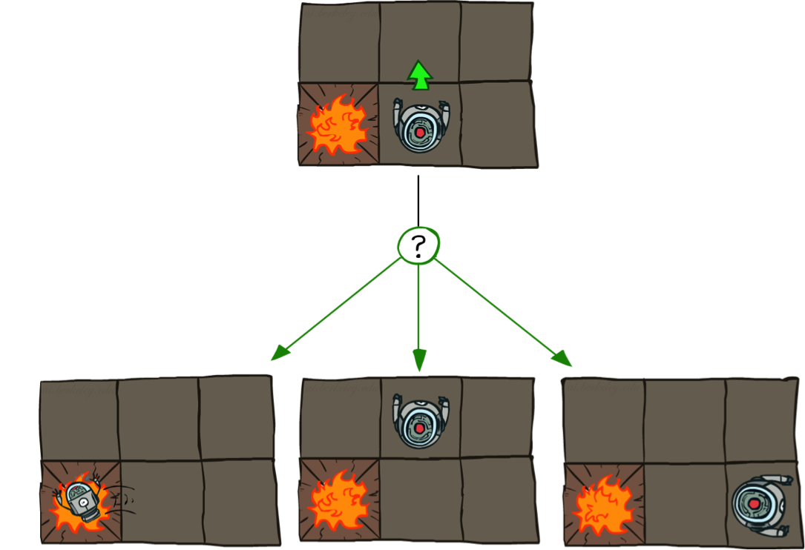
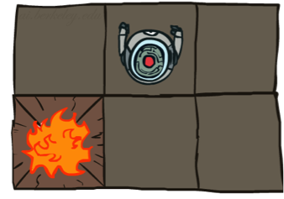
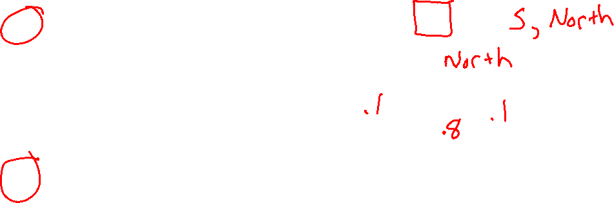
Grid World Actions
Deterministic Grid World
Stochastic Grid World

Slide 11
Markov Decision Processes
An MDP is defined by:
A set of states s ∈ S
A set of actions a ∈ A
A transition function T(s, a, s’)
Probability that a from s leads to s’, i.e., P(s’| s, a)
Also called the “model” or the “dynamics”
A reward function R(s, a, s’)
Sometimes just R(s) or R(s’) or R(s,a)
May be a terminal state
MDPs are non-deterministic search problems
One way to solve them is with expectimax search
You’ll learn a new algorithm soon
Notes:
In search problems: did not talk about actions, but about successor functions --- now the information inside the successor function is unpacked into actions, transitions and reward
Write out S, A, example entry in T, entry in R
Reward function different from the book : R(s,a,s’)
In book simpler for equations, but not useful for the projects.
Need to modify expectimax a tiny little bit to account for rewards along the way, but that’s something you should be able to do, and so you can already solve MDP’s (not in most efficient way)

Slide 12
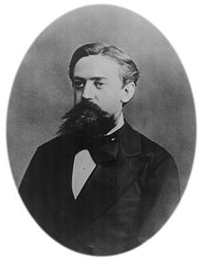

What is Markov about MDPs?
“Markov” generally means that given the present state, the future and the past are independent
For Markov decision processes, “Markov” means action outcomes depend only on the current state
This is just as in search, where the successor function could only depend on the current state (not the history)
Andrey Markov (1856-1922)
Notes:
Like search: successor function only depended on current state
Can make this happen by stuffing more into the state;
Very similar to search problems: when solving a maze with food pellets, we stored which food pellets were eaten

Slide 13

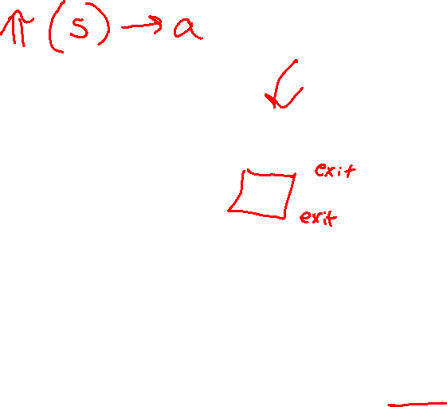
Policies
In deterministic single-agent search problems, we wanted an optimal plan, or sequence of actions, from start to a goal
For MDPs, we want an optimal policy π*: S → A
A policy π gives an action for each state
An optimal policy is one that maximizes expected utility if followed
An explicit policy defines a reflex agent
Expectimax didn’t compute entire policies
It computed the action for a single state only
Optimal policy when R(s, a, s’) = -0.03 for all non-terminal states s, s’
and discount factor is 0.9

Slide 14
Poll 2 (this one is on Piazza)
Which sequence of optimal policies matches
the following sequence of “living rewards” R(s):
{-0.01, -0.03, -0.4, -2.0}
{A, B, C, D}
{B, C, A, D}
{D, C, B, A}
{D, A, C, B}
A)
B)
+1
+1
-1
-1
C)
D)
+1
+1
-1
-1
Notes:
There is no discount factor in this example.
Answer: II

Slide 15
Optimal Policies
R(s) = -0.01
R(s) = -0.03
R(s) = -0.4
R(s) = -2.0
Notes:
R(s) = the “living reward”

Slide 16
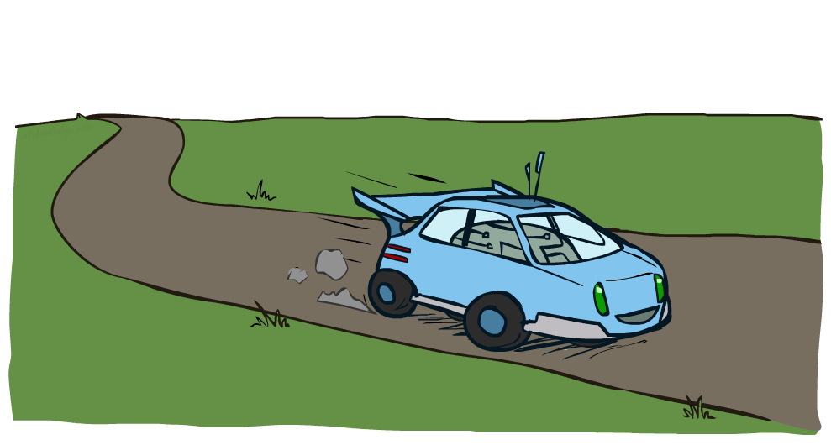
Example: Racing

Slide 17
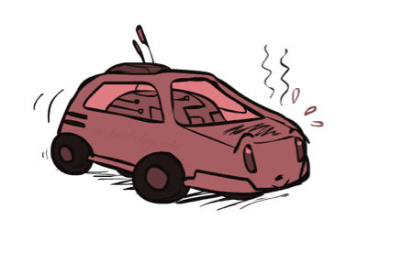
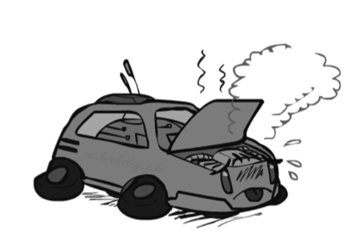

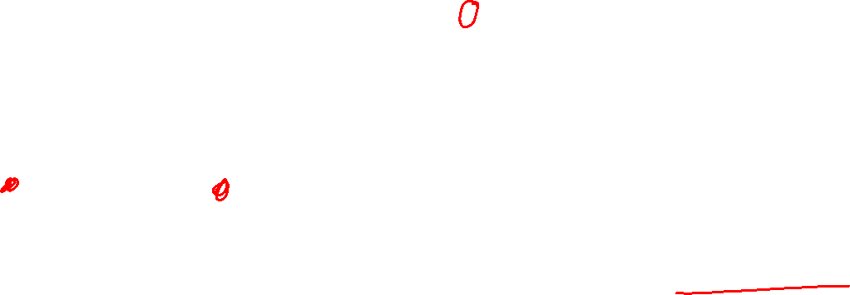
Example: Racing
A robot car wants to travel far, quickly
Three states: Cool, Warm, Overheated
Two actions: Slow, Fast
Going faster gets double reward
1.0
0.5
Fast
(r=-10)
0.5
+1
Slow (r=1)
1.0
Fast
Slow
-10
0.5
+1
0.5
Slow (r=1)
Warm
Slow
Fast
0.5
+2
Fast
(r=2)
0.5
Cool
0.5
Overheated
+1
1.0
1.0
+2
0.5

Slide 18




Racing Search Tree

Slide 19
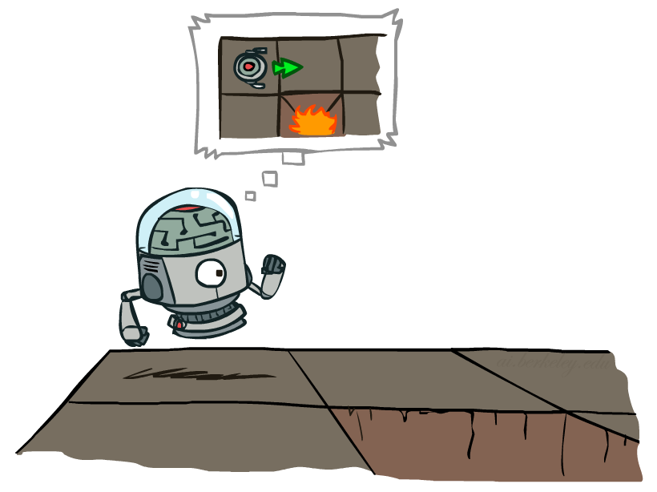

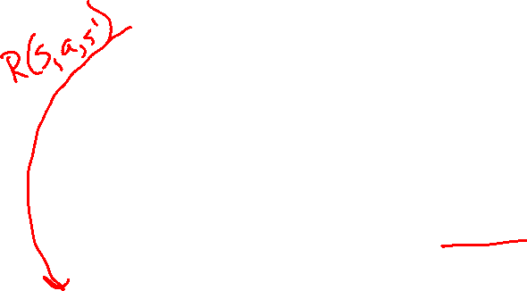
MDP Search Trees
Each MDP state projects an expectimax-like search tree
s
s is a state
a
(s, a) is a q-state
s, a
(s,a,s’) called a transition
T(s,a,s’) = P(s’|s,a)
R(s,a,s’)
s,a,s’
s’
Notes:
In MDP chance node represents uncertainty about what might happen based on (s,a) [as opposed to being a random adversary]
Q-state (s,a) is when you were in a state and took an action

Slide 20
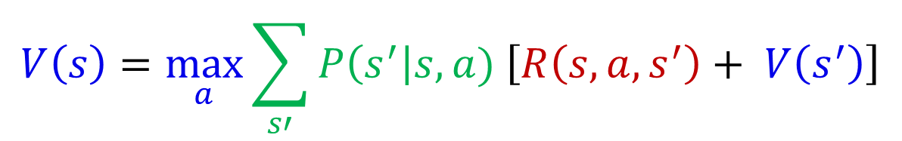
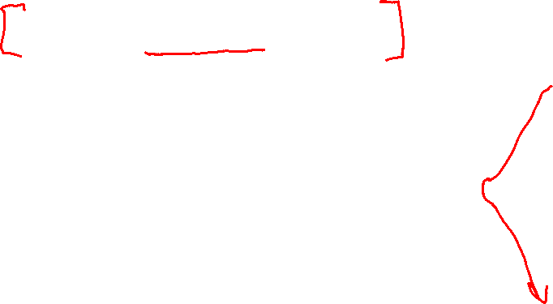
Recursive Expectimax
$$V\left(s\right)=\max_{a}{\sum_{s′}{P\left(s^{′}\right|s,a) \left[R\left(s, a, s^{′}\right)+ V\left(s^{′}\right)\right]}}$$
s
a
s, a
s,a,s’
s’

Slide 21
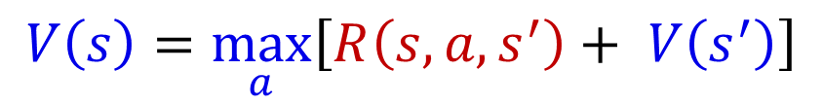
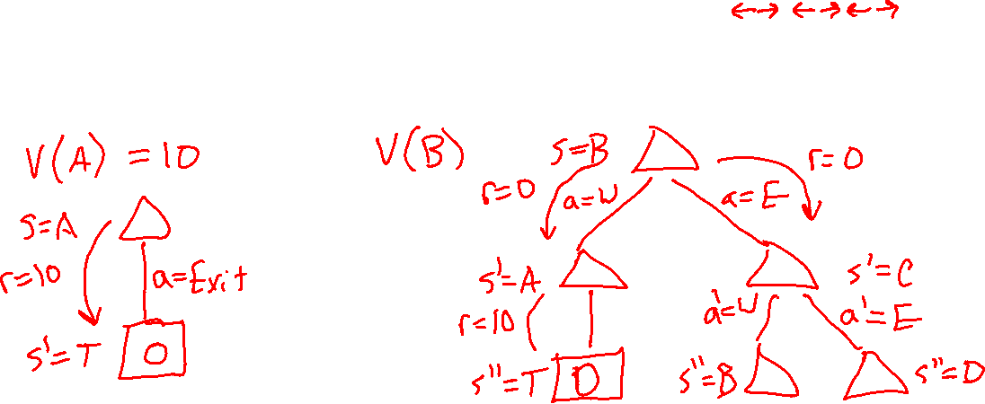
Simple Deterministic Example
T (Terminal)
R(A, Exit, T) = 10
R(E, Exit, T) = 1
Actions: B, C, D: East, West
Actions: A, E: Exit
Transitions: deterministic
Rewards only for transitioning to terminal state
A | B | C | D | E
$$V\left(s\right)=\max_{a}\left[R\left(s, a, s^{′}\right)+ V\left(s^{′}\right)\right]$$

Slide 22
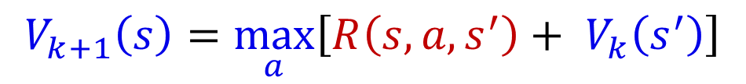
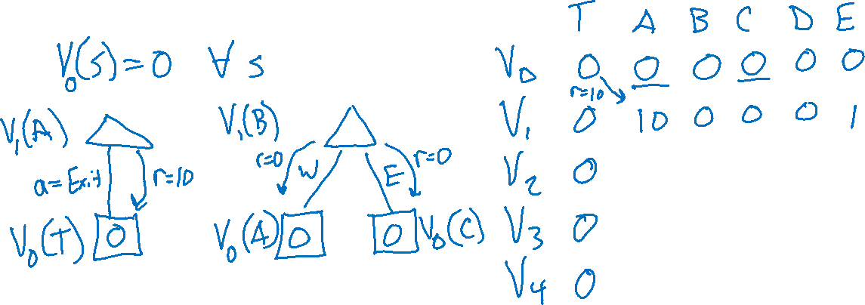
Simple Deterministic Example
T (Terminal)
R(A, Exit, T) = 10
R(E, Exit, T) = 1
Actions: B, C, D: East, West
Actions: A, E: Exit
Transitions: deterministic
Rewards only for transitioning to terminal state
A | B | C | D | E
$$V_{k+1}\left(s\right)=\max_{a}\left[R\left(s, a, s^{′}\right)+ V_{k}\left(s^{′}\right)\right]$$

Slide 23
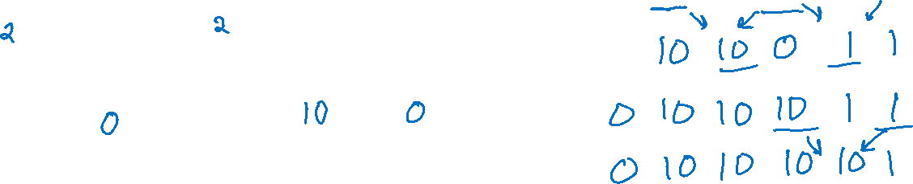
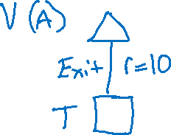
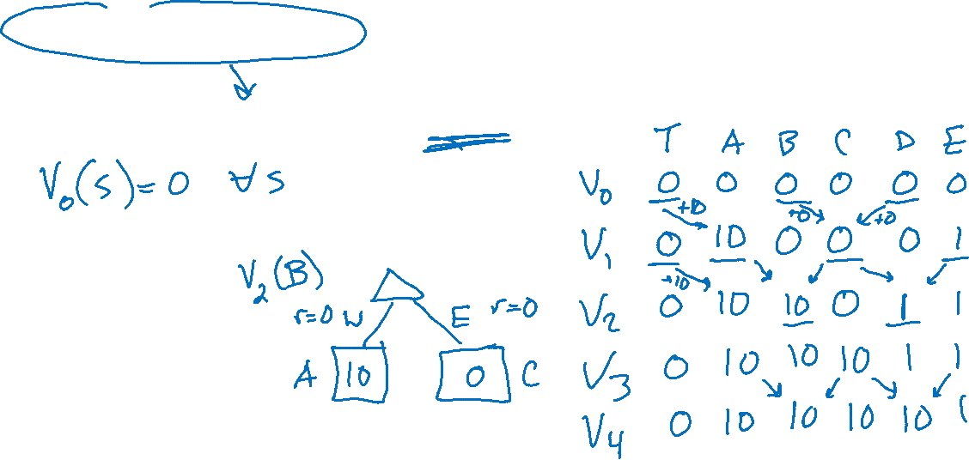
Simple Deterministic Example
T (Terminal)
R(A, Exit, T) = 10
R(E, Exit, T) = 1
Actions: B, C, D: East, West
Actions: A, E: Exit
Transitions: deterministic
Rewards only for transitioning to terminal state
A | B | C | D | E
$$V_{k+1}\left(s\right)=\max_{a}\left[R\left(s, a, s^{′}\right)+ V_{k}\left(s^{′}\right)\right]$$

Slide 24
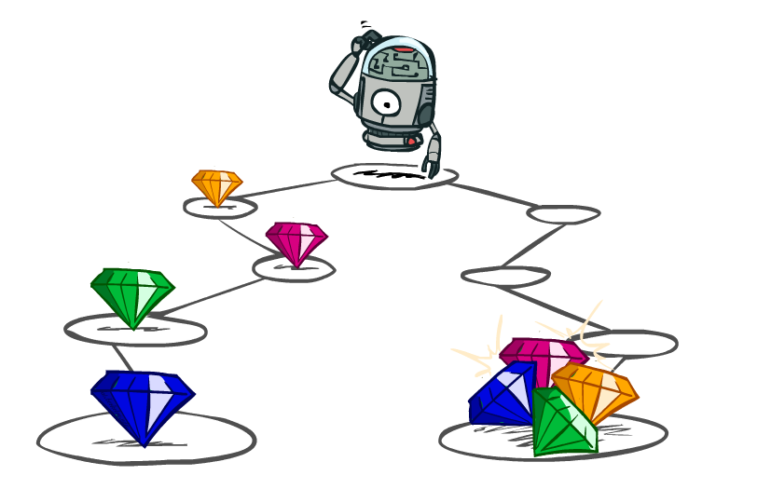
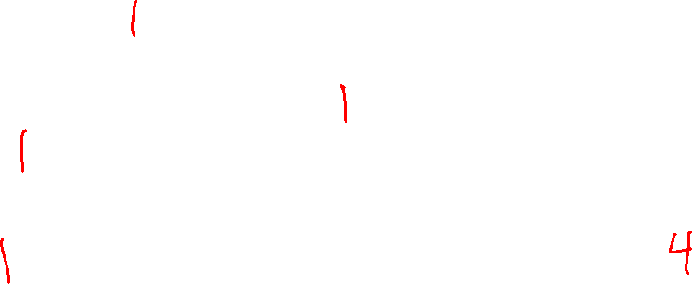
Utilities of Sequences

Slide 25
Utilities of Sequences
What preferences should an agent have over reward sequences?
More or less?
Now or later?
[1, 2, 2]
or
[2, 3, 4]
[0, 0, 1]
or
[1, 0, 0]

Slide 26
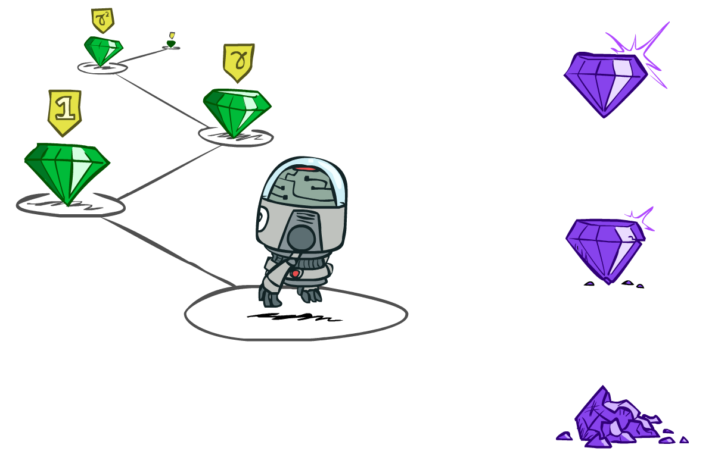

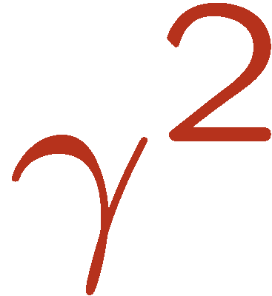

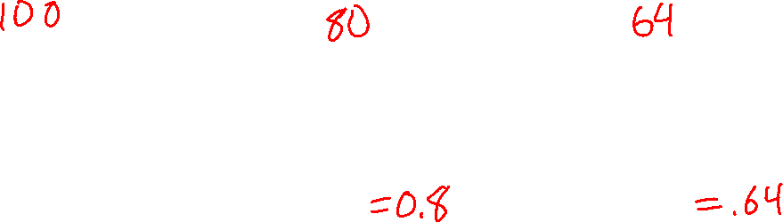
Discounting
It’s reasonable to maximize the sum of rewards
It’s also reasonable to prefer rewards now to rewards later
One solution: values of rewards decay exponentially
Worth Now
Worth Next Step
Worth In Two Steps

Slide 27

Discounting
How to discount?
Each time we descend a level, we multiply in the discount once
Why discount?
Sooner rewards probably do have higher utility than later rewards
Also helps our algorithms converge

Slide 28

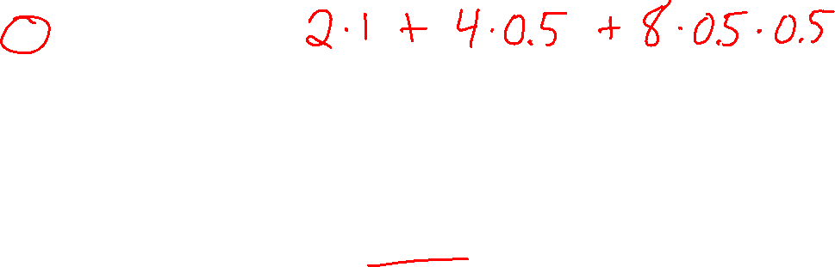
Poll 3
What is the value of U[2,4,8] with $γ=0.5?$
3
6
7
14

Slide 29
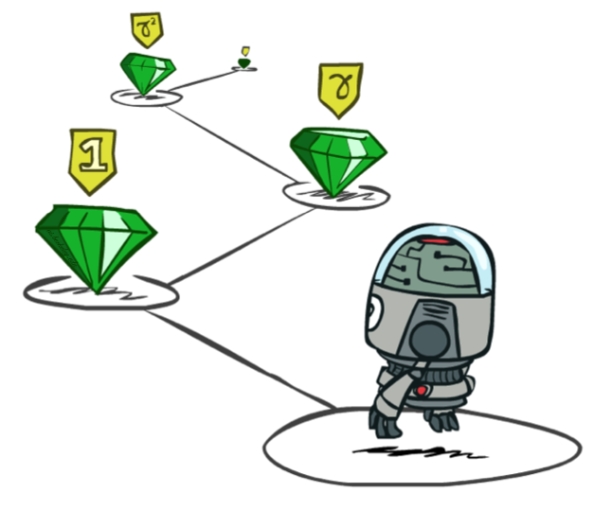
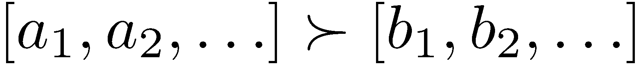
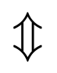
Stationary Preferences
Theorem: if we assume stationary preferences:
Then: there are only two ways to define utilities
Additive utility:
Discounted utility:

Slide 30
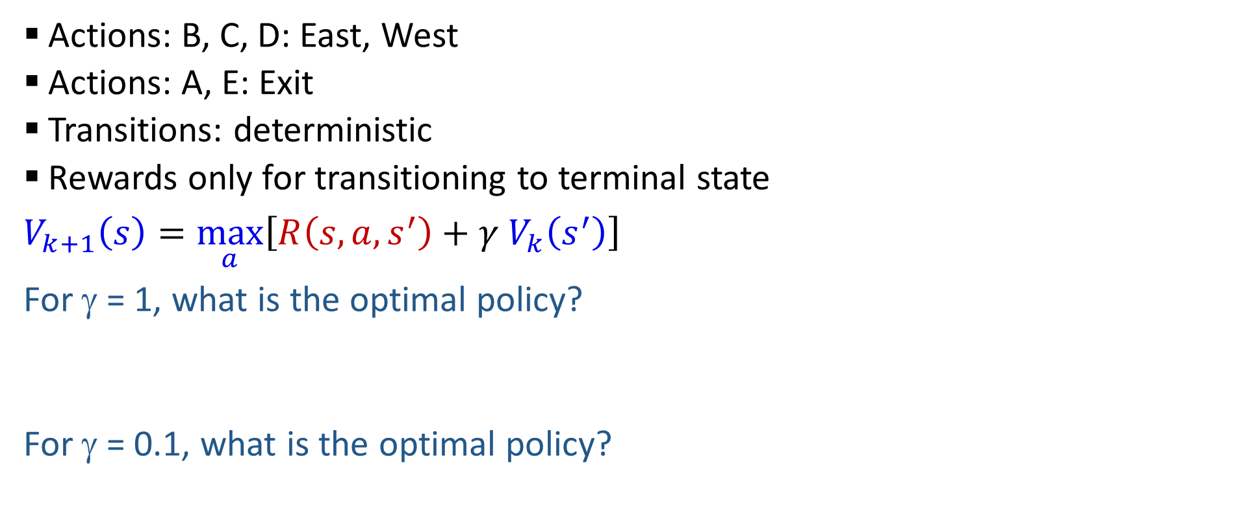
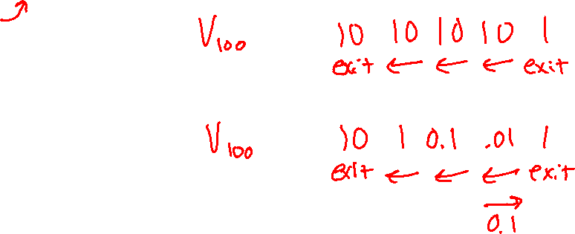
Discounting
T (Terminal)
R(A, Exit, T) = 10
R(E, Exit, T) = 1
Actions: B, C, D: East, West
Actions: A, E: Exit
Transitions: deterministic
Rewards only for transitioning to terminal state
$V_{k+1}\left(s\right)=\max_{a}\left[R\left(s, a, s^{′}\right)+γ V_{k}\left(s^{′}\right)\right]$
For γ = 1, what is the optimal policy?
For γ = 0.1, what is the optimal policy?
A | B | C | D | E

Slide 31

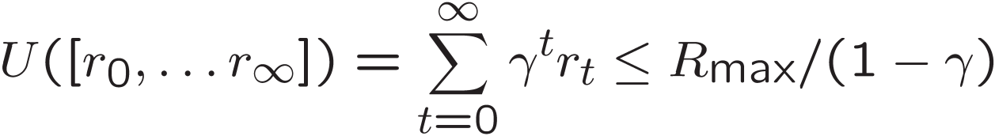
Infinite Utilities?!
Problem: What if the game lasts forever? Do we get infinite rewards?
Solutions:
Finite horizon: (similar to depth-limited search)
Terminate episodes after a fixed T steps (e.g., life)
Gives nonstationary policies (π depends on time left)
Discounting: use 0 < γ < 1
Smaller γ means smaller “horizon” – shorter term focus
Absorbing state: guarantee that for every policy, a terminal state will eventually be reached (like “overheated” for racing)

Slide 32
Recap: Defining MDPs
Markov decision processes:
Set of states S
Start state s₀
Set of actions A
Transitions P(s’|s,a) (or T(s,a,s’))
Rewards R(s,a,s’) (and discount γ)
MDP quantities so far:
Policy = Choice of action for each state
Utility = sum of (discounted) rewards
s
a
s, a
s,a,s’
s’

Slide 33
Solving MDPs

Slide 34
Optimal Quantities
The value (utility) of a state s:
V*(s) = expected utility starting in s and acting optimally
The value (utility) of a “q-state” (s,a):
Q*(s,a) = expected utility starting out having taken action a from state s and thereafter acting optimally
The optimal policy:
π*(s) = optimal action from state s
s
s is a state
a
(s, a) is a q-state
s, a
s,a,s’
(s,a,s’) is a transition
s’

Slide 35
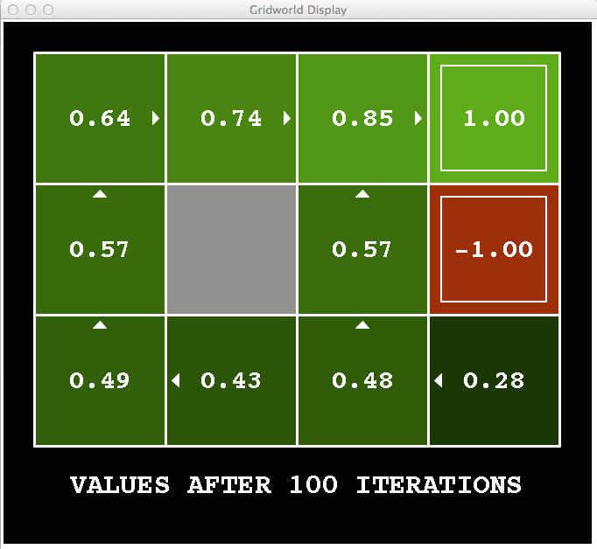
Snapshot of Demo – Gridworld V Values
Noise = 0.2
Discount = 0.9
Living reward = 0
Notes:
This demo doesn’t show anything in action, it just shows the V and Q values.

Slide 36
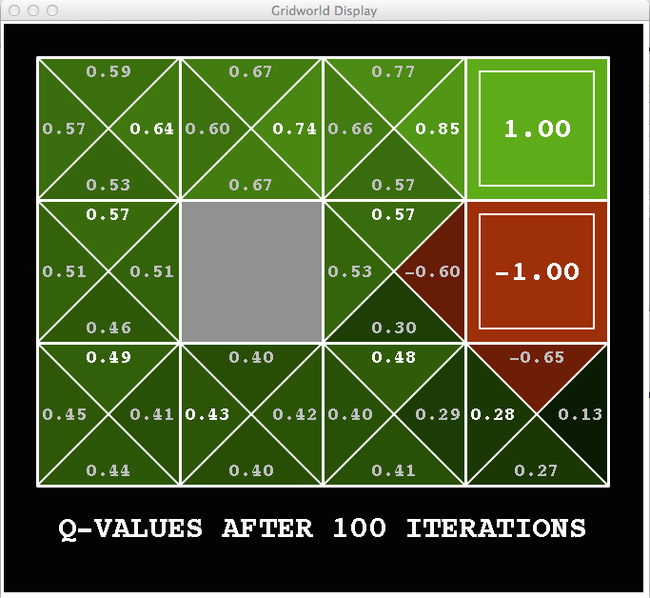
Snapshot of Demo – Gridworld Q Values
Noise = 0.2
Discount = 0.9
Living reward = 0
Notes:
This demo doesn’t show anything in action, it just shows the V and Q values.

Slide 37

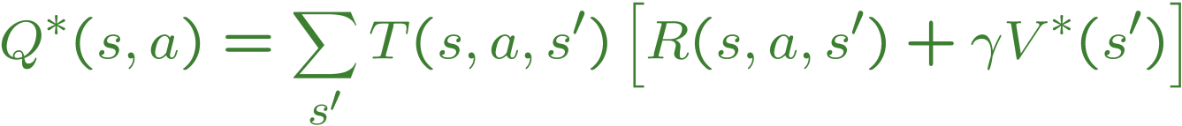
Values of States
Fundamental operation: compute the (expectimax) value of a state
Expected utility under optimal action
Average sum of (discounted) rewards
This is just what expectimax computed!
Recursive definition of value:
s
a
s, a
s,a,s’
s’

Slide 38
Racing Search Tree

Slide 39




Racing Search Tree
We’re doing way too much work with expectimax!
Problem: States are repeated
Idea: Only compute needed quantities once
Problem: Tree goes on forever
Idea: Do a depth-limited computation, but with increasing depths until change is small
Note: deep parts of the tree eventually don’t matter if γ < 1

Slide 40





Time-Limited Values
Key idea: time-limited values
Define V_{k}(s) to be the optimal value of s if the game ends in k more time steps
Equivalently, it’s what a depth-k expectimax would give from s

Slide 41





Computing Time-Limited Values

Slide 42

k=0
Noise = 0.2
Discount = 0.9
Living reward = 0
Notes:
Assuming zero living reward

Slide 43


k=1
Noise = 0.2
Discount = 0.9
Living reward = 0
Notes:
Assuming zero living reward

Slide 44

k=2
Noise = 0.2
Discount = 0.9
Living reward = 0
Notes:
Assuming zero living reward

Slide 45

k=3
Noise = 0.2
Discount = 0.9
Living reward = 0
Notes:
Assuming zero living reward

Slide 46

k=4
Noise = 0.2
Discount = 0.9
Living reward = 0
Notes:
Assuming zero living reward

Slide 47

k=5
Noise = 0.2
Discount = 0.9
Living reward = 0
Notes:
Assuming zero living reward

Slide 48

k=6
Noise = 0.2
Discount = 0.9
Living reward = 0
Notes:
Assuming zero living reward

Slide 49

k=7
Noise = 0.2
Discount = 0.9
Living reward = 0
Notes:
Assuming zero living reward

Slide 50

k=8
Noise = 0.2
Discount = 0.9
Living reward = 0
Notes:
Assuming zero living reward

Slide 51

k=9
Noise = 0.2
Discount = 0.9
Living reward = 0
Notes:
Assuming zero living reward

Slide 52

k=10
Noise = 0.2
Discount = 0.9
Living reward = 0
Notes:
Assuming zero living reward

Slide 53

k=11
Noise = 0.2
Discount = 0.9
Living reward = 0
Notes:
Assuming zero living reward

Slide 54

k=12
Noise = 0.2
Discount = 0.9
Living reward = 0
Notes:
Assuming zero living reward

Slide 55

k=100
Noise = 0.2
Discount = 0.9
Living reward = 0
Notes:
Assuming zero living reward

Slide 56

Value Iteration

Slide 57
Value Iteration
Start with V₀(s) = 0: no time steps left means an expected reward sum of zero
Given vector of V_{k}(s) values, do one ply of expectimax from each state:
Repeat until convergence
Complexity of each iteration: O(S²A)
Theorem: will converge to unique optimal values
Basic idea: approximations get refined towards optimal values
Policy may converge long before values do
V_{k+1}(s)
a
s, a
s,a,s’
V_{k}(s’)
Notes:
Discuss computational complexity: S * A * S times number of iterations
Note: updates not in place [if in place, it means something else and not even clear what it means]

Slide 58







Example: Value Iteration
0.5
1.0
Fast
(R=-10)
Slow (R=1)
0.5
3.5 2.5 0
Slow (R=1)
Fast
(R=2)
0.5
2 1 0
1.0
0.5
Assume no discount!
0 0 0

Slide 59


Convergence
How do we know the V_{k} vectors are going to converge?
Case 1: If the tree has maximum depth M, then V_{M} holds the actual untruncated values
Case 2: If the discount is less than 1
Sketch: For any state V_{k} and V_{k+1} can be viewed as depth k+1 expectimax results in nearly identical search trees
The difference is that on the bottom layer, V_{k+1} has actual rewards while V_{k} has zeros
That last layer is at best all R_{MAX}
It is at worst R_{MIN}
But everything is discounted by γ^{k} that far out
So V_{k} and V_{k+1} are at most γ^{k} max|R| different
So as k increases, the values converge

