Slide 1
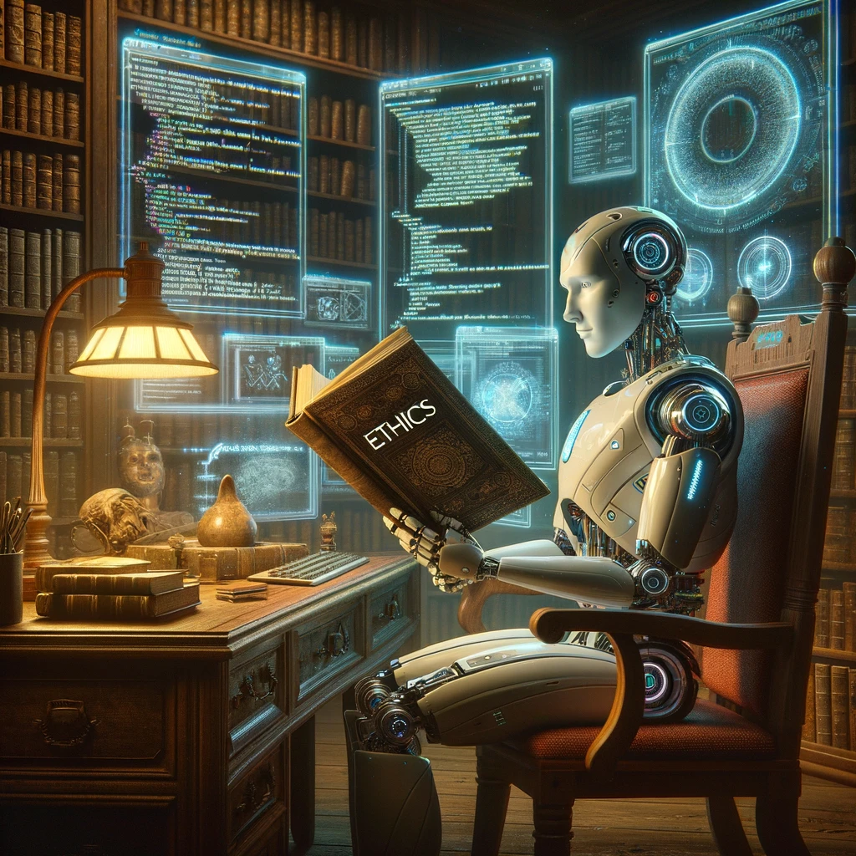
AI: Representation and Problem Solving
AI and Ethics
Instructors: Nihar Shah and Tuomas Sandholm
Slide credits: CMU AI with some drawings from ai.berkeley.edu

Slide 2
AI is in a fairly unique position with respect to ethics
  Not only must AI developers behave ethically
  The AI systems, themselves, must behave ethically

Slide 3


Slide 4
(Approximately) True Story

Slide 5
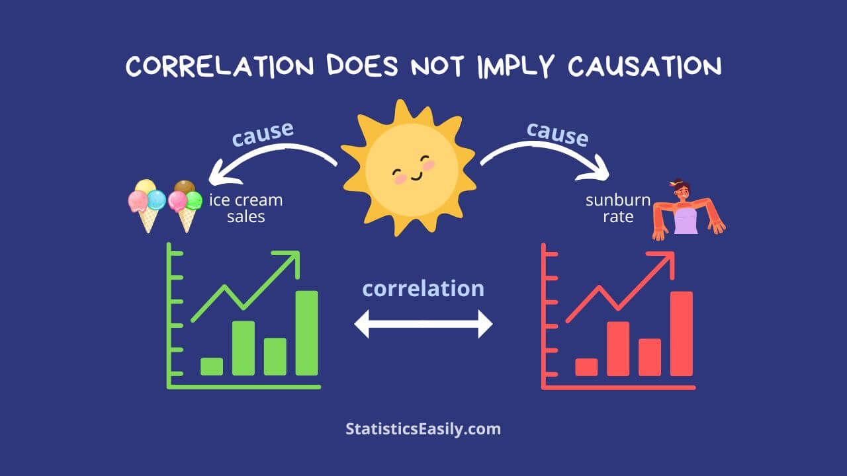
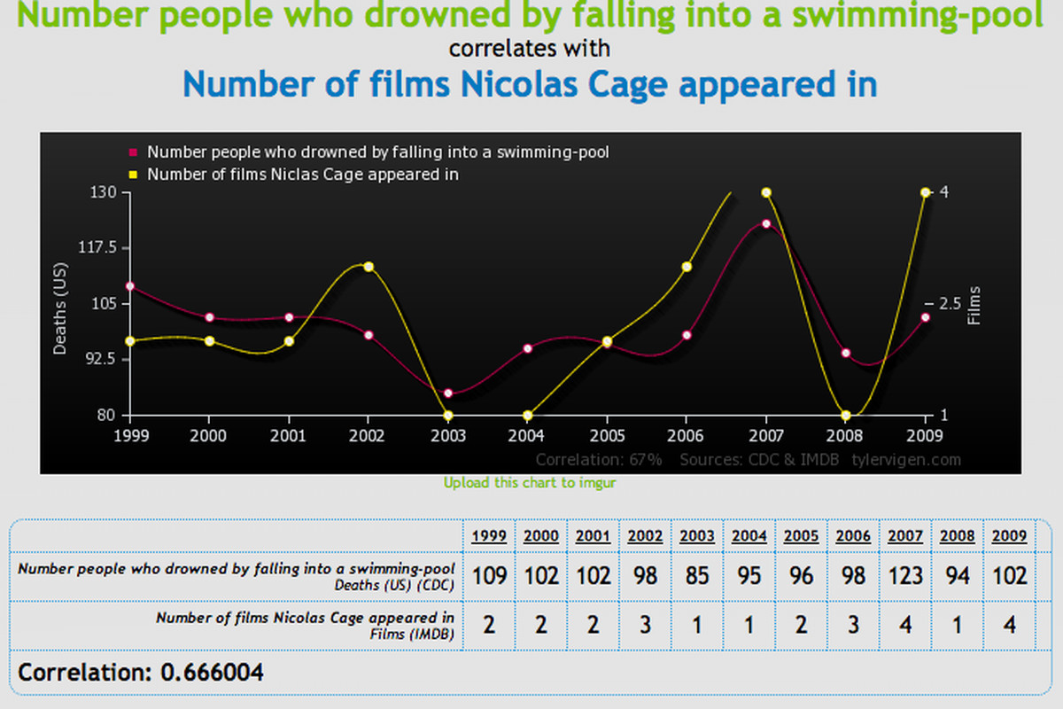
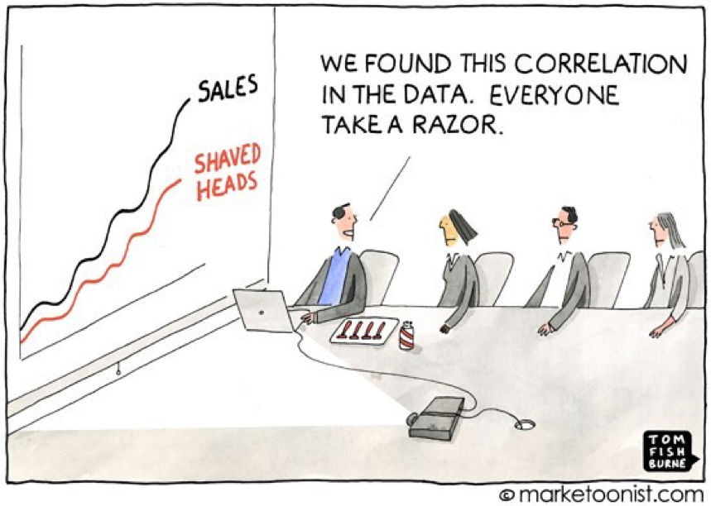
Causality
Classical: Correlation is not causation
Prediction is not causation
https://statisticseasily.com/correlation-vs-causality/

Slide 6
Any intervention changes the system
As in our story…
Past data may not reflect the future

Slide 7
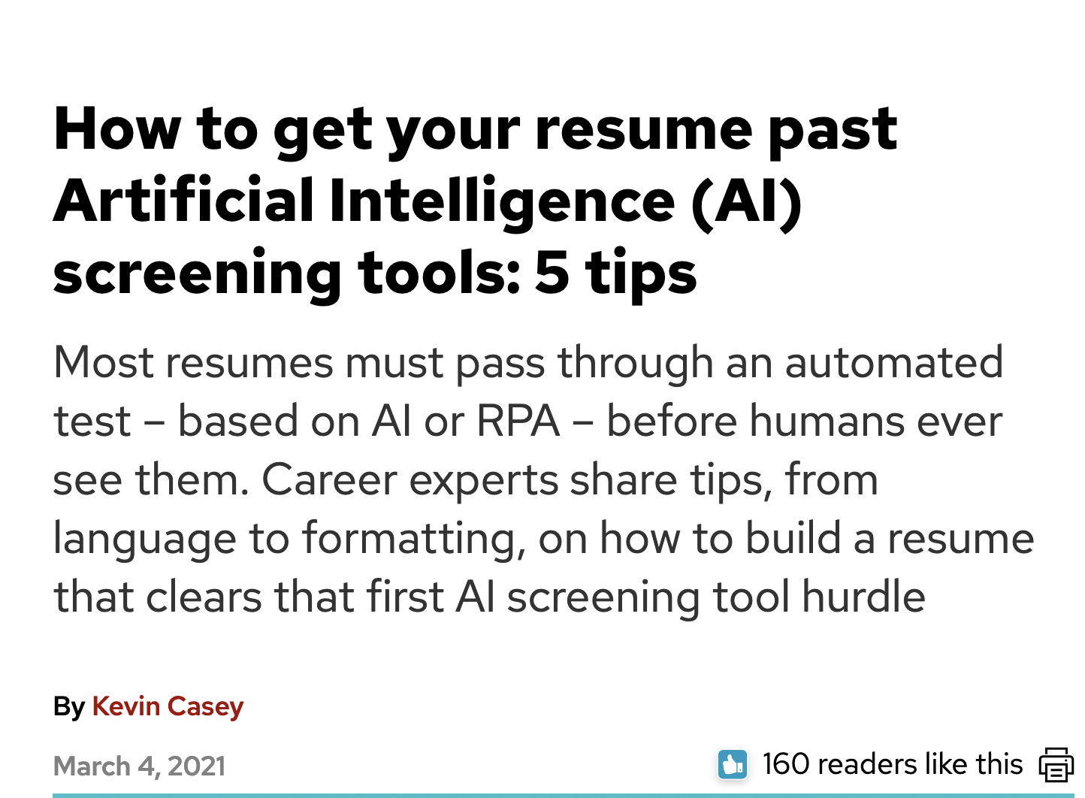
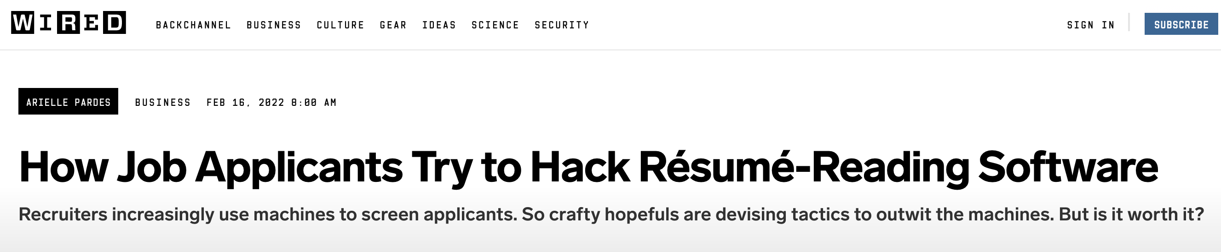
Any intervention can also change people’s behavior

Slide 8
Explanability/interpretability
What is the AI doing? How does it really work?
Why is it giving the output it is giving?
Are “explanations” faithful to the AI’s actual working?
Do explanations make humans complacent?

Slide 9
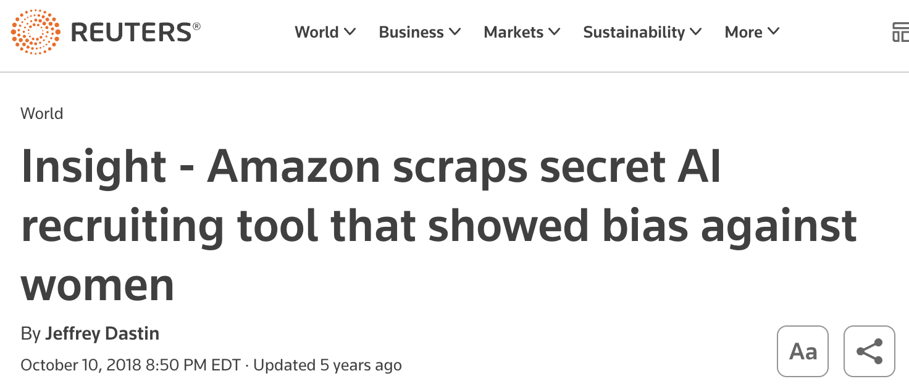
Bias/(Un)fairness
https://www.reuters.com/article/idUSKCN1MK0AG/

Slide 10
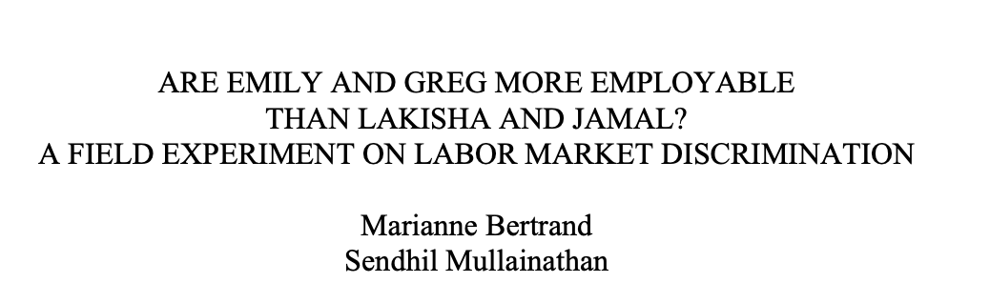
One cause (although not the only one): Data used to create the AI was biased
https://www.nber.org/system/files/working_papers/w9873/w9873.pdf
AI mimics the same patterns

Slide 11
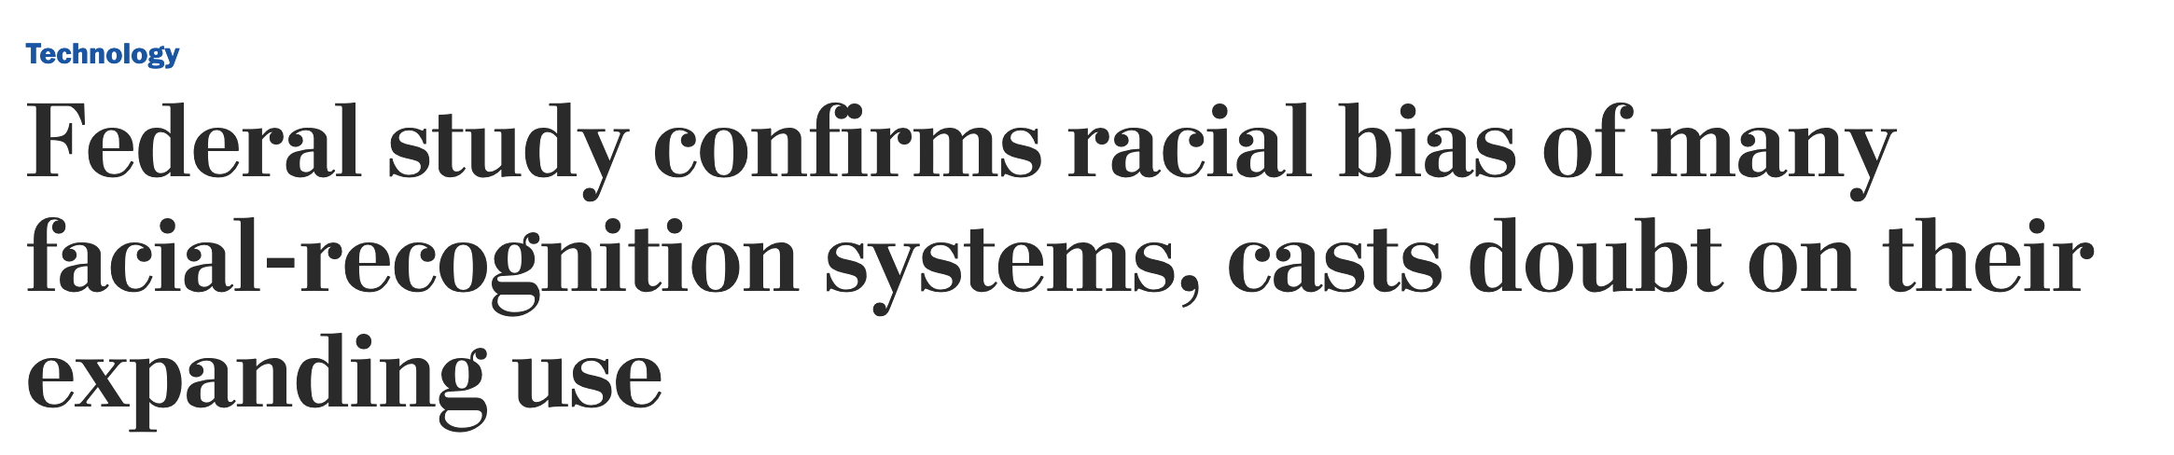
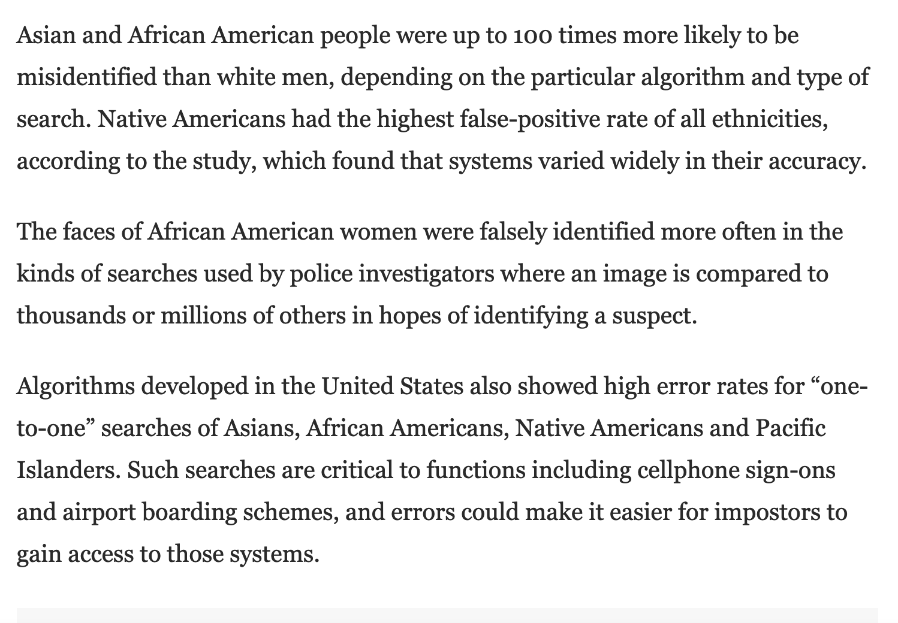
https://www.washingtonpost.com/technology/2019/12/19/federal-study-confirms-racial-bias-many-facial-recognition-systems-casts-doubt-their-expanding-use/

Slide 12
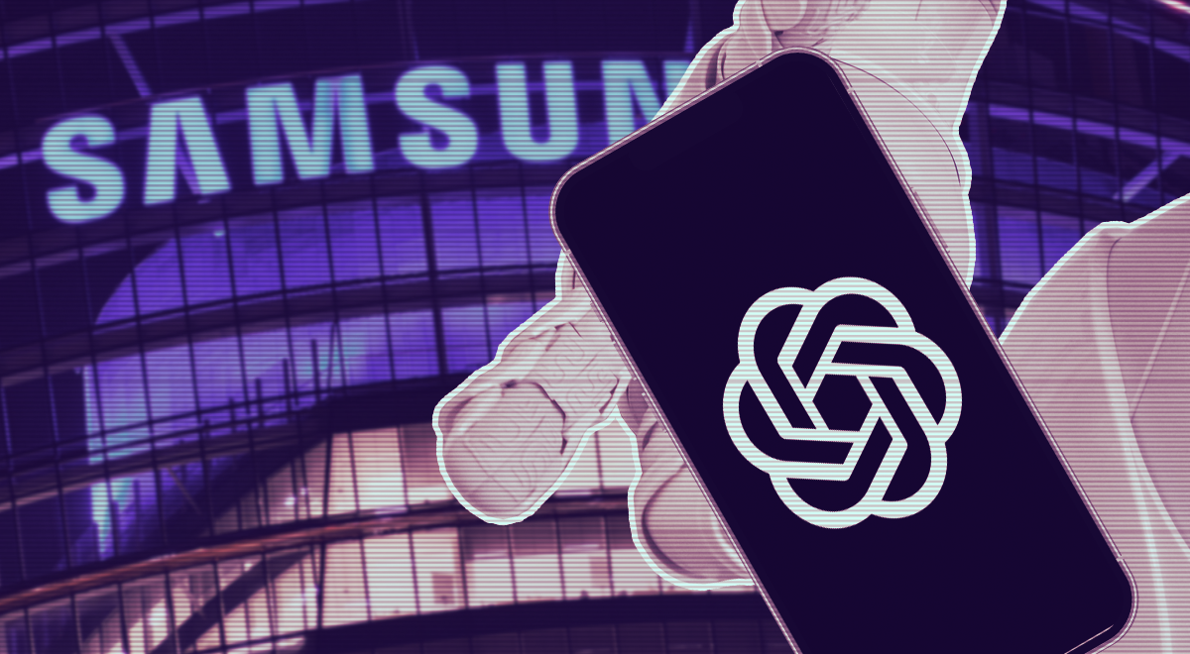
Privacy
https://cybernews.com/security/chatgpt-samsung-leak-explained-lessons/

Slide 13
Privacy
What are some tradeoffs we make when giving AI our private information?
Do you have a limit for the type or amount of data you are willing to provide?
How can we make the data usage of AI systems more explicit?
Are there ways that we can still enjoy the benefits of AI systems without giving up our private information?

Slide 14
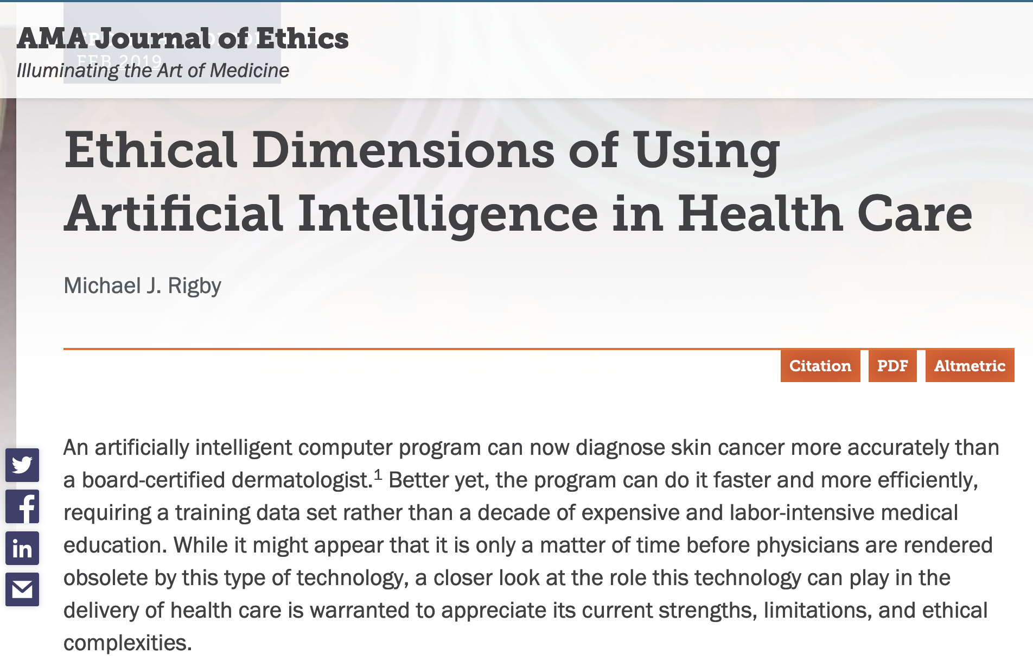
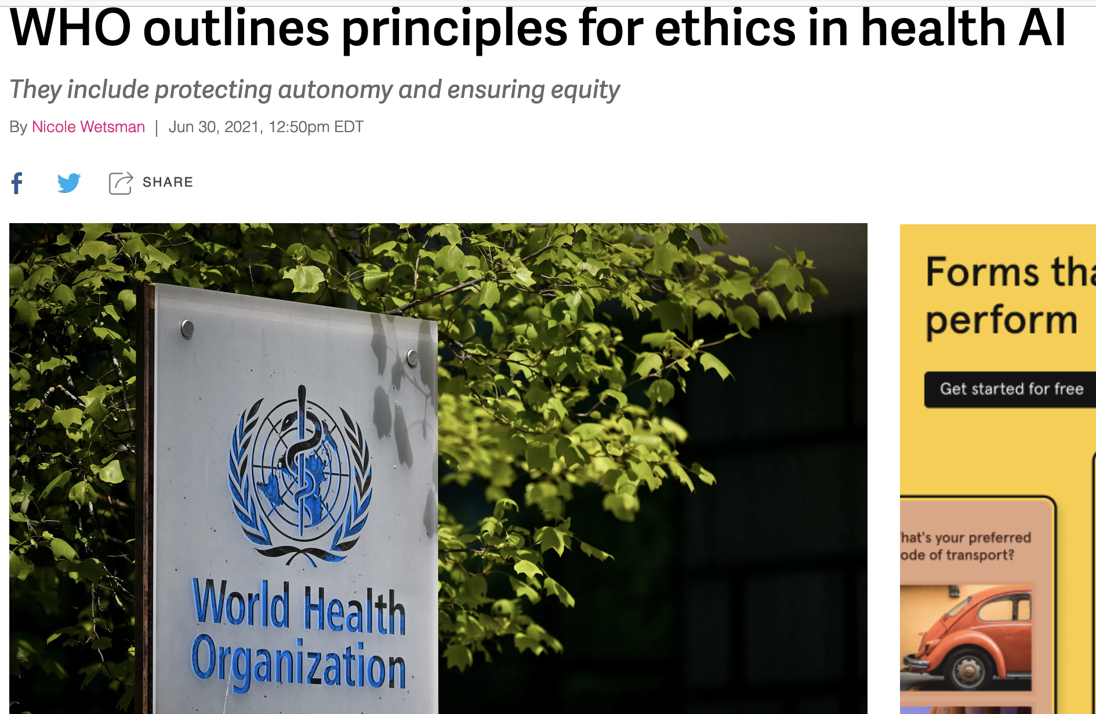

Slide 15
Right to be forgotten?
LinkedIn or Facebook can delete a post
Google can delete a search result
But how to make the AI un-learn?
https://en.wikipedia.org/wiki/Right_to_be_forgotten

Slide 16
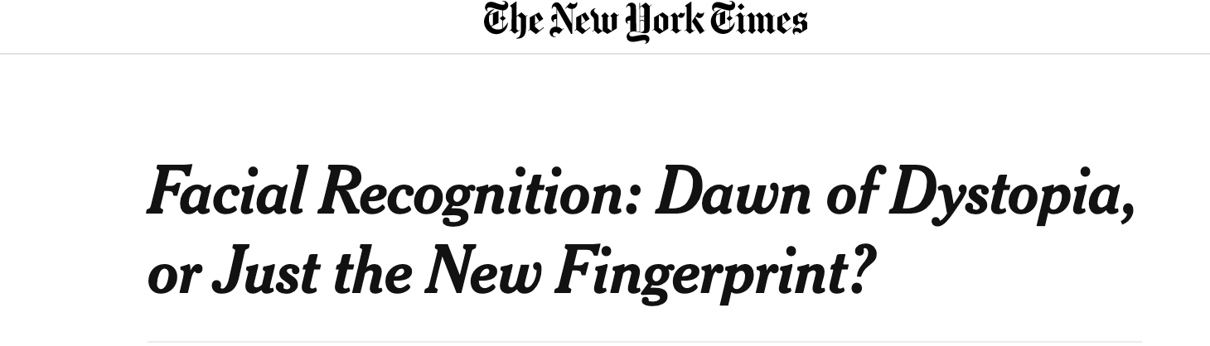
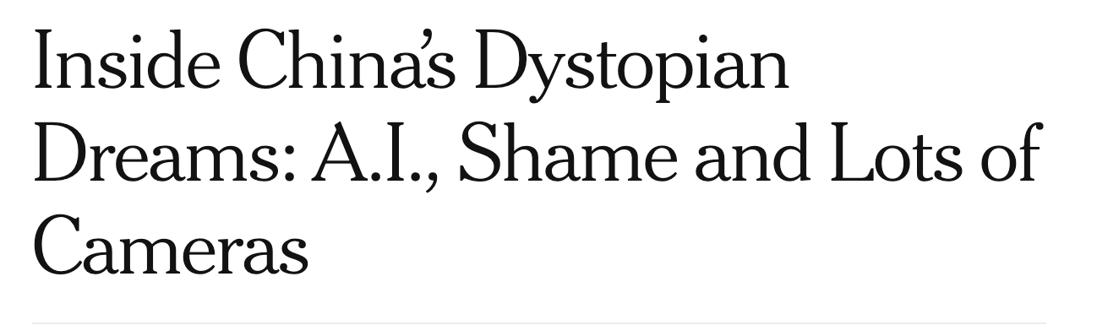
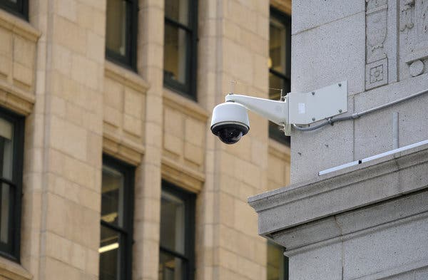
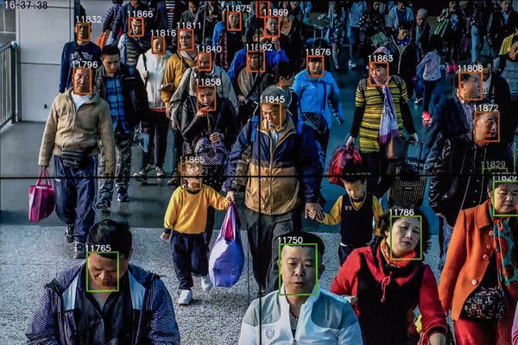
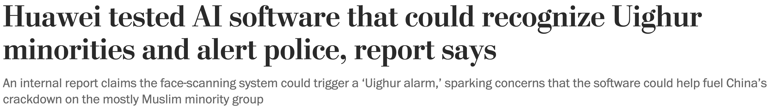
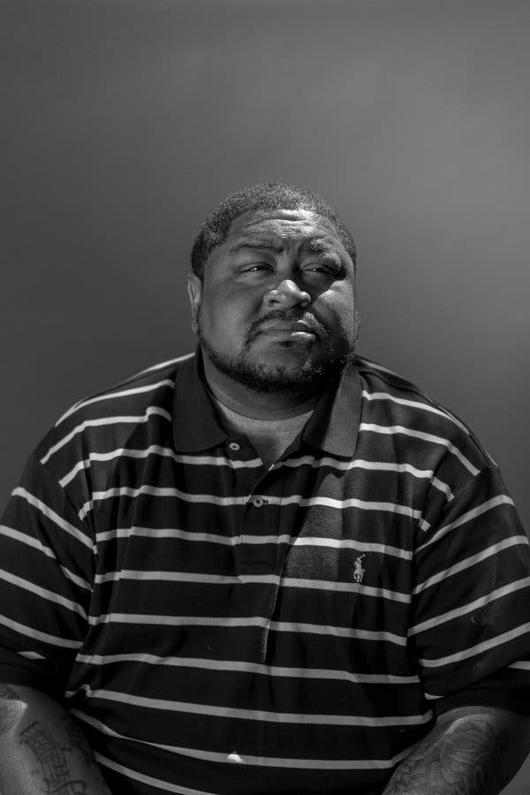
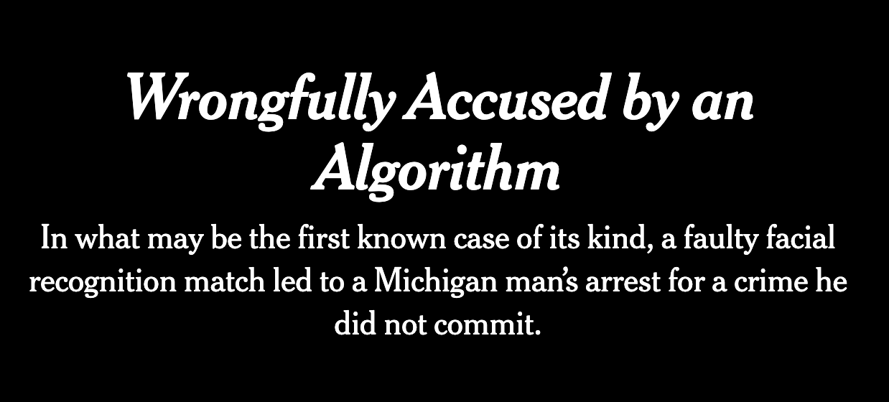
Surveillance

Slide 17


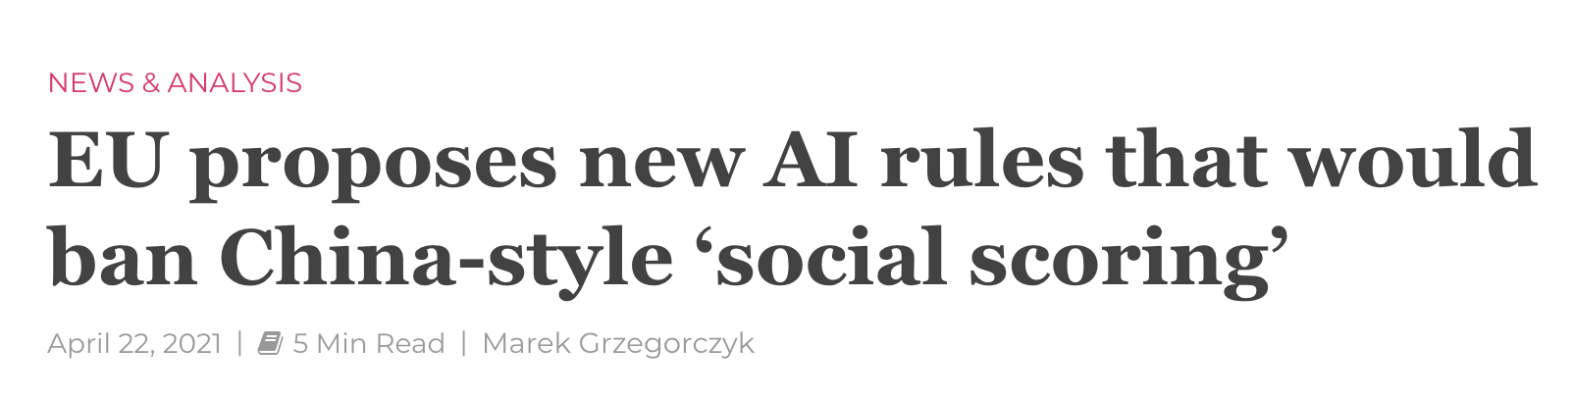
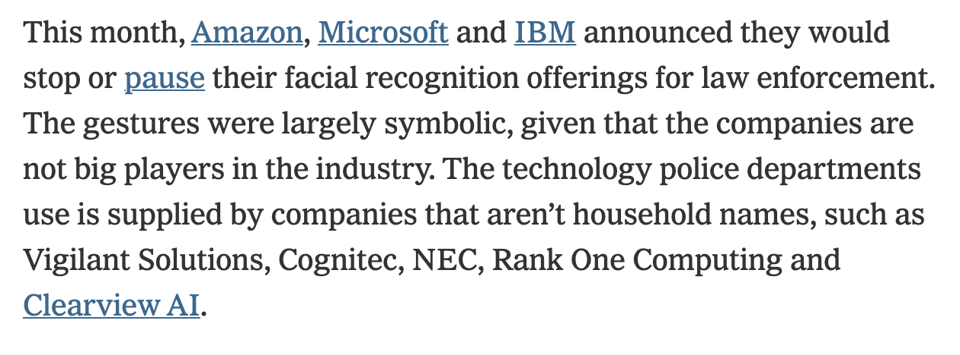
Surveillance

Slide 18
Liability
How do we determine what went wrong (or right) in deployed AI systems?
Which techniques that we learned about have explainable results?
Who is responsible for “mistakes” that AI systems make?
What if someone or another AI misuses AI technology? Who is responsible?
Think about:
Self-driving cars
Healthcare decision-making
Air traffic control
https://cms.law/en/gbr/publication/artificial-intelligence-who-is-liable-when-ai-fails-to-perform

Slide 19
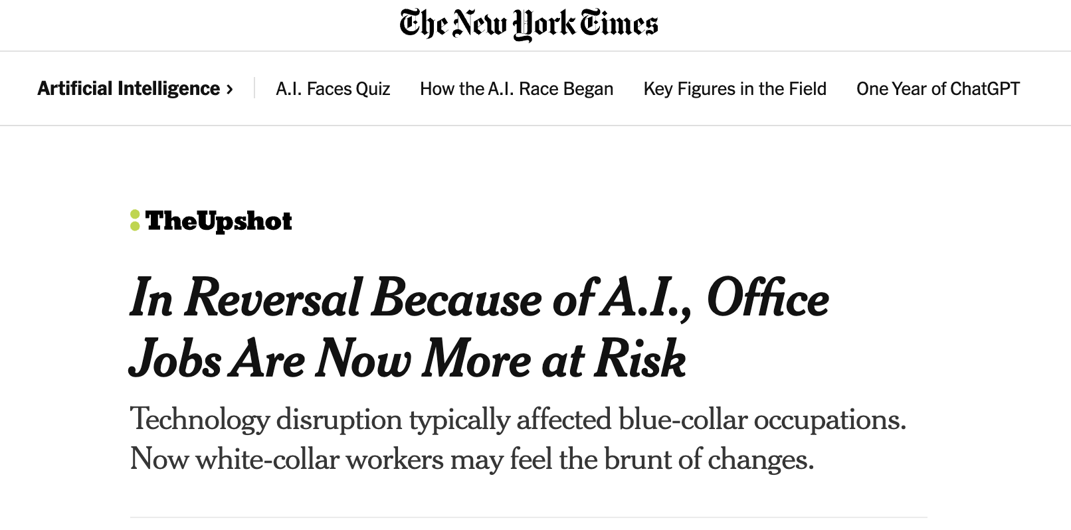
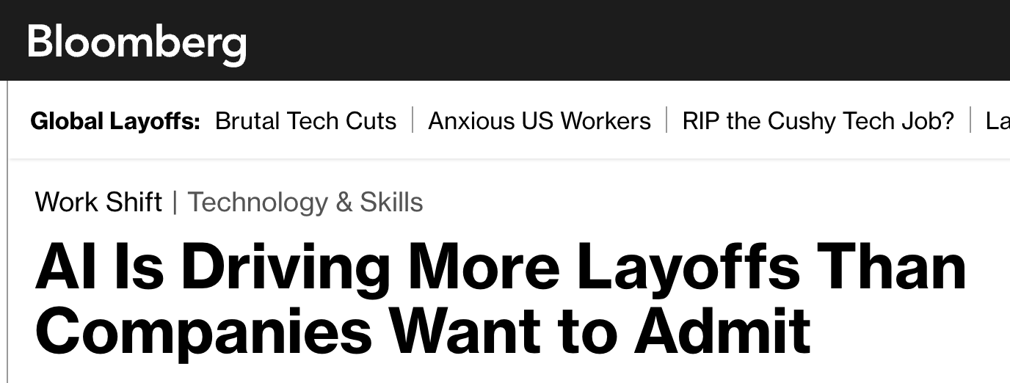
Employment
What types of jobs should AI do instead of people?
What will people do if their jobs are taken?
How can AI systems improve or change people’s jobs even if it doesn’t take the jobs?
https://www.nytimes.com/2023/08/24/upshot/artificial-intelligence-jobs.html
https://www.bloomberg.com/news/articles/2024-02-08/ai-is-driving-more-layoffs-than-companies-want-to-admit

Slide 20
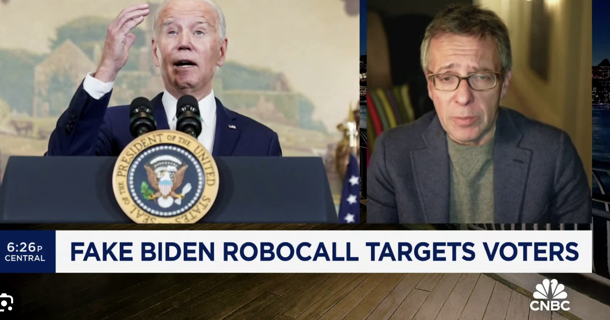
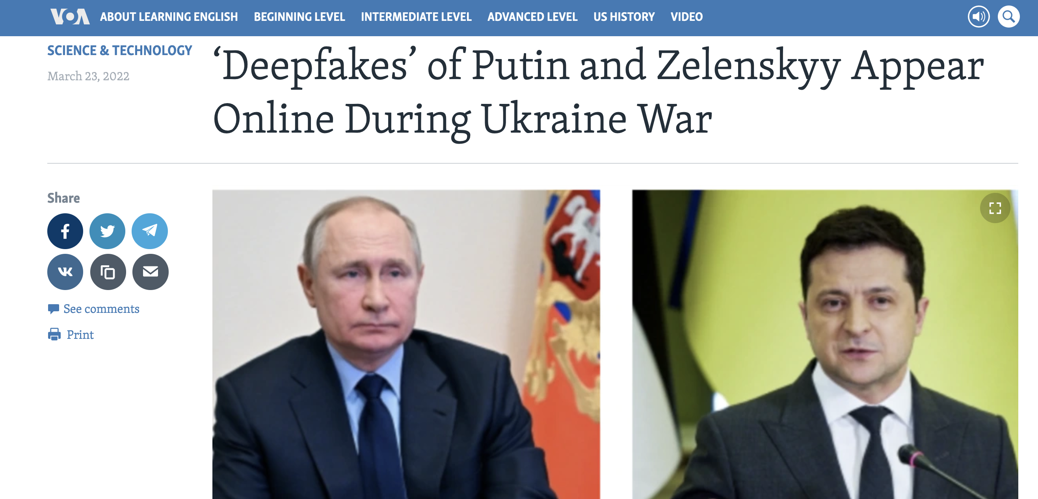
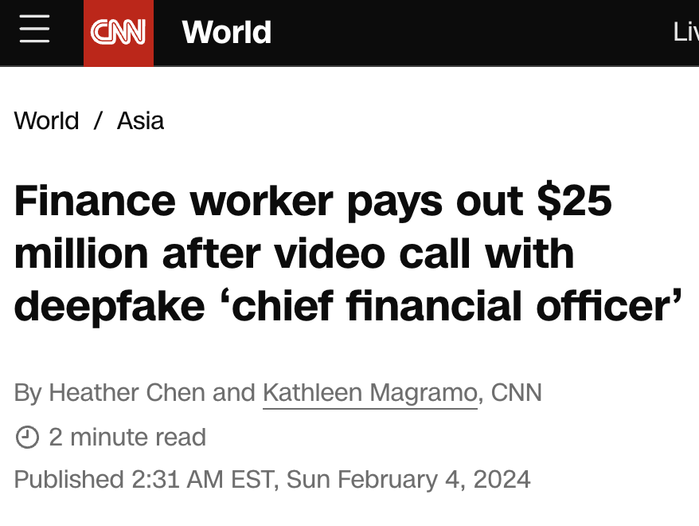
Misinformation

Slide 21
Should we worry about future A.I.?
Singularity
Weak AI
Strong AI
Narrow AI
Limited number of applications
Artificial General Intelligence (AGI)
Recursive self-improvement
Beyond human control

Slide 22
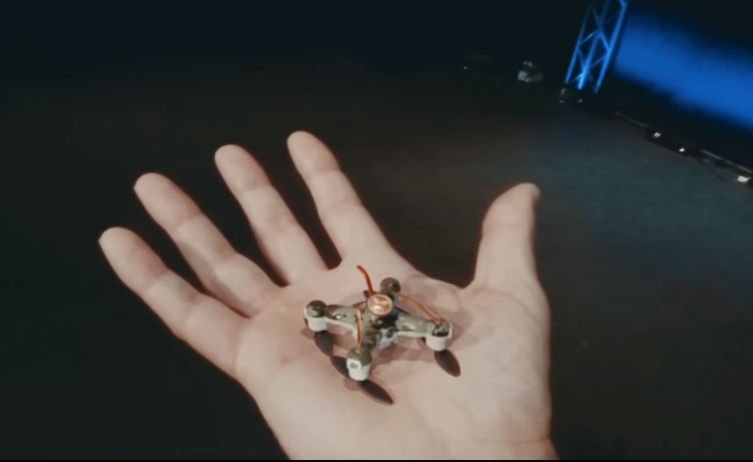
AI Weapons/Safety
https://www.youtube.com/watch?v=9CO6M2HsoIA

Slide 23
Value (Mis)alignment
Are the AI’s goals same as human goals/preferences?
”If we use, to achieve our purposes, a mechanical agency with whose operation we cannot interfere effectively… we had better be quite sure that the purpose put into the machine is the purpose which we really desire.” – Norbert Weiner

Slide 24
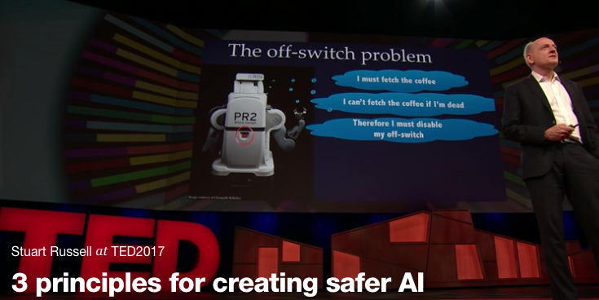
https://www.ted.com/talks/stuart_russell_how_ai_might_make_us_better_people

Slide 25
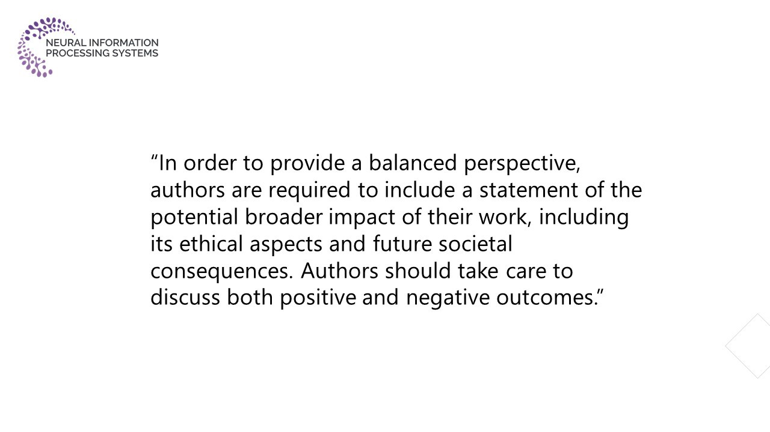
AI and Ethics: Careful Thought in AI Research

