Slide 1
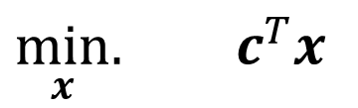
As you come in…
Consider an LP with no constraints
$\min_{x}.{ c^{T}x}$
Suppose vector c is not all 0s.
Then what is the minimum value of the objective?

Slide 2
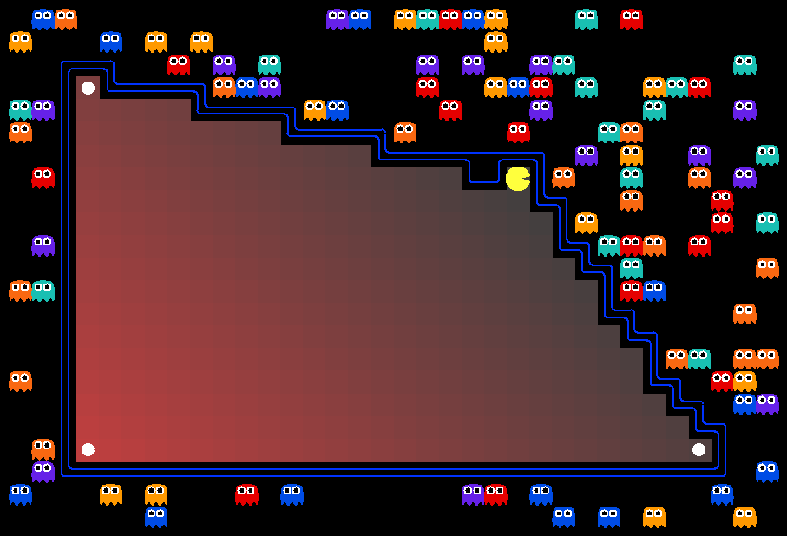
AI: Representation and Problem Solving
Solving linear programs;
Integer programs
Instructors: Nihar Shah and Tuomas Sandholm
Slide credits: CMU AI with some drawings from ai.berkeley.edu

Slide 3
“Convex” set
A set in R^{d} is said to be a convex set if for every pair of points in the set, all the points on the line joining these two points are also in the set.
Very useful for many types of problems!

Slide 4
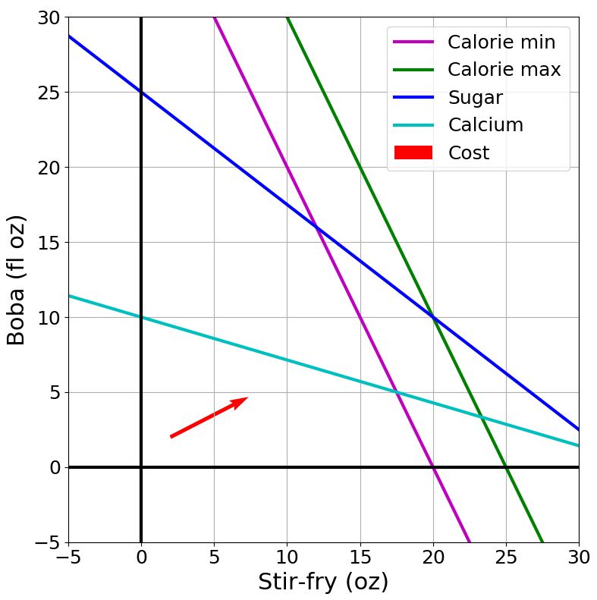

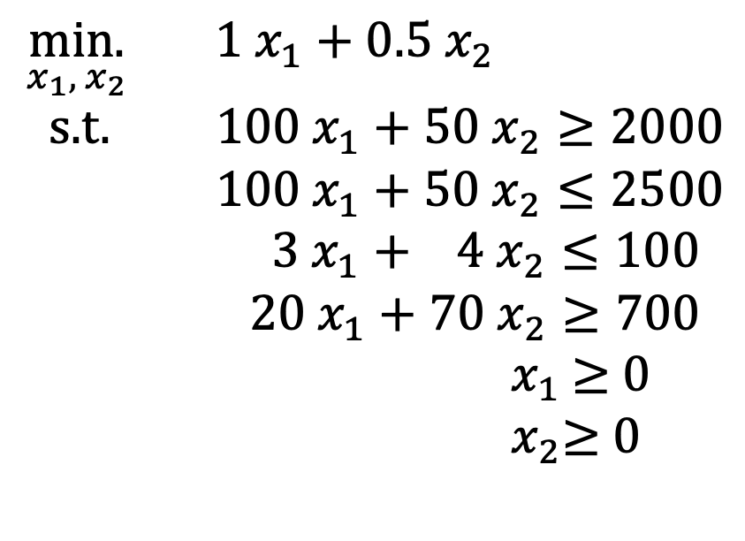

Recall from previous lecture
Non-
negativity
$\underset{x_{1}, { x}_{2}}{min.}{ {1 x}_{1}+0.5 x_{2}}$
s.t. $100 x_{1}+50 x_{2}≥2000$
$100 x_{1}+50 x_{2}≤2500$
$3 x_{1}+ 4 x_{2}≤100$
$20 x_{1}+70 x_{2}≥700$
${ x}_{1}$ $≥$ 0
${ x}_{2}≥$ 0
$$x_{2 }$$
Non-
negativity
$$x_{1}$$
Is the feasible set convex?

Slide 5


Non-
negativity
$$x_{2 }$$
Non-
negativity
$$x_{1}$$

Slide 6
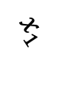

Non-
negativity
What is the leftmost point in the feasible set?
$$x_{2 }$$
Non-
negativity
$$x_{1}$$

Slide 7
Non-
negativity
What is the leftmost point in the feasible set?
$$x_{2 }$$
Non-
negativity
$$x_{1}$$

Slide 8
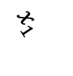

Generalizing this example
Non-
negativity
Consider any linear program
Suppose x = [x₁, x₂] (i.e., it is 2 dimensional)
Assume feasible set is closed
∴ Feasible set is a convex polygon
Consider any direction of minimization
There will be a minimizer at a corner of the polygon
$$x_{2 }$$
Non-
negativity
$$x_{1}$$

Slide 9



But.. what exactly is a “corner”?
Non-
negativity
$\underset{x_{1}, { x}_{2}}{min.}{ {1 x}_{1}+0.5 x_{2}}$
s.t. $100 x_{1}+50 x_{2}≥2000$
$100 x_{1}+50 x_{2}≤2500$
$3 x_{1}+ 4 x_{2}≤100$
$20 x_{1}+70 x_{2}≥700$
${ x}_{1}$ $≥$ 0
${ x}_{2}≥$ 0
$$x_{2 }$$
Non-
negativity
$$x_{1}$$
In two dimensions: A corner is a point where two constraints are met with equality. In other words, it is a point at the intersection of constraint boundaries.

Slide 10
But.. what exactly is a “corner”?
Non-
negativity
But there are 6 constraints in this problem, so there should be 6 choose 2 corners. You are showing us only 4 corners?!
$\underset{x_{1}, { x}_{2}}{min.}{ {1 x}_{1}+0.5 x_{2}}$
s.t. $100 x_{1}+50 x_{2}≥2000$
$100 x_{1}+50 x_{2}≤2500$
$3 x_{1}+ 4 x_{2}≤100$
$20 x_{1}+70 x_{2}≥700$
${ x}_{1}$ $≥$ 0
${ x}_{2}≥$ 0
$$x_{2 }$$
Corners that are feasible
Non-
negativity
$$x_{1}$$
In two dimensions: A corner is a point where two constraints are met with equality. In other words, it is a point at the intersection of constraint boundaries.

Slide 11
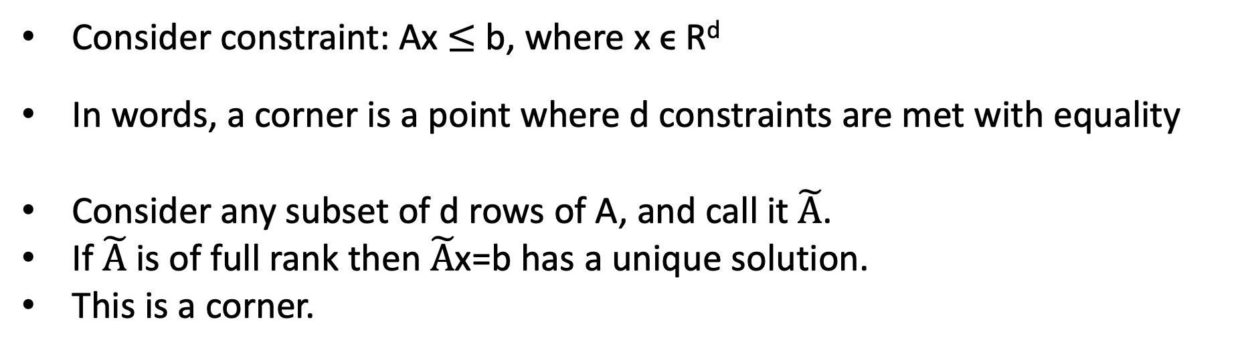
What about higher dimensions?
Consider constraint: Ax $≤$ b, where x ϵ R^{d}
In words, a corner is a point where d constraints are met with equality
Consider any subset of d rows of A, and call it $\tilde{A}$.
If $\tilde{A}$ is of full rank then $\tilde{A}$x=b has a unique solution.
This is a corner.

Slide 12
Solving an LP
Algorithm
Enumerate all intersections (corners).
Keep only those that are feasible (i.e., satisfy all inequalities).
Return feasible intersection with the lowest objective value.
Problem: There may be too many feasible intersections.

Slide 13


Simplex algorithm (intuition)
Non-
negativity
Start at a feasible intersection (if not trivial, can solve another LP to find one)
Define successors as “neighbors” of current intersection
  i.e., remove one row from our square subset of A, and add another row not in the subset; then check feasibility
Move to any successor with lower objective than current intersection
  If no such successors, we are done
$$x_{2 }$$
Non-
negativity
$$x_{1}$$
Greedy local hill-climbing search! … but always finds optimal solution (if defined right)

Slide 14
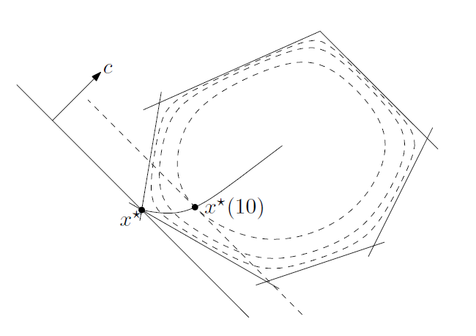
Solving an LP
Remember: Solutions are at feasible intersections of constraint boundaries
Algorithms
Check objective at all feasible intersections
Simplex
Interior point methods
Figure 11.2 from Boyd and Vandenberghe, Convex Optimization

Slide 15
Integer Programs
Another representation

Slide 16
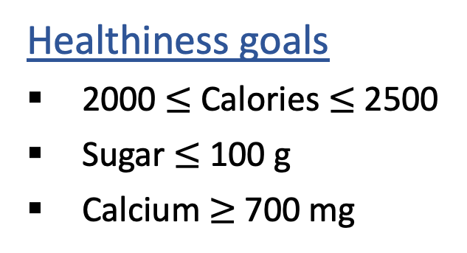
Linear Programming
We are trying healthy by finding the optimal amount of food to purchase.
We can choose the amount of stir-fry (ounce) and boba (fluid ounces).
Food | Cost | Calories | Sugar | Calcium
Stir-fry (per oz) | 1 | 100 | 3 | 20
Boba (per fl oz) | 0.5 | 50 | 4 | 70
Healthiness goals
2000 $≤$ Calories $≤$ 2500
Sugar $≤$ 100 g
Calcium $≥$ 700 mg
What is the cheapest way to stay “healthy” with this menu?
How much stir-fry (ounce) and boba (fluid ounces) should we buy?

Slide 17
Linear Programming → Integer Programming
We are trying healthy by finding the optimal amount of food to purchase.
We can choose the amount of stir-fry (bowls) and boba (glasses).
Food | Cost | Calories | Sugar | Calcium
Stir-fry (per bowl) | 1 | 100 | 3 | 20
Boba (per glass) | 0.5 | 50 | 4 | 70
Healthiness goals
2000 $≤$ Calories $≤$ 2500
Sugar $≤$ 100 g
Calcium $≥$ 700 mg
What is the cheapest way to stay “healthy” with this menu?
How much stir-fry (bowls) and boba (glasses) should we buy?

Slide 18
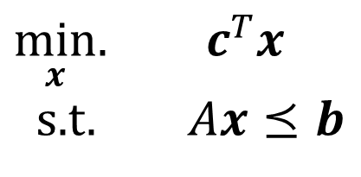
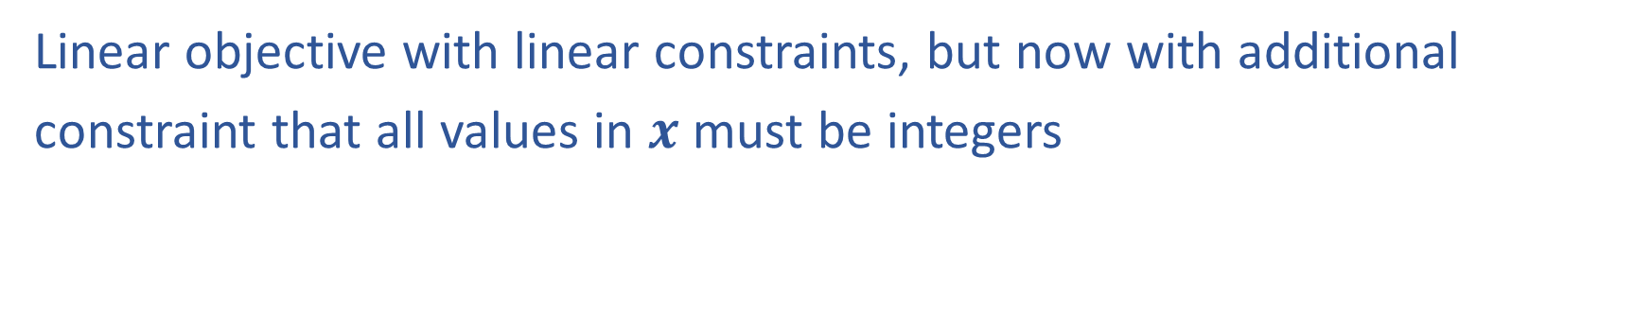
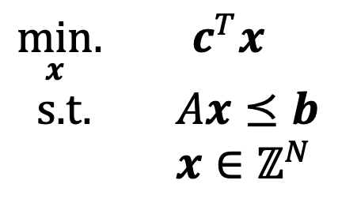
Linear Programming vs Integer Programming
Linear objective with linear constraints, but now with additional
constraint that all values in $x$ must be integers
$\min_{x}.{ c^{T}x}$
s.t. $Ax⪯b$
$\min_{x}.{ c^{T}x}$
s.t. $Ax⪯b$
$x∈ℤ^{N}$
We could also do:
Binary Integer Programming: Constraints restrict each entry of x to take values in {0,1}
Mixed Integer Linear Programming: Some variables have integer constraints and some don’t

Slide 19
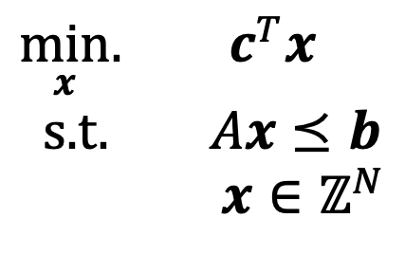
Solving integer programs
$\min_{x}.{ c^{T}x}$
s.t. $Ax⪯b$
$x∈ℤ^{N}$
Relax the integer program to a linear program by simply dropping integer constraints
We know how to solve linear programming problems.
Can we just solve this LP and use the output as our solution for the IP?
Problem: The solution to the LP may not be integer valued.

Slide 20
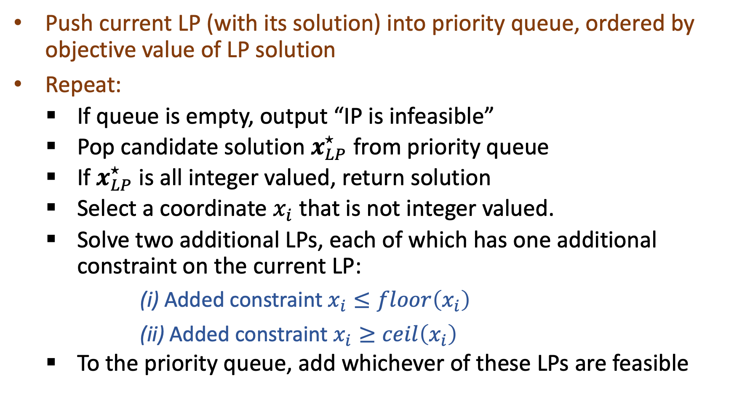
Branch and Bound algorithm
Push current LP (with its solution) into priority queue, ordered by objective value of LP solution
Repeat:
    If queue is empty, output “IP is infeasible”
    Pop candidate solution $x_{LP}^{⋆}$ from priority queue
    If $x_{LP}^{⋆}$ is all integer valued, return solution
    Select a coordinate $x_{i}$ that is not integer valued.
    Solve two additional LPs, each of which has one additional constraint on the current LP:
(i) Added constraint $x_{i}≤floor\left(x_{i}\right)$
(ii) Added constraint $x_{i}≥ceil\left(x_{i}\right)$
    To the priority queue, add whichever of these LPs are feasible

Slide 21
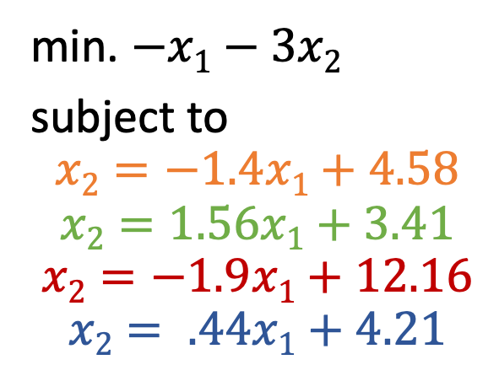
Example
min. $−x1−3x2$
subject to
$$x2=−1.4x1+4.58$$
$$x2=1.56x1+3.41$$
$$x2=−1.9x1+12.16$$
$$x2= .44x1+4.21$$
(3.4,5.7)
(.2,4.3)
(4.5,3.61)
x₂
What is the LP solution?
(2.7,0.8)
C =[-1,-3]
x₁
Notes:
LP* = -20.5 @ 3.4,5.7

Slide 22
min. $−x1−3x2$
subject to
$$x2=−1.4x1+4.58$$
$$x2=1.56x1+3.41$$
$$x2=−1.9x1+12.16$$
$$x2= .44x1+4.21$$
(3.4,5.7)
(.2,4.3)
(4.5,3.61)
Priority Queue:
-20.5: (3.4,5.7)
x₂
(2.7,0.8)
C =[-1,-3]
x₁
Notes:
LP* = -20.5 @ 3.4,5.7

Slide 23
min. $−x1−3x2$
subject to
$$x2=−1.4x1+4.58$$
$$x2=1.56x1+3.41$$
$$x2=−1.9x1+12.16$$
$$x2= .44x1+4.21$$
(3.4,5.7)
(.2,4.3)
(4.5,3.61)
Priority Queue:
-20.5: (3.4,5.7)
-19.6: (3,5.53) (x <= 3)
-17.7: (4,4.56) (x >=4)
x₂
(2.7,0.8)
C =[-1,-3]
x₁
Notes:
LP* = -20.5 @ 3.4,5.7

Slide 24
min. $−x1−3x2$
subject to
$$x2=−1.4x1+4.58$$
$$x2=1.56x1+3.41$$
$$x2=−1.9x1+12.16$$
$$x2= .44x1+4.21$$
(3.4,5.7)
(.2,4.3)
(4.5,3.61)
Priority Queue:
-20.5: (3.4,5.7)
-19.6: (3,5.53) (x <= 3)
-17.7: (4,4.56) (x >=4)
-18.0: (3,5) (x<=3,y<=5)
Inf: (x<=3,y>=6)
x₂
(2.7,0.8)
C =[-1,-3]
Why do we not need to recurse on -17.7?
x₁
Notes:
LP* = -20.5 @ 3.4,5.7

Slide 25
Convex optimization
Another representation…there is an entire course on this! 10-725

Slide 26
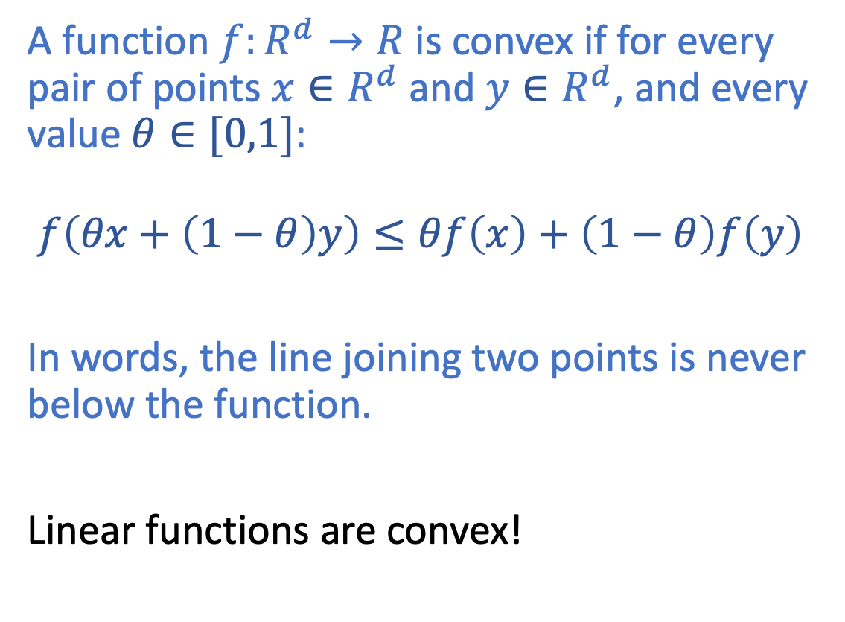
Convex functions
A function $f:R^{d}→R$ is convex if for every pair of points ${x∈R}^{d}$ and ${y∈R}^{d}$, and every value $θ∈[0,1]$:
$f\left(θx+\left(1−θ\right)y\right)≤θf\left(x\right)+\left(1−θ\right)f\left(y\right)$
In words, the line joining two points is never below the function.
Linear functions are convex!

Slide 27
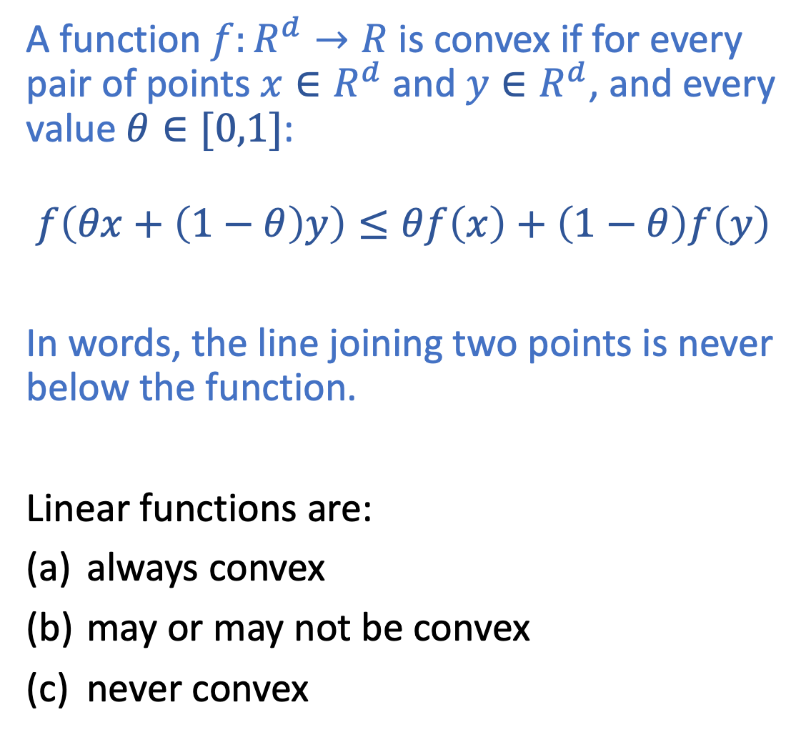
Convex functions
A function $f:R^{d}→R$ is convex if for every pair of points ${x∈R}^{d}$ and ${y∈R}^{d}$, and every value $θ∈[0,1]$:
$f\left(θx+\left(1−θ\right)y\right)≤θf\left(x\right)+\left(1−θ\right)f\left(y\right)$
In words, the line joining two points is never below the function.
Linear functions are:
always convex
may or may not be convex
never convex

Slide 28
Convex optimization
An optimization problem is a convex optimization problem if the objective is a convex function and the feasible set is a convex set.
Are linear programming problems also convex optimization problems?
Yes.
Are integer programming problems also convex optimization problems?
No.
Very useful property of convex optimization: any local minimum is also the global minimum

Slide 29
Convex optimization
An optimization problem is a convex optimization problem if the objective is a convex function and the feasible set is a convex set.
Very useful property of convex optimization: any local minimum is also the global minimum
Greedy (“gradient descent”) works!

Slide 30

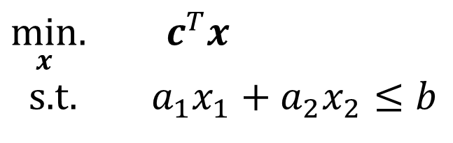
Poll 1
Consider a linear program of the following form with exactly one constraint, and assume c is not 0. Then it will always have a minimum objective value of $−∞$.
$\min_{x}.{ c^{T}x}$
s.t. $a_{1}x_{1}+a_{2}x_{2}≤b$
(True or False)

Slide 31
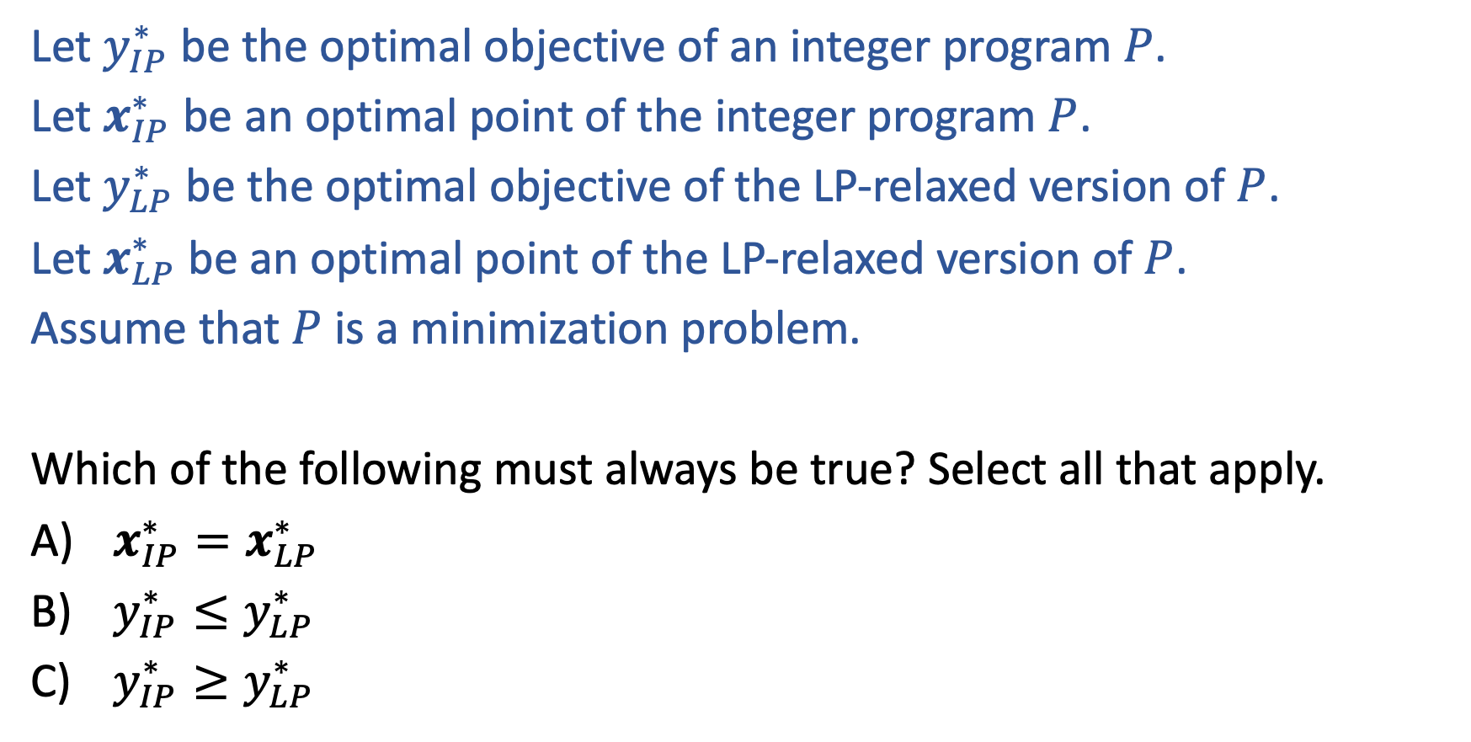
Poll 2:
Let $y_{IP}^{∗}$ be the optimal objective of an integer program $P$.
Let $x_{IP}^{∗}$ be an optimal point of the integer program $P$.
Let $y_{LP}^{∗}$ be the optimal objective of the LP-relaxed version of $P$.
Let $x_{LP}^{∗}$ be an optimal point of the LP-relaxed version of $P$.
Assume that $P$ is a minimization problem.
Which of the following must always be true? Select all that apply.
$x_{IP}^{∗}=x_{LP}^{∗}$
$y_{IP}^{∗}≤y_{LP}^{∗}$
$y_{IP}^{∗}≥y_{LP}^{∗}$

