Slide 1
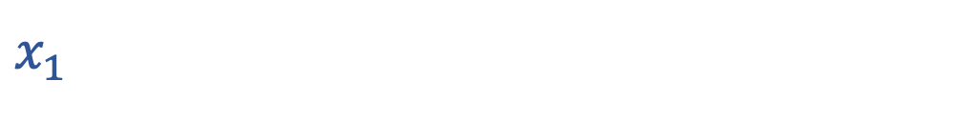

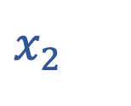
As you come in…
Draw a graph with $x_{1}$ as the x-axis and $x_{2}$ as the y-axis.
You can restrict attention to x₁ ≥ 0, x₂ ≥ 0.
Mark the region where $3 x_{1}+ 4 x_{2}≤100$.
…
40
$x_{2}$
30
20
10
0
10
20
30
40
…
$x_{1}$

Slide 2
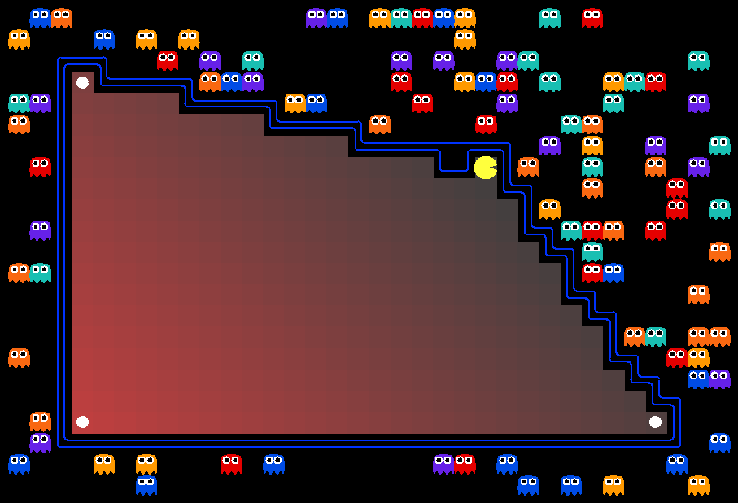
AI: Representation and Problem Solving
Optimization
&
Linear Programming
Instructors: Nihar Shah and Tuomas Sandholm
Slide credits: CMU AI with some drawings from ai.berkeley.edu

Slide 3
Optimization: BIG PICTURE

Slide 4

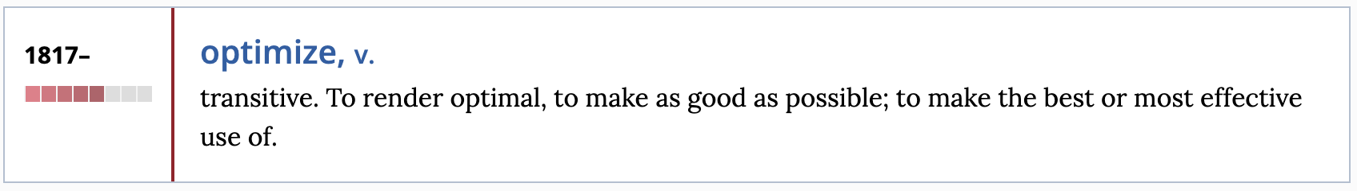
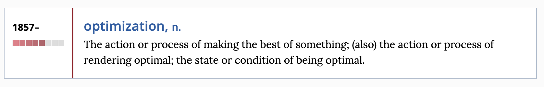

Slide 5
Optimization
minimize (or maximize) something
subject to some constraints

Slide 6
Optimization
“How much time to spend on this course?”
maximize your learning (or your grade)
subject to also having a life outside of work

Slide 7
Optimization
“How much time to spend on this course?”
maximize time spent on course
subject to at least blah time for blah activities
objective
how you spend your time
optimization variable(s): this is what you can choose
constraint(s)

Slide 8
Optimization
“How much time to spend on this course?”
maximize
subject to x₁ = 3, x₃ ≥ blah, x₄ ≥ blah,
x₁ + x₂ + x₃ + x₄ = 24*7
x₁ ≥ 0, x₂ ≥ 0, x₃ ≥ 0, x₄ ≥ 0
x₁ + x₂
x₁, x_{2,} x₃, x₄
x₁: time spent in 281’s lectures
x₂: time spent on 281 outside lectures
x₃: sleeping, eating, …
x₄: spending time with friends, …

Slide 9

Optimization: Many, many applications
Machine Learning / Natural language processing (including ChatGPT )
Operations research (e.g., making airline schedules)
Telecommunications
Finance
Power systems
Healthcare
and many more.

Slide 10

Optimization recipe
You have a real-world problem to solve
First write it mathematically as an optimization problem
There are many optimization “solvers” available online – can use them
  e.g., Gurobi, scipy.optimize, cvxpy, …
There are specific representations of optimization problems for which specialized, more efficient algorithms are known.
  e.g., linear programs, integer programs, …
Check if your problem has such a representation. If not, check if you can transform your problem to such a representation. If so, use the relevant solver.
  e.g., scipy.optimize.linprog
  Otherwise use a generic solver
freepik.com

Slide 11
Linear Programs
A specific representation

Slide 12
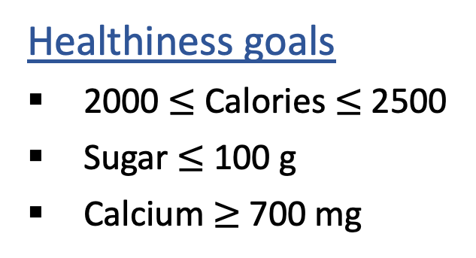
Another example: What to eat?
We are staying healthy by finding the optimal amount of food to purchase.
We can choose the amount of stir-fry (ounce) and boba (fluid ounces).
Food | Cost | Calories | Sugar | Calcium
Stir-fry (per oz) | 1 | 100 | 3 | 20
Boba (per fl oz) | 0.5 | 50 | 4 | 70
Healthiness goals
2000 $≤$ Calories $≤$ 2500
Sugar $≤$ 100 g
Calcium $≥$ 700 mg
What is the cheapest way to stay “healthy” with this menu?
How much stir-fry (ounce) and boba (fluid ounces) should we buy?

Slide 13
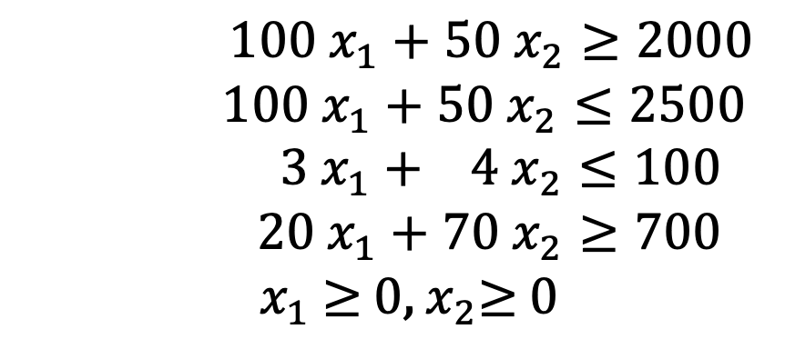

We can choose the amount of stir-fry (ounce) and boba (fluid ounces)
Food | Cost | Calories | Sugar | Calcium
Stir-fry (per oz) | 1 | 100 | 3 | 20
Boba (per fl oz) | 0.5 | 50 | 4 | 70
2000 $≤$ Calories $≤$ 2500
Sugar $≤$ 100 g
Calcium $≥$ 700 mg
What is the cheapest way to stay “healthy” with this menu?
How much stir-fry (ounce) and boba (fluid ounces) should we buy?
Variables?
Amount of stir-fry and boba
x₁
x₂
Objective?
Cost
1*x₁ + 0.5*x₂
Constraints?
Calories min
Calories max
Sugar
Calcium
Non-negativity
$$100 x_{1}+50 x_{2}≥2000$$
$100 x_{1}+50 x_{2}≤2500$
$3 x_{1}+ 4 x_{2}≤100$
$20 x_{1}+70 x_{2}≥700$
${ x}_{1}$ $≥$ 0,${ x}_{2}≥$ 0

Slide 14
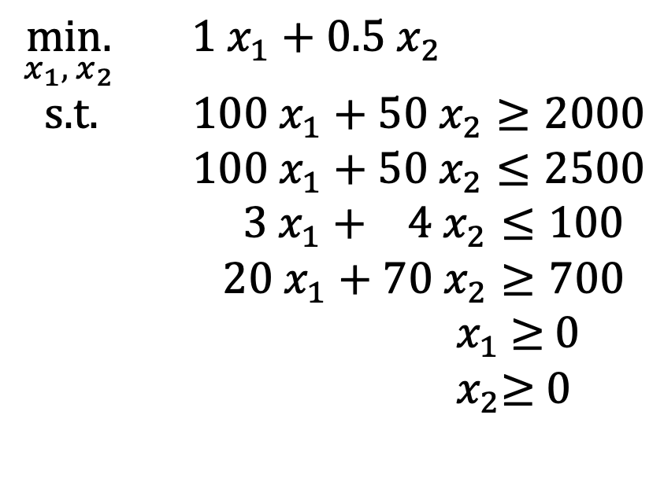
We can choose the amount of stir-fry (ounce) and boba (fluid ounces)
Food | Cost | Calories | Sugar | Calcium
Stir-fry (per oz) | 1 | 100 | 3 | 20
Boba (per fl oz) | 0.5 | 50 | 4 | 70
2000 $≤$ Calories $≤$ 2500
Sugar $≤$ 100 g
Calcium $≥$ 700 mg
What is the cheapest way to stay “healthy” with this menu?
How much stir-fry (ounce) and boba (fluid ounces) should we buy?
$\underset{x_{1}, { x}_{2}}{min.}{ {1 x}_{1}+0.5 x_{2}}$
s.t. $100 x_{1}+50 x_{2}≥2000$
$100 x_{1}+50 x_{2}≤2500$
$3 x_{1}+ 4 x_{2}≤100$
$20 x_{1}+70 x_{2}≥700$
${ x}_{1}$ $≥$ 0
${ x}_{2}≥$ 0

Slide 15
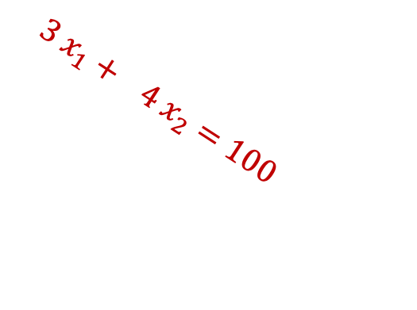
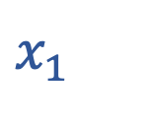
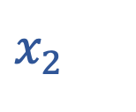
Let’s look at any one constraint
$$3 x_{1}+ 4 x_{2}≤100$$
In two dimensions, constraint is simply entire region on one side of a line!
“Linear constraint”
…
40
False
$x_{2}$
30
20
True
10
$$3 x_{1}+ 4 x_{2}=100$$
0
10
20
30
40
…
$x_{1}$

Slide 16
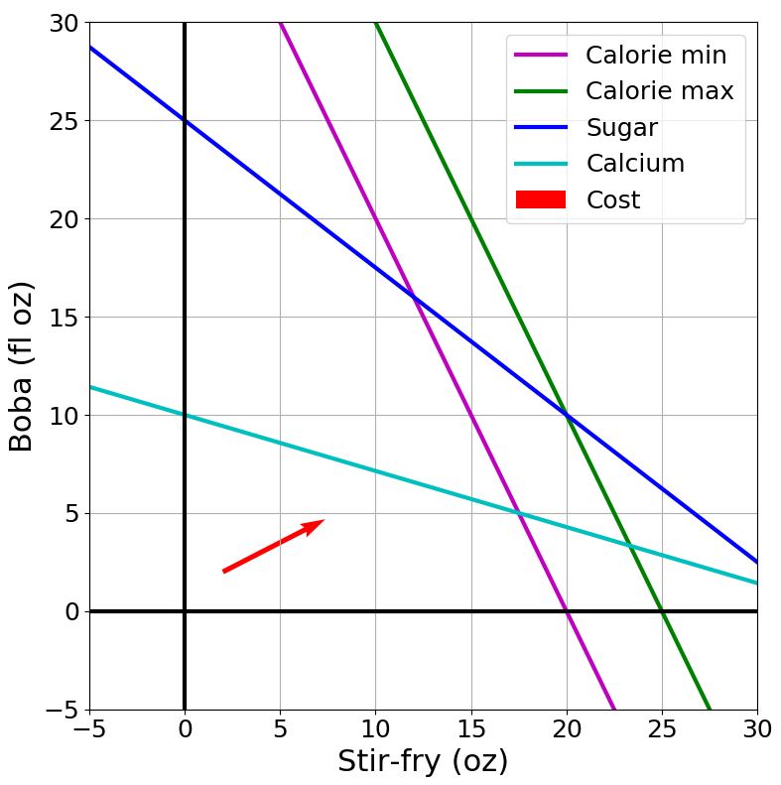
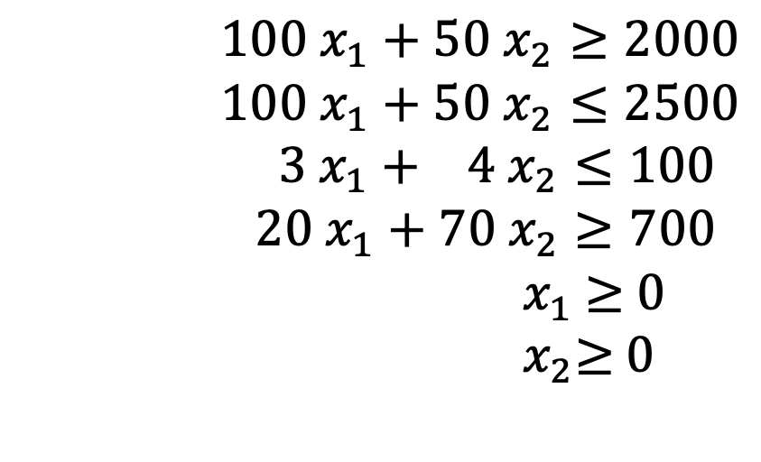


Our constraints are linear
Non-
negativity
Calories min
Calories max
Sugar
Calcium
Non-negativity
$100 x_{1}+50 x_{2}≥2000$
$100 x_{1}+50 x_{2}≤2500$
$3 x_{1}+ 4 x_{2}≤100$
$20 x_{1}+70 x_{2}≥700$
${ x}_{1}$ $≥$ 0
${ x}_{2}≥$ 0
$$x_{2 }$$
Non-
negativity
$$x_{1}$$

Slide 17
Our constraints are linear
Non-
negativity
Calories min
Calories max
Sugar
Calcium
Non-negativity
$100 x_{1}+50 x_{2}≥2000$
$100 x_{1}+50 x_{2}≤2500$
$3 x_{1}+ 4 x_{2}≤100$
$20 x_{1}+70 x_{2}≥700$
${ x}_{1}$ $≥$ 0
${ x}_{2}≥$ 0
$$x_{2 }$$
Non-
negativity
$$x_{1}$$
“feasible region”: this is where all constraints are satisfied

Slide 18
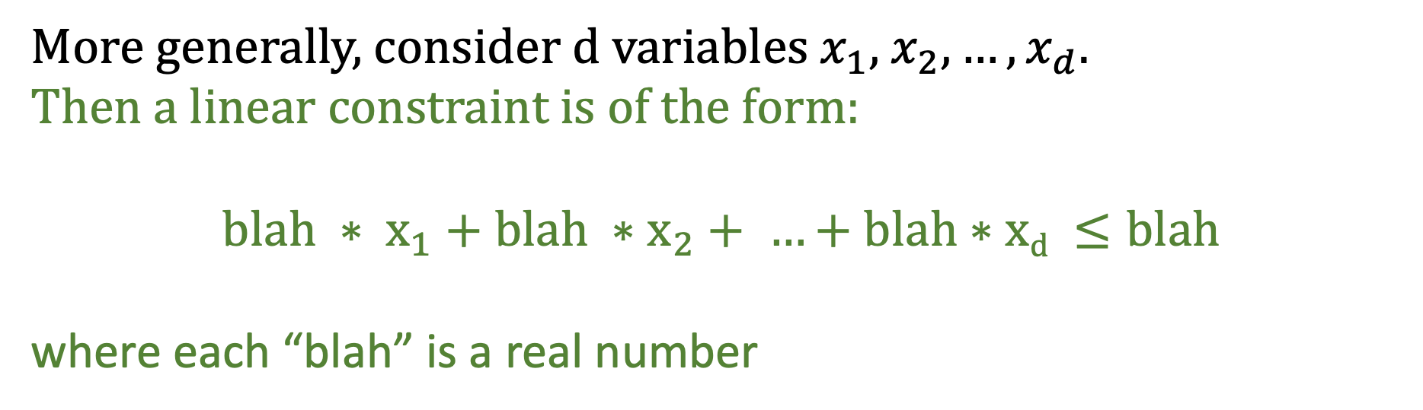
Mathematical representation of linear constraints
Our problem had 2 variables, and constraints like $3 x_{1}+ 4 x_{2}≤100$
More generally, consider d variables $x_{1}$, $x_{2},…,x_{d}$.
Then a linear constraint is of the form:
$$blah ∗ x_{1}+blah ∗x_{2}+ …+blah∗xd ≤blah$$
where each “blah” is a real number

Slide 19
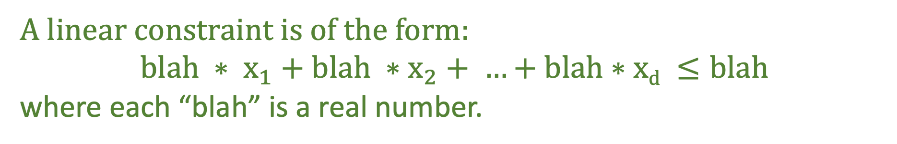

A linear constraint is of the form:
$$blah ∗ x_{1}+blah ∗x_{2}+ …+blah∗xd ≤blah$$
where each “blah” is a real number.
Are our constraints linear?
Calories min
Calories max
Sugar
Calcium
Non-negativity
$100 x_{1}+50 x_{2}≥2000$
$100 x_{1}+50 x_{2}≤2500$
$3 x_{1}+ 4 x_{2}≤100$
$20 x_{1}+70 x_{2}≥700$
${ x}_{1}$ $≥$ 0
${ x}_{2}≥$ 0
First constraint: $100 x_{1}+50 x_{2}≥2000$
Equivalent constraint: $−100 x_{1}−50 x_{2}≤−2000$

Slide 20
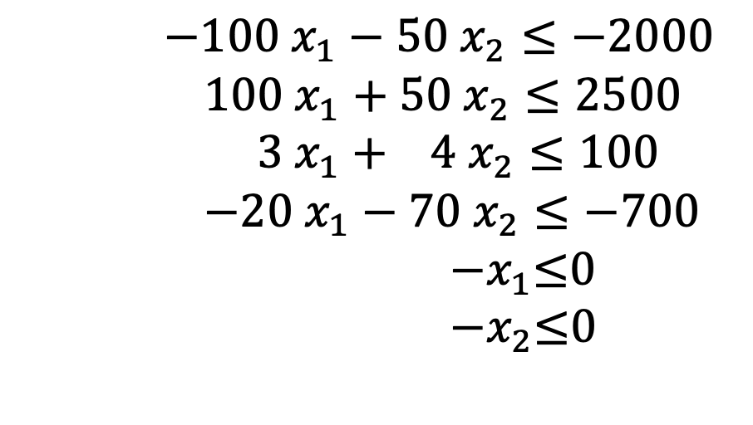
A linear constraint is of the form:
$$blah ∗ x_{1}+blah ∗x_{2}+ …+blah∗xd ≤blah$$
where each “blah” is a real number.
Are our constraints linear?
Calories min
Calories max
Sugar
Calcium
Non-negativity
$−100 x_{1}−50 x_{2}≤−2000$
$100 x_{1}+50 x_{2}≤2500$
$3 x_{1}+ 4 x_{2}≤100$
$−20 x_{1}−70 x_{2}≤−700$
${ −x}_{1}≤$0
${ −x}_{2}≤$0
Yes!

Slide 21
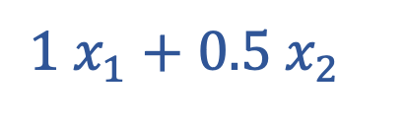

Now let’s stare at our objective
$${1 x}_{1}+0.5 x_{2}$$
$$💡$$
Seems to have a familiar form
$$blah ∗ x_{1}+blah ∗x_{2}+ …+blah∗xd$$
“Linear objective”
Let’s look at it on a graph…

Slide 22
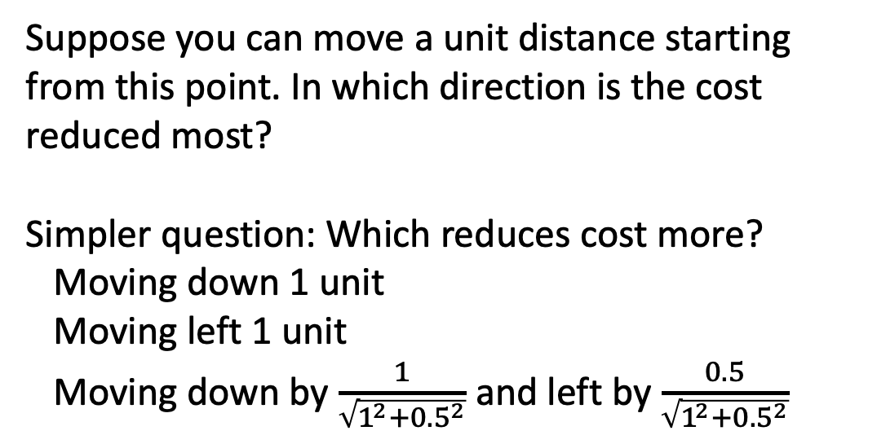

Now let’s look at our objective
min. ${1 x}_{1}+0.5 x_{2}$
Suppose you can move a unit distance starting from this point. In which direction is the cost reduced most?
Simpler question: Which reduces cost more?
Moving down 1 unit
Moving left 1 unit
Moving down by $\frac{1}{\sqrt{1^{2}+{0.5}^{2}}}$ and left by $\frac{0.5}{\sqrt{1^{2}+{0.5}^{2}}}$
…
40
$x_{2}$
30
20
10
0
10
20
30
40
…
$x_{1}$
Third option actually results in max decrease
∴Keep going along this line to keep reducing cost
“Linear” objective

Slide 23
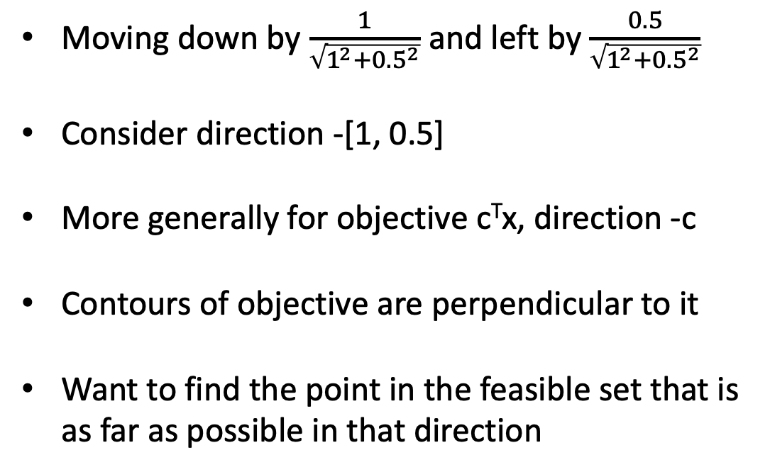
Now let’s look at our objective
min. ${1 x}_{1}+0.5 x_{2}$
Moving down by $\frac{1}{\sqrt{1^{2}+{0.5}^{2}}}$ and left by $\frac{0.5}{\sqrt{1^{2}+{0.5}^{2}}}$
Consider direction -[1, 0.5]
More generally for objective c^{T}x, direction -c
Contours of objective are perpendicular to it
Want to find the point in the feasible set that is as far as possible in that direction
…
40
objective = 45
$x_{2}$
30
objective = 37
objective = 29
20
10
0
10
20
30
40
…
$x_{1}$

Slide 24
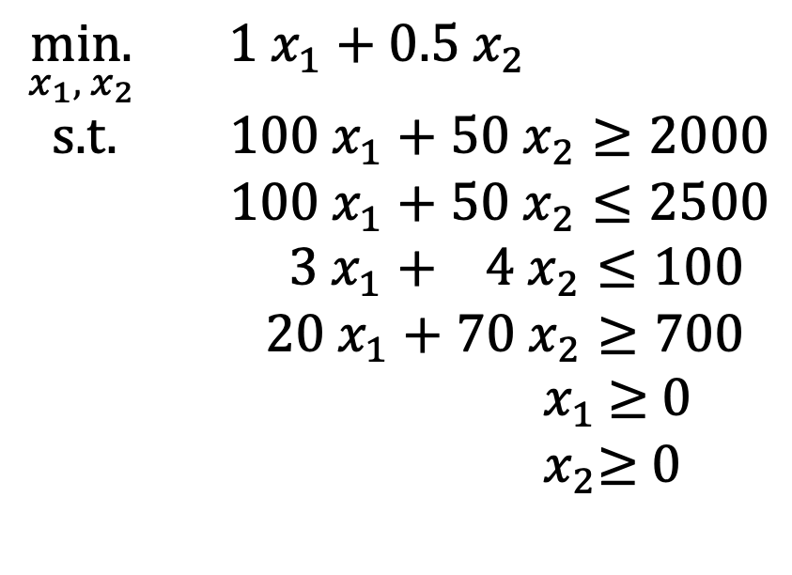
Putting it back together
Non-
negativity
$\underset{x_{1}, { x}_{2}}{min.}{ {1 x}_{1}+0.5 x_{2}}$
s.t. $100 x_{1}+50 x_{2}≥2000$
$100 x_{1}+50 x_{2}≤2500$
$3 x_{1}+ 4 x_{2}≤100$
$20 x_{1}+70 x_{2}≥700$
${ x}_{1}$ $≥$ 0
${ x}_{2}≥$ 0
$$x_{2 }$$
Non-
negativity
$$x_{1}$$

Slide 25
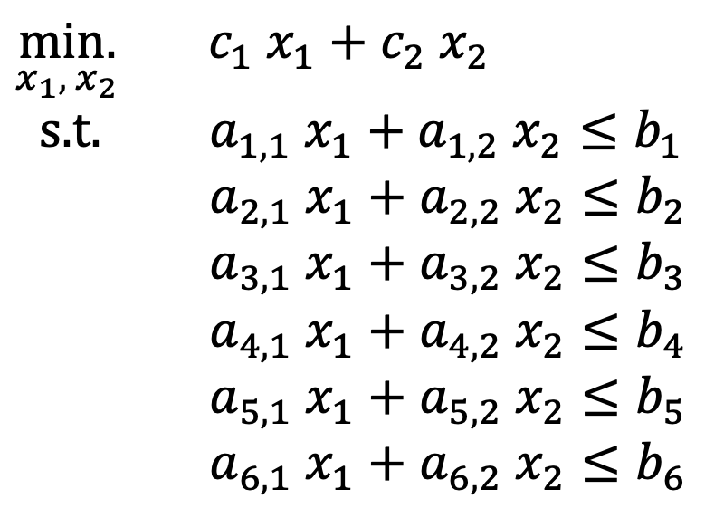
More generally
Non-
negativity
$\underset{x_{1}, { x}_{2}}{min.}{ {c_{1} x}_{1}+c_{2} x_{2}}$
s.t. $a_{1,1} x_{1}+a_{1,2} x_{2}≤b_{1}$
$a_{2,1} x_{1}+a_{2,2} x_{2}≤b_{2}$
$a_{3,1} x_{1}+a_{3,2} x_{2}≤b_{3}$
$a_{4,1} x_{1}+a_{4,2} x_{2}≤b_{4}$
$a_{5,1} x_{1}+a_{5,2} x_{2}≤b_{5}$
$a_{6,1} x_{1}+a_{6,2} x_{2}≤b_{6}$
$$x_{2 }$$
Non-
negativity
$$x_{1}$$

Slide 26
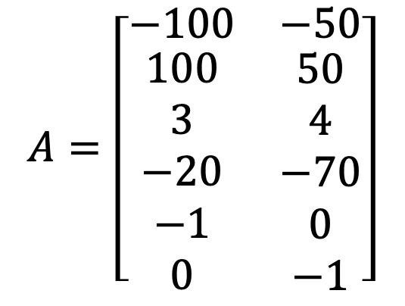
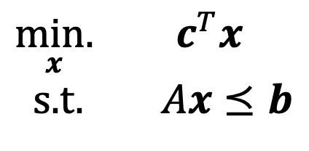

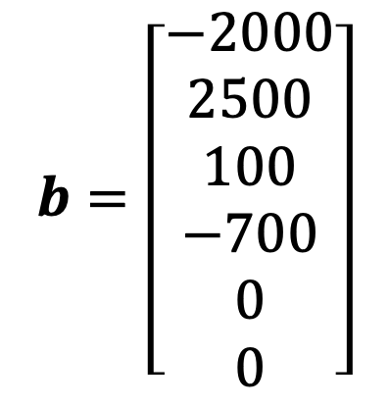
Even more generally, a linear program is…
$\underset{x}{min.}{ c^{T}x}$
s.t. $Ax⪯b$
Stir-fry
Boba
$$A=\left[\begin{matrix}−100 & −50 \\ \begin{aligned}100 \\ 3 \\ −20 \\ −1 \\ 0\end{aligned} & \begin{aligned}50 \\ 4 \\ −70 \\ 0 \\ −1\end{aligned}\end{matrix}\right]$$
$$b=\left[\begin{aligned}−2000 \\ 2500 \\ 100 \\ −700 \\ 0 \\ 0\end{aligned}\right]$$
Calorie min
$$c=\left[\begin{aligned}1 \\ 0.5\end{aligned}\right]$$
Calorie max
Sugar
Calcium
Non-negativity

Slide 27
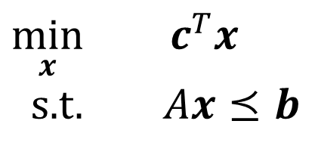
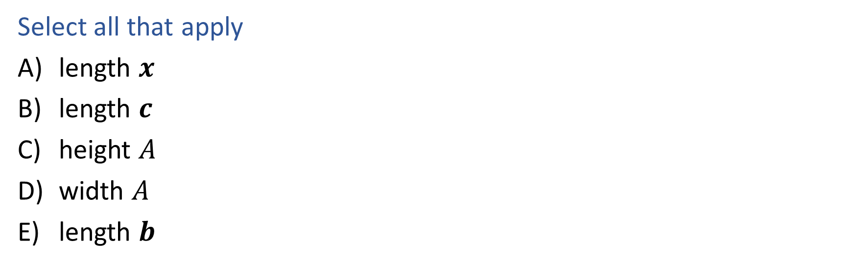
Question 1
What has to increase to add more nutrition constraints?
$\min_{x}{ c^{T}x}$
s.t. $Ax⪯b$
Select all that apply
length $x$
length $c$
height $A$
width $A$
length $b$
Notes:
C and E

Slide 28
Question 2
What has to increase to add more menu items?
$\min_{x}{ c^{T}x}$
s.t. $Ax⪯b$
Select all that apply
length $x$
length $c$
height $A$
width $A$
length $b$
Notes:
A, B, D

Slide 29
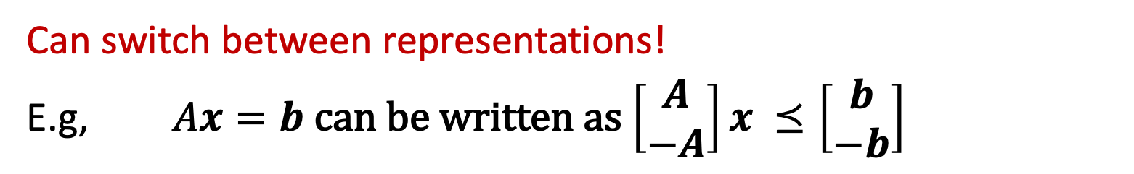
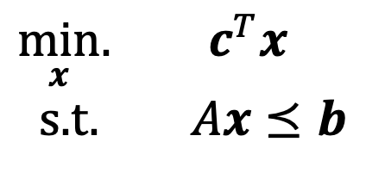
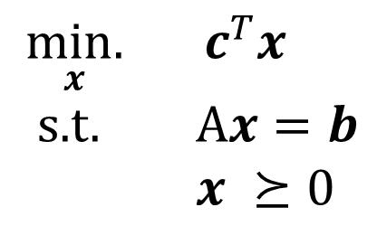
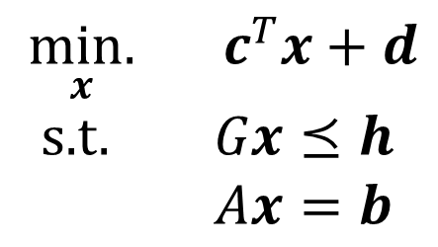
Linear Programming
Different representations
Inequality form
General form
Standard form
$\min_{x}.{ c^{T}x}$
s.t. $Ax⪯b$
$\underset{x}{min.}{ c^{T}x}+d$
s.t. $Gx⪯h$
$Ax=b$
$\underset{x}{min.}{ c^{T}x}$
s.t. A$x=b$
$x ⪰0$
Can switch between representations!
E.g, $Ax=b$ can be written as $\left[\begin{matrix}A \\ −A\end{matrix}\right]x ⪯\left[\begin{matrix}b \\ −b\end{matrix}\right]$

Slide 30
Optimization: General form

Slide 31
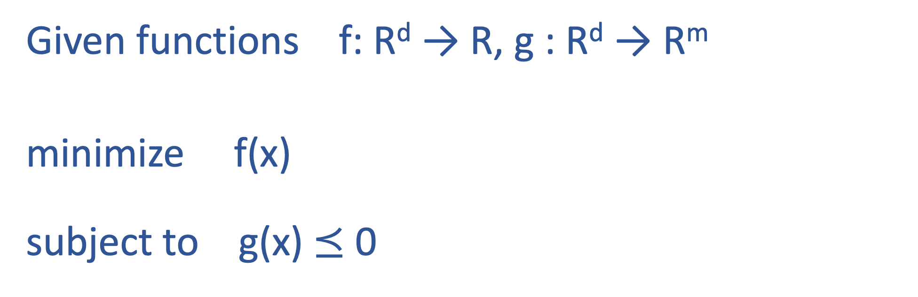
Optimization: General form
Given functions f: R^{d} → R, g : R^{d} → R^{m}
minimize f(x)
subject to g(x) $⪯$ 0
x ϵ R^{d}

Slide 32
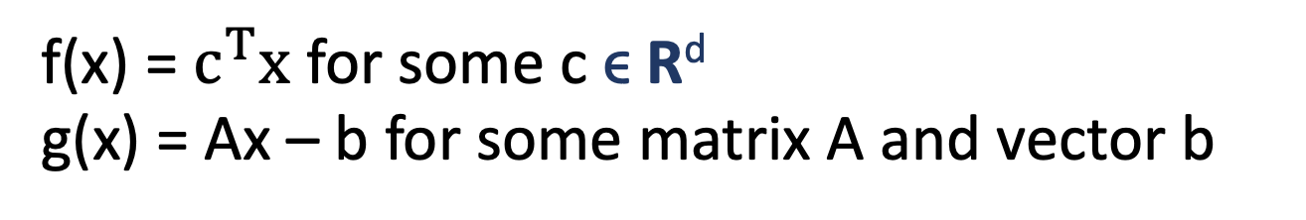
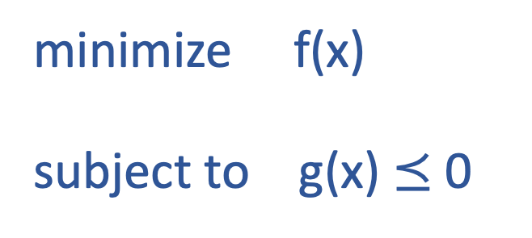
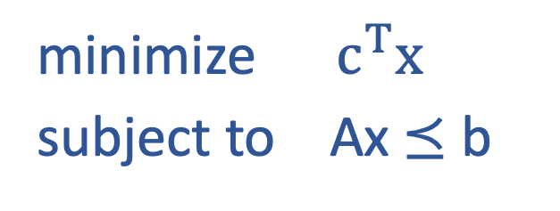
General form
minimize f(x)
subject to g(x) $⪯$ 0
x ϵ R^{d}
Linear program
f(x) = $c^{T}x$ for some c ϵ R^{d}
g(x) = Ax – b for some matrix A and vector b
minimize ${ c}^{T}x$
subject to Ax $⪯$ b
x ϵ R^{d}

Slide 33
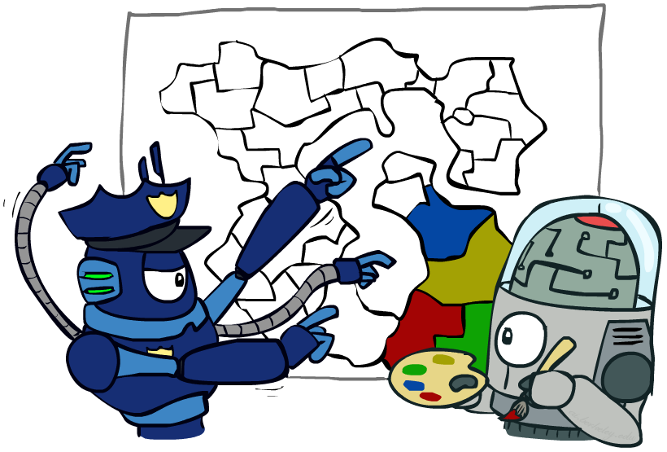

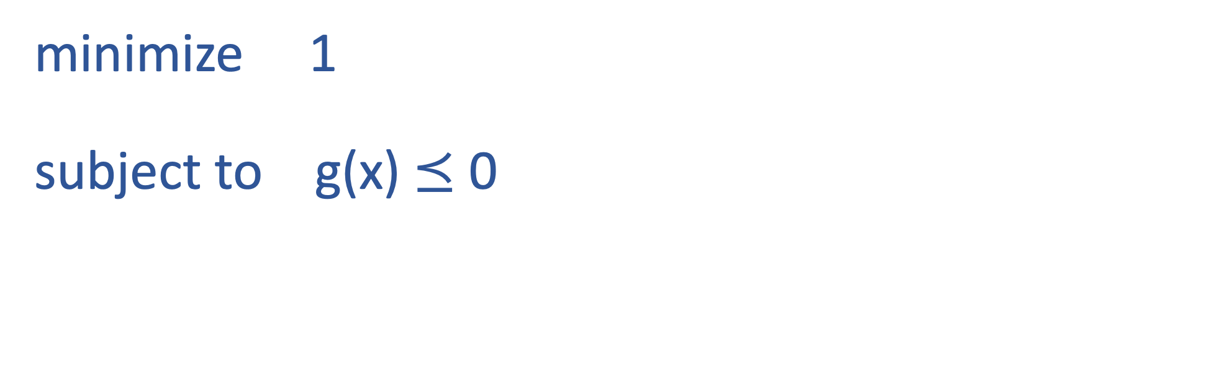
Special case: Constraint Satisfaction Problems
Is there any x which satisfies the constraints?
E.g., map coloring problem
$Find any{ x}$ s.t. $x satisfies constraints$
minimize 1
subject to g(x) $⪯$ 0
x ϵ R^{d}

Slide 34
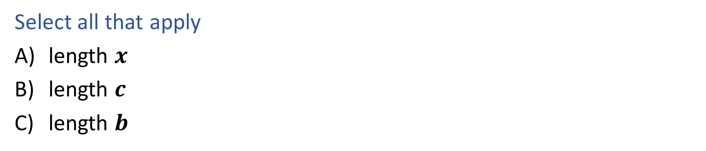
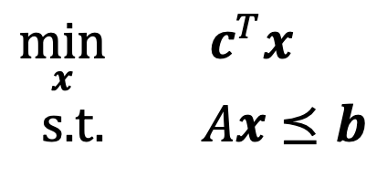
Poll
$\min_{x}{ c^{T}x}$
s.t. $Ax⪯b$
If $A∈ℝ^{M×N}$, which of the following also equals $N$?
Select all that apply
length $x$
length $c$
length $b$

