Slide 1
Plan
Last time
Tree search vs graph search
BFS, DFS, Uniform cost search, iterative deepening search
Today
Heuristics
Greedy search
A* search
    Optimality
More on heuristics

Slide 2
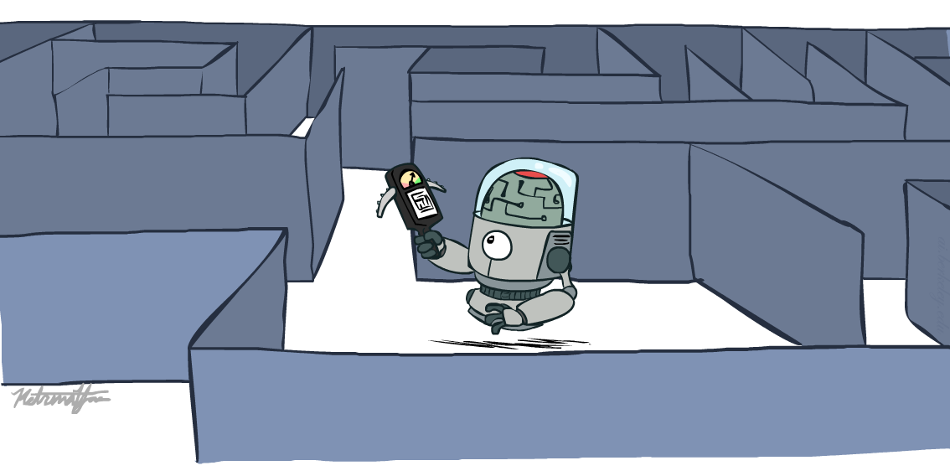
AI: Representation and Problem Solving
Informed Search
Instructor: Tuomas Sandholm and Nihar Shah
Slide credits: CMU AI, http://ai.berkeley.edu

Slide 3
Breadth-First Search (BFS) Properties
What nodes does BFS expand?
  Processes all nodes above shallowest solution
  Let depth of shallowest solution be s
  Search takes time O(b^{s})
How much space does the frontier take?
  Has roughly the last tier, so O(b^{s})
Is it complete?
  s must be finite if a solution exists, so yes!
Is it optimal?
  Only if costs are all the same (more on costs later)
1 node
b
…
b nodes
s tiers
b² nodes
b^{s} nodes
b^{m} nodes

Slide 4
Uniform Cost Search (UCS) Properties
What nodes does UCS expand?
  Processes all nodes with cost less than cheapest solution
  If that solution costs C* and step costs are at least ε , then the “effective depth” is roughly C*/ε
  Takes time O(b^{C*/ε}) (exponential in effective depth)
How much space does the frontier take?
  Has roughly the last tier, so O(b^{C*/ε})
Is it complete?
  Assuming best solution has a finite cost and minimum step cost is positive, yes!
Is it optimal?
  Yes! (Proof via A*)
b
c ≤ 1
…
C*/ε “tiers”
c ≤ 2
c ≤ 3

Slide 5
Uniform Cost Issues
Strategy:
Explore (expand) the lowest path cost on frontier
The good:
UCS is complete and optimal!
The bad:
  Explores options in every “direction”
  No information about goal location
We’ll fix that today!
…
c ≤ 1
c ≤ 2
c ≤ 3
Start
Goal

Slide 6
function GRAPH-SEARCH(problem) returns a solution, or failure
initialize the explored set to be empty
initialize the frontier as a priority queue using some metric as the priority
add initial state of problem to frontier with initial metric = 0
loop do
if the frontier is empty then
return failure
choose a node and remove it from the frontier
if the node contains a goal state then
return the corresponding solution
add the node state to the explored set
for each resulting child from node
if the child state is not already in the frontier or explored set then
add child to the frontier
else if the child is already in the frontier with worse metric then
replace that frontier node with child

Slide 7
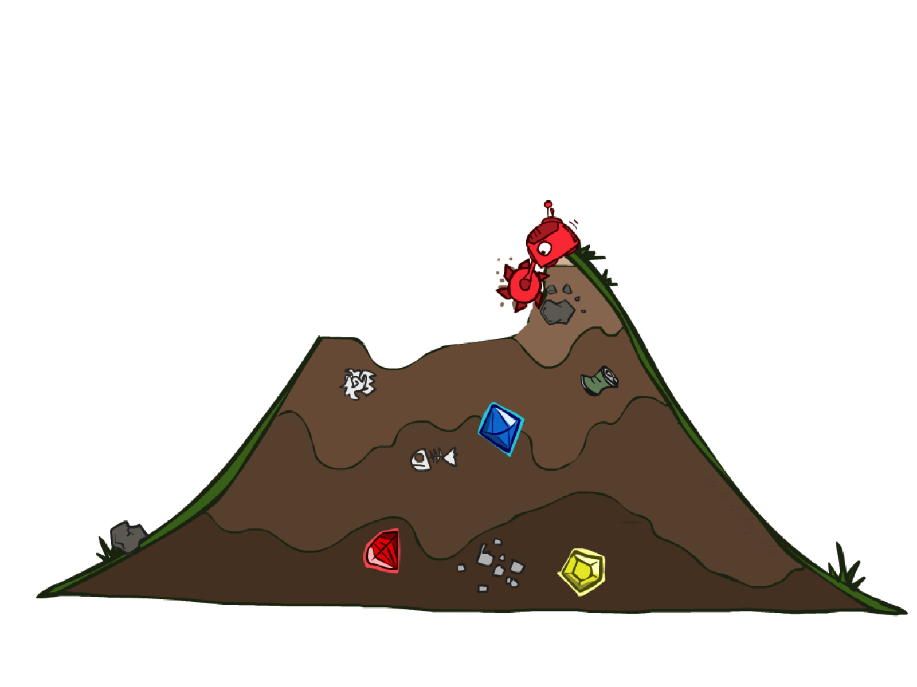
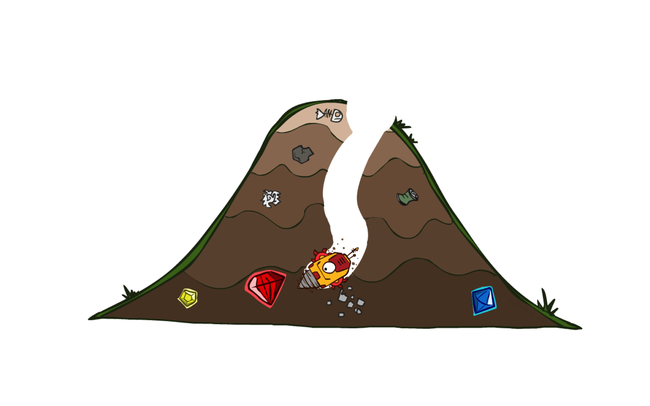
Uninformed vs Informed Search

Slide 8

Today
Informed Search
  Heuristics
  Greedy Search
  A* Search

Slide 9
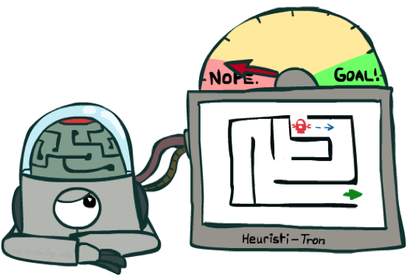
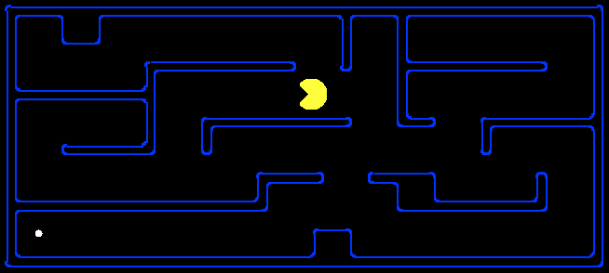
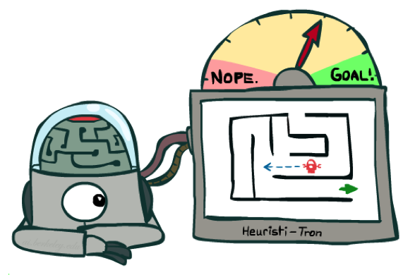
Search Heuristics
A heuristic is:
A function that estimates how close a state is to a goal
Designed for a particular search problem
Examples: Manhattan distance, Euclidean distance for pathing
10
5
11.2

Slide 10
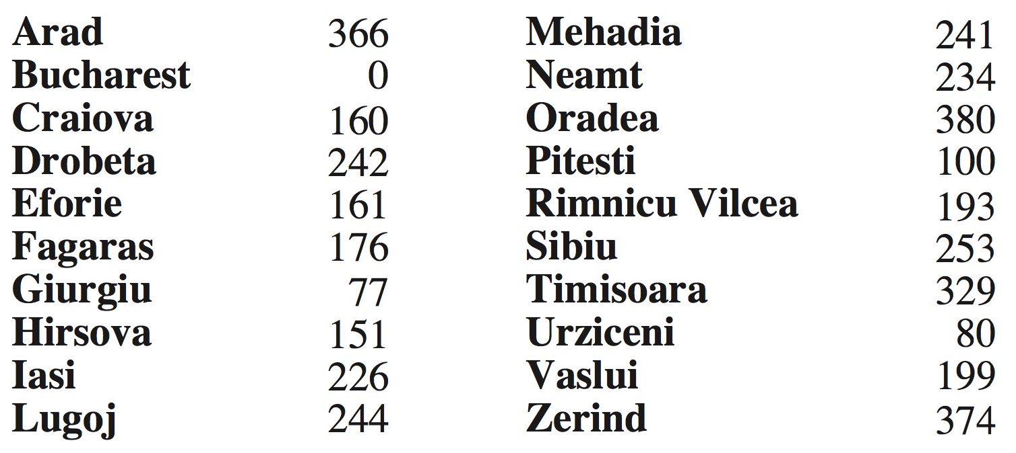
Example: Euclidean distance to Bucharest
h(state) → value

Slide 11
Effect of heuristics
Guide search towards the goal instead of all over the place
Start
Goal
Start
Goal
Informed
Uninformed

Slide 12
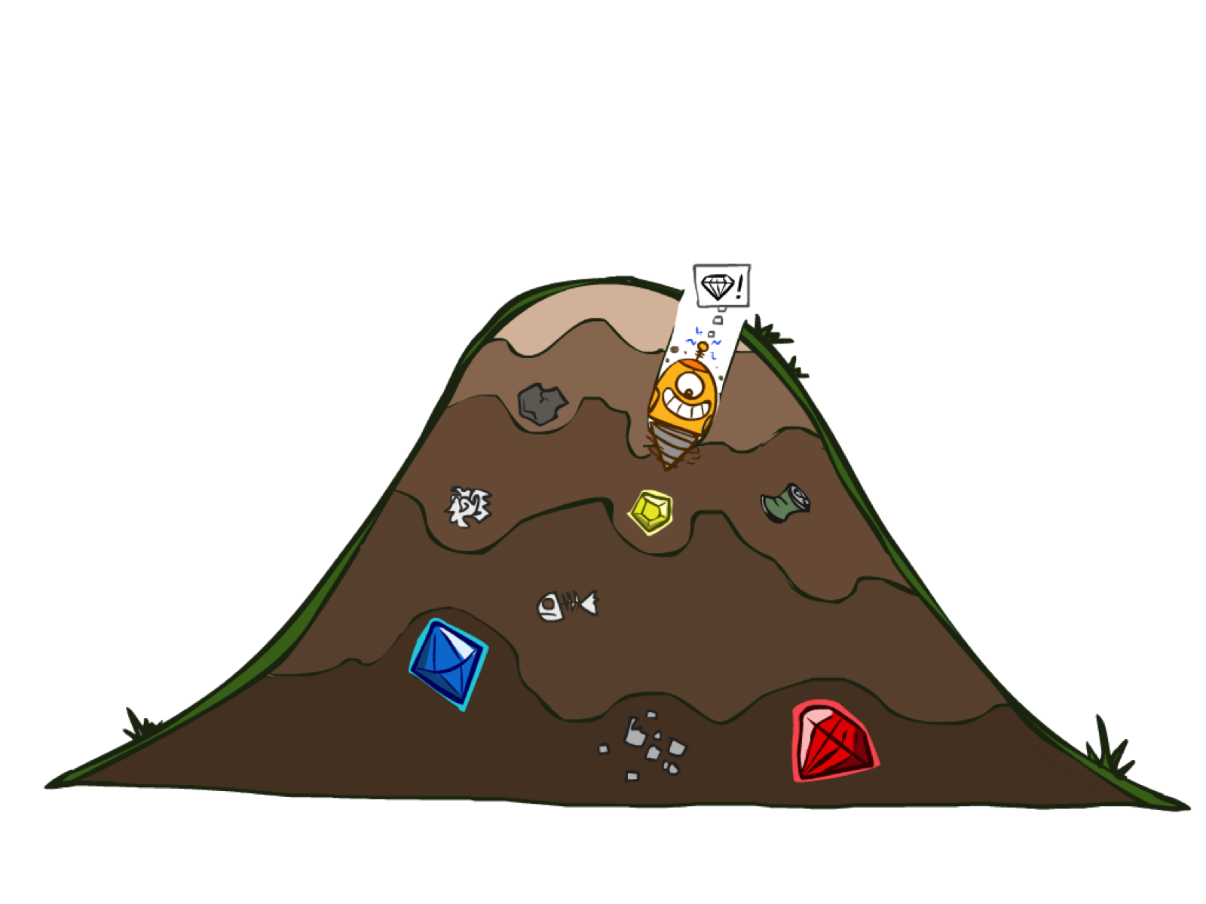
Greedy Search

Slide 13

Greedy Search
(An aside: greedy search is not a greedy algorithm.
The latter, viewed through the lense of search algorithms, is just one branch of a tree.)
Expand the node that seems closest…(order frontier by h)
What can possibly go wrong?
Sibiu-Fagaras-Bucharest =
99+211 = 310
Sibiu-Rimnicu Vilcea-Pitesti-Bucharest =
80+97+101 = 278
h= 253
h=176
h=193
1000000
h=100
h=0

Slide 14
Greedy Search
b
Strategy: expand a node that seems closest to a goal state, according to h
Problem 1: it chooses a node even if it’s at the end of a very long and winding road
Problem 2: it takes h literally even if it’s completely wrong
…
Notes:
For any search problem, you know the goal. Now, you have an idea of how far away you are from the goal.

Slide 15
A* Search

Slide 16



A* Search
UCS
Greedy
A*
Notes:
Notes: these images licensed from iStockphoto for UC Berkeley use.

Slide 17
Combining UCS and Greedy
Uniform-cost orders by path cost, or backward cost g(n)
Greedy orders by goal proximity, or forward cost h(n)
A* Search orders by the sum: f(n) = g(n) + h(n)
8
g = 0 h=6
S
e
h=1
g = 1 h=5
a
1
1
3
2
g = 2 h=6
g = 9 h=1
S
a
d
G
b
d
g = 4 h=2
e
h=6
1
h=5
h=2
h=0
1
g = 3 h=7
g = 6 h=0
g = 10 h=2
c
b
c
G
d
h=7
h=6
g = 12 h=0
G
Example: Teg Grenager

Slide 18
function UNIFORM-COST-SEARCH(problem) returns a solution, or failure
initialize the explored set to be empty
initialize the frontier as a priority queue using g(n) as the priority
add initial state of problem to frontier with priority g(S) = 0
loop do
if the frontier is empty then
return failure
choose a node and remove it from the frontier
if the node contains a goal state then
return the corresponding solution
add the node state to the explored set
for each resulting child from node
if the child state is not already in the frontier or explored set then
add child to the frontier
else if the child is already in the frontier with higher g(n) then
replace that frontier node with child

Slide 19
function A-STAR-SEARCH(problem) returns a solution, or failure
initialize the explored set to be empty
initialize the frontier as a priority queue using f(n) = g(n) + h(n) as the priority
add initial state of problem to frontier with priority f(S) = 0 + h(S)
loop do
if the frontier is empty then
return failure
choose a node and remove it from the frontier
if the node contains a goal state then
return the corresponding solution
add the node state to the explored set
for each resulting child from node
if the child state is not already in the frontier or explored set then
add child to the frontier
else if the child is already in the frontier with higher f(n) then
replace that frontier node with child

Slide 20
A* Search Algorithms
A* Tree Search
Same tree search algorithm but with a frontier that is a priority queue using priority f(n) = g(n) + h(n)

Slide 21
A* Search Algorithms
A* Tree Search
Same tree search algorithm but with a frontier that is a priority queue using priority f(n) = g(n) + h(n)
A* Graph Search
Same as UCS graph search algorithm but with a frontier that is a priority queue using priority f(n) = g(n) + h(n)

Slide 22
UCS vs A* Contours
Uniform-cost expands equally in all “directions”
A* expands mainly toward the goal, but does hedge its bets to ensure optimality
Start
Goal
Start
Goal

Slide 23
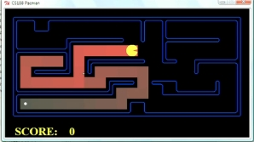
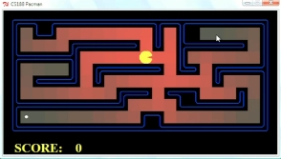
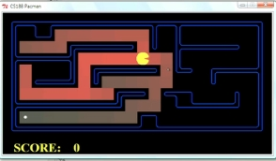
Comparison
Greedy
Uniform Cost
A*

Slide 24
Is A* Optimal?
h = 6
1
A
3
S
h = 7
G
h = 0
5
What went wrong?
Actual bad goal cost < estimated good goal cost
We need estimates to be less than actual costs!

Slide 25
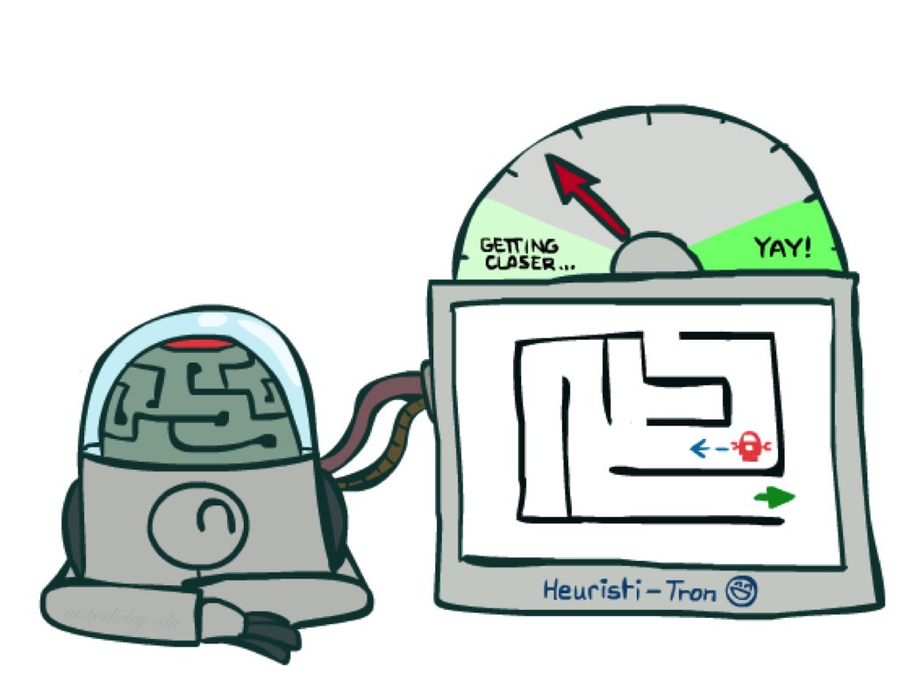
Admissible Heuristics

Slide 26
Admissible Heuristics
A heuristic h is admissible (optimistic) if:
  0 ≤ h(n) ≤ h*(n)
where h*(n) is the true cost to a nearest goal
Example:
Coming up with admissible heuristics is most of what’s involved in using A* in practice.
15

Slide 27

Optimality of A* Tree Search

Slide 28
A* Tree Search
State space graph
Search tree
h=4
S (0+2)
1
A
1
h=1
S
C
A (1+4)
C (3+1)
h=2
3
3
C (2+1)
G (6+0)
G (5+0)
G
h=0

Slide 29
Optimality of A* Tree Search
Assume:
A is an optimal goal node
B is a suboptimal goal node
h is admissible
Claim:
A will be chosen for exploration (popped off the frontier) before B
…
A
B

Slide 30
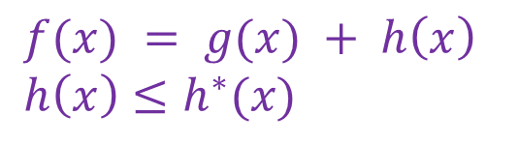
Optimality of A* Tree Search: Blocking
$f(x) = g(x) + h\left(x\right)$
$h\left(x\right)≤h^{∗}(x)$
Proof:
Imagine B is on the frontier
Some ancestor n of A is on the frontier, too (Maybe the start state; maybe A itself!)
Claim: n will be explored before B
  f(n) is less than or equal to f(A)
…
n
A
B
f(n) = g(n) + h(n) Definition of f-cost
f(n) ≤ g(A) Admissibility of h
g(A) = f(A) h = 0 at a goal

Slide 31
Optimality of A* Tree Search: Blocking
$f(x) = g(x) + h\left(x\right)$
$h\left(x\right)≤h^{∗}(x)$
Proof:
Imagine B is on the frontier
Some ancestor n of A is on the frontier, too (Maybe the start state; maybe A itself!)
Claim: n will be explored before B
  f(n) is less than or equal to f(A)
  f(A) is less than f(B)
…
n
A
B
g(A) < g(B) Suboptimality of B
f(A) < f(B) h = 0 at a goal

Slide 32
Optimality of A* Tree Search: Blocking
$f(x) = g(x) + h\left(x\right)$
$h\left(x\right)≤h^{∗}(x)$
Proof:
Imagine B is on the frontier
Some ancestor n of A is on the frontier, too (Maybe the start state; maybe A itself!)
Claim: n will be explored before B
  f(n) is less than or equal to f(A)
  f(A) is less than f(B)
  n is explored before B
All ancestors of A are explored before B
A is explored before B
A* search is optimal
…
n
A
B
f(n) ≤ f(A) < f(B)

Slide 33
Optimality of A* Graph Search

Slide 34
Poll 1: A* Graph Search
What nodes does A* graph search consider during its search?
h=4
A) S, S-A, S-C, S-C-G
1
A
1
h=1
B) S, S-A, S-C, S-A-C, S-C-G
S
C
C) S, S-A, S-A-C, S-A-C-G
h=2
3
D) S, S-A, S-C, S-A-C, S-A-C-G
3
G
h=0

Slide 35
Poll 1: A* Graph Search
Which paths does A* graph search consider during its search?
h=4
A) S, S-A, S-C, S-C-G
1
A
1
h=1
B) S, S-A, S-C, S-A-C, S-C-G
S
C
C) S, S-A, S-A-C, S-A-C-G
h=2
3
D) S, S-A, S-C, S-A-C, S-A-C-G
3
G
h=0

Slide 36
A* Graph Search
A)
A
S
C
What does the resulting graph search
tree look like?
G
h=4
A
A
B)
1
1
S
C
h=1
S
C
h=2
3
G
3
C)
A
S
C
G
h=0
G

Slide 37
A* Graph Search Gone Wrong?
State space graph
Search tree
h=4
S (0+2)
1
A
1
h=1
S
C
A (1+4)
C (3+1)
h=2
3
3
G (6+0)
Simple check against explored set blocks C
G
Fancy check allows new C if cheaper than old
but requires recalculating C’s descendants
h=0

Slide 38
Admissibility of Heuristics
Main idea: Estimated heuristic values ≤ actual costs
  Admissibility:
  heuristic value ≤ actual cost to goal
  h(A) ≤ actual cost from A to G
A
1
C
h=4
3
G

Slide 39
Consistency of Heuristics
Main idea: Estimated heuristic costs ≤ actual costs
  Admissibility:
  heuristic cost ≤ actual cost to goal
  h(A) ≤ actual cost from A to G
  Consistency:
  “heuristic step cost” ≤ actual cost for each step
  h(A) – h(C) ≤ cost(A to C)
  triangle inequality
  h(A) ≤ cost(A to C) + h(C)
Consequences of consistency:
  The f value along a path never decreases
  A* graph search is optimal
A
1
C
h=4
h=2
h=1
G

Slide 40
Optimality of A* Graph Search
Sketch: consider what A* does with a consistent heuristic:
  Fact 1: In tree search, A* expands nodes in increasing total f value (f-contours)
  Fact 2: For every state s, nodes that reach s optimally are explored before nodes that reach s suboptimally
  Result: A* graph search is optimal
…
f ≤ 1
f ≤ 2
f ≤ 3

Slide 41
Optimality
Tree search:
  A* is optimal if heuristic is admissible
  UCS is a special case (h = 0)
Graph search:
  A* optimal if heuristic is consistent
  UCS optimal (h = 0 is consistent)
Consistency implies admissibility
In general, most natural admissible heuristics tend to be consistent, especially if from relaxed problems

Slide 42

Creating Heuristics

Slide 43
Creating Admissible Heuristics
Most of the work in solving hard search problems optimally is in coming up with admissible heuristics
Often, admissible heuristics are solutions to relaxed problems, where new actions are available
366
15

Slide 44
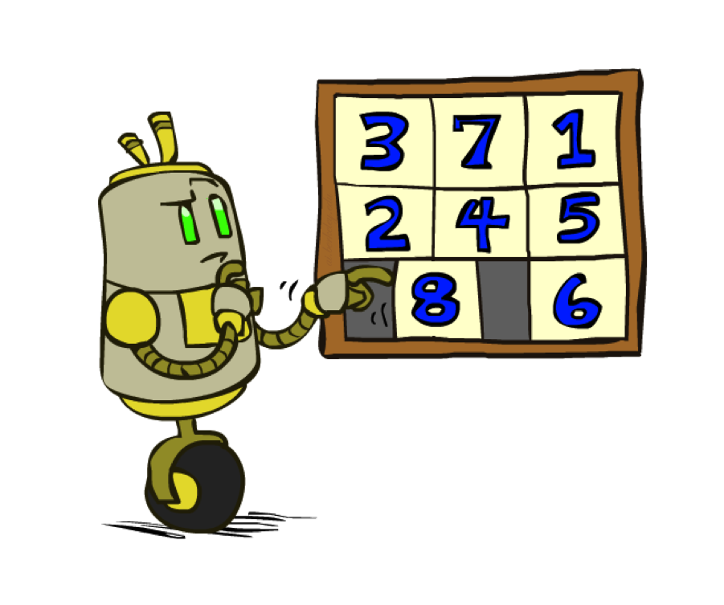
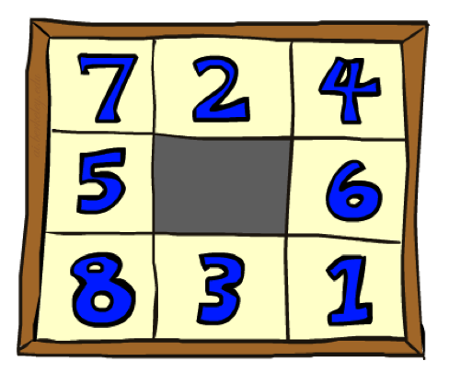
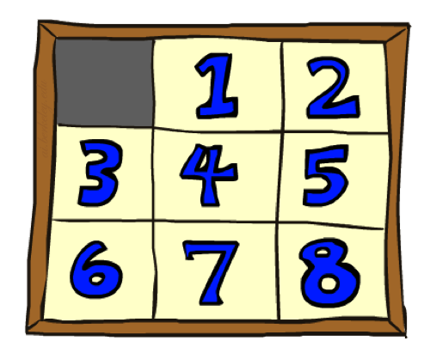
Example: 8 Puzzle
Start State
Actions
Goal State
What are the states?
How many states?
What are the actions?
How many actions from the start state?
What should the step costs be?

Slide 45
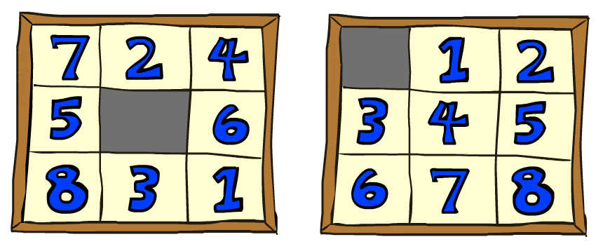

8 Puzzle I
Heuristic: Number of tiles misplaced
Why is it admissible?
h(start) =
This is a relaxed-problem heuristic
8
Start State
Goal State
 | Average nodes expanded when the optimal path has…
 | …4 steps | …8 steps | …12 steps
UCS | 112 | 6,300 | 3.6 x 10⁶
A*TILES | 13 | 39 | 227
Statistics from Andrew Moore

Slide 46
8 Puzzle II
What if we had an easier 8-puzzle where any tile could slide any direction at any time, ignoring other tiles?
Total Manhattan distance
Why is it admissible?
h(start) =
Start State
Goal State
 | Average nodes expanded when the optimal path has…
 | …4 steps | …8 steps | …12 steps
A*TILES | 13 | 39 | 227
A*MANHATTAN | 12 | 25 | 73
3 + 1 + 2 + … = 18

Slide 47
Combining heuristics
Dominance: h_{a} ≥ h_{c} if
∀n h_{a}(n) ≥ h_{c}(n)
  Roughly speaking, larger is better as long as both are admissible
  The zero heuristic is pretty bad (what does A* do with h=0?)
  The exact heuristic is pretty good, but usually too expensive!
What if we have two heuristics, neither dominates the other?
  Form a new heuristic by taking the max of both:
  h(n) = max( h_{a}(n), h_{b}(n) )
  Max of admissible heuristics is admissible and dominates both!
Notes:
Semi-lattice: x <= y <-> x = x ^ y

Slide 48
In-Class Activity
Q1: Practice creating heuristics and running Greedy and A* search
Q2: Walk through Amazon Robot Example

Slide 49

A*: Summary

Slide 50

A*: Summary
A* uses both cost so far (“backward cost”) and (estimates of) cost to go (“forward cost”)
A* is optimal with admissible / consistent heuristics
Heuristic design is key: often use relaxed problems

