Slide 1
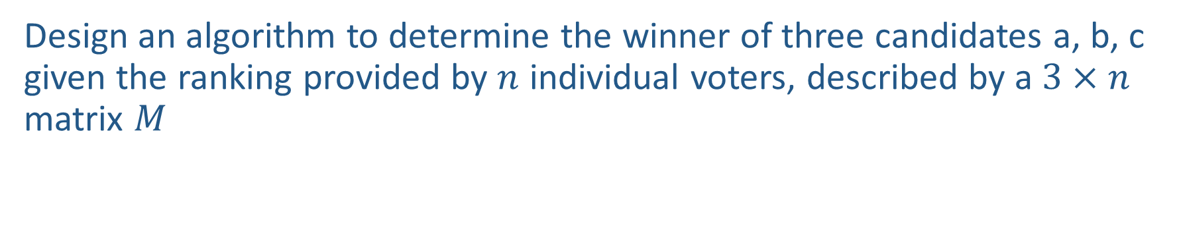

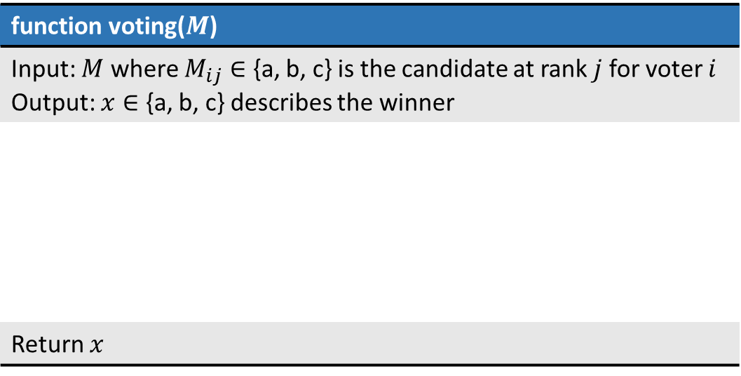
Warm-up
Design an algorithm to determine the winner of three candidates a, b, c given the ranking provided by $n$ individual voters, described by a $3×n$ matrix $M$
Example Matrix $M$
function voting($M$)
Input: $M$ where $M_{ij}∈$ {a, b, c} is the candidate at rank $j$ for voter $i$ Output: $x∈$ {a, b, c} describes the winner
Return $x$
Voter 1
Voter 2
Voter 3
Voter 4
Rank 1
a | c | b | a
b | b | c | b
c | a | a | c
Rank 2
Rank 3

Slide 2
Announcements
Feedback (please don’t forget!):
www.cmu.edu/hub/fce
https://www.ugrad.cs.cmu.edu/ta/S24/feedback/
Final Exam:
All material is fair game
  Will focus disproportionately on material not yet covered on midterm exams
Look at post on Piazza with instructions

Slide 3
AI: Representation and Problem Solving
Social Choice
Instructors: Tuomas Sandholm and Nihar Shah
Slide credits: CMU AI

Slide 4
Warm-up
Design an algorithm to determine the winner of three candidates a, b, c given the ranking provided by $n$ individual voters, described by a $3×n$ matrix $M$
Example Matrix $M$
function voting($M$)
Input: $M$ where $M_{ij}∈$ {a, b, c} is the candidate at rank $j$ for voter $i$ Output: $x∈$ {a, b, c} describes the winner
Return $x$
Voter 1
Voter 2
Voter 3
Voter 4
Rank 1
a | c | b | a
b | b | c | b
c | a | a | c
Rank 2
Rank 3

Slide 5


Social Choice Theory
A mathematical theory that deal with aggregation of individual preferences
Wide applications in economics, public policy, etc.
Origins in Ancient Greece
18th century
Formal foundations by Condorcet and Borda
19th Century
Charles Dodgson
20th Century
Nobel Prize in Economics
20th Century – Winners of Nobel Memorial Prize in Economic Sciences
Kenneth Arrow
Amartya Kumar Sen

Slide 6
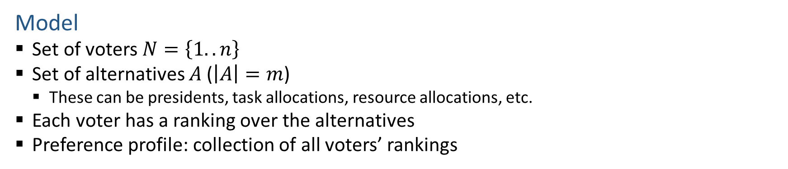
Voting Model
Model
  Set of voters $N=\left\{1..n\right\}$
  Set of alternatives $A$ ($\left|A\right|=m$)
    These can be presidents, task allocations, resource allocations, etc.
  Each voter has a ranking over the alternatives
  Preference profile: collection of all voters’ rankings
Voter ID | 1 | 2 | 3 | 4
Ranking | a | c | b | a
 | b | b | c | b
 | c | a | a | c

Slide 7

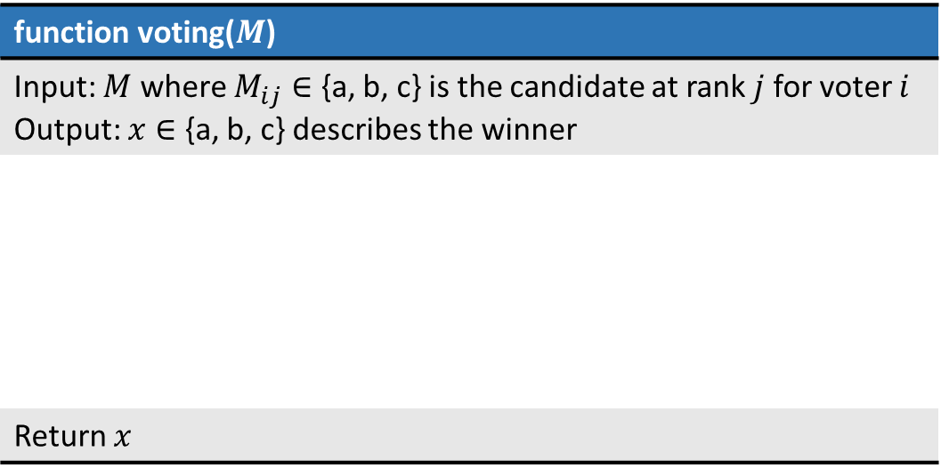
Voting Rules
Voting rule: function that maps preference profiles to alternatives that specifies the winner of the election
function voting($M$)
Input: $M$ where $M_{ij}∈$ {a, b, c} is the candidate at rank $j$ for voter $i$ Output: $x∈$ {a, b, c} describes the winner
Return $x$
Example Matrix $M$
a | c | b | a
b | b | c | b
c | a | a | c

Slide 8
Voting Rules
Plurality (used in many political elections)
  Each voter gives one point to top alternative
  Alternative with most points wins
Who’s the winner?
a
Voter ID | 1 | 2 | 3 | 4
Ranking | a | c | b | a
 | b | b | c | b
 | c | a | a | c

Slide 9
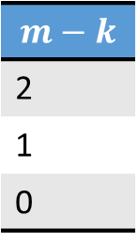
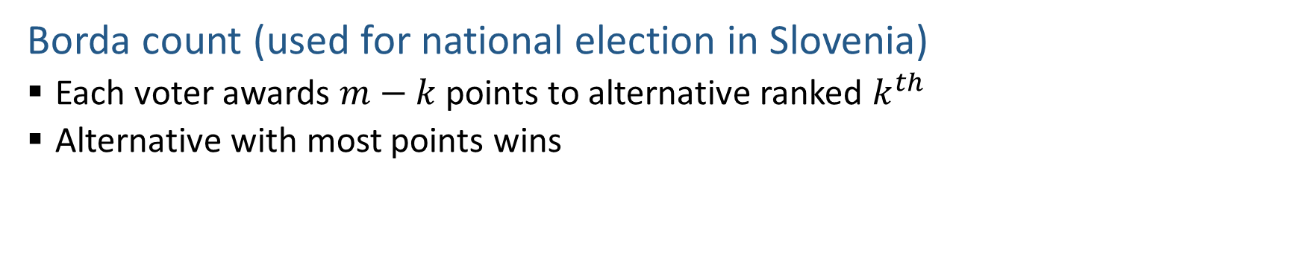
Voting Rules
Borda count (used for national election in Slovenia)
  Each voter awards $m−k$ points to alternative ranked $k^{th}$
  Alternative with most points wins
Who’s the winner?
b
Voter ID | 1 | 2 | 3 | 4
Ranking | a | c | b | a
 | b | b | c | b
 | c | a | a | c
$$m−k$$
2
1
0
a: 2+0+0+2 = 4
b: 1+1+2+1 = 5
c: 0+2+1+0 = 3

Slide 10
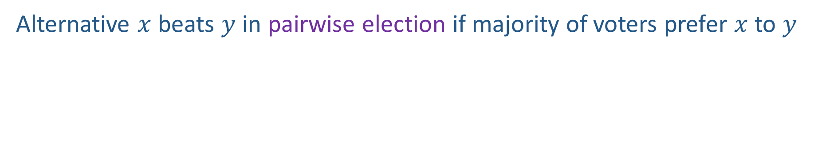
Pairwise Election
Alternative $x$ beats $y$ in pairwise election if majority of voters prefer $x$ to $y$
Who beats whom in pairwise election?
b beats c
Voter ID | 1 | 2 | 3 | 4
Ranking | a | c | b | a
 | b | b | c | b
 | c | a | a | c

Slide 11
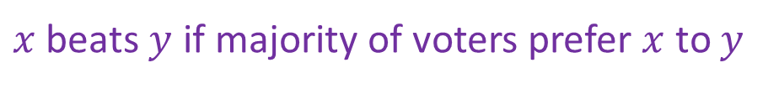
Voting Rules
Plurality with runoff
  First round: two alternatives with highest plurality scores survive
  Second round: pairwise election between the two
$x$ beats $y$ if majority of voters prefer $x$ to $y$
Who’s the winner?
Voter ID | 1 | 2 | 3 | 4
Ranking | a | c | b | a
 | b | b | c | b
 | c | a | a | c

Slide 12
Voting Rules
Plurality with runoff
  First round: two alternatives with highest plurality scores survive
  Second round: pairwise election between the two
$x$ beats $y$ if majority of voters prefer $x$ to $y$
Who’s the winner?
Depends on the tie breaking rule.
If break tie alphabetically:
a and b survive in 1st round
a wins the pairwise election
Voter ID | 1 | 2 | 3 | 4
Ranking | a | c | b | a
 | b | b | c | b
 | c | a | a | c
Voter ID | 1 | 2 | 3 | 4
Ranking | a | b | b | a
 | b | a | a | b

Slide 13
Voting Rules
Plurality with runoff
  First round: two alternatives with highest plurality scores survive
  Second round: pairwise election between the two
$x$ beats $y$ if majority of voters prefer $x$ to $y$
Who’s the winner?
Voter ID | 1 | 2 | 3 | 4 | 5
Ranking | a | c | b | a | c
 | b | b | c | b | b
 | c | a | a | c | a

Slide 14
Voting Rules
Plurality with runoff
  First round: two alternatives with highest plurality scores survive
  Second round: pairwise election between the two
$x$ beats $y$ if majority of voters prefer $x$ to $y$
Who’s the winner?
a and c survive, and then c beats a
Voter ID | 1 | 2 | 3 | 4 | 5
Ranking | a | c | b | a | c
 | b | b | c | b | b
 | c | a | a | c | a

Slide 15
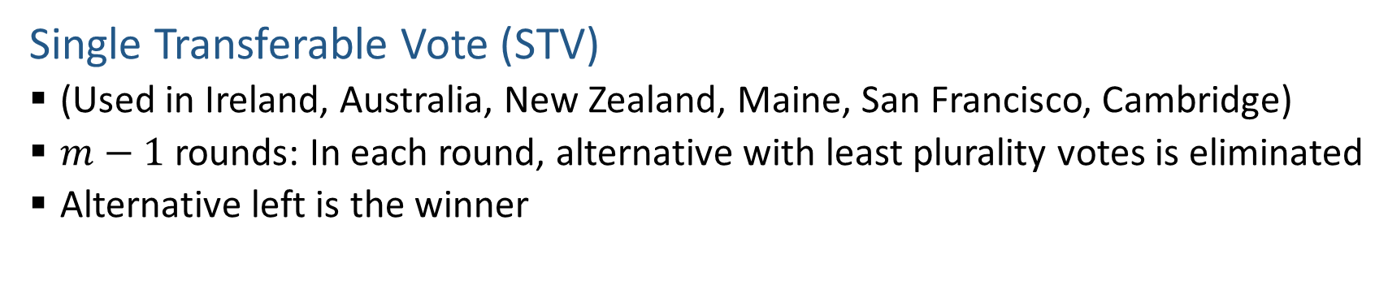
Voting Rules
Single Transferable Vote (STV)
  (Used in Ireland, Australia, New Zealand, Maine, San Francisco, Cambridge)
  $m−1$ rounds: In each round, alternative with least plurality votes is eliminated
  Alternative left is the winner
Who’s the winner?
Voter ID | 1 | 2 | 3 | 4 | 5
Ranking | a | d | b | a | b
 | b | b | c | b | d
 | d | c | a | d | a
 | c | a | d | c | c

Slide 16
Voting Rules
Single Transferable Vote (STV)
  (Used in Ireland, Australia, New Zealand, Maine, San Francisco, Cambridge)
  $m−1$ rounds: In each round, alternative with least plurality votes is eliminated
  Alternative left is the winner
Who’s the winner?
c is eliminated, then d, then a, leaving b as the winner.
Voter ID | 1 | 2 | 3 | 4 | 5
Ranking | a | d | b | a | b
 | b | b | c | b | d
 | d | c | a | d | a
 | c | a | d | c | c
Note: When d is eliminated, the vote from voter 2 is effectively transferred to b

Slide 17
Representation of Preference Profile
Identity of voters does not matter
Only record how many voters has a preference
33 voters | 16 voters | 3 voters | 8 voters | 18 voters | 22 voters
a | b | c | c | d | e
b | d | d | e | e | c
c | c | b | b | c | b
d | e | a | d | b | d
e | a | e | a | a | a

Slide 18
Tie Breaking
Commonly used tie breaking rules include
  Borda count
  Having the most votes in the first round
  …

Slide 19
Social Choice Axioms
How do we choose among different voting rules?
What are the desirable properties?

Slide 20
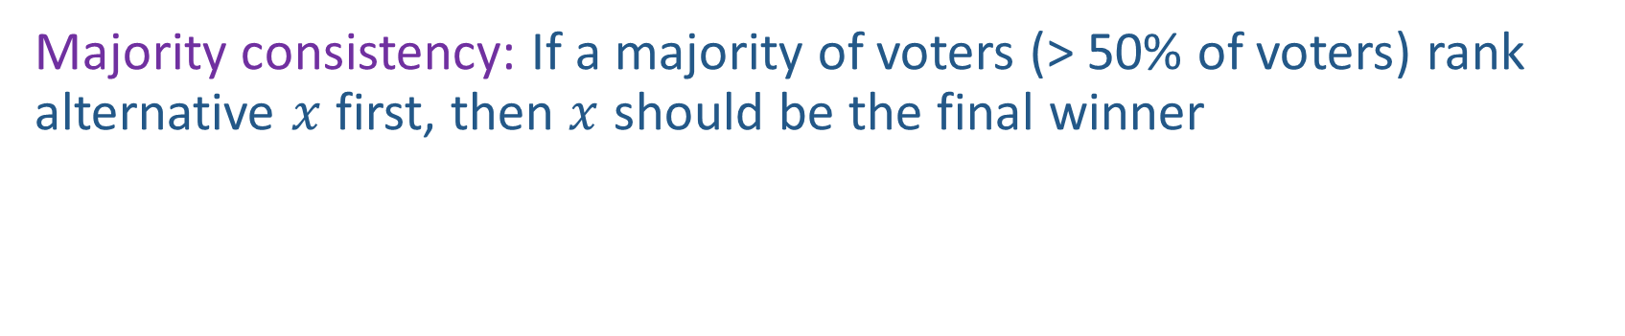
Majority consistency
Majority consistency: If a majority of voters (> 50% of voters) rank alternative $x$ first, then $x$ should be the final winner

Slide 21
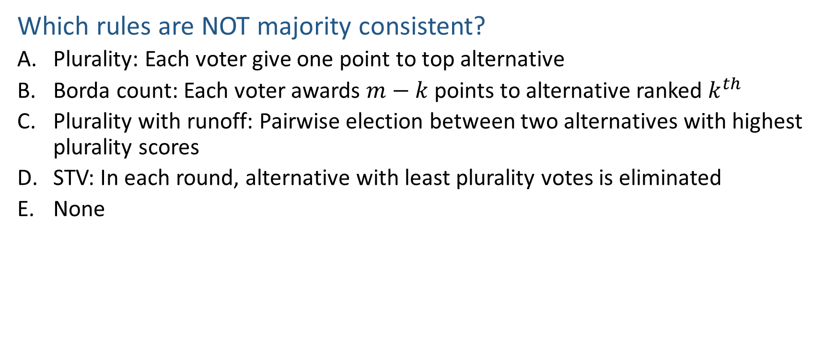
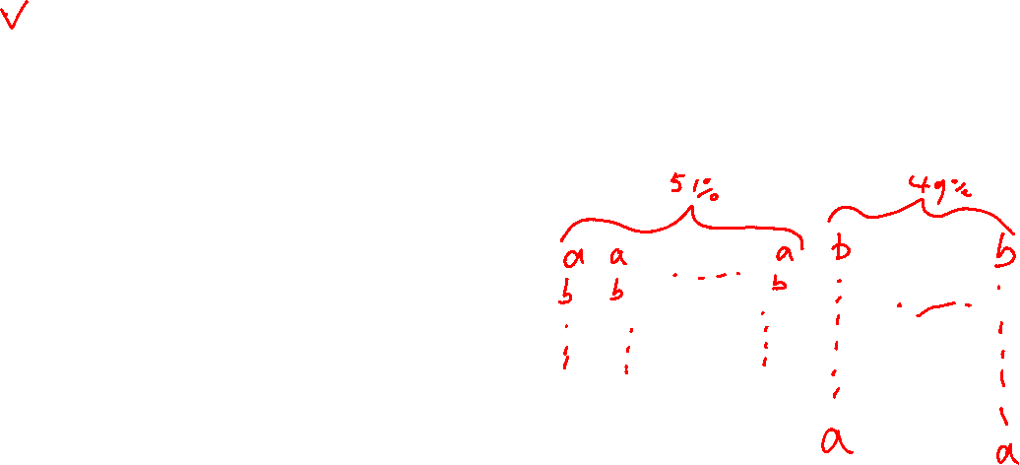
Poll 1
Which rules are NOT majority consistent?
  Plurality: Each voter give one point to top alternative
  Borda count: Each voter awards $m−k$ points to alternative ranked $k^{th}$
  Plurality with runoff: Pairwise election between two alternatives with highest plurality scores
  STV: In each round, alternative with least plurality votes is eliminated
  None
Notes:
B. Borda not consistent

Slide 22
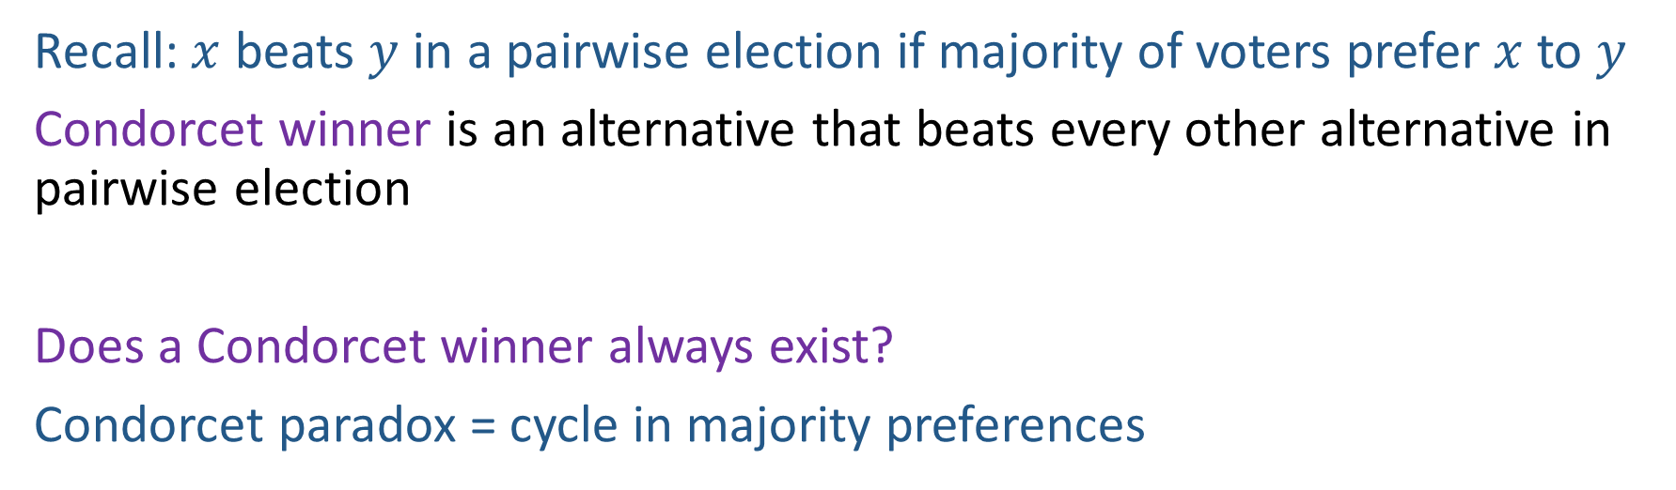
Condorcet Consistency
Recall: $x$ beats $y$ in a pairwise election if majority of voters prefer $x$ to $y$
Condorcet winner is an alternative that beats every other alternative in pairwise election
Does a Condorcet winner always exist?
Condorcet paradox = cycle in majority preferences
Voter ID | 1 | 2 | 3
Ranking over alternatives (first row is the most preferred) | a | c | b
 | b | a | c
 | c | b | a
Notes:
no

Slide 23
Condorcet Consistency: a Condorcet winner
(if one exists) should always win
If a rule satisfies majority consistency, does it satisfy Condorcet consistency?
Vice versa?

Slide 24
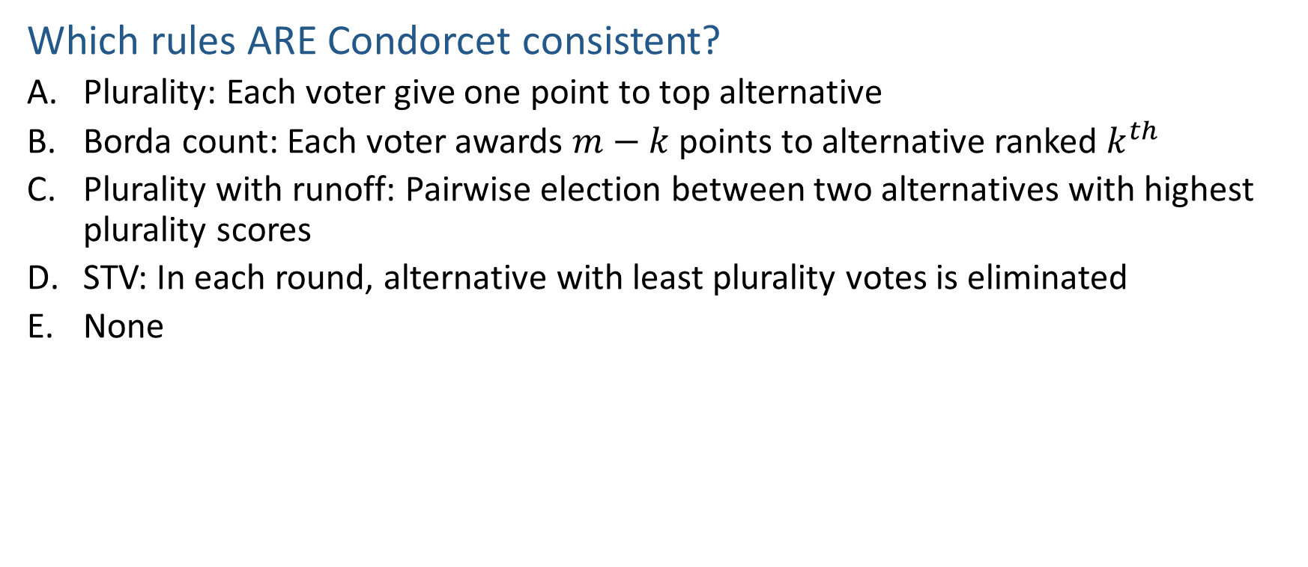
Poll 2
Which rules ARE Condorcet consistent?
  Plurality: Each voter give one point to top alternative
  Borda count: Each voter awards $m−k$ points to alternative ranked $k^{th}$
  Plurality with runoff: Pairwise election between two alternatives with highest plurality scores
  STV: In each round, alternative with least plurality votes is eliminated
  None
Notes:
None

Slide 25
Condorcet Consistency
Winner under different voting rules in this example
  Plurality:
  Borda:
  Plurality with runoff:
  STV:
  Condorcet winner:
33 voters | 16 voters | 3 voter | 8 voters | 18 voters | 22 voters
a | b | c | c | d | e
b | d | d | e | e | c
c | c | b | b | c | b
d | e | a | d | b | d
e | a | e | a | a | a
Notes:
Plurality: a
Borda count:
a: 33*4 + 3*1 = 135
b: 33*3 + 16*4 + 3*2 + 8*2 + 18*1 + 22*2 = 247
c: 33*2 + 16*2 + 3*4 + 8*4 + 18*2 + 22*3 = 244
d: 33 + 16*3 + 3*3 + 8 + 22 + 18*4 = 192
e: 16 + 8*3 + 18*3 + 22*4 = 182
Plurality with run off:
a and e runoff and e wins
STV:
c voted off first
b voted off second
e voted off third
a voted off
d wins
Condorcet winner:
c beats a
c beats b
c beats d
c beats e
c wins

Slide 26
Condorcet Consistency
Winner under different voting rules in this example
  Plurality: a
  Borda: b
  Plurality with runoff: e
  STV: d
  Condorcet winner: c
33 voters | 16 voters | 3 voter | 8 voters | 18 voters | 22 voters
a | b | c | c | d | e
b | d | d | e | e | c
c | c | b | b | c | b
d | e | a | d | b | d
e | a | e | a | a | a

Slide 27
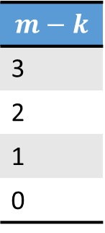
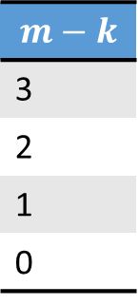
Strategy-Proofness
Consider Borda Count
Who is the winner?
Voter ID | 1 | 2 | 3
Ranking over alternatives (first row is the most preferred) | b | b | a
 | a | a | b
 | c | c | c
 | d | d | d
$$m−k$$
3
2
1
0
Who is the winner now?
Voter ID | 1 | 2 | 3
Ranking over alternatives (first row is the most preferred) | b | b | a
 | a | a | c
 | c | c | d
 | d | d | b
$$m−k$$
3
2
1
0

Slide 28
Strategy-Proofness
A single voter can manipulate the outcome!
Voter ID | 1 | 2 | 3
Ranking over alternatives (first row is the most preferred) | b | b | a
 | a | a | b
 | c | c | c
 | d | d | d
$$m−k$$
3
2
1
0
b: 2*3+1*2=8
a: 2*2+1*3=7
b is the winner
Voter ID | 1 | 2 | 3
Ranking over alternatives (first row is the most preferred) | b | b | a
 | a | a | c
 | c | c | d
 | d | d | b
$$m−k$$
3
2
1
0
b: 2*3+1*0=6
a: 2*2+1*3=7
a is the winner

Slide 29
Strategy-Proofness
A voting rule is strategyproof (SP) if a voter can never benefit from lying about his preferences (regardless of what other voters do)
  Benefit: a more preferred alternative is selected as winner
Do not lie: b is the winner
Lie: a is the winner
Voter ID | 1 | 2 | 3
Ranking | b | b | a
 | a | a | b
 | c | c | c
 | d | d | d
Voter ID | 1 | 2 | 3
Ranking | b | b | a
 | a | a | c
 | c | c | d
 | d | d | b
If a voter’s preference is a>b>c, c will be selected w/o lying, and b will be selected w/ lying, then the voter still benefits

Slide 30
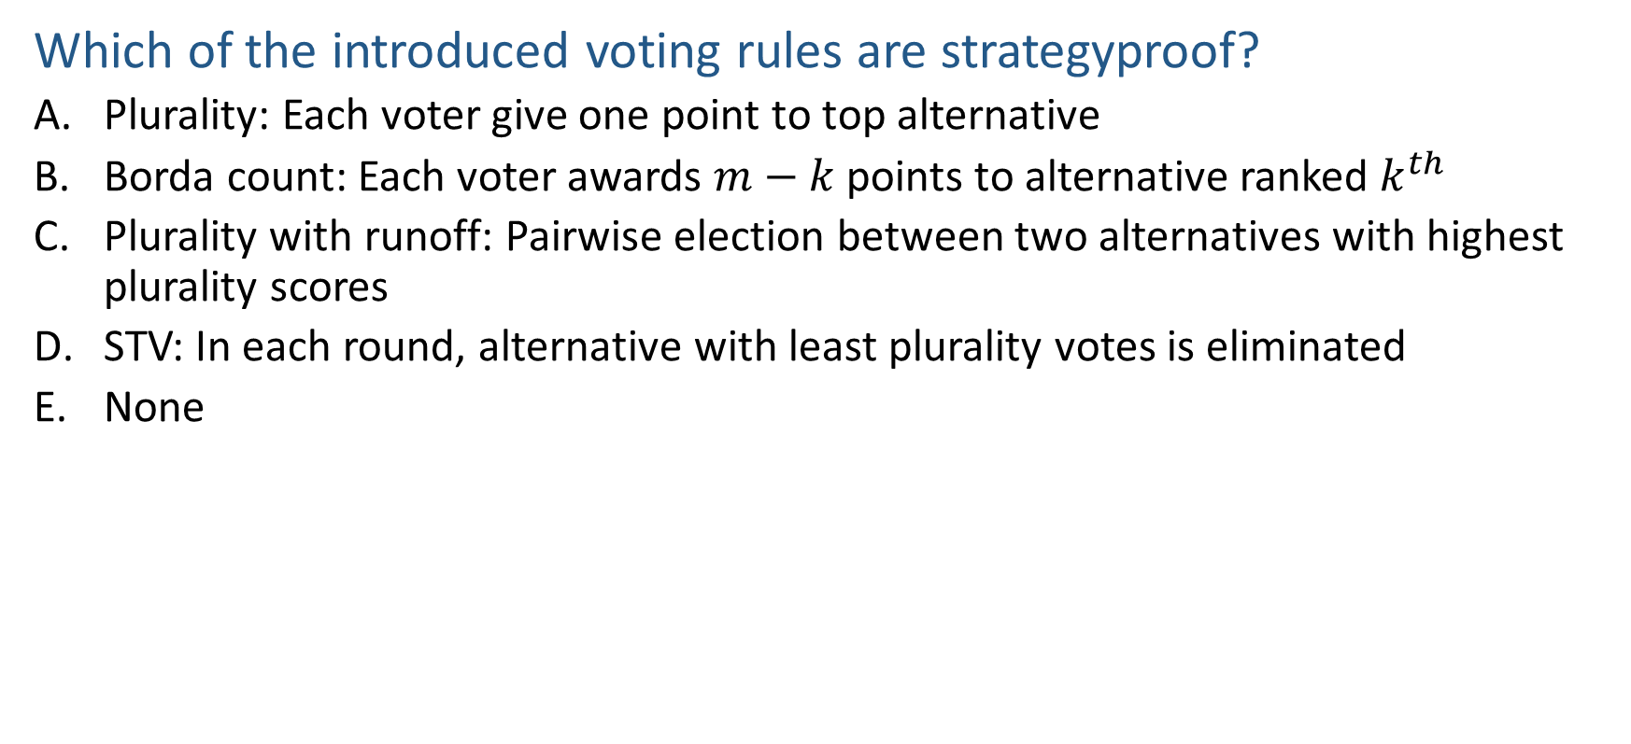
Poll 3
Which of the introduced voting rules are strategyproof?
  Plurality: Each voter give one point to top alternative
  Borda count: Each voter awards $m−k$ points to alternative ranked $k^{th}$
  Plurality with runoff: Pairwise election between two alternatives with highest plurality scores
  STV: In each round, alternative with least plurality votes is eliminated
  None
Notes:
none

Slide 31
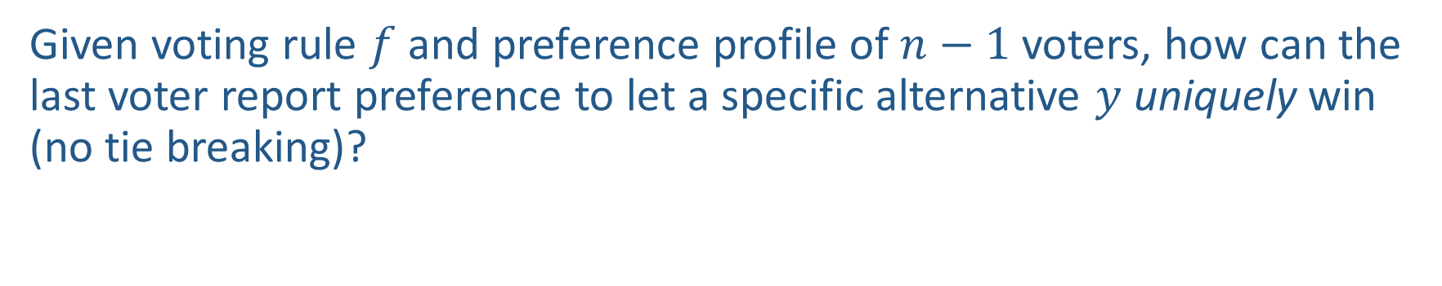
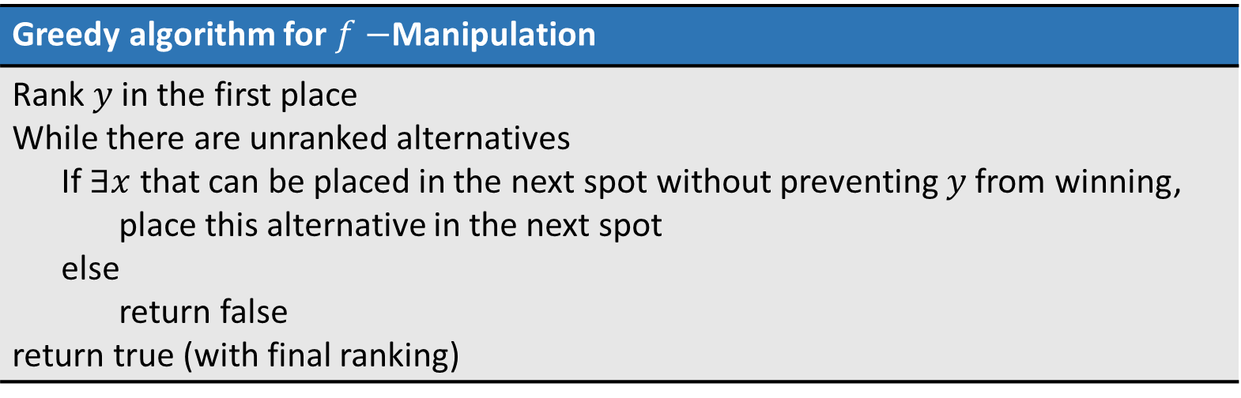
Greedy Algorithm for $f−$Manipulation
Given voting rule $f$ and preference profile of $n−1$ voters, how can the last voter report preference to let a specific alternative $y$ uniquely win (no tie breaking)?
Greedy algorithm for $f−$Manipulation
Rank $y$ in the first place While there are unranked alternatives If $∃x$ that can be placed in the next spot without preventing $y$ from winning, place this alternative in the next spot else return false return true (with final ranking)
Correctness proved (Bartholdi et al., 1989)

Slide 32

Greedy Algorithm for $f−$Manipulation
Example with Borda count voting rule
Voter ID | 1 | 2 | 3
Ranking over alternatives (first row is the most preferred) | b | b | a
 | a | a
 | c | c
 | d | d

Slide 33
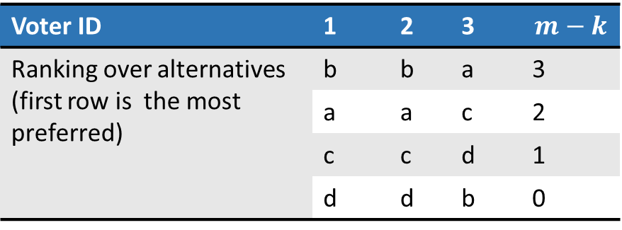
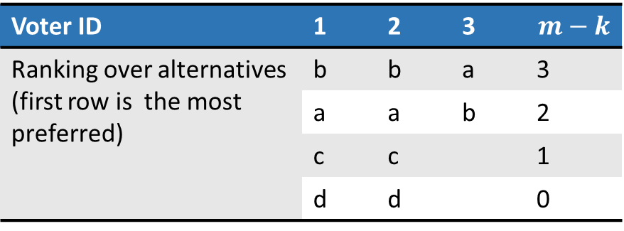
Greedy Algorithm for $f−$Manipulation
Example with Borda count voting rule
Voter ID | 1 | 2 | 3 | $$m−k$$
Ranking over alternatives (first row is the most preferred) | b | b | a | 3
 | a | a | b | 2
 | c | c |  | 1
 | d | d |  | 0
b: 2*3+1*2=8
a: 2*2+1*3=7
Cannot put b here
c: 2*1+1*2=4
a: 2*2+1*3=7
c can be placed second
b: 2*3+1*1=7
b cannot be placed third
d: 2*0+1*1=1
d can be placed third
Voter ID | 1 | 2 | 3 | $$m−k$$
Ranking over alternatives (first row is the most preferred) | b | b | a | 3
 | a | a | c | 2
 | c | c | d | 1
 | d | d | b | 0

Slide 34
Other Properties
A voting rule is dictatorial if there is a voter who always gets their most preferred alternative
A voting rule is constant if the same alternative is always chosen (regardless of the stated preferences)
A voting rule is onto if any alternative can win, for some set of stated preferences
Which of the introduced voting rules (Plurality, Borda count, Plurality with runoff, STV) are dictatorial, constant, or onto?
Notes:
All onto
Not constant, not dictatorial

Slide 35
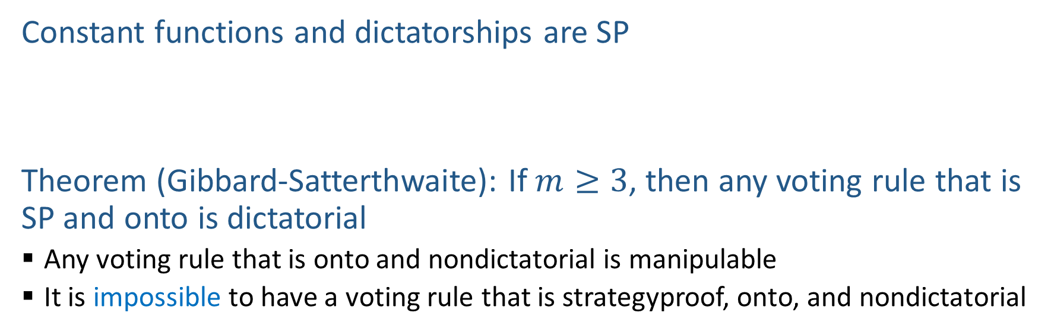
Results in Social Choice Theory
Why?
Constant functions and dictatorships are SP
Theorem (Gibbard-Satterthwaite): If $m≥3$, then any voting rule that is SP and onto is dictatorial
  Any voting rule that is onto and nondictatorial is manipulable
  It is impossible to have a voting rule that is strategyproof, onto, and nondictatorial

Slide 36
Activity: Favorite topics of 15281 (by approval voting)

Slide 37
Plurality Vote

Slide 38
Borda Count

Slide 39
Plurality with Runoff

Slide 40
Single Transferable Vote

Slide 41
Learning Objectives
Understand the voting model
Find the winner under the following voting rules
    Plurality, Borda count, Plurality with runoff, Single Transferable Vote
Describe the following concepts, axioms, and properties of voting rules
    Pairwise election, Condorcet winner
    Majority consistency, Condorcet consistency, Strategyproofness
    Dictatorial, constant, onto
Understand the possibility of satisfying multiple properties
Describe the greedy algorithm for voting rule manipulation

Slide 42
Post-Lecture Poll
Consider the following randomized voting rule.
  With probability p, select a dictator at random
  Otherwise (i.e., with probability 1-p), select two candidates at random (possibly with unequal probabilities), and conduct a plurality election among the two
Is this voting rule strategyproof?
Yes
No

