Slide 1

AI: Representation and Problem Solving
Particle Filtering
Instructors: Nihar B. Shah and Tuomas Sandholm
Slide credits: CMU AI and ai.berkeley.edu

Slide 2

Hidden Markov Models
In many applications, the true state is not observed directly
Hidden Markov models (HMMs)
  Underlying Markov chain over states X
  You observe evidence E at each time step
  X_{t} is a single discrete variable; E_{t} may be continuous and may consist of several variables
X₁
X₂
X₃
X₅
E₁
E₂
E₃
E₅

Slide 3
Filtering
P(X_{T}|e_{1:T})=?
X₁
X₂
X₃
X₄
e₁
e₂
e₃
e₄

Slide 4
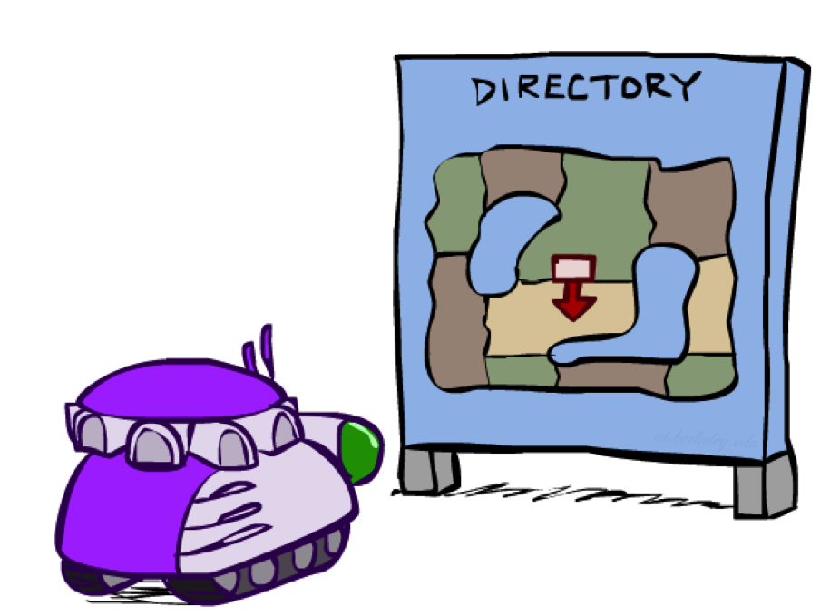
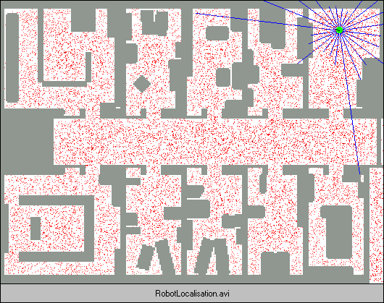
Robot Localization
We know the map, but not the robot’s position
Observations are some sensor readings
Another challenge: State space and readings are typically continuous (works basically like a very fine grid) and so we cannot store P(X)

Slide 5

Particle Filter Localization (Sonar)
[Dieter Fox, et al.]
[Video: global-sonar-uw-annotated.avi]

Slide 6
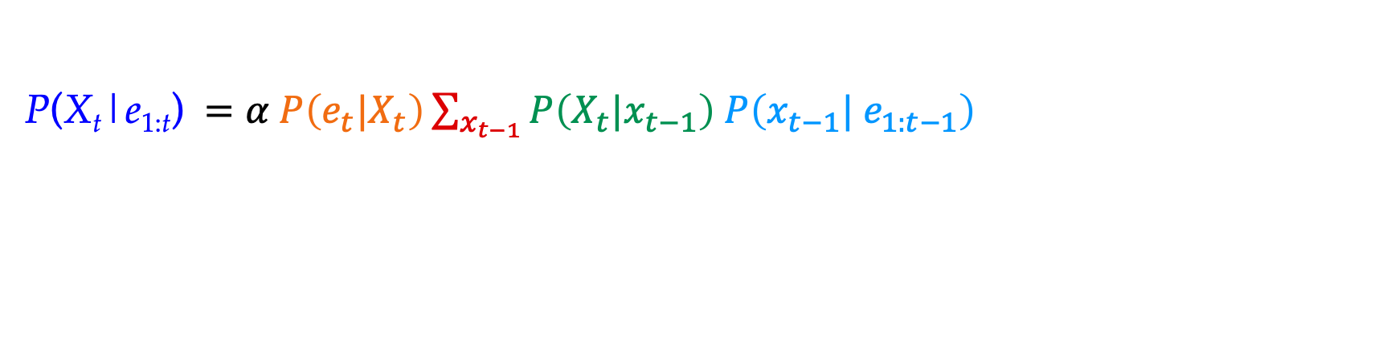
What about our current algorithms?
Previous lecture: Exact inference
X₁
X₂
X₃
P(X_{t}|e_{1:t}) $=α P\left(e_{t}|X_{t}\right)\sum_{x_{t−1}}{P\left(X_{t}|x_{t−1}\right) P\left(x_{t−1}| e_{1:t−1}\right) }$
E₁
E₂
E₃
Normalize
Update
Predict
Computational cost per time step:
O(|X|²) where |X| is the number of states
O(|X|²) is infeasible for models with many state variables

Slide 7
What about our current algorithms?
Want to compute P(X|E). What algorithm have we learnt for this?
Likelihood weighted sampling!
  For t in 1,2,….
    Draw x_{t}~ P(X_{t}|X_{t-1}=x_{t-1})
    w=w*P(e_{t}|x_{t})
  Take many such samples (say, N samples) and consider their weighted average
Fails – number of samples needed grows exponentially with T
Why??!!
X₁
X₂
X₃
E₁
E₂
E₃

Slide 8
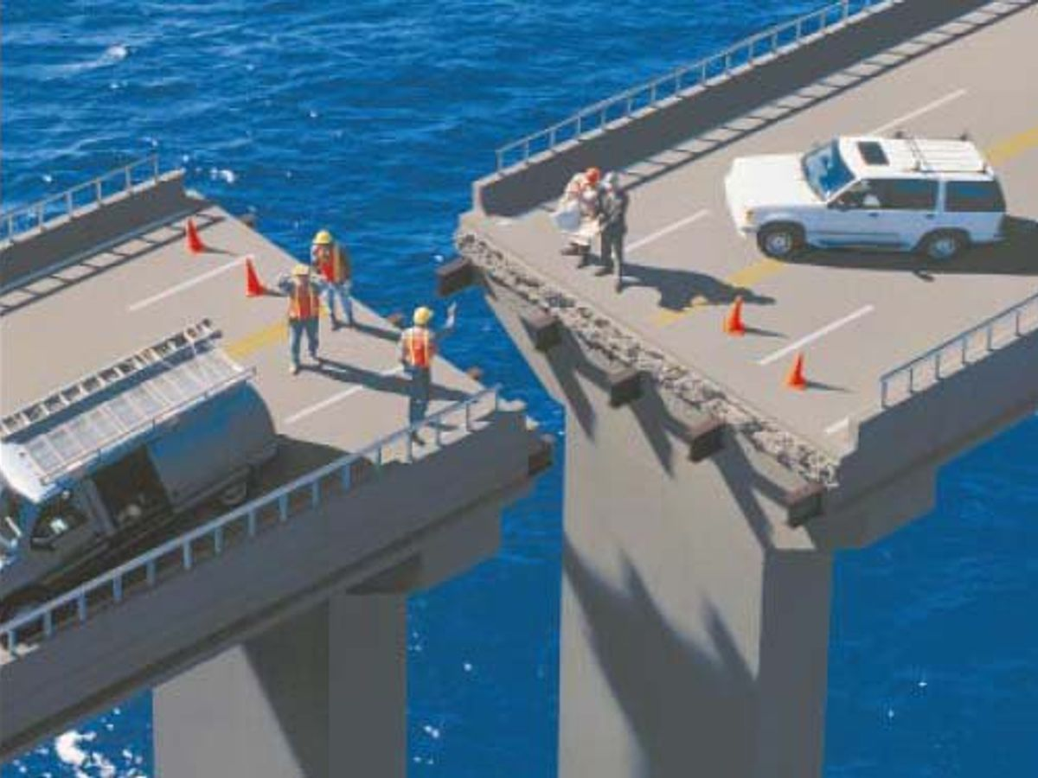
Failure of likelihood weighted sampling
Want to compute P(X|E=e), so want samples which have high probability of E=e
We sample from P(X_{t}|X_{t-1})
Mismatch!
Values of X which have high probability in P(X_{t}|X_{t-1}) may have low probability of evidence E=e, i.e., low P(E=e|X=sample)
As t increases, samples eventually have very low probability of E=e

Slide 9
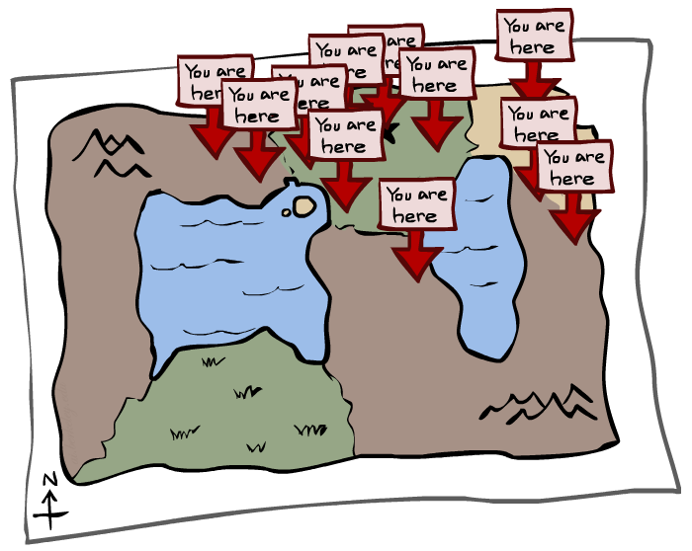
Particle Filtering
Filtering: P(X_{T}|e_{1:T})=?
X₁
X₂
X₃
X₄
e₁
e₂
e₃
e₄

Slide 10

New algorithm: Particle filtering
Builds on likelihood weighted sampling
Idea #1!
Recall that the probability distribution of the samples are based on P(X_{t}|X_{t-1}).
But we are interested in samples with high probability of P(E=e|X)
What captures this distribution?
  The weights! (w=w*P(e_{t}|x_{t}))
  Let’s use weights to somehow create a distribution to draw the samples from… (but how?)

Slide 11
New algorithm: Particle filtering
Idea #2!
Let’s use weights to somehow create a distribution to draw the samples from… (but how?)
For any sample, we have one weight. How can we really use that as a distribution?
We are actually drawing N samples. This set of N weights can approximate a distribution!
Don’t draw samples one at a time, but instead in parallel.
  First draw N samples from P(X₁)
  Set weights for all N samples
  Then move on to X₂ for all N samples, and so on.
But how are we using it as a distribution?

Slide 12
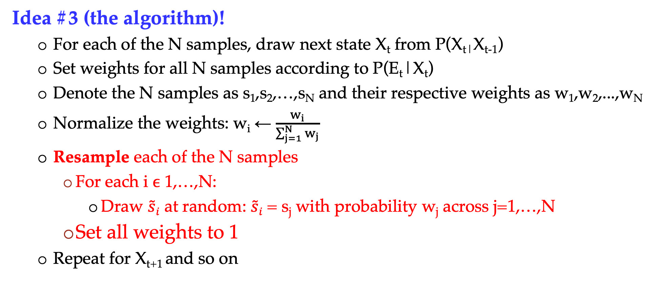
New algorithm: Particle filtering
Idea #3 (the algorithm)!
  For each of the N samples, draw next state X_{t} from P(X_{t|}X_{t-1})
  Set weights for all N samples according to P(E_{t}|X_{t})
  Denote the N samples as s₁,s₂,…,s_{N} and their respective weights as w₁,w₂,...,w_{N}
  Normalize the weights: w_{i} ← $\frac{w_{i}}{\sum_{j=1}^{N}{w_{j}}}$
  Resample each of the N samples
    For each i ϵ 1,…,N:
      Draw $\tilde{s}i$ at random: $\tilde{s}i$ = s_{j} with probability w_{j} across j=1,…,N
    Set all weights to 1
  Repeat for X_{t+1} and so on

Slide 13
Robot Localization
We know the map, but not the robot’s position
Observations are some sensor readings
Another challenge: State space and readings are typically continuous (works basically like a very fine grid) and so we cannot store P(X)

Slide 14
Particle Filter Localization (Sonar)
[Dieter Fox, et al.]
[Video: global-sonar-uw-annotated.avi]

Slide 15
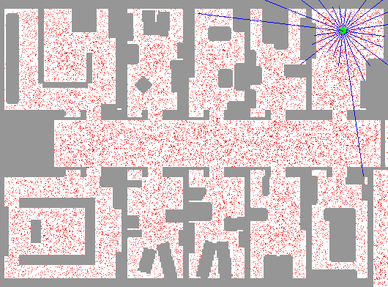
Particle Filter Localization (Laser)
[Dieter Fox, et al.]
[Video: global-floor.gif]

Slide 16
Summary: Particle Filtering
Particles: track samples of states rather than an explicit distribution
Propagate forward
based on transition function
Weight based on observation function
Resample using weighted particles
Particles:
(3,3)
(2,3)
(3,3)
(3,2)
(3,3)
(3,2)
(1,2)
(3,3)
(3,3)
(2,3)
Particles:
(3,2)
(2,3)
(3,2)
(3,1)
(3,3)
(3,2)
(1,3)
(2,3)
(3,2)
(2,2)
Particles:
(3,2) w=.9
(2,3) w=.2
(3,2) w=.9
(3,1) w=.4
(3,3) w=.4
(3,2) w=.9
(1,3) w=.1
(2,3) w=.2
(3,3) w=.4
(2,2) w=.4
(New) Particles:
(3,2)
(2,2)
(3,2)
(2,3)
(3,3)
(3,2)
(1,3)
(2,3)
(3,2)
(3,2)

Slide 17
Question
If we only have one particle which of these steps are unnecessary?
  Select all that are unnecessary.
  Propagate forward
  Weight
  Resample
  None of the above
Propagate forward
Weight
Resample

Slide 18
Question
If we only have one particle which of these steps are unnecessary?
  Select all that are unnecessary.
  Propagate forward
  Weight
  Resample
  None of the above
Propagate forward
Weight
Resample
Unless the weight is zero, in which case, you’ll want to resample from the beginning ☹

Slide 19

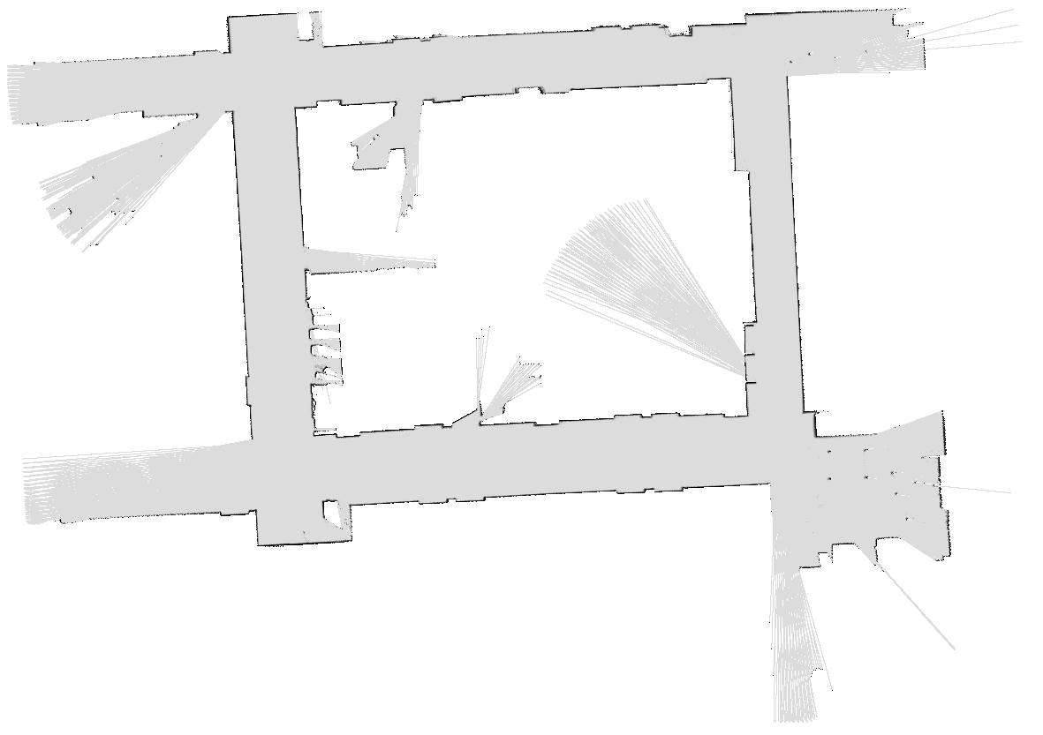
Robot Mapping
SLAM: Simultaneous Localization And Mapping
  We do not know the map or our location
  State consists of position AND map!
  Main techniques: Kalman filtering (Gaussian HMMs) and particle methods
DP-SLAM, Ron Parr
[Demo: PARTICLES-SLAM-mapping1-new.avi]

Slide 20
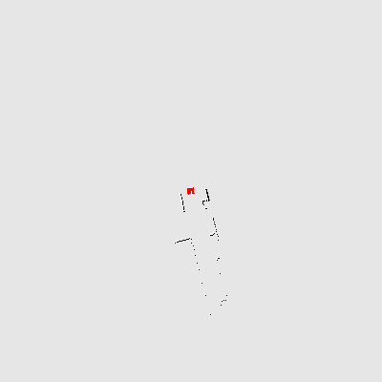
Particle Filter SLAM – Video 1
[Sebastian Thrun, et al.]
[Demo: PARTICLES-SLAM-mapping1-new.avi]

Slide 21
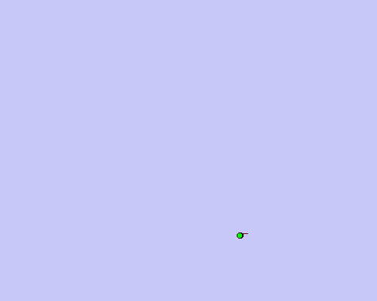
Particle Filter SLAM – Video 2
[Dirk Haehnel, et al.]
[Demo: PARTICLES-SLAM-fastslam.avi]

Slide 22

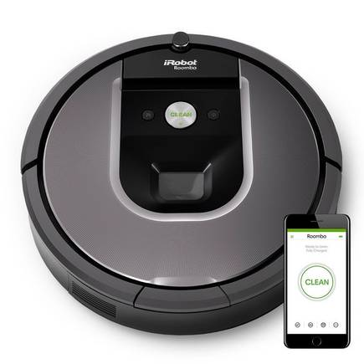
SLAM
https://www.irobot.com/

Slide 23
In Class Activity
Given the following starting particles, transition model, and e₁ and e₂ observed at time 1 and time 2, estimate P(X₂|e₁,e₂).
T=0
P(X_{t+1}|X_{t} in middle row)
P(X_{t+1}|X_{t} in top row)
P(X_{t+1}|X_{t} in bottom row)
0.15
0.1
0.1
0.8
0.7
0.8
0.1
0.15
0.1
P(e₁|x₁)
P(e₂|x₂)
.3
.5
.05
.4
.5
.5
.3
.5
.2
.5
.05
.2
Notes:
Row 3 (top row):
P((k,2) | (k,3)) = .8
P((k,3) | (k,3)) = .1
P((k+1,3) | (k,3)) = .1
Row 2 (middle row):
P((k+1,2) | (k,2)) = .7
P((k+1,1) | (k,2)) = .15
P((k+1,3) | (k,2)) = .15
Row 1 (bottom row):
P((k,2) | (k,1)) = .8
P((k,1) | (k,1)) = .1
P((k+1,1) | (k,1)) = .1

Slide 24
In Class Activity
  Given the following starting particles, transition model, and e₁ and e₂ observed at time 1 and time 2, estimate P(X₁|e₁).
T=0
T=1
Propagate forward
P(e₁|x₁)
.3
.5
.5
.5
.2
.5
Notes:
Row 3 (top row):
P((k,2) | (k,3)) = .8
P((k,3) | (k,3)) = .1
P((k+1,3) | (k,3)) = .1
Row 2 (middle row):
P((k+1,2) | (k,2)) = .7
P((k+1,1) | (k,2)) = .15
P((k+1,3) | (k,2)) = .15
Row 1 (bottom row):
P((k,2) | (k,1)) = .8
P((k,1) | (k,1)) = .1
P((k+1,1) | (k,1)) = .1

Slide 25
In Class Activity
  Given the following starting particles, transition model, and e₁ and e₂ observed at time 1 and time 2, estimate P(X₁|e₁).
T=0
T=1
.5
Propagate forward
1.5
Weight based on e₁
.5
P(e₁|x₁)
.3
.5
.5
.5
.2
.5
Notes:
Row 3 (top row):
P((k,2) | (k,3)) = .8
P((k,3) | (k,3)) = .1
P((k+1,3) | (k,3)) = .1
Row 2 (middle row):
P((k+1,2) | (k,2)) = .7
P((k+1,1) | (k,2)) = .15
P((k+1,3) | (k,2)) = .15
Row 1 (bottom row):
P((k,2) | (k,1)) = .8
P((k,1) | (k,1)) = .1
P((k+1,1) | (k,1)) = .1

Slide 26
In Class Activity
  Given the following starting particles, transition model, and e₁ and e₂ observed at time 1 and time 2, estimate P(X₁|e₁).
T=0
T=1
.2
Propagate forward
.6
.2
Resample
Weight based on e₁
P(e₁|x₁)
.3
.2
.5
Estimate
.5
.3
.5
.5
.2
.5
Notes:
Row 3 (top row):
P((k,2) | (k,3)) = .8
P((k,3) | (k,3)) = .1
P((k+1,3) | (k,3)) = .1
Row 2 (middle row):
P((k+1,2) | (k,2)) = .7
P((k+1,1) | (k,2)) = .15
P((k+1,3) | (k,2)) = .15
Row 1 (bottom row):
P((k,2) | (k,1)) = .8
P((k,1) | (k,1)) = .1
P((k+1,1) | (k,1)) = .1

Slide 27
In Class Activity
Given the particles at T=1, transition model, and e₂ observed at time 2, estimate P(X₂|e₁,e₂).
T=1
T=2
Propagate forward
P(e₂|x₂)
.05
.4
.3
.5
.05
.2
Notes:
Row 3 (top row):
P((k,2) | (k,3)) = .8
P((k,3) | (k,3)) = .1
P((k+1,3) | (k,3)) = .1
Row 2 (middle row):
P((k+1,2) | (k,2)) = .7
P((k+1,1) | (k,2)) = .15
P((k+1,3) | (k,2)) = .15
Row 1 (bottom row):
P((k,2) | (k,1)) = .8
P((k,1) | (k,1)) = .1
P((k+1,1) | (k,1)) = .1

Slide 28
In Class Activity
  Given the particles at T=1, transition model, and e₂ observed at time 2, estimate P(X₂|e₁,e₂).
T=1
T=2
.4
Propagate forward
Weight based on e₂
2.1
1.0
P(e₂|x₂)
.05
.4
.3
.5
.05
.2
Notes:
Row 3 (top row):
P((k,2) | (k,3)) = .8
P((k,3) | (k,3)) = .1
P((k+1,3) | (k,3)) = .1
Row 2 (middle row):
P((k+1,2) | (k,2)) = .7
P((k+1,1) | (k,2)) = .15
P((k+1,3) | (k,2)) = .15
Row 1 (bottom row):
P((k,2) | (k,1)) = .8
P((k,1) | (k,1)) = .1
P((k+1,1) | (k,1)) = .1

Slide 29
In Class Activity
  Given the particles at T=1, transition model, and e₂ observed at time 2, estimate P(X₂|e₁,e₂).
T=1
T=2
.11
Propagate forward
Weight based on e₂
.6
.29
Resample
P(e₂|x₂)
.1
.05
.4
Estimate
.6
.3
.3
.5
.05
.2
Notes:
Row 3 (top row):
P((k,2) | (k,3)) = .8
P((k,3) | (k,3)) = .1
P((k+1,3) | (k,3)) = .1
Row 2 (middle row):
P((k+1,2) | (k,2)) = .7
P((k+1,1) | (k,2)) = .15
P((k+1,3) | (k,2)) = .15
Row 1 (bottom row):
P((k,2) | (k,1)) = .8
P((k,1) | (k,1)) = .1
P((k+1,1) | (k,1)) = .1

