Slide 1
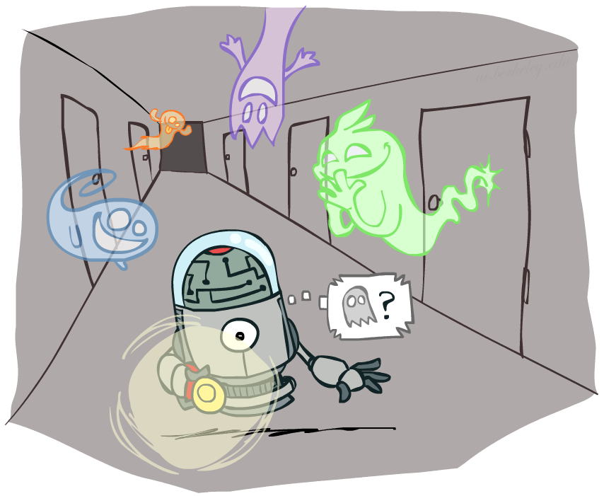
AI: Representation and Problem Solving
Sequential Data and Hidden Markov Models
Instructors: Nihar B. Shah and Tuomas Sandholm
Slide credits: CMU AI and ai.berkeley.edu

Slide 2

Sequential data
  Finance
  Speech recognition
  Robot localization
  User attention
  Medical monitoring
Need to introduce time (or space) into our models

Slide 3
Today
Two popular models for sequential data
Markov chains and hidden Markov models (HMMs)
Used widely in many applications
Also form building blocks for more complex models

Slide 4
Markov Chains
X₁
X₂
X₃
X₄
  Let X denote the quantity of interest (e.g., stock price)
  Consider discrete time (e.g., days)
  Let X_{t} denote random variable for the value of X (stock price) at time t (i.e., day t)
  Possible values of X at a given time are called the states
  Initial state probabilities: Probability distribution of X₁
  Transition probabilities or dynamics: P(X_{t}|X_{t-1}) specify how the state evolves over time
  Stationarity assumption: transition probabilities same at all times, i.e., P(X_{t}|X_{t-1}) = P(X_{t’}|X_{t’-1})
  Same as MDP transition model, but no choice of action, no rewards

Slide 5
Conditional Independence
X₁
X₂
X₃
X₄
  Past and future independent given the present
  Each time step only depends on the previous
  This is called the (first order) Markov property
Note that the chain is just a (growable) Bayes net

Slide 6
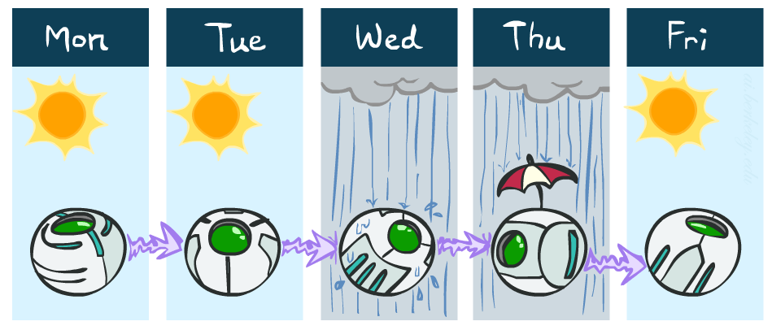
Example: Markov Chain Weather
States: X = {rain, sun}
Initial distribution: 1.0 sun
CPT P(X_{t} | X_{t-1}):
Two new ways of representing the same CPT
X_{t-1} | X_{t} | P(X_{t}|X_{t-1})
sun | sun | 0.9
sun | rain | 0.1
rain | sun | 0.3
rain | rain | 0.7
0.9
0.3
0.9
rain
sun
sun
sun
0.1
0.3
rain
rain
0.7
0.7
0.1

Slide 7
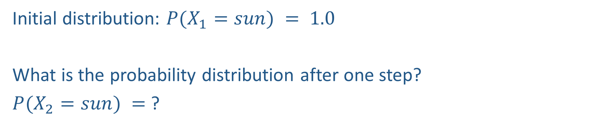
Example: Markov Chain Weather
0.9
0.3
rain
sun
Initial distribution: $P(X_{1}=sun) = 1.0$
What is the probability distribution after one step?
$P(X_{2}=sun) =$ ?
0.7
0.1

Slide 8
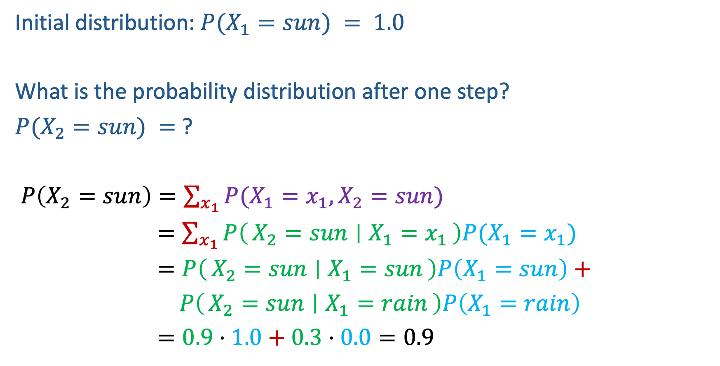
Example: Markov Chain Weather
0.9
0.3
rain
sun
Initial distribution: $P(X_{1}=sun) = 1.0$
What is the probability distribution after one step?
$P(X_{2}=sun) =$ ?
$P\left(X_{2}=sun\right)=\sum_{x_{1}}{P(X_{1}=x_{1}, X_{2}=sun})$
$=\sum_{x_{1}}{P\left(X_{2}=sun ∣ X_{1}=x_{1}\right)P(X_{1}=x_{1}})$
$=P\left(X_{2}=sun ∣ X_{1}=sun\right)P\left(X_{1}=sun\right)+$
$P\left(X_{2}=sun ∣ X_{1}=rain\right)P\left(X_{1}=rain\right)$
$=0.9⋅1.0+0.3⋅0.0=0.9$
0.7
0.1

Slide 9
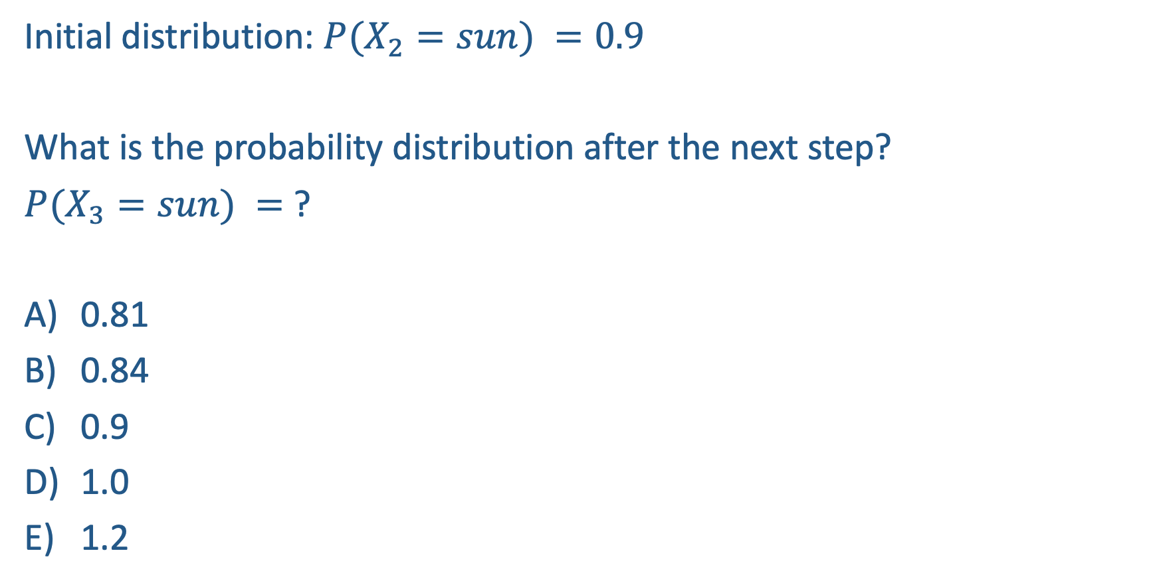
Question
0.9
0.3
rain
sun
Initial distribution: $P(X_{2}=sun) =0.9$
What is the probability distribution after the next step?
$P(X_{3}=sun) =$ ?
0.81
0.84
0.9
1.0
1.2
0.7
0.1

Slide 10

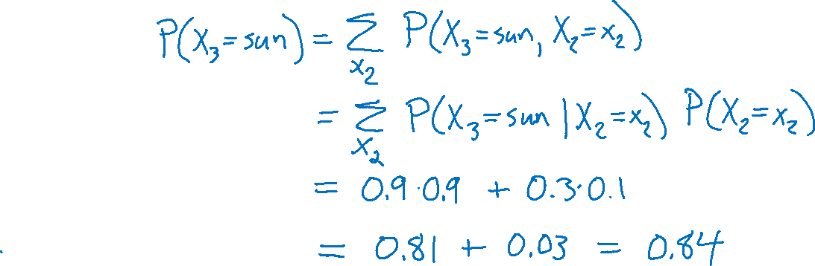
Question
0.9
0.3
rain
sun
Initial distribution: $P(X_{2}=sun) =0.9$
What is the probability distribution after the next step?
$P(X_{3}=sun) =$ ?
0.81
0.84
0.9
1.0
1.2
0.7
0.1

Slide 11

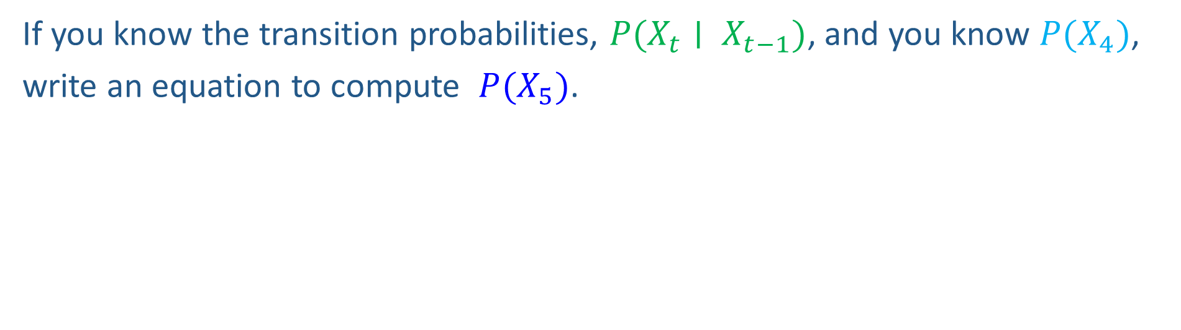
Markov Chain Inference
X₁
X₂
X₃
X₄
If you know the transition probabilities, $P(X_{t}∣ X_{t−1})$, and you know $P(X_{4})$,
write an equation to compute $P(X_{5})$.

Slide 12
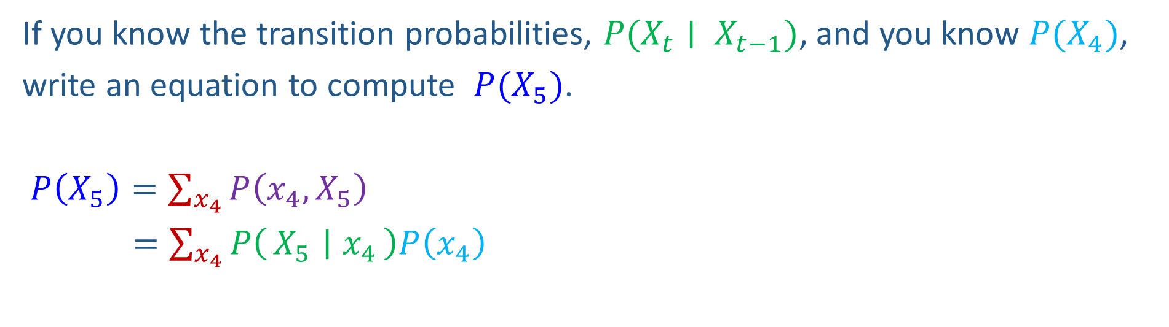
Markov Chain Inference
X₁
X₂
X₃
X₄
If you know the transition probabilities, $P(X_{t}∣ X_{t−1})$, and you know $P(X_{4})$,
write an equation to compute $P(X_{5})$.
$P\left(X_{5}\right)=\sum_{x_{4}}{P\left(x_{4},X_{5}\right)}$
$=\sum_{x_{4}}{P\left(X_{5} ∣ x_{4}\right)P\left(x_{4}\right)}$

Slide 13
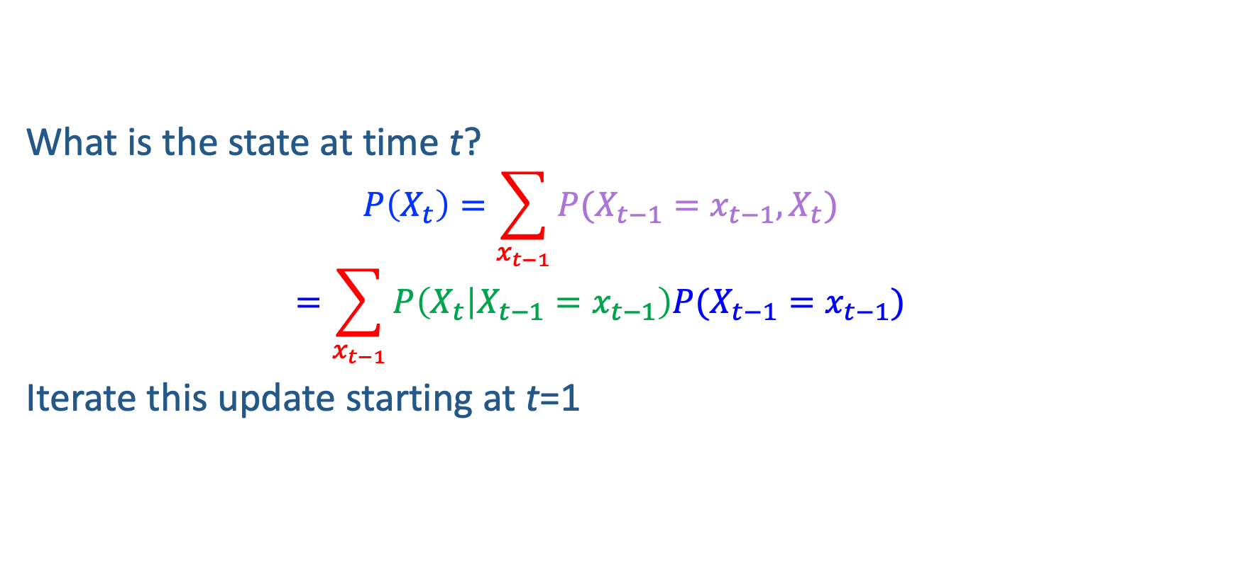
More generally
What is the state at time t?
  $$P\left(X_{t}\right)=\sum_{x_{t−1}}{P(X_{t−1}=x_{t−1}, X_{t})}$$
  $$=\sum_{x_{t−1}}{P\left(X_{t} | X_{t−1}=x_{t−1}\right)P(X_{t−1}=x_{t−1})}$$
Iterate this update starting at t=1
Transition model
Probability from previous iteration

Slide 14

Hidden Markov Models

Slide 15
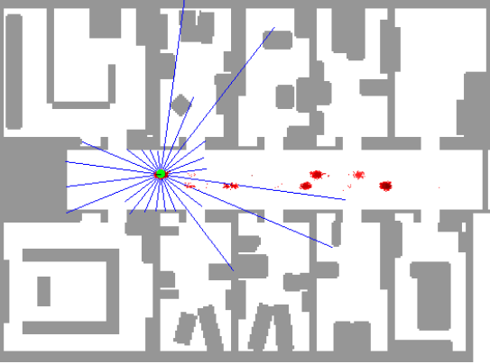
Hidden Markov Models
In many applications, the true state is not observed directly.
Instead, you observe some possibly noisy information.
Robot tracking:
  Observations are range readings (continuous)
  States are positions on a map (continuous)
Speech recognition HMMs:
  Observations are acoustic signals (continuous valued)
  States are specific positions in specific words (so, tens of thousands)
Machine translation HMMs:
  Observations are words (tens of thousands)
  States are translation options
Molecular biology:
  Observations are nucleotides ACGT
  States are coding/non-coding/start/stop/splice-site etc.

Slide 16
Hidden Markov Models
In many applications, the true state is not observed directly.
Instead, you observe some possibly noisy information.
  Underlying Markov chain over states X
  You observe evidence E_{t} at each time step t
X₀
X₁
X₂
X₃
X₅
E₁
E₂
E₃
E₅

Slide 17
X₁
e₁

Slide 18
X₁
X₂
e₁
e₂

Slide 19
X₁
X₂
X₃
e₁
e₂
e₃

Slide 20
X₁
X₂
X₃
X₄
….
e₁
e₂
e₃
e₄

Slide 21

Example: Weather HMM
An HMM is defined by:
  Initial distribution: P(X₁)
  Transition model: P(X_{t} | X_{t-1})
  Sensor model: P(E_{t} | X_{t})
X_{t-1} | P(X_{t}|X_{t-1})
 | sun | rain
sun | 0.9 | 0.1
rain | 0.3 | 0.7
Weather _{t-1}
Weather _{t}
Weather _{t+1}
X_{t} | P(E_{t}|X_{t})
 | true | false
sun | 0.2 | 0.8
rain | 0.9 | 0.1
Sensor _{t-1}
Sensor _{t}
Sensor _{t+1}
Notes:
demo

Slide 22
HMM as Probability Model
X₀
X₁
X₂
X₃
X₅
  Joint distribution for Markov model:
  P(X₀,…, X_{T}) = P(X₀) ∏_{t=1,…,T} P(X_{t} | X_{t-1})
  Joint distribution for hidden Markov model:
  P(X₀, X₁,E₁, …, X_{T},E_{T}) = P(X₀) ∏_{t=1,…,T} P(X_{t} | X_{t-1}) P(E_{t} | X_{t})
  Future states are independent of the past given the present
  Current evidence is independent of everything else given the current state
  Exercise: Are evidence variables independent of each other?
E₁
E₂
E₃
E₅
Notes:
Add conditional independence consequences here

Slide 23
Some useful stuff
Notation: X_{a:b} = (X_{a} , X_{a+1}, …, X_{b})
For example: P(X_{1:2} | e_{1:3}) = P(X₁, X₂, | e₁ , e₂, e₃)
Probability: Consider a random variable B taking three possible values b₁,b₂,b₃. Suppose you know that P(b₁)=2⍺, P(b₂)=1.25⍺, P(b₃)=0.75⍺, for some ⍺>0. Then what is P(b₁)?
Key takeaway: If you know P(B=b) for all b up to a constant, then you can recover P(B) by normalizing.

Slide 24
HMM Queries
Filtering: P(X_{t}|e_{1:t})
Prediction: P(X_{t+k}|e_{1:t})
X₁
X₂
X₃
X₄
X₁
X₂
X₃
X₄
X₅
e₁
e₂
e₃
e₄
e₁
e₂
e₃
Smoothing: P(X_{k}|e_{1:t}), k<t
Explanation: P(X_{1:t}|e_{1:t})
X₁
X₂
X₃
X₄
X₁
X₂
X₃
X₄
e₁
e₂
e₃
e₄
e₁
e₂
e₃
e₄

Slide 25
Filtering
What is the current state, given all of the current and past evidence ?
That is, what is P(X_{t}|e_{1:t})?
X₁
X₂
X₃
X₄
e₁
e₂
e₃
e₄

Slide 26
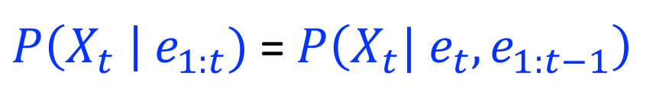

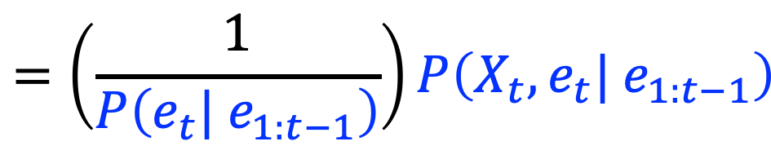
Filtering Algorithm: Exact inference
$P\left(X_{t} \right| e_{1:t})$ =$P\left(X_{t}{| e_{t}, e}_{1:t−1}\right)$
X₁
X₂
X₃
X₄
$$=\left(\frac{1}{P\left({e_{t}| e}_{1:t−1}\right)}\right)P\left(X_{t}, {e_{t}| e}_{1:t−1}\right)$$
e₁
e₂
e₃
e₄
Def. of cond. probability with $X_{t}$, $e_{t}$
does not depend on X_{t}
Notes:
Explain propto

Slide 27
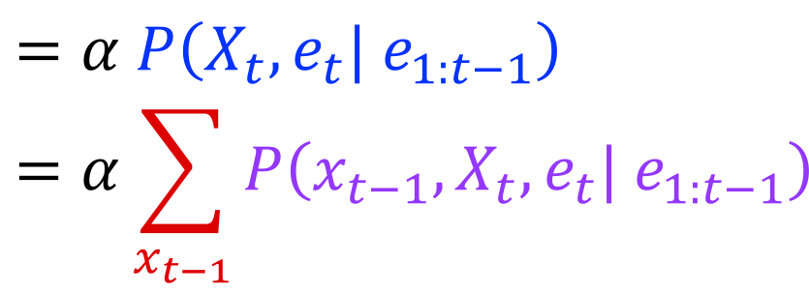

Filtering Algorithm
$P\left(X_{t} \right| e_{1:t})$ =$P\left(X_{t}{| e_{t}, e}_{1:t−1}\right)$
X₁
X₂
X₃
X₄
$$=α P\left(X_{t}, {e_{t}| e}_{1:t−1}\right)$$
$$=α\sum_{x_{t−1}}{P\left(x_{t−1},X_{t}, e_{t}| e_{1:t−1}\right)}$$
e₁
e₂
e₃
e₄
Summation over variable $X_{t−1}$

Slide 28
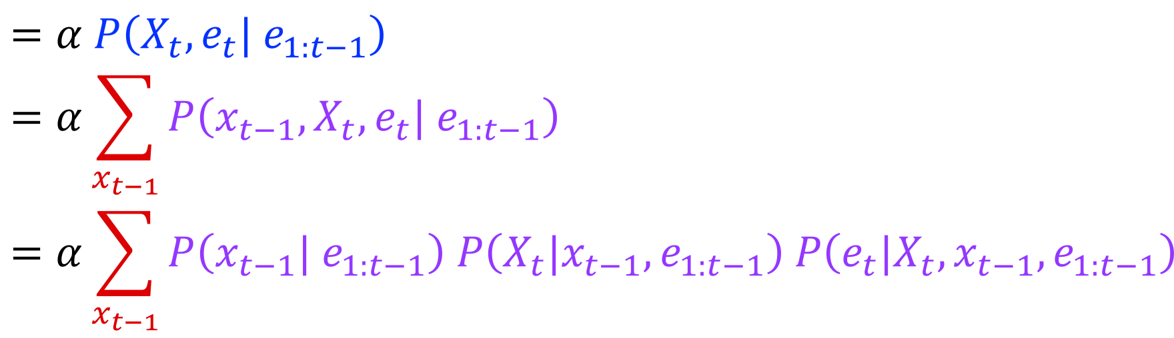

Filtering Algorithm
$P\left(X_{t} \right| e_{1:t})$ =$P\left(X_{t}{| e_{t}, e}_{1:t−1}\right)$
X₁
X₂
X₃
X₄
$$=α P\left(X_{t}, {e_{t}| e}_{1:t−1}\right)$$
$$=α\sum_{x_{t−1}}{P\left(x_{t−1},X_{t}, e_{t}| e_{1:t−1}\right)}$$
$$=α\sum_{x_{t−1}}{P\left(x_{t−1}| e_{1:t−1}\right) P\left(X_{t}|x_{t−1},e_{1:t−1}\right) P\left(e_{t}|X_{t},x_{t−1},e_{1:t−1}\right)}$$
e₁
e₂
e₃
e₄
Chain rule with $x_{t−1}$, $X_{t}$, and $e_{t}$

Slide 29
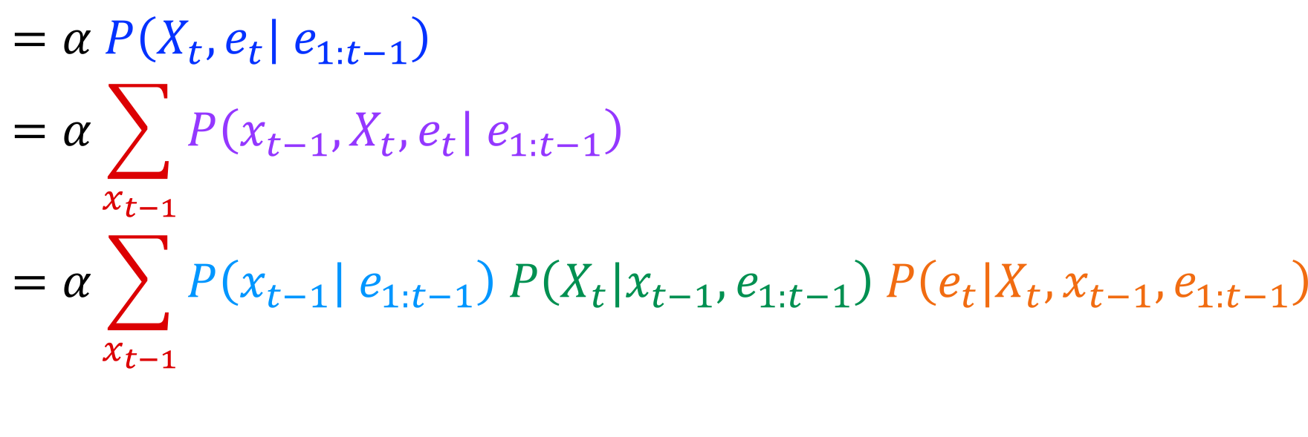
Filtering Algorithm
$P\left(X_{t} \right| e_{1:t})$ =$P\left(X_{t}{| e_{t}, e}_{1:t−1}\right)$
X₁
X₂
X₃
X₄
$$=α P\left(X_{t}, {e_{t}| e}_{1:t−1}\right)$$
$$=α\sum_{x_{t−1}}{P\left(x_{t−1},X_{t}, e_{t}| e_{1:t−1}\right)}$$
$$=α\sum_{x_{t−1}}{P\left(x_{t−1}| e_{1:t−1}\right) P\left(X_{t}|x_{t−1},e_{1:t−1}\right) P\left(e_{t}|X_{t},x_{t−1},e_{1:t−1}\right)}$$
e₁
e₂
e₃
e₄
Chain rule with $x_{t−1}$, $X_{t}$, and $e_{t}$

Slide 30
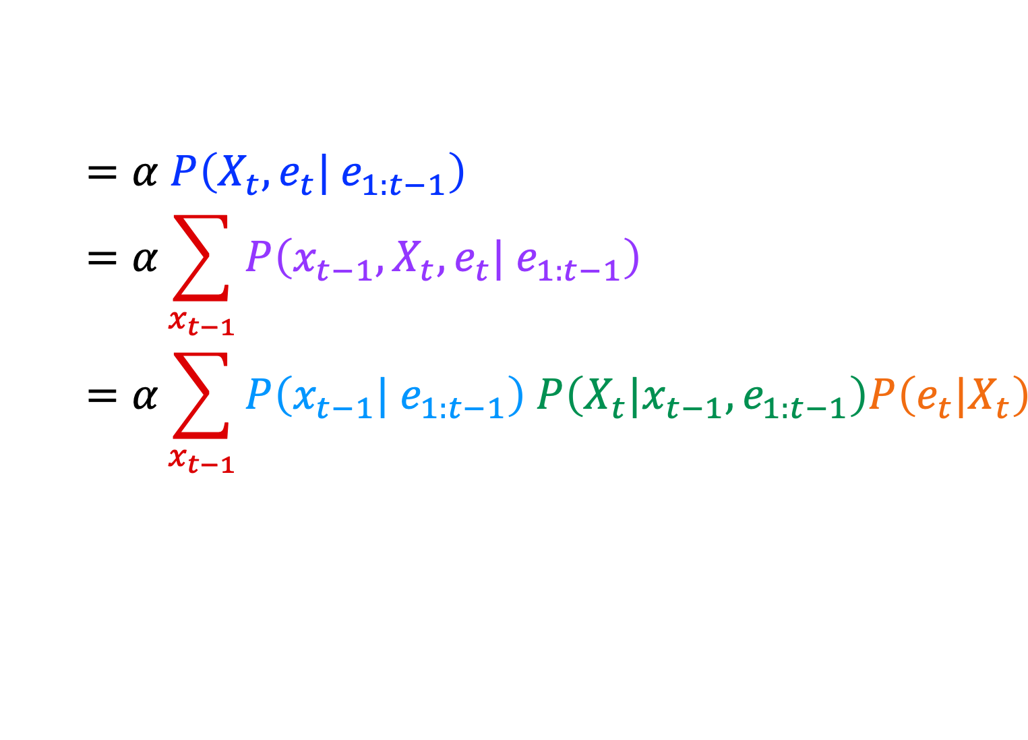
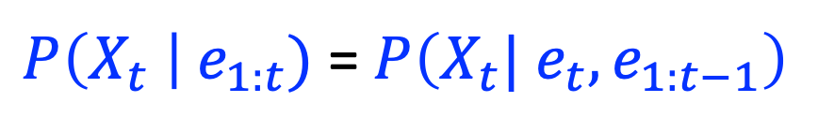
Filtering Algorithm
$P\left(X_{t} \right| e_{1:t})$ =$P\left(X_{t}{| e_{t}, e}_{1:t−1}\right)$
X₁
X₂
X₃
X₄
$$=α P\left(X_{t}, {e_{t}| e}_{1:t−1}\right)$$
$$=α\sum_{x_{t−1}}{P\left(x_{t−1},X_{t}, e_{t}| e_{1:t−1}\right)}$$
$$=α\sum_{x_{t−1}}{P\left(x_{t−1}| e_{1:t−1}\right) P\left(X_{t}|x_{t−1},e_{1:t−1}\right)P\left(e_{t}|X_{t}\right)}$$
e₁
e₂
e₃
e₄
Bayes net conditional independence

Slide 31
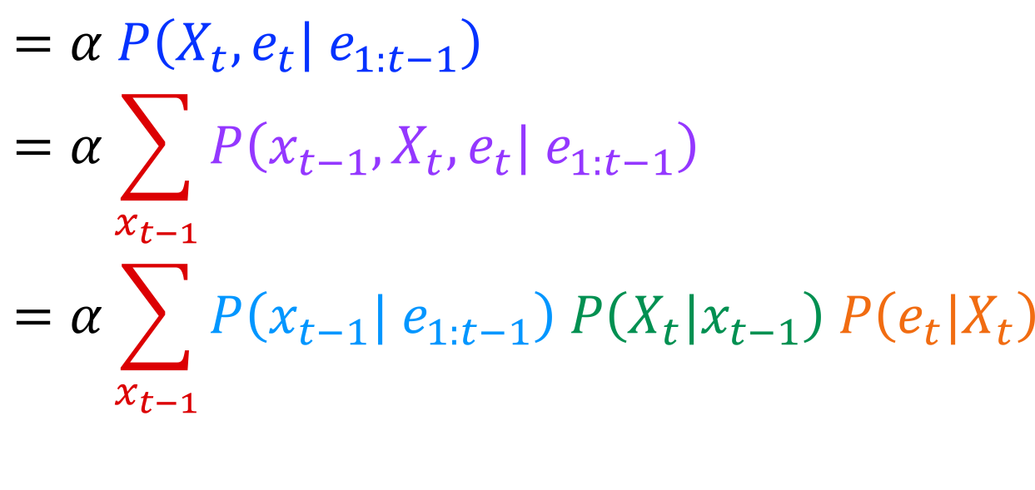
Filtering Algorithm
$P\left(X_{t} \right| e_{1:t})$ =$P\left(X_{t}{| e_{t}, e}_{1:t−1}\right)$
X₁
X₂
X₃
X₄
$$=α P\left(X_{t}, {e_{t}| e}_{1:t−1}\right)$$
$$=α\sum_{x_{t−1}}{P\left(x_{t−1},X_{t}, e_{t}| e_{1:t−1}\right)}$$
$$=α\sum_{x_{t−1}}{P\left(x_{t−1}| e_{1:t−1}\right) P\left(X_{t}|x_{t−1}\right) P\left(e_{t}|X_{t}\right)}$$
e₁
e₂
e₃
e₄
Bayes net conditional independence

Slide 32
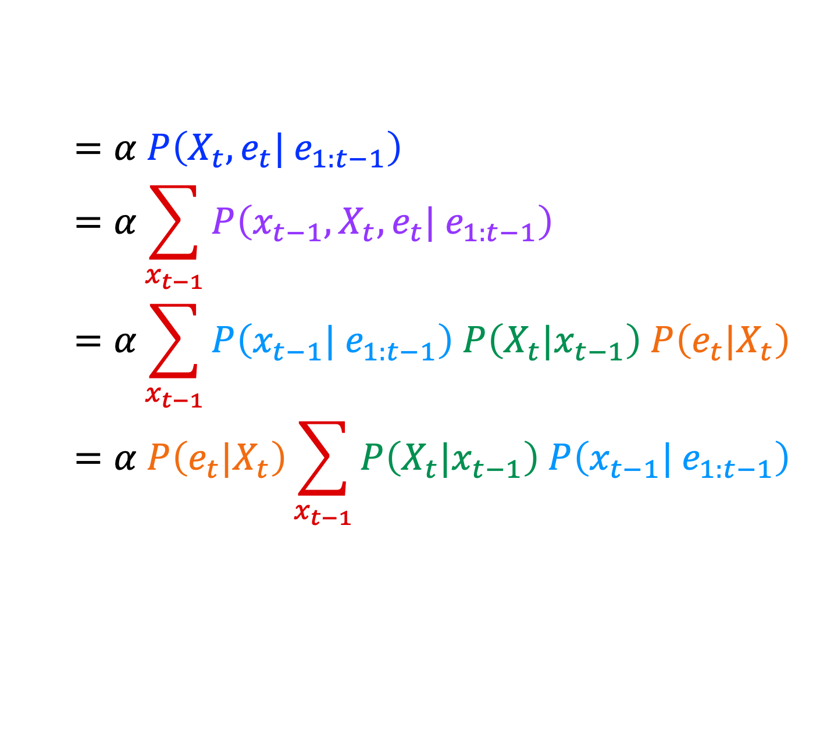

Filtering Algorithm
$P\left(X_{t} \right| e_{1:t})$ =$P\left(X_{t}{| e_{t}, e}_{1:t−1}\right)$
X₁
X₂
X₃
X₄
$$=α P\left(X_{t}, {e_{t}| e}_{1:t−1}\right)$$
$$=α\sum_{x_{t−1}}{P\left(x_{t−1},X_{t}, e_{t}| e_{1:t−1}\right)}$$
$$=α\sum_{x_{t−1}}{P\left(x_{t−1}| e_{1:t−1}\right) P\left(X_{t}|x_{t−1}\right) P\left(e_{t}|X_{t}\right)}$$
$$=α P\left(e_{t}|X_{t}\right)\sum_{x_{t−1}}{P\left(X_{t}|x_{t−1}\right) P\left(x_{t−1}| e_{1:t−1}\right) }$$
e₁
e₂
e₃
e₄
Pulling $P\left(e_{t}|X_{t}\right)$ out of the summation

Slide 33

Filtering Algorithm
$P\left(X_{t} \right| e_{1:t})$ =$P\left(X_{t}{| e_{t}, e}_{1:t−1}\right)$
X₁
X₂
X₃
X₄
$$=α P\left(X_{t}, {e_{t}| e}_{1:t−1}\right)$$
$$=α\sum_{x_{t−1}}{P\left(x_{t−1},X_{t}, e_{t}| e_{1:t−1}\right)}$$
$$=α\sum_{x_{t−1}}{P\left(x_{t−1}| e_{1:t−1}\right) P\left(X_{t}|x_{t−1}\right) P\left(e_{t}|X_{t}\right)}$$
$$=α P\left(e_{t}|X_{t}\right)\sum_{x_{t−1}}{P\left(X_{t}|x_{t−1}\right) P\left(x_{t−1}| e_{1:t−1}\right) }$$
e₁
e₂
e₃
e₄
Recursion!

Slide 34
Filtering Algorithm
$P\left(X_{t} \right| e_{1:t})$ =$P\left(X_{t}{| e_{t}, e}_{1:t−1}\right)$
X₁
X₂
X₃
X₄
$$=α P\left(X_{t}, {e_{t}| e}_{1:t−1}\right)$$
$$=α\sum_{x_{t−1}}{P\left(x_{t−1},X_{t}, e_{t}| e_{1:t−1}\right)}$$
$$=α\sum_{x_{t−1}}{P\left(x_{t−1}| e_{1:t−1}\right) P\left(X_{t}|x_{t−1}\right) P\left(e_{t}|X_{t}\right)}$$
$$=α P\left(e_{t}|X_{t}\right)\sum_{x_{t−1}}{P\left(X_{t}|x_{t−1}\right) P\left(x_{t−1}| e_{1:t−1}\right) }$$
e₁
e₂
e₃
e₄
Recursion!

Slide 35
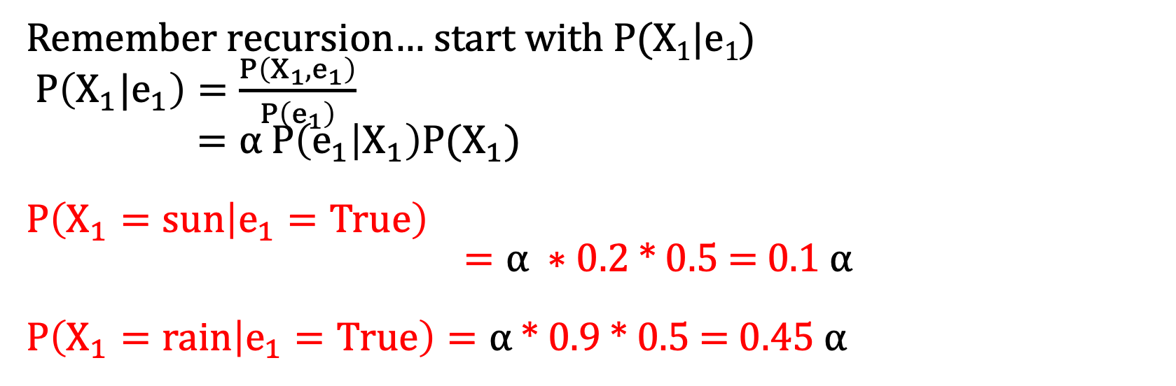
In Class Activity: Weather HMM
X_{t-1} | P(X_{t}|X_{t-1})
 | sun | rain
sun | 0.9 | 0.1
rain | 0.3 | 0.7
X_{t} | P(E_{t}|X_{t})
 | true | false
sun | 0.2 | 0.8
rain | 0.9 | 0.1
  Given P(X₁) = {sun:0.5, rain:0.5}
  Goal: Compute P(X₂=sun | e₂= e₁=True)
  Remember recursion… start with P(X₁|e₁)
  $P\left(X_{1}|e_{1}\right)=\frac{P\left(X_{1},e_{1}\right)}{P\left(e_{1}\right)}$
  $=⍺ P\left(e_{1} | X_{1}\right)P(X_{1})$
  $$P\left(X_{1}=sun | e_{1}=True\right)$$
  $=⍺ ∗$ 0.2 * 0.5 = 0.1 $⍺$
  $P\left(X_{1}=rain | e_{1}=True\right)=⍺$ * 0.9 * 0.5 = 0.45 $⍺$
Notes:
demo

Slide 36
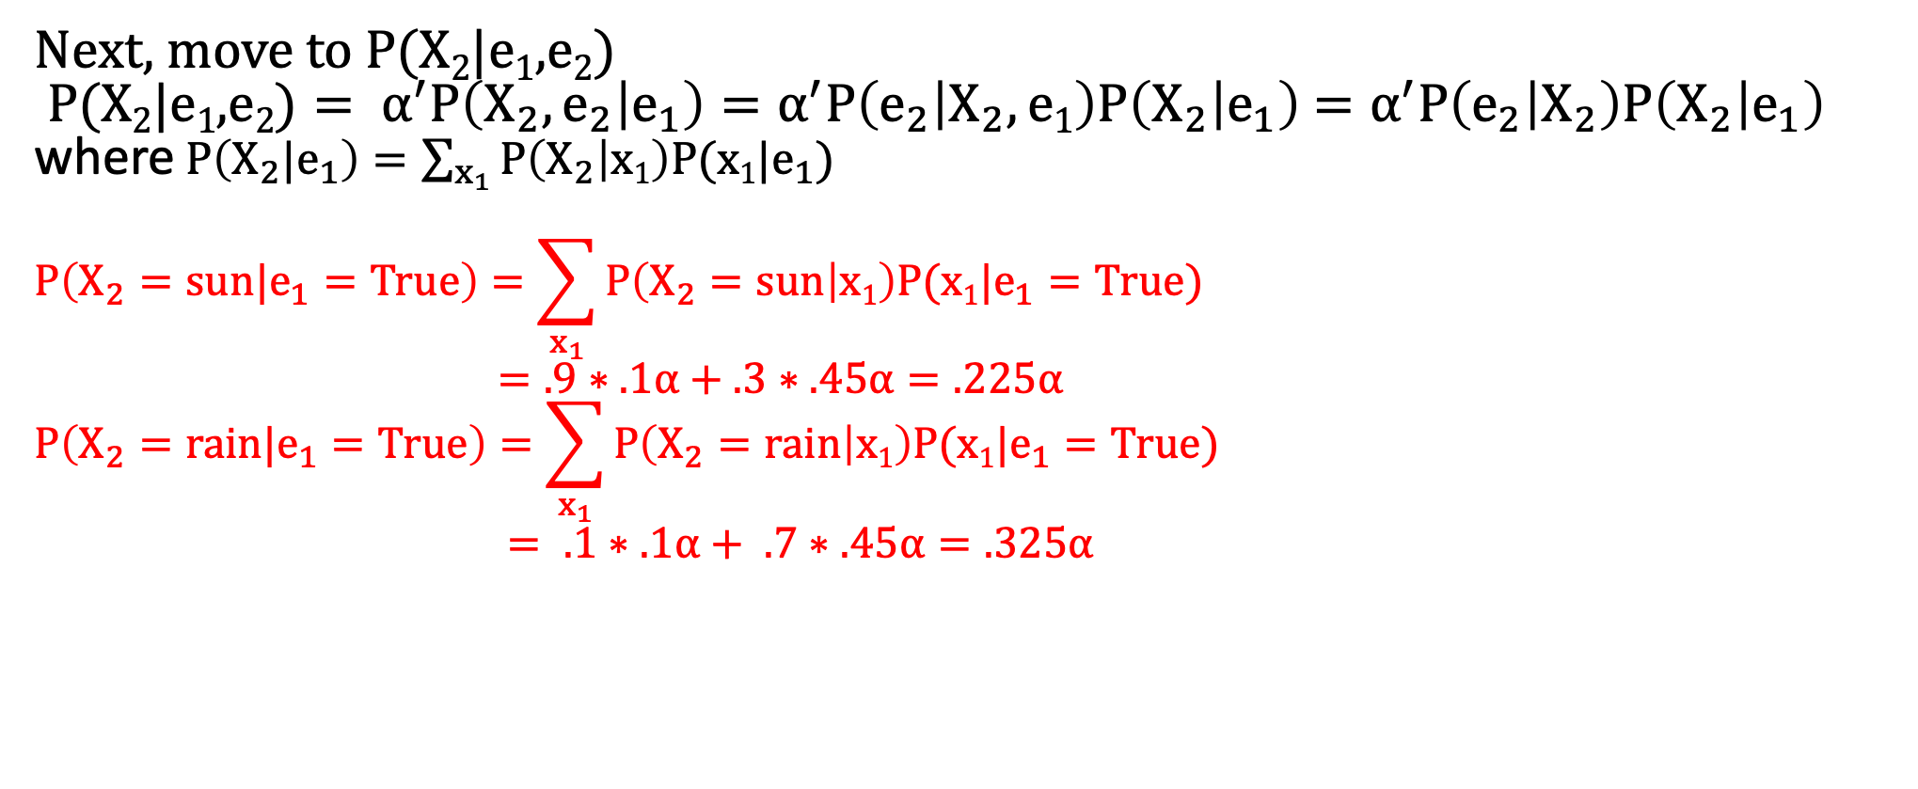
In Class Activity: Weather HMM
X_{t-1} | P(X_{t}|X_{t-1})
 | sun | rain
sun | 0.9 | 0.1
rain | 0.3 | 0.7
X_{t} | P(E_{t}|X_{t})
 | true | false
sun | 0.2 | 0.8
rain | 0.9 | 0.1
  Given P(X₁) = {sun:0.5, rain:0.5}
  Goal: Compute P(X₂=sun | e₂= e₁=True)
  Next, move to P(X₂|e₁,e₂)
  $\text{P}\text{(}\text{X}\text{2}\text{|}\text{e}\text{1}\text{,}\text{e}\text{2}\text{)}= α^{′}P\left(X_{2},e_{2} | e_{1}\right)=α^{′}P\left(e_{2} | X_{2},e1\right)P\left(X_{2} | e_{1}\right)$ $=α^{′}P\left(e_{2} | X_{2}\right)P\left(X_{2} | e_{1}\right)$
  where$P\left(X_{2}|e_{1}\right)=\sum_{x_{1}}{P\left(X_{2} | x1\right)P(x1|e_{1})}$
  $$P\left(X_{2}=sun|e_{1}=True\right)=\sum_{x_{1}}{P\left(X_{2}=sun | x1\right)P(x1|e_{1}=True)}$$
  $=.9∗.1⍺+.3∗.45⍺=.225⍺$
  $$P\left(X_{2}=rain|e_{1}=True\right)=\sum_{x_{1}}{P\left(X_{2}=rain | x1\right)P(x1|e_{1}=True)}$$
  $= .1∗.1⍺+ .7∗.45⍺=.325⍺$
Notes:
demo

Slide 37
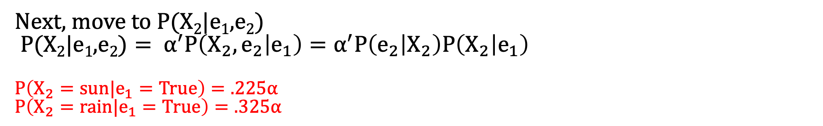
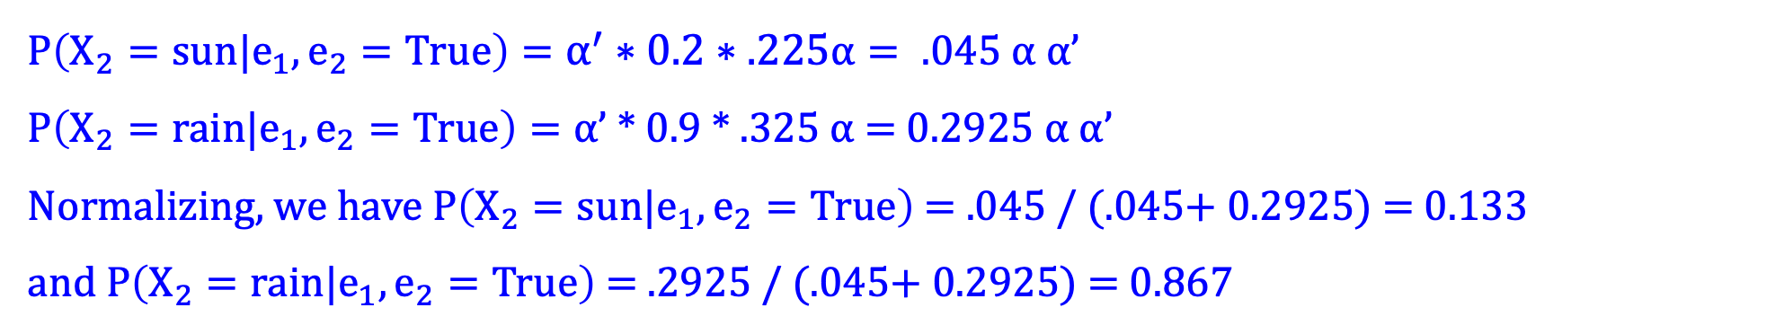
In Class Activity: Weather HMM
X_{t-1} | P(X_{t}|X_{t-1})
 | sun | rain
sun | 0.9 | 0.1
rain | 0.3 | 0.7
X_{t} | P(E_{t}|X_{t})
 | true | false
sun | 0.2 | 0.8
rain | 0.9 | 0.1
  Given P(X₁) = {sun:0.5, rain:0.5}
  Goal: Compute P(X₂=sun | e₂= e₁=True)
  Next, move to P(X₂|e₁,e₂)
  $\text{P}\text{(}\text{X}\text{2}\text{|}\text{e}\text{1}\text{,}\text{e}\text{2}\text{)}= α^{′}P\left(X_{2},e_{2} | e_{1}\right)=α^{′}P\left(e_{2} | X_{2}\right)P\left(X_{2} | e_{1}\right)$
  $$P\left(X_{2}=sun|e_{1}=True\right)=.225⍺$$
  $$P\left(X_{2}=rain|e_{1}=True\right)=.325⍺$$
  $P\left(X_{2}=sun|e_{1},e_{2}=True\right)=α^{′}∗0.2∗.225⍺= .045$ $⍺$ $⍺$’
  $P\left(X_{2}=rain|e_{1},e_{2}=True\right)=⍺$’ * 0.9 * .325 $⍺$ = 0.2925 $⍺$ $⍺$’
  Normalizing, we have $P\left(X_{2}=sun|e_{1},e_{2}=True\right)$ = $.045$ / ($.045$+ 0.2925) = 0.133
  and $P\left(X_{2}=rain|e_{1},e_{2}=True\right)$ = $.2925$ / ($.045$+ 0.2925) = 0.867
Notes:
demo

Slide 38
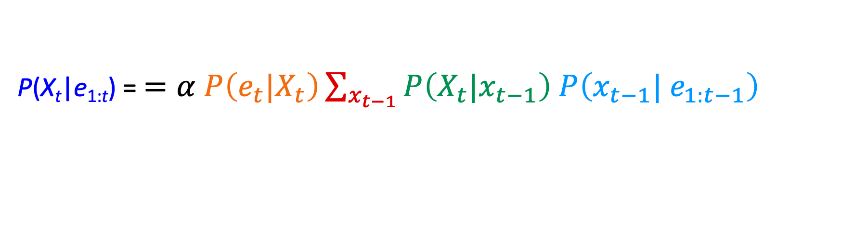
Filtering Algorithm: Computational complexity
P(X_{t}|e_{1:t}) = $=α P\left(e_{t}|X_{t}\right)\sum_{x_{t−1}}{P\left(X_{t}|x_{t−1}\right) P\left(x_{t−1}| e_{1:t−1}\right) }$
Normalize
Update
Predict
Computational cost per time step:
O(|X|²) where |X| is the number of states
O(|X|²) is infeasible for models with many state variables
Next lecture: Approximations!

