Slide 1
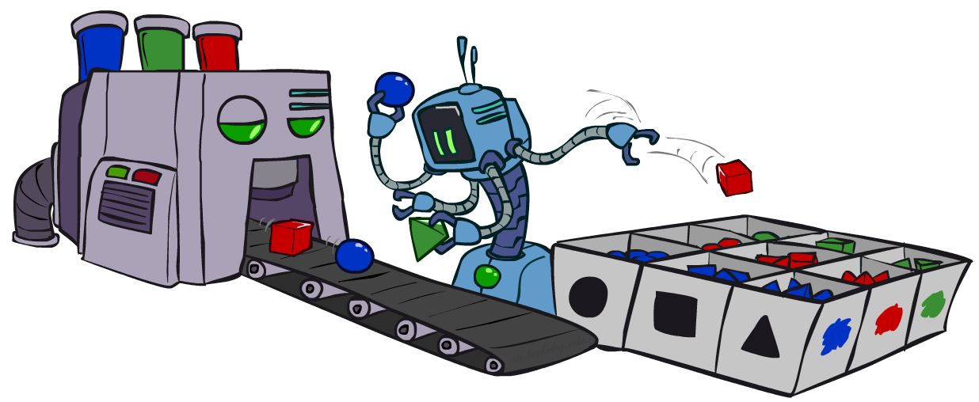
AI: Representation and Problem Solving
Bayes Nets Sampling
Instructors: Nihar B. Shah and Tuomas Sandholm
Slide credits: CMU AI and ai.berkeley.edu

Slide 2
Today: Sampling
For random variables X₁,…,X_{n}
  How to get a sample from P(X₁,…,X_{n})?
  How to get a sample from P(X_{5,}X₆|X₃=x₃,X₇=x₇)?
Why do we need this?

Slide 3
Reason 1: Inference
Estimating posterior probabilities (P(Query|evidence)) can be computationally expensive
Instead, sampling from the posterior distribution can be easier
  Recall Monte Carlo approach from earlier
  Given enough samples, counts converge to true probability
Use that to approximate the posterior probability

Slide 4
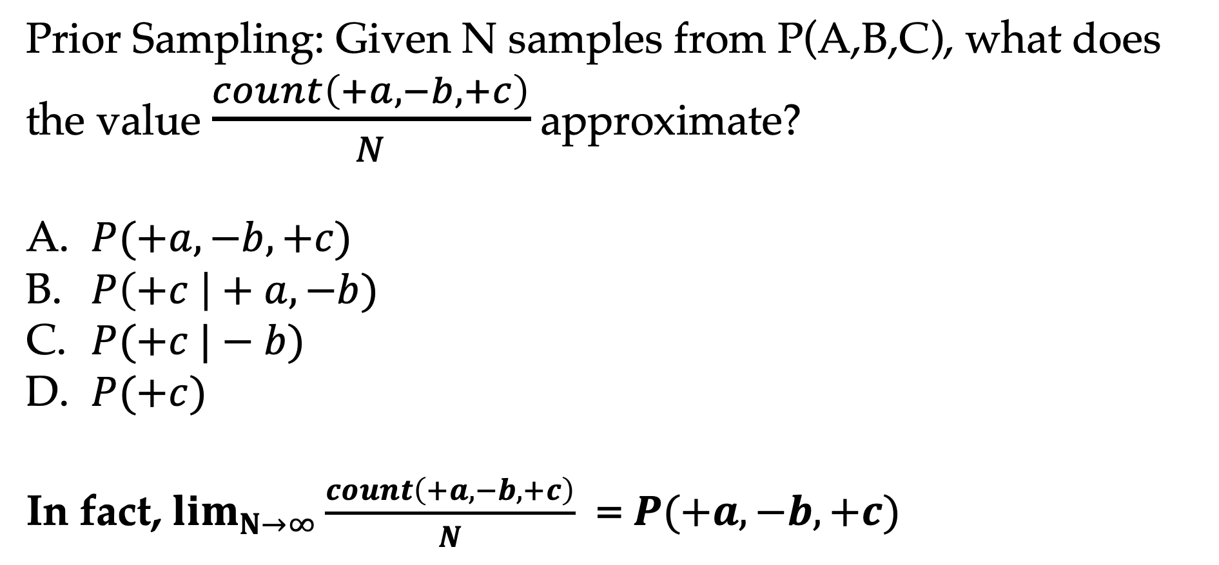
Warm up
Prior Sampling: Given N samples from P(A,B,C), what does the value $\frac{count\left(+a, −b, +c\right)}{N}$ approximate?
$P(+a, −b, +c)$
$P\left(+c \right|+a, −b)$
$P(+c |−b)$
$P(+c)$
In fact, $\lim_{N→∞}{\frac{count\left(+a, −b, +c\right)}{N}}$ = $P(+a, −b, +c)$

Slide 5
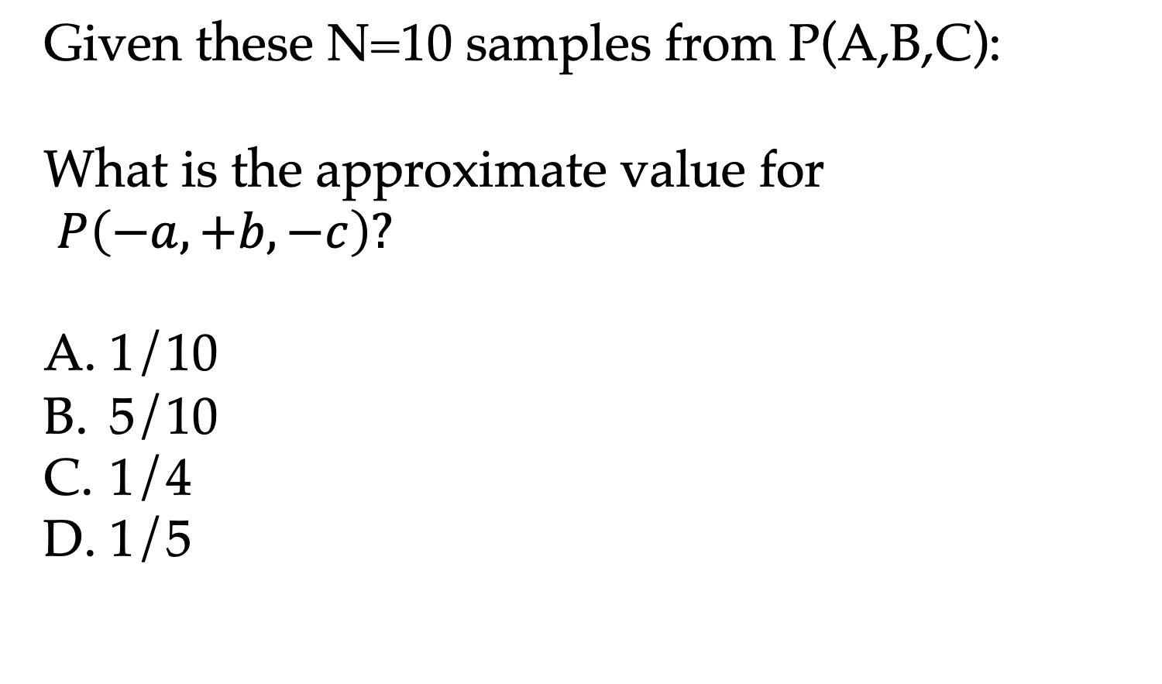
Warm-up
Given these N=10 samples from P(A,B,C):
What is the approximate value for
$P\left(−a, +b, −c\right)?$
1/10
5/10
1/4
1/5
Counts
+a | +b | +c | 0
+a | +b | -c | 0
+a | -b | +c | 3
+a | -b | -c | 0
-a | +b | +c | 4
-a | +b | -c | 1
-a | -b | +c | 2
-a | -b | -c | 0

Slide 6
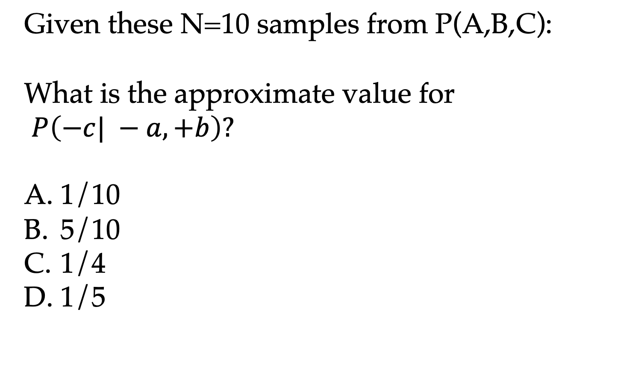
Warm-up
Given these N=10 samples from P(A,B,C):
What is the approximate value for
$P\left(−c| −a, +b\right)?$
1/10
5/10
1/4
1/5
Counts
+a | +b | +c | 0
+a | +b | -c | 0
+a | -b | +c | 3
+a | -b | -c | 0
-a | +b | +c | 4
-a | +b | -c | 1
-a | -b | +c | 2
-a | -b | -c | 0

Slide 7
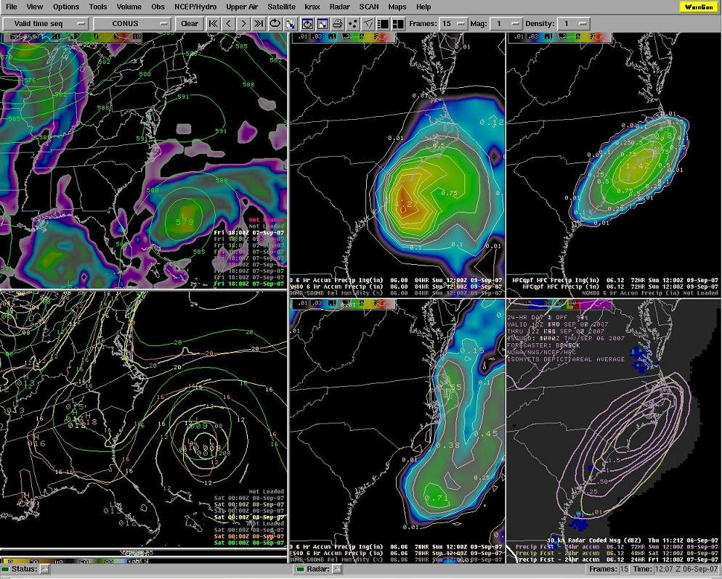
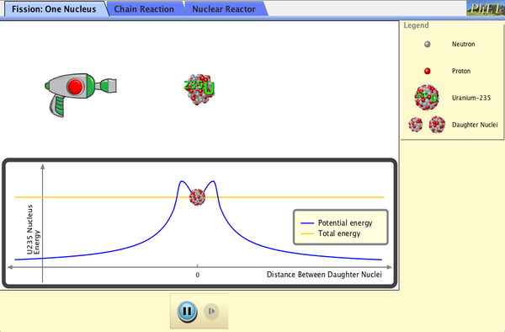
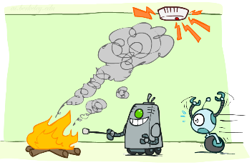



Reason 2: Simulations
Fire department wants to conduct a drill
Simulate daily conditions by drawing from P(F, S, A)
Simulate situation of an alarm by drawing from P(F, S | A=+a)
$$F$$
$$S$$
$$A$$

Slide 8

Cool connection: GenAI Image generation
This is at its core a sampling problem
It is generating random samples from the distribution, in this example, of human images
The distribution is unknown and hard to specify
Techniques much more advanced than what we’ll study here

Slide 9
Sampling in Bayes’ Nets
Prior Sampling
Rejection Sampling
Likelihood Weighting
Gibbs Sampling

Slide 10
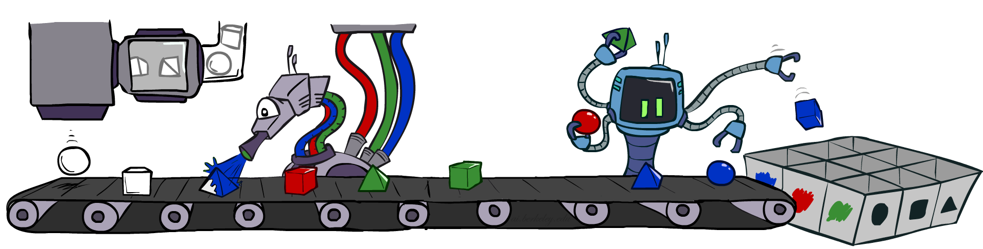
Prior Sampling

Slide 11
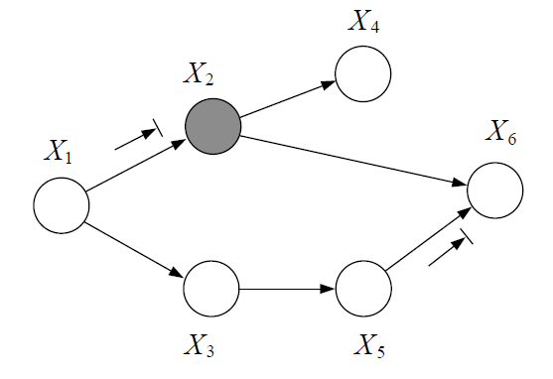
Given a Bayes net, how to sample from P(X₁,…,X_{n})?
  Certain applications (e.g., simulations) need sample from entire joint distribution
  To answer a conditional or marginal probability query
    Approximate joint distribution based on samples
    Answer desired query from it

Slide 12

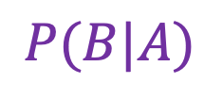
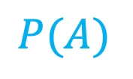

Example
How would you sample from P(A,B)?
  You have access to P(A) and P(B|A)
P(A, B) = P(A) P(B|A)
First draw a sample a~P(A)
Then draw b~P(B|A=a)
Thus (a, b) is a sample from P(A,B)
$$A$$
$$B$$
+a | +b | 1/10
 | -b | 9/10
-a | +b | 1/2
 | -b | 1/2
+a | 1/2
-a | 1/2
$$P(A)$$
$$P(B|A)$$

Slide 13
Prior Sampling
Given a Bayes net, how to sample from P(X₁,…,X_{n})?
  You have access to the CPTs used to construct the Bayes net
Consider a topological ordering of the nodes of the Bayes net (say, it is X₁,…,X_{n})
For i=1, 2, …, n
  Sample x_{i} ~ P(X_{i} | Parents(X_{i})=their sampled values)
Return (x₁, x₂, …, x_{n})

Slide 14






Question
How many $\{−a,+b,−c\}$ samples out of N=1000
should we expect?
1
50
125
200
+a | 1/2
-a | 1/2
$$P(A)$$
$$A$$
+a | +b | 1/10
 | -b | 9/10
-a | +b | 1/2
 | -b | 1/2
$$P(B|A)$$
$$B$$
+b | +c | 4/5
 | -c | 1/5
-b | +c | 1
 | -c | 0
$$C$$
$$P(C|B)$$

Slide 15
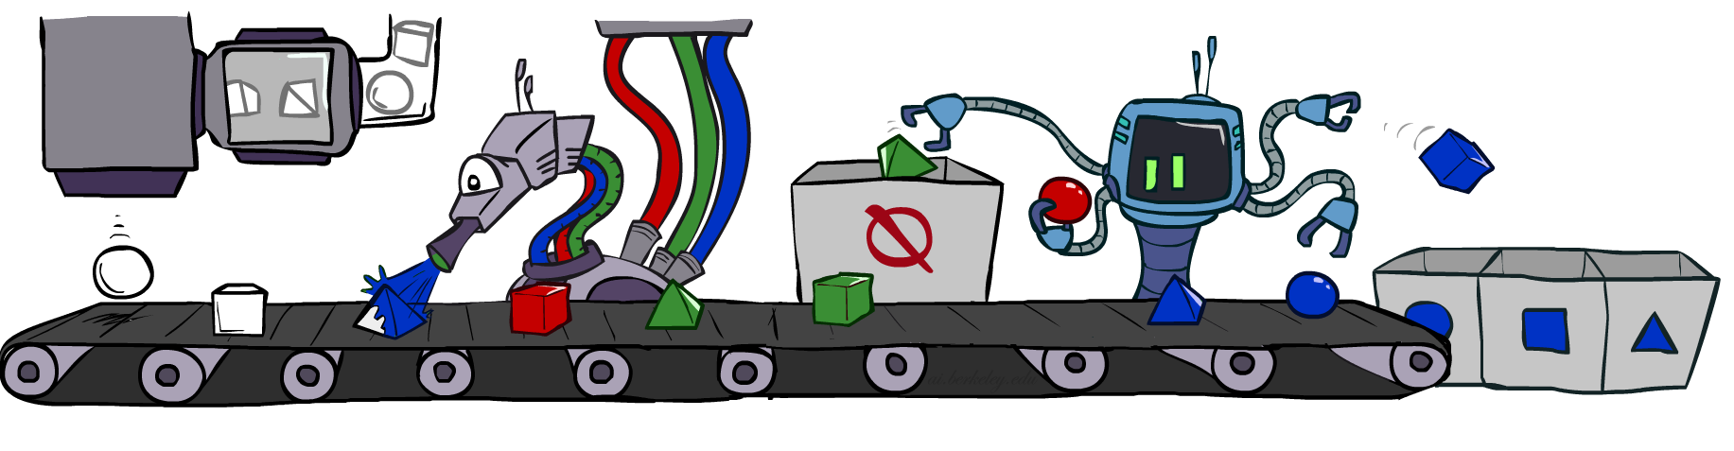
Rejection Sampling

Slide 16
How to sample conditionals?
$$F$$
$$S$$
$$A$$
How to get a sample from P(F|A=+a)
  E.g., for a fire department drill
Rejection sampling:
Use prior sampling to get a sample (f, s, a) ~ P(F, S, A)
If a = -a, then discard this sample and go back to the step above
If a = +a, then return the sampled value of f

Slide 17
Rejection Sampling
For given values of variable(s) X_{e}=x_{e}, want to draw a sample from P(other X’s | X_{e}=x_{e} )
Sample (x₁, …, x_{n}) ~ P(X₁,…,X_{n})
  If sample for X_{e} is different from given evidence
    Discard sample and go back to first step
Return sampled value

Slide 18
Rejection Sampling in Bayes nets
For given values of variable(s) X_{e}=x_{e}, want to draw a sample from P(other X’s | X_{e}=x_{e} )
For i=1, 2, …, n (assumed topological ordering of graph)
  Sample x_{i} from P(X_{i} | Parents(X_{i}) = sampled values)
  If i is in evidence set e, and sampled x_{e} is different from given evidence
    Restart from first step, starting again from i=1
Return sampled value

Slide 19
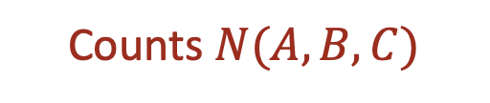
Question
$$A$$
Consider rejection sampling under evidence C=+c.
Suppose you draw 10 samples, and observe the
following counts.
Why don’t you observe
any samples with –c?
Counts $N(A,B,C)$
$$B$$
+a | +b | +c | 4
+a | +b | -c
+a | -b | +c | 3
+a | -b | -c
-a | +b | +c | 2
-a | +b | -c
-a | -b | +c | 1
-a | -b | -c
$$C$$

Slide 20




Question
$$A$$
Consider rejection sampling under evidence C=+c.
Suppose you draw 10 samples, and observe the
following counts.
Approximately, what is
P(+a,+b|+c)?
1/10
1/20
¼
1/2
$$B$$
Counts $N(A,B,C)$
+a | +b | +c | 4
+a | +b | -c
+a | -b | +c | 3
+a | -b | -c
-a | +b | +c | 2
-a | +b | -c
-a | -b | +c | 1
-a | -b | -c
$$C$$

Slide 21
Problem with rejection sampling
“If a = -a, then discard this sample…”
Can be very wasteful!
E.g., if P(evidence) is low, then will have to discard a large fraction of samples!

Slide 22
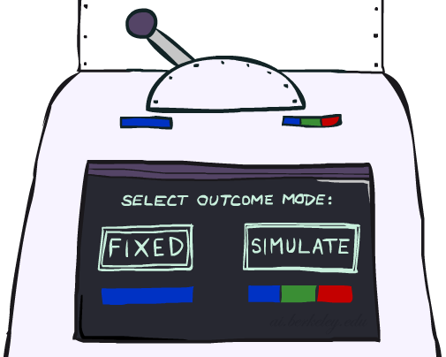
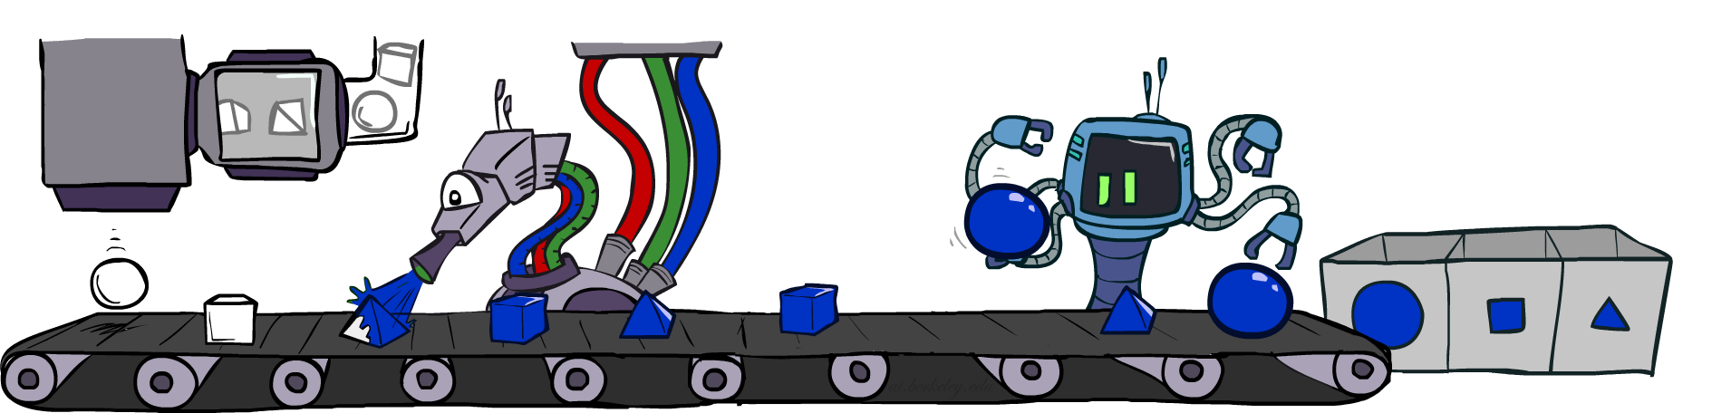
Likelihood Weighting

Slide 23
Likelihood reweighing: Main idea
In rejection sampling, we were drawing samples from P(X₁,…,X_{n}) without regard to given evidence
Instead:
  Let’s fix evidence variables X_{e}=x_{e}
  Sample the remaining variables
  Due to the “fixing”, the distribution of the sampling may have issues
  Do some reweighing to address these issues

Slide 24
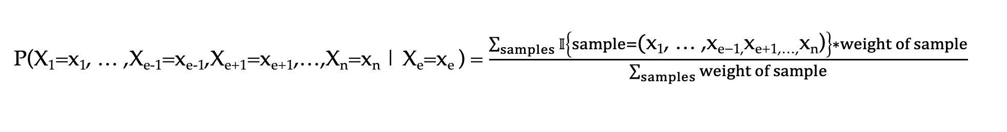
Likelihood weighted Sampling
For given values of variable X_{e}=x_{e}, want to obtain P(other X’s | X_{e}=x_{e} )
For i=1, 2, …, n (assumed toplogical ordering of graph)
  If i = e
    Set x_{e} as the given value
    Let w = P(X_{e}=x_{e} | Parents(X_{e}) = sampled values)
  Else
    Sample x_{i} from P(X_{i} |Parents(X_{i})=sampled or given values)
Return sample along with weight w
Instead of sampling X_{e}, we set it to given evidence x_{e} and give a weight to this sample as its probability conditioned on sampled values of its parents
P(X₁=x₁, … ,X_{e-1}=x_{e-1},X_{e+1}=x_{e+1},…,X_{n}=x_{n} | X_{e}=x_{e} ) = $\frac{\sum_{samples}{𝕀}\left\{sample=\text{(}\text{x}\text{1}\text{, … ,} \text{x}\text{e}\text{−1,} \text{x}\text{e}\text{+1,…,} \text{x}\text{n}\text{)}\right\}∗weight of sample}{\sum_{samples}{weight of sample}}$

Slide 25
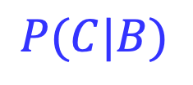
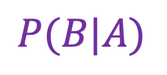


Question
Suppose e = B. We want to estimate P(A, C | B = +b) via likelihood reweighing.
$$A$$
+a | 1/2
-a | 1/2
$$P(A)$$
What variable should we sample first? What distribution?
Sample A via P(A)
Suppose you draw +a
What should you do next?
Next variable in topological ordering is the evidence variable B
Set weight w = P(B=+b | A = +a)
w=1/10
What next?
Sample C via P(C|B=+b)
Suppose you draw –c
Output sample (+a, -c) with weight 1/10
+a | +b | 1/10
 | -b | 9/10
-a | +b | 1/2
 | -b | 1/2
$$B$$
$$P(B|A)$$
$$C$$
+b | +c | 4/5
 | -c | 1/5
-b | +c | 1
 | -c | 0
$$P(C|B)$$

Slide 26


Question
Suppose e = B. We want to estimate P(A, C | B = +b) via likelihood reweighing.
$$A$$
+a | 1/2
-a | 1/2
$$P(A)$$
What are possible values that weight w can take?
Recall w = P(B = +b | A)
Thus w can take values 1/10 or 1/2
+a | +b | 1/10
 | -b | 9/10
-a | +b | 1/2
 | -b | 1/2
$$B$$
$$P(B|A)$$
$$C$$
+b | +c | 4/5
 | -c | 1/5
-b | +c | 1
 | -c | 0
$$P(C|B)$$

Slide 27
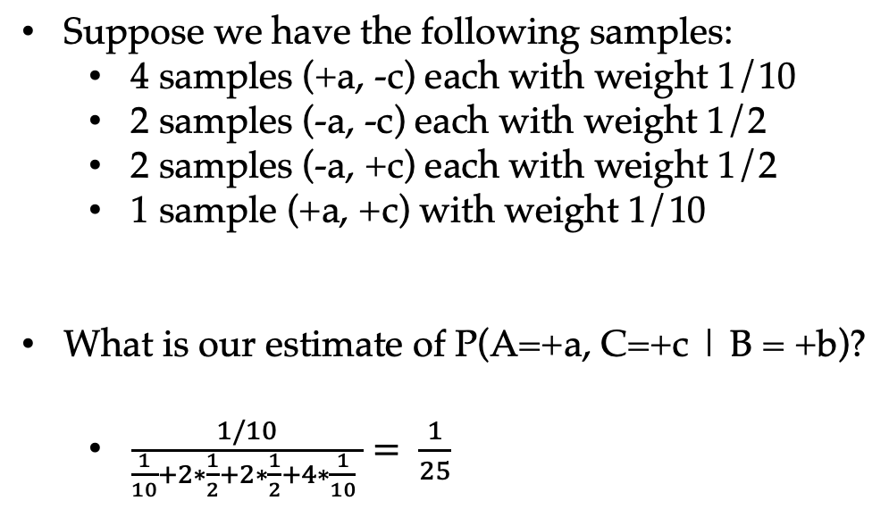
Question
Suppose e = B. We want to estimate P(A, C | B = +b) via likelihood reweighing.
$$A$$
+a | 1/2
-a | 1/2
$$P(A)$$
Suppose we have the following samples:
  4 samples (+a, -c) each with weight 1/10
  2 samples (-a, -c) each with weight 1/2
  2 samples (-a, +c) each with weight 1/2
  1 sample (+a, +c) with weight 1/10
What is our estimate of P(A=+a, C=+c | B = +b)?
  $\frac{1/10}{\frac{1}{10}+2∗\frac{1}{2}+2∗\frac{1}{2}+4∗\frac{1}{10} }= \frac{1}{25}$
+a | +b | 1/10
 | -b | 9/10
-a | +b | 1/2
 | -b | 1/2
$$B$$
$$P(B|A)$$
$$C$$
+b | +c | 4/5
 | -c | 1/5
-b | +c | 1
 | -c | 0
$$P(C|B)$$
Notes:
Exact: ½ * 1/10*4/5 = 1/25

Slide 28
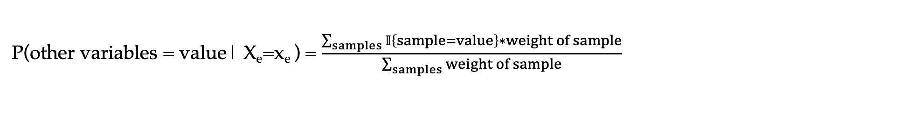
Likelihood weighted Sampling
What if there are multiple evidence (given) variables?
Initialize weight w=1
For i=1, 2, …, n (assumed toplogical ordering of graph)
  If i is an evidence (given) variable
    Set x_{e} as the given value
    w = w * P(X_{e}=x_{e} | Parents(X_{e}) = sampled values)
  Else
    Sample x_{i} from P(X_{i} | Parents(X_{i}) = sampled or given values)
Return sample along with weight w
P(other variables = value| X_{e}=x_{e} ) = $\frac{\sum_{samples}{𝕀}\left\{sample=value\right\}∗weight of sample}{\sum_{samples}{weight of sample}}$

Slide 29
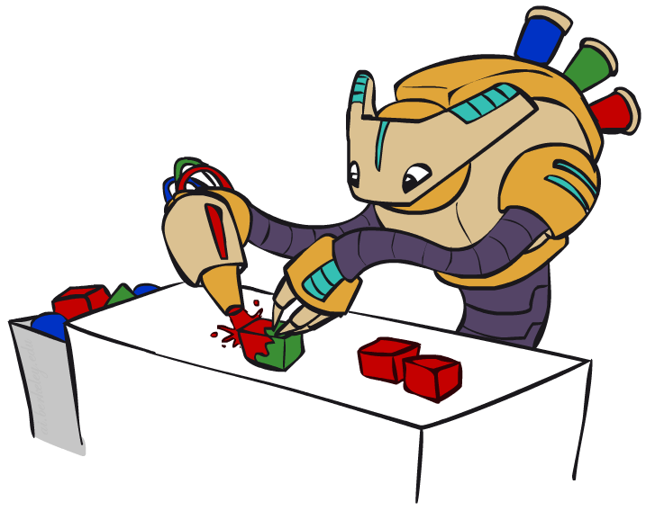
Gibbs Sampling

Slide 30


GenAI Image Generation
Suppose you want to generate images
These images don’t actually exist and you want to generate new ones
Popular technique: Diffusion models
Also: Generative Adversarial Networks (GANs)
At its core, this involves sampling from some unknown crazy distribution!
Today: Let’s understand Gibbs sampling via a toy version of this

Slide 31
Image generation: Toy example
Image comprises a foreground and a background
  Image foreground ϵ {Cow, human, airplane, car}
  Image background ϵ {Buildings, sky, grass}
Want to generate an image randomly~P(Foreground, Background)
What is P(Foreground = cow)? What is P(Background = Buildings)?
  Hard to tell
What is P(Foreground = cow | Background = grass)?
What is P(Background = grass | Foreground = airplane)?
Marginals are hard to specify or estimate but conditionals are easier!

Slide 32
Gibbs sampling
You have access to P(X_{i}|X₁,…,X_{i-1},X_{i+1},…,X_{n}) for all i
Want to sample from P(X₁,…,X_{n})
Initialize some values (x₁,…,x_{n})
Repeat many times:
  For i = 1,…,n:
    Let x_{i}~P(X_{i}|X₁= x₁,…,X_{i-1}=x_{i-1},X_{i+1}=x_{i+1},…,X_{n}=x_{n})
    Note: this will overwrite the previous value of x_{i}
Output x₁,…,x_{n}

Slide 33

Gibbs sampling: Toy example
Initialize Foreground = cow, Background = sky
  Draw from P(Foreground|Background=sky) to get airplane
  Draw from P(Background|Foreground= airplane) to get sky
  Draw from P(Foreground|Background=sky) to get human
  Draw from P(Background|Foreground=human) to get buildings
  Draw from P(Foreground|Background=buildings) to get car
  Draw from P(Background|Foreground=car) to get grass
Output (Foreground=car, Background=grass)

Slide 34
Gibbs sampling of conditional
You are given X_{e}=x_{e}
You have access to P(X_{i}|X₁,…,X_{i-1},X_{i+1},…,X_{n}) for every remaining variable i
Want to sample from P(other variables| X_{e}=x_{e})
Initialize some values for all other variables
Repeat many times:
  For every variable i not in e
    Let x_{i}~P(X_{i}|X₁= x₁,…,X_{i-1}=x_{i-1},X_{i+1}=x_{i+1},…,X_{n}=x_{n})
    Note: this will overwrite the previous value of x_{i}
Output x₁,…,x_{n}

Slide 35
Poll
Consider two variables A and B, taking values {-a,+a} and {-b,+b} respectively.
To avoid pathological cases, suppose P(A=a,B=b)>0 for every (a,b).
You are given access to P(A|B) and P(B|A).
Gibbs sampling produces P(A,B) from these two conditionals. But one may wonder whether the two conditionals even specify P(A,B) uniquely or whether they leave some ambiguity. To this end, work out the following.
State true or false: From this data, one can always recover P(A, B).

