Slide 1
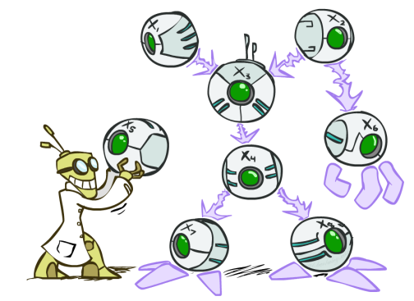
AI: Representation and Problem Solving
Bayes Nets II: Modeling
Instructors: Nihar Shah and Tuomas Sandholm
Slide credits: CMU AI and ai.berkeley.edu

Slide 2
Recap

Slide 3
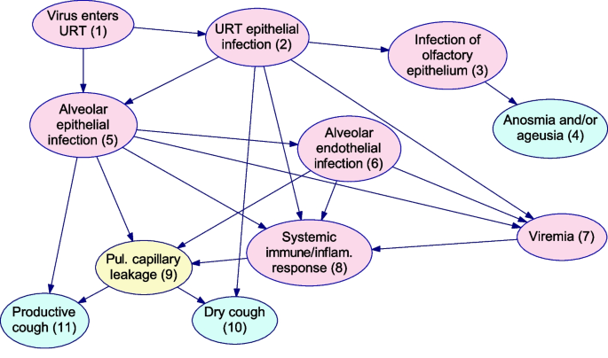
Example: COVID modeling
What is P(URT elipthelial infection = yes | dry cough=yes, productive cough=no, anosmia=yes)?
https://bmcmedresmethodol.biomedcentral.com/articles/10.1186/s12874-023-01856-1

Slide 4
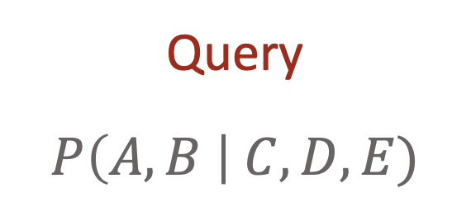
How to answer queries?
Joint distributions are the best!
  Allow us to answer all marginal or conditional queries
  However…
Often we don’t have the joint table. Only know some set of conditional probability tables (CPTs)
Joint
Query
$$P\left(A,B \right| C,D,E)$$

Slide 5
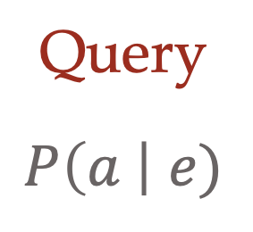
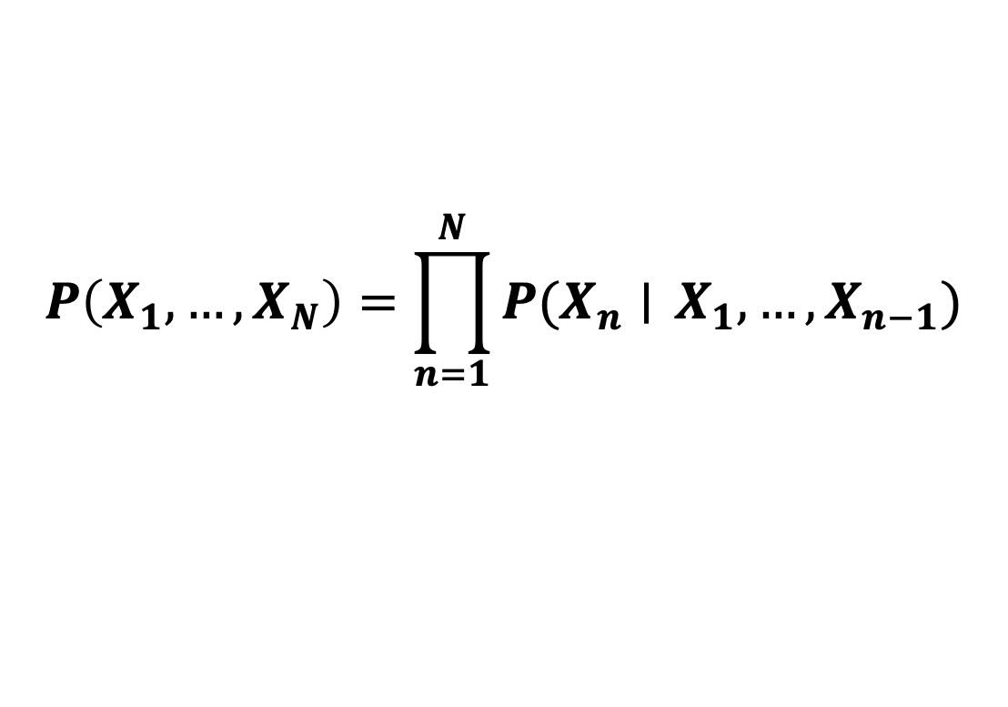
Construct joint from marginals/conditionals
Joint
$P\left(A\right) P\left(B | A\right) P\left(C | A,B\right) P\left(D | A,B,C\right)$ $P(E|A, B,C,D)$
Chain
Rule
Query
$$P\left(a \right| e)$$
$$P\left(X_{1}, …, X_{N}\right)=\prod_{n=1}^{N}{P(X_{n}∣} X_{1},…, X_{n−1})$$

Slide 6
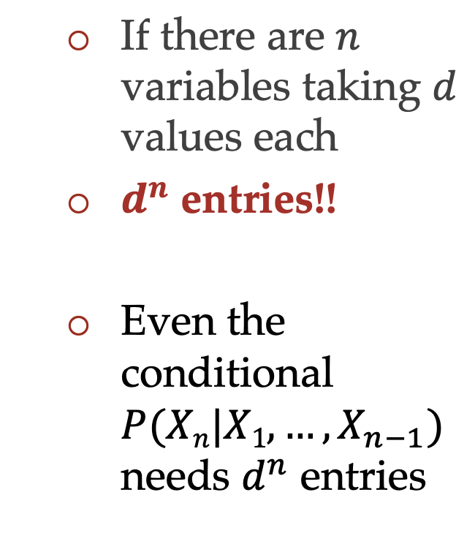
Answering queries from CPTs: Problem
$P\left(A\right) P\left(B | A\right) P\left(C | A,B\right) P\left(D | A,B,C\right)$ $P(E|A, B,C,D)$
    If there are $n$ variables taking $d$ values each
    $d^{n}$ entries!!
    Even the conditional $P(Xn|X1, …,X_{n−1})$ needs $d^{n}$ entries

Slide 7
Today
Addressing this issue by simplifying conditional distributions
  Conditional independence assumptions
Constructing the Bayes net
Answering certain questions
  “Bayes ball”

Slide 8
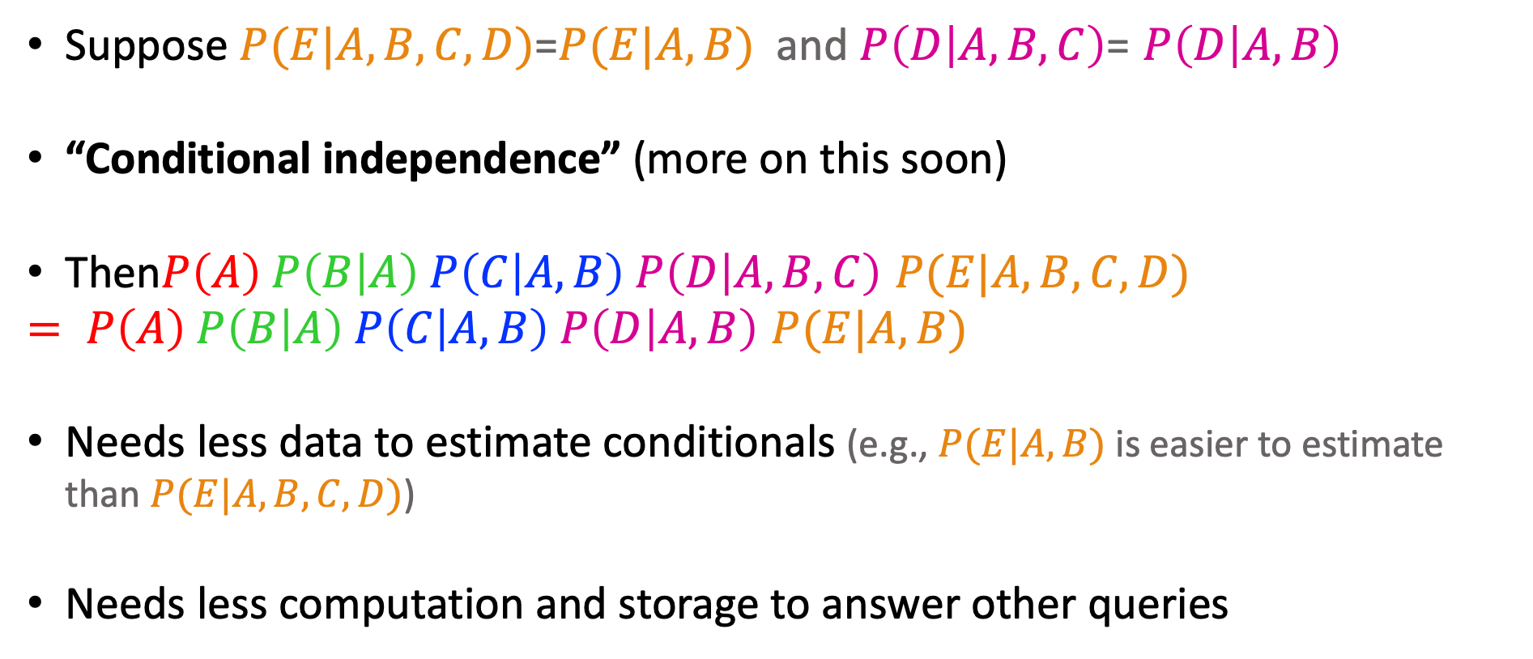
Sometimes, distributions have simpler structure
$P\left(A, B,C,D,E\right)= P\left(A\right) P\left(B | A\right) P\left(C | A,B\right) P\left(D | A,B,C\right)$ $P(E|A, B,C,D)$
Suppose $P(E|A, B,C,D)$=$P(E|A, B)$ and $P\left(D | A,B,C\right)$= $P\left(D | A,B\right)$
“Conditional independence” (more on this soon)
Then$P\left(A\right) P\left(B | A\right) P\left(C | A,B\right) P\left(D | A,B,C\right)$ $P(E|A, B,C,D)$
$= P\left(A\right) P\left(B | A\right) P\left(C | A,B\right) P\left(D | A,B\right)$ $P(E|A, B)$
Needs less data to estimate conditionals (e.g., $P(E|A, B)$ is easier to estimate than $P(E|A, B,C,D)$)
Needs less computation and storage to answer other queries

Slide 9
What is this “Independence”?

Slide 10
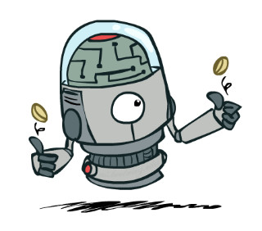
I roll two fair dice…
What is the probability that the first roll is 5?
What is the probability that the second roll is 5?
What is the probability that both rolls are 5?
If the first roll is 5, what is the probability that the second roll is 5?
  P(Roll₁=5, Roll₂=5) = P(Roll₁=5) P(Roll₂=5) = 1/6 x 1/6 = 1/36
  P(Roll₂=5 | Roll₁=5) = P(Roll₂=5) = 1/6
Independence and conditional independence!

Slide 11
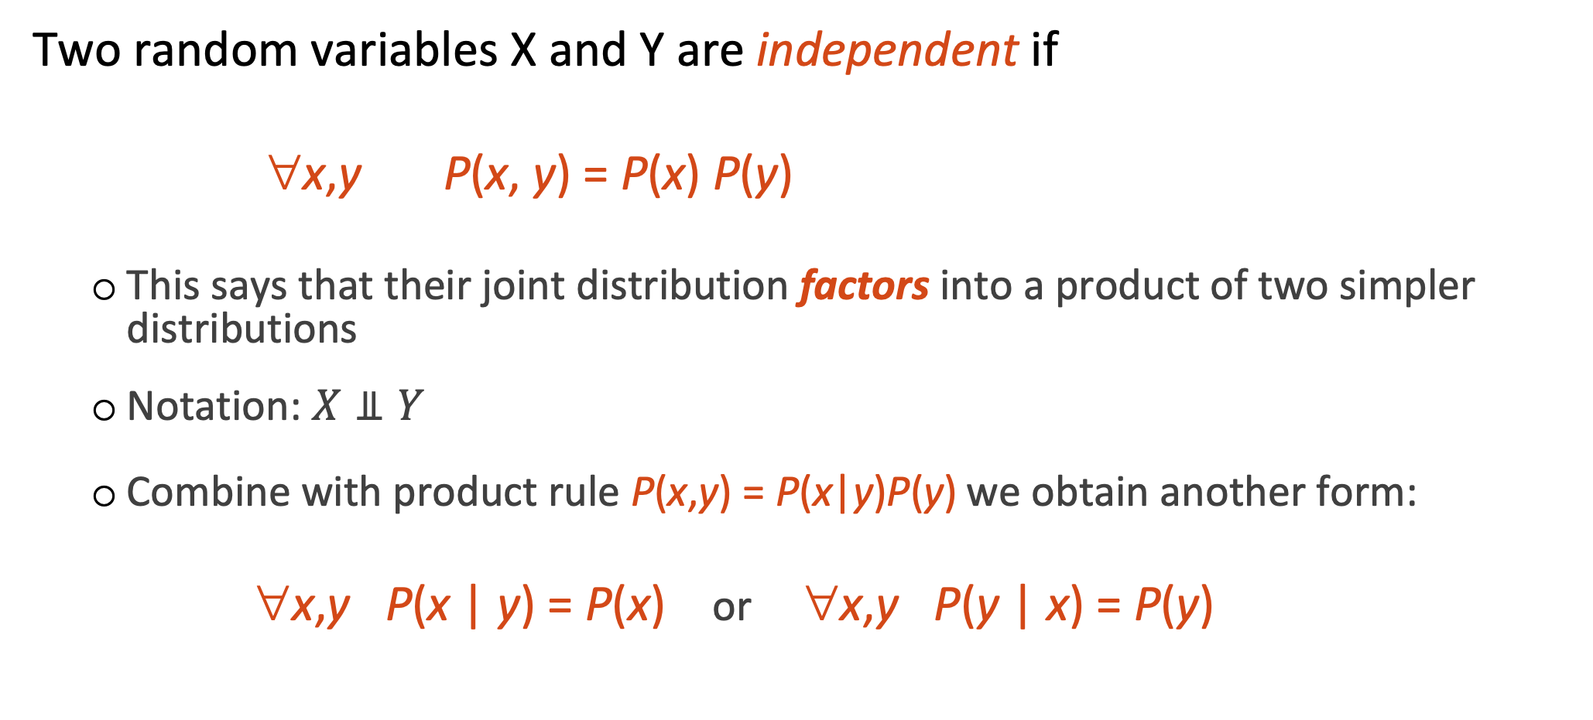
Independence
Two random variables X and Y are independent if
∀x,y P(x, y) = P(x) P(y)
  This says that their joint distribution factors into a product of two simpler distributions
  Notation: $X⫫Y$
  Combine with product rule P(x,y) = P(x|y)P(y) we obtain another form:
  ∀x,y P(x | y) = P(x) or ∀x,y P(y | x) = P(y)

Slide 12

Example: Independence
n fair, independent coin flips:
P(X₁)
P(X₂)
P(X_{n})
H | 0.5
T | 0.5
H | 0.5
T | 0.5
H | 0.5
T | 0.5
P(X₁,X₂,...,X_{n})
2^{n}
joint distribution is simply the product

Slide 13
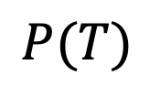

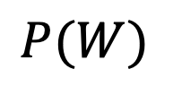
Question
Are Temperature and Wetness independent?
$$P\left(T,W\right)$$
$$P(T)$$
$$P(W)$$
T | W | P
hot | sun | 0.4
hot | rain | 0.1
cold | sun | 0.2
cold | rain | 0.3
T | P
hot | 0.5
cold | 0.5
W | P
sun | 0.6
rain | 0.4

Slide 14
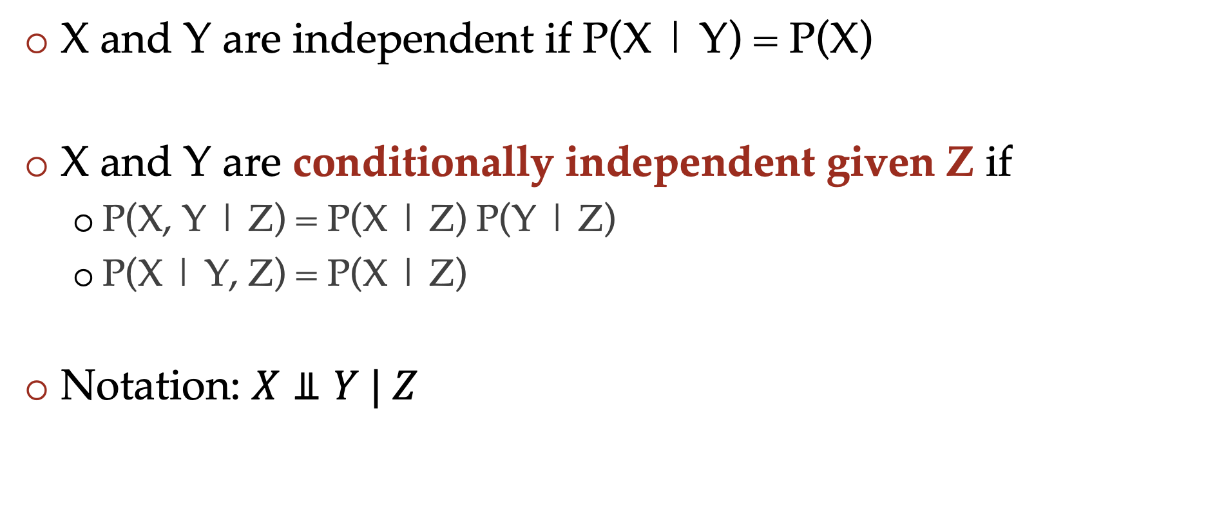
Conditional independence
X and Y are independent if P(X | Y) = P(X)
X and Y are conditionally independent given Z if
  P(X, Y | Z) = P(X | Z) P(Y | Z)
  P(X | Y, Z) = P(X | Z)
Notation: $X⫫Y | Z$

Slide 15
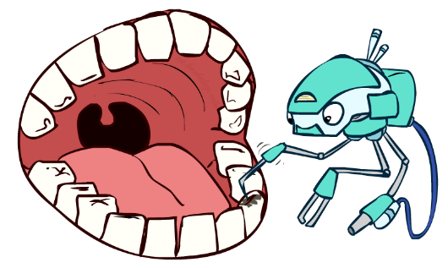
Conditional independence
P(Toothache, Cavity, (p)Robe)
If I have a cavity, the probability that the probe catches in it doesn't depend on whether I have a toothache:
  P(+r | +toothache, +cavity) = P(+r | +cavity)
The same independence holds if I don’t have a cavity:
  P(+r | +toothache, -cavity) = P(+r| -cavity)
Probe is conditionally independent of Toothache given Cavity:
  P(R | T, C) = P(R | C)

Slide 16
Conditional independence
Equivalent statements:
P(Toothache | Probe , Cavity) = P(Toothache | Cavity)
P(Toothache, Probe | Cavity) = P(Toothache | Cavity) P(Probe | Cavity)

Slide 17
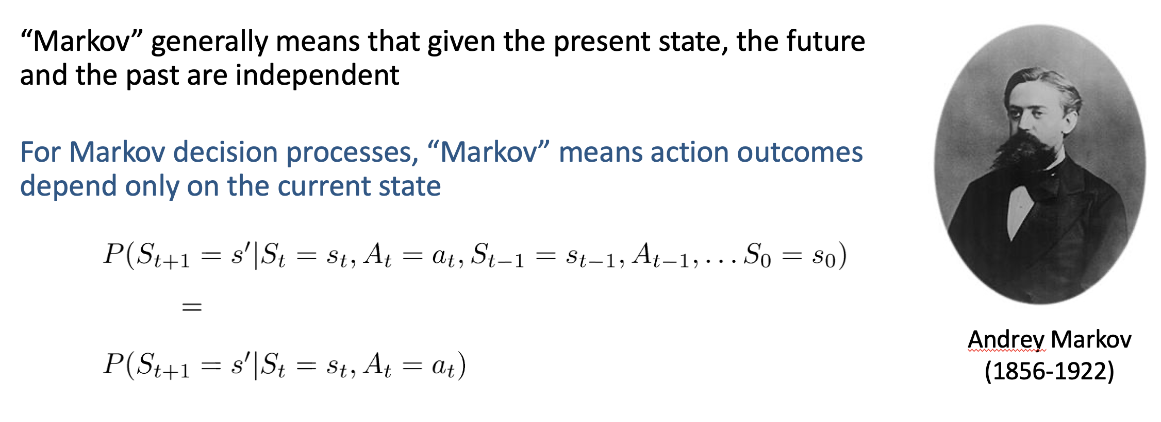
Have we seen conditional independence in previous lectures?
MDPs

Slide 18
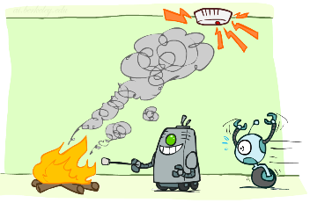
Moving back to Bayes nets via a cute example
Fire, Smoke, Alarm
What is P(Fire | Alarm = yes)?
Joint distribution: P(S, F, A) = P(F) P(S | F) P(A | S, F)
Estimate each term in the right hand side from some data
P(A|S,F) involves estimating 4 distributions (corresponding to S,F=yes,yes; S,F=yes,no; S,F=no,yes; S,F=no,no)
But we may assume that given there is (or isn’t) smoke, the ringing of the alarm doesn’t depend on whether there is fire
P(A|S,F)=P(A,S) Conditional independence!
P(S, F, A) = P(F) P(S | F) P(A | S)
P(A|S) involves estimating and storing only 2 distributions

Slide 19
Bayes nets
Graphical representation of conditional probability tables
One node per random variable
Directed acyclic graph
Exploit conditional independence

Slide 20
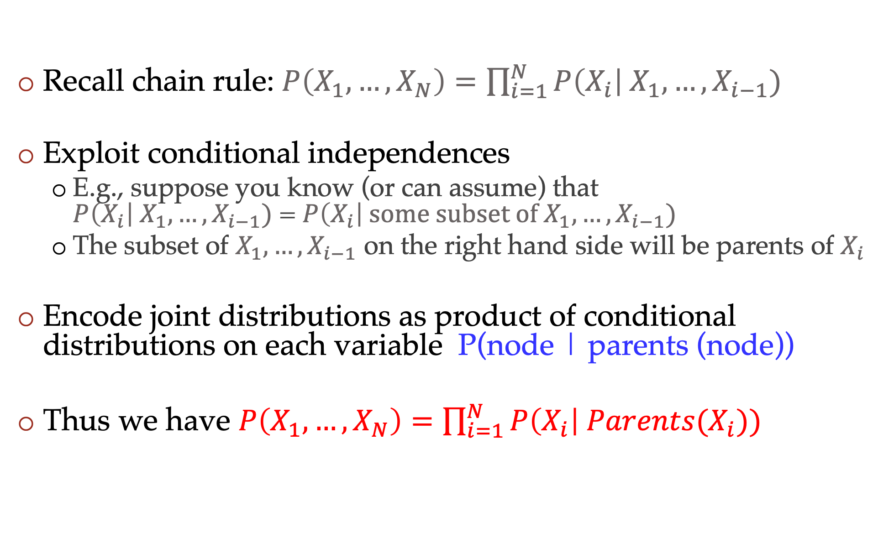
Bayes nets
Recall chain rule: $P\left(X_{1},…,X_{N}\right)=\prod_{i=1}^{N}{P\left(X_{i}\right| X_{1},…,X_{i−1})}$
Exploit conditional independences
  E.g., suppose you know (or can assume) that $P\left(X_{i}\right| X_{1},…,X_{i−1})$ = $P\left(X_{i}\right| some subset of X_{1},…,X_{i−1})$
  The subset of $X_{1},…,X_{i−1}$ on the right hand side will be parents of $X_{i}$
Encode joint distributions as product of conditional distributions on each variable P(node | parents (node))
Thus we have $P\left(X_{1},…,X_{N}\right)=\prod_{i=1}^{N}{P\left(X_{i}\right| Parents(X_{i}))}$

Slide 21





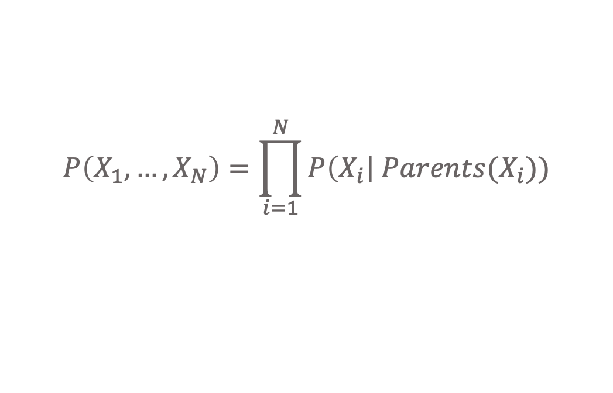
Bayes nets .
$$P\left(X_{1},…,X_{N}\right)=\prod_{i=1}^{N}{P\left(X_{i}\right| Parents(X_{i}))}$$
$$F$$
$$S$$
$$A$$
$$P\left(S, F, A\right)=P\left(F\right) P\left(S | F\right) P\left(A | S,F\right)$$
$$F$$
$$S$$
$$P\left(S, F, A\right)=P\left(F\right) P\left(S | F\right) P\left(A | S\right)$$
$$A$$

Slide 22




Question
Write down the Bayes net for
P(A,B,C,D) = P(A) P(B|A) P(C|A) P(D|A,C)
$$A$$
$$B$$
$$C$$
$$D$$

Slide 23

Another example: Coin Flips
N independent coin flips
What is the Bayes net?
P(X₁,…,X_{n}) = P(X₁) P(X₂) … P(X_{n})
All variables are independent
X₁
X₂
X_{n}

Slide 24
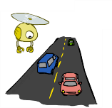
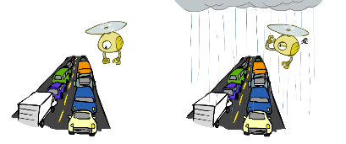
Example: Traffic
Variables:
  R: It rains
  T: There is traffic
  Which of the following is a better model?
Model 1
Model 2
Model 3
R
R
T
T
T
R

Slide 25
Conditional independence questions
We wanted to answer questions of the form “What is P(infected|cough)?” or “What is P(infected)?”
An important special case is to identify if variables are (conditionally) independent. Examples:
  Is the probability of stock price going up tomorrow independent of global factors given domestic factors?
  Is air pollution in a city independent of traffic patterns given amount of factory smoke?
  A company may wish to know whether performance of an intern is independent of pre-req courses given their 281 grade

Slide 26
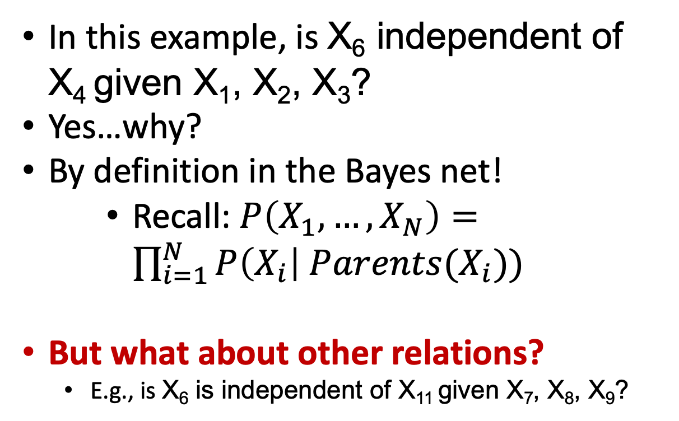
Conditional independence in Bayes nets
Every variable is conditionally independent of its non-descendants given its parents
X₄
In this example, is X₆ independent of X₄ given X₁, X₂, X₃?
Yes…why?
By definition in the Bayes net!
    Recall: $P\left(X_{1},…,X_{N}\right)=\prod_{i=1}^{N}{P\left(X_{i}\right| Parents(X_{i}))}$
But what about other relations?
  E.g., is X₆ is independent of X₁₁ given X₇, X₈, X₉?
X₂
X₁
X₃
X₆
X₅
X₇
X₈
X₉
X₁₀
X₁₁
26

Slide 27

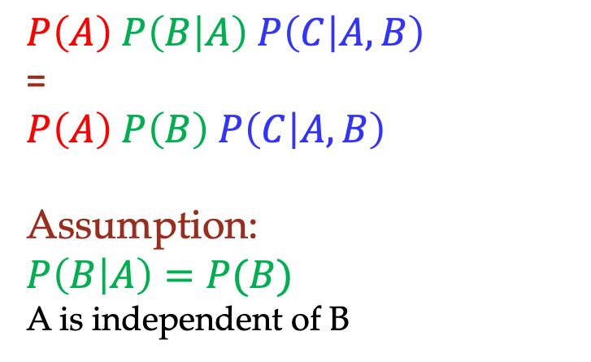


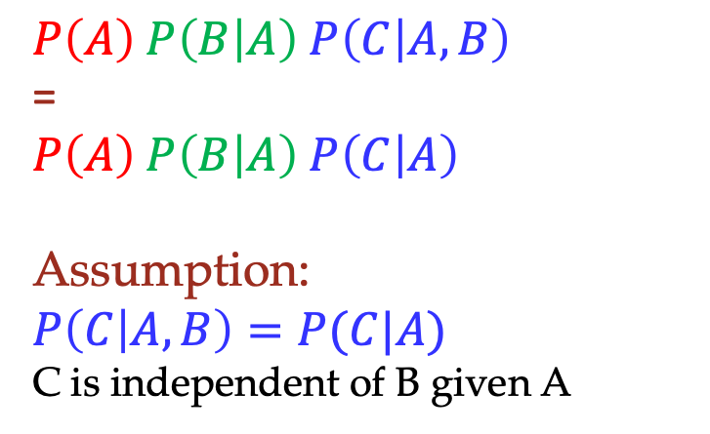





Special cases that are useful building blocks
For the following Bayes nets, write down the conditional independence assumption being made
$$A$$
$$A$$
$$B$$
$$A$$
$$B$$
$$C$$
$$B$$
$$C$$
$$C$$
  $$P\left(A\right) P\left(B | A\right) P\left(C | A,B\right)$$
  =
  $$P\left(A\right) P\left(B | A\right) P\left(C | B\right)$$
  Assumption:
  $$P\left(C | A,B\right)=P(C|B)$$
  C is independent of A given B
  $$P\left(A\right) P\left(B | A\right) P\left(C | A,B\right)$$
  =
  $$P\left(A\right) P\left(B | A\right) P\left(C | A\right)$$
  Assumption:
  $$P\left(C | A,B\right)=P(C|A)$$
  C is independent of B given A
  $$P\left(A\right) P\left(B | A\right) P\left(C | A,B\right)$$
  =
  $$P\left(A\right) P\left(B\right) P\left(C | A, B\right)$$
  Assumption:
  $$P\left(B | A\right)=P(B)$$
  A is independent of B

Slide 28
Let’s dig deeper, and take a slightly different perspective
Proving conditional independence from the joint distribution

Slide 29
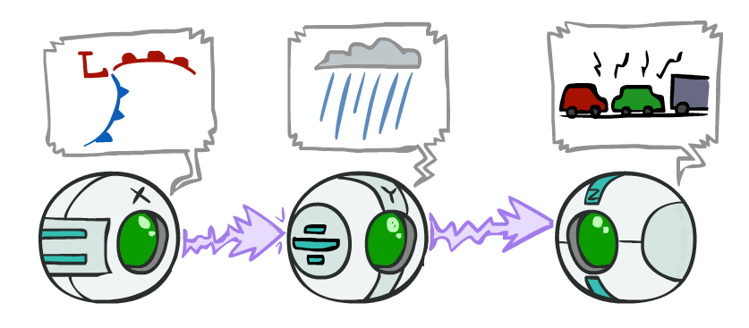
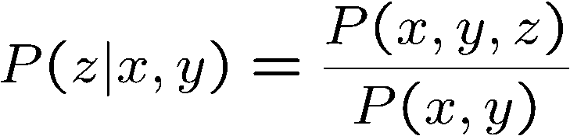
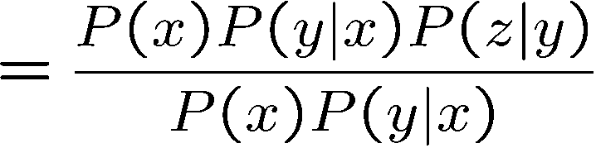

Causal Chain
Are X and Z independent given Y?
We often say that evidence (of Y) along the chain blocks the influence (of X on Z)
X: Low pressure Y: Rain Z: Traffic
Yes!

Slide 30
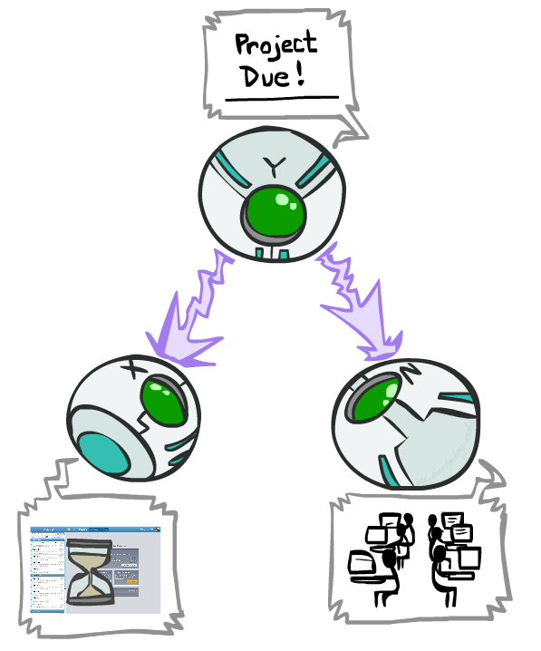
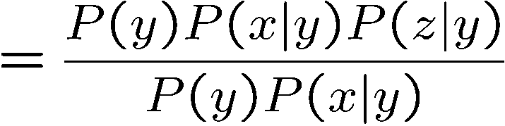
Common Cause
Are X and Z independent given Y?
  We often say that observing the cause (Y) blocks influence between effects X and Z.
Y: Project due
X: Forums busy
Z: Lab full
Yes!

Slide 31
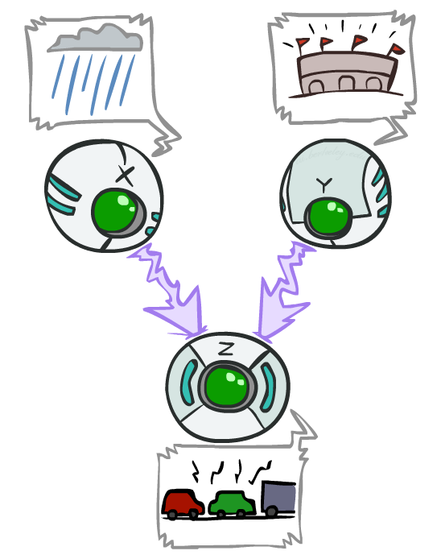
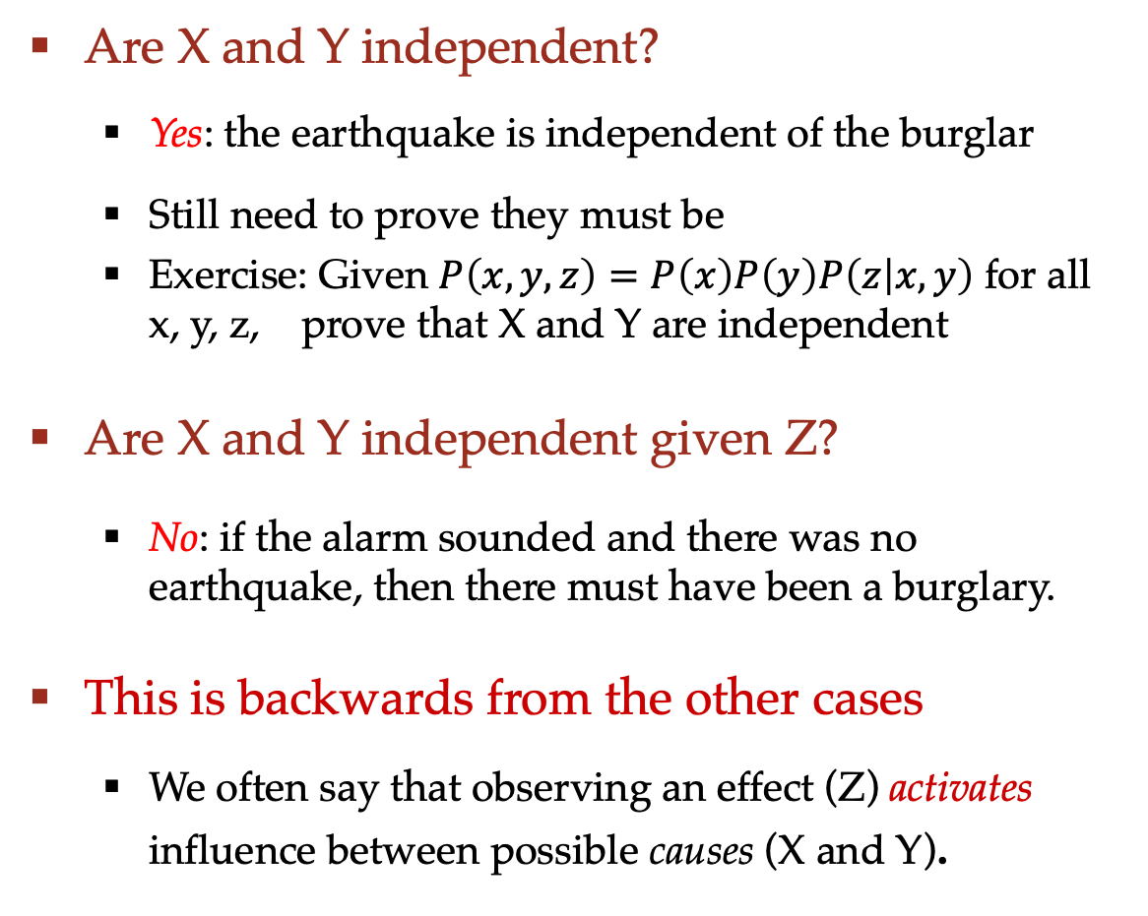

Common Effect
X: Burglary
Y: Earthquake
Are X and Y independent?
  Yes: the earthquake is independent of the burglar
  Still need to prove they must be
  Exercise: Given $P\left(x,y,z\right)=P\left(x\right)P\left(y\right)P\left(z | x,y\right)$ for all x, y, z, prove that X and Y are independent
Are X and Y independent given Z?
  No: if the alarm sounded and there was no earthquake, then there must have been a burglary.
This is backwards from the other cases
  We often say that observing an effect (Z) activates influence between possible causes (X and Y).
Z: Alarm
$$P\left(x,y,z\right)=P\left(x\right)P\left(y\right)P(z|x,y)$$

Slide 32
Common Effect
X: Burglary
Y: Earthquake
Are X and Y independent given Z?
  No: if the alarm sounded and there was no earthquake, then there must have been a burglary.
  On the other hand, if the alarm sounded and there was an earthquake, there was probably no burglary.
“Explaining away”
  Suppose two causes positively influence an effect. Conditioned on the effect, further conditioning on one cause reduces the probability of the other cause
Z: Alarm
$$P\left(x,y,z\right)=P\left(x\right)P\left(y\right)P(z|x,y)$$

Slide 33
Recipe (“Bayes ball”)
Question: Are X and Y conditionally independent given “evidence” variables {Z}?
Consider all (undirected) paths from X to Y
A path is active if each triple is active
  Causal chain A → B → C where B is unobserved (either direction)
  Common cause A ← B → C where B is unobserved
  Common effect A → B ← C where B or one of its descendents is observed
No active paths => independence
Shachter, "Bayes-Ball: Rational Pastime (for Determining Irrelevance and Requisite Information in Belief Networks and Influence Diagrams)," UAI 1998.

Slide 34

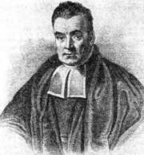
Bayes Ball in pictures
Given nodes (“evidence” nodes) are shaded
Active Paths
Inactive Paths
34

Slide 35
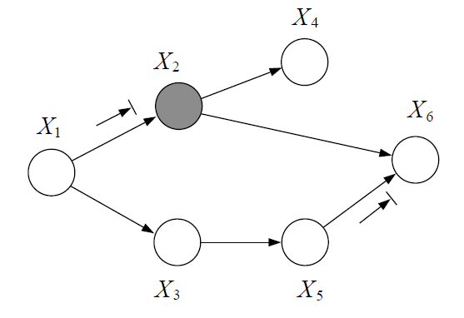

Question
Is $X_{1}$ independent of $X_{6}$ given $X_{2}$?
35

Slide 36
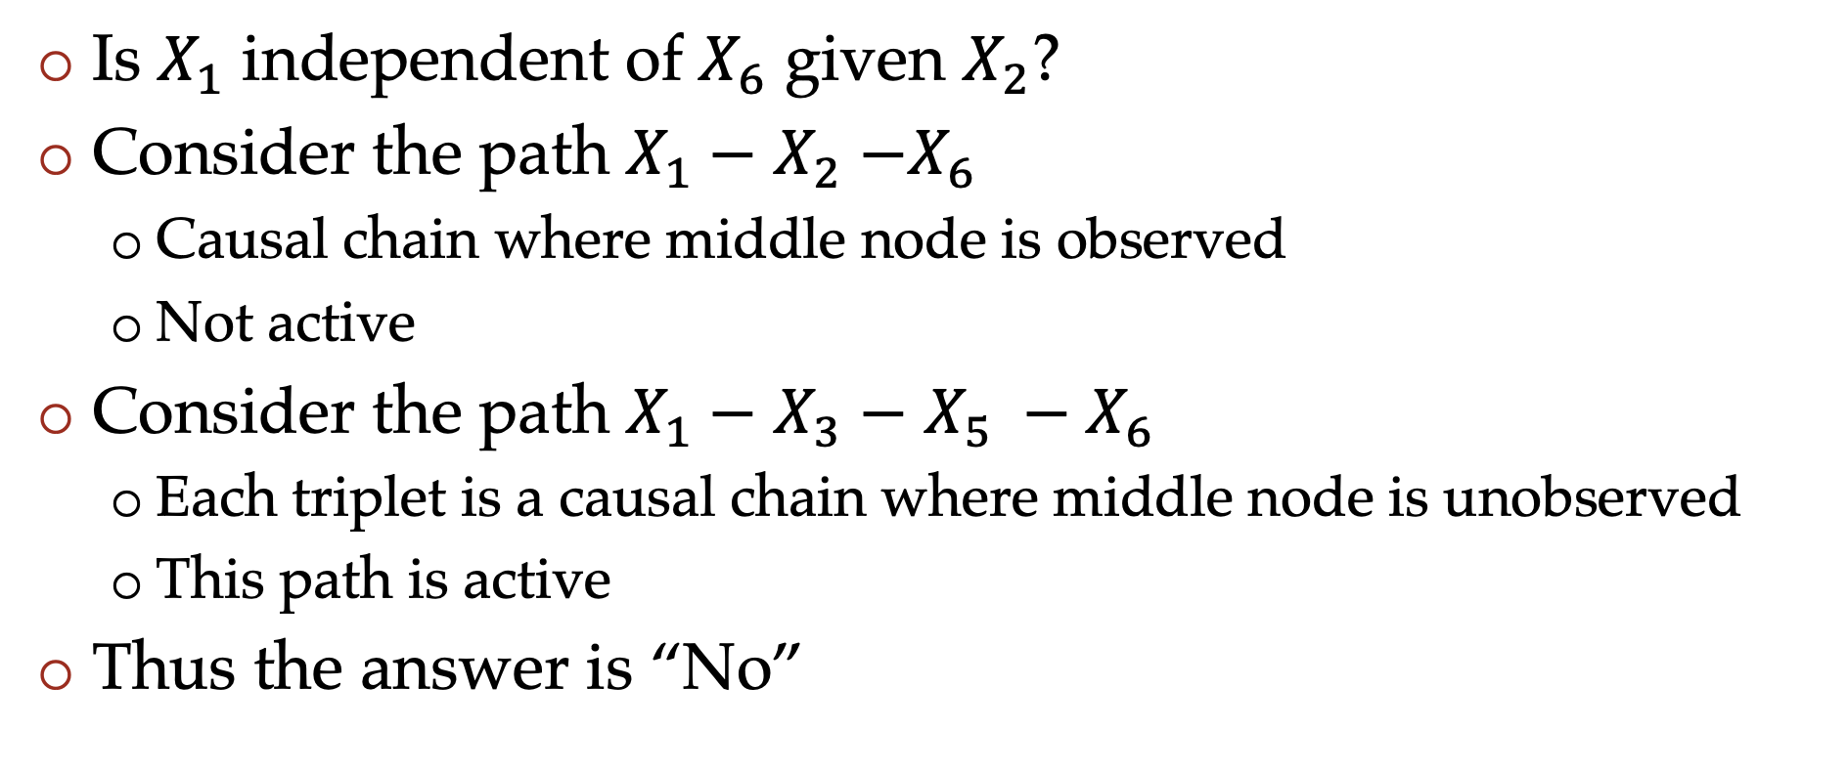
Question
Is $X_{1}$ independent of $X_{6}$ given $X_{2}$?
Consider the path $X_{1}−$ $X_{2}$ $−X_{6}$
  Causal chain where middle node is observed
  Not active
Consider the path $X_{1}−$ $X_{3}$ $−$ $X_{5} −X_{6}$
  Each triplet is a causal chain where middle node is unobserved
  This path is active
Thus the answer is “No”
36

Slide 37
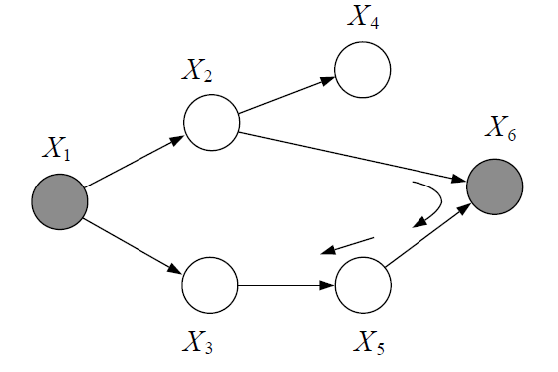

Another question
Is $X_{2}$ independent of $X_{3}$ given $X_{1}$ and $X_{6}$?
37

Slide 38
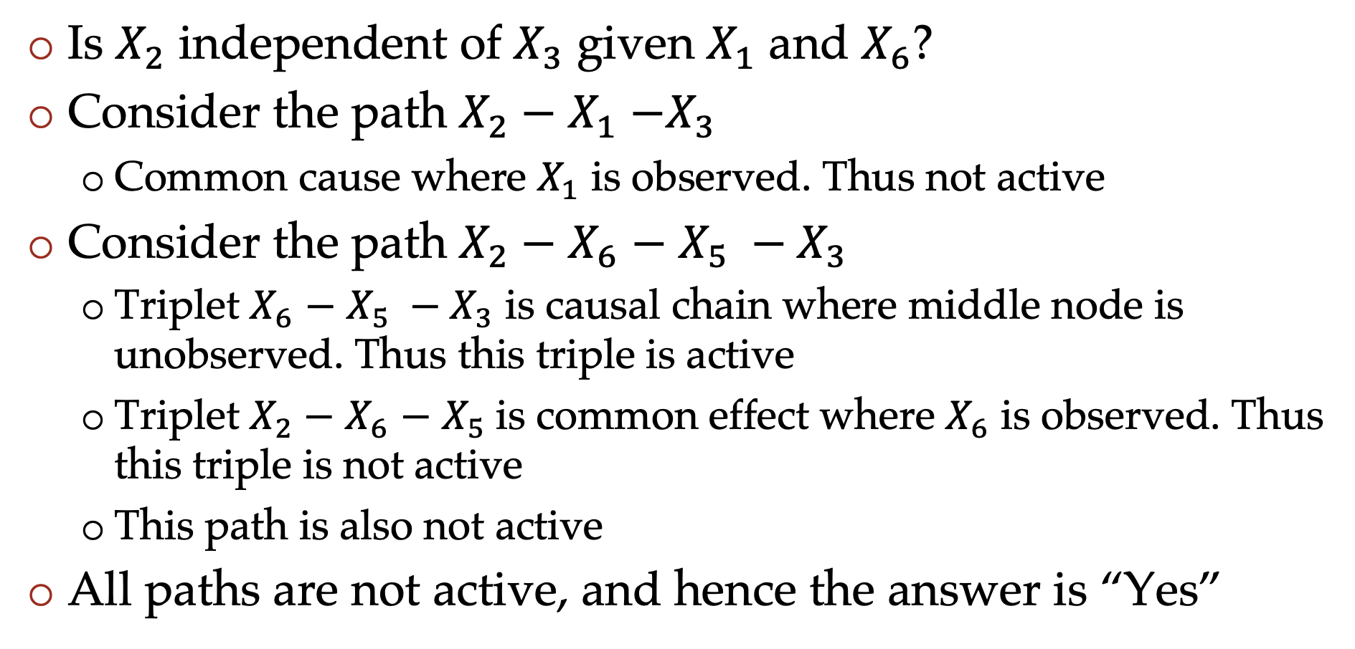
Question
Is $X_{2}$ independent of $X_{3}$ given $X_{1}$ and $X_{6}$?
Consider the path $X_{2}−$ $X_{1}$ $−X_{3}$
  Common cause where $X_{1}$ is observed. Thus not active
Consider the path $X_{2}−$ $X_{6}$ $−$ $X_{5} −X_{3}$
  Triplet $X_{6}$ $−$ $X_{5} −X_{3}$ is causal chain where middle node is unobserved. Thus this triple is active
  Triplet $X_{2}−$ $X_{6}$ $−$ $X_{5}$is common effect where $X_{6}$ is observed. Thus this triple is not active
  This path is also not active
All paths are not active, and hence the answer is “Yes”
38

Slide 39
Important note
We look at all paths using undirected edges
But when going down a path and looking at triplets, we need to look at the direction of the edges
Common cause and common effect induce opposite effects: observing parent causes independence, observing child causes dependence

Slide 40
Poll
Choose the true statement(s):
If X and Y are conditionally independent given Z, then X and Y are independent
If X and Y are independent, then X and Y are also conditionally independent given Z
Neither is true

