Slide 1
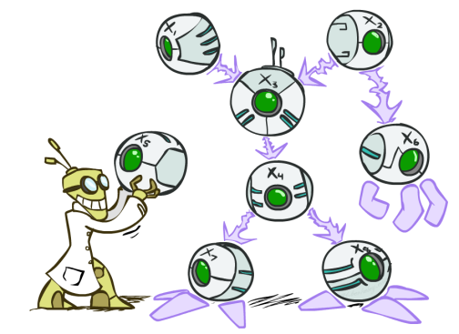
AI: Representation and Problem Solving
Bayes Nets I
Instructors: Nihar Shah and Tuomas Sandholm
Slide credits: CMU AI and ai.berkeley.edu

Slide 2
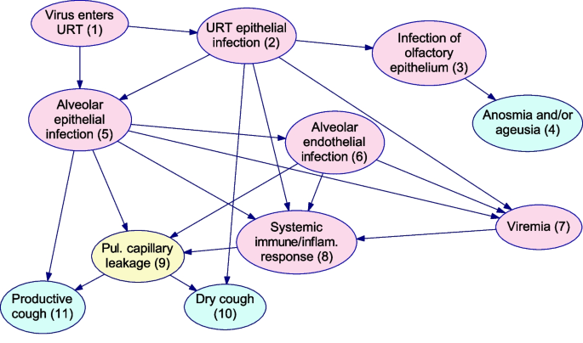
Example: COVID modeling
What is P(URT elipthelial infection = yes | dry cough=yes, productive cough=no, anosmia=yes)?
https://bmcmedresmethodol.biomedcentral.com/articles/10.1186/s12874-023-01856-1

Slide 3
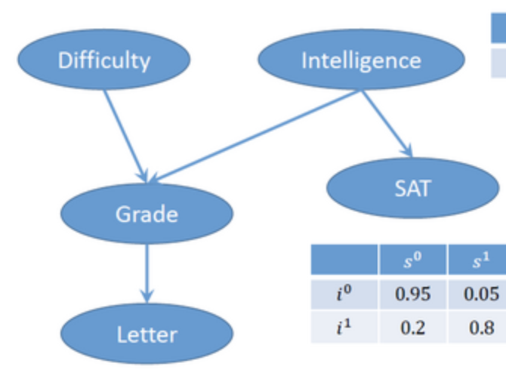
Simpler example: Grade prediction
What is P(grade = A | SAT = 1550) ?
https://uol.de/en/lcs/probabilistic-programming/webchurch-and-openbugs/example-6a-bayesian-network-student-model-with-evidence

Slide 4
Bayes nets
A Bayes net (Bayesian network) is a way to model relationships between various variables
Goal is to obtain some marginal or conditional distributions
  e.g., P(infected) or P(infected | cough)

Slide 5
Probability overview…

Slide 6



281 Pizzeria!
You pick one slice uniformly at random.
What is the probability of getting a slice with:
  No mushrooms
  Spinach and no mushrooms
  Spinach, when asking for slice with no mushrooms
Icons: CC, https://openclipart.org/detail/296791/pizza-slice

Slide 7
281 Pizzeria!
You pick one slice uniformly at random.
What is the probability of getting a slice with:
  Mushrooms
  Spinach
  No spinach
  No spinach and mushrooms
  No spinach when asking for no mushrooms
  No spinach when asking for mushrooms
  Spinach when asking for mushrooms
  No mushrooms and no spinach
Icons: CC, https://openclipart.org/detail/296791/pizza-slice

Slide 8
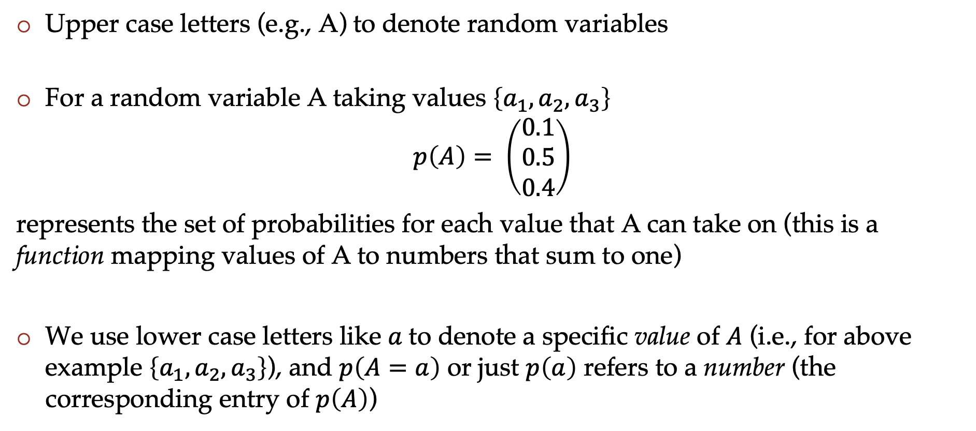
Probability notation
Upper case letters (e.g., A) to denote random variables
For a random variable A taking values $\left\{a_{1},a_{2},a_{3}\right\}$
$$p\left(A\right)= \left(\begin{matrix}0.1 \\ 0.5 \\ 0.4\end{matrix}\right)$$
represents the set of probabilities for each value that A can take on (this is a function mapping values of A to numbers that sum to one)
We use lower case letters like $a$to denote a specific value of $A$ (i.e., for above example $\left\{a_{1},a_{2},a_{3}\right\}$), and $p\left(A=a\right)$ or just $p\left(a\right)$ refers to a number (the corresponding entry of $p\left(A\right)$)

Slide 9
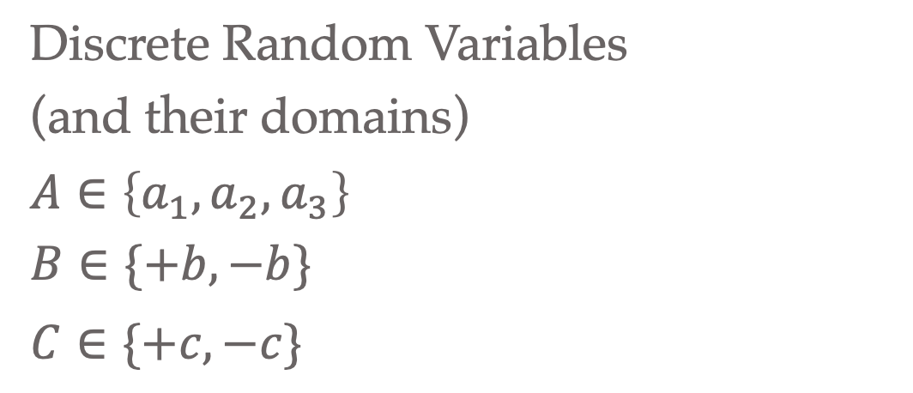
Discrete Probability Distributions
  For each random variable
  Discrete outcomes
  Disjoint outcomes
  Accounts for entire event space
  Not always binary
Discrete Random Variables
(and their domains)
$A∈\left\{a_{1},a_{2}, a_{3}\right\}$
$B∈\{+b, −b\}$
$C∈\{+c, −c\}$

Slide 10
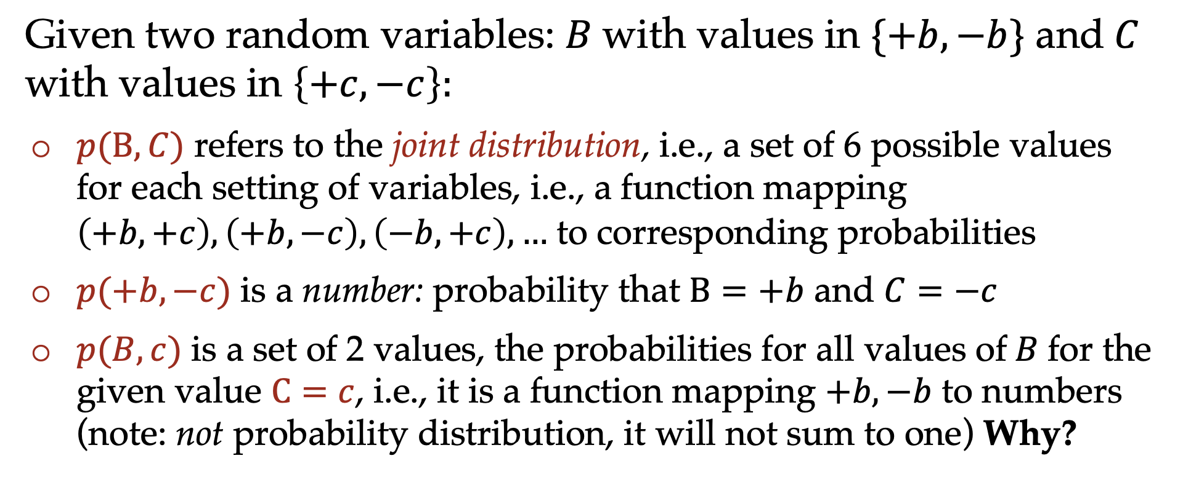
Probability notation
Given two random variables: $B$with values in $\{+b, −b\}$ and$C$ with values in $\left\{+c,−c\right\}:$
$p(B,C)$ refers to the joint distribution, i.e., a set of 6 possible values for each setting of variables, i.e., a function mapping $\left(+b,+c\right), \left(+b,−c\right),\left(−b,+c\right),…$ to corresponding probabilities
$p(+b,−c)$ is a number: probability that $B=+b$ and $C=−c$
$p(B,c)$ is a set of 2 values, the probabilities for all values of$B$for the given value $C=c$, i.e., it is a function mapping $+b, −b$ to numbers (note: not probability distribution, it will not sum to one) Why?

Slide 11
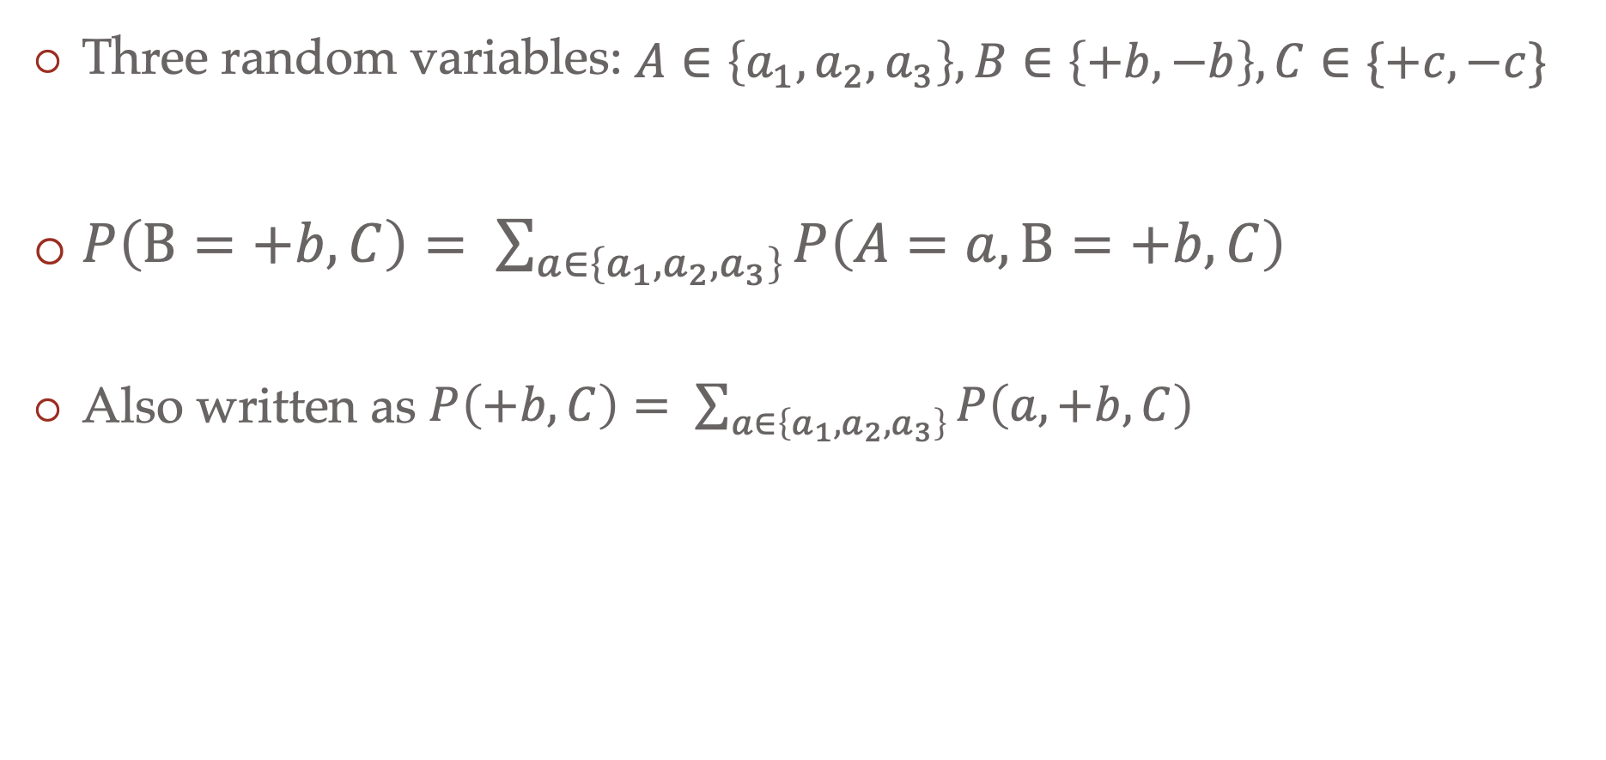
Probability notation
Three random variables: $A∈\left\{a_{1},a_{2}, a_{3}\right\}, B∈\left\{+b, −b\right\}, C∈\{+c, −c\}$
$P\left(B=+b, C\right)= \sum_{a∈\left\{a_{1}, a_{2},a_{3}\right\}}{P\left(A=a, B=+b, C\right)}$
Also written as $P\left(+b, C\right)= \sum_{a∈\left\{a_{1}, a_{2},a_{3}\right\}}{P\left(a, +b, C\right)}$

Slide 12
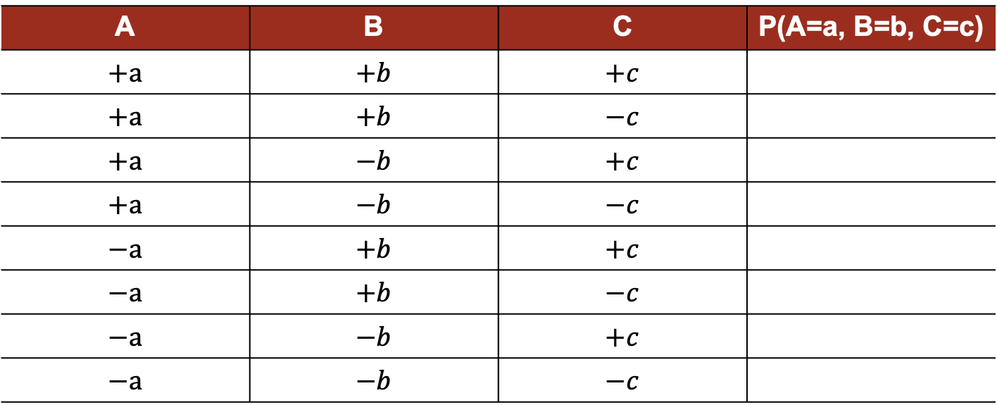

Joint probability distribution
Table representing all values
$A∈\left\{+a, −a \right\}$
$B∈\{+b, −b\}$
$C∈\{+c, −c\}$
A | B | C | P(A=a, B=b, C=c)
$$+a$$ | $$+b$$ | $$+c$$
$$+a$$ | $$+b$$ | $$−c$$
$$+a$$ | $$−b$$ | $$+c$$
$$+a$$ | $$−b$$ | $$−c$$
$$−a$$ | $$+b$$ | $$+c$$
$$−a$$ | $$+b$$ | $$−c$$
$$−a$$ | $$−b$$ | $$+c$$
$$−a$$ | $$−b$$ | $$−c$$

Slide 13
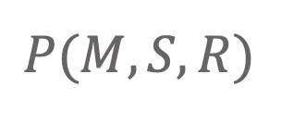
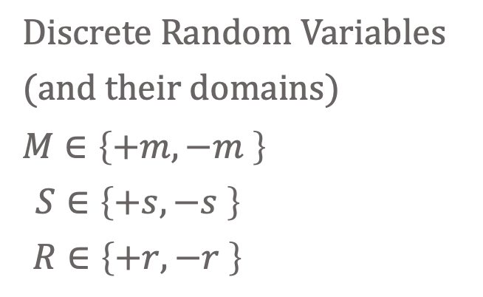
Discrete probability distributions
Joint distribution
$$P(M, S, R)$$
Discrete Random Variables
(and their domains)
$M∈\left\{+m, −m \right\}$
$S∈\left\{+s, −s \right\}$
$R∈\left\{+r, −r \right\}$
Icons: CC, https://openclipart.org/detail/296791/pizza-slice

Slide 14
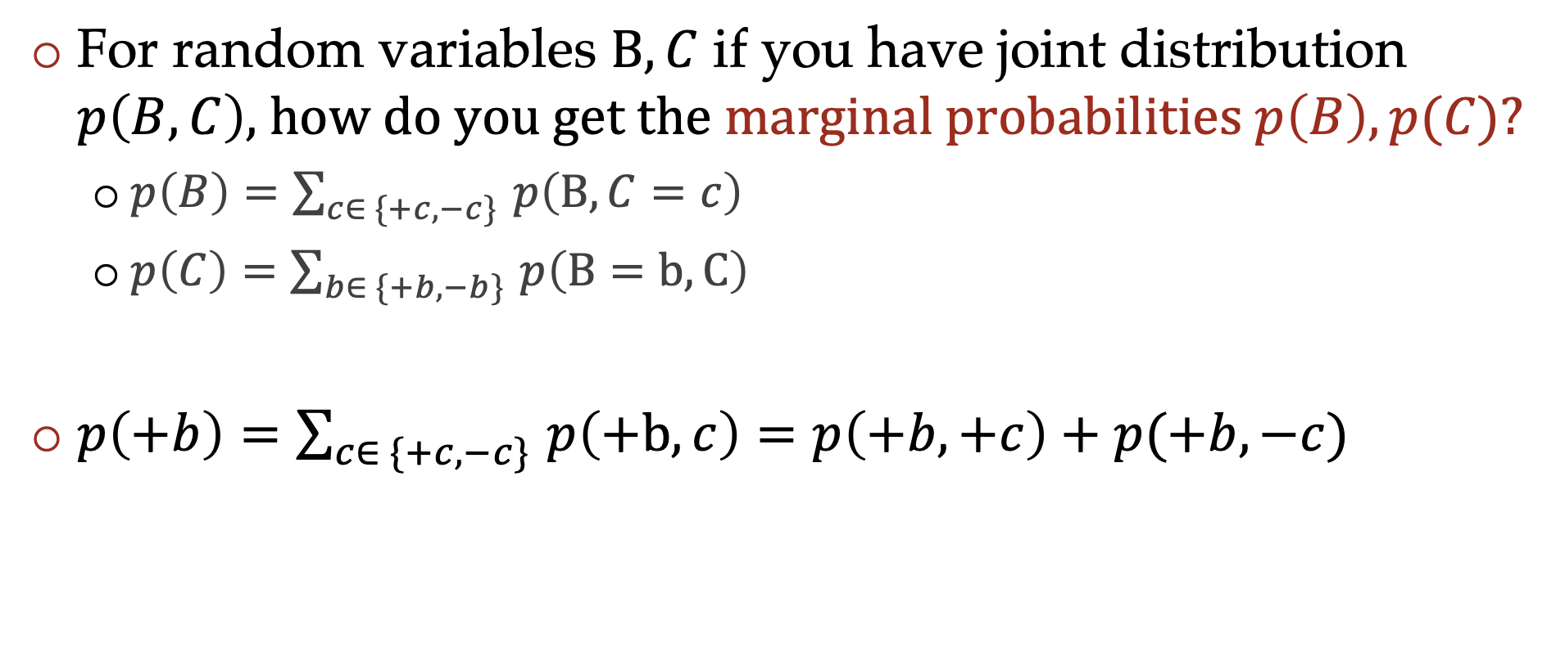
Marginalization
For random variables $B, C$ if you have joint distribution $p\left(B, C\right)$, how do you get the marginal probabilities $p\left(B\right), p(C)$?
  $p\left(B\right)=\sum_{c∈ \{+c, −c\} }{p\left(B,C=c\right)}$
  $p\left(C\right)=\sum_{b∈ \{+b, −b\} }{p\left(B=b, C\right)}$
$p\left(+b\right)=\sum_{c∈ \{+c, −c\} }{p\left(+b, c\right)}=p\left(+b, +c\right)+p(+b, −c)$
Marginalization is summing out a subset of random variables from a joint distribution to obtain a distribution of the remaining subset

Slide 15
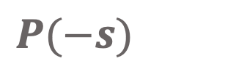
Discrete probability distributions
Marginal distribution
E.g., what is the probability that chosen slice has no spinach?
$P(−s)$

Slide 16

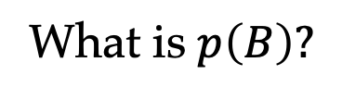
Marginalization from table
A | B | C | P(A=a, B=b, C=c)
$$+a$$ | $$+b$$ | $$+c$$
$$+a$$ | $$+b$$ | $$−c$$
$$+a$$ | $$−b$$ | $$+c$$
$$+a$$ | $$−b$$ | $$−c$$
$$−a$$ | $$+b$$ | $$+c$$
$$−a$$ | $$+b$$ | $$−c$$
$$−a$$ | $$−b$$ | $$+c$$
$$−a$$ | $$−b$$ | $$−c$$
$A∈\left\{+a, −a \right\}$
$B∈\{+b, −b\}$
$C∈\{+c, −c\}$
What is $p\left(B\right)?$
Sum rows that share the same value of$B$

Slide 17
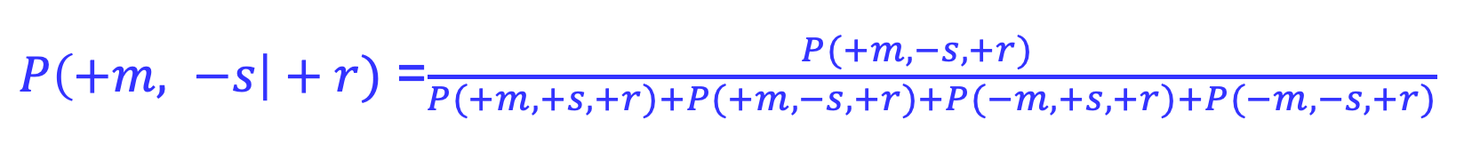
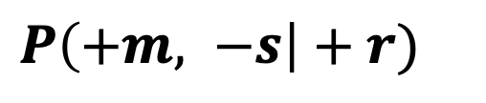
Conditional probability
Given that the chosen slice has roasted onion, what is the probability it has mushrooms and no spinach?
$P\left(+m, −s\right|+r)$
We restrict our attention to satisfying the “given” condition, and then normalize the values so that they sum to 1 (form a distribution)
$P\left(+m, −s\right|+r)$ =$\frac{P(+m, −s,+r) }{\begin{aligned}P(+m, +s, +r)+P(+m, −s, +r)+P(−m, +s, +r)+P(−m, −s, +r) \\ \end{aligned}}$
$$P(+r)$$

Slide 18
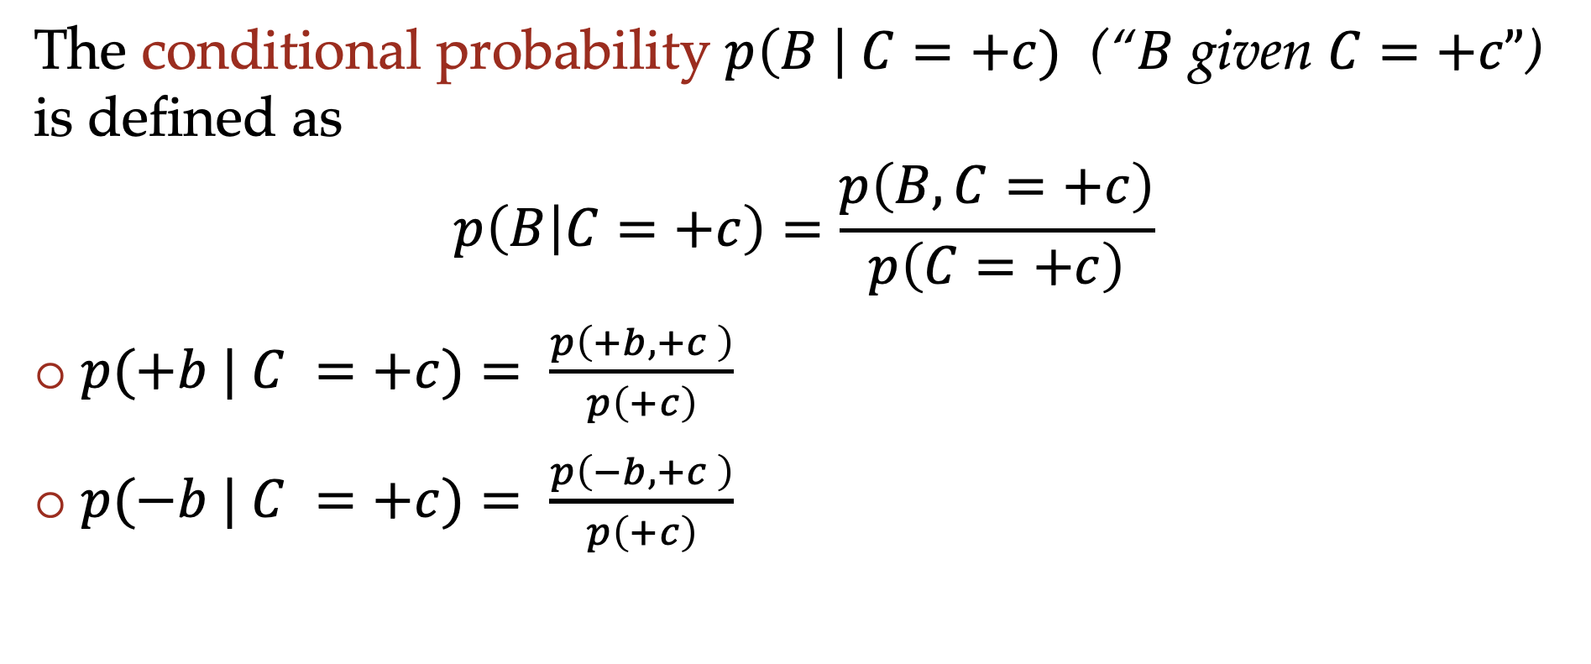
Conditional probability
The conditional probability $p\left(B \right| C=+c)$ (“$B$ given $C=+c”$) is defined as
$$p\left(B | C=+c\right)=\frac{p\left(B, C=+c\right)}{p\left(C=+c\right)}$$
$p(+b | C =+c)= \frac{p\left(+b, +c \right)}{p\left(+c\right)}$
$p(−b | C =+c)= \frac{p\left(−b, +c \right)}{p\left(+c\right)}$

Slide 19
Conditional probability from table
A | B | C | P(A=a, B=b, C=c)
$$+a$$ | $$+b$$ | $$+c$$
$$+a$$ | $$+b$$ | $$−c$$
$$+a$$ | $$−b$$ | $$+c$$
$$+a$$ | $$−b$$ | $$−c$$
$$−a$$ | $$+b$$ | $$+c$$
$$−a$$ | $$+b$$ | $$−c$$
$$−a$$ | $$−b$$ | $$+c$$
$$−a$$ | $$−b$$ | $$−c$$
$A∈\left\{+a, −a \right\}$
$B∈\{+b, −b\}$
$C∈\{+c, −c\}$
What is $p\left(A=+a, B=+b| C= +c\right)?$
We restrict our attention to rows that satisfy the “given” condition, and then normalize the values so that they sum to 1 (form a distribution)

Slide 20
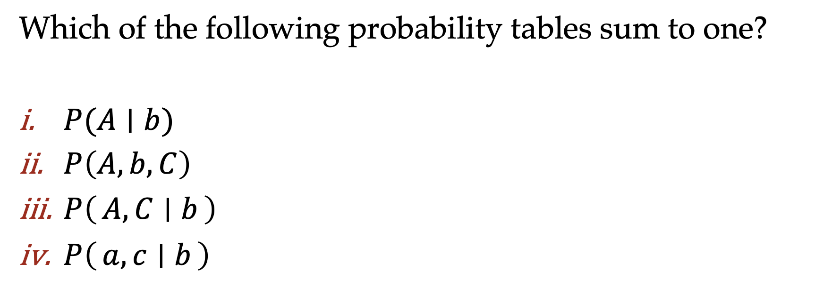
Question
Which of the following probability tables sum to one?
$P(A∣b)$
$P\left(A, b, C\right)$
$P\left(A, C ∣ b\right)$
$P\left(a, c ∣ b\right)$

Slide 21
More practice
What is the probability of getting a slice with….

Slide 22
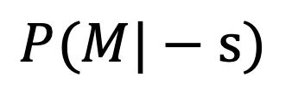
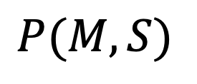
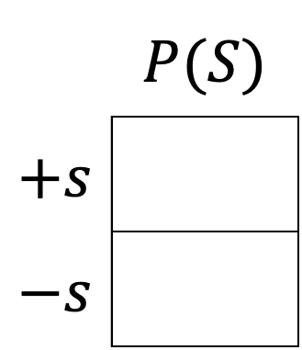
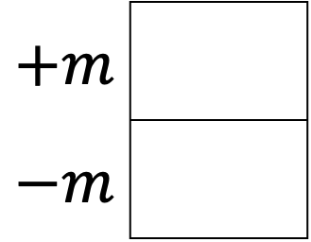
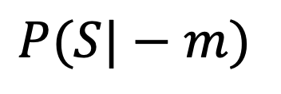
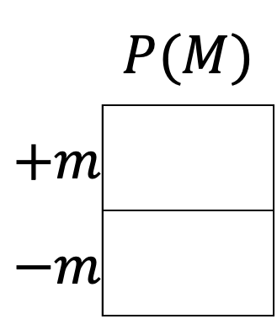
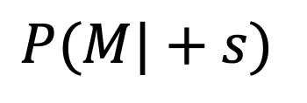
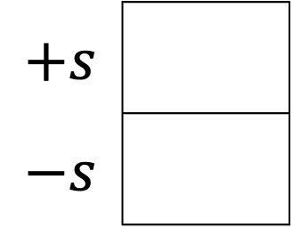
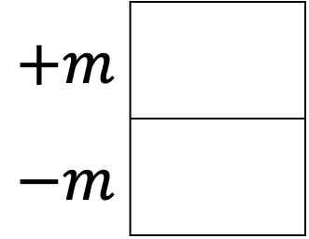

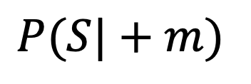
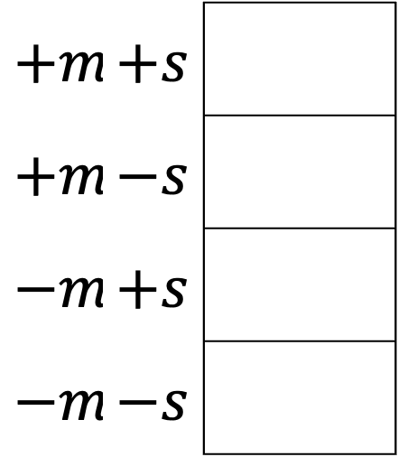
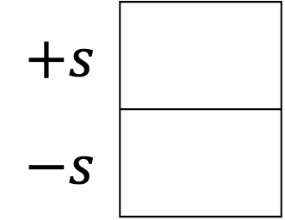

Answer queries from joint distribution
You can answer all of these questions:
$P(M|+s)$
$P(M|−s)$
 | $$P(M)$$
$$+m$$
$$−m$$
$P(M,S)$
$$+m$$
$$−m$$
$$+m$$
$$−m$$
$$8/20$$
$$+m$$ | $$+s$$
$$+m$$ | $$−s$$
$$−m$$ | $$+s$$
$$−m$$ | $$−s$$
$P(S|+m)$
$P(S|−m)$
 | $$P(S)$$
$$+s$$
$$−s$$
$$+s$$
$$−s$$
$$+s$$
$$−s$$
$$1/2$$

Slide 23
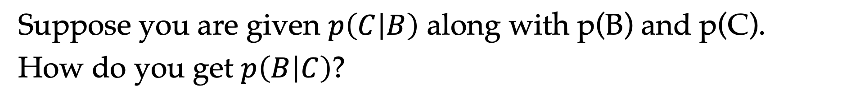



Bayes rule
Suppose you are given $p\left(C | B\right)$ along with p(B) and p(C).
How do you get $p\left(B | C\right)$?
Hint: Think about the equations of conditional probability
$$p(B|C)=\frac{p\left(B, C\right)}{p\left(C\right)}$$
$$p(C|B)=\frac{p\left(B, C\right)}{p\left(B\right)}$$
$$p(B|C)=\frac{p(C|B)p(B)}{p\left(C\right)}$$

Slide 24
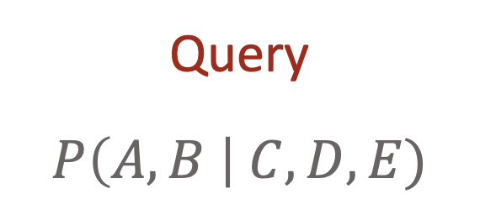
How to answer queries?
Joint distributions are the best!
  Allow us to answer all marginal or conditional queries
  However…
Often we don’t have the joint table. Only know some set of conditional probability tables (CPTs)
Joint
Query
$$P\left(A,B \right| C,D,E)$$

Slide 25
Only know some set of conditional probability tables
E.g., know P(dry cough|URT elipthelial infection, Pul. capillary leakage), P(anosmia and/or ageusia | Infection of olfactory epithelium), etc.
Want to answer questions like:
What is P(elipthelial infection = yes | dry cough=yes, productive cough=no, anosmia=yes) ?

Slide 26
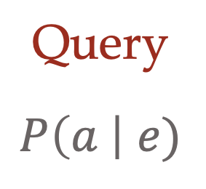
Answering queries from CPTs
Joint
Conditional Probability Tables
Chain
Rule
Query
$$P\left(a \right| e)$$
$P\left(A\right) P\left(B | A\right) P\left(C | A,B\right) P\left(D | A,B,C\right)$ $P(E|A, B,C,D)$

Slide 27

Joint distribution from conditionals
Product rule
Can you write $P\left(A,B\right) in terms of P\left(A ∣ B\right) and P\left(B\right)?$
$P\left(A,B\right)=P\left(A ∣ B\right)P\left(B\right)$

Slide 28

Joint distribution from conditionals
Product rule
$P\left(A,B\right)=P\left(A ∣ B\right)P\left(B\right)$
$P\left(A,B\right)=P\left(B ∣ A\right)P(A)$

Slide 29
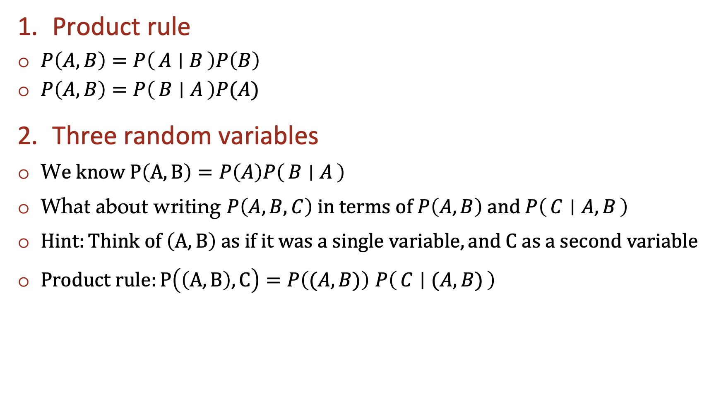
Joint distribution from conditionals
Product rule
$P\left(A,B\right)=P\left(A ∣ B\right)P\left(B\right)$
$P\left(A,B\right)=P\left(B ∣ A\right)P(A)$
Three random variables
W$e know P\left(A,B\right)=P\left(A\right)P\left(B ∣ A\right)$
What about writing $P\left(A,B,C\right) in terms of P\left(A,B\right) and P\left(C ∣ A, B\right)$
$Hint:Think of \left(A,B\right) as if it was a single variable, and C as a second variabl$e
$Product rule:P\left(\left(A,B\right),C\right)=P\left((A,B)\right)$ $P\left(C ∣ (A, B)\right)$

Slide 30
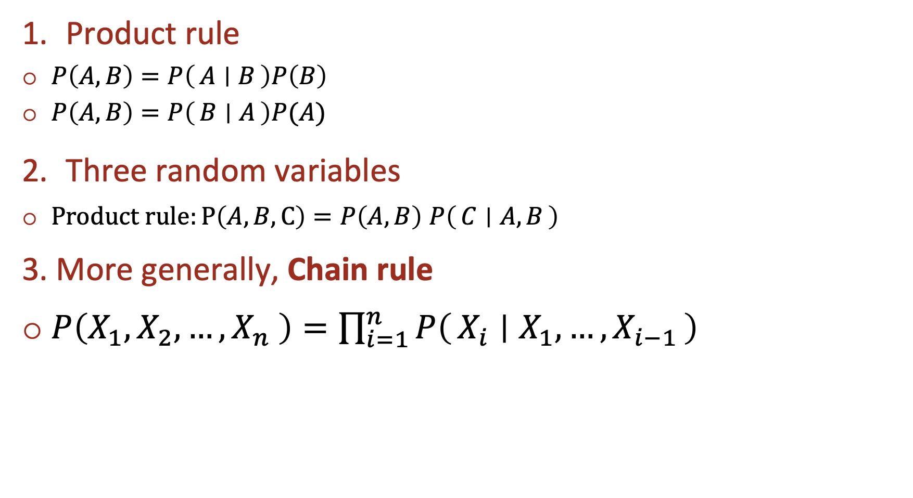
Joint distribution from conditionals
Product rule
$P\left(A,B\right)=P\left(A ∣ B\right)P\left(B\right)$
$P\left(A,B\right)=P\left(B ∣ A\right)P(A)$
Three random variables
$Product rule:P\left(A,B,C\right)=P\left(A,B\right)$ $P\left(C ∣ A, B\right)$
3. More generally, Chain rule
$P\left(X_{1},X_{2},…,X_{n} \right)=\prod_{i=1}^{n}{P\left(X_{i} ∣ X_{1},…,X_{i−1}\right)}$

Slide 31
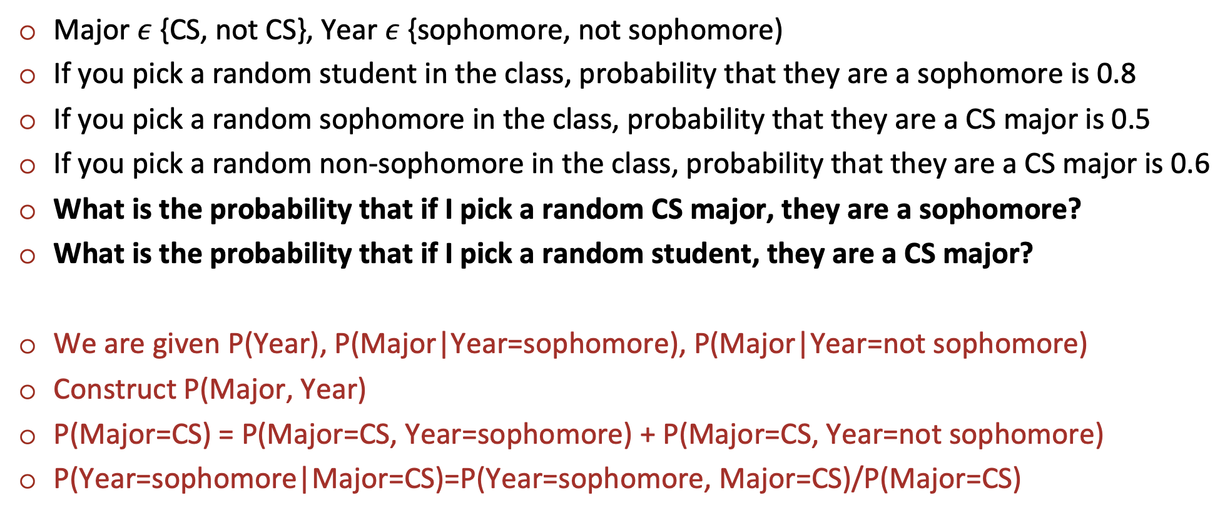
Answering queries from CPTs: Example
Major $ε$ {CS, not CS}, Year $ε$ {sophomore, not sophomore)
If you pick a random student in the class, probability that they are a sophomore is 0.8
If you pick a random sophomore in the class, probability that they are a CS major is 0.5
If you pick a random non-sophomore in the class, probability that they are a CS major is 0.6
What is the probability that if I pick a random CS major, they are a sophomore?
What is the probability that if I pick a random student, they are a CS major?
We are given P(Year), P(Major|Year=sophomore), P(Major|Year=not sophomore)
Construct P(Major, Year)
P(Major=CS) = P(Major=CS, Year=sophomore) + P(Major=CS, Year=not sophomore)
P(Year=sophomore|Major=CS)=P(Year=sophomore, Major=CS)/P(Major=CS)

Slide 32

Answering queries from CPTs: Problem
Conditional Probability Tables and Chain Rule
    If there are $n$ variables taking $d$ values each
    $d^{n}$ entries!!
$P\left(A\right) P\left(B | A\right) P\left(C | A,B\right) P\left(D | A,B,C\right)$ $P(E|A, B,C,D)$

Slide 33

Sometimes, distributions have simpler structure
$P\left(A, B,C,D,E\right)= P\left(A\right) P\left(B | A\right) P\left(C | A,B\right) P\left(D | A,B,C\right)$ $P(E|A, B,C,D)$
Suppose $P(E|A, B,C,D)$=$P(E|A, B)$ and $P\left(D | A,B,C\right)$= $P\left(D | A,B\right)$
“Conditional independence” (more on this soon)
E.g., P(dry cough|URT elipthelial infection, Pul. capillary leakage, virus enters URT)
= P(dry cough|URT elipthelial infection, Pul. capillary leakage)

Slide 34
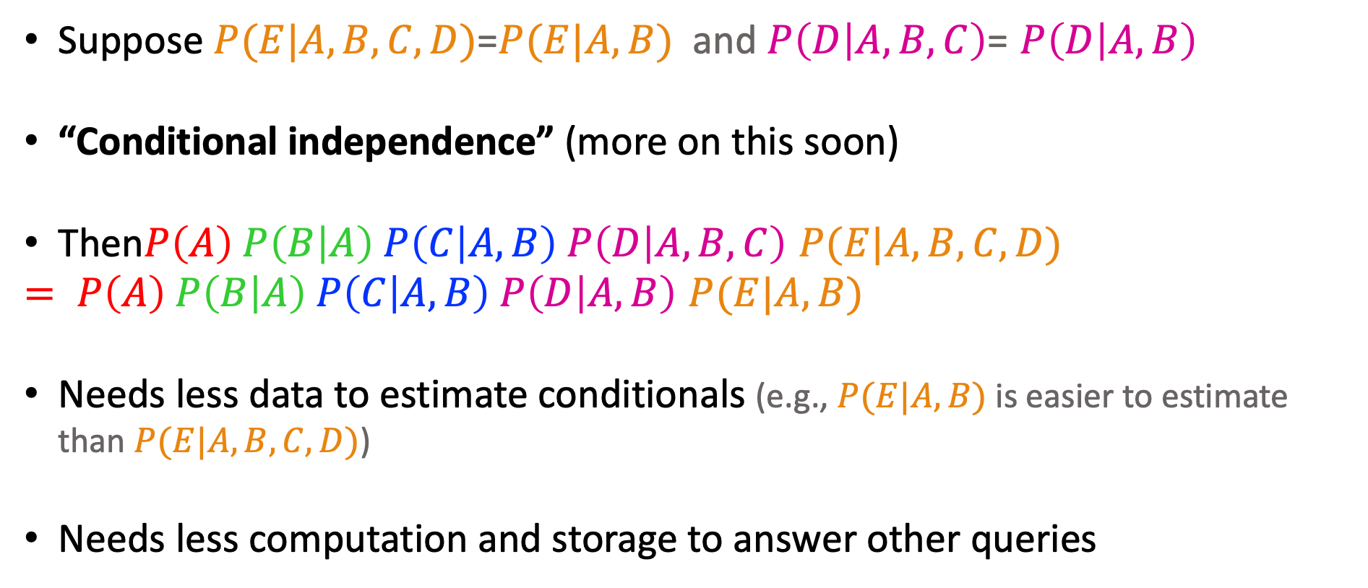
Sometimes, distributions have simpler structure
$P\left(A, B,C,D,E\right)= P\left(A\right) P\left(B | A\right) P\left(C | A,B\right) P\left(D | A,B,C\right)$ $P(E|A, B,C,D)$
Suppose $P(E|A, B,C,D)$=$P(E|A, B)$ and $P\left(D | A,B,C\right)$= $P\left(D | A,B\right)$
“Conditional independence” (more on this soon)
Then$P\left(A\right) P\left(B | A\right) P\left(C | A,B\right) P\left(D | A,B,C\right)$ $P(E|A, B,C,D)$
$= P\left(A\right) P\left(B | A\right) P\left(C | A,B\right) P\left(D | A,B\right)$ $P(E|A, B)$
Needs less data to estimate conditionals (e.g., $P(E|A, B)$ is easier to estimate than $P(E|A, B,C,D)$)
Needs less computation and storage to answer other queries

Slide 35
But what is this “Independence”?

Slide 36

I roll two fair dice…
What is the probability that the first roll is 5?
What is the probability that the second roll is 5?
What is the probability that both rolls are 5?
If the first roll is 5, what is the probability that the second roll is 5?
  P(Roll₁=5, Roll₂=5) = P(Roll₁=5) P(Roll₂=5) = 1/6 x 1/6 = 1/36
  P(Roll₂=5 | Roll₁=5) = P(Roll₂=5) = 1/6
Independence and conditional independence!

Slide 37
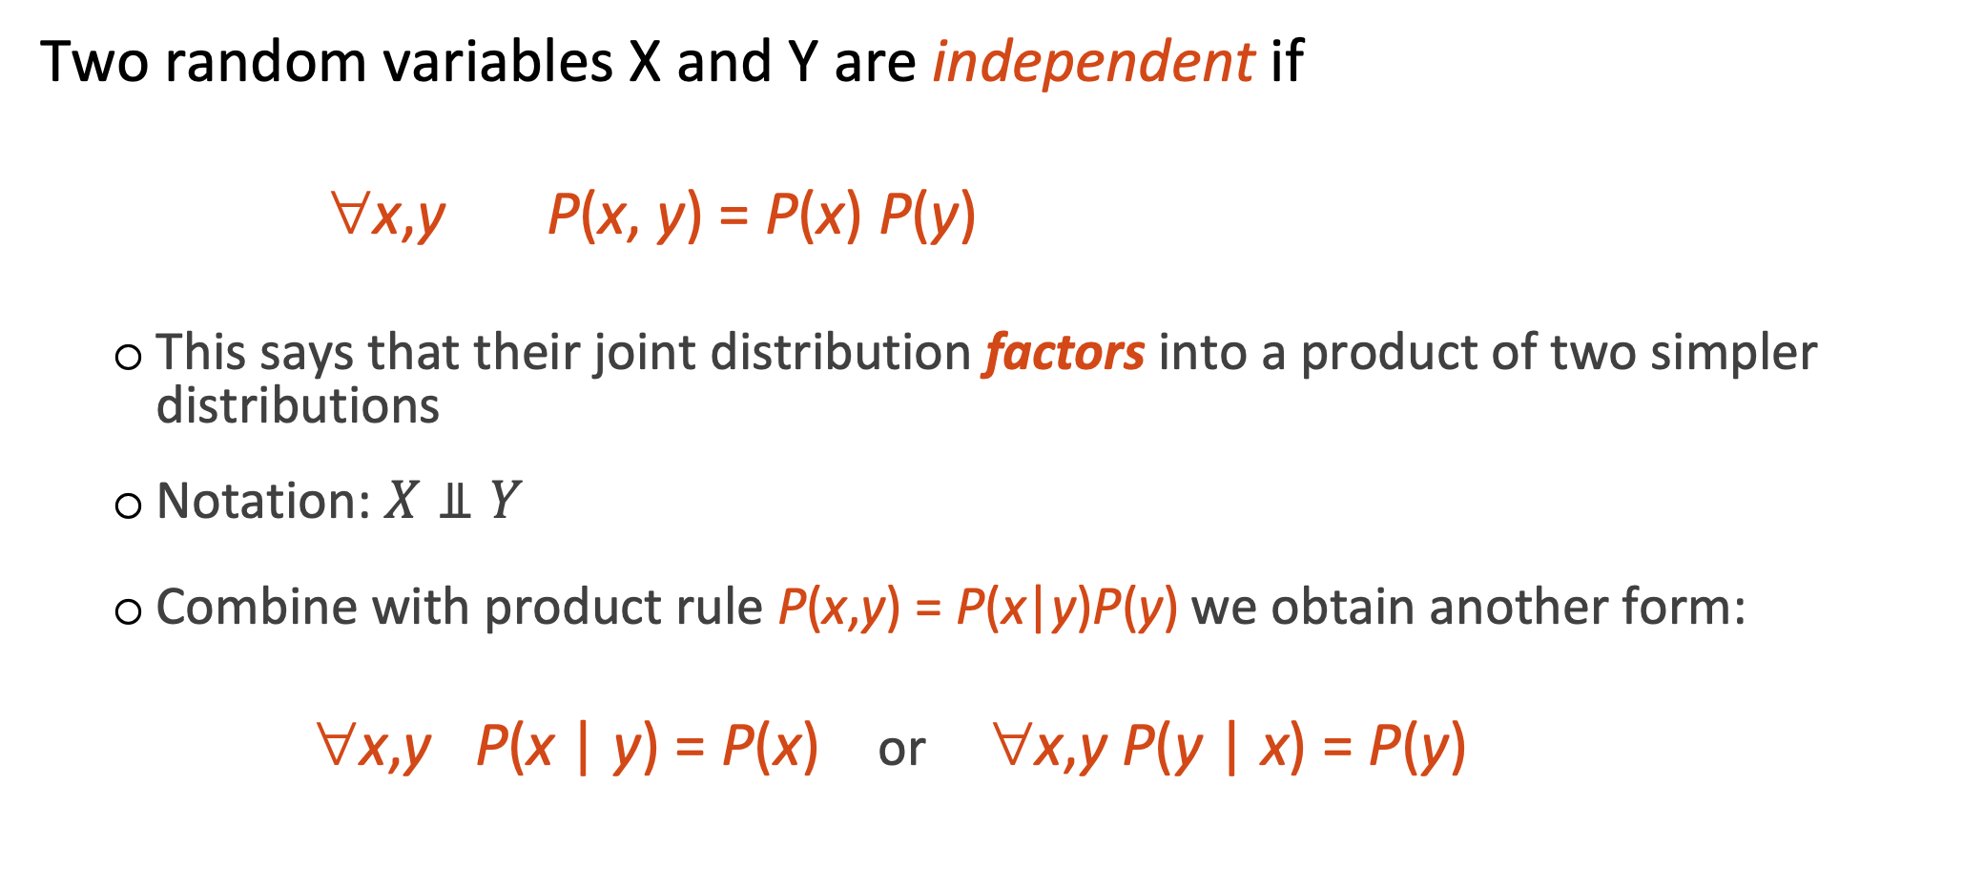
Independence
Two random variables X and Y are independent if
∀x,y P(x, y) = P(x) P(y)
  This says that their joint distribution factors into a product of two simpler distributions
  Notation: $X⫫Y$
  Combine with product rule P(x,y) = P(x|y)P(y) we obtain another form:
  ∀x,y P(x | y) = P(x) or ∀x,y P(y | x) = P(y)

Slide 38

Example: Independence
n fair, independent coin flips:
P(X₁)
P(X₂)
P(X_{n})
H | 0.5
T | 0.5
H | 0.5
T | 0.5
H | 0.5
T | 0.5
P(X₁,X₂,...,X_{n})
2^{n}
joint distribution is simply the product

Slide 39



Question
Are T and W independent?
$$P(T)$$
T | P
hot | 0.5
cold | 0.5
$$P\left(T,W\right)$$
T | W | P
hot | sun | 0.4
hot | rain | 0.1
cold | sun | 0.2
cold | rain | 0.3
$$P(W)$$
W | P
sun | 0.6
rain | 0.4

Slide 40
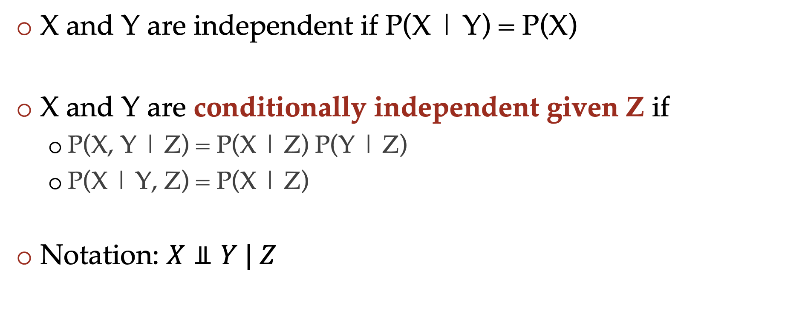
Conditional independence
X and Y are independent if P(X | Y) = P(X)
X and Y are conditionally independent given Z if
  P(X, Y | Z) = P(X | Z) P(Y | Z)
  P(X | Y, Z) = P(X | Z)
Notation: $X⫫Y | Z$

Slide 41

Conditional independence
P(Toothache, Cavity, (p)Robe)
If I have a cavity, the probability that the probe catches in it doesn't depend on whether I have a toothache:
  P(+r | +toothache, +cavity) = P(+r | +cavity)
The same independence holds if I don’t have a cavity:
  P(+r | +toothache, -cavity) = P(+r| -cavity)
Probe is conditionally independent of Toothache given Cavity:
  P(R | T, C) = P(R | C)

Slide 42
Conditional independence
Equivalent statements:
P(Toothache | Probe , Cavity) = P(Toothache | Cavity)
P(Toothache, Probe | Cavity) = P(Toothache | Cavity) P(Probe | Cavity)

Slide 43
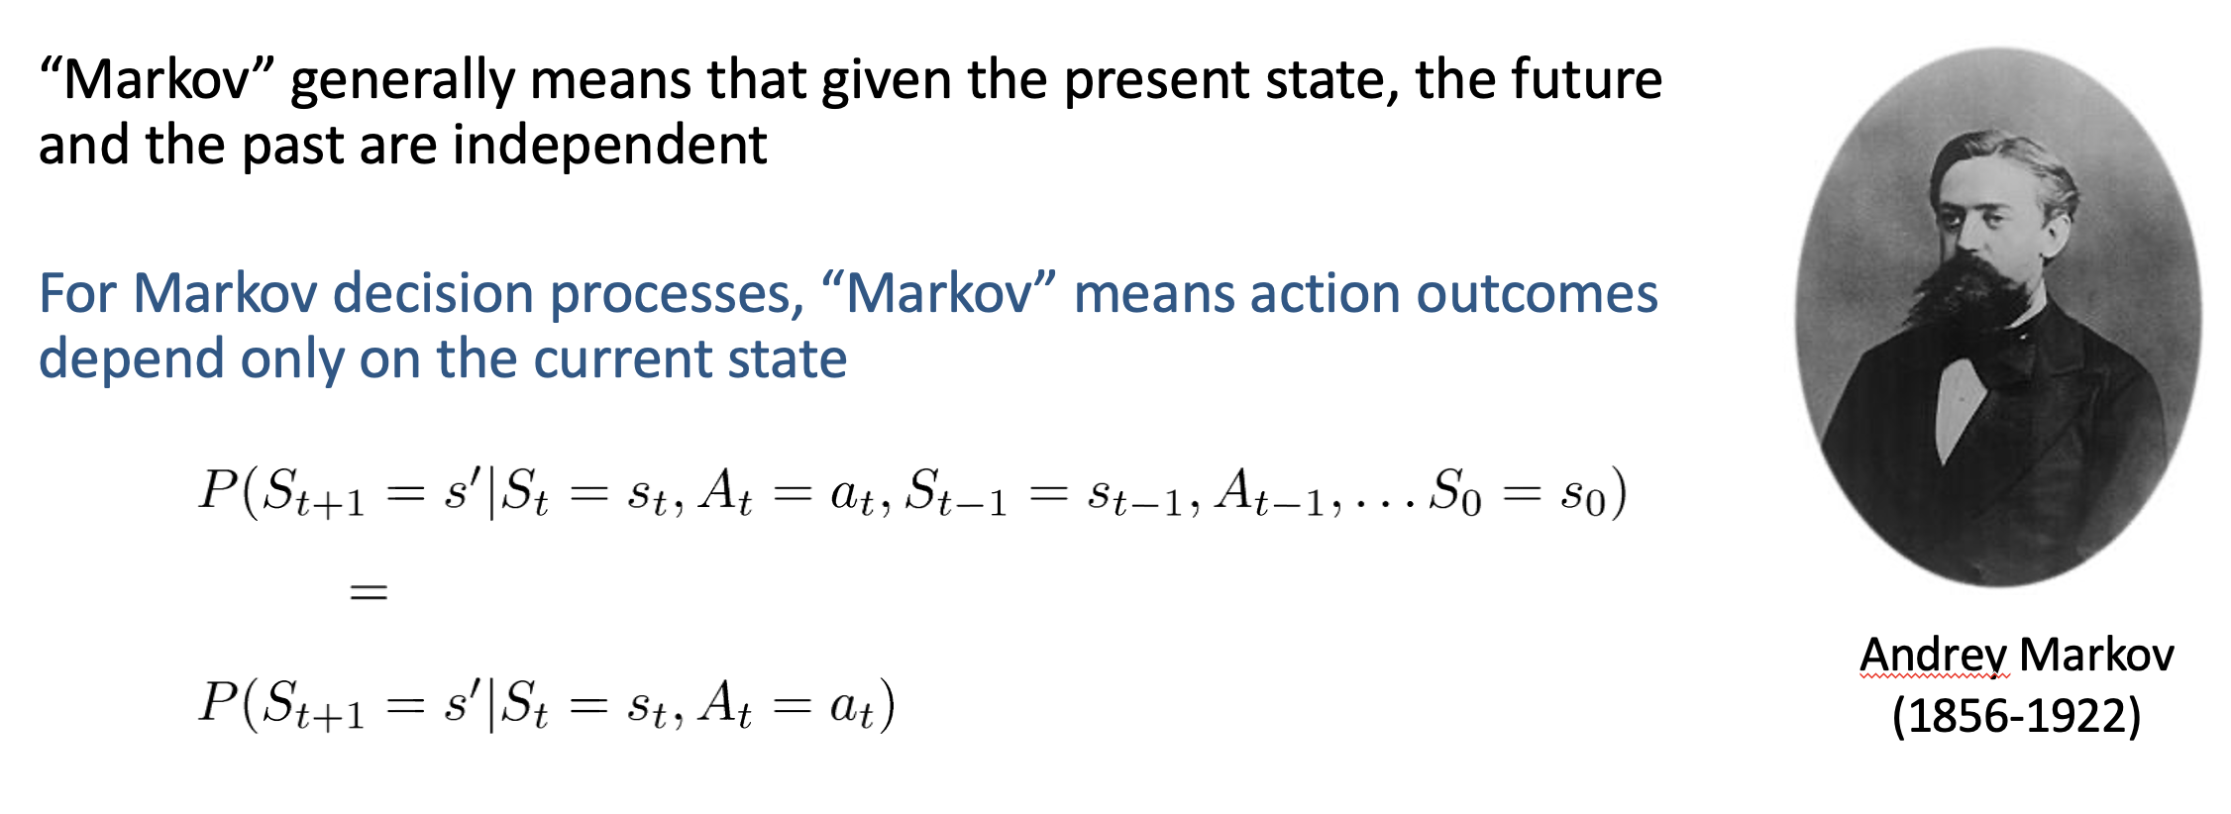
Have we seen conditional independence in previous lectures?
MDPs

Slide 44
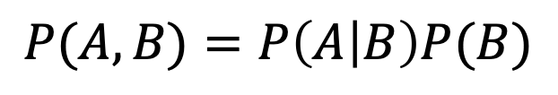
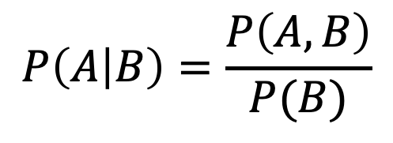
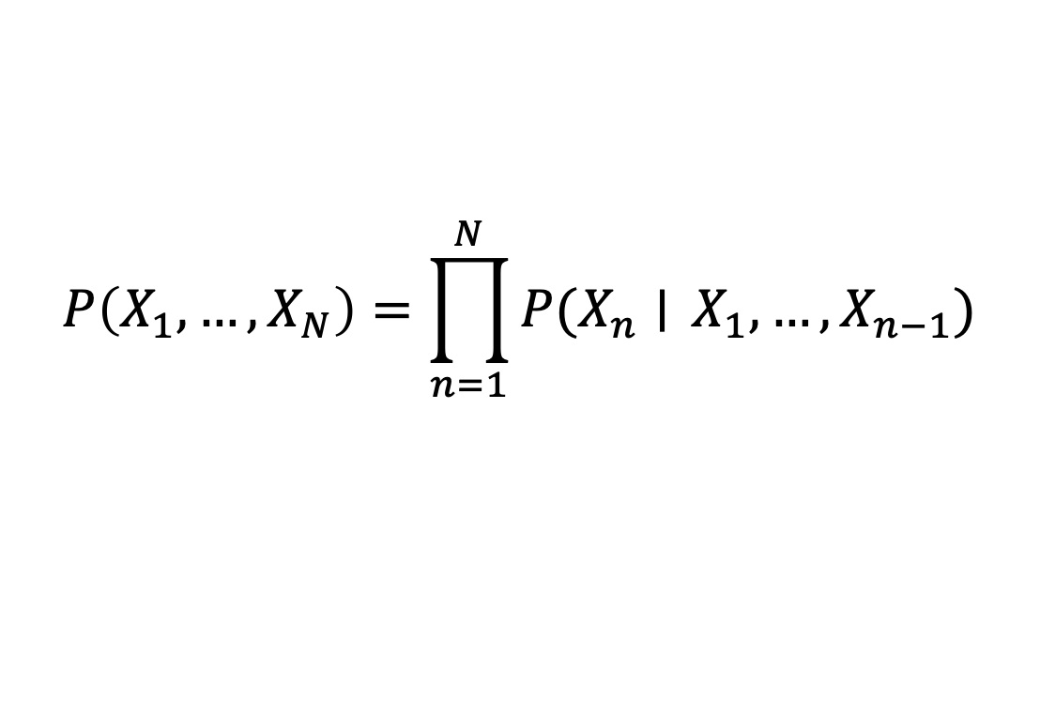
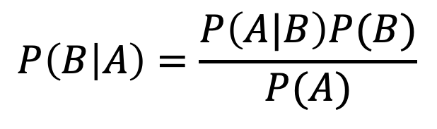
Probability Tools Summary
Definition of conditional probability
Product Rule
Bayes’ theorem
Chain Rule
$$P\left(A | B\right)=\frac{P\left(A, B\right)}{P(B)}$$
$$P(A,B)=P\left(A | B\right)P(B)$$
$$P\left(B | A\right)=\frac{P\left(A|B\right)P(B)}{P(A)}$$
$$P\left(X_{1}, …, X_{N}\right)=\prod_{n=1}^{N}{P(X_{n}∣} X_{1},…, X_{n−1})$$

Slide 45
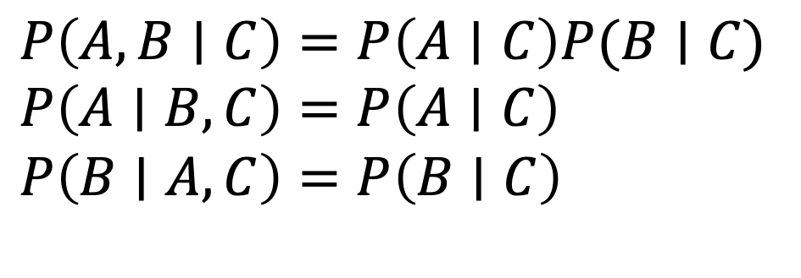
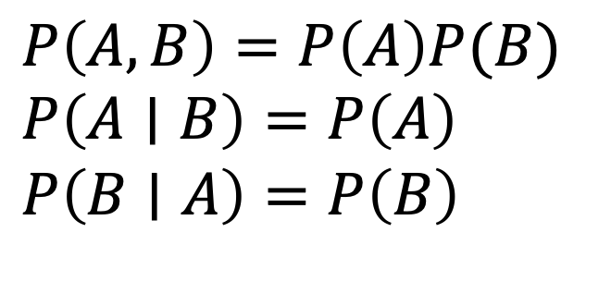
Summary of Independence Rules
Independence
If A and B are independent, then:
Conditional independence
If A and B are conditionally
independent given C, then:
$P\left(A, B\right)=P\left(A\right)P(B)$
$P\left(A∣B\right)=P\left(A\right)$
$P\left(B∣A\right)=P\left(B\right)$
$P\left(A, B∣C\right)=P\left(A∣C\right)P(B∣C)$
$P\left(A∣B, C\right)=P\left(A∣C\right)$
$P\left(B∣A, C\right)=P\left(B∣C\right)$

Slide 46
Poll
I want to know if I have come down with a rare strain of flu (occurring in only 1/10,000 people). There is an “accurate” test for the flu: if I have the flu, it will tell me I have 99% of the time, and if I do not have it, it will tell me I do not have it 99% of the time. I go to the doctor and test positive. What is the probability I have this flu?
  (A) ≈ 99%
  (B) ≈ 10%
  (C) ≈ 1%
  (D) ≈ 0.1%

