Slide 1
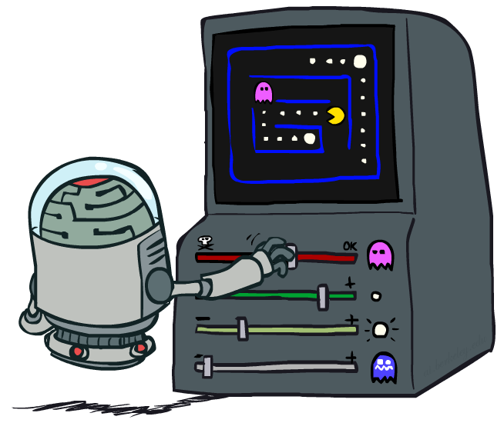
AI: Representation and Problem Solving
Reinforcement Learning II
Instructors: Tuomas Sandholm and Nihar Shah
Slide credits: CMU AI and http://ai.berkeley.edu

Slide 2
Logistics
Midterm 2 on Wednesday
  Covers from propositional logic up to (and including) basic Q learning
  Doesn’t include the rest today’s lecture (after basic Q learning), which will be covered on the Final Exam
Extra-cool, optional:
Prof. Bart Selman will give the
Inaugural Hans Berliner Lecture on
“Mathematical and Scientific Discovery: A New Frontier for AI”
  On 4/4/2024 at 4 PM in Rashid Auditorium in GHC

Slide 3

Reinforcement Learning (RL) Review So Far
We still assume an MDP:
  A set of states s ∈ S
  A set of actions (per state) A
  A model T(s,a,s’)
  A reward function R(s,a,s’)
Still looking for a policy π(s)
The twist: don’t know T or R, so must try out actions
Big idea: Compute all averages over transition probabilities using sample outcomes

Slide 4
Summary so far
Passive RL: agent has to learn from experience
Model-based: Estimate the transition and rewards; run value iteration or policy iteration
Model-free:
  Direct policy evaluation – empirical average utility
  Temporal difference learning – sample based policy iteration update via running averages

Slide 5
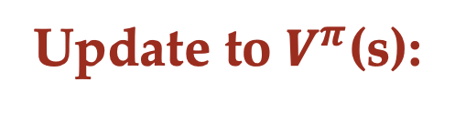
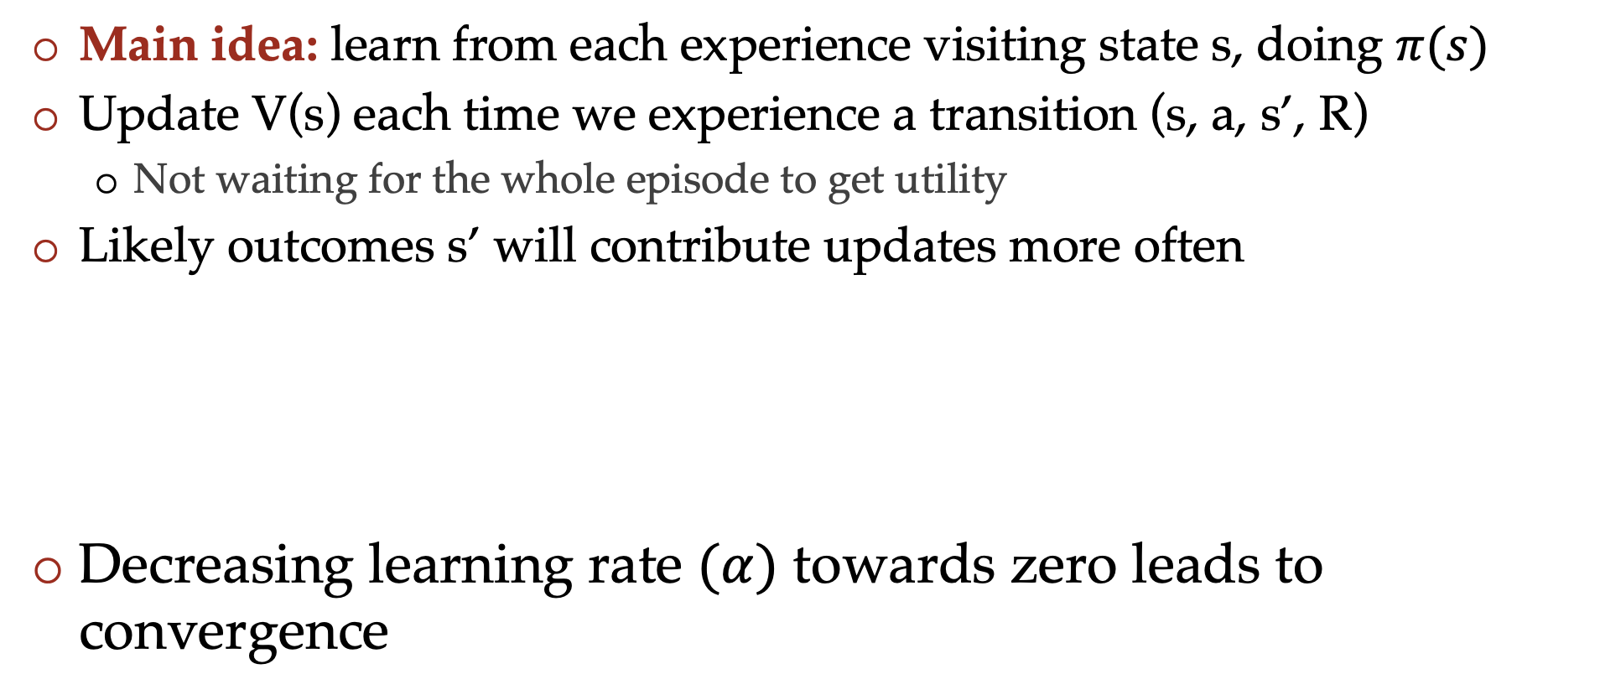
Temporal Difference learning
Main idea: learn from each experience visiting state s, doing $π(s)$
Update V(s) each time we experience a transition (s, a, s’, R)
  Not waiting for the whole episode to get utility
Likely outcomes s’ will contribute updates more often
Decreasing learning rate $(α)$ towards zero leads to convergence
Sample of $V^{π}$(s): sample = $R+γ V^{π}(s^{′})$
Update to $V^{π}$(s):

Slide 6


Example: Model-Based Learning
Input Policy π
Observed Episodes (Training)
Learned Model
Episode 1
Episode 2
T(s,a,s’).
T(B, east, C) =
T(C, east, D) =
T(C, east, A) =
…
R(s,a,s’).
R(B, east, C) =
R(C, east, D) =
R(D, exit, x) =
…
 | A
B | C | D
 | E
B, east, C, -1
C, east, D, -1
D, exit, x, +10
B, east, C, -1
C, east, D, -1
D, exit, x, +10
Episode 3
Episode 4
E, north, C, -1
C, east, D, -1
D, exit, x, +10
E, north, C, -1
C, east, A, -1
A, exit, x, -10
Assume: γ = 1
Notes:
T(s,a,s’).
T(B, east, C) = 1.00
T(C, east, D) = 0.75
T(C, east, A) = 0.25
R(s,a,s’).
R(B, east, C) = -1
R(C, east, D) = -1
R(D, exit, x) = +10
…

Slide 7
Example: Model-Based Learning
Input Policy π
Observed Episodes (Training)
Learned Model
Episode 1
Episode 2
T(s,a,s’).
T(B, east, C) = 1
T(C, east, D) = 0.75
T(C, east, A) = 0.25
…
R(s,a,s’).
R(B, east, C) = -1
R(C, east, D) = -1
R(D, exit, x) = 10
…
 | A
B | C | D
 | E
B, east, C, -1
C, east, D, -1
D, exit, x, +10
B, east, C, -1
C, east, D, -1
D, exit, x, +10
Episode 3
Episode 4
E, north, C, -1
C, east, D, -1
D, exit, x, +10
E, north, C, -1
C, east, A, -1
A, exit, x, -10
Assume: γ = 1
Notes:
T(s,a,s’).
T(B, east, C) = 1.00
T(C, east, D) = 0.75
T(C, east, A) = 0.25
R(s,a,s’).
R(B, east, C) = -1
R(C, east, D) = -1
R(D, exit, x) = +10
…

Slide 8
Example: Model-Free Direct Evaluation
Input Policy π
Observed Episodes (Training)
Output Values
Episode 1
Episode 2
A:
B:
C:
D:
E:
 | A
B | C | D
 | E
B, east, C, -1
C, east, D, -1
D, exit, x, +10
B, east, C, -1
C, east, D, -1
D, exit, x, +10
Episode 3
Episode 4
E, north, C, -1
C, east, D, -1
D, exit, x, +10
E, north, C, -1
C, east, A, -1
A, exit, x, -10
Assume: γ = 1
Algorithm: Average all total/future rewards that start at each state
Notes:
A = -10
D = +10
C = (10-1)+(10-1)+(10-1)+(-10-1)/4 = 16/4 = 4
B = (8 + 8)/2 = 8
E = 8+-12/2 = -2

Slide 9
Example: Model-Free Direct Evaluation
Input Policy π
Observed Episodes (Training)
Output Values
Episode 1
Episode 2
A: -10 [-10]
B: 8, 8 [8]
C: 9, 9, 9, -11 [4]
D: 10, 10, 10 [10]
E: 8, -12 [-2]
 | A
B | C | D
 | E
B, east, C, -1
C, east, D, -1
D, exit, x, +10
B, east, C, -1
C, east, D, -1
D, exit, x, +10
Episode 3
Episode 4
E, north, C, -1
C, east, D, -1
D, exit, x, +10
E, north, C, -1
C, east, A, -1
A, exit, x, -10
Assume: γ = 1
Algorithm: Average all total/future rewards that start at each state
Notes:
A = -10
D = +10
C = (10-1)+(10-1)+(10-1)+(-10-1)/4 = 16/4 = 4
B = (8 + 8)/2 = 8
E = 8+-12/2 = -2

Slide 10
Example: Temporal Difference Learning
States
Observed Transitions
B, east, C, -2
C, east, D, -2
 | A
B | C | D
 | E
 | 0
0 | 0 | 8
 | 0
 | 0
-1 | 0 | 8
 | 0
 | 0
-1 | 3 | 8
 | 0
Assume: γ = 1, α = 0.5
Notes:
i = 0.8*0 + 0.2*(-2) = -0.4
ii = -0.4 (doesn’t change)
iii = 0.8*0 + 0.2*(-2+8) = 1.2

Slide 11
Poll
Which of the following allows you to estimate the optimal policy?
(A) Model-based RL
(B) Model-free RL : direct policy evaluation
(C) Model-free RL : temporal difference value learning

Slide 12
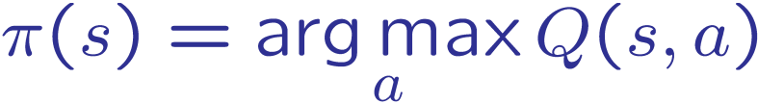
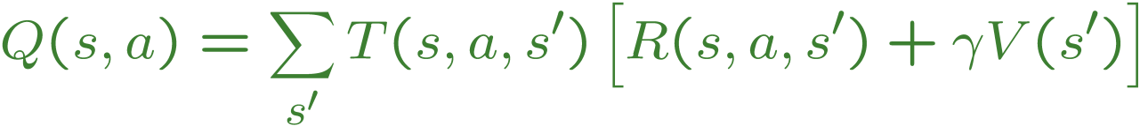
From TD Value Learning to Q-learning
TD value learning is a model-free way to do policy evaluation, mimicking Bellman updates with running sample averages
If we want to turn values into a (new) policy, we can learn Q-values, not state values
s
a
s, a
s,a,s’
s’
Conceptual; actual details in next slides

Slide 13
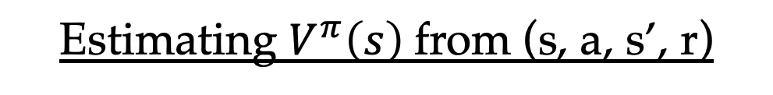

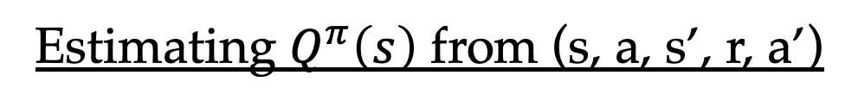
Bootstrapped prediction of Q-values
Estimating $V^{π}\left(s\right)$from (s, a, s’, r)
Sample of $V^{π}$(s): sample = $r+γ V^{π}(s^{′})$
Update to $V^{π}$(s):
Estimating $Q^{π}\left(s\right)$ from (s, a, s’, r, a’)
Sample of $Q^{π}$(s): sample = $r+γ Q^{π}(s^{′}, a^{′})$
Update to $Q^{π}$(s): $Q^{π}\left(s\right) ←\left(1 −α\right) Q^{π}\left(s\right)+α sample$

Slide 14
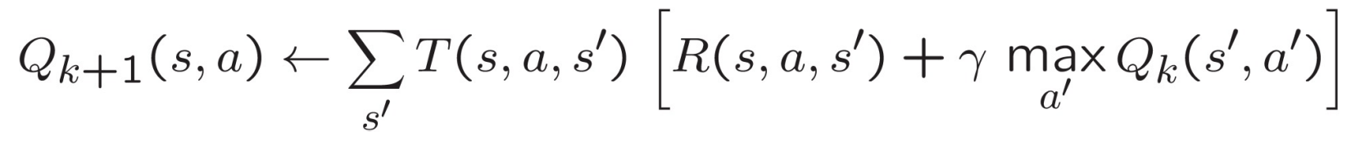
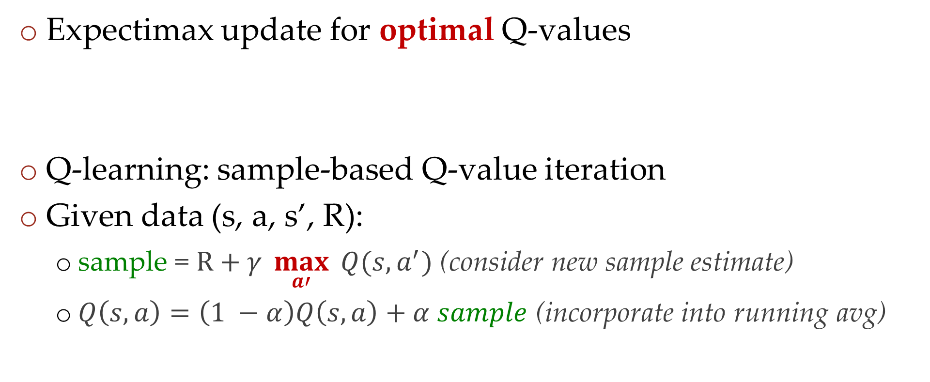
Q-learning
Expectimax update for optimal Q-values
Q-learning: sample-based Q-value iteration
Given data (s, a, s’, R):
  sample = $R+γ \max_{a′}{ Q(s, a^{′})}$ (consider new sample estimate)
  $Q\left(s, a\right)=\left(1 −α\right)Q\left(s, a\right)+α sample$ (incorporate into running avg)

Slide 15
Q-learning properties
Important property: Q-learning converges to values of the optimal policy even if you are acting suboptimally
This is called off-policy learning
  Learning about the optimal policy while the experience is obtained via a different (suboptimal) policy
Caveats:
  Data-collecting policy has to explore enough
  Have to lower the learning rate α eventually
    But not too quickly
Basically, in the limit, doesn’t matter how you select actions!

Slide 16
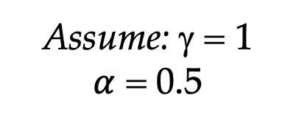
In-class activity
Input S,A
Observed Episodes (Training)
Output Q-Values
Episode 1
Episode 2
 | A
B | C | D
 | E
 | A
B | C | D
 | E
B, east, C, -1
C, east, D, -1
D, exit, x, +10
B, east, C, -1
C, east, D, -1
D, exit, x, +10
Episode 3
Episode 4
E, north, C, -1
C, east, D, -1
D, exit, x, +10
E, north, C, -1
C, east, A, -1
A, exit, x, -10
Assume: γ = 1
$α$ = 0.5
Notes:
For episode 1:
Initialize all Qs to 0
Q(B,East) = -.5
Q(C,East) = -.5
Q(D,exit) = 5
Episode 2:
Q(B,East) = -.75 = (.5*-.5)+(.5*(-1+0))
Q(C,East) = 1.75 = (.5*-.5)+(.5*(-1+5))
Q(D,exit) = 7.5
Episode 3:
Q(E,North) = 0.375
Q(C,East) = 4.125
Q(D,exit) = 8.75
Episode 4:
Q(E,North) = 1.75
Q(C,East) = 1.5625
Q(A,exit) = -5

Slide 17
The Story So Far: MDPs and RL
Known MDP: Offline Solution
Goal Technique
Compute V*, Q*, π* Value / policy iteration
Evaluate a fixed policy π Policy evaluation
Model-Based RL
Model-Free RL
Goal Technique
Compute V*, Q*, π* VI/PI on approx. MDP
Evaluate a fixed policy π PE on approx. MDP
Goal Technique
Compute V*, Q*, π* Q-learning
Evaluate a fixed policy π TD Value Learning

Slide 18
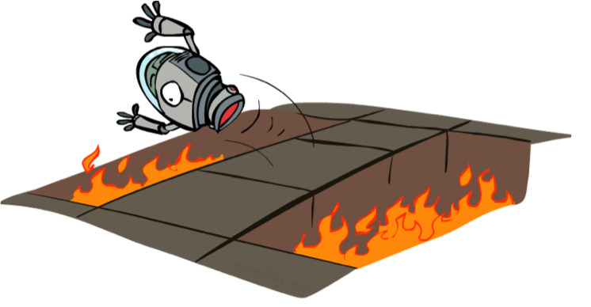
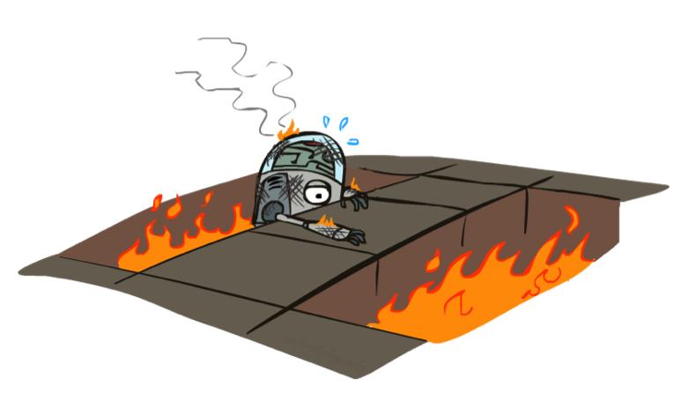
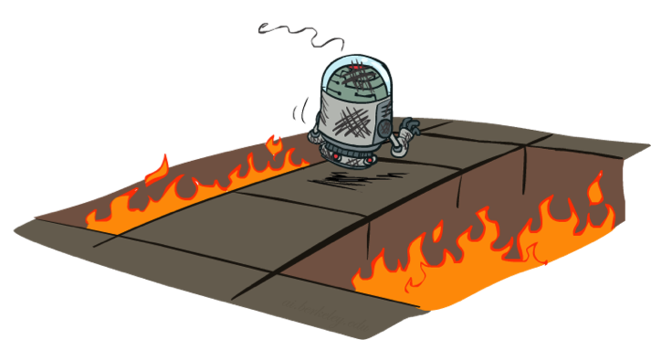
Active Reinforcement Learning

Slide 19
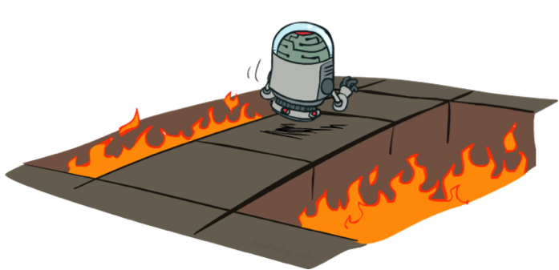
Active Reinforcement Learning
Full reinforcement learning: optimal policies (like value iteration)
  You don’t know the transitions T(s,a,s’)
  You don’t know the rewards R(s,a,s’)
  You choose the actions now
  Goal: learn the optimal policy / values
In this case:
  Learner makes choices!
  Fundamental tradeoff: exploration vs. exploitation
  This is NOT offline planning! You actually take actions in the world and find out what happens…

Slide 20
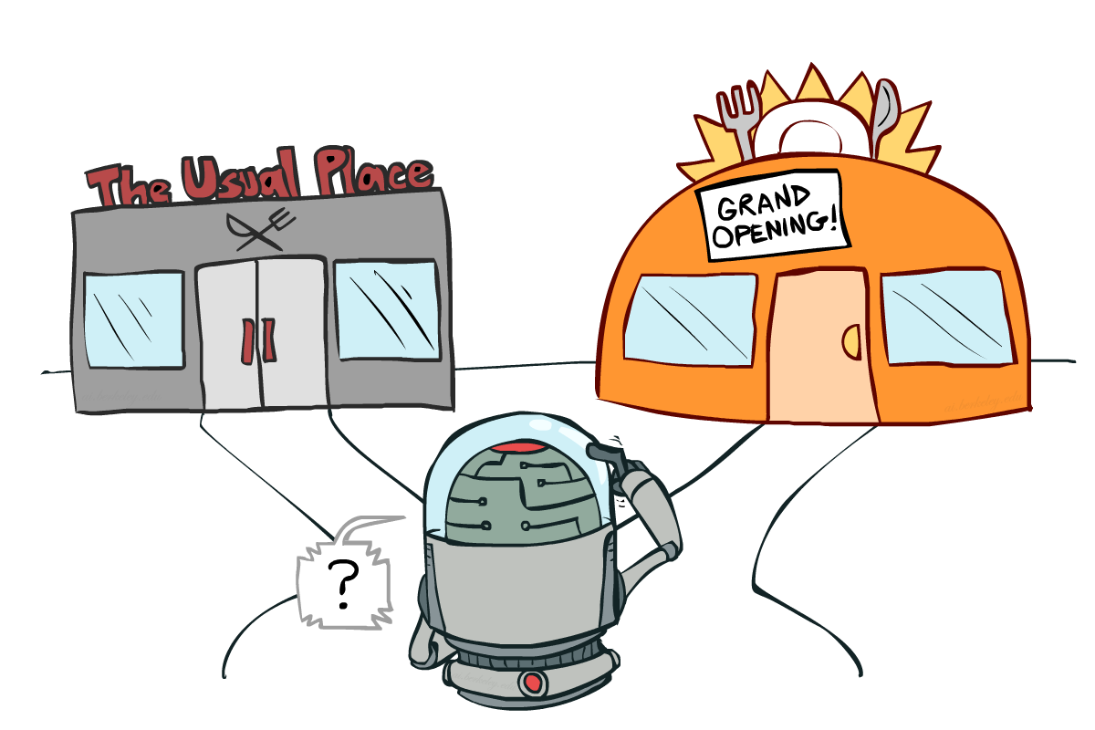
Exploration vs. Exploitation

Slide 21

How to Explore?
Several schemes for forcing exploration
  Simplest: random actions (ε-greedy)
    Every time step, flip a coin
    With (small) probability ε, act randomly
    With (large) probability 1-ε, act on current policy
  Problems with random actions?
    You do eventually explore the space, but keep thrashing around once learning is done
    One solution: lower ε over time
    Another solution: exploration function …

Slide 22
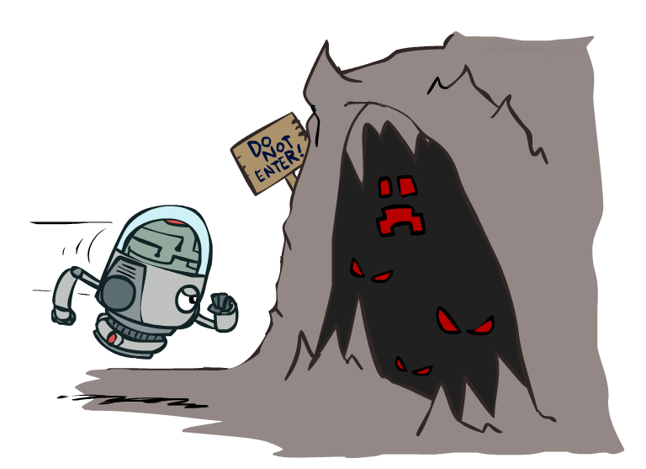
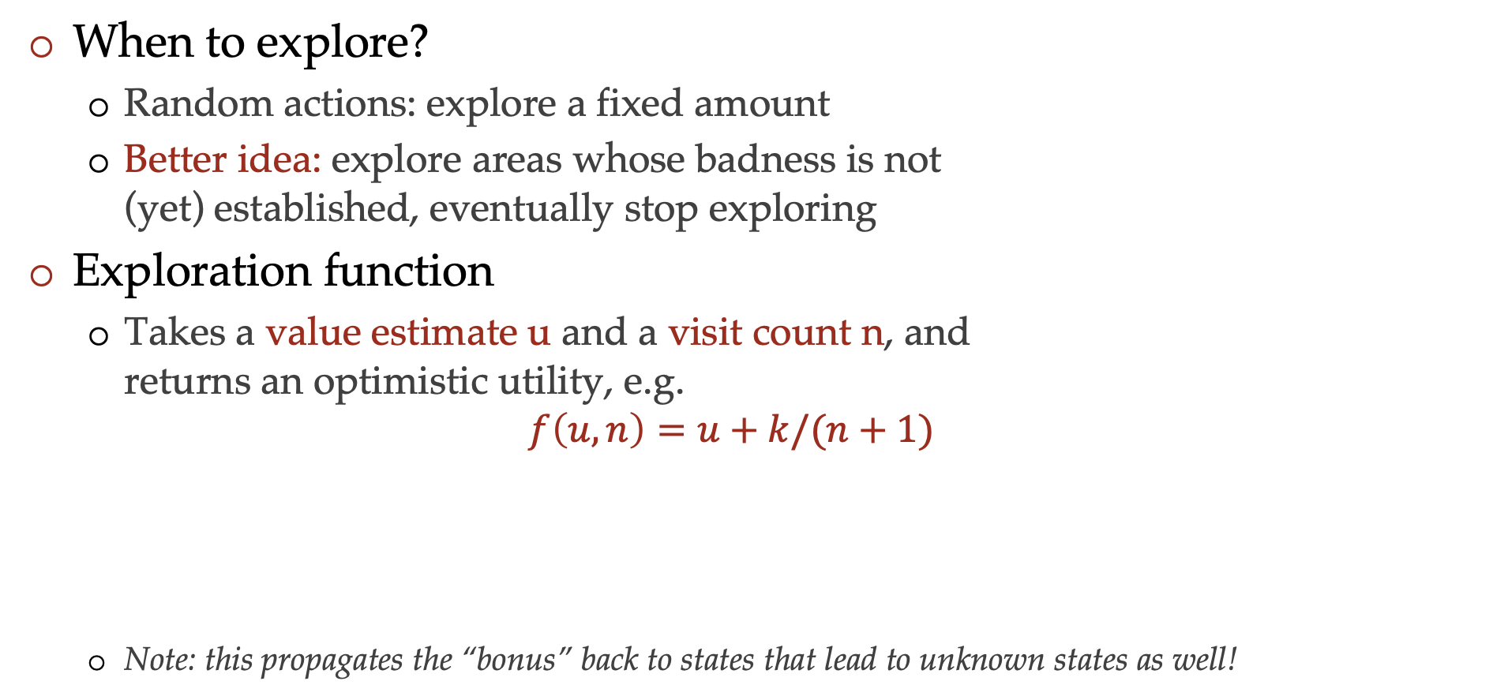
Exploration Functions
When to explore?
  Random actions: explore a fixed amount
  Better idea: explore areas whose badness is not
  (yet) established, eventually stop exploring
Exploration function
  Takes a value estimate u and a visit count n, and
  returns an optimistic utility, e.g.
  $$f\left(u, n\right)=u+k/(n+1)$$
  Note: this propagates the “bonus” back to states that lead to unknown states as well!
Regular Q-Update: $Q\left(s, a\right)=\left(1 −α\right)Q\left(s,a\right)+α [r+γ\max_{a^{′}} Q\left(s^{′}, a^{′}\right)]$
Modified Q-Update: $Q\left(s, a\right)=\left(1 −α\right)Q\left(s,a\right)+α [r+γ\max_{a^{′}} f(Q\left(s^{′}, a^{′}\right), N\left(s^{′}, a^{′}\right))]$

Slide 23
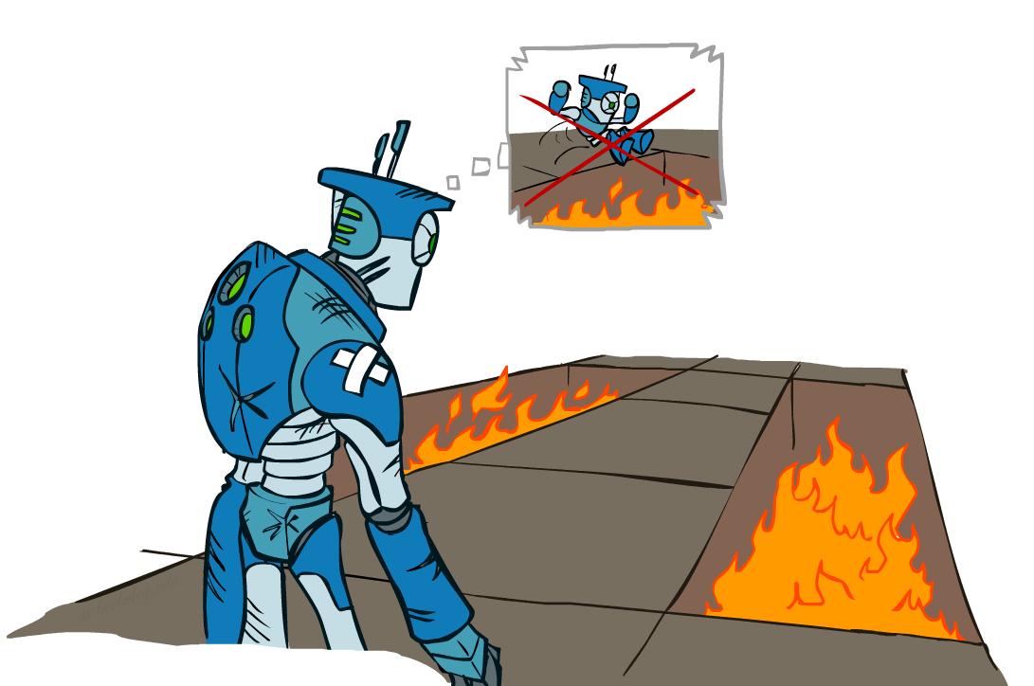
Regret
Even if you learn the optimal policy, you still make mistakes along the way!
Regret is a measure of your total mistake cost: the difference between your (expected) rewards, including youthful suboptimality, and optimal (expected) rewards
Minimizing regret goes beyond learning to be optimal – it requires optimally learning to be optimal
Example: random exploration and exploration functions both end up optimal, but random exploration has higher regret

Slide 24
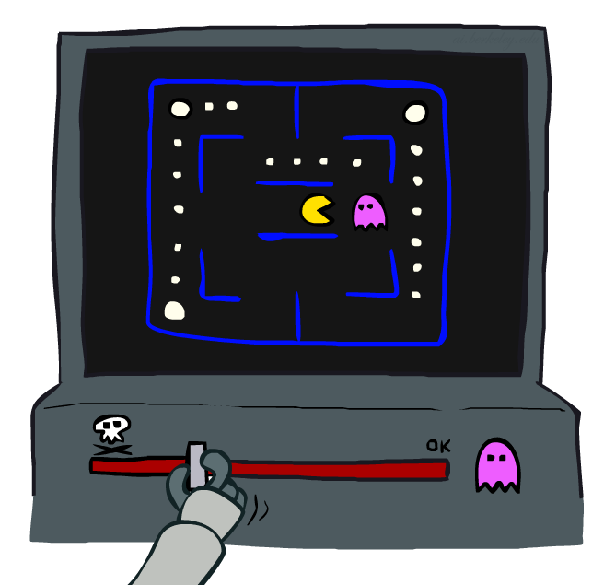
Approximate Q-Learning
Notes:
:34 in, :40 to go

Slide 25
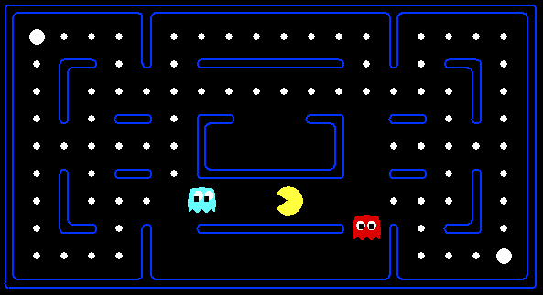



Example: Pacman
Let’s say we discover through experience that this state is bad:
In naïve q-learning, we know nothing about this state:
Or even this one!

Slide 26

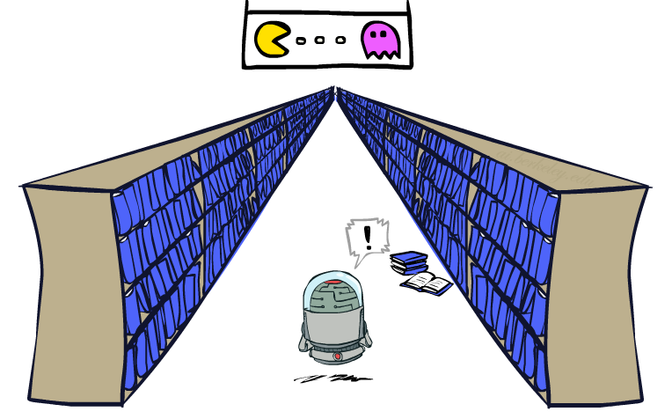
Generalizing Across States
Basic Q-Learning keeps a table of all q-values
In realistic situations, we cannot possibly learn about every single state!
  Too many states to visit them all in training
  Too many states to hold the q-tables in memory
Instead, we want to generalize:
  Learn about some small number of training states from experience
  Generalize that experience to new, similar situations
Notes:
[demo – RL pacman]

Slide 27
Feature-Based Representations
Solution: describe a state using a vector of features (properties)
  Features are functions from states to real numbers (often 0/1) that capture important properties of the state
  Can also describe a q-state (s, a) with features (e.g., action moves closer to food)
  Example features:
    Distance to closest ghost
    Distance to closest dot
    Number of ghosts
    1 / (dist to dot)²
    Is Pacman in a tunnel? (0/1)
Notes:
Distance to closest ghost
Distance to closest dot
Number of ghosts
1 / (dist to dot)²
Is Pacman in a tunnel? (0/1)
…… etc.
Is it the exact state on this slide?

Slide 28
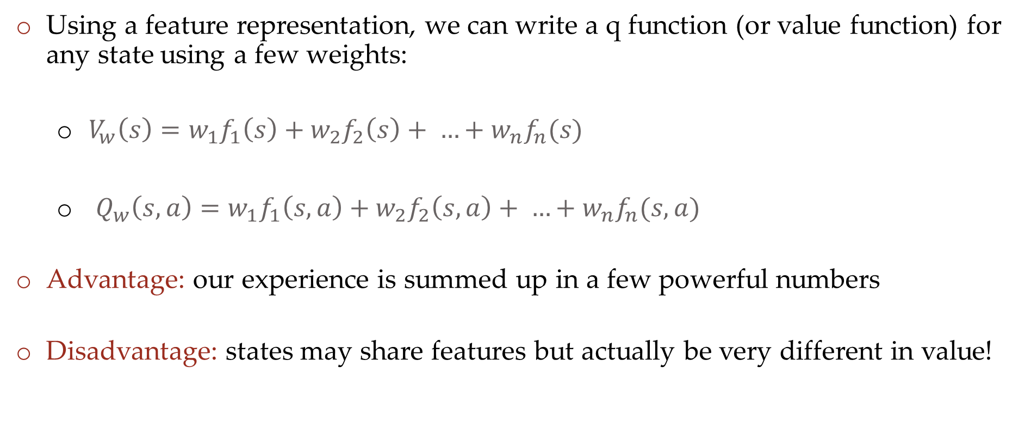
Linear value functions
Using a feature representation, we can write a q function (or value function) for any state using a few weights:
  $V_{w}\left(s\right)=w_{1}f_{1}\left(s\right)+w_{2}f_{2}\left(s\right)+ …+w_{n}f_{n}(s)$
  $Q_{w}\left(s,a\right)=w_{1}f_{1}\left(s,a\right)+w_{2}f_{2}\left(s,a\right)+ …+w_{n}f_{n}(s,a)$
Advantage: our experience is summed up in a few powerful numbers
Disadvantage: states may share features but actually be very different in value!

Slide 29
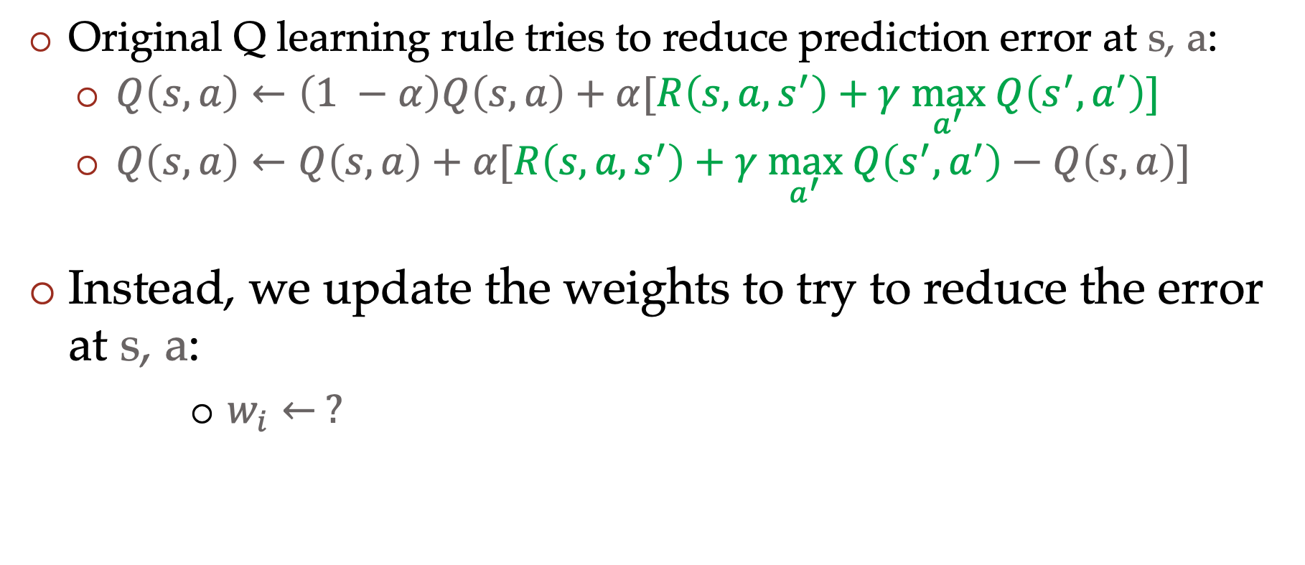
Updating a linear value function
Original Q learning rule tries to reduce prediction error at s, a:
    $Q\left(s,a\right)←\left(1 −α\right)Q\left(s,a\right)+α[R\left(s,a,s^{′}\right)+γ \max_{a^{′}} Q\left(s^{′},a^{′}\right)]$
    $Q\left(s,a\right)←Q\left(s,a\right)+α[R\left(s,a,s^{′}\right)+γ \max_{a^{′}} Q\left(s^{′},a^{′}\right)−Q\left(s,a\right)]$
Instead, we update the weights to try to reduce the error at s, a:
      $w_{i}← ?$

Slide 30
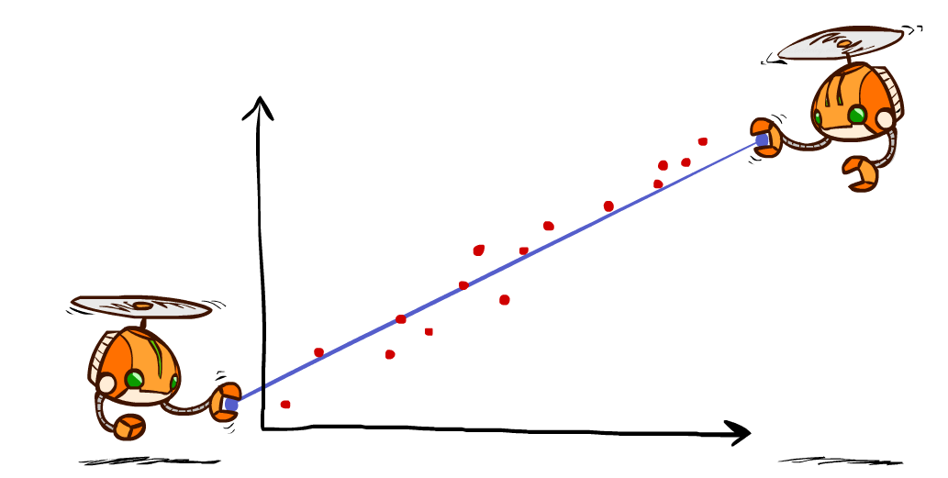
Detour: Minimizing Error and Least Squares
Notes:
DK :57 in, :17 to go

Slide 31

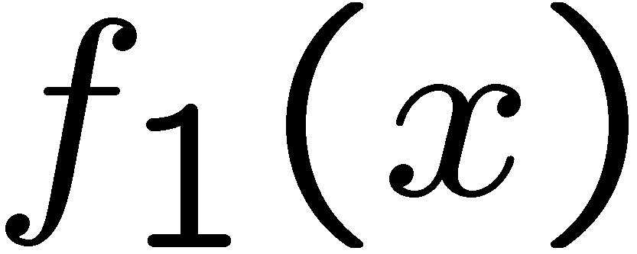
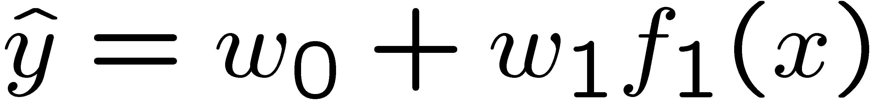
Linear Approximation: Regression
40
26
24
20
22
20
30
20
40
0
0
20
30
10
20
0
10
0
Prediction:
Prediction:
Notes:
Figure 1: scatter(1:20,10+(1:20)+2*randn(1,20),'k','filled'); a=axis; a(3)=0; axis(a);

Slide 32
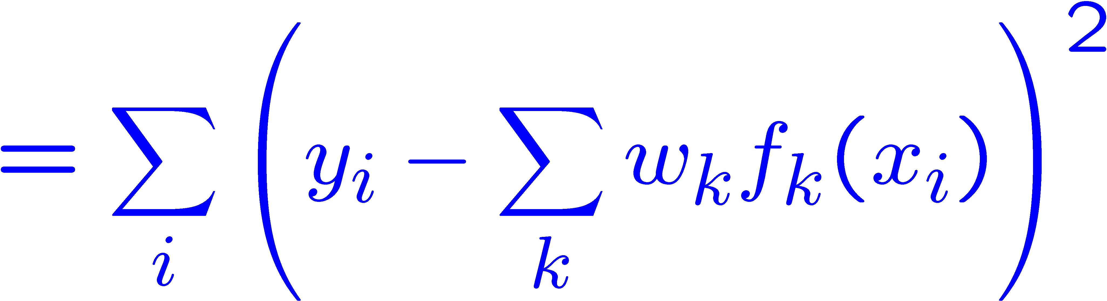
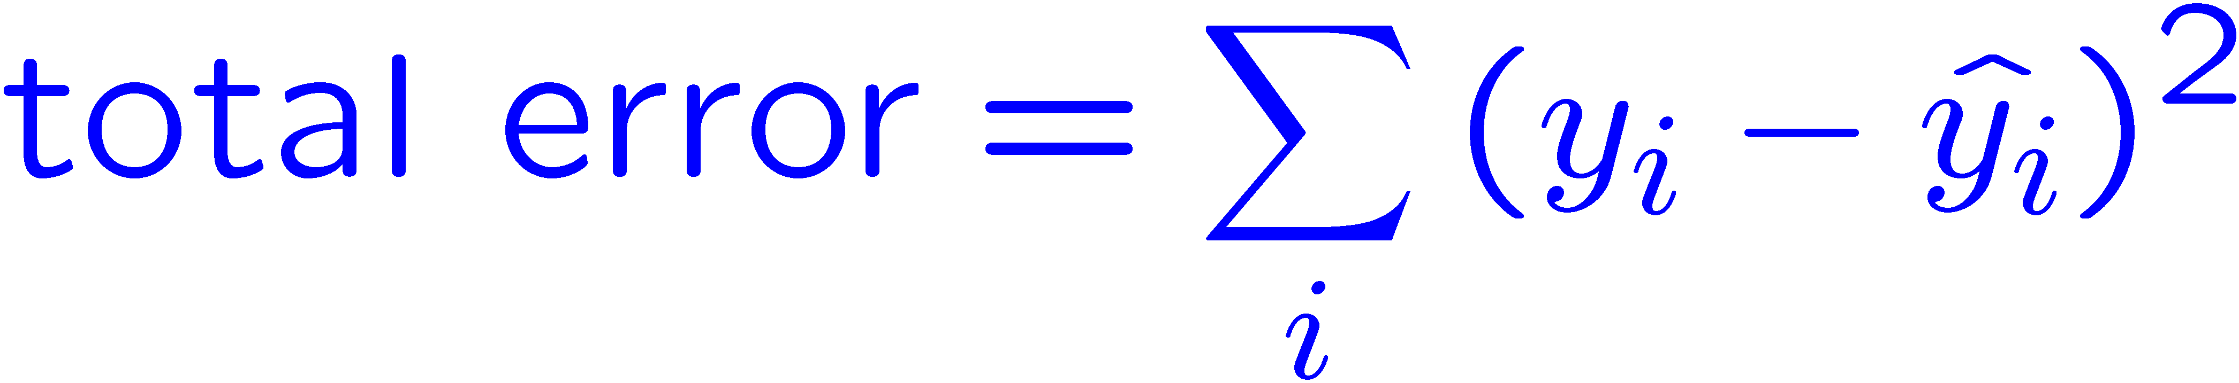
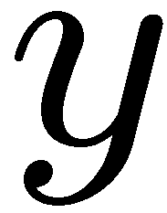


Optimization: Least Squares
Error or “residual”
Observation
Prediction
0
0
20
Notes:
Figure 1: scatter(1:20,10+(1:20)+2*randn(1,20),'k','filled'); a=axis; a(3)=0; axis(a);

Slide 33
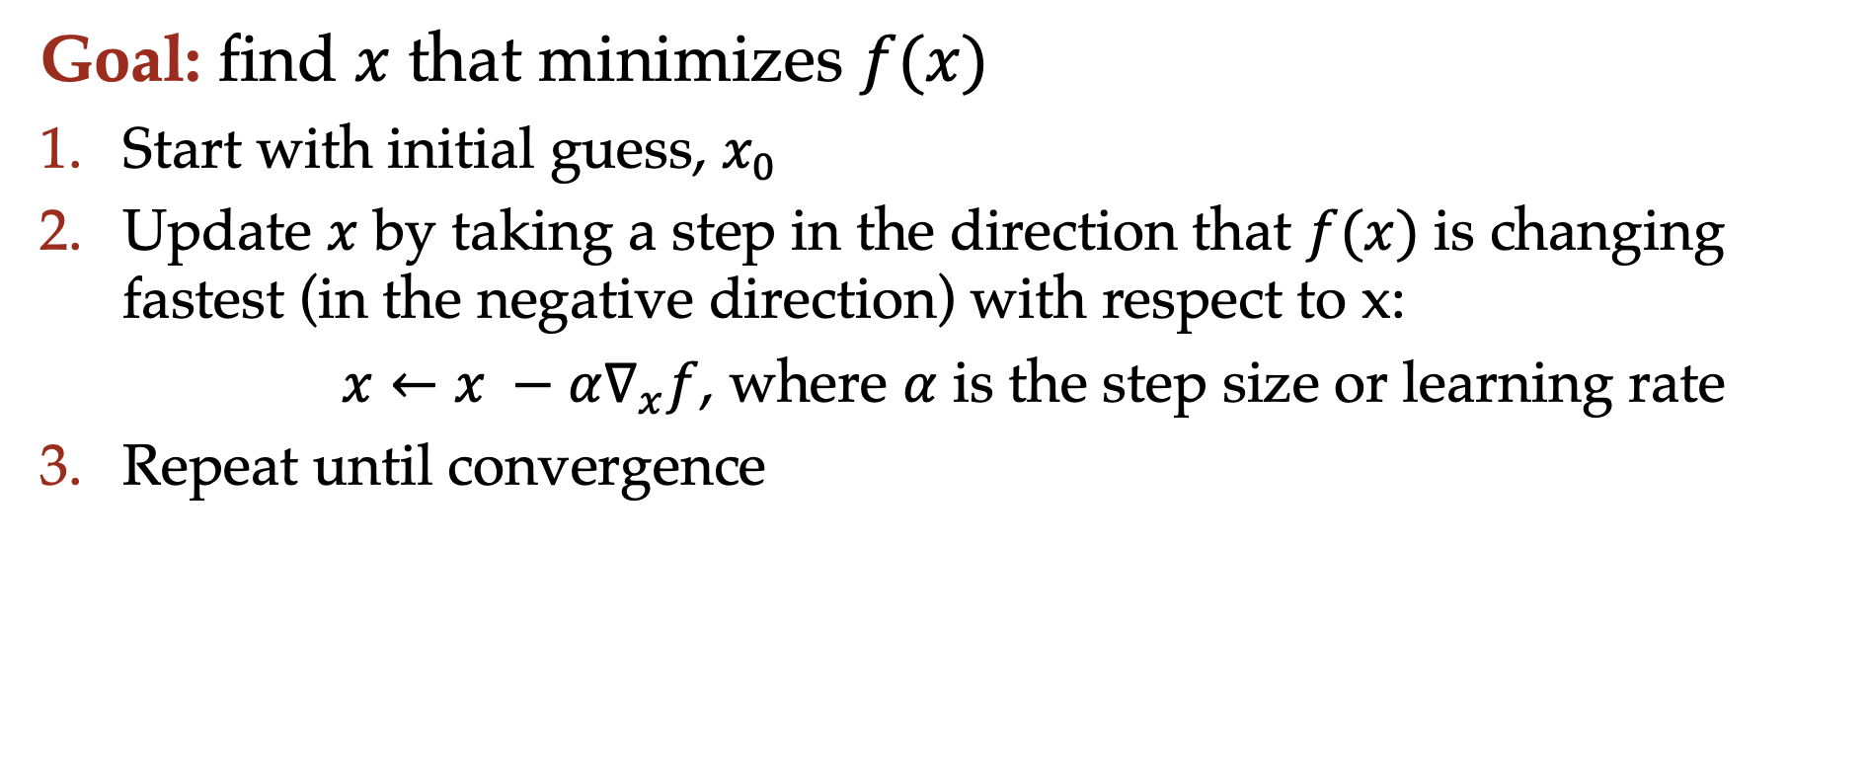
Gradient Descent
Goal: find $x$ that minimizes $f(x)$
Start with initial guess, $x_{0}$
Update $x$ by taking a step in the direction that $f(x)$ is changing fastest (in the negative direction) with respect to x:
$x←x −α∇_{x}f$, where $α$ is the step size or learning rate
Repeat until convergence

Slide 34
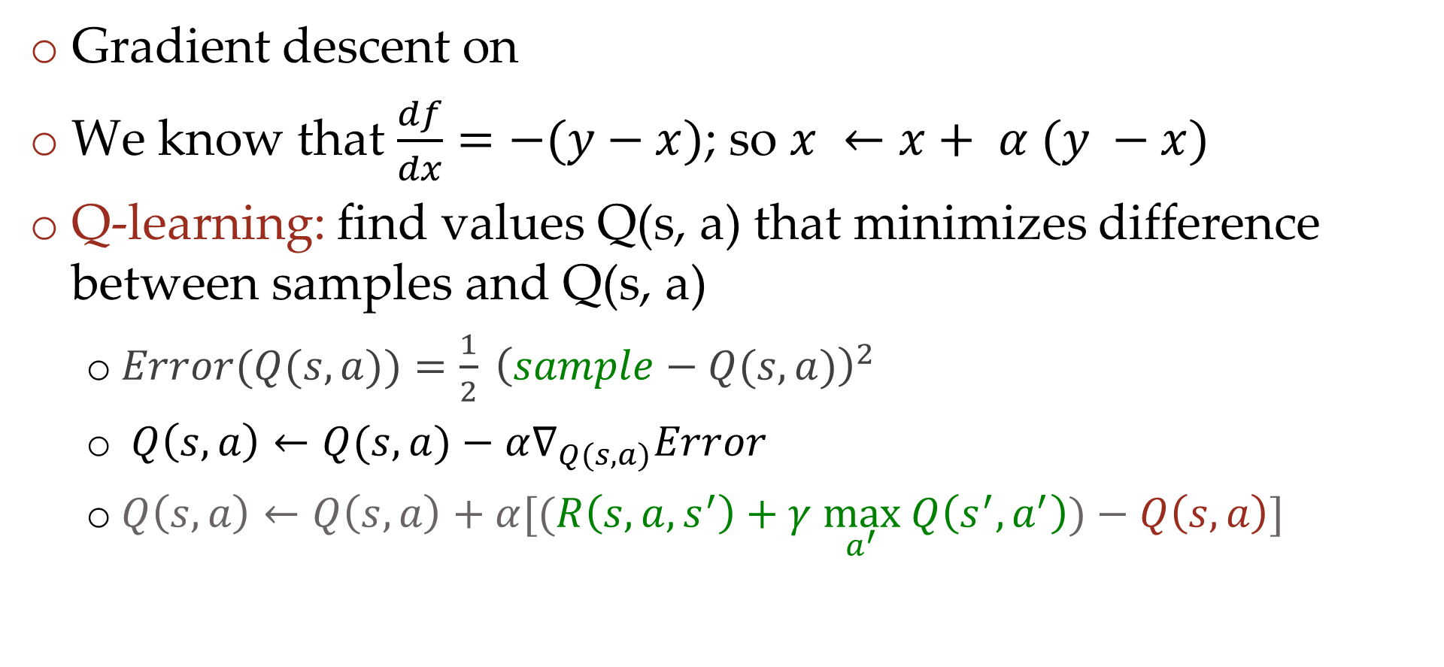

Gradient Descent and Q learning
$$f\left(x\right)=\frac{1}{2}{\left(y−x\right)}^{2}$$
Gradient descent on
We know that $\frac{df}{dx}=−(y−x)$; so $x ←x+ α (y −x)$
Q-learning: find values Q(s, a) that minimizes difference between samples and Q(s, a)
  $Error(Q(s, a))=\frac{1}{2} {\left(sample−Q(s, a)\right)}^{2}$
  $Q\left(s, a\right)←Q(s, a)−α∇_{Q(s, a)}Error$
  $Q\left(s,a\right)←Q\left(s,a\right)+α[(R\left(s,a,s^{′}\right)+γ \max_{a^{′}} Q\left(s^{′},a^{′}\right))−Q\left(s,a\right)]$
“target” (sample)
“prediction”

Slide 35
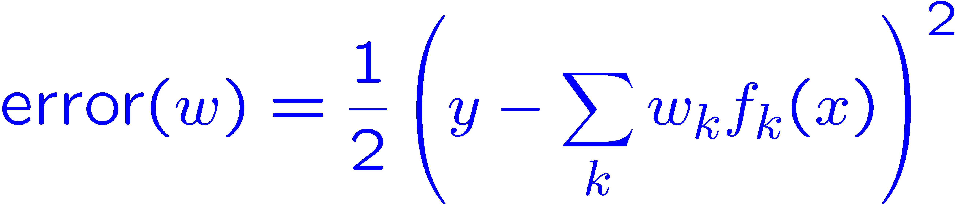
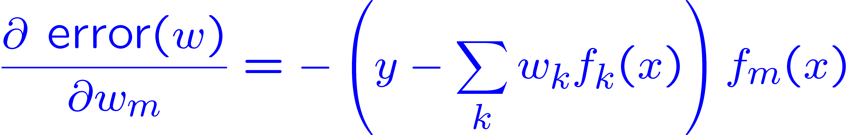
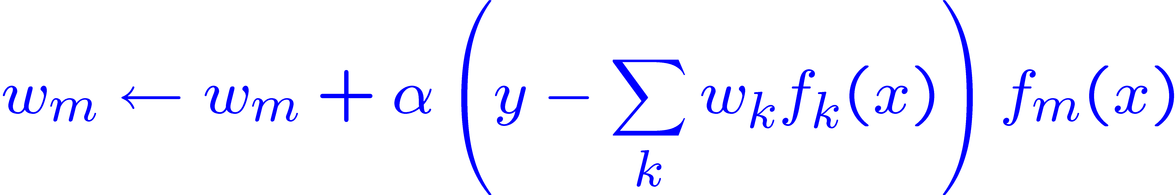
Approximate Q-learning and gradient descent
Imagine we had only one point x, with features f(x), target value y, and weights w:
Approximate Q-update:
“target” (sample)
“prediction”

Slide 36
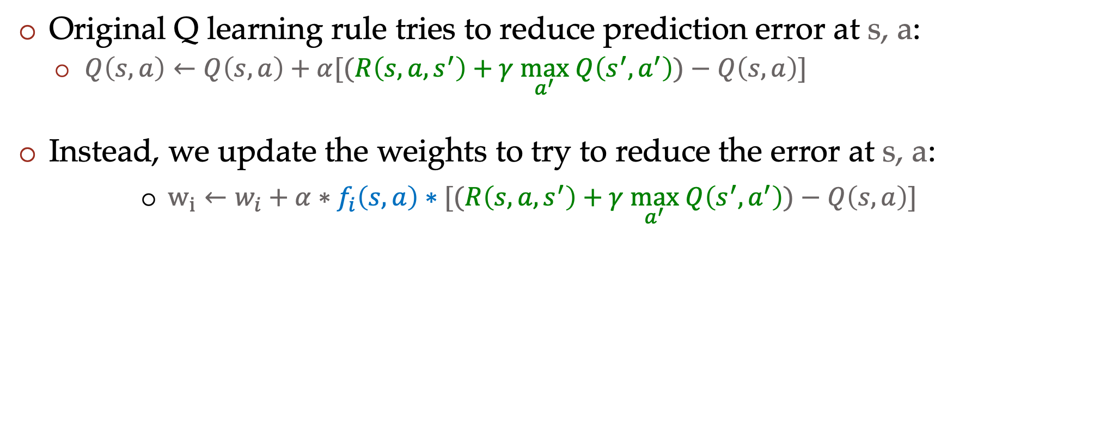
Updating a linear value function
Original Q learning rule tries to reduce prediction error at s, a:
    $Q\left(s,a\right)←Q\left(s,a\right)+α[(R\left(s,a,s^{′}\right)+γ \max_{a^{′}} Q\left(s^{′},a^{′}\right))−Q\left(s,a\right)]$
Instead, we update the weights to try to reduce the error at s, a:
      $w_{i}←w_{i}+α∗f_{i}\left(s,a\right)∗[(R\left(s,a,s^{′}\right)+γ \max_{a^{′}} Q\left(s^{′},a^{′}\right))−Q\left(s,a\right)]$

Slide 37
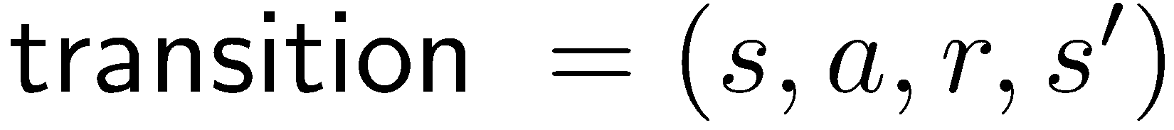

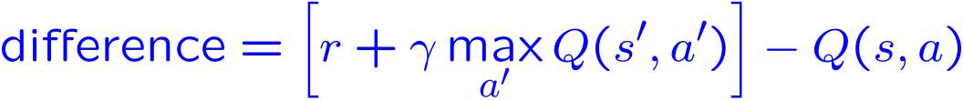
Approximate Q-Learning summary
Q-learning with linear Q-functions:
Intuitive interpretation:
  Adjust weights of active features
  E.g., if something unexpectedly bad happens, blame the features that were on: disprefer all states with that state’s features
Formal justification: online least squares
Exact Q’s
Approximate Q’s

Slide 38


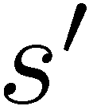

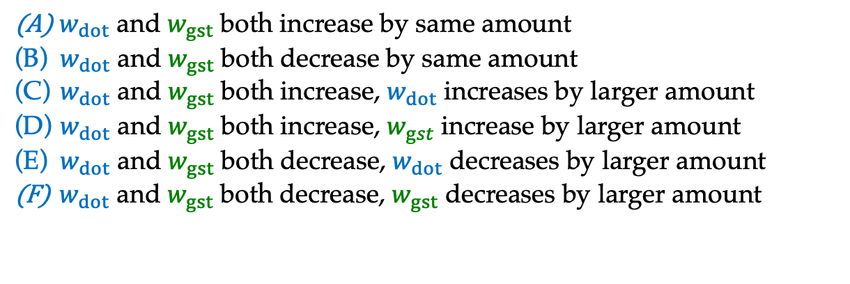
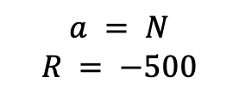

Poll: Pacman with approximate Q learning
Two features: $f_{dot}\left(s, a\right)$ and $f_{gst}\left(s, a\right)$ $α=0.004$
Current weights: $w_{dot}=4,w_{gst}=−1$
Q(s, N) = 4*0.5 + (-1)*1 = 1
$$f_{dot}\left(s, N\right)=0.5$$
$$a = N$$
$$R = −500$$
$$f_{gst}\left(s, N\right)=1.0$$
$w_{dot}$ and $w_{gst}$ both increase by same amount
$w_{dot}$ and $w_{gst}$ both decrease by same amount
$w_{dot}$ and $w_{gst}$ both increase, $w_{dot}$ increases by larger amount
$w_{dot}$ and $w_{gst}$ both increase, $w_{gst}$increase by larger amount
$w_{dot}$ and $w_{gst}$ both decrease, $w_{dot}$ decreases by larger amount
$w_{dot}$ and $w_{gst}$ both decrease, $w_{gst}$ decreases by larger amount

Slide 39

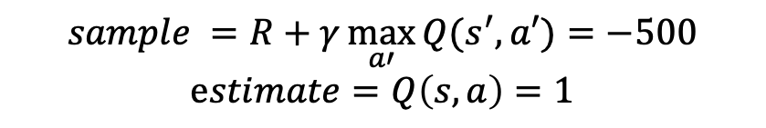
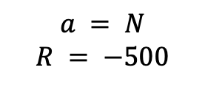
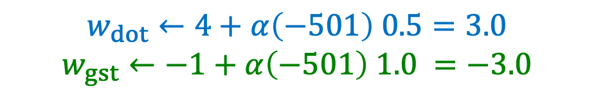
Poll: Pacman with approximate Q learning
Two features: $f_{dot}\left(s, a\right)$ and $f_{gst}\left(s, a\right)$ $α=0.004, γ=1.0$
Current weights: $w_{dot}=4,w_{gst}=−1$
$$Q\left(s’, a\right)= 0 ∀a$$
Q(s, N) = 4*0.5 + (-1)*1 = 1
$$f_{dot}\left(s, N\right)=0.5$$
$$a = N$$
$$R = −500$$
$$f_{gst}\left(s, N\right)=1.0$$
$$sample =R+γ\max_{a′}{Q(s^{′},a′)}=−500$$
$$estimate=Q\left(s, a\right)=1$$
$$w_{dot}←4+α\left(−501\right) 0.5=3.0$$
$$w_{gst}←−1+α\left(−501\right) 1.0 =−3.0$$

Slide 40
All equations we saw so far
$$V\left(s\right)=\max_{a}{\sum_{s′}{P\left(s^{′}\right|s,a)V(s^{′})}}$$
$$V^{∗}\left(s\right)=\max_{a}{\sum_{s′}{P\left(s^{′} | s,a\right)\left[R\left(s,a,s^{′}\right)+γV^{∗}\left(s^{′}\right)\right]}}$$
$$V_{k+1}\left(s\right)=\max_{a}{\sum_{s′}{P\left(s^{′} | s,a\right)\left[R\left(s,a,s^{′}\right)+γV_{k}\left(s^{′}\right)\right]}}, ∀ s$$
$$Q_{k+1}\left(s,a\right)=\sum_{s′}{P\left(s^{′} | s,a\right)[R\left(s,a,s^{′}\right)+γ\max_{a^{′}}{Q_{k}(s^{′},a^{′})]}, } ∀ s,a$$
$$π_{V}\left(s\right)=\underset{a}{argmax}{\sum_{s′}{P\left(s^{′} | s,a\right)[R\left(s,a,s^{′}\right)+γV\left(s^{′}\right)]}}, ∀ s$$
$$V_{k+1}^{π}\left(s\right)=\sum_{s′}{P\left(s^{′} | s,π\left(s\right)\right)[R\left(s,π\left(s\right),s^{′}\right)+γV_{k}^{π}\left(s^{′}\right)]}, ∀ s$$
$$π_{new}\left(s\right)=\underset{a}{argmax}{\sum_{s′}{P\left(s^{′} | s,a\right)\left[R\left(s,a,s^{′}\right)+γV^{π_{old}}\left(s^{′}\right)\right]}}, ∀ s$$
$$V^{π}\left(s\right) = V^{π}(s) +α \left[r+γ V^{π}\left(s^{′}\right)− V^{π}\left(s\right)\right]$$
$Q(s,a) = Q(s,a) +α[r+γ \max_{a^{′}} Q\left(s^{′},a^{′}\right)−Q\left(s, a\right)]$
Standard expectimax:
Bellman equations:
Value iteration:
Q-iteration:
Policy extraction:
Policy evaluation:
Policy improvement:
Value (TD) learning:
Q-learning:

Slide 41
Recent Reinforcement Learning Milestones

Slide 42
TDGammon
1992 by Gerald Tesauro
4-ply lookahead using V(s) trained from 1,500,000 games of self-play
3 hidden layers, ~100 units each
Input: contents of each location
plus several handcrafted features
Experimental results:
  Approximately as strong as world champion
  Led to radical changes in the way
  humans play backgammon

Slide 43
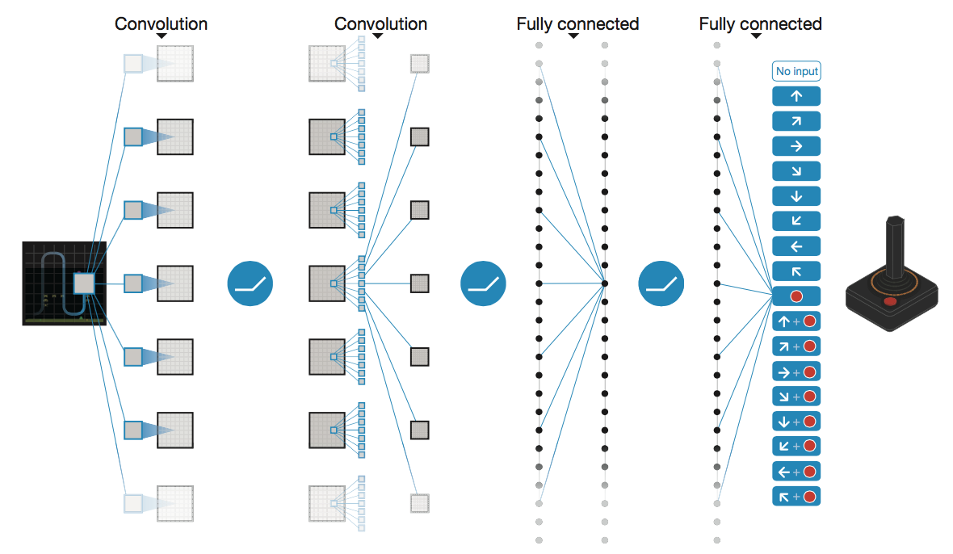
Deep Q-Networks
Deep Mind, 2015
Used a deep learning network to represent Q:
  Input is last 4 images (84x84 pixel values) plus score
49 Atari games, incl. Breakout, Space Invaders, Seaquest, Enduro
Image: Deep Mind

Slide 44
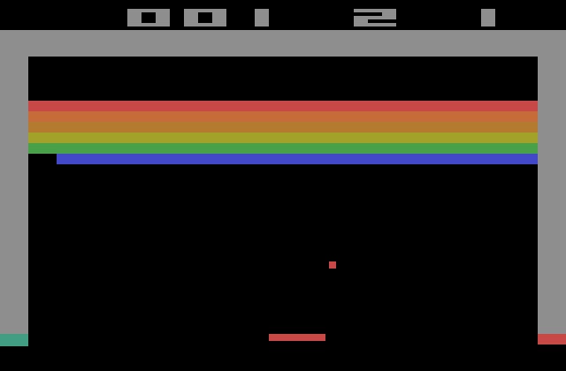
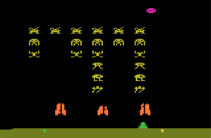
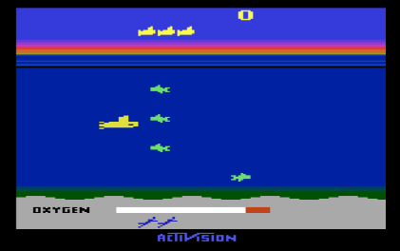
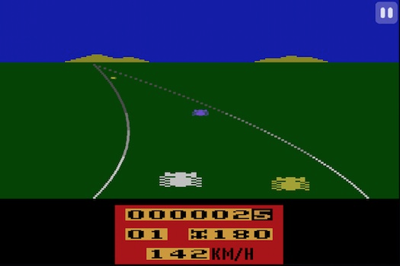
Images: Open AI, Atari

Slide 45

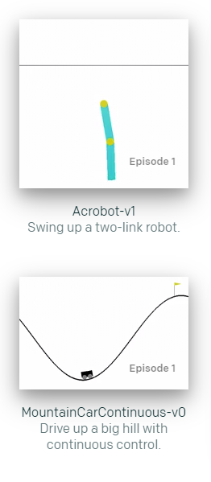


OpenAI Gym
2016+
Benchmark problems for learning agents
https://gym.openai.com/envs
Images: Open AI

Slide 46

AlphaGo, AlphaZero
Deep Mind, 2016+

Slide 47
Autonomous Vehicles?

