Slide 1
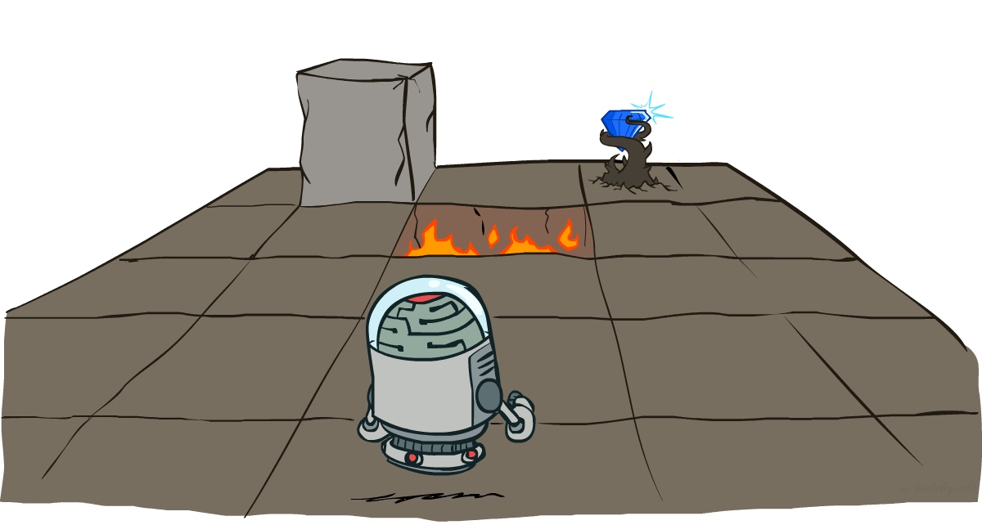
AI: Representation and Problem Solving
Markov Decision Processes
Instructors: Nihar Shah and Tuomas Sandholm
Slide credits: CMU AI and ai.berkeley.edu

Slide 2

The relationship between actions & consequences is not deterministic, but is stochastic (random)

Slide 3
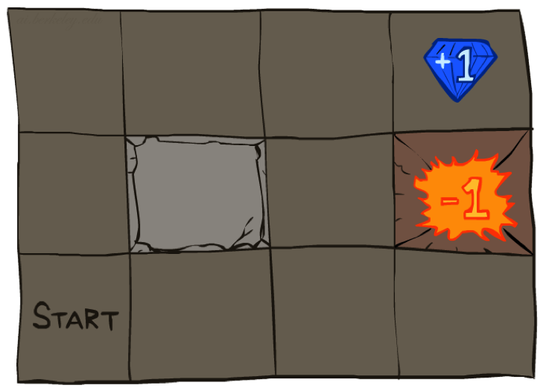




Example: Grid World
A maze-like problem
  The agent lives in a grid
  Walls block the agent’s path
Noisy movement: actions do not always go as planned
  80% of the time, the action North takes the agent North
  (if there is no wall there)
  10% of the time, North takes the agent West; 10% East
  If there is a wall in the direction the agent would have been taken, the agent stays put
The agent receives rewards each time step
  Reward depends on agent’s state and action
  Can be positive, zero or negative
Goal: maximize sum of rewards
Notes:
[cut demo of moving around in grid world program]

Slide 4
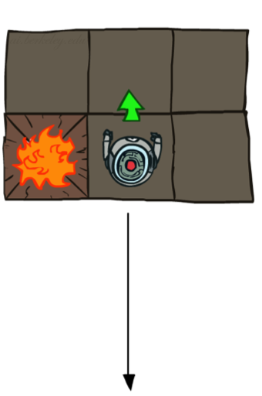
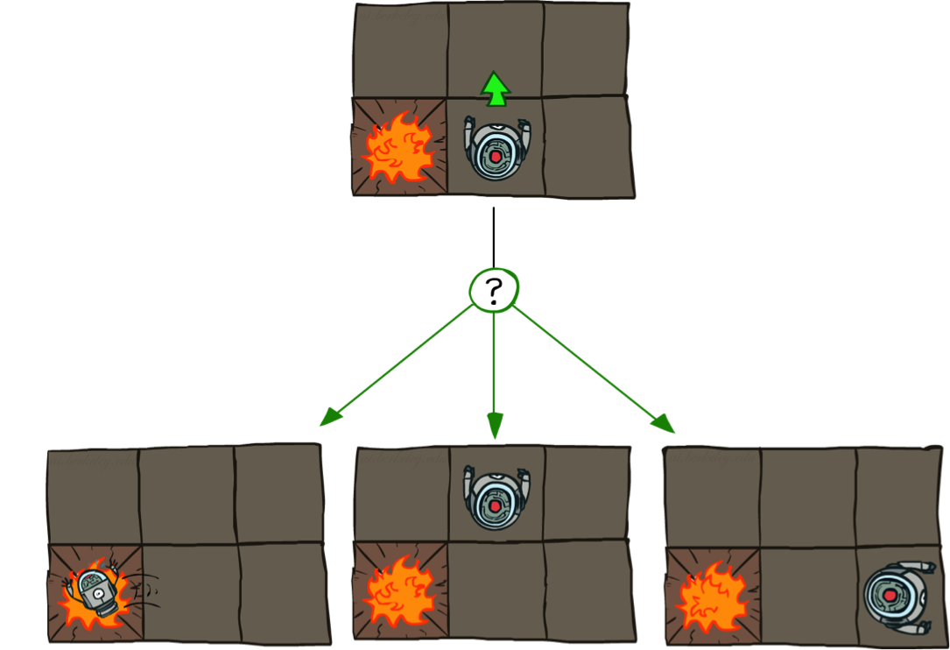
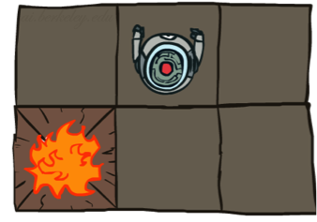
Grid World Actions
Deterministic Grid World
Stochastic Grid World

Slide 5
Markov Decision Processes
An MDP is defined by:
  A set of states s ∈ S
  A set of actions a ∈ A
  A transition function T(s, a, s’)
    Probability that a from s leads to s’, i.e., P(s’| s, a)
  A reward function R(s, a, s’)
  All of this information is known beforehand
Notes:
In search problems: did not talk about actions, but about successor functions --- now the information inside the successor function is unpacked into actions, transitions and reward
Write out S, A, example entry in T, entry in R
Reward function different from the book : R(s,a,s’)
In book simpler for equations, but not useful for the projects.
Need to modify expectimax a tiny little bit to account for rewards along the way, but that’s something you should be able to do, and so you can already solve MDP’s (not in most efficient way)

Slide 6
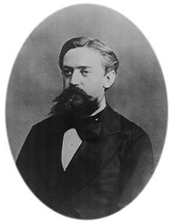

What is Markov about MDPs?
“Markov” generally means that given the present state, the future and the past are independent
For Markov decision processes, “Markov” means action outcomes depend only on the current state
Andrey Markov (1856-1922)
Notes:
Like search: successor function only depended on current state
Can make this happen by stuffing more into the state;
Very similar to search problems: when solving a maze with food pellets, we stored which food pellets were eaten

Slide 7
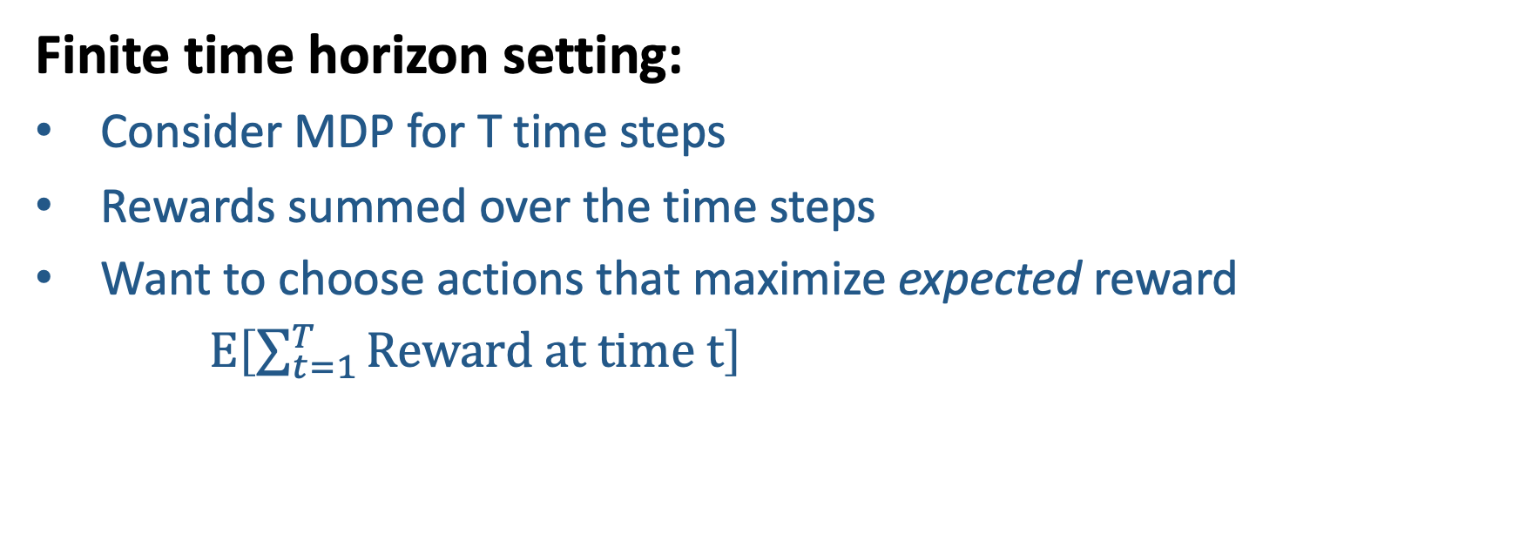
Goal: Maximize sum of rewards
Finite time horizon setting:
Consider MDP for T time steps
Rewards summed over the time steps
Want to choose actions that maximize expected reward
$E\left[\sum_{t=1}^{T}{Reward at time t}\right]$

Slide 8
Markov Decision Processes
What actions will yield the highest expected reward?
Suppose you choose the action “up”. Then suppose:
There is an 80% chance you go up, and get a reward of +2
There is a 10% chance you go left, and get a reward of -1
There is a 10% chance you go right, and get a reward of -1
The expected reward in this step under this action is 0.8*(+2) + 0.1*(-1) + 0.1*(-1) = 1.4
Want to choose actions that maximize total reward across
many time steps (not just in the current time step)
Notes:
In search problems: did not talk about actions, but about successor functions --- now the information inside the successor function is unpacked into actions, transitions and reward
Write out S, A, example entry in T, entry in R
Reward function different from the book : R(s,a,s’)
In book simpler for equations, but not useful for the projects.
Need to modify expectimax a tiny little bit to account for rewards along the way, but that’s something you should be able to do, and so you can already solve MDP’s (not in most efficient way)

Slide 9
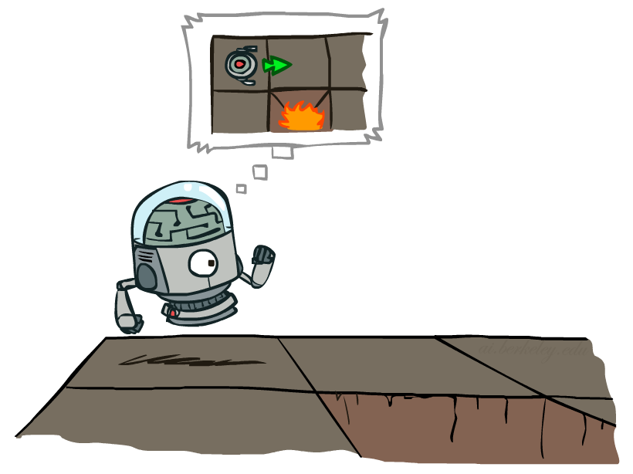
MDP Search Trees
s is a state
s
a
s, a
R(s,a,s’)
Transition: T(s,a,s’) = P(s’|s,a)
s’
Notes:
In MDP chance node represents uncertainty about what might happen based on (s,a) [as opposed to being a random adversary]
Q-state (s,a) is when you were in a state and took an action

Slide 10

Policies
In deterministic single-agent search problems, we wanted an optimal plan, or sequence of actions, from start to a goal
For MDPs, we want an optimal policy
  A policy π gives an action for each state
  An optimal policy is one that maximizes expected utility if followed
Notes:
Dan has a DEMO for this.

Slide 11
Solution method 1: Expectimax search

Slide 12
Suppose the MDP has only 1 state and will run only for 1 time step. If you were to take Left, what is the expected reward?
A) 12
B) 8
C) 7
D) 4
Left
Right
Center
1/4
1/2
1/2
1/2
1/3
2/3
1/4
12
8
4
8
6
12
6

Slide 13
Suppose the MDP has only 1 state and will run only for 1 time step. If you were to take Center, what is the expected reward?
A) 12
B) 8
C) 7
D) 4
Left
Right
Center
1/4
1/2
1/2
1/2
1/3
2/3
1/4
12
8
4
8
6
12
6

Slide 14
Suppose the MDP has only 1 state and will run only for 1 time step. If you were to take Right, what is the expected reward?
A) 12
B) 8
C) 7
D) 4
Left
Right
Center
1/4
1/2
1/2
1/2
1/3
2/3
1/4
12
8
4
8
6
12
6

Slide 15
Suppose the MDP has only 1 state and will run only for 1 time step. Which action should we choose?
A) Left
B) Center
C) Right
D) Cannot determine
Left
Right
Center
1/4
1/2
1/2
1/2
1/3
2/3
1/4
12
8
4
8
6
12
6

Slide 16
Solution method 1: Expectimax search
Starting from the start state, expand the tree to depth k, for some chosen k
    Previous example was for depth 1
    Here is an example for depth 2…

Slide 17
Left
Right
1/2
1/2
1
12
4
10
Left
Right
Left
Right
Left
Right
1/2
1
1
1
1
1
1/2
14
9
4
9
12
4
10

Slide 18
Solution method 1: Expectimax search
Starting from the start state, expand the tree to depth k, for some chosen k
Move up the tree, recursively computing the reward obtained
  Compute expectations at nodes and max at nodes

Slide 19
Left
Right
19.5
18
1/2
1/2
1
12
4
9
9
14
9
4
9
Left
14
9
Left
9
Right
Right
8
Left
Right
1/2
1
1
1
1
1
1/2
14
9
4
9
12
4
9

Slide 20
function EXPECTIMAX(node, depth):
if depth = 0:
return 0
if node is a MAX node (denoted as s):
value = -∞
for each possible action a:
value = max(value, EXPECTIMAX( (s,a) , depth - 1))
return value
else if node is an EXPECTATION node (denoted as (s,a)):
value = 0
for each child of node s’, with probability given by the transition T(s,a,s’):
value += T(s,a,s’) * (R(s,a,s’) + EXPECTIMAX(s’, depth))
return value

Slide 21
Goal: Maximize sum of rewards
Finite time horizon setting:
Consider MDP for T time steps
Rewards summed over the time steps
Want to choose actions that maximize expected reward
$E\left[\sum_{t=1}^{T}{Reward at time t}\right]$
?
Will the optimal choice of actions depend on time?
If you are in a state s at time 1 versus in the state s at time 10, can the optimal action be different?

Slide 22
same state
Left
Right
1/2
1/2
1
12
4
10
Left
Right
Left
Right
Left
Right
1/2
1
1
1
1
1
1/2
14
9
4
9
12
4
10

Slide 23
same state
Left
Right
19.5
18
1/2
1/2
1
12
4
9
9
14
9
different optimal actions
4
9
Left
14
9
Left
9
Right
Right
8
Left
Right
1/2
1
1
1
1
1
1/2
14
9
4
9
12
4
9

Slide 24
Goal: Maximize sum of rewards
Finite time horizon setting:
Consider MDP for T time steps
Rewards summed over the time steps
Want to choose actions that maximize expected reward
$E\left[\sum_{t=1}^{T}{Reward at time t}\right]$
?
Will the optimal choice of actions depend on time?
If you are in a state s at time 1 versus in the state s at time 10, can the optimal action be different?
YES

Slide 25
Goal: Maximize sum of rewards
Finite time horizon setting:
Consider MDP for T time steps
Rewards summed over the time steps
Want to choose actions that maximize expected reward
$E\left[\sum_{t=1}^{T}{Reward at time t}\right]$
Challenges
Optimal action depends on time step
Need to compute it separately for each time step…
  Computational cost + headache
May not know horizon T in advance

Slide 26
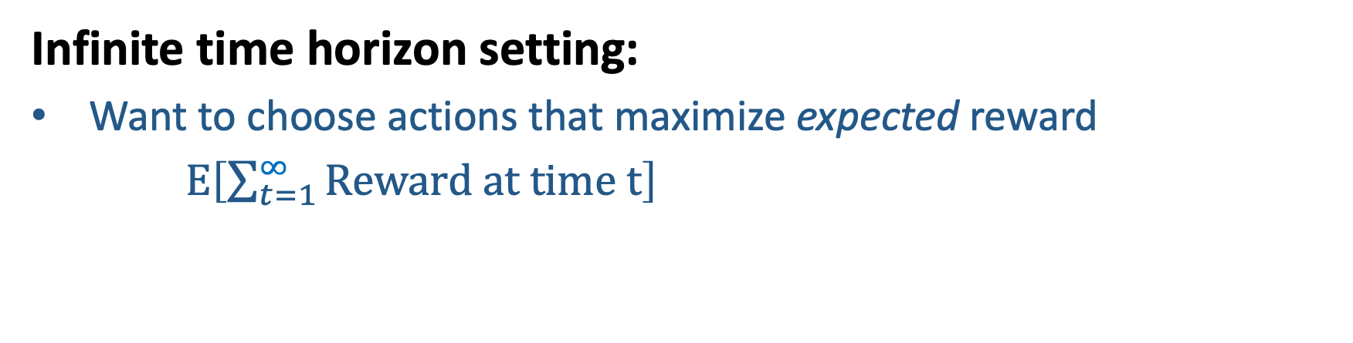
Goal: Maximize sum of rewards
Infinite time horizon setting:
Want to choose actions that maximize expected reward
$E\left[\sum_{t=1}^{∞}{Reward at time t}\right]$

Slide 27

Goal: Maximize sum of rewards
Infinite time horizon setting:
Want to choose actions that maximize expected reward
$E\left[\sum_{t=1}^{∞}{Reward at time t}\right]$
Challenge
This can be infinite for many choices of actions…
Infinity vs. infinity?

Slide 28

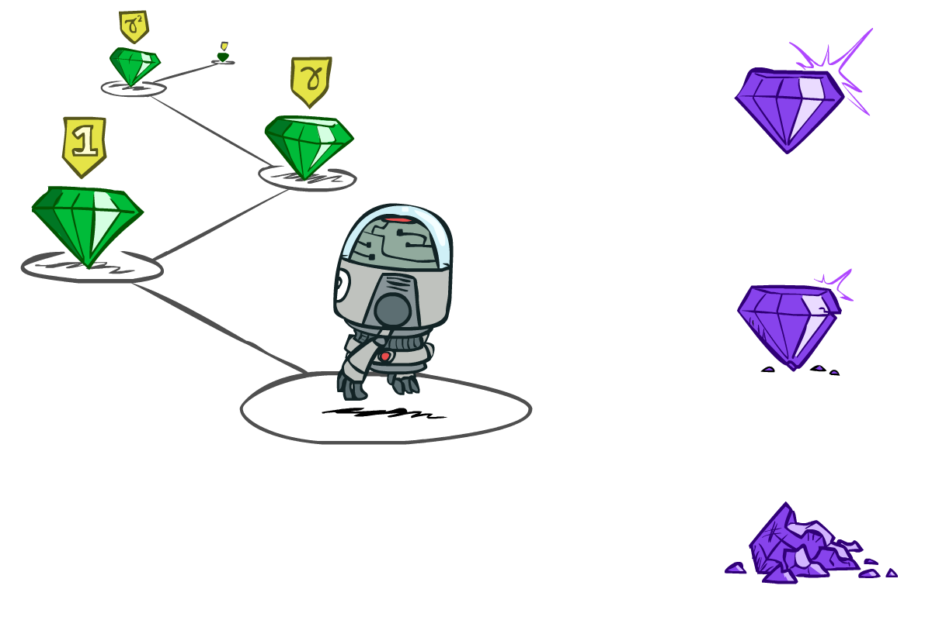

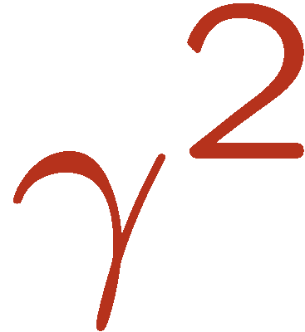

Discounting
It’s reasonable to maximize the sum of rewards
It’s also reasonable to prefer rewards now to rewards later
One solution: values of rewards decay exponentially
Worth Now
Worth Next Step
Worth In Two Steps

Slide 29
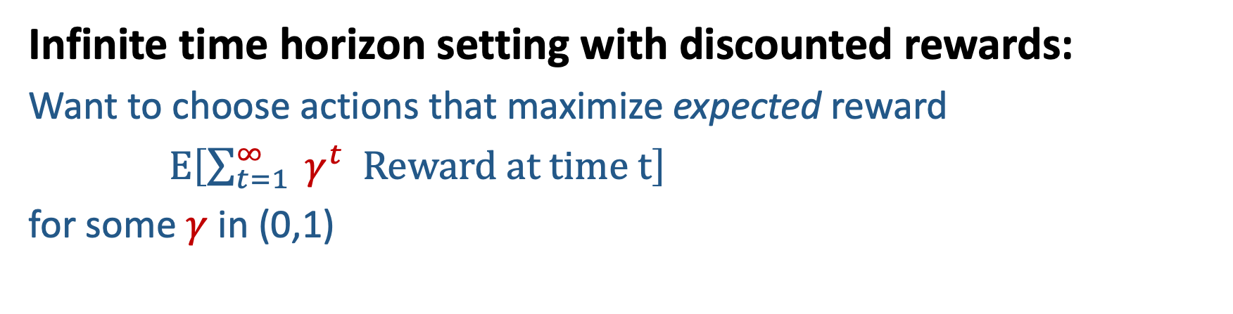
Goal: Maximize sum of rewards
Infinite time horizon setting with discounted rewards:
Want to choose actions that maximize expected reward
$E\left[\sum_{t=1}^{∞}{ γ^{t} Reward at time t}\right]$
for some $γ$ in (0,1)
If you are in some state s at some time t₁
versus
if you are in that state s at some time t₂
Does the optimal action need to differ?

Slide 30
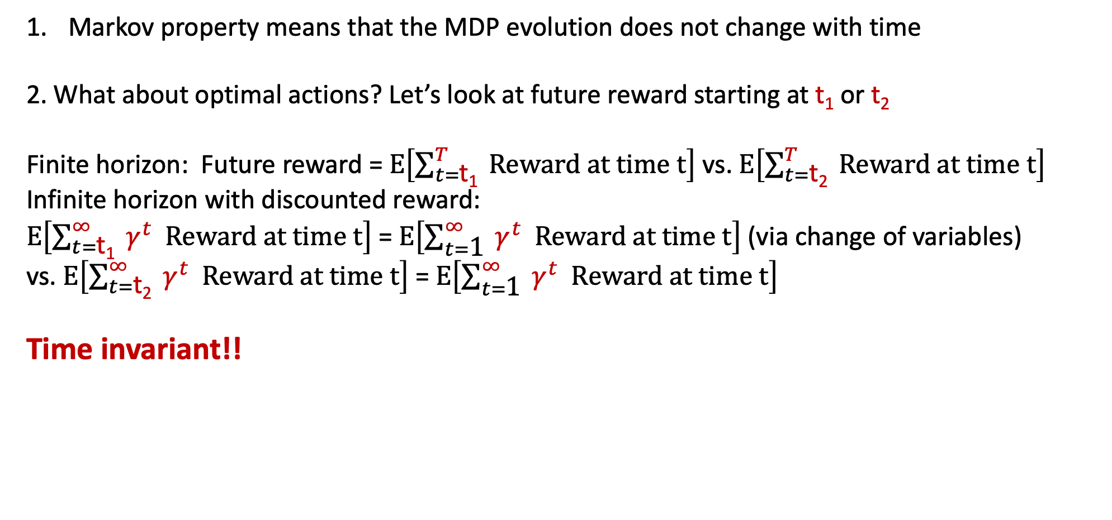
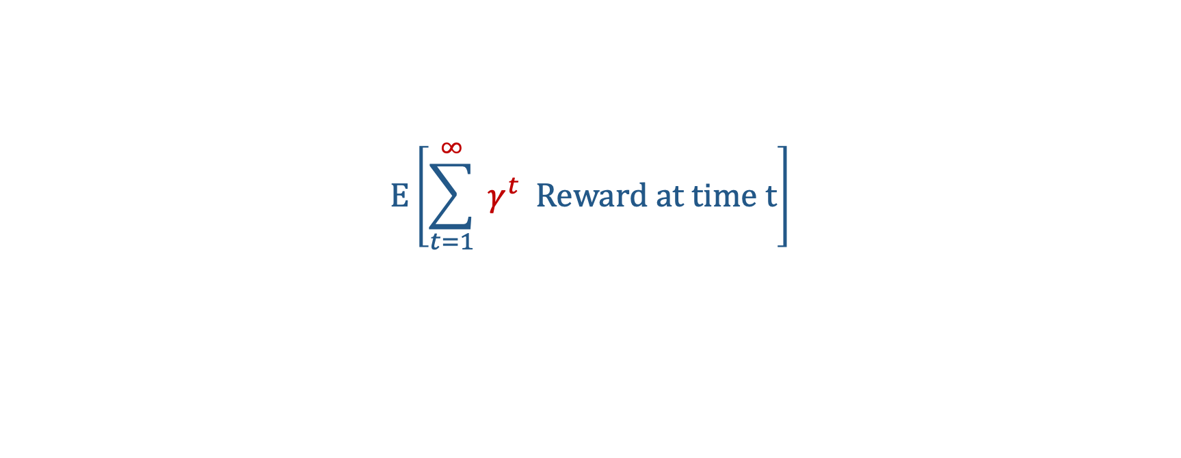
Goal: Maximize sum of rewards
$$E\left[\sum_{t=1}^{∞}{ γ^{t} Reward at time t}\right]$$
Does the optimal action need to differ with time?
Markov property means that the MDP evolution does not change with time
2. What about optimal actions? Let’s look at future reward starting at $\text{t}\text{1}$ or $\text{t}\text{2}$
Finite horizon: Future reward = $E\left[\sum_{t=\text{t}\text{1}}^{T}{ Reward at time t}\right]$ vs. $E\left[\sum_{t=\text{t}\text{2}}^{T}{ Reward at time t}\right]$
Infinite horizon with discounted reward:
$E\left[\sum_{t=\text{t}\text{1}}^{∞}{ γ^{t} Reward at time t}\right]$ = $E\left[\sum_{t=\text{1}}^{∞}{ γ^{t} Reward at time t}\right]$ (via change of variables)
vs. $E\left[\sum_{t=\text{t}\text{2}}^{∞}{ γ^{t} Reward at time t}\right]$ = $E\left[\sum_{t=\text{1}}^{∞}{ γ^{t} Reward at time t}\right]$
Time invariant!!

Slide 31
Policies
In deterministic single-agent search problems, we wanted an optimal plan, or sequence of actions, from start to a goal
For MDPs, we want an optimal policy
  A policy π gives an action for each state
  An optimal policy is one that maximizes expected utility if followed
  Action depends only on the state you are in, and not on when
  Policy π:S→A
Notes:
Dan has a DEMO for this.

Slide 32
Solution method 2: Value iteration

Slide 33
Optimal Quantities
s is a state
s
a
The value (utility) of a state s:
  V*(s) = expected total reward starting in s and acting optimally
The value (utility) of a q-state (s,a):
  Q*(s,a) = expected total reward starting out having taken action a from state s and (thereafter) acting optimally
The optimal policy:
  π*(s) = optimal action from state s
(s, a) is a q-state
s, a
s,a,s’
(s,a,s’) is a
transition
s’
Notes:
* Is optimality

Slide 34
Optimal Quantities
Bellman equations
The value (utility) of a state s:
  V*(s) = expected total reward starting in s and acting optimally
The value (utility) of a q-state (s,a):
  Q*(s,a) = expected total reward starting out having taken action a from state s and (thereafter) acting optimally
The optimal policy:
  π*(s) = optimal action from state s
for every state s
Notes:
* Is optimality

Slide 35

Optimal Quantities
Question: If you have Q*, how to get V*?
The value (utility) of a state s:
  V*(s) = expected total reward starting in s and acting optimally
The value (utility) of a q-state (s,a):
  Q*(s,a) = expected total reward starting out having taken action a from state s and (thereafter) acting optimally
The optimal policy:
  π*(s) = optimal action from state s
Notes:
* Is optimality

Slide 36
Optimal Quantities
Question: If you have Q*, how to get π*?
The value (utility) of a state s:
  V*(s) = expected total reward starting in s and acting optimally
The value (utility) of a q-state (s,a):
  Q*(s,a) = expected total reward starting out having taken action a from state s and (thereafter) acting optimally
The optimal policy:
  π*(s) = optimal action from state s
π*(s) = arg
Notes:
* Is optimality

Slide 37
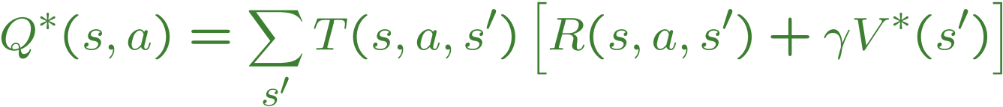
Optimal Quantities
Question: If you have V*, how to get Q*?
The value (utility) of a state s:
  V*(s) = expected total reward starting in s and acting optimally
The value (utility) of a q-state (s,a):
  Q*(s,a) = expected total reward starting out having taken action a from state s and (thereafter) acting optimally
The optimal policy:
  π*(s) = optimal action from state s
Notes:
* Is optimality

Slide 38
Optimal Quantities
Question: If you have V*, how to get π*?
The value (utility) of a state s:
  V*(s) = expected total reward starting in s and acting optimally
The value (utility) of a q-state (s,a):
  Q*(s,a) = expected total reward starting out having taken action a from state s and (thereafter) acting optimally
The optimal policy:
  π*(s) = optimal action from state s
π*(s) = arg
“Policy extraction”
Notes:
* Is optimality

Slide 39
Solution method 2: Value iteration
If we can estimate V*, we can find the optimal policy
Key idea:
Initialize V* (either a guess or set it to 0)
Keep updating the guess using the equation above
Notes:
Discuss computational complexity: S * A * S times number of iterations
Note: updates not in place [if in place, it means something else and not even clear what it means]

Slide 40
Solution method 2: Value iteration
Start with initial guess of the value function V, e.g., V(s) = 0 for all s
Given vector of V(s) values, do one iteration of expectimax for each state:
Repeat
Notes:
Discuss computational complexity: S * A * S times number of iterations
Note: updates not in place [if in place, it means something else and not even clear what it means]

Slide 41
Solution method 2: Value iteration
Example on the board

Slide 42
Solution method 2: Value iteration
Start with initial guess of the value function V, e.g., V(s) = 0 for all s
Given vector of V(s) values, do one iteration of expectimax for each state:
Repeat
Complexity of each iteration:
O(S²A)
Theorem: will converge to unique optimal values
Notes:
Discuss computational complexity: S * A * S times number of iterations
Note: updates not in place [if in place, it means something else and not even clear what it means]

Slide 43
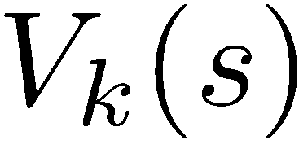
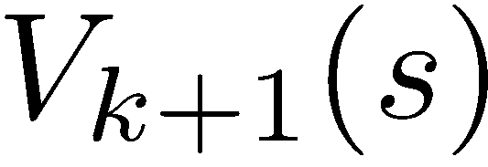
Convergence
How do we know the V_{k} vectors are going to converge?
  Proof sketch: Suppose rewards are bounded in [R_{MIN} , R_{MAX} ]
  For any state V_{k} and V_{k+1} can be viewed as depth k+1 expectimax results in nearly identical search trees
  The difference is that on the bottom layer, V_{k+1} has actual rewards while V_{k} has zeros
  That last layer is at best all R_{MAX}
  It is at worst R_{MIN}
  But everything is discounted by γ^{k} that far out
  So V_{k} and V_{k+1} are at most γ^{k} max|R| different
  So as k increases, the values converge

