Slide 1
Warm-up:
What is the relationship between number of constraints and number of possible solutions?
In other words, as the number of the constraints increases,
does the number of possible solutions:
Increase
Decrease
Stay the same

Slide 2

Announcements
Assignments:
HW5 (written)
    Out Today, Due Tues 2/28, 10 pm
P2: Optimization
    Due Thurs 2/23, 10 pm
P3: Logic and Classical Planning
    Out Thursday
    FIRST HALF!! Due Friday 3/3, 10 pm before spring break
    ALL!! Due Friday 3/17, 10 pm Friday after spring break
    Grading

Slide 3
Announcements
Midterm 1 Exam
How did it go?
Canvas
Grades synced up to Midterm 1
Reach out with questions, comments, concerns

Slide 4

AI: Representation and Problem Solving
Propositional Logic and Logical Agents
Instructor: Stephanie Rosenthal
Slide credits: CMU AI, http://ai.berkeley.edu

Slide 5
Logical Agents
Logical agents and environments
Agent
Environment
Percepts
Sensors
Knowledge Base
Inference
?
Actions
Actuators

Slide 6
Logical Agents
So what do we TELL our knowledge base (KB)?
  Facts (sentences)
      The grass is green
      The sky is blue
  Rules (sentences)
      Eating too much candy makes you sick
      When you’re sick you don’t go to school
  Percepts and Actions (sentences)
      Stephanie ate too much candy today
What happens when we ASK the agent?
  Inference – new sentences created from old
      Stephanie is not going to school today

Slide 7

Models
How do we represent possible worlds with models and knowledge bases?
How do we then do inference with these representations?

Slide 8

Logic Language
Natural language?
Propositional logic
  Syntax: P ∨ (¬Q ∧ R); X₁ ⇔ (Raining ⇒ Sunny)
  Possible world: {P=true, Q=true, R=false, S=true} or 1101
  Semantics: α ∧ β is true in a world iff is α true and β is true (etc.)
First-order logic
  Syntax: ∀x ∃y P(x,y) ∧ ¬Q(Joe,f(x)) ⇒ f(x)=f(y)
  Possible world: Objects o₁, o₂, o₃; P holds for <o₁,o₂>; Q holds for <o₃>; f(o₁)=o₁; Joe=o₃; etc.
  Semantics: φ(σ) is true in a world if σ=o_{j} and φ holds for o_{j}; etc.

Slide 9
Propositional Logic

Slide 10
Propositional Logic
Symbol:
Variables that can be true or false
We’ll try to use capital letters, e.g. A, B, P_{1,2}
Often include True and False
Operators:
¬ A: not A
A ∧ B: A and B (conjunction)
A ∨ B: A or B (disjunction) Note: this is not an “exclusive or”
A ⇒ B: A implies B (implication). If A then B
A ⇔ B: A if and only if B (biconditional)
Sentences

Slide 11
Propositional Logic Syntax
Given: a set of proposition symbols {X₁, X₂, …, X_{n}}
    (we often add True and False for convenience)
X_{i} is a sentence
If α is a sentence then ¬α is a sentence
If α and β are sentences then α ∧ β is a sentence
If α and β are sentences then α ∨ β is a sentence
If α and β are sentences then α ⇒ β is a sentence
If α and β are sentences then α ⇔ β is a sentence
And p.s. there are no other sentences!

Slide 12
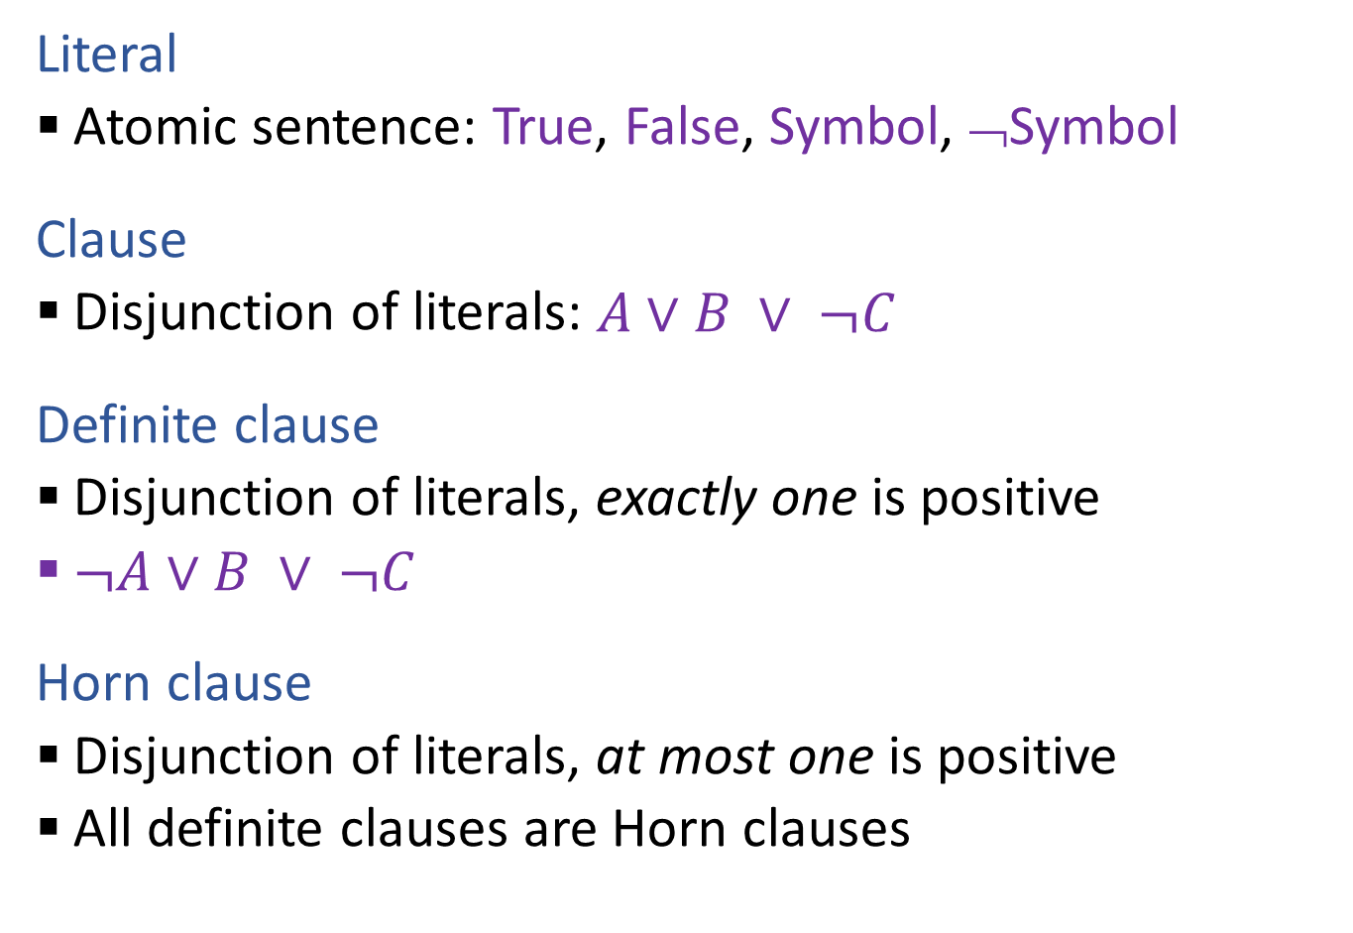
Propositional Logical Vocab
Literal
  Atomic sentence: True, False, Symbol, ¬Symbol
Clause
  Disjunction of literals: $A∨B ∨ ¬C$
Definite clause
  Disjunction of literals, exactly one is positive
  $¬A∨B ∨ ¬C$
Horn clause
  Disjunction of literals, at most one is positive
  All definite clauses are Horn clauses
Vocab Alert!

Slide 13
Notes on Operators
𝛂 ∨ 𝛃 is inclusive or, not exclusive

Slide 14
Truth Tables
𝛂 ∨ 𝛃 is inclusive or, not exclusive
𝛂 | 𝛃 | 𝛂 ∧ 𝛃
F | F | F
F | T | F
T | F | F
T | T | T
𝛂 | 𝛃 | 𝛂 ∨ 𝛃
F | F | F
F | T | T
T | F | T
T | T | T

Slide 15
Notes on Operators
𝛂 ∨ 𝛃 is inclusive or, not exclusive
𝛂 ⇒ 𝛃 is equivalent to ¬𝛂 ∨ 𝛃
Says who?

Slide 16
Truth Tables
𝛂 ⇒ 𝛃 is equivalent to ¬𝛂 ∨ 𝛃
𝛂 | 𝛃 | 𝛂 ⇒ 𝛃 | ¬𝛂 | ¬𝛂 ∨ 𝛃
F | F | T | T | T
F | T | T | T | T
T | F | F | F | F
T | T | T | F | T

Slide 17
Notes on Operators
𝛂 ∨ 𝛃 is inclusive or, not exclusive
𝛂 ⇒ 𝛃 is equivalent to ¬𝛂 ∨ 𝛃
Says who?
𝛂 ⇔ 𝛃 is equivalent to (𝛂 ⇒ 𝛃) ∧ (𝛃 ⇒ 𝛂)
Prove it!

Slide 18
Truth Tables
𝛂 ⇔ 𝛃 is equivalent to (𝛂 ⇒ 𝛃) ∧ (𝛃 ⇒ 𝛂)
𝛂 | 𝛃 | 𝛂 ⇔ 𝛃 | 𝛂 ⇒ 𝛃 | 𝛃 ⇒ 𝛂 | (𝛂⇒𝛃) ∧ (𝛃⇒𝛂)
F | F | T | T | T | T
F | T | F | T | F | F
T | F | F | F | T | F
T | T | T | T | T | T
Equivalence: it’s true in all models. Expressed as a logical sentence:
(𝛂 ⇔ 𝛃) ⇔ [(𝛂 ⇒ 𝛃) ∧ (𝛃 ⇒ 𝛂)]

Slide 19
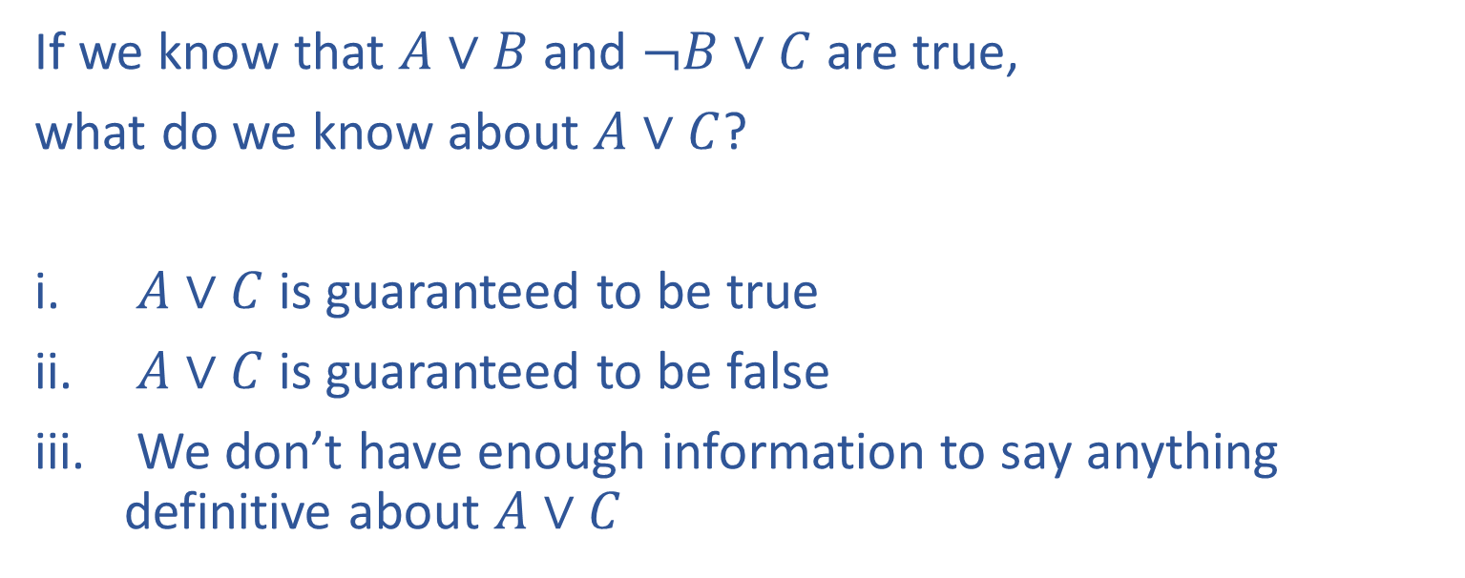
Poll 1
If we know that $A∨B$ and $¬B∨C$ are true,
what do we know about $A∨C$?
$A∨C$ is guaranteed to be true
$A∨C$ is guaranteed to be false
We don’t have enough information to say anything definitive about $A∨C$

Slide 20
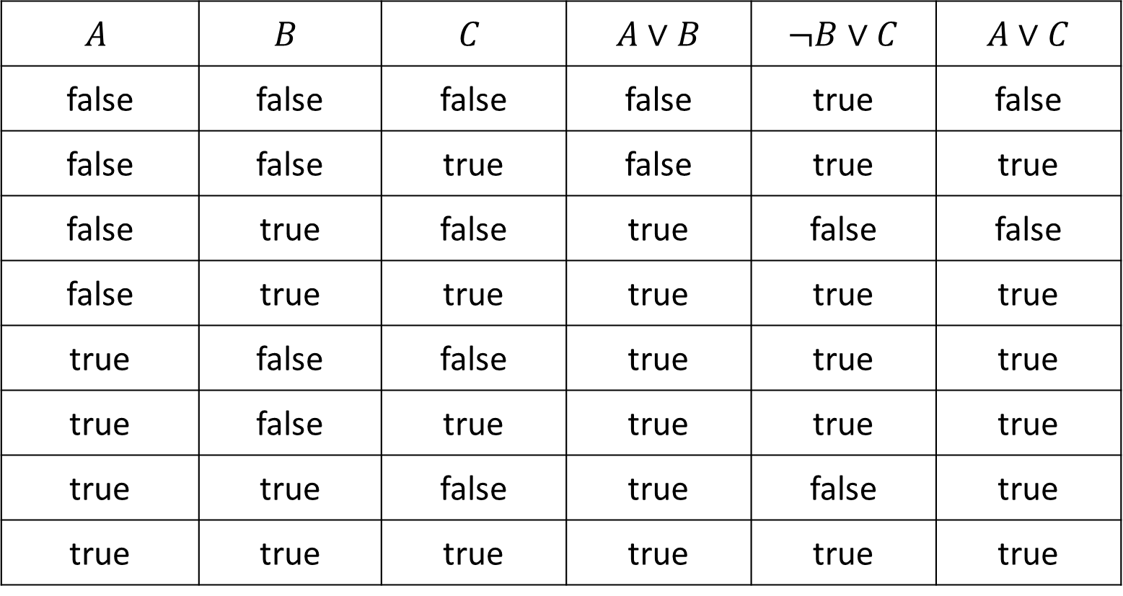
Poll 1
If we know that $A∨B$ and $¬B∨C$ are true, what do we know about $A∨C$?
$$A$$ | $$B$$ | $$C$$ | $A∨B$ | $¬B∨C$ | $A∨C$
false | false | false | false | true | false
false | false | true | false | true | true
false | true | false | true | false | false
false | true | true | true | true | true
true | false | false | true | true | true
true | false | true | true | true | true
true | true | false | true | false | true
true | true | true | true | true | true

Slide 21
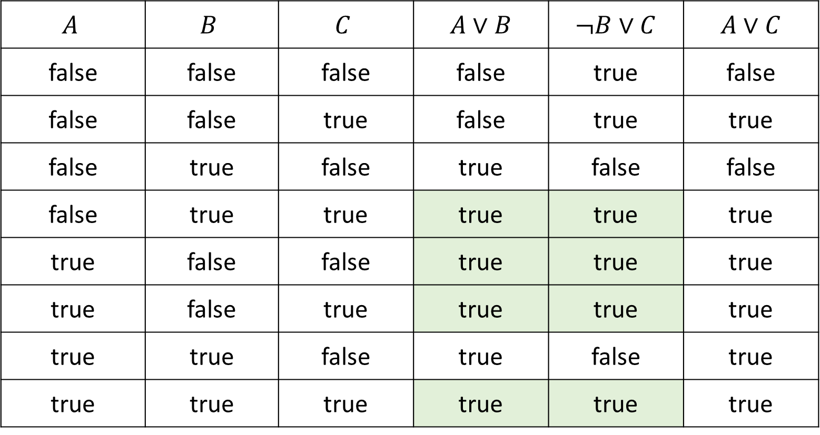

Poll 1
If we know that $A∨B$ and $¬B∨C$ are true, what do we know about $A∨C$?
$$A$$ | $$B$$ | $$C$$ | $A∨B$ | $¬B∨C$ | $A∨C$
false | false | false | false | true | false
false | false | true | false | true | true
false | true | false | true | false | false
false | true | true | true | true | true
true | false | false | true | true | true
true | false | true | true | true | true
true | true | false | true | false | true
true | true | true | true | true | true

Slide 22
Poll 1
If we know that $A∨B$ and $¬B∨C$ are true,
what do we know about $A∨C$?
$A∨C$ is guaranteed to be true
$A∨C$ is guaranteed to be false
We don’t have enough information to say anything definitive about $A∨C$

Slide 23
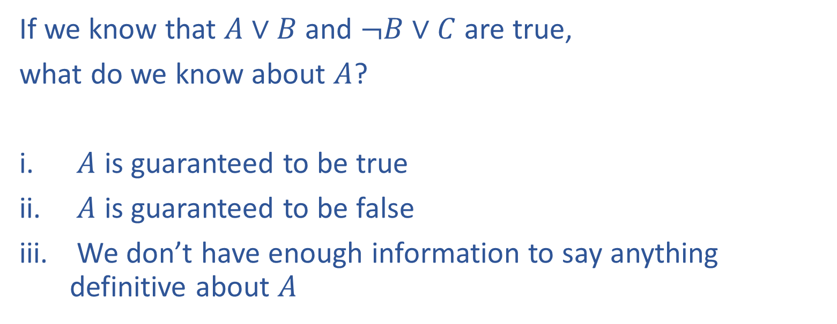

Poll 2
If we know that $A∨B$ and $¬B∨C$ are true,
what do we know about $A$?
$A$ is guaranteed to be true
$A$ is guaranteed to be false
We don’t have enough information to say anything definitive about $A$

Slide 24

Poll 2
If we know that $A∨B$ and $¬B∨C$ are true, what do we know about $A$?
$$A$$ | $$B$$ | $$C$$ | $A∨B$ | $¬B∨C$ | $A∨C$
false | false | false | false | true | false
false | false | true | false | true | true
false | true | false | true | false | false
false | true | true | true | true | true
true | false | false | true | true | true
true | false | true | true | true | true
true | true | false | true | false | true
true | true | true | true | true | true

Slide 25
Poll 2
If we know that $A∨B$ and $¬B∨C$ are true,
what do we know about $A$?
$A$ is guaranteed to be true
$A$ is guaranteed to be false
We don’t have enough information to say anything definitive about $A$

Slide 26

Logic Representation of World Models
  Knowledge Base of things we know to be true (logical sentences):
    P ∨ (¬Q ∧ R); X₁ ⇔ (Raining ⇒ Sunny)
  Possible world model (assignment of variables to values):
  {P=true, Q=true, R=false, S=true} or 1101
  Semantics: α ∧ β is true in a world iff is α true and β is true (etc.)

Slide 27
Propositional Logic
Check if sentence is true in given model
In other words, does the model satisfy the sentence?
function PL-TRUE?(α,model) returns true or false
if α is a symbol then return Lookup(α, model)
if Op(α) = ¬ then return not(PL-TRUE?(Arg1(α),model))
if Op(α) = ∧ then return and(PL-TRUE?(Arg1(α),model),
PL-TRUE?(Arg2(α),model))
etc.
(Sometimes called “recursion over syntax”)

Slide 28

Warm-up:
What is the relationship between number of constraints and number of possible solutions?
In other words, as the number of the constraints increases,
does the number of possible solutions:
Increase
Decrease
Stay the same
Where is the knowledge in our CSPs?
Notes:
0=7, R=4, W=6, U=2, T=8, F=1; 867 + 867 = 1734

Slide 29
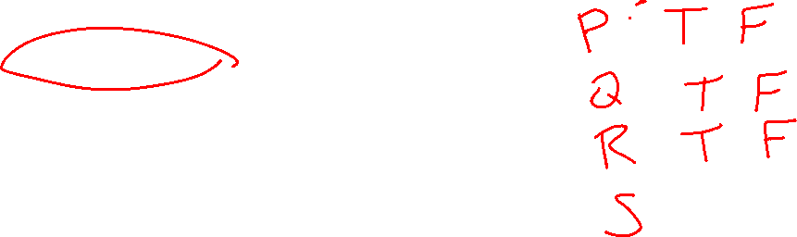
Question
What is the relationship between the size of the knowledge base and number of satisfiable models?
In other words, as the number of the knowledge base rules increases,
does the number of satisfiable models:
Increase
Decrease
Stay the same
Notes:
0=7, R=4, W=6, U=2, T=8, F=1; 867 + 867 = 1734

Slide 30
Sentences as Constraints
Adding a sentence to our knowledge base constrains the
number of possible models:
KB: Nothing
Possible
Models
P | Q | R
false | false | false
false | false | true
false | true | false
false | true | true
true | false | false
true | false | true
true | true | false
true | true | true

Slide 31
Sentences as Constraints
Adding a sentence to our knowledge base constrains the
number of possible models:
KB: Nothing
KB: [(P ∧ ¬Q) ∨ (Q ∧ ¬P)] ⇒ R
Possible
Models
P | Q | R
false | false | false
false | false | true
false | true | false
false | true | true
true | false | false
true | false | true
true | true | false
true | true | true

Slide 32
Sentences as Constraints
Adding a sentence to our knowledge base constrains the
number of possible models:
KB: Nothing
KB: [(P ∧ ¬Q) ∨ (Q ∧ ¬P)] ⇒ R
KB: R, [(P ∧ ¬Q) ∨ (Q ∧ ¬P)] ⇒ R
Possible
Models
P | Q | R
false | false | false
false | false | true
false | true | false
false | true | true
true | false | false
true | false | true
true | true | false
true | true | true

Slide 33
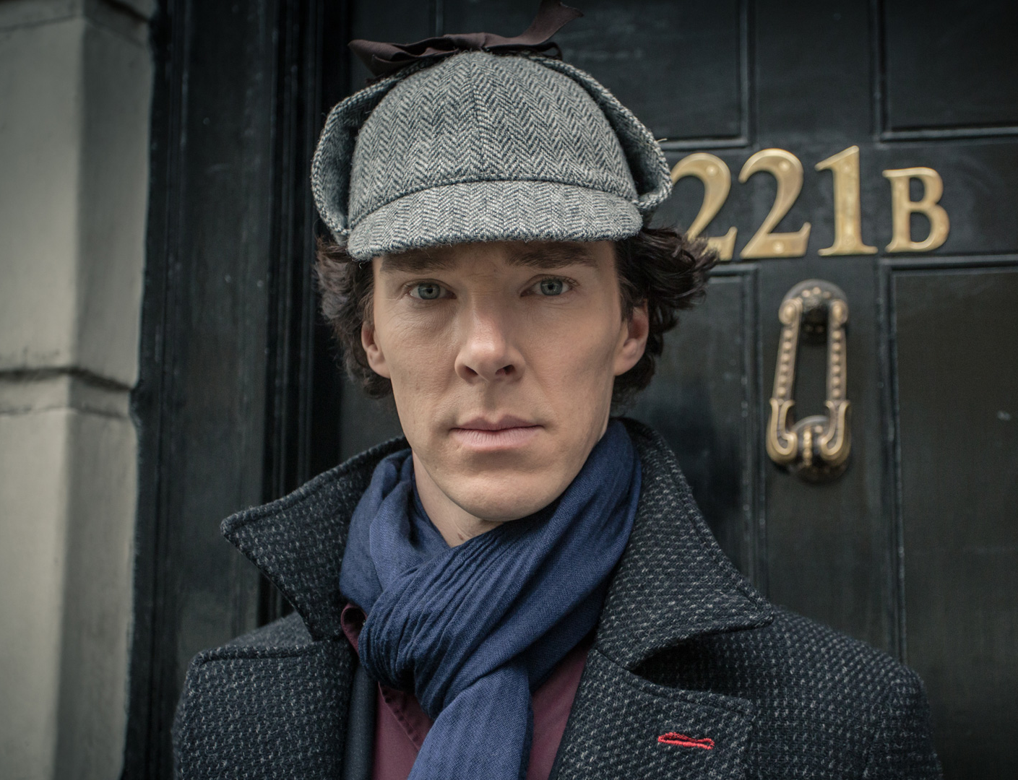
Sherlock Entailment
“When you have eliminated the impossible, whatever remains, however improbable, must be the truth” – Sherlock Holmes via Sir Arthur Conan Doyle
(Not quite)
Knowledge base and inference allow us to remove impossible models, helping us to see what is true in all of the remaining models

Slide 34
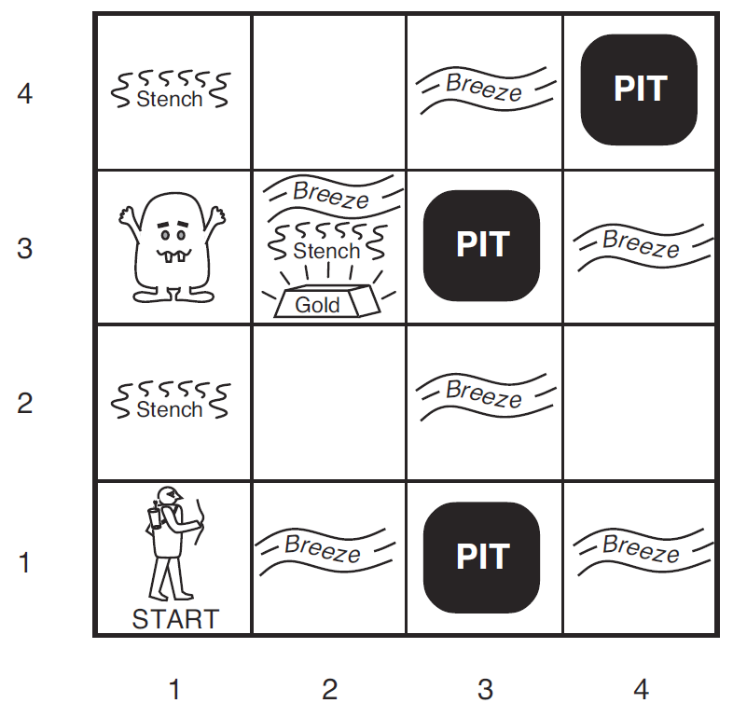

Wumpus World
Logical Reasoning as a CSP
B_{ij} = breeze felt
S_{ij} = stench smelt
P_{ij} = pit here
W_{ij} = wumpus here
G = gold
http://thiagodnf.github.io/wumpus-world-simulator/

Slide 35
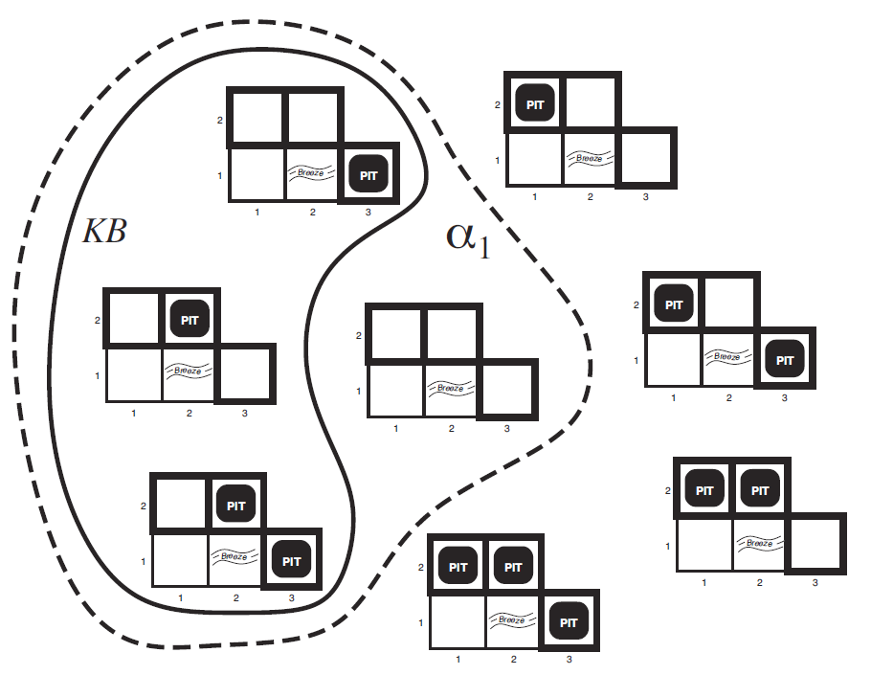

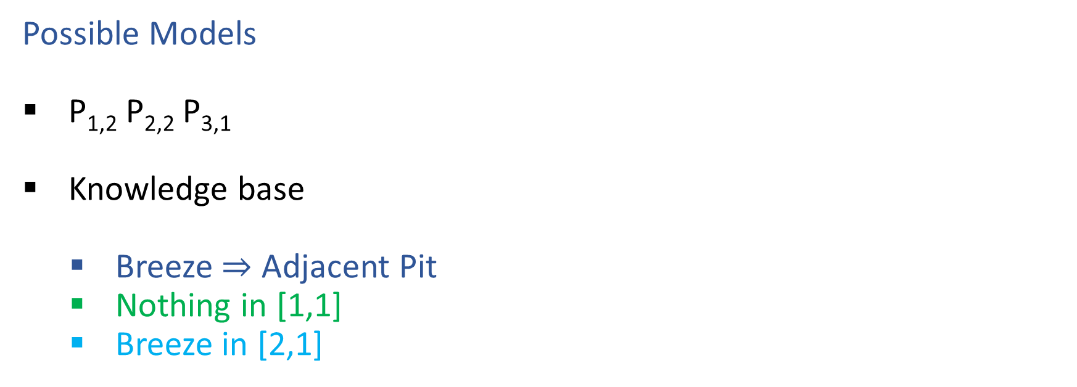

Wumpus World
Possible Models
P_{1,2} P_{2,2} P_{3,1}
Knowledge base
    Breeze $⇒$ Adjacent Pit
    Nothing in [1,1]
    Breeze in [2,1]

Slide 36

Entailment
Entailment: α |= β (“α entails β” or “β follows from α”) iff in every world where α is true, β is also true
    I.e., the α-worlds are a subset of the β-worlds [models(α) ⊆ models(β)]
Usually, we want to know if KB |= query
  models(KB) ⊆ models(query)
  In other words
    KB removes all impossible models (any model where KB is false)
    If query is true in all of these remaining models, we conclude that query must be true
Entailment and implication are very much related
  However, entailment relates two sentences, while an implication is itself a sentence (usually derived via inference to show entailment)

Slide 37
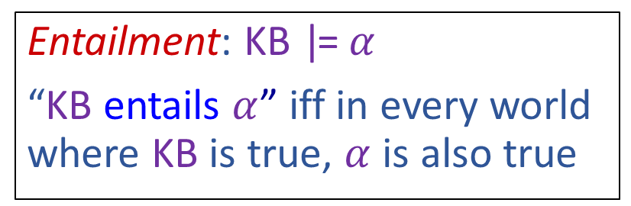
Wumpus World
Possible Models
P_{1,2} P_{2,2} P_{3,1}
Knowledge base
    Breeze $⇒$ Adjacent Pit
    Nothing in [1,1]
    Breeze in [2,1]
Entailment: KB |= $α$
“KB entails $α$” iff in every world where KB is true, $α$ is also true

Slide 38
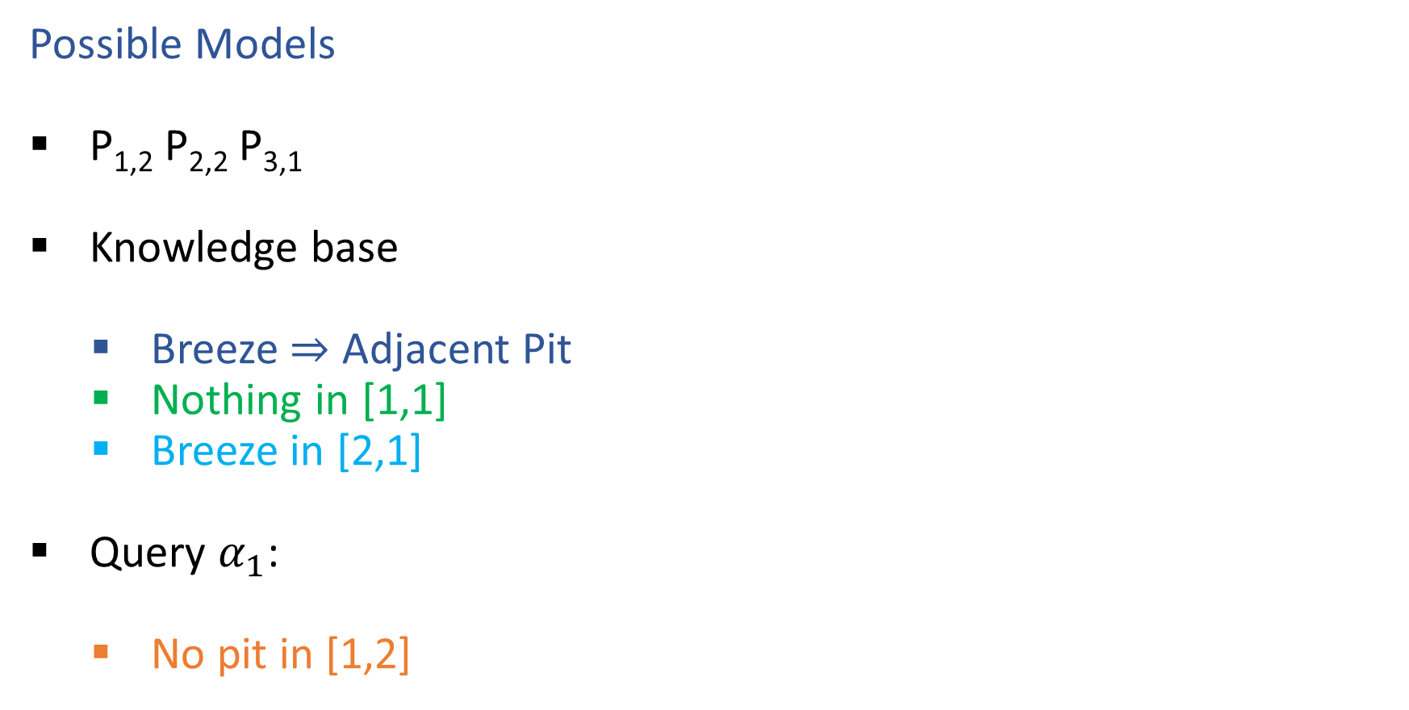

Wumpus World
Possible Models
P_{1,2} P_{2,2} P_{3,1}
Knowledge base
    Breeze $⇒$ Adjacent Pit
    Nothing in [1,1]
    Breeze in [2,1]
Query $α_{1}$:
    No pit in [1,2]
Entailment: KB |= $α$
“KB entails $α$” iff in every world where KB is true, $α$ is also true

Slide 39
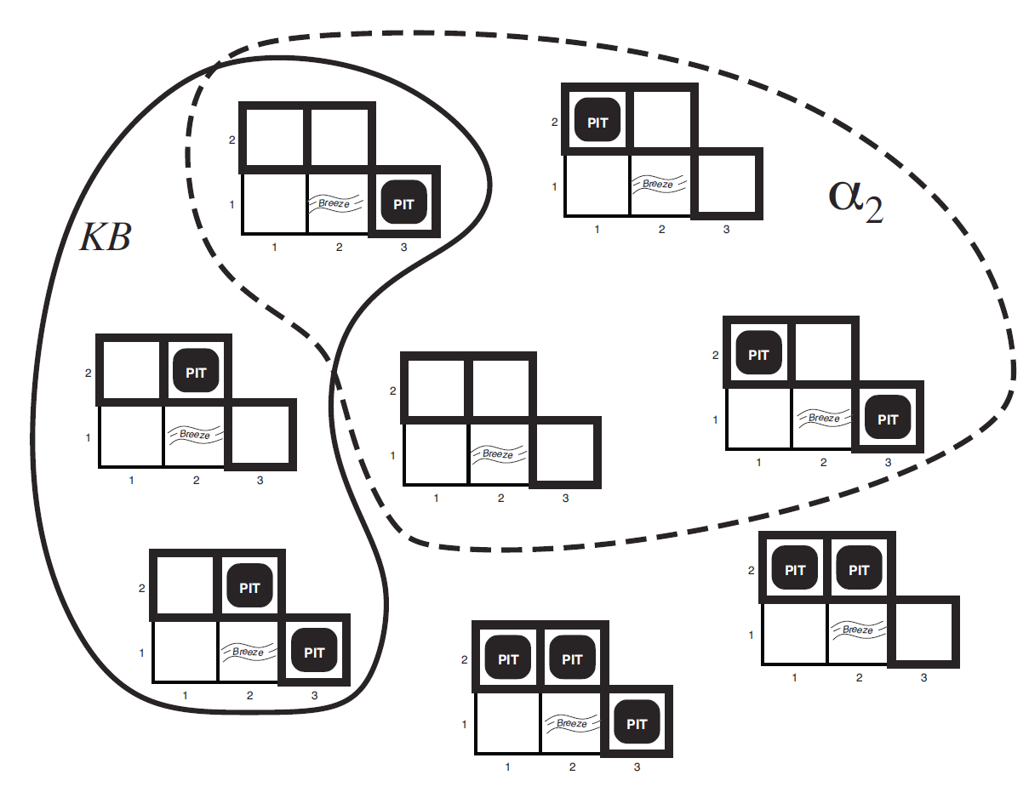
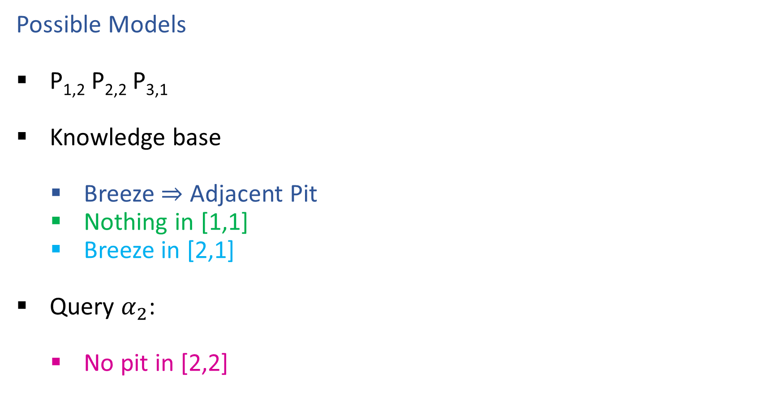

Wumpus World
Possible Models
P_{1,2} P_{2,2} P_{3,1}
Knowledge base
    Breeze $⇒$ Adjacent Pit
    Nothing in [1,1]
    Breeze in [2,1]
Query $α_{2}$:
    No pit in [2,2]
Entailment: KB |= $α$
“KB entails $α$” iff in every world where KB is true, $α$ is also true

Slide 40
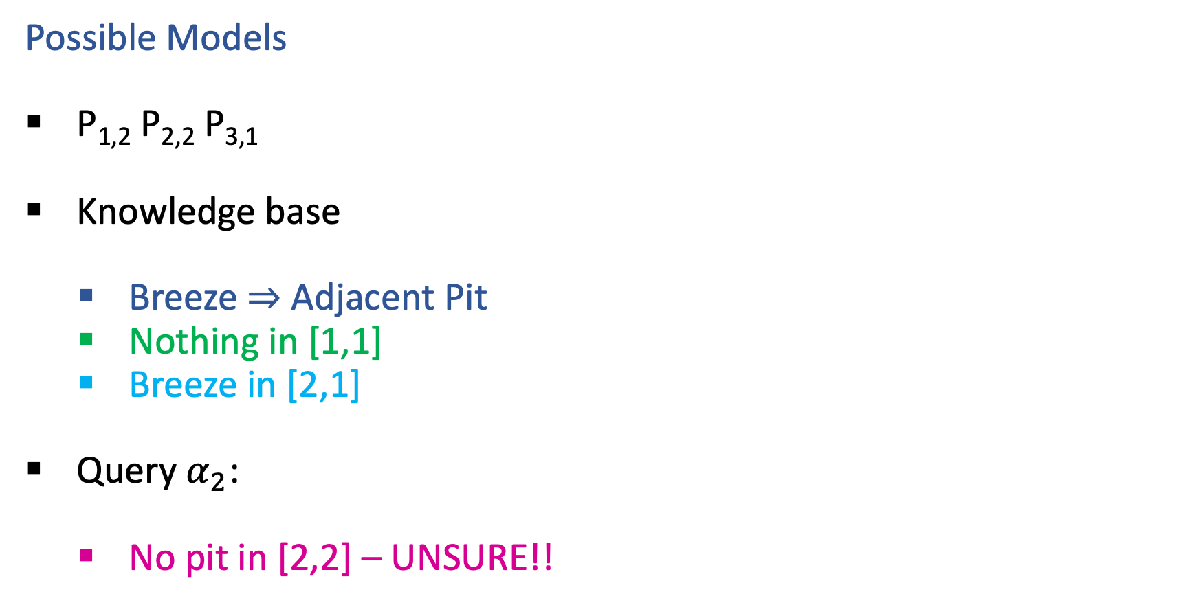
Wumpus World
Possible Models
P_{1,2} P_{2,2} P_{3,1}
Knowledge base
    Breeze $⇒$ Adjacent Pit
    Nothing in [1,1]
    Breeze in [2,1]
Query $α_{2}$:
    No pit in [2,2] – UNSURE!!
Entailment: KB |= $α$
“KB entails $α$” iff in every world where KB is true, $α$ is also true

Slide 41
Propositional Logic Models
All Possible Models
A | 0 | 0 | 0 | 0 | 1 | 1 | 1 | 1
B | 0 | 0 | 1 | 1 | 0 | 0 | 1 | 1
C | 0 | 1 | 0 | 1 | 0 | 1 | 0 | 1
Model Symbols

Slide 42

Poll 3
Entailment: α |= β
“α entails β” iff in every world where α is true, β is also true
Does the KB entail query C?
All Possible Models
A | 0 | 0 | 0 | 0 | 1 | 1 | 1 | 1
B | 0 | 0 | 1 | 1 | 0 | 0 | 1 | 1
C | 0 | 1 | 0 | 1 | 0 | 1 | 0 | 1
A | 0 | 0 | 0 | 0 | 1 | 1 | 1 | 1
B⇒C | 1 | 1 | 0 | 1 | 1 | 1 | 0 | 1
A⇒B∨C | 1 | 1 | 1 | 1 | 0 | 1 | 1 | 1
C | 0 | 1 | 0 | 1 | 0 | 1 | 0 | 1
Model Symbols
Knowledge Base
Query

Slide 43

Poll 3
Entailment: α |= β
“α entails β” iff in every world where α is true, β is also true
Does the KB entail query C?
Yes!
All Possible Models
A | 0 | 0 | 0 | 0 | 1 | 1 | 1 | 1
B | 0 | 0 | 1 | 1 | 0 | 0 | 1 | 1
C | 0 | 1 | 0 | 1 | 0 | 1 | 0 | 1
A | 0 | 0 | 0 | 0 | 1 | 1 | 1 | 1
B⇒C | 1 | 1 | 0 | 1 | 1 | 1 | 0 | 1
A⇒B∨C | 1 | 1 | 1 | 1 | 0 | 1 | 1 | 1
KB | 0 | 0 | 0 | 0 | 0 | 1 | 0 | 1
C | 0 | 1 | 0 | 1 | 0 | 1 | 0 | 1
Model Symbols
Knowledge Base
Query

Slide 44

Entailment
How do we implement a logical agent that proves entailment?
  Logic language
    Propositional logic
    First order logic
  Knowledge Base
    Add known logical rules and facts
  Inference algorithms
    Theorem proving
    Model checking

Slide 45

Simple Model Checking
function TT-ENTAILS?(KB, α) returns true or false

Slide 46
Simple Model Checking, contd.
Same recursion as backtracking
P₁=true
P₁=false
P₂=true
P₂=false
P_{n}=true
P_{n}=false
KB?
α?
11111…1
0000…0

Slide 47
Simple Model Checking
function TT-ENTAILS?(KB, α) returns true or false
return TT-CHECK-ALL(KB, α, symbols(KB) U symbols(α),{})
function TT-CHECK-ALL(KB, α, symbols,model) returns true or false
if empty?(symbols) then
if PL-TRUE?(KB, model) then return PL-TRUE?(α, model)
else return true
else
P ← first(symbols)
rest ← rest(symbols)
return and (TT-CHECK-ALL(KB, α, rest, model ∪ {P = true})
TT-CHECK-ALL(KB, α, rest, model ∪ {P = false }))

Slide 48
Simple Model Checking, contd.
Same recursion as backtracking
O(2^{n}) time, linear space
Can we do better?
P₁=true
P₁=false
P₂=true
P₂=false
P_{n}=true
P_{n}=false
KB?
α?
11111…1
0000…0

Slide 49

Inference: Proofs
A proof is a demonstration of entailment between α and β
Method 1: model-checking
  For every possible world, if α is true make sure that is β true too
  OK for propositional logic (finitely many worlds); not easy for first-order logic
Method 2: theorem-proving
  Search for a sequence of proof steps (applications of inference rules) leading from α to β
  E.g., from P ∧ (P ⇒ Q), infer Q by Modus Ponens
Properties
Sound algorithm: everything it claims to prove is in fact entailed
Complete algorithm: every sentence that is entailed can be proved

Slide 50

Simple Theorem Proving: Forward Chaining
Forward chaining applies Modus Ponens to generate new facts:
  Given X₁ ∧ X₂ ∧ … X_{n} ⇒ Y and X₁, X₂, …, X_{n}
  Infer Y
Forward chaining keeps applying this rule, adding new facts, until nothing more can be added
Requires KB to contain only definite clauses:
  (Conjunction of symbols) ⇒ symbol; or
  A single symbol (note that X is equivalent to True ⇒ X)

Slide 51

Forward Chaining Algorithm
function PL-FC-ENTAILS?(KB, q) returns true or false
Clauses
P ⇒ Q
L ∧ M ⇒ P
B ∧ L ⇒ M
A ∧ P ⇒ L
A ∧ B ⇒ L
A
B

Slide 52
Forward Chaining Algorithm
function PL-FC-ENTAILS?(KB, q) returns true or false
count ← a table, where count[c] is the number of symbols in c’s premise
inferred ← a table, where inferred[s] is initially false for all s
agenda ← a queue of symbols, initially symbols known to be true in KB
Clauses
Count
Inferred
Agenda
P ⇒ Q
L ∧ M ⇒ P
B ∧ L ⇒ M
A ∧ P ⇒ L
A ∧ B ⇒ L
A
B
1
2
2
2
2
0
0
A false
B false
L false
M false
P false
Q false

Slide 53
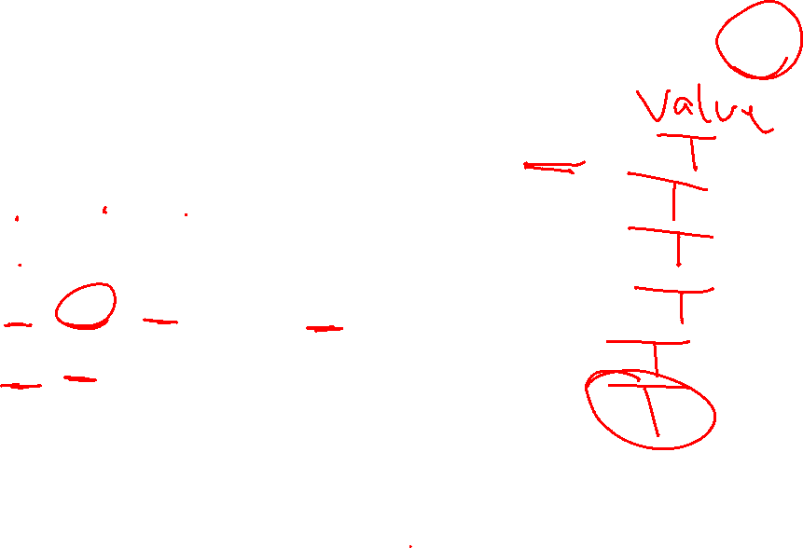
Forward Chaining Example: Proving Q
Clauses
Count
Inferred
1
2
2
2
2
0
0
A false
B false
L false
M false
P false
Q false
P ⇒ Q
L ∧ M ⇒ P
B ∧ L ⇒ M
A ∧ P ⇒ L
A ∧ B ⇒ L
A
B
// 0
xxxx true
// 1
xxxx true
// 0
// 0
xxxx true
// 1
// 0
xxxx true
// 1
xxxx true
// 0
// 1
xxxx true
Agenda
x
x
Q
x
L
x
x
x
M
P
A B
x
L

Slide 54

Forward Chaining Algorithm
function PL-FC-ENTAILS?(KB, q) returns true or false
count ← a table, where count[c] is the number of symbols in c’s premise
inferred ← a table, where inferred[s] is initially false for all s
agenda ← a queue of symbols, initially symbols known to be true in KB
while agenda is not empty do
p ← Pop(agenda)
if p = q then return true
if inferred[p] = false then
inferred[p]←true
for each clause c in KB where p is in c.premise do
decrement count[c]
if count[c] = 0 then add c.conclusion to agenda
return false

Slide 55

Properties of forward chaining
Theorem: FC is sound and complete for definite-clause KBs
Soundness: follows from soundness of Modus Ponens (easy to check)
Completeness proof:
1. FC reaches a fixed point where no new atomic sentences are derived
2. Consider the final inferred table as a model m, assigning true/false to symbols
3. Every clause in the original KB is true for m
Proof: Suppose a clause a₁∧... ∧a_{k} ⇒ b is false for m
Then a₁∧... ∧a_{k} is true in m and b is false for m
Therefore the algorithm has not reached a fixed point!
4. Hence m is a model of KB
5. If KB |= q, q is true in every model of KB, including m
A false
B false
L false
M false
P false
Q false
xxxx true
xxxx true
xxxx true
xxxx true
xxxx true
xxxx true

Slide 56


Inference Rules
Modus Ponens
$\frac{α⇒β, α}{β}$
Unit Resolution
$\frac{a∨b, ¬b∨c}{a∨c}$
General Resolution
$\frac{a_{1}∨…∨a_{m}∨b, ¬b∨c_{1}∨…∨c_{n}}{a_{1}∨…∨a_{m}∨c_{1}∨…∨c_{n}}$
Notation Alert!

Slide 57
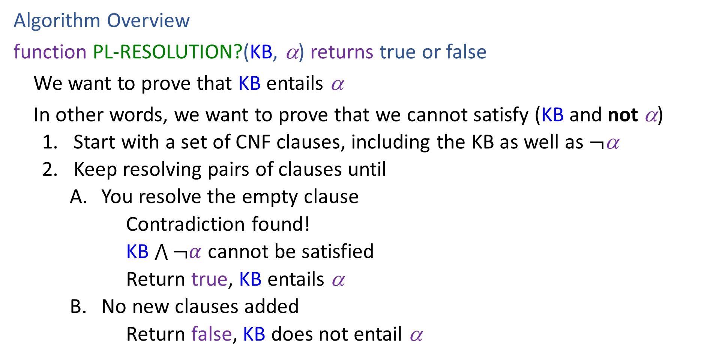
Resolution
Algorithm Overview
function PL-RESOLUTION?(KB, α) returns true or false
We want to prove that KB entails α
In other words, we want to prove that we cannot satisfy (KB and not α)
    Start with a set of CNF clauses, including the KB as well as $¬$α
    Keep resolving pairs of clauses until
        You resolve the empty clause
        Contradiction found!
        KB $\bigwedge{¬α}$ cannot be satisfied
        Return true, KB entails α
        No new clauses added
        Return false, KB does not entail α

Slide 58
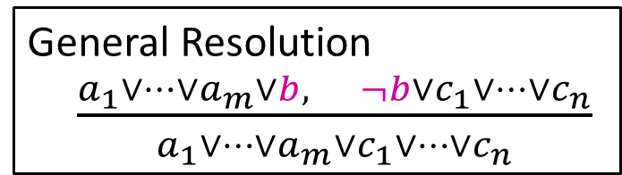






Resolution
General Resolution
$\frac{a_{1}∨…∨a_{m}∨b, ¬b∨c_{1}∨…∨c_{n}}{a_{1}∨…∨a_{m}∨c_{1}∨…∨c_{n}}$
Example trying to prove $¬P_{1,2}$
Knowledge Base
$$¬P_{2,1}∨B_{1,1}$$
$$¬B_{1,1}∨P_{1,2}∨P_{2,1}$$
$$¬P_{1,2}∨B_{1,1}$$
$$¬B_{1,1}$$
$$¬¬P_{1,2}$$

Slide 59








Resolution
General Resolution
$\frac{a_{1}∨…∨a_{m}∨b, ¬b∨c_{1}∨…∨c_{n}}{a_{1}∨…∨a_{m}∨c_{1}∨…∨c_{n}}$
Example trying to prove $¬P_{1,2}$
Knowledge Base
$$¬P_{2,1}∨B_{1,1}$$
$$¬B_{1,1}∨P_{1,2}∨P_{2,1}$$
$$¬P_{1,2}∨B_{1,1}$$
$$¬B_{1,1}$$
$$P_{1,2}$$
$$¬B_{1,1}∨P_{1,2}∨B_{1,1}$$
$$P_{1,2}∨P_{2,1}∨¬P_{2,1}$$
$$¬B_{1,1}∨P_{2,1}∨B_{1,1}$$
$$P_{1,2}∨P_{2,1}∨¬P_{1,2}$$
$$¬P_{2,1}$$
$$¬P_{1,2}$$

Slide 60
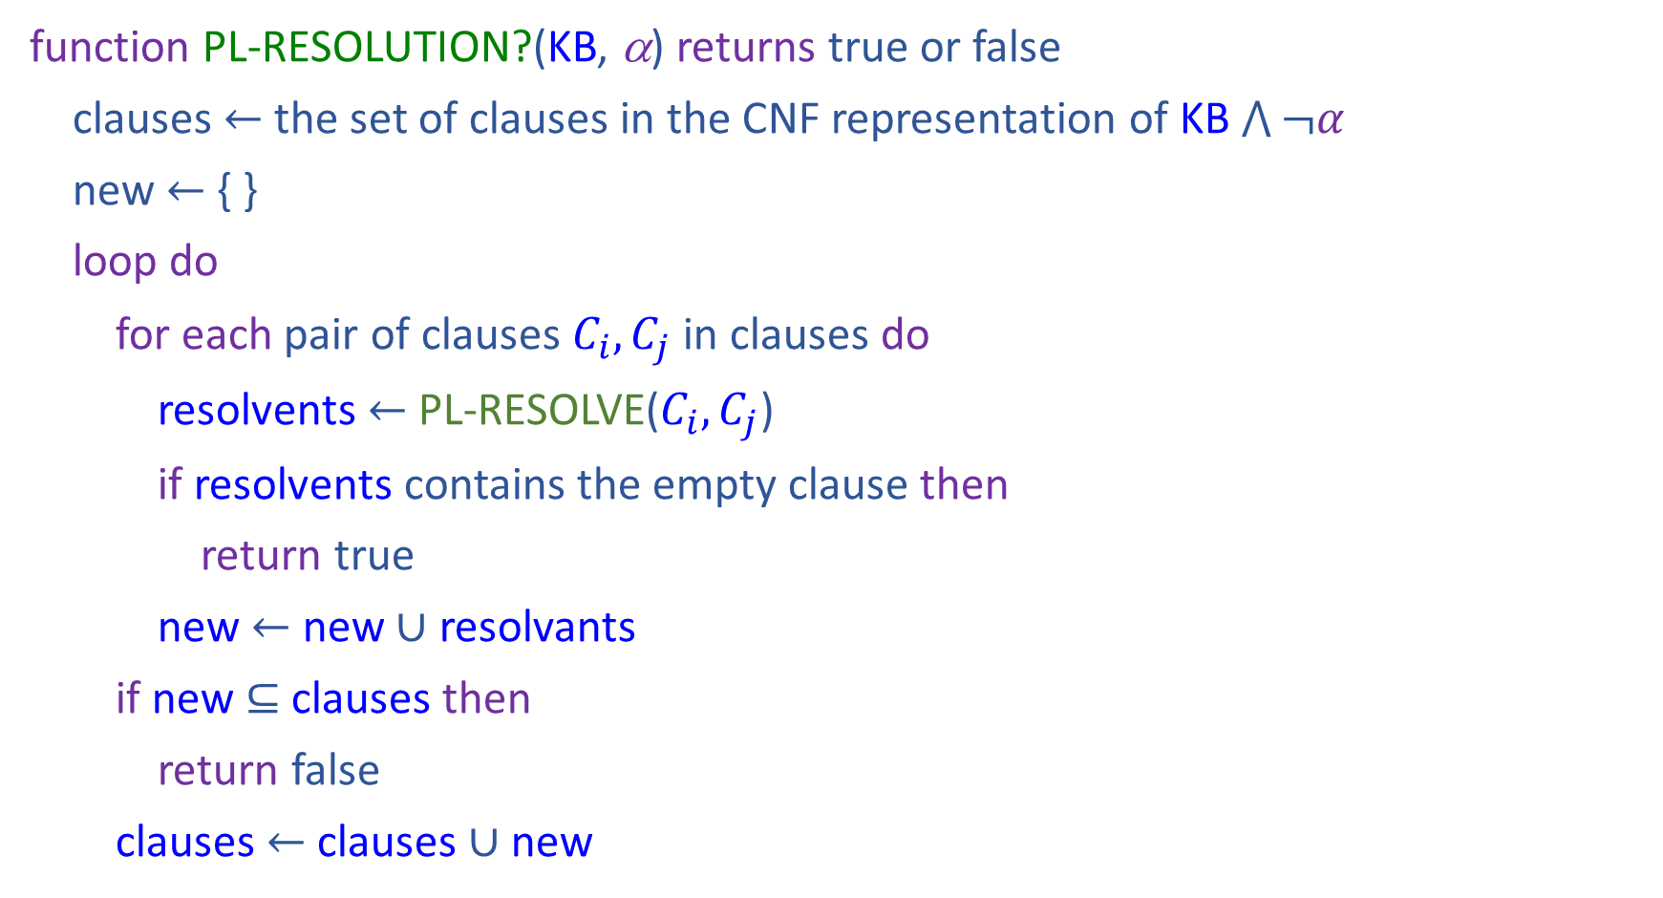
Resolution
function PL-RESOLUTION?(KB, α) returns true or false
clauses $←$ the set of clauses in the CNF representation of KB $\bigwedge{¬α}$
new $←${ }
loop do
for each pair of clauses $C_{i}, C_{j}$ in clauses do
resolvents $←$ PL-RESOLVE($C_{i}, C_{j}$)
if resolvents contains the empty clause then
return true
new $←$ new $∪$ resolvants
if new $⊆$ clauses then
return false
clauses $←$ clauses $∪$ new

Slide 61
Properties
Forward Chaining is:
Sound and complete for definite-clause KBs
Complexity: linear time
Resolution is:
Sound and complete for any PL KBs!
Complexity: exponential time ☹

Slide 62


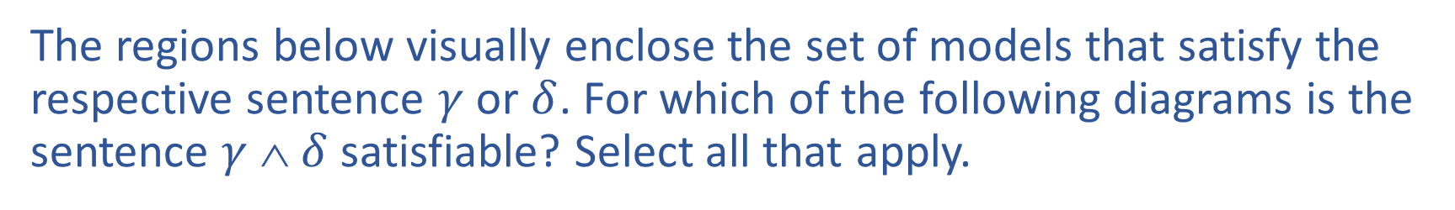








Poll 4
The regions below visually enclose the set of models that satisfy the respective sentence $γ$ or $δ$. For which of the following diagrams is the sentence $γ$ ∧ $δ$ satisfiable? Select all that apply.
A)
B)
C)
$$γ$$
$$δ$$
$$γ$$
$$δ$$
$$γ$$
$$δ$$
D)
E)
$$γ$$
$$δ$$
$$δ$$
$$γ$$
Notes:
A, C, D, E

Slide 63
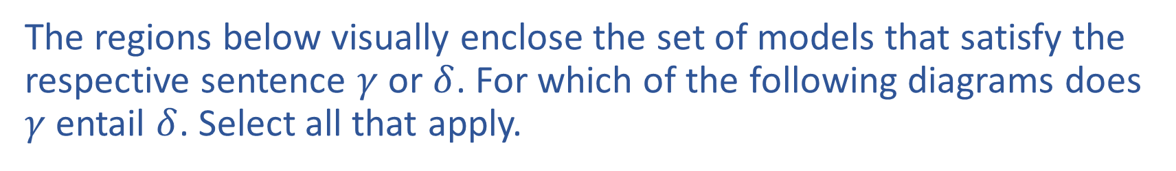

Poll 5
The regions below visually enclose the set of models that satisfy the respective sentence $γ$ or $δ$. For which of the following diagrams does $γ$ entail $δ$. Select all that apply.
A)
B)
C)
$$γ$$
$$δ$$
$$γ$$
$$δ$$
$$γ$$
$$δ$$
D)
E)
$$γ$$
$$δ$$
$$δ$$
$$γ$$
Notes:
C and E

Slide 64
Satisfiability and Entailment
A sentence is satisfiable if it is true in at least one world (e.g., CSPs!)

Slide 65
Satisfiability and Entailment
A sentence is satisfiable if it is true in at least one world (e.g., CSPs!)
Suppose we have a hyper-efficient SAT solver; how can we use it to test entailment?
  Suppose α |= β
  Then α ⇒ β is true in all worlds
  Hence ¬(α ⇒ β) is false in all worlds
  Hence α ∧ ¬β is false in all worlds, i.e., unsatisfiable
So, add the negated conclusion to what you know, test for (un)satisfiability; also known as reductio ad absurdum
Efficient SAT solvers operate on conjunctive normal form

Slide 66
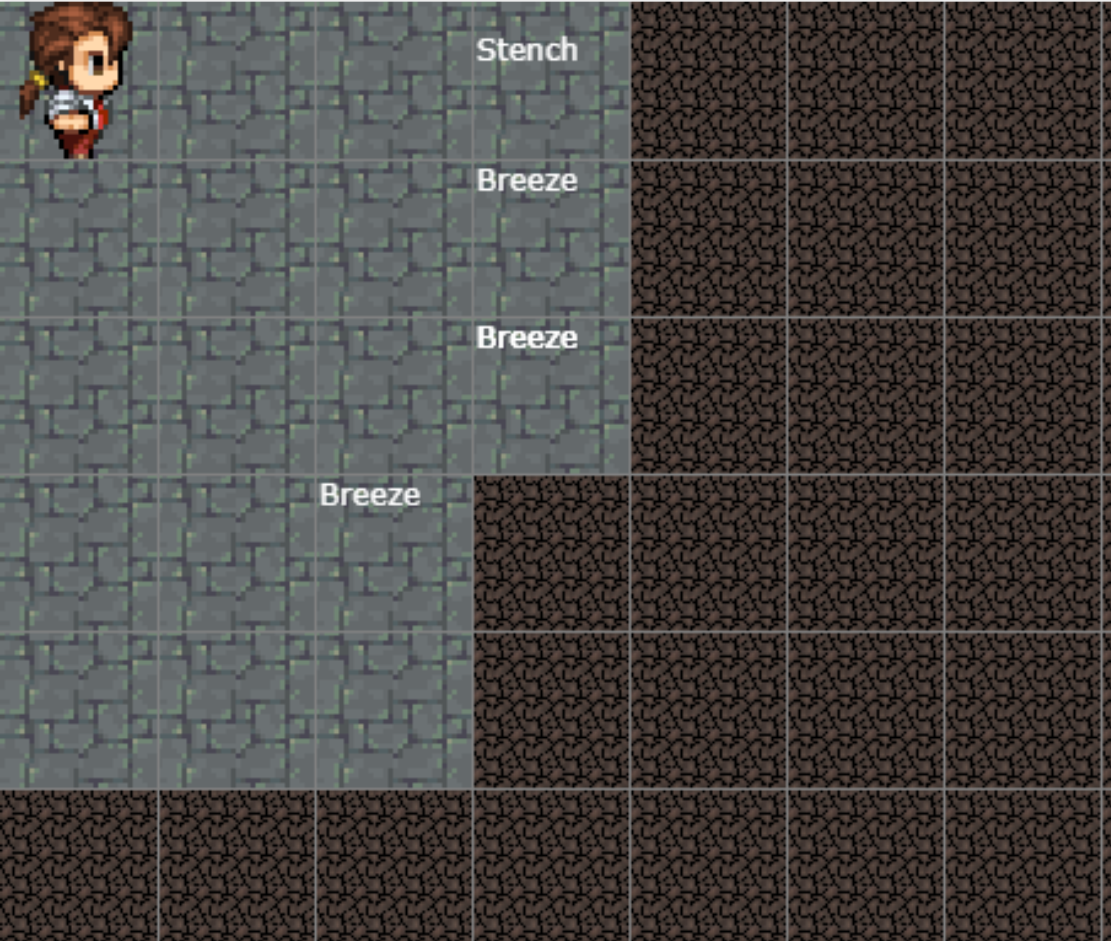
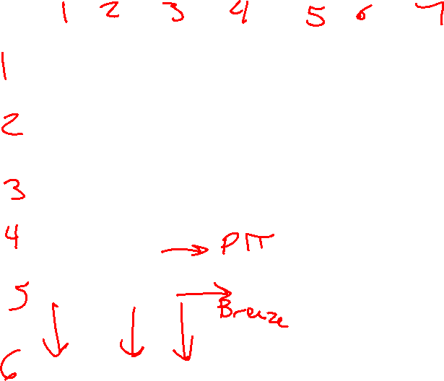
Satisfiability and Entailment
http://thiagodnf.github.io/wumpus-world-simulator/

Slide 67
Conjunctive Normal Form (CNF)
Replace biconditional by two implications
Every sentence can be expressed as a conjunction of clauses
Each clause is a disjunction of literals
Each literal is a symbol or a negated symbol
Conversion to CNF by a sequence of standard transformations:
  At_1,1_0 ⇒ (Wall_0,1 ⇔ Blocked_W_0)
  At_1,1_0 ⇒ ((Wall_0,1 ⇒ Blocked_W_0) ∧ (Blocked_W_0 ⇒Wall_0,1))
  ¬At_1,1_0 v ((¬Wall_0,1 v Blocked_W_0) ∧ (¬Blocked_W_0 v Wall_0,1))
  (¬At_1,1_0 v ¬Wall_0,1 v Blocked_W_0) ∧ (¬At_1,1_0 v ¬Blocked_W_0 v Wall_0,1)
Replace α ⇒ β by ¬α v β
Distribute v over ∧

Slide 68
Efficient SAT solvers
DPLL (Davis-Putnam-Logemann-Loveland) is the core of modern solvers
Essentially a backtracking search over models with some extras:
  Early termination: stop if
    all clauses are satisfied; e.g., (A ∨ B) ∧ (A ∨ ¬C) is satisfied by {A=true}
    any clause is falsified; e.g., (A ∨ B) ∧ (A ∨ ¬C) is satisfied by {A=false, B=false}
  Pure literals: if all occurrences of a symbol in as-yet-unsatisfied clauses have the same sign, then give the symbol that value
    E.g., A is pure and positive in (A ∨ B) ∧ (A ∨ ¬C) ∧ (C ∨ ¬B) so set it to true
  Unit clauses: if a clause is left with a single literal, set symbol to satisfy clause
    E.g., if A=false, (A ∨ B) ∧ (A ∨ ¬C) becomes (false ∨ B) ∧ (false ∨ ¬C), i.e. (B) ∧ (¬C)
    Satisfying the unit clauses often leads to further propagation, new unit clauses, etc.

Slide 69
DPLL algorithm
function DPLL(clauses, symbols, model) returns true or false
if every clause in clauses is true in model then return true
if some clause in clauses is false in model then return false
P, value ←FIND-PURE-SYMBOL(symbols, clauses, model)
if P is non-null then return DPLL(clauses, symbols–P, model∪{P=value})
P, value ←FIND-UNIT-CLAUSE(clauses, model)
if P is non-null then return DPLL(clauses, symbols–P, model∪{P=value})
P ← First(symbols)
rest ← Rest(symbols)
return or(DPLL(clauses, rest, model∪{P=true}),
DPLL(clauses, rest, model∪{P=false}))

Slide 70
Planning as Satisfiability
Given a hyper-efficient SAT solver, can we use it to make plans?
Yes, for fully observable, deterministic case: planning problem is solvable iff there is some satisfying assignment for actions etc.

Slide 71
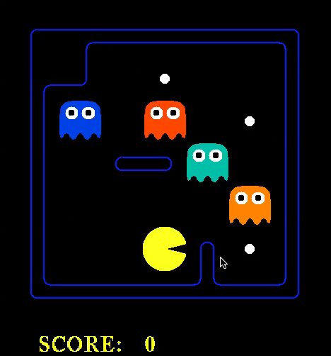

Slide 72
Planning as Satisfiability
Given a hyper-efficient SAT solver, can we use it to make plans?
Yes, for fully observable, deterministic case: planning problem is solvable iff there is some satisfying assignment for actions etc.
For T = 1 to infinity, set up the KB as follows and run SAT solver:
  Initial state, domain constraints
  Transition model sentences up to time T
  Goal is true at time T
  Precondition axioms: At_1,1_0 ∧ N_0 ⇒ ¬Wall_1,2 etc.
  Action exclusion axioms: ¬(N_0 ∧ W_0) ∧ ¬(N_0 ∧ S_0) ∧ .. etc.

Slide 73
Initial State
The agent may know its initial location:
  At_1,1_0
Or, it may not:
  At_1,1_0 v At_1,2_0 v At_1,3_0 v … v At_3,3_0
We also need a domain constraint – cannot be in two places at once!
  ¬(At_1,1_0 ∧ At_1,2_0) ∧ ¬(At_1,1_0 ∧ At_1,3_0) ∧ …
  ¬(At_1,1_1 ∧ At_1,2_1) ∧ ¬(At_1,1_1 ∧ At_1,3_1) ∧ …
  …

Slide 74
Fluents and Effect Axioms
A fluent is a state variable that changes over time
How does each state variable or fluent at each time gets its value?
Fluents for PL Pacman are Pacman_x,y_t , e.g., Pacman _3,3_17

Slide 75
Fluents and Successor-state Axioms
A fluent is a state variable that changes over time
How does each state variable or fluent at each time gets its value?
Fluents for PL Pacman are Pacman_x,y_t , e.g., Pacman _3,3_17
A state variable gets its value according to a successor-state axiom
  X_{t} ⇔ [X_{t-1} ∧ ¬(some action_{t-1} made it false)] v
  [¬X_{t-1} ∧ (some action_{t-1} made it true)]

Slide 76
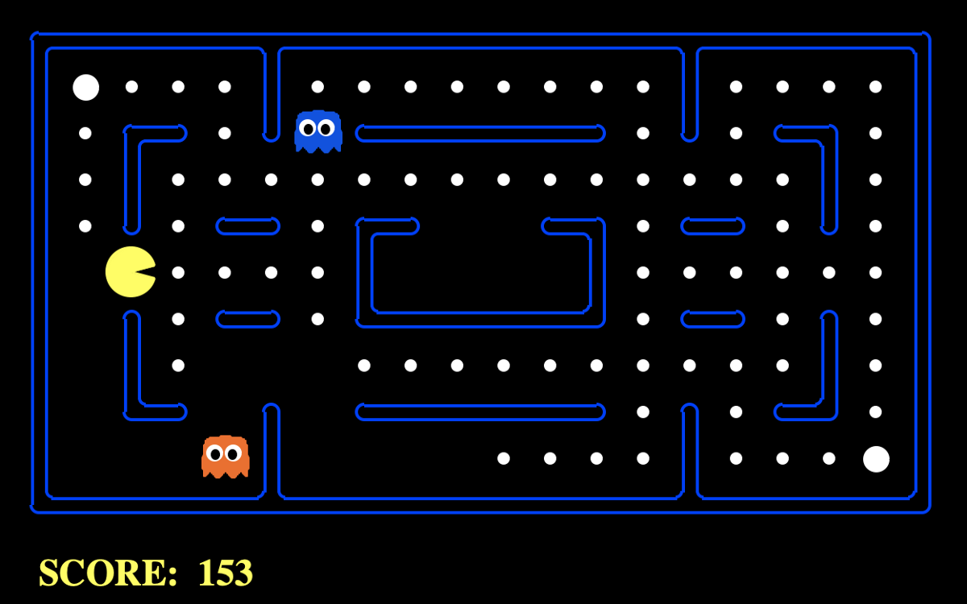
Fluents and Successor-state Axioms
Write the successor-state axiom for pacman’s location

Slide 77
Planning as Satisfiability
For T = 1 to infinity, set up the KB as follows and run SAT solver:
  Initial state, domain constraints
  Transition model sentences up to time T
  Goal is true at time T
  Why?
  If I can find a satisfying set of variables that meet the constraints, then I have also found a plan as the set of action variables.

Slide 78
EXTRA SLIDES

Slide 79
Logical Agent Vocab
Model
  Complete assignment of symbols to True/False
Sentence
  Logical statement
  Composition of logic symbols and operators
KB
  Collection of sentences representing facts and rules we know about the world
Query
  Sentence we want to know if it is provably True, provably False, or unsure.

Slide 80
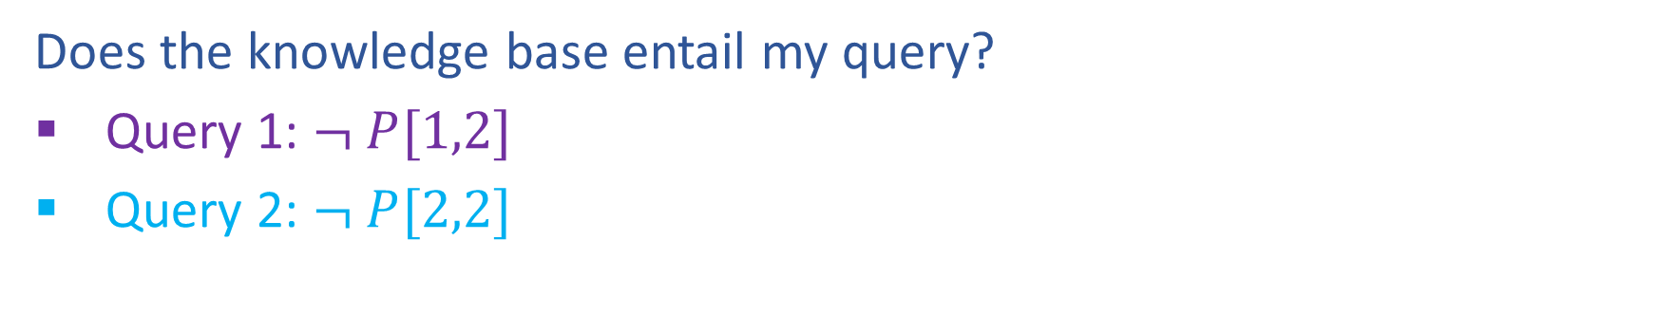

Entailment
Does the knowledge base entail my query?
Query 1: $¬ P[1,2]$
Query 2: $¬ P[2,2]$

Slide 81
Provably True, Provably False, or Unsure
http://thiagodnf.github.io/wumpus-world-simulator/

Slide 82
Logical Agent Vocab
Entailment
  Input: sentence1, sentence2
  Each model that satisfies sentence1 must also satisfy sentence2
  "If I know 1 holds, then I know 2 holds"
  (ASK), TT-ENTAILS, FC-ENTAILS, RESOLUTION-ENTAILS
Satisfy
  Input: model, sentence
  Is this sentence true in this model?
  Does this model satisfy this sentence
  "Does this particular state of the world work?’
  PL-TRUE

Slide 83
Logical Agent Vocab
Satisfiable
  Input: sentence
  Can find at least one model that satisfies this sentence
      (We often want to know what that model is)
  "Is it possible to make this sentence true?"
  DPLL
Valid
  Input: sentence
  sentence is true in all possible models

