Slide 1
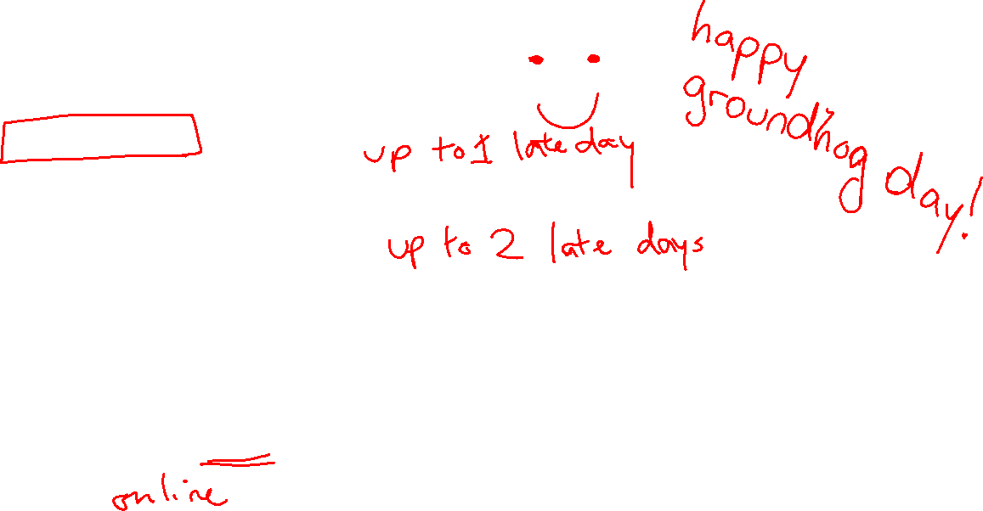
Announcements
Assignments:
HW3 (online)
    Due Tue 2/7, 10 pm
P1: Search and Games
    Due Mon 2/6, 10 pm
    Submit to Gradescope early and as often as you like
Recitation:
Last week to “shop around”
Stay tuned to Piazza for informal recitation switch form
Outlook: HW4 due 2/14, Exam 1 2/16

Slide 2
Plan
Last Time
Constraint Satisfaction Problems
Today
CSPs continued (MRV, LCV)
Local Search

Slide 3
Back to CSPs Lecture

Slide 4
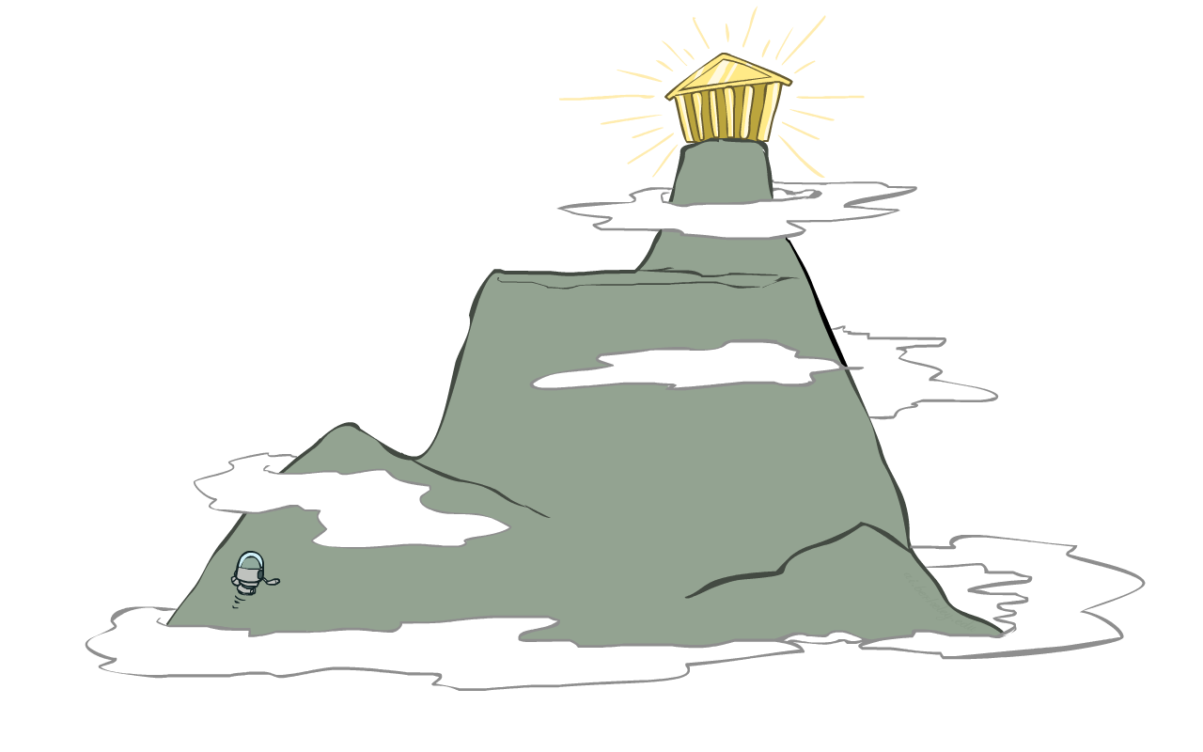
AI: Representation and Problem Solving
Local Search
Instructor: Stephanie Rosenthal
Slide credits: CMU AI, http://ai.berkeley.edu

Slide 5

Local Search
Can be applied to identification problems (e.g., CSPs), as well as some planning and optimization problems
For identification problems, we use a complete-state formulation, e.g., all variables assigned in a CSP (may not satisfy all the constraints)
For planning problems, typically we make local decisions. e.g., not a plan all the way to the goal or not a deep search

Slide 6
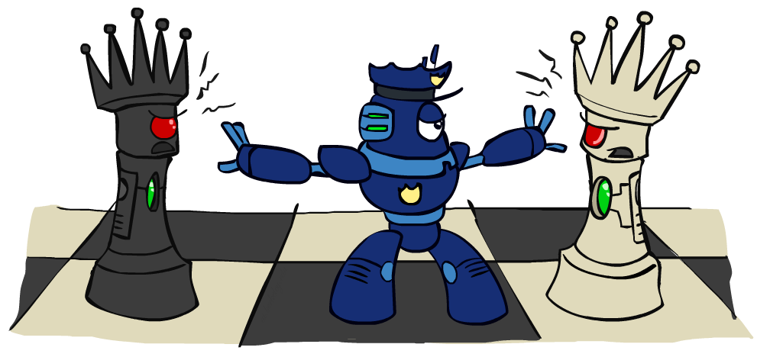
Iterative Improvement for CSPs

Slide 7
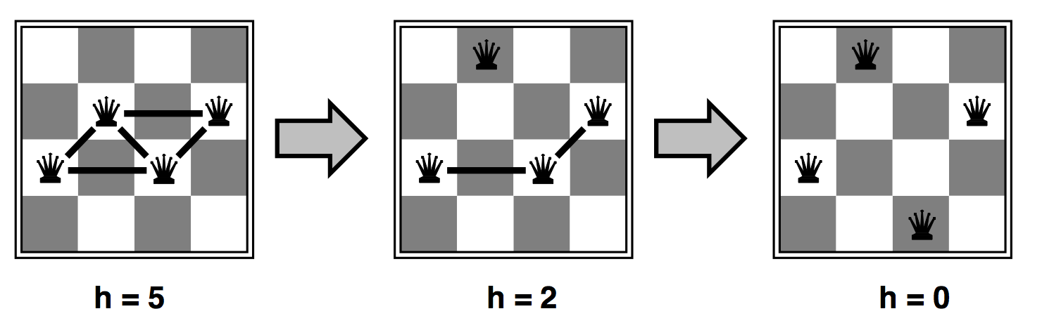

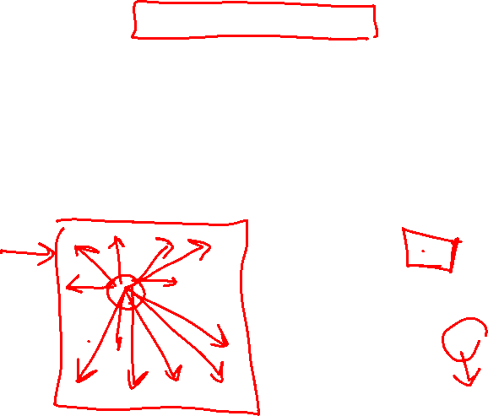
Iterative Improvement for CSPs
Start with an arbitrary assignment, iteratively reassign variable values
While not solved,
  Variable selection: randomly select a conflicted variable
  Value selection with min-conflicts heuristic $h$: Choose a value that violates the fewest constraints (break tie randomly)
For $n$-Queens: Variables $x_{i}∈\{1..n\}$; Constraints $x_{i}≠x_{j}$, $\left|x_{i}−x_{j}\right|≠\left|i−j\right|,∀i≠j$
Notes:
(row index of queen in column $i$)

Slide 8
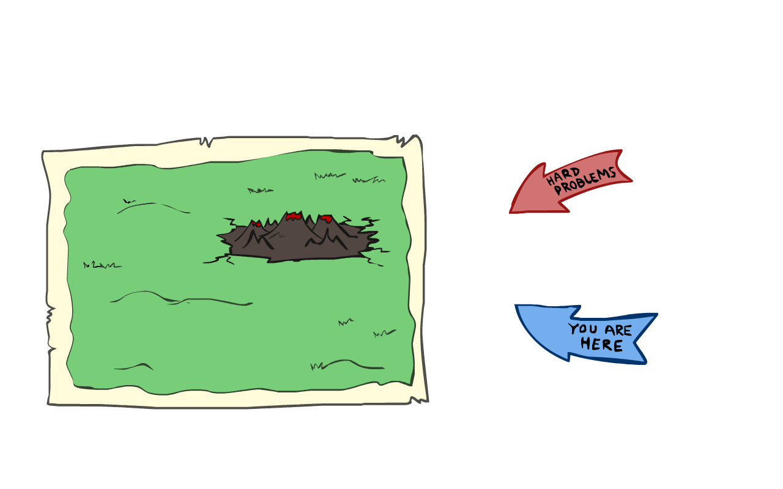
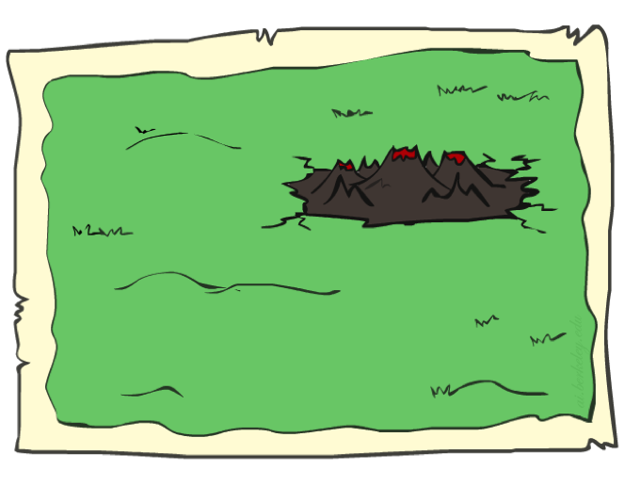
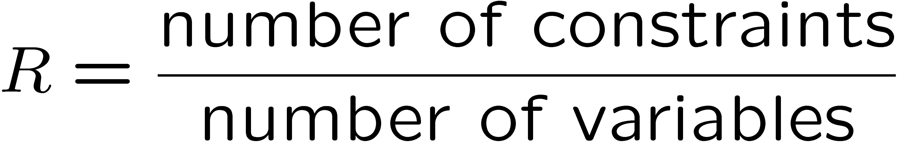
Iterative Improvement for CSPs
Given random initial state, can solve n-queens in almost constant time for arbitrary n with high probability (e.g., n = 10,000,000)!
Same for any randomly-generated CSP except in a narrow range of the ratio

Slide 9
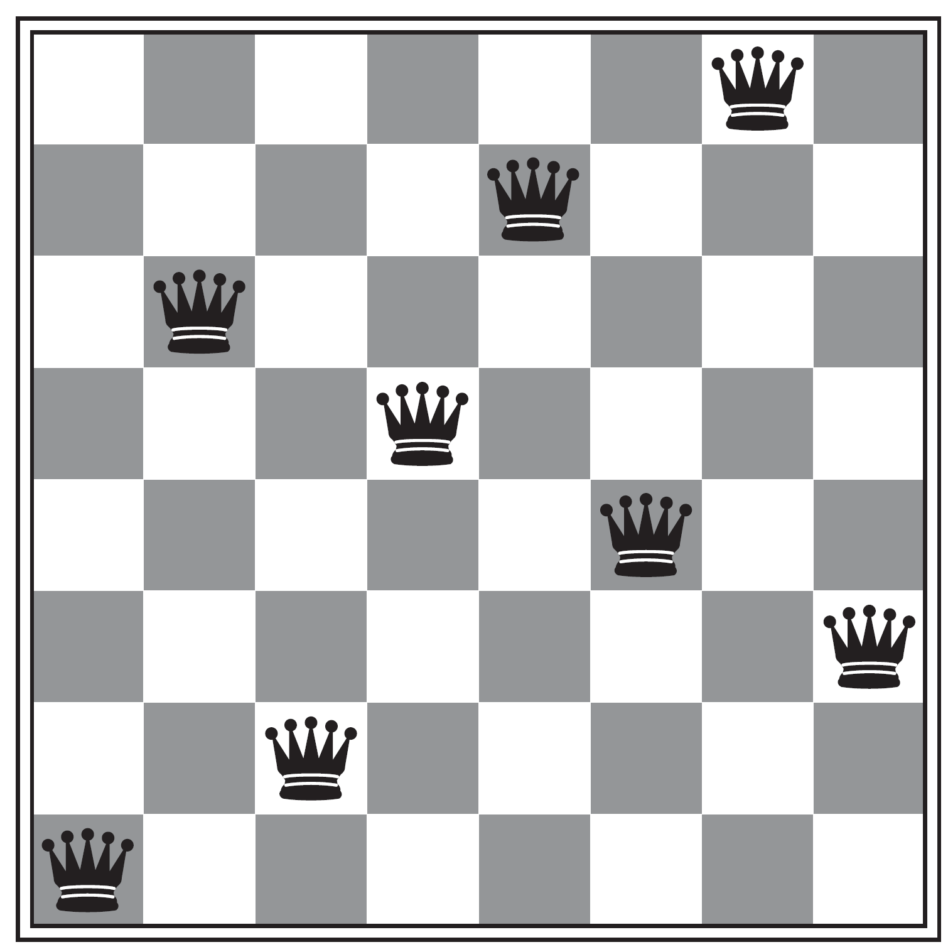


Local Search
A local search algorithm is…
  Optimal if it always finds a global minimum/maximum heuristic value
$$h=1$$
Will an iterative improvement algorithm for CSPs always find a solution?
No! May get stuck in a local optima

Slide 10
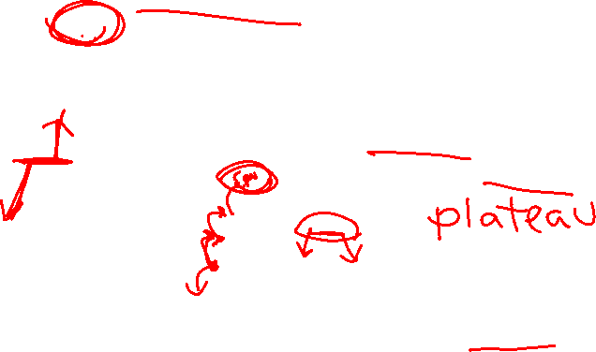
State-Space Landscape
In identification problems, could be a function measuring how close you are to a valid solution, e.g., $−1×$ #conflicts in n-Queens/CSP
What’s the difference between shoulder and flat local maximum (both are plateaux)?

Slide 11
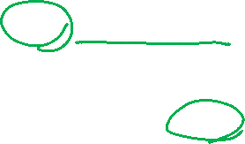
Hill Climbing (Greedy Local Search)
Simple, general idea:
  Start wherever
  Repeat: move to the best “neighboring” state (successor state) instead of picking variable randomly
  If no neighbors better than current, quit

Slide 12
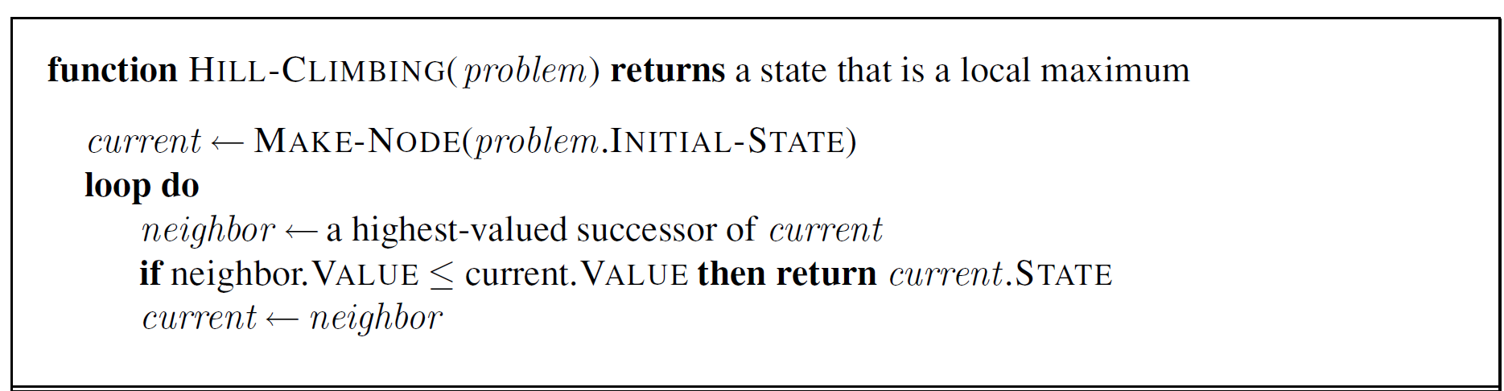


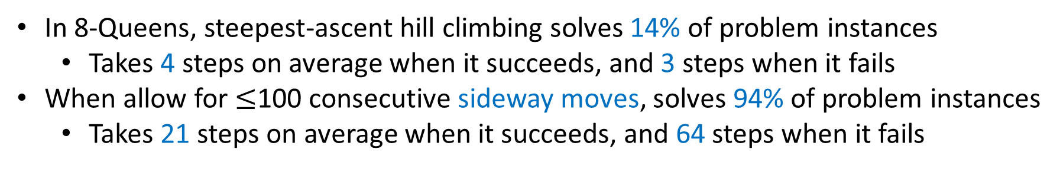
Hill Climbing (Greedy Local Search)
What if there is a tie?
Typically break ties randomly
What if we do not stop here?
Make a sideway move if “$=$”
In 8-Queens, steepest-ascent hill climbing solves 14% of problem instances
  Takes 4 steps on average when it succeeds, and 3 steps when it fails
When allow for $≤$100 consecutive sideway moves, solves 94% of problem instances
  Takes 21 steps on average when it succeeds, and 64 steps when it fails

Slide 13
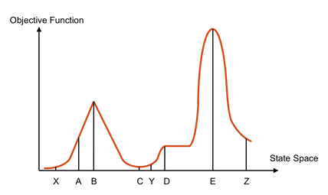
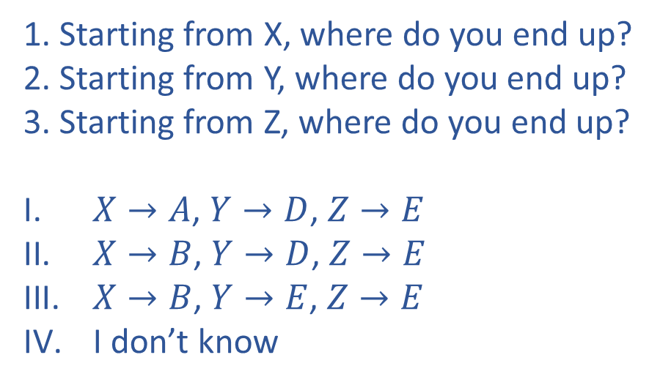

Poll 1: Hill Climbing
1. Starting from X, where do you end up?
2. Starting from Y, where do you end up?
3. Starting from Z, where do you end up?
$X→A$, $Y→D$, $Z→E$
$X→B$, $Y→D$, $Z→E$
$X→B$, $Y→E$, $Z→E$
I don’t know

Slide 14
Variants of Hill Climbing
Random-restart hill climbing
  “If at first you don’t succeed, try, try again.”
  What kind of landscape will random-restarts hill climbing work the best?
Stochastic hill climbing
  Choose randomly from the uphill moves, with probability dependent on the “steepness” (i.e., amount of improvement)
  Converge slower than steepest ascent, but may find better solutions
First-choice hill climbing
  Generate successors randomly (one by one) until a better one is found
  Suitable when there are too many successors to enumerate

Slide 15

Variants of Hill Climbing
What if variables are continuous, e.g. find $x∈[0,1]$ that maximizes $f\left(x\right)$?
  Gradient ascent
    Use gradient to find best direction
    Use the magnitude of the gradient to determine how big a step you move
Value space of variables

Slide 16
Random Walk
Uniformly randomly choose a neighbor to move to
Save the best you’ve seen so far
Stop after K moves
What happens to the solution as K increases?

Slide 17

Simulated Annealing
Combines random walk and hill climbing
Inspired by statistical physics
Annealing – Metallurgy
  Heating metal to high temperature then cooling
  Reaching low energy state
Simulated Annealing – Local Search
  Allow for downhill moves and make them rarer as time goes on
  Escape local maxima and reach global maxima

Slide 18
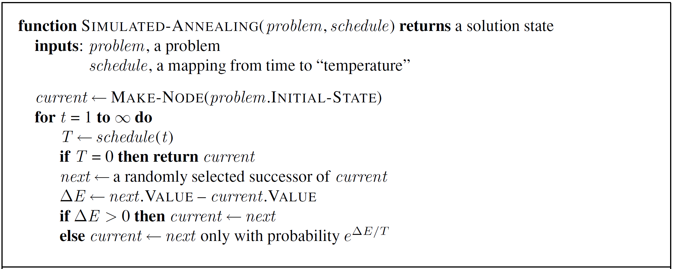
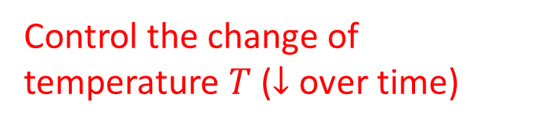
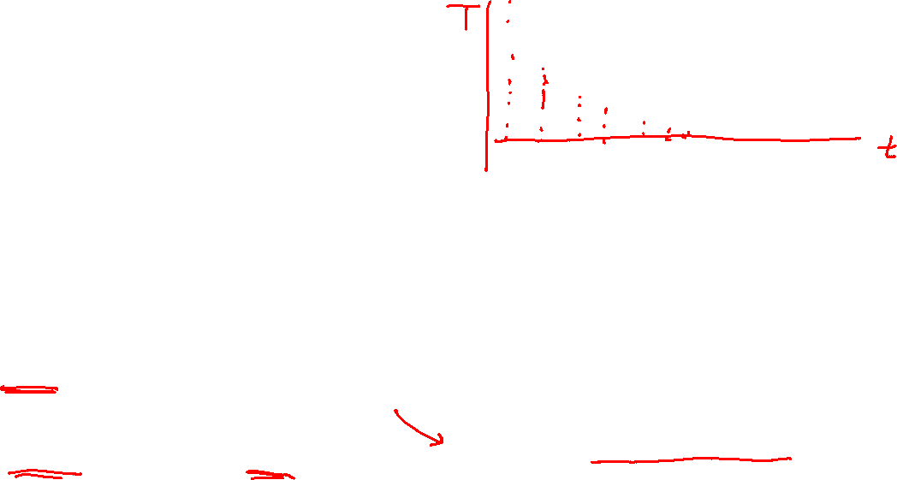
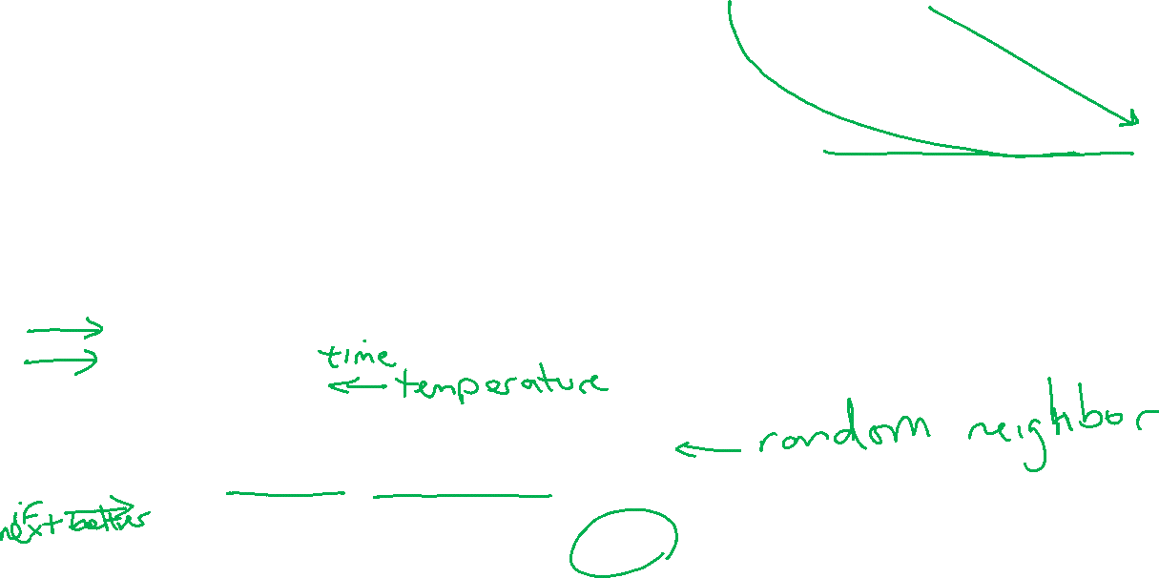
Simulated Annealing
Control the change of temperature $T$ ($↓$ over time)
Almost the same as hill climbing except for a random successor
Unlike hill climbing, move downhill with some prob.

Slide 19

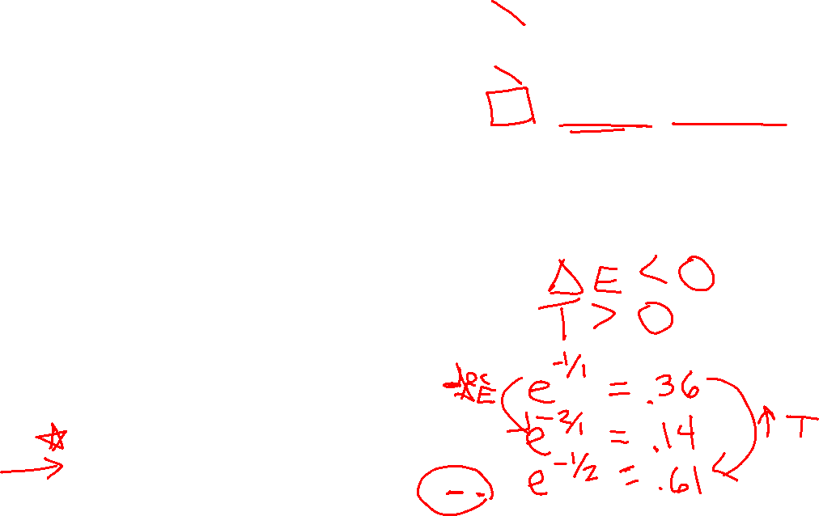
Poll 2:
Decrease $T$, decrease $ΔE$
Decrease $T$, increase $ΔE$
Increase $T$, decrease $ΔE$
Increase $T$, increase $ΔE$
Which of the following will make it more likely that we’ll take a downward step?

Slide 20

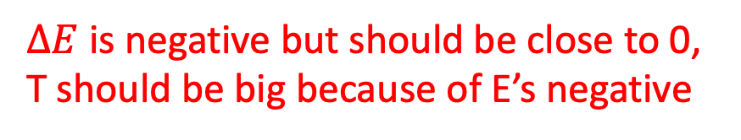
Poll 2:
Decrease $T$, decrease $ΔE$
Decrease $T$, increase $ΔE$
Increase $T$, decrease $ΔE$
Increase $T$, increase $ΔE$
Which of the following will make it more likely that we’ll take a downward step?
$ΔE$ is negative but should be close to 0, T should be big because of E’s negative

Slide 21
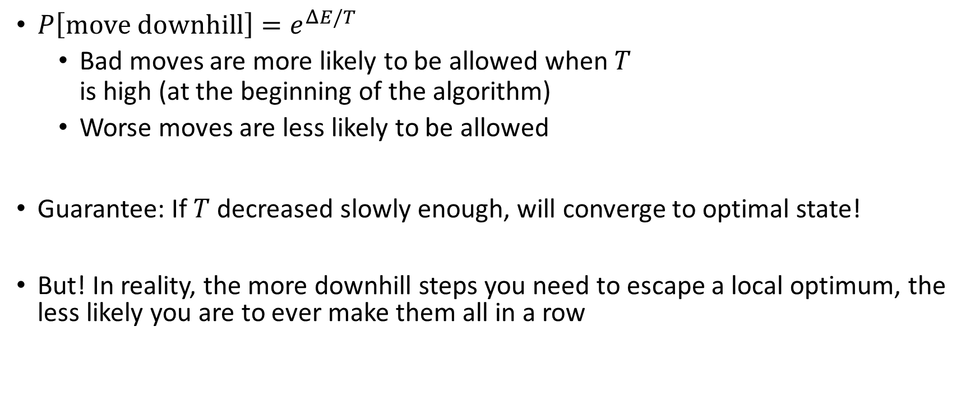
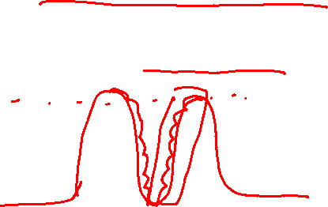
Simulated Annealing
$P\left[move downhill\right]=e^{ΔE/T}$
  Bad moves are more likely to be allowed when $T$
  is high (at the beginning of the algorithm)
  Worse moves are less likely to be allowed
Guarantee: If $T$ decreased slowly enough, will converge to optimal state!
But! In reality, the more downhill steps you need to escape a local optimum, the less likely you are to ever make them all in a row

Slide 22

Summary: Local Search
Maintain a constant number of current nodes or states, and move to “neighbors” or generate “offspring” in each iteration
  Do not maintain a search tree or multiple paths
  Typically, do not retain the path to the node
Advantages
  Use little memory
  Can potentially solve large-scale problems or get a reasonable (suboptimal or almost feasible) solution

