Slide 1
Warm-up: DFS Graph Search
S
Why is the answer S->B->G, not S->A->B->G?
After all, we were doing DFS and breaking ties alphabetically.
A
B
C
G

Slide 2
Announcements
Assignments:
HW1 (online) due tonight
Can use late day (1 per written/online assignment, 2 per programming, 6 total for semester)
HW2 (written) out tonight
Due 1/31 at 10pm
P1 out
Due Monday 2/6 at 10pm

Slide 3
Plan
Last time
Tree search vs graph search
BFS, DFS, Uniform cost search
Today
Heuristics
Greedy search
A* search
Optimality
More on heuristics

Slide 4
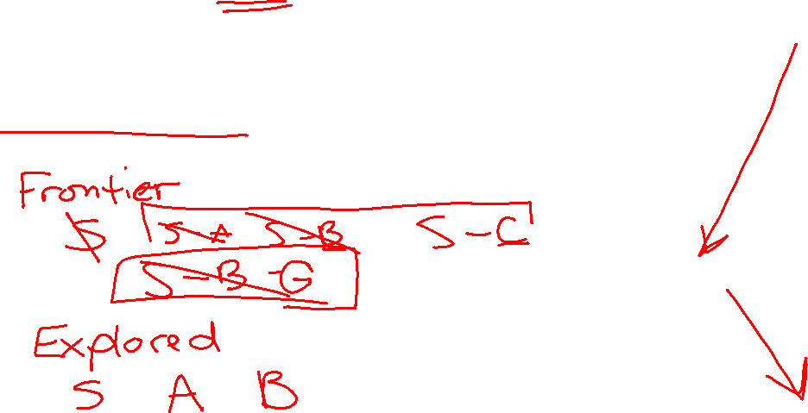
Warm-up: DFS Graph Search
S
Why is the answer S->B->G, not S->A->B->G?
After all, we were doing DFS and breaking ties alphabetically.
A
B
C
G

Slide 5
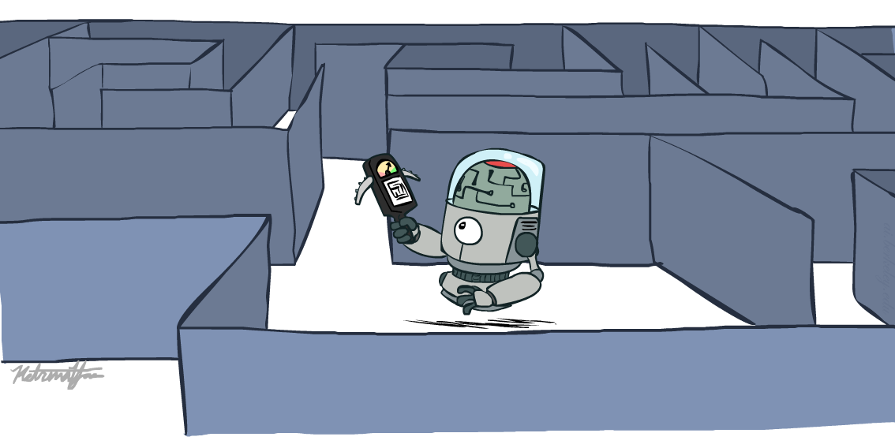
AI: Representation and Problem Solving
Informed Search
Instructor: Stephanie Rosenthal
Slide credits: CMU AI, http://ai.berkeley.edu

Slide 6
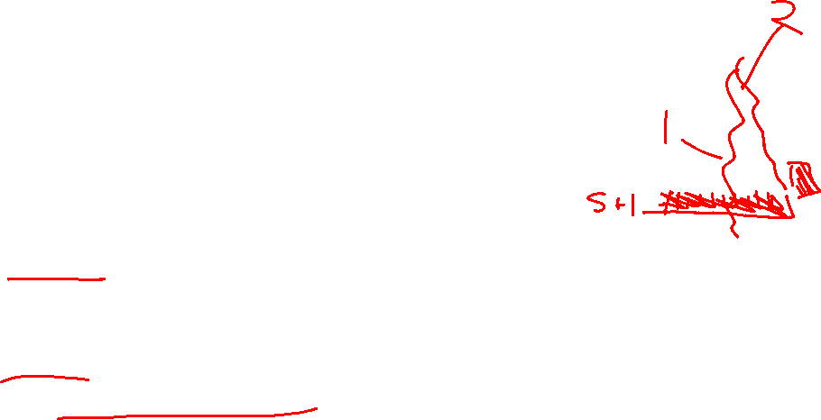
Breadth-First Search (BFS) Properties
What nodes does BFS expand?
Processes all nodes above shallowest solution
Let depth of shallowest solution be s
Search takes time O(b^{s})
How much space does the frontier take?
Has roughly the last tier, so O(b^{s})
Is it complete?
s must be finite if a solution exists, so yes!
Is it optimal?
Only if costs are all the same (more on costs later)
1 node
b
…
b nodes
s tiers
b² nodes
b^{s} nodes
b^{m} nodes

Slide 7

Uniform Cost Search (UCS) Properties
What nodes does UCS expand?
Processes all nodes with cost less than cheapest solution
If that solution costs C* and step costs are at least ε , then the “effective depth” is roughly C*/ε
Takes time O(b^{C*/ε}) (exponential in effective depth)
How much space does the frontier take?
Has roughly the last tier, so O(b^{C*/ε})
Is it complete?
Assuming best solution has a finite cost and minimum step cost is positive, yes!
Is it optimal?
Yes! (Proof via A*)
b
c ≤ 1
…
C*/ε “tiers”
c ≤ 2
c ≤ 3

Slide 8
Uniform Cost Issues
Strategy:
Explore (expand) the lowest path cost on frontier
The good:
UCS is complete and optimal!
The bad:
Explores options in every “direction”
No information about goal location
We’ll fix that today!
…
c ≤ 1
c ≤ 2
c ≤ 3
Start
Goal

Slide 9
function GRAPH-SEARCH(problem) returns a solution, or failure
initialize the explored set to be empty
initialize the frontier as a priority queue using some metric as the priority
add initial state of problem to frontier with initial metric = 0 loop do
if the frontier is empty then
return failure choose a node and remove it from the frontier if the node contains a goal state then
return the corresponding solution
add the node state to the explored set
for each resulting child from node
if the child state is not already in the frontier or explored set then
add child to the frontier
else if the child is already in the frontier with worse metric then
replace that frontier node with child

Slide 10
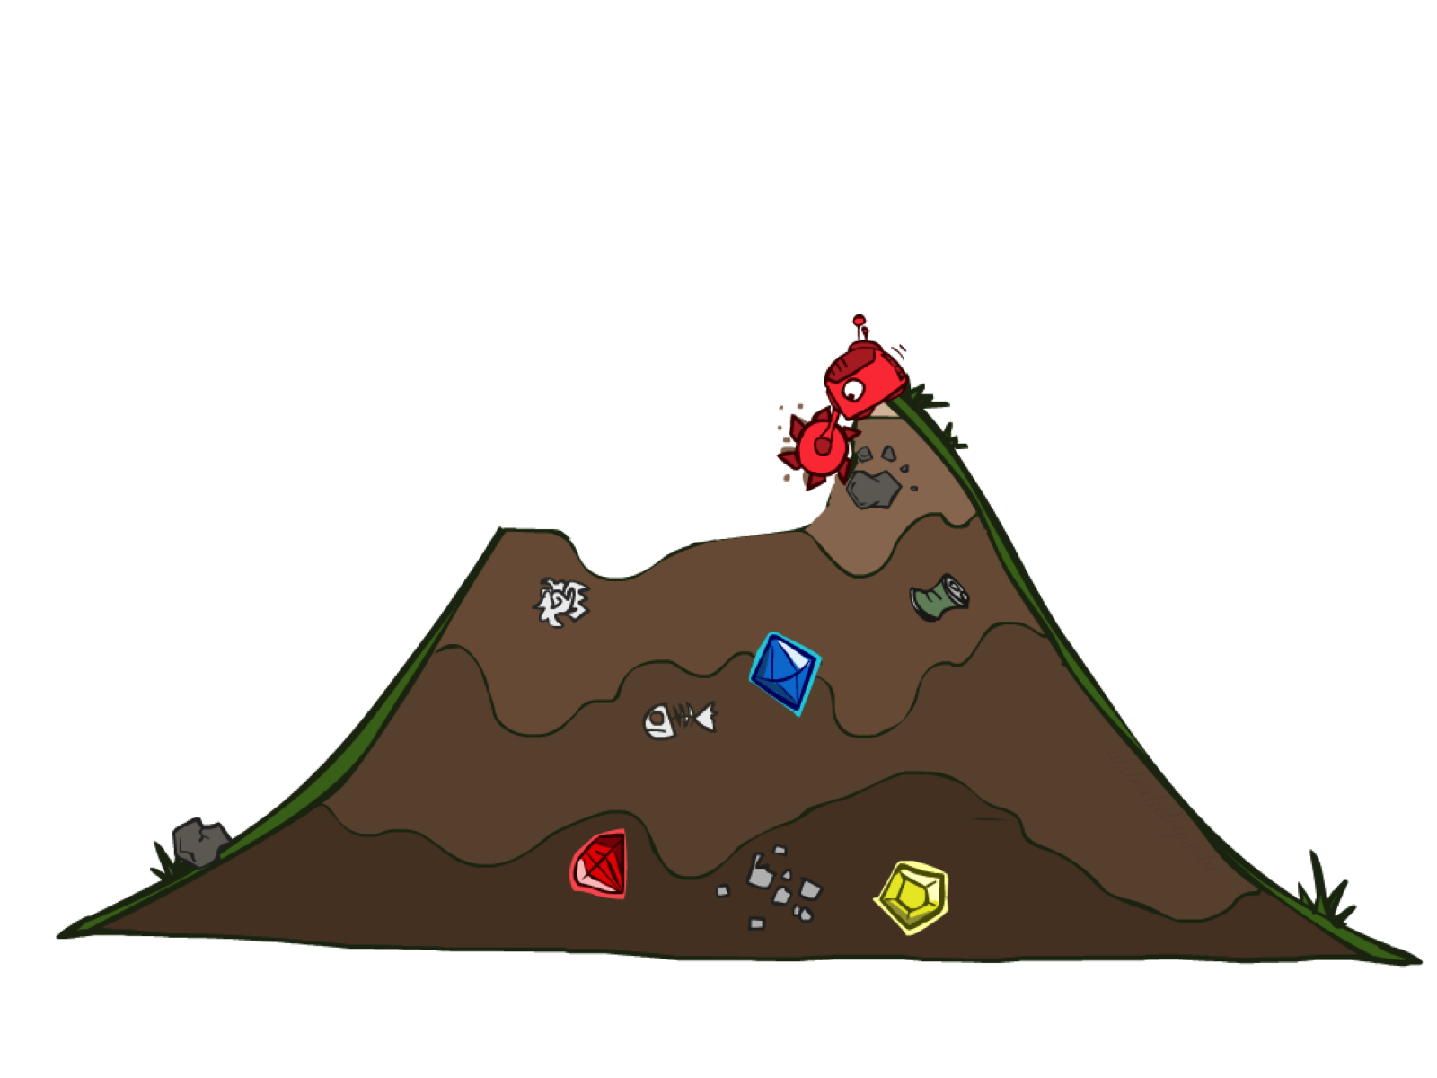
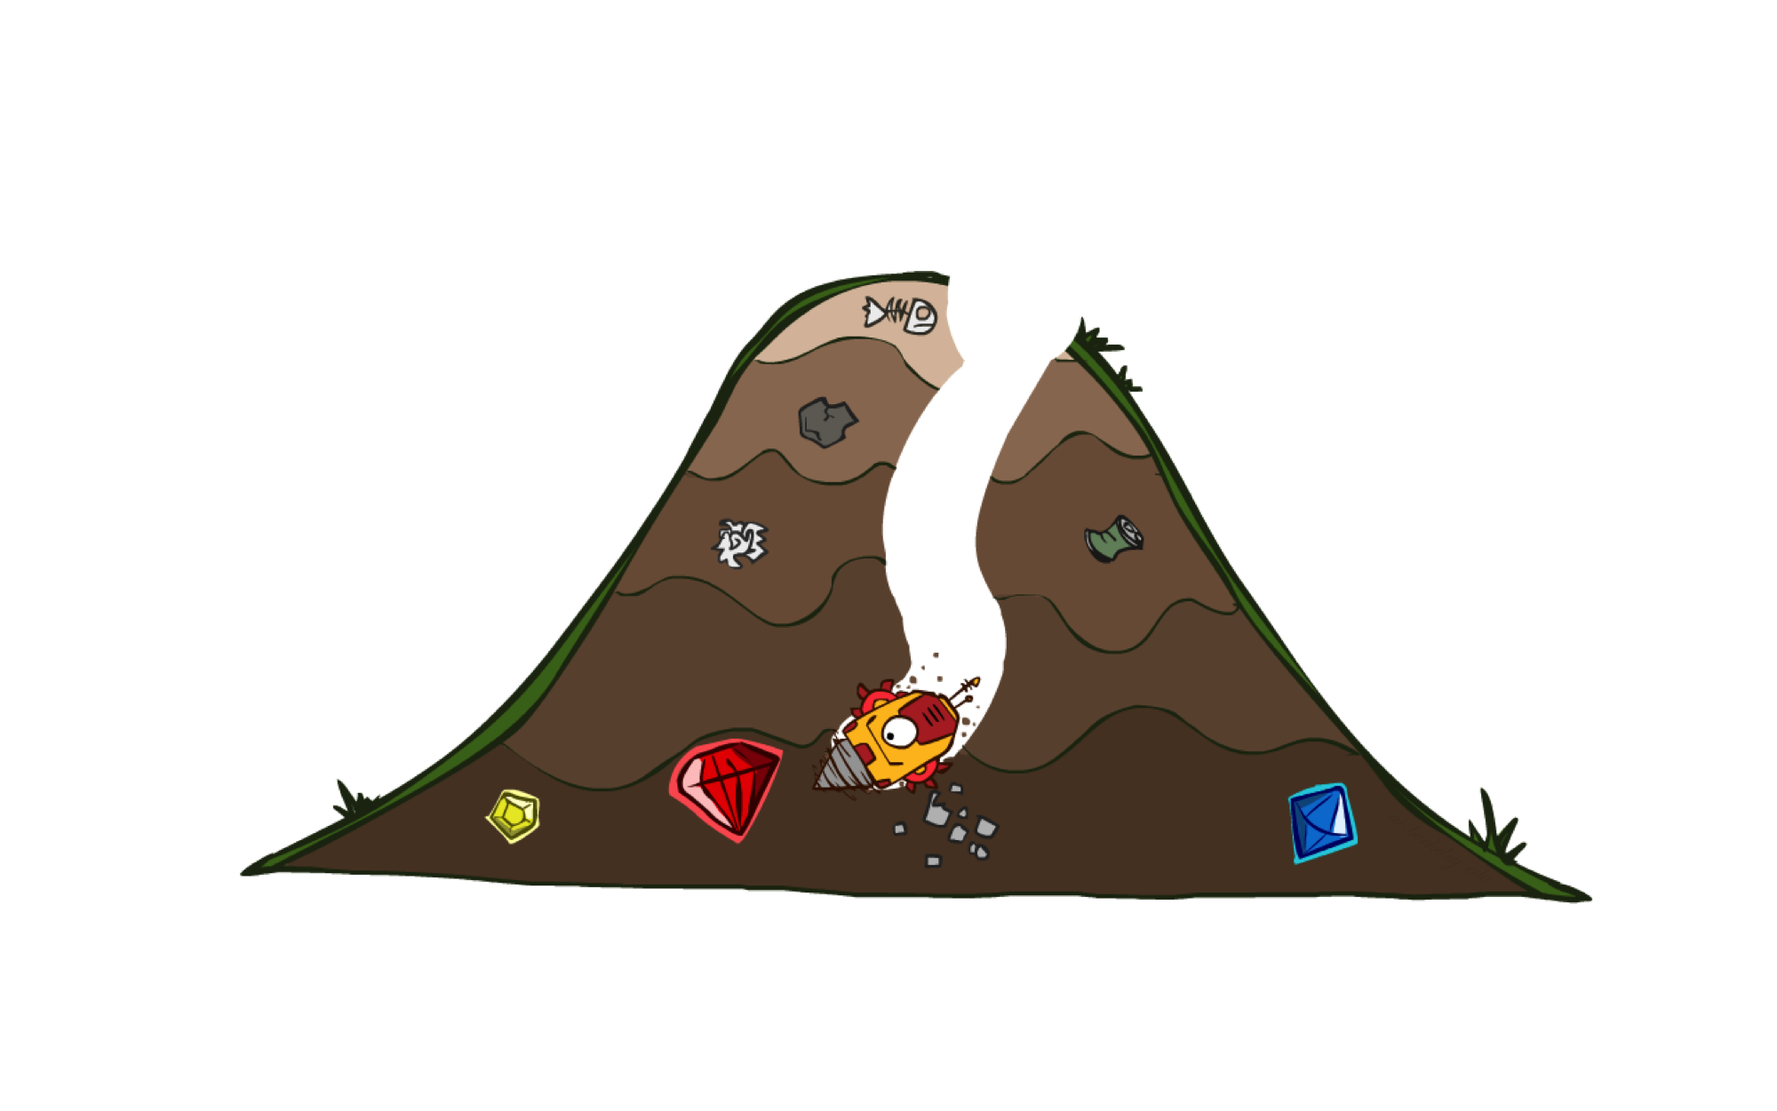
Uninformed vs Informed Search

Slide 11

Today
Informed Search
Heuristics
Greedy Search
A* Search

Slide 12
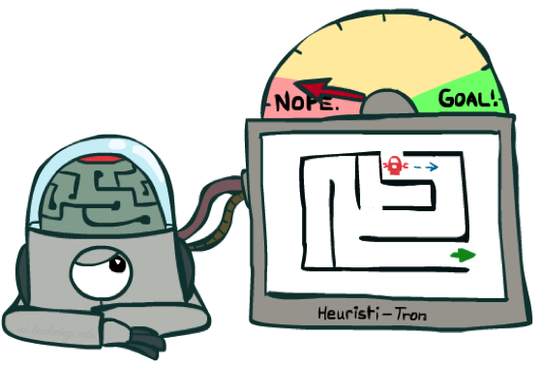
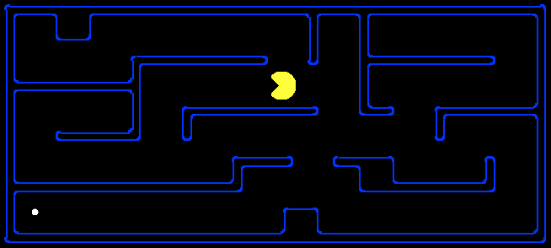
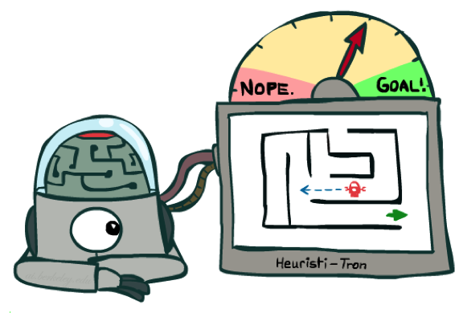
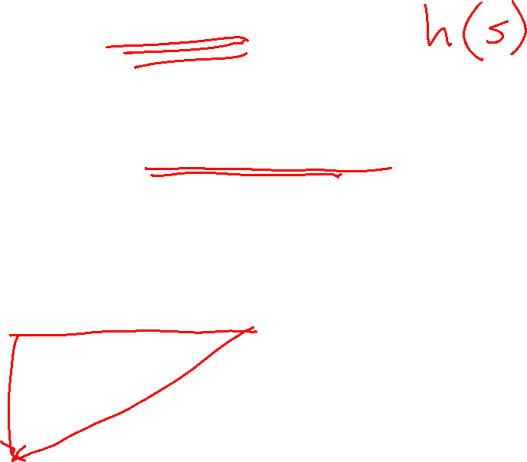
Search Heuristics
A heuristic is:
A function that estimates how close a state is to a goal
Designed for a particular search problem
Examples: Manhattan distance, Euclidean distance for pathing
10
5
11.2

Slide 13
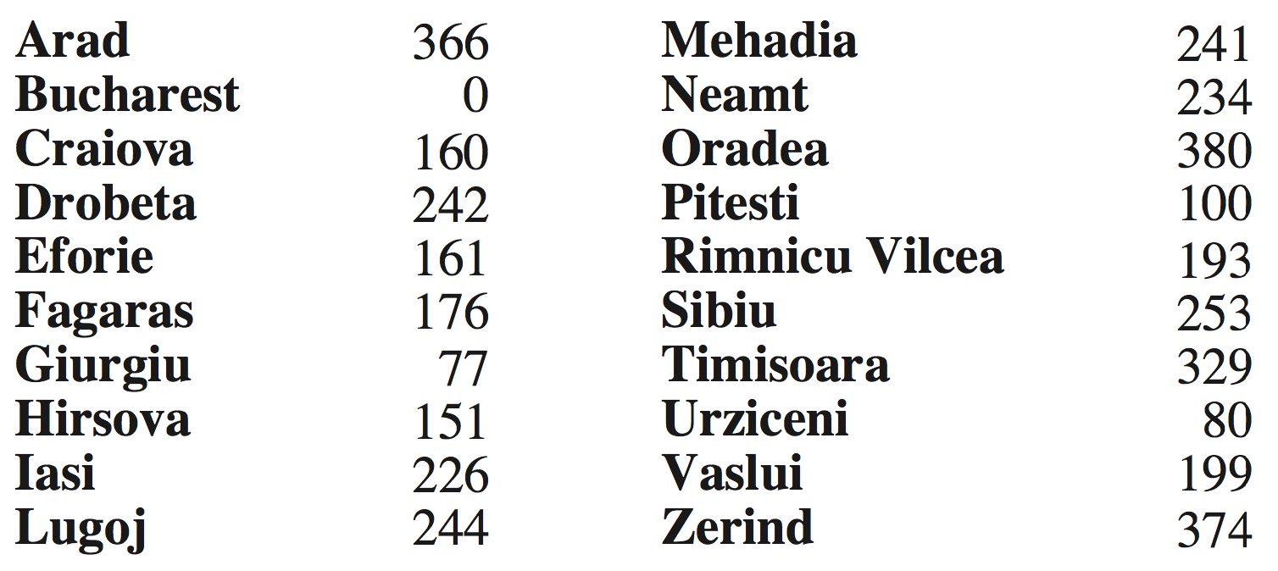

Example: Euclidean distance to Bucharest
h(state) → value

Slide 14
Effect of heuristics
Guide search towards the goal instead of all over the place
Start
Goal
Start
Goal
Informed
Uninformed

Slide 15
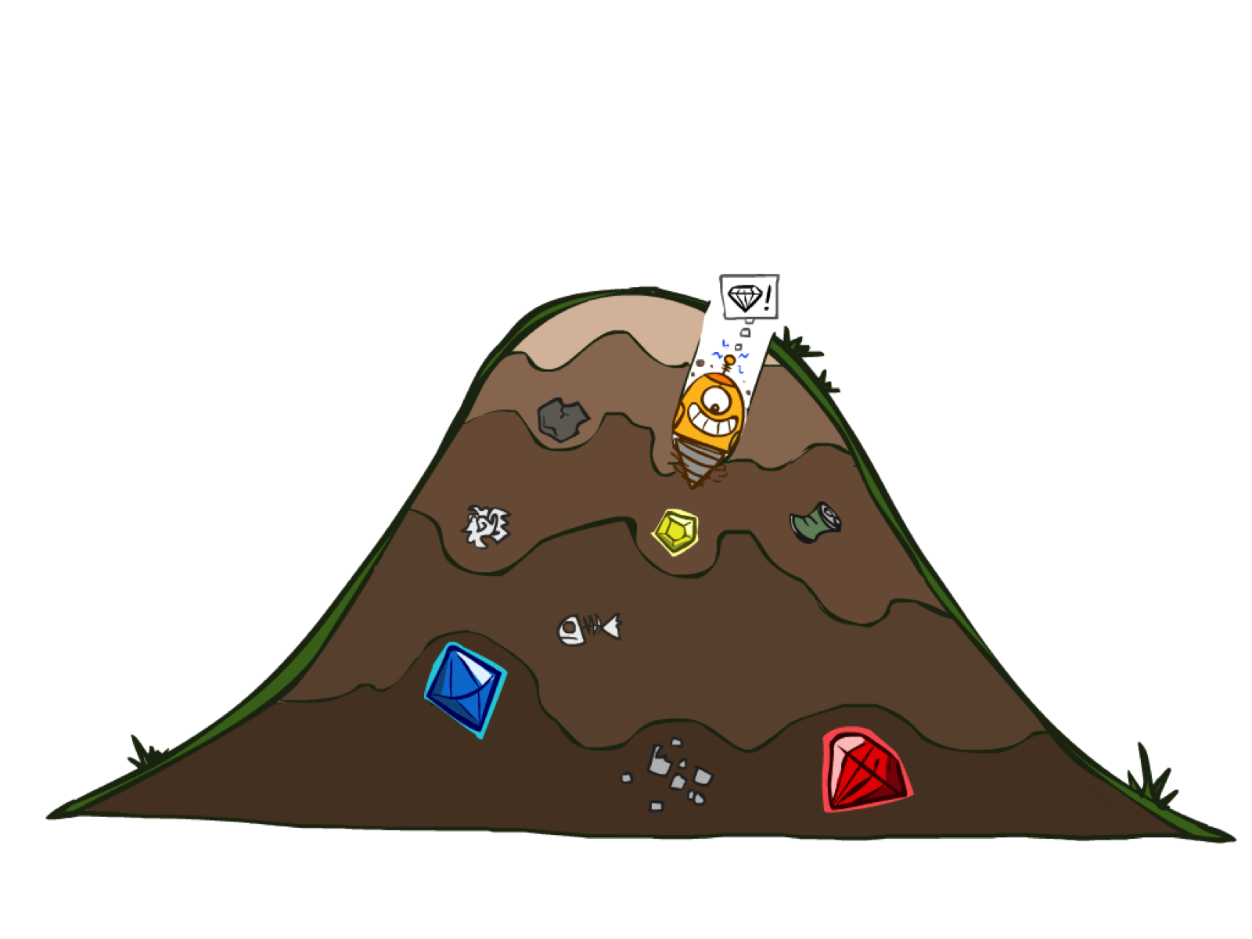
Greedy Search

Slide 16

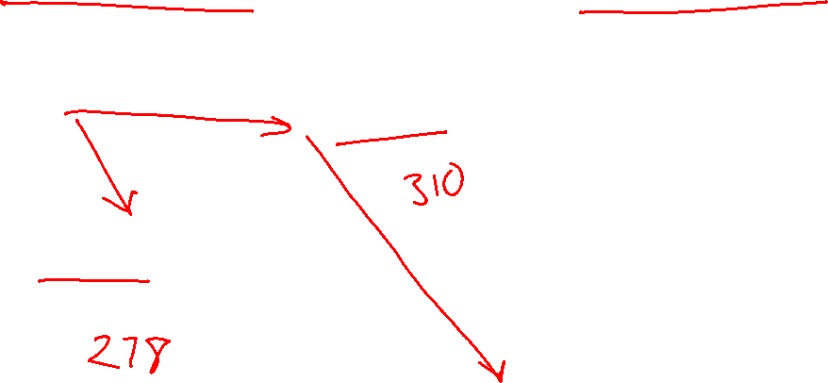
Greedy Search
Expand the node that seems closest…(order frontier by h)
What can possibly go wrong?
Sibiu-Fagaras-Bucharest =
99+211 = 310
Sibiu-Rimnicu Vilcea-Pitesti-Bucharest =
80+97+101 = 278
h= 253
h=176
h=193
1000000
h=100
h=0

Slide 17
Greedy Search
b
Strategy: expand a node that seems closest to a goal state, according to h
Problem 1: it chooses a node even if it’s at the end of a very long and winding road
Problem 2: it takes h literally even if it’s completely wrong
…
Notes:
For any search problem, you know the goal. Now, you have an idea of how far away you are from the goal.

Slide 18
A* Search

Slide 19



A* Search
UCS
Greedy
A*
Notes:
Notes: these images licensed from iStockphoto for UC Berkeley use.

Slide 20

Combining UCS and Greedy
Uniform-cost orders by path cost, or backward cost g(n)
Greedy orders by goal proximity, or forward cost h(n)
A* Search orders by the sum: f(n) = g(n) + h(n)
8
g = 0 h=6
S
e
h=1
g = 1 h=5
a
1
1
3
2
g = 2 h=6
g = 9 h=1
S
a
d
G
b
d
g = 4 h=2
e
h=6
1
h=5
h=2
h=0
1
g = 3 h=7
g = 6 h=0
g = 10 h=2
c
b
c
G
d
h=7
h=6
g = 12 h=0
G
Example: Teg Grenager

Slide 21

function UNIFORM-COST-SEARCH(problem) returns a solution, or failure
initialize the explored set to be empty
initialize the frontier as a priority queue using g(n) as the priority
add initial state of problem to frontier with priority g(S) = 0 loop do
if the frontier is empty then
return failure choose a node and remove it from the frontier if the node contains a goal state then
return the corresponding solution
add the node state to the explored set
for each resulting child from node
if the child state is not already in the frontier or explored set then
add child to the frontier
else if the child is already in the frontier with higher g(n) then
replace that frontier node with child

Slide 22
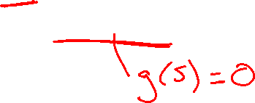
function A-STAR-SEARCH(problem) returns a solution, or failure
initialize the explored set to be empty
initialize the frontier as a priority queue using f(n) = g(n) + h(n) as the priority
add initial state of problem to frontier with priority f(S) = 0 + h(S) loop do
if the frontier is empty then
return failure choose a node and remove it from the frontier if the node contains a goal state then
return the corresponding solution
add the node state to the explored set
for each resulting child from node
if the child state is not already in the frontier or explored set then
add child to the frontier
else if the child is already in the frontier with higher f(n) then
replace that frontier node with child

Slide 23
A* Search Algorithms
A* Tree Search
Same tree search algorithm but with a frontier that is a priority queue using priority f(n) = g(n) + h(n)

Slide 24

A* Search Algorithms
A* Tree Search
Same tree search algorithm but with a frontier that is a priority queue using priority f(n) = g(n) + h(n)
A* Graph Search
Same as UCS graph search algorithm but with a frontier that is a priority queue using priority f(n) = g(n) + h(n)

Slide 25
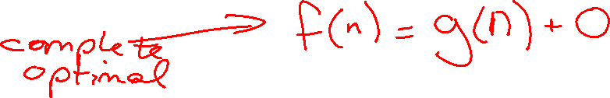
UCS vs A* Contours
Uniform-cost expands equally in all “directions”
A* expands mainly toward the goal, but does hedge its bets to ensure optimality
Start
Goal
Start
Goal

Slide 26
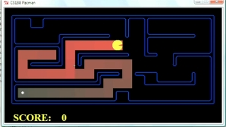
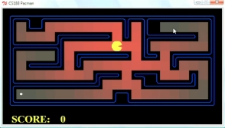
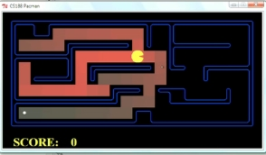
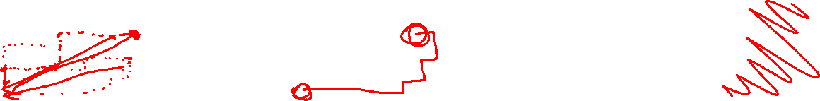
Comparison
Greedy
Uniform Cost
A*

Slide 27
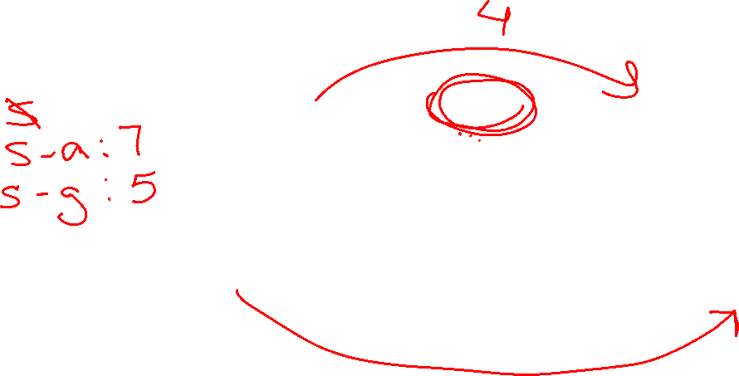
Is A* Optimal?
h = 6
1
A
3
S
h = 7
G
h = 0
5
What went wrong?
Actual bad goal cost < estimated good goal cost
We need estimates to be less than actual costs!

Slide 28
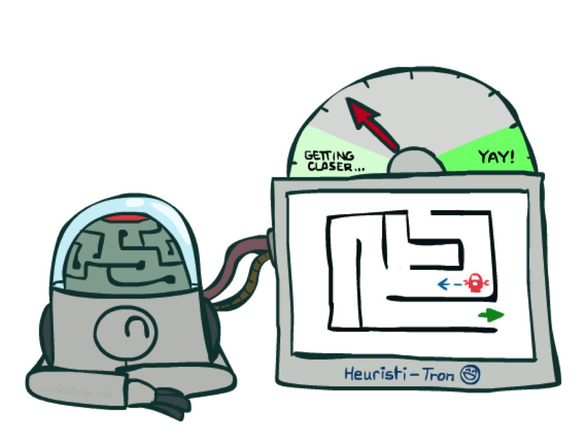
Admissible Heuristics

Slide 29
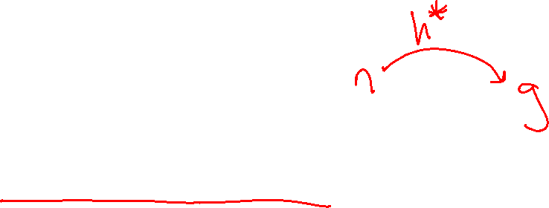
Admissible Heuristics
A heuristic h is admissible (optimistic) if:
0 ≤ h(n) ≤ h*(n)
where h*(n) is the true cost to a nearest goal
Example:
Coming up with admissible heuristics is most of what’s involved in using A* in practice.
15

Slide 30

Optimality of A* Tree Search

Slide 31
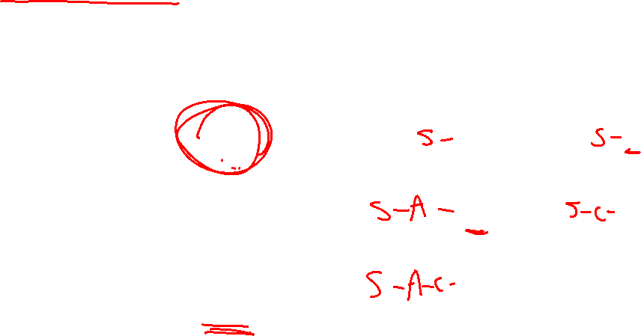
A* Tree Search
State space graph
Search tree
h=4
S (0+2)
1
A
1
h=1
S
C
A (1+4)
C (3+1)
h=2
3
3
C (2+1)
G (6+0)
G (5+0)
G
h=0

Slide 32

Optimality of A* Tree Search
Assume:
A is an optimal goal node
B is a suboptimal goal node
h is admissible
Claim:
A will be chosen for exploration (popped off the frontier) before B
…
A
B

Slide 33
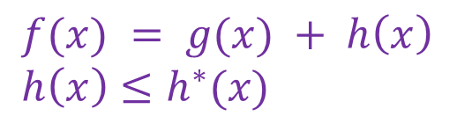
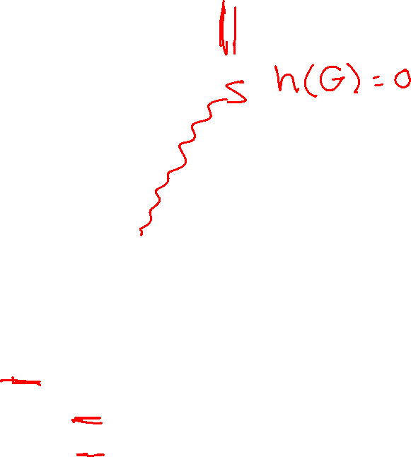
Optimality of A* Tree Search: Blocking
$f(x) = g(x) + h\left(x\right)$
$h\left(x\right)≤h^{∗}(x)$
Proof:
Imagine B is on the frontier
Some ancestor n of A is on the frontier, too (Maybe the start state; maybe A itself!)
Claim: n will be explored before B
f(n) is less than or equal to f(A)
…
n
A
B
f(n) = g(n) + h(n) Definition of f-cost
f(n) ≤ g(A) Admissibility of h
g(A) = f(A) h = 0 at a goal

Slide 34
Optimality of A* Tree Search: Blocking
$f(x) = g(x) + h\left(x\right)$
$h\left(x\right)≤h^{∗}(x)$
Proof:
Imagine B is on the frontier
Some ancestor n of A is on the frontier, too (Maybe the start state; maybe A itself!)
Claim: n will be explored before B
f(n) is less than or equal to f(A)
f(A) is less than f(B)
…
n
A
B
g(A) < g(B) Suboptimality of B
f(A) < f(B) h = 0 at a goal

Slide 35

Optimality of A* Tree Search: Blocking
$f(x) = g(x) + h\left(x\right)$
$h\left(x\right)≤h^{∗}(x)$
Proof:
Imagine B is on the frontier
Some ancestor n of A is on the frontier, too (Maybe the start state; maybe A itself!)
Claim: n will be explored before B
f(n) is less than or equal to f(A)
f(A) is less than f(B)
n is explored before B
All ancestors of A are explored before B
A is explored before B
A* search is optimal
…
n
A
B
f(n) ≤ f(A) < f(B)

Slide 36
Optimality of A* Graph Search

Slide 37
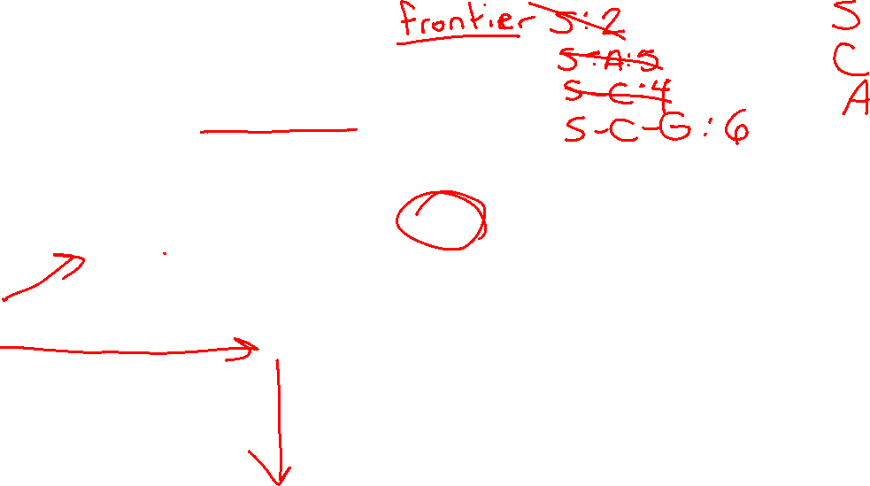
Poll 1: A* Graph Search
What nodes does A* graph search consider during its search?
h=4
A) S, S-A, S-C, S-C-G
1
A
1
h=1
B) S, S-A, S-C, S-A-C, S-C-G
S
C
C) S, S-A, S-A-C, S-A-C-G
h=2
3
D) S, S-A, S-C, S-A-C, S-A-C-G
3
G
h=0

Slide 38
Poll 1: A* Graph Search
What paths does A* graph search consider during its search?
h=4
A) S, S-A, S-C, S-C-G
1
A
1
h=1
B) S, S-A, S-C, S-A-C, S-C-G
S
C
C) S, S-A, S-A-C, S-A-C-G
h=2
3
D) S, S-A, S-C, S-A-C, S-A-C-G
3
G
h=0

Slide 39

A* Graph Search
A)
A
S
C
What does the resulting graph search
tree look like?
G
h=4
A
A
B)
1
1
S
C
h=1
S
C
h=2
3
G
3
C)
A
S
C
G
h=0
G

Slide 40
A* Graph Search Gone Wrong?
State space graph
Search tree
h=4
S (0+2)
1
A
1
h=1
S
C
A (1+4)
C (3+1)
h=2
3
3
G (6+0)
Simple check against explored set blocks C
G
Fancy check allows new C if cheaper than old
but requires recalculating C’s descendants
h=0

Slide 41
Admissibility of Heuristics
Main idea: Estimated heuristic values ≤ actual costs
Admissibility:
heuristic value ≤ actual cost to goal
h(A) ≤ actual cost from A to G
A
1
C
h=4
3
G

Slide 42
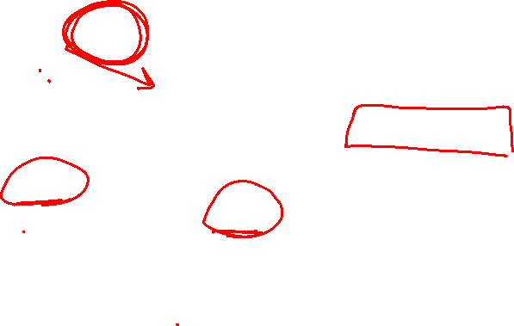
Consistency of Heuristics
Main idea: Estimated heuristic costs ≤ actual costs
Admissibility:
heuristic cost ≤ actual cost to goal
h(A) ≤ actual cost from A to G
Consistency:
“heuristic step cost” ≤ actual cost for each step
h(A) – h(C) ≤ cost(A to C)
triangle inequality
h(A) ≤ cost(A to C) + h(C)
Consequences of consistency:
The f value along a path never decreases
A* graph search is optimal
A
1
C
h=4
h=2
h=1
G

Slide 43
Optimality of A* Graph Search
Sketch: consider what A* does with a consistent heuristic:
Fact 1: In tree search, A* expands nodes in increasing total f value (f-contours)
Fact 2: For every state s, nodes that reach s optimally are explored before nodes that reach s suboptimally
Result: A* graph search is optimal
…
f ≤ 1
f ≤ 2
f ≤ 3

Slide 44
Optimality
Tree search:
A* is optimal if heuristic is admissible
UCS is a special case (h = 0)
Graph search:
A* optimal if heuristic is consistent
UCS optimal (h = 0 is consistent)
Consistency implies admissibility
In general, most natural admissible heuristics tend to be consistent, especially if from relaxed problems

Slide 45

Creating Heuristics

Slide 46
Creating Admissible Heuristics
Most of the work in solving hard search problems optimally is in coming up with admissible heuristics
Often, admissible heuristics are solutions to relaxed problems, where new actions are available
366
15

Slide 47
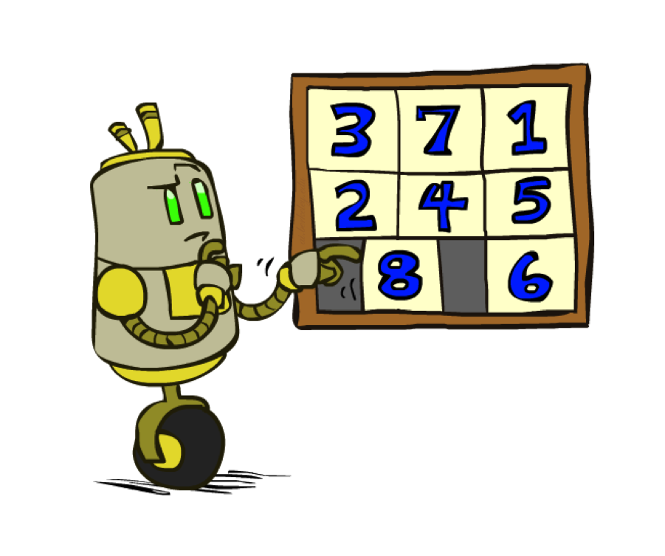
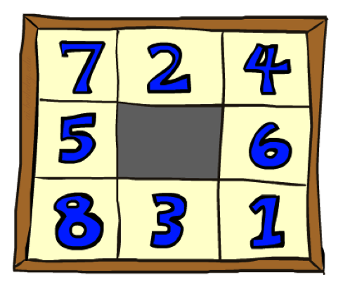
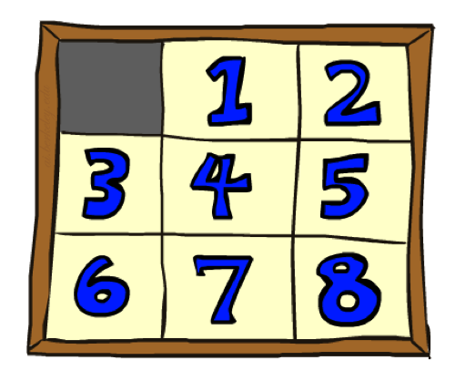
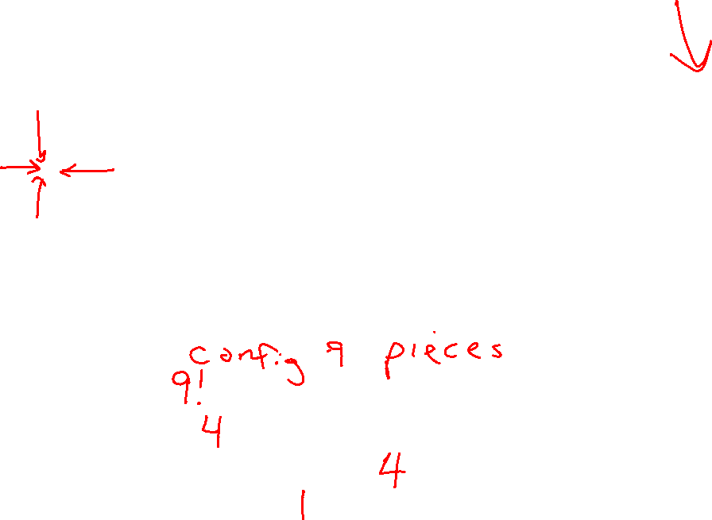
Example: 8 Puzzle
Start State
Actions
Goal State
What are the states?
How many states?
What are the actions?
How many actions from the start state?
What should the step costs be?

Slide 48
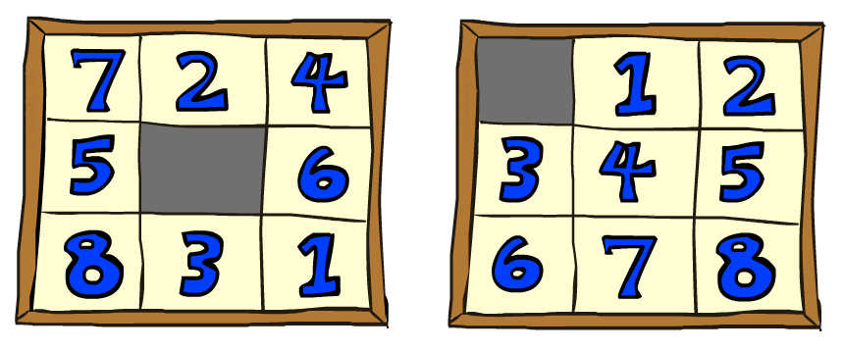

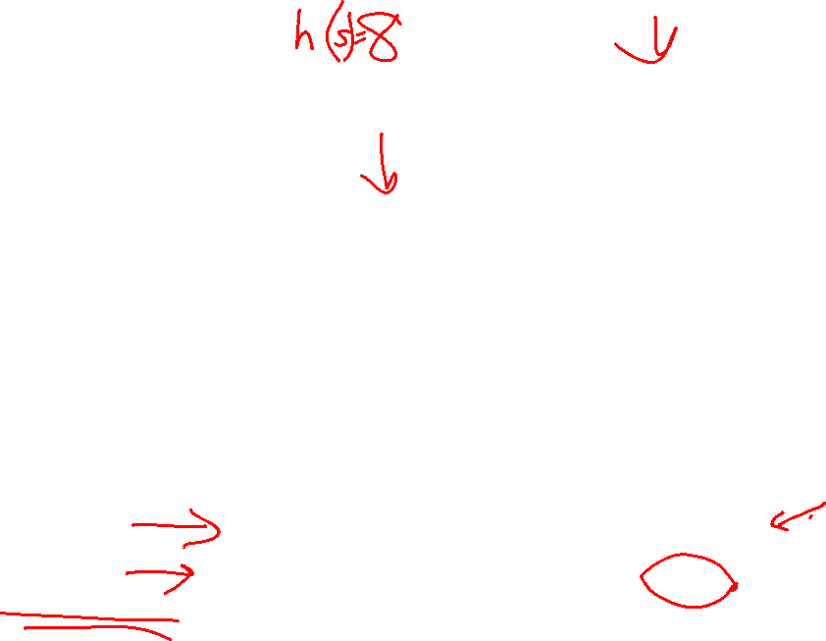
8 Puzzle I
Heuristic: Number of tiles misplaced
Why is it admissible?
h(start) =
This is a relaxed-problem heuristic
8
Start State
Goal State
 | Average nodes expanded when the optimal path has…
 | …4 steps | …8 steps | …12 steps
UCS | 112 | 6,300 | 3.6 x 10⁶
A*TILES | 13 | 39 | 227
Statistics from Andrew Moore

Slide 49
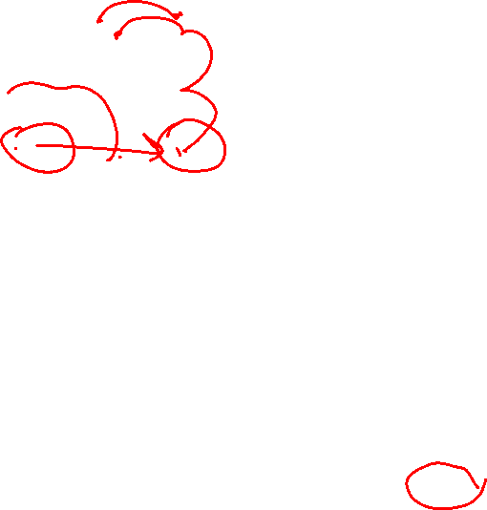
8 Puzzle II
What if we had an easier 8-puzzle where any tile could slide any direction at any time, ignoring other tiles?
Total Manhattan distance
Why is it admissible?
h(start) =
Start State
Goal State
 | Average nodes expanded when the optimal path has…
 | …4 steps | …8 steps | …12 steps
A*TILES | 13 | 39 | 227
A*MANHATTAN | 12 | 25 | 73
3 + 1 + 2 + … = 18

Slide 50

Combining heuristics
Dominance: h_{a} ≥ h_{c} if
∀n h_{a}(n) ≥ h_{c}(n)
Roughly speaking, larger is better as long as both are admissible
The zero heuristic is pretty bad (what does A* do with h=0?)
The exact heuristic is pretty good, but usually too expensive!
What if we have two heuristics, neither dominates the other?
Form a new heuristic by taking the max of both:
h(n) = max( h_{a}(n), h_{b}(n) )
Max of admissible heuristics is admissible and dominates both!
Notes:
Semi-lattice: x <= y <-> x = x ^ y

Slide 51
In-Class Activity
Q1: Practice creating heuristics and running Greedy and A* search
Q2: Walk through Amazon Robot Example

Slide 52

A*: Summary

Slide 53

A*: Summary
A* uses both backward costs and (estimates of) forward costs
A* is optimal with admissible / consistent heuristics
Heuristic design is key: often use relaxed problems

