Slide 1
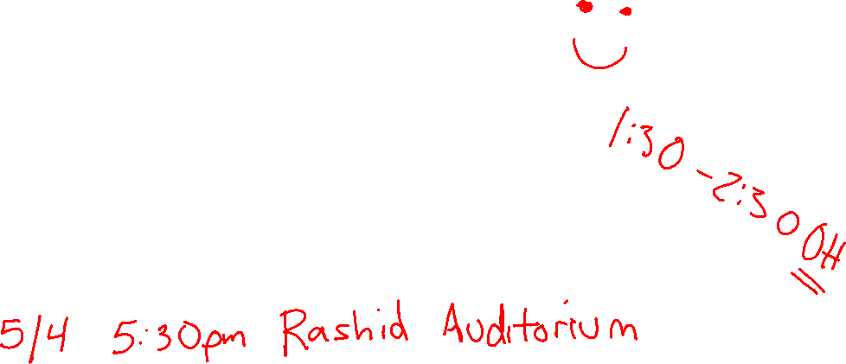
Announcements
Feedback (take time now to fill it out):
www.cmu.edu/hub/fce
https://ugrad.cs.cmu.edu/ta/S23/feedback
Assignments:
HW10 due tonight
P5 due Thursday night
Final Exam:
More heavily weighted towards the last 1/3 of the material
All material in the class (lectures, activities, recitations, homeworks) are fair game for the final
Look at post on Piazza with instructions

Slide 2
Homework 10 BONUS
We created a 10pt bonus HW10 problem so you can practice voting strategies on Gradescope
Due 5/4 at 4:30pm, no late days
Strong preference that you complete earlier!

Slide 3
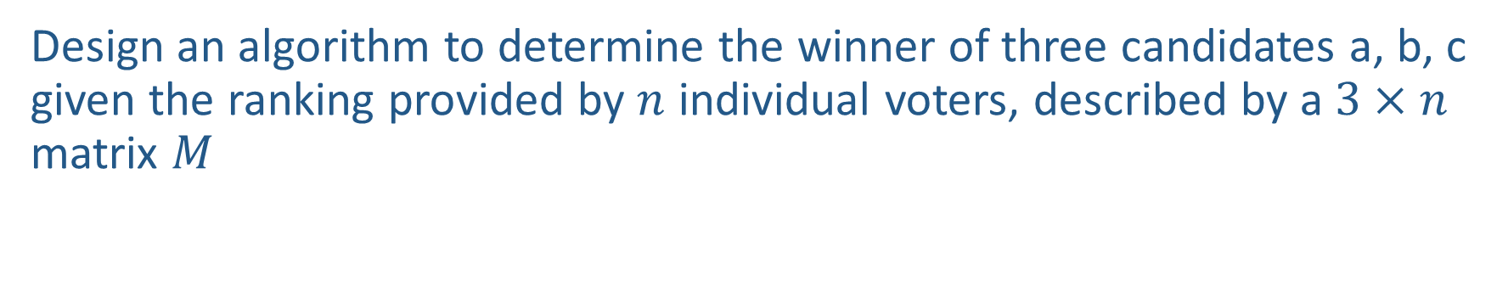

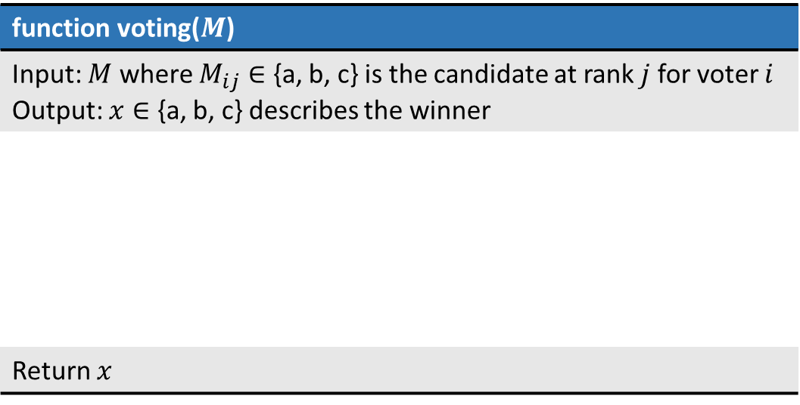
Warm-up
Design an algorithm to determine the winner of three candidates a, b, c given the ranking provided by $n$ individual voters, described by a $3×n$ matrix $M$
Example Matrix $M$
function voting($M$)
Input: $M$ where $M_{ij}∈$ {a, b, c} is the candidate at rank $j$ for voter $i$ Output: $x∈$ {a, b, c} describes the winner
Return $x$
Voter 1
Voter 2
Voter 3
Voter 4
Rank 1
a | c | b | a
b | b | c | b
c | a | a | c
Rank 2
Rank 3

Slide 4

AI: Representation and Problem Solving
Game Theory: Equilibrium (cont) & Social Choice
Instructors: Stephanie Rosenthal
Slide credits: CMU AI, Fei Fang
Image credit: ai.berkeley.edu

Slide 5
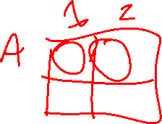
Normal-Form Games
A game in normal form consists of the following elements
  Set of players
  Set of actions for each player
  Payoffs / Utility functions
    Determines the utility for each player given the actions chosen by all players (referred to as action profile)
  Bimatrix game is special case: two players, finite action sets
Players move simultaneously and the game ends immediately afterwards
Notes:
A normal-form game is a representation of a game in game theory. It directly specifies the set of players' strategies where a strategy is a complete plan of action for every stage of the game, regardless of whether that stage actually arises in play.

Slide 6
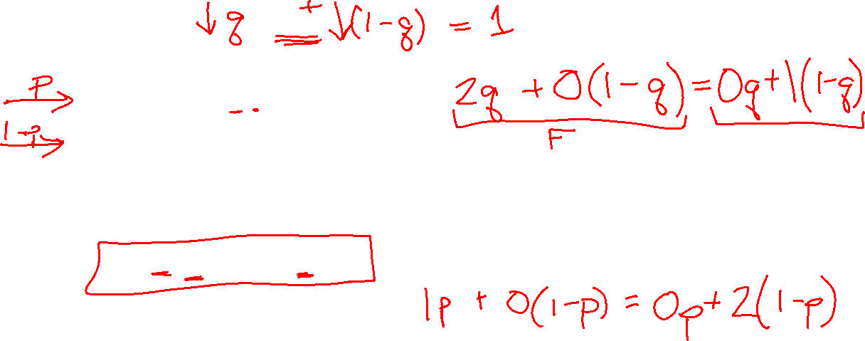
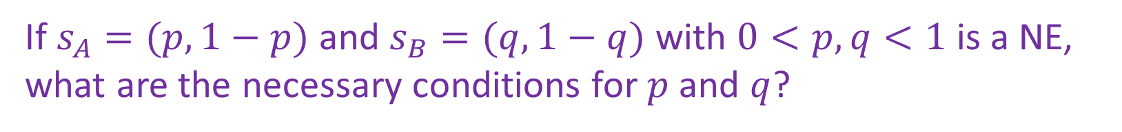
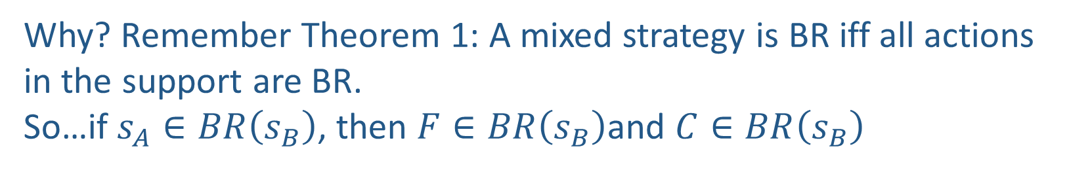


Find Mixed Strategy Nash Equilibrium
How to find mixed strategy NE (after iterative removal)?
Berry
 | Football | Concert
Football | 2,1 | 0,0
Concert | 0,0 | 1,2
Alex
If $s_{A}=(p,1−p)$ and $s_{B}=(q,1−q)$ with $0<p,q<1$ is a NE, what are the necessary conditions for $p$ and $q$?
$$u_{A}\left(F,s_{B}\right)=u_{A}\left(C,s_{B}\right)$$
$$u_{B}\left(s_{A},F\right)=u_{B}\left(s_{A},C\right)$$
Why? Remember Theorem 1: A mixed strategy is BR iff all actions in the support are BR.
So…if $s_{A}∈BR\left(s_{B}\right)$, then $F∈BR\left(s_{B}\right)$and $C∈BR\left(s_{B}\right)$
Notes:
, i.e., no strictly dominated strategies in the remaining game
Now assume you are given a 2 by 2 bimatrix game after iterative removal. Further, you are told that in a NE, all the actions are chosen with non-zero probability. What are the necessary conditions for a mixed strategy NE?
Check the FvsC game, in addition to PSNEs (F,F) and (C,C), there is a mixed strategy NE shown below.

Slide 7
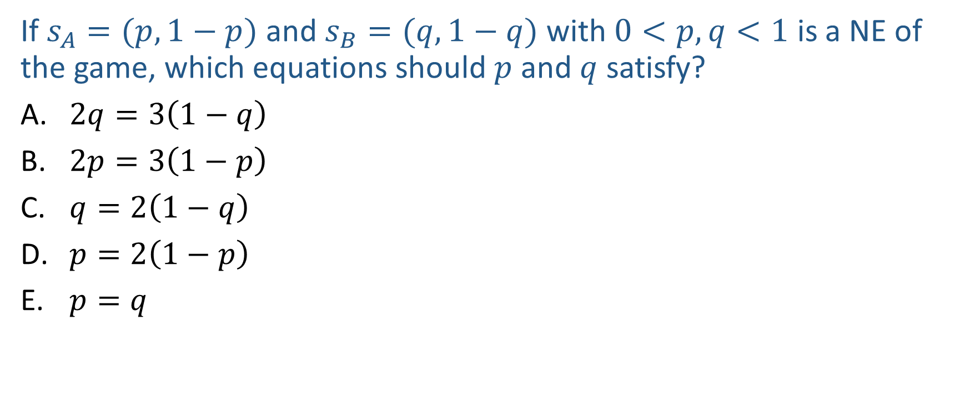
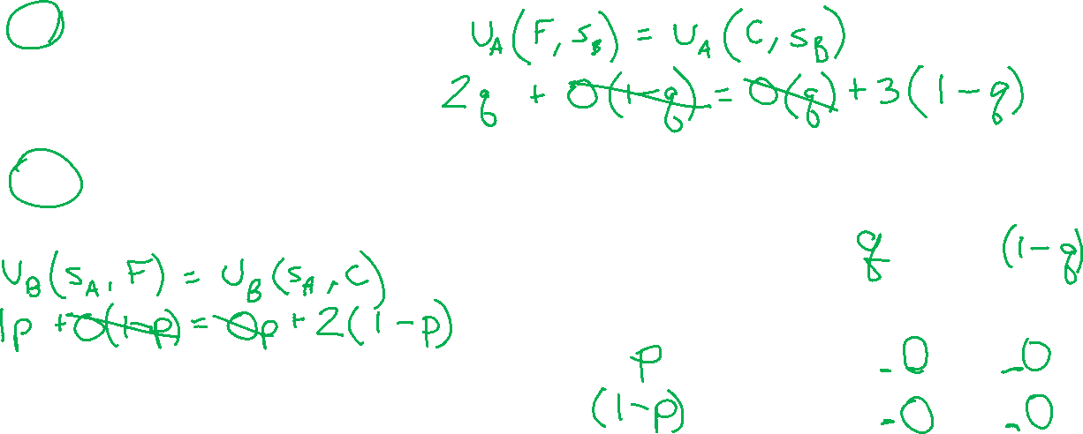
Poll 1 (graded for accuracy)
If $s_{A}=(p,1−p)$ and $s_{B}=(q,1−q)$ with $0<p,q<1$ is a NE of the game, which equations should $p$ and $q$ satisfy?
$2q=3\left(1−q\right)$
$2p=3\left(1−p\right)$
$q=2\left(1−q\right)$
$p=2\left(1−p\right)$
$p=q$
Berry
 | Football | Concert
Football | 2,1 | 0,0
Concert | 0,0 | 3,2
Alex
Notes:
A/D

Slide 8
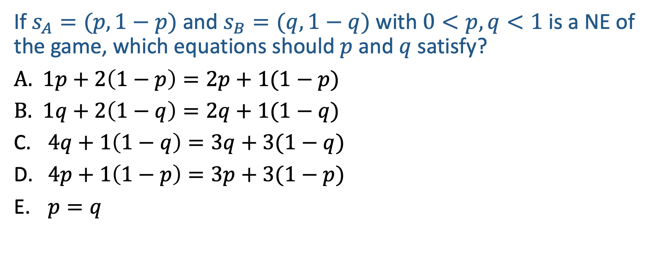
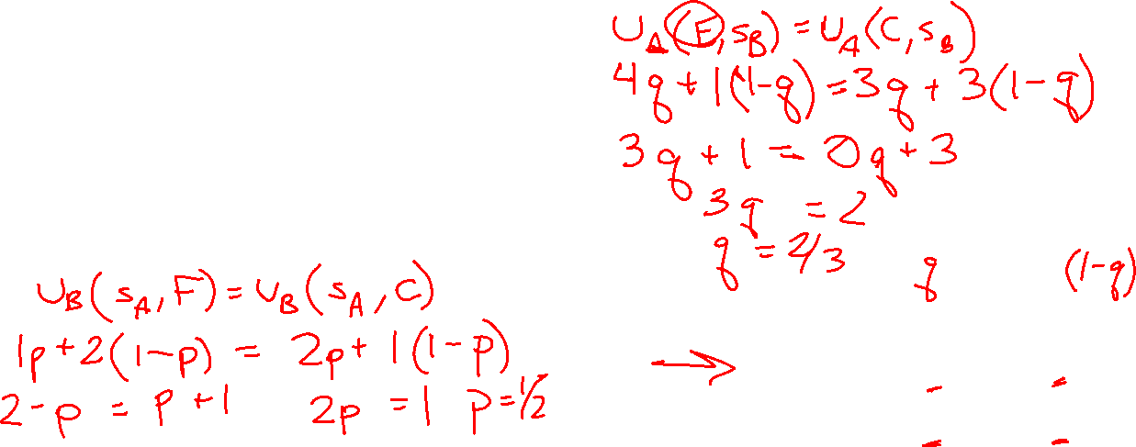
Poll 2 (graded for accuracy)
If $s_{A}=(p,1−p)$ and $s_{B}=(q,1−q)$ with $0<p,q<1$ is a NE of the game, which equations should $p$ and $q$ satisfy?
$1p+2\left(1−p\right)=2p+1(1−p)$
$1q+2\left(1−q\right)=2q+1(1−q)$
$4q+1\left(1−q\right)=3q+3(1−q)$
$4p+1\left(1−p\right)=3p+3(1−p)$
$p=q$
Berry
 | Football | Concert
Football | 4,1 | 1,2
Concert | 3,2 | 3,1
Alex
Notes:
4q + 1(1-q) = 3q + 3(1-q)
3q = 2
Q = 2/3
1p + 2(1-p) = 2p + 1(1-p)
1 = 2p
P = 1/2

Slide 9
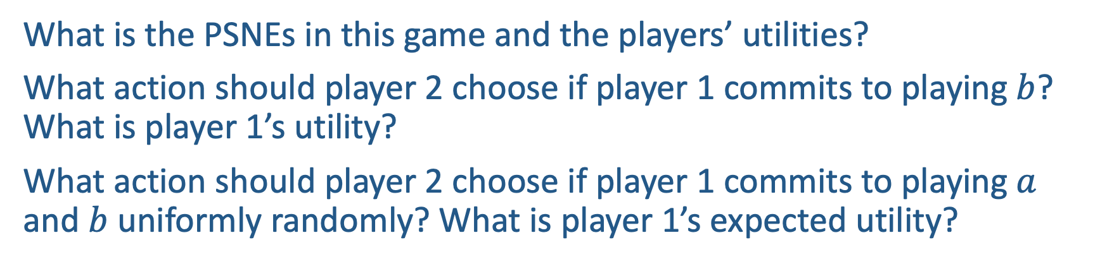
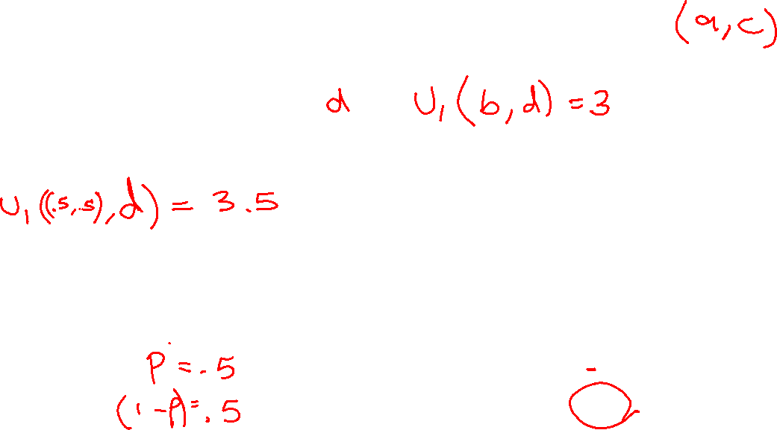
Power of Commitment
What is the PSNEs in this game and the players’ utilities?
What action should player 2 choose if player 1 commits to playing $b$? What is player 1’s utility?
What action should player 2 choose if player 1 commits to playing $a$ and $b$ uniformly randomly? What is player 1’s expected utility?
Player 2
 | c | d
a | 2,1 | 4,0
b | 1,0 | 3,2
Player 1

Slide 10
Stackelberg Equilibrium
Stackelberg Game
  Leader commits to a strategy first
  Follower responds after observing the leader’s strategy
Stackelberg Equilibrium
  Follower best responds to leader’s strategy
  Leader commits to a strategy that maximize her utility assuming follower best responds
Player 2
 | c | d
a | 2,1 | 4,0
b | 1,0 | 3,2
Player 1

Slide 11
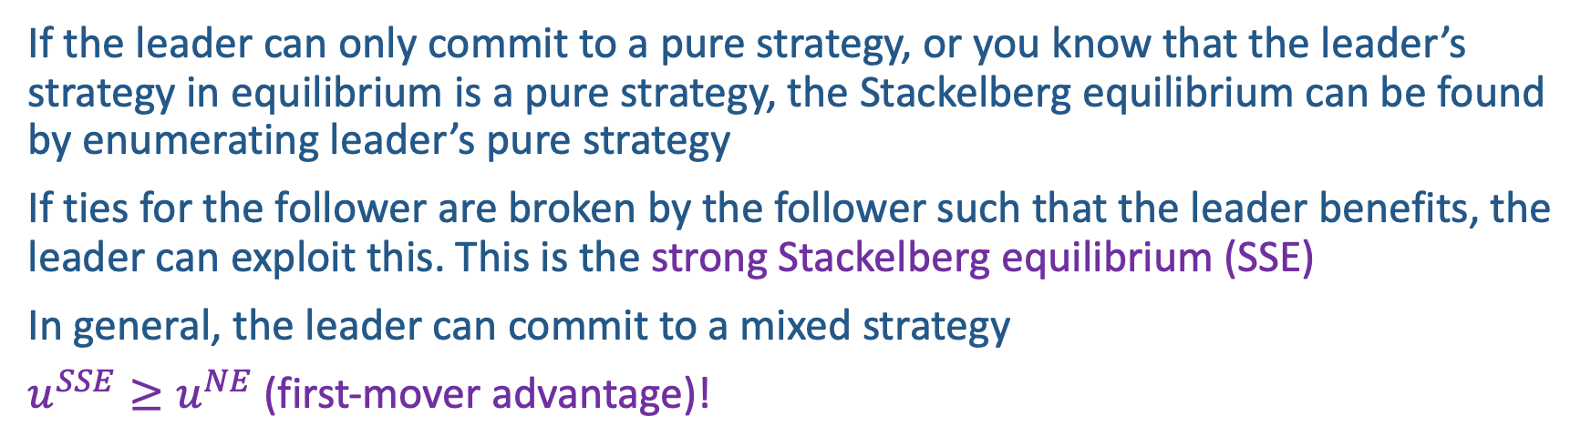
Stackelberg Equilibrium
If the leader can only commit to a pure strategy, or you know that the leader’s strategy in equilibrium is a pure strategy, the Stackelberg equilibrium can be found by enumerating leader’s pure strategy
If ties for the follower are broken by the follower such that the leader benefits, the leader can exploit this. This is the strong Stackelberg equilibrium (SSE)
In general, the leader can commit to a mixed strategy
$u^{SSE}≥u^{NE}$ (first-mover advantage)!
Berry
Player 2
 | Football | Concert
Football | 2,1 | 0,0
Concert | 0,0 | 1,2
 | c | d
a | 2,1 | 4,0
b | 1,0 | 3,2
Alex
Player 1

Slide 12

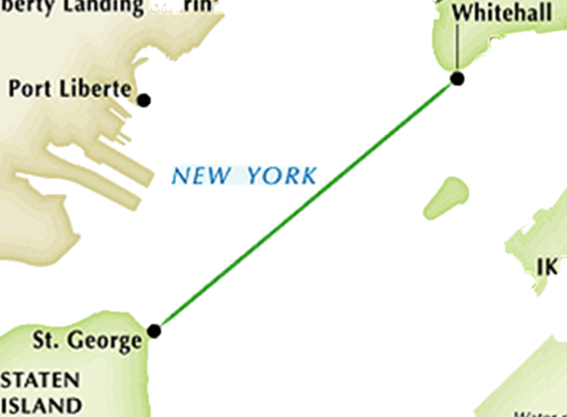
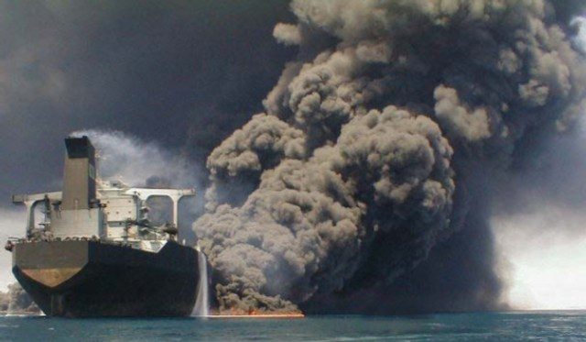

Protecting Staten Island Ferry
Ferry Line
Notes:
The Staten Island Ferry in New York provides a crucial link between Manhattan and the Staten Island. It carries roughly 60,000 passengers a day on weekdays. So the ferries may present as attractive targets for an attacker, who may ram a suicide boat packed with explosives into the ferry as happened with attacks on French supertanker Limburg and USS Cole. So how to protect the ferries?

Slide 13


Protecting Staten Island Ferry
Notes:
But in the real world, the heroes are from US Coast Guard, who run patrol boats which are equipped with machine guns and can stop attackers within a certain radius.

Slide 14




Previous USCG Approach

Slide 15

Problem
Optimal Patrol Strategy for Protecting Moving Targets with Multiple Mobile Resources
Fei Fang, Albert Xin Jiang, Milind Tambe
In AAMAS-13: The Twelfth International Conference on Autonomous Agents and Multiagent Systems, May 2013
Notes:
In this problem, there are many routes the patrol boat can take along the ferry line, and any deterministic route can be easily exploited by the attacker. So it is crucial to randomize but the problem is how.

Slide 16

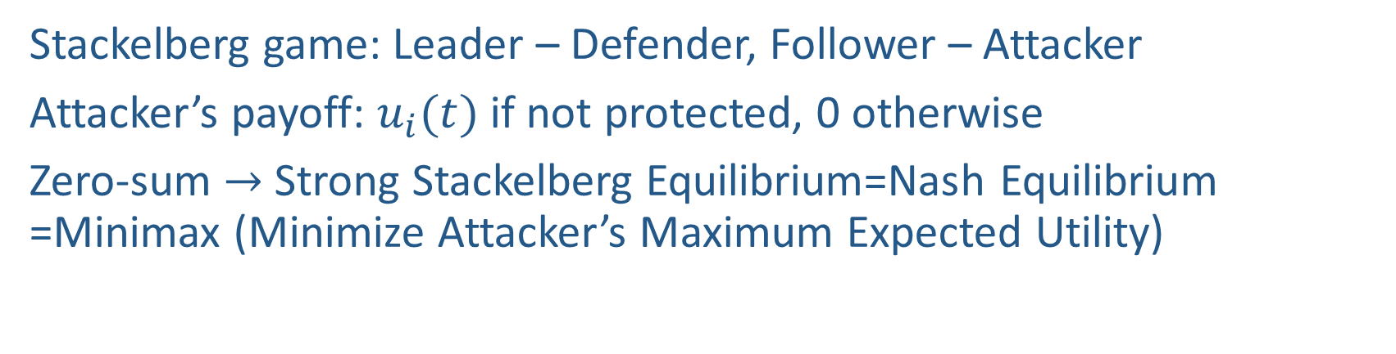


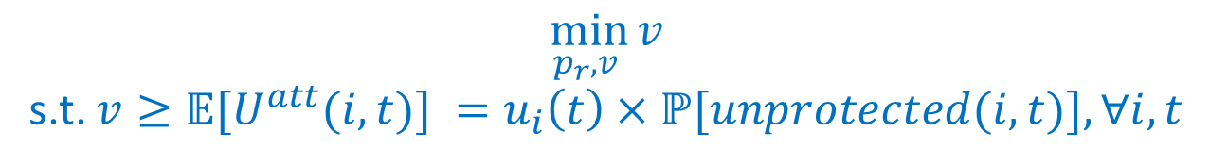
Game Model and Linear Programming-based Solution
Stackelberg game: Leader – Defender, Follower – Attacker
Attacker’s payoff: $u_{i}(t)$ if not protected, 0 otherwise
Zero-sum $→$ Strong Stackelberg Equilibrium=Nash Equilibrium =Minimax (Minimize Attacker’s Maximum Expected Utility)
$$\min_{p_{r},v }{v}$$
s.t. $v≥𝔼[U^{att}(i,t)] =u_{i}\left(t\right)×ℙ[unprotected(i,t)],∀i,t$
Adversary
$$p_{r}$$
 | 10:00:00 AM Target 1 | 10:00:01 AM Target 1 | … | 10:30:00 AM Target 3 | …
Purple Route
Orange Route
Blue Route
……
0,
-5,
0
5
-4,
30%
4
Defender
40%
$$\sum_{r}{p_{r}}≤1$$
20%
Notes:
We model it as a Stackleberg game, or leader-follower game, where the defender is the leader and commits to a randomized strategy first, in this case a probability distribution over possible patrol routes, and the attacker is the follower, who observes the defender’s strategy and then choose a target and a time to attack. This table shows the payoff matrix. We assume the attacker gets a payoff of $u_{i}(t)$ if he attacks target $i$ at time $t$ and succeeded, meaning, no defender is close to ferry to protect it, say within 100 meters. Otherwise he gets 0. We assume it is a zero-sum game, meaning what the attacker gets is what the defender loses. In this case, solution concepts like Strong Stackelberg Equilibrium, Nash Equilibrium and Minimax Strategy coincide. So assuming the attacker is perfectly rational, the optimal defender strategy is the one that minimizes the attacker’s maximum possible expected utility, which can be computed through linear programming. The decision various are the probabilities of taking each route, and the attacker’s expected utility is calculated as the target utility at that time, multiplied by the probability he can succeed in attacking.
(e.g., >100m)

Slide 17

Evaluation: Simulation & Real-World Feedback
Reduce potential risk by 50%
Deployed by US Coast Guard
USCG evaluation
  Point defense to zone defense
  Increased randomness
Professional mariners:
  Apparent increase in Coast Guard patrols
Notes:
On randomly chosen utility functions, we show that the potential risk, measured by maximum attacker expected utility, is cut down by half when using our algorithm. As our work is brought to the real-world, it has resulted in a radical shift in the patrolling tactics of the US Coast Guard. And the feedback to us is terrific. They call this shift as from point defense to zone defense, an analogy from the basketball game because before they are defending against potential attacks to one ferry and now they are defending against potential attacks to high risk zones. They think our solution has improved the randomness of the patrols. Professional mariners also mentioned that there is an apparent increase in Coast Guard patrols using new patrol schedules.

Slide 18
Game Theory: Social Choice

Slide 19

Warm-up
Design an algorithm to determine the winner of three candidates a, b, c given the ranking provided by $n$ individual voters, described by a $3×n$ matrix $M$
Example Matrix $M$
function voting($M$)
Input: $M$ where $M_{ij}∈$ {a, b, c} is the candidate at rank $j$ for voter $i$ Output: $x∈$ {a, b, c} describes the winner
Return $x$
Voter 1
Voter 2
Voter 3
Voter 4
Rank 1
a | c | b | a
b | b | c | b
c | a | a | c
Rank 2
Rank 3

Slide 20

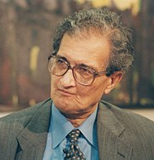
Social Choice Theory
A mathematical theory that deal with aggregation of individual preferences
Wide applications in economics, public policy, etc.
Origins in Ancient Greece
18th century
Formal foundations by Condorcet and Borda
19th Century
Charles Dodgson
20th Century
Nobel Prize in Economics
20th Century – Winners of Nobel Memorial Prize in Economic Sciences
Kenneth Arrow
Amartya Kumar Sen

Slide 21
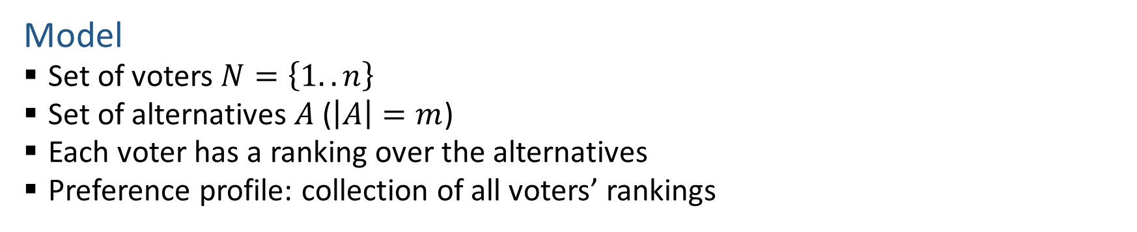
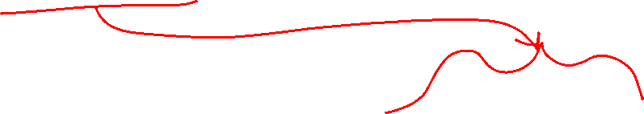
Voting Model
Model
  Set of voters $N=\left\{1..n\right\}$
  Set of alternatives $A$ ($\left|A\right|=m$)
  Each voter has a ranking over the alternatives
  Preference profile: collection of all voters’ rankings
Voter ID | 1 | 2 | 3 | 4
Ranking | a | c | b | a
 | b | b | c | b
 | c | a | a | c

Slide 22

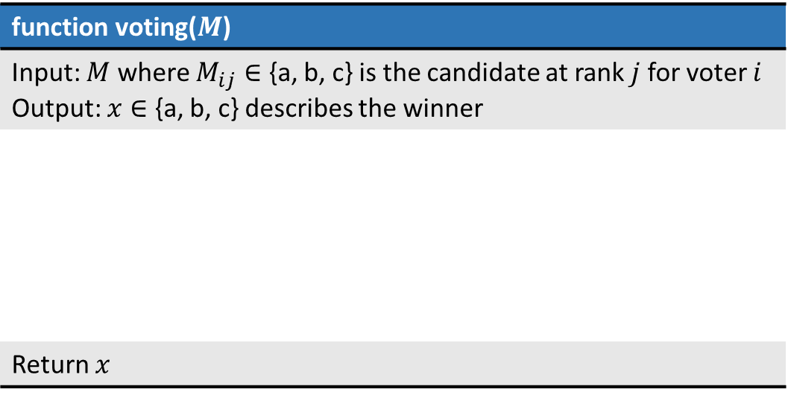
Voting Rules
Voting rule: function that maps preference profiles to alternatives that specifies the winner of the election
function voting($M$)
Input: $M$ where $M_{ij}∈$ {a, b, c} is the candidate at rank $j$ for voter $i$ Output: $x∈$ {a, b, c} describes the winner
Return $x$
Example Matrix $M$
a | c | b | a
b | b | c | b
c | a | a | c

Slide 23
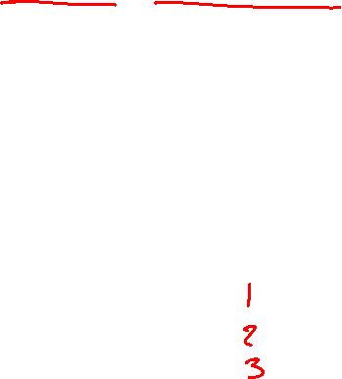
Voting Rules
Plurality (used in many political elections)
  Each voter give one point to top alternative
  Alternative with most points win
Who’s the winner?
a
Voter ID | 1 | 2 | 3 | 4
Ranking | a | c | b | a
 | b | b | c | b
 | c | a | a | c

Slide 24
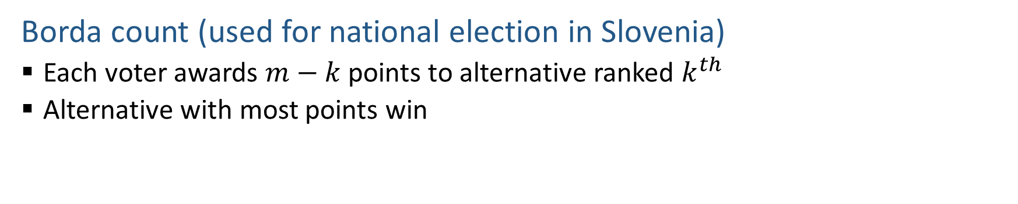
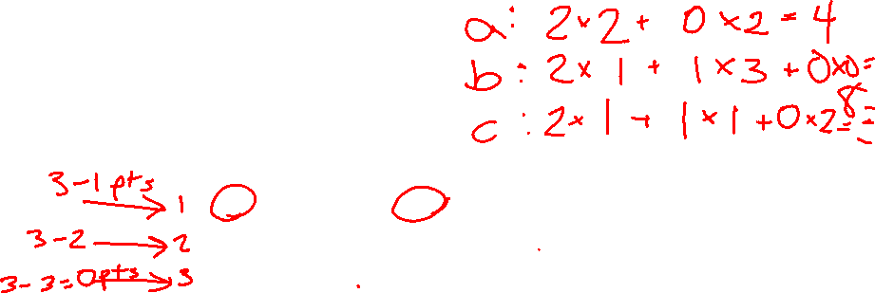
Voting Rules
Borda count (used for national election in Slovenia)
  Each voter awards $m−k$ points to alternative ranked $k^{th}$
  Alternative with most points win
Who’s the winner?
b
Voter ID | 1 | 2 | 3 | 4
Ranking | a | c | b | a
 | b | b | c | b
 | c | a | a | c

Slide 25
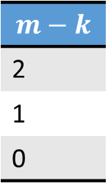
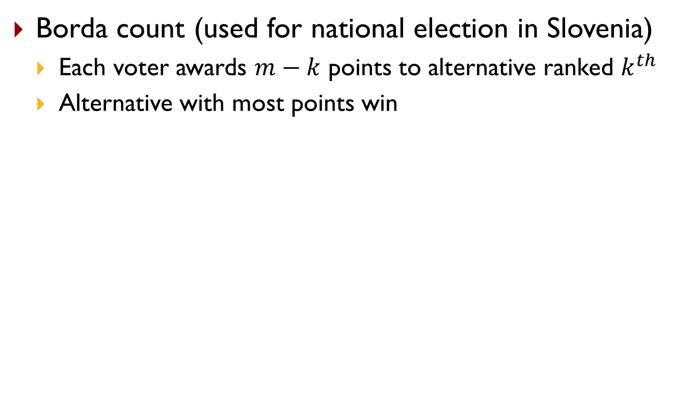
Voting Rules
Borda count (used for national election in Slovenia)
  Each voter awards $m−k$ points to alternative ranked $k^{th}$
  Alternative with most points win
Who’s the winner?
b
Voter ID | 1 | 2 | 3 | 4
Ranking | a | c | b | a
 | b | b | c | b
 | c | a | a | c
$$m−k$$
2
1
0
a: 2+0+0+2=4; b: 1+1+2+1=5; c: 0+2+1+0=3

Slide 26
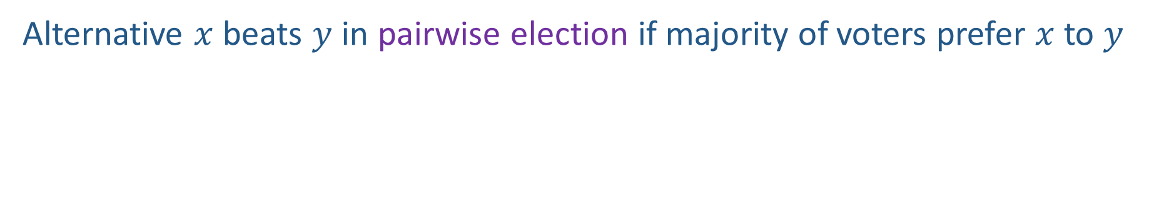
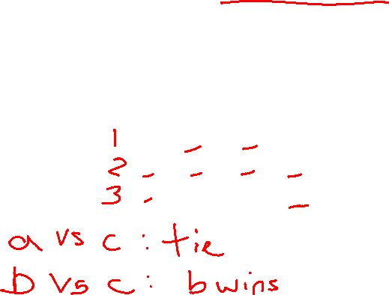
Pairwise Election
Alternative $x$ beats $y$ in pairwise election if majority of voters prefer $x$ to $y$
Who beats who in pairwise election?
b beats c
Voter ID | 1 | 2 | 3 | 4
Ranking | a | c | b | a
 | b | b | c | b
 | c | a | a | c

Slide 27
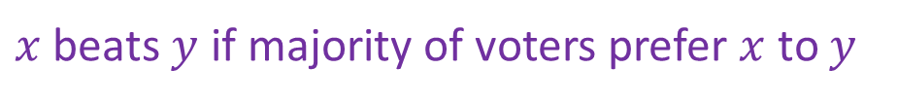
Voting Rules
Plurality with runoff
  First round: two alternatives with highest plurality scores survive
  Second round: pairwise election between the two
$x$ beats $y$ if majority of voters prefer $x$ to $y$
Who’s the winner?
Voter ID | 1 | 2 | 3 | 4
Ranking | a | c | b | a
 | b | b | c | b
 | c | a | a | c

Slide 28
Voting Rules
Plurality with runoff
  First round: two alternatives with highest plurality scores survive
  Second round: pairwise election between the two
$x$ beats $y$ if majority of voters prefer $x$ to $y$
Who’s the winner?
Depends on the tie breaking rule.
If break tie alphabetically:
a and b survive in 1st round
a wins the pairwise election
Voter ID | 1 | 2 | 3 | 4
Ranking | a | c | b | a
 | b | b | c | b
 | c | a | a | c
Voter ID | 1 | 2 | 3 | 4
Ranking | a | b | b | a
 | b | a | a | b

Slide 29
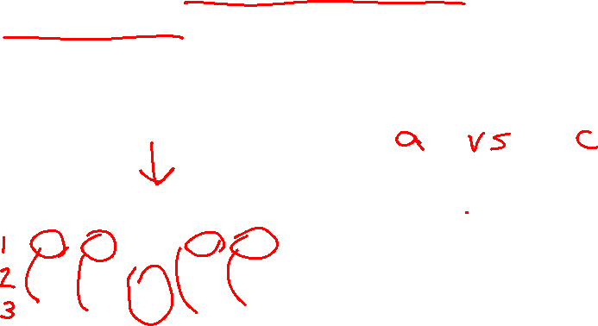
Voting Rules
Plurality with runoff
  First round: two alternatives with highest plurality scores survive
  Second round: pairwise election between the two
$x$ beats $y$ if majority of voters prefer $x$ to $y$
Who’s the winner?
Voter ID | 1 | 2 | 3 | 4 | 5
Ranking | a | c | b | a | c
 | b | b | c | b | b
 | c | a | a | c | a

Slide 30
Voting Rules
Plurality with runoff
  First round: two alternatives with highest plurality scores survive
  Second round: pairwise election between the two
$x$ beats $y$ if majority of voters prefer $x$ to $y$
Who’s the winner?
a and c survive, and then c beats a
Voter ID | 1 | 2 | 3 | 4 | 5
Ranking | a | c | b | a | c
 | b | b | c | b | b
 | c | a | a | c | a

Slide 31
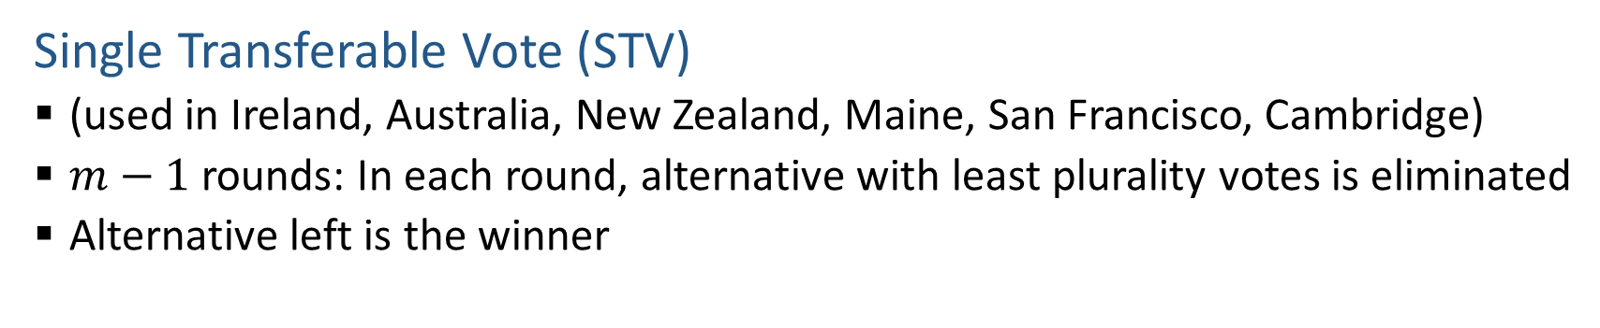
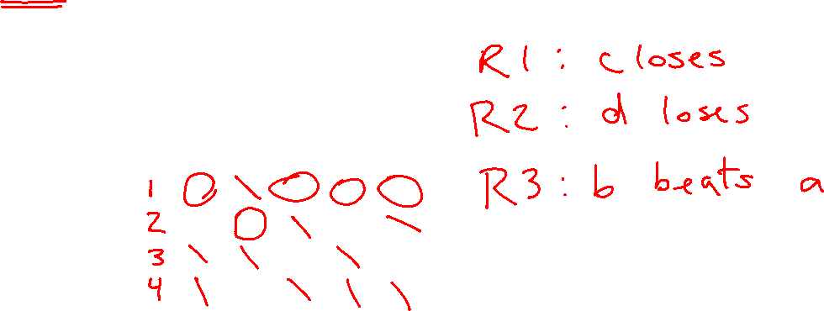
Voting Rules
Single Transferable Vote (STV)
  (used in Ireland, Australia, New Zealand, Maine, San Francisco, Cambridge)
  $m−1$ rounds: In each round, alternative with least plurality votes is eliminated
  Alternative left is the winner
Who’s the winner?
Voter ID | 1 | 2 | 3 | 4 | 5
Ranking | a | d | b | a | b
 | b | b | c | b | d
 | d | c | a | d | a
 | c | a | d | c | c

Slide 32

Voting Rules
Single Transferable Vote (STV)
  (used in Ireland, Australia, New Zealand, Maine, San Francisco, Cambridge)
  $m−1$ rounds: In each round, alternative with least plurality votes is eliminated
  Alternative left is the winner
Who’s the winner?
c is eliminated, then d, then a, leaving b as the winner.
Voter ID | 1 | 2 | 3 | 4 | 5
Ranking | a | d | b | a | b
 | b | b | c | b | d
 | d | c | a | d | a
 | c | a | d | c | c
Note: When d is eliminated, the vote from voter 2 is effectively transferred to b

Slide 33

Representation of Preference Profile
Identity of voters does not matter
Only record how many voters has a preference
33 voters | 16 voters | 3 voters | 8 voters | 18 voters | 22 voters
a | b | c | c | d | e
b | d | d | e | e | c
c | c | b | b | c | b
d | e | a | d | b | d
e | a | e | a | a | a

Slide 34
Tie Breaking
Commonly used tie breaking rules include
  Borda count
  Having the most votes in the first round
  …

Slide 35
Social Choice Axioms
How do we choose among different voting rules? What are the desirable properties?

Slide 36
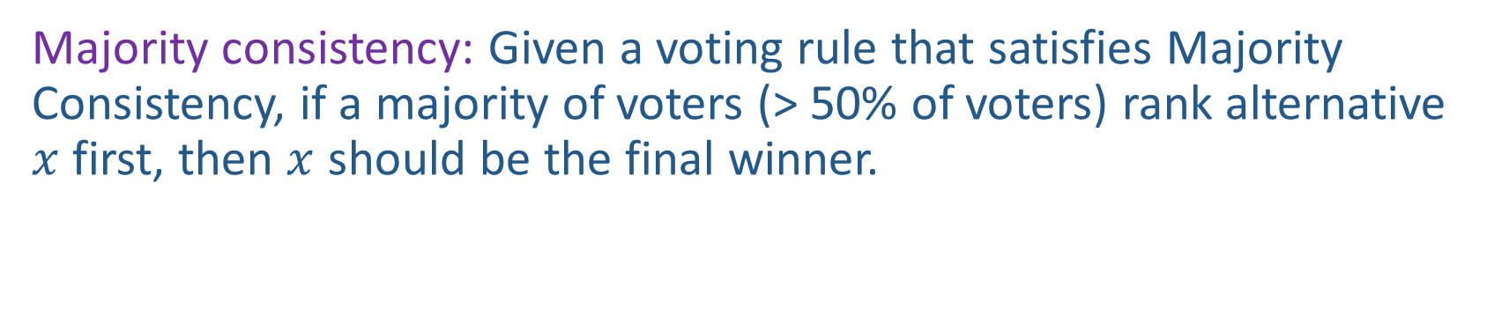
Majority consistency
Majority consistency: Given a voting rule that satisfies Majority Consistency, if a majority of voters (> 50% of voters) rank alternative $x$ first, then $x$ should be the final winner.

Slide 37
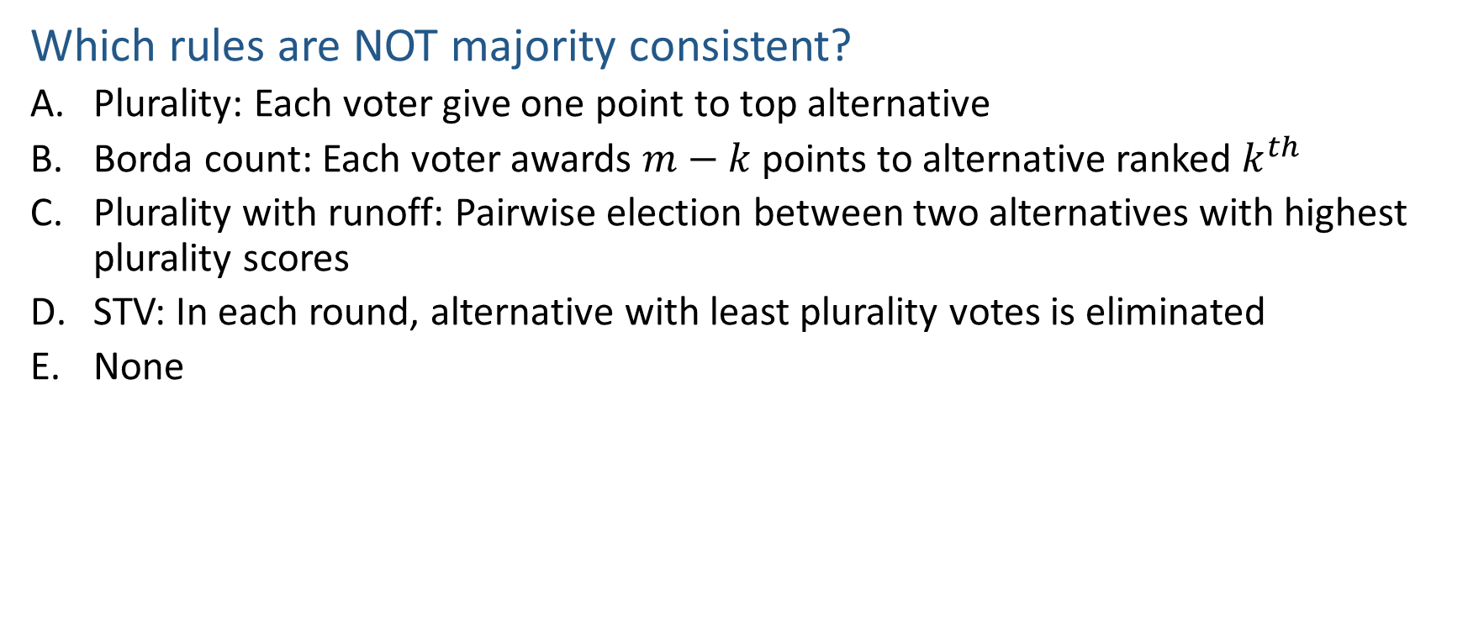

Poll 3
Which rules are NOT majority consistent?
  Plurality: Each voter give one point to top alternative
  Borda count: Each voter awards $m−k$ points to alternative ranked $k^{th}$
  Plurality with runoff: Pairwise election between two alternatives with highest plurality scores
  STV: In each round, alternative with least plurality votes is eliminated
  None
Notes:
B. Borda not consistent

Slide 38
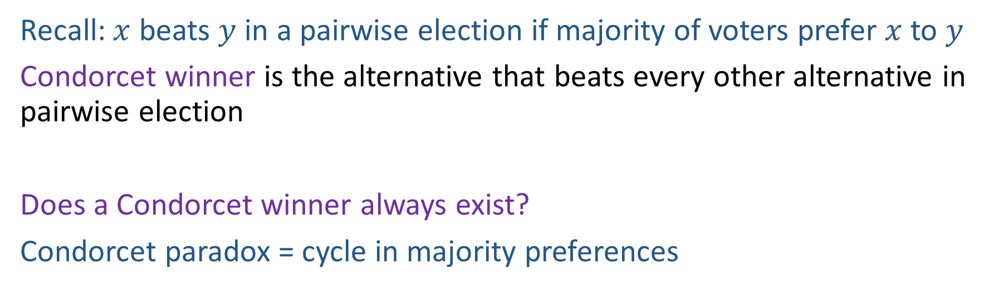
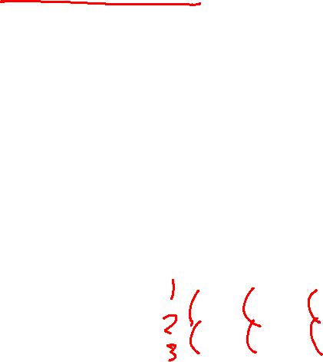
Condorcet Consistency
Recall: $x$ beats $y$ in a pairwise election if majority of voters prefer $x$ to $y$
Condorcet winner is the alternative that beats every other alternative in pairwise election
Does a Condorcet winner always exist?
Condorcet paradox = cycle in majority preferences
Voter ID | 1 | 2 | 3
Ranking over alternatives (first row is the most preferred) | a | c | b
 | b | a | c
 | c | b | a
Notes:
no

Slide 39
Condorcet Consistency
Condorcet consistency: A voting rule that satisfies majority consistency should select a Condorcet Winner as the final winner if one exists.
Which of the introduced voting rules (Plurality, Borda count, Plurality with runoff, STV) are Condorcet consistent?

Slide 40
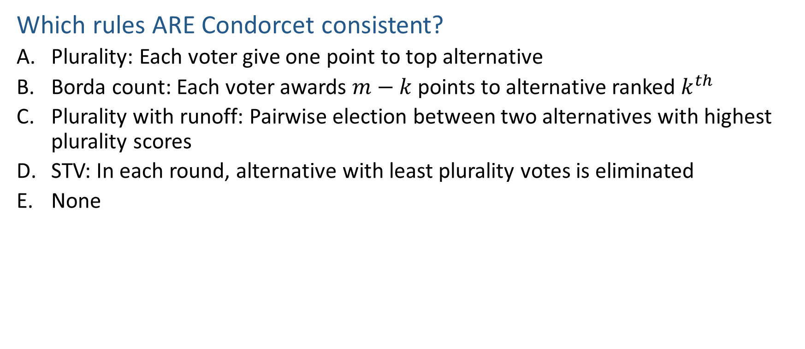

Poll 4
Which rules ARE Condorcet consistent?
  Plurality: Each voter give one point to top alternative
  Borda count: Each voter awards $m−k$ points to alternative ranked $k^{th}$
  Plurality with runoff: Pairwise election between two alternatives with highest plurality scores
  STV: In each round, alternative with least plurality votes is eliminated
  None
Notes:
None

Slide 41
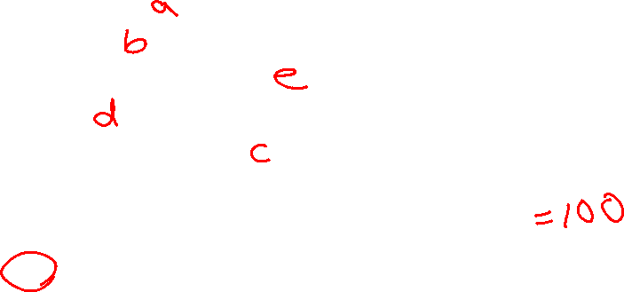
Condorcet Consistency
Winner under different voting rules in this example
  Plurality:
  Borda:
  Plurality with runoff:
  STV:
  Condorcet winner:
33 voters | 16 voters | 3 voter | 8 voters | 18 voters | 22 voters
a | b | c | c | d | e
b | d | d | e | e | c
c | c | b | b | c | b
d | e | a | d | b | d
e | a | e | a | a | a
Notes:
Plurality: a
Borda count:
a: 33*4 + 3*1 = 135
b: 33*3 + 16*4 + 3*2 + 8*2 + 18*1 + 22*2 = 247
c: 33*2 + 16*2 + 3*4 + 8*4 + 18*2 + 22*3 = 244
d: 33 + 16*3 + 3*3 + 8 + 22 + 18*4 = 192
e: 16 + 8*3 + 18*3 + 22*4 = 182
Plurality with run off:
a and e runoff and e wins
STV:
c voted off first
b voted off second
e voted off third
a voted off
d wins
Condorcet winner:
c beats a
c beats b
c beats d
c beats e
c wins

Slide 42
Condorcet Consistency
Winner under different voting rules in this example
  Plurality: a
  Borda: b
  Plurality with runoff: e
  STV: d
  Condorcet winner: c
33 voters | 16 voters | 3 voter | 8 voters | 18 voters | 22 voters
a | b | c | c | d | e
b | d | d | e | e | c
c | c | b | b | c | b
d | e | a | d | b | d
e | a | e | a | a | a

Slide 43
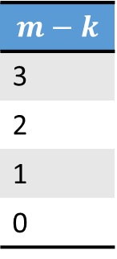
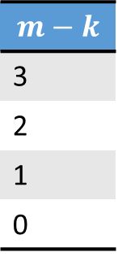
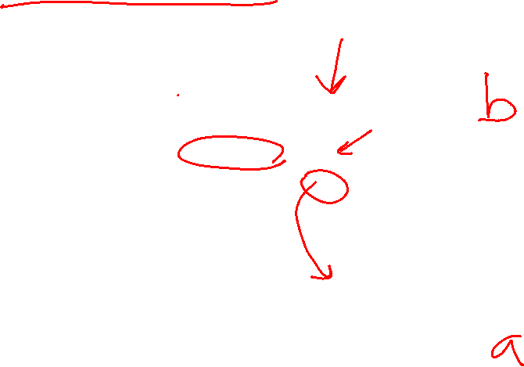
Strategy-Proofness
Using Borda Count
Who is the winner?
Voter ID | 1 | 2 | 3
Ranking over alternatives (first row is the most preferred) | b | b | a
 | a | a | b
 | c | c | c
 | d | d | d
$$m−k$$
3
2
1
0
Who is the winner now?
Voter ID | 1 | 2 | 3
Ranking over alternatives (first row is the most preferred) | b | b | a
 | a | a | c
 | c | c | d
 | d | d | b
$$m−k$$
3
2
1
0

Slide 44
Strategy-Proofness
A single voter can manipulate the outcome!
Voter ID | 1 | 2 | 3
Ranking over alternatives (first row is the most preferred) | b | b | a
 | a | a | b
 | c | c | c
 | d | d | d
$$m−k$$
3
2
1
0
b: 2*3+1*2=8
a: 2*2+1*3=7
b is the winner
Voter ID | 1 | 2 | 3
Ranking over alternatives (first row is the most preferred) | b | b | a
 | a | a | c
 | c | c | d
 | d | d | b
$$m−k$$
3
2
1
0
b: 2*3+1*0=6
a: 2*2+1*3=7
a is the winner

Slide 45
Strategy-Proofness
A voting rule is strategyproof (SP) if a voter can never benefit from lying about his preferences (regardless of what other voters do)
  Benefit: a more preferred alternative is selected as winner
Do not lie: b is the winner
Lie: a is the winner
Voter ID | 1 | 2 | 3
Ranking | b | b | a
 | a | a | b
 | c | c | c
 | d | d | d
Voter ID | 1 | 2 | 3
Ranking | b | b | a
 | a | a | c
 | c | c | d
 | d | d | b
If a voter’s preference is a>b>c, c will be selected w/o lying, and b will be selected w/ lying, then the voter still benefits

Slide 46
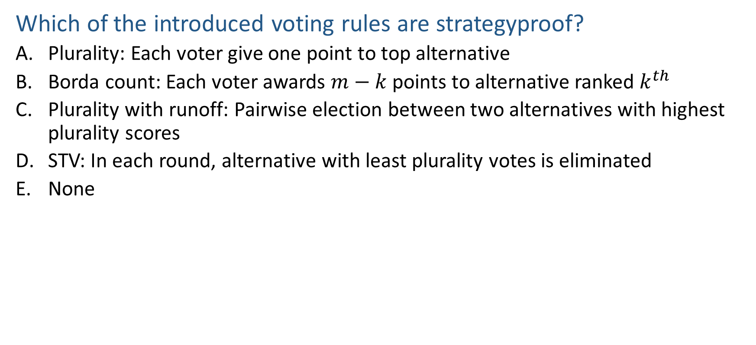

Poll 5
Which of the introduced voting rules are strategyproof?
  Plurality: Each voter give one point to top alternative
  Borda count: Each voter awards $m−k$ points to alternative ranked $k^{th}$
  Plurality with runoff: Pairwise election between two alternatives with highest plurality scores
  STV: In each round, alternative with least plurality votes is eliminated
  None
Notes:
none

Slide 47
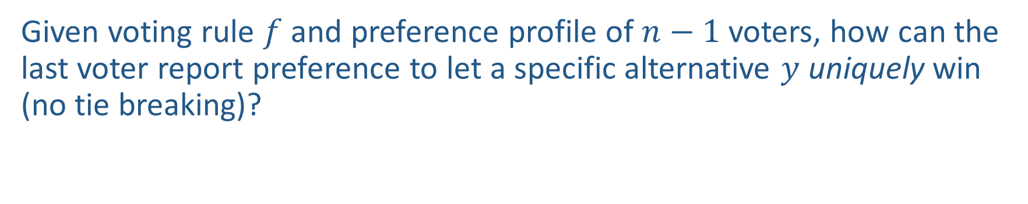

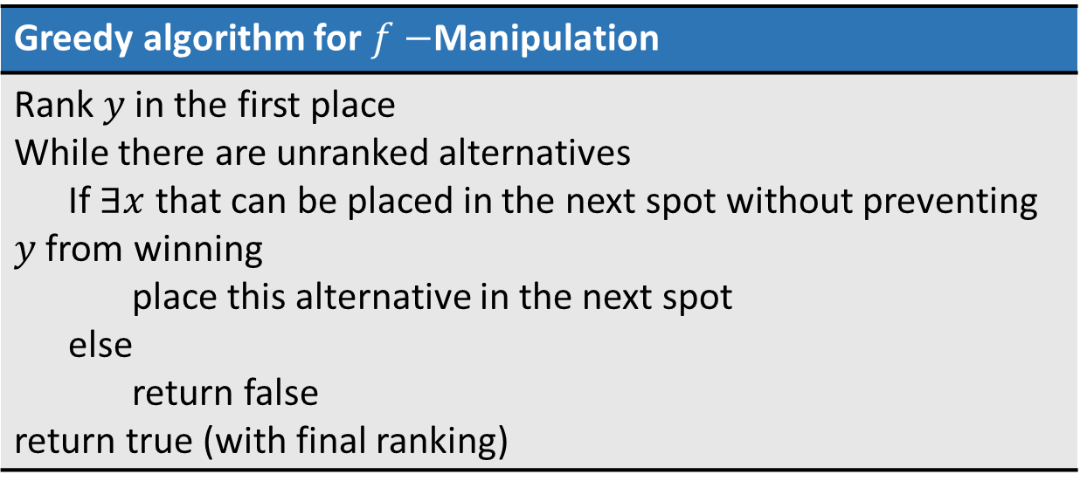
Greedy Algorithm for $f−$Manipulation
Given voting rule $f$ and preference profile of $n−1$ voters, how can the last voter report preference to let a specific alternative $y$ uniquely win (no tie breaking)?
Greedy algorithm for $f−$Manipulation
Rank $y$ in the first place While there are unranked alternatives If $∃x$ that can be placed in the next spot without preventing $y$ from winning place this alternative in the next spot else return false return true (with final ranking)
Correctness proved (Bartholdi et al., 1989)

Slide 48

Greedy Algorithm for $f−$Manipulation
Example with Borda count voting rule
Voter ID | 1 | 2 | 3
Ranking over alternatives (first row is the most preferred) | b | b | a
 | a | a
 | c | c
 | d | d

Slide 49
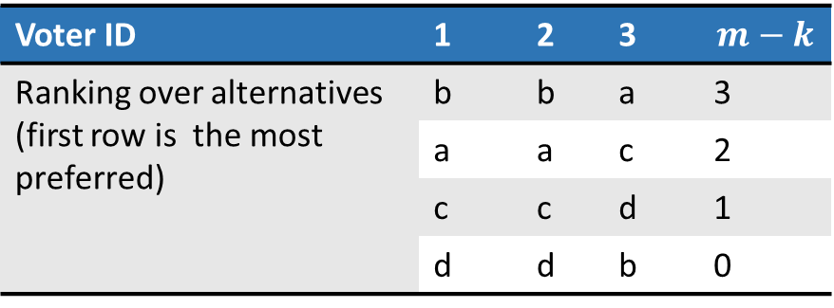
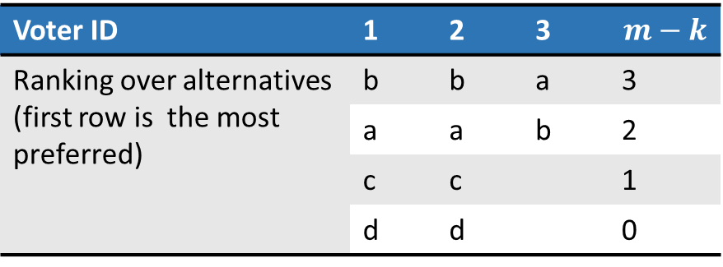
Greedy Algorithm for $f−$Manipulation
Example with Borda count voting rule
Voter ID | 1 | 2 | 3 | $$m−k$$
Ranking over alternatives (first row is the most preferred) | b | b | a | 3
 | a | a | b | 2
 | c | c |  | 1
 | d | d |  | 0
b: 2*3+1*2=8
a: 2*2+1*3=7
Cannot put b here
c: 2*1+1*2=4
a: 2*2+1*3=7
c can be placed second
b: 2*3+1*1=7
b cannot be placed third
d: 2*0+1*1=1
d can be placed third
Voter ID | 1 | 2 | 3 | $$m−k$$
Ranking over alternatives (first row is the most preferred) | b | b | a | 3
 | a | a | c | 2
 | c | c | d | 1
 | d | d | b | 0

Slide 50
Other Properties
A voting rule is dictatorial if there is a voter who always gets their most preferred alternative
A voting rule is constant if the same alternative is always chosen (regardless of the stated preferences)
A voting rule is onto if any alternative can win, for some set of stated preferences
Which of the introduced voting rules (Plurality, Borda count, Plurality with runoff, STV) are dictatorial, constant or onto?
Notes:
All onto
Not constant, not dictatorial

Slide 51
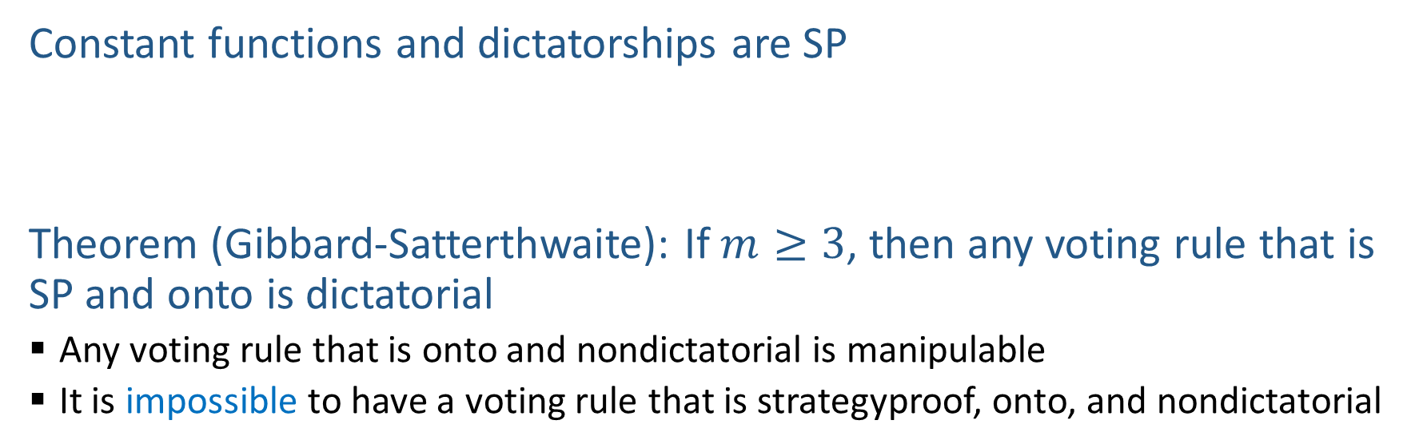
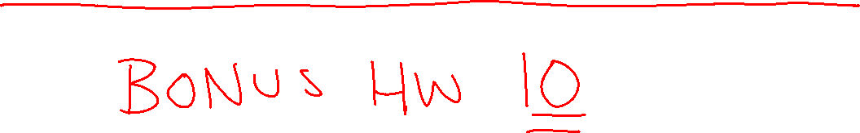
Results in Social Choice Theory
Why?
Constant functions and dictatorships are SP
Theorem (Gibbard-Satterthwaite): If $m≥3$, then any voting rule that is SP and onto is dictatorial
  Any voting rule that is onto and nondictatorial is manipulable
  It is impossible to have a voting rule that is strategyproof, onto, and nondictatorial

Slide 52

Activity: Favorites of 15281

Slide 53
Plurality Vote

Slide 54
Borda Count

Slide 55
Plurality with Runoff

Slide 56
Single Transferrable Vote

Slide 57
Learning Objectives
Understand the voting model
Find the winner under the following voting rules
  Plurality, Borda count, Plurality with runoff, Single Transferable Vote
Describe the following concepts, axioms, and properties of voting rules
  Pairwise election, Condorcet winner
  Majority consistency, Condorcet consistency, Strategyproof
  Dictatorial, constant, onto
Understand the possibility of satisfying multiple properties
Describe the greedy algorithm for voting rule manipulation

