Slide 1
Announcements
Assignments
HW10
    Due 4/25, 10 pm
P5
    Due 4/27, 10 pm
Late days can be used on either/both assignments
Final Exam – 5/4 5:30pm (location TBA)

Slide 2
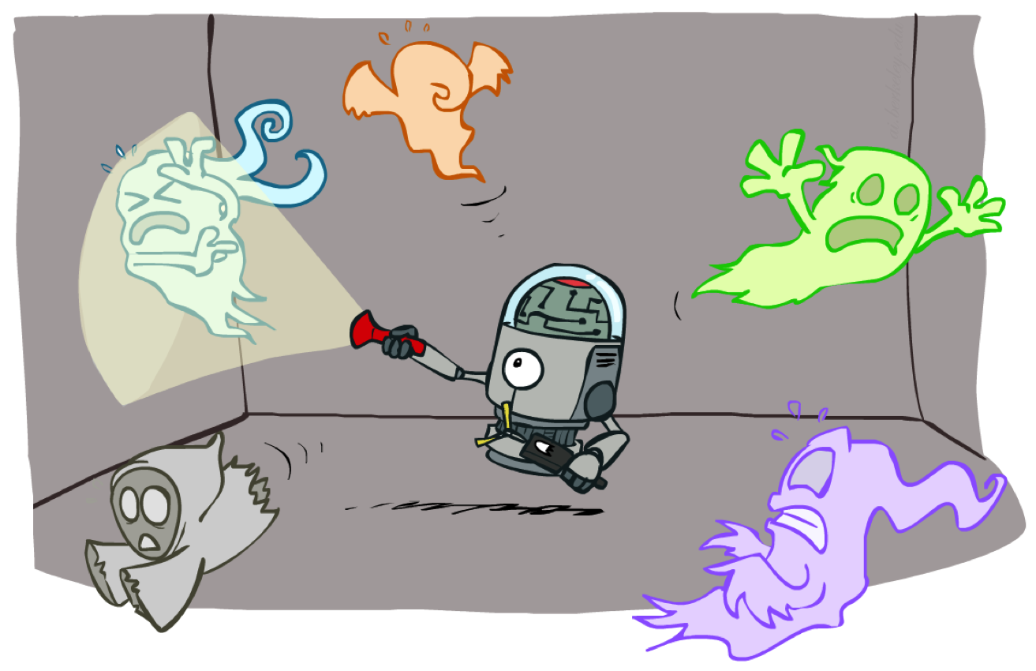
AI: Representation and Problem Solving
Particle Filtering
Instructor: Stephanie Rosenthal
Slide credits: CMU AI and http://ai.berkeley.edu

Slide 3
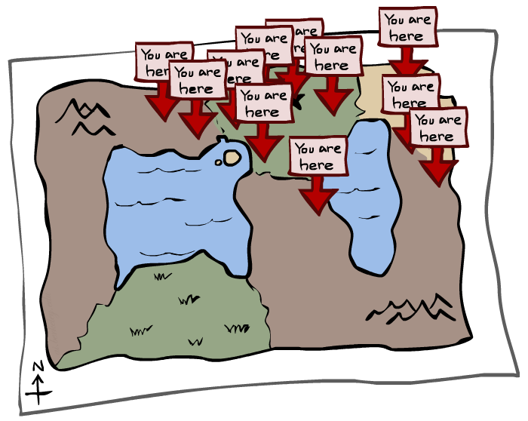
Particle Filtering

Slide 4
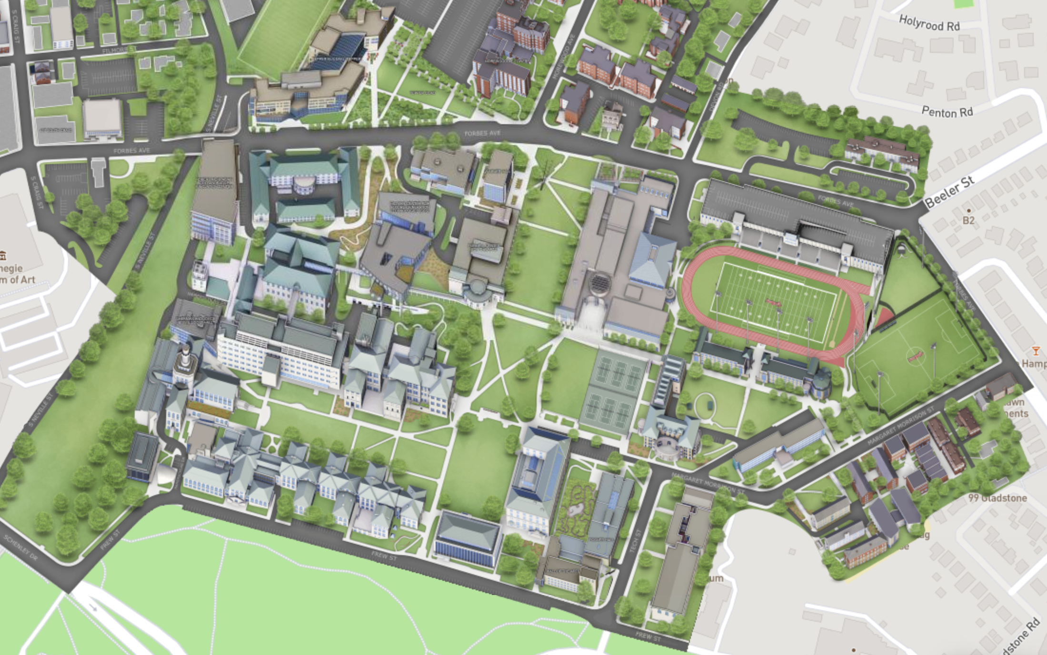
Particle Filtering

Slide 5
Belief States
When we’re predicting the actual location we’re in at each time step X_{k}
Really, what we’re doing is maintaining a probability distribution over all possible states
This distribution is called a belief state, it represents the belief of where we are
We denote the belief state for X at time 3 is b(X₃)=P(X₃)
X₀
X₁
X₂
X₃
E₁
E₂
E₃

Slide 6
We need a new algorithm!
When |X| is more than 10⁶ or so (e.g., 3 ghosts in a 10x20 world), exact inference to compute the belief state becomes infeasible
We could try to sample our Bayes net to compute b(X)
Likelihood weighting fails completely – number of samples needed grows exponentially with T
X₀
X₁
X₂
X₃
E₁
E₂
E₃

Slide 7
We need a new idea!
t=2
t=7
Idea: Sample in the first state, and then move those samples by sampling the transition function
The problem: sample state trajectories go off into low-probability regions, ignoring the evidence; too few “reasonable” samples
Solution: kill the bad ones, make more of the good ones. This way the population of samples stays in the high-probability region.
This is called resampling or survival of the fittest

Slide 8
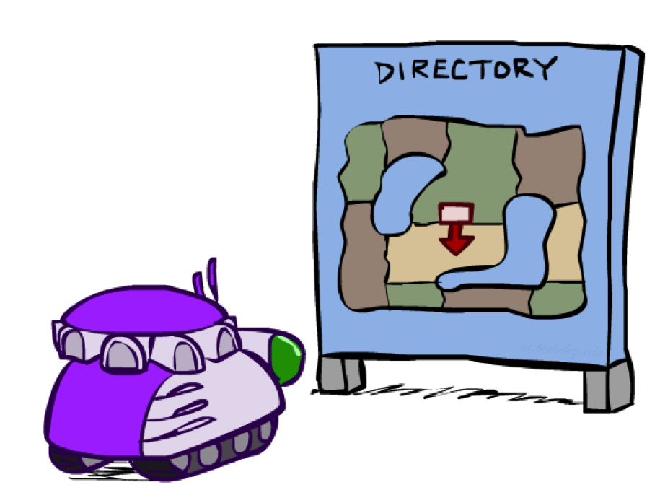
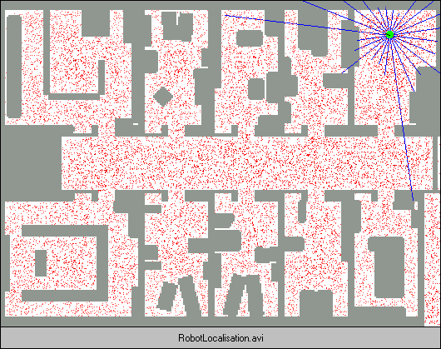
Robot Localization
In robot localization:
  We know the map, but not the robot’s position
  Observations may be vectors of range finder readings
  State space and readings are typically continuous (works basically like a very fine grid) and so we cannot store B(X)
  Particle filtering is a main technique

Slide 9

Particle Filter Localization (Sonar)
[Dieter Fox, et al.]
[Video: global-sonar-uw-annotated.avi]

Slide 10
Particle Filtering
Represent belief state by a set of samples
  Samples are called particles
  Time per step is linear in the number of samples
  But: number needed may be large
This is how robot localization works in practice
0.0
0.1
0.0
0.0
0.0
0.2
0.0
0.2
0.5

Slide 11
Representation: Particles
Our representation of P(X) is now a list of N particles (samples)
  Generally, N << |X|
  Storing dictionary mapping from X to counts would defeat the point
P(x) approximated by number of particles with value x
  So, many x may have P(x) = 0!
  More particles, more accuracy
  Usually we want a low-dimensional marginal
    E.g., “Where is ghost 1?” rather than “Are ghosts 1,2,3 in {2,6], [5,6], and [8,11]?”
For now, all particles have a weight of 1
Particles:
(3,3)
(2,3)
(3,3)
(3,2)
(3,3)
(3,2)
(1,2)
(3,3)
(3,3)
(2,3)

Slide 12
Particle Filtering: Propagate forward (“Predict”)
A particle in state x_{t} is moved by sampling its next position directly from the transition model:
  x_{t+1} ~ P(X_{t+1} | x_{t})
  Here, most samples move clockwise, but some move in another direction or stay in place
This captures the passage of time
  If enough samples, close to exact values before and after (consistent)
Particles:
(3,3)
(2,3)
(3,3)
(3,2)
(3,3)
(3,2)
(1,2)
(3,3)
(3,3)
(2,3)
Particles:
(3,2)
(2,3)
(3,2)
(3,1)
(3,3)
(3,2)
(1,3)
(2,3)
(3,3)
(2,2)

Slide 13
Particle Filtering: Observe/Weight (“Update” part 1)
Particles:
(3,2)
(2,3)
(3,2)
(3,1)
(3,3)
(3,2)
(1,3)
(2,3)
(3,2)
(2,2)
Slightly trickier:
  Don’t sample observation, fix it
  Similar to likelihood weighting, weight samples based on the evidence
    W = P(e_{t}| x_{t})
  Normalize the weights: particles that fit the data better get higher weights, others get lower weights
Particles:
(3,2) w=.9
(2,3) w=.2
(3,2) w=.9
(3,1) w=.4
(3,3) w=.4
(3,2) w=.9
(1,3) w=.1
(2,3) w=.2
(3,3) w=.4
(2,2) w=.4

Slide 14
Particle Filtering: Resample (“Update” part 2)
Rather than tracking weighted samples, we resample
We have an updated belief distribution based on the weighted particles
We sample N new particles from the weighted belief distributions
Now the update is complete for this time step, continue with the next one
Particles:
(3,2) w=.9
(2,3) w=.2
(3,2) w=.9
(3,1) w=.4
(3,3) w=.4
(3,2) w=.9
(1,3) w=.1
(2,3) w=.2
(3,3) w=.4
(2,2) w=.4
(New) Particles:
(3,2)
(2,2)
(3,2)
(2,3)
(3,3)
(3,2)
(1,3)
(2,3)
(3,2)
(3,2)

Slide 15
Weighting and Resampling
How to compute a belief distribution given weighted particles
Weight
Particles:
(3,2) w=.9
(2,3) w=.2
(3,2) w=.9
(3,1) w=.4
(3,3) w=.4
(3,2) w=.9
(1,3) w=.1
(2,3) w=.2
(3,3) w=.4
(2,2) w=.4

Slide 16
Summary: Particle Filtering
Particles: track samples of states rather than an explicit distribution
Propagate forward
based on transition function
Weight based on observation function
Resample using weighted particles
Particles:
(3,3)
(2,3)
(3,3)
(3,2)
(3,3)
(3,2)
(1,2)
(3,3)
(3,3)
(2,3)
Particles:
(3,2)
(2,3)
(3,2)
(3,1)
(3,3)
(3,2)
(1,3)
(2,3)
(3,2)
(2,2)
Particles:
(3,2) w=.9
(2,3) w=.2
(3,2) w=.9
(3,1) w=.4
(3,3) w=.4
(3,2) w=.9
(1,3) w=.1
(2,3) w=.2
(3,3) w=.4
(2,2) w=.4
(New) Particles:
(3,2)
(2,2)
(3,2)
(2,3)
(3,3)
(3,2)
(1,3)
(2,3)
(3,2)
(3,2)
Consistency: see proof in AIMA Ch. 14

Slide 17
Poll 1
If we only have one particle which of these steps are unnecessary?
  Select all that are unnecessary.
  Propagate forward
  Weight
  Resample
  None of the above
Propagate forward
Weight
Resample

Slide 18
Poll 1
If we only have one particle which of these steps are unnecessary?
  Select all that are unnecessary.
  Propagate forward
  Weight
  Resample
  None of the above
Propagate forward
Weight
Resample
Unless the weight is zero, in which case, you’ll want to resample from the beginning ☹

Slide 19
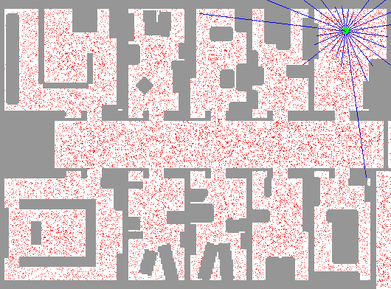
Particle Filter Localization (Laser)
[Dieter Fox, et al.]
[Video: global-floor.gif]

Slide 20

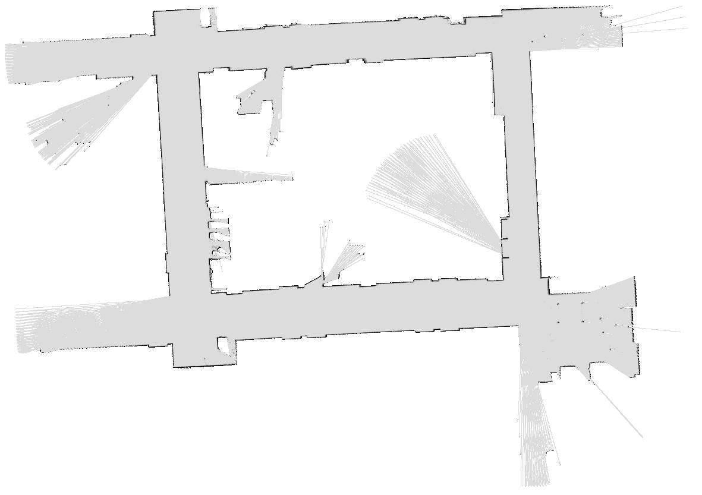
Robot Mapping
SLAM: Simultaneous Localization And Mapping
  We do not know the map or our location
  State consists of position AND map!
  Main techniques: Kalman filtering (Gaussian HMMs) and particle methods
DP-SLAM, Ron Parr
[Demo: PARTICLES-SLAM-mapping1-new.avi]

Slide 21
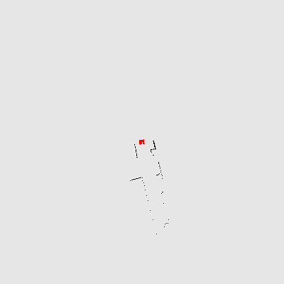
Particle Filter SLAM – Video 1
[Sebastian Thrun, et al.]
[Demo: PARTICLES-SLAM-mapping1-new.avi]

Slide 22
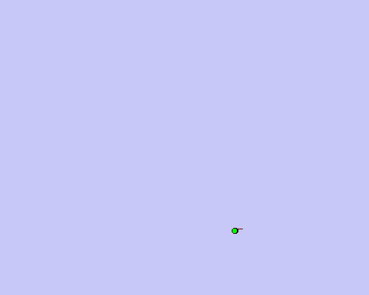
Particle Filter SLAM – Video 2
[Dirk Haehnel, et al.]
[Demo: PARTICLES-SLAM-fastslam.avi]

Slide 23
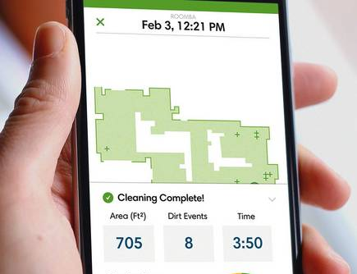
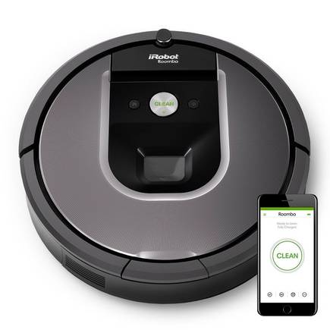
SLAM
https://www.irobot.com/

Slide 24
In Class Activity
Use Python random.random() or Google to sample
Given the following starting particles, transition model, and e₁ and e₂ observed at time 1 and time 2, what is the approximate belief state at time 2?
y
T=0
P(M_{t+1}|M_{t} in middle row)
P(M_{t+1}|M_{t} in top row)
P(M_{t+1}|M_{t} in bottom row)
0.15
0.1
0.1
3
2
0.8
0.7
0.8
1
0.1
0.15
0.1
1
2
3
x
P(e₁|m₁)
P(e₂|m₂)
.3
.5
.05
.4
.5
.5
.3
.5
.2
.5
.05
.2
Notes:
Row 3 (top row):
P((k,2) | (k,3)) = .8
P((k,3) | (k,3)) = .1
P((k+1,3) | (k,3)) = .1
Row 2 (middle row):
P((k+1,2) | (k,2)) = .7
P((k+1,1) | (k,2)) = .15
P((k+1,3) | (k,2)) = .15
Row 1 (bottom row):
P((k,2) | (k,1)) = .8
P((k,1) | (k,1)) = .1
P((k+1,1) | (k,1)) = .1

Slide 25
In Class Activity
Use random.random() or Google to sample
Given the following starting particles, transition model, and e₁ observed at time 1, what is the approximate belief state at time 1?
y
T=0
T=1
3
2
Propagate forward
Weight based on e₁
Resample
1
1
2
3
x
P(e₁|m₁)
.3
.5
.5
.5
.2
.5
Notes:
Row 3 (top row):
P((k,2) | (k,3)) = .8
P((k,3) | (k,3)) = .1
P((k+1,3) | (k,3)) = .1
Row 2 (middle row):
P((k+1,2) | (k,2)) = .7
P((k+1,1) | (k,2)) = .15
P((k+1,3) | (k,2)) = .15
Row 1 (bottom row):
P((k,2) | (k,1)) = .8
P((k,1) | (k,1)) = .1
P((k+1,1) | (k,1)) = .1

Slide 26
In Class Activity – Poll 2
Use random.random() or Google to sample
Given the particles at T=1, transition model, and e₂ observed at time 2, what is the approximate belief state at time 2?
y
T=1
T=2
How many samples at (3,2)?
3
2
Propagate forward
Weight based on e₂
Resample
1
1
2
3
x
P(e₂|x₂)
.05
.4
.3
.5
.05
.2
Notes:
Row 3 (top row):
P((k,2) | (k,3)) = .8
P((k,3) | (k,3)) = .1
P((k+1,3) | (k,3)) = .1
Row 2 (middle row):
P((k+1,2) | (k,2)) = .7
P((k+1,1) | (k,2)) = .15
P((k+1,3) | (k,2)) = .15
Row 1 (bottom row):
P((k,2) | (k,1)) = .8
P((k,1) | (k,1)) = .1
P((k+1,1) | (k,1)) = .1

Slide 27
In Class Activity – Example Solution
Use random.random() to sample
Given the following starting particles, transition model, and e₁ observed at time 1, what is the approximate belief state at time 1?
y
T=0
T=1
3
0
.5
Propagate forward
1.5
Resample
2
Weight based on e₁
.5
1
0
0
1
2
3
x
P(e₁|m)
.3
.5
.5
.5
.2
.5
Notes:
Row 3 (top row):
P((k,2) | (k,3)) = .8
P((k,3) | (k,3)) = .1
P((k+1,3) | (k,3)) = .1
Row 2 (middle row):
P((k+1,2) | (k,2)) = .7
P((k+1,1) | (k,2)) = .15
P((k+1,3) | (k,2)) = .15
Row 1 (bottom row):
P((k,2) | (k,1)) = .8
P((k,1) | (k,1)) = .1
P((k+1,1) | (k,1)) = .1

Slide 28
In Class Activity – Example Solution
Use random.random() to sample
Given the T=1 particles, transition model, and e₂ observed at time 2, what is the approximate belief state at time 2?
y
T=1
T=2
How many samples at (3,2)?
3
0
.4
2
Propagate forward
Weight based on e₂
2.1
1.0
Resample
1
0
0
1
2
3
x
(2,2) = 2.1/3.5 = .6
(3,2) = 1.0/3.5 = .29
(3,3) = .4/3.5 = .11
P(e₂|x₂)
.05
.4
.3
.5
.05
.2
Notes:
Row 3 (top row):
P((k,2) | (k,3)) = .8
P((k,3) | (k,3)) = .1
P((k+1,3) | (k,3)) = .1
Row 2 (middle row):
P((k+1,2) | (k,2)) = .7
P((k+1,1) | (k,2)) = .15
P((k+1,3) | (k,2)) = .15
Row 1 (bottom row):
P((k,2) | (k,1)) = .8
P((k,1) | (k,1)) = .1
P((k+1,1) | (k,1)) = .1

