Slide 1

As you come in… Candy Grab Game
Everyone should take a worksheet.
Work in groups of 3-4 people, one person should take a bag of colored discs.
Two people take turns, starting with 11 discs (fill in sheet):
On your turn, take 1 or 2 discs
The person to take the last disc wins
Is there a winning strategy? Think about how you might implement an Agent:
class Agent
function getAction(state)
return action

Slide 2
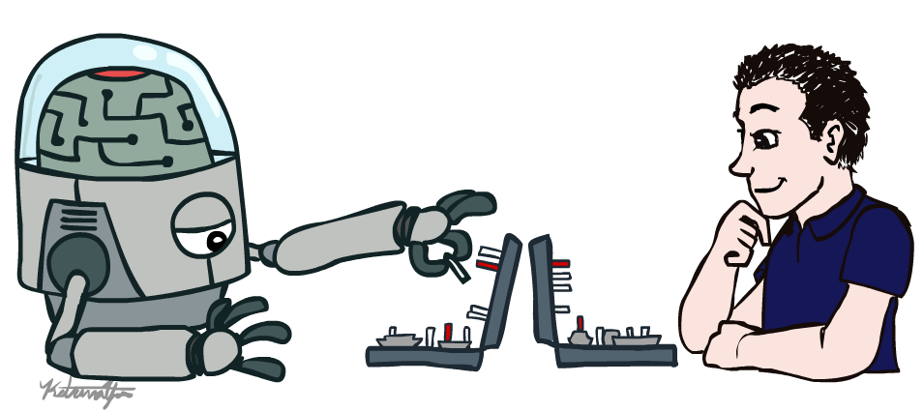
AI: Representation and Problem Solving
Introduction
Instructor: Stephanie Rosenthal
Slide credits: CMU AI & http://ai.berkeley.edu

Slide 3











Course Team
Teaching Assistants
Instructor
Ihita (Head TA)
Simrit (Head TA)
Olivia
Stephanie Rosenthal
Gavin
Alex
Raashi
Mansi
Lily
Josep

Slide 4




Course Information
Website: www.cs.cmu.edu/~15281
Canvas: canvas.cmu.edu
Gradescope: gradescope.com
Communication: www.piazza.com/cmu/spring2023/15281
(password AIRPS-S23)
E-mail: srosenth@andrew.cmu.edu
Prerequisites/Corequisites/Course Scope

Slide 5
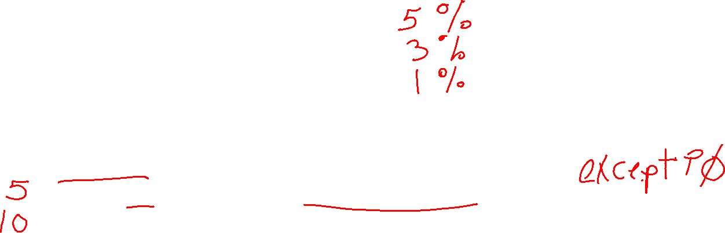
Participation Points and Late Days
Participation points! Last semester we had 65 points
Lecture Polls
In-Class Activities
Recitation Attendance
Late Days
6 late days to use during the semester
At most 2 can be used on a single programming assignment
At most 1 can be used on a single online/written assignment

Slide 6
Safety and Wellness
Virtual and in-person office hours!
Lectures are recorded for everyone to use, no questions asked.
Use the late days appropriately.
Contact me ASAP if you think you’ll miss more than one class so we can make a plan for how to catch up!

Slide 7

Announcements
Recitation starting this Friday
  Recommended. Materials are fair game for exams
  Attendance counts towards participation points
  Choosing sections
Assignments:
P0: Python & Autograder Tutorial (out now)
    Required, but worth zero points
    Already released
    Due Friday 1/20, 10 pm (no OH on Fridays!)
HW1 (online)
    Released Today!
    Due Tues 1/24, 10 pm

Slide 8
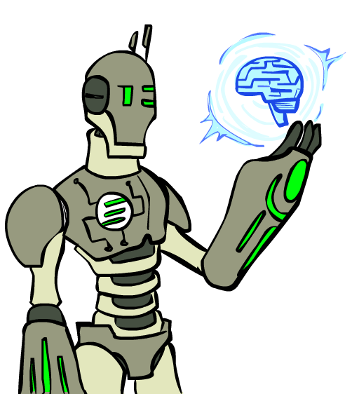
Today
An AI game
What is AI?
A brief history of AI
State representation and world modeling

Slide 9

Candy Grab Agent
class Agent
function getAction(state)
return action

Slide 10
Candy Grab Agent
Agent 001 – Always choose 1
function getAction( numPiecesAvailable )
return 1

Slide 11
Candy Grab Agent
Agent 004 – Choose the opposite of opponent
function getAction( numPiecesAvailable )
return ?

Slide 12

Candy Grab Agent
Agent 007 – Whatever you think is best
function getAction( numPiecesAvailable )
return ?

Slide 13
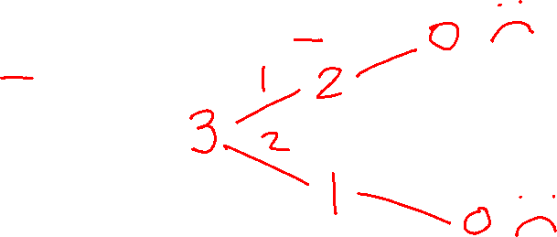
Candy Grab Agent
Agent 007 – Whatever you think is best
function getAction( numPiecesAvailable )
if numPiecesAvailable % 3 == 2
return 2
else
return 1

Slide 14
Games – Three “Intelligent” Agents
Participation Poll Question
Which agent code is the most “intelligent”?

Slide 15

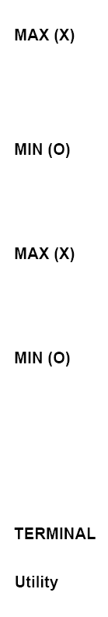

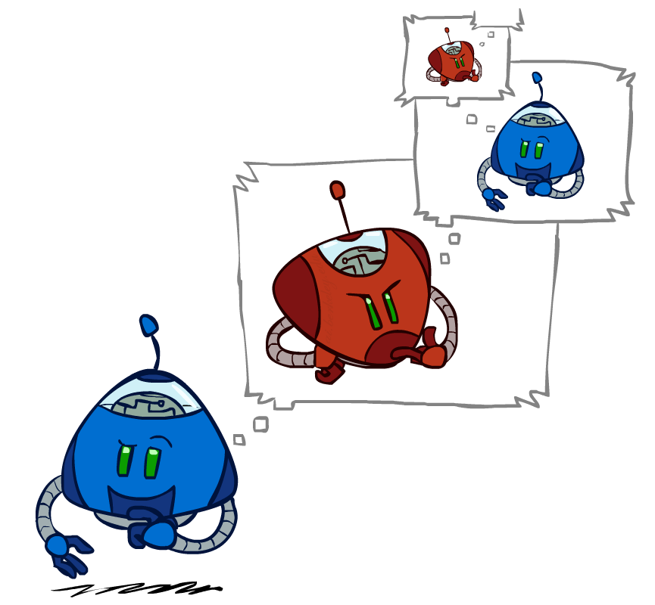
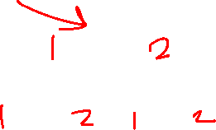
Games – Three “Intelligent” Agents
A: Search / Recursion
11
10
9
9
8
8
7
8
7
…
…
2
1
0
+1
+1
-1

Slide 16
Games – Three “Intelligent” Agents
B: Encode the pattern
10’s value:Win
9’s value:Lose
8’s value:Win
7’s value:Win
6’s value:Lose
5’s value:Win
4’s value:Win
3’s value:Lose
2’s value:Win
1’s value:Win
0’s value:Lose
function getAction( numPiecesAvailable )
if numPiecesAvailable % 3 == 2
return 2
else
return 1

Slide 17
Games – Three “Intelligent” Agents
C: Record statistics of winning positions
Pieces Available | Take 1 | Take 2
2
3
4
5
6
7
Pieces Available | Take 1 | Take 2
2 |  | 100%
3
4 | 100%
5
6
7 |  | 100%
Pieces Available | Take 1 | Take 2
2 |  | 100%
3 | 0%
4 | 100%
5
6
7 |  | 50%
Pieces Available | Take 1 | Take 2
2 | 0% | 100%
3 | 2% | 0%
4 | 75% | 2%
5 | 4% | 68%
6 | 5% | 6%
7 | 60% | 5%

Slide 18
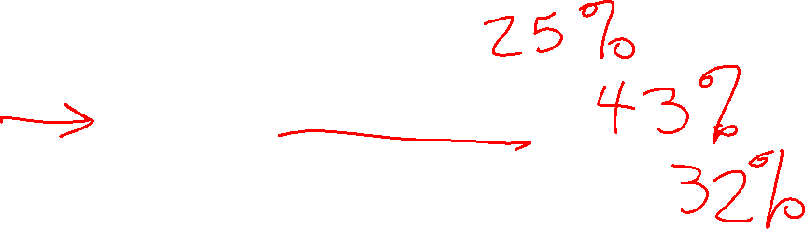
Poll question
Games – Three “Intelligent” Agents
Which agent code is the most “intelligent”?
Search / Recursion
Encode multiple of 3 pattern
Keep stats on winning positions
Which agent code is the most “intelligent”?

Slide 19
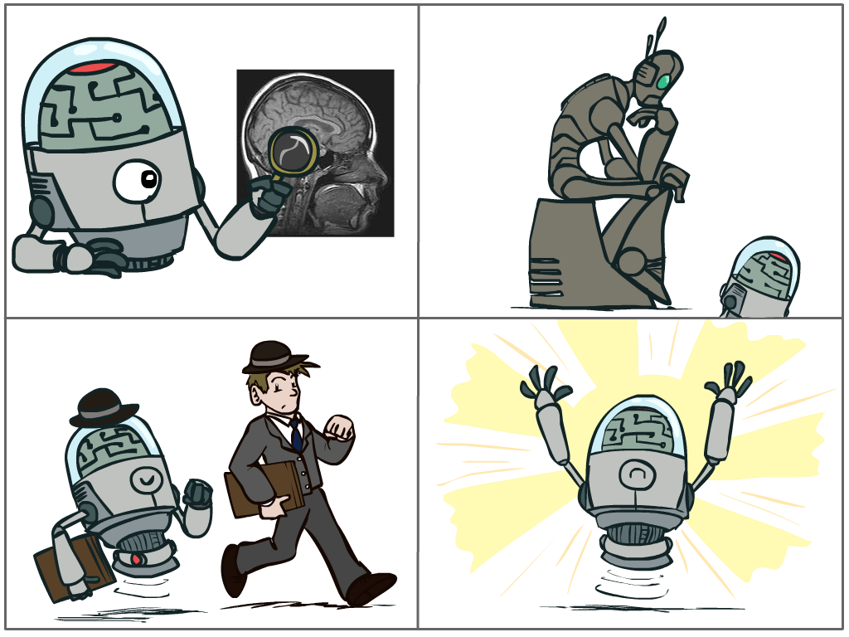
What is AI?
The science of making machines that:
Think like people
Think rationally
Act like people
Act rationally
Notes:
Top left: Think like people --- cognitive science, neuroscience
Bottom left: act like people --- actually very early definition, dating back to Alan Turing --- Turing test; problem to do really well you start focusing on things like don’t answer too quickly what the square root of 1412 is, don’t spell too well, and make sure you have a favorite movie etc. So it wasn’t really leading us to build intelligence
Think rationally – long tradition dating back to Aristotle --- but not a winner, because difficult to encode how to think, and in the end it’s not about how you think, it’s about how you end up acting

Slide 20
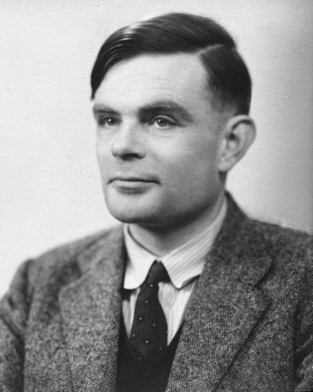
Turing Test
In 1950, Turing defined a test of whether a machine could “think”
“A human judge engages in a natural language conversation with one human and one machine, each of which tries to appear human. If judge can’t tell, machine passes the Turing test”
en.wikipedia.org/wiki/Turing_test
Notes:
Top left: Think like people --- cognitive science, neuroscience
Bottom left: act like people --- actually very early definition, dating back to Alan Turing --- Turing test; problem to do really well you start focusing on things like don’t answer too quickly what the square root of 1412 is, don’t spell too well, and make sure you have a favorite movie etc. So it wasn’t really leading us to build intelligence
Think rationally – long tradition dating back to Aristotle --- but not a winner, because difficult to encode how to think, and in the end it’s not about how you think, it’s about how you end up acting

Slide 21

What is AI?
The science of making machines that:
Think like people
Think rationally
Act like people
Act rationally
Notes:
Top left: Think like people --- cognitive science, neuroscience
Bottom left: act like people --- actually very early definition, dating back to Alan Turing --- Turing test; problem to do really well you start focusing on things like don’t answer too quickly what the square root of 1412 is, don’t spell too well, and make sure you have a favorite movie etc. So it wasn’t really leading us to build intelligence
Think rationally – long tradition dating back to Aristotle --- but not a winner, because difficult to encode how to think, and in the end it’s not about how you think, it’s about how you end up acting

Slide 22
Rational Decisions
We’ll use the term rational in a very specific, technical way:
  Rational: maximally achieving pre-defined goals
  Rationality only concerns what decisions are made
  (not the thought process behind them)
  Goals are expressed in terms of the utility of outcomes
  Being rational means maximizing your expected utility
A better title for this course would be:
Computational Rationality
Notes:
Example of utilities. 10 for A, 1 for each Friday with friends

Slide 23
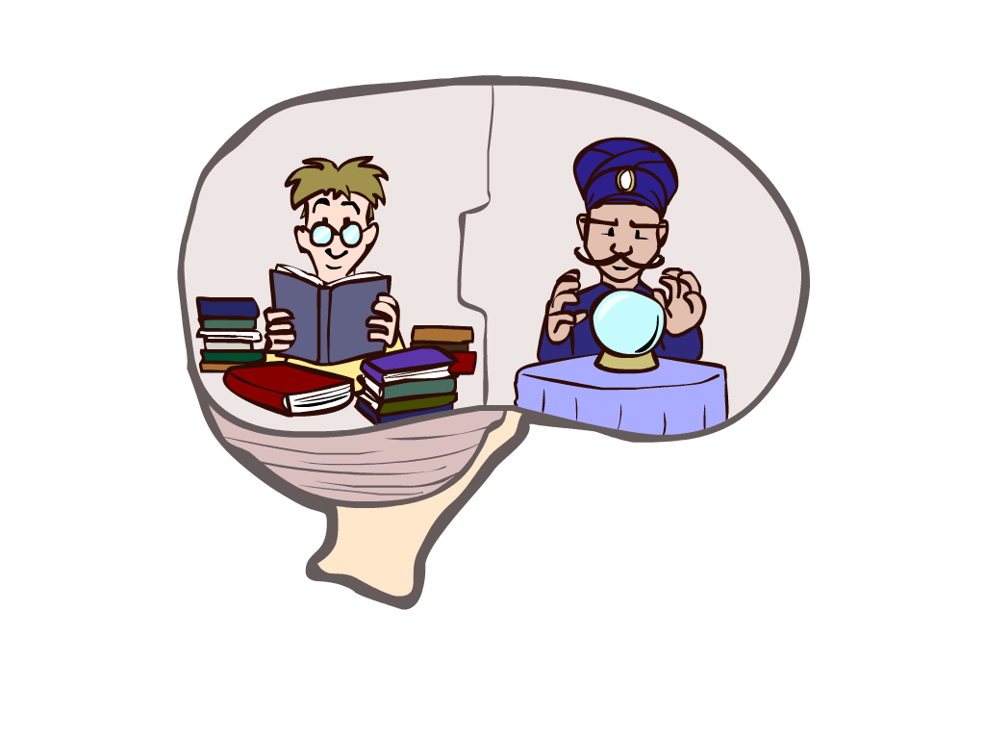
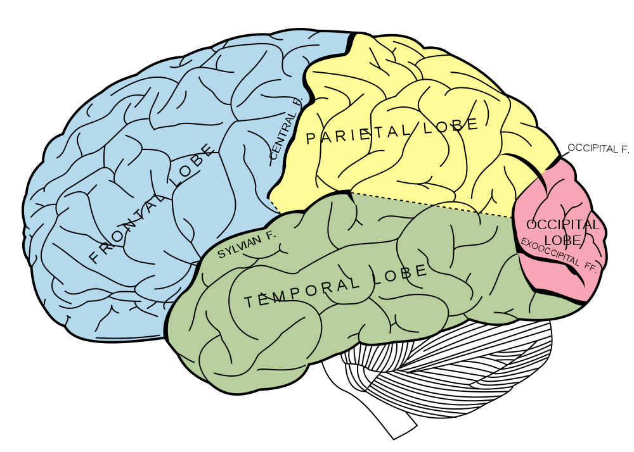
What About the Brain?
Brains (human minds) are very good at making rational decisions, but not perfect
Brains aren’t as modular as software, so hard to reverse engineer!
“Brains are to intelligence as wings are to flight”
Lessons learned from the brain: memory and simulation are key to decision making

Slide 24
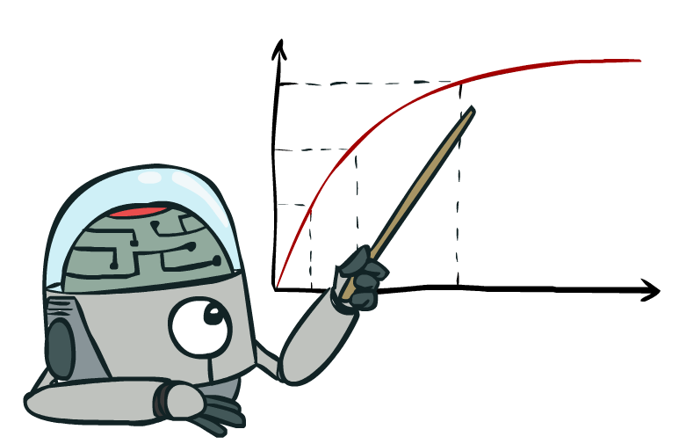

Rationality, contd.
What is rational depends on:
  Performance measure
  Agent’s prior knowledge of environment
  Actions available to agent
  Percept sequence to date
Being rational means maximizing your expected utility

Slide 25
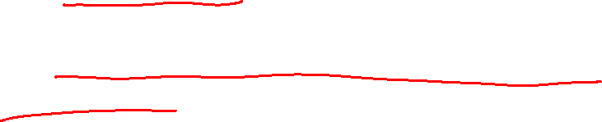
Rational Agents
Are rational agents omniscient?
  No – they are limited by the available percepts and state
Are rational agents clairvoyant?
  No – they may lack knowledge of the environment dynamics
Do rational agents explore and learn?
  Yes – in unknown environments these are essential
So rational agents are not necessarily successful, but they are autonomous (i.e., make decisions on their own to achieve their goals)

Slide 26
Maximize Your
Expected Utility

Slide 27
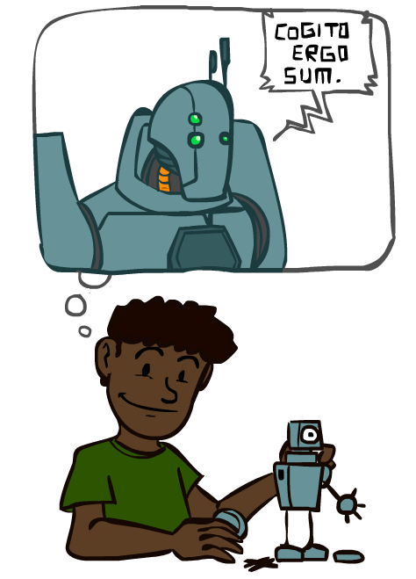
A Brief History of AI

Slide 28
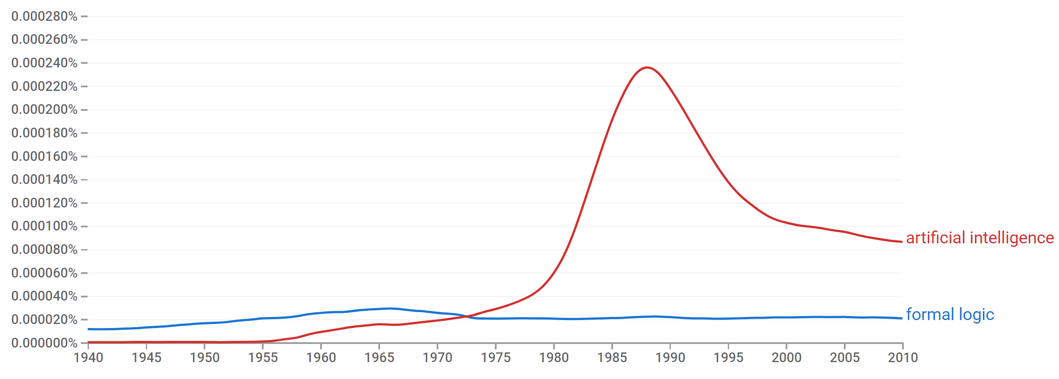

A Brief History of AI
Knowledge Based
Systems
1970-1990
AI
Excitement!
1950-1970
artificial intelligence
formal logic
https://books.google.com/ngrams

Slide 29
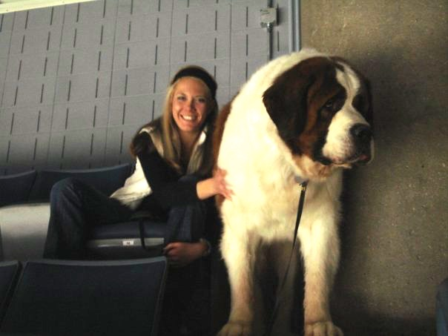
What went wrong?
Dog
  Barks
  Has Fur
  Has four legs
Buster

Slide 30
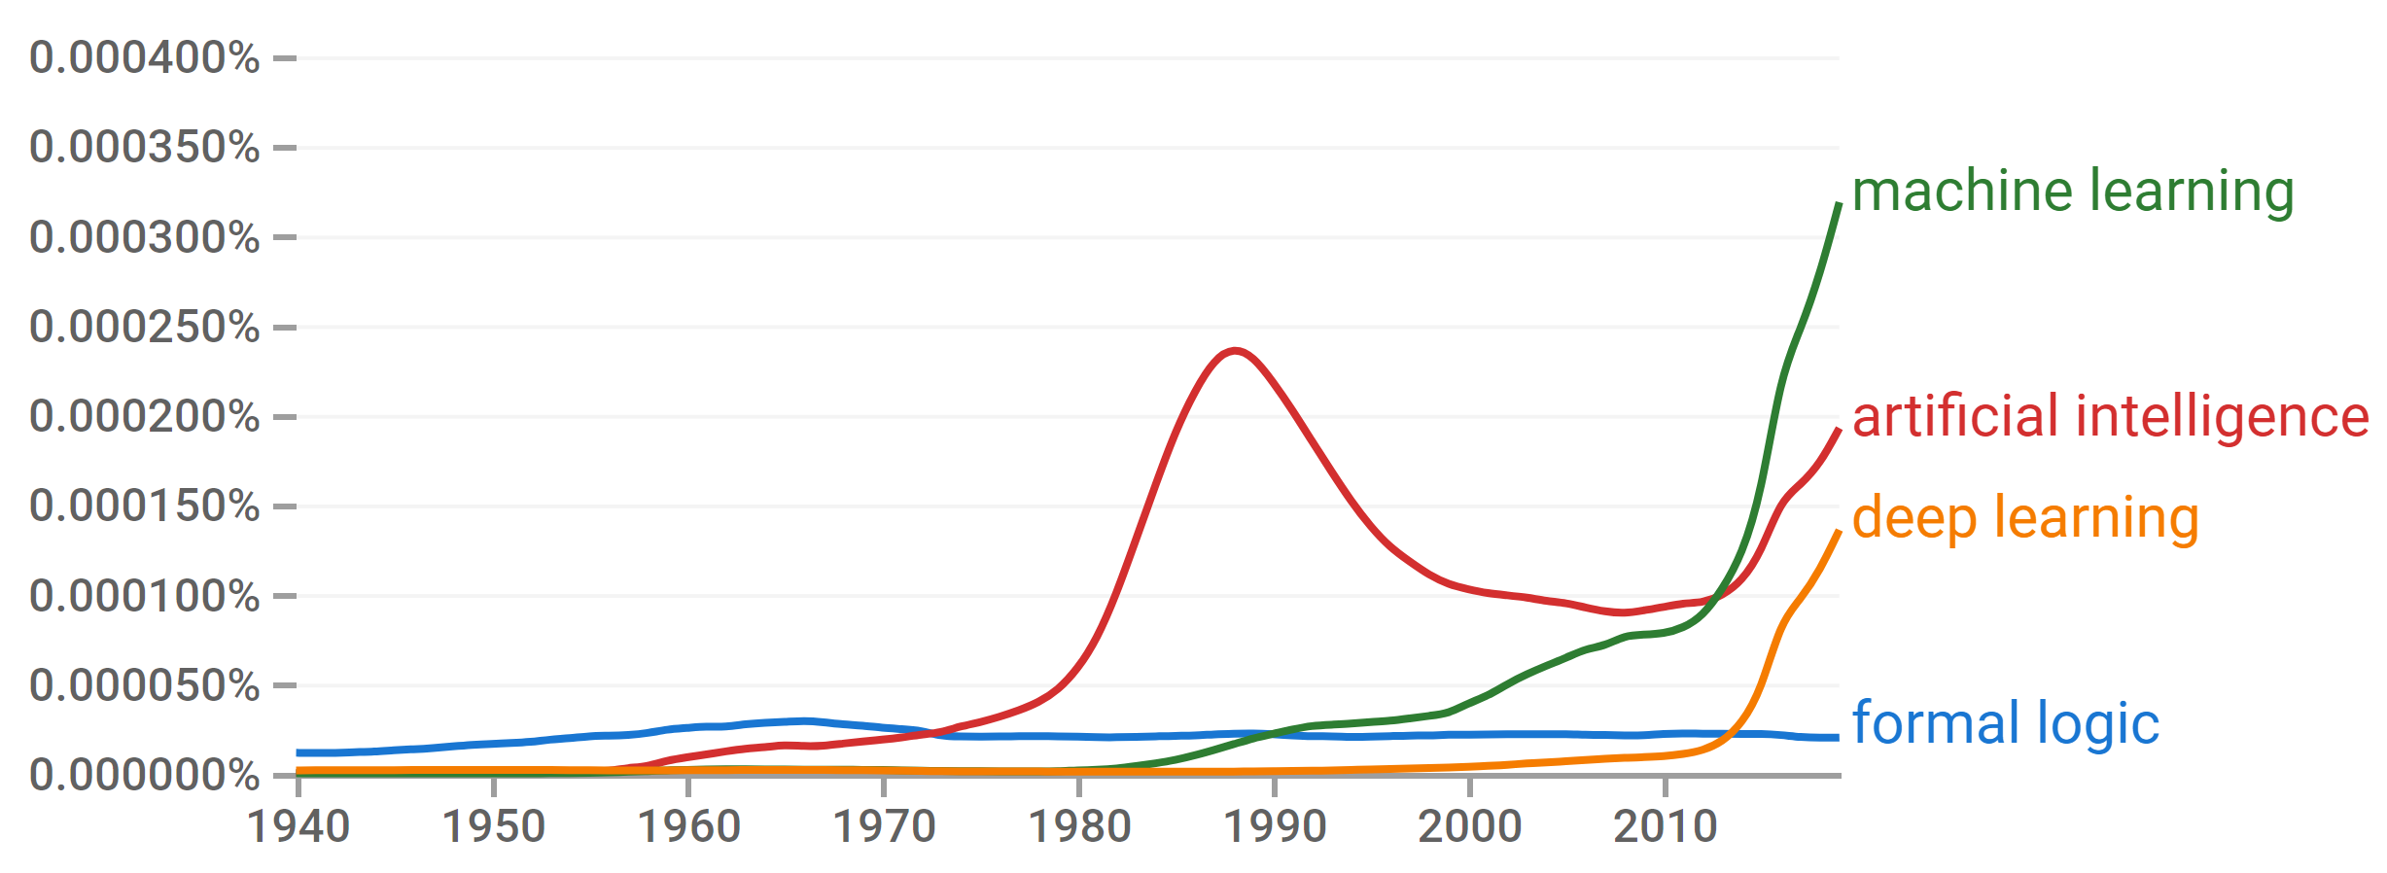
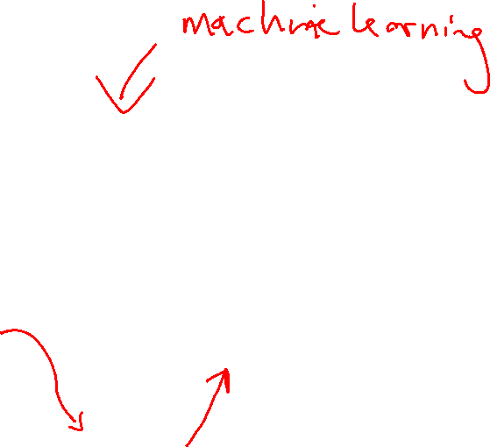
A Brief History of AI
Knowledge Based
Systems
1970-1990
AI
Excitement!
1950-1970
Statistical Approaches
1990-
Deep Learning Era
2012-
https://books.google.com/ngrams

Slide 31

A Brief History of AI
1940-1950: Early days
  1943: McCulloch & Pitts: Boolean circuit model of brain
  1950: Turing's “Computing Machinery and Intelligence”
1950—70: Excitement: Look, Ma, no hands!
  1950s: Early AI programs, including Samuel's checkers program, Newell & Simon's Logic Theorist, Gelernter's Geometry Engine
  1956: Dartmouth meeting: “Artificial Intelligence” adopted
1970—90: Knowledge-based approaches
  1969—79: Early development of knowledge-based systems
  1980—88: Expert systems industry booms
  1988—93: Expert systems industry busts: “AI Winter”
1990—: Statistical approaches
  Resurgence of probability, focus on uncertainty
  General increase in technical depth
  Agents and learning systems… “AI Spring”?
2012—: Deep learning
  2012: ImageNet & AlexNet
Images: ai.berkeley.edu
Notes:
Million dollar computer with less computation than your phone
MT was

Slide 32
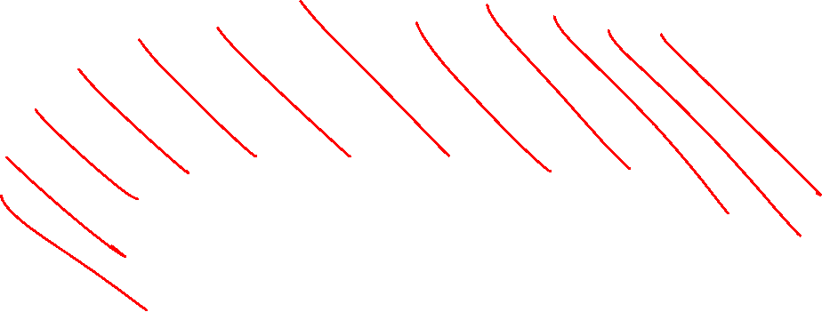
Artificial Intelligence vs Machine Learning?
Artificial Intelligence
Machine Learning
Deep Learning

Slide 33
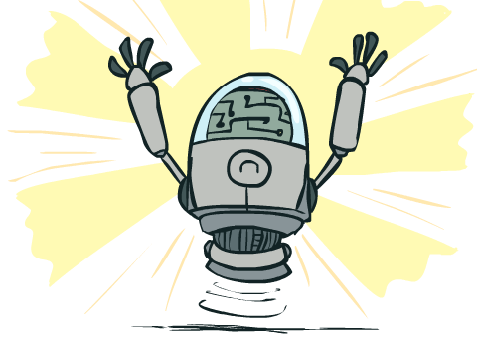
What Can AI Do?
Quiz: Which of the following can be done at present?
Play a decent game of table tennis?
Play a decent game of Jeopardy?
Drive safely along a curving mountain road?
Drive safely across Pittsburgh?
Buy a week's worth of groceries on the web?
Buy a week's worth of groceries at Giant Eagle?
Discover and prove a new mathematical theorem?
Converse successfully with another person for an hour?
Perform a surgical operation?
Put away the dishes and fold the laundry?
Translate spoken Chinese into spoken English in real time?
Generate intentionally funny memes?

Slide 34
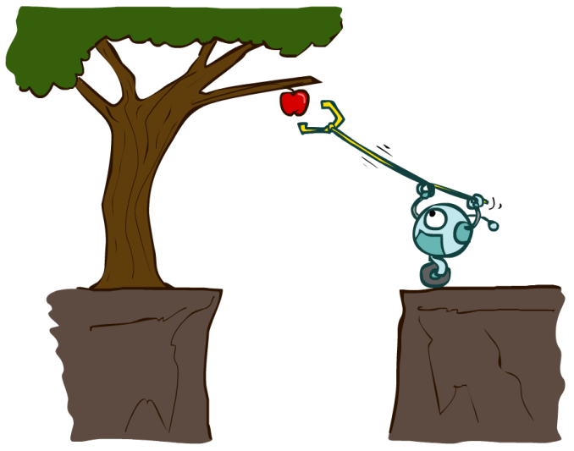
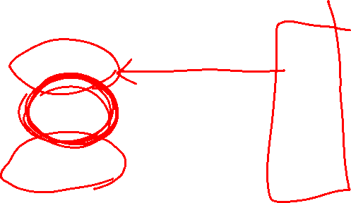
Designing Agents
An agent is an entity that perceives and acts.
Characteristics of the percepts and state, environment, and action space dictate techniques for selecting actions
How can we design an AI agent to solve our problems given their task environments?
Sensors
Agent
Percepts
Environment
?
Actuators
Actions

Slide 35
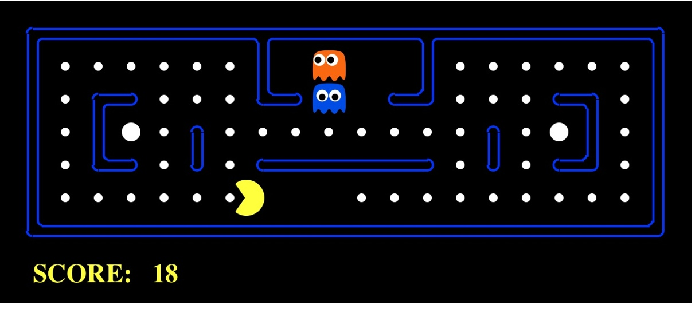
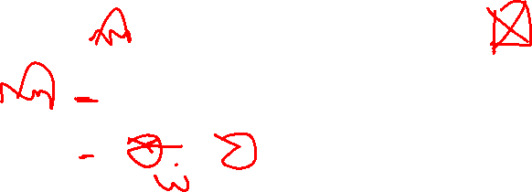
Pac-Man as an Agent
Agent
Sensors
Environment
World Model
States
Transitions
Costs/Utilities
Percepts
?
Actuators
Actions
Pac-Man is a registered trademark of Namco-Bandai Games, used here for educational purposes

Slide 36
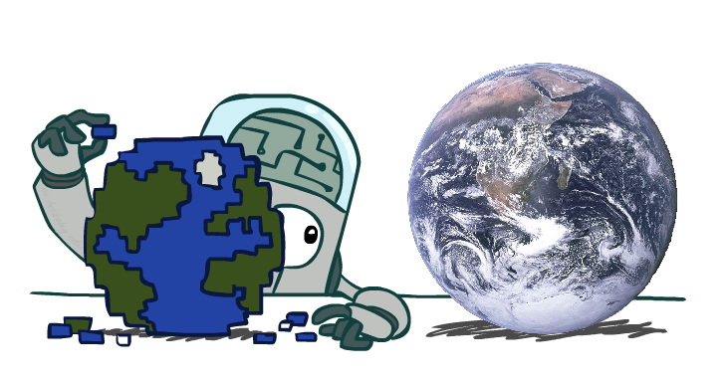

World Models

Slide 37

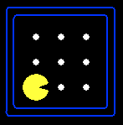

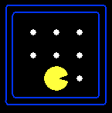




Representing an AI problem (PEAS)
A task environment consists of:
  A state space - what the agent knows about the world
  For each state, a set of
  Actions(s) of allowable actions
  OR Value(s) to assign to states
  Environmental dynamics how the world moves when the agent acts in it
  Performance measure as a metric for utility/reward/cost
{N, E}
1
N
E
1
Notes:
Often comes back on exams
Goal test – sometimes more than one state that satisfies having achieved the goal, for example, “eat all the dots”
Abstraction

Slide 38
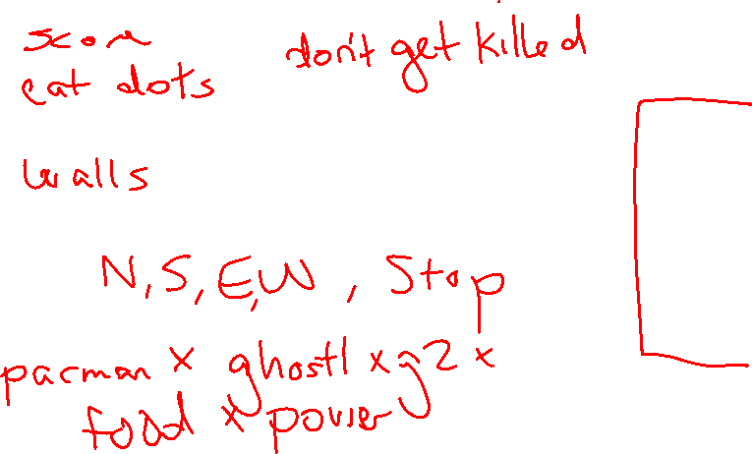
Task Environment - Pacman
Performance measure
  -1 per step; +10 food; +500 win; -500 die; +200 hit scared ghost
Environment
  Pacman dynamics (incl ghost behavior)
Actions
  North, South, East, West, (Stop)
State
  where pacman is
  all dots?
  all ghosts?

Slide 39
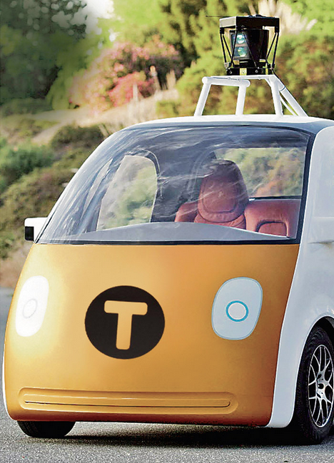
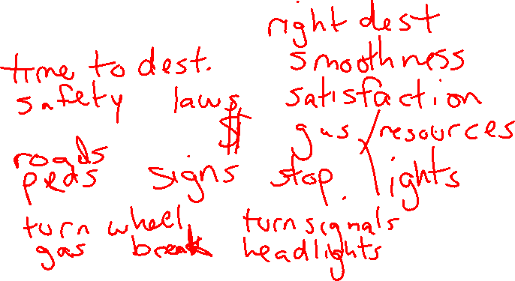
Task Environment – Automated Taxi
Performance measure
  Income, happy customer, vehicle costs, fines, insurance premiums
Environment
  US streets, other drivers, customers
Actions
  Steering, brake, gas, display/speaker
State Information
  Camera, radar, accelerometer, engine sensors, microphone
Image: http://nypost.com/2014/06/21/how-google-might-put-taxi-drivers-out-of-business/

Slide 40
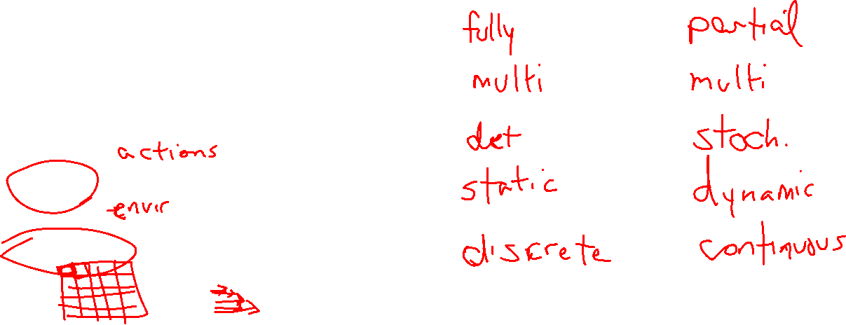
Environment Types
 | Pacman | Taxi
Fully or partially observable
Single agent or multi-agent
Deterministic or stochastic
Static or dynamic
Discrete or continuous

Slide 41
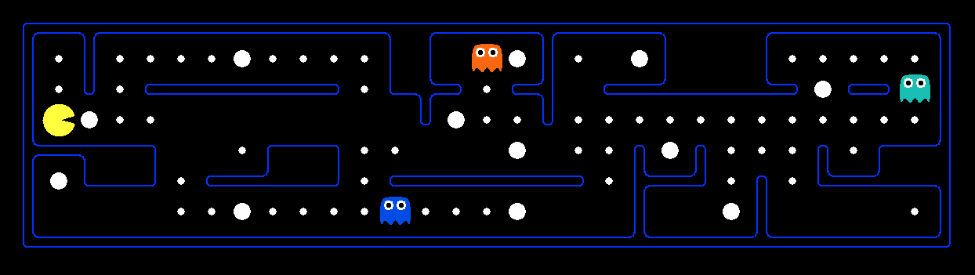

What’s in a State Space?
The real world state includes every last detail of the environment
A state (for AI) abstracts away details not needed to solve the problem
Problem: Pathing
  State representation: (x,y) location
  Actions: NSEW
  Transition model: update location
  Goal test: is (x,y)=END
Problem: Eat-All-Dots
  State representation: {(x,y), dot booleans}
  Actions: NSEW
  Transition model: update location and possibly a dot boolean
  Goal test: dots all false
Notes:
Wrong example for “eat-all-dots”: (x, y, dot count)

Slide 42
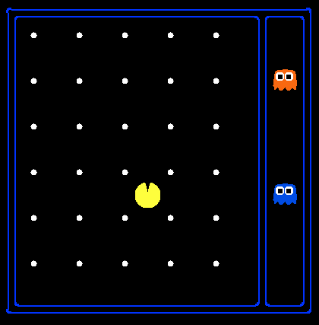

State Space Sizes?
World state:
  Agent positions: 120
  Food count: 30
  Ghost positions: 12
  Agent facing: NSEW
How many
  World states?
  120x(2³⁰)x(12²)x4
  States for pathing?
  120
  States for eat-all-dots?
  120x(2³⁰)
Notes:
90 * (2^30-1) + 30 * 2^29 = 145 billion
2^29 = 536 870 912

Slide 43
Safe Passage
Problem: eat all dots while keeping the ghosts perma-scared
What does the state representation have to specify?
  (agent position, dot booleans, power pellet booleans, remaining scared time)

Slide 44
Designing Agents
An agent is an entity that perceives and acts.
Characteristics of the percepts and state, environment, and action space dictate techniques for selecting actions
This course is about:
  General AI techniques for a variety of problem types
  Learning to recognize when and how a new problem can be solved with an existing technique
Sensors
Agent
Percepts
Environment
?
Actuators
Actions

Slide 45
In-Class Activity Part 2
Answer Poll Question at the end…

Slide 46
Take some candy on the way out!
Return the bag of discs!
Summary:
- An agent perceives the world and acts in it
- PEAS framework for task environments
- Environment types
- State space calculations
- Rationality

