Slide 1
Warm-up as you walk in
For the following Bayes net, write the query P(X₄ | e_{1:4}) in terms of the conditional probability tables associated with the Bayes net.
P(X₄ | e₁,e₂,e₃,e₄) =
X₁
X₂
X₃
X₄
e₁
e₂
e₃
e₄

Slide 2
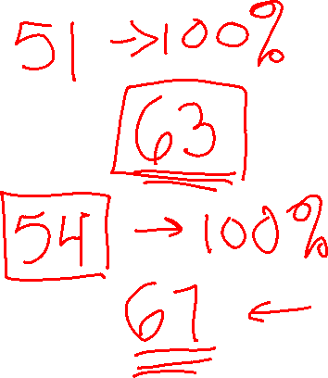
Announcements
TA applications: https://www.ugrad.cs.cmu.edu/ta/F23/
Assignments
HW9
Due tonight, 10 pm
HW10
Out next week, due 4/25, 10 pm
P5
Out tonight, due Thursday 4/27, 10 pm

Slide 3
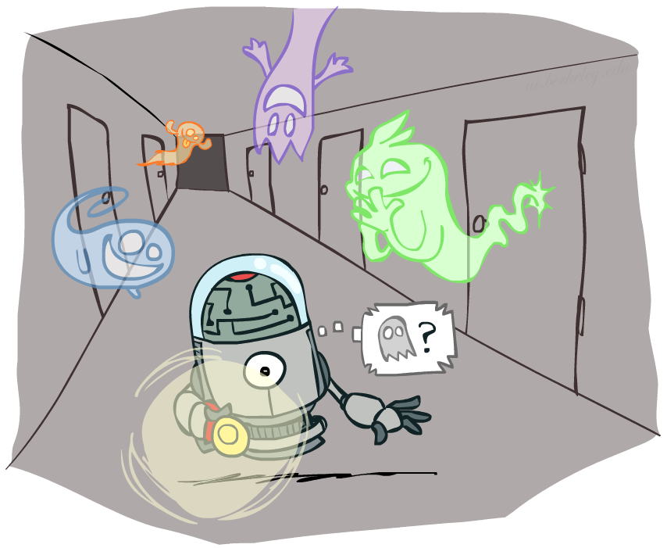
AI: Representation and Problem Solving
Hidden Markov Models
Instructors: Stephanie Rosenthal
Slide credits: CMU AI and http://ai.berkeley.edu

Slide 4
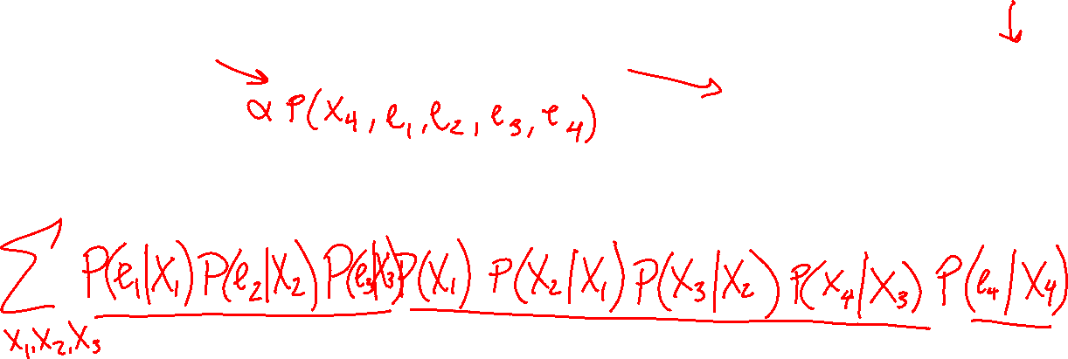
Warm-up as you walk in
For the following Bayes net, write the query P(X₄ | e_{1:4}) in terms of the conditional probability tables associated with the Bayes net.
P(X₄ | e₁,e₂,e₃,e₄) =
X₁
X₂
X₃
X₄
e₁
e₂
e₃
e₄

Slide 5
Reasoning over Time or Space
Often, we want to reason about a sequence of observations
Speech recognition
Robot localization
User attention
Medical monitoring
Need to introduce time (or space) into our models

Slide 6


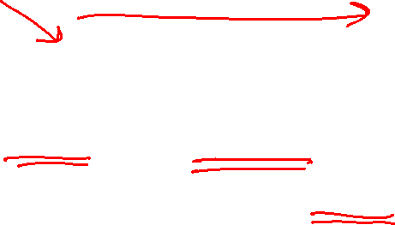
Markov Chains
Value of X at a given time is called the state
Parameters: called transition probabilities or dynamics, specify how the state evolves over time (also, initial state probabilities)
Stationarity assumption: transition probabilities the same at all times
Same as MDP transition model, but no choice of action
X₁
X₂
X₃
X₄

Slide 7

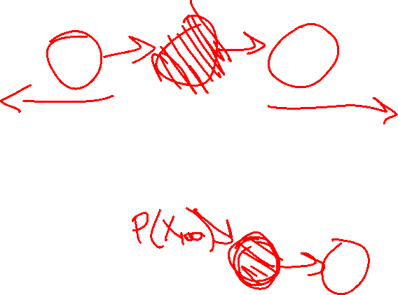
Conditional Independence
Basic conditional independence:
Past and future independent given the present
Each time step only depends on the previous
This is called the (first order) Markov property
Note that the chain is just a (growable) BN
We can always use generic BN reasoning on it if we truncate the chain at a fixed length

Slide 8
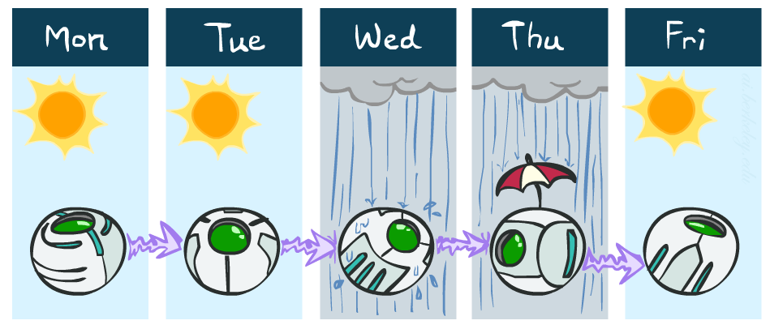
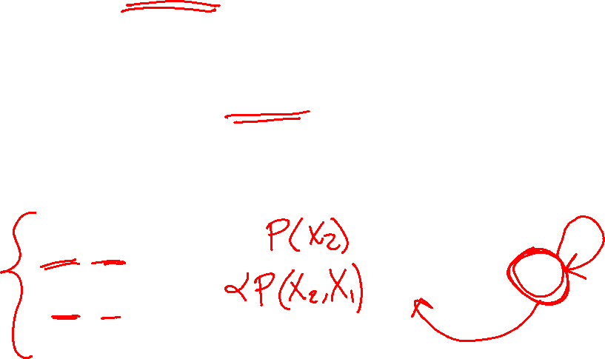
Example: Markov Chain Weather
States: X = {rain, sun}
Initial distribution: 1.0 sun
CPT P(X_{t} | X_{t-1}):
Two new ways of representing the same CPT
X_{t-1} | X_{t} | P(X_{t}|X_{t-1})
sun | sun | 0.9
sun | rain | 0.1
rain | sun | 0.3
rain | rain | 0.7
0.9
0.3
0.9
rain
sun
sun
sun
0.1
0.3
rain
rain
0.7
0.7
0.1

Slide 9
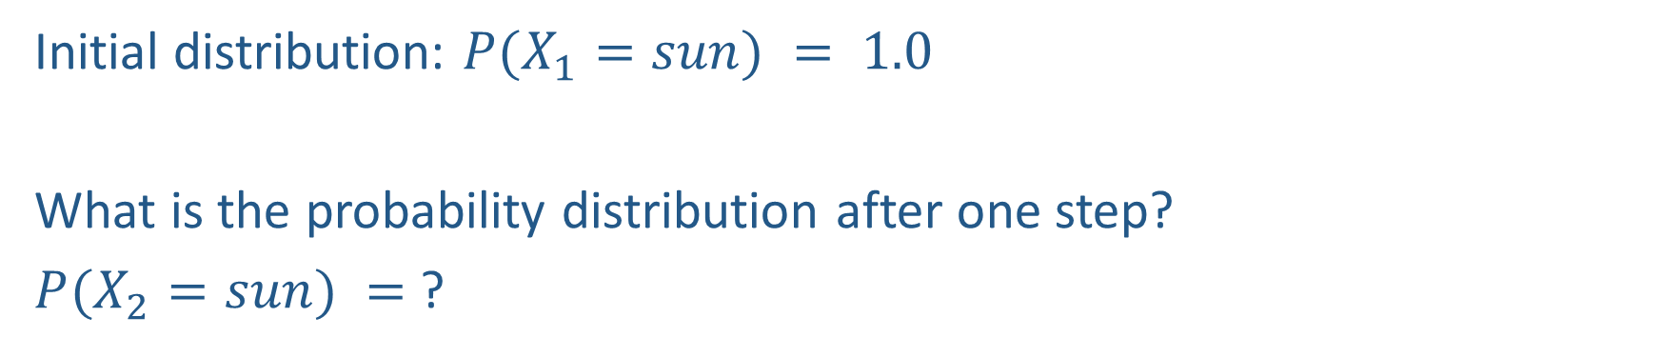
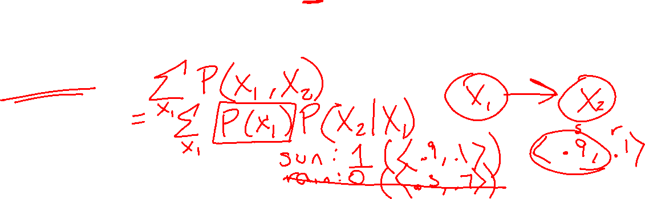
Example: Markov Chain Weather
0.9
0.3
rain
sun
Initial distribution: $P(X_{1}=sun) = 1.0$
What is the probability distribution after one step?
$P(X_{2}=sun) =$ ?
0.7
0.1

Slide 10
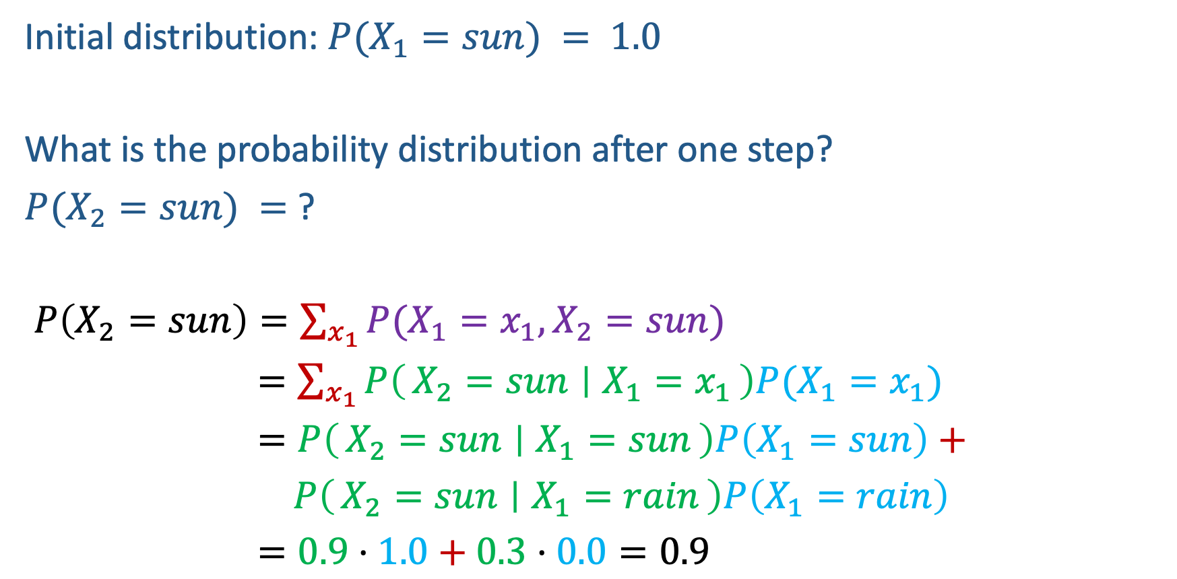
Example: Markov Chain Weather
0.9
0.3
rain
sun
Initial distribution: $P(X_{1}=sun) = 1.0$
What is the probability distribution after one step?
$P(X_{2}=sun) =$ ?
$P\left(X_{2}=sun\right)=\sum_{x_{1}}{P(X_{1}=x_{1}, X_{2}=sun})$
$=\sum_{x_{1}}{P\left(X_{2}=sun ∣ X_{1}=x_{1}\right)P(X_{1}=x_{1}})$
$=P\left(X_{2}=sun ∣ X_{1}=sun\right)P\left(X_{1}=sun\right)+$
$P\left(X_{2}=sun ∣ X_{1}=rain\right)P\left(X_{1}=rain\right)$
$=0.9⋅1.0+0.3⋅0.0=0.9$
0.7
0.1

Slide 11
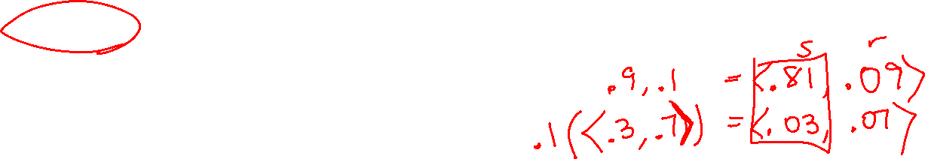
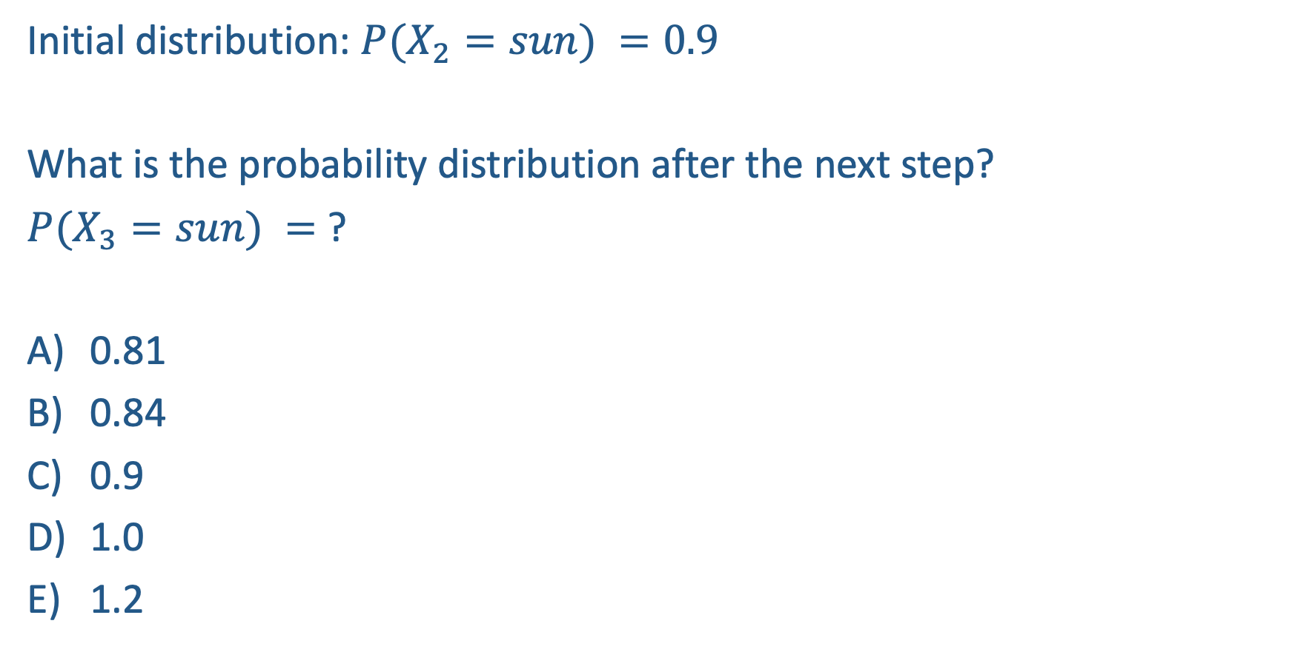

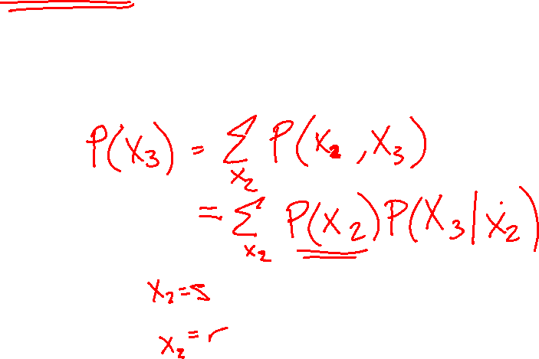
Poll 1
0.9
0.3
rain
sun
Initial distribution: $P(X_{2}=sun) =0.9$
What is the probability distribution after the next step?
$P(X_{3}=sun) =$ ?
0.81
0.84
0.9
1.0
1.2
0.7
0.1

Slide 12

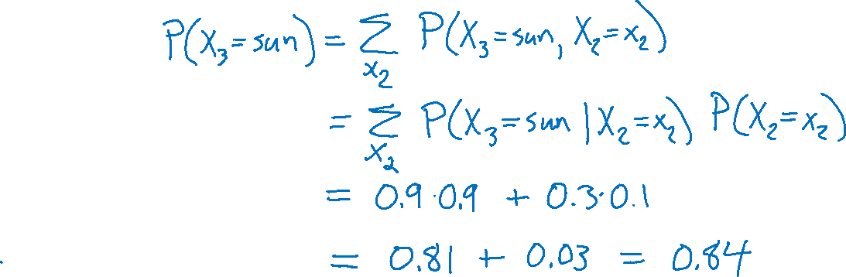
Poll 1
0.9
0.3
rain
sun
Initial distribution: $P(X_{2}=sun) =0.9$
What is the probability distribution after the next step?
$P(X_{3}=sun) =$ ?
0.81
0.84
0.9
1.0
1.2
0.7
0.1

Slide 13
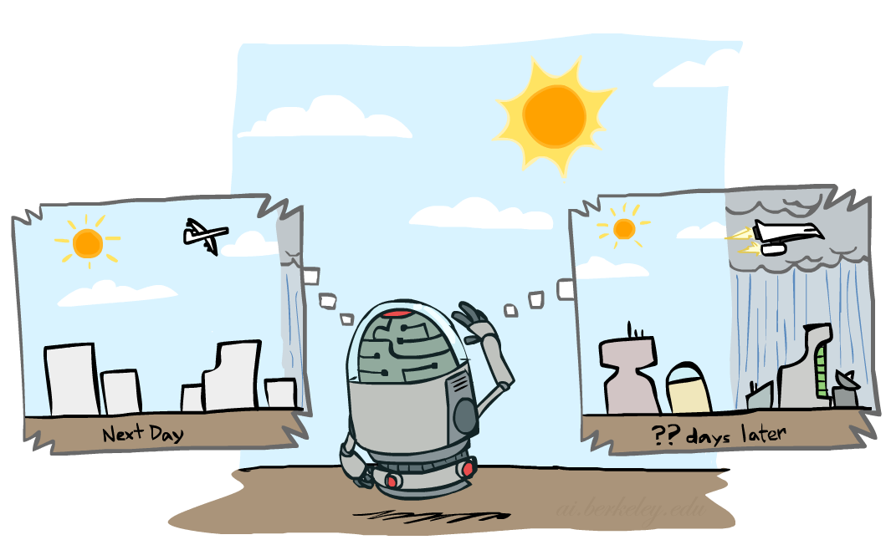
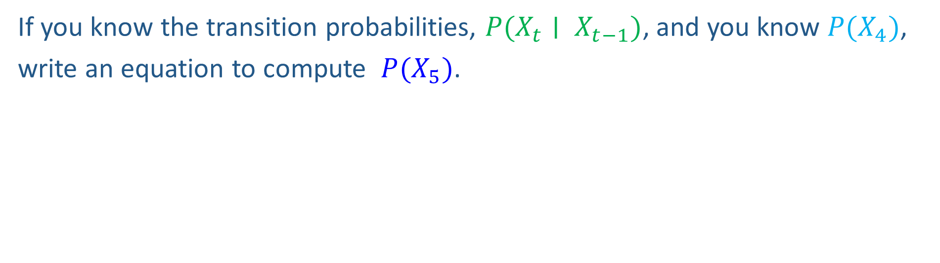
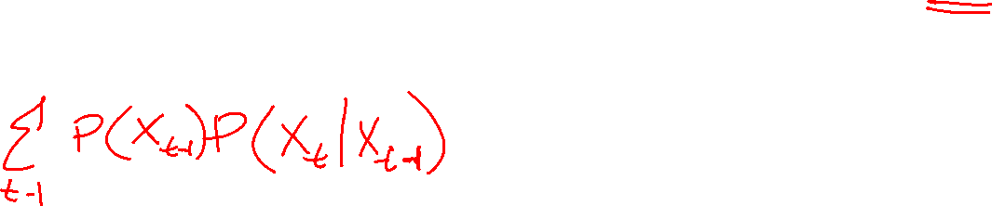
Markov Chain Inference
X₁
X₂
X₃
X₄
If you know the transition probabilities, $P(X_{t}∣ X_{t−1})$, and you know $P(X_{4})$,
write an equation to compute $P(X_{5})$.

Slide 14
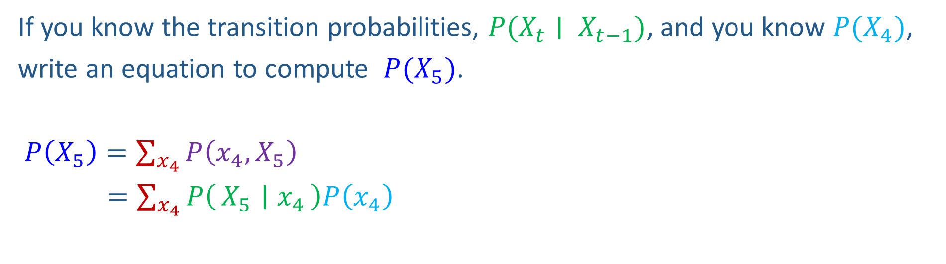

Markov Chain Inference
X₁
X₂
X₃
X₄
If you know the transition probabilities, $P(X_{t}∣ X_{t−1})$, and you know $P(X_{4})$,
write an equation to compute $P(X_{5})$.
$P\left(X_{5}\right)=\sum_{x_{4}}{P\left(x_{4},X_{5}\right)}$
$=\sum_{x_{4}}{P\left(X_{5} ∣ x_{4}\right)P\left(x_{4}\right)}$

Slide 15
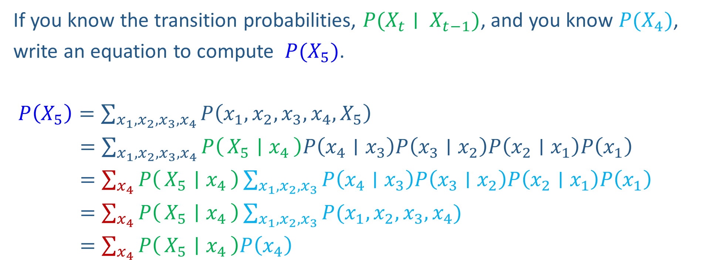
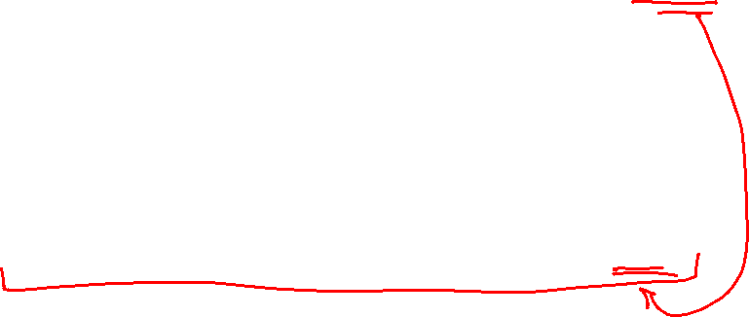
Markov Chain Inference
X₁
X₂
X₃
X₄
If you know the transition probabilities, $P(X_{t}∣ X_{t−1})$, and you know $P(X_{4})$,
write an equation to compute $P(X_{5})$.
$P\left(X_{5}\right)=\sum_{{x_{1},x_{2}, x_{3},x}_{4}}{P\left({x_{1},x_{2},x_{3},x}_{4},X_{5}\right)}$
$=\sum_{{x_{1},x_{2}, x_{3},x}_{4}}{P\left(X_{5} ∣ x_{4}\right)P\left(x_{4}∣x_{3}\right)P\left(x_{3}∣x_{2}\right)P\left(x_{2}∣x_{1}\right)P\left(x_{1}\right)}$
$=\sum_{x_{4}}{P\left(X_{5} ∣ x_{4}\right)}\sum_{x_{1},x_{2}, x_{3}}{P\left(x_{4}∣x_{3}\right)P\left(x_{3}∣x_{2}\right)P\left(x_{2}∣x_{1}\right)P\left(x_{1}\right)}$
$=\sum_{x_{4}}{P\left(X_{5} ∣ x_{4}\right)}\sum_{x_{1},x_{2}, x_{3}}{P(x_{1},x_{2},x_{3},x_{4})}$
$=\sum_{x_{4}}{P\left(X_{5} ∣ x_{4}\right)P\left(x_{4}\right)}$

Slide 16
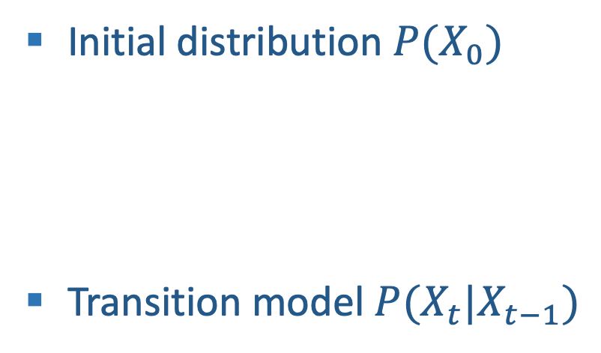
Weather prediction
States {rain, sun}
Initial distribution $P(X_{0})$
Transition model $P(X_{t}|X_{t−1})$
P(X₀)
sun | rain
0.5 | 0.5
Two new ways of representing the same CPT
0.9
0.3
0.9
X_{t-1} | P(X_{t}|X_{t-1})
 | sun | rain
sun | 0.9 | 0.1
rain | 0.3 | 0.7
rain
sun
sun
sun
0.1
0.3
rain
rain
0.7
0.7
0.1

Slide 17
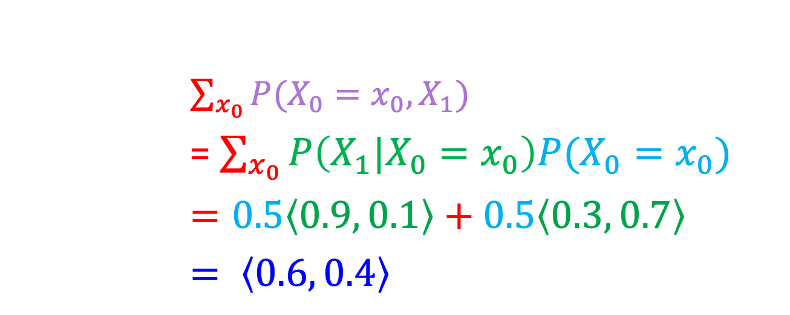

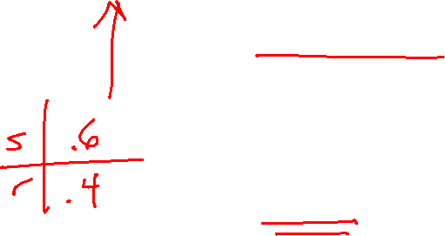
Weather prediction
X_{t-1} | P(X_{t}|X_{t-1})
 | sun | rain
sun | 0.9 | 0.1
rain | 0.3 | 0.7
Time 0: $P\left(X_{0}\right)=⟨0.5, 0.5⟩$
What is the weather like at time 1?
$P\left(X_{1}\right)=$
$\sum_{x_{0}}{P(X_{0}=x_{0},X_{1})}$
= $\sum_{x_{0}}{P\left({X_{1}|X}_{0}=x_{0}\right)P(X_{0}=x_{0})}$
$=0.5\left\langle 0.9, 0.1\right\rangle +0.5\left\langle 0.3, 0.7\right\rangle$
$= \left\langle 0.6, 0.4\right\rangle$
X₀
X₁

Slide 18
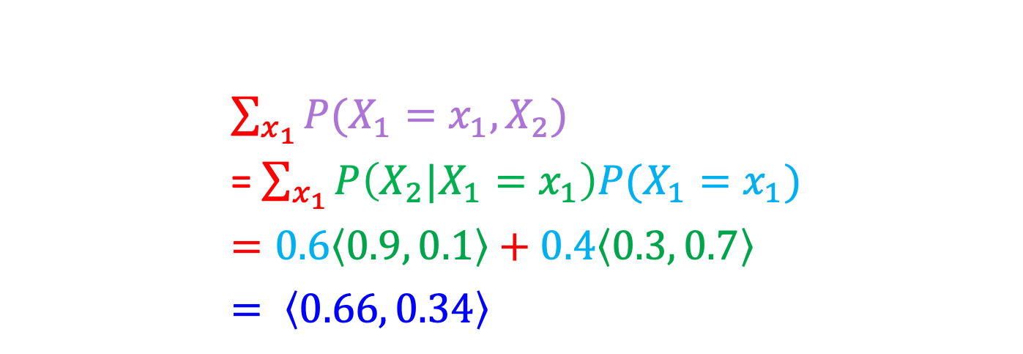
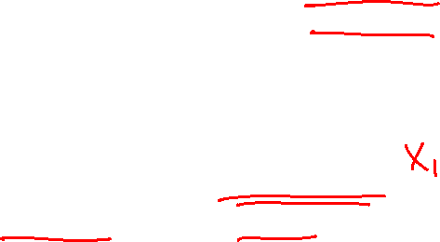

Weather prediction, contd.
X_{t-1} | P(X_{t}|X_{t-1})
 | sun | rain
sun | 0.9 | 0.1
rain | 0.3 | 0.7
Time 1: $P\left(X_{1}\right)=⟨0.6, 0.4⟩$
What is the weather like at time 2?
P(X₂) =
$\sum_{x_{1}}{P(X_{1}=x_{1},X_{2})}$
= $\sum_{x_{1}}{P\left({X_{2}|X}_{1}=x_{1}\right)P(X_{1}=x_{1})}$
$=0.6\left\langle 0.9, 0.1\right\rangle +0.4\left\langle 0.3, 0.7\right\rangle$
$= \left\langle 0.66, 0.34\right\rangle$
X₀
X₁
X₂

Slide 19
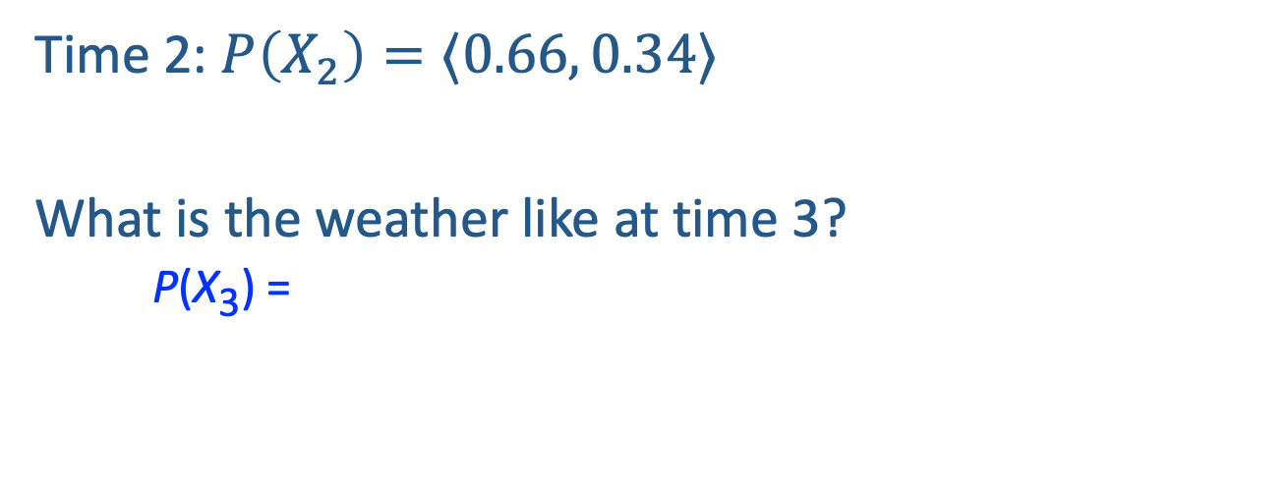
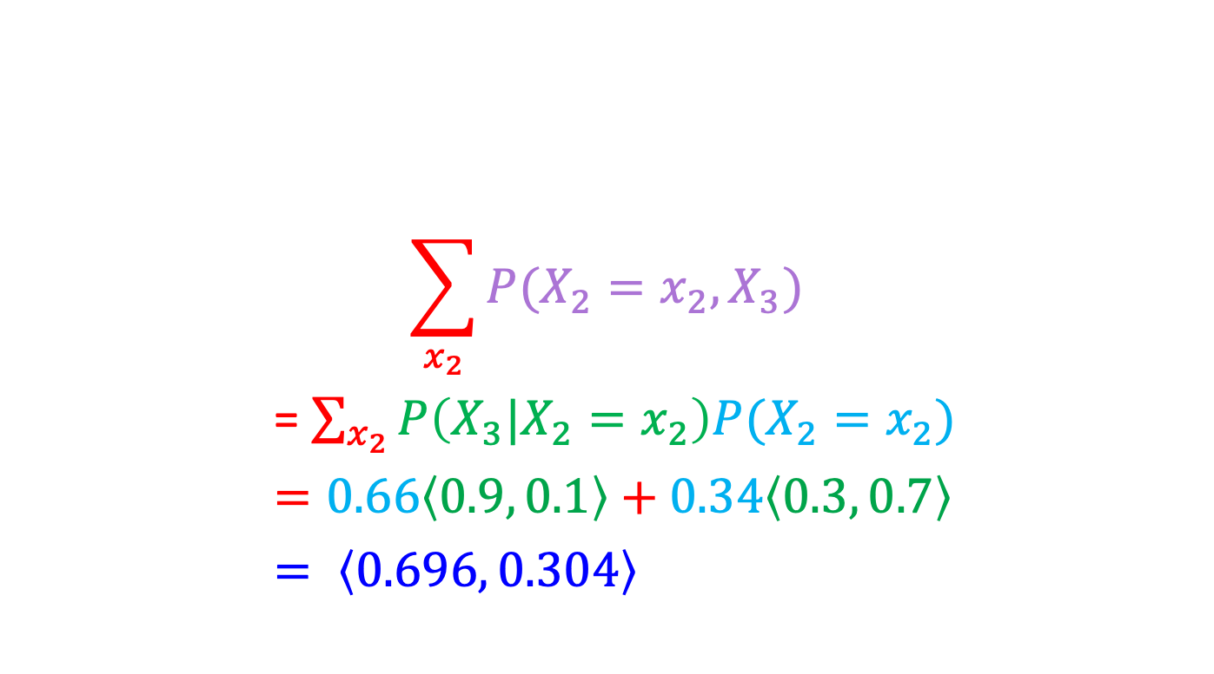
Weather prediction, contd.
X_{t-1} | P(X_{t}|X_{t-1})
 | sun | rain
sun | 0.9 | 0.1
rain | 0.3 | 0.7
Time 2: $P\left(X_{2}\right)=⟨0.66, 0.34⟩$
What is the weather like at time 3?
P(X₃) =
$$\sum_{x_{2}}{P(X_{2}=x_{2},X_{3})}$$
= $\sum_{x_{2}}{P\left({X_{3}|X}_{2}=x_{2}\right)P(X_{2}=x_{2})}$
$=0.66\left\langle 0.9, 0.1\right\rangle +0.34\left\langle 0.3, 0.7\right\rangle$
$= \left\langle 0.696, 0.304\right\rangle$
X₁
X₂
X₃

Slide 20
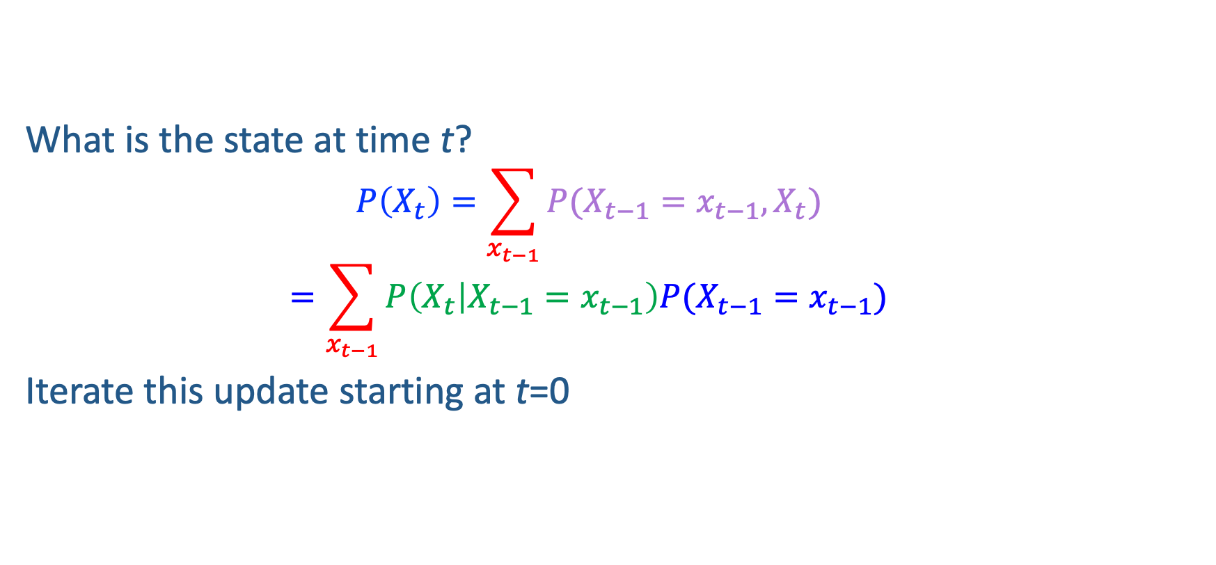
Forward algorithm (simple form)
What is the state at time t?
$$P\left(X_{t}\right)=\sum_{x_{t−1}}{P(X_{t−1}=x_{t−1}, X_{t})}$$
$$=\sum_{x_{t−1}}{P\left(X_{t} | X_{t−1}=x_{t−1}\right)P(X_{t−1}=x_{t−1})}$$
Iterate this update starting at t=0
Transition model
Probability from previous iteration

Slide 21

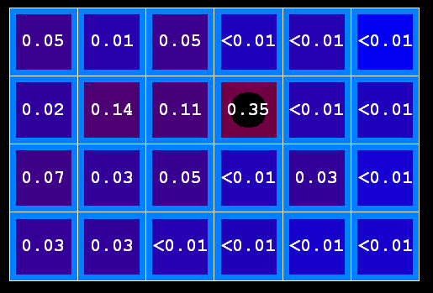
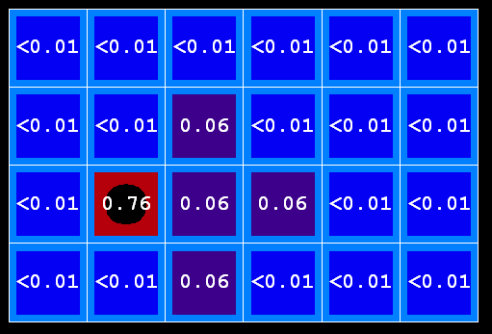
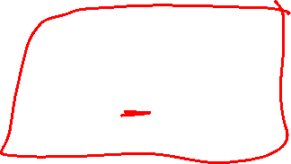
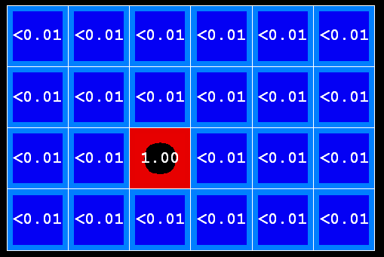
Prediction with Markov chains
As time passes, uncertainty “accumulates”
(Transition model: ghosts usually go clockwise)
T = 1
T = 2
T = 5

Slide 22


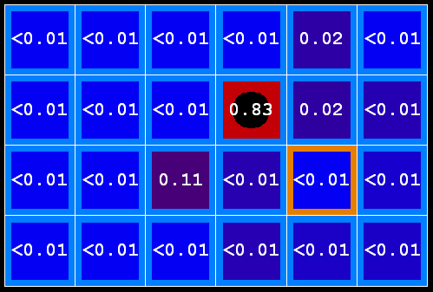
Observations Reduce Uncertainty
As we get observations, beliefs get reweighted, uncertainty “decreases”
Before observation
After observation

Slide 23

Hidden Markov Models

Slide 24
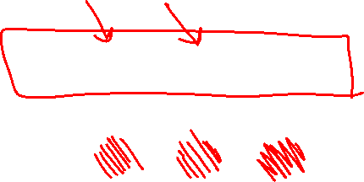
Hidden Markov Models
Usually the true state is not observed directly
Hidden Markov models (HMMs)
Underlying Markov chain over states X
You observe evidence E at each time step
X_{t} is a single discrete variable; E_{t} may be continuous and may consist of several variables
X₀
X₁
X₂
X₃
X₅
E₁
E₂
E₃
E₅

Slide 25
Real HMM Examples
Speech recognition HMMs:
Observations are acoustic signals (continuous valued)
States are specific positions in specific words (so, tens of thousands)
Machine translation HMMs:
Observations are words (tens of thousands)
States are translation options
Robot tracking:
Observations are range readings (continuous)
States are positions on a map (continuous)
Molecular biology:
Observations are nucleotides ACGT
States are coding/non-coding/start/stop/splice-site etc.

Slide 26
HMM as a Bayes Net Warm-up
For the following Bayes net, write the query P(X₄ | e_{1:4}) in terms of the conditional probability tables associated with the Bayes net.
P(X₄ | e₁,e₂,e₃,e₄) =
X₁
X₂
X₃
X₄
e₁
e₂
e₃
e₄

Slide 27


Example: Weather HMM
An HMM is defined by:
Initial distribution: P(X₀)
Transition model: P(X_{t} | X_{t-1})
Sensor model: P(E_{t} | X_{t})
W_{t-1} | P(W_{t}|W_{t-1})
 | sun | rain
sun | 0.9 | 0.1
rain | 0.3 | 0.7
Weather _{t-1}
Weather _{t}
Weather _{t+1}
W_{t} | P(U_{t}|W_{t})
 | true | false
sun | 0.2 | 0.8
rain | 0.9 | 0.1
Umbrella _{t-1}
Umbrella _{t}
Umbrella _{t+1}
Notes:
demo

Slide 28
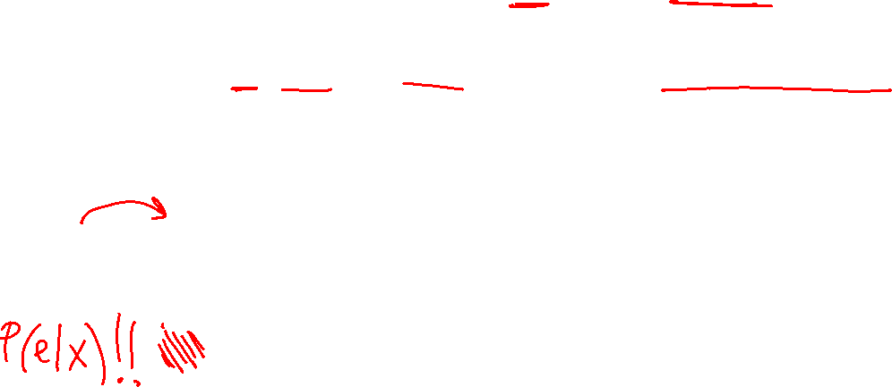
HMM as Probability Model
Joint distribution for Markov model:
P(X₀,…, X_{T}) = P(X₀) ∏_{t=1:T} P(X_{t} | X_{t-1})
Joint distribution for hidden Markov model:
P(X₀, X₁,E₁, …, X_{T},E_{T}) = P(X₀) ∏_{t=1:T} P(X_{t} | X_{t-1}) P(E_{t} | X_{t})
Future states are independent of the past given the present
Current evidence is independent of everything else given the current state
Are evidence variables independent of each other?
X₀
X₁
X₂
X₃
X₅
Useful notation: X_{a:b} = X_{a} , X_{a+1}, …, X_{b}
For example: P(X_{1:2} | e_{1:3}) = P(X₁, X₂, | e₁ , e₂, e₃)
E₁
E₂
E₃
E₅
Notes:
Add conditional independence consequences here

Slide 29
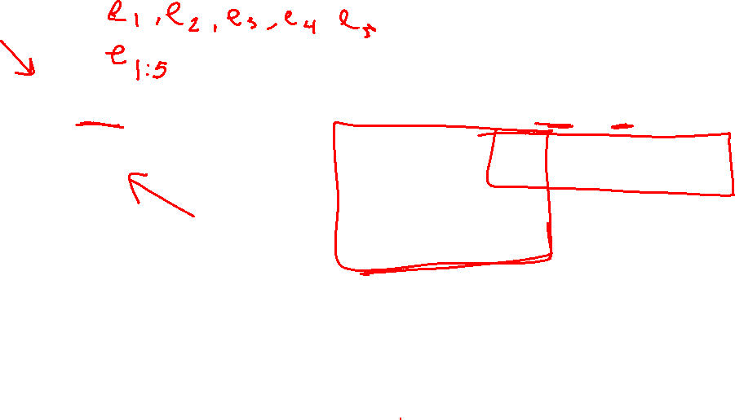
HMM Queries
Filtering: P(X_{t}|e_{1:t})
Prediction: P(X_{t+k}|e_{1:t})
X₁
X₂
X₃
X₄
X₁
X₂
X₃
X₄
X₅
e₁
e₂
e₃
e₄
e₁
e₂
e₃
Smoothing: P(X_{k}|e_{1:t}), k<t
Explanation: P(X_{1:t}|e_{1:t})
X₁
X₂
X₃
X₄
X₁
X₂
X₃
X₄
e₁
e₂
e₃
e₄
e₁
e₂
e₃
e₄

Slide 30
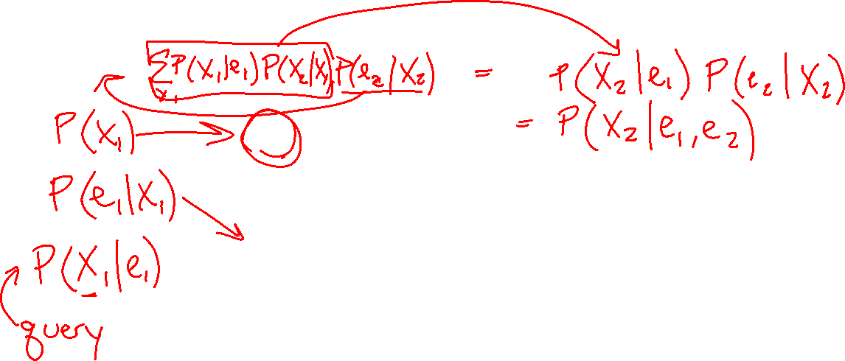
Filtering Algorithm
Query: What is the current state, given all of the current and past evidence?
Marching forward through the HMM network
X₁
X₂
e₁
e₂

Slide 31
Filtering Algorithm
Query: What is the current state, given all of the current and past evidence?
Marching forward through the HMM network
X₁
X₂
X₃
e₁
e₂
e₃

Slide 32
Filtering Algorithm
Query: What is the current state, given all of the current and past evidence?
Marching forward through the HMM network
X₁
X₂
X₃
X₄
e₁
e₂
e₃
e₄

Slide 33
Filtering Algorithm
Query: What is the current state, given all of the current and past evidence?
Marching forward through the HMM network
X₁
X₂
X₃
X₄
e₁
e₂
e₃
e₄

Slide 34
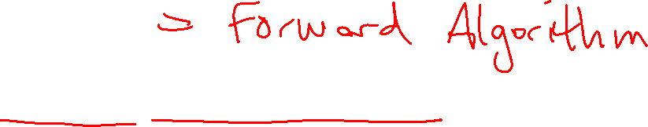
Filtering Algorithm
P(X_{t+1}|e_{1:t+1}) = α P(e_{t+1}|X_{t+1}) ∑_{xt} P(X_{t+1}| x_{t}) P(x_{t} | e_{1:t})
f_{1:t+1} = Forward(f_{1:t} , e_{t+1})
Normalize
Update
Predict

Slide 35
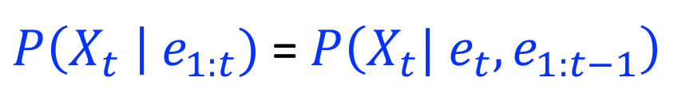



Filtering Algorithm
Query: What is the current state, given all of the current and past evidence?
Matching math with Bayes net
$P\left(X_{t} \right| e_{1:t})$ =$P\left(X_{t}{| e_{t}, e}_{1:t−1}\right)$
X₁
X₂
X₃
X₄
$$=α P\left(X_{t}, {e_{t}| e}_{1:t−1}\right)$$
e₁
e₂
e₃
e₄
Def. of cond. probability with $X_{t}$, $e_{t}$
Notes:
Explain propto

Slide 36
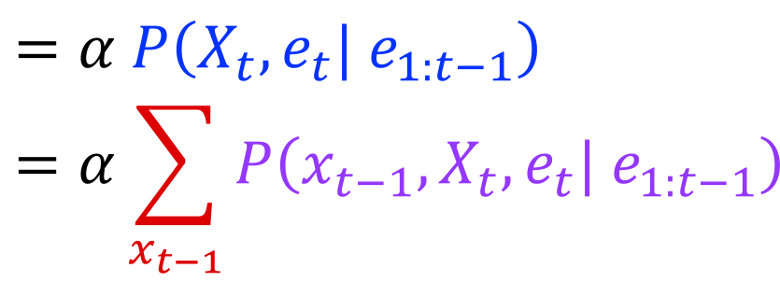

Filtering Algorithm
Query: What is the current state, given all of the current and past evidence?
Matching math with Bayes net
$P\left(X_{t} \right| e_{1:t})$ =$P\left(X_{t}{| e_{t}, e}_{1:t−1}\right)$
X₁
X₂
X₃
X₄
$$=α P\left(X_{t}, {e_{t}| e}_{1:t−1}\right)$$
$$=α\sum_{x_{t−1}}{P\left(x_{t−1},X_{t}, e_{t}| e_{1:t−1}\right)}$$
e₁
e₂
e₃
e₄
Summation over variable $X_{t−1}$

Slide 37
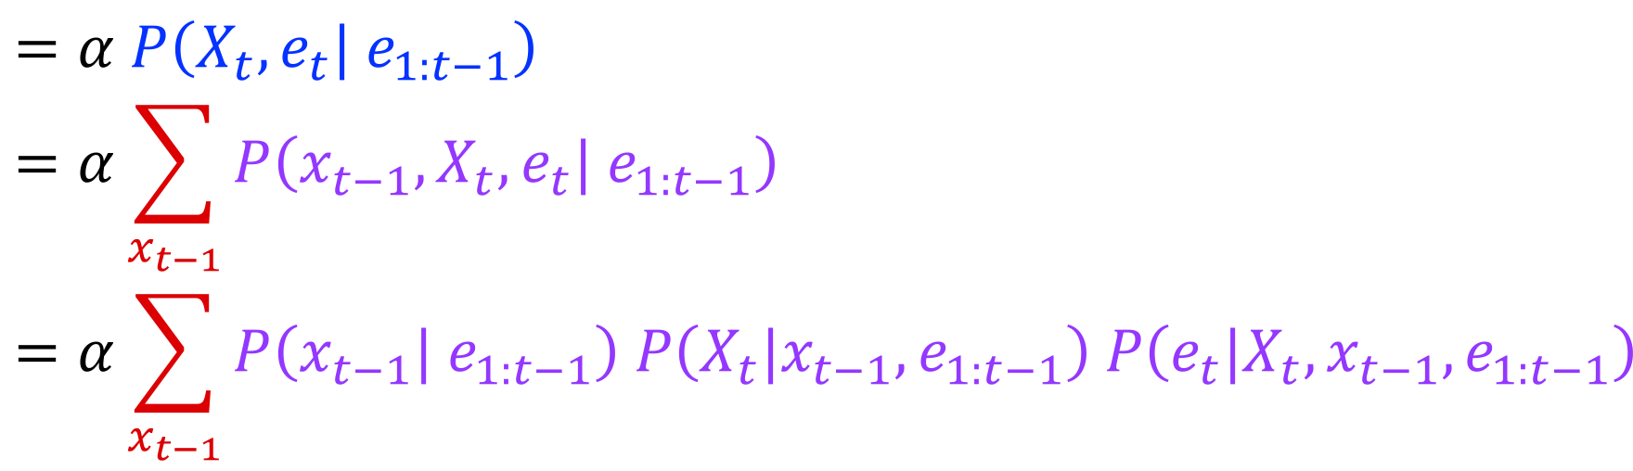


Filtering Algorithm
Query: What is the current state, given all of the current and past evidence?
Matching math with Bayes net
$P\left(X_{t} \right| e_{1:t})$ =$P\left(X_{t}{| e_{t}, e}_{1:t−1}\right)$
X₁
X₂
X₃
X₄
$$=α P\left(X_{t}, {e_{t}| e}_{1:t−1}\right)$$
$$=α\sum_{x_{t−1}}{P\left(x_{t−1},X_{t}, e_{t}| e_{1:t−1}\right)}$$
$$=α\sum_{x_{t−1}}{P\left(x_{t−1}| e_{1:t−1}\right) P\left(X_{t}|x_{t−1},e_{1:t−1}\right) P\left(e_{t}|X_{t},x_{t−1},e_{1:t−1}\right)}$$
e₁
e₂
e₃
e₄
Chain rule with $x_{t−1}$, $X_{t}$, and $e_{t}$

Slide 38
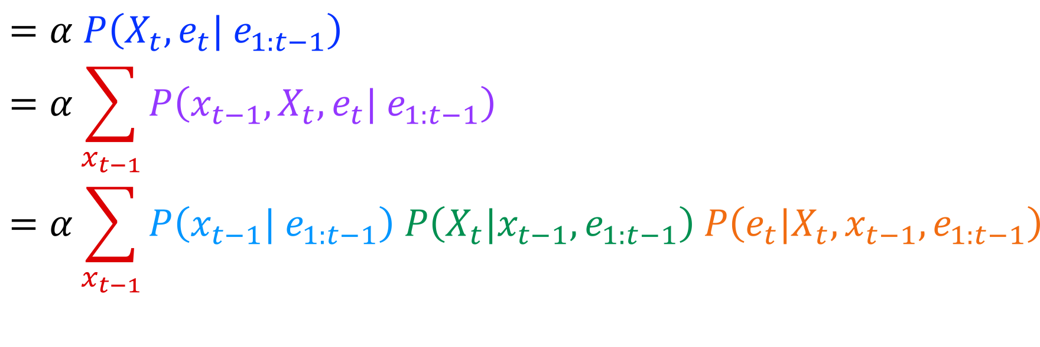

Filtering Algorithm
Query: What is the current state, given all of the current and past evidence?
Matching math with Bayes net
$P\left(X_{t} \right| e_{1:t})$ =$P\left(X_{t}{| e_{t}, e}_{1:t−1}\right)$
X₁
X₂
X₃
X₄
$$=α P\left(X_{t}, {e_{t}| e}_{1:t−1}\right)$$
$$=α\sum_{x_{t−1}}{P\left(x_{t−1},X_{t}, e_{t}| e_{1:t−1}\right)}$$
$$=α\sum_{x_{t−1}}{P\left(x_{t−1}| e_{1:t−1}\right) P\left(X_{t}|x_{t−1},e_{1:t−1}\right) P\left(e_{t}|X_{t},x_{t−1},e_{1:t−1}\right)}$$
e₁
e₂
e₃
e₄
Chain rule with $x_{t−1}$, $X_{t}$, and $e_{t}$

Slide 39
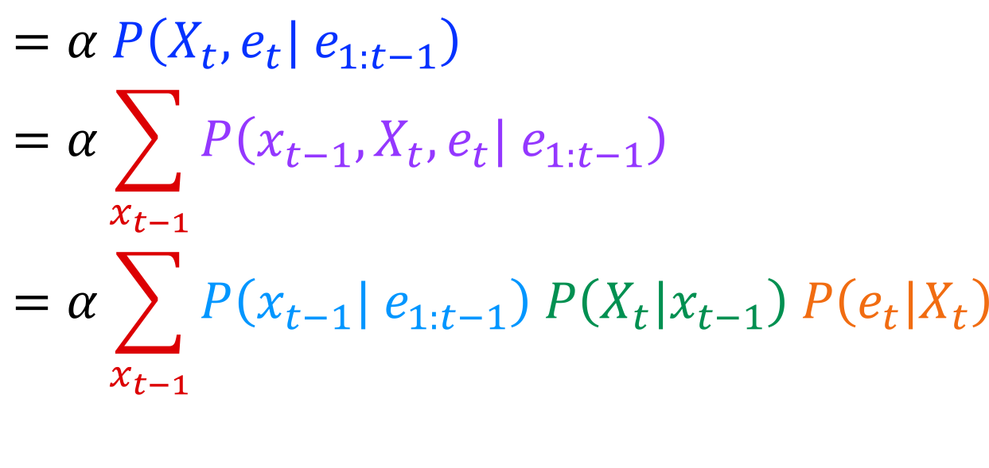

Filtering Algorithm
Query: What is the current state, given all of the current and past evidence?
Matching math with Bayes net
$P\left(X_{t} \right| e_{1:t})$ =$P\left(X_{t}{| e_{t}, e}_{1:t−1}\right)$
X₁
X₂
X₃
X₄
$$=α P\left(X_{t}, {e_{t}| e}_{1:t−1}\right)$$
$$=α\sum_{x_{t−1}}{P\left(x_{t−1},X_{t}, e_{t}| e_{1:t−1}\right)}$$
$$=α\sum_{x_{t−1}}{P\left(x_{t−1}| e_{1:t−1}\right) P\left(X_{t}|x_{t−1}\right) P\left(e_{t}|X_{t}\right)}$$
e₁
e₂
e₃
e₄
Bayes net conditional independence

Slide 40
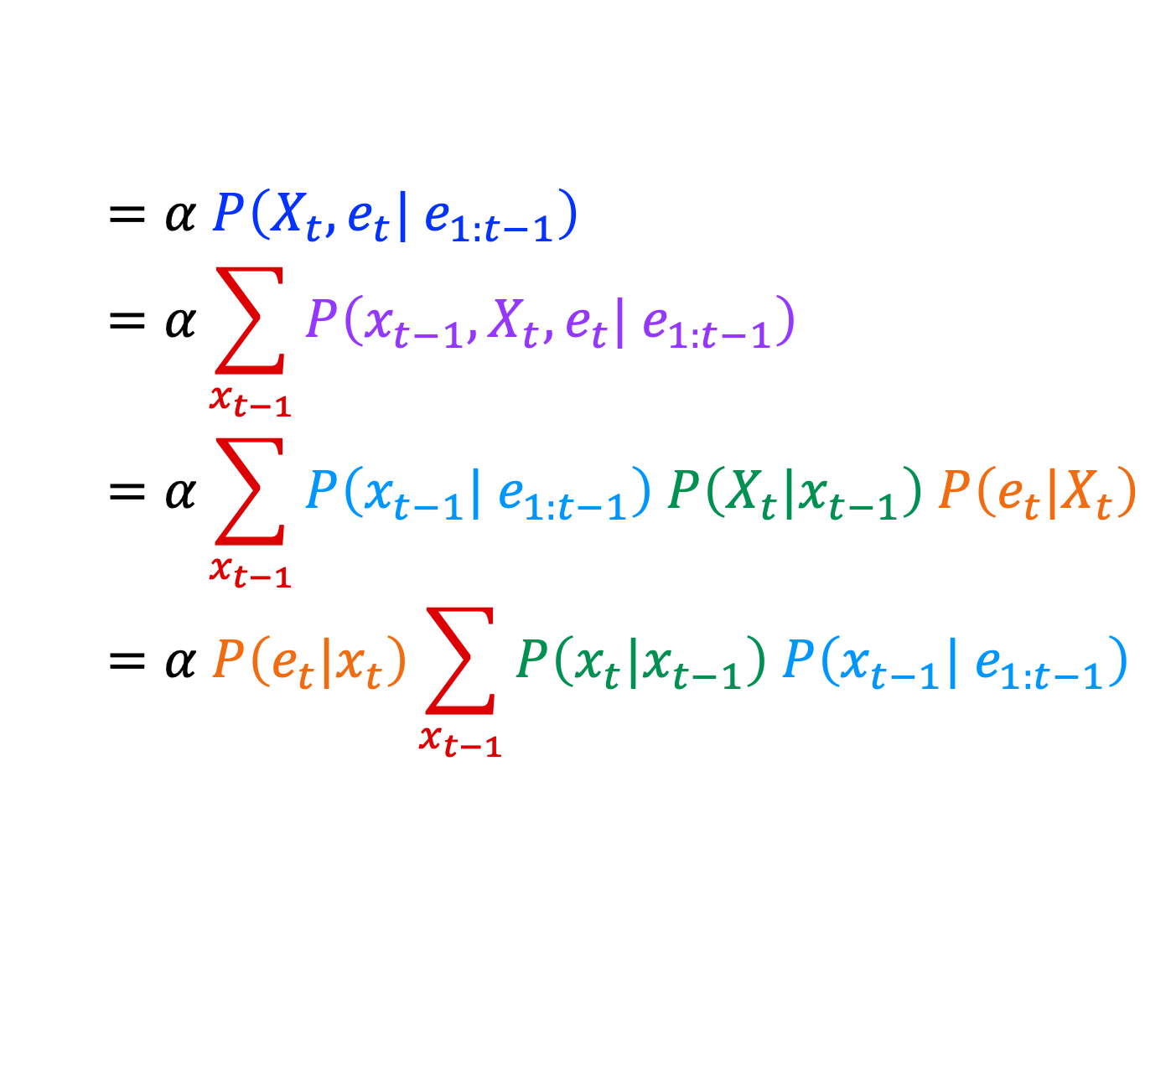

Filtering Algorithm
Query: What is the current state, given all of the current and past evidence?
Matching math with Bayes net
$P\left(X_{t} \right| e_{1:t})$ =$P\left(X_{t}{| e_{t}, e}_{1:t−1}\right)$
X₁
X₂
X₃
X₄
$$=α P\left(X_{t}, {e_{t}| e}_{1:t−1}\right)$$
$$=α\sum_{x_{t−1}}{P\left(x_{t−1},X_{t}, e_{t}| e_{1:t−1}\right)}$$
$$=α\sum_{x_{t−1}}{P\left(x_{t−1}| e_{1:t−1}\right) P\left(X_{t}|x_{t−1}\right) P\left(e_{t}|X_{t}\right)}$$
$$=α P\left(e_{t}|x_{t}\right)\sum_{x_{t−1}}{P\left(x_{t}|x_{t−1}\right) P\left(x_{t−1}| e_{1:t−1}\right) }$$
e₁
e₂
e₃
e₄
Pulling $P\left(e_{t}|X_{t}\right)$ out of the summation

Slide 41

Filtering Algorithm
Query: What is the current state, given all of the current and past evidence?
Matching math with Bayes net
$P\left(X_{t} \right| e_{1:t})$ =$P\left(X_{t}{| e_{t}, e}_{1:t−1}\right)$
X₁
X₂
X₃
X₄
$$=α P\left(X_{t}, {e_{t}| e}_{1:t−1}\right)$$
$$=α\sum_{x_{t−1}}{P\left(x_{t−1},X_{t}, e_{t}| e_{1:t−1}\right)}$$
$$=α\sum_{x_{t−1}}{P\left(x_{t−1}| e_{1:t−1}\right) P\left(X_{t}|x_{t−1}\right) P\left(e_{t}|X_{t}\right)}$$
$$=α P\left(e_{t}|x_{t}\right)\sum_{x_{t−1}}{P\left(x_{t}|x_{t−1}\right) P\left(x_{t−1}| e_{1:t−1}\right) }$$
e₁
e₂
e₃
e₄
Recursion!

Slide 42
Filtering Algorithm
Query: What is the current state, given all of the current and past evidence?
Matching math with Bayes net
$P\left(X_{t} \right| e_{1:t})$ =$P\left(X_{t}{| e_{t}, e}_{1:t−1}\right)$
X₁
X₂
X₃
X₄
$$=α P\left(X_{t}, {e_{t}| e}_{1:t−1}\right)$$
$$=α\sum_{x_{t−1}}{P\left(x_{t−1},X_{t}, e_{t}| e_{1:t−1}\right)}$$
$$=α\sum_{x_{t−1}}{P\left(x_{t−1}| e_{1:t−1}\right) P\left(X_{t}|x_{t−1}\right) P\left(e_{t}|X_{t}\right)}$$
$$=α P\left(e_{t}|x_{t}\right)\sum_{x_{t−1}}{P\left(x_{t}|x_{t−1}\right) P\left(x_{t−1}| e_{1:t−1}\right) }$$
e₁
e₂
e₃
e₄
Recursion!

Slide 43
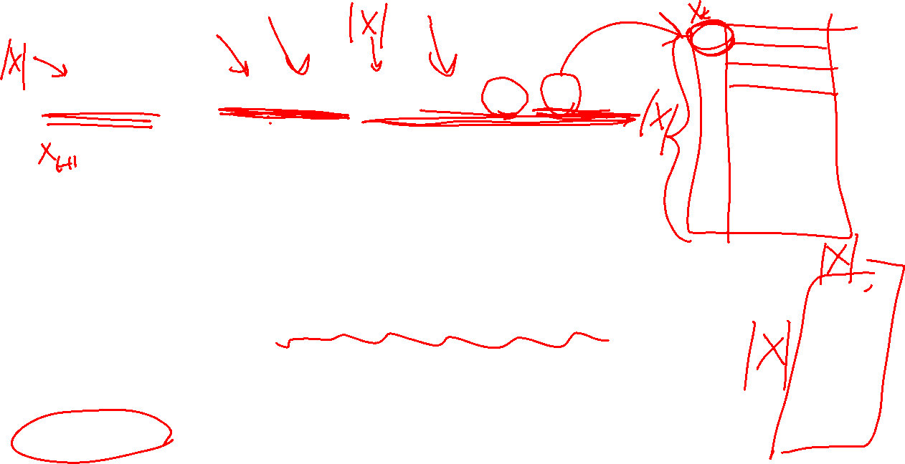
Poll 2
P(X_{t+1}|e_{1:t+1}) = α P(e_{t+1}|X_{t+1}) ∑_{xt} P(X_{t+1}| x_{t}) P(x_{t} | e_{1:t})
What is the runtime of the forward algorithm in terms of the number of states |X| and time t? Assume all 3 CPTs are given.
A) O(|X|² * t)
B) O(|X| * t)
C) O(|X|²)
D) O(|X|)
Normalize
Update
Predict

Slide 44
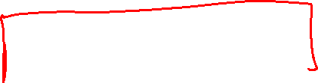
Filtering Algorithm
P(X_{t+1}|e_{1:t+1}) = α P(e_{t+1}|X_{t+1}) ∑_{xt} P(X_{t+1}| x_{t}) P(x_{t} | e_{1:t})
f_{1:t+1} = Forward(f_{1:t} , e_{t+1})
Cost per time step: O(|X|²) where |X| is the number of states
Time and space costs are constant, independent of t
O(|X|²) is infeasible for models with many state variables
We get to invent really cool approximate filtering algorithms
Normalize
Update
Predict

Slide 45
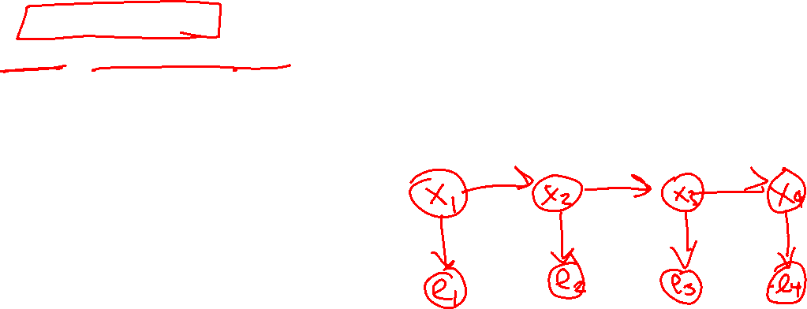
In Class Activity: Weather HMM
An HMM is defined by:
Initial distribution: P(X₁)
Transition model: P(X_{t} | X_{t-1}) = P(W_{t} |W _{t-1})
Sensor model: P(E_{t} | X_{t}) = P(U_{t} |W _{t})
Given P(X₁) = {sun:0.5, rain:0.5}
Compute P(X₄=sun | e₄= e₃= e₂= e₁=True)
W_{t-1} | P(W_{t}|W_{t-1})
 | sun | rain
sun | 0.9 | 0.1
rain | 0.3 | 0.7
W_{t} | P(U_{t}|W_{t})
 | true | false
sun | 0.2 | 0.8
rain | 0.9 | 0.1
W _{t-1}
W _{t}
W _{t+1}
U _{t-1}
U _{t}
U _{t+1}
Notes:
demo

Slide 46
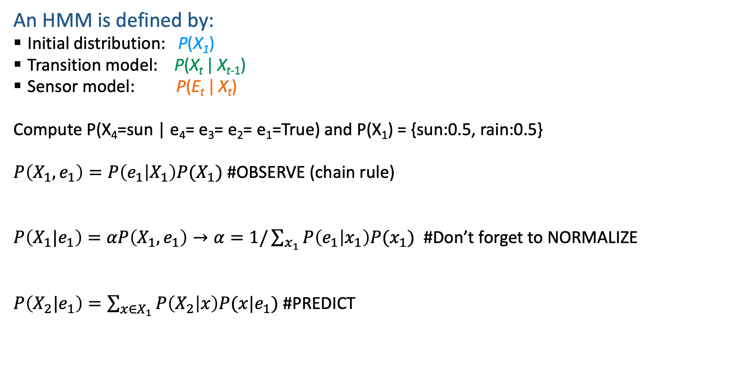
In Class Activity: Weather HMM
An HMM is defined by:
Initial distribution: P(X₁)
Transition model: P(X_{t} | X_{t-1})
Sensor model: P(E_{t} | X_{t})
Compute P(X₄=sun | e₄= e₃= e₂= e₁=True) and P(X₁) = {sun:0.5, rain:0.5}
$P\left(X_{1},e_{1}\right)=P\left(e_{1} | X_{1}\right)P(X_{1})$ #OBSERVE (chain rule)
$P\left(X_{1}|e_{1}\right)=αP\left(X_{1},e_{1}\right)→α=1/\sum_{x_{1}}{P\left(e_{1} | x_{1}\right)P(x_{1})}$ #Don’t forget to NORMALIZE
$P\left(X_{2}|e_{1}\right)=\sum_{{x∈X}_{1}}{P\left(X_{2} | x\right)P(x|e_{1})}$ #PREDICT
W_{t-1} | P(W_{t}|W_{t-1})
 | sun | rain
sun | 0.9 | 0.1
rain | 0.3 | 0.7
W_{t} | P(U_{t}|W_{t})
 | true | false
sun | 0.2 | 0.8
rain | 0.9 | 0.1
Notes:
demo

Slide 47

In Class Activity: Weather HMM
An HMM is defined by:
Initial distribution: P(X₁)
Transition model: P(X_{t} | X_{t-1})
Sensor model: P(E_{t} | X_{t})
Compute P(X₄=sun | e₄= e₃= e₂= e₁=True) and P(X₁) = {sun:0.5, rain:0.5}
$P\left(X_{2}|e_{1}\right)=\sum_{{x∈X}_{1}}{P\left(X_{2} | x\right)P(x|e_{1})}$ #PREDICT
$$P\left(X_{2}|e_{1},e_{2}\right)=αP\left(X_{2},e_{2} | e_{1}\right)=αP\left(e_{2} | X_{2}\right)P\left(X_{2} | e_{1}\right); α=1/\sum_{{x∈X}_{2}}{P\left(e_{2} | x\right)P(x|e_{1}) }$$
$P\left(X_{3}|e_{1},e_{2}\right)=\sum_{x_{2}∈X_{2}}{P\left(X_{3} | x_{2}\right)P(x_{2}|e_{1},e_{2})}$ #PREDICT
W_{t-1} | P(W_{t}|W_{t-1})
 | sun | rain
sun | 0.9 | 0.1
rain | 0.3 | 0.7
W_{t} | P(U_{t}|W_{t})
 | true | false
sun | 0.2 | 0.8
rain | 0.9 | 0.1
Notes:
demo

Slide 48

In Class Activity: Weather HMM
An HMM is defined by:
Initial distribution: P(X₁)
Transition model: P(X_{t} | X_{t-1})
Sensor model: P(E_{t} | X_{t})
Compute P(X₄=sun | e₄= e₃= e₂= e₁=True) and P(X₁) = {sun:0.5, rain:0.5}
$P\left(X_{3}|e_{1},e_{2}\right)=\sum_{x_{2}∈X_{2}}{P\left(X_{3} | x_{2}\right)P(x_{2}|e_{1},e_{2})}$ #PREDICT
$$P\left(X_{3}|e_{1},e_{2},e_{3}\right)=αP\left(X_{3},e_{3} | e_{1},e_{2}\right)=αP\left(e_{3} | X_{3}\right)P\left(X_{3} | e_{1},e_{2}\right);$$
$$α=1/\sum_{{x∈X}_{3}}{P\left(e_{3} | x\right)P(x|e_{1},e_{2}) }$$
$P\left(X_{4}|e_{1},e_{2},e_{3}\right)=\sum_{x∈X_{3}}{P\left(X_{4} | x\right)P(x|e_{1},e_{2},e_{3})}$ #PREDICT
W_{t-1} | P(W_{t}|W_{t-1})
 | sun | rain
sun | 0.9 | 0.1
rain | 0.3 | 0.7
W_{t} | P(U_{t}|W_{t})
 | true | false
sun | 0.2 | 0.8
rain | 0.9 | 0.1
Notes:
demo

Slide 49

In Class Activity: Weather HMM
An HMM is defined by:
Initial distribution: P(X₁)
Transition model: P(X_{t} | X_{t-1})
Sensor model: P(E_{t} | X_{t})
Compute P(X₄=sun | e₄= e₃= e₂= e₁=True) and P(X₁) = {sun:0.5, rain:0.5}
$P\left(X_{4}|e_{1},e_{2},e_{3}\right)=\sum_{x∈X_{3}}{P\left(X_{4} | x\right)P(x|e_{1},e_{2},e_{3})}$ #PREDICT
$$P\left(X_{4}|e_{1},e_{2},e_{3},e_{4}\right)=αP\left(X_{4},e_{4} | e_{1},e_{2},e_{3}\right)=αP\left(e_{4} | X_{4}\right)P\left(X_{4} | e_{1},e_{2},e_{3}\right);$$
$$α=1/\sum_{{x∈X}_{4}}{P\left(e_{4} | x\right)P(x|e_{1},e_{2},e_{3}) }$$
W_{t-1} | P(W_{t}|W_{t-1})
 | sun | rain
sun | 0.9 | 0.1
rain | 0.3 | 0.7
W_{t} | P(U_{t}|W_{t})
 | true | false
sun | 0.2 | 0.8
rain | 0.9 | 0.1
Notes:
demo

Slide 50

In Class Activity: Weather HMM
An HMM is defined by:
Initial distribution: P(X₁)
Transition model: P(X_{t} | X_{t-1})
Sensor model: P(E_{t} | X_{t})
Compute P(X₄=sun | e₄= e₃= e₂= e₁=True) and P(X₁) = {sun:0.5, rain:0.5}
$P\left(X_{1},e_{1}\right)=P\left(e_{1} | X_{1}\right)P(X_{1})$ #OBSERVE (chain rule)
$$P\left(e_{1}=True | X_{1}=sun\right)P\left(X_{1}=sun\right)=.2∗.5= .1$$
$$P\left(e_{1}=True | X_{1}=rain\right)P\left(X_{1}=rain\right)= .9∗.5= .45$$
$P\left(X_{1}|e_{1}\right)=\frac{P\left(X_{1},e_{1}\right)}{P\left(e_{1}\right)}= P\left(e_{1} | X_{1}\right)P(X_{1})/\sum_{x∈X_{1}}{P\left(e_{1} | x\right)P\left(x\right)}$ #NORMALIZE USING BAYES RULE
$$P\left(X_{1}=sun | e_{1}=True\right)=\frac{.1}{.1+.45}= .18$$
$$P\left(X_{1}=rain | e_{1}=True\right)=\frac{.45}{.1+.45}= .82$$
W_{t-1} | P(W_{t}|W_{t-1})
 | sun | rain
sun | 0.9 | 0.1
rain | 0.3 | 0.7
W_{t} | P(U_{t}|W_{t})
 | true | false
sun | 0.2 | 0.8
rain | 0.9 | 0.1
Notes:
demo

Slide 51

In Class Activity: Weather HMM
An HMM is defined by:
Initial distribution: P(X₁)
Transition model: P(X_{t} | X_{t-1})
Sensor model: P(E_{t} | X_{t})
Compute P(X₄=sun | e₄= e₃= e₂= e₁=True) and P(X₁) = {sun:0.5, rain:0.5}
$P\left(X_{2}|e_{1}\right)=\sum_{{x∈X}_{1}}{P\left(X_{2} | x\right)P(x|e_{1})}$ #PREDICT
$$P\left(X_{2}=sun|e_{1}=True\right)=\sum_{{x∈X}_{1}}{P\left(X_{2}=sun | x\right)P(x|e_{1}=True)}= .9∗.18+ .3∗.82= .41$$
$$P\left(X_{2}=rain|e_{1}=True\right)=\sum_{{x∈X}_{1}}{P\left(X_{2}=rain | x\right)P(x|e_{1}=True)}= .1∗.18+ .7∗.82= .59$$
W_{t-1} | P(W_{t}|W_{t-1})
 | sun | rain
sun | 0.9 | 0.1
rain | 0.3 | 0.7
W_{t} | P(U_{t}|W_{t})
 | true | false
sun | 0.2 | 0.8
rain | 0.9 | 0.1
Notes:
demo

Slide 52

In Class Activity: Weather HMM
An HMM is defined by:
Initial distribution: P(X₁)
Transition model: P(X_{t} | X_{t-1})
Sensor model: P(E_{t} | X_{t})
Compute P(X₄=sun | e₄= e₃= e₂= e₁=True) and P(X₁) = {sun:0.5, rain:0.5}
$$P\left(X_{2}|e_{1},e_{2}\right)=αP\left(X_{2},e_{2} | e_{1}\right)=αP\left(e_{2} | X_{2}\right)P\left(X_{2} | e_{1}\right); α=1/\sum_{{x∈X}_{2}}{P\left(e_{2} | x\right)P(x|e_{1}) }$$
$P\left(X_{2}=sun|e_{1},e_{2}=True\right)=αP\left(e_{2} | X_{2}=sun\right)P\left(X_{2}=sun | e_{1}\right)=α\left(.2\right)\left(.41\right)= .13$
$P\left(X_{2}=rain|e_{1},e_{2}=True\right)=αP\left(e_{2} | X_{2}=rain\right)P\left(X_{2}=rain | e_{1}\right)=α\left(.9\right)\left(.59\right)= .87$
$P\left(X_{3}|e_{1},e_{2}\right)=\sum_{x∈X_{2}}{P\left(X_{3} | x\right)P(x|e_{1},e_{2})}$ #PREDICT
$P\left(X_{3}=sun|e_{1},e_{2}\right)=P\left(X_{3}=sun | x=sun\right)P\left(x=sun | e_{1},e_{2}\right)+$ $P\left(X_{3} | x=rain\right)P\left(x=rain | e_{1},e_{2}\right)$ = 0.38
$P\left(X_{3}=rain|e_{1},e_{2}\right)=P\left(X_{3}=rain | x=sun\right)P\left(x=sun | e_{1},e_{2}\right)+$ $P\left(X_{3} | x=rain\right)P\left(x=rain | e_{1},e_{2}\right)$ = 0.62
W_{t-1} | P(W_{t}|W_{t-1})
 | sun | rain
sun | 0.9 | 0.1
rain | 0.3 | 0.7
W_{t} | P(U_{t}|W_{t})
 | true | false
sun | 0.2 | 0.8
rain | 0.9 | 0.1
Notes:
demo

Slide 53

In Class Activity: Weather HMM
An HMM is defined by:
Initial distribution: P(X₁)
Transition model: P(X_{t} | X_{t-1})
Sensor model: P(E_{t} | X_{t})
Compute P(X₄=sun | e₄= e₃= e₂= e₁=True) and P(X₁) = {sun:0.5, rain:0.5}
$$P\left(X_{3}|e_{1},e_{2},e_{3}\right)=αP\left(X_{3},e_{3} | e_{1},e_{2}\right)=αP\left(e_{3} | X_{3}\right)P\left(X_{3} | e_{1},e_{2}\right);$$
$$α=1/\sum_{{x∈X}_{3}}{P\left(e_{3} | x\right)P(x|e_{1},e_{2}) }$$
$P\left(X_{3}=sun|e_{1},e_{2},e_{3}\right)=αP\left(e_{3}=True | X_{3}=sun\right)P\left(X_{3}=sun | e_{1},e_{2}\right)=α\left(.2\right)\left(.38\right)$ = .12
$P\left(X_{3}=rain|e_{1},e_{2},e_{3}\right)=αP\left(e_{3}=True | X_{3}=rain\right)P\left(X_{3}=rain | e_{1},e_{2}\right)=α\left(.9\right)(.62)$= .88
W_{t-1} | P(W_{t}|W_{t-1})
 | sun | rain
sun | 0.9 | 0.1
rain | 0.3 | 0.7
W_{t} | P(U_{t}|W_{t})
 | true | false
sun | 0.2 | 0.8
rain | 0.9 | 0.1
Notes:
demo

Slide 54

In Class Activity: Weather HMM
An HMM is defined by:
Initial distribution: P(X₁)
Transition model: P(X_{t} | X_{t-1})
Sensor model: P(E_{t} | X_{t})
Compute P(X₄=sun | e₄= e₃= e₂= e₁=True) and P(X₁) = {sun:0.5, rain:0.5}
$P\left(X_{4}|e_{1},e_{2},e_{3}\right)=\sum_{x∈X_{3}}{P\left(X_{4} | x\right)P(x|e_{1},e_{2},e_{3})}$ #PREDICT
$$P\left(X_{4}=sun|e_{1},e_{2},e_{3}\right)=\sum_{x∈\{sun,rain\}}{P\left(X_{4}=sun | x\right)P(x|e_{1},e_{2},e_{3})}= .9∗.12+ .3∗.88= .37$$
$$P\left(X_{4}=rain|e_{1},e_{2},e_{3}\right)=\sum_{x∈\{sun,rain\}}{P\left(X_{4}=rain | x\right)P(x|e_{1},e_{2},e_{3})}= .1∗.12+ .7∗.88= .63$$
W_{t-1} | P(W_{t}|W_{t-1})
 | sun | rain
sun | 0.9 | 0.1
rain | 0.3 | 0.7
W_{t} | P(U_{t}|W_{t})
 | true | false
sun | 0.2 | 0.8
rain | 0.9 | 0.1
Notes:
demo

Slide 55

In Class Activity: Weather HMM
An HMM is defined by:
Initial distribution: P(X₁)
Transition model: P(X_{t} | X_{t-1})
Sensor model: P(E_{t} | X_{t})
Compute P(X₄=sun | e₄= e₃= e₂= e₁=True) and P(X₁) = {sun:0.5, rain:0.5}
$$P\left(X_{4}|e_{1},e_{2},e_{3},e_{4}\right)=αP\left(X_{4},e_{4} | e_{1},e_{2},e_{3}\right)=αP\left(e_{4} | X_{4}\right)P\left(X_{4} | e_{1},e_{2},e_{3}\right);$$
$$α=1/\sum_{{x∈X}_{4}}{P\left(e_{4} | x\right)P(x|e_{1},e_{2},e_{3}) }$$
$αP\left(e_{4}=True | X_{4}=sun\right)P\left(X_{4}=sun | e_{1},e_{2},e_{3}\right)=α$(.2*.37) = .115
$αP\left(e_{4}=True | X_{4}=rain\right)P\left(X_{4}=rain | e_{1},e_{2},e_{3}\right)=α($.9*.63) = .885
W_{t-1} | P(W_{t}|W_{t-1})
 | sun | rain
sun | 0.9 | 0.1
rain | 0.3 | 0.7
W_{t} | P(U_{t}|W_{t})
 | true | false
sun | 0.2 | 0.8
rain | 0.9 | 0.1
Notes:
demo

Slide 56
Poll 3
Suppose we are given P(X4=sun | e4= e3= e2= e1=True), along with the same CPT tables as the activity example, and we want to compute P(X5=sun | e5= e4= e3= e2= e1=True).
What is the first step we would perform?
Predict
Observe
Forward
Smoothing

Slide 57
Other HMM Queries
Filtering: P(X_{t}|e_{1:t})
Prediction: P(X_{t+k}|e_{1:t})
X₁
X₂
X₃
X₄
X₁
X₂
X₃
X₄
X₅
e₁
e₂
e₃
e₄
e₁
e₂
e₃
Smoothing: P(X_{k}|e_{1:t}), k<t
Explanation: P(X_{1:t}|e_{1:t})
X₁
X₂
X₃
X₄
X₁
X₂
X₃
X₄
e₁
e₂
e₃
e₄
e₁
e₂
e₃
e₄

Slide 58
Inference Tasks
Filtering: P(X_{t}|e_{1:t})
belief state—input to the decision process of a rational agent
Prediction: P(X_{t+k}|e_{1:t}) for k > 0
evaluation of possible action sequences; like filtering without the evidence
Smoothing: P(X_{k}|e_{1:t}) for 0 ≤ k < t
better estimate of past states, essential for learning
Most likely explanation: argmax_{x1:t} P(x_{1:t} | e_{1:t})
speech recognition, decoding with a noisy channel

Slide 59

Dynamic Bayes Nets (DBNs)
We want to track multiple variables over time, using multiple sources of evidence
Idea: Repeat a fixed Bayes net structure at each time
Variables from time t can condition on those from t-1
t =1
t =2
t =3
G₁ª
G₂ª
G₃ª
G₁^{b}
G₂^{b}
G₃^{b}
E₁ª
E₁^{b}
E₂ª
E₂^{b}
E₃ª
E₃^{b}
Notes:
Ghost A is aware of Ghost B’s previous location as well.

